Slide 1
PIZZA HONOR
https://wiki.pathfindersonline.org/w/AY_Honors/Pizza_Maker/Requirements

Slide 2

On a white board, draw 2 circles divided
One for each team. When a team gets a correct answer, they can fill in a pizza slice.

Slide 3
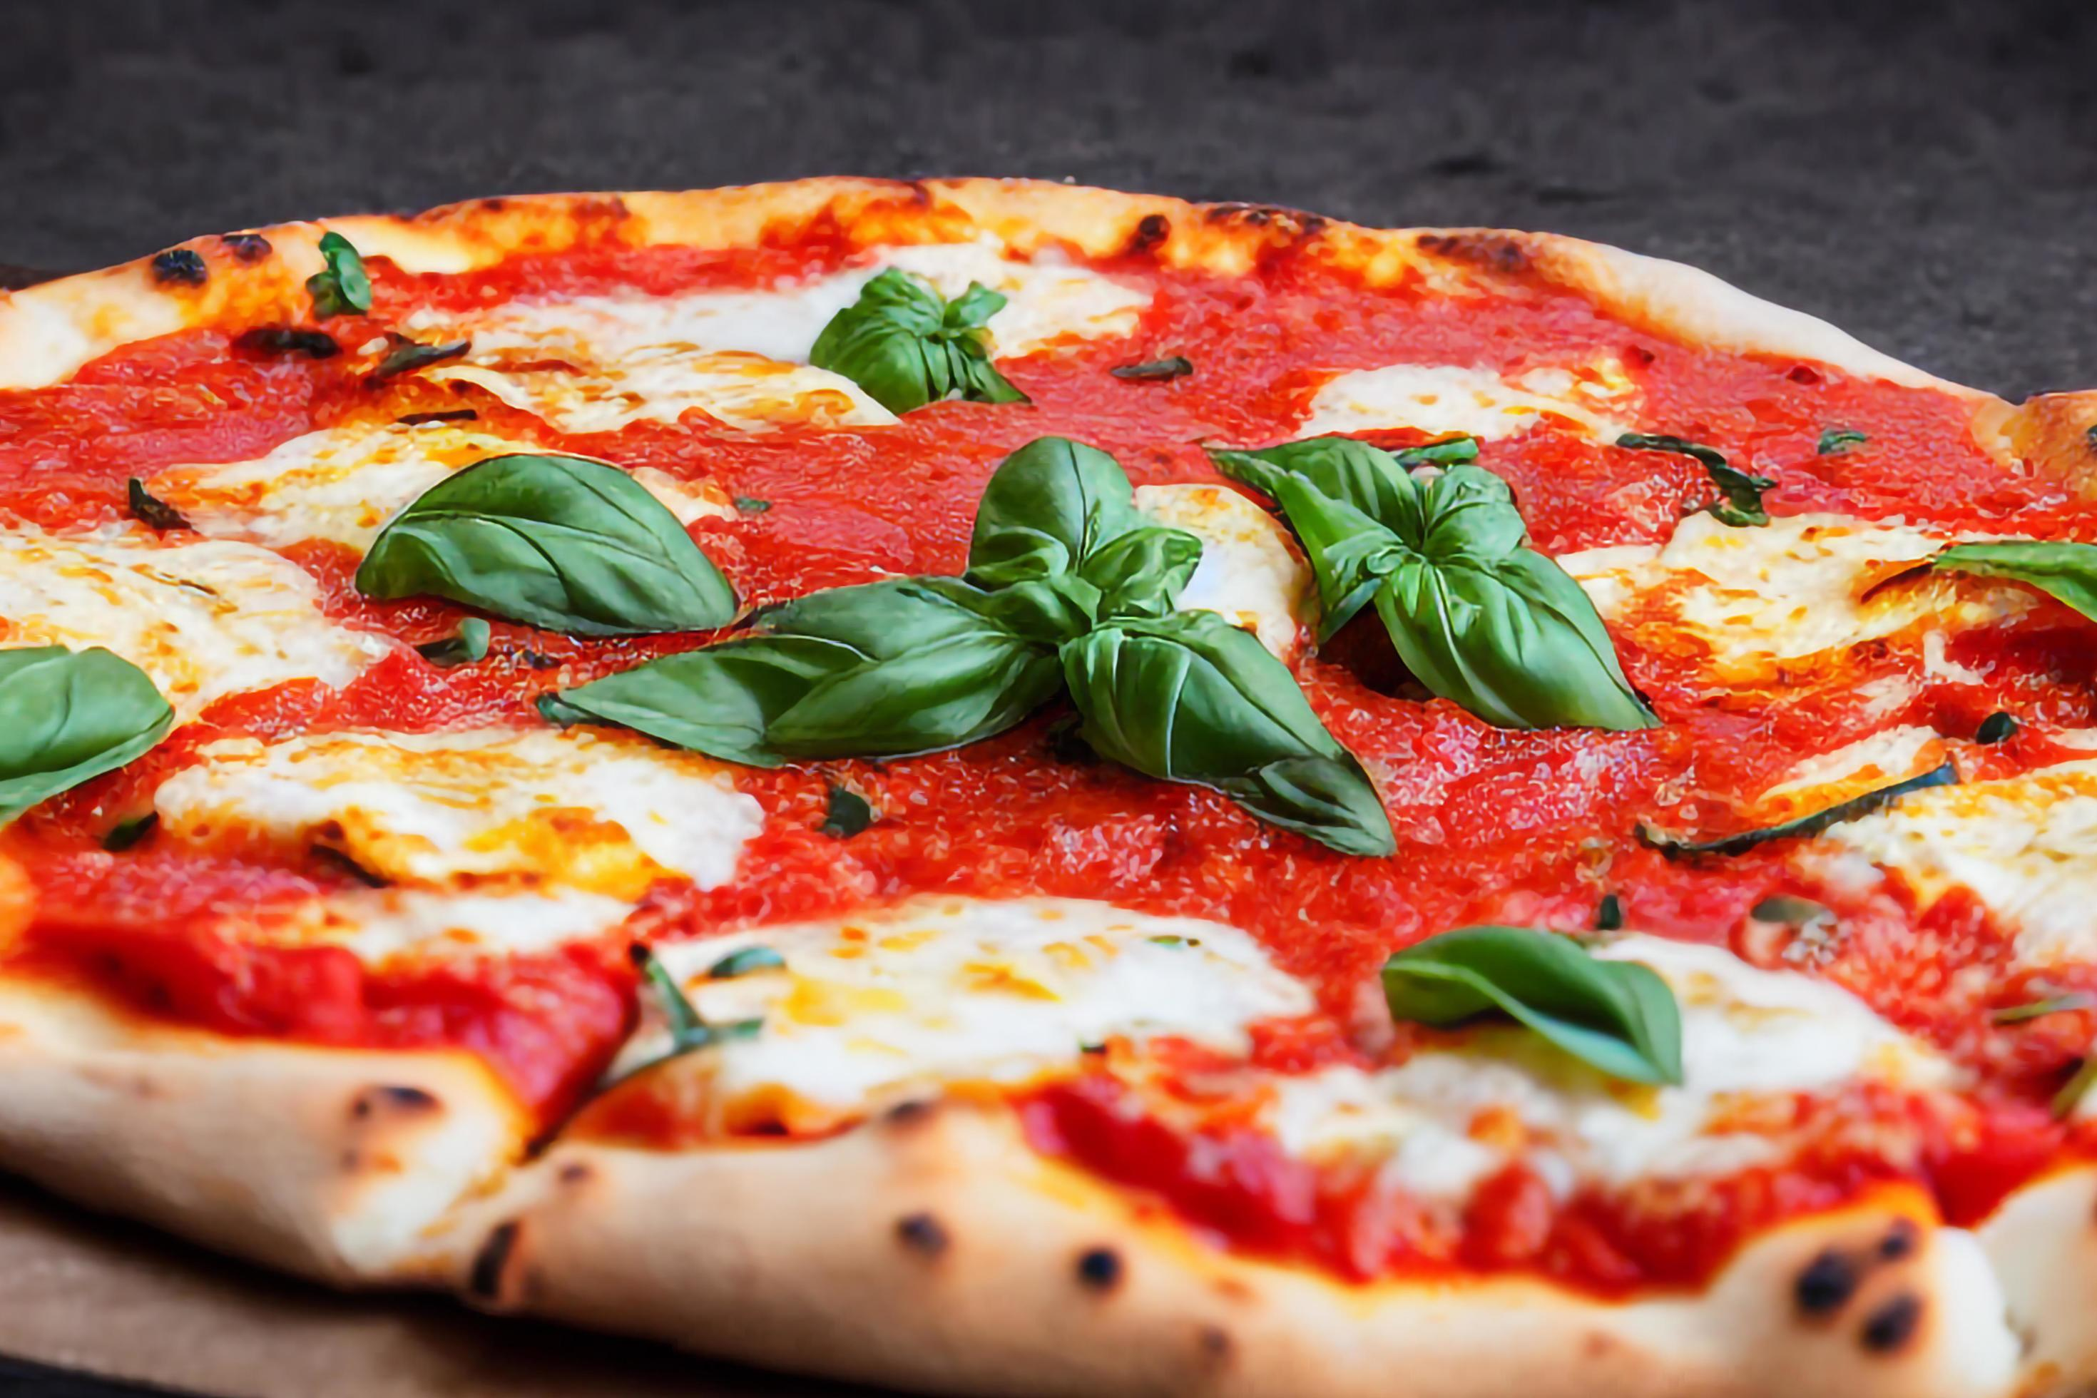
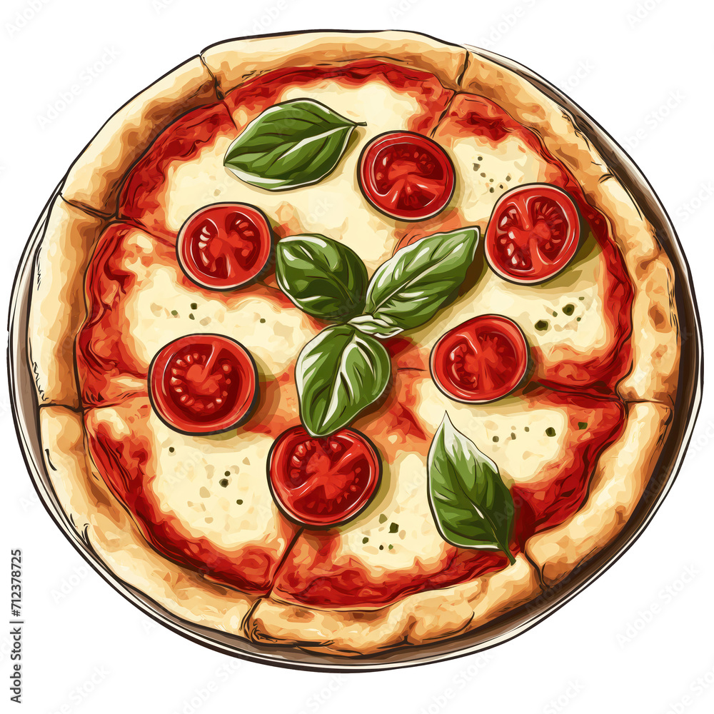
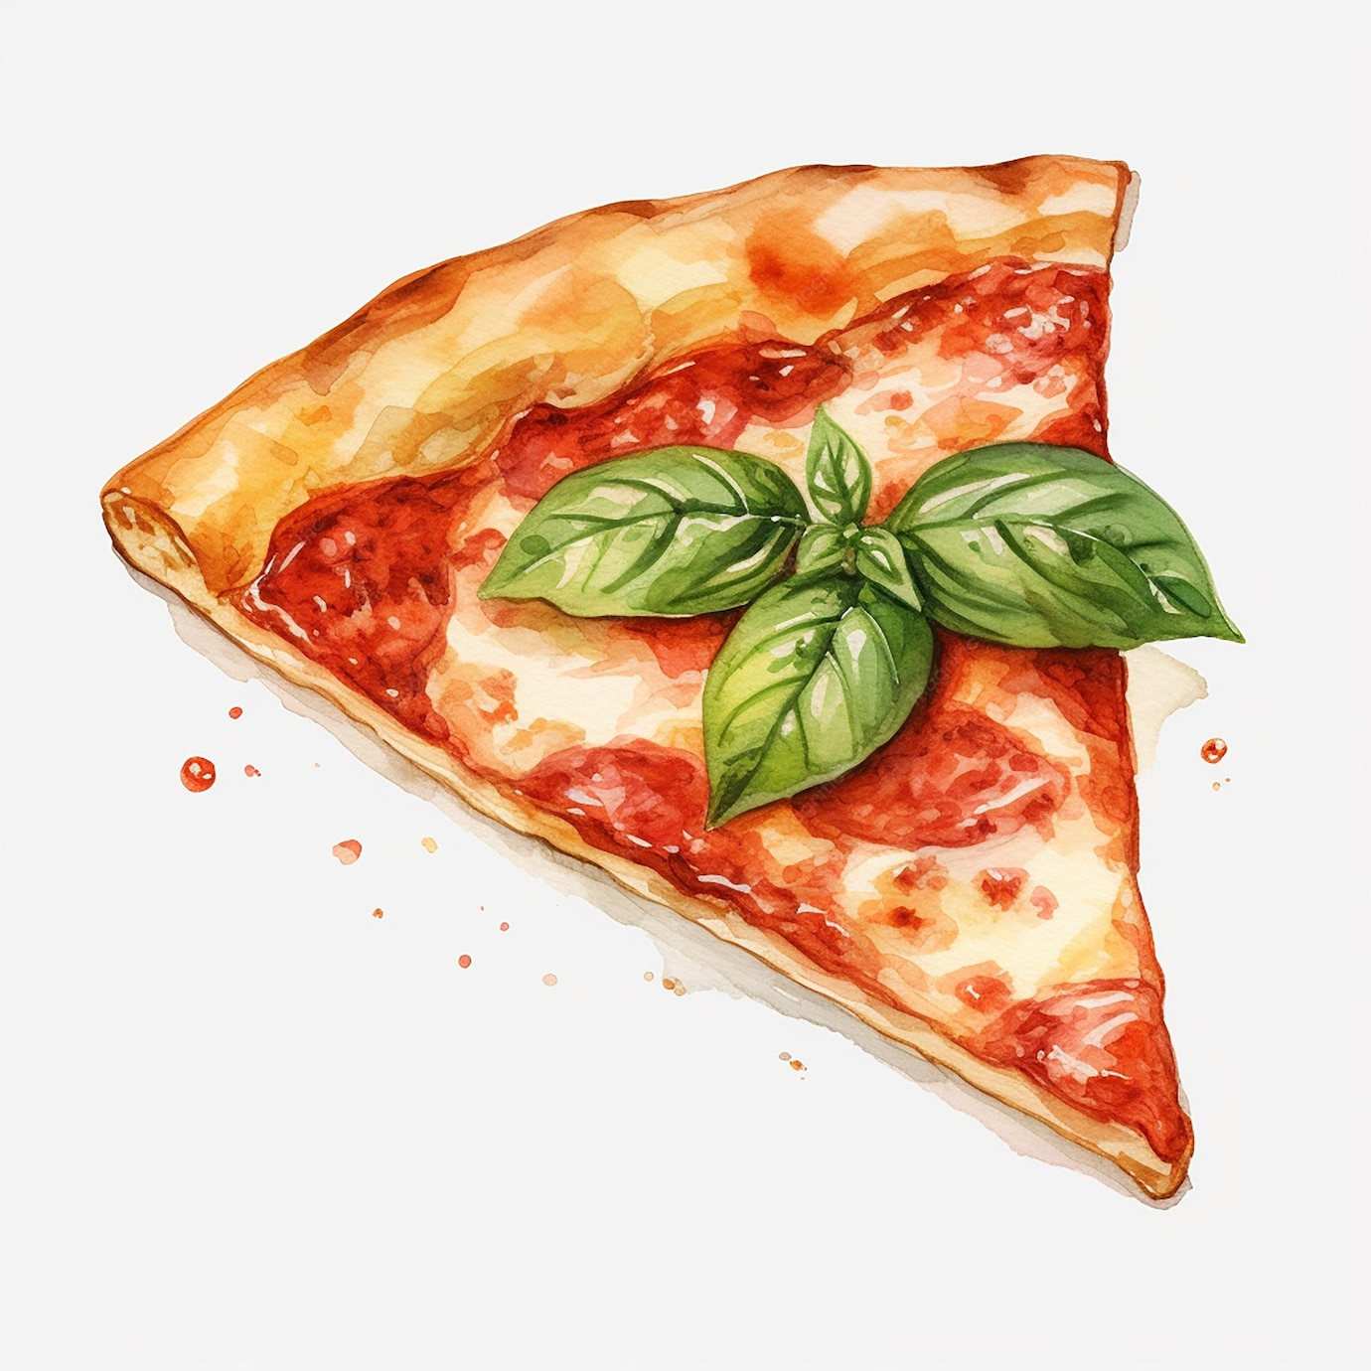
C) Both of the above
Q
When and where was pizza called pizza?
997 AD Gaeta, Italy
16th Century Naples
Both of the above
The other team can steal the point
by answering now
A

Slide 4
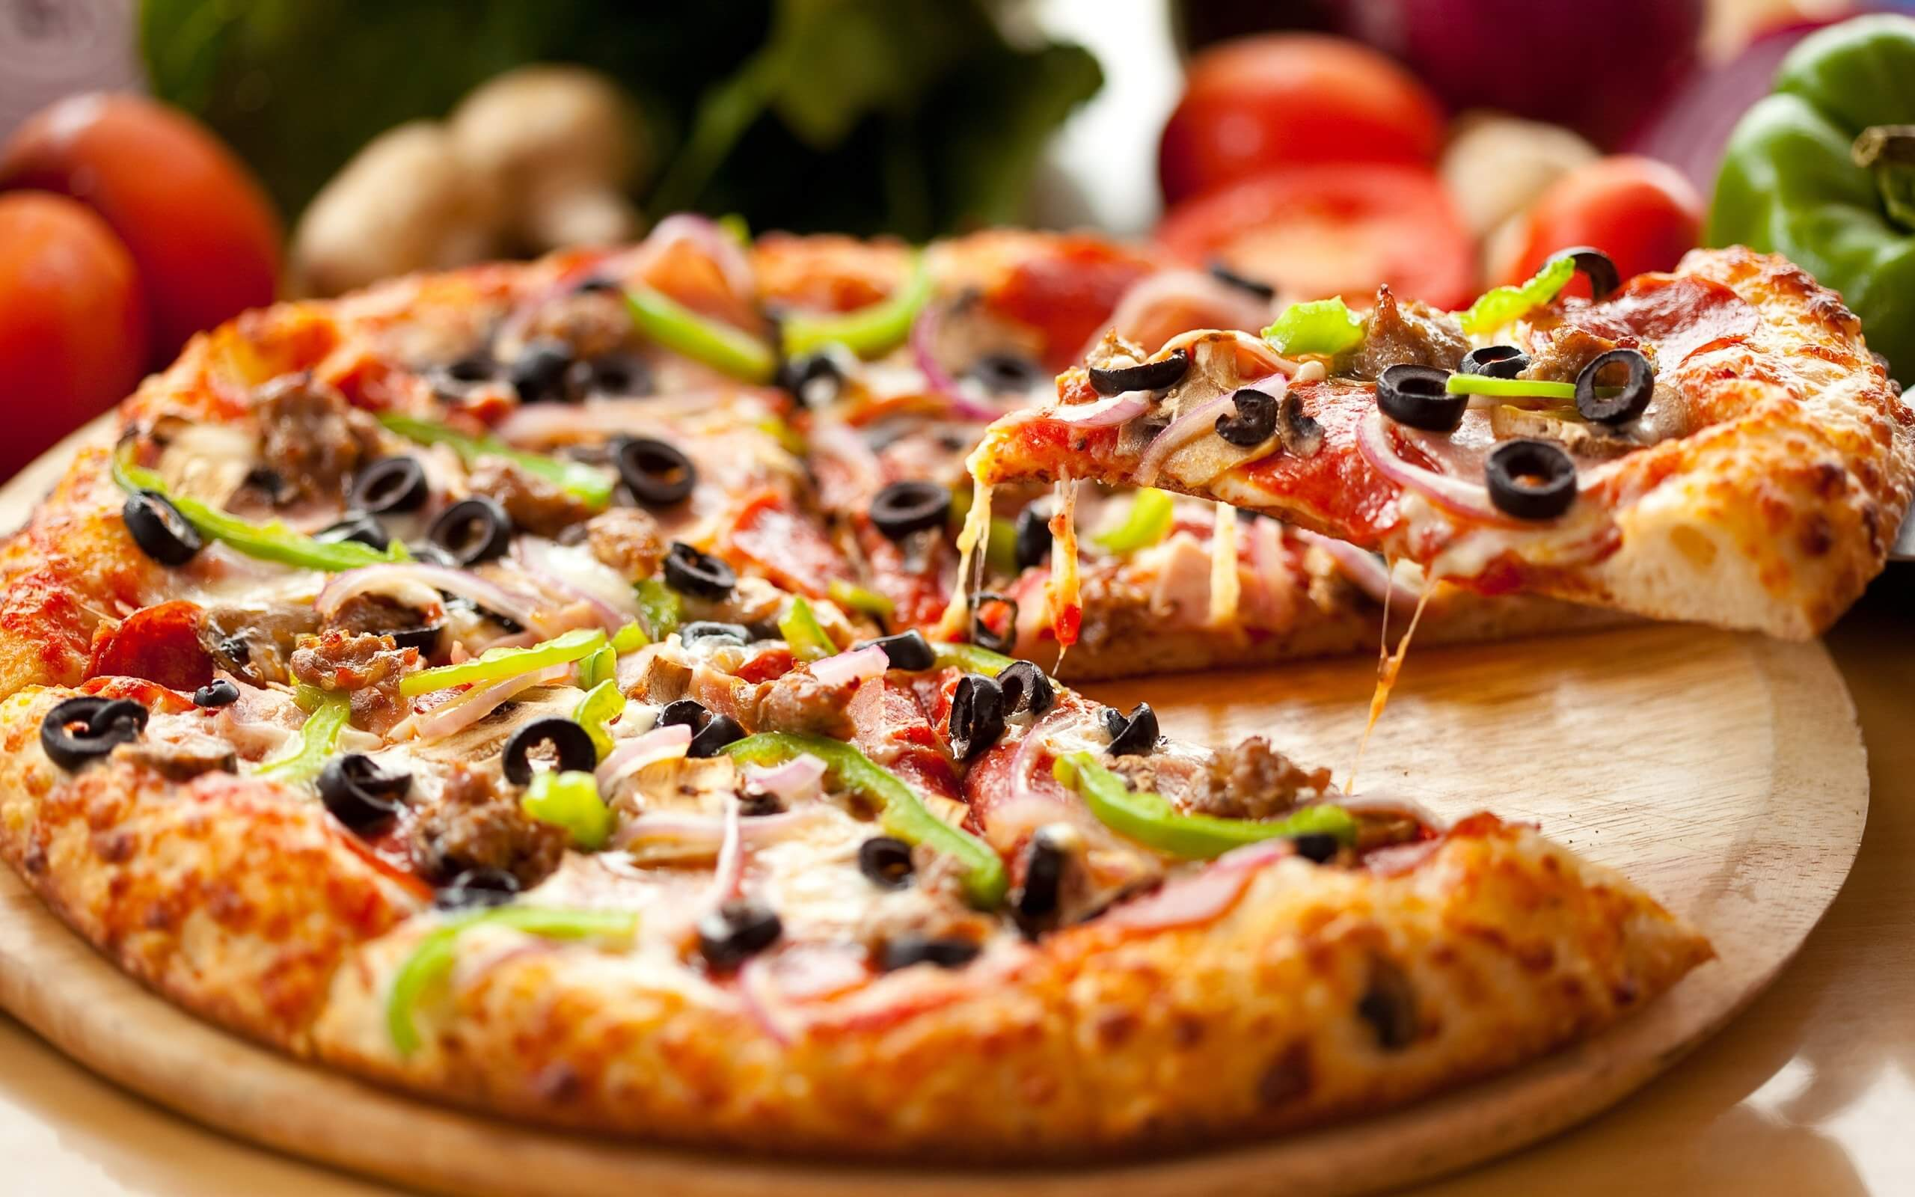
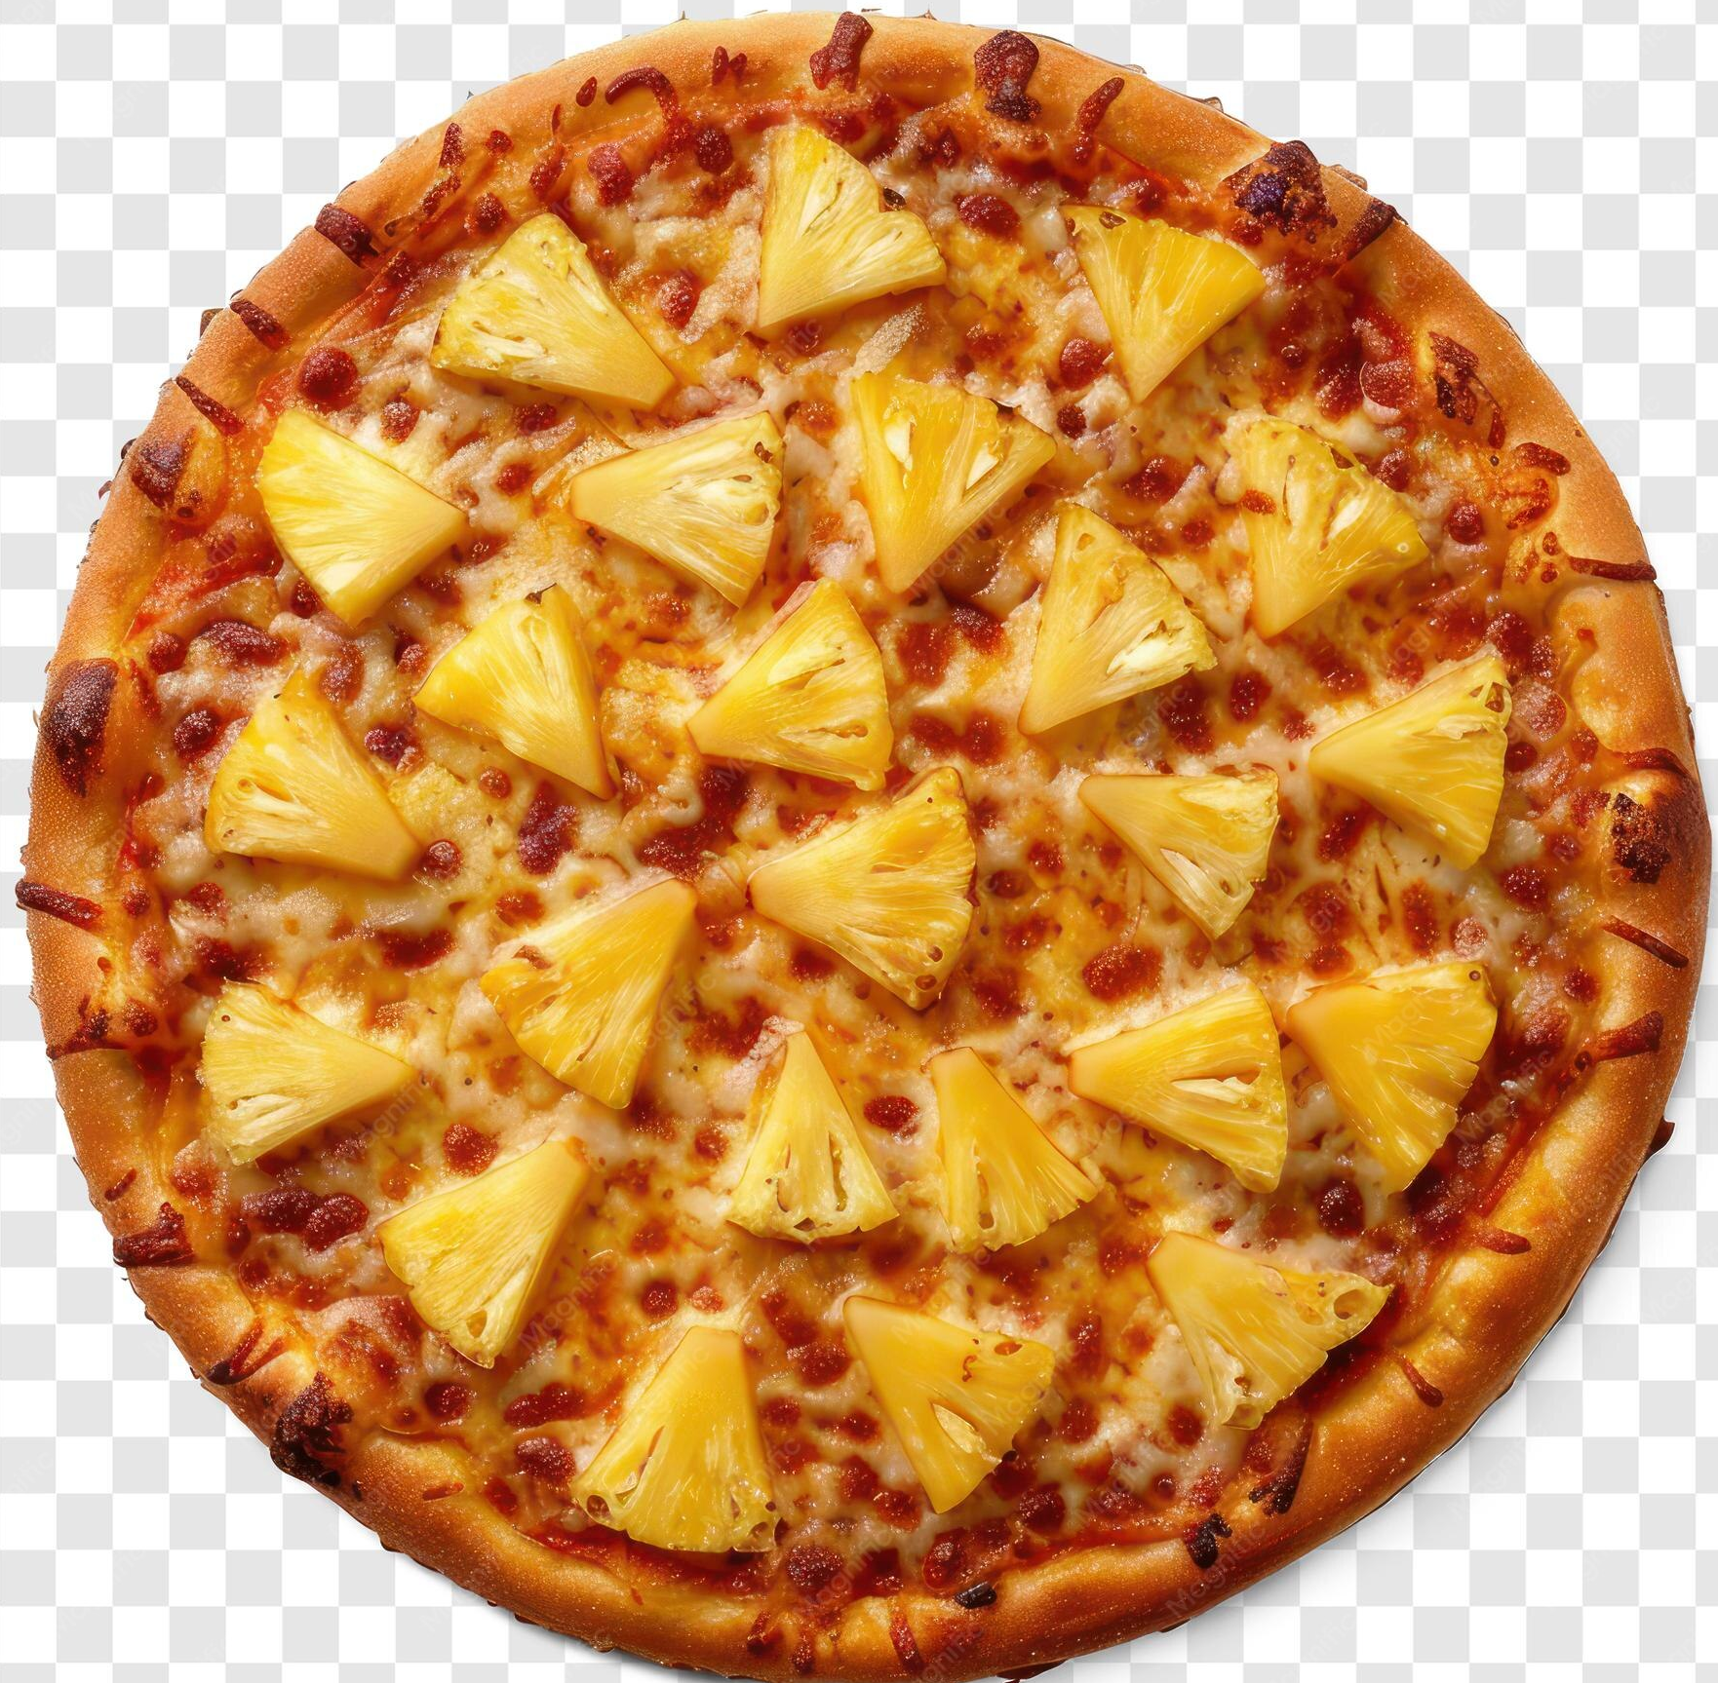
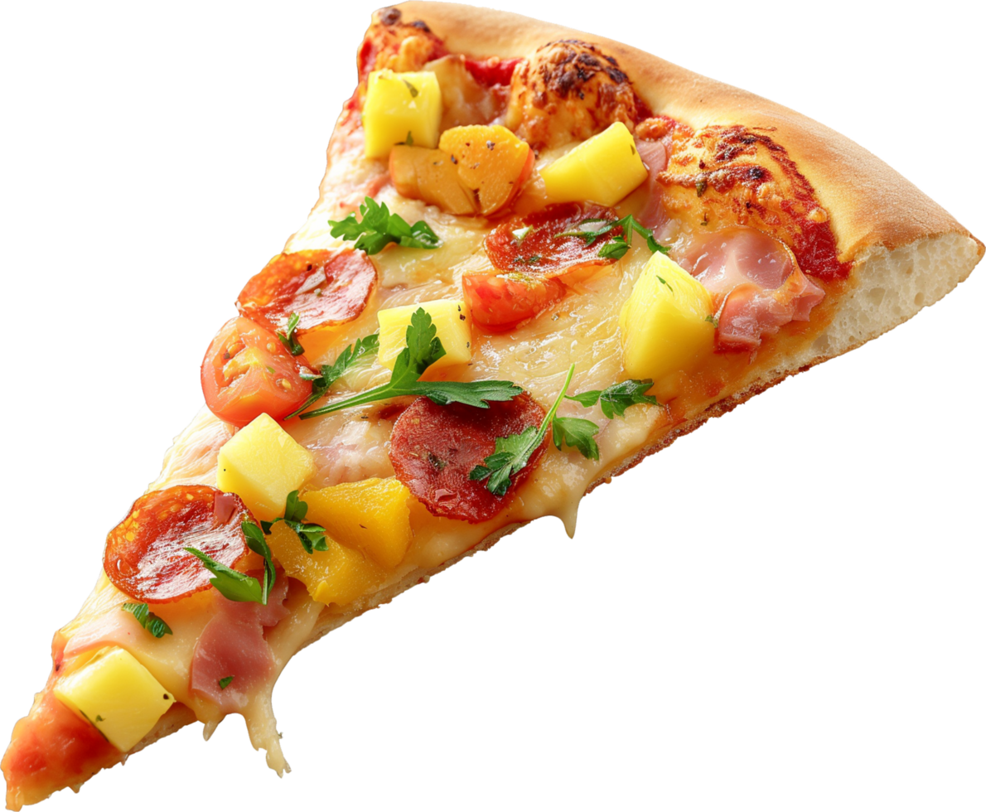
b) The Queen consort of Italy, Margherita of Savoy
(It was made by Raffaele Esposito June 11, 1889)
Q
For whom was the Margherita Pizza first made?
Raffaele Esposito
The Queen consort of Italy, Margherita of Savoy
Margarette Dumas
The other team can steal the point
by answering now
A

Slide 5

C They represent the colors of the Italian flag
Q
A Pizza Margherita has tomatoes, Mozzerella & Basil.
What is the significance of these 3 ingredients?
They were Raffaele’s favorites
They came from Margherita’s farm.
They represent the colors of the Italian flag
The other team can steal the point
by answering now
A

Slide 6
True
Q
True or False
Until about 1830, pizza was sold from open-air stands and out of pizza bakeries. Pizzerias keep this old tradition alive today.
It is possible to enjoy paper-wrapped pizza and a drink sold from open-air stands outside the premises.
The other team can steal the point
by answering now
A

Slide 7
True
Q
True or False
Antica Pizzeria Port'Alba in Naples
is widely regarded as the city's first pizzeria.
The other team can steal the point
by answering now
A

Slide 8
Oil
Pouring oil over it consecrated it and made it holy.
Q
In the following verses, find a common ingredient of pizza.
Name it and tell what its spiritual significance is.
^{Leviticus 2:1} “When anyone brings a grain offering to the Lord, their offering is to be of the finest flour;
they are to pour olive oil on it, put incense on it.”
^{Levitucus 40:9} “Take the anointing oil and anoint the tabernacle and everything in it; consecrate it and all its furnishings,
and it will be holy.”
The other team can steal the point
by answering now
A

Slide 9
Water
Jesus is the living water. He gives everlasting life
Q
In the following verse, find an ingredient of pizza.
Name it and tell what its spiritual significance is.
^{John 4:14} but whoever drinks of the water that I shall give him will never thirst. But the water that I shall give him will become in him a fountain of water springing up into everlasting life.”
The other team can steal the point
by answering now
A

Slide 10
Yeast
The kingdom of heaven is like yeast that permeates every part of the dough
Q
In the following verse, find a different ingredient of pizza.
Name it and tell what its spiritual significance is.
^{Mattew 13:33} He also used this example:
“The Kingdom of Heaven can be compared to a woman making bread. She takes a measure of flour and mixes in the yeast until it permeates every part of the dough.”
The other team can steal the point
by answering now
A

Slide 11
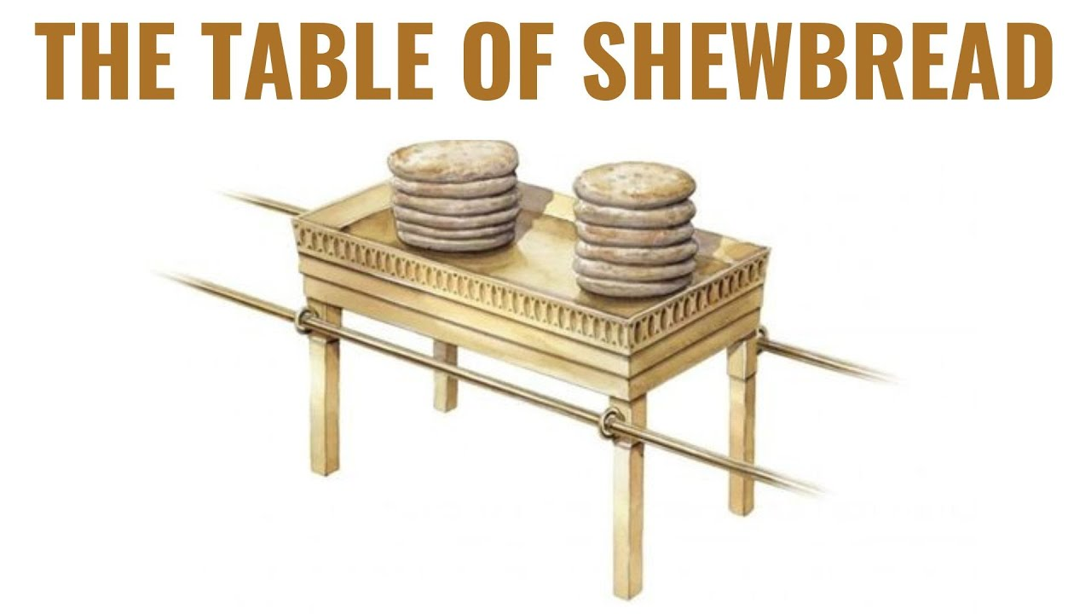
Flour
The bread symbolized Jesus
(Jesus died, his sacrifice, is a continual offering to God for out sins.
Jesus rose again. His resurrection is a promise of our resurrection.)
Q
In the following verse, find an ingredient of pizza.
Name it and tell what its spiritual significance is.
^{Leviticus 23:17} You shall bring from your dwellings two wave loaves of two-tenths of an ephah. They shall be of fine flour; they shall be baked with leaven.
They are the firstfruits to the Lord.
^{1 Corinthians 15:20} But the fact is that Christ (the Messiah) has been raised from the dead, and He became the firstfruits of those who have fallen asleep [in death].
^{John 6:35} And Jesus said to them, “I am the bread of life. He who comes to Me shall never hunger, and he who believes in Me shall never thirst.
The other team can steal the point
by answering now
A

Slide 12
Honey (or sugar)
God’s statutes, commands, or judgements are to be desired like sweet honey. They give us wisdom.
Q
In the following verse, find an ingredient of pizza.
Name it and tell what its spiritual significance is.
^{Psalms 19:8} The statutes of the Lord are right, rejoicing the heart;
The commandment of the Lord is pure, enlightening the eyes;
⁹ The fear of the Lord is clean, enduring forever;
The judgments of the Lord are true and righteous altogether.
¹⁰ More to be desired are they than gold,
Yea, than much fine gold;
Sweeter also than honey and the honeycomb.
The other team can steal the point
by answering now
A

Slide 13
Salt
We are the salt of the earth
(We are to flavor the earth with God’s love and goodness)
Q
In the following verse, find an ingredient of pizza.
Name it and tell what its spiritual significance is.
^{Matthew 5:13-14}“You are the salt of the earth;
but if the salt loses its flavor, how shall it be seasoned?
It is then good for nothing but to be thrown out and trampled underfoot by men.
The other team can steal the point
by answering now
A

Slide 14
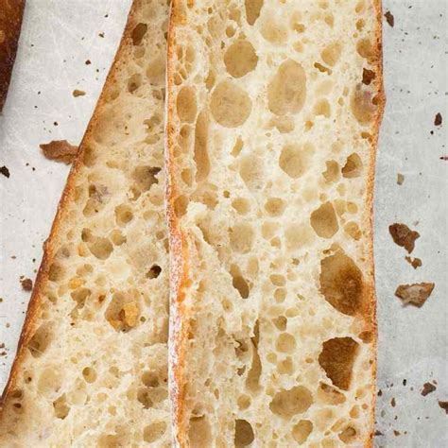
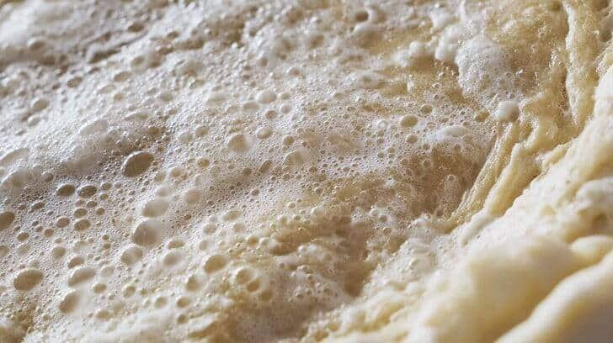
The yeast forms bubbles (from carbon dioxide) which catches in the flour gluten matrix to form air pockets
Q
How does yeast or other leavening agents lighten or soften
the pizza crust, bread (or other final product)?
The other team can steal the point
by answering now
A

Slide 15
Neapolitan style of pizza
Q
Which type of pizza ends up being thicker and softer: Neapolitan style or Roman style of Pizza?
r
The other team can steal the point
by answering now
Neapolitan style of Pizza | Roman style of Pizza
Formed by hand | formed or stretched with a rolling pin
baked for a longer time at a lower temperature | baked for at a higher temperature for a shorter time
A

Slide 16
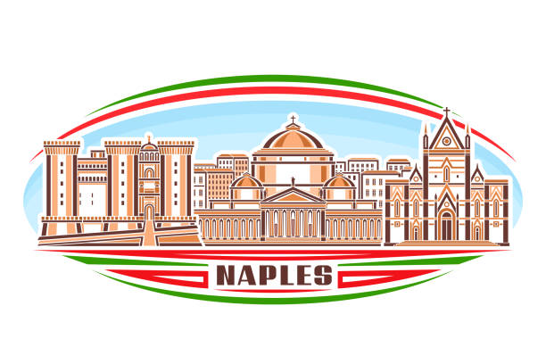
Neapolitan Pizza from Naples, Italy
Q
What kind of pizza is this:
A thick, hearth-baked, chewy crust topped with tomatoes or tomato sauce and mild cheese.
The other team can steal the point
by answering now
a) Neapolitan Pizza | d) Sicilian Pizza | g) Chicago Pizza Pie
b) California style pizza | e) Sourdough Pizza | h) Pizza Pocket
c) Pizza Turnover | f) Pizza on a stick | i) stuffed crust pizza
A

Slide 17
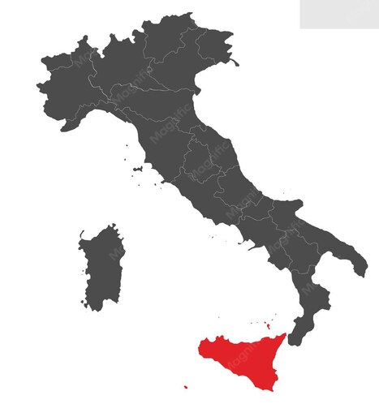
Sicilian Pizza
Q
What kind of pizza is this:
A rectangular slab of bread with toppings — which typically do not include cheese — pushed into the dough before baking.
The other team can steal the point
by answering now
a) Neapolitan Pizza | d) Sicilian Pizza | g) Chicago Pizza Pie
b) California style pizza | e) Sourdough Pizza | h) Pizza Pocket
c) Pizza Turnover | f) Pizza on a stick | i) stuffed crust pizza
A

Slide 18
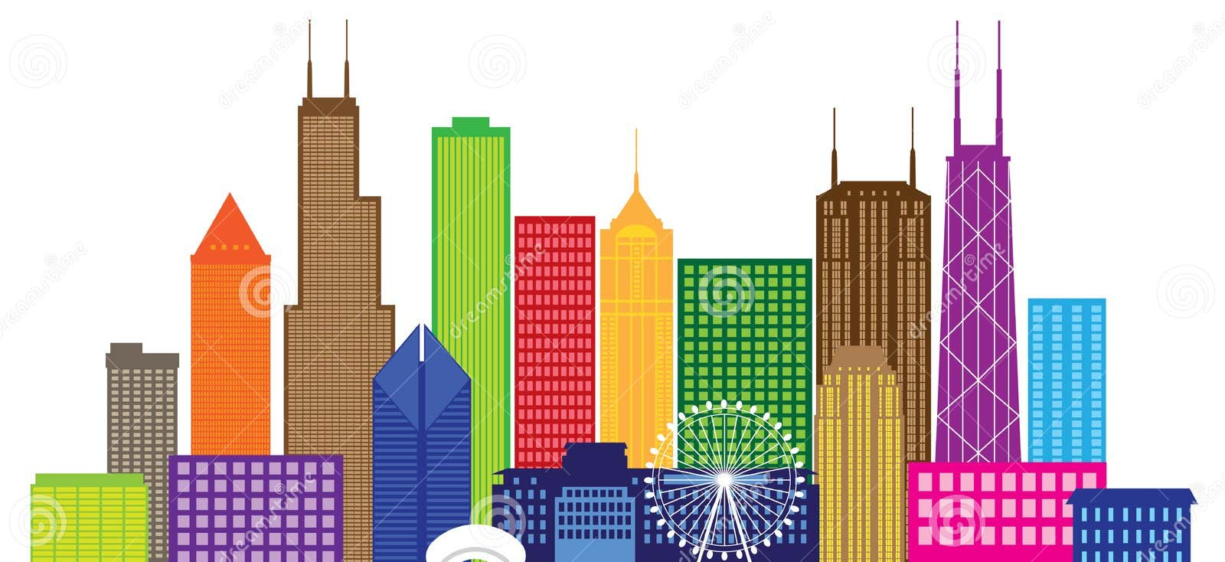
Chicago Pizza Pie
Q
What kind of pizza is this:
A deep-dish, multi-layered pizzas first created by Ike Sewell in the mid-twentieth century. That pie, almost a casserole, offers a unique pizza experience. It usually includes a thin crust in a deep dish, with toppings on the bottom, covered in cheese and tomato sauce on the top.
The other team can steal the point
by answering now
a) Neapolitan Pizza | d) Sicilian Pizza | g) Chicago Pizza Pie
b) California style pizza | e) Sourdough Pizza | h) Pizza Pocket
c) Pizza Turnover | f) Pizza on a stick | i) stuffed crust pizza
A

Slide 19
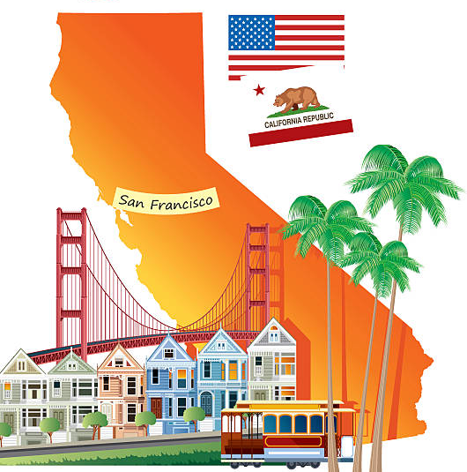
California style Pizza
Q
What kind of pizza is this:
Characterized by a plate-sized, very thin cracker-like crust and a range of unusual toppings
The other team can steal the point
by answering now
a) Neapolitan Pizza | d) Sicilian Pizza | g) Chicago Pizza Pie
b) California style pizza | e) Sourdough Pizza | h) Pizza Pocket
c) Pizza Turnover | f) Pizza on a stick | i) stuffed crust pizza
A

Slide 20
Sourdough Pizza
Q
What kind of pizza is this:
San Franciscans have long adored their hearty sourdough-crust pizzas topped with the freshest ingredients.
The other team can steal the point
by answering now
a) Neapolitan Pizza | d) Sicilian Pizza | g) Chicago Pizza Pie
b) California style pizza | e) Sourdough Pizza | h) Pizza Pocket
c) Pizza Turnover | f) Pizza on a stick | i) stuffed crust pizza
A

Slide 21
Pizza Pocket or Calzone
Q
What kind of pizza is this:
A pocket is made with crust on the top and bottom
and is filled with traditional pizza toppings.
The other team can steal the point
by answering now
a) Neapolitan Pizza | d) Sicilian Pizza | g) Chicago Pizza Pie
b) California style pizza | e) Sourdough Pizza | h) Pizza Pocket or Calzone
c) Pizza Turnover | f) Pizza on a stick | i) stuffed crust pizza
A

Slide 22
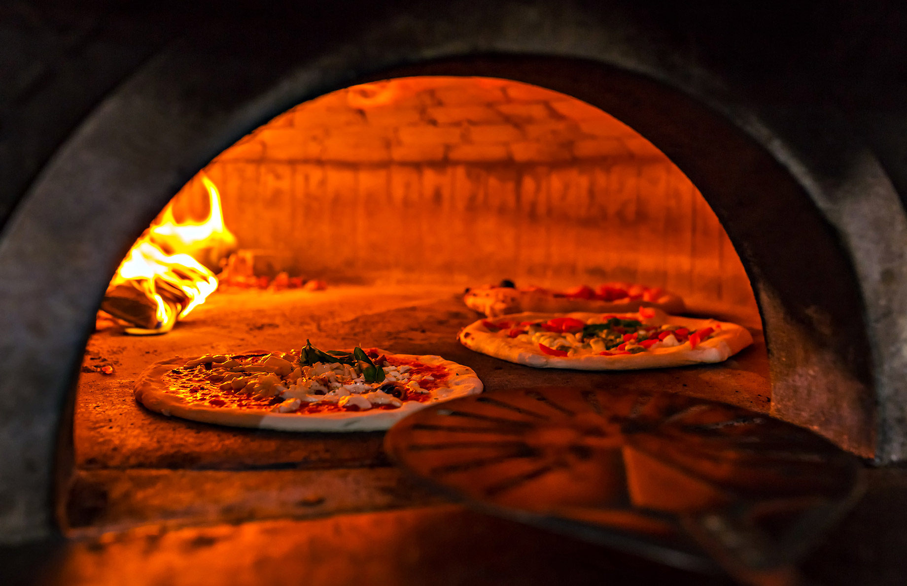
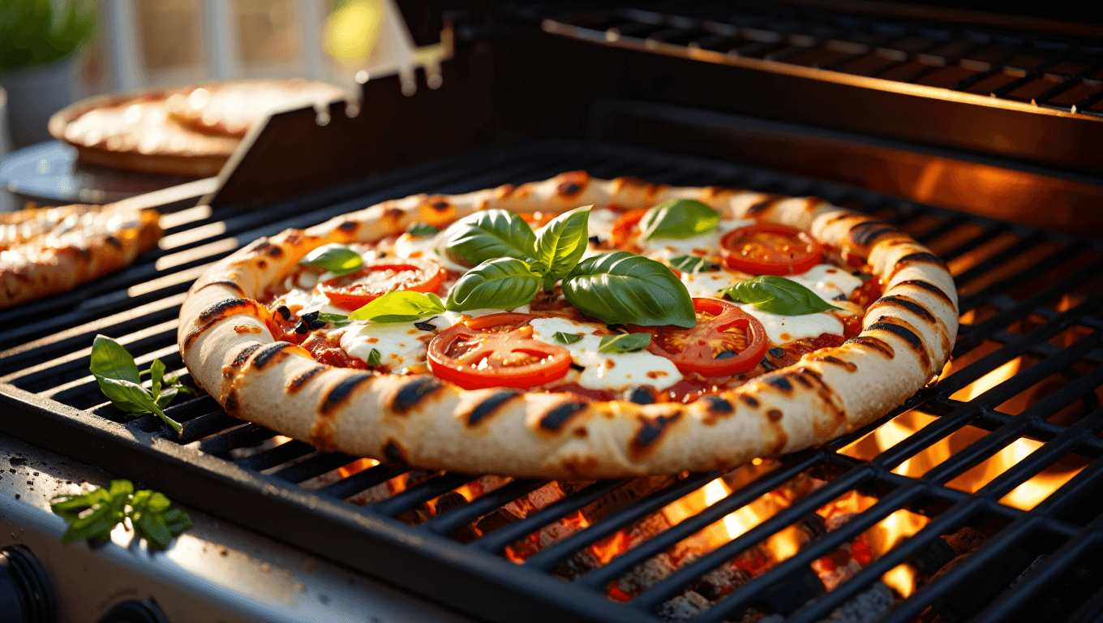
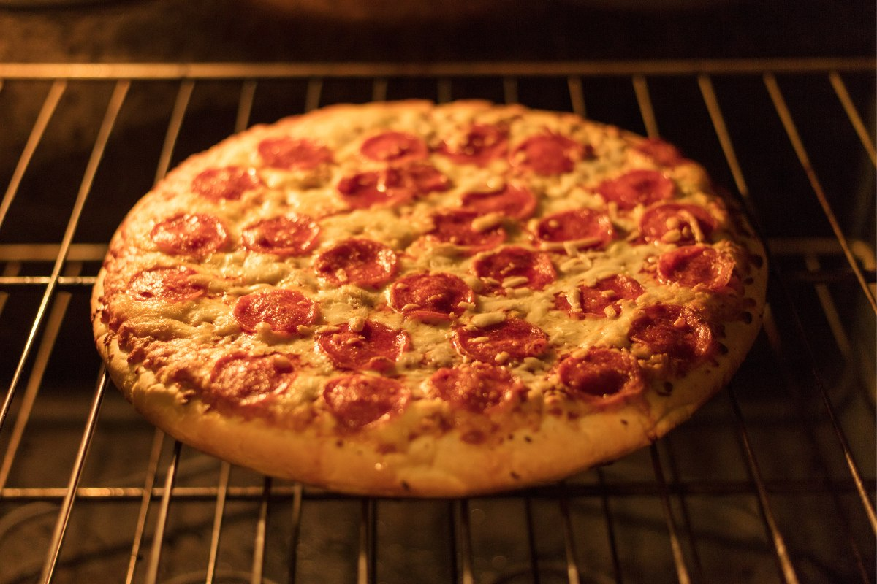
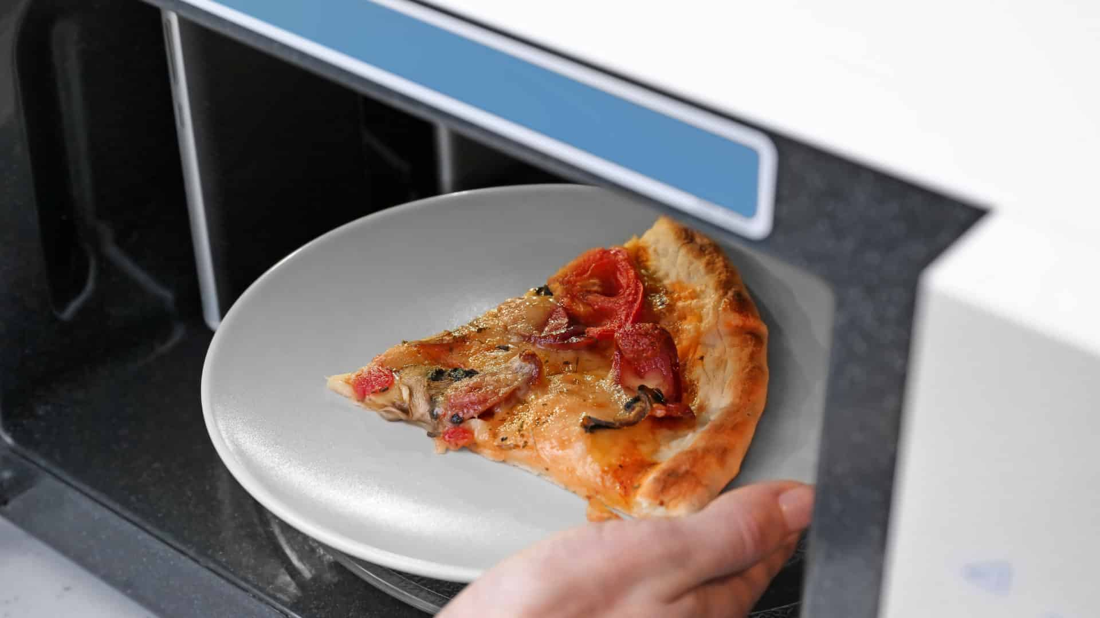
Give any 2:
Brick oven (wood or coal fired) baked in front of the fire
Stove (gas or electric) baked on a pan, pizza stone, or the rack
Grill (electric, gas or charcoal) grill dough, flip, quickly put on topping and cook it
Microwave (not preferred) heat on a pre-heated crisper tray
Q
What are 2 different ways to bake a pizza?
Describe how it is baked in each method.
The other team can steal the point
by answering now
A

Slide 23
752°
Q
What is the ideal temperature to cook pizza
if you use a wood oven?
752°
450-500°
626°
The other team can steal the point
by answering now
A

Slide 24
450-500°
Q
What is the ideal temperature to cook pizza
if you use a home oven?
752°
450-500°
626°
The other team can steal the point
by answering now
A

Slide 25
626°
Q
0-500°
What is the ideal temperature to cook pizza
if you use an industrial oven?
752°
450-500°
626°
The other team can steal the point
by answering now
A

Slide 26
Tomatoes or tomato sauce, cheese, and basil.
Q
What are the traditional Margherita Pizza ingredients?
The other team can steal the point
by answering now
A

Slide 27
Let’s make and eat Pizza!
CONGRATULATIONS!
https://wiki.pathfindersonline.org/w/AY_Honors/Pizza_Maker/Requirements

Slide 28


