Slide 1
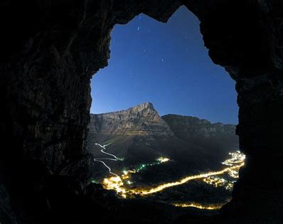
Jealous
King Saul turns against
David
David refuses to harm King Saul
1 Samuel 24 and 26

Slide 2
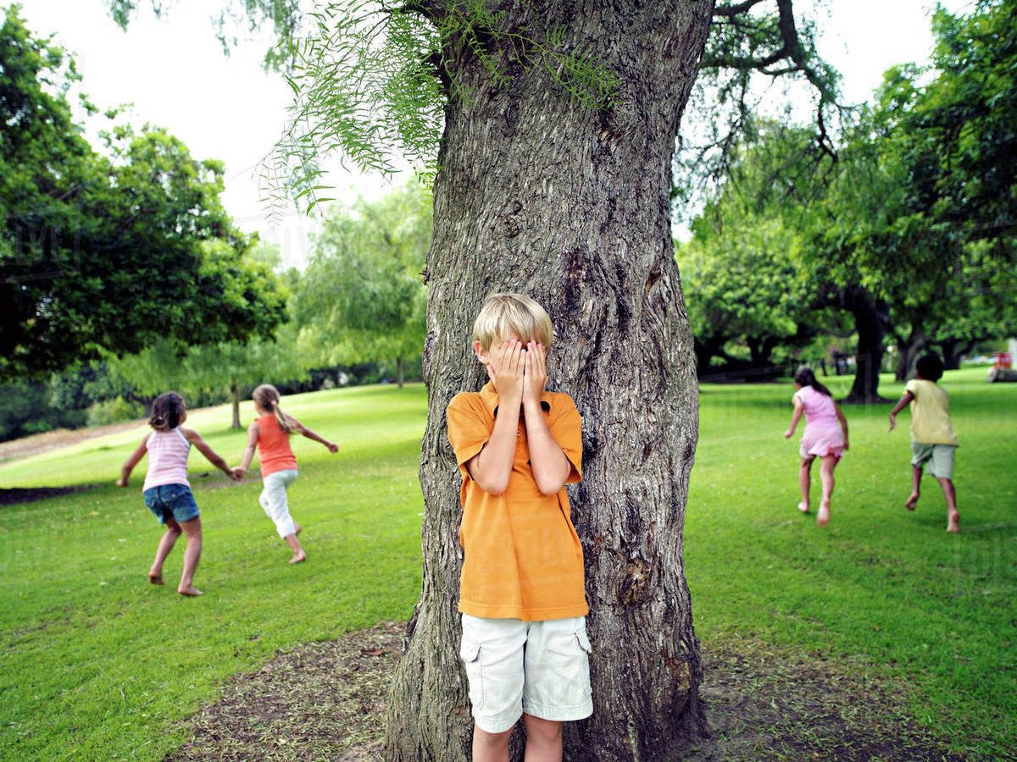
We’re going to start with a game today!
We’re going to play hide and seek tag outside.
We’ll choose an object in the center of our area (a tree, pole, or object). This is the base.
One or two people will be IT and hide their eyes and count at the base.
Everyone else will hide.
When the IT person gets done counting, they’ll say “Ready or not here I come” and will search for everyone hiding and try to tag them.
Everyone hiding will stay hidden until it’s safe to run to the base, touch it and say “FREE!”
It you are tagged, you are out.

Slide 3
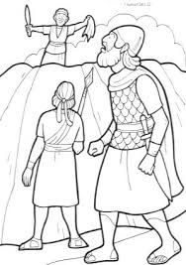
Color page
You may color and listen to our story today

Slide 4
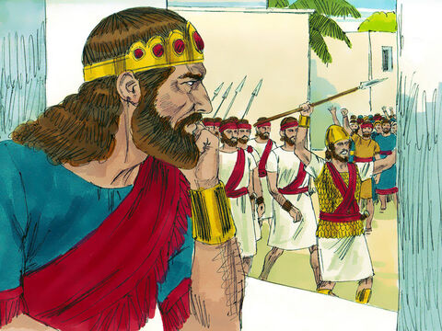
In our story, one man was hiding one man was chasing him.
Remember David slew Goliath. David won!
David joined the army and Saul even made him a commander!
Everyone loved David because he helped them win!
When the war was done, they welcomed the army home and celebrated. One day they sang this song:
“Saul has slain his thousands,
and David his tens of thousands.”
(1 Samuel 18:7)
That made Saul very jealous!
He began to think that David would kill him and take the throne – become king.

Slide 5
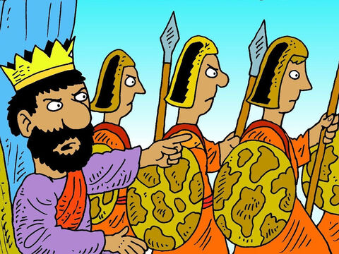
1 Samuel 24
After Saul returned from pursuing the Philistines, he was told, “David is in the Desert of En Gedi.” ² So Saul took three thousand able young men from all Israel and set out to look for David and his men near the Crags of the Wild Goats.
Who was hiding?
Who was chasing him?

Slide 6

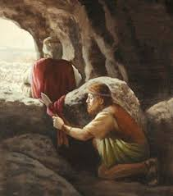
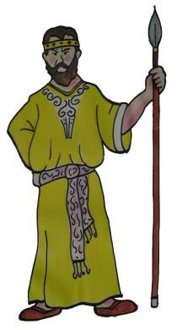

In a cave
³ He came to the sheep pens along the way; a cave was there, and Saul went in to relieve himself. David and his men were far back in the cave.
⁴ The men said, “This is the day the Lord spoke of when he said^{[b]} to you, ‘I will give your enemy into your hands for you to deal with as you wish.’”
Then David crept up unnoticed and cut off a corner of Saul’s robe.

Slide 7
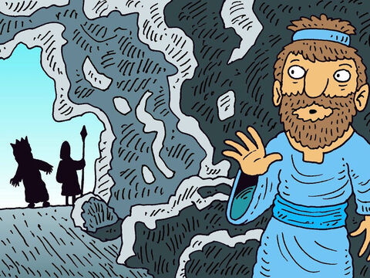
I think that was wrong
The Lord forbid
that I should stretch out my hand against the Lord’s anointed.
It is wrong for me to hurt or kill the one who God has
anointed to be king.
⁵ Afterward, David was conscience-stricken for having cut off a corner of his robe. ⁶ He said to his men, “The Lord forbid that I should do such a thing to my master, the Lord’s anointed, or lay my hand on him; for he is the anointed of the Lord.” ⁷ With these words David sharply rebuked his men and did not allow them to attack Saul. And Saul left the cave and went his way.

Slide 8
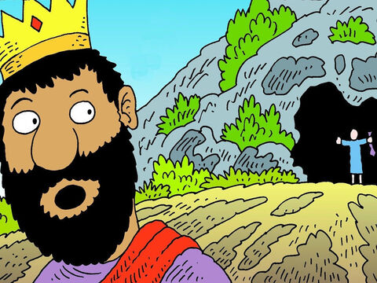
I will not harm you
Saul! Saul!
Why do you think I will hurt you?
Look at this robe in my hand.
I could have killed you, but I didn’t.
I will not harm you. You are my king!
⁸ Then David went out of the cave and called out to Saul, “My lord the king!” When Saul looked behind him, David bowed down and prostrated himself with his face to the ground. ⁹ He said to Saul, “Why do you listen when men say, ‘David is bent on harming you’? ¹⁰ This day you have seen with your own eyes how the Lord delivered you into my hands in the cave. Some urged me to kill you, but I spared you; I said, ‘I will not lay my hand on my lord, because he is the Lord’s anointed.’ ¹¹ See, my father, look at this piece of your robe in my hand! I cut off the corner of your robe but did not kill you. See that there is nothing in my hand to indicate that I am guilty of wrongdoing or rebellion. I have not wronged you, but you are hunting me down to take my life. ¹² May the Lord judge between you and me. And may the Lord avenge the wrongs you have done to me, but my hand will not touch you. ¹³ As the old saying goes, ‘From evildoers come evil deeds,’ so my hand will not touch you.

Slide 9
I was wrong
Why are you chasing me?
¹⁴ “Against whom has the king of Israel come out? Who are you pursuing? A dead dog? A flea? ¹⁵ May the Lord be our judge and decide between us. May he consider my cause and uphold it; may he vindicate me by delivering me from your hand.”
¹⁶ When David finished saying this, Saul asked, “Is that your voice, David my son?” And he wept aloud. ¹⁷ “You are more righteous than I,” he said. “You have treated me well, but I have treated you badly. ¹⁸ You have just now told me about the good you did to me; the Lord delivered me into your hands, but you did not kill me. ¹⁹ When a man finds his enemy, does he let him get away unharmed? May the Lord reward you well for the way you treated me today.
David is that you, my son?
You are better than I.
You have treated me well
You did not kill me.
May the Lord bless you.

Slide 10
Please save me
I will not wipe out your family.
You are my king.
²⁰ I know that you will surely be king and that the kingdom of Israel will be established in your hands. ²¹ Now swear to me by the Lord that you will not kill off my descendants or wipe out my name from my father’s family.”
²² So David gave his oath to Saul. Then Saul returned home, but David and his men went up to the stronghold.
I know you will be king some day. Swear to me that you won’t kill my family.

Slide 11
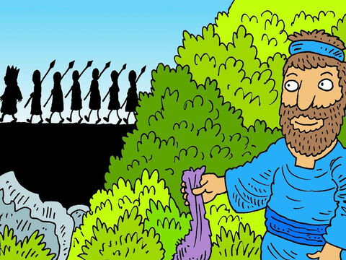
Safe!
²² So David gave his oath to Saul. Then Saul returned home, but David and his men went up to the stronghold.
Time went on…..

Slide 12
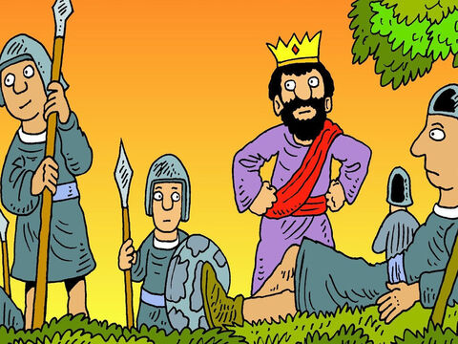
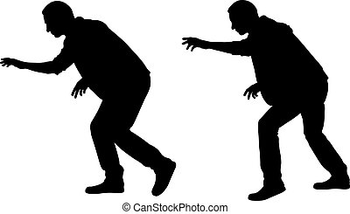
1 Samuel 26
Later …..
The Ziphites went to Saul at Gibeah and said, “Is not David hiding on the hill of Hakilah, which faces Jeshimon?”
² So Saul went down to the Desert of Ziph, with his three thousand select Israelite troops, to search there for David.
³ Saul made his camp beside the road on the hill of Hakilah facing Jeshimon, but David stayed in the wilderness. When he saw that Saul had followed him there, ⁴ he sent out scouts and learned that Saul had definitely arrived.

Slide 13
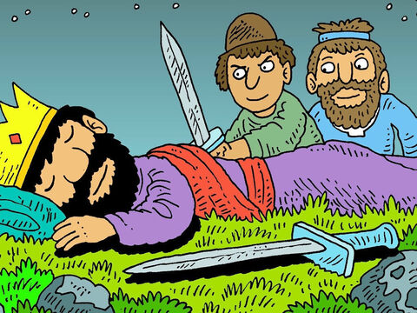
Spying on the king
Shhh!
There’s King Saul. He’s asleep.
All of his men are asleep too!
⁵ Then David set out and went to the place where Saul had camped. He saw where Saul and Abner son of Ner, the commander of the army, had lain down. Saul was lying inside the camp, with the army encamped around him.
⁶ David then asked Ahimelek the Hittite and Abishai son of Zeruiah, Joab’s brother, “Who will go down into the camp with me to Saul?”
“I’ll go with you,” said Abishai.
⁷ So David and Abishai went to the army by night, and there was Saul, lying asleep inside the camp with his spear stuck in the ground near his head. Abner and the soldiers were lying around him.

Slide 14
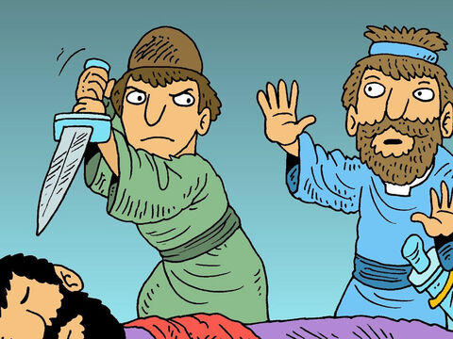
At some time, according to God’s will,
the king will die by illness or battle,
But not by my hand. We will not kill him!
Stop! No!
We will not kill God’s anointed king!
⁸ Abishai said to David, “Today God has delivered your enemy into your hands. Now let me pin him to the ground with one thrust of the spear; I won’t strike him twice.”
⁹ But David said to Abishai, “Don’t destroy him! Who can lay a hand on the Lord’s anointed and be guiltless? ¹⁰ As surely as the Lord lives,” he said, “the Lord himself will strike him, or his time will come and he will die, or he will go into battle and perish. ¹¹ But the Lord forbid that I should lay a hand on the Lord’s anointed.

Slide 15
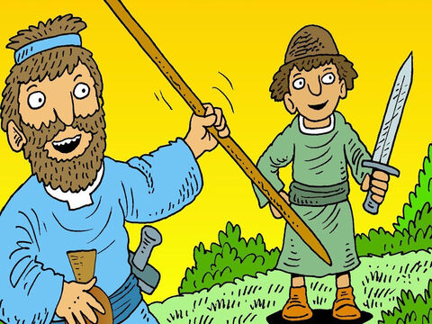
We’ll just take his water jug and spear.
That will teach him a lesson.
Now get the spear and water jug that are near his head, and let’s go.”
¹² So David took the spear and water jug near Saul’s head, and they left. No one saw or knew about it, nor did anyone wake up. They were all sleeping, because the Lord had put them into a deep sleep.

Slide 16
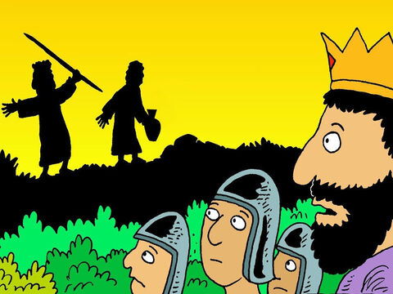
Wake up!
Look around you.
Abner! Wake up!
Why were you sleeping instead of guarding the king?
Look around. What is missing?
¹³ Then David crossed over to the other side and stood on top of the hill some distance away; there was a wide space between them. ¹⁴ He called out to the army and to Abner son of Ner, “Aren’t you going to answer me, Abner?”
Abner replied, “Who are you who calls to the king?”
¹⁵ David said, “You’re a man, aren’t you? And who is like you in Israel? Why didn’t you guard your lord the king? Someone came to destroy your lord the king. ¹⁶ What you have done is not good. As surely as the Lord lives, you and your men must die, because you did not guard your master, the Lord’s anointed. Look around you. Where are the king’s spear and water jug that were near his head?”
Who is calling to the king?

Slide 17
Wake up!
Look around you.
Yes King Saul! It is me.
Why are you chasing your servant?
What have I done wrong?
¹⁷ Saul recognized David’s voice and said, “Is that your voice, David my son?”
David replied, “Yes it is, my lord the king.” ¹⁸ And he added, “Why is my lord pursuing his servant? What have I done, and what wrong am I guilty of? ¹⁹ Now let my lord the king listen to his servant’s words. If the Lord has incited you against me, then may he accept an offering. If, however, people have done it, may they be cursed before the Lord! They have driven me today from my share in the Lord’s inheritance and have said, ‘Go, serve other gods.’ ²⁰ Now do not let my blood fall to the ground far from the presence of the Lord. The king of Israel has come out to look for a flea—as one hunts a partridge in the mountains.”
²¹ Then Saul said, “I have sinned. Come back, David my son. Because you considered my life precious today, I will not try to harm you again. Surely I have acted like a fool and have been terribly wrong.”
Is that you David?
I have sinned.
Come back David.
I won’t try to harm you again.

Slide 18
Good bye
Here is the king’s spear.
Have one of your men come get it.
May God bless you, David.
You will do great things and triumph.
²² “Here is the king’s spear,” David answered. “Let one of your young men come over and get it. ²³ The Lord rewards everyone for their righteousness and faithfulness. The Lord delivered you into my hands today, but I would not lay a hand on the Lord’s anointed. ²⁴ As surely as I valued your life today, so may the Lord value my life and deliver me from all trouble.”
²⁵ Then Saul said to David, “May you be blessed, David my son; you will do great things and surely triumph.”
So, David went on his way, and Saul returned home.

Slide 19

How should we treat leaders and those in authority?
All of you must obey those who rule over you.
There are no authorities except the ones God has chosen.
Those who now rule have been chosen by God. “
Romans 13:1
Find It
Read it
Romans 13:1
(1-7)

Slide 20
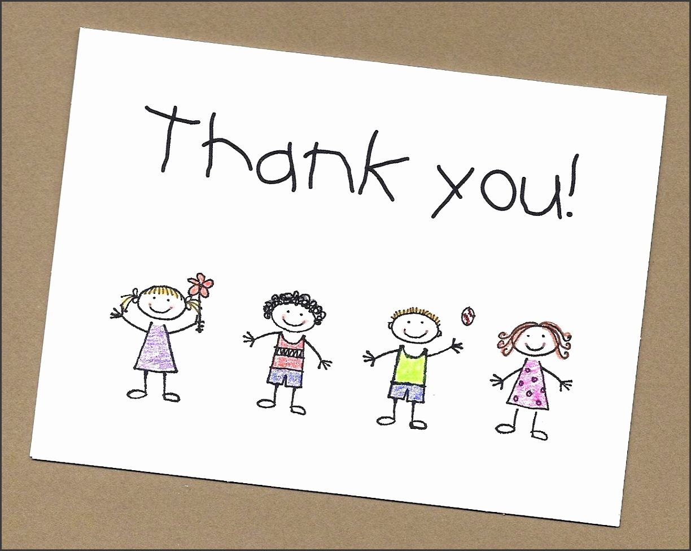
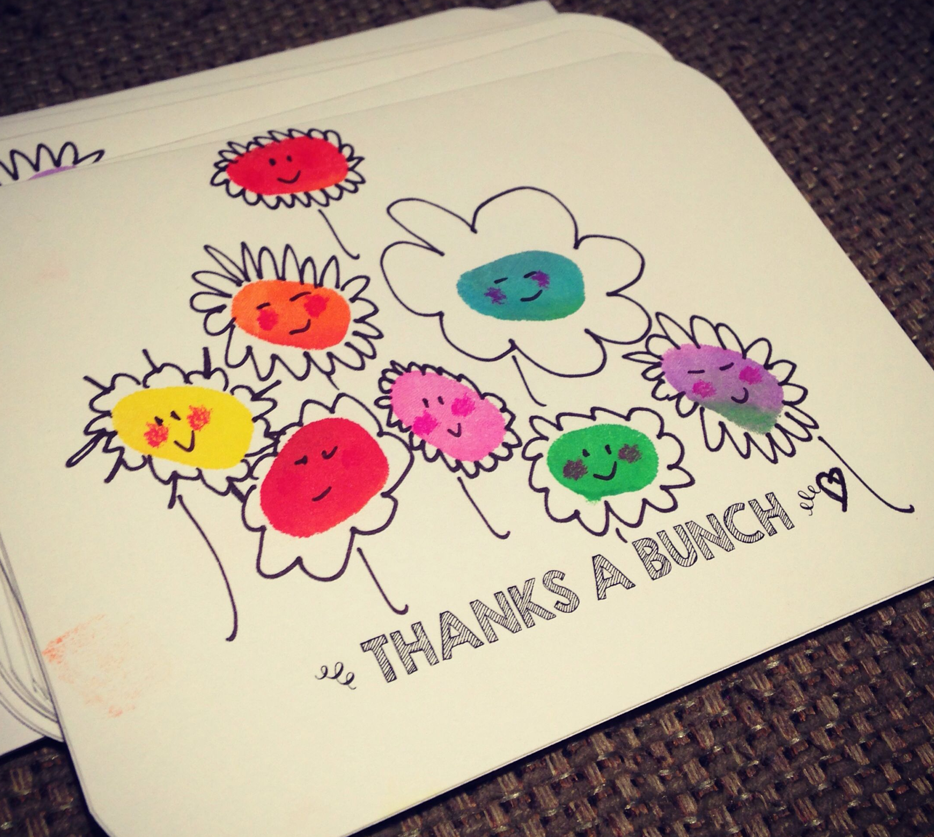

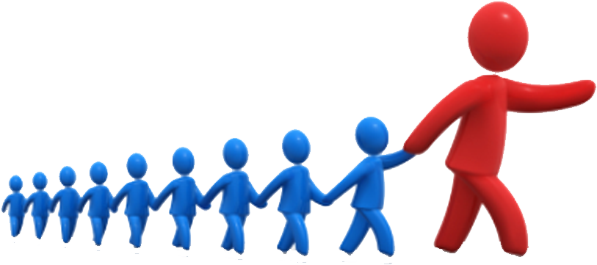


CRAFT TIME
We’re going to make cards for those in leadership.
Who should we give them to?
Police in our area
Teachers
Mayor or official
Church leaders
Here are some card ideas:
I have some cards with messages. Choose 1.
Add decorations on the front and inside.

Slide 21
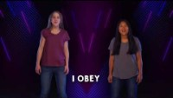
Sing

Slide 22
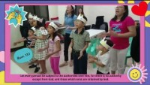

Slide 23
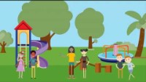
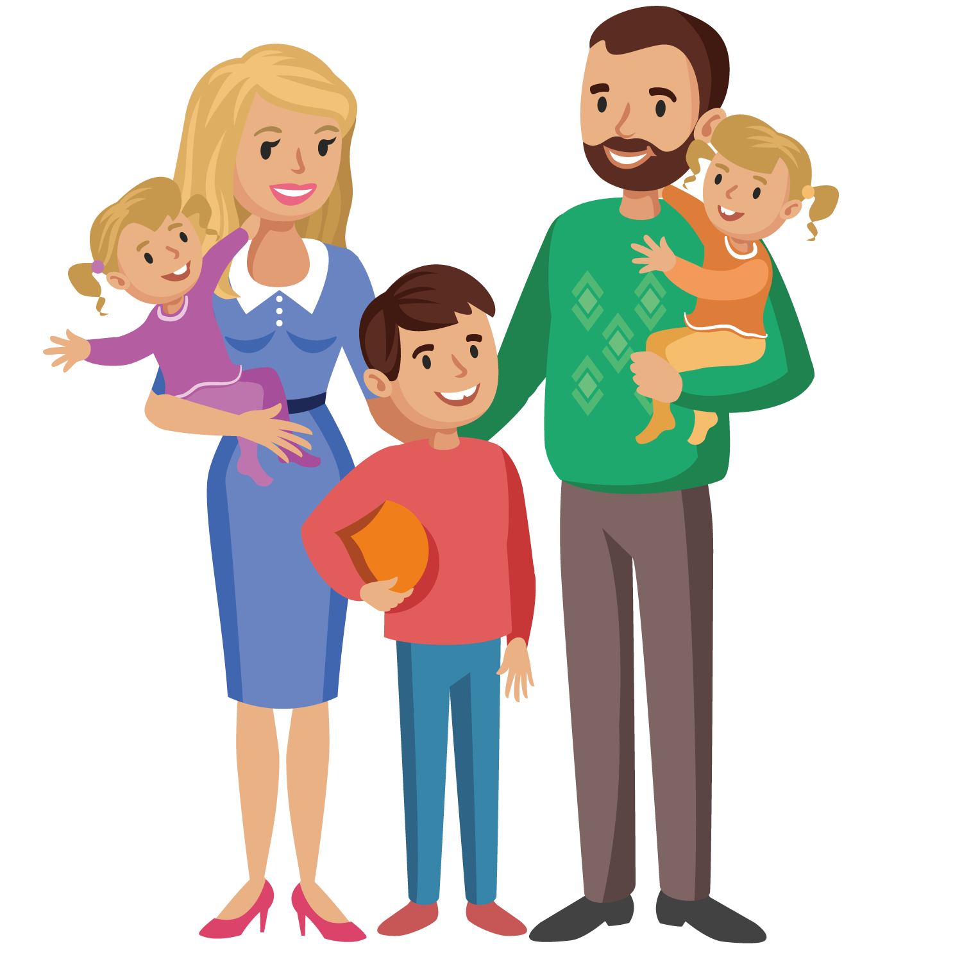


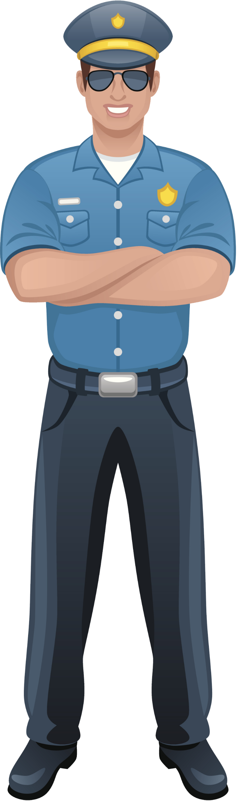
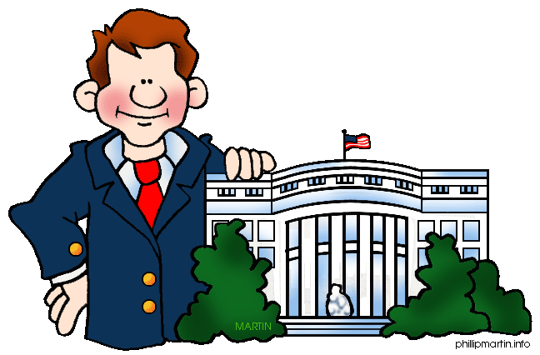
Who should we obey?
What are some examples of rules?

Slide 24

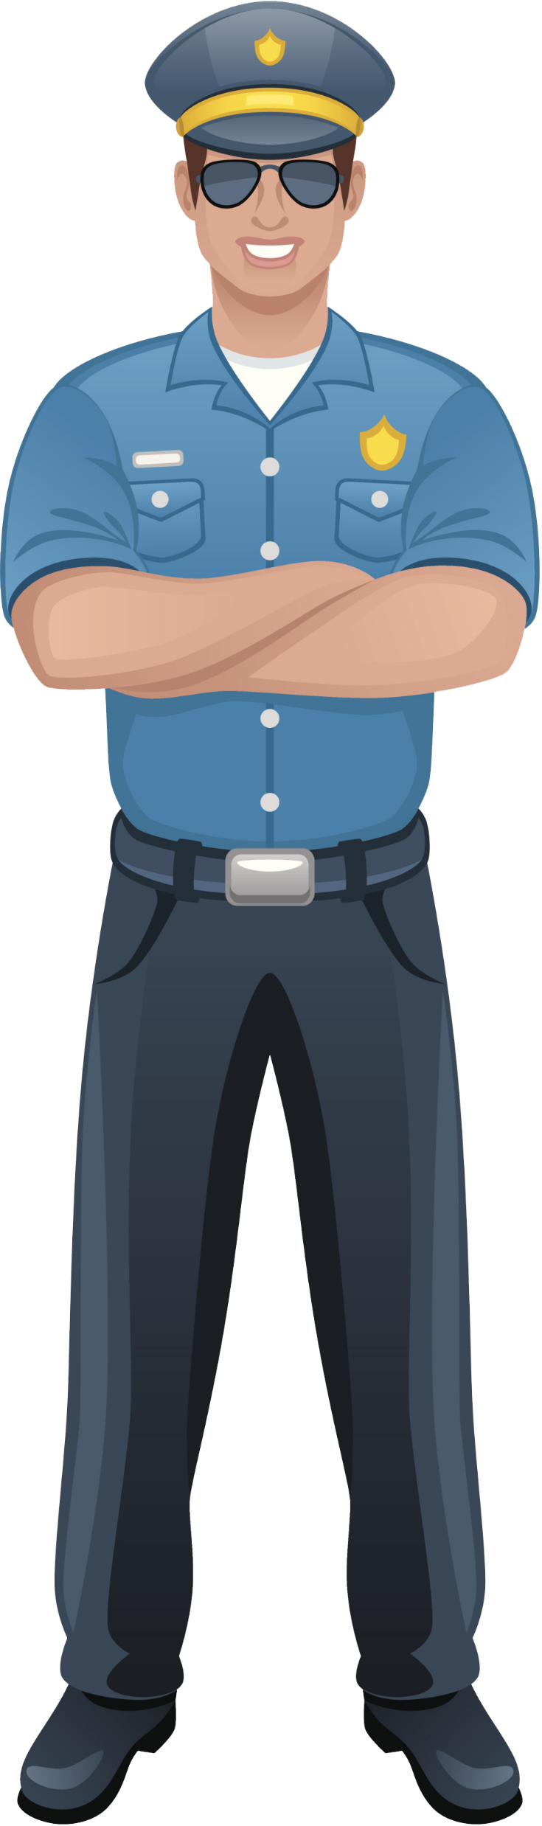
Sing

Slide 25
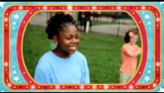
Sing

Slide 26
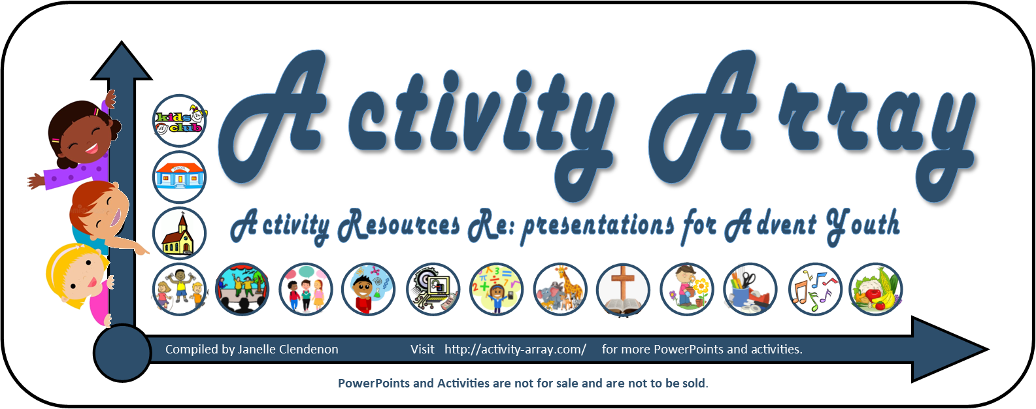

Slide 27
Extra -- extra…..
These are extra slides (such as other craft ideas) that you can put where desired in the slide show.

Slide 28
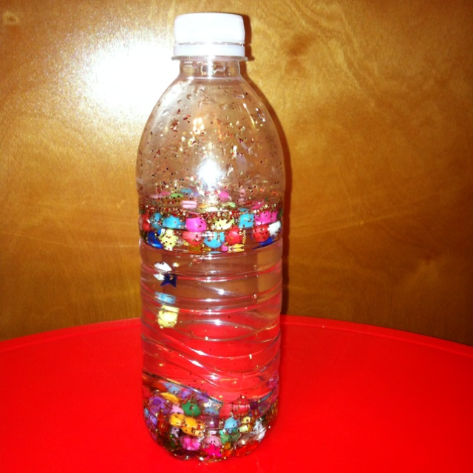
Craft idea – water jug
NEED:
Water bottle
Plastic sequins and jewels
Glitter
Sticker label that says:
I will honor God.
I will respect authority.
I will honor God.
I will respect authority.

Slide 29
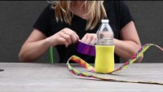
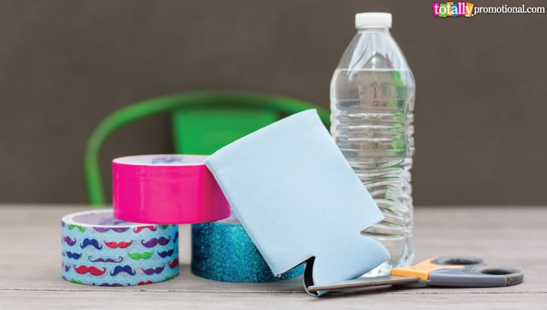
Craft idea – water bottle holder (craft for older children).
NEED:
Foam cup insulator
Roll of fancy duct tape or 2
https://www.totallypromotional.com/blog/diy-water-bottle-holder/

