Slide 1

God Wins
Even if we mess up
GOD DIRECTS OUR STEPS
David and His men at Ziklag
1 Samuel 29 and 30

Slide 2
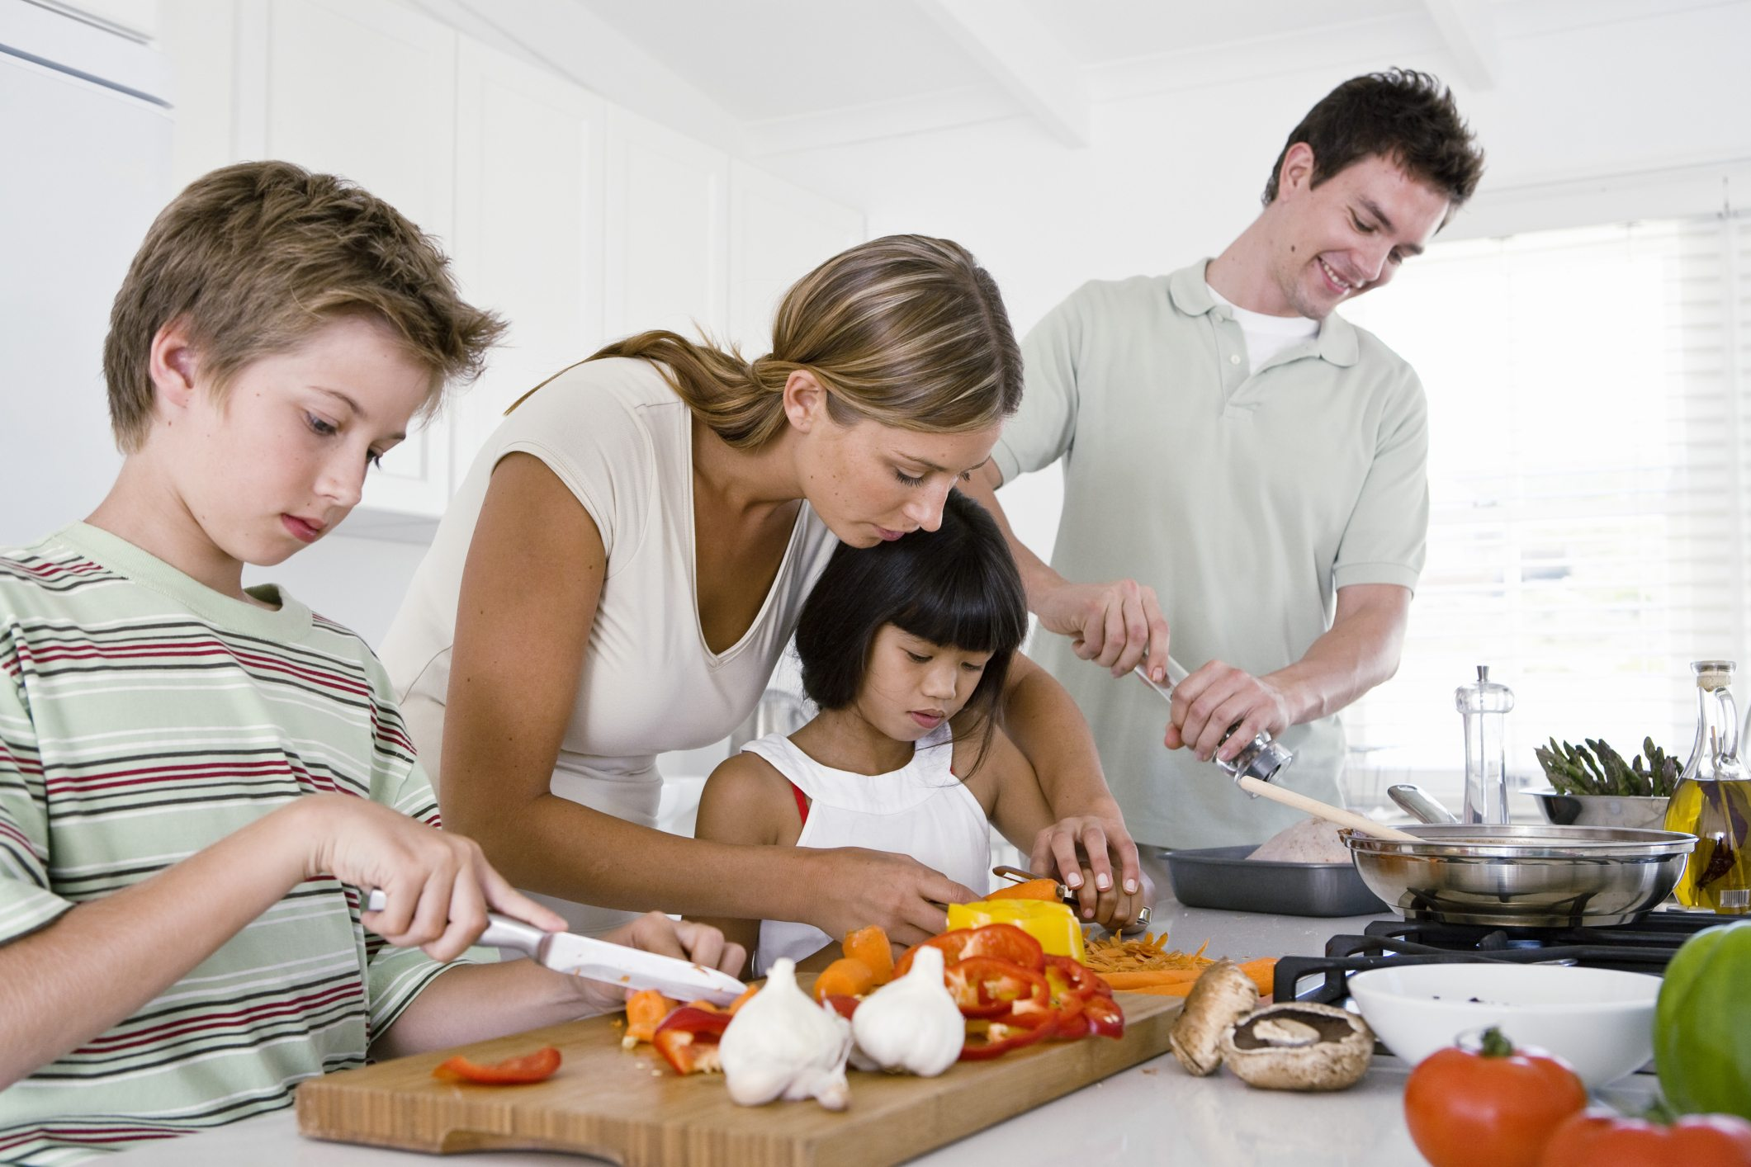
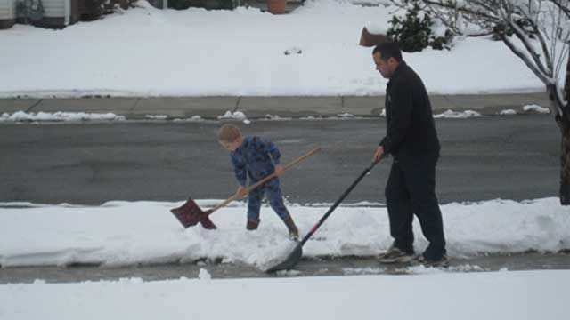
Have you and your family worked together this week?
What did you do?

Slide 3
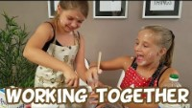

Slide 4

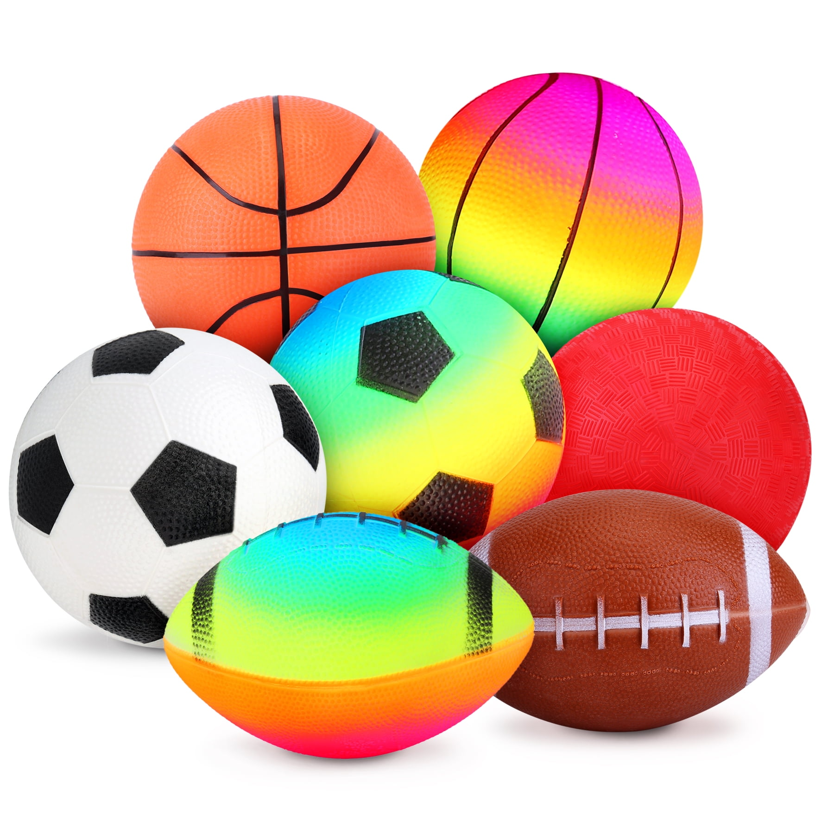

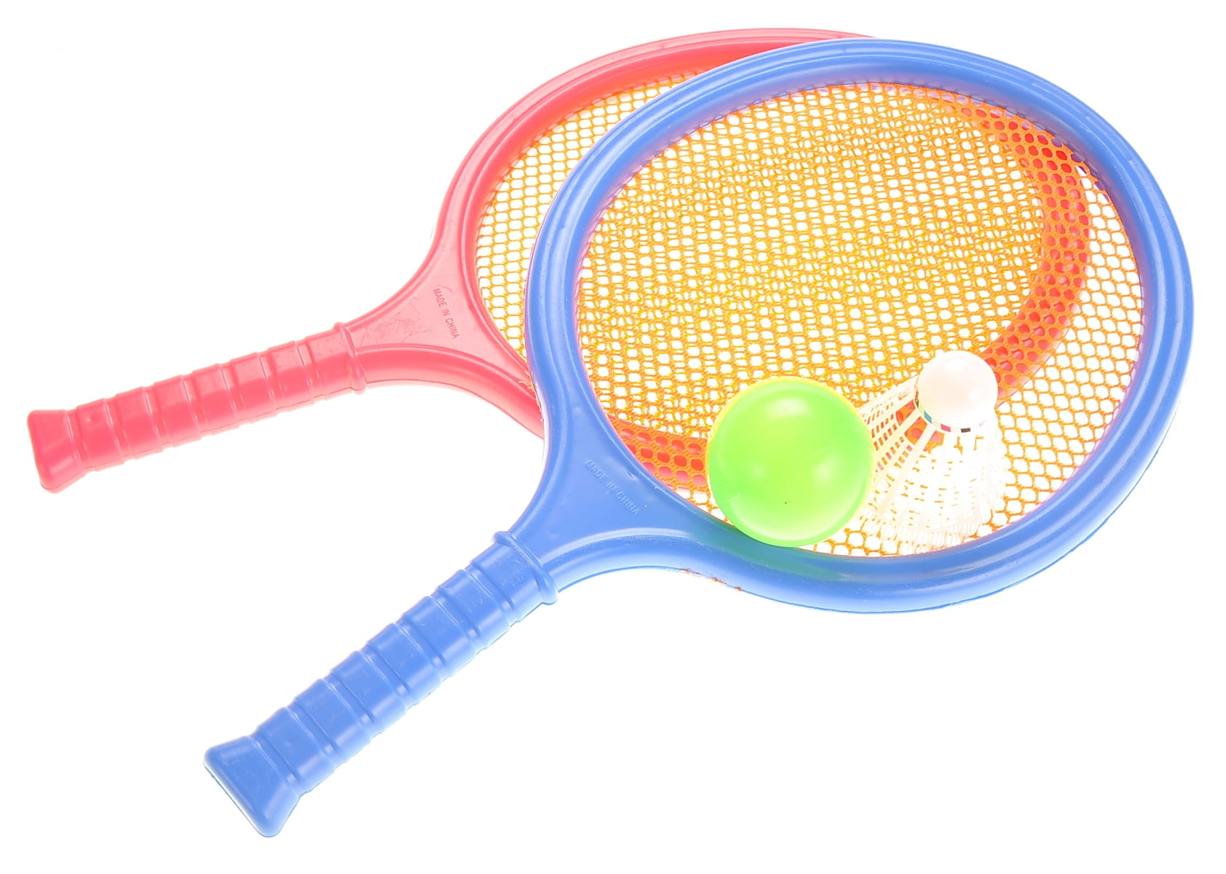
What team games have you played?
In what ways do you work as a team?

Slide 5
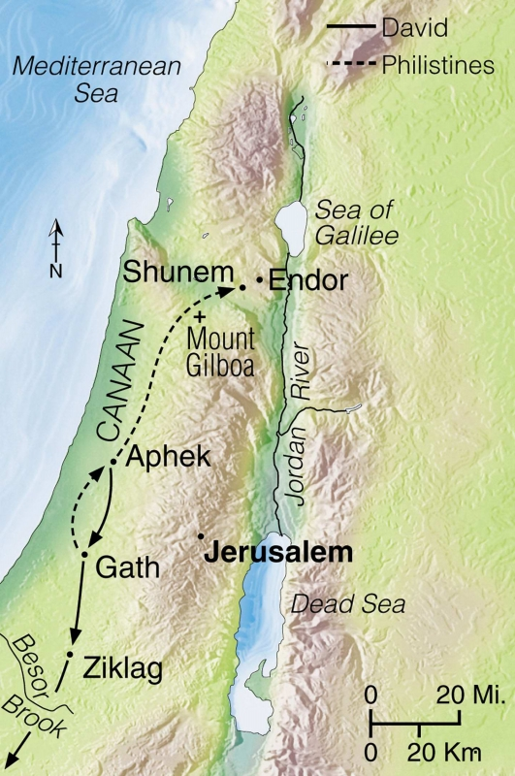
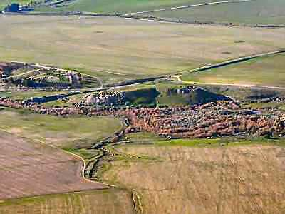
1 Samuel 27 -- David is in Ziklag
David got tired of Saul hunting him.
So, David decided to go to the Philistine king, Achish, king of Gath
Achish gave David and his men the city of Ziklag.
Can you find those cities?

Slide 6
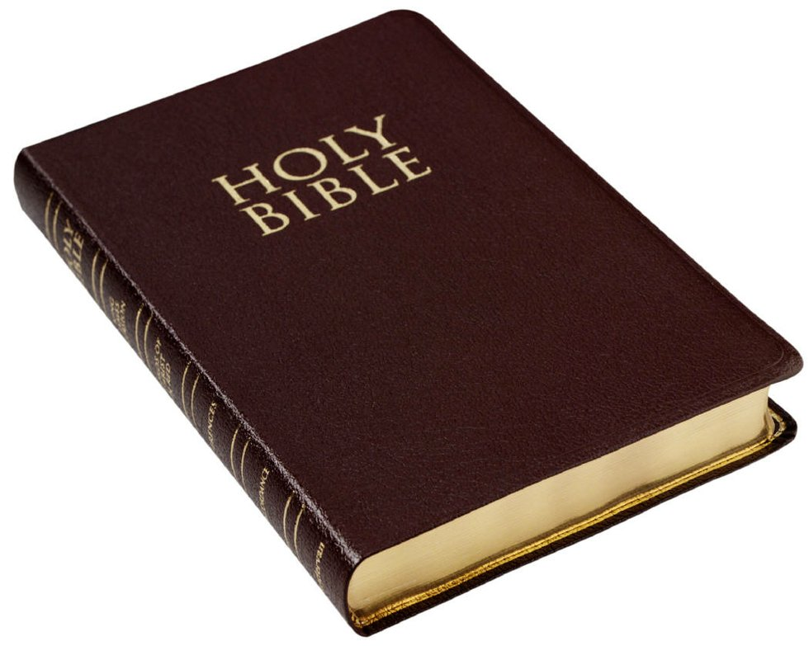
You can find those stories and the story for today in your Bible in the book of 1 Samuel. Let’s find it.
GENESIS
EXODUS
LEVITCUS
NUMBERS
DEUTERONOMY -- they are the 5 books that Moses wrote
JOSHUA -- was Israel’s leader after Moses
JUDGES -- tells about the leaders after Joshua
RUTH -- Ruth was David’s great grandma
1 SAMUEL -- tells about Samuel, Saul, and David

Slide 7

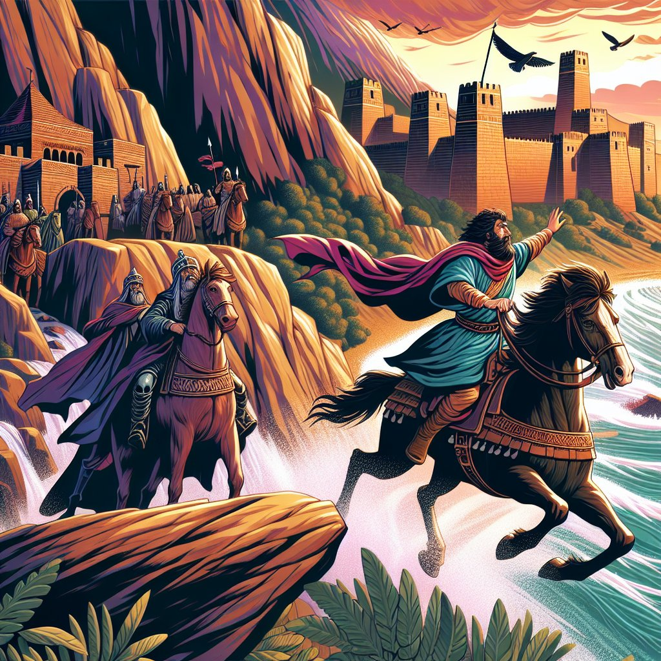
What does the Bible say David did in Ziklag?
1 Samuel
27:1-12

Slide 8
What does the Bible say David did in Ziklag?
A man’s heart plans his way,
But the Lord directs his steps.
Proverbs
16:9

Slide 9



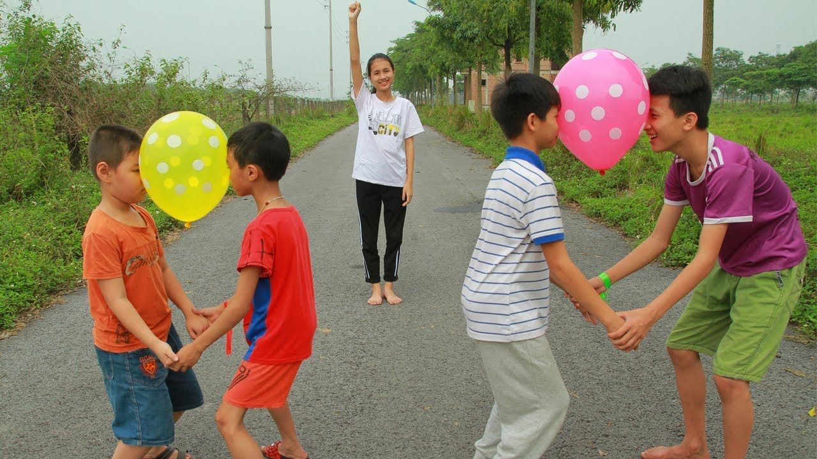
Team ZIG-ZAG CHALLENGE
Spin together in a circle
Today I have a team challenge for you today.
There’s a zig-zag course. You and your partner will need to travel the course with a ball or balloon between your backs. At the end of each zig or zag there will be a stack of cards and a challenge.
Pick up 1 of the cards. Do the challenge together and then go to the end of that zig or zag to get another card and do another challenge.
Choose a partner and a ball or balloon.
Stand back to back and have someone place the balloon or ball between your backs. Press together to hold it there while you move or are still.
If you drop the balloon or ball, you need to back to the beginning of that zig or zag.
Do 3 squats together
Put the ball/balloon between your hips for the next zag
Do the last zig backwards
Note: the cards are parts of MV Prov. 16:9

Slide 10
One final challenge
Spin together in a circle
Work together to put the cards
in order.
Your hint is to look at the cards with numbers on them.
Put the ball/balloon between your hips for the next zag
Do 3 squats together
Do the last zig hold the ball/balloon between your heads.
Note: the cards are parts of MV Prov. 16:9

Slide 11
CONGRATULATIONS!
A man’s heart plans his way,
But the Lord directs his steps.
Enjoy a cool snack treat!
What was difficult about that challenge?
What did you figure out that you had to do to be successful?
GREAT TEAM WORK!
Spin together in a circle
Put the ball/balloon between your hips for the next zag
Do 3 squats together
Do the last zig hold the ball/balloon between your heads.
Note: the cards are parts of MV Prov. 16:9

Slide 12
When LORD?
Remember that Samuel anointed David to be the next king.
In our stories thus far, has David become king?
NO
It was like God took David on a very challenging ZIG-ZAG path.
And David kept waiting for GOD to establish God’s plan
and David’s steps.

Slide 13
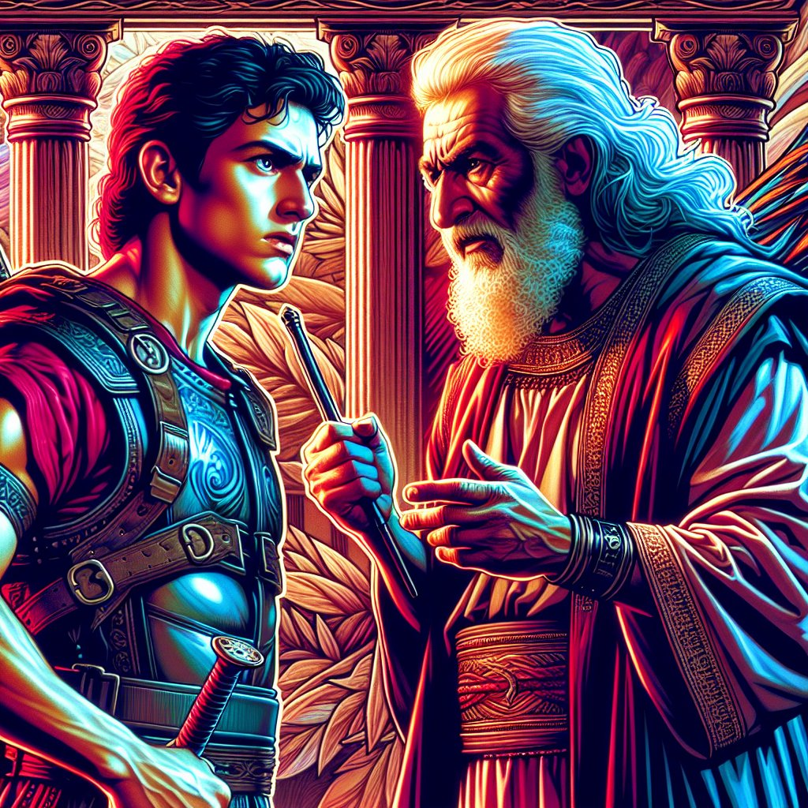
1 Samuel 28 -- David is in Ziklag
28 While David was living in Ziklag, the Philistines gathered their army together. They planned to fight against Israel. Achish said to David, “Here is what you must understand. You and your men must march out with me and my army.”
² David said, “I understand. You will see for yourself what I can do.”
Achish replied, “All right. I’ll make you my own personal guard for life.”
“Here is what you must understand. You and your men must march out with me and my army.
“All right. I’ll make you my own personal guard for life.”
“I understand.
You will see for yourself what I can do.”

Slide 14
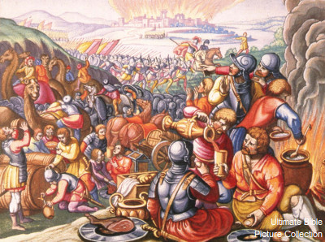
The Philistines are going to go fight Israel. Will David go?
Why are David and his men here!?
He won’t help us fight Israel.
He’ll turn against us. Send him home!
He won’t help us fight Israel.
He’ll turn against us. Send him home!
29 The Philistines gathered their whole army together at Aphek. Israel’s army camped by the spring of water at Jezreel. ² The Philistine rulers marched out in groups of hundreds and thousands. David and his men were marching with Achish behind the others. ³ The commanders of the Philistines asked, “Why are these Hebrews here?”
Achish replied, “That’s David, isn’t it? Wasn’t he an officer of Saul, the king of Israel? He has already been with me for more than a year. I haven’t found any fault in him. That’s been true from the day he left Saul until now.”
⁴ But the Philistine commanders were angry with Achish. They said, “Send David back. Let him return to the town you gave him. He must not go with us into battle. If he does, he’ll turn against us during the fighting. In fact, he might even cut off the heads of our own men. What better way could he choose to win back his master’s favor? ⁵ Isn’t David the one the Israelites sang about when they danced? They sang,
“ ‘Saul has killed thousands of men.
David has killed tens of thousands.’ ”
Wasn’t he an officer of Saul, king of Israel.
But he’s been with me more than a year.
He’s left Saul and served me well.
I have found no fault in him.

Slide 15
The Philistines are going to go fight Israel. Will David go?
6 So Achish called David over to him. He said, “You have been faithful to me. And that’s just as sure as the Lord is alive. I would be pleased to have you serve with me in the army. I haven’t found any fault in you. That’s been true from the day you came to me until today. But the Philistine rulers aren’t pleased to have you come along. 7 So now go back home in peace. Don’t do anything that wouldn’t please the Philistine rulers.”
8 “But what have I done?” asked David. “What have you found against me from the day I came to you until now? Why can’t I go and fight against your enemies? After all, you are my king and master.”
9 Achish answered, “You have been as pleasing to me as an angel of God. But the Philistine commanders have said, ‘We don’t want David to go up with us into battle.’ 10 So get up early in the morning. Take with you the men who used to serve Saul. Leave as soon as the sun begins to come up.”
You have been as pleasing to me as an angel of God, but the Philistine commanders, my allies, have said, “We don’t want David to go up with us into battle.” So go home in the morning..
I would be pleased to have you with me,
but the commanders don’t trust you.
You must go home.
But what have I done?
Have I wronged you in any way?
Why can’t I do with you to fight your enemies?
Afterall you are my king and master.
Whew! We don’t have to fight against our people!

Slide 16
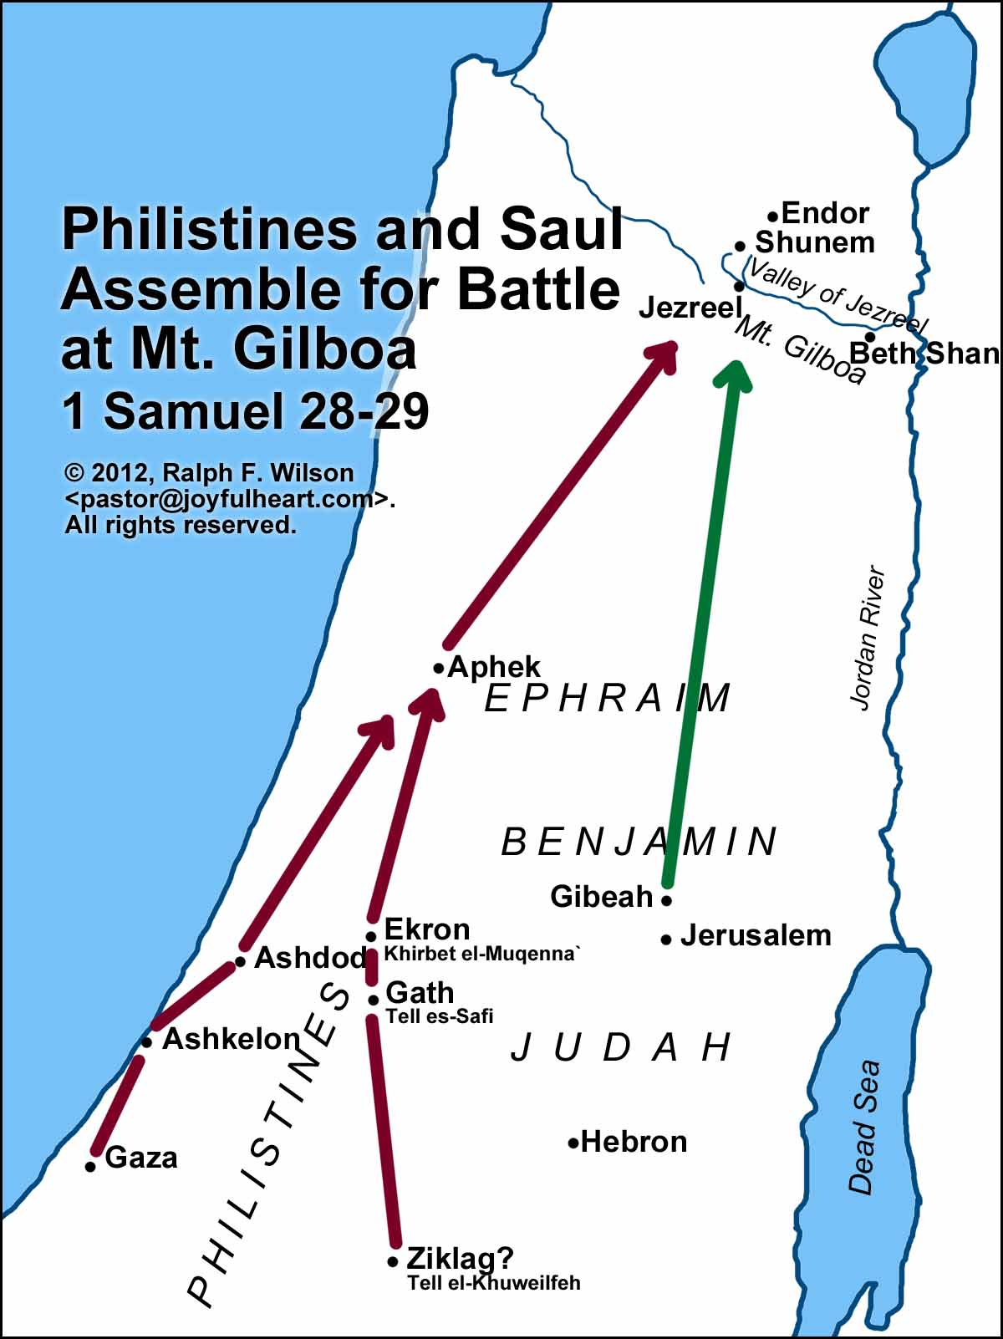
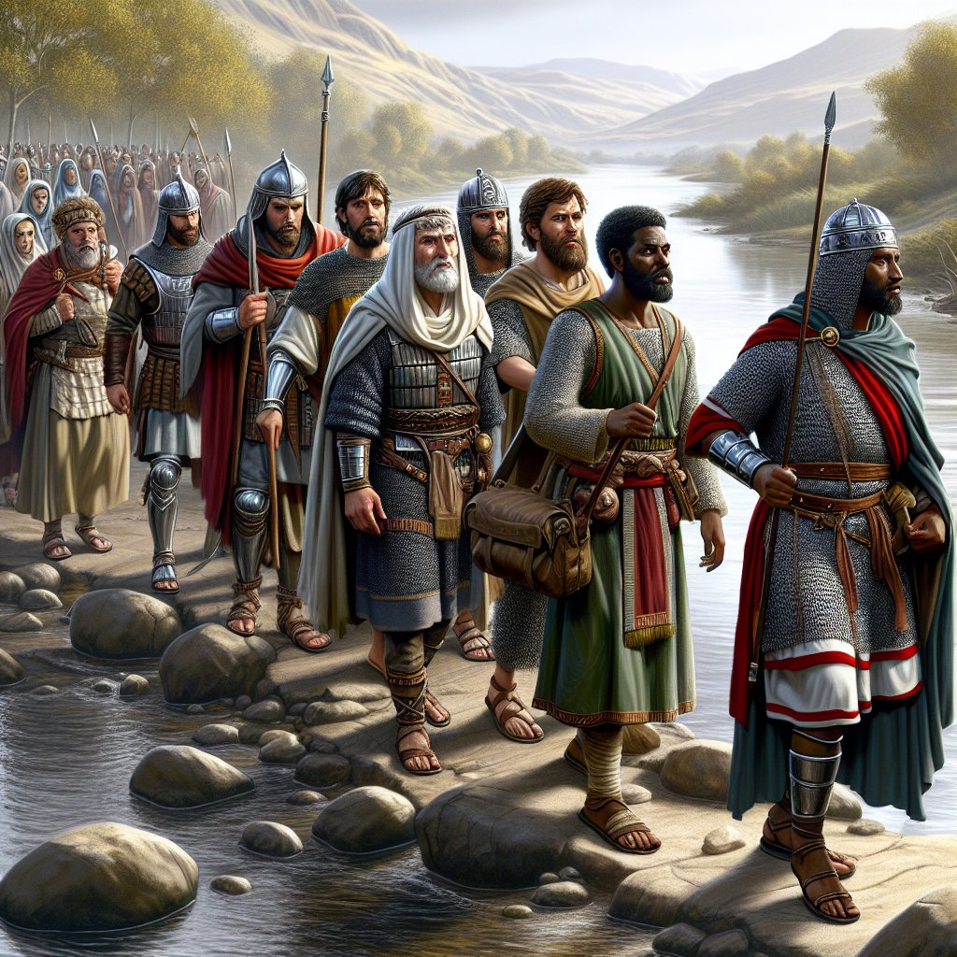
David followed his commander's orders
11 So David and his men got up early in the morning. They went back to the land of the Philistines. And the Philistines went up to Jezreel.
Can you find those cities?

Slide 17
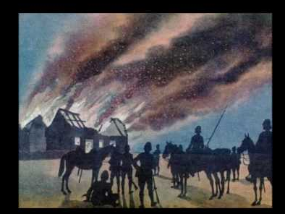
When they got to Ziklag, they were horrified to see…
30 On the third day David and his men arrived in Ziklag. The Amalekites had attacked the people of the Negev Desert. They had also attacked Ziklag and burned it.
2 They had captured the women and everyone else in Ziklag. They had taken as prisoners young people and old people alike. But they didn’t kill any of them. Instead, they carried them off as they went on their way.
3 David and his men reached Ziklag. They saw that it had been destroyed by fire. They found out that their wives and sons and daughters had been captured. 4 So David and his men began to weep out loud. They wept until they couldn’t weep anymore. 5 David’s two wives had been captured. Their names were Ahinoam from Jezreel and Abigail from Carmel. Abigail was Nabal’s widow. 6 David was greatly troubled. His men were even talking about killing him by throwing stones at him. All of them were very bitter because their sons and daughters had been taken away
OH NO!
Our homes and families are gone! What are we going to do?

Slide 18
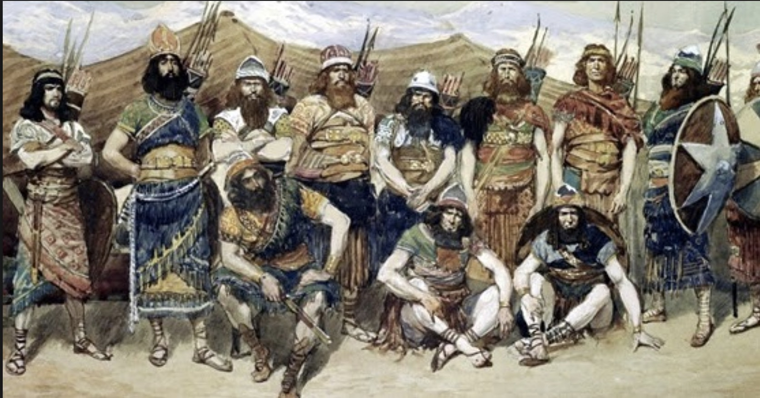
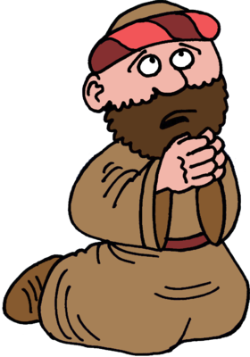
Lord, what shall we do? Shall we pursue them?
Chase after them.
You will succeed in saving those who were captured.
But David was made strong by the Lord his God.
7 Then David spoke to Abiathar the priest, the son of Ahimelek. He said, “Bring me the linen ephod.” Abiathar brought it to him.
8 David asked the Lord for advice. He said, “Should I chase after the men who attacked Ziklag? If I do, will I we catch up with them?”
“Chase after them,” the Lord answered. “You will certainly catch up with them. You will succeed in saving those who were captured.”

Slide 19
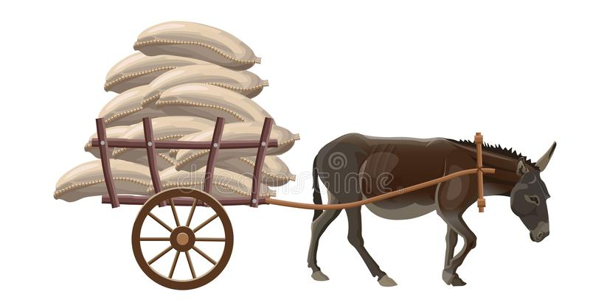
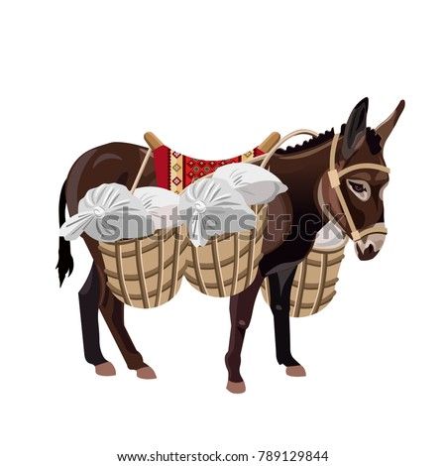
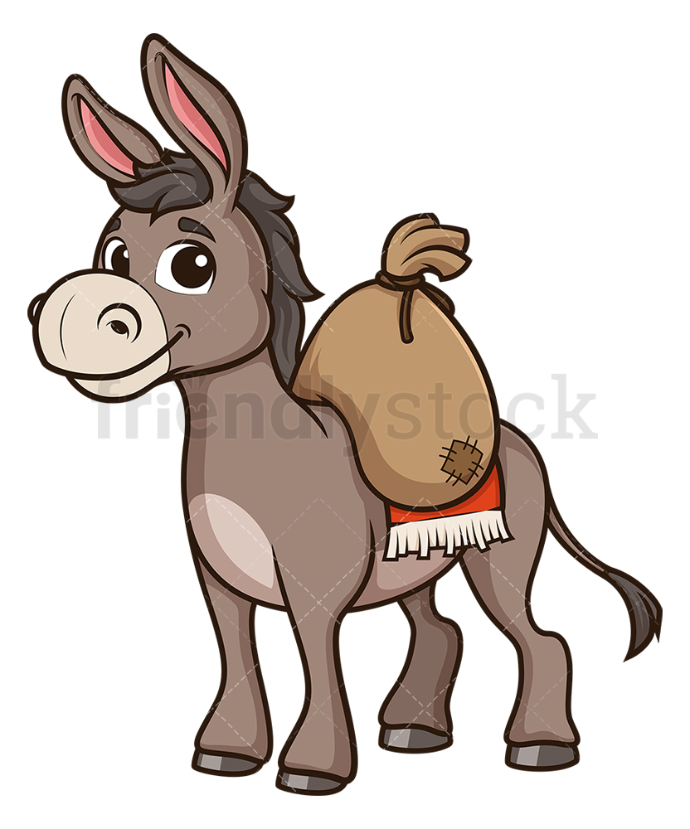
They ran for 3 days! They still hadn’t found them. David’s men were tired.
We’re exhausted! May we stay here?
We’ll watch the stuff while you chase the bandits.
⁹ David and his 600 men came to the Besor Valley. Some of them stayed behind there. ¹⁰ That’s because 200 of them were too tired to go across the valley. But David and the other 400 continued the chase.

Slide 20
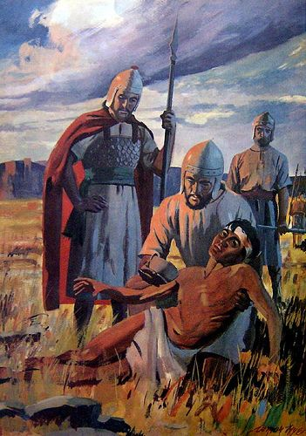
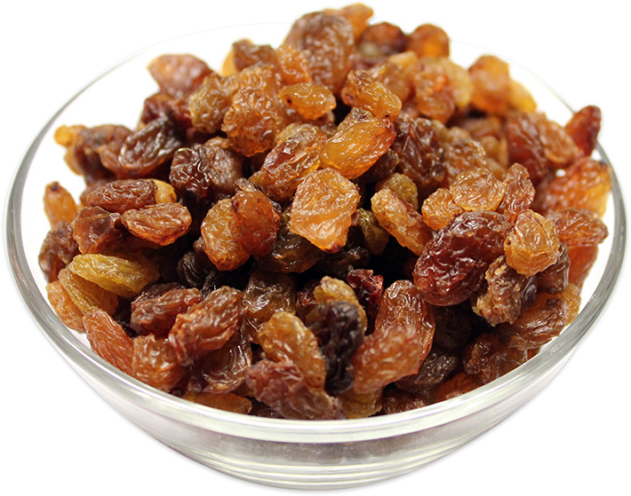
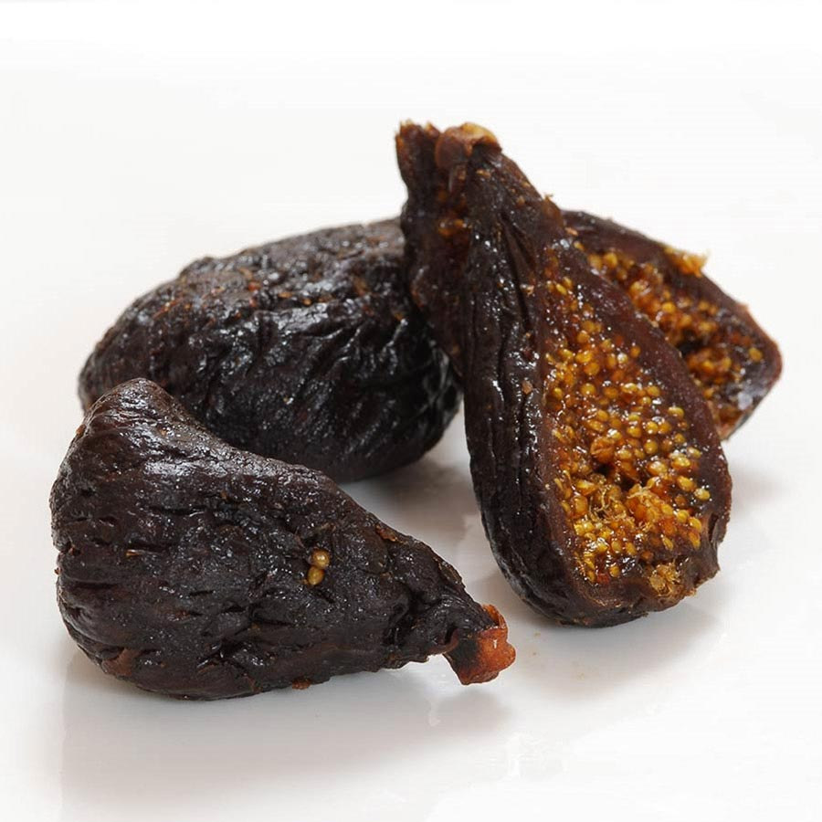
Finally, they found a clue – an Egyptian slave.
Do you know which way the Amalekites went?
¹¹ David’s men found an Egyptian in a field. They brought him to David. They gave him water to drink and food to eat. ¹² They gave him part of a cake of pressed figs. They also gave him two raisin cakes. After he ate them, he felt as good as new. That’s because he hadn’t eaten any food for three days and three nights. He hadn’t drunk any water during that time either.
¹³ David asked him, “Who do you belong to? Where do you come from?”
The man said, “I’m from Egypt. I’m the slave of an Amalekite. My master deserted me when I became ill three days ago. ¹⁴ We attacked the people in the Negev Desert of the Kerethites. We attacked the territory that belongs to Judah. We attacked the people in the Negev Desert of Caleb. And we burned Ziklag.”
¹⁵ David asked him, “Can you lead me down to the men who attacked Ziklag?”
He answered, “Make a promise to me in the name of God. Promise that you won’t kill me. Promise that you won’t hand me over to my master. Then I’ll take you down to them.”
Thank you for the food.
Promise me you won’t kill me nor give me back to my master and I will take you to them.
A man’s heart plans his way,
But the Lord directs his steps.
SNACK TIME

Slide 21
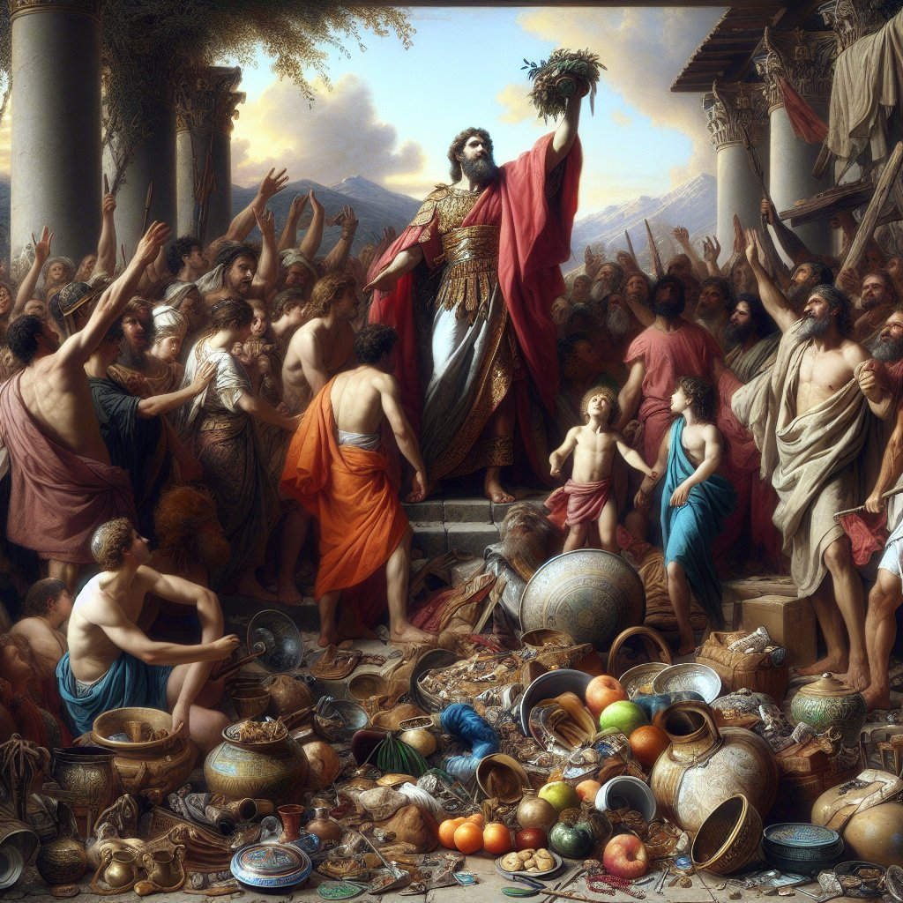
The Amalekites were celebrating… but not for long.
David and his men fought them all day and won!
¹⁶ He led David down to where the men were.
They were scattered all over the countryside. They were eating and drinking and dancing wildly. That’s because they had taken a large amount of goods from those they had attacked. They had taken it from the land of the Philistines and from the people of Judah.

Slide 22
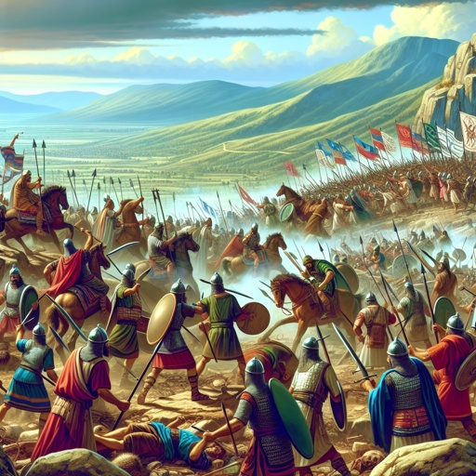
The Amalekites were celebrating… but not for long.
David and his men fought them all day and won!
¹⁷ David fought against them from sunset until the evening of the next day.
None of them escaped except 400 young men. They rode off on camels and got away.

Slide 23
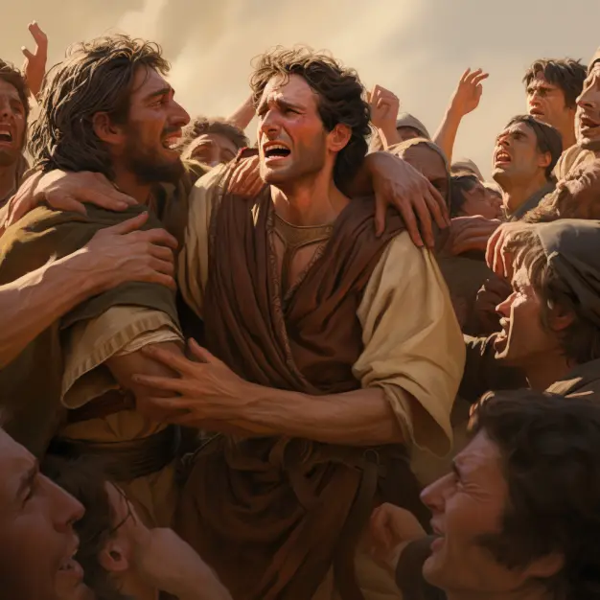
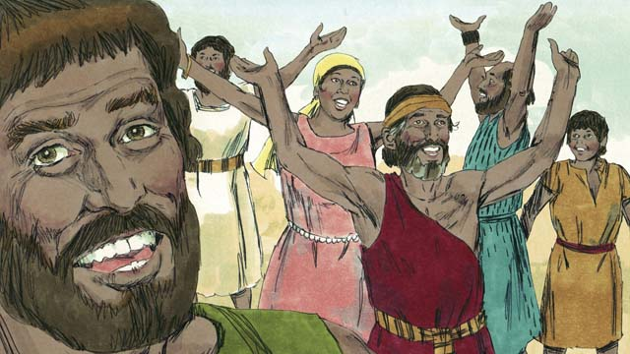
Now David, his men, and their families celebrated!
¹⁸ David got everything back that the Amalekites had taken. That included his two wives. ¹⁹ Nothing was missing. Not one young person or old person or boy or girl was missing. None of the goods or anything else the Amalekites had taken was missing. David brought everything back. ²⁰ He brought back all the flocks and herds. His men drove them on ahead of the other livestock. They said, “Here’s what David has captured.”

Slide 24

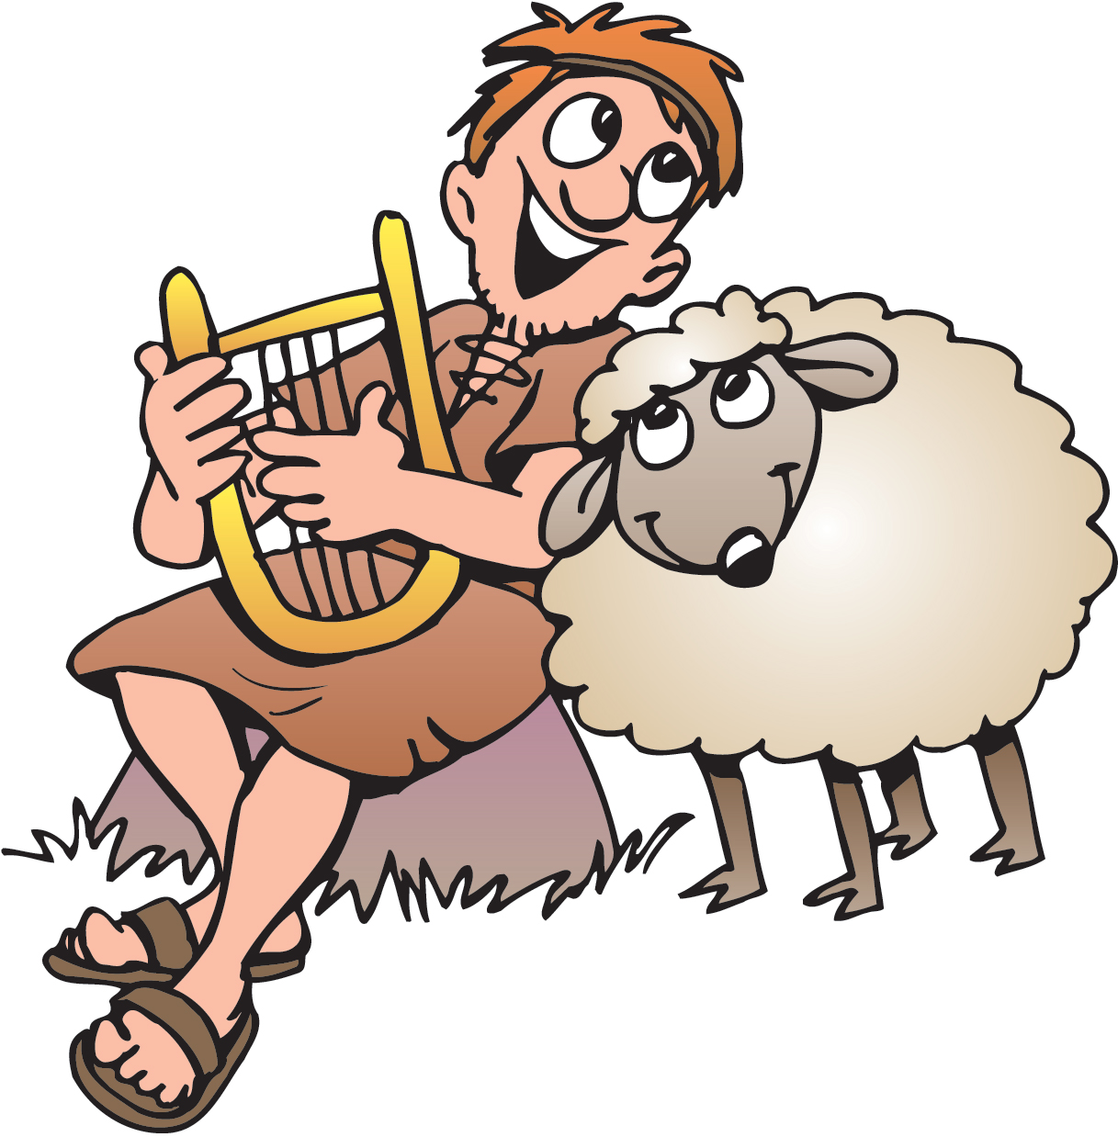
David wrote a song to God:
“Your arm is powerful.
Your hand is strong.
Your right hand is mighty.”
Psalm 89:13

Slide 25
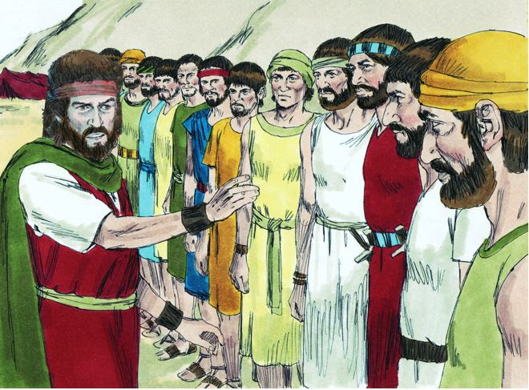
David and his men came back to where the others were.
Who gets the loot?
The Lord has watched over all of us.
He has given us success. We will all share.
Everyone who fought, and
Everyone who watched over our baggage, and
the elders and people of Judah who have supported us, as an offering to God -- all will receive a portion of our profits (the loot).
21 Then David came to the 200 men who had been too tired to follow him. They had been left behind in the Besor Valley. They came out to welcome David and the men with him. As David and his men approached, he asked them how they were. 22 But some of the men who had gone out with David were evil. They wanted to stir up trouble. They said, “The 200 men didn’t go out into battle with us. So we won’t share with them the goods we brought back. But each man can take his wife and children and go home.”
23 David replied, “No, my friends. You must not hold back their share of what the Lord has given us. He has kept us safe. He has handed over to us the men who attacked us. 24 So no one will pay any attention to what you are saying. Each man who stayed with the supplies will receive the same share as each man who went down to the battle. Everyone’s share will be the same.” 25 David made that a law and a rule for Israel. It has been followed from that day until now.
26 David reached Ziklag. He sent some of the goods to the elders of Judah. They were his friends. He said, “Here’s a gift for you. It’s part of the things we took from the Lord’s enemies.”
27 David sent some goods to the elders in Bethel, Ramoth Negev and Jattir. 28 He sent some to the elders in Aroer, Siphmoth, Eshtemoa 29 and Rakal. He sent some to the elders in the towns of the Jerahmeelites and Kenites. 30 He sent some to the elders in Hormah, Bor Ashan, Athak 31 and Hebron. He also sent some to the elders in all the other places where he and his men had wandered around.

Slide 26
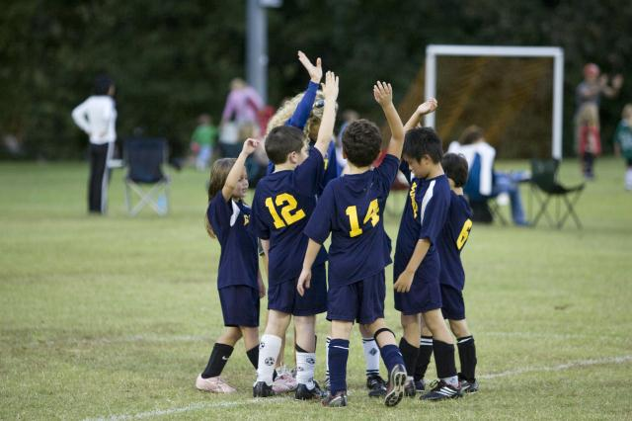
We are a team
We all work together.
Everyone does what they can.
We all share in the rewards.

Slide 27
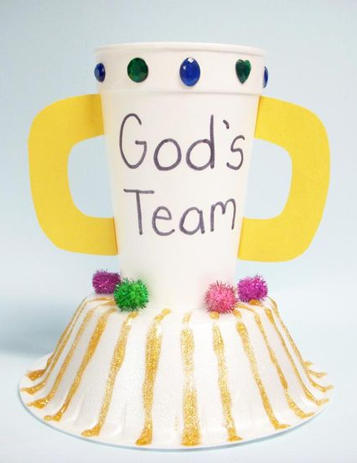
God’s Team Wins
Make a trophy
Styrofoam cup (glue on top of bowl)
Styrofoam bowl
Jewels (put around top of cup)
Pom pom balls (glue on top of bowl)
Glitter glue (decorate bowl and write “God’s Team on cup)
Paper cardstock – make handles for cup

Slide 29
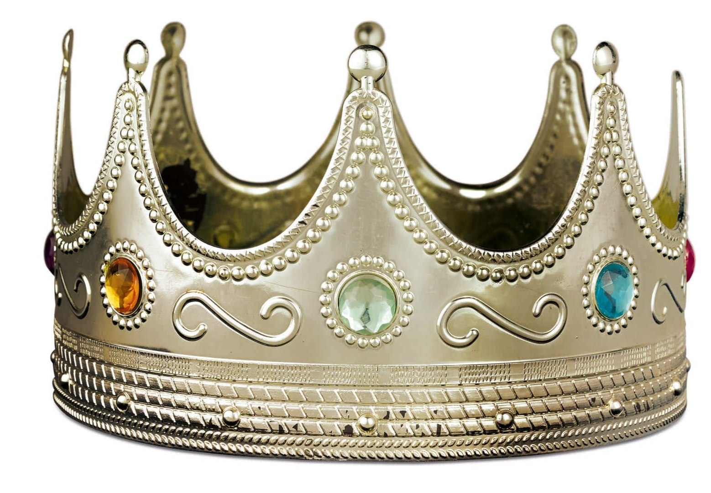
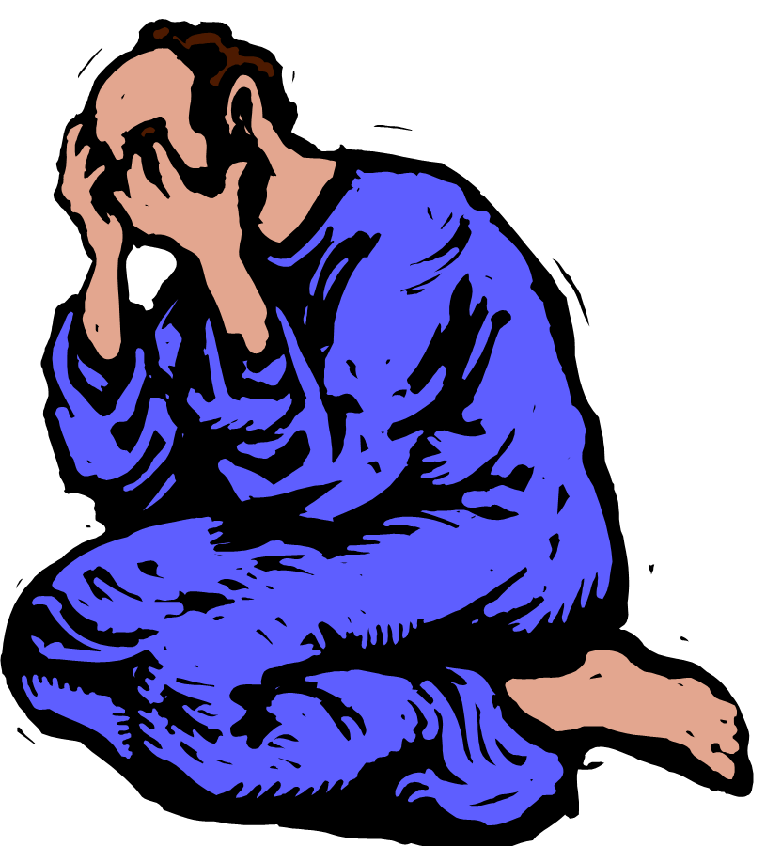
What about the other battle? Did the Israelites win?
31 The Philistines fought against the Israelites. The Israelites ran away from them. But many Israelites were killed on Mount Gilboa. 2 The Philistines kept chasing Saul and his sons. They killed his sons Jonathan, Abinadab and Malki-Shua. 3 The fighting was heavy around Saul. Men who were armed with bows and arrows caught up with him. They shot their arrows at him and wounded him badly….
So Saul took his own sword and fell on it. … 6 Saul and his three sons died together that same day. The man who carried his armor also died with them that day. So did all of Saul’s men….
11 Then David tore his clothes. And all his men tore their clothes. 12 All of them were filled with sadness. They mourned over the whole nation of Israel. They didn’t eat anything until evening. That’s because Saul and Jonathan and the Lord’s army had been killed by swords.
David became king after that, but that’s another story. David waited for God to make him king in HIS time.

Slide 30

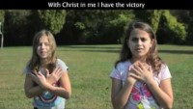
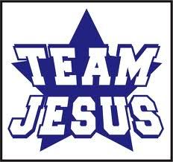
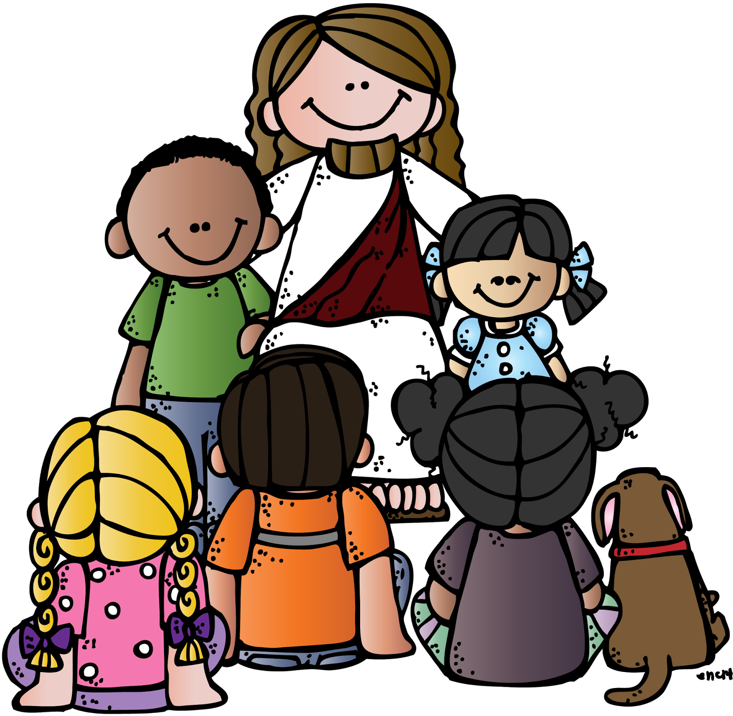

Slide 31


Slide 32
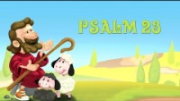

Slide 33
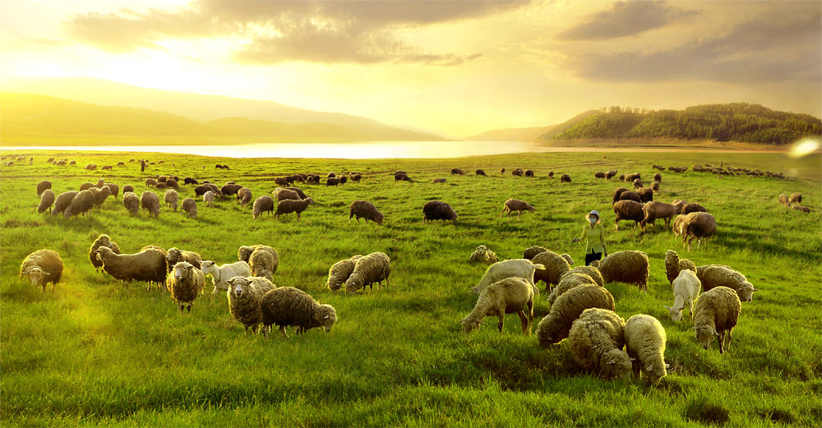
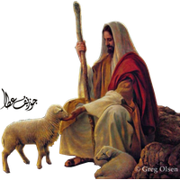
Yea, though I walk through the valley of the shadow of death,
I will fear no evil;
For You are with me;
23 The Lord is my shepherd;
I shall not want.
² He makes me to lie down in ]green pastures;
He leads me beside the still waters.
³ He restores my soul;
He leads me in the paths of righteousness
For His name’s sake.
⁴ Yea, though I walk through the valley of the shadow of death,
I will fear no evil;
For You are with me;
Your rod and Your staff, they comfort me.
⁵ You prepare a table before me in the presence of my enemies;
You anoint my head with oil;
My cup runs over.
⁶ Surely goodness and mercy shall follow me
All the days of my life;
And I will dwell in the house of the Lord
Forever.

Slide 34
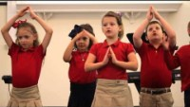

Slide 35

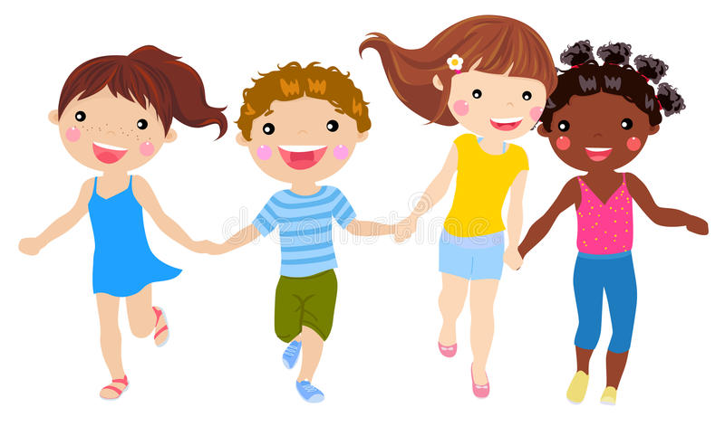

Slide 36
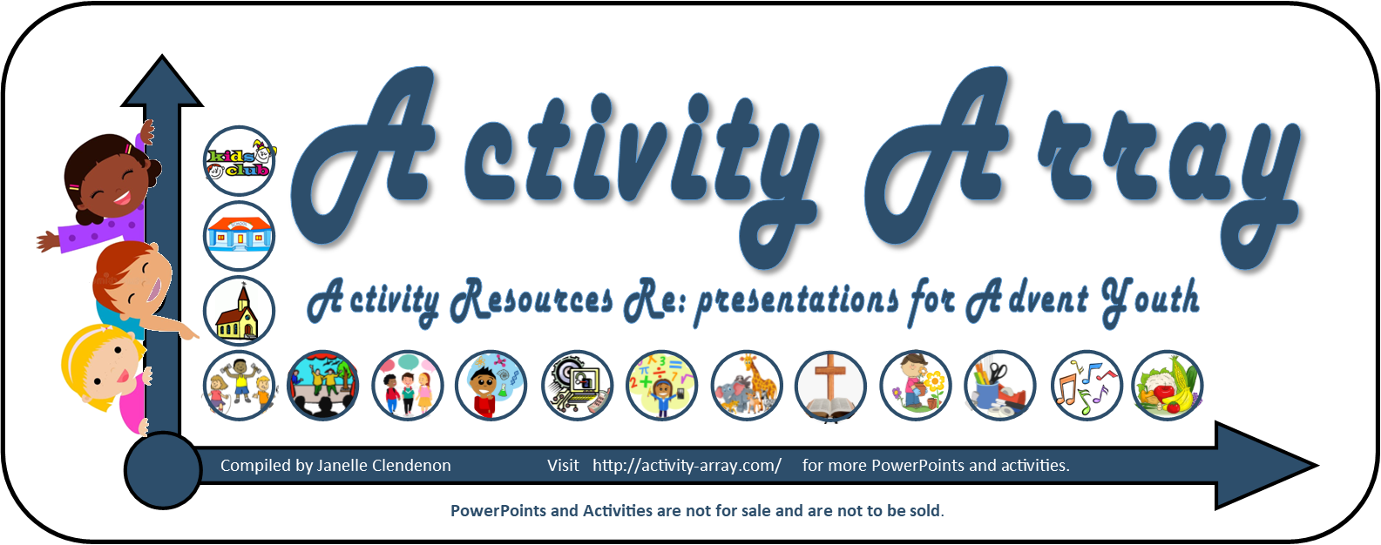
The End

Slide 37
EXTRA --- EXTRA to use if you wish…

Slide 38
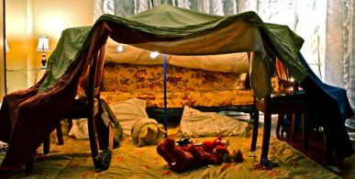
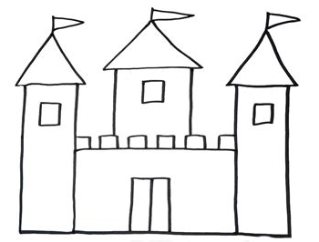
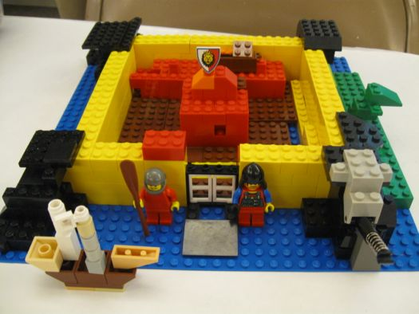
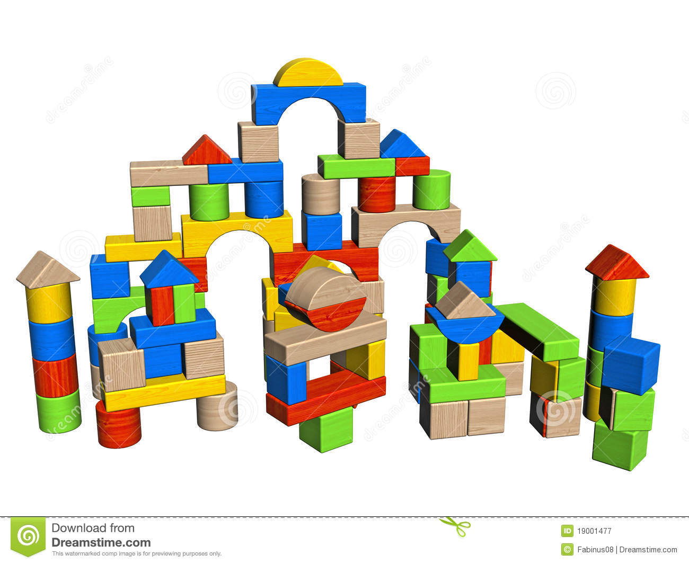
Team Activity option 1
Everyone work together
Choose something to do with your family or table mates:
Build a fort with:
blankets
Legos or
Blocks
Paper (draw 4 sides and fasten them together to make a stand-up fort)

Slide 39
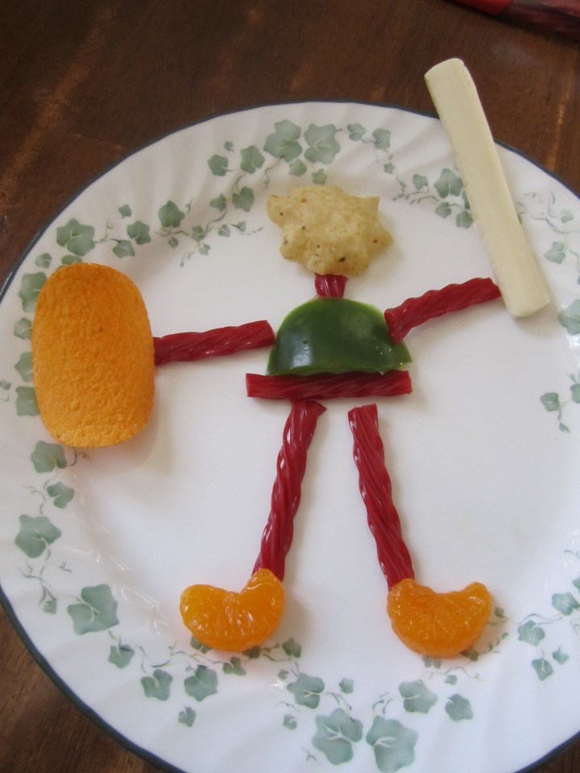
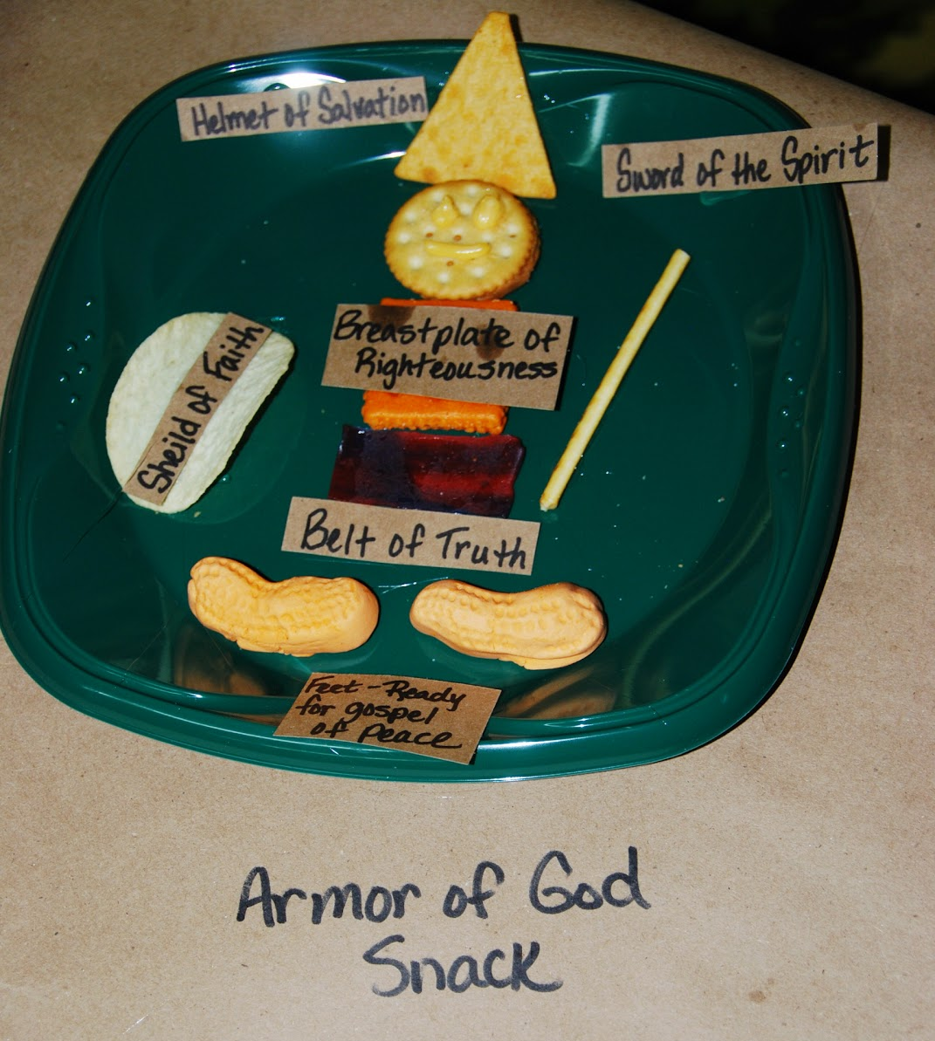
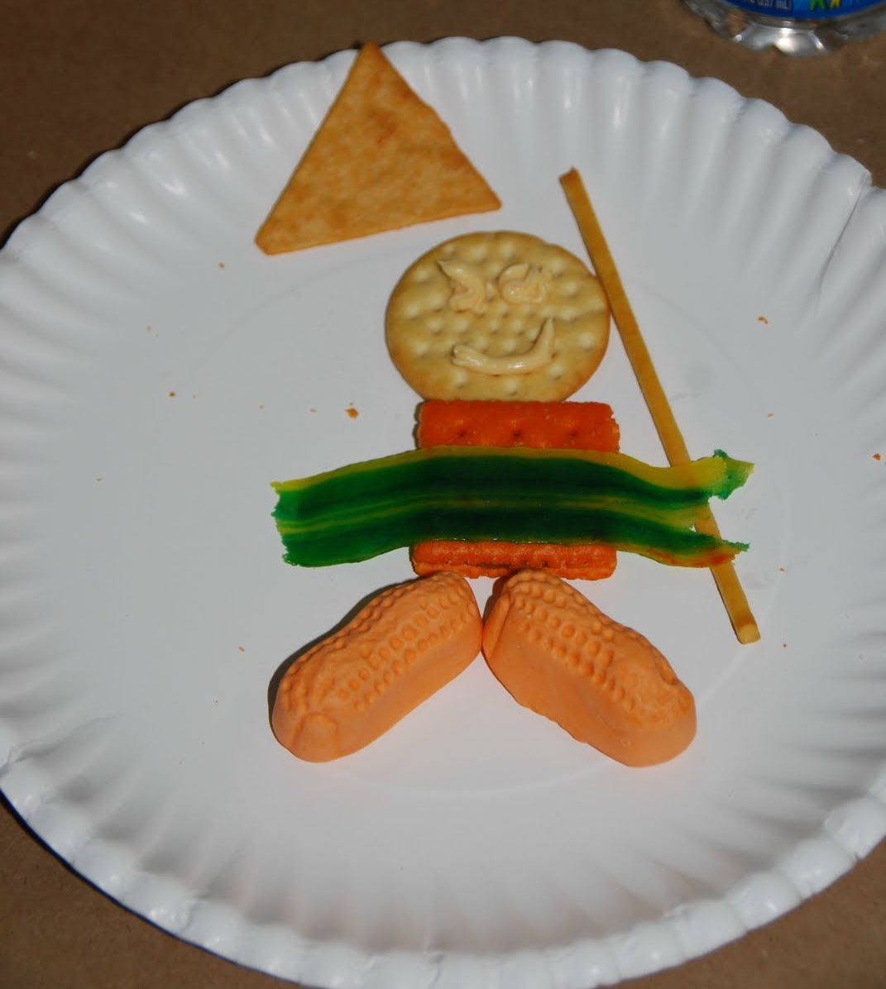
Team Activity option 2
Everyone work together
Choose something to do with your family or table mates:
Build a puzzle
Build a snack soldier

Slide 40
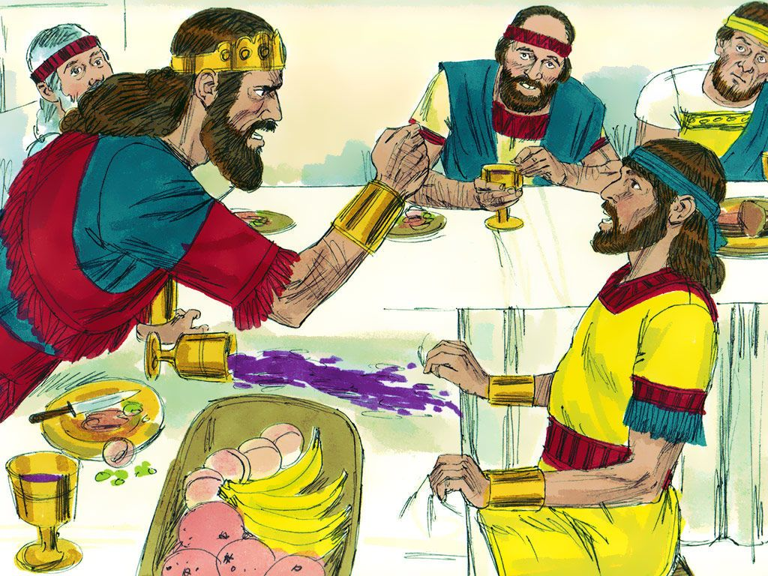



You should know that ….
King Saul was so jealous of David that he almost killed David again and again.

Slide 41


I wish I could tell you about….
How David respected King Saul and saved him again and again when he could have killed him .

Slide 42







I wish I could tell you about….
How David was respected.
And how many became his friends and saved him.

Slide 43

Story When God wins, we are winnwers!

