Slide 1
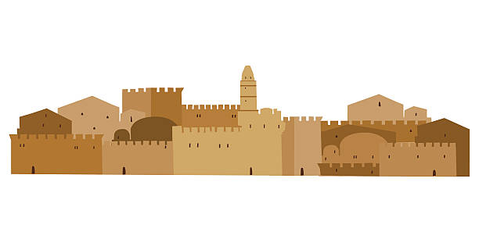

A Crown and
A City for David
2 Samuel 5

Slide 2

Have you ever had to wait and wait and wait for something?
Maybe it was something that your parents promised you.
What did you wait for?

Slide 3
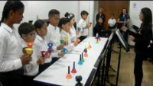
Today we’re going to talk about waiting.
When I played the bells, we had to wait our turn and play at the right time, so the song sounded good. Like this:

Slide 4
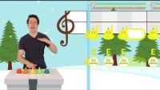
On a piece of paper make these color circles:
Pretend to play the bell at the right time.

Slide 5


Wait for the Lord; be strong and take heart and wait for the Lord.
FIND IT
Psalms 27:14

Slide 6
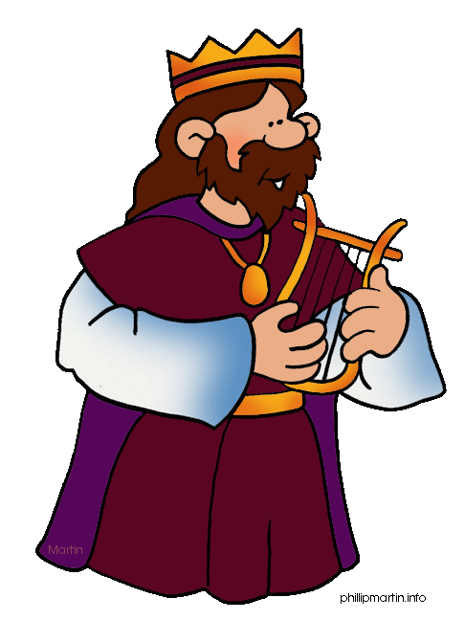
A Crown for David

Slide 7


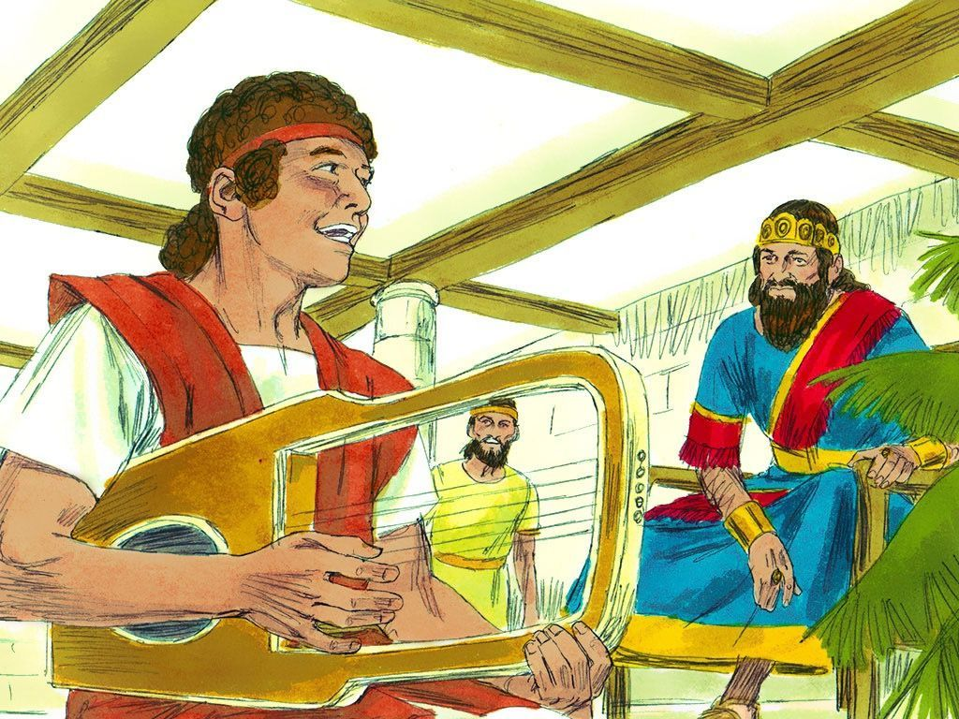
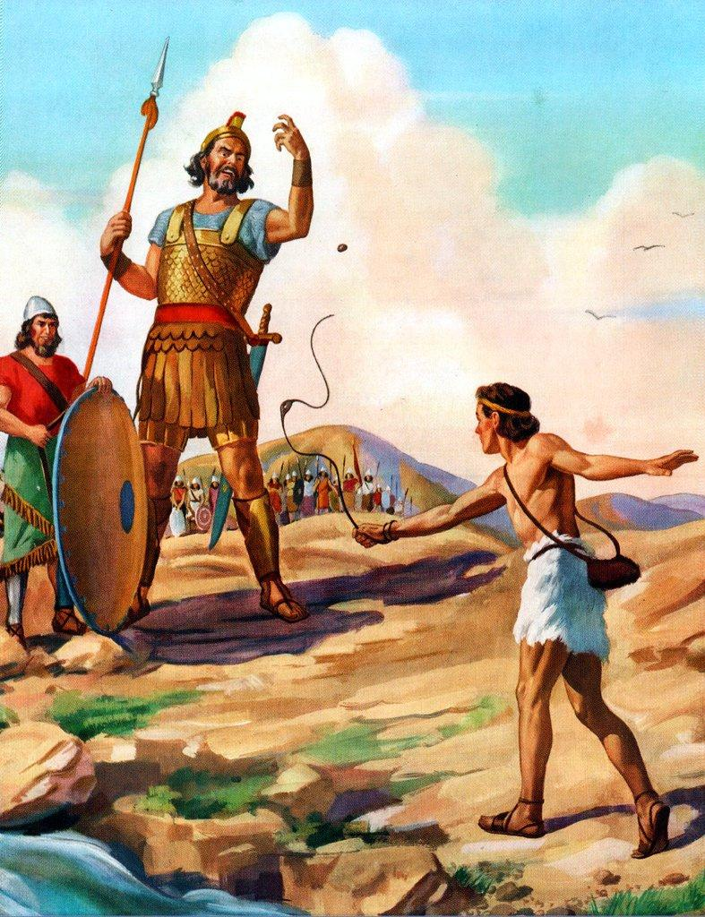
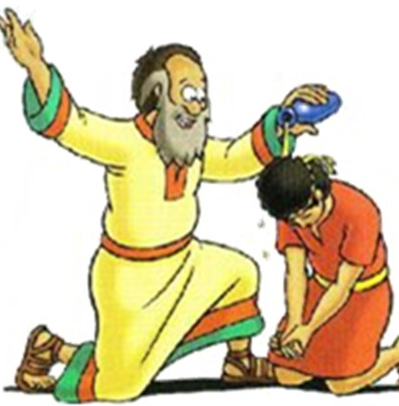
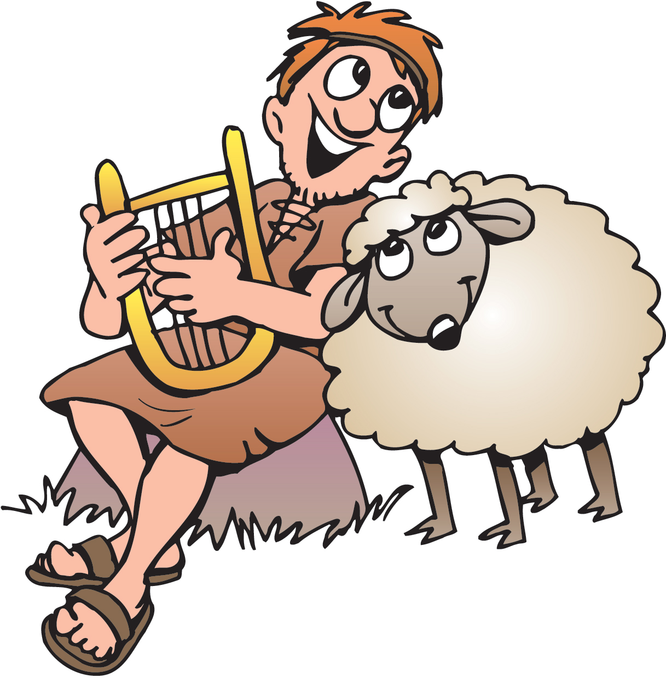
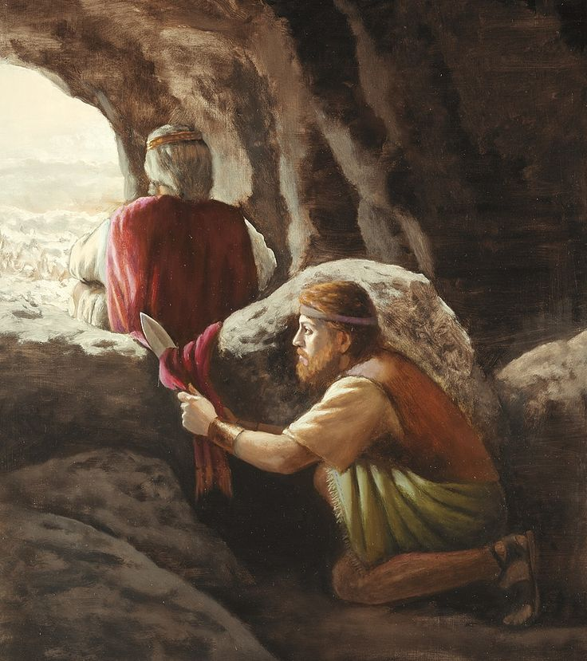
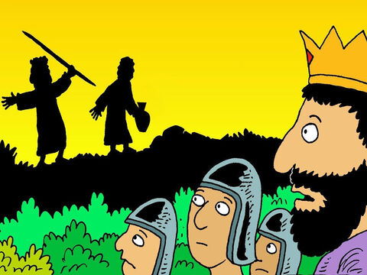
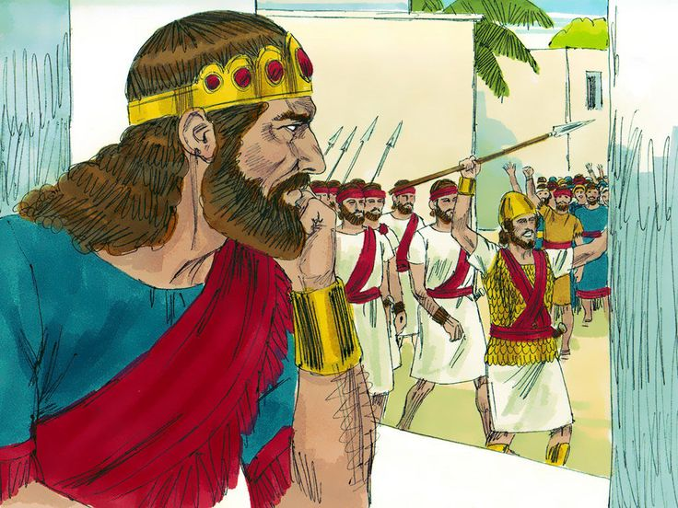
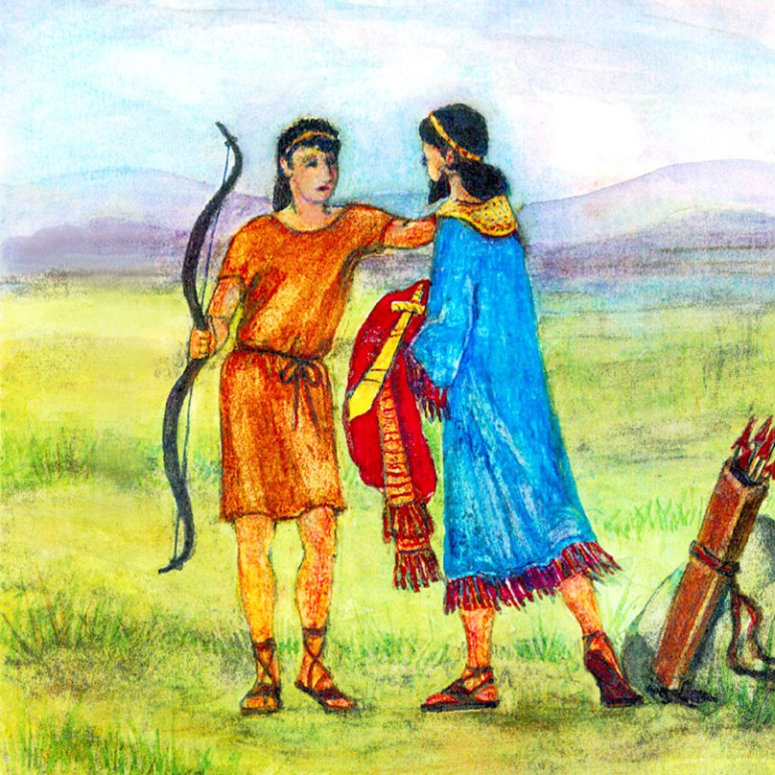
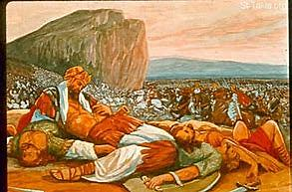
Is it time?
The story
Of David
David played harp for Saul.
David was chosen to be king some day.
David was a shepherd
David killed Goliath.
David could have killed Saul but didn’t. 1 Samuel 24
Jonathan gave David his bow, sword, prince clothing and they pledged friendship.
David could have killed Saul but didn’t. 1 Samuel 26
David was commander of army
Saul grew jealous.
When Saul and Jonathan died in battle?
NO
Not yet
David waited
To be king?

Slide 8

David waited for God. He waited for the people to be ready.
Wait for the Lord;
be strong and take heart
and wait for the Lord.

Slide 9
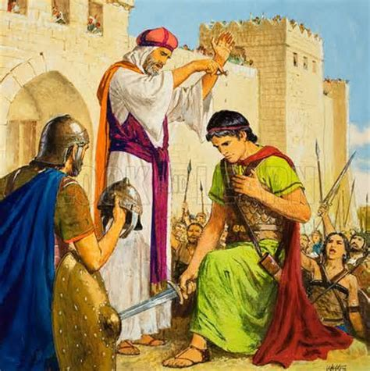
David is Crowned King
You are one of our family.
God chose you to be king long ago.
We anoint you king over Israel
Saul and Jonathan died in a terrible war.
2 Samuel 5
5 All the tribes of Israel came to David at Hebron and said, “We are your own flesh and blood. ² In the past, while Saul was king over us, you were the one who led Israel on their military campaigns. And the Lord said to you, ‘You will shepherd my people Israel, and you will become their ruler.’”
³ When all the elders of Israel had come to King David at Hebron, the king made a covenant with them at Hebron before the Lord, and they anointed David king over Israel.
You have led our army to win many wars.
With God’s help, as your king,
I will protect you.
I will make fair judgements.

Slide 10

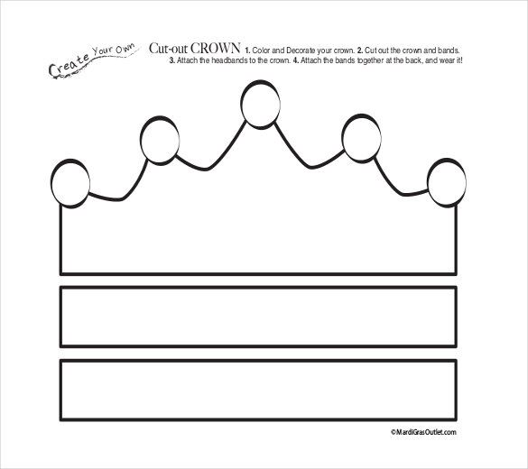
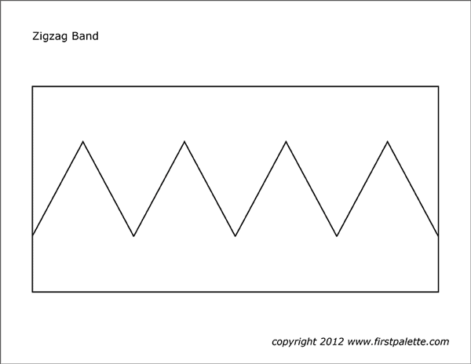
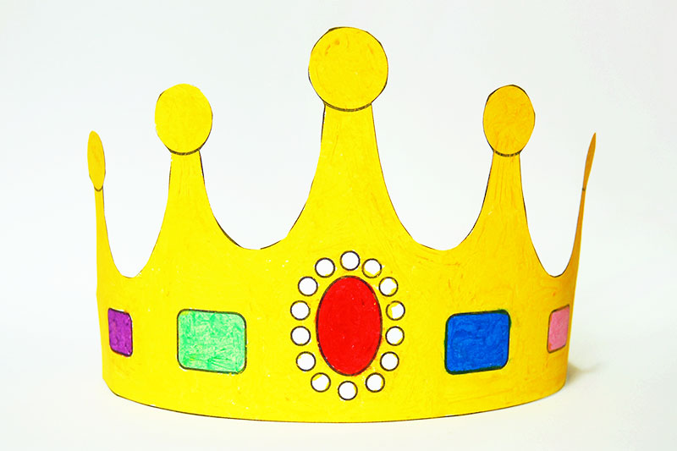
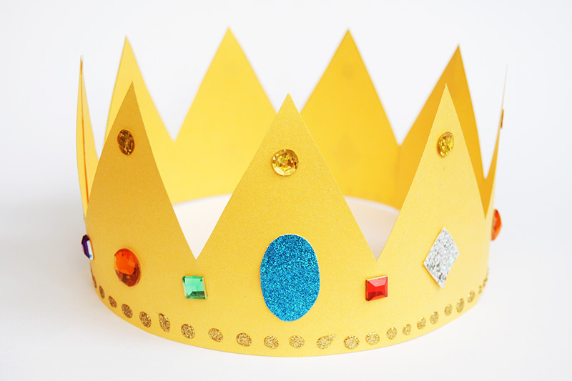
Craft Time – Make a Crown
(or purchase one or get one from Burger King)
Crown template from AllBusinessTemplates.com

Slide 11
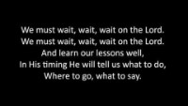
Sing – Wait, Wait, wait
Wait on the Lord

Slide 12
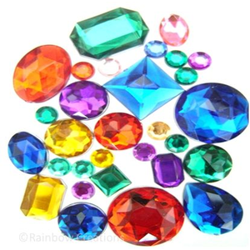
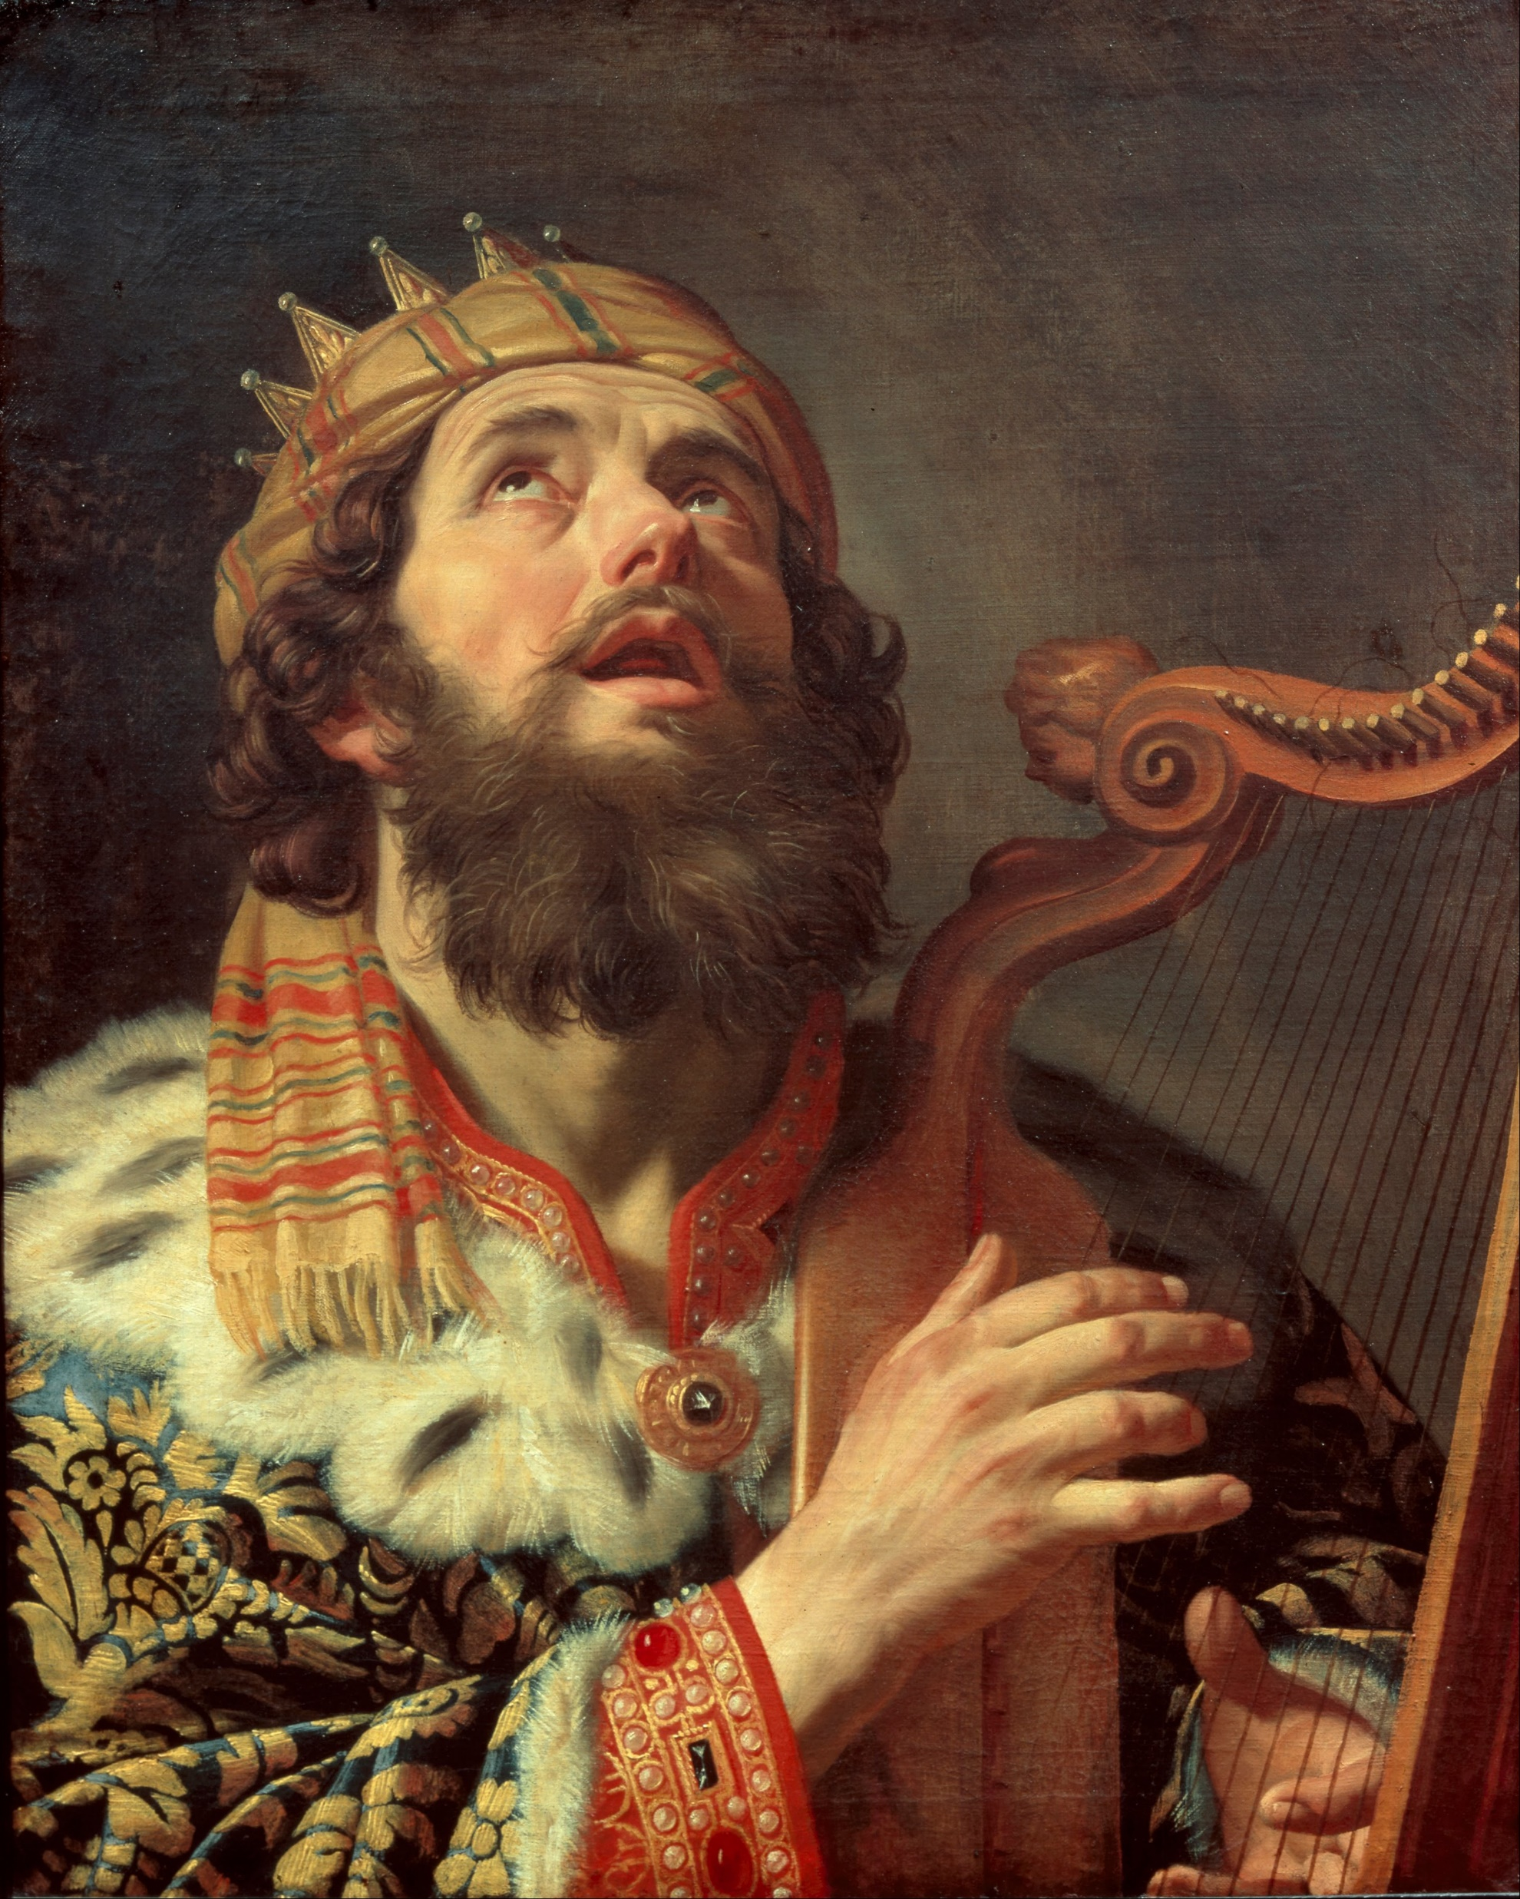
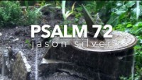
Craft Time – Decorate a Crown and listen

Slide 13

Craft Time – Decorate a Crown and listen to our story

Slide 14
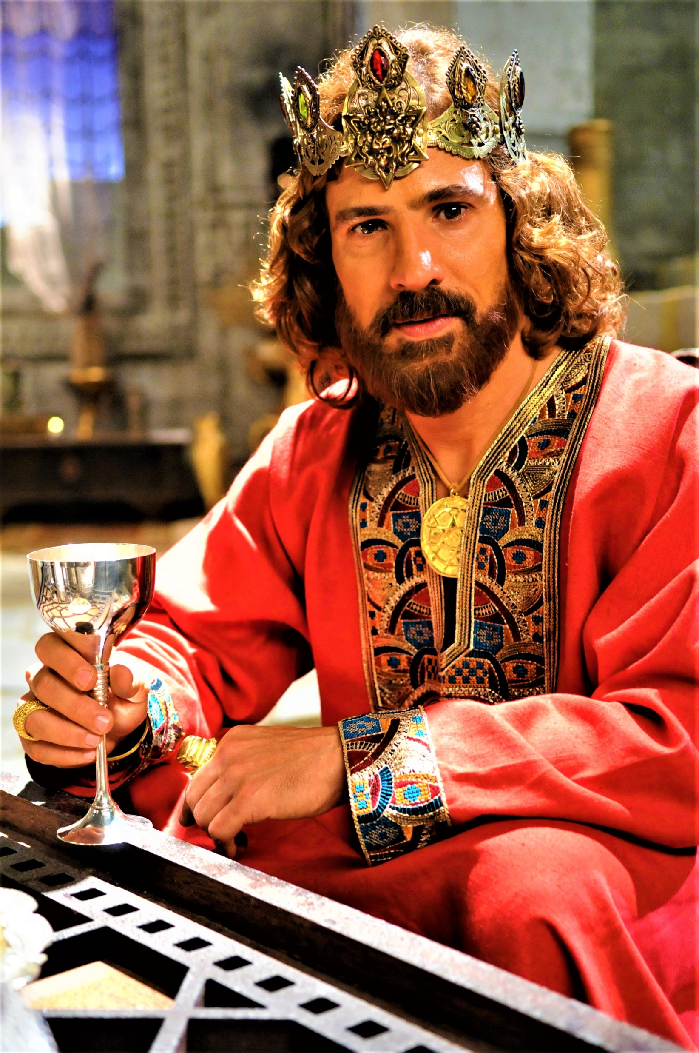

King David
^{2 Samuel 5:4} David was thirty years old when he became king, and he reigned forty years. ⁵ In Hebron he reigned over Judah seven years and six months, and in Jerusalem he reigned over all Israel and Judah thirty-three years.
7 ½
+ 33

Slide 15
A City for David

Slide 16
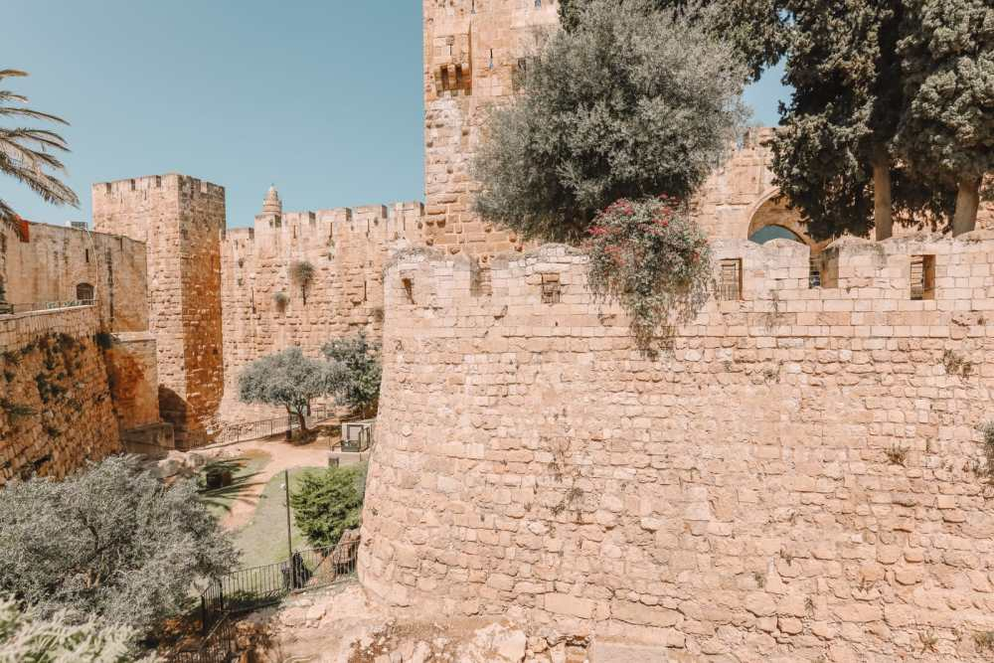
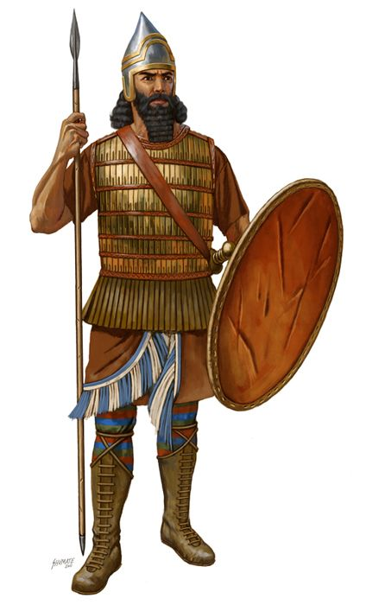
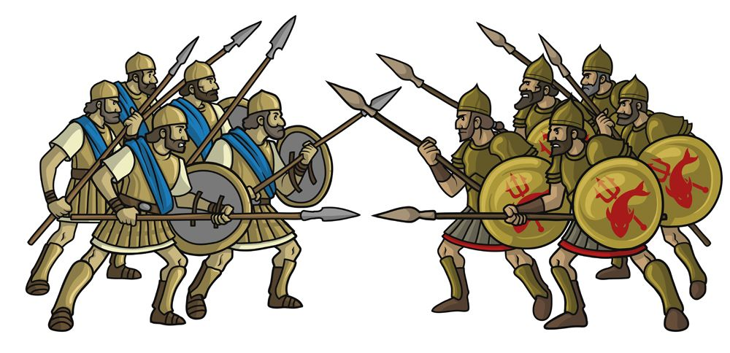
Jerusalem – a Strong Fort
You will not get in here!
Our walls are strong!
⁶ The king and his men marched to Jerusalem to attack the Jebusites, who lived there. The Jebusites said to David, “You will not get in here; even the blind and the lame can ward you off.” They thought, “David cannot get in here.” ⁷ Nevertheless, David captured the fortress of Zion—which is the City of David.
Ha! Even the lame and blind can ward you off!
Come on men.
I know a way in.

Slide 17
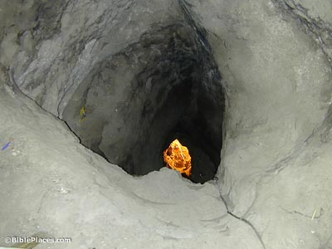
David Conquers Jerusalem by going up the water shaft!
David knew a secret way into the city.
He didn’t go up the steep road.
He didn’t climb the steep walls or build ramparts.
He went up a shaft that took water up to the city.
⁸ On that day David had said, “Anyone who conquers the Jebusites will have to use the water shaft to reach those ‘lame and blind’ who are David’s enemies.^{[a]}” That is why they say, “The ‘blind and lame’ will not enter the palace.”
DO IT
Line up a bunch of chairs;
Go under them like a tunnel.

Slide 18
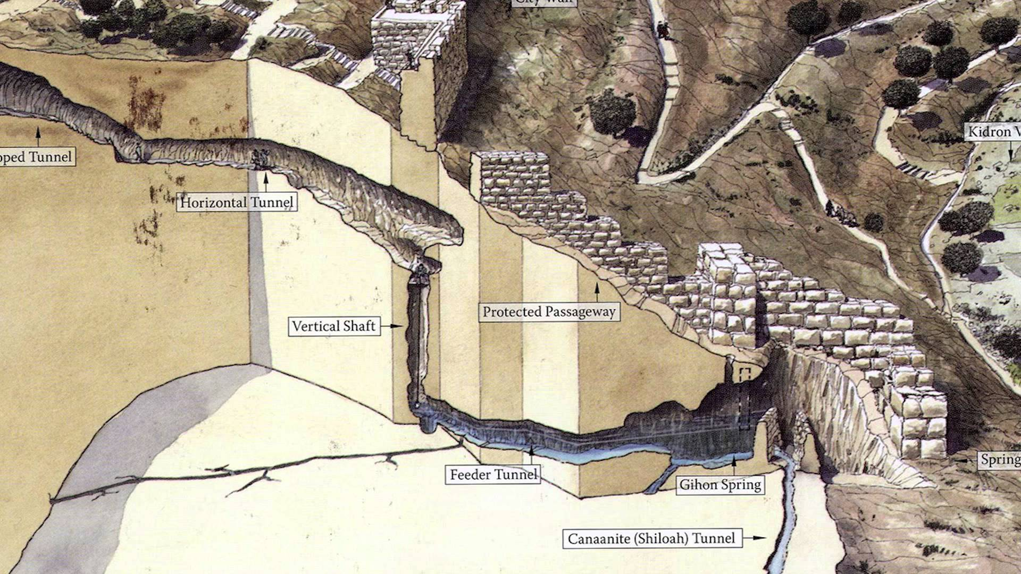
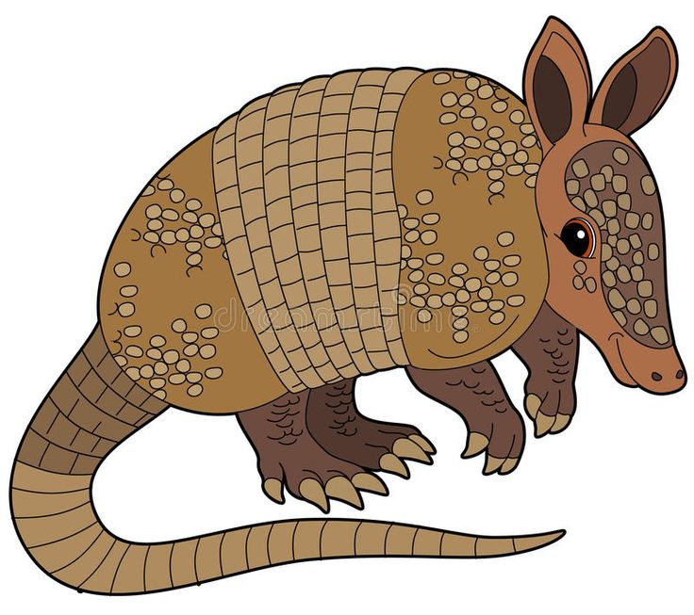
Who will go up the dangerous water shaft?
^{1 Chronicles 11:6} David had said, “Whoever leads the attack on the Jebusites will become commander-in-chief.” Joab son of Zeruiah went up first, and so he received the command.

Slide 19
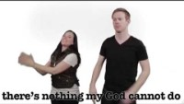
Sing – My God is So Great So Strong and So Mighty

Slide 20
David trusted and praised God!
I love you, Lord, my strength.
² The Lord is my rock, my fortress and my deliverer;
my God is my rock, in whom I take refuge,
my shield^{[b]} and the horn^{[c]} of my salvation, my stronghold.
³ I called to the Lord, who is worthy of praise,
and I have been saved from my enemies….
¹⁶ He reached down from on high and took hold of me;
he drew me out of deep waters.
¹⁷ He rescued me from my powerful enemy,
from my foes, who were too strong for me….
²⁸ You, Lord, keep my lamp burning;
my God turns my darkness into light.
²⁹ With your help I can advance against a troop^{[e]};
with my God I can scale a wall.
³⁰ As for God, his way is perfect:
The Lord’s word is flawless;
he shields all who take refuge in him.
³¹ For who is God besides the Lord?
And who is the Rock except our God?
³² It is God who arms me with strength
and keeps my way secure.
³³ He makes my feet like the feet of a deer;
he causes me to stand on the heights.
³⁴ He trains my hands for battle;
my arms can bend a bow of bronze.
³⁵ You make your saving help my shield,
and your right hand sustains me;…
⁴⁶ The Lord lives! Praise be to my Rock!
Exalted be God my Savior!
⁴⁷ He is the God who avenges me,
who subdues nations under me,
⁴⁸ who saves me from my enemies.
You exalted me above my foes;
from a violent man you rescued me.
⁴⁹ Therefore I will praise you, Lord, among the nations;
I will sing the praises of your name.
⁵⁰ He gives his king great victories;
he shows unfailing love to his anointed,
to David and to his descendants forever.
Let’s read what David wrote in Psalms 18:28-35
and Psalms 18:46-48

Slide 21
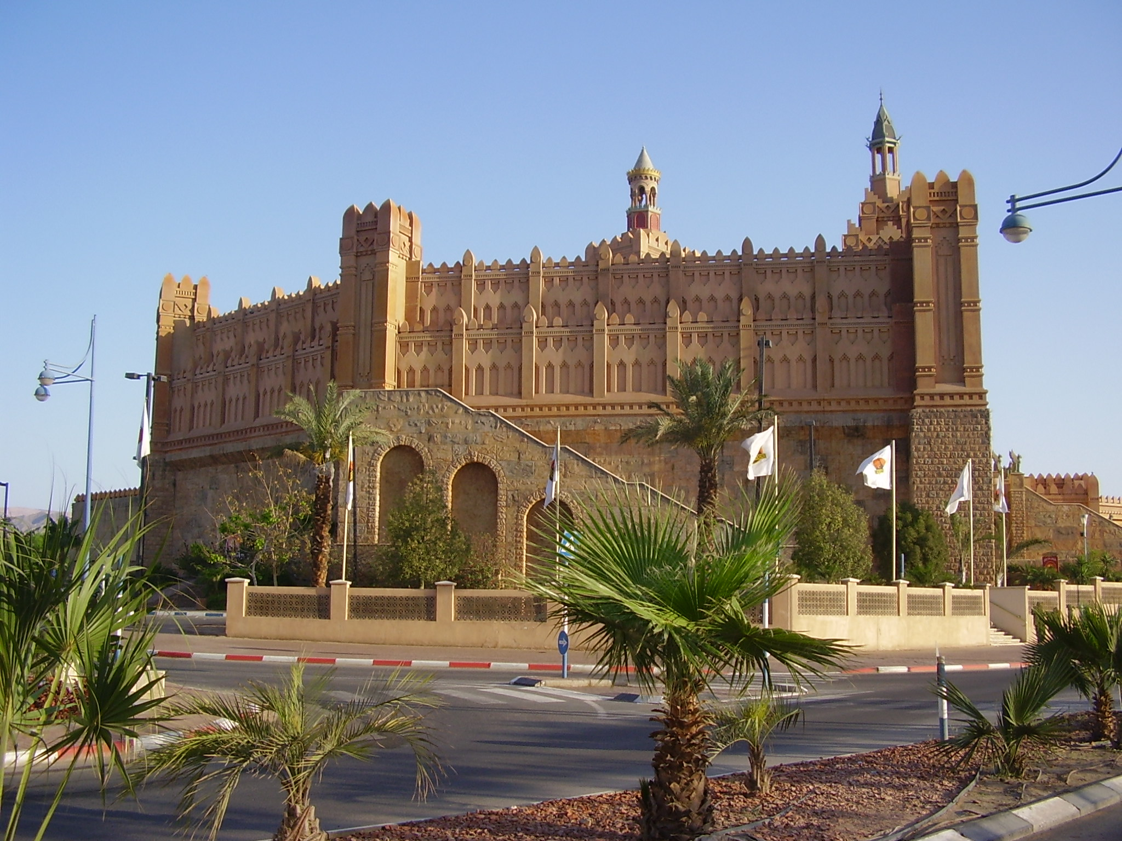
David Built a Palace
2 Samuel 5:⁹ David then took up residence in the fortress and called it the City of David. He built up the area around it, from the terraces^{[b]} inward. ¹⁰ And he became more and more powerful, because the Lord God Almighty was with him.
¹¹ Now Hiram king of Tyre sent envoys to David, along with cedar logs and carpenters and stonemasons, and they built a palace for David. ¹² Then David knew that the Lord had established him as king over Israel and had exalted his kingdom for the sake of his people Israel.
DO IT
Build a palace
Or draw a picture
Optional Craft A
https://www.mommymadethat.com/build-a-castle-craft/
Optional craft B
https://dyethrive.com/paper-craft-castle-model/

Slide 22
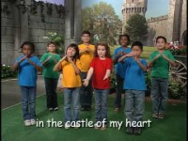
Sing –
There’s a Flag Flying High

Slide 23
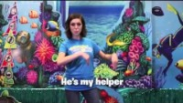
Sing – The Lord is my Strength and my Shield

Slide 24
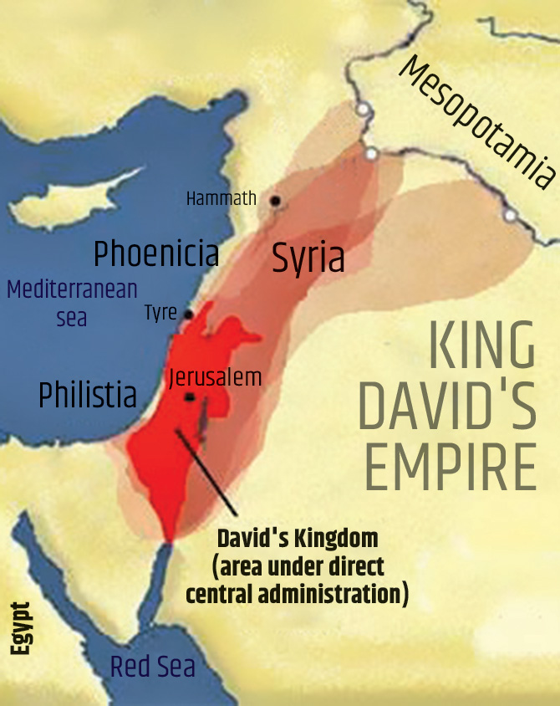
God Establishes David’s Kingdom

Slide 25
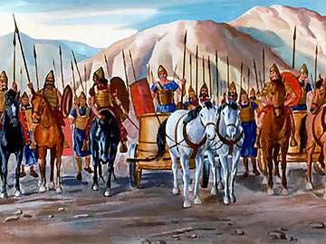
God helped King David Conquer His Enemies
¹⁷ When the Philistines heard that David had been anointed king over Israel, they went up in full force to search for him,
but David heard about it and went down to the stronghold. ¹⁸ Now the Philistines had come and spread out in the Valley of Rephaim; ¹⁹ so David inquired of the Lord, “Shall I go and attack the Philistines? Will you deliver them into my hands?”
The Lord answered him, “Go, for I will surely deliver the Philistines into your hands.”
²⁰ So David went to Baal Perazim, and there he defeated them. He said, “As waters break out, the Lord has broken out against my enemies before me.” So that place was called Baal Perazim.^{[c]} ²¹ The Philistines abandoned their idols there, and David and his men carried them off.

Slide 26
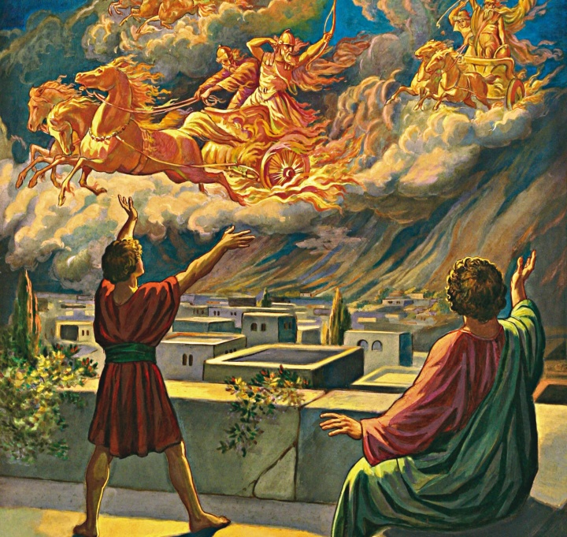
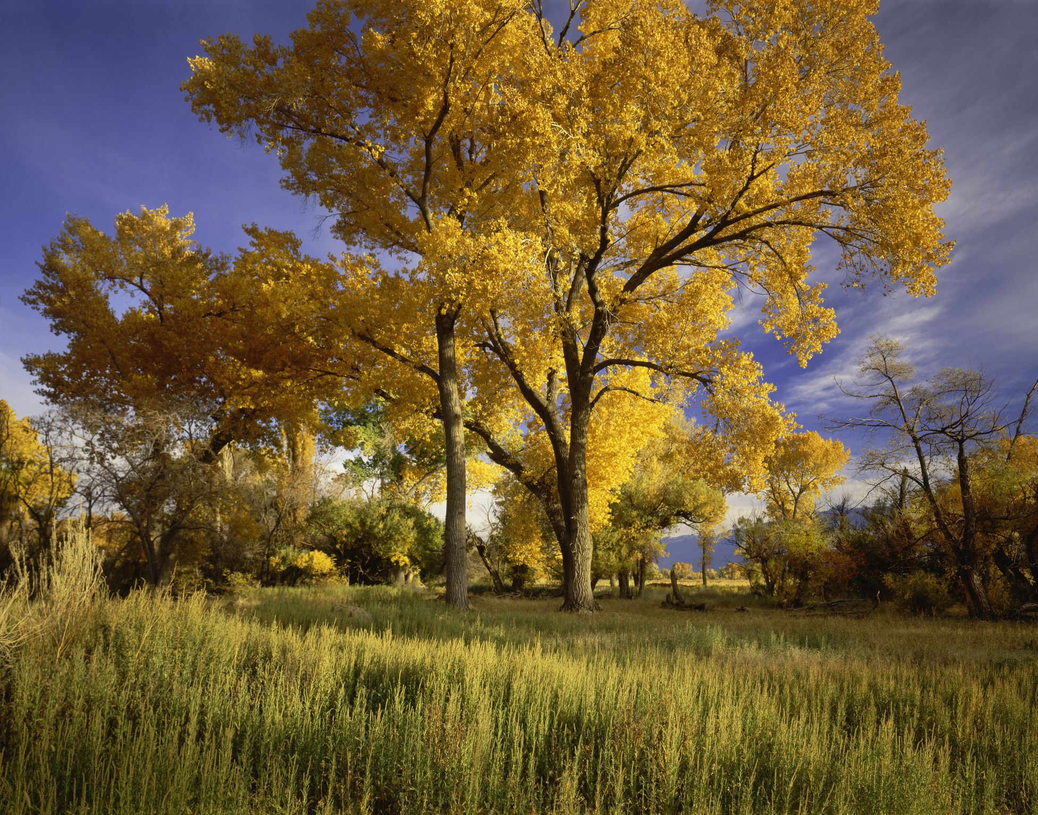
God Wins!
²² Once more the Philistines came up and spread out in the Valley of Rephaim; ²³ so David inquired of the Lord, and he answered, “Do not go straight up, but circle around behind them and attack them in front of the poplar trees. ²⁴ As soon as you hear the sound of marching in the tops of the poplar trees, move quickly, because that will mean the Lord has gone out in front of you to strike the Philistine army.”
²⁵ So David did as the Lord commanded him, and he struck down the Philistines all the way from Gibeon^{[d]} to Gezer.
Make sound of marching feet
God is the commander.
The battle is the Lord’s!
David asked God what the plan was!

Slide 27
Trust God
God will keep His promises What did He promise David?
You will be king
God will give us what we need What did God give David?
A crown, a kingdom, and a capitol city (Jerusalem)
God wins! Do not be afraid. How did God win the battles?
He made David strong and surprised the enemy
God’s timing is perfect. Did David trust God’s timing?
Yes he did!

Slide 28
Sing – My God is So Great So Strong and So Mighty

Slide 29
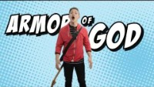
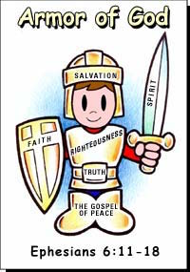
Sing – Put on the Full Armor of God

Slide 30

Nature Nugget – OWLs
This owl is waiting patiently for just the right time to….

