Slide 1

Welcome to Pathfinders
Club Meeting or Event
Intro

Slide 2

Pledge of Allegiance All
I pledge allegiance
to the flag of the United States of America,
and to the republic for which it stands,
one nation under God, indivisible,
with liberty and justice for all.

Slide 3
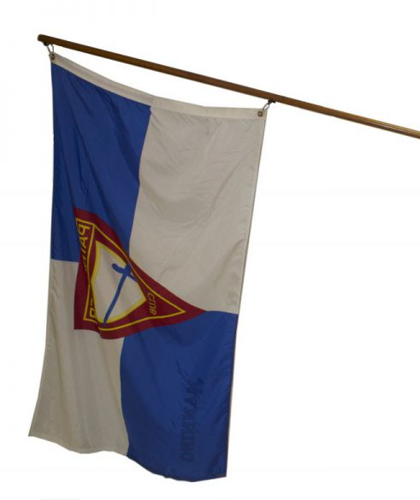
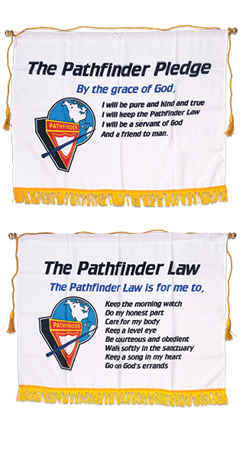

Slide 5
Pathfinder Song
Oh, we are the Pathfinders strong,
The servants of God are we.
Faithful as we march along,
In kindness, truth, and purity
A Message to tell to the world,
A truth that will set us free!
King Jesus the Savior's coming back
For you, and me!

Slide 6


