Slide 1
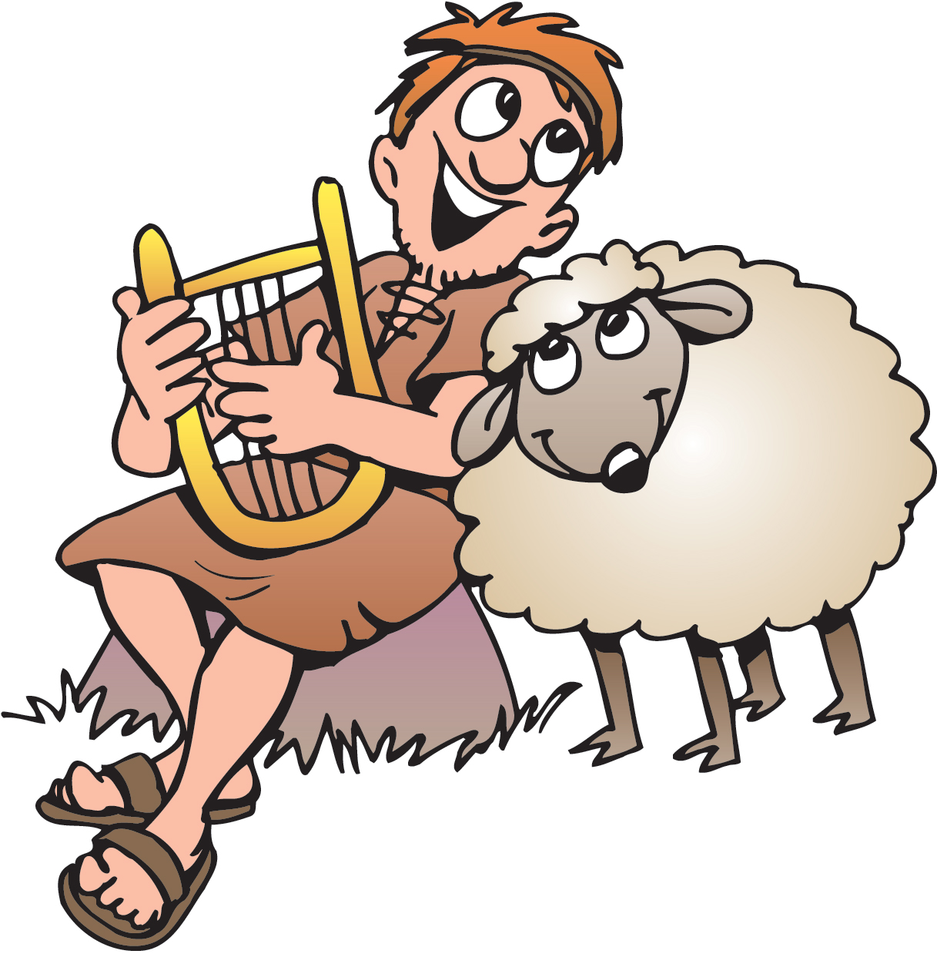
David the Shepherd and Goliath
1 Samuel 16, 17:13-36
Psalms 23

Slide 2
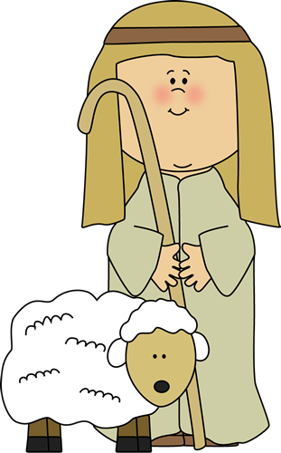
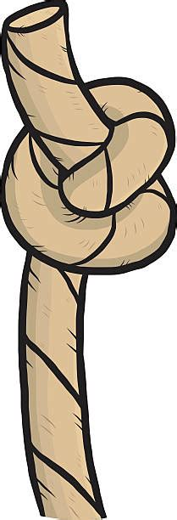
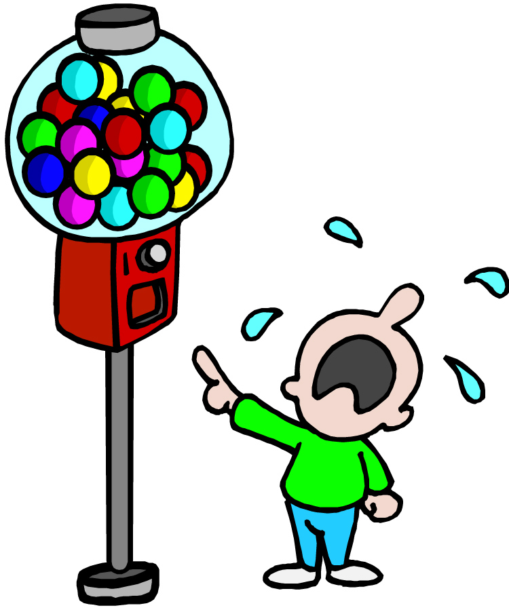
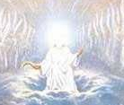
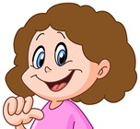

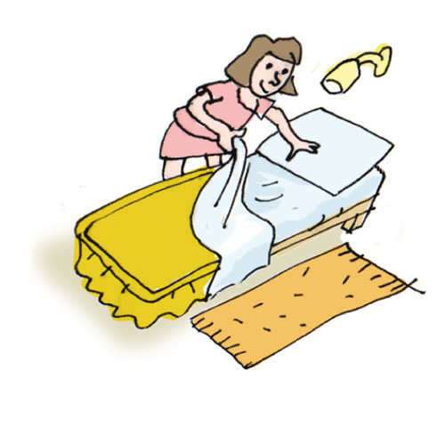
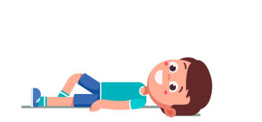
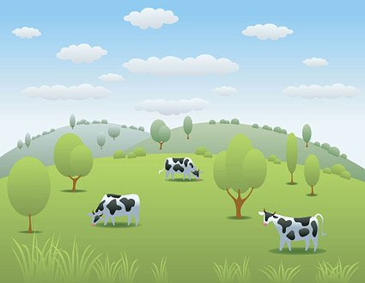
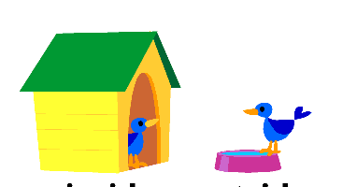
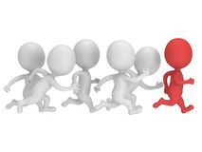
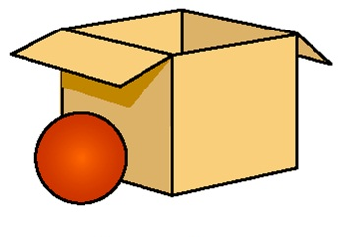
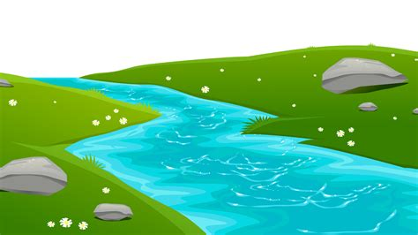
Can you figure out what the memory verse is? Each line is a letter. Use the picture clues.
Lord
my
shepherd
I
not
want
The _ _ _ _ is _ _ _ _ _ _ _ _ _. _ shall _ _ _ _ _ _ _.
He _ _ _ _ _ _ _ _ _ _ _ _ _ _ _ _ _ _ _ _ _ _ _ _ _ _ _ _ _.
He _ _ _ _ _ _ _ _ _ _ _ _ still _ _ _ _ _ _. Psalms (10x2) + (1+2) :1 & 2
makes
me
lie
down
in
green
pastures
leads
me
beside
waters

Slide 3
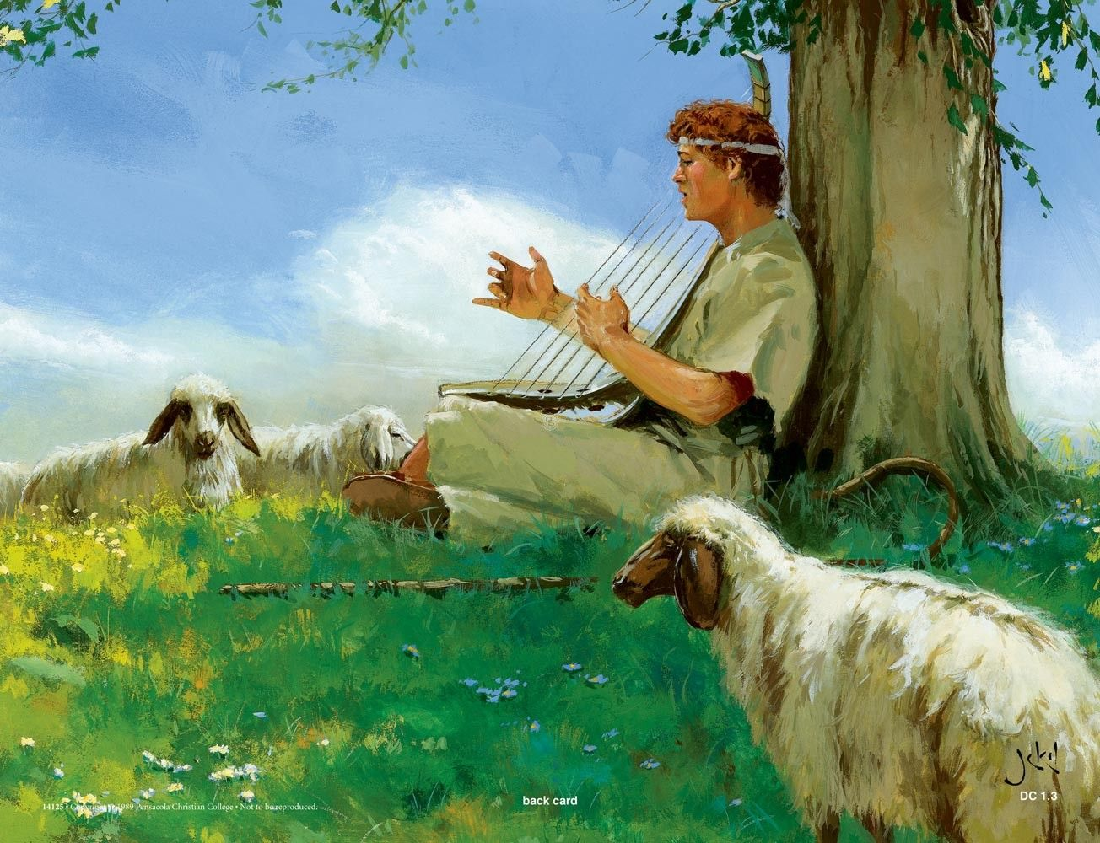


Can you fill in the blanks..
The Lord gives me strength. He is like a _____
that keeps me safe.
My ____ trusts in him, and he helps me.
My heart jumps for joy.
With my ____ I praise him.
Psalms 28:7
shield
heart
song

Slide 4
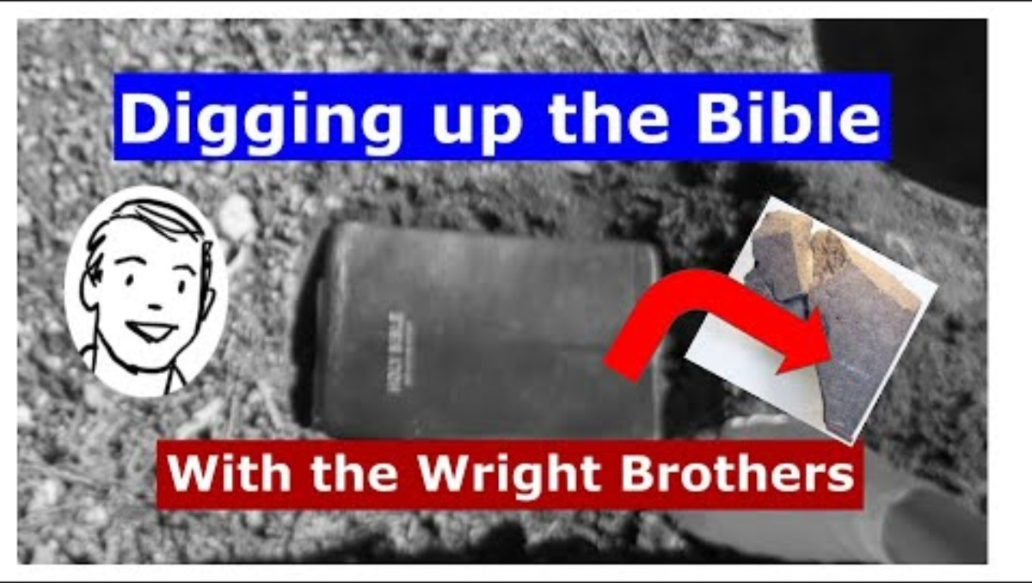
Evidence of Truth

Slide 5
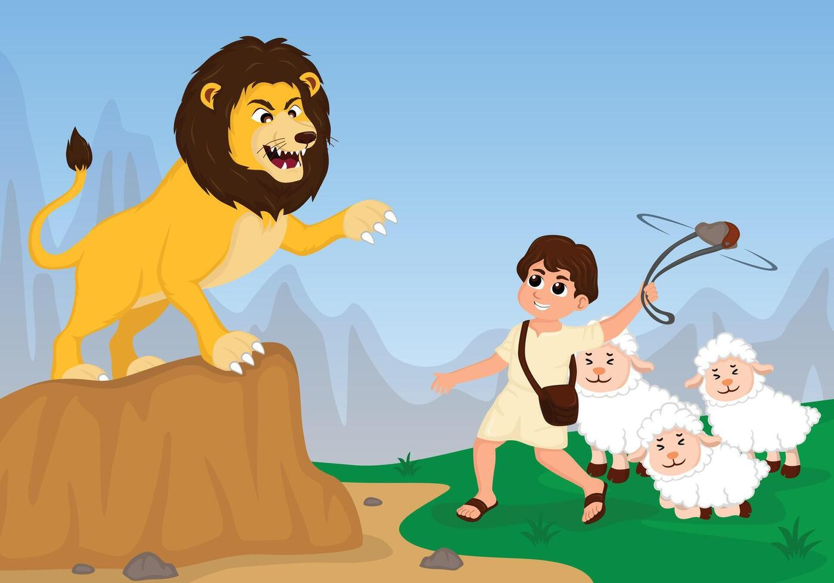
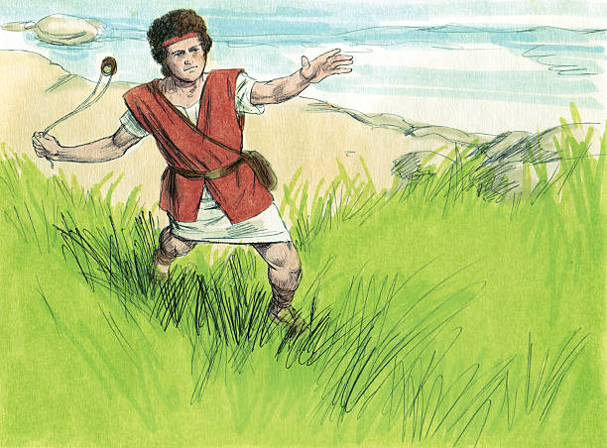
³⁴ But David said to Saul, “I’ve been taking care of my father’s sheep. Sometimes a lion or a bear would come and carry off a sheep from the flock. ³⁵ Then I would go after it and hit it. I would save the sheep it was carrying in its mouth. If it turned around to attack me, I would grab its hair. I would strike it down and kill it. ³⁶ In fact, I’ve killed both a lion and a bear…
While caring for my father’s sheep, I have killed a lion and a bear. The Lord saved me from the paw of the lion and bear and He will save me from the powerful hand of this Philistine!
Protection
David used his staff, rod, and sling to protect his sheep and himself.

Slide 6
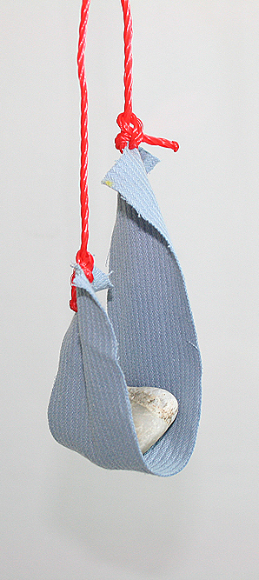
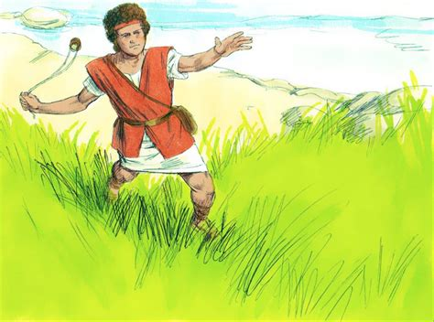
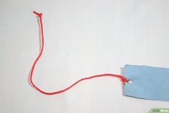
Craft Time
Do you have a sling?
Make a hole or slit on each end.
Tie a string or yarn in the hole or slit.
Felt

Slide 7
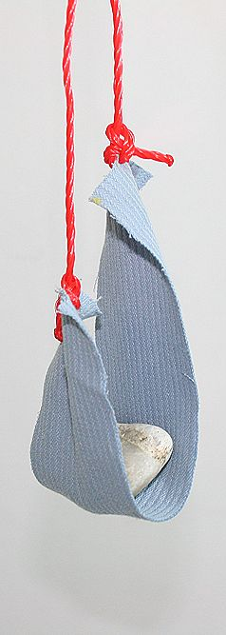
Practice using your sling.
Choose a safe place and a target (not a person or animal).
Put a wad of paper, cotton ball, pom-pom, or marshmallow in the sling.
Hold both strings and swing it round and round.
Let go of one string and sling the ball to your target.

Slide 8

Sing Only a Boy Named David
Use your sling and act out the story while we sing

Slide 9
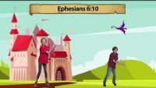
Sing Be Strong in the Lord

Slide 10
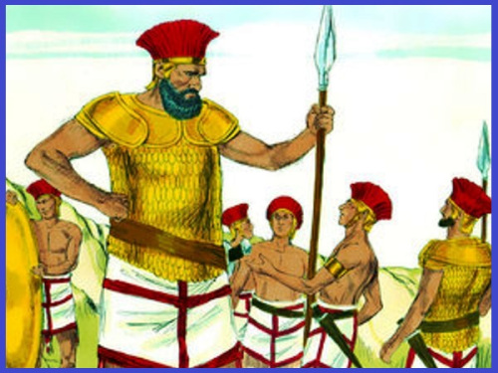
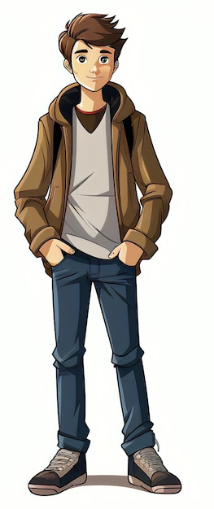
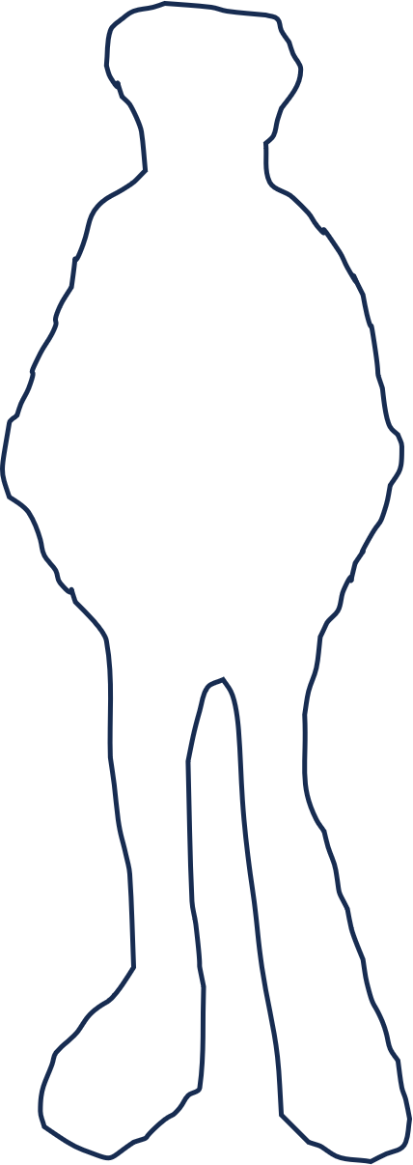
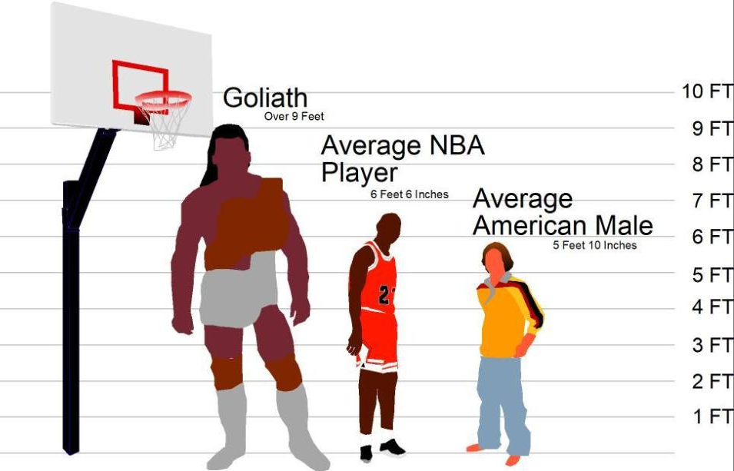
⁴ A mighty hero named Goliath came out of the Philistine camp. He was from Gath. He was more than nine feet tall.
Activity:
Get some butcher or packing paper and cut it 10 feet long.
Fold it in half
Fold the top upper portion down to the bottom fold (like a fourth)
Have a child lay down and draw their head and torso on the top half and their legs and feet on the lower quarter. Draw around their body
Open the page to the full height to have them as tall as Goliath.
Draw a proportional Goliath on the back side.
Measure how tall 9 feet is

Slide 11
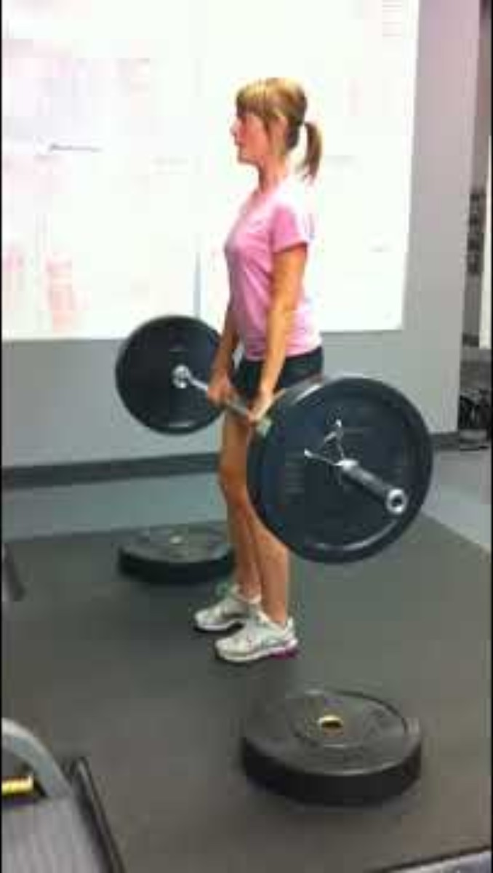
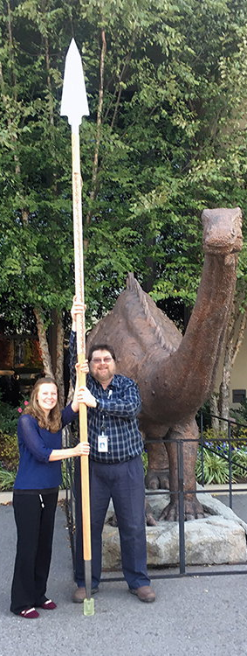
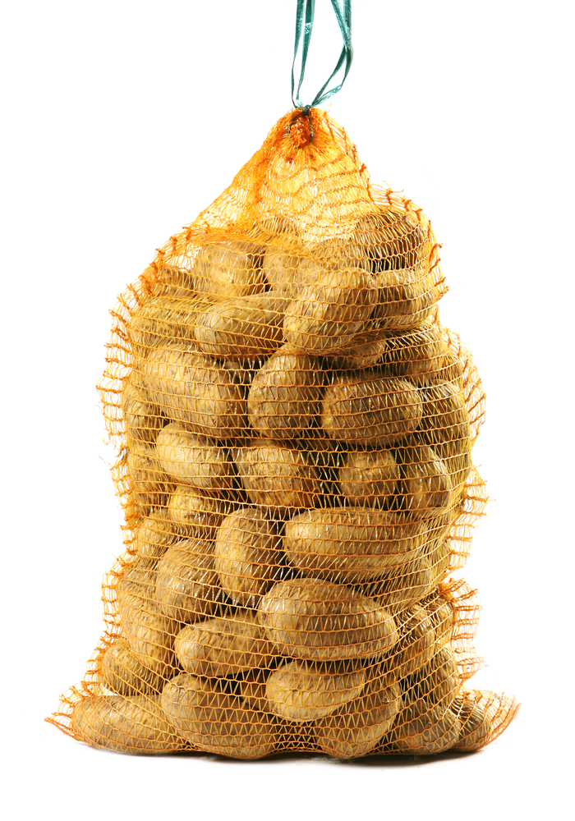
GOLIATH
⁵ He had a bronze helmet on his head.
He wore bronze armor that weighed 125 pounds.
⁶ On his legs he wore bronze guards. He carried a bronze javelin on his back.
⁷ His spear was as big as a weaver’s rod. Its iron point weighed 15 pounds.
The man who carried his shield walked along in front of him.
125 pounds

Slide 12
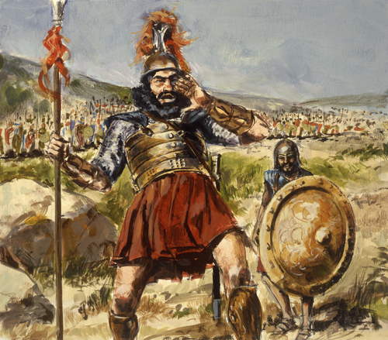
The Philistines have come to make war with Israel.

Slide 13
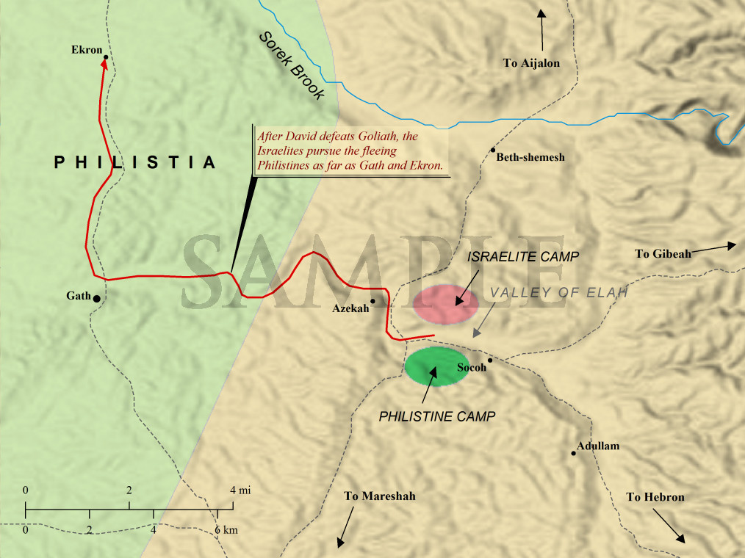
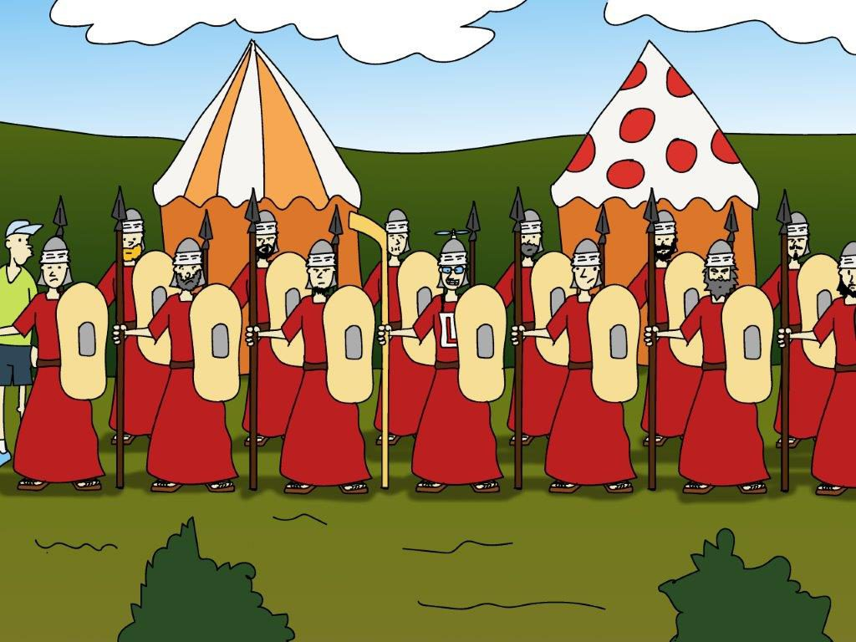
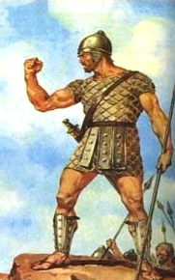
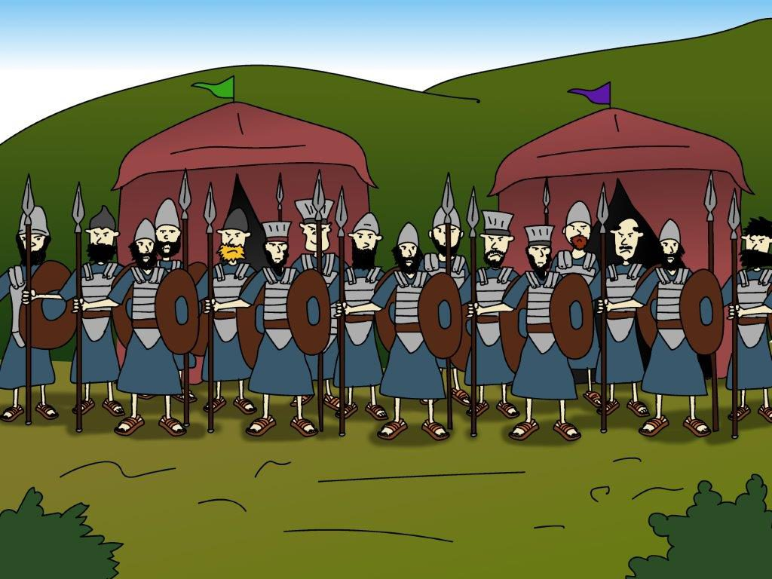
1 Samuel 17
The Philistines gathered their army together for war. They came to Sokoh in Judah. They set up camp at Ephes Dammim. It was between Sokoh and Azekah. ² Saul and the army of Israel gathered together. They camped in the Valley of Elah. They lined up their men to fight against the Philistines. ³ The Philistine army was camped on one hill. Israel’s army was on another. The valley was between them.
⁴ A mighty hero named Goliath came out of the Philistine camp. He was from Gath.

Slide 14
“Why do you come out and line up for battle? I’m a Philistine. You are servants of Saul. Choose one of your men. Have him come down and face me. If he’s able to fight and kill me, we’ll become your slaves. But if I win and kill him, you will become our slaves and serve us.”
⁸ Goliath stood there and shouted to the soldiers of Israel. He said, “Why do you come out and line up for battle? I’m a Philistine. You are servants of Saul. Choose one of your men. Have him come down and face me. ⁹ If he’s able to fight and kill me, we’ll become your slaves. But if I win and kill him, you will become our slaves and serve us.” ¹⁰ Goliath continued, “This day I dare the soldiers of Israel to send a man down to fight against me.” ¹¹ Saul and the whole army of Israel heard what the Philistine said. They were terrified.
……
¹⁶ Every morning and evening Goliath came forward and stood there. He did it for 40 days.

Slide 15
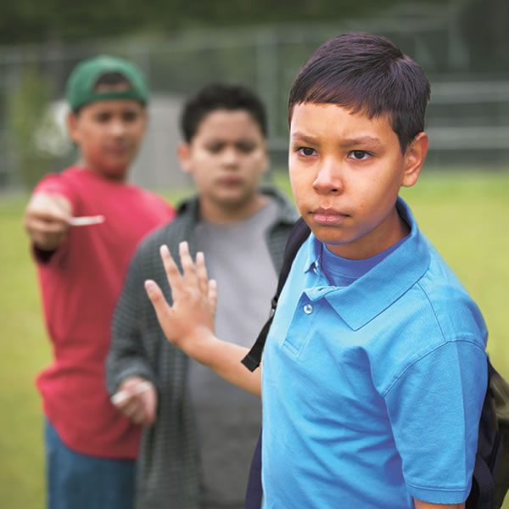
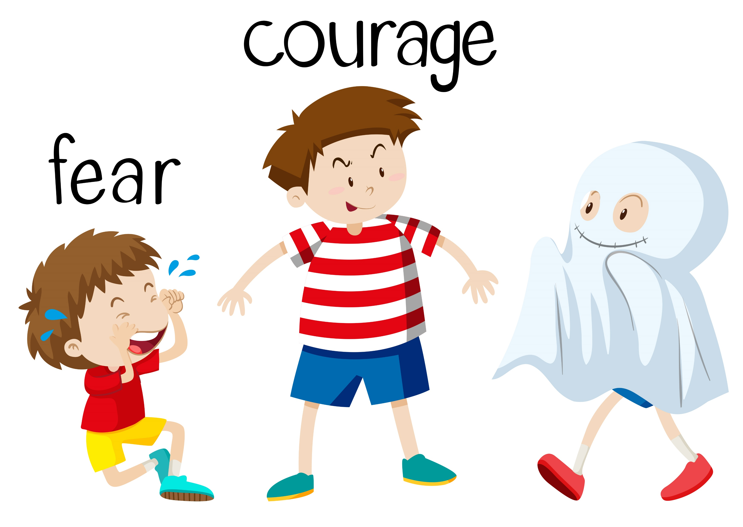
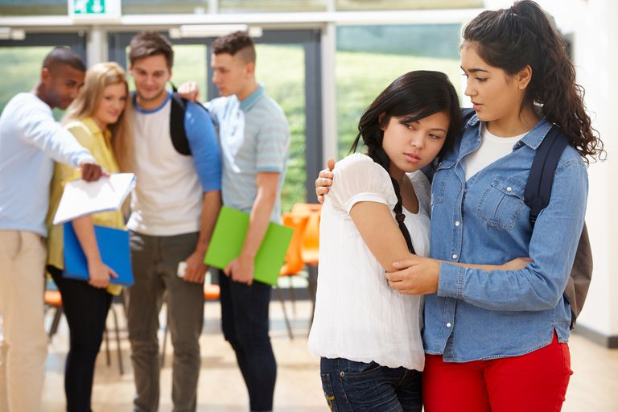
Do you face big problems?
God will help you!
Are you tempted to do wrong? God can make you strong.
Do kids make fun of you? God can help you make a friend.
Are you afraid of something? God can give you courage!

Slide 16
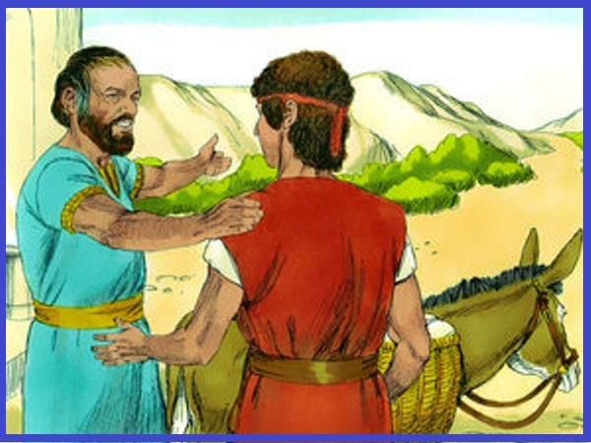
¹⁷ Jesse said to his son David, “Get at least half a bushel of grain that has been cooked. Also get ten loaves of bread. Take all of it to your brothers. Hurry to their camp. ¹⁸ Take along these ten chunks of cheese to the commander of their military group. Find out how your brothers are doing. Bring me back some word about them. ¹⁹ They are with Saul and all the men of Israel. They are in the Valley of Elah. They are fighting against the Philistines.”
²⁰ Early in the morning David left his father’s flock in the care of a shepherd. David loaded up the food and started out, just as Jesse had directed.
Hurry, take 10 loaves of bread to your brothers. They are with Saul in the valley of Elah. Also take 10 chunks of cheese to their commander.
Sure Dad, I can do that.

Slide 17
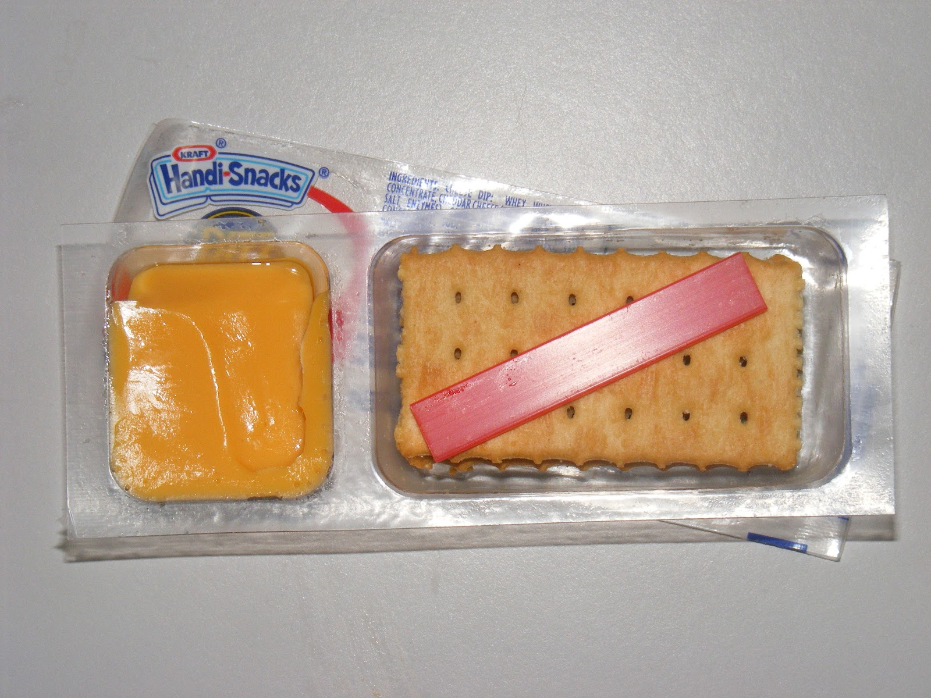
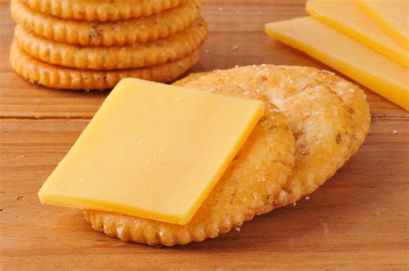
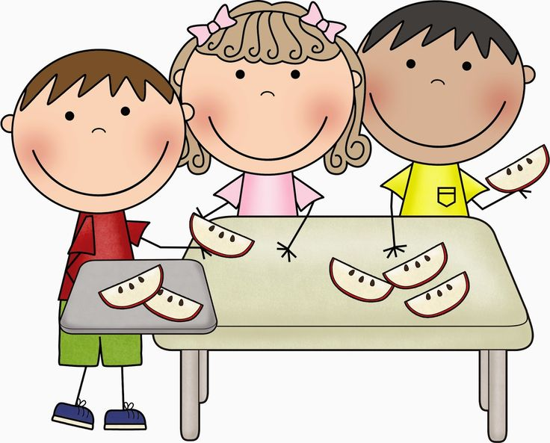
Snack time David brought
bread and cheese to his brothers

Slide 18
This day I defy the armies of Israel!
I dare you to defeat me.
I am stronger than you and your God.
“Why do you come out and line up for battle? I’m a Philistine. You are servants of Saul. Choose one of your men. Have him come down and face me. If he’s able to fight and kill me, we’ll become your slaves. But if I win and kill him, you will become our slaves and serve us.”
²² David left what he had brought with the man who took care of the supplies. He ran to the battle lines and asked his brothers how they were.
²³ As David was talking with them, Goliath stepped forward from his line. Goliath was a mighty Philistine hero from Gath. He again dared someone to fight him, and David heard it.
²⁴ Whenever Israel’s army saw Goliath, all of them ran away from him. That’s because they were so afraid.

Slide 19
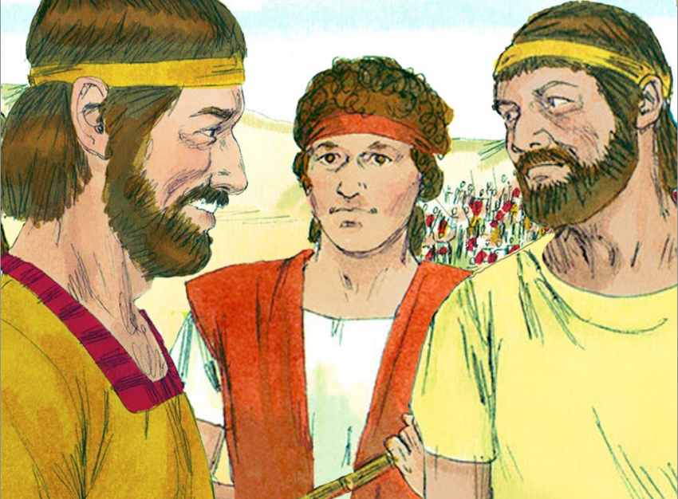
Goliath is bringing shame on Israel.
What will be done for the one who removes it? What is the reward?
²⁵ The Israelites had been saying, “Just look at how this man keeps daring Israel to fight him! The king will make the man who kills Goliath very wealthy. The king will also give his own daughter to be that man’s wife. The king won’t require anyone in the man’s family to pay any taxes in Israel.”
²⁶ David spoke to the men standing near him. He asked them, “What will be done for the man who kills this Philistine? Goliath is bringing shame on Israel. What will be done for the one who removes it? This Philistine isn’t even circumcised. He dares the armies of the living God to fight him. Who does he think he is?”
²⁷ The men told David what Israel’s soldiers had been saying. The men told him what would be done for the man who killed Goliath.
²⁸ David’s oldest brother Eliab heard him speaking with the men. So Eliab became very angry with him. Eliab asked David, “Why have you come down here? Who is taking care of those few sheep in the desert for you? I know how proud you are. I know how evil your heart is. The only reason you came down here was to watch the battle.”
²⁹ “What have I done now?” said David. “Can’t I even speak?” ³⁰ Then he turned away to speak to some other men. He asked them the same question he had asked before. And they gave him the same answer. ³¹ Someone heard what David said and reported it to Saul. So Saul sent for David.
King Saul will give lots of riches,
His daughter will be the man’s wife,
And he won’t have to pay taxes.
He defies the armies of the living God to fight him. Who does he think he is?”

Slide 20
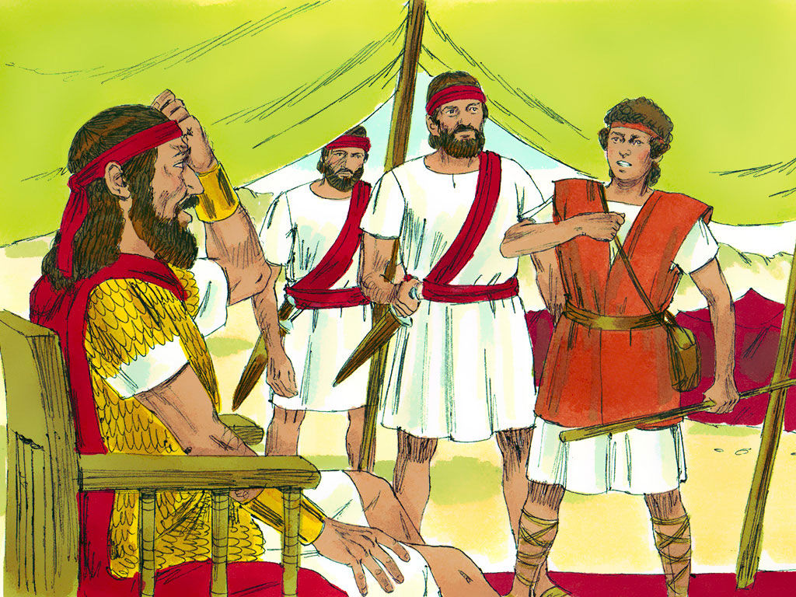
³² David said to Saul, “Don’t let anyone lose hope because of that Philistine. I’ll go out and fight him.”
³³ Saul replied, “You aren’t able to go out there and fight that Philistine. You are too young. He’s been a warrior ever since he was a boy.”
³⁴ But David said to Saul, “I’ve been taking care of my father’s sheep. Sometimes a lion or a bear would come and carry off a sheep from the flock. ³⁵ Then I would go after it and hit it. I would save the sheep it was carrying in its mouth. If it turned around to attack me, I would grab its hair. I would strike it down and kill it. ³⁶ In fact, I’ve killed both a lion and a bear. I’ll do the same thing to this Philistine. He isn’t even circumcised. He has dared the armies of the living God to fight him. ³⁷ The Lord saved me from the paw of the lion. He saved me from the paw of the bear. And he’ll save me from the powerful hand of this Philistine too.”
“Don’t let anyone lose hope because of that Philistine. I’ll go out and fight him.”
While caring for my father’s sheep, I have killed a lion and a bear. The Lord saved me from the paw of the lion and bear and He will save me from the powerful hand of this Philistine!
I may be taller than everyone, but I’m not going out there to fight that giant!
“You aren’t able to go out there and fight that Philistine. You are too young. He’s been a warrior ever since he was a boy.”

Slide 21
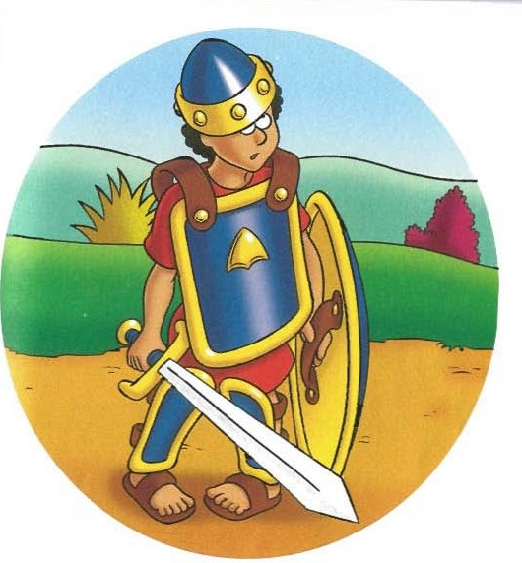
³⁸ Then Saul dressed David in his own military clothes. He put a coat of armor on him. He put a bronze helmet on his head. ³⁹ David put on Saul’s sword over his clothes. He walked around for a while in all that armor because he wasn’t used to it.
“I can’t go out there in all this armor,” he said to Saul. “I’m not used to it.” So, he took it off.
“Go and may the Lord be with you. You may wear my armor.”
No Thank you. I’m not used to it. I will be fine.

Slide 22
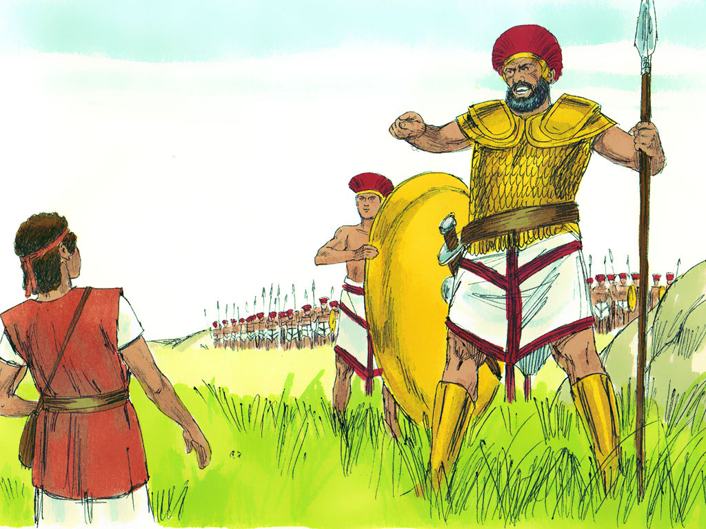
⁴⁰ Then David picked up his wooden staff. He went down to a stream and chose five smooth stones. He put them in the pocket of his shepherd’s bag. Then he took his sling in his hand and approached Goliath.
⁴¹ At that same time, the Philistine kept coming closer to David. The man carrying Goliath’s shield walked along in front of him. ⁴² Goliath looked David over. He saw how young he was. He also saw how healthy and handsome he was. And he hated him. ⁴³ He said to David, “Why are you coming at me with sticks? Do you think I’m only a dog?” The Philistine cursed David in the name of his gods. ⁴⁴ “Come over here,” he said. “I’ll feed your body to the birds and wild animals!”
⁴⁵ David said to Goliath, “You are coming to fight against me with a sword, a spear and a javelin. But I’m coming against you in the name of the Lord who rules over all. He is the God of the armies of Israel. He’s the one you have dared to fight against. ⁴⁶ This day the Lord will give me the victory over you. I’ll strike you down. I’ll cut your head off. This day I’ll feed the bodies of the Philistine army to the birds and wild animals. Then the whole world will know there is a God in Israel. ⁴⁷ The Lord doesn’t rescue people by using a sword or a spear. And everyone here will know it. The battle belongs to the Lord. He will hand all of you over to us.”
“Come here and I’ll feed your body to the birds and wild animals!”
“Do you think I’m a dog that you come against me with sticks and stones! … ”
You are coming to fight against me with a sword, a spear and a javelin.
But I’m coming against you in the name of the Lord Almighty! He will give me the victory! The battle belongs to the Lord!

Slide 23
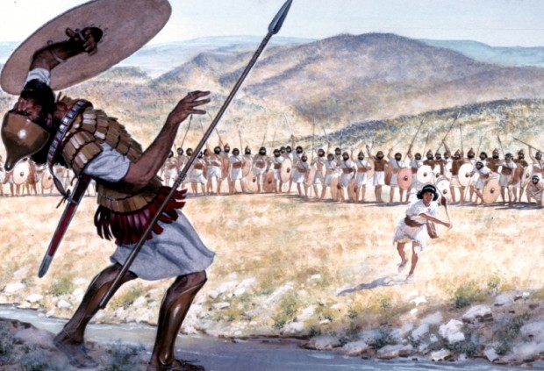
⁴⁸ As the Philistine moved closer to attack him, David ran quickly to the battle line to meet him. ⁴⁹ He reached into his bag. He took out a stone. He put it in his sling. He slung it at Goliath. The stone hit him on the forehead and sank into it. He fell to the ground on his face.
HURRAH!

Slide 24
Sing Only a Boy Named David

Slide 25
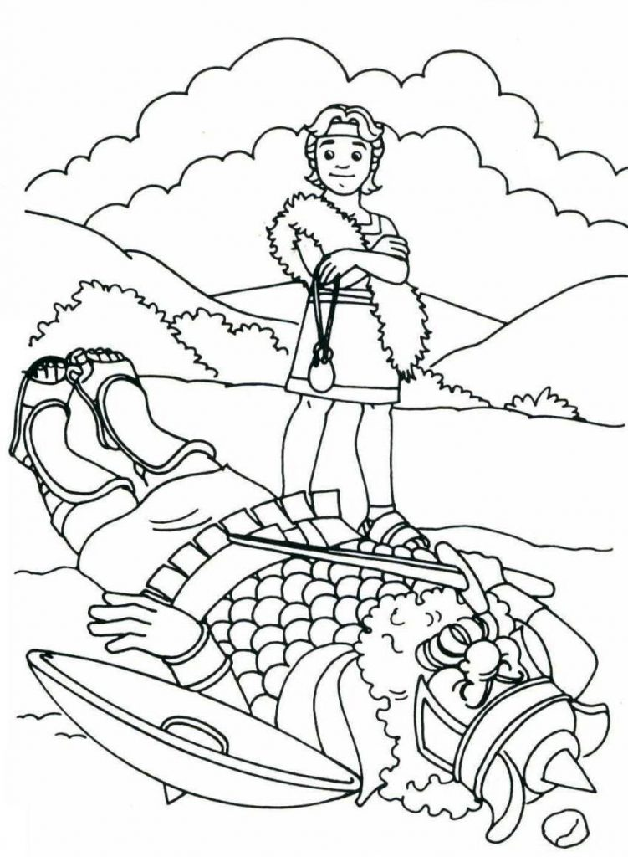
WITH GOD
ALL THINGS
ARE POSSIBLE!
The Lord gives me strength. He is like a shield
that keeps me safe.
My heart trusts in Him, and He helps me.
My heart jumps for joy.
With my songs
I praise Him!
Psalms 28:7
⁵⁰ So David won the fight against Goliath with a sling and a stone. He struck down the Philistine and killed him. He did it without even using a sword.
⁵¹ David ran and stood over him. He picked up Goliath’s sword and cut off his head with it.

Slide 26

David wrote a song to God:
“Your arm is powerful.
Your hand is strong.
Your right hand is mighty.”
Psalm 89:13

Slide 27
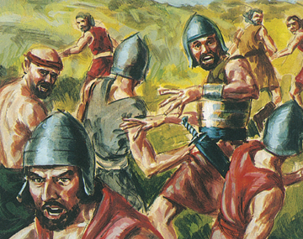
The Philistines saw that their hero was dead. So they turned around and ran away. ⁵² Then the men of Israel and Judah shouted and rushed forward. They chased the Philistines to the entrance of Gath. They chased them to the gates of Ekron. Bodies of dead Philistines were scattered all along the road to Gath and Ekron. That’s the road that leads to Shaaraim. ⁵³ Israel’s army returned from chasing the Philistines. They had taken everything from the Philistine camp.
⁵⁴ David picked up Goliath’s head. He brought it to Jerusalem. He put Goliath’s weapons in his own tent.
RUN!

Slide 28
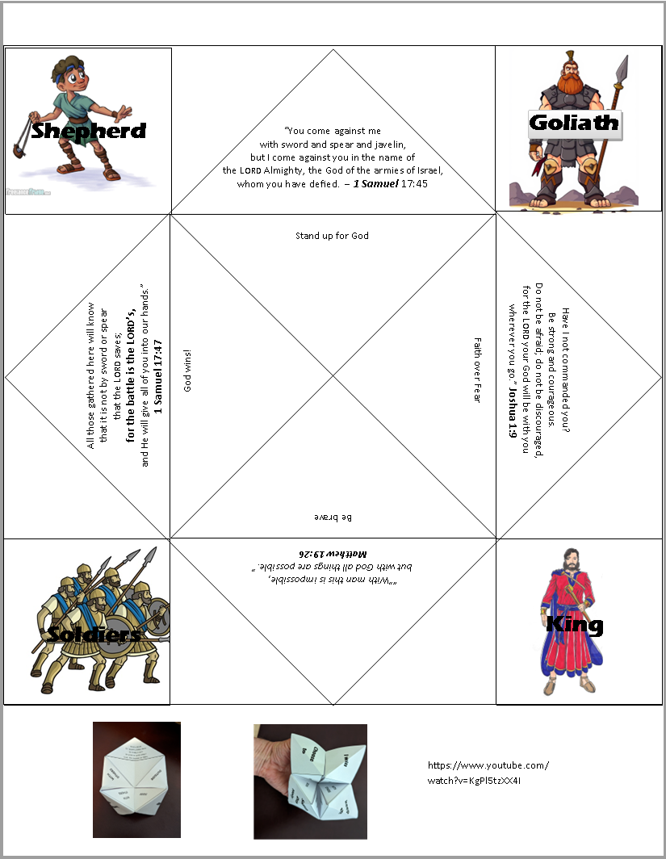
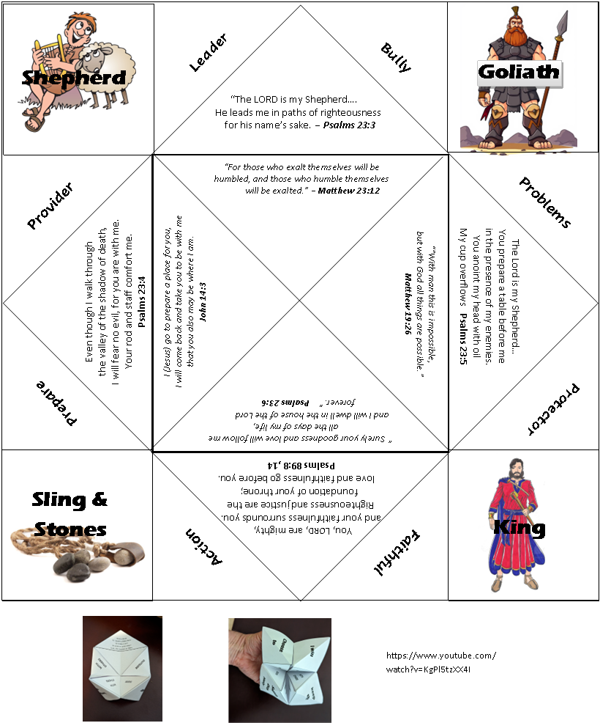

Craft Time
You can add your own fortune or action (such as)
Directions:
Cut the paper on the top and bottom lines to make a square
Turn the paper over with the writing facing down.
All the other lines will be fold lines.
  Fold each corner into the center so that each corner touches the center point where the diagonal lines meet.
  Turn the paper over and fold the new corners into the center like before.
  Once again; Turn the paper over and fold the new corners into the center like before.
  Now fold that square in half *top to bottom” (not corner to corner)
  Unfold that fold and fold the square in half the other way “side to side”
  Unfold the fold and put fingers under the corner flaps to work the fortune teller
Sing or Act: David & Goliath
What battles has God won?
Arm wrestle me
What has God helped you do?

Slide 29

The End
Extra Extra Yep there’s more….

Slide 30

Bible Story – David & Goliath

Slide 31

More Evidence –
David & Goliath

