Slide 1
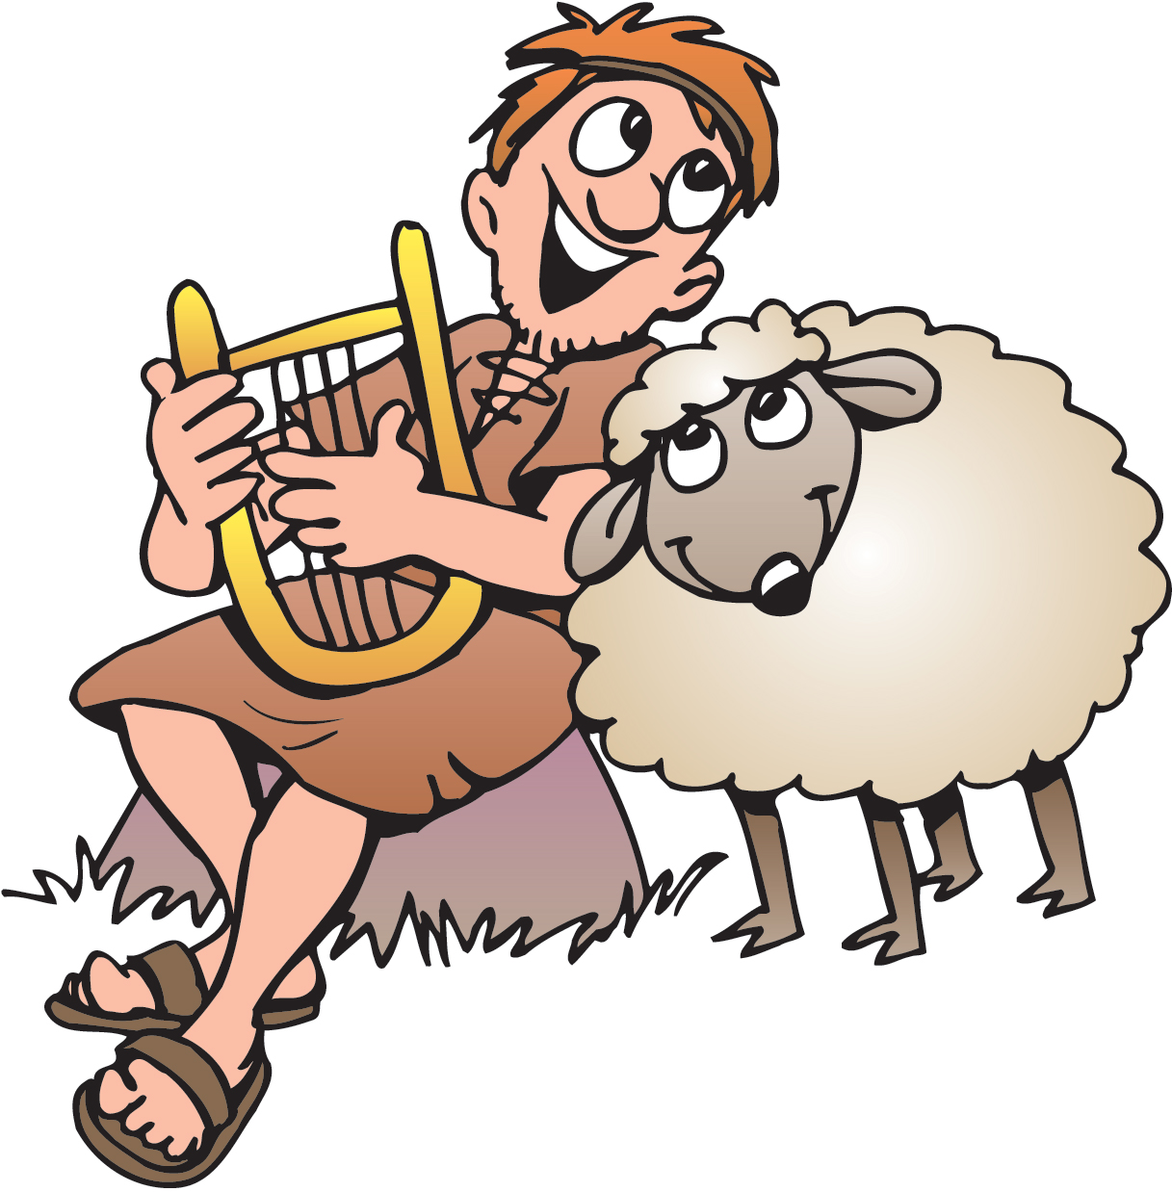
David the Shepherd
Anointed
1 Samuel 16, 17:13-36
Psalms 23

Slide 2

What jobs do you do at home?
How do you help your family?
¹⁰ For we are God’s handiwork, created in Christ Jesus to do good works, which God prepared in advance for us to do.
Ephesians
2:10

Slide 3
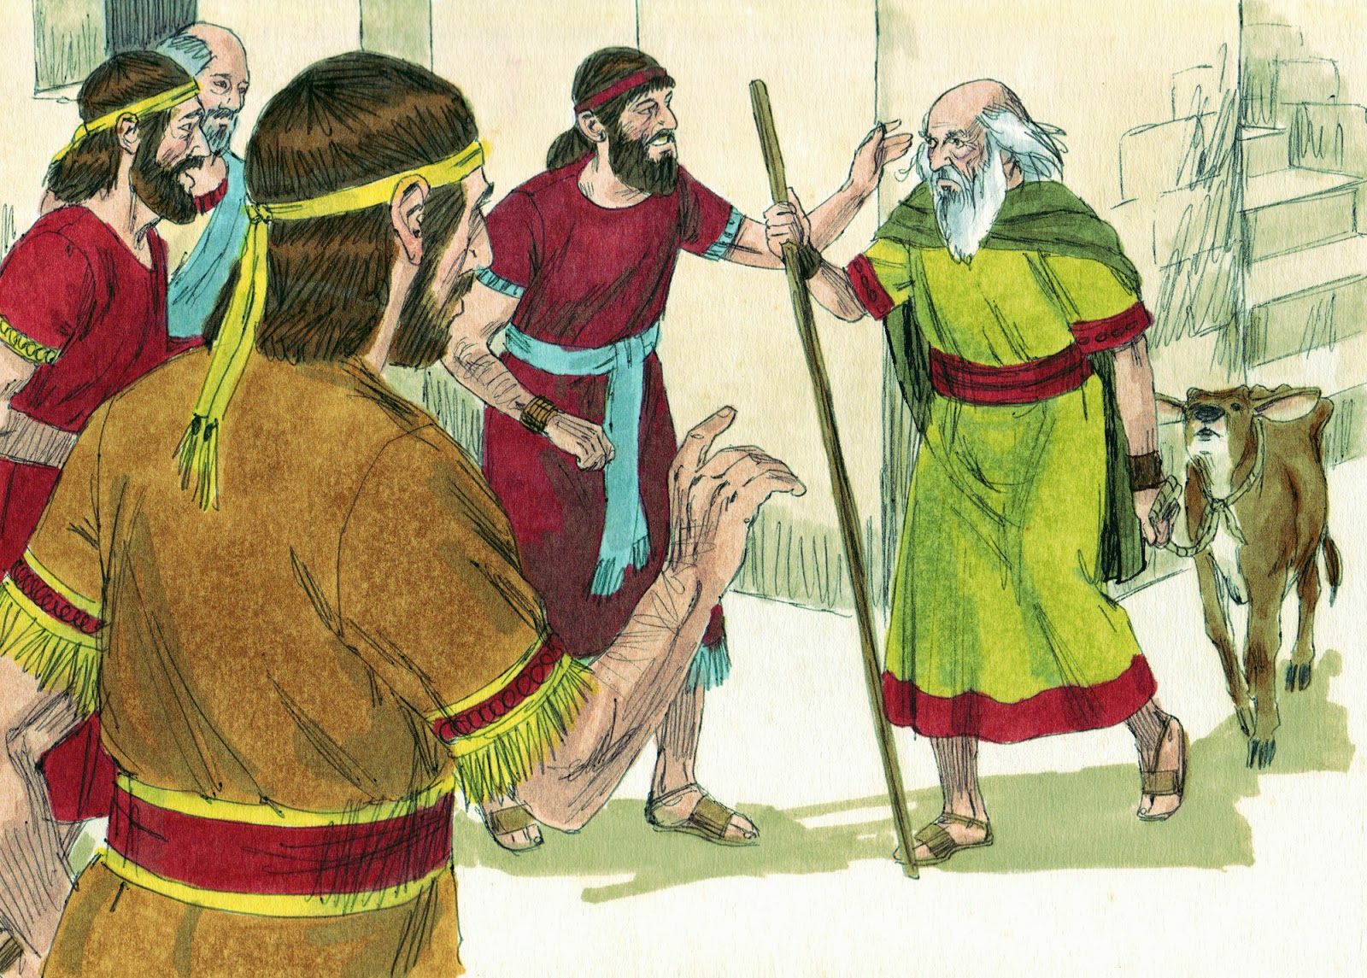
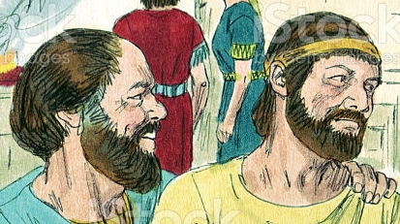
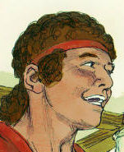
You can help tell the Bible story by reading one of the parts.
Whose part do you want to read?
Voice of God
Jesse and his sons
Samuel
David

Slide 4
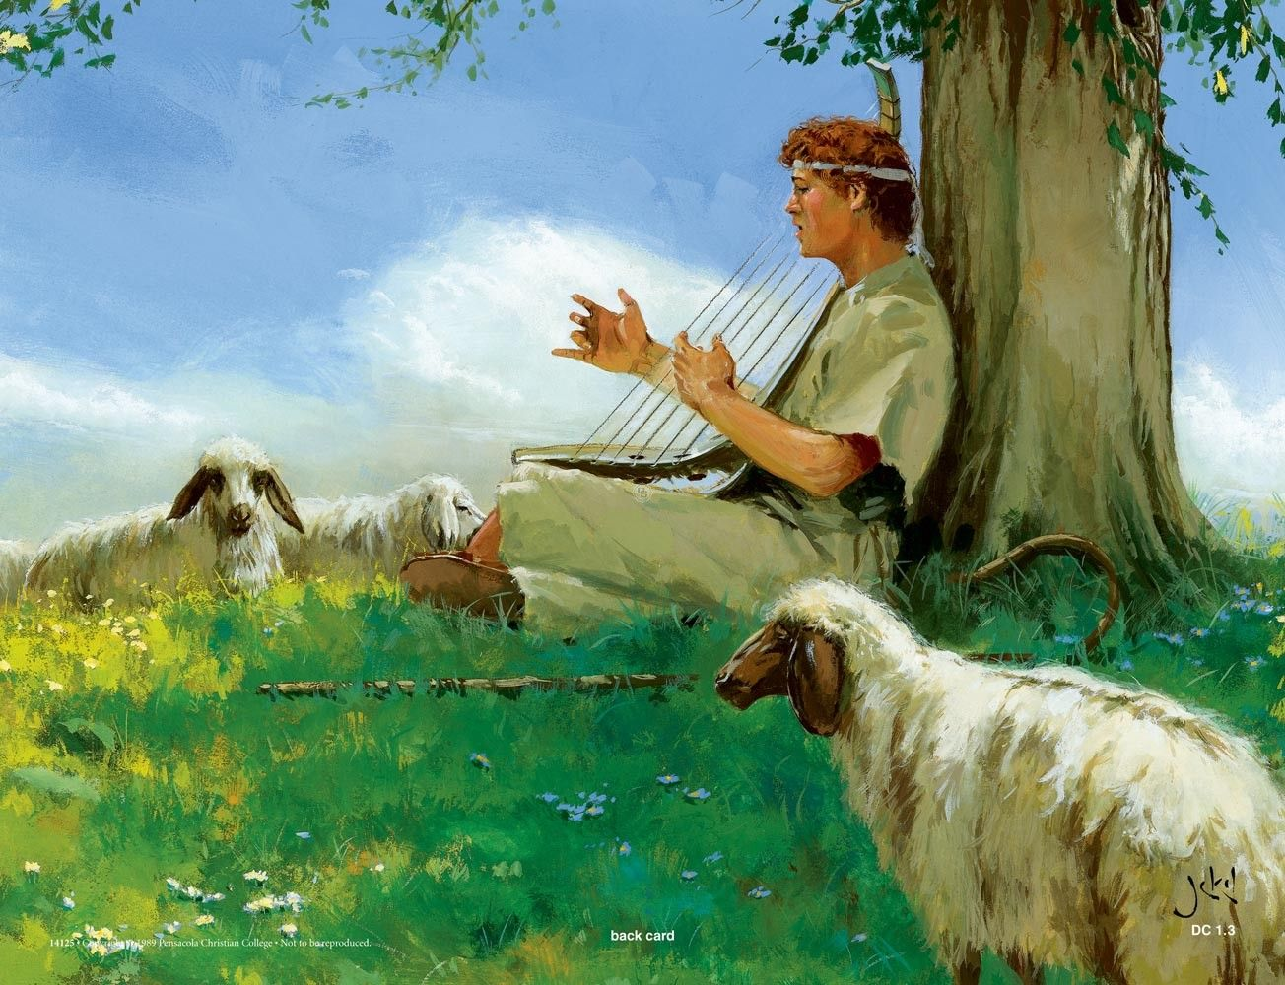
David was a shepherd watching his sheep.
He wrote songs, which we can find in the Psalms.
Psalms 23
The LORD is my Shepherd
I shall not want
Just like I take care of the sheep and make sure they have everything they need, God takes care of me.

Slide 5
Sheep will not lay down if they are hungry or thirsty or scared or quarreling.
Psalms 23
He makes me lie down
in green pastures.
I know God is with me. He has protected me and provided everything I need.
I am content.

Slide 6
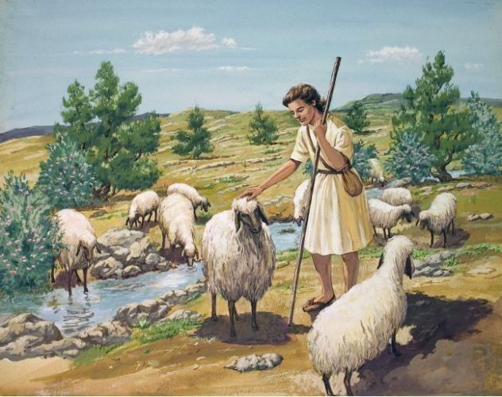
If sheep drink from flowing water, it is easy for the water to get up their nose. That can make them choke or get sick.
Psalms 23
There, my sheep, I finished clearing the rocks and building a dam.
Now that running water won’t scare you or go up your nose!
You can drink and we can relax and enjoy some time of refreshment.
And I can sing to God
That gives me an idea for
another line for my song….
“He leads me beside still water..”

Slide 7
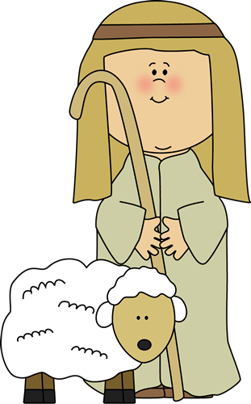


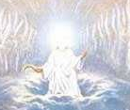


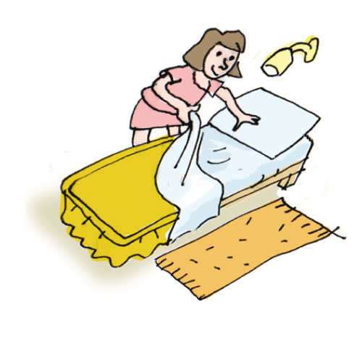
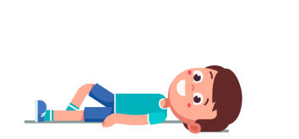
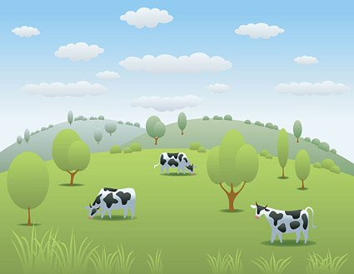
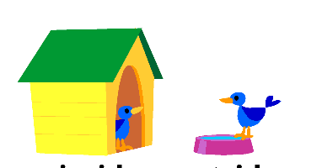


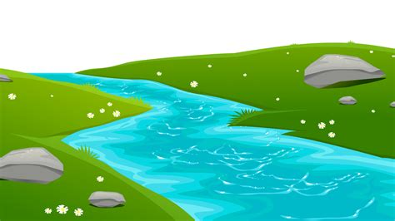
Can you figure out what the memory verse is? Each line is a letter. Use the picture clues.
Lord
my
shepherd
I
not
want
The _ _ _ _ is _ _ _ _ _ _ _ _ _. _ shall _ _ _ _ _ _ _.
He _ _ _ _ _ _ _ _ _ _ _ _ _ _ _ _ _ _ _ _ _ _ _ _ _ _ _ _ _.
He _ _ _ _ _ _ _ _ _ _ _ _ still _ _ _ _ _ _. Psalms (10x2) + (1+2) :1 & 2
makes
me
lie
down
in
green
pastures
leads
me
beside
waters

Slide 8
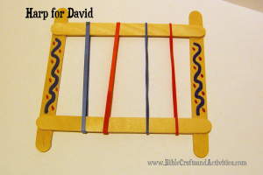
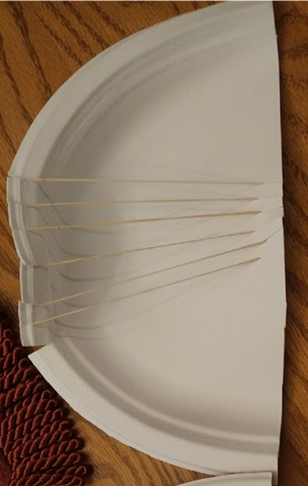
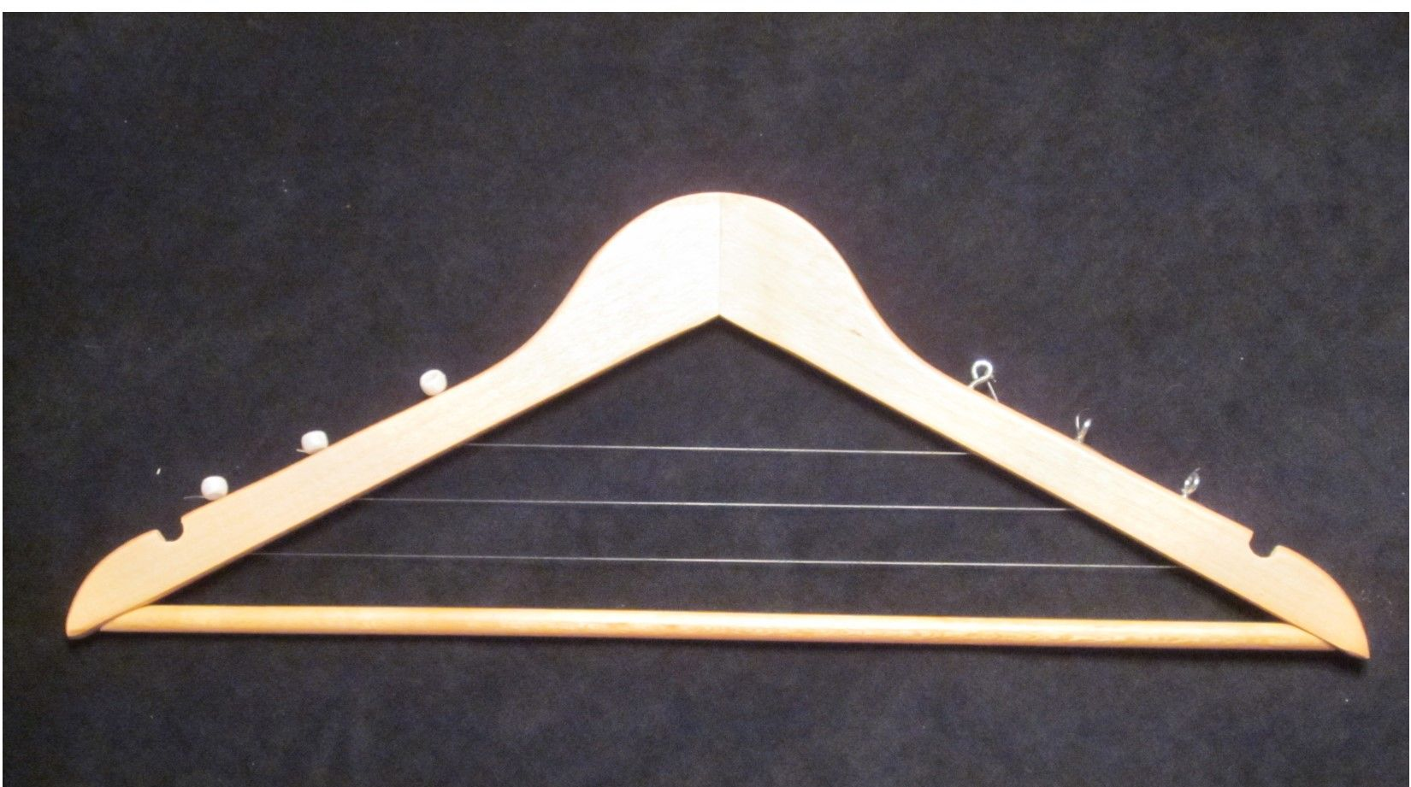
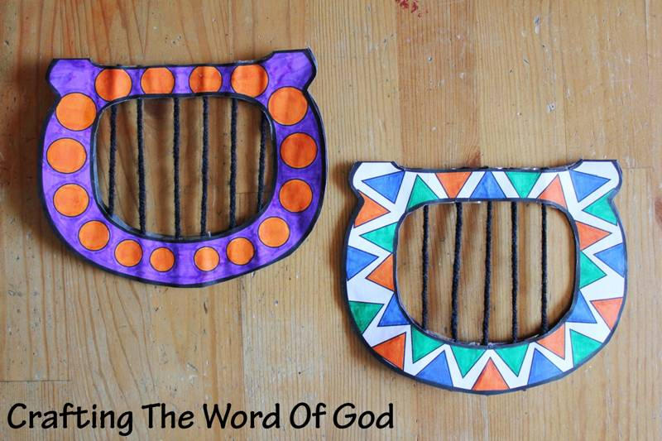
Craft Time Make a harp
choose a way – here are some ideas
Put on rubber bands
Decorate harp
Then you can play it while we sing..

Slide 9

The grass is sweeter and the air is cooler beside water.
Psalms 23
He leads me beside still waters.
He restores my soul.

Slide 10
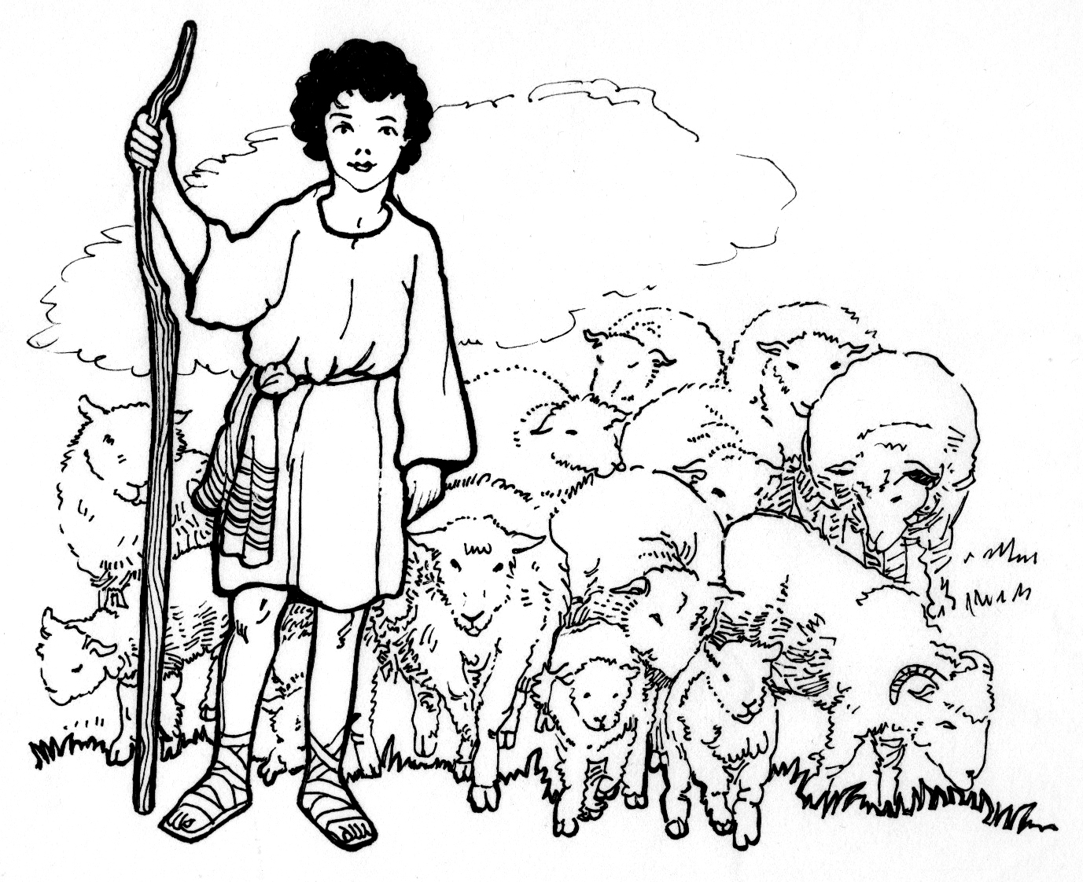
The good shepherd
“calls his own sheep by name and leads them out. When he has brought out all his own, he goes on ahead of them, and his sheep follow him because they know his voice.”
John 10:3-4
Psalms 23
It’s time to go home.
Come lambs. Come sheep.
Let’s go.
I’ll show you the way.
He leads me in the paths of righteousness
For His name sake.
God will lead me.
He will let me know what he wants me to do with my life,
because that will glorify His name.
Yes! That’s a great idea for
the next line ….
“He leads me in the paths of righteousness.”

Slide 11

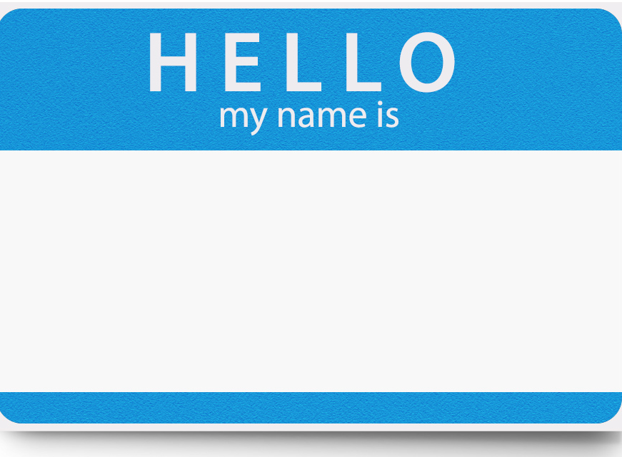
Can you figure out what the memory verse is? Each line is a letter. Use the picture clues.
my
He restores _ _ soul
He _ _ _ _ _ _ _ _ _ the _ _ _ _ _ of _ _ _ _ _eousness
_ _ _ His _ _ _ _ sake Psalms (4x5)+3 : (1+2)
leads
me
in
paths
right
4
for
name

Slide 12
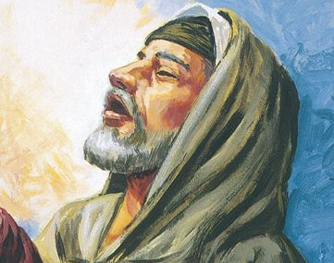
Samuel, Go to Jesse in Bethlehem.
I have chosen one of his sons
to be king instead of Saul.
You must anoint the one
I point out to you.
1 Samuel 16
The Lord said to Samuel, “How long will you be filled with sorrow because of Saul? I have refused to have him as king over Israel. Fill your animal horn with olive oil and go on your way. I am sending you to Jesse in Bethlehem. I have chosen one of his sons to be king.”
² But Samuel said, “How can I go? Suppose Saul hears about it. Then he’ll kill me.”
The Lord said, “Take a young cow with you. Tell the elders of Bethlehem, ‘I’ve come to offer a sacrifice to the Lord.’ ³ Invite Jesse to the sacrifice. Then I will show you what to do. You must anoint for me the one I point out to you.”
But, Lord, if Saul hears that I’m anointing another king, he will kill me.
Take a young cow and gather the people for a sacrifice.
I will tell you what to do.

Slide 13
Have you come in peace?
Yes, I’ve come in peace.
I’ve come to offer a sacrifice to God.
Your family is invited.
Prepare yourself by cleaning your bodies, clothes and hearts.
⁴ Samuel did what the Lord said. He arrived at Bethlehem. The elders of the town met him. They were trembling with fear. They asked, “Have you come in peace?”
⁵ Samuel replied, “Yes, I’ve come in peace. I’ve come to offer a sacrifice to the Lord. Set yourselves apart to him and come to the sacrifice with me.” Then he set Jesse and his sons apart to the Lord. He invited them to the sacrifice.

Slide 14
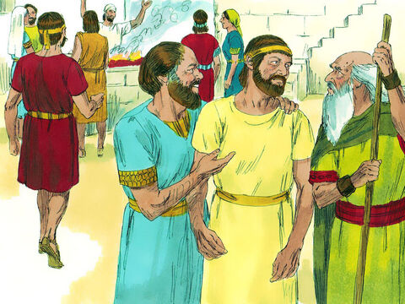
⁶ When they arrived, Samuel saw Eliab. He thought, “This has to be the one the Lord wants me to anoint for him.”
⁷ But the Lord said to Samuel, “Do not consider how handsome or tall he is. I have not chosen him. The Lord does not look at the things people look at. People look at the outside of a person. But the Lord looks at what is in the heart.”
Here is my son Eliab
He is tall and handsome!
Don’t look at his looks.
He’s not the one.
Man looks at what people look like, but God looks at their heart – how much they love God and others.
Who is your next son?

Slide 15
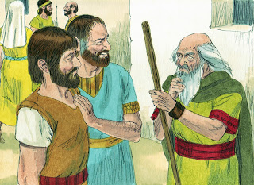
⁸ Then Jesse called for Abinadab. He had him walk in front of Samuel. But Samuel said, “The Lord hasn’t chosen him either.” ⁹ Then Jesse had Shammah walk by. But Samuel said, “The Lord hasn’t chosen him either.” ¹⁰ Jesse had seven of his sons walk in front of Samuel. But Samuel said to him, “The Lord hasn’t chosen any of them.” ¹¹ So he asked Jesse, “Are these the only sons you have?”
“No,” Jesse answered. “My youngest son is taking care of the sheep.”
Samuel said, “Send for him. We won’t sit down to eat until he arrives.
Here is my son Abinadab
Is this the right one?
No, he is not the one
Who is your next son?

Slide 16
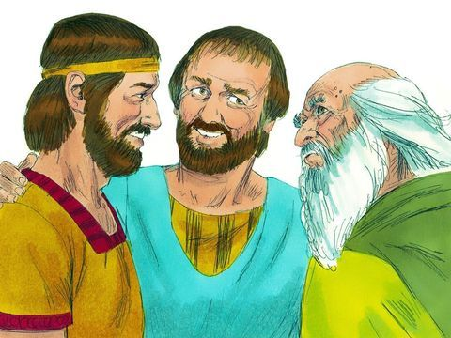
⁸ Then Jesse called for Abinadab. He had him walk in front of Samuel. But Samuel said, “The Lord hasn’t chosen him either.” ⁹ Then Jesse had Shammah walk by. But Samuel said, “The Lord hasn’t chosen him either.” ¹⁰ Jesse had seven of his sons walk in front of Samuel. But Samuel said to him, “The Lord hasn’t chosen any of them.” ¹¹ So he asked Jesse, “Are these the only sons you have?”
“No,” Jesse answered. “My youngest son is taking care of the sheep.”
Samuel said, “Send for him. We won’t sit down to eat until he arrives.
How about this son?
Is this the right one?
No, he is not the one
No, do you have any others?
Just the youngest watching the sheep.
Send for him

Slide 17
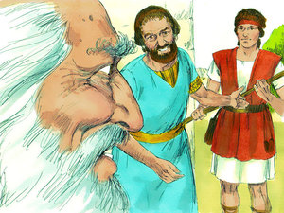
Here is my youngest son David
Is this the right one?
Yes, anoint David as the next king.
¹² So Jesse sent for his son and had him brought in. He looked very healthy. He had a fine appearance and handsome features.
Then the Lord said, “Get up and anoint him. This is the one.”
This is the one. God has chosen him!

Slide 18
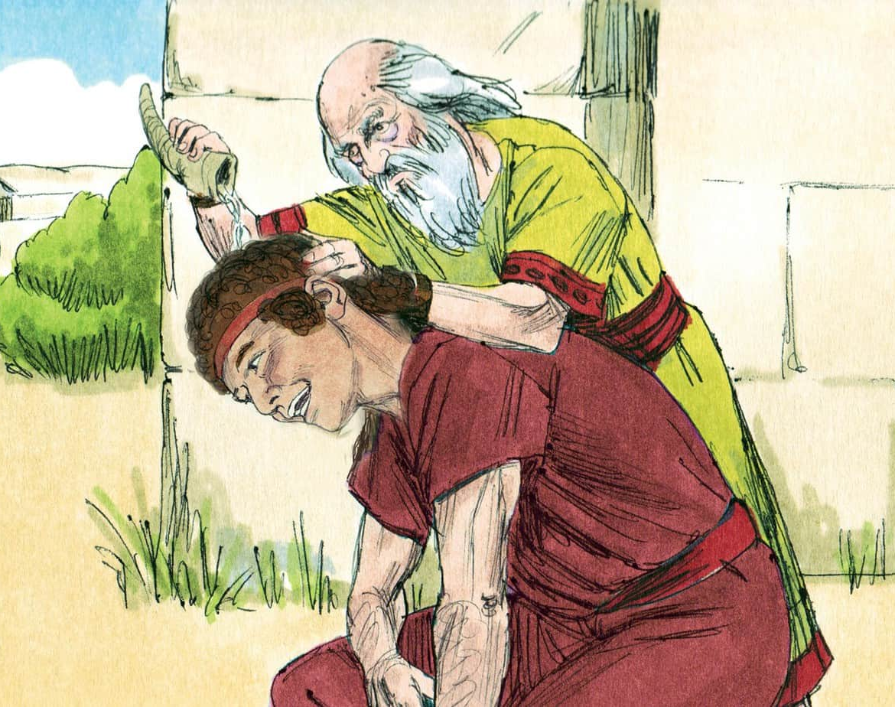

God has chosen you
to be the next king
when it is time.
To you, David,
I give the sword of my Holy Spirit, the Word of God.
¹³ So Samuel got the animal horn that was filled with olive oil. He anointed David in front of his brothers. From that day on, the Spirit of the Lord came powerfully on David. Samuel went back to Ramah.

Slide 19
David went back and continued watching his father’s sheep.
Sometimes it was fun. Sometimes it was hard work!
He made sure the sheep had grass to eat.
He made sure they had clear, calm water to drink
He made sure they were all safe in their sheep fold at night.
Day and night, he had to keep them safe.

Slide 20
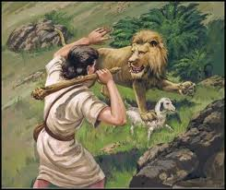
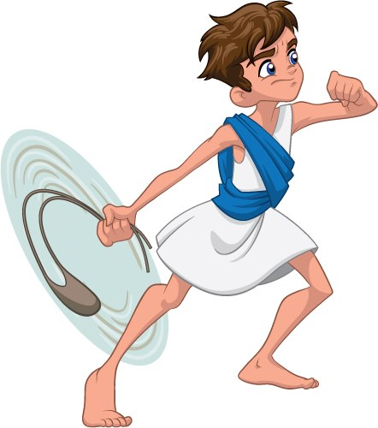
Sometimes it was scary!
He had to watchout for
LIONS
BEARS
COYOTES
SNAKES
He fought the sheep’s enemies with his rod and his sling.
He trusted God to protect him while he protected the sheep.

Slide 21
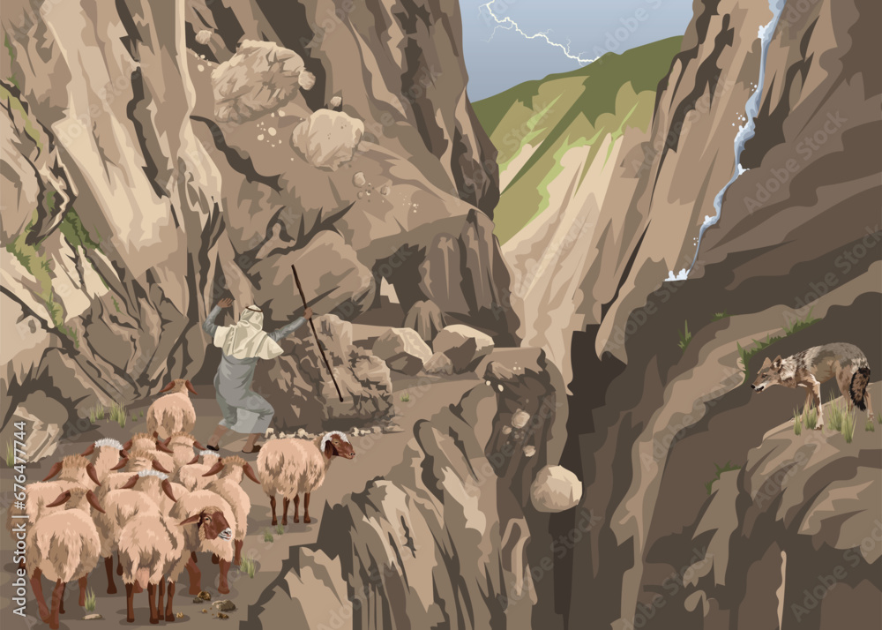
Yikes! That was close.
Those rocks almost hit us!
God is protecting us.
Never fear, my sheep,
I am with you.
Baa. You say.
Oh, I see,
there’s a wolf just over there.

Slide 22
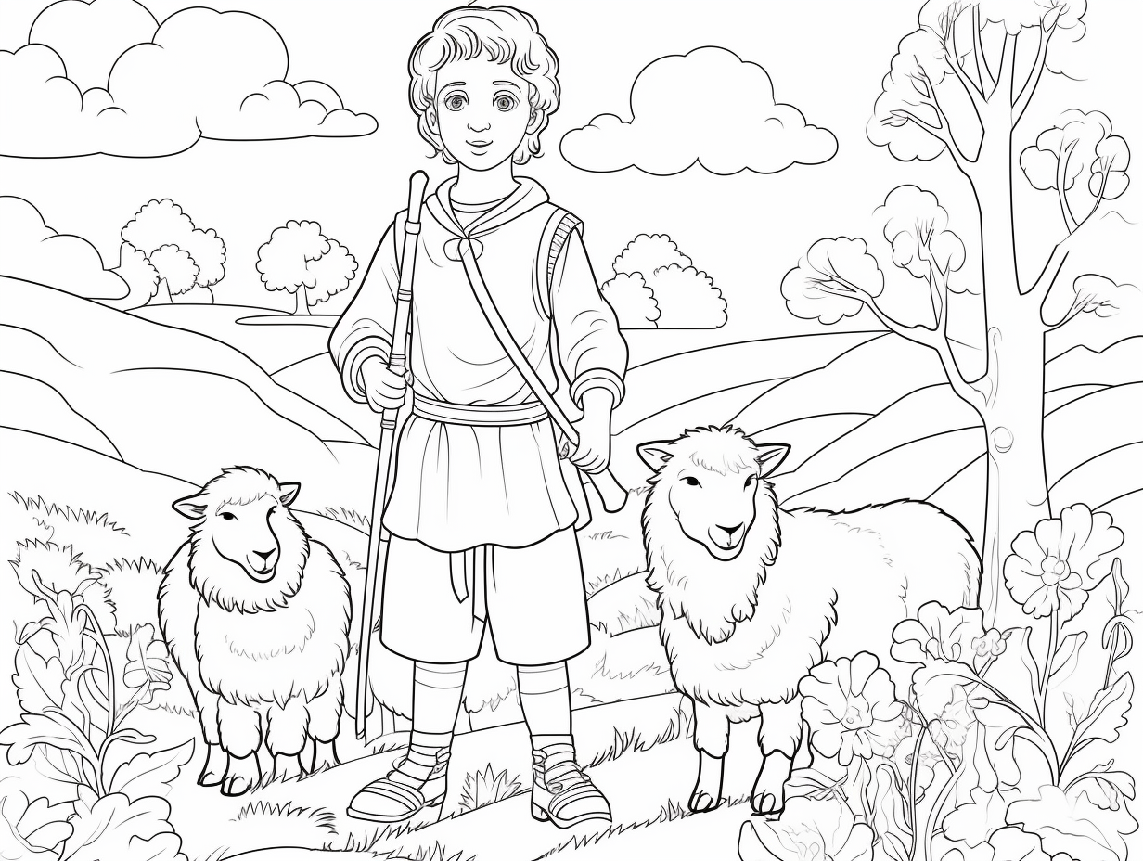
Psalms 23
That’s it!
“Yea, though I walk through the valley of the shadow of death,
I will fear no evil;
For You are with me;
Your rod and Your staff,
they comfort me.”
Yes, there have been some scary times.
We’ve gone through our share of dark valleys.
Whew! That was a long scary climb through the valley, but now we are here in the upper meadow – safe and sound.

Slide 23
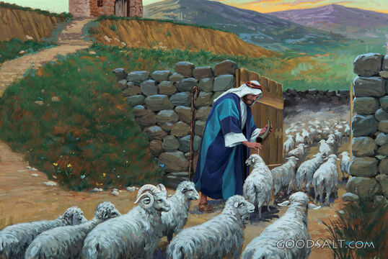
I see, you too have an injury. A little oil will help it heal.
I too, was anointed with oil.
Some day I will be king.
I know how to care for sheep, but I don’t know how to be king.
And you have some fleas.
Oil will send them away.

Slide 24
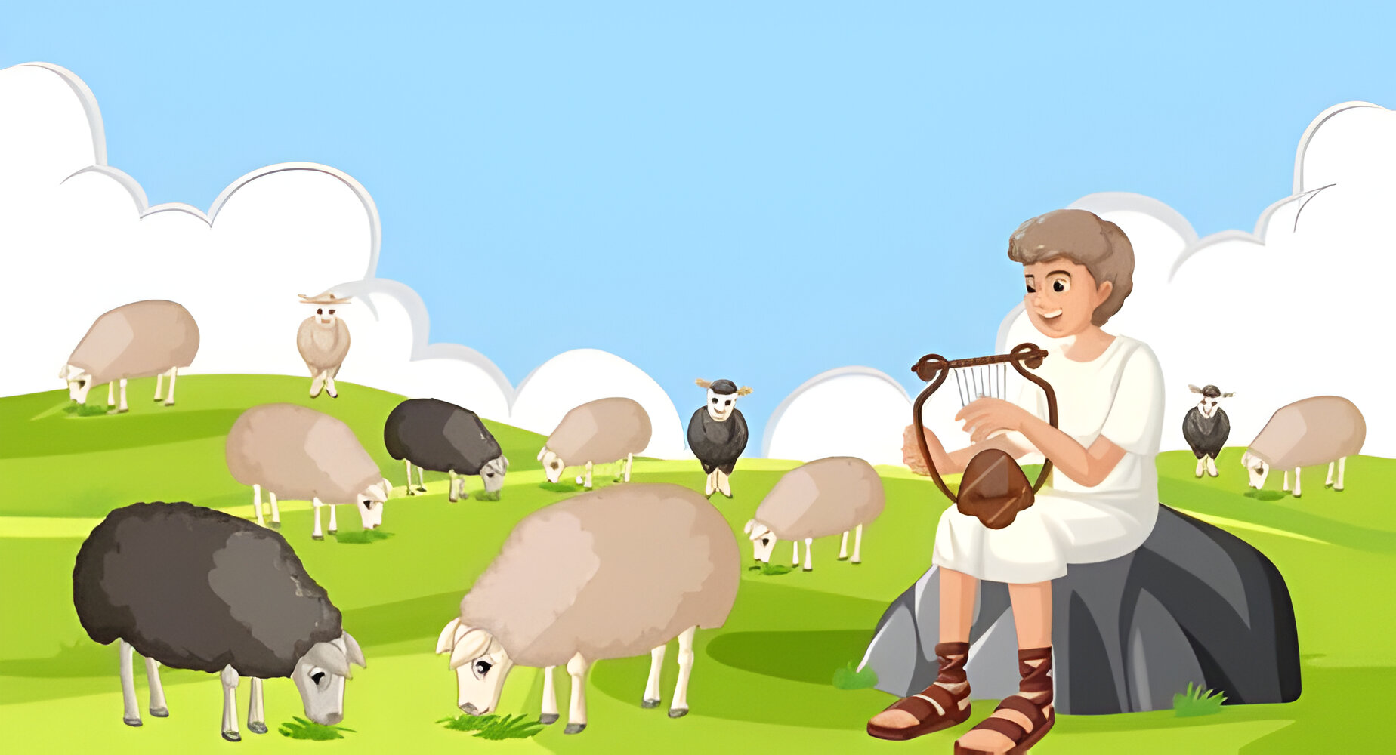
I trust God that He will prepare me for His special job for me.
He will prepare me to be king.
Enjoy the sweet grass of the highland! I looked the area over and removed the dangers.
You prepare a table before me in the presence of my enemies.
You anoint my head with oil;
My cup runs over.

Slide 25



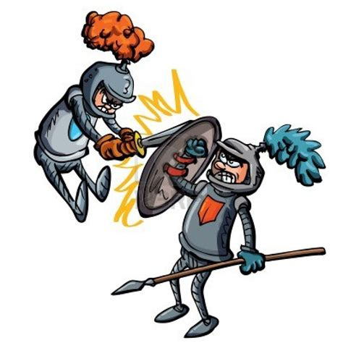
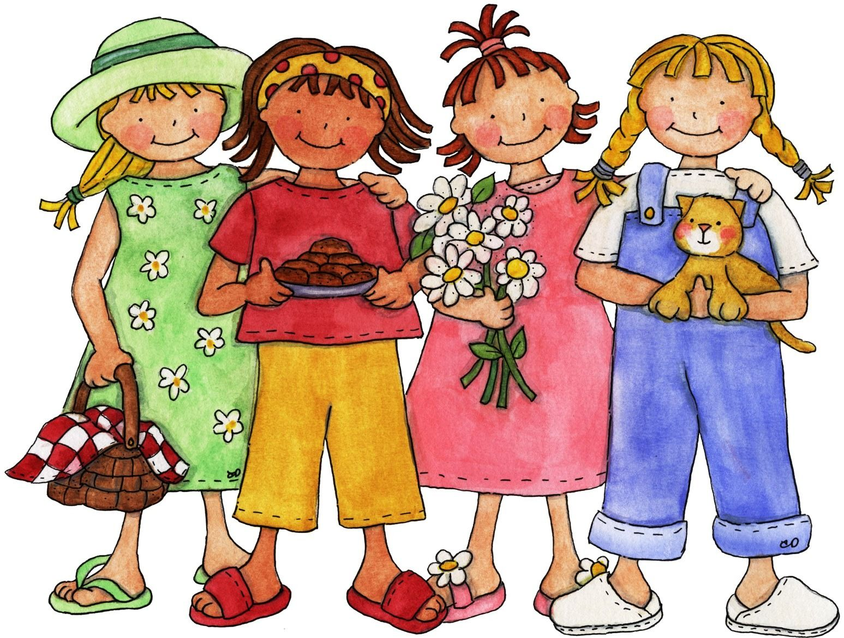





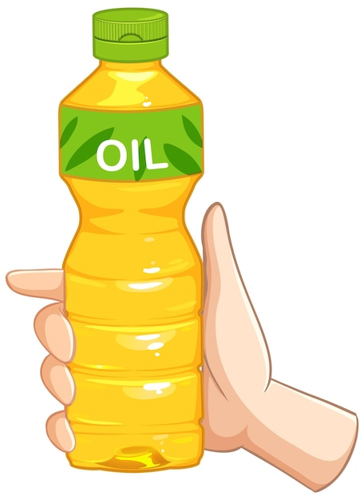

Can you figure out what the memory verse is? Each line is a letter. Use the picture clues.
4
prepare
table
before
me
You _ _ _ _ _ _ _ a _ _ _ _ _ _ _ _ _ _ _ _
_ _ the _ _ _ _ _ _ _ _ of _ _ _ _ _ _ _ _ _.
_ _ _ anoint _ _ _ _ _ _ with _ _ _. _ _ _ _ _ runs _ _ _ _
Psalms (5x4)+2 : (2+3)
in
presence
my
enemies
You
my
head
oil
My
cup
over

Slide 26
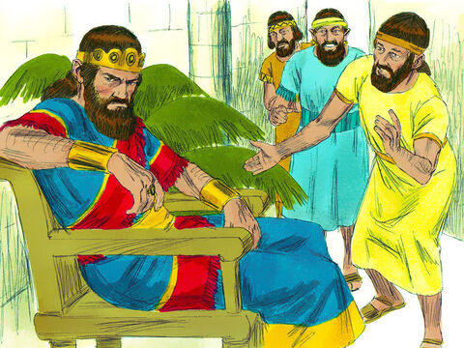
God had not forgotten David nor Saul.
I do everything wrong.
No one likes me.
The evil torments me.
1 Samuel 16:
¹⁴ The Spirit of the Lord had left Saul. And an evil spirit sent by the Lord terrified him.
¹⁵ Saul’s attendants said to him, “An evil spirit sent by God is terrifying you. ¹⁶ Give us an order to look for someone who can play the harp. He will play it when the evil spirit sent by God comes on you. Then you will feel better.”
Tell us to find someone who can play the harp to soothe your troubled thoughts.

Slide 27
God had a special job for David to do.
While David did this job he was learning how to be a king.
1 Samuel 16:
¹⁷ So Saul said to his attendants, “Find someone who plays the harp well. Bring him to me.”
¹⁸ One of the servants said, “I’ve seen someone who knows how to play the harp. He is a son of Jesse from Bethlehem. He’s a brave man. He would make a good soldier. He’s a good speaker. He’s very handsome. And the Lord is with him.”
¹⁹ Then Saul sent messengers to Jesse. He said, “Send me your son David, the one who takes care of your sheep.”
He is David, the son of Jesse. He takes care of his father’s sheep.
I know a handsome strong boy who plays the harp well.
He is also a warrior.
Go tell Jesse.
“Send me your son David, the one who takes care of your sheep.

Slide 28
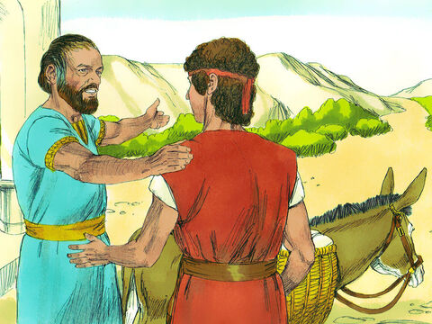
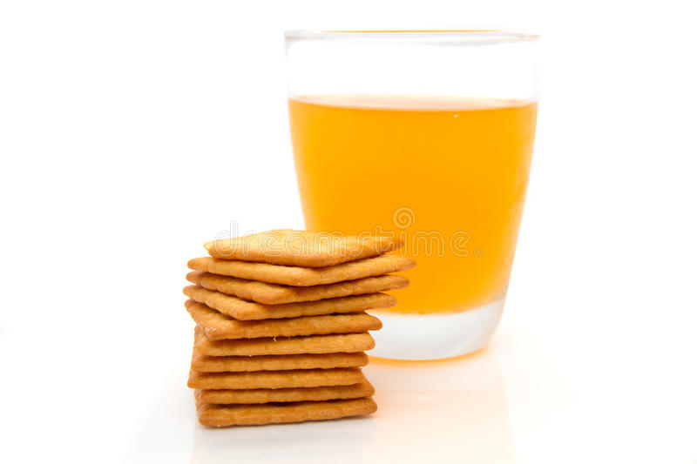
David served the king
Take these gifts to the king. May God be with you as you serve him.
I will miss you and my sheep.
Take care….
I will father.
Thank you!
1 Samuel 16:
²⁰ So Jesse got some bread and a bottle of wine. The bottle was made out of animal skin. He also got a young goat. He loaded everything on the back of a donkey. He sent all of it to Saul with his son David.
SNACK
TIME

Slide 29
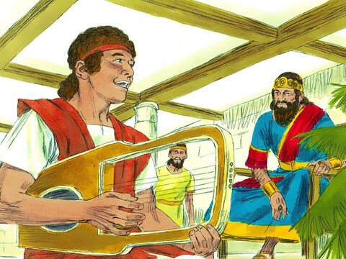
David served the king
Surely goodness and mercy
shall follow me all the days of my life;
And I will dwell in the house of the Lord forever.
Thank you!
I appreciate you.
1 Samuel 16:
²¹ David went to Saul and began to serve him. Saul liked him very much.

Slide 30
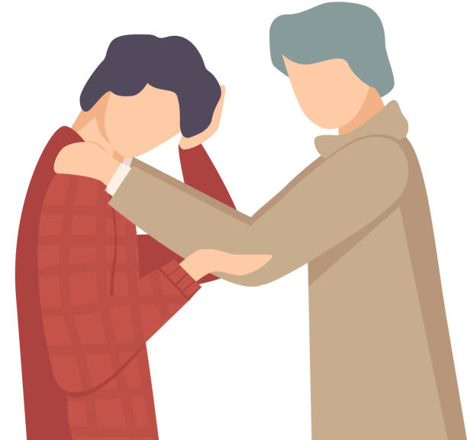
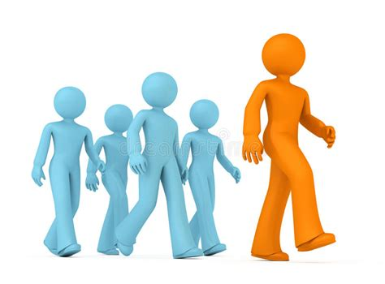




Can you figure out what the memory verse is? Each line is a letter. Use the picture clues.
good
mercy
follow
me
Surely _ _ _ _ ness and _ _ _ _ _ will _ _ _ _ _ _ _ _
all the _ _ _ _ of _ _ life.
And _ will dwell _ _ the _ _ _ _ _ of the _ _ _ _ forever.
Psalms (5x4)+2 : (3+3)
days
my
I
in
house
Lord

Slide 31
David served the king
The Lord gives me strength.
He is like a shield that keeps me safe.
My heart trusts in him, and he helps me.
My heart jumps for joy.
With my song I praise him.
Psalms 28:7
Please stay here and serve me.
In fact, I would like you to be my armor bearer.
1 Samuel 16:
David became one of the men who carried Saul’s armor. ²² Saul sent a message to Jesse. Saul said, “Let David stay here. I want him to serve me. I’m pleased with him.”

Slide 32
David served the king
The Lord will keep you from all harm—
He will watch over your life;
the Lord will watch over your coming and going both now and forevermore.
Psalms 121:7-8
You have soothed my troubled mind. When you are here, the evil spirit leaves.
1 Samuel 16:
²³ When the evil spirit sent by God would come on Saul, David would get his harp and play it. That would help Saul. He would feel better, and the evil spirit would leave him.

Slide 33

David wrote a song to God:
“Your arm is powerful.
Your hand is strong.
Your right hand is mighty.”
Psalm 89:13

Slide 34

Sing God is our Refuge and Strenth
God is our refuge and strength,
A very present help in trouble. Psalms 46:1

Slide 35
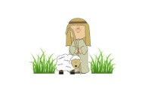
Sing Psalms 23

Slide 36

Our Story in Review

Slide 37
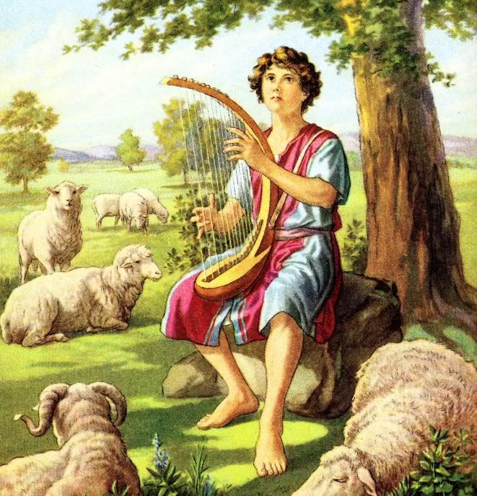
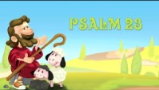
While the sheep rested, David enjoyed playing a harp and praising God.
He wrote many of the songs in the book of Psalms in the Bible.
^{Here’s one song:}
Let’s find Psalms 23
in our Bibles
and read it together.

Slide 38

The End

