Slide 1

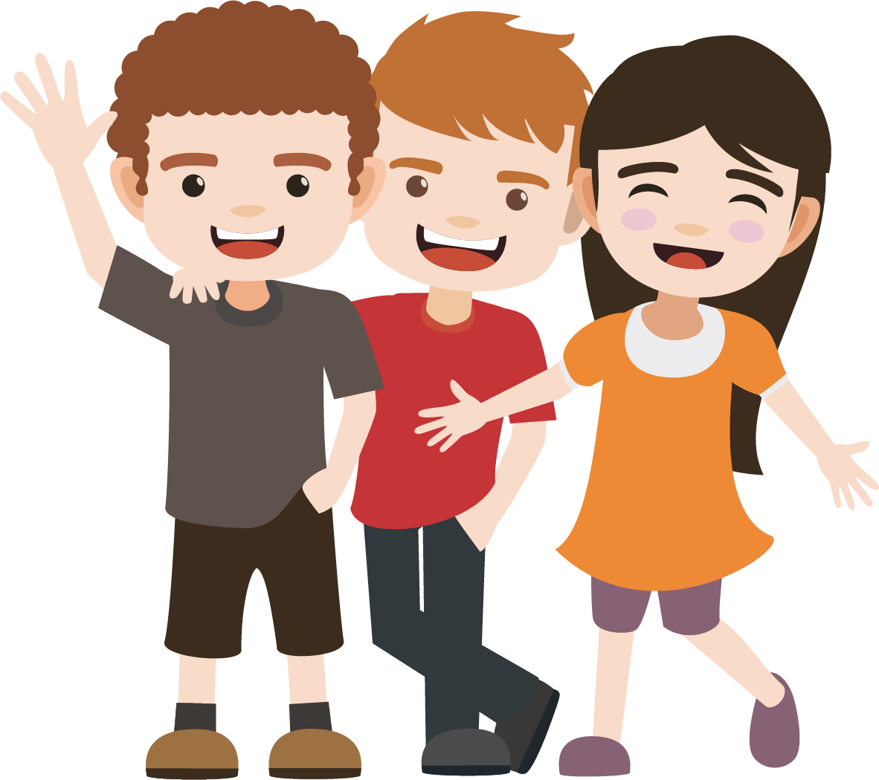
David and Jonathan
Promised Friendship and Loyalty
1 Samuel 18:1-4
1 Samuel 20

Slide 2
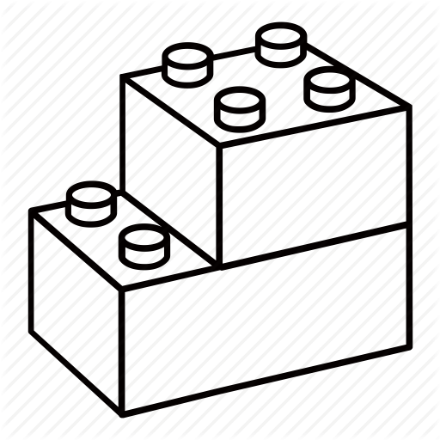
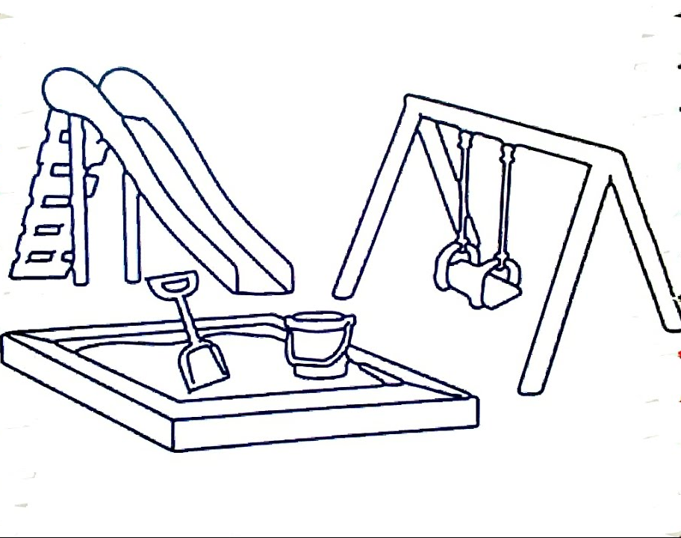
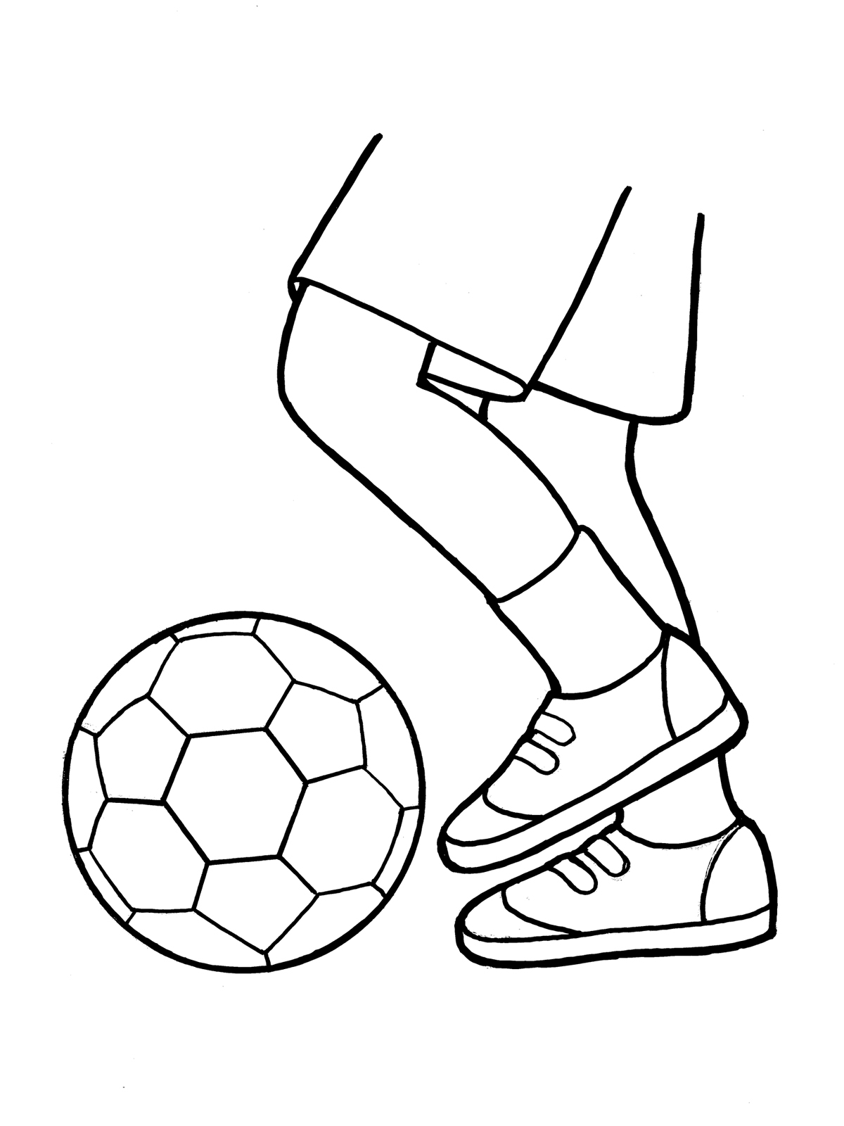

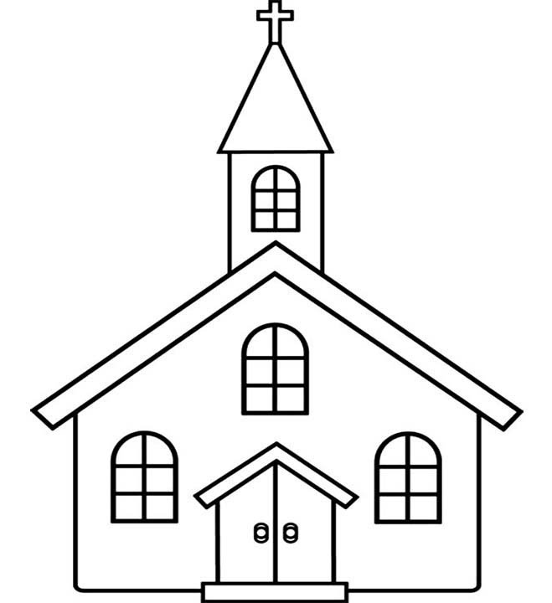
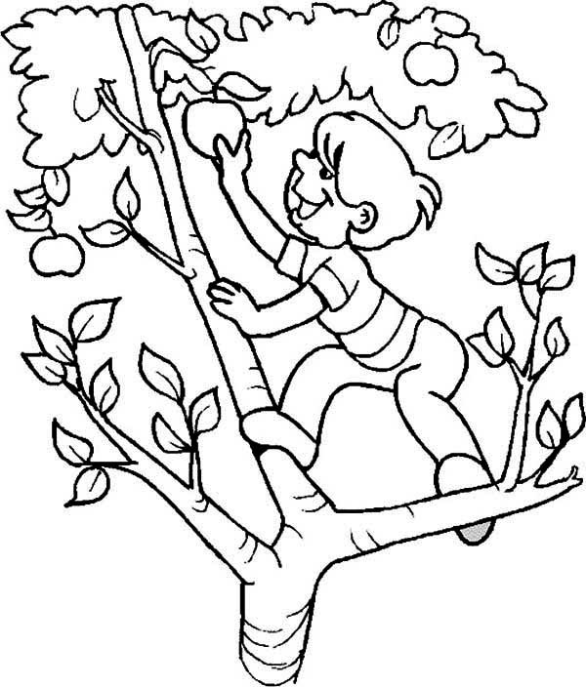
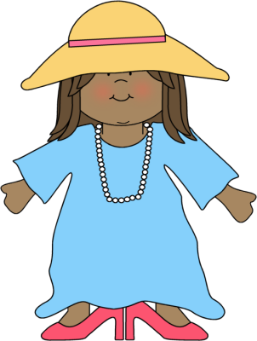
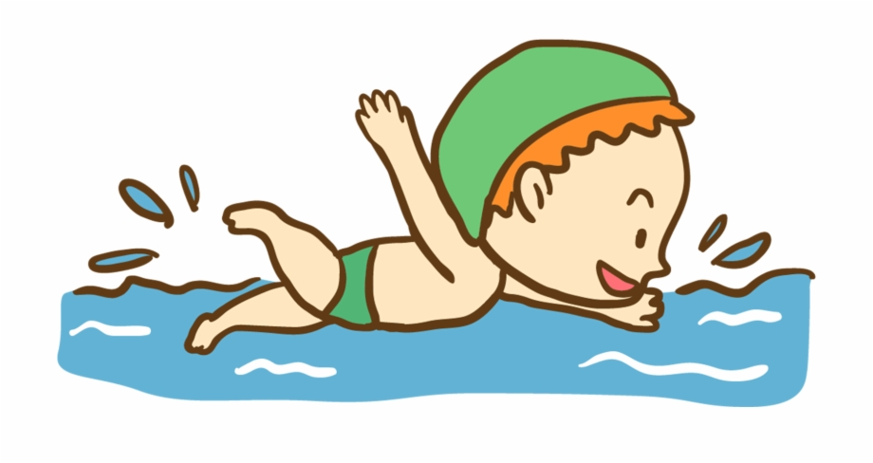
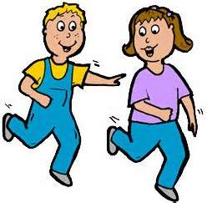
What do you like to do with your friends?
Make a Best Friend Forever Card
B | F | F
On each square of the card draw something that you like to do with friends.
You might draw something like this …
(if that is what you like)
Now go around the room and have other kids write their names on the squares that show things they also like to do.

Slide 3

Real Friends

Slide 4

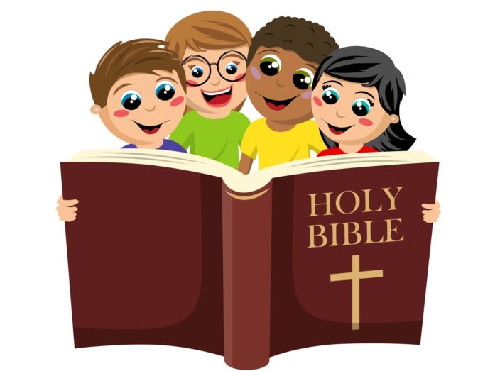
Friendship
Let’s find and read:
The righteous choose their friends carefully, but the way of the wicked leads them astray.
The Bible teaches us to love everyone, to be kind to everyone. That is important!
David and Jonathan both were kind and loving to everyone, but their friendship was something very special.
They both believed in God and His Almighty power. They both wanted to do God’s will. They promised to encourage each other and support each other to continue to do this.
This is very important.
Proverbs 12:26

Slide 5
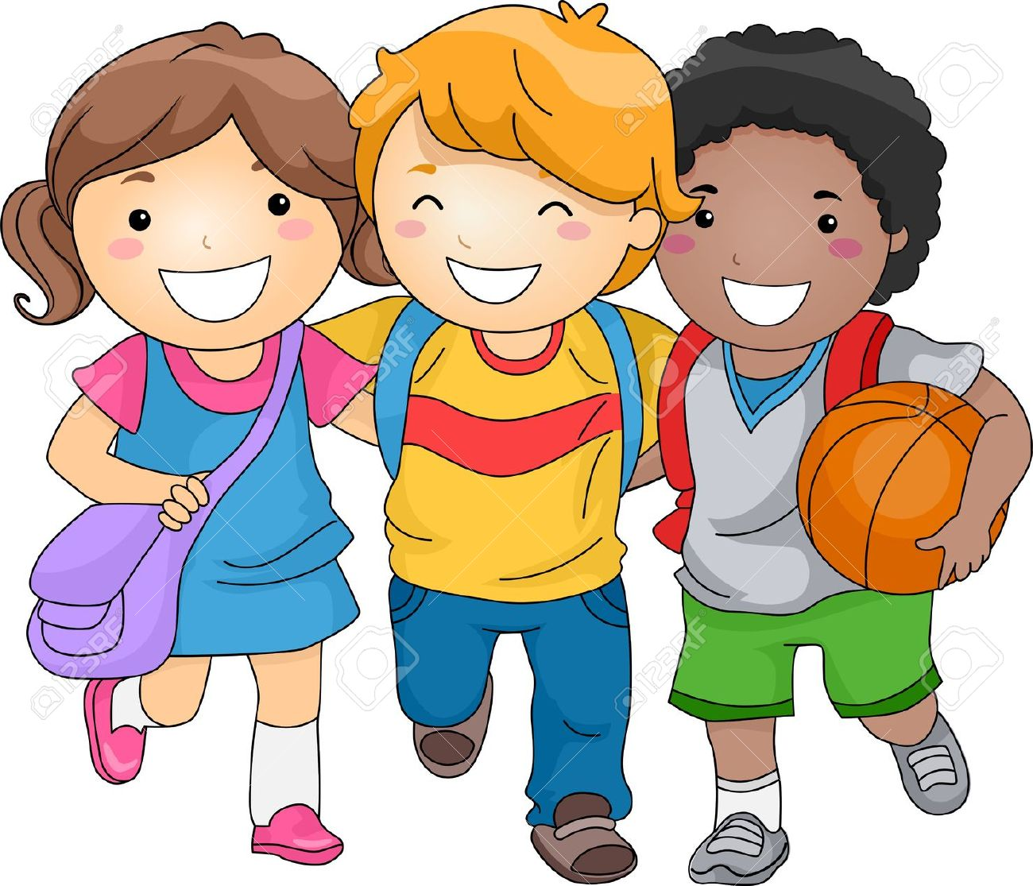
Friendship
Let’s find and read:
Walk with the wise and become wise; associate with fools and get in trouble.
Proverbs 13:20
Good friends help us make good choices!

Slide 6
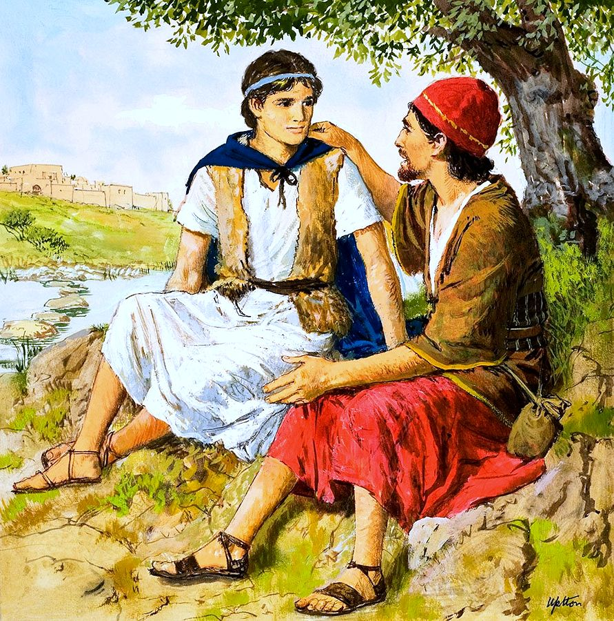
Our story today is about two gentlemen who loved God with all their hearts and became great friends.

Slide 7
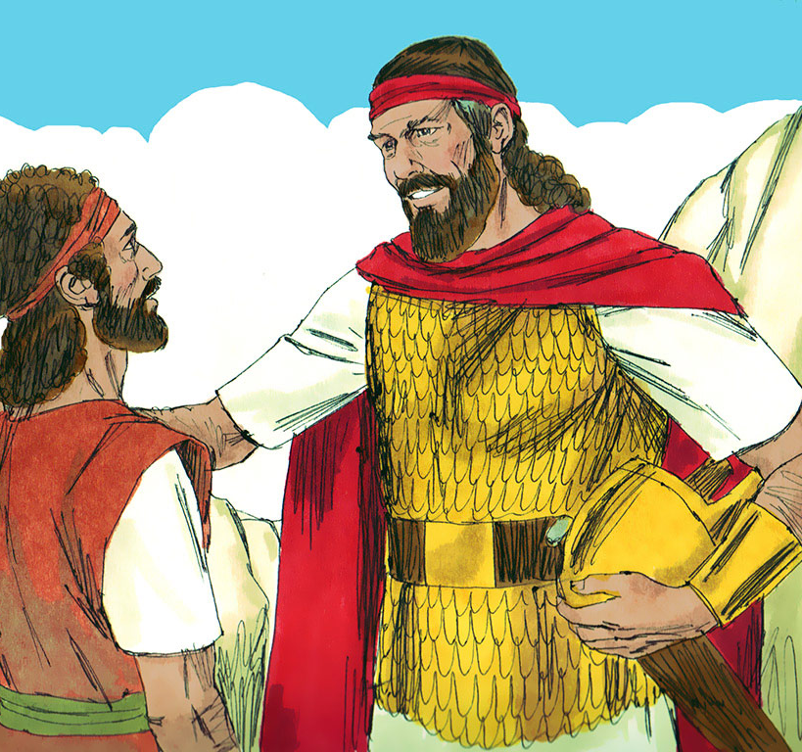
David
Welcomed to the Palace
1 Samuel 18
(David had just led the Israelites in victory over Goliath and the Philistines…)
After David had finished talking with Saul, Jonathan became one in spirit with David, and he loved him as himself.
² From that day Saul kept David with him and did not let him return home to his family. ….
⁵ Whatever mission Saul sent him on, David was so successful that Saul gave him a high rank in the army. This pleased all the troops, and Saul’s officers as well.

Slide 8
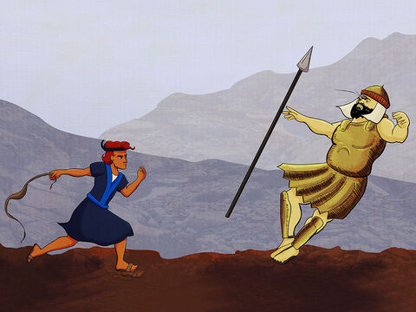
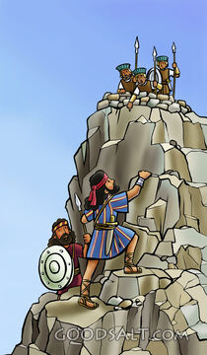
Prince Jonathan
Jonathan was King Saul’s son.
He was prince of Israel.
When Jonathan met David, they became the best of friends! They both believed in God and that our Almighty, Powerful God was with them and that He strengthened them to overcome evil. They both trusted God and wanted His will to be done.
Jonathan knew in his heart that God had chosen David to be the future king. Even though he was prince, Jonathan accepted David and was not jealous of him.
David, I like how you trust in God.
Like me, you believe, that God can save whether there are many or few with us.
God has helped each of us win battles alone,
by His Almighty Power!
Let’s make a covenant to be friends.
Let’s make a covenant that we will always
help and protect each other.

Slide 9
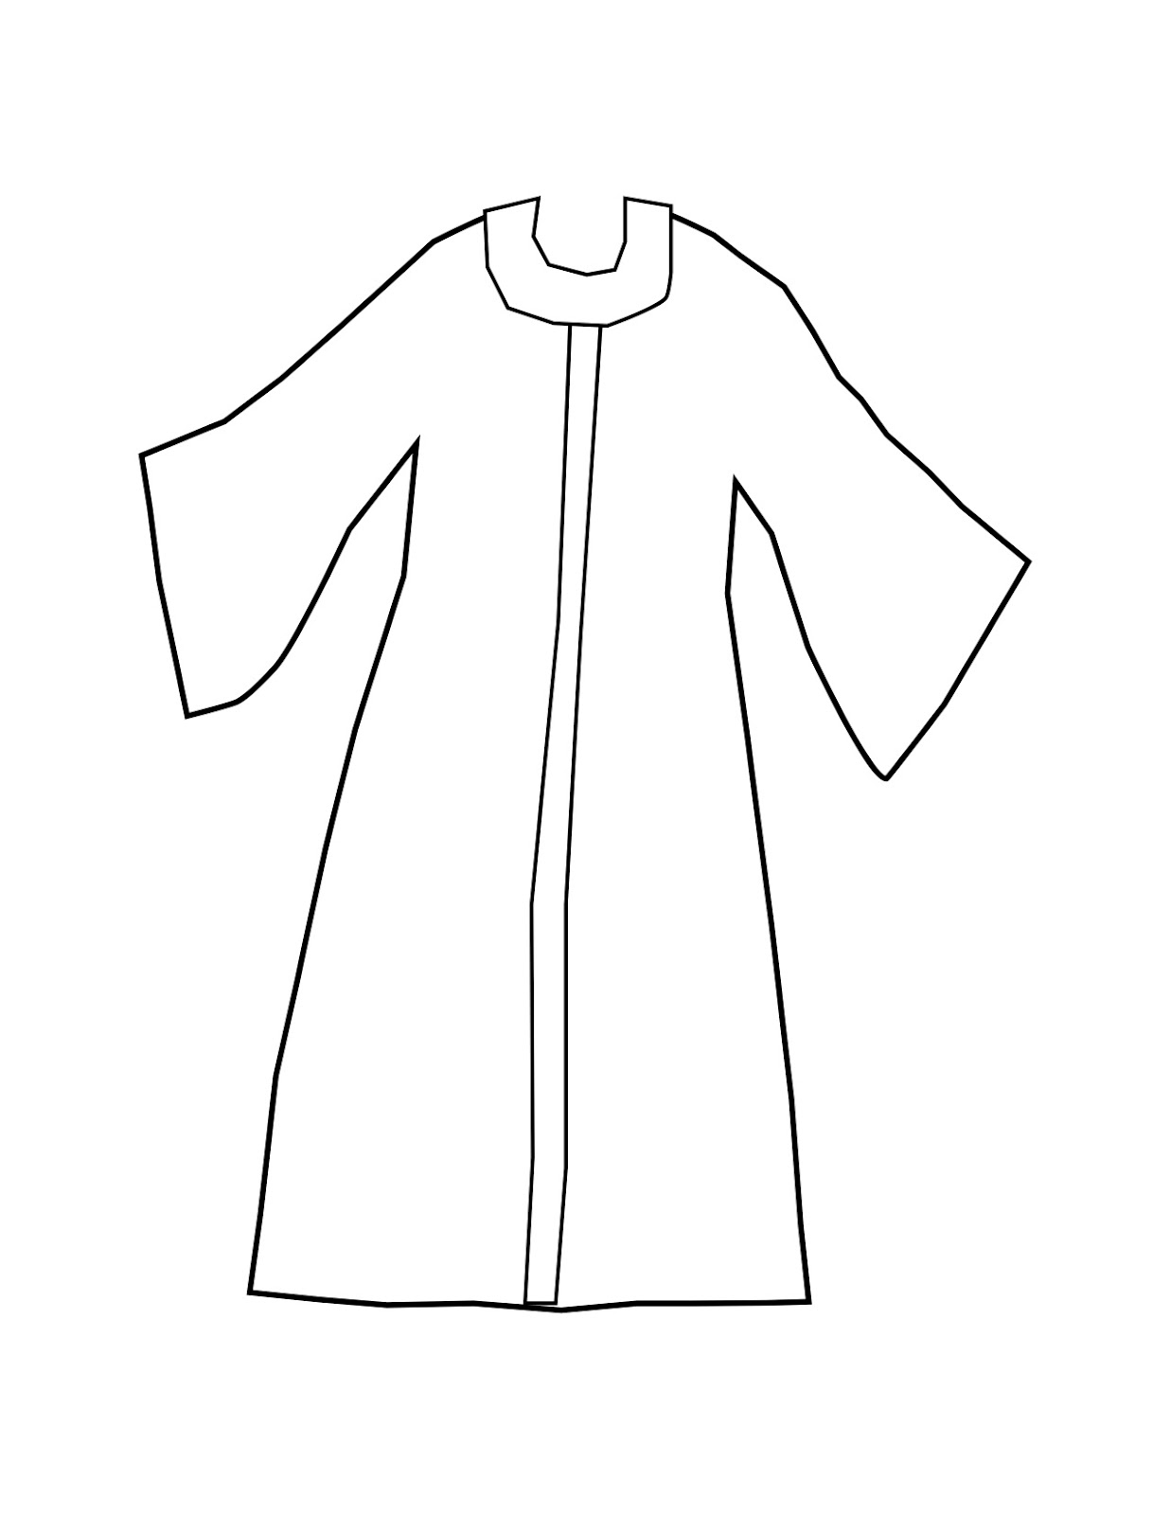
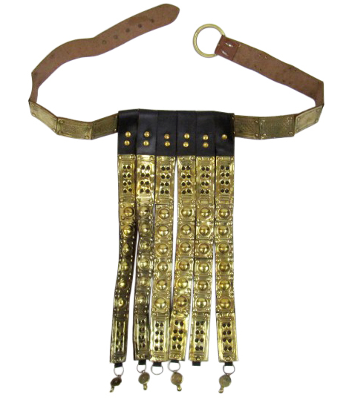
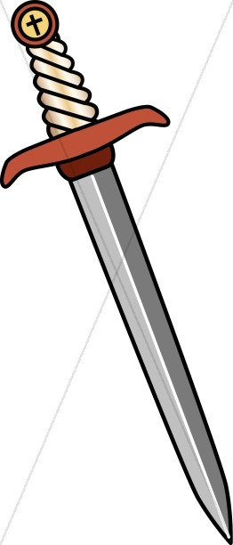
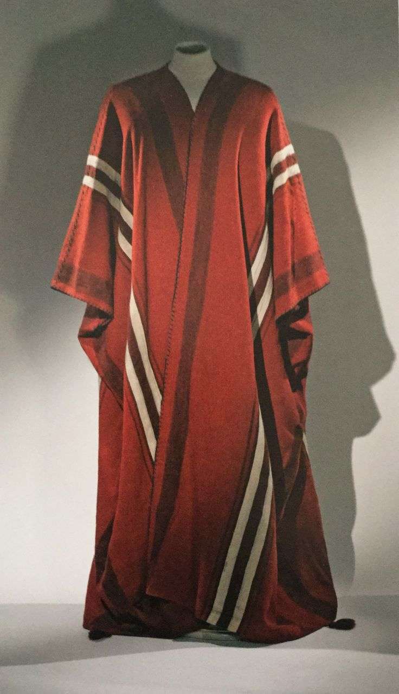
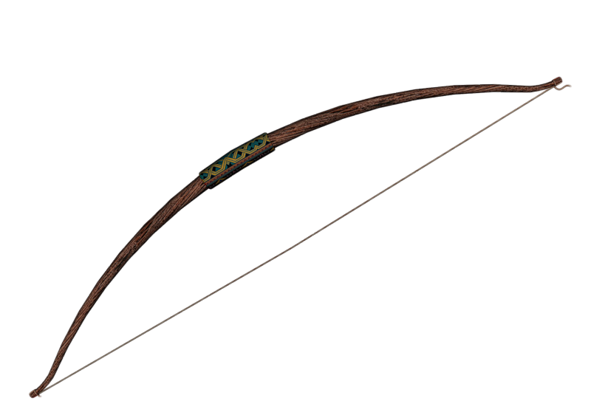
I need two volunteers to act out the next part of our story.
One of you will be Jonathan and the other one David.
Jonathan, I’m giving you some things that every prince would wear.
You can put them on:
A tunic
A belt for protection
An expensive princely robe
A sword
A bow

Slide 10
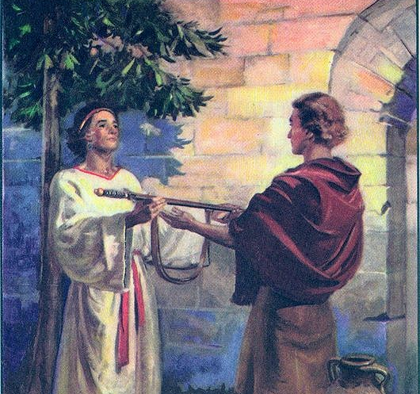
Jonathan honored David
He gave him his princely clothing
^{1 Samuel 18:3}Jonathan made a covenant with David because he loved him as himself. ⁴ Jonathan took off the robe he was wearing and gave it to David,
Jonathan remembered what Samuel had told Saul, a message from the LORD:
^{: 1 Samuel 13}:¹⁴ But now your kingdom will not endure; the Lord has sought out a man after his own heart and appointed him ruler of his people, because you have not kept the Lord’s command.’
I know that Samuel told my father, King Saul, that the kingdom will not stay in our family.
Put on my robe, the robe that signifies that I am prince of Isreal and will become king.
I humbly accept that you are God’s choice
to be the next king.
Samuel said that God has chosen someone else to be king some day.
I believe that someone is you.
I can see that the LORD is with you
and that you trust Him.

Slide 11
Jonathan honored David
He gave him his princely clothing
^{1 Samuel 18:3}Jonathan made a covenant with David because he loved him as himself. ⁴ Jonathan took off the robe he was wearing and gave it to David, along with his tunic, and even his sword, his bow and his belt.
Here, put on my personal tunic.
You trust God, like I do.
I will treat you with love and respect
as if you were myself.

Slide 12
Jonathan honored David
He gave him his princely clothing
Put on my sword.
You will lead the army in the Lord’s battles.
I give you my weapons because
I will not go against you.
I surrender my place as prince and give it to you.
Take my bow.
May God strengthen your arm.
The Battle is the LORD’s
Also put on my belt.
When I wear it I am ready for battle.
It holds my weapons and is my armor.
God will make you ready and protect you.
^{1 Samuel 18:3}Jonathan made a covenant with David because he loved him as himself. ⁴ Jonathan took off the robe he was wearing and gave it to David, along with his tunic, and even his sword, his bow and his belt.

Slide 13
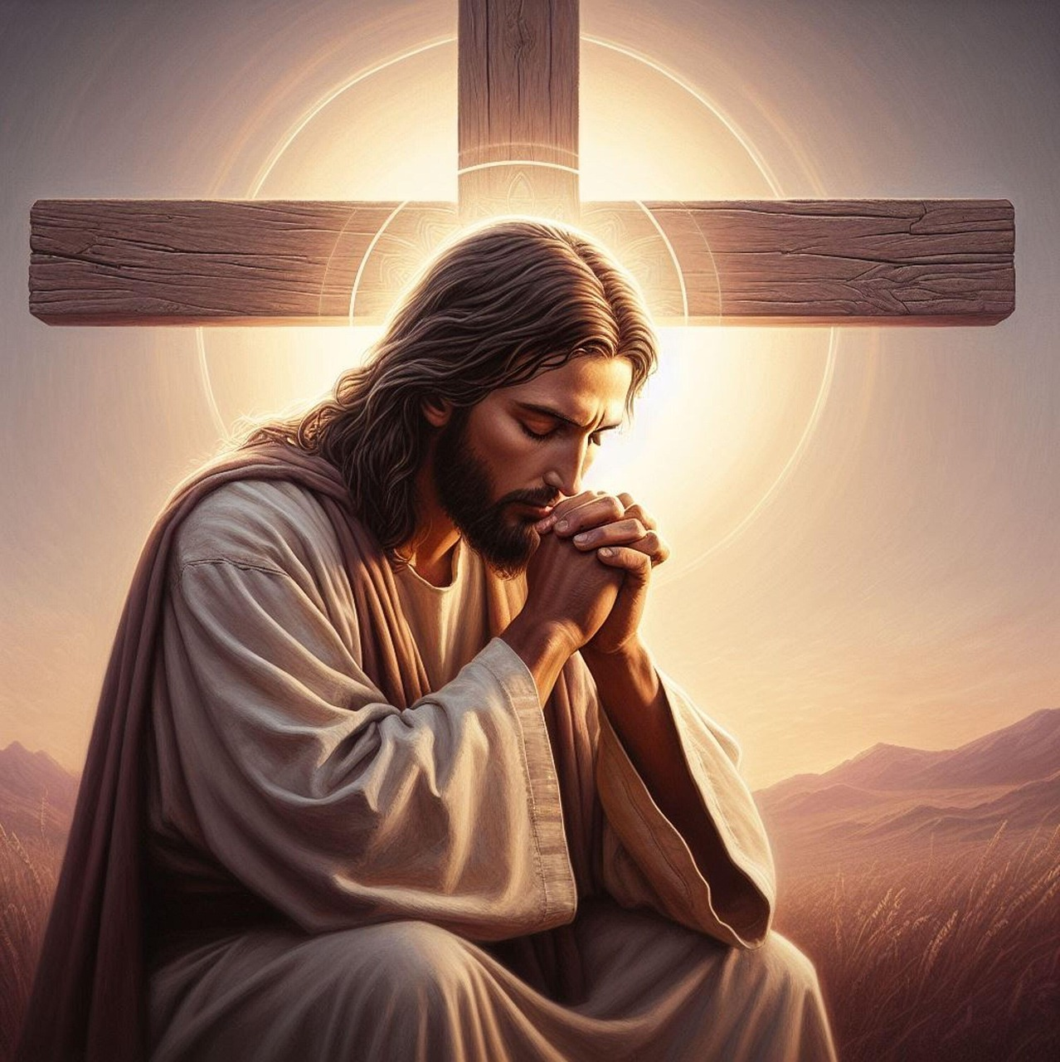
humility
Jonathan gives us a picture of Christ.
. Self-Emptying. Jonathan, the rightful heir, voluntarily relinquishes honor—anticipating the Messiah who “emptied Himself, taking the form of a servant” (Philippians 2:7).
2. Covenant Mediator. As Jonathan stands between Saul and David (1 Samuel 19:4), he prefigures the one Mediator between God and man (1 Timothy 2:5).
3. Garment Exchange & Imputed Righteousness. Just as Jonathan clothes David, Isaiah foresees believers “clothed with garments of salvation” (Isaiah 61:10), fulfilled in Christ’s imparted righteousness (2 Corinthians 5:21).
Christ Jesus:
⁶ who, being in very nature^{[a]} God,
did not consider equality with God something to be used to his own advantage;
⁷ rather, he made himself nothing
by taking the very nature^{[b]} of a servant,
being made in human likeness.
⁸ And being found in appearance as a man,
he humbled himself
by becoming obedient to death –
even death on a cross!
^{1 Samuel 19:4} Jonathan spoke well of David to Saul his father and said to him, ‘Let not the king do wrong to his servant David; he has not wronged you, and what he has done has benefited you greatly
.
^{1Timothy 2:5} For there is one God and one mediator between God and mankind, the man Christ Jesus,
^{Isaiah 61:10} I delight greatly in the Lord;
my soul rejoices in my God.
For he has clothed me with garments of salvation
and arrayed me in a robe of his righteousness,
as a bridegroom adorns his head like a priest,
and as a bride adorns herself with her jewels.
^{2 Corinthians 5:21} Christ didn’t have any sin. But God made him become sin for us. So we can be made right with God because of what Christ has done for us.
https://biblehub.com/q/Why_are_Jonathan_s_gifts_to_David_key.htm

Slide 14
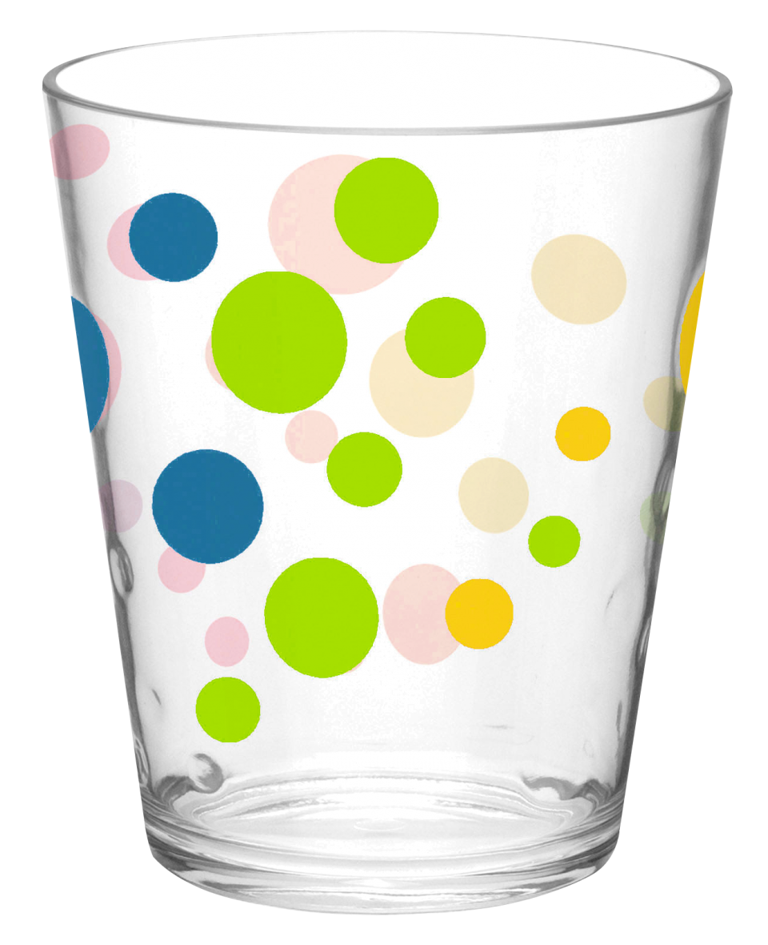

What does it mean to want God’s will?
Tape stationary bottom edge of lazy susan to the table.
Place a cup in the center and spin lazy susan.
When we are in the center of God’s will, all goes well.
Place cup off center and spin lazy susan
When we aren’t willing to do God’s will, disaster happens.
you
me
God & His will
Teacher preview Object lesson by Dr Mark Jackson

Slide 15
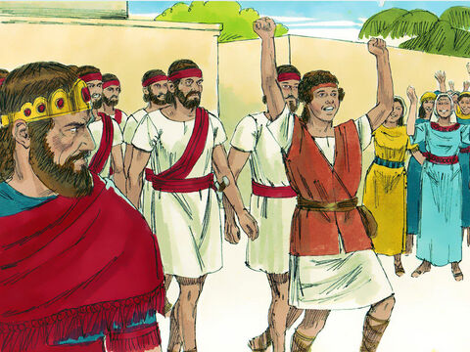
But Saul grew jealous
Saul has slain his thousands, and
David has slain his tens of thousands.
⁶ When the men were returning home after David had killed the Philistine, the women came out from all the towns of Israel to meet King Saul with singing and dancing, with joyful songs and with timbrels and lyres. ⁷ As they danced, they sang:
“Saul has slain his thousands,
and David his tens of thousands.”
⁸ Saul was very angry; this refrain displeased him greatly. “They have credited David with tens of thousands,” he thought, “but me with only thousands. What more can he get but the kingdom?” ⁹ And from that time on Saul kept a close eye on David.
What more can he get but the kingdom?
I must keep a close eye on David.
They have credited David with 10,000’s and me only with 1,000’s

Slide 16
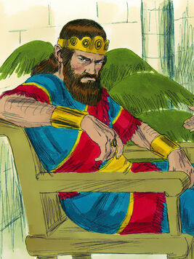
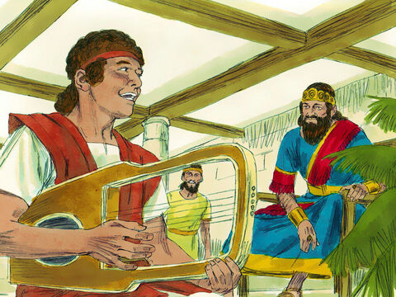
An evil spirit was present
They have credited David with 10,000’s and me only with 1,000’s
The Lord is my light and my salvation—
whom shall I fear?
The Lord is the stronghold of my life—
of whom shall I be afraid?
(Psalms 27:1)
¹⁰ The next day an evil spirit from God came forcefully on Saul. He was prophesying in his house, while David was playing the lyre, as he usually did.

Slide 17
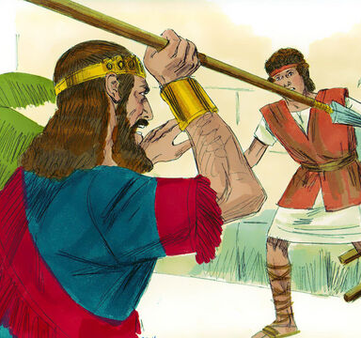
Saul’s jealousy became dangerous
Yikes!
God, protect me.
Saul had a spear in his hand ¹¹ and he hurled it, saying to himself, “I’ll pin David to the wall.”
But David eluded him twice.
Missed.
Try again.
I’ll pin David
to the wall.

Slide 18
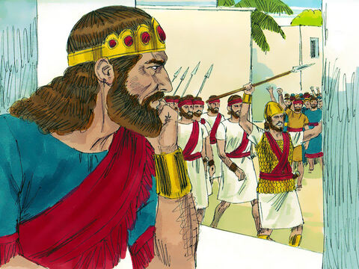
Saul’s jealousy became dangerous
I sent David out to lead only a 1,000 men in battle. It looks like he was not killed.
The people are still singing his praises.
Saul has slain his thousands, and
David has slain his tens of thousands.
¹² Saul was afraid of David, because the Lord was with David but had departed from Saul.
¹³ So he sent David away from him and gave him command over a thousand men, and David led the troops in their campaigns. ¹⁴ In everything he did he had great success, because the Lord was with him. ¹⁵ When Saul saw how successful he was, he was afraid of him.
¹⁶ But all Israel and Judah loved David, because he led them in their campaigns.

Slide 19
Who wanted to God’s will?
Who wanted to obey God and follow him?
Saul
David
Jonathan

Slide 20
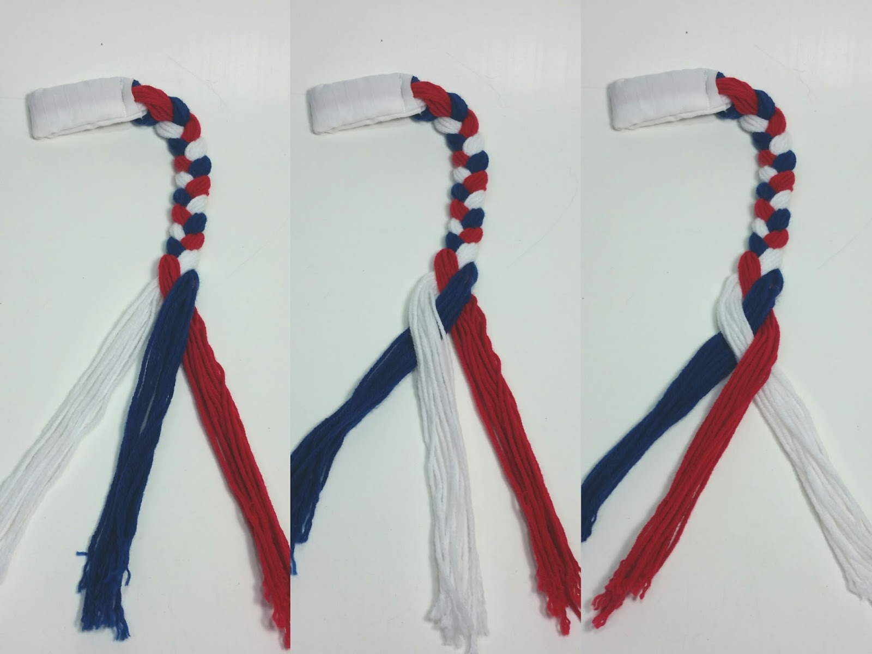

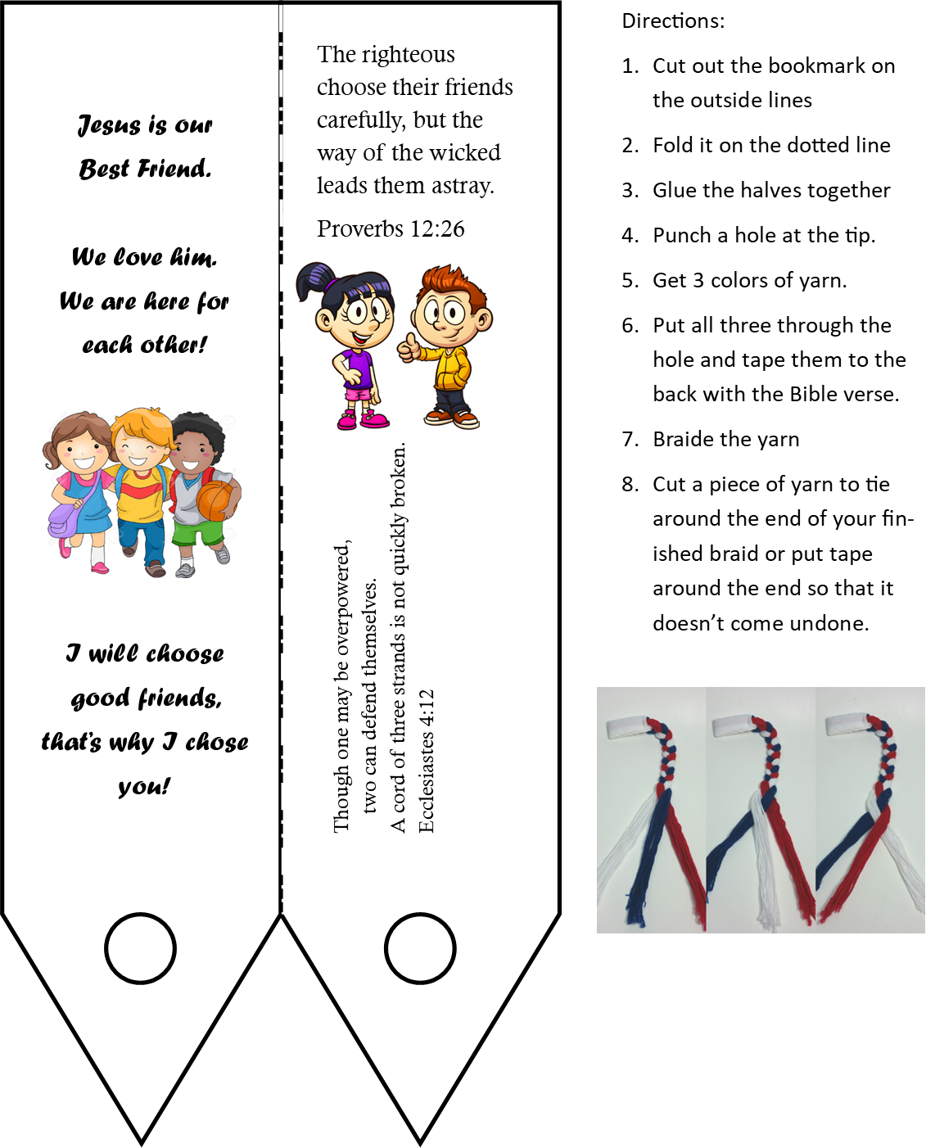
Craft time
Today we’re going to braid yarn to remember that we should connect ourselves with those who are also connected with jesus.
Jesus
is our
best friend.
We are here for each other!
You can keep working on your braid as we continue.

Slide 21
Friendship
Let’s find and read:
Walk with the wise and become wise; associate with fools and get in trouble.
Proverbs 13:20
Good friends help us make good choices!

Slide 22
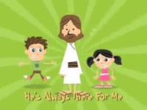
Jesus is my Best Friend

Slide 23
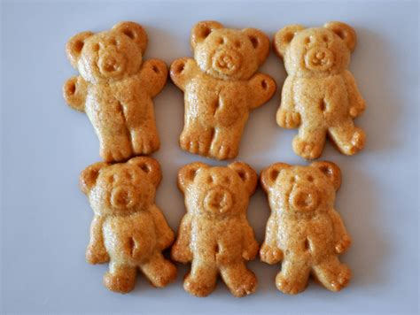
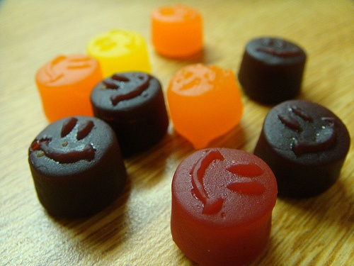
Snack and movie Time

Slide 24
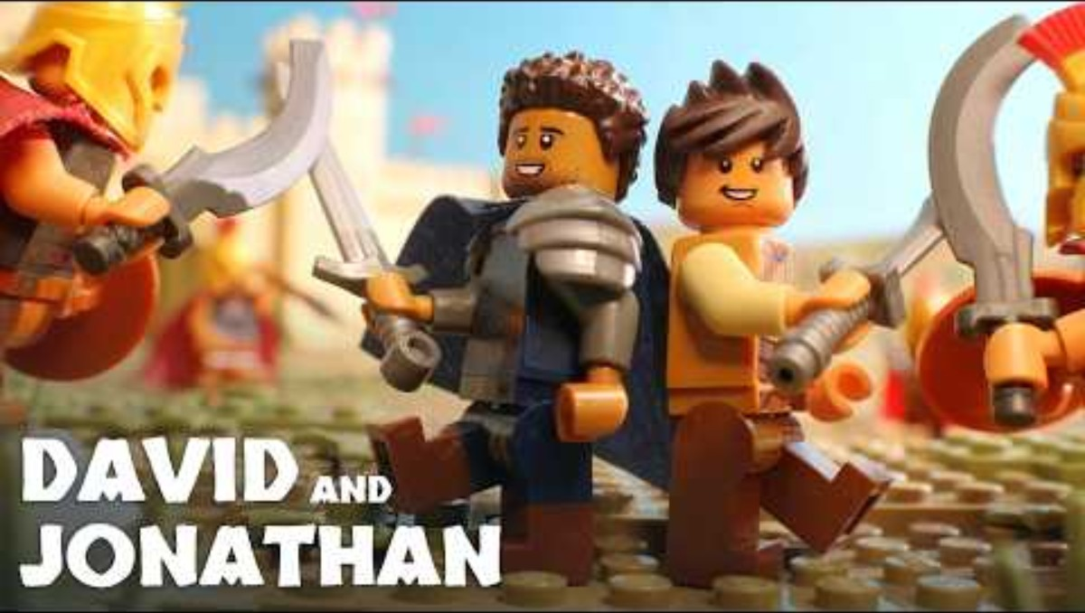

Slide 25
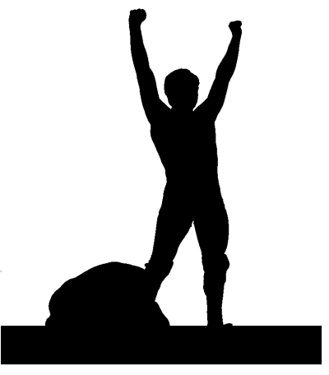
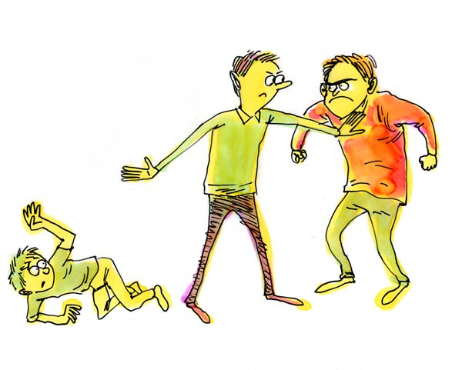
There were times that Jonathan encouraged david
Though one may be overpowered,
two can defend themselves.
A cord of three strands is not quickly broken.
Ecclesiastes 4:12

Slide 26
Friendship
Let’s find and read:
The righteous choose their friends carefully, but the way of the wicked leads them astray.
The Bible teaches us to love everyone, to be kind to everyone. That is important!
David and Jonathan both were kind and loving to everyone, but their friendship was something very special.
They both believed in God and His Almighty power. They both wanted to do God’s will. They promised to encourage each other and support each other to continue to do this.
This is very important.
Proverbs 12:26

Slide 27
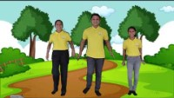
Walking with Jesus

Slide 28
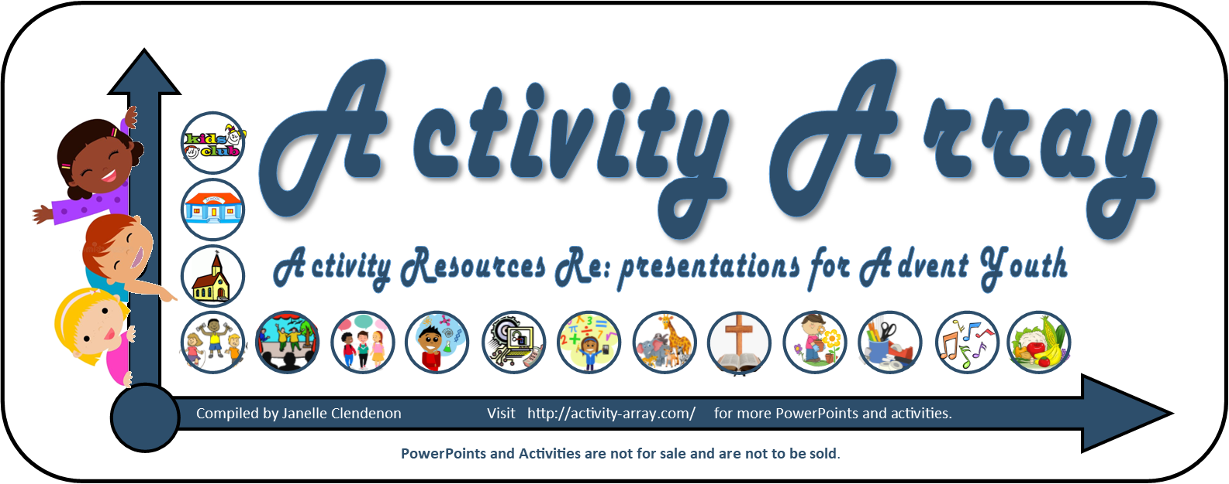
The End
See more at: https://activity-array.com/2022/07/29/david-a-shepherd-boy-becomes-a-king/

Slide 29
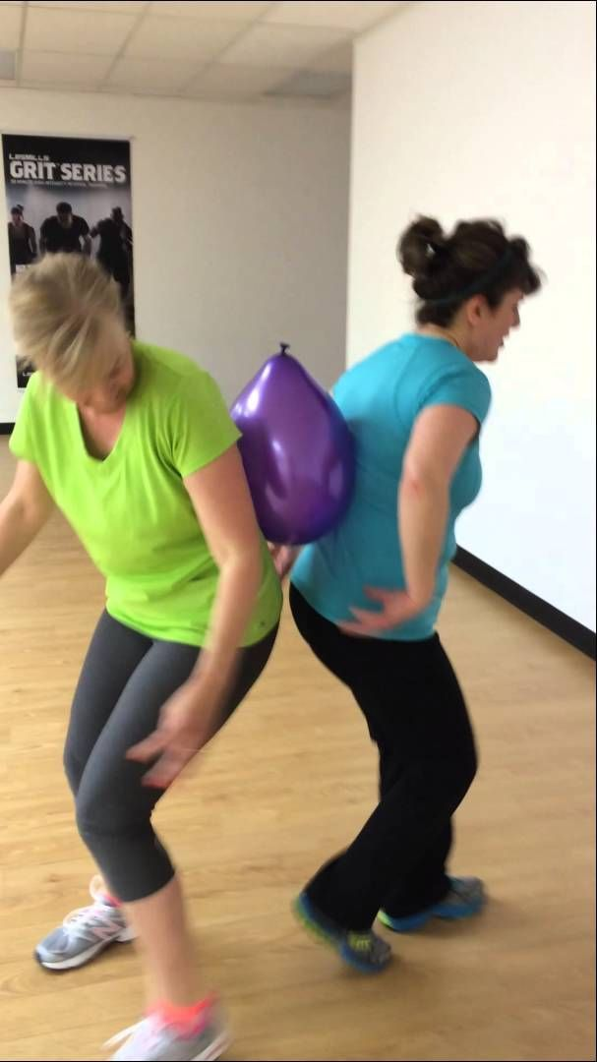
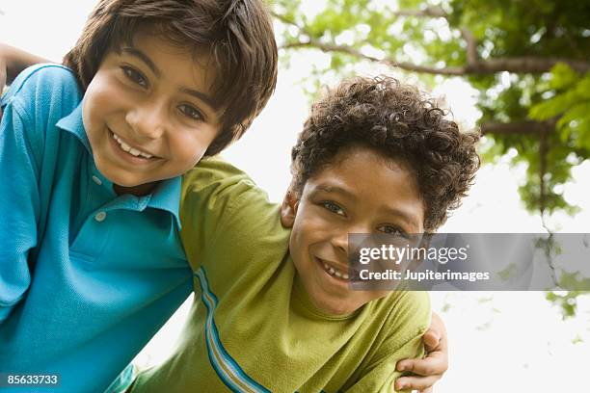
Be a Faithful Friend
Friendship Balloon Balance
Pairs must keep a balloon between their backs or shoulders while moving across the room. This game represents how friends support each other.
Friendship Freeze Tag
Tagged players can be freed only when another child links arms with them. This game reminds kids that friends don’t leave others out.
Game Ideas: at Church Leaders

Slide 30
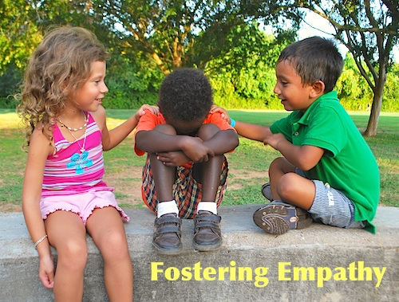
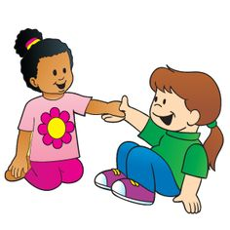
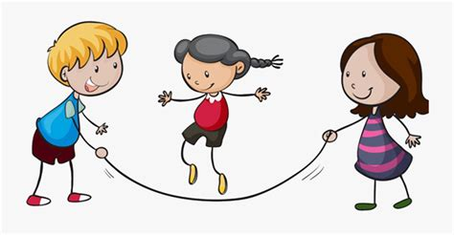
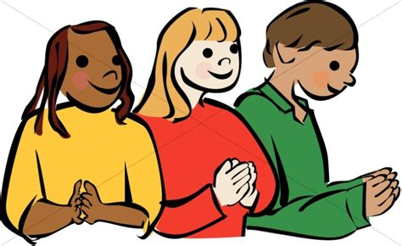
David and Jonathan
Helped one another
Protected one another
Had fun together
Encouraged each other
Both had faith in God

Slide 31
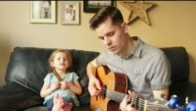
You’Ve Got a friend in me

Slide 32
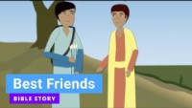
1 Samuel 20

Slide 33
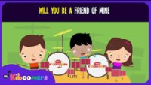
Will you a friend of mine

Slide 34
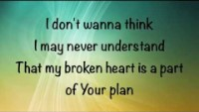
Thy Will Be Done

Slide 35

In review

Slide 36
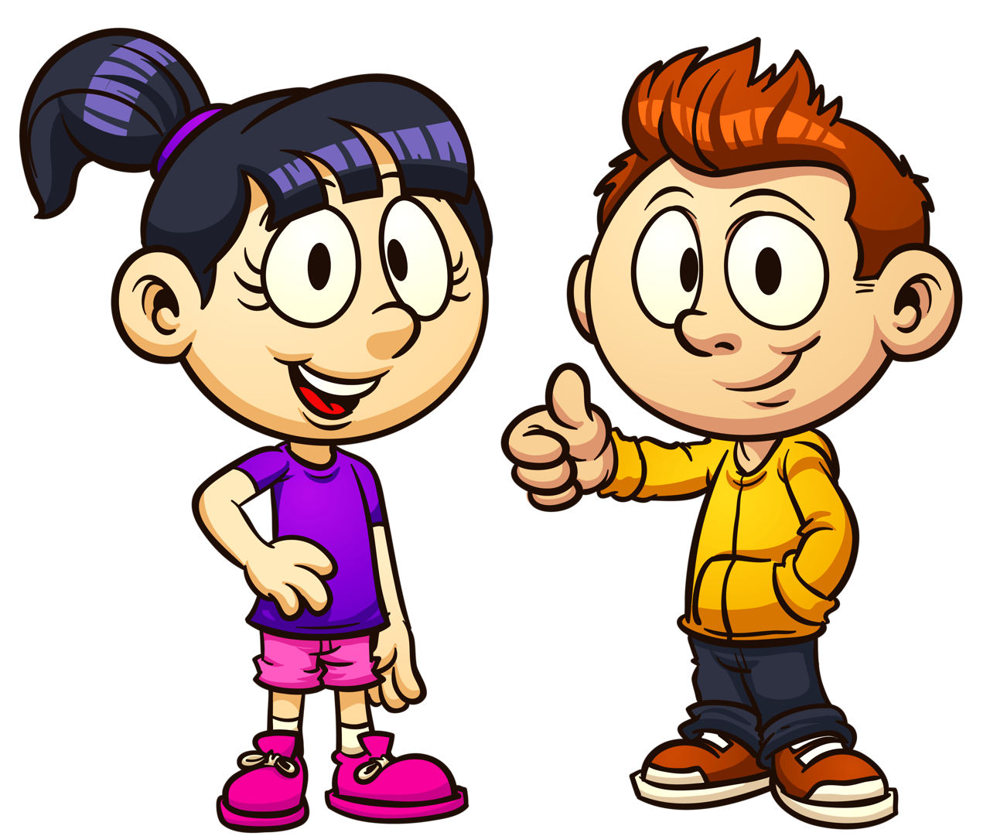
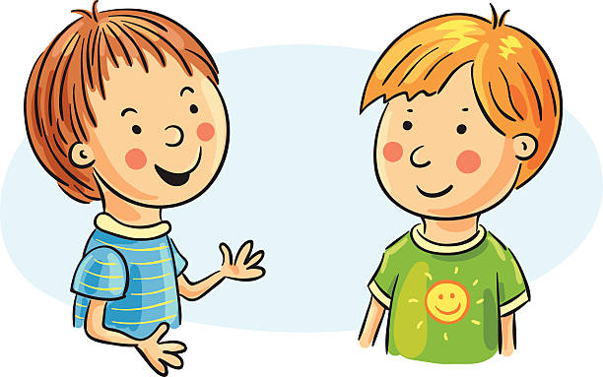
I’m going to give you some stickers.
Go to someone here and ask, “Do you believe in Jesus?”
If they say, “Yes.” Give them a sticker and say, “I would like you to be my friend.”
I would like you to be my good friend!
Do you believe in Jesus?
Yes!

