Slide 1
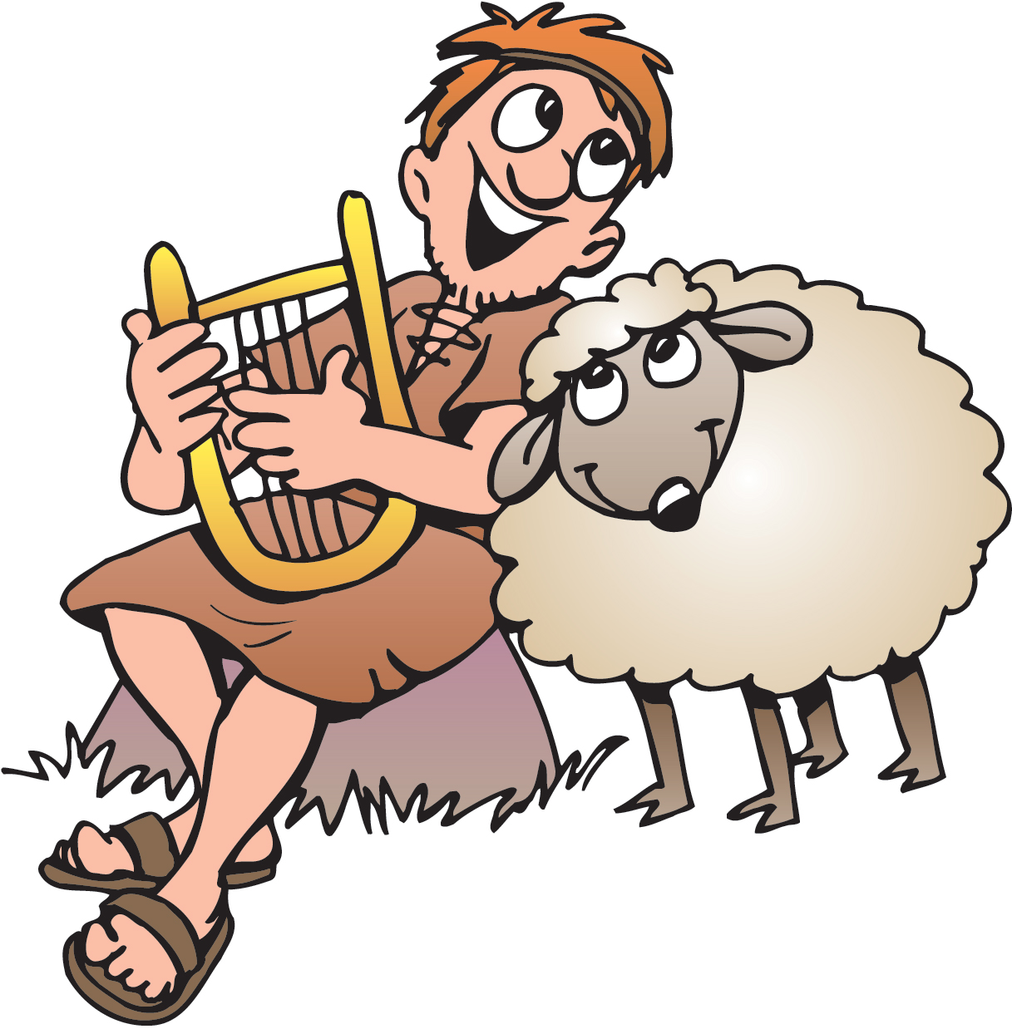
David the Shepherd and Goliath
1 Samuel 16, 17:13-36
Psalms 23

Slide 2
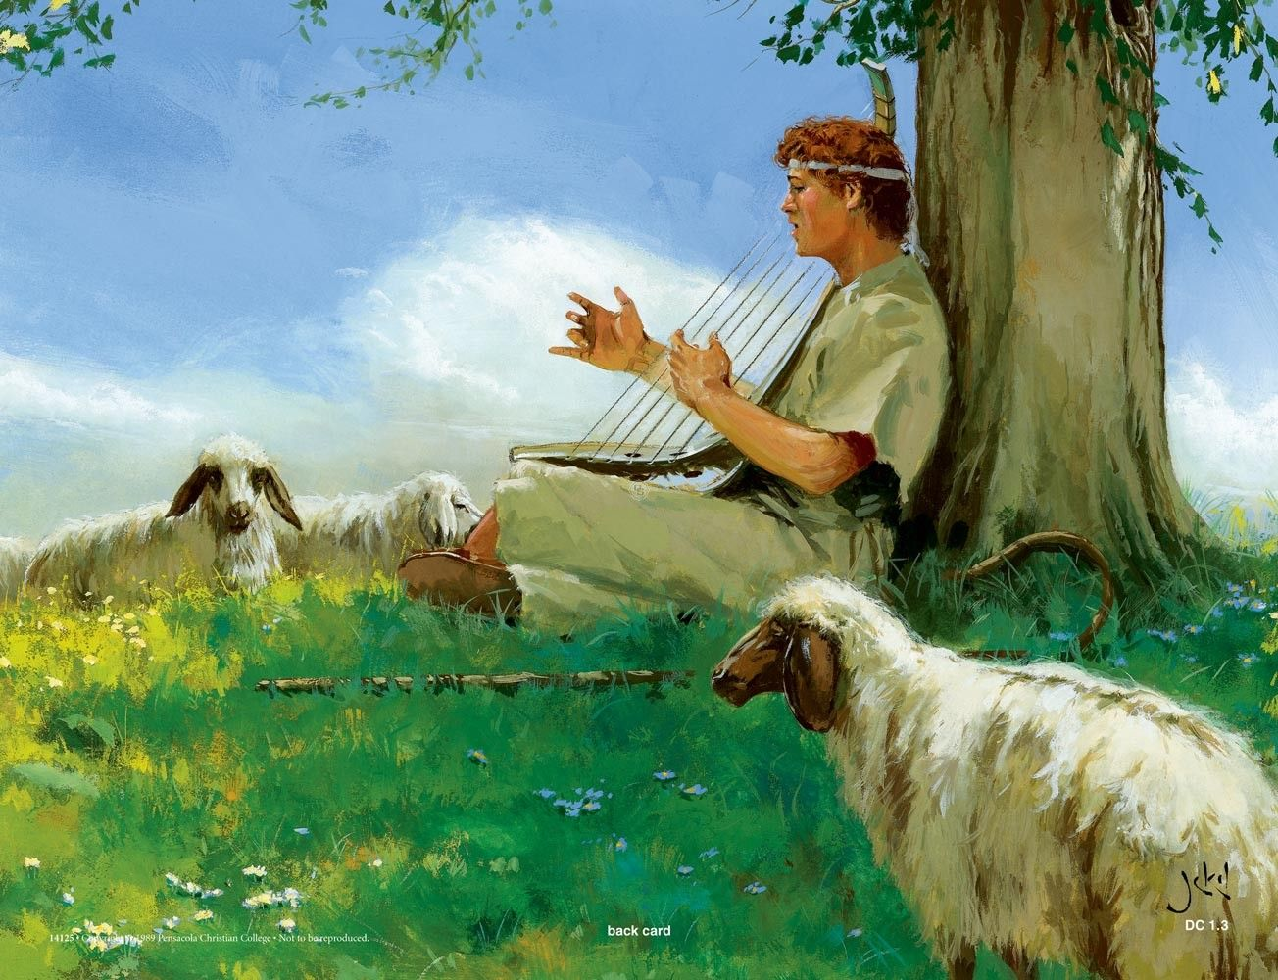


Can you fill in the blanks..
The Lord gives me strength. He is like a _____
that keeps me safe.
My ____ trusts in him, and he helps me.
My heart jumps for joy.
With my ____ I praise him.
Psalms 28:7
shield
heart
song

Slide 3

Bible Story – David & Goliath

Slide 4

Sing Only a Boy Named David

Slide 5
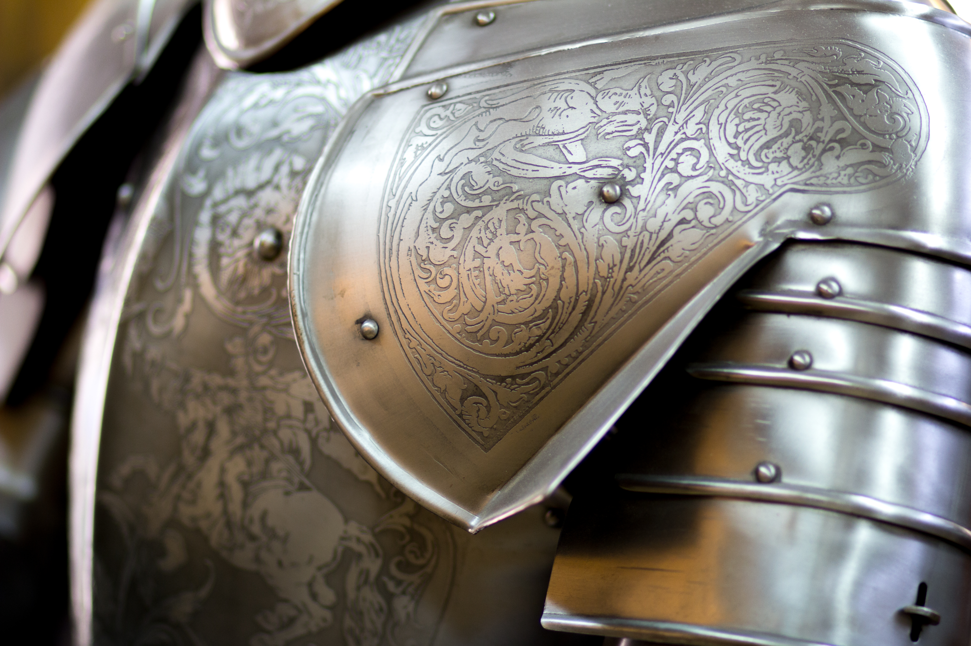
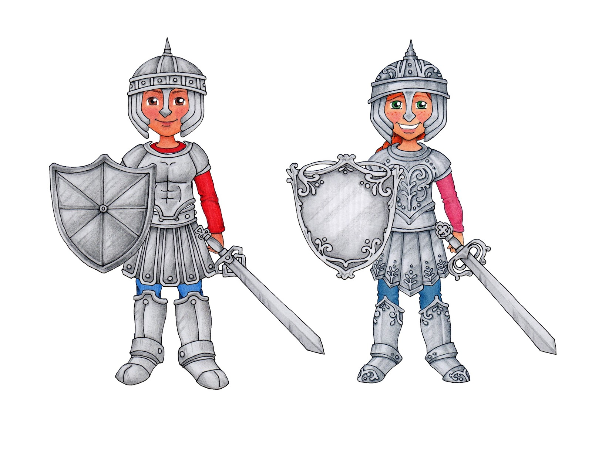
Put on your full armor
David has his full armor on.
But it wasn’t made of metal.
What was his armor?

Slide 6

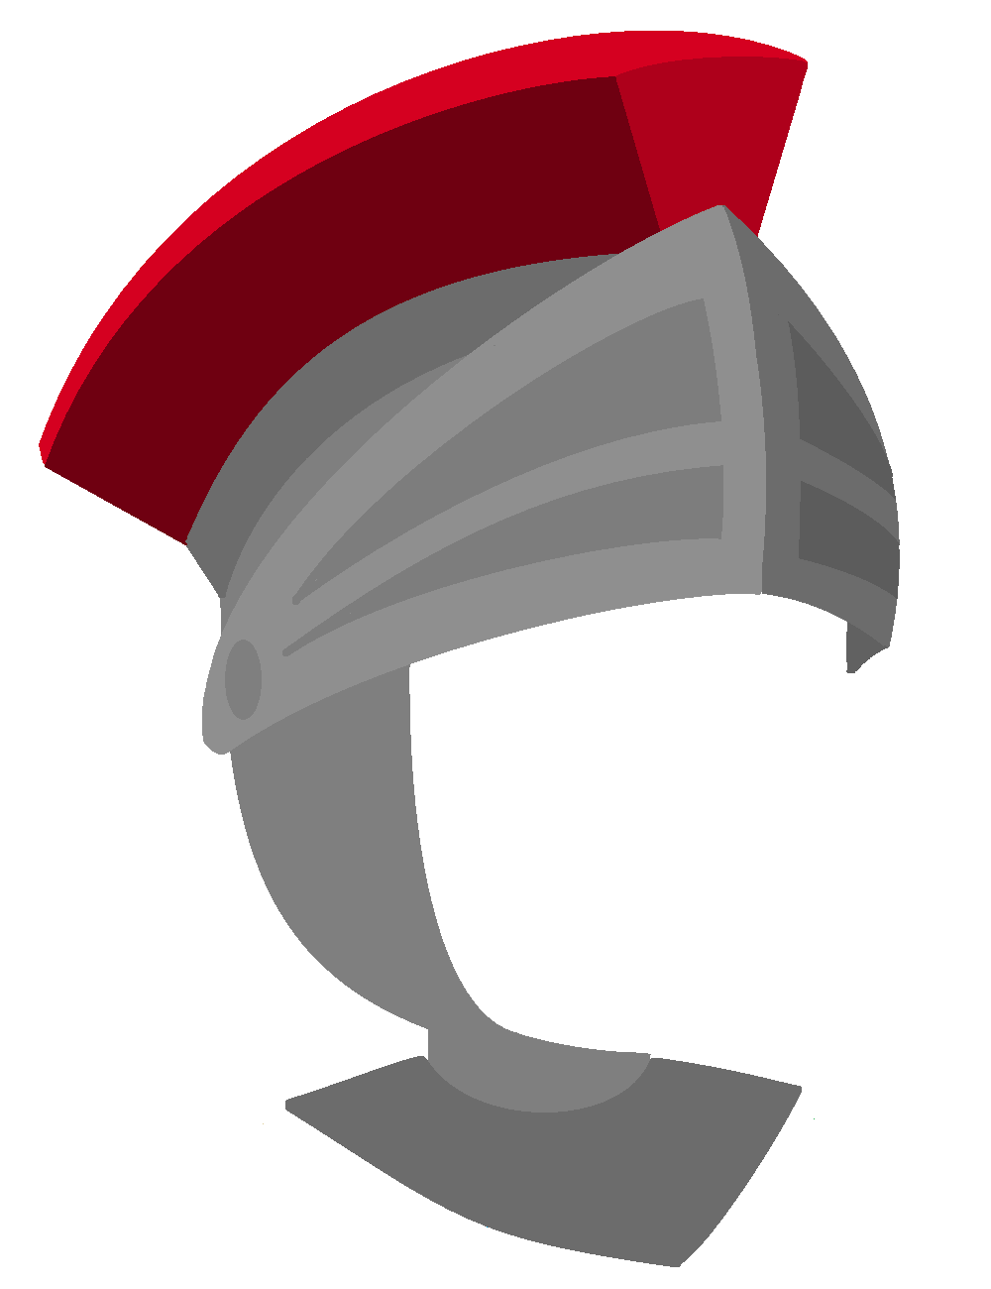
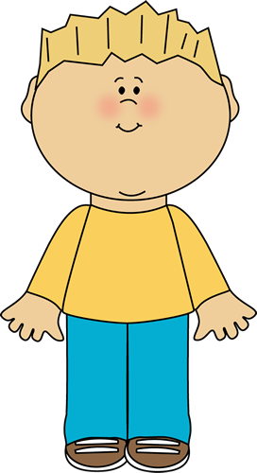
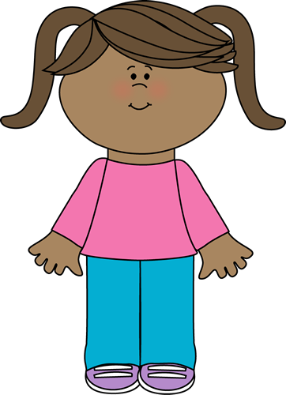
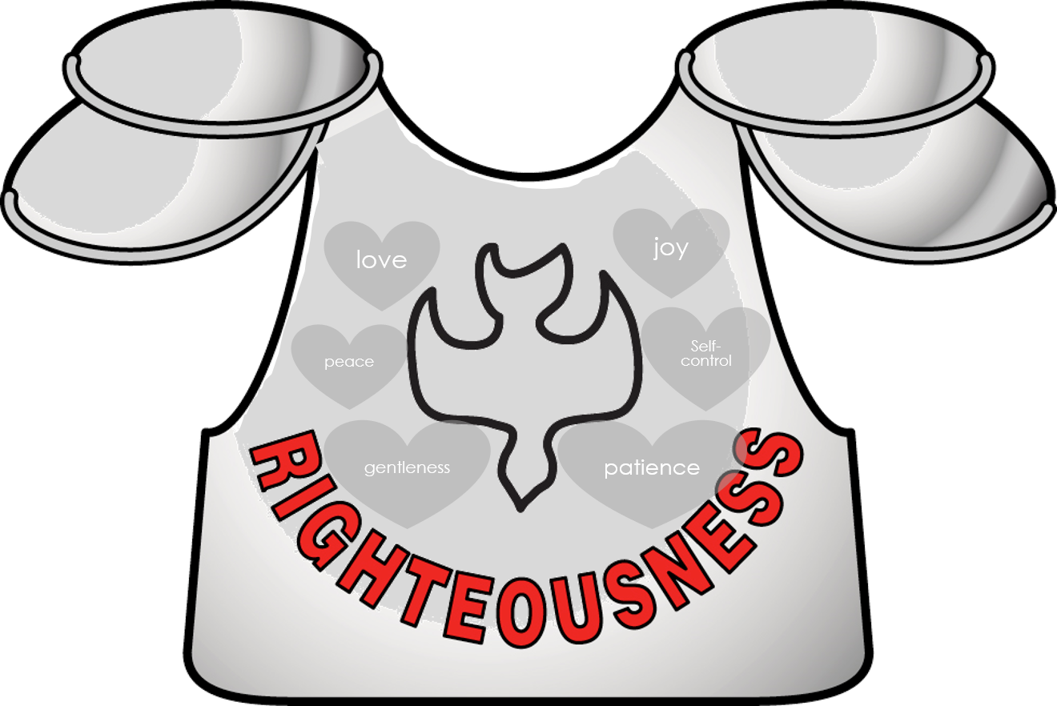
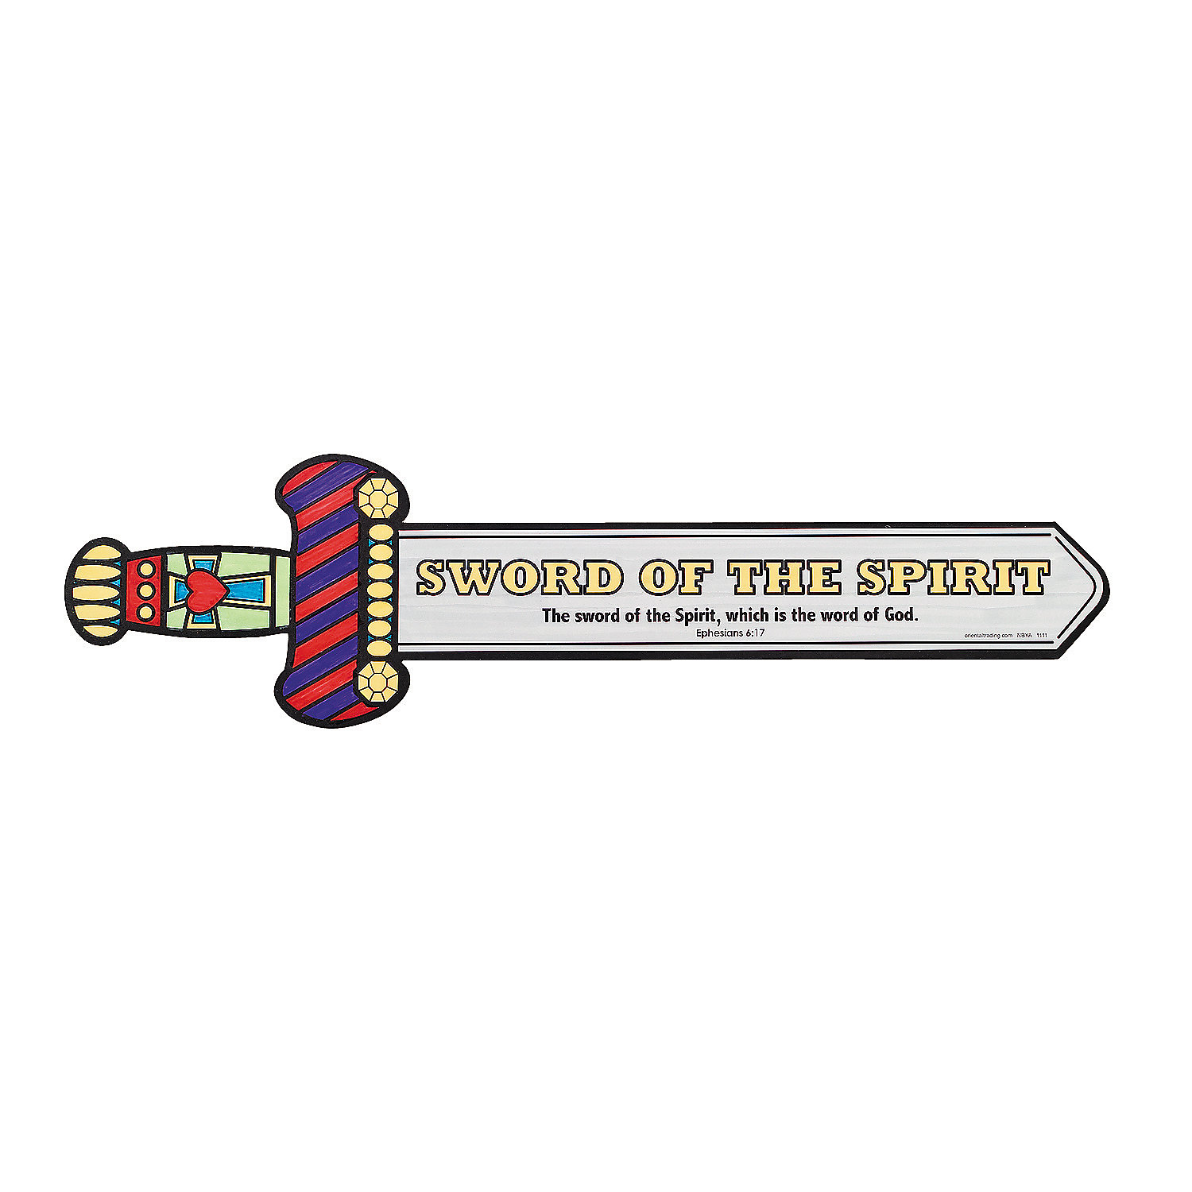
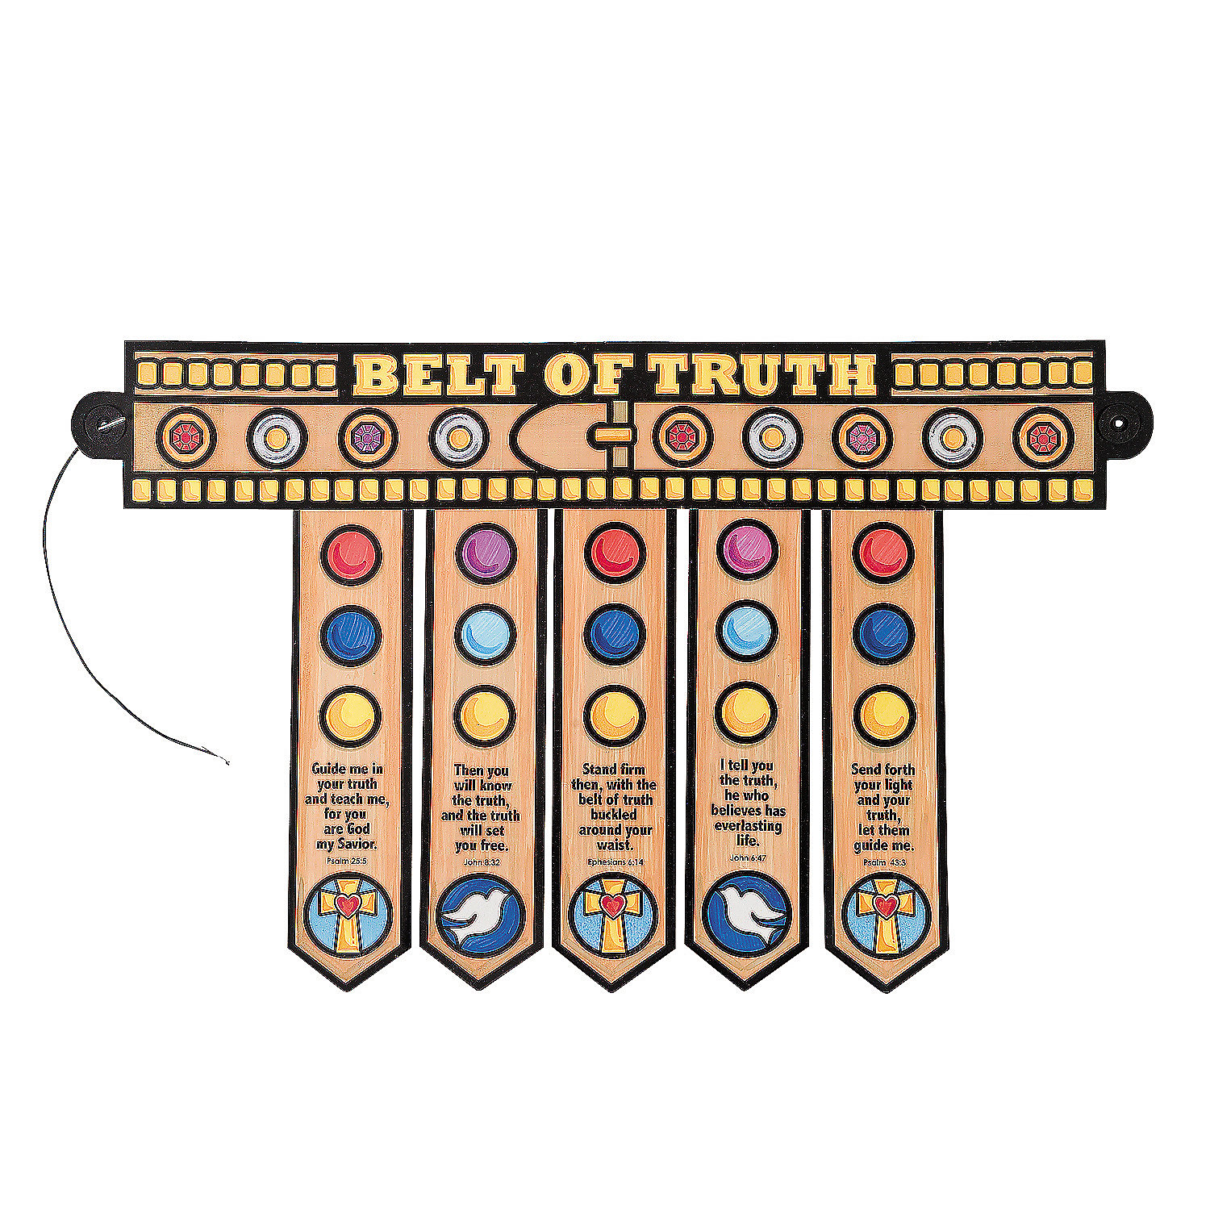
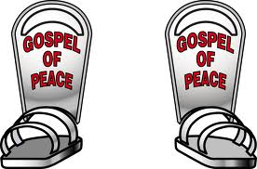
He depended on God
Dear Jesus,
I have faith that you will take care of me.
Dear Jesus,
I need Your helmet of salvation.
Thank you for saving me!
Please keep evil thoughts away from me.
Dear Jesus, I need the belt of truth.
The truth is I’m are not perfect, but You are!
Please forgive me.
I’m not strong, but You are! The battle is the Lord’s!
The truth is You love me and have made me Your child.
Dear Jesus,
I need a Your sword.
Thank you for the Bible and the Holy Spirit.
With your Word and power, I can fight temptation.
Dear Jesus,
I need your breast plate of righteousness.
You are right and good.
Please fill me with your Holy Spirit.
Thank you..
Dear Jesus,
I want to tell others about You. I need the shoes of readiness that come from the gospel of peace.
You love me. You save me. You give me peace!
¹⁰ Finally, let the Lord make you strong. Depend on his mighty power. ¹¹ Put on all of God’s armor. Then you can remain strong against the devil’s evil plans…
¹⁴ So remain strong in the faith. Put the belt of truth around your waist. Put the armor of godliness on your chest. ¹⁵ Wear on your feet what will prepare you to tell the good news of peace. ¹⁶ Also, pick up the shield of faith. With it you can put out all the flaming arrows of the evil one. ¹⁷ Put on the helmet of salvation. And take the sword of the Holy Spirit. The sword is God’s word.
¹⁸ At all times, pray by the power of the Spirit. Pray all kinds of prayers. Be watchful, so that you can pray.
Ephesians
6:10-18

Slide 7
Yes!
We are ready!

Slide 8
CRAFT TIME
You can choose to make a suit of God’s Armor to wear
Or a smaller Armor of God craft

Slide 9
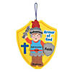
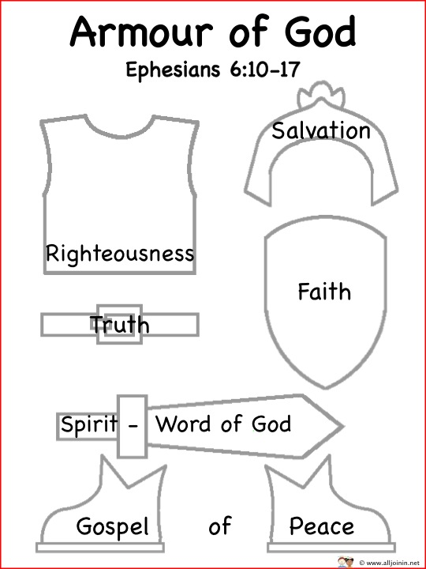
Craft Time
Option 1
Or make a DIY Armor of God that you can wear
… see next pages.>>>>>
Order from Oriental Trading
Link to download:
http://allplayonsunday.blogspot.com/2011/10/armour-of-god.html

Slide 10
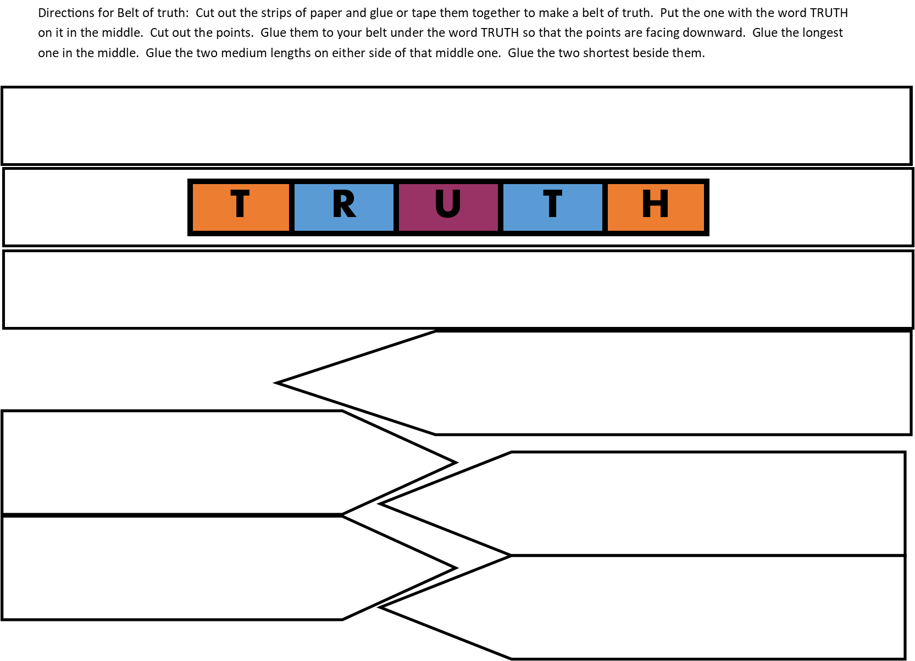
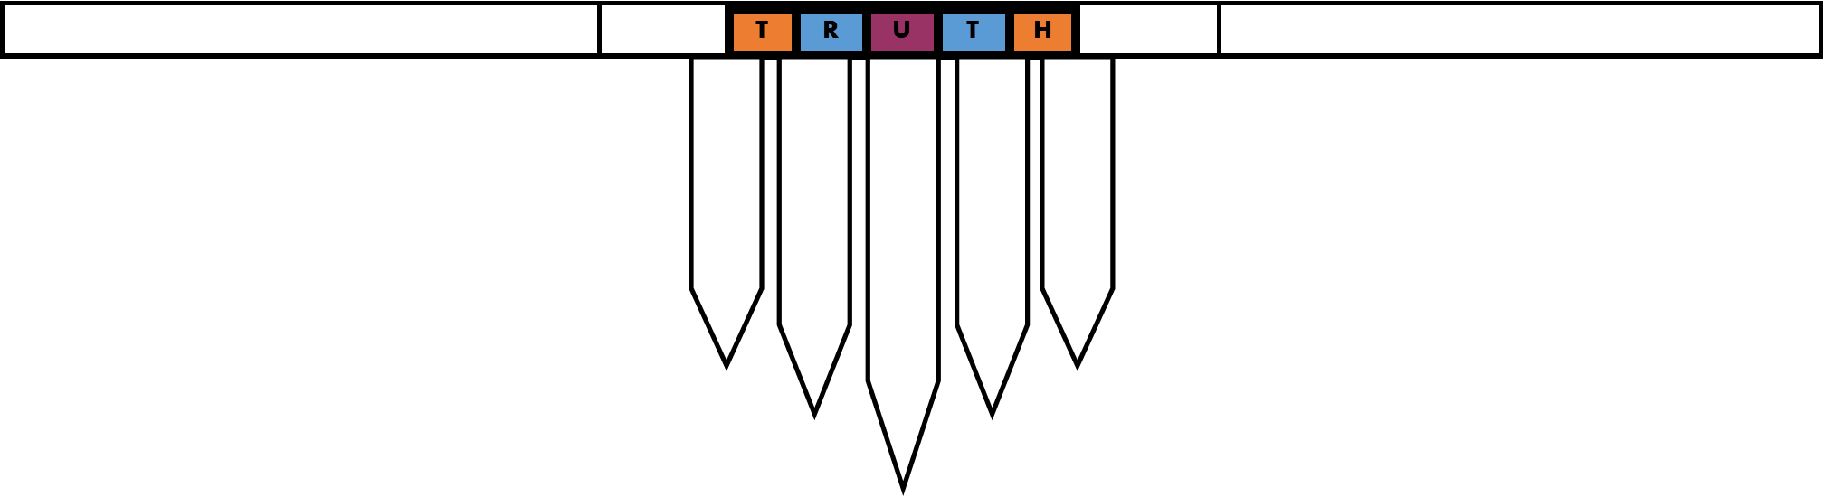
Craft Time
Directions for Belt of truth: Cut out the strips of paper and glue or tape them together to make a belt of truth. Put the one with the word TRUTH on it in the middle. Cut out the points. Glue them to your belt under the word TRUTH so that the points are facing downward. Glue the longest one in the middle. Glue the two medium lengths on either side of that middle one. Glue the two shortest beside them.

Slide 11

David wrote a song to God:
“Your arm is powerful.
Your hand is strong.
Your right hand is mighty.”
Psalm 89:13

Slide 12
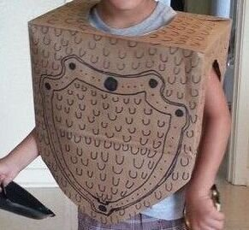
Craft Time
Option 2
Cut and decorate
A paper bag as shown
To make a
Breastplate
Of
Righteousness

Slide 13


Slide 14
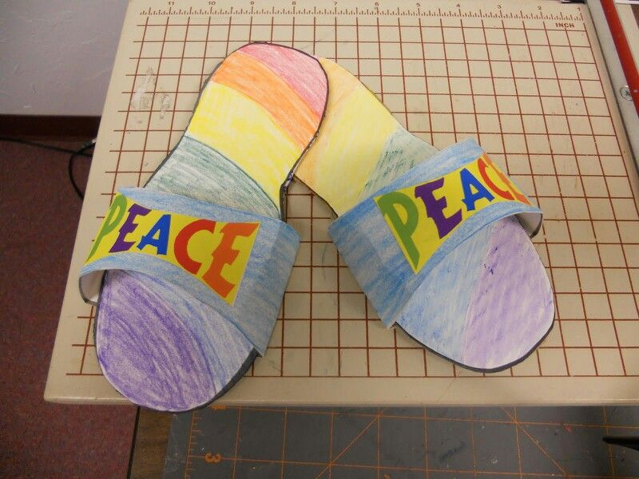
Craft Time
Option 2
Place your foot on a cardstock paper.
Draw around your shoe,
If you want to wear it over your shoe.
OR
Draw around your foot,
If you want to wear it barefoot.
Cut another piece of cardstock to go over the top.
Write PEACE or GOSPEL on it.

Slide 15
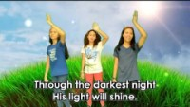
Sing God is Good All the Time

Slide 16
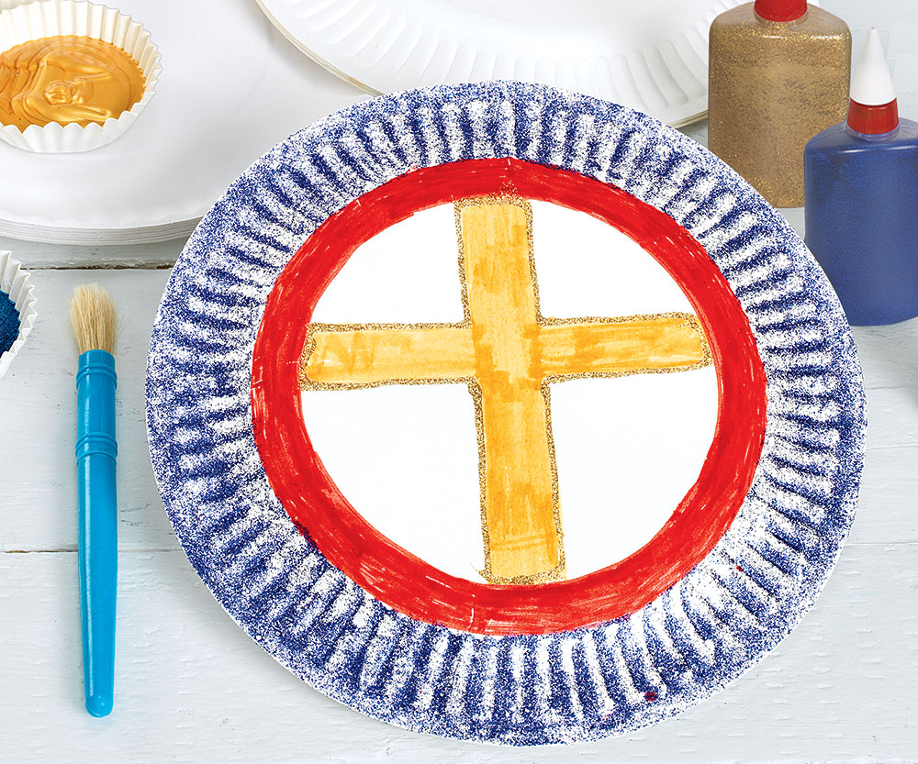
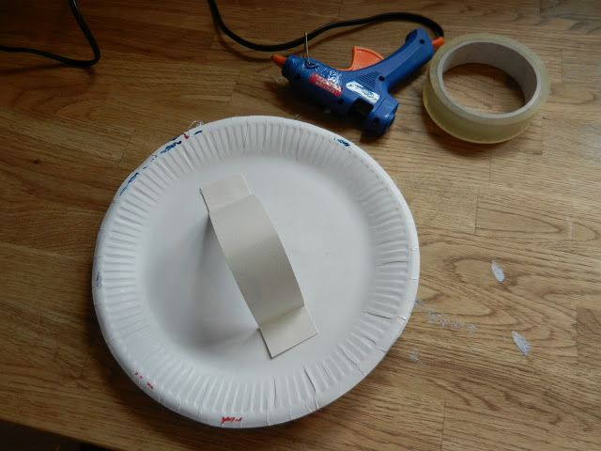
Craft Time
Option 2
Make a shield of Faith
Out of paper plate
Or
A shield out of cardboard

Slide 17

Sing God is our Refuge and Strenth
God is our refuge and strength,
A very present help in trouble. Psalms 46:1

Slide 18
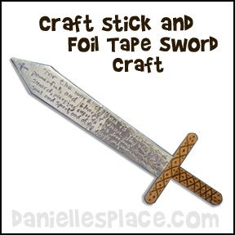
Craft Time
Option 2
Cut a sword shape out of cardstock.
Add popsicle sticks
to strengthen the handle.
Add gray duct tape
to strengthen the sword.

Slide 19
David wrote a song to God:
“Your arm is powerful.
Your hand is strong.
Your right hand is mighty.”
Psalm 89:13

Slide 20
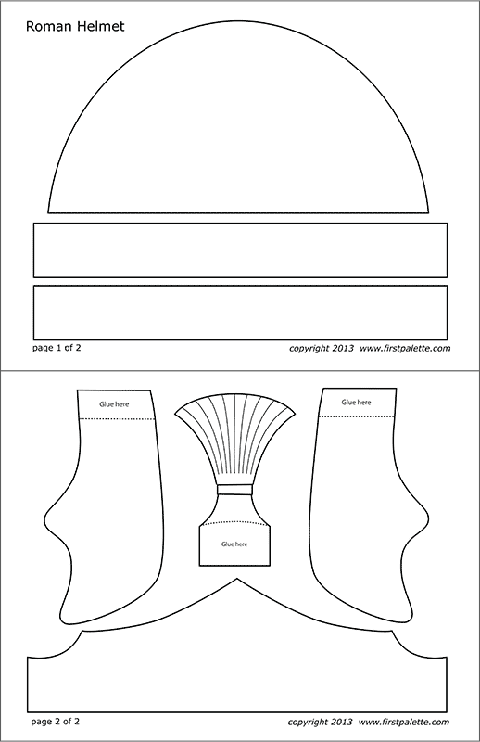
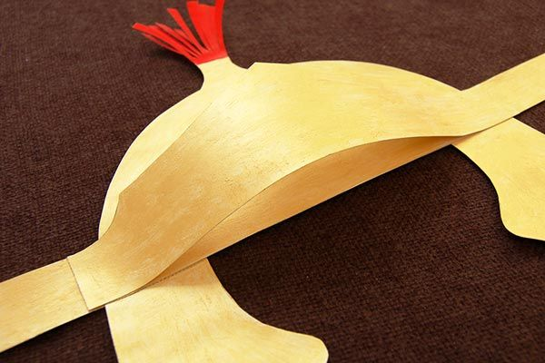
Craft Time
Option 2
Make a helmet using the pattern found at:
FirstPalette
Print pattern on gray or gold cardstock.

Slide 21
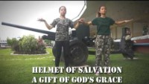

Slide 22
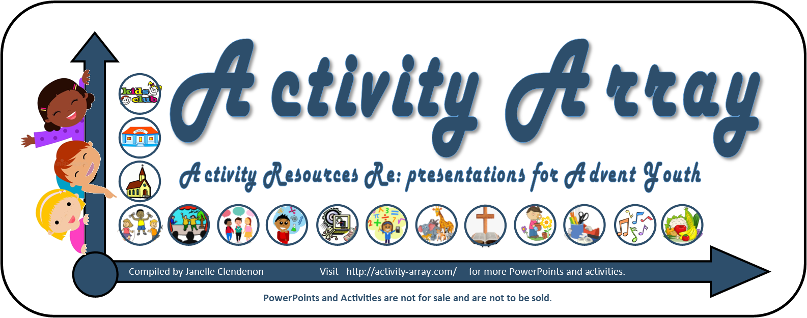
The End
Extra Extra Yep there’s more….

