Slide 1
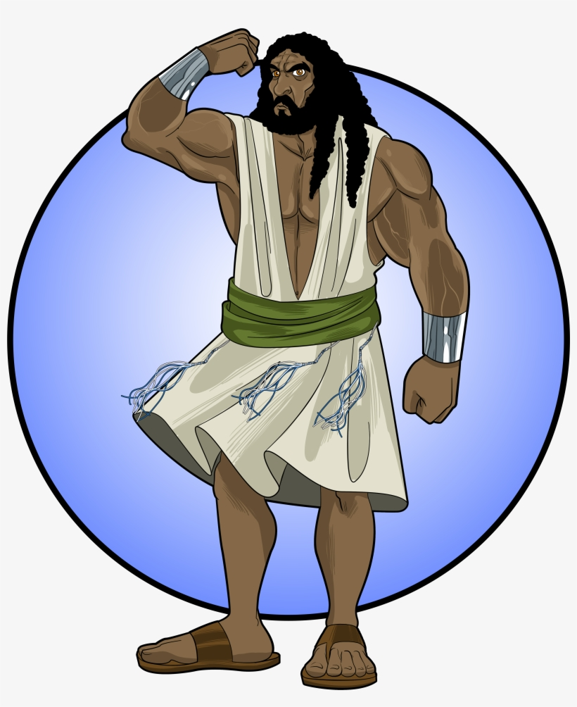
Samson
STRONG
Yet weak

Slide 2
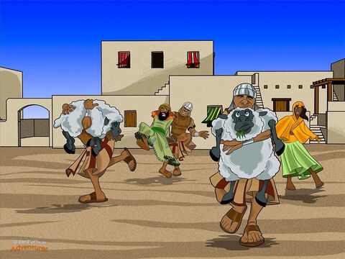
Isreal again did evil and forgot God
Judges 13
Once again the Israelites did what was evil in the sight of the Lord. So the Lord handed them over to the Philistines for 40 years.

Slide 3
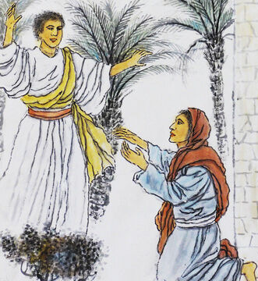
Your son will defeat the Philistines
You are not able to have children, but you will have a baby boy!
The boy will be set apart from birth – a Nazirite.
His hair must never be cut.
Do not drink
any kind of wine.
Do not eat anything God has called unclean.
Your son will take the lead in saving Israel from the power of the Philistines.
Judges 13
² A certain man from Zorah was named Manoah. He was from the tribe of Dan. Manoah had a wife who wasn’t able to have children.
³ The angel of the Lord appeared to Manoah’s wife. He said, “You are not able to have children. But you are going to become pregnant. You will have a baby boy.
⁴ Make sure you do not drink any kind of wine. Also make sure you do not eat anything that is ‘unclean.’ ⁵ You will become pregnant. You will have a son. The hair on his head must never be cut. That is because the boy will be a Nazirite.
He will be set apart to God from the day he is born. He will take the lead in saving Israel from the power of the Philistines.”
I must tell my husband

Slide 4
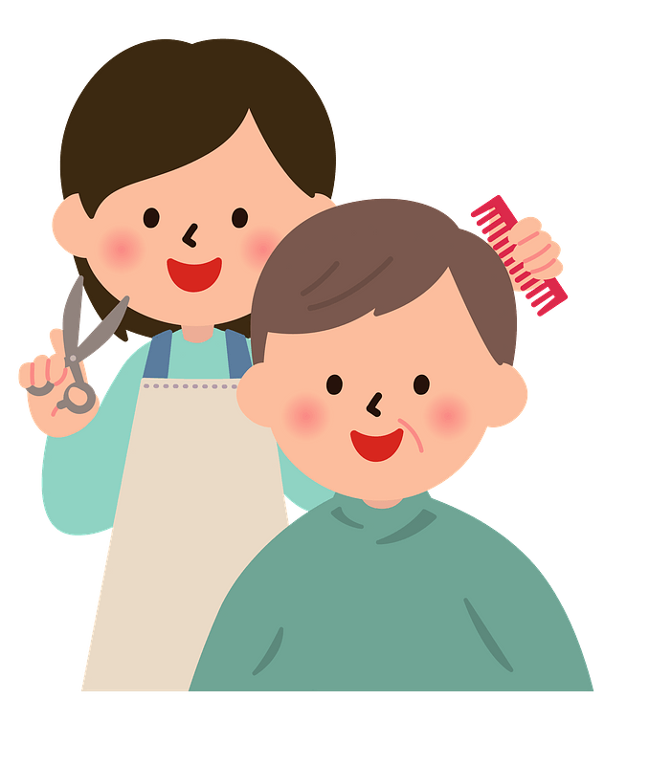
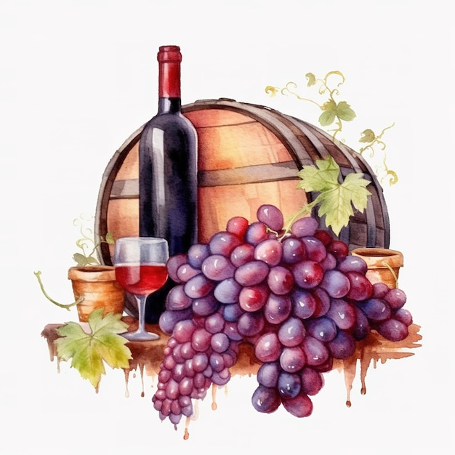

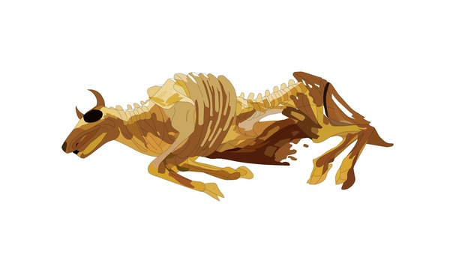
Nazarite vow
Chosen and willing to be used by God
Do not cut hair
Do not drink wine, grape juice, grapes, or raisins
Do not touch anything that’s dead
Numbers 6
God told Moses, who wrote it down:
“ The Lord said to Moses, ² “Say to the Israelites, ‘Suppose a man or woman wants to make a special promise. They want to set themselves apart to the Lord for a certain period of time. They want to be Nazirites. ³ Then they must not drink any kind of wine. They must not drink vinegar made out of wine of any kind. They must not drink grape juice. They must not eat grapes or raisins. ⁴ As long as they are Nazirites, they must not eat anything grapevines produce. They must not even eat the seeds or skins of grapes.
⁵ “ ‘They must not use razors on their heads. They must not cut their hair during the whole time they have set themselves apart to the Lord. They must be holy until that time is over. They must let the hair on their heads grow long.
⁶ “ ‘And they must not go near a dead body during that whole time. ⁷ But what if their father or mother dies? Or what if their brother or sister dies? Then they must not make themselves “unclean” because of them. The hair on their heads shows they are set apart for God. ⁸ During the whole time they are set apart they are holy to the Lord.

Slide 5
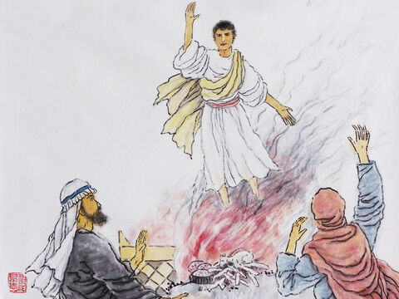
The angel came again.
As I told your wife, she must not drink
any kind of wine
nor eat anything God has called unclean.
Even if I stay, I will not eat any of your food.
But you may prepare a sacrifice to the LORD.
The boy will be set apart from birth – a Nazirite.
His hair must never be cut.
Manoah’s wife told him about the angel and all that he had said.
Manoah prayed …
The angel came back and repeated what he had told Manoah’s wife.
Judges 13
¹⁵ Manoah said to the angel of the Lord, “We would like you to stay and eat. We want to prepare a young goat for you.”
¹⁶ The angel of the Lord replied, “Even if I stay, I will not eat any of your food. But if you still want to prepare a burnt offering, you must offer it to the Lord.” Manoah didn’t realize it was the angel of the Lord.
¹⁷ Then Manoah asked the angel of the Lord a question. “What is your name?” he said. “We want to honor you when your word comes true.”
¹⁸ The angel replied, “Why are you asking me what my name is? You would not be able to understand it.”
Dear LORD, please send your messenger back. Tell us how to raise this child.
We would like you to stay and eat with us. We would like to prepare a young goat.

Slide 6
The angel came again.
We’re going to die we’ve seen God!
¹⁹ Manoah got a young goat. He brought it along with the grain offering. He sacrificed it on a rock to the Lord.
Then the Lord did an amazing thing. It happened while Manoah and his wife were watching. ²⁰ A flame blazed up from the altar toward heaven. The angel of the Lord rose up in the flame.
When Manoah and his wife saw it, they fell with their faces to the ground. ²¹ The angel of the Lord didn’t show himself again to Manoah and his wife. Then Manoah realized it was the angel of the Lord.
²² “We’re going to die!” he said to his wife. “We’ve seen God!”
²³ But his wife answered, “The Lord doesn’t want to kill us. If he did, he wouldn’t have accepted a burnt offering and a grain offering from us. He wouldn’t have shown us all these things. He wouldn’t have told us we’re going to have a son.”
No. If the LORD wanted to kill us, he wouldn’t have accepted our burnt offering.

Slide 7
Our Story is about
Samson very STRONG Man
CHALLENGE ALERT: Try some of the strength challenges

Slide 8
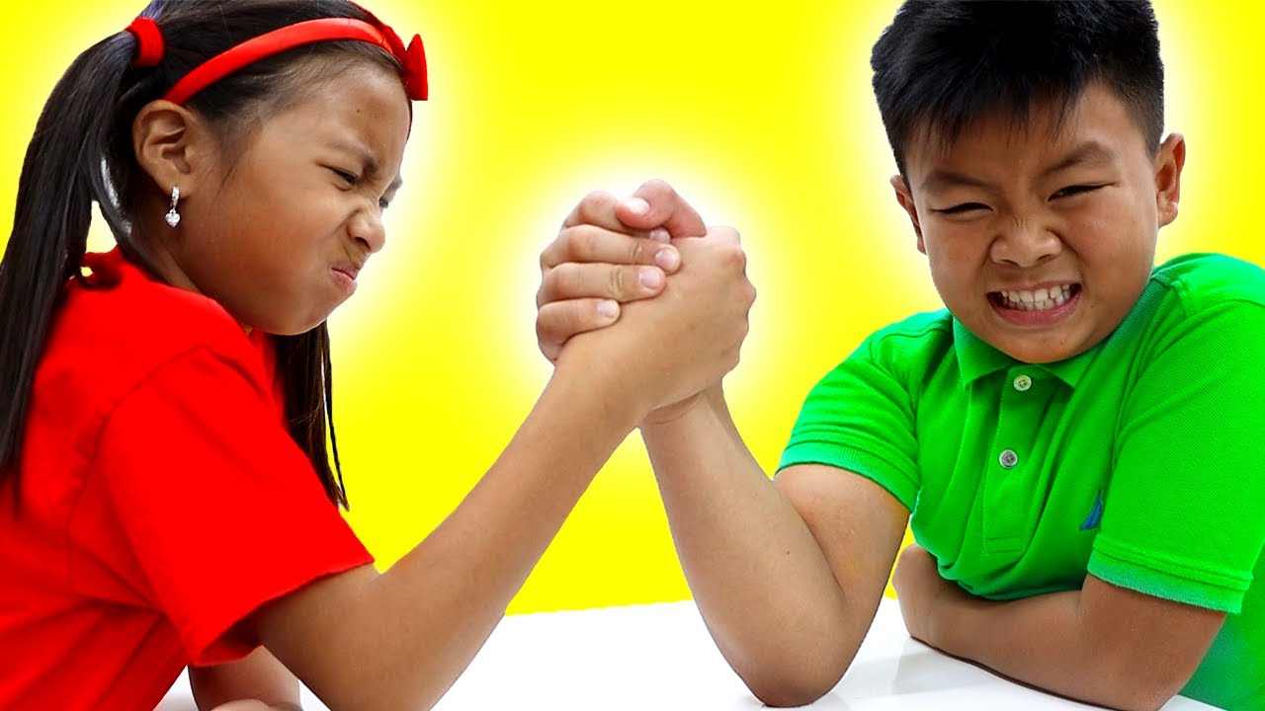
Challenge #1 -- Who is stronger?
If you volunteer for this challenge you will:
Choose a partner
Arm wrestle
  Hold hands with your elbows on the table
  Keep your elbows on the table.
  Both of you push the other person’s hand with your hand – just that one hand.
  Try to push their hand down to the table. If you do, you win!

Slide 9
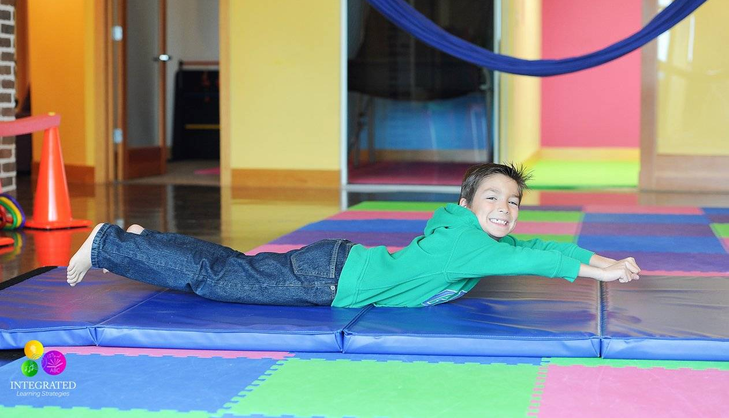
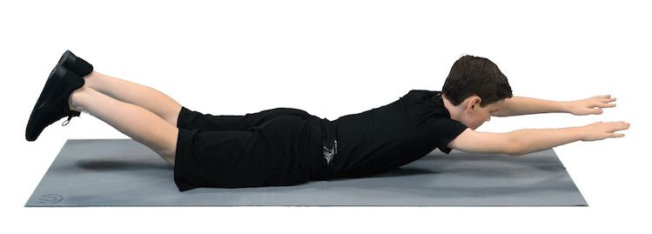
Challenge #4 -- Can you hold it the longest?
If you volunteer for this challenge you will:
Do the superman pose as pictured. This time your tummy can touch the ground, but your arms, hands, feet and knees need to be off the floor.
We will see who can stay in this position the longest.

Slide 10
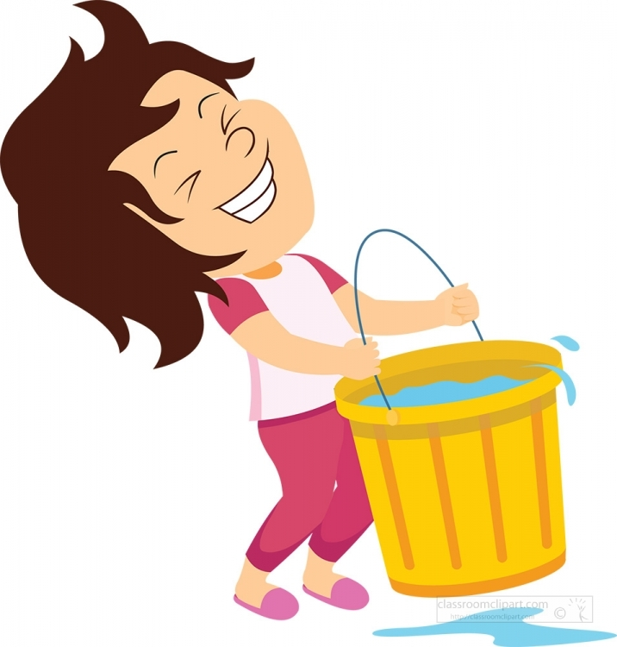
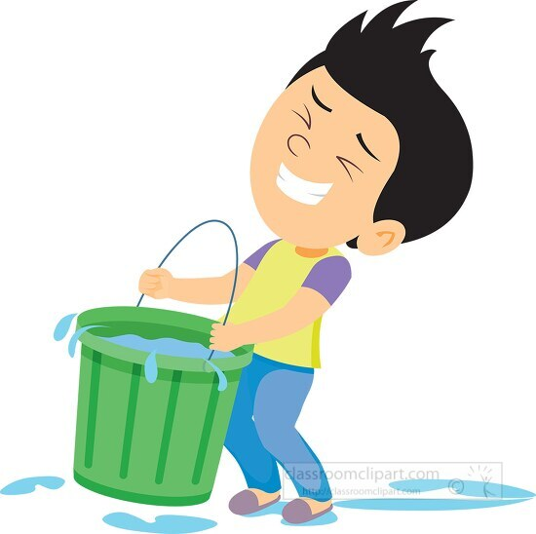
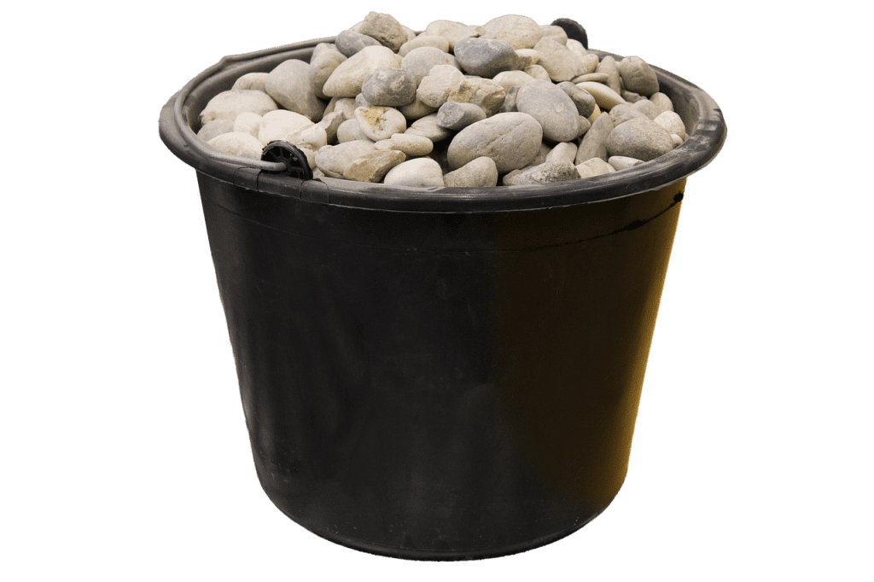

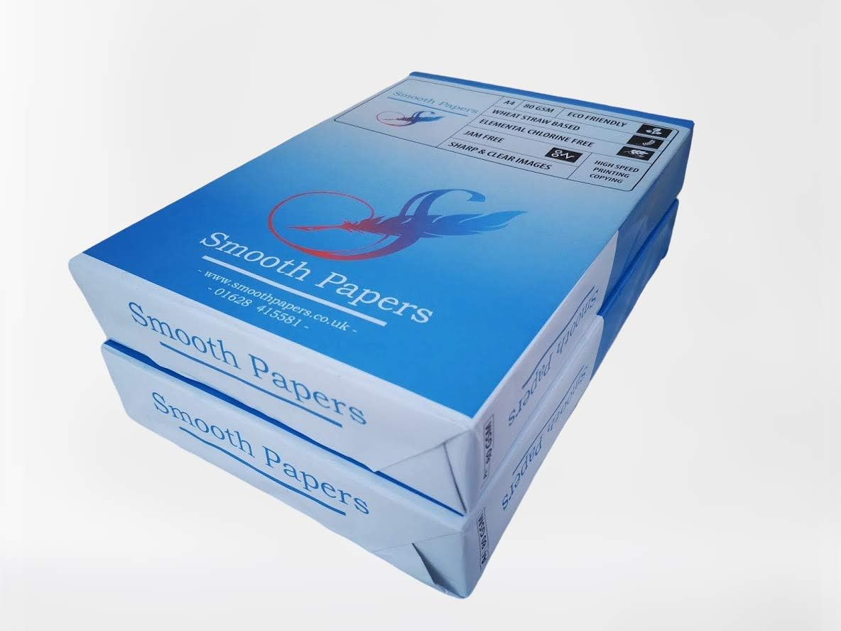
Challenge #5 -- Can you lift it?
If you volunteer for this challenge you will:
Try to lift a bucket that is full of:
  Level 1 – a bucket full of paper (ream or package)
  Level 2 – a bucket full of rocks
  Level 3 – a bucket full of water (with its lid on tight)

Slide 11
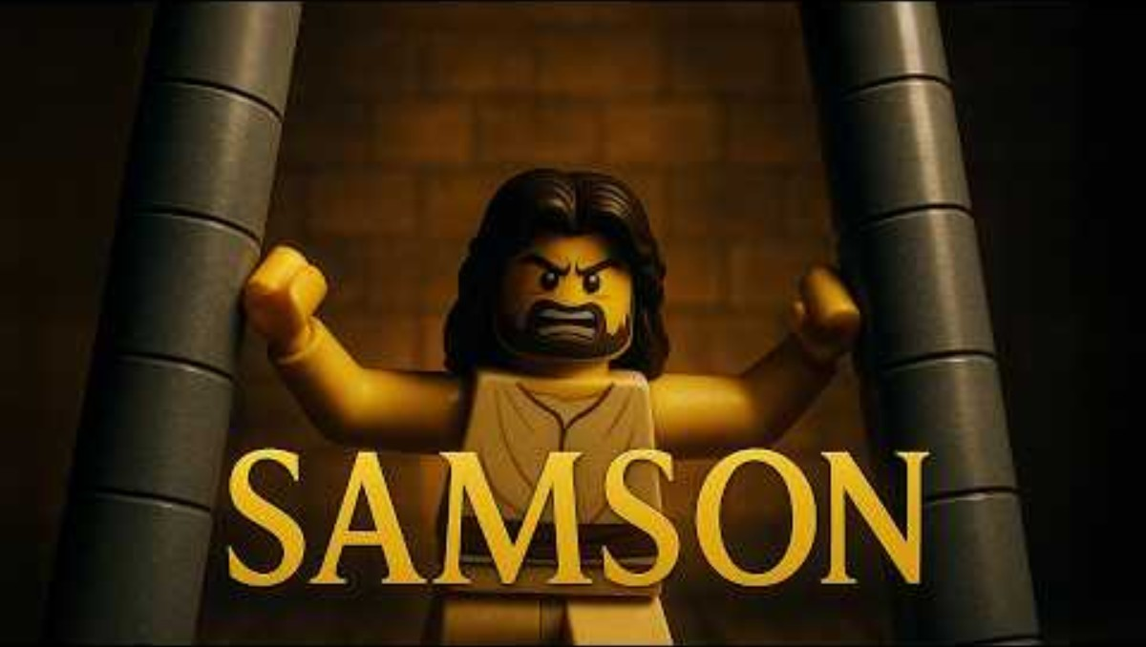
The Story of Samson

Slide 12
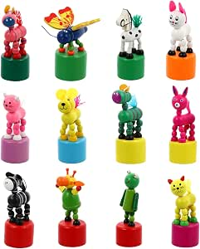

I have a gift for you.
I have little push puppets for you.
What happens if you push the button under it?
We’re going to talk about Samson.
When talk about his strength, make it stand tall.
If we mention a weakness, push the button and let it fall.
God is the STRONGEST of all. He gives us strength.
When we are weak, He strengthens us, helps us and He wins the victory!
You can put this sticker on your puppet:
God is STRONG and strengthens me!
He lifts me up when I am weak.
Psalms 18:1-17
Amazon Purchase link

Slide 13
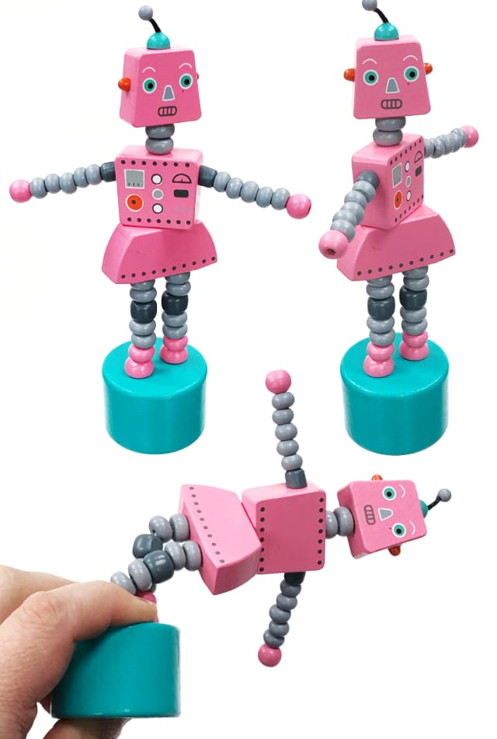
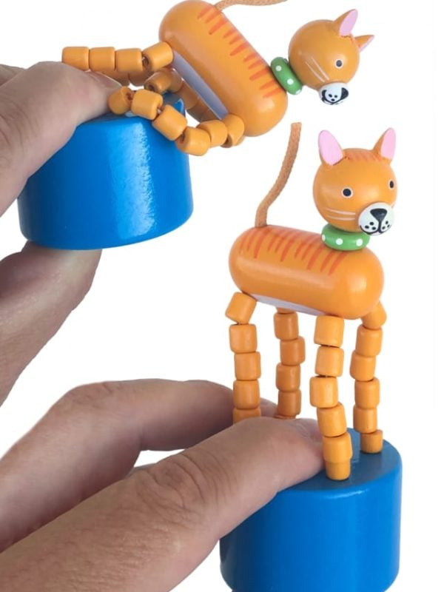
Samson was STRONG, but weak
Although Samson had VERY STRONG muscles,
Samson had a weakness.
He was tempted by the beautiful Philistine women (Remember the Philistines were the enemies and they didn’t love, worship, nor obey God.).

Slide 14
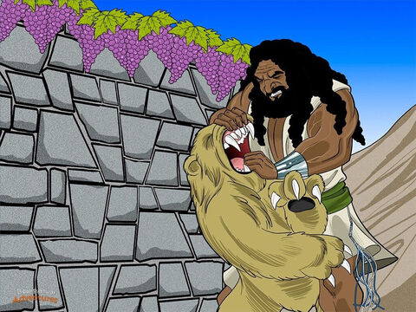
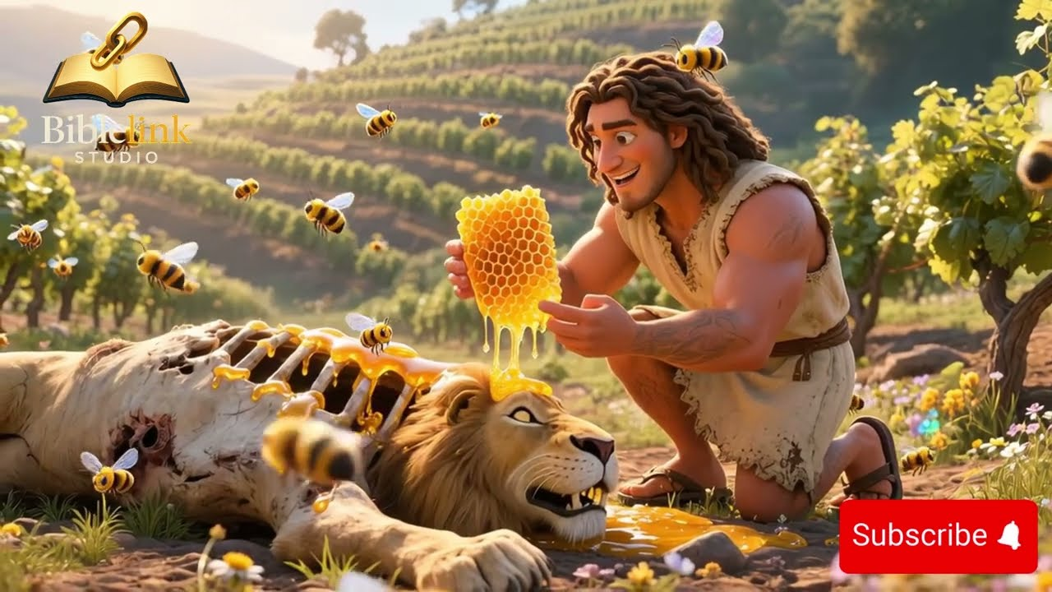
Samson was STRONG, but weak
Although Samson had VERY STRONG muscles,
  Once Samson was attacked by a lion!
  He killed the lion with his bare hands!
  He tore it apart.
he had a weakness.
Tho he was under the Nazarite vow,
Dead things didn’t concern him.
He found a honey comb in the lion later.
He ate some honey and
gave some to his parents.

Slide 15
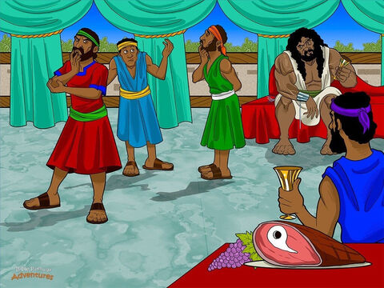
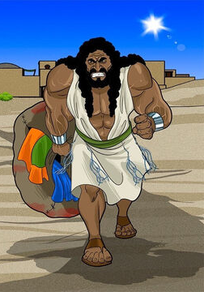
Samson was STRONG, but weak
Out of the eater came something to eat.
Out of the strong came something sweet
Although Samson had VERY STRONG muscles,
  At his wedding, Samson told the men a riddle.
  If they didn’t answered it correctly,
  they would each give Samson a set of clothes
  -- 30 sets of clothes
But, Samson had a weakness.
When he got mad. He was destructive!
Samson was mad that the men had used his wife to figure out the riddle.
Samson went out to get the 30 sets of clothes – by killing 30 Philistines!

Slide 16
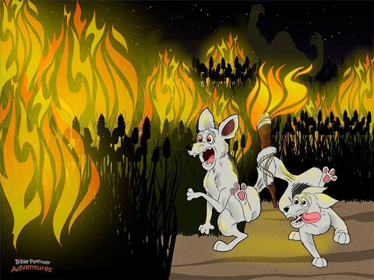
Samson was STRONG, but weak
Samson was STRONG,
Just like God said, Samson did fight the enemy and won!
  Once He caught 300 foxes. (Catching 1 is hard!)
  He tied their tails together! (WOW)
  And tied on a torch. When the foxes ran away, and destroyed the (enemy) Philistine’s crops!
We’re not perfect, but God helps us do what He wants to happen.
“Whose weakness was turned to strength;
and who became powerful in battle and routed foreign armies.” – Hebrews 11:34

Slide 17
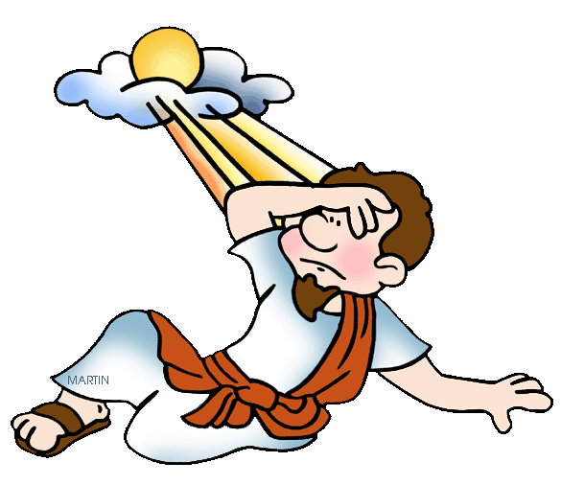
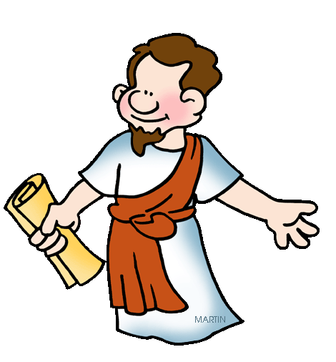
Take away my weakness
My grace is sufficient for you.
My power is made perfect in weakness.
2 Corinthians 12
⁷ God has shown me amazing and wonderful things. People should not think more of me because of it.
So, I wouldn’t become proud of myself, I was given a problem. This problem caused pain in my body. It is a messenger from Satan to make me suffer.
⁸ Three times I begged the Lord to take it away from me.
⁹ But he said to me, “My grace is all you need. My power is strongest when you are weak.”
So, I am very happy to brag about how weak I am. Then Christ’s power can rest on me. ¹⁰ Because of how I suffered for Christ, I’m glad that I am weak.
I am glad in hard times. I am glad when people say mean things about me. I am glad when things are difficult. And I am glad when people make me suffer.
When I am weak, I am strong.
LORD, please take away my weakness.
It is a thorn in my side.

Slide 18
If more sin leads to more grace, Should I sin more?
Where there is lots of sin
God’s grace increases even more.
So, is it OK to keep sinning?
NO!
Sin hurts people.
Sin hurts me.
It brings death.
If we sin and then
confess our sin,
Jesus forgives us
by His grace.
Romans 5
²⁰ The law was given so that sin would increase. But where sin increased, God’s grace increased even more. ²¹ Sin ruled and brought death. But grace rules in the lives of those who are right with God. The grace of God brings eternal life. That’s because of what Jesus Christ our Lord has done.
Romans 6
What should we say then? Should we keep on sinning so that God’s grace can increase? ² Not at all!

Slide 19
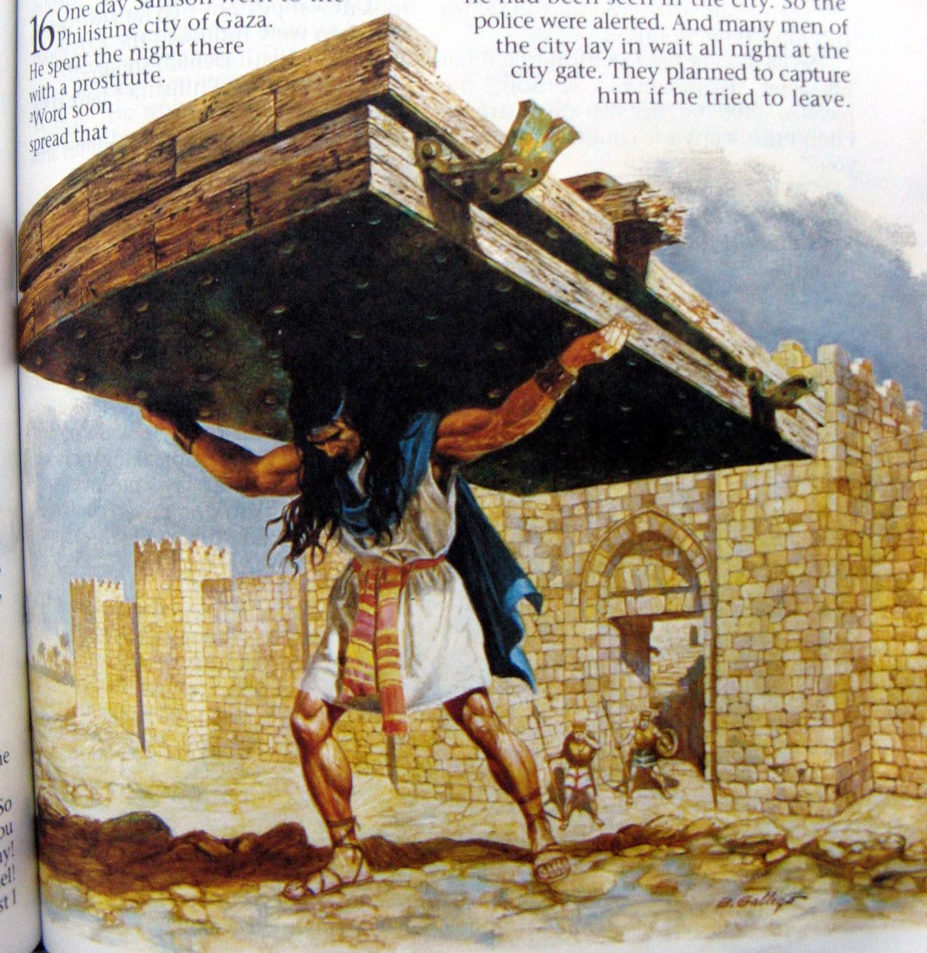
Samson had weakness, but he was STRONG
Samson had a weakness – he desired the beautiful Philistine women.
But Samson had VERY STRONG muscles,
  Once the Philistines thought they had trapped in the city. But Samson woke up in the middle of the night, tore the humongous gate right out of the city walls and carried it to the top of the hill!
  Could you do that?

Slide 20
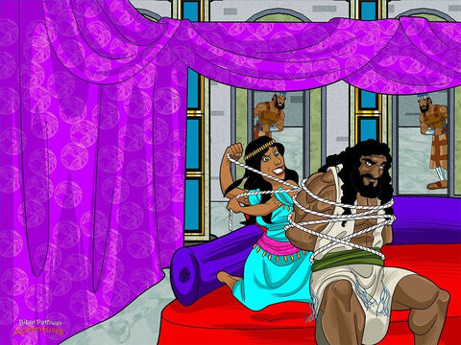
Samson was STRONG
Samson was not afraid.
He was tied up many times
tied with ropes by the Israelites
tied with green ropes by Delilah
tied with raw bow strings by Delilah
his hair was woven into the loom cloth
Each time he easily broke loose!

Slide 21
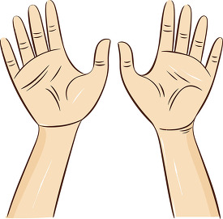
Challenge -- Can you break it?
If you volunteer for this challenge you will:
Wrap this cardstock paper around your wrists to protect them
Put your wrists close together
I will wrap some string around both your wrists to tie them together.
See if you can separate your wrists and break the string.
Level 1: string wrapped around 1 time
Level 2: string wrapped around 2 times
Level 3: string wrapped around 5 times
Level 4: string wrapped around 10 times

Slide 22
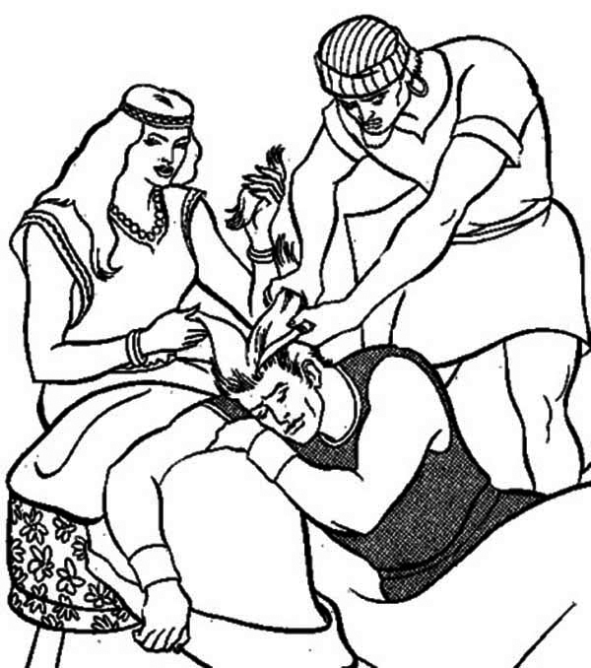
Samson was STRONG, but weak
Although Samson had VERY STRONG muscles,
he had a weakness. He couldn’t resist the Philistine women.
Delilah kept pestering Samson and finally, he told her the secret about his strength. He told her about the vow and that his hair was never to be cut.
What do you think Delilah did?
She cut Samson’s hair while he slept.
His strength left him.
This time he could not fight off the Philistines.
The Philistines bound him. Blinded him.
And made him grind grain like an ox.

Slide 23
What a wretched man I am
I know what is right and good.
But I keep sinning!
Sin keeps
controlling me.
Who will save me from this sin that brings death?
Jesus will!
Thank you God!
Paul knew what was right and good. He was a teacher of the law and became a teacher of grace. But he recognized that he kept doing what was wrong. He felt like a failure and exclaimed, “who will save me?” He knew that answer. It is Jesus! Jesus died to save us from our sin. He rose again to give us eternal life!
Romans 7
²¹ Here is the law I find working in me. When I want to do good, evil is right there with me. ²² Deep inside me I find joy in God’s law. ²³ But I see another law working in me. It fights against the law of my mind. It makes me a prisoner of the law of sin. That law controls me. ²⁴ What a terrible failure I am! Who will save me from this sin that brings death to my body? ²⁵ I give thanks to God who saves me. He saves me through Jesus Christ our Lord.
So in my mind I am a slave to God’s law. But sin controls my desires. So I am a slave to the law of sin.

Slide 24
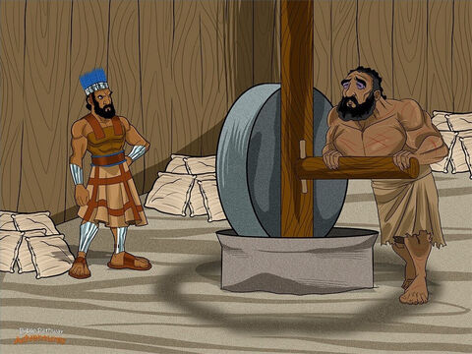
Samson was WEAK
Now Samson was very weak.
He was blind and a slave.
But even though he couldn’t see, he began to understand.
His hair began to grow.
He prayed to God.
Then he had an opportunity….

Slide 25
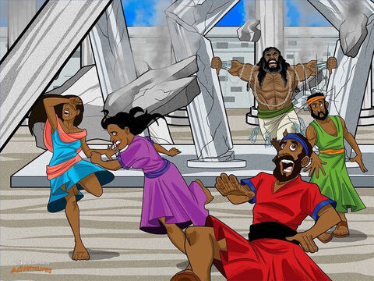

God made Samson STRONG
Lord, hear me one more time. Please give me strength. Let me die with the Philistines.
The Philistines were having a party for their god, dagon. They brought Samson out so that they could make fun of him.
Samson asked the boy leading him to lead him to the middle pillars.
Samson put his hands on the pillars and prayed that God would make him strong once more. He prayed that God would deliver the Israelites from the Philistines.
God did! Samson pushed on the pillars and the whole building fell down! Thousands of Philistines died.

Slide 26
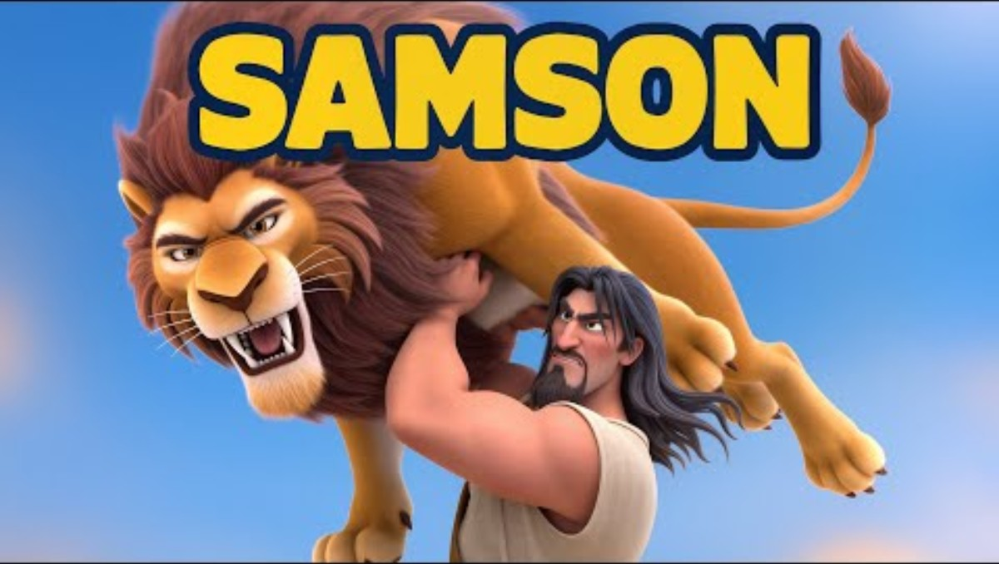
A Song of Samson

Slide 27
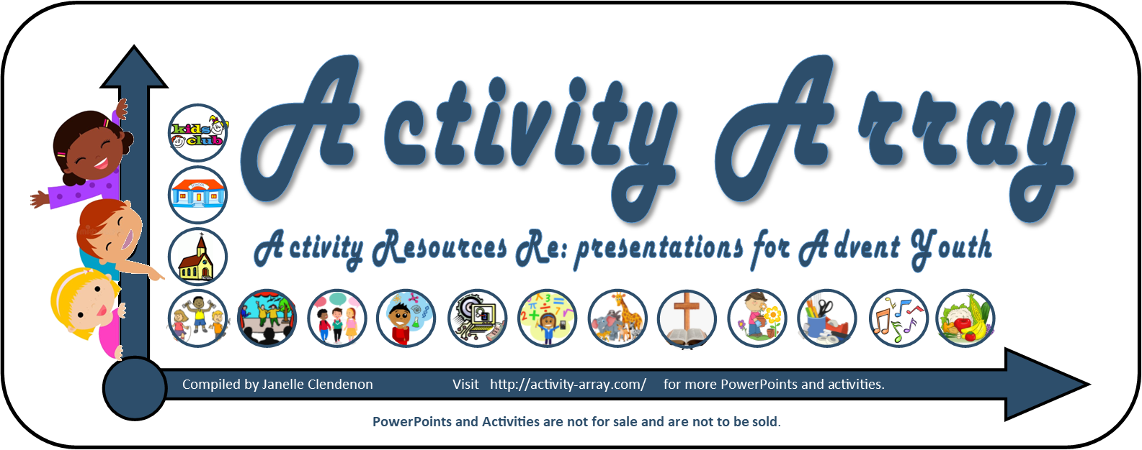
THE END
https://activity-array.com/

Slide 28
EXTRA CHALLENGE ALERTS
CHALLENGE ALERT: Try some of the strength challenges
As desired, you may replace the strength challenges

Slide 29
Challenge #1 -- Who is stronger?
If you volunteer for this challenge you will:
Choose a partner
Arm wrestle
  Hold hands with your elbows on the table
  Keep your elbows on the table.
  Both of you push the other person’s hand with your hand – just that one hand.
  Try to push their hand down to the table. If you do, you win!

Slide 30
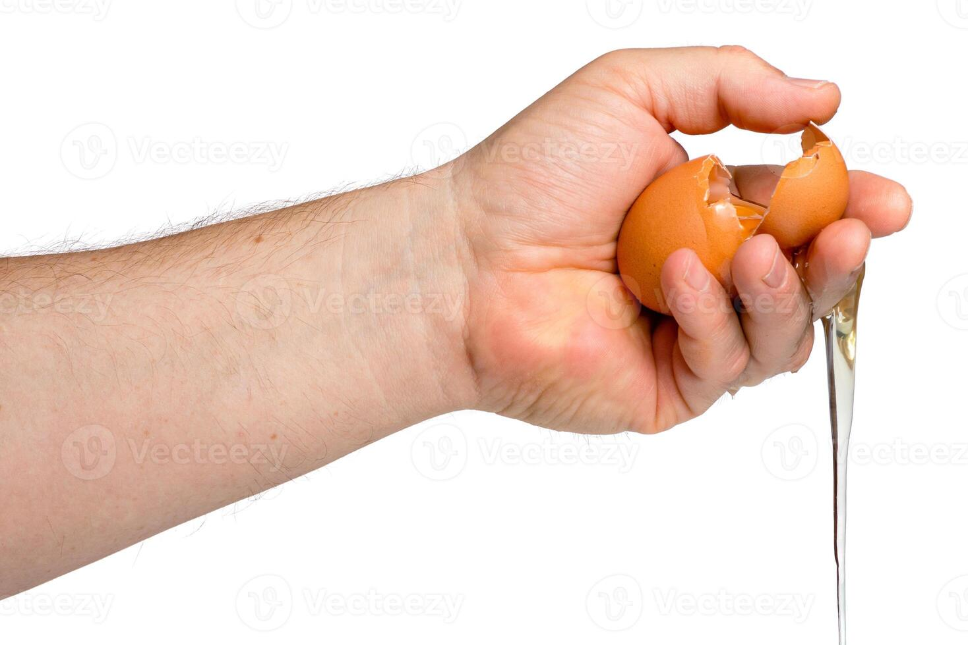
Challenge #2 – Can you squeeze to break it?
If you volunteer for this challenge you will:
Be given a raw egg to break BUT you must ONLY squeeze it with one hand.
  You may NOT bang (including such things such as tapping, hitting, etc.) it against something
  You may not put your fingernails into it
Squeeze it over the bowl provided. If it breaks, wipe your hands on the paper towels and wipes.

Slide 31
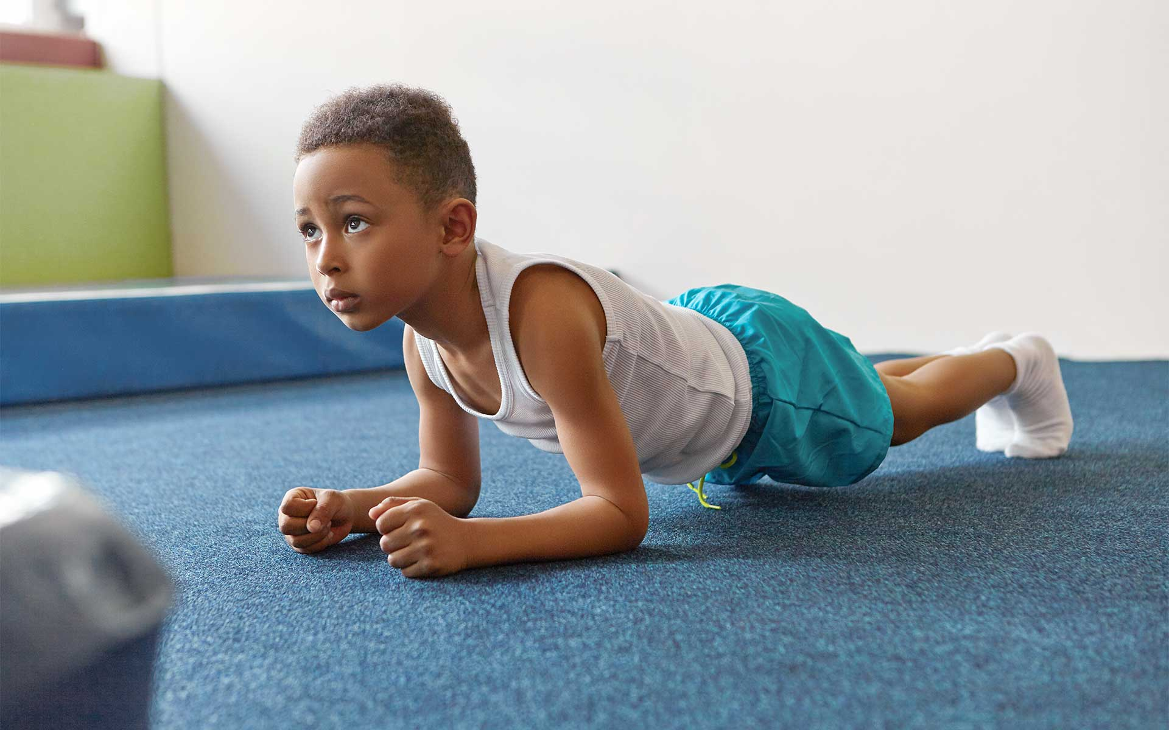
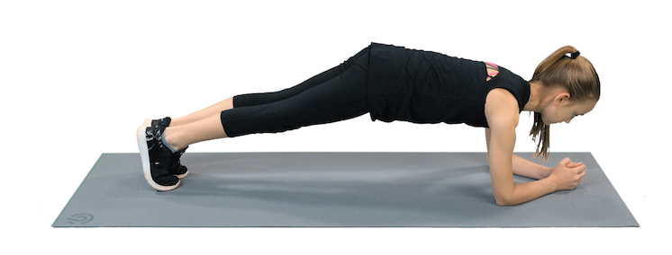
Challenge #3 -- Can you hold it the longest?
If you volunteer for this challenge you will:
Do a plank like the picture shows along with all other volunteers.
Only your fore arms, hands, and toes can touch the floor. The rest of your body needs to be above the floor.
We will see who can stay in this position the longest.

Slide 32
Challenge #4 -- Can you hold it the longest?
If you volunteer for this challenge you will:
Do the superman pose as pictured. This time your tummy can touch the ground, but your arms, hands, feet and knees need to be off the floor.
We will see who can stay in this position the longest.

Slide 33
Challenge #5 -- Can you lift it?
If you volunteer for this challenge you will:
Try to lift a bucket that is full of:
  Level 1 – a bucket full of paper (ream or package)
  Level 2 – a bucket full of rocks
  Level 3 – a bucket full of water (with its lid on tight)

