Slide 1
Gideon
Torches & Trumpets
For the LORD and For Gideon
Judges 7

Slide 2

It’s 4th of July. Why do we celebrate?
Freedom Country
God helped us win and become a country of freedom.

Slide 3
Last week in Review

Slide 4
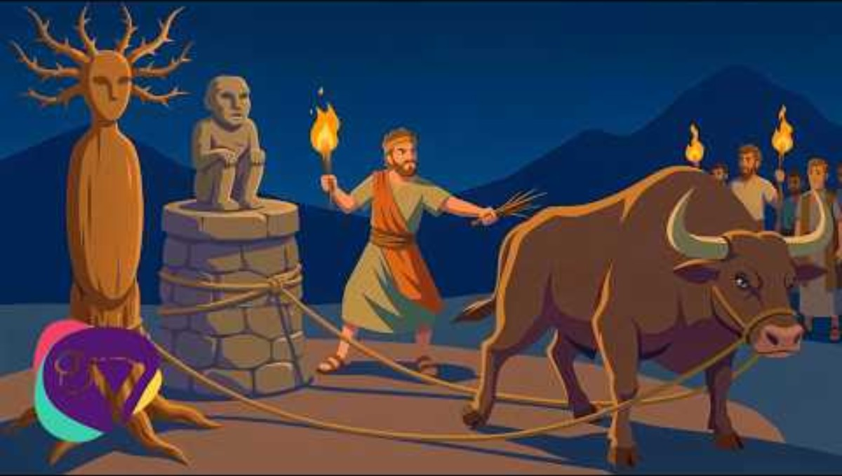
God chose Gideon
Judges 6

Slide 5
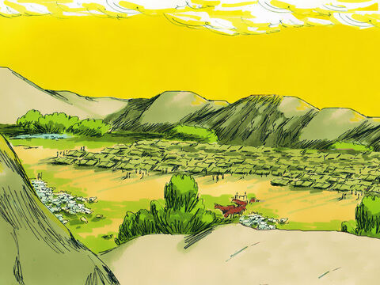
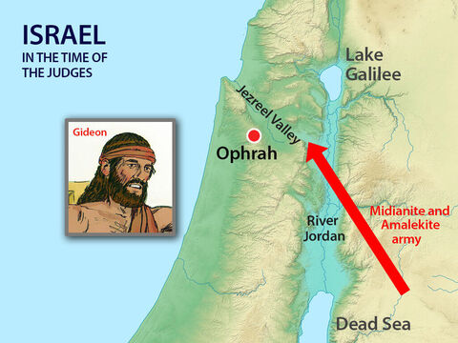
They have come again!
³³ All the Midianites, the Amalekites and other peoples from the east joined together. They came across the Jordan River and camped in the Valley of Jezreel.

Slide 6
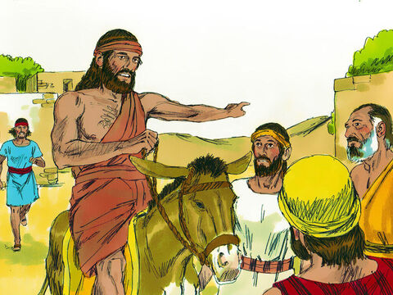

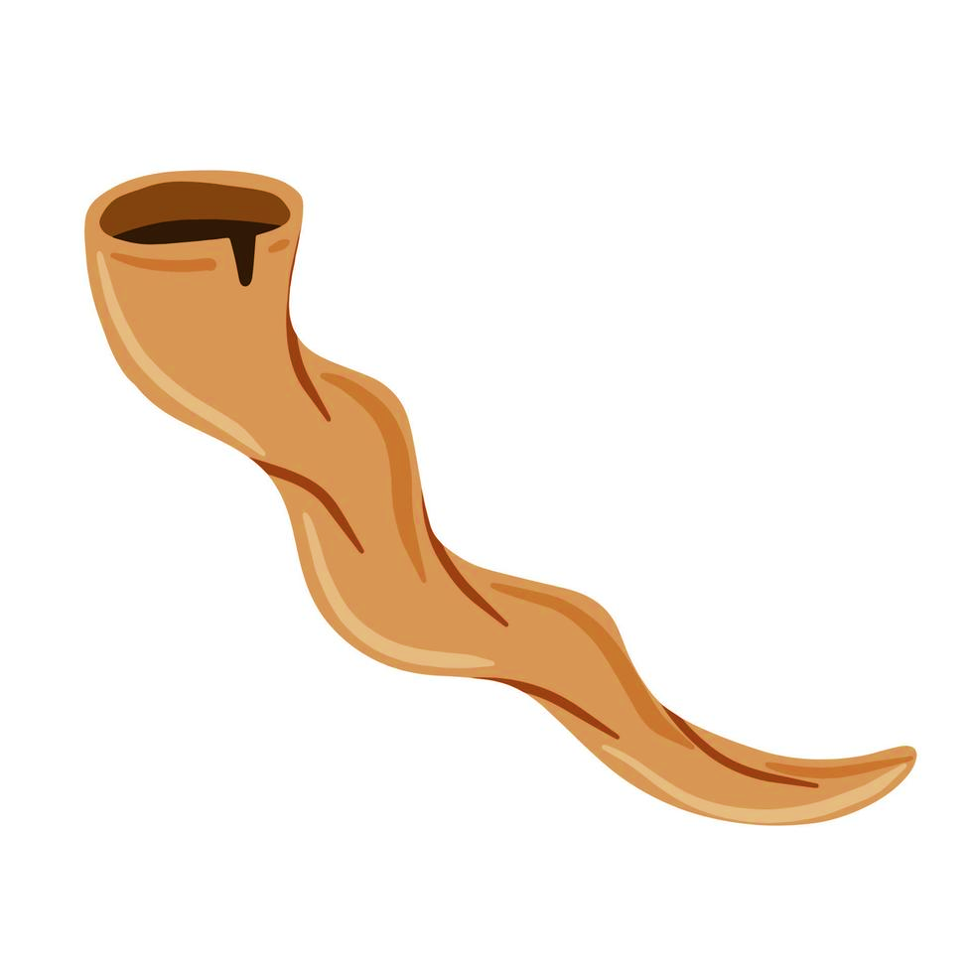
Blow the war horn
Come follow me.
We will fight the Midianites.
The LORD is with us!
He has told me to go fight.
GO. Tell all the men to come.
³⁴ But the Spirit of the Lord entered Gideon! Gideon blew a trumpet to call the Abiezrites to follow him.
³⁵ He sent messengers to all of Manasseh. The people of Manasseh were called to follow Gideon. Gideon also sent messengers to the people of Asher, Zebulun and Naphtali. They also went up to meet Gideon and his men.
I’m coming!
I’m tired of them destroying our land and stealing our food and cattle!

Slide 7
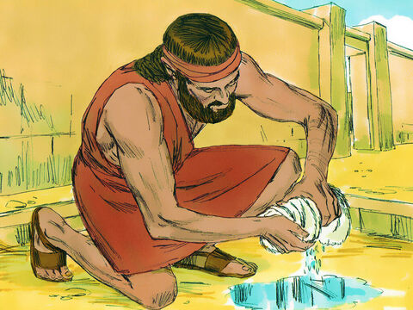
Put out the Fleece
Lord,
You said you would help me save Israel.
Please show me it’s true
I will put this wool out tonight. If it is wet and the ground is dry, I will know you will use me
to save Israel.
⁶ Then Gideon said to God, “You said you would help me save Israel.
³⁷ I will put some wool on the threshing floor. Let there be dew only on the wool. But let all of the ground be dry.
Then I will know what you said is true. I will know that you will use me to save Israel.”
³⁸ And that is just what happened.
Gideon got up early the next morning and squeezed the wool. He got a full bowl of water from the wool.

Slide 8
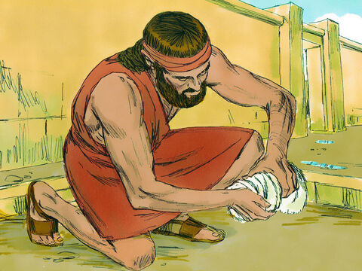
Put out the Fleece - 2
LORD, Don’t be angry with me. Please let me make one more test.
I will put this wool out tonight. If it is dry and the ground is wet, I will know all things are possible.
⁹ Then Gideon said to God, “Don’t be angry with me. Let me ask just one more thing. Please let me make one more test. Let the wool be dry while the ground around it gets wet with dew.”
⁴⁰ That night God did that very thing. Just the wool was dry, but the ground around it was wet with dew.

Slide 9
Our story continues….

Slide 10
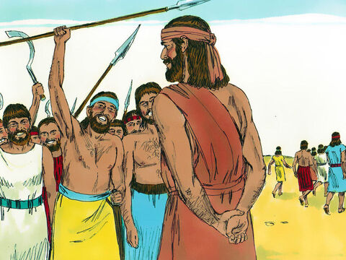
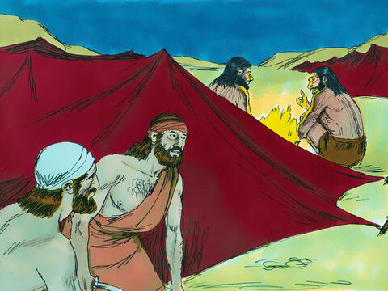
Act it out
You may help act out and tell the story.
Who would you like to be? Most of you can be Israelite soldiers. Only 2 are Midianites.
I’m Gideon
I’m Midianite 1
I’m Midianite 2
We’re soldiers
(no talking parts)
Servant Purah
(No speaking parts)

Slide 11
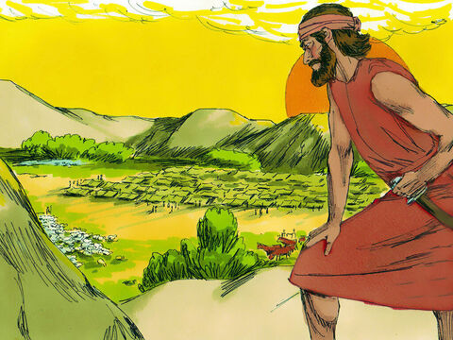
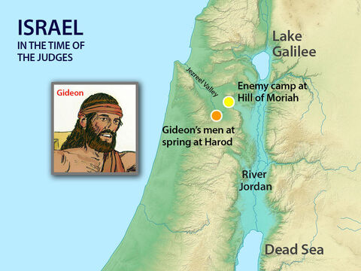
Battle camps
7 Early in the morning Jerub-Baal and all his men set up their camp at the spring of Harod. (Jerub-Baal is also called Gideon.)
The Midianites were camped north of them. The Midianites were camped in the valley at the bottom of the hill called Moreh.
(Moreh, or Moriah is the mountain that Abraham was told to sacrifice Isaac on, but God had a goat ready to be a replacement. It is the mountain later the tabernacle in Jerusalem would be built.)

Slide 12
Many Men had come to fight the Midianites
I don’t want them to brag that they saved themselves.
Anyone who is afraid
can go home.
You have too many men to fight the Midianites.
If any of you are afraid you may go home.
² Then the Lord said to Gideon, “You have too many men to defeat the Midianites. I don’t want the Israelites to brag that they saved themselves. ³ So now, announce to the people, ‘Anyone who is afraid may leave Mount Gilead. He may go back home.’”
And 22,000 men went back home.
But 10,000 remained.
So how many men had responded to Gideon’s request to come to fight Midianites?
22,000
+10,000

Slide 13
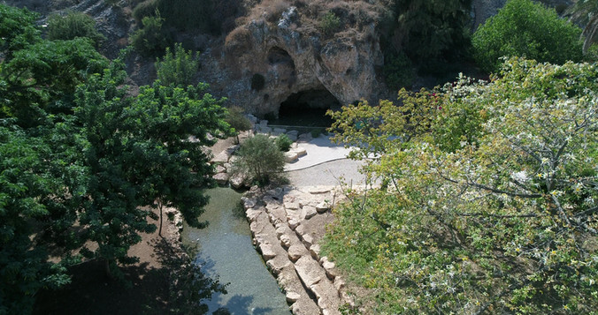
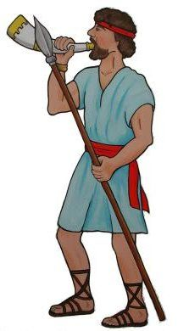
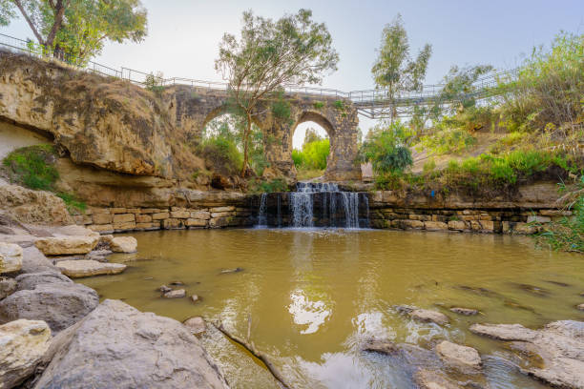
Still too many men
There are still too many men.
Take them to the water. I will test them there.
Those I say must leave, must go.
⁴ Then the Lord said to Gideon, “There are still too many men. Take the men down to the water, and I will test them for you there. If I say, ‘This man will go with you,’ he will go. But if I say, ‘That one will not go with you,’ he will not go.”
⁵ So Gideon led the men down to the water.
The spring of Harod in the Jezreel valley.

Slide 14
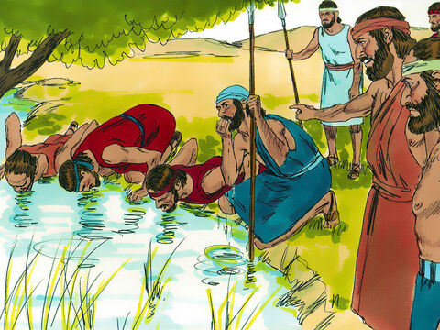
How will you drink?
Separate the men.
Those who drink water by lapping it up like a dog will be in one group.
Those who bend down to drink will be in the other group.
I will save you using the 300 men who brought the water up to their mouths and lapped the water like a dog.
I will allow you to defeat Midian.
Let all the other men go home.
⁵ So Gideon led the men down to the water. There the Lord said to him, “Separate them. Those who drink water by lapping it up like a dog will be in one group. Those who bend down to drink will be in the other group.” ⁶ There were 300 men who used their hands to bring water to their mouths. They lapped it as a dog does. All the rest got down on their knees to drink.
⁷ Then the Lord said to Gideon, “I will save you, using the 300 men who lapped the water. And I will allow you to defeat Midian. Let all the other men go to their homes.” ⁸ So Gideon sent the rest of Israel to their homes. But he kept 300 men.
He took the jars and the trumpets of those who went home.
The LORD has said that everyone in group 2
must go home.

Slide 15
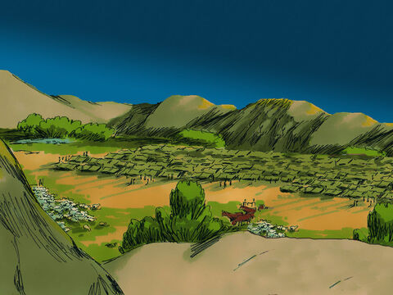
Go listen
You and the 300 men can go attack the Midianites.
But, if you are afraid, take your servant Purah and go to the camp of Midian. Listen to what they are saying.
Then you won’t be afraid.
Now the camp of Midian was in the valley below Gideon.
⁹ That night the Lord spoke to Gideon. He said, “Get up. Go down and attack the camp of the Midianites. I will allow you to defeat them.
¹⁰ But if you are afraid to go down, take your servant Purah with you. ¹¹ When you come to the camp of Midian, you will hear what they are saying. Then you will not be afraid to attack the camp.”
So Gideon and his servant Purah went down to the edge of the enemy camp.
¹² The Midianites, the Amalekites and all the peoples from the east were camped in that valley. There were so many of them they seemed like locusts. They had so many camels no one could count them. There were as many as there are grains of sand on the seashore!

Slide 16
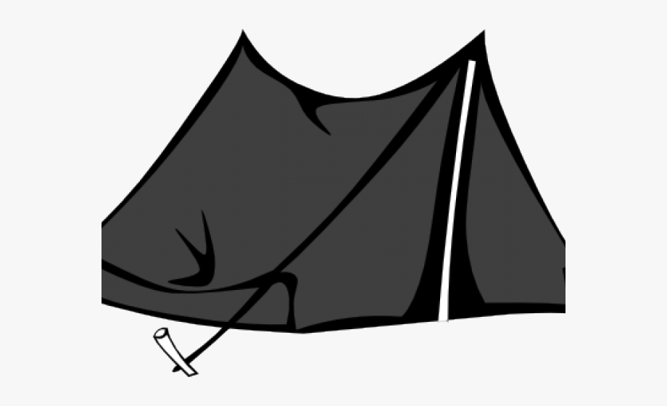
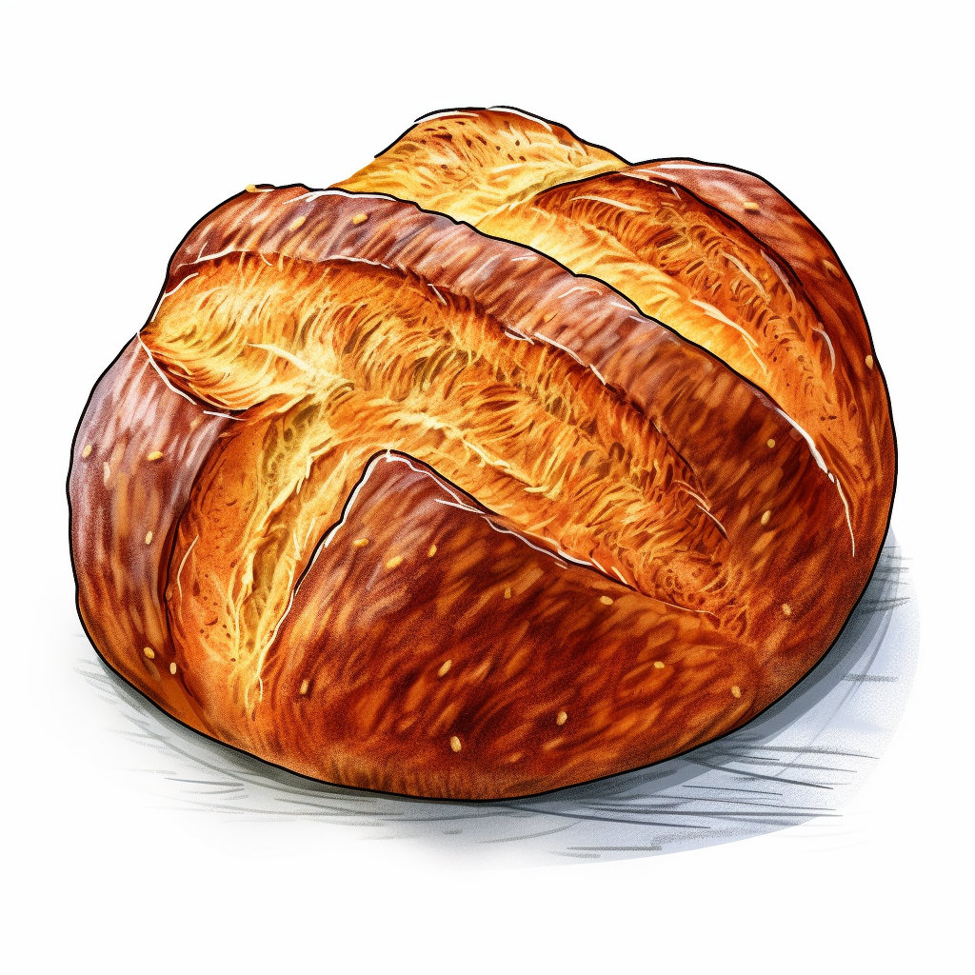
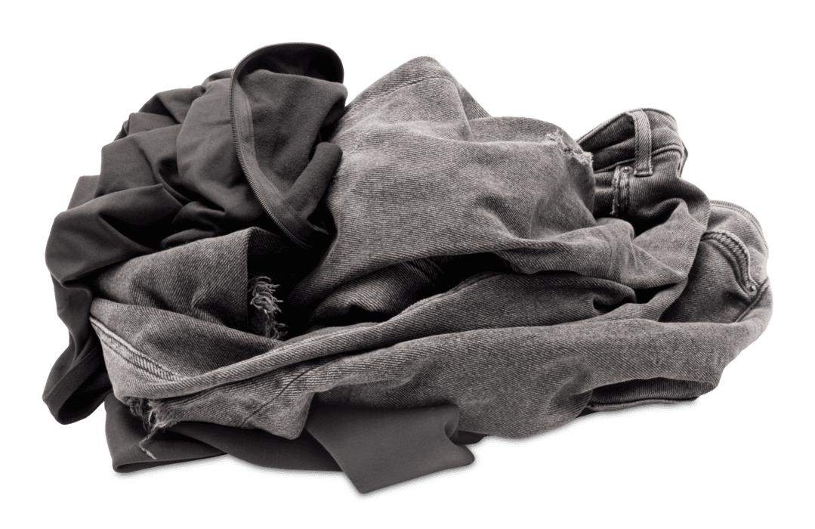
Spying on the Enemy
Listen. I dreamed that a loaf of barley bread rolled into the camp of Midian.
It hit the tent so hard that the tent turned over
and fell flat!
Your dream is about the sword of Gideon, son of Joash, a man of Israel.
God will defeat Midian and the whole army!
¹³ When Gideon came to the enemy camp, he heard a man talking. That man was telling his friend about a dream. He was saying, “Listen, I dreamed that a loaf of barley bread rolled into the camp of Midian. It hit the tent so hard that the tent turned over and fell flat!”
¹⁴ The man’s friend said, “Your dream is about the sword of Gideon son of Joash, a man of Israel. God will let Gideon defeat Midian and the whole army!”
¹⁵ When Gideon heard about the dream and what it meant, he worshiped God. Then Gideon went back to the camp of Israel.
Praise the LORD!

Slide 17
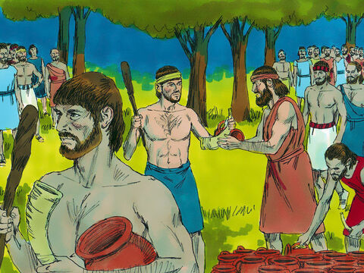
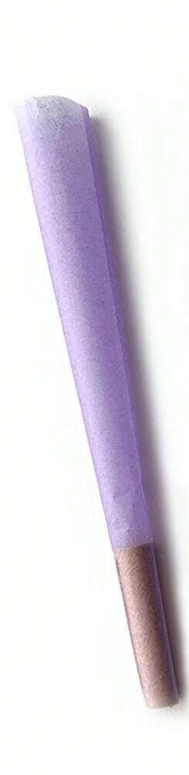
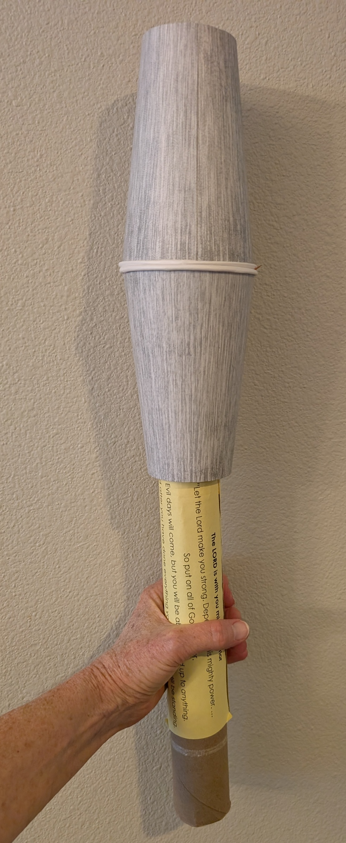
Get up! Get ready!
Get up! It is time! The Lord has defeated Midian!
Everyone gets a trumpet and a jar with a torch..
Listen to your group number: You sir are in group 1. You sir are in group 2. You sir are in group 3.
You are in group 1. You sir are in group 2.
You sir are in group 3…… 100 in each group.
Then Gideon went back to the camp of Israel. He called out to them, “Get up! The Lord has defeated the army of Midian for you!”
¹⁶ Then Gideon divided the 300 men into three groups. He gave each man a trumpet and an empty jar. A burning torch was inside each jar.

Slide 18
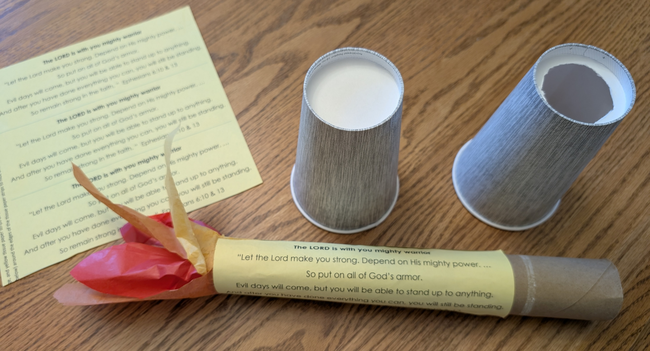
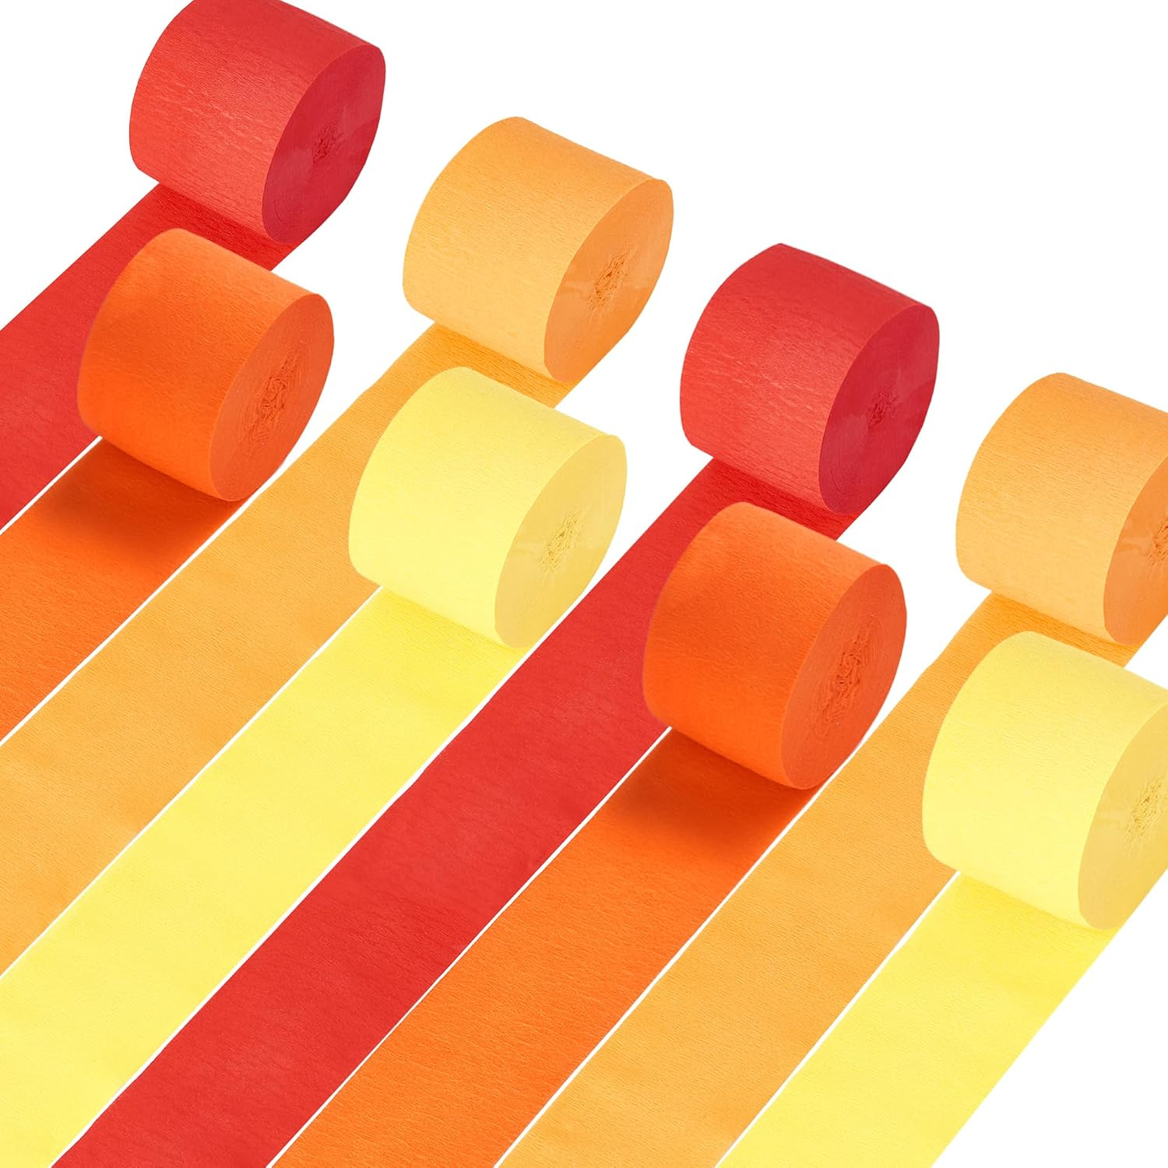
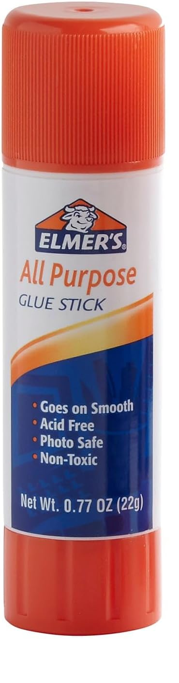
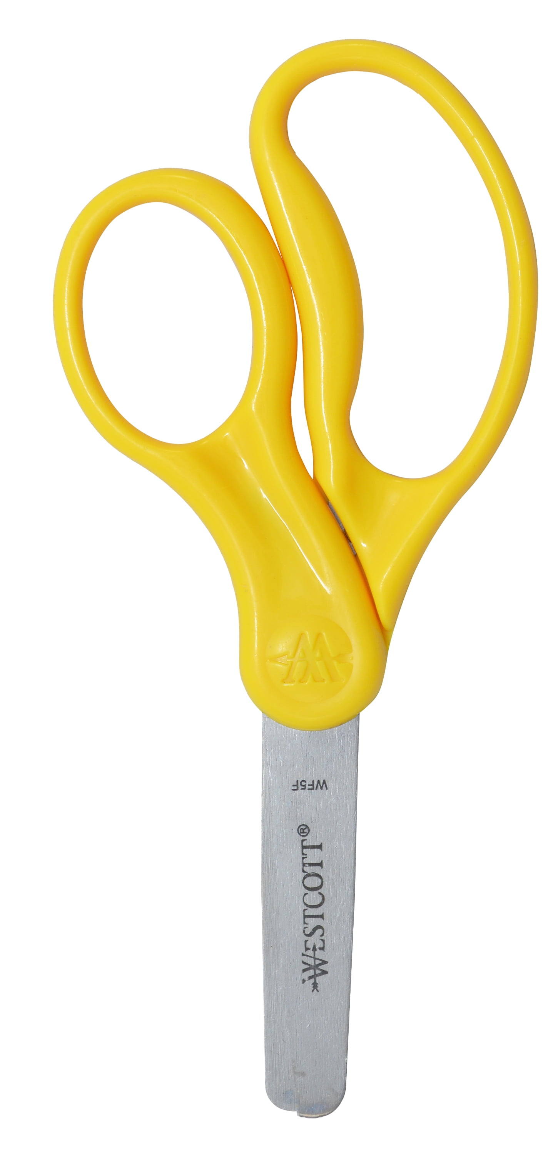
CRAFT TIME:
Come get your supplies to make your trumpet, torch, and jug.
Plain white paper for trumpet
For torch: 2 Paper coffee cups; 1 with the bottom cut out
Scissors
Brown Construction paper or paper towel roll
Yellow and Orange streamer or tissue paper
Glue stick
Paper with verses

Slide 19
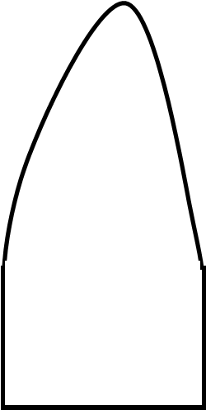
CRAFT TIME: Make a Torch
Prior to craft time, use the shape below as a pattern to cut 3 flames from red tissue paper/streamer, 3 from yellow and 3 from orange.
Glue them to the top of a paper towel roll so that there is 1 of each color going around the top. Then glue another 3 so that they overlap the others.
Cut on the straight line of the scripture paper to the left. Glue the paper onto the paper towel roll. It should overlap the glued bottom portion of the flames and help secure them.
Prior to craft time, cut the bottom out of a paper cup. Insert torch up into the cup. Cover with another cup (not cut) as the upper portion of the jug which is ’broken’ off.

Slide 20
CRAFT TIME:
Let’s make a trumpet. This is easy.
Trumpet:
Roll the paper. Start with side A and roll towards side B. Then tape it there.
The mouth end should be smaller.
Side A
Side B
https://www.kgmcrafts.com/bible-crafts-gideon.html#torchinjar

Slide 21
Now we are ready to act out the story.
Remember:
It was in the middle of the night. Everyone was sleeping. Gideon woke them up, gave them each a torch in a jug and a trumpet. He separated them into 3 groups.
Put your torch in your paper cup jug. Also hold your trumpet.
Separate into 3 groups.
Now listen to the Gideon’s instructions:

Slide 22
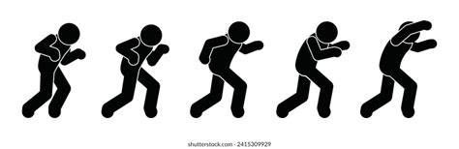
QUIET SNEAK DARK 3 groups around 3 edges
INSTRUCTIONS
¹⁷ Gideon told the men, “Watch me and do what I do. When I get to the edge of the camp, do what I do.
¹⁸ Surround the enemy camp. I and everyone with me will blow our trumpets. When we blow our trumpets, you blow your trumpets, too. Then shout, ‘For the Lord and for Gideon!’”
GET READY
¹⁹ So Gideon and the 100 men with him came to the edge of the enemy camp. They came just after the enemy had changed guards. It was during the middle watch of the night.

Slide 23
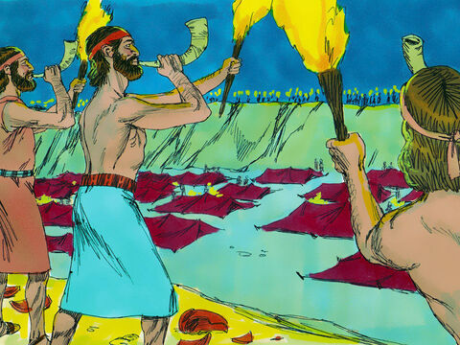
SURPRISE!
BLOW! BREAK! SHOUT!
A SWORD FOR THE LORD
AND FOR GIDEON!
Then Gideon and his men blew their trumpets and smashed their jars. ²⁰ All three groups of Gideon’s men blew their trumpets and smashed their jars.
They held the torches in their left hands and the trumpets in their right hands.
Then they shouted, “A sword for the Lord and for Gideon!”
²¹ Each of Gideon’s men stayed in his place around the camp.
But inside the camp, the men of Midian began shouting and running away.
²² When Gideon’s 300 men blew their trumpets, the Lord caused all the men of Midian to fight each other with their swords!

Slide 24
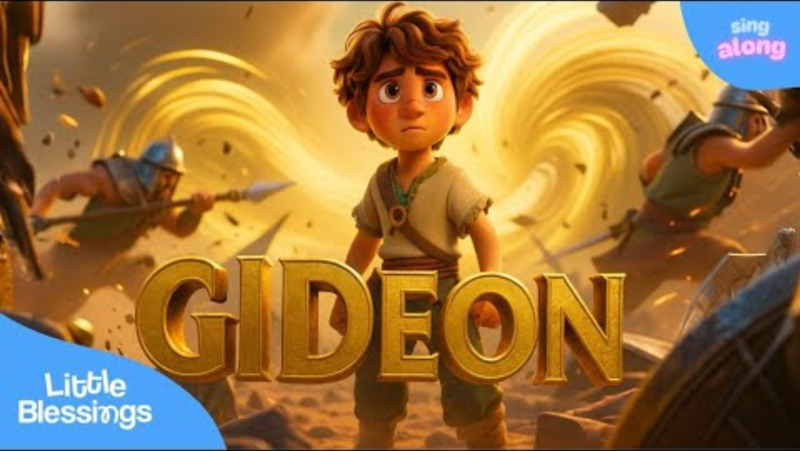
Song of Gideon

Slide 25

Fight the Good Fight
What fight are we to fight?
The fight of faith.
Fight the urge to trust in money & riches
Fight the urge to trust anything other than God
Fight the temptations to think evil thoughts
Fight the temptations to do evil
Run the good race – Press On
Continue to trust God and have faith in His Word
Continue to love God and others
Continue to have hope, patience, gentleness
Continue to obey the Truth
1 Timothy
6:11-12
Ephesians
6:10-18
² Our fight is not against people on earth. We are fighting against the rulers and authorities and the powers of this world’s darkness. We are fighting against the spiritual powers of evil in the heavenly world.
¹² Keeping your faith is like running a race. Try as hard as you can to win. Be sure you receive the life that continues forever. You were called to have that life. And you confessed the great truth about Christ in a way that many people heard.

Slide 26
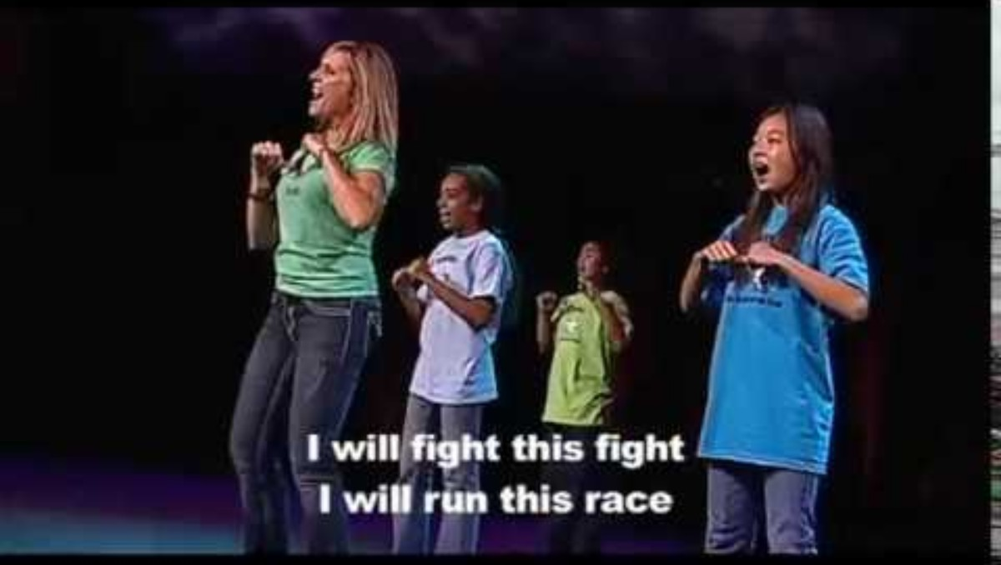
Fight the Fight of Faith

Slide 27
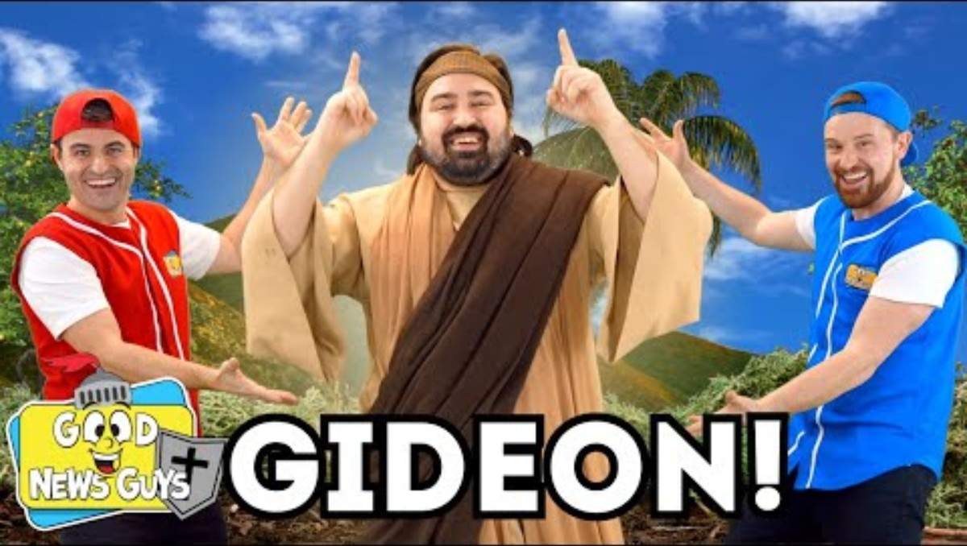
Song of Gideon

Slide 28
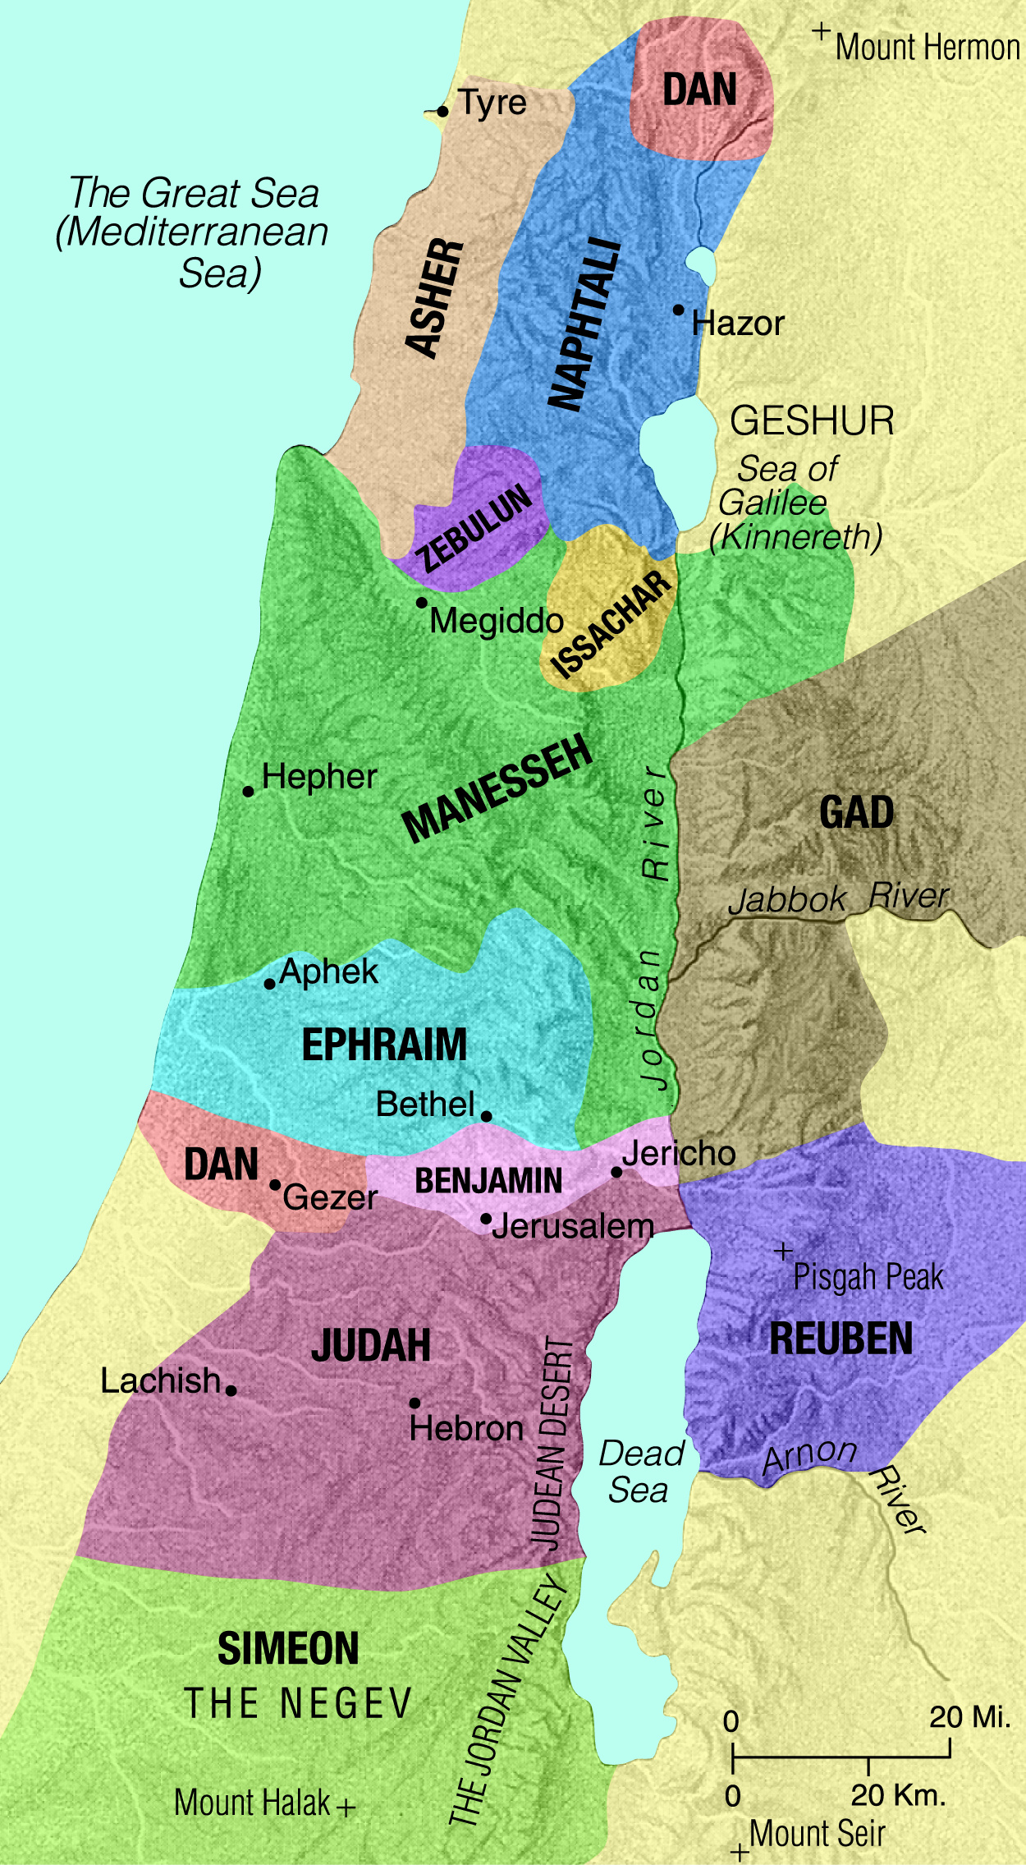
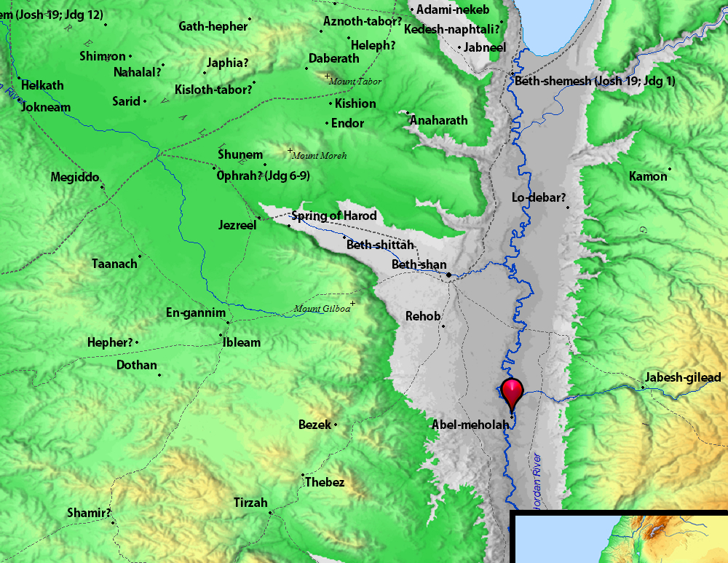
Chase! Attack!
All men from the tribes of Naphtali, Asher, and Manasseh. Come help us!
Take control of the Jordan River before the Midianites can get to the river!
The enemy army ran away to the city of Beth Shittah. It is toward Zererah. They ran as far as the border of the city of Abel Meholah. It is near the city of Tabbath. ²³ Then men of Israel from Naphtali, Asher and all of Manasseh were called out to chase the Midianites.
²⁴ Gideon sent messengers through all the mountains of Ephraim. They said, “Come down and attack the Midianites. Take control of the Jordan River as far as Beth Barah. Do this before the Midianites can get to the river and cross it.”
So they called out all the men of Ephraim. They took control of the Jordan River as far as Beth Barah.
²⁵ The men of Ephraim captured two princes of Midian named Oreb and Zeeb. The men of Ephraim killed Oreb at the rock of Oreb. They killed Zeeb at the winepress of Zeeb. And they continued chasing the Midianites. They cut off the heads of Oreb and Zeeb and took them to Gideon. He was now east of the Jordan River.

Slide 29
The Rest of the Story --- optional
Judges 8 --- Victory in Battle But defeat in life Will you remain true?

Slide 30
They won!
Gideon, we want you and your son to rule over us.
The Battle continued. (Judges 8)
Gideon’s men were tired and hungry. Gideon asked the people of Succoth and Peniel to give them bread. But they didn’t. They said, “you have to bring us back our enemies, Zebah and Zalmunna first.”
That wasn’t nice or fair. Gideon taught them a lesson later, after he and his army conquered the enemy armies and brought back Zebah and Zalmunna.
Judges 8:
²² The people of Israel said to Gideon, “You saved us from the Midianites. So now, rule over us. We want you, your son and your grandson to rule over us.”
²³ But Gideon told them, “The Lord will be your ruler. I will not rule over you. And my son will not rule over you.” …..
²⁸ So Midian was forced to be under the rule of Israel. Midian did not cause trouble anymore. And the land had peace for 40 years, as long as Gideon was alive.
²⁹ Gideon son of Joash went to his home to live.
No. The LORD is your ruler.
I will not rule over you.

Slide 31
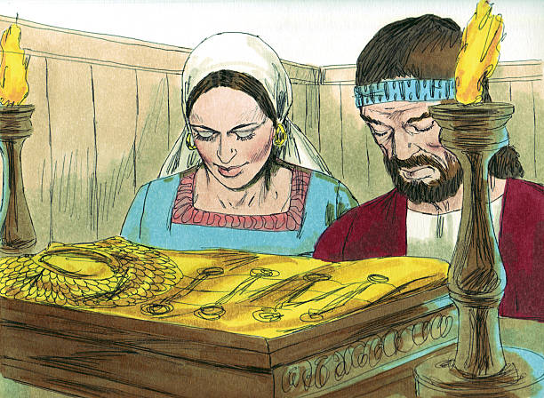
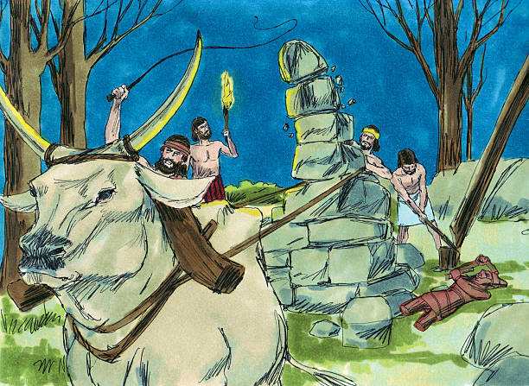
But then Gideon made a sad bad mistake that caused many to not worship the LORD
²⁴ He said, “I want you to do this one thing for me. I want each of you to give me a gold earring from the things you took in the fighting.” (The Ishmaelite men wore gold earrings. And some Ishmaelites had been defeated in the battle.)
²⁵ So the people of Israel said to Gideon, “We will gladly give you what you want.” So they put a coat down on the ground. Each man threw an earring onto the coat. ²⁶ The gold earrings weighed about 43 pounds. This did not count the weight of the other gifts the people gave to Gideon. They gave him decorations, necklaces and purple robes. These were things that the kings of Midian had worn. The people also gave him chains from the camels of the kings of Midian. ²⁷ Gideon used the gold to make an idol. He put the idol in his hometown of Ophrah. All the people of Israel were unfaithful to God and worshiped the idol. It became a trap that caused Gideon and his family to sin.
Oh, if only Gideon would have led the people to worship the LORD and only the LORD!

Slide 32
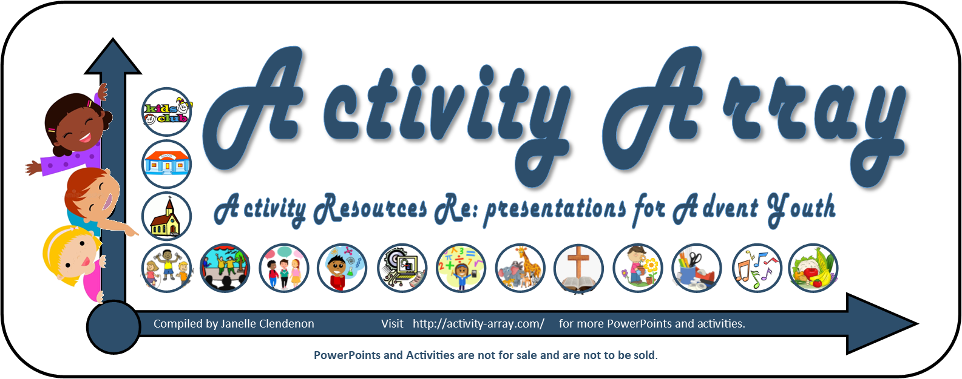
https://activity-array.com/

Slide 33
CRAFT Activity Option 2
If you choose this option, replace the craft slides with the following slides.

Slide 34
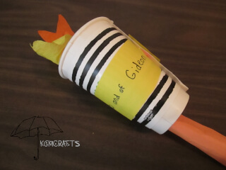
Get up! Get ready!
Get up! It is time! The Lord has defeated Midian!
Everyone gets a trumpet and a jar with a torch..
Listen to your group number: You sir are in group 1. You sir are in group 2. You sir are in group 3.
You are in group 1. You sir are in group 2.
You sir are in group 3…… 100 in each group.
Then Gideon went back to the camp of Israel. He called out to them, “Get up! The Lord has defeated the army of Midian for you!”
¹⁶ Then Gideon divided the 300 men into three groups. He gave each man a trumpet and an empty jar. A burning torch was inside each jar.
https://www.kgmcrafts.com/bible-crafts-gideon.html#torchinjar

Slide 35
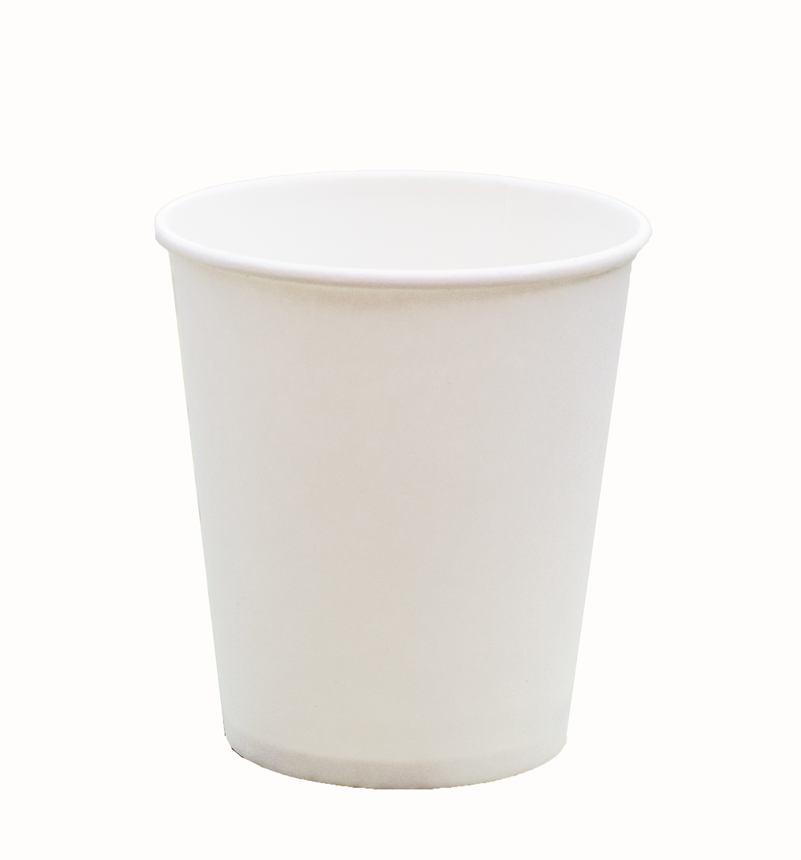
CRAFT TIME:
Come get your supplies to make your trumpet, torch, and jug.
White paper
Paper coffee cup
Scissors
Brown Construction paper or paper towel roll
Yellow and Orange streamer or tissue paper
Glue stick
Stapler
Hole punch
https://www.kgmcrafts.com/bible-crafts-gideon.html#torchinjar

Slide 36
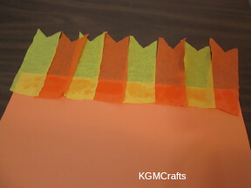
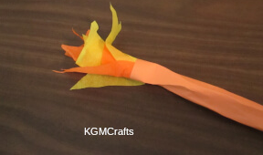

CRAFT TIME:
Let’s make the torch.
Torch:
Cut the streamers in about 5” lengths
Glue them to a short end of the brown construction paper or paper towel roll
Roll brown construction paper straight across to be the torch stick and then tape it to secure it.
Wrap memory verse paper around the bottom of the streamers to help them stay glued and look nice.
The Lord is with you mighty Warrior
https://www.kgmcrafts.com/bible-crafts-gideon.html#torchinjar

Slide 37
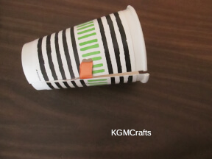
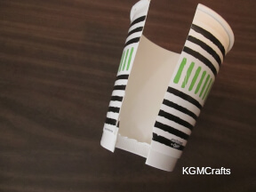
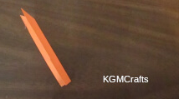
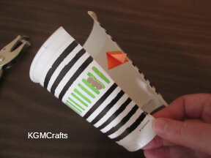
CRAFT TIME:
Let’s make our jugs.
In our story, they will hide the torch until they are broken.
Jug:
Cut down the seam of the paper cup
Then cut out the bottom of the cup.
Use the small cut orange or yellow construction paper (1”x4” inches) Fold in in half lengthwise and cut a diagonal cut at the top.
Stapel the straight end of that paper to the inside of the cup as shown.
Hole punch 3 holes in a line on the other side of the cut of the cup as shown.
Put the pointed end through this 3 hole slit. Pull it thru and fold it to hold the cup together.
Now gently stretch the top or bottom of your cup’s sides to open the cup and ‘break’ the jug
Attach the yellow paper that says, “For the LORD and for Gideon” Make sure it does not cover the opening nor the opener paper.
https://www.kgmcrafts.com/bible-crafts-gideon.html#torchinjar

Slide 38
CRAFT Activity Option 3
If you choose this option, replace the craft slides with the following slides.

Slide 39
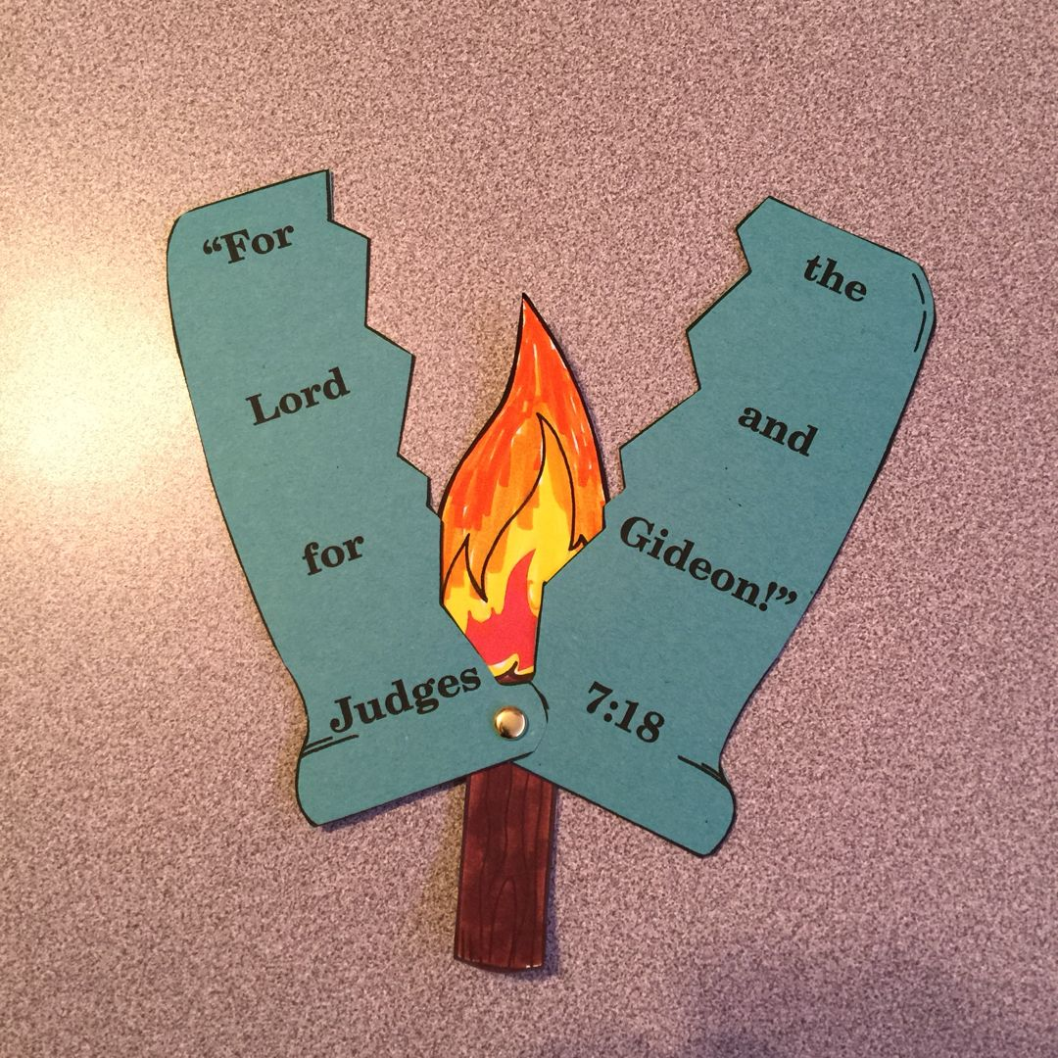
Get up! Get ready!
Get up! It is time! The Lord has defeated Midian!
Everyone gets a trumpet and a jar with a torch..
Listen to your group number: You sir are in group 1. You sir are in group 2. You sir are in group 3.
You are in group 1. You sir are in group 2.
You sir are in group 3…… 100 in each group.
Then Gideon went back to the camp of Israel. He called out to them, “Get up! The Lord has defeated the army of Midian for you!”
¹⁶ Then Gideon divided the 300 men into three groups. He gave each man a trumpet and an empty jar. A burning torch was inside each jar.
https://www.kgmcrafts.com/bible-crafts-gideon.html#torchinjar

Slide 40
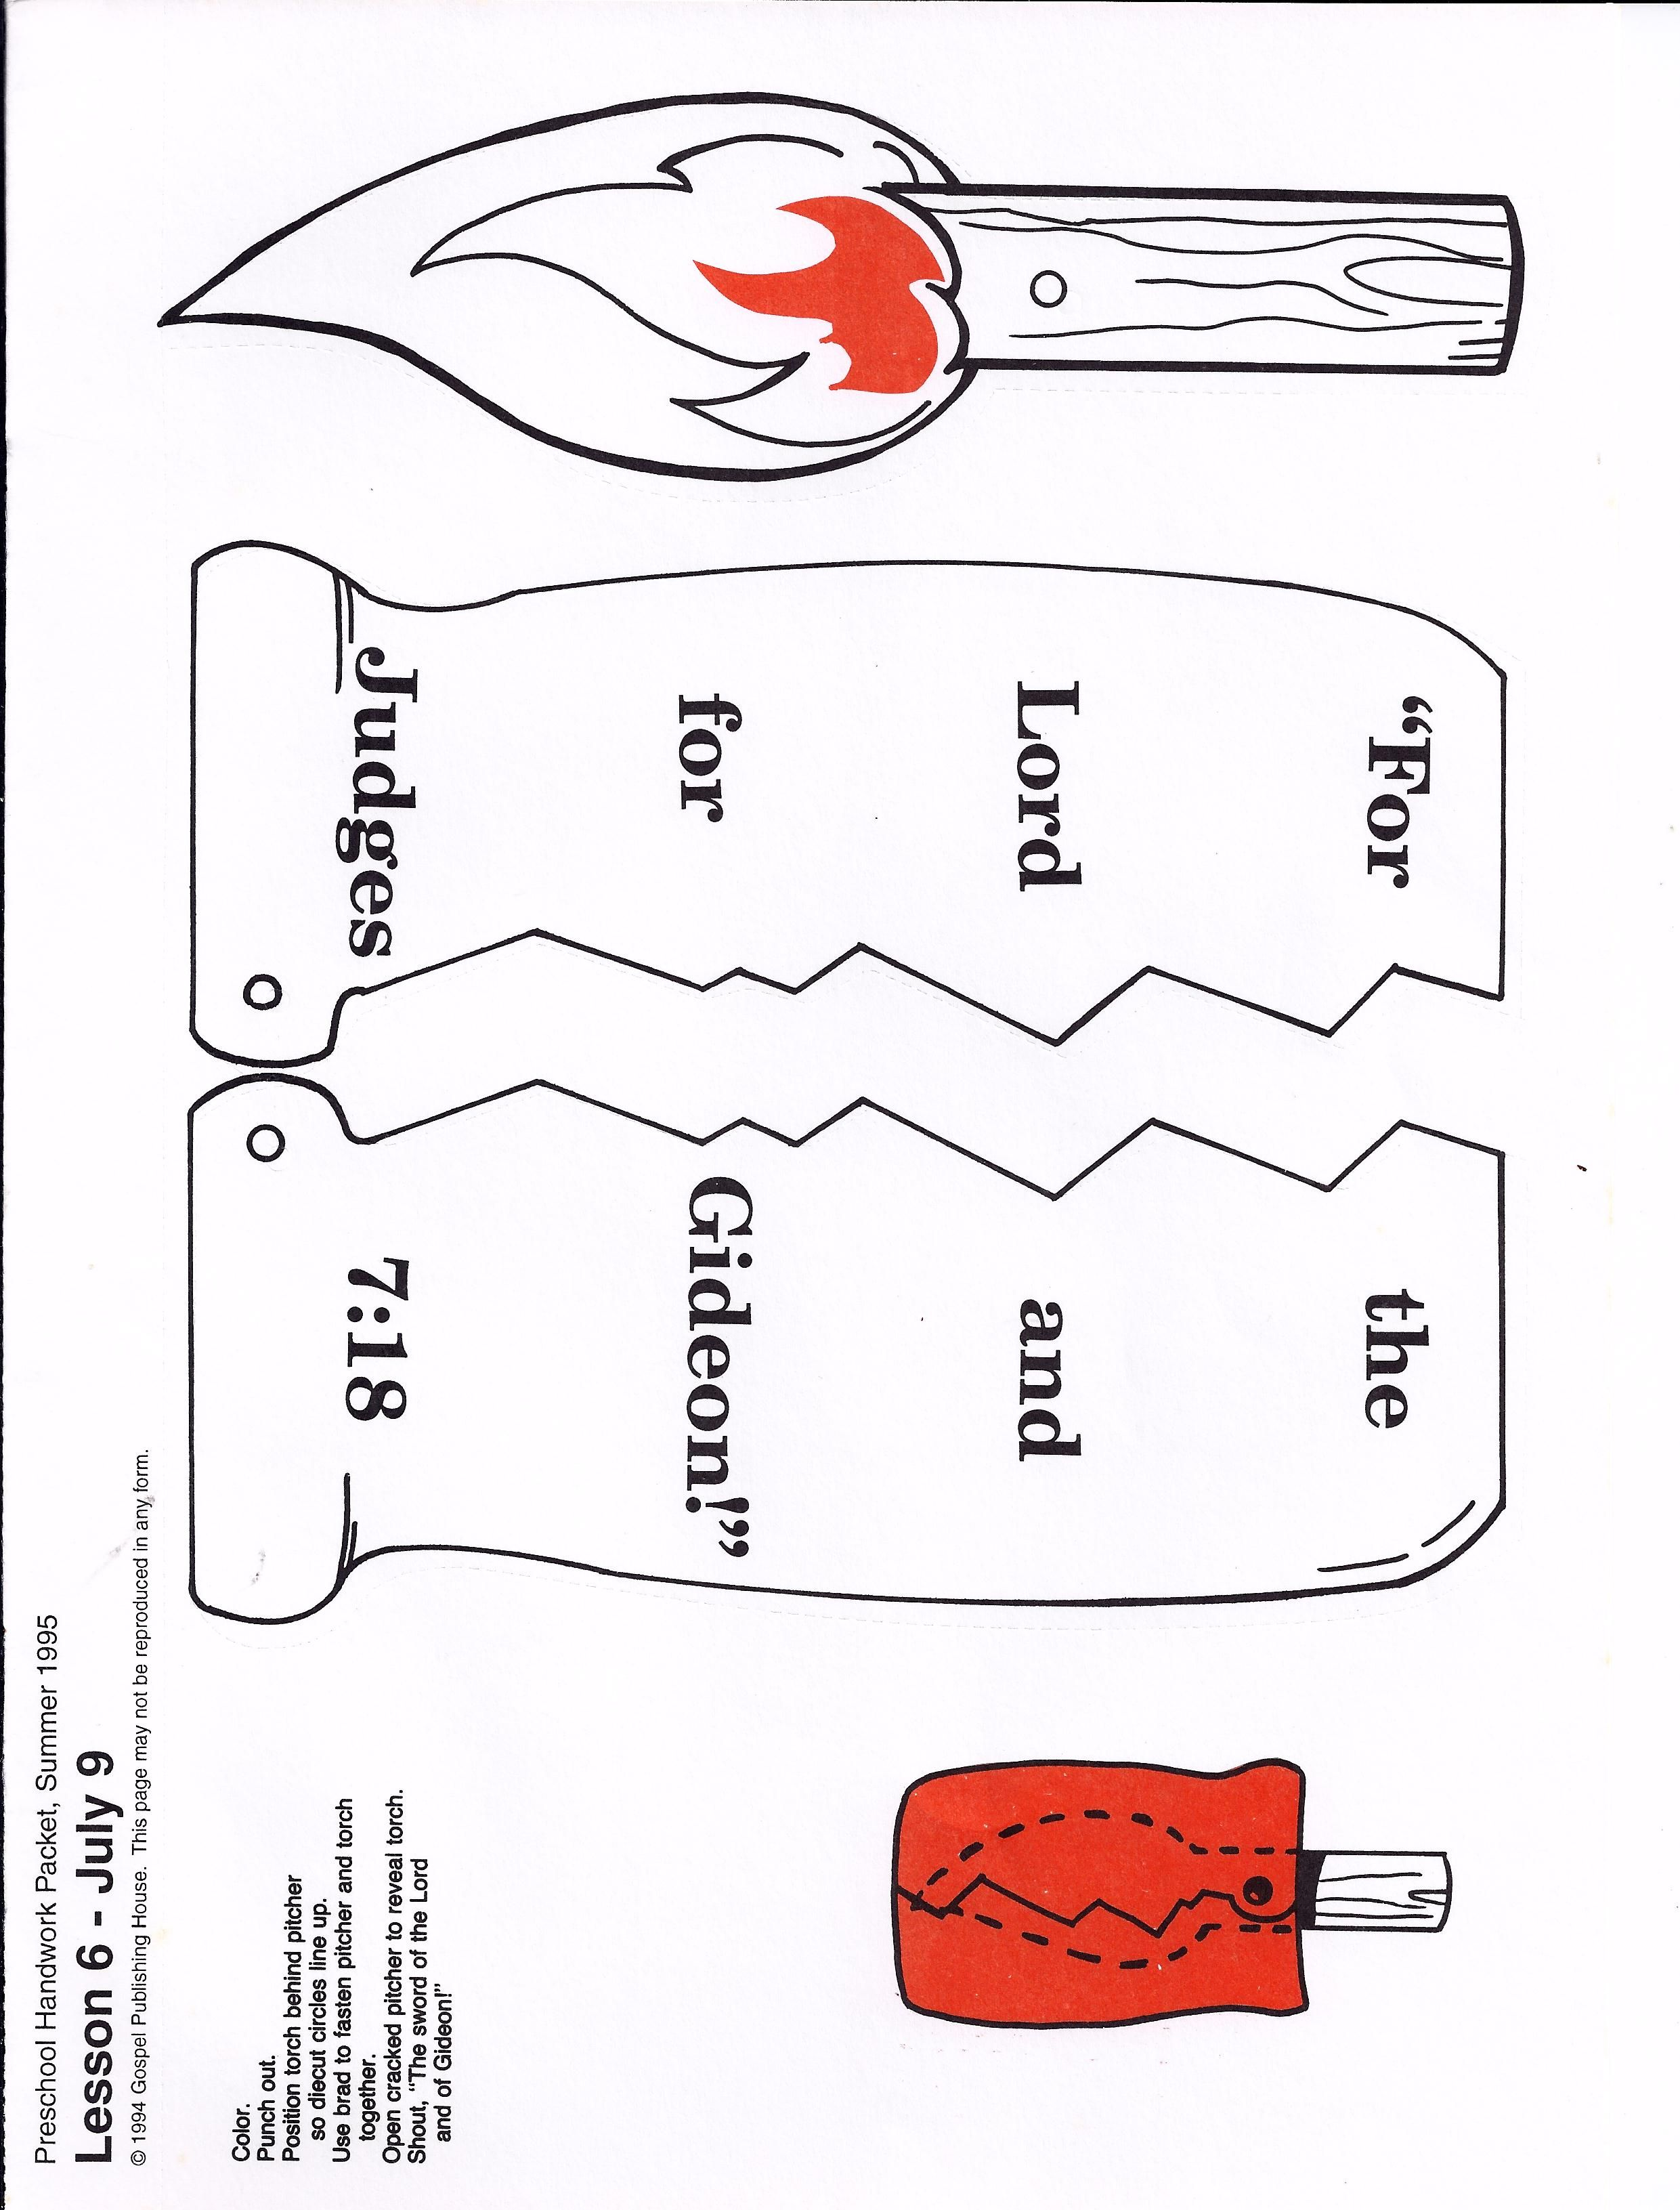
CRAFT TIME:
Come get your supplies to make your trumpet, torch, and jug.
White paper
Printed paper
Brad
https://www.pinterest.com/pin/68733161360/visual-search/?x=16&y=16&w=532&h=709&surfaceType=flashlight

Slide 41
CRAFT TIME:
Let’s make a trumpet. This is easy.
Trumpet:
Roll the paper. Start with side A and roll towards side B. Then tape it there.
The mouth end should be smaller.
Side A
Side B
https://www.kgmcrafts.com/bible-crafts-gideon.html#torchinjar

Slide 42
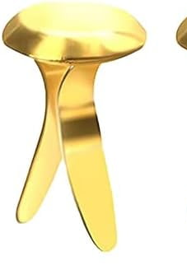
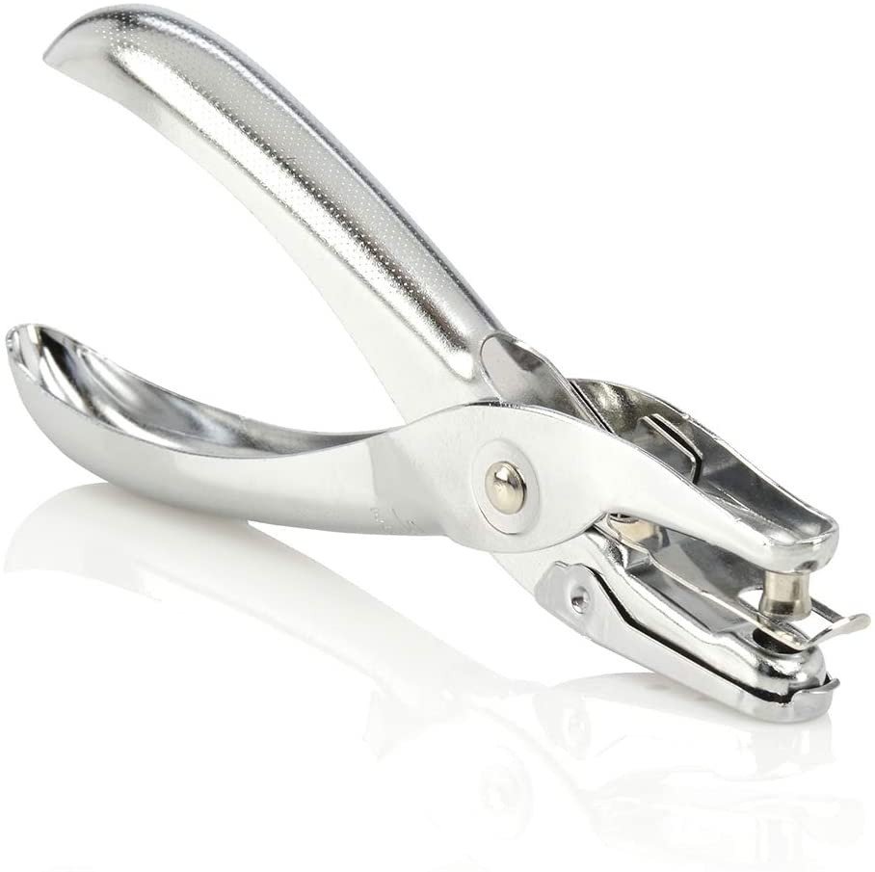
CRAFT TIME:
Make the torch and trumpet
Color the jug and torch
Cut them out
Punch the circles with a hole puncher.
Place the holes on top of each other as shown and put a brad in them to hold them together. Make sure the pitcher when closed lines up properly.
https://www.pinterest.com/pin/68733161360/visual-search/?x=16&y=16&w=532&h=709&surfaceType=flashlight

Slide 43
CRAFT Activity Option 4
If you choose this option, replace the craft slides with the following slides.
The men broke the jugs with a loud crack exposing the bright torches.
This option is a loud popper.

Slide 44
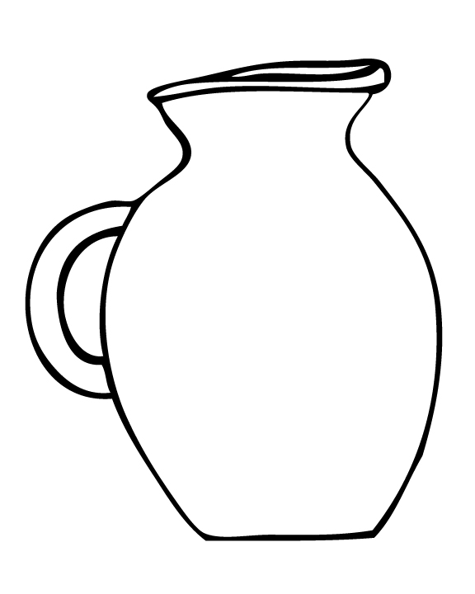

Get up! Get ready!
Get up! It is time! The Lord has defeated Midian!
Everyone gets a trumpet and a jar with a torch..
Listen to your group number: You sir are in group 1. You sir are in group 2. You sir are in group 3.
You are in group 1. You sir are in group 2.
You sir are in group 3…… 100 in each group.
Then Gideon went back to the camp of Israel. He called out to them, “Get up! The Lord has defeated the army of Midian for you!”
¹⁶ Then Gideon divided the 300 men into three groups. He gave each man a trumpet and an empty jar. A burning torch was inside each jar.
https://www.kgmcrafts.com/bible-crafts-gideon.html#torchinjar

Slide 45
CRAFT TIME:
Let’s make a trumpet. This is easy.
Trumpet:
Roll the paper. Start with side A and roll towards side B. Then tape it there.
The mouth end should be smaller.
Side A
Side B
https://www.kgmcrafts.com/bible-crafts-gideon.html#torchinjar

Slide 46

CRAFT TIME: How to make a popper -- torch and jug

