Slide 1
One of The Judges
Gideon
A quick overview of Judges 1-5
Judges 6

Slide 2








What do you do when someone asks you to do something really hard or scary?

Slide 3
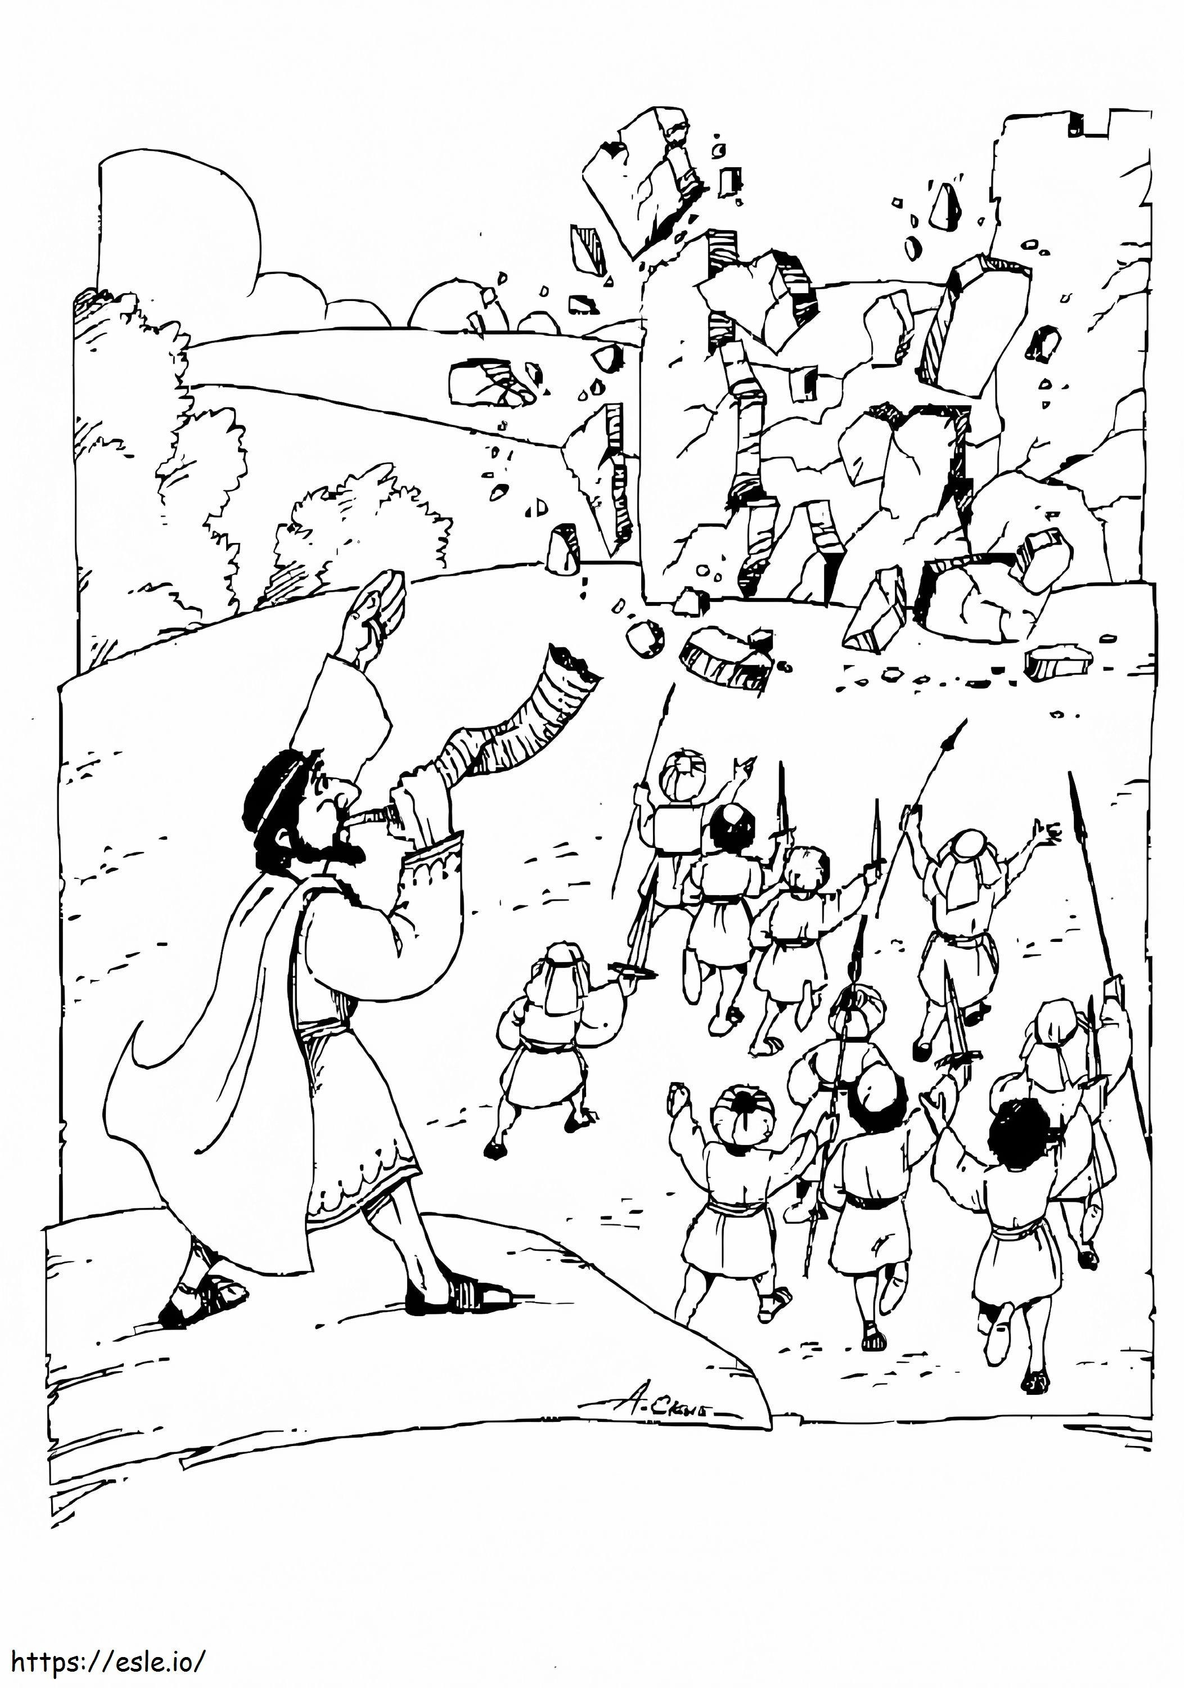
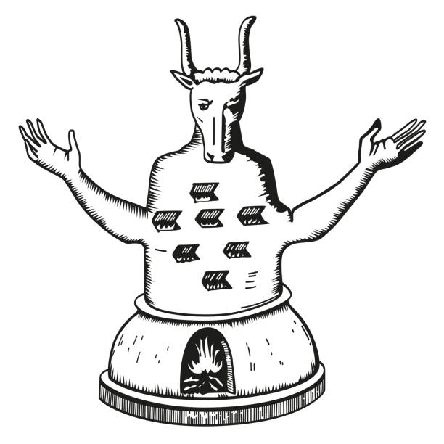
Once upon a Time
1400 BC 1300 BC 1200 BC 1100 BC 1000 BC 900 BC
Enter Promised Land
Israelites did evil
I kept my covenant with you. I gave you land, strength, & my commandments. I was with you. But you did not obey me. You let the evil continue.
You even began worshipping their false gods – idols. Will they care for you?
enslaved
With God, the Israelites won war after war. God gave them the land of Canaan, just like He promised Abraham, Isaac, and Jacob. The people celebrated and settled in the land. They worshipped God …. until Joshua died…… then….
Some Israelite tribes didn’t take over all the land God gave them. They let sin live among them and then started worshipping the idols themselves. First, they decided just to enslave the Canaanites. Then the Canaanites enslaved the Israelites.
Because the people did evil and trusted in idols - the fake gods and totally ignored the One True Living God, God let them see the consequences. Things were very bad! Time passed. Bad became terrible! Finally, the people cried out to God – LORD help us!
God heard their cry. He chose and called a person to rescue the people. The person was called a judge. The judge led the people to fight and win. Then the Israelites followed God until the judge died. …. Then……… they went back to the idols. (repeat)

Slide 4
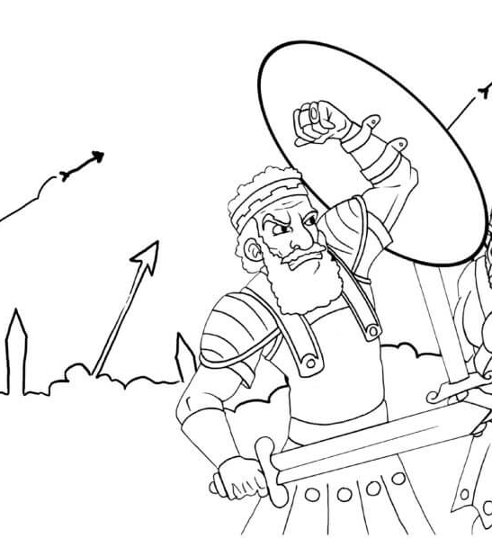
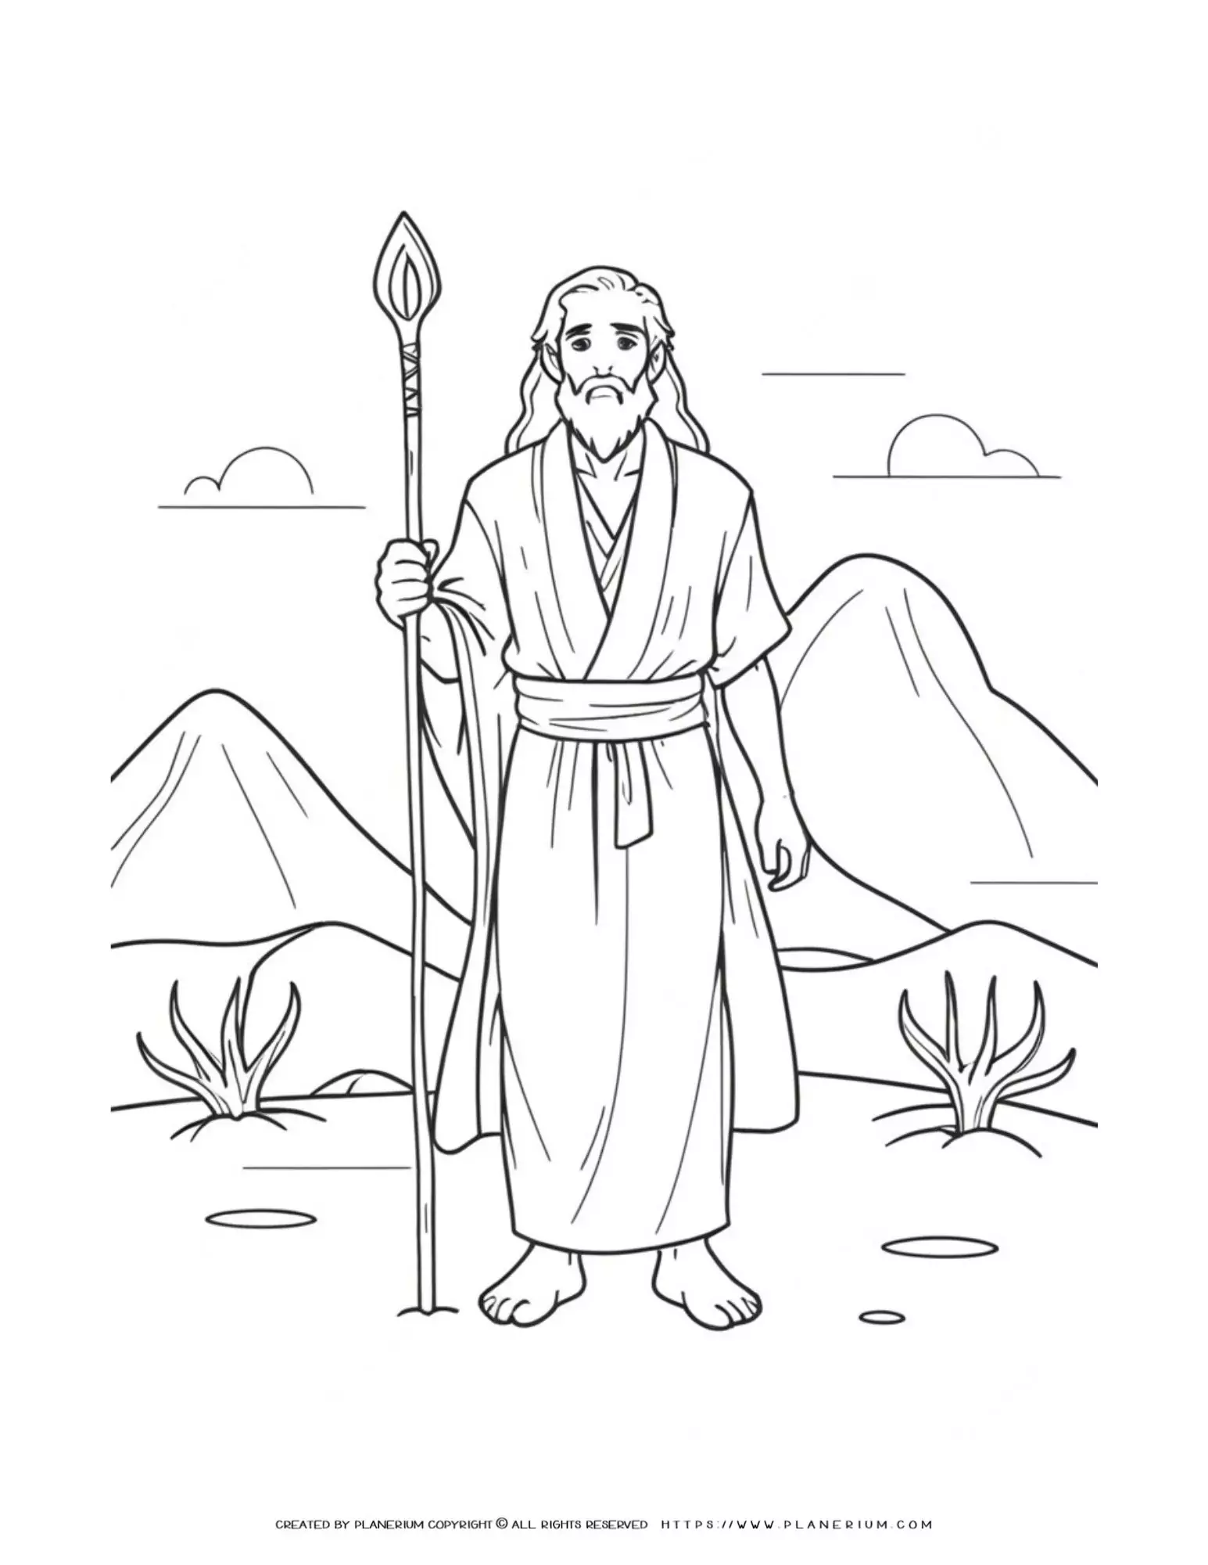
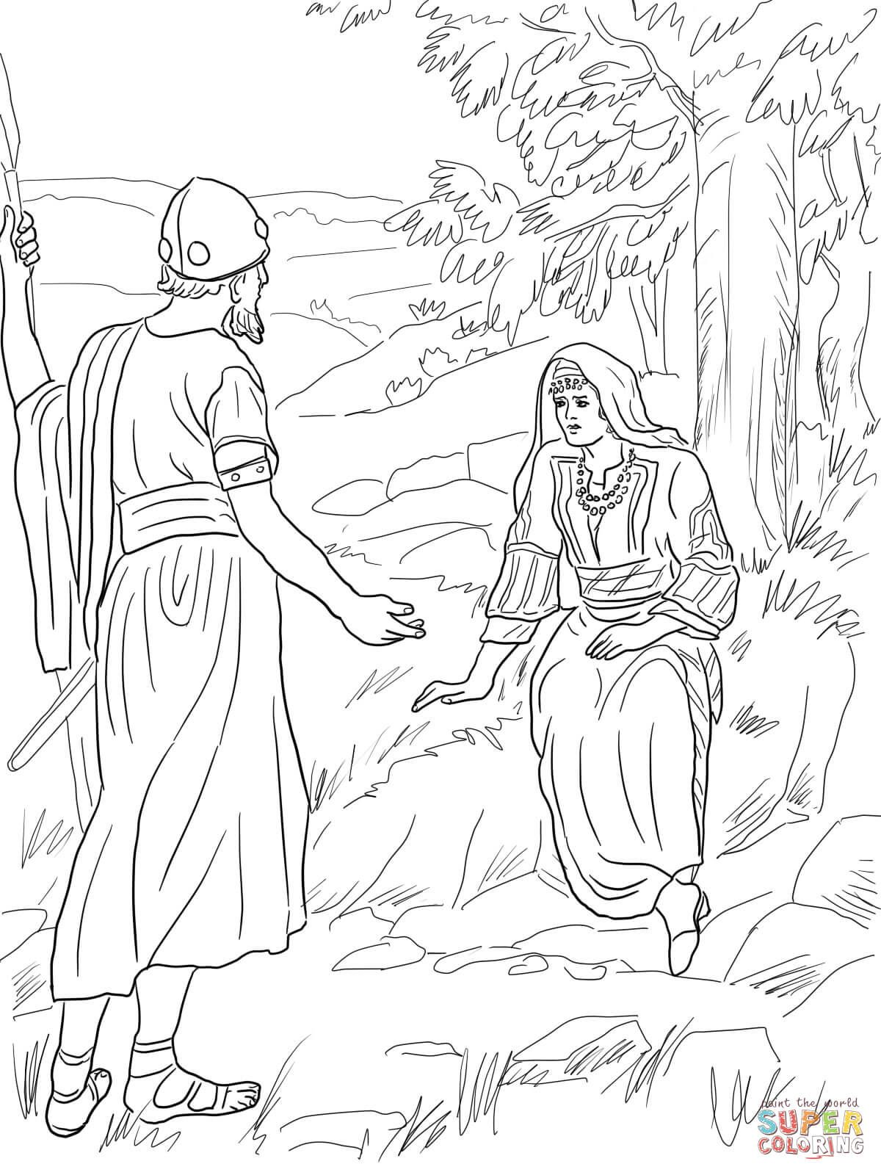


Once upon a Time
1400 BC 1300 BC 1200 BC
Enter Promised Land
Israelites did evil
Caleb’s son, Othniel went to war and then there was peace.
Israelites did evil
Israelites did evil
Judge Deborah taught, listened, and solved problems.
Left-handed Ehud attacked the enemy
Enslaved by Aram 8 yrs.
Enslaved by Moab 18 years
Cruelly oppressed
Peace for 40 years.
Barak and Deborah went to war. Jaal, a woman killed the enemy king.
There was peace for 40 years.
There was peace for 80 years.
The Israelites tried to be like the other nations and people around them. But the other nations weren’t nice.
They were mean and did not worship God. They were bad influences.
Soon the Israelites were making lots of bad choices and stopped worshipping God too. Every day became a bad day.
Then they remembered God and prayed. God came to their rescue, because God love us, forgives us, and cares for us!

Slide 5
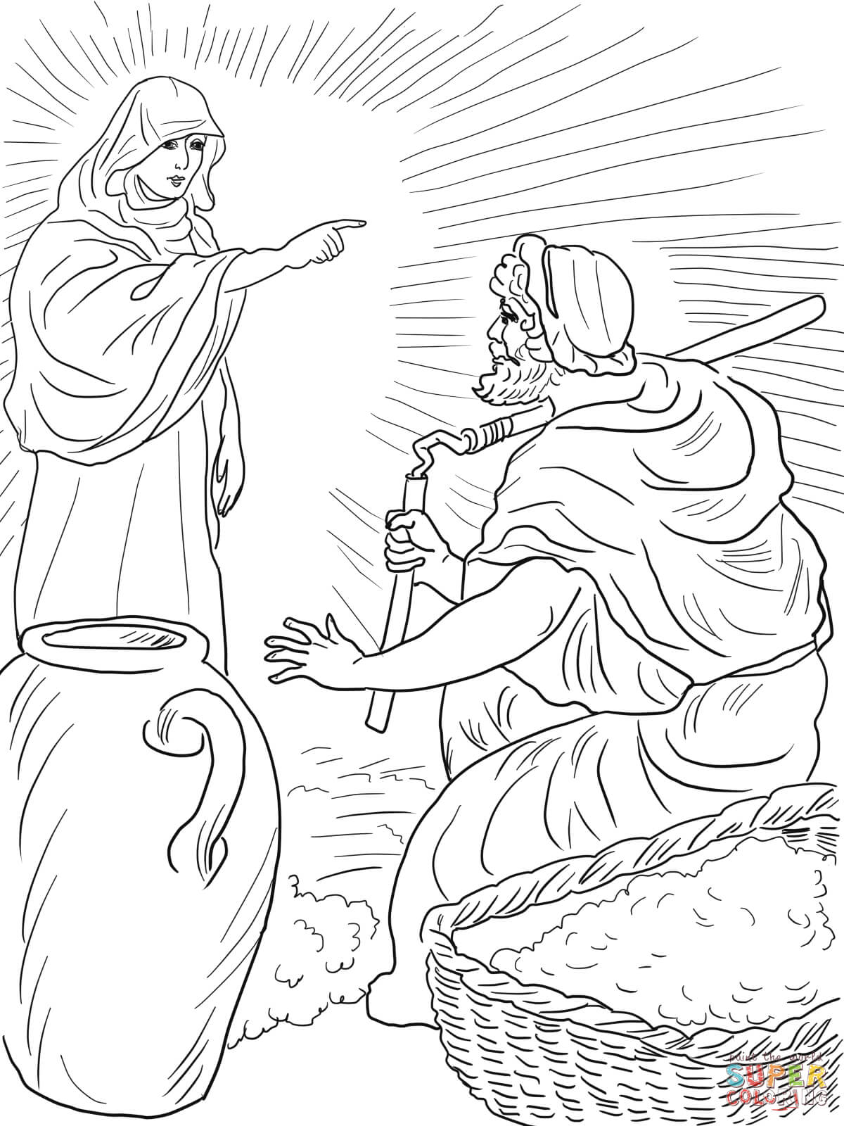
Again it repeated
1200 BC 1100 BC 1300 BC
Israelites did evil
Judge Deborah taught, listened, and solved problems.
Israelites
did evil
God chose Gideon to bring freedom & peace
Cruelly oppressed
Land destroyed by Midianites for 7 yrs
Barak and Deborah went to war. Jaal, a woman killed the enemy king.
There was peace for 40 years.
There will be peace
Judges 6
Again, the people of Israel did what the Lord said was wrong. So, for seven years the Lord let the people of Midian rule Israel.

Slide 6
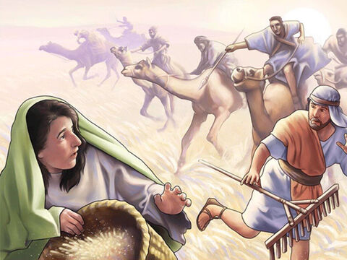
Land Destroyed
² The Midianites were very powerful and were cruel to the Israelites. So, the Israelites made hiding places in the mountains. They also hid in caves and safe places.
³ Whenever the Israelites planted crops, the Midianites, Amalekites and other peoples from the east would come and attack them. ⁴ These people camped in the land. And they destroyed the crops that the Israelites had planted. They did this as far as the land near Gaza. The people left nothing for Israel to eat. They left them no sheep, cattle or donkeys.
⁵ The Midianites came up and camped in the land. They brought their tents and their animals with them. They were like swarms of locusts! There were so many people and camels they could not be counted. These people came into the land to ruin it. ⁶ Israel became very poor because of the Midianites.

Slide 7
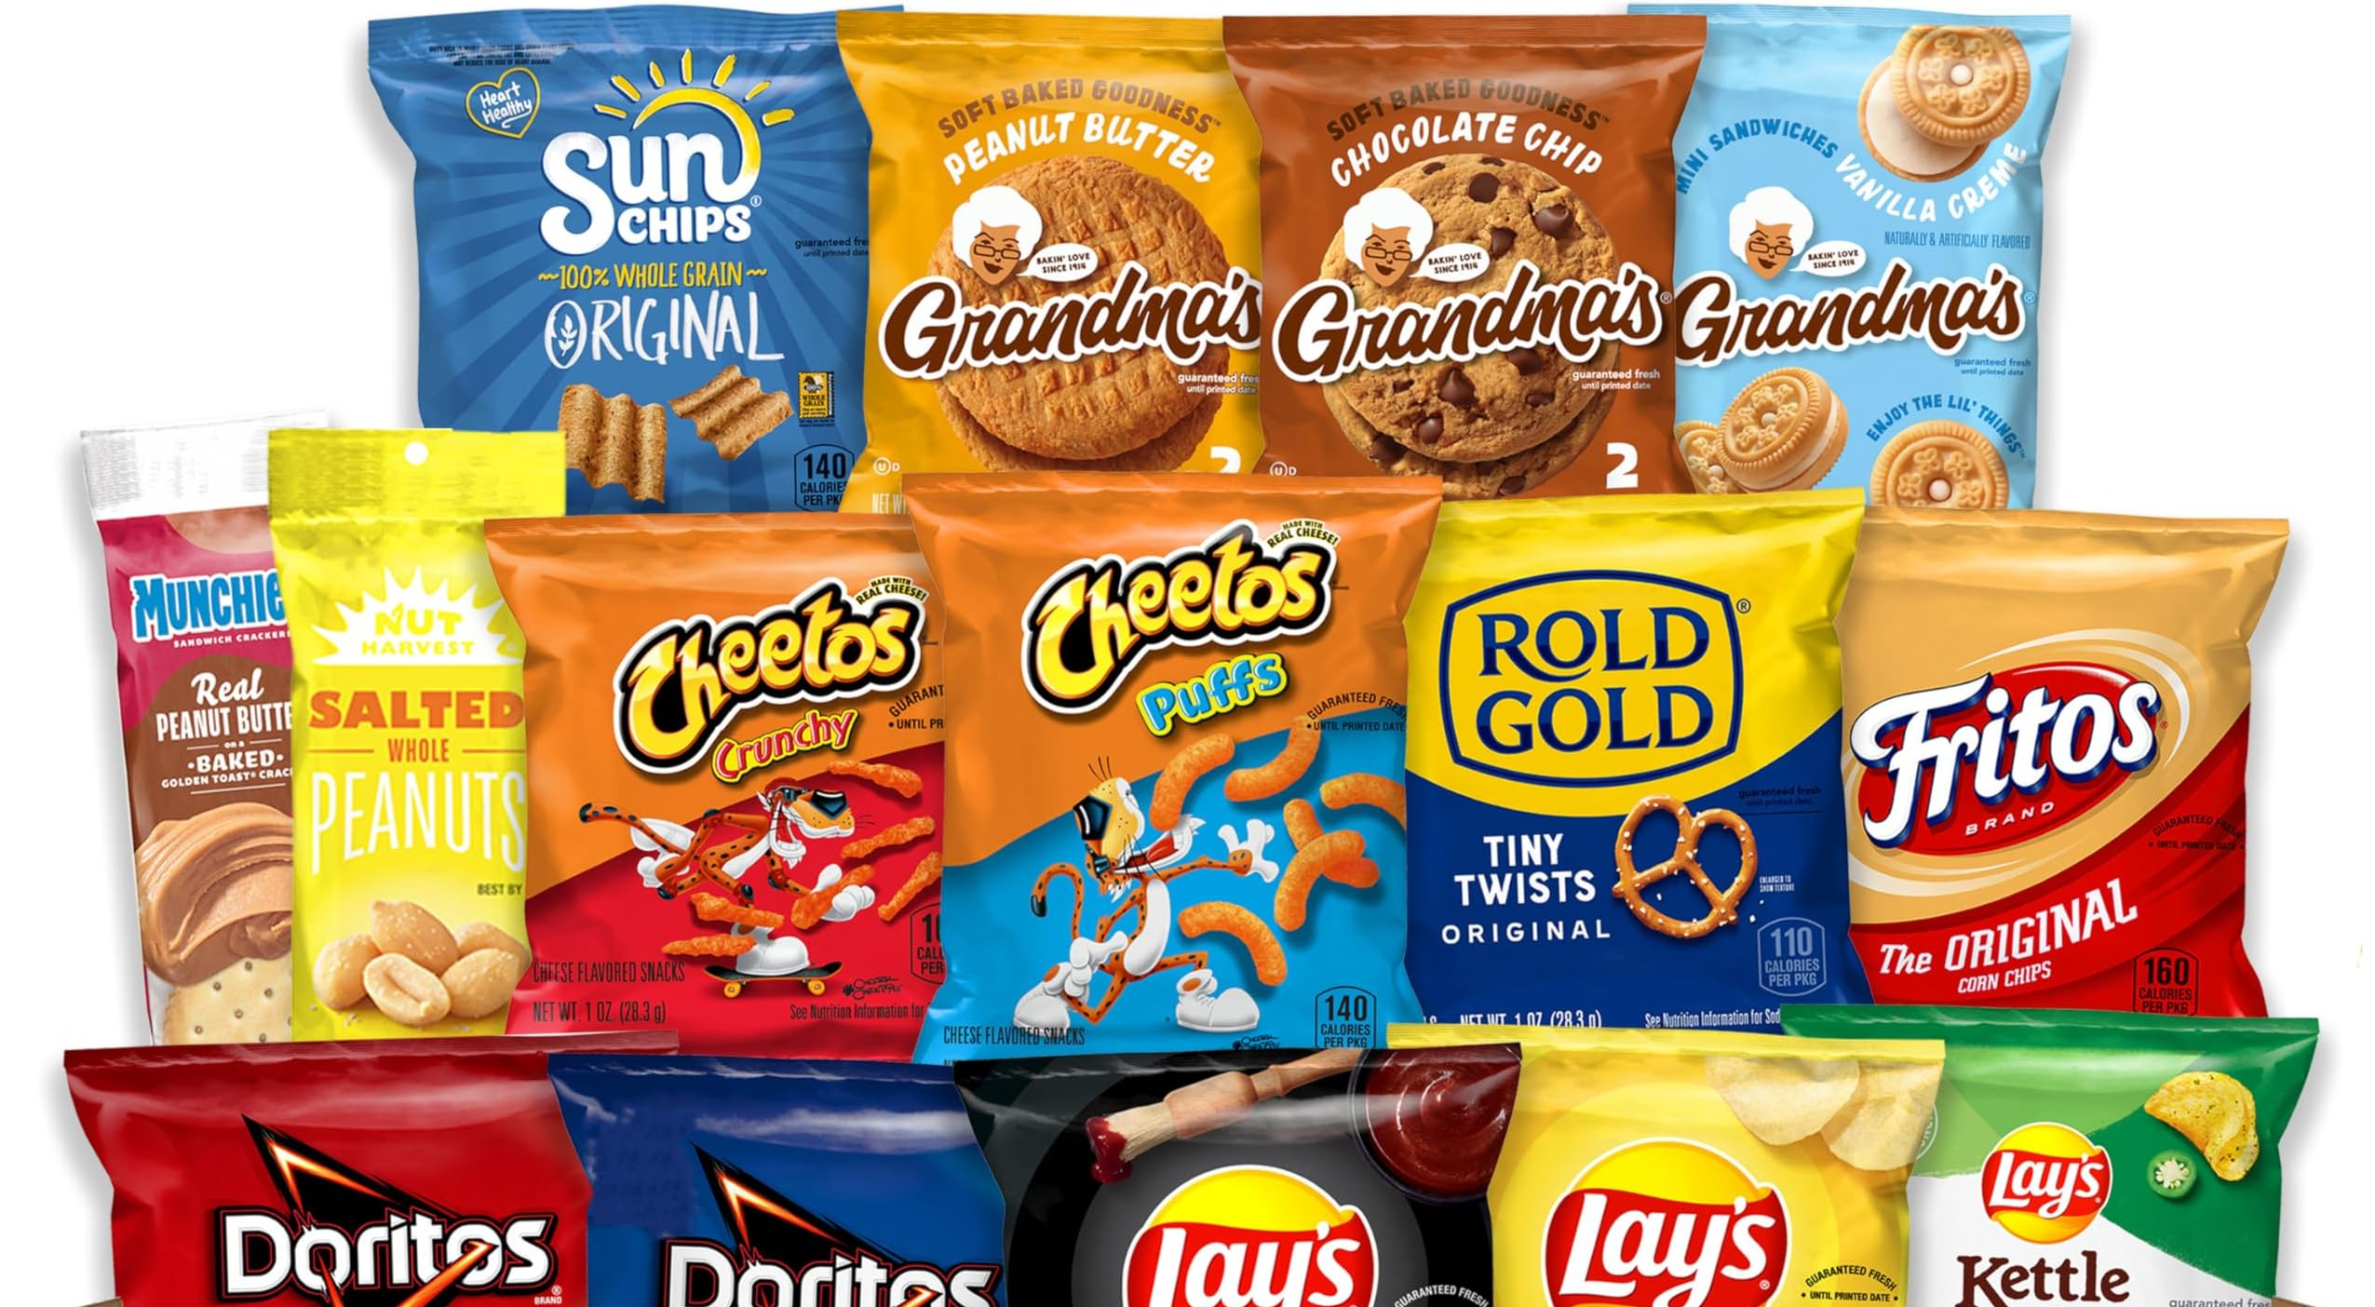

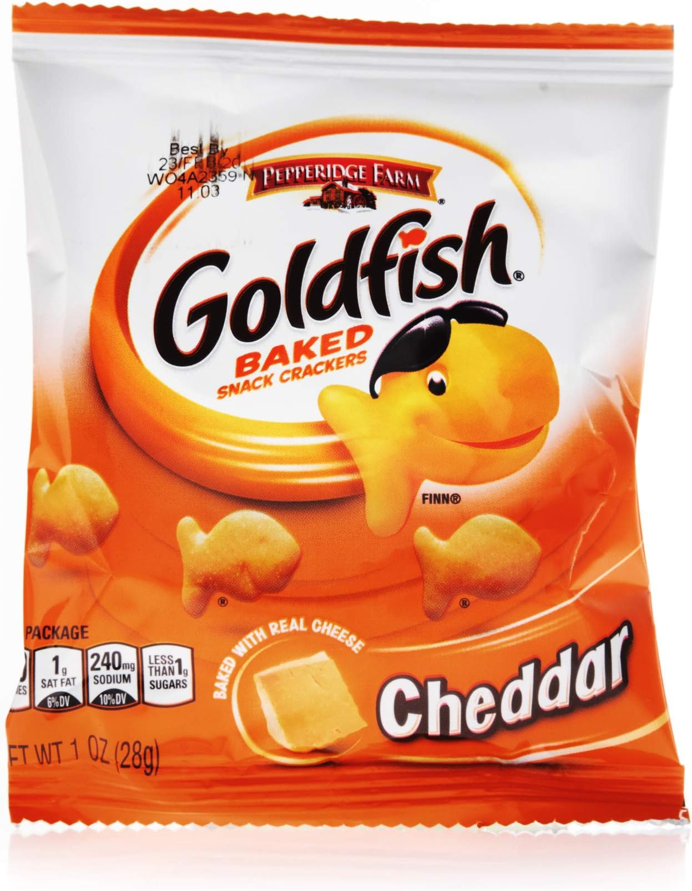
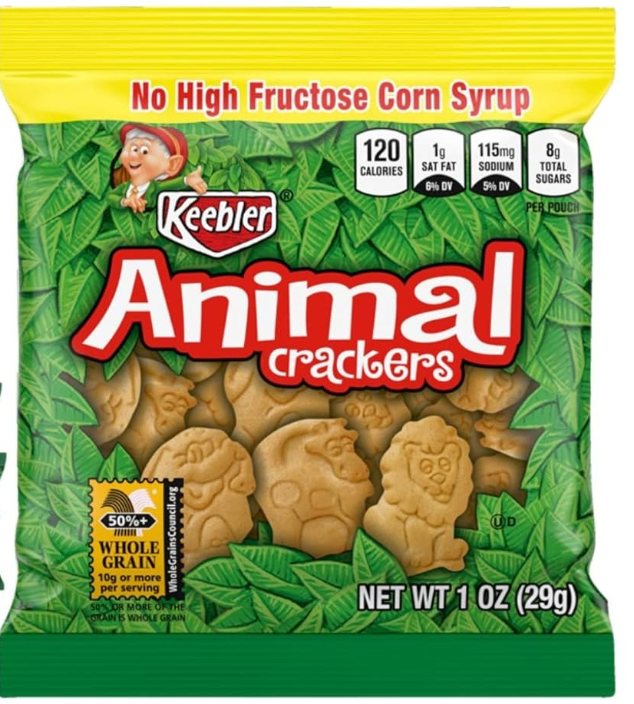
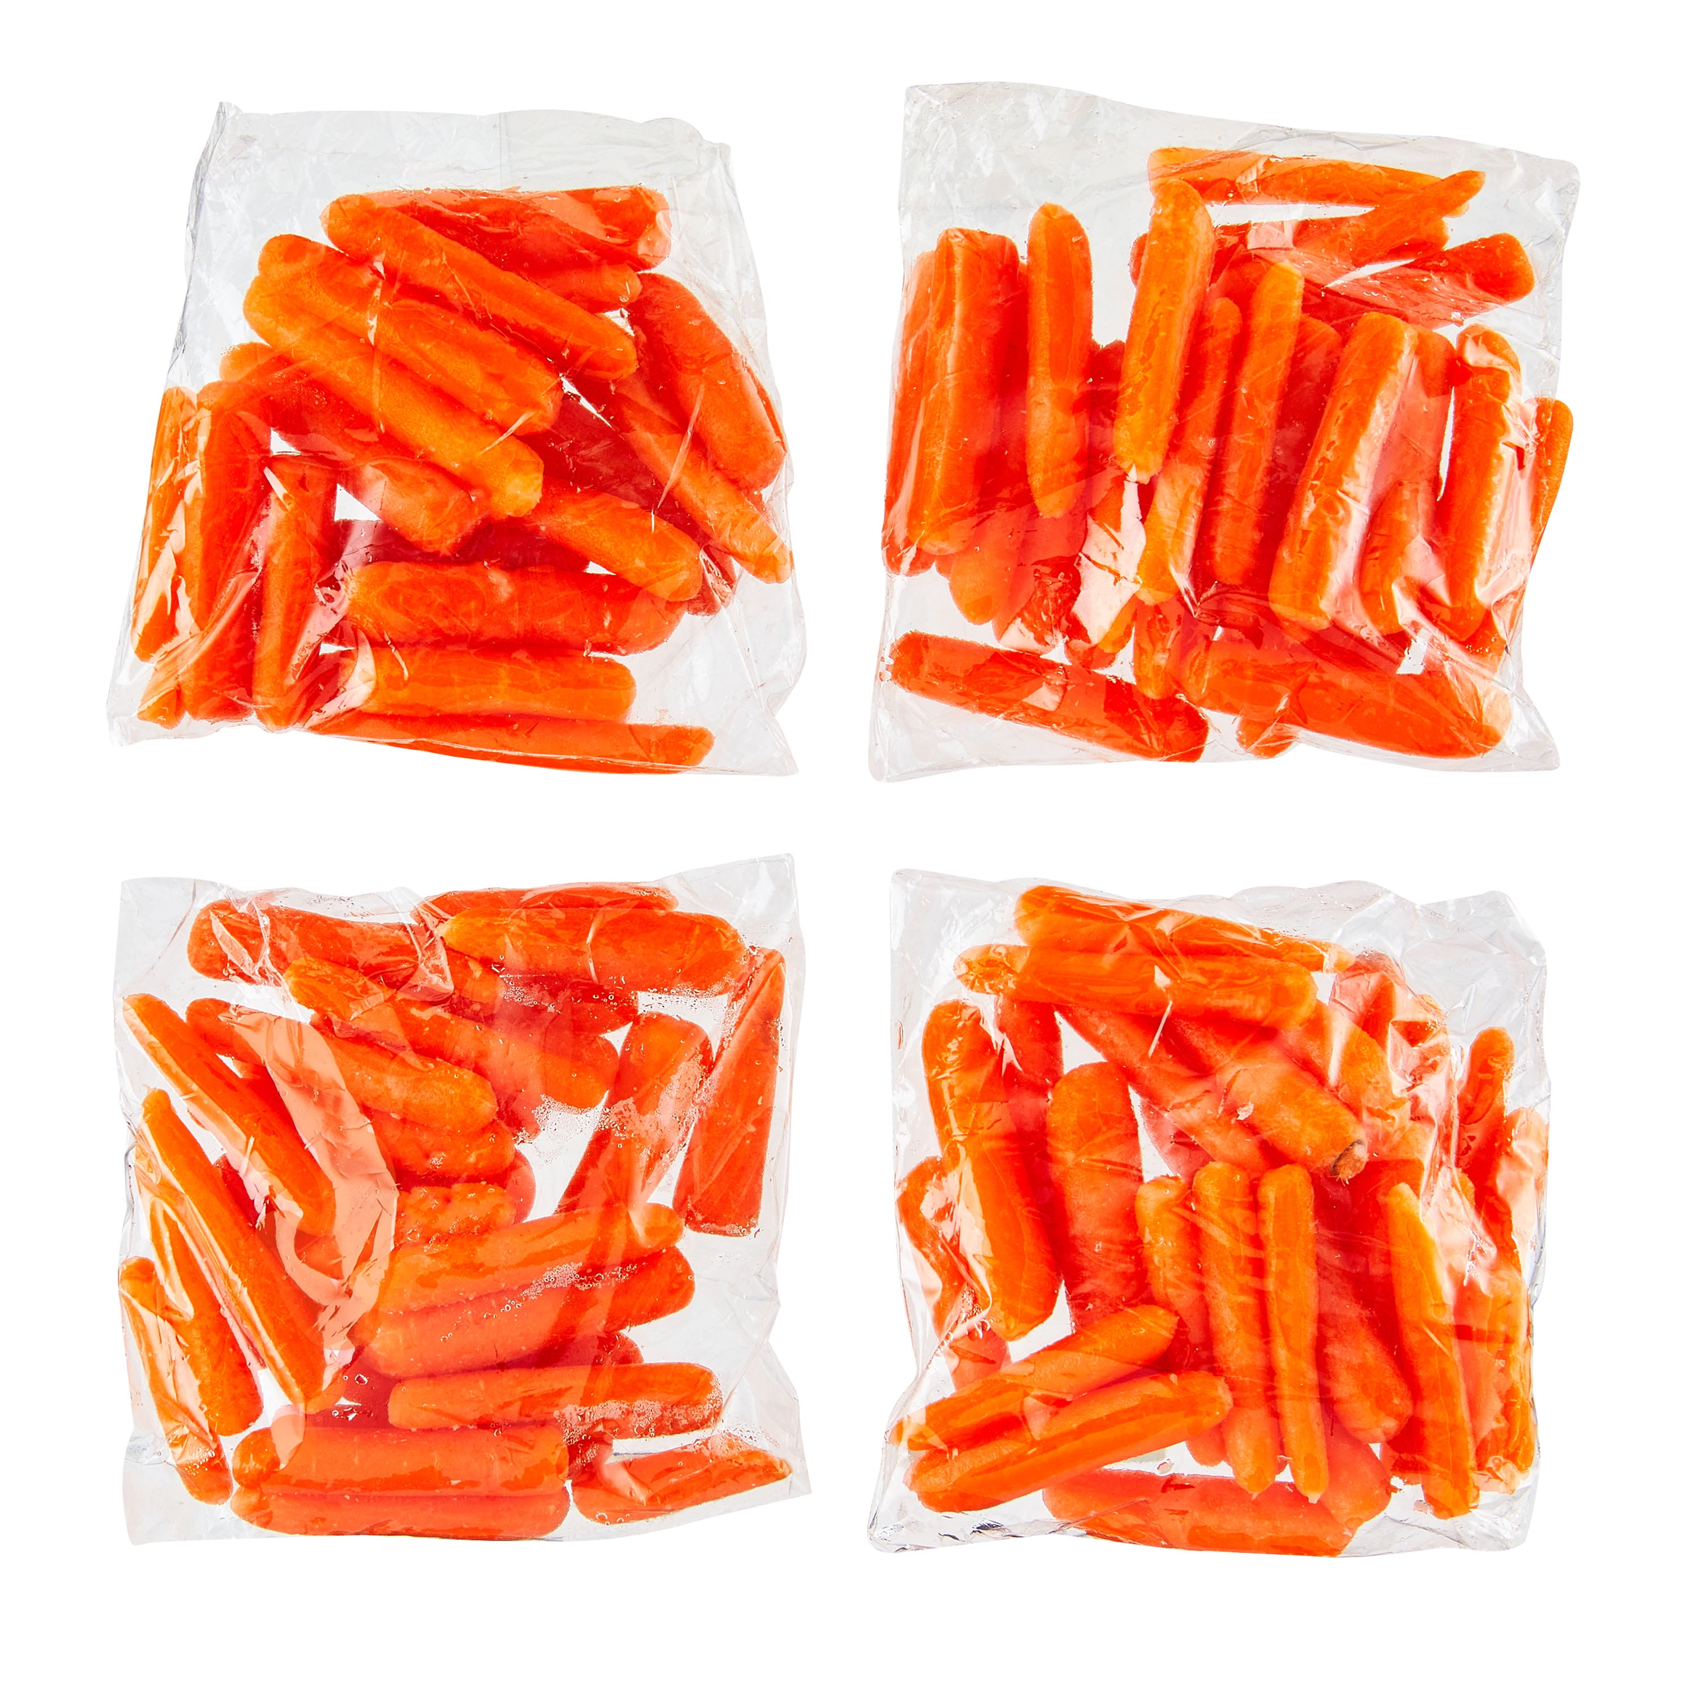


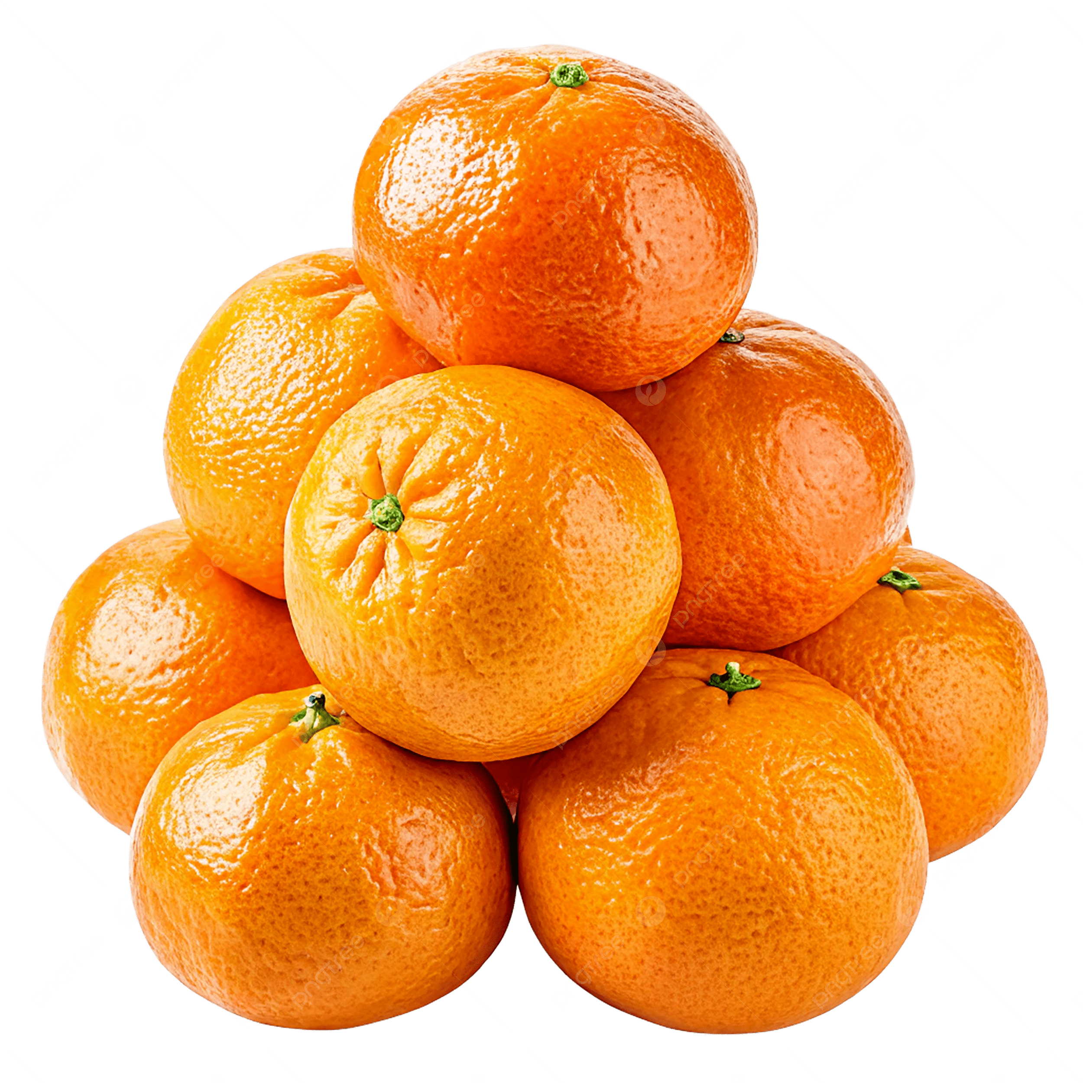
Snack Time
I have snacks for us. But wait…..
Remember what the Midianites did?
When the Israelites planted seeds, the Midianites trampled the ground with their camels so that most of the crops couldn’t even grow! With very little grain, there’s very little flour and hardly any bread or crackers. (remove most of crackers and grain) I guess we’ll just have to share this small bag.
The Midianites camped everywhere on the Israelite land and helped themselves to the food. Fruit and vegetables were stolen. (remove most of the fruit and vegetables) I guess we’ll just have to share this small bag.

Slide 8
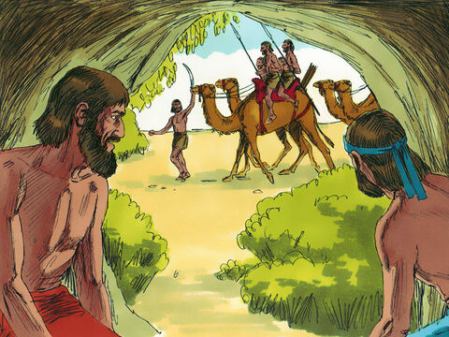
Pray
I heard them ask for help.
They remembered Me!!
So, the Israelites cried out to the Lord for help.
⁷ The Israelites cried out to the Lord for help against the Midianites.
The only way this is going to stop is if God in heaven saves us.
There the Midianites go with our crops and herds! It’s terrible!
LORD, God, Please help us! Save us from the Midianites. They have ruined everything!

Slide 9
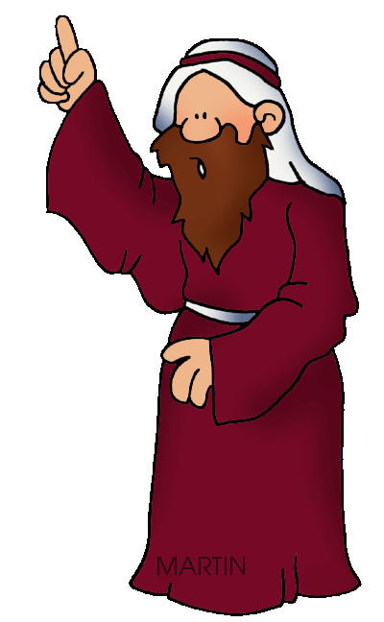
Message from the Lord
Go speak to my people.
Tell them….
This is what the LORD says.
I brought you out of Egypt.
I saved you from the Egyptians and slavery.
I brought you to Canaan.
I forced the Canaanites out of the land.
I told you,
“I am the LORD your God.” Do not worship idols.
But you didn’t obey me.
⁸ So the Lord sent a prophet to them. The prophet said, “This is what the Lord, the God of Israel, says: I brought you out of Egypt, the land of slavery. ⁹ I saved you from the people of Egypt. And I saved you from all the people of Canaan. I forced them out of their land. And I gave it to you. ¹⁰ Then I said to you, ‘I am the Lord your God. You will live in the land of the Amorites, but you must not worship their gods.’ But you did not obey me.”

Slide 10
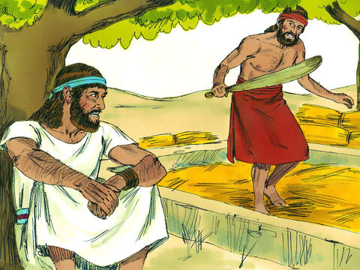

An Angel Comes
It’s not time to squeeze grapes. Hopefully, the Midianites won’t find me threshing wheat here at the winepress.
Wait. Who is that?
Judges 6
¹¹ The angel of the Lord came and sat down under an oak tree at Ophrah.
The oak tree belonged to Joash, who was one of the Abiezrite people. Joash was the father of Gideon. (Their family were related to Joseph’s son Manasseh.)
Gideon was separating some wheat from the chaff in a winepress. Gideon did this to keep the wheat from the Midianites.
¹² The angel of the Lord appeared to Gideon and said, “The Lord is with you, mighty warrior!”
The Lord is with you, mighty warrior!

Slide 11
Conversing with the Angel of the LORD
Pardon me, sir. If the Lord is with us, why are we having so many troubles? Our ancestors told us about the LORD’s strength and miracles.
But He has allowed the Midianites
to defeat us.
¹³ Then Gideon said, “Pardon me, sir. If the Lord is with us, why are we having so many troubles? Our ancestors told us he did miracles. They told us the Lord brought them out of Egypt. But now he has left us. He has allowed the Midianites to defeat us.”
¹⁴ The Lord turned to Gideon and said, “You have the strength to save the people of Israel. Go and save them from the Midianites. I am the one who is sending you.”
You have the strength
to save the people of Israel.
Go and save them from the Midianites.
I am the one sending you,

Slide 12
Conversing with the Angel of the LORD
Pardon me, LORD.
How can I save Israel?
My family group is the weakest in our state of Manasseh. And I am the least important member of my family!
¹⁵ But Gideon answered, “Pardon me, Lord. How can I save Israel? My family group is the weakest in Manasseh. And I am the least important member of my family.”
(See how humble Gideon was.
He didn’t assume he could do it.)
¹⁶ The Lord answered him, “I will be with you. It will seem as if you are fighting only one man.”
“I will be with you.
It will seem as if you are
fighting only one man.”

Slide 13
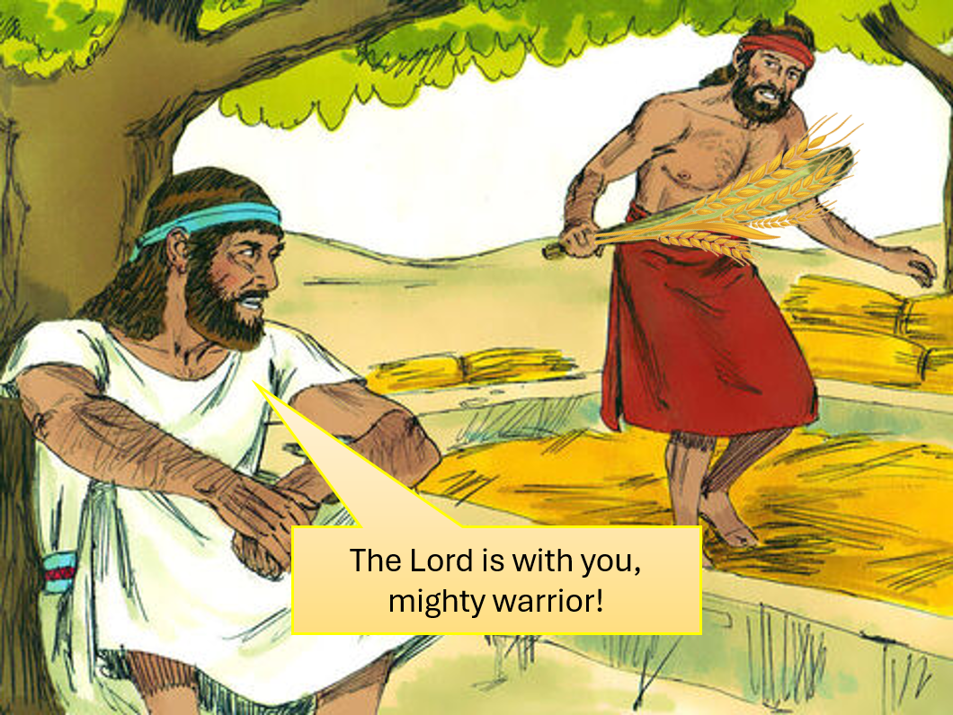
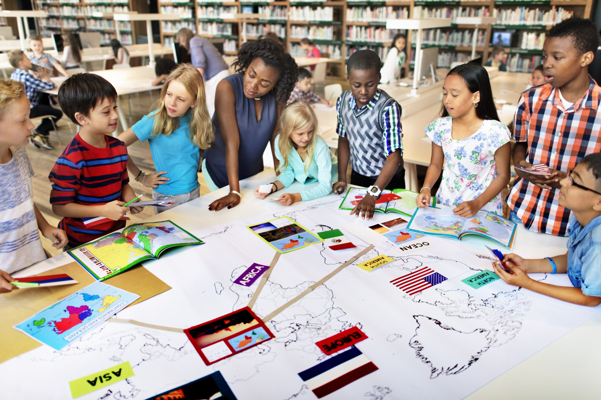
God knows who He made us to be.
The Lord is with you,
faithful friend!
The Lord is with you,
wise learner!
The Lord is with you,
strong helper!
Gideon thought because his family was small and weak, he was insignificant. Was he weak?
How does God see you?

Slide 14
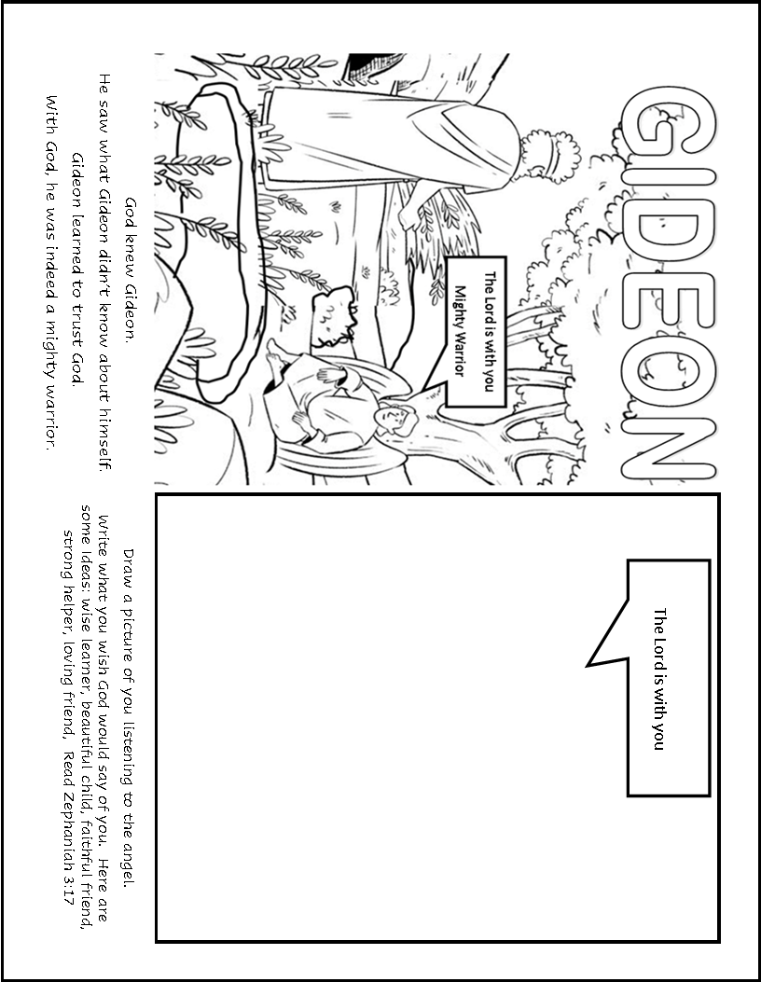
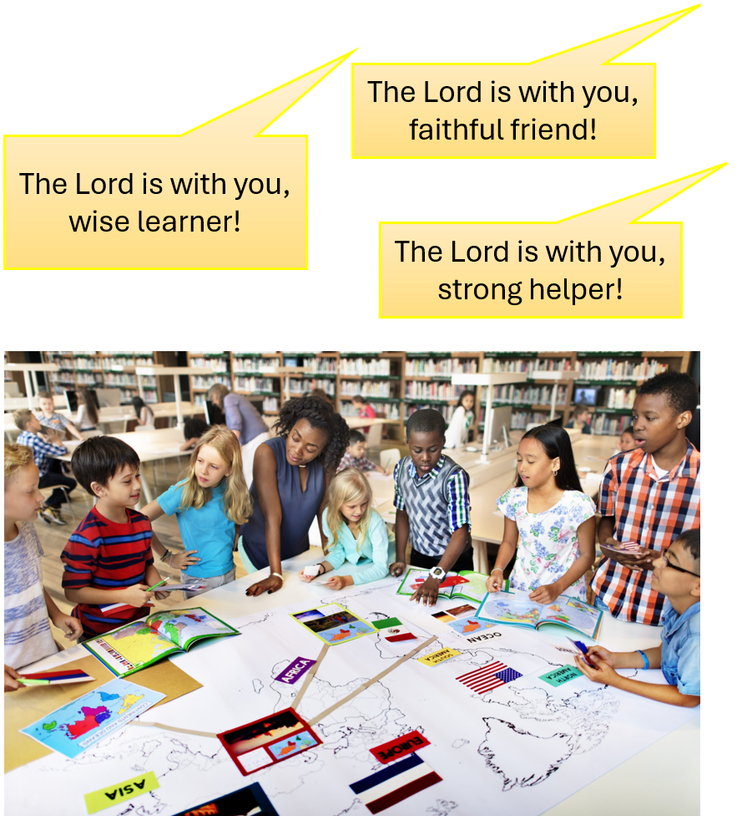
God knows who He made us to be.
  “The Lord your God is with you.
  The mighty One will save you.
  The Lord will be happy with you.
  You will rest in his love.
  He will sing and be joyful about you.” – Zephaniah 3:17
  “For we are God’s handiwork, created in Christ Jesus to do good works, which God prepared in advance for us to do.” – Ephesians 2:10
What do you want God to call you or say to you? Write it in the conversation bubble.
Draw a picture of you talking with the angel. Color the picture.

Slide 15
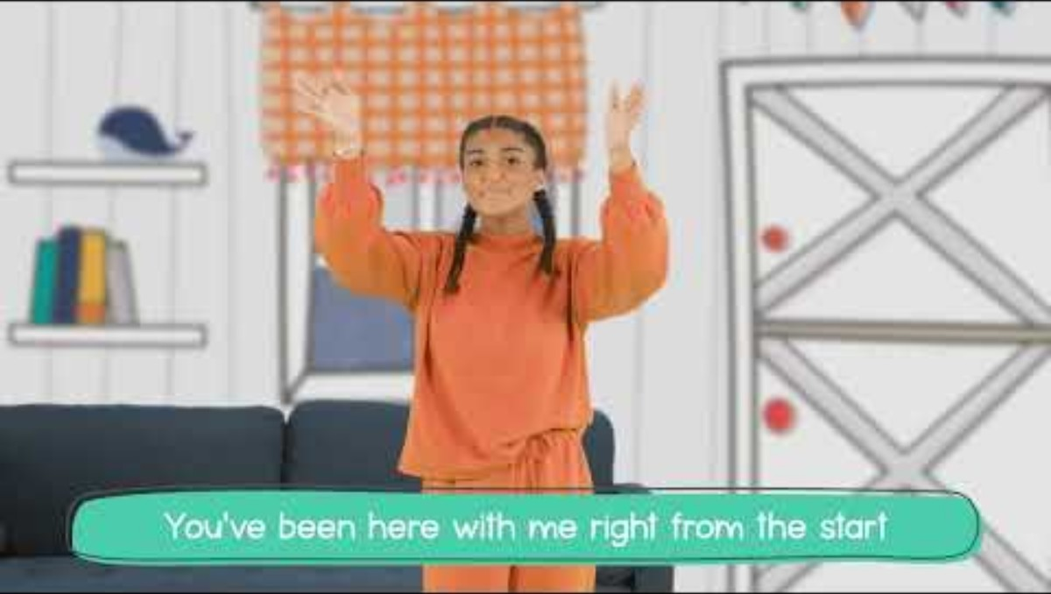
The Lord is with you, mighty warrior!

Slide 16
Conversing with the Angel of the LORD
If you are pleased with me,
please give me proof.
Let me bring a sacrifice offering to you.
Please stay until I return.
¹⁷ Then Gideon said to the Lord, “If you are pleased with me, give me proof. Show me that it is really you talking with me. ¹⁸ Please wait here. Do not go away until I come back to you. Let me bring my offering and set it in front of you.”
And the Lord said, “I will wait until you come back.”
God is patient!
He has time for us!
I will wait until you come back.

Slide 17
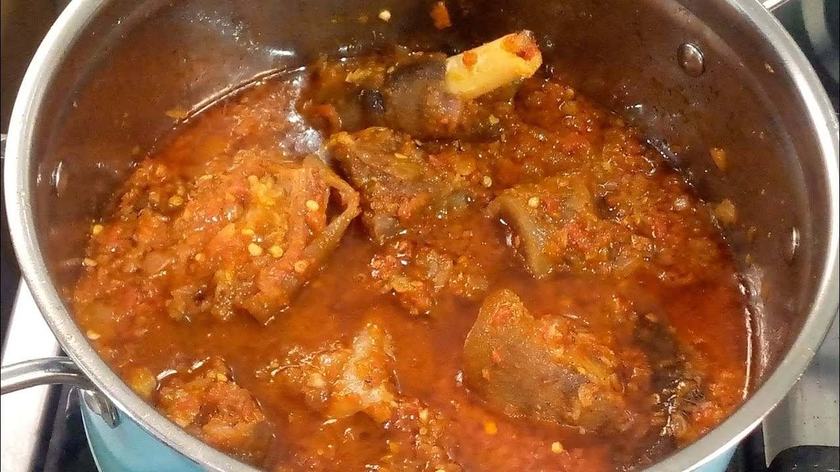

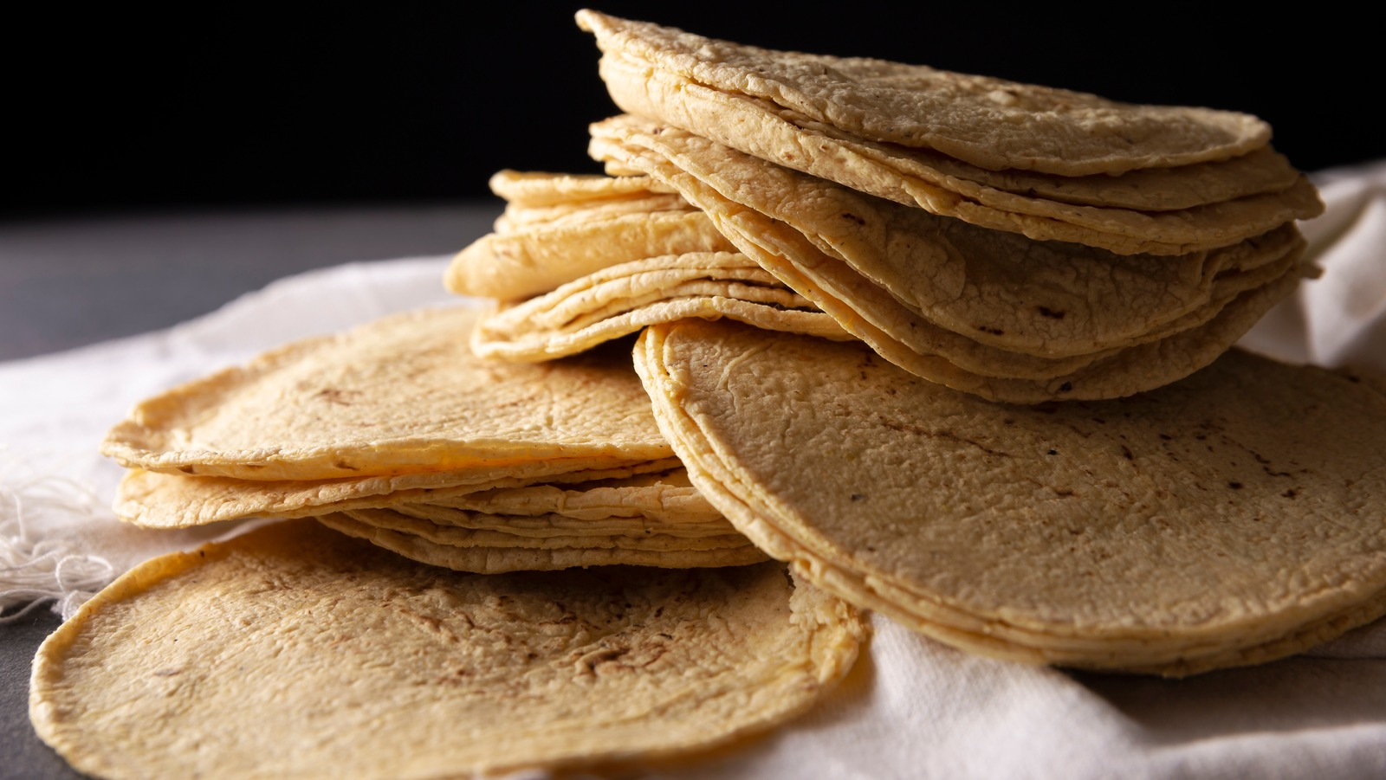
Time Passed
^{19”} So Gideon went in and cooked a young goat. He also took about 20 quarts of flour and made bread without yeast. Then he put the meat into a basket. And he put the broth from the boiled meat into a pot.”
This was a big sacrifice not just a meal for 2 people! Remember food was scarce and very precious.
20 quarts of flour = 22 pounds of flour = 4 bags of flour = 400 tortillas or 20 loaves of bread! That is a LOT of bread! (show flour sack and bread loaf)
This took a long time.
Catch, butcher, and clean the goat (3-6 hours)
Cook the goat stew (1.5-3 hours)
Make unleavened bread (2-4 hours)

Slide 18
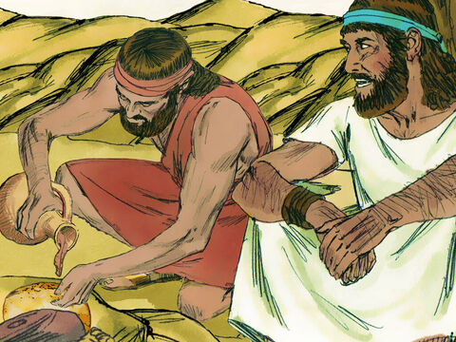
Sacrifice brought
Put the meat and bread on the rock over there. Then pour the broth on them.
Then he put the meat into a basket. And he put the broth from the boiled meat into a pot.
He brought out the meat, the broth and the bread without yeast.
He brought the food to the angel of the Lord. Gideon gave it to him under the oak tree.
²⁰ The angel of God said to Gideon, “Put the meat and the bread without yeast on that rock over there. Then pour the broth on them.” And Gideon did as he was told.

Slide 19
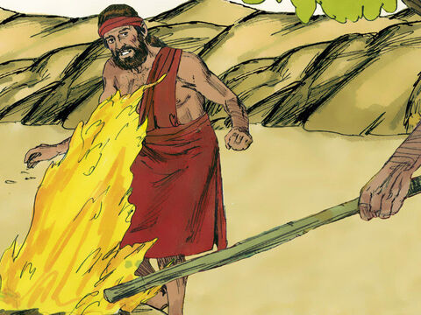
Sacrifice accepted
A plain staff.
Fire from a rock!
God has accepted my sacrifice!
Calm down.
Don’t be afraid.
You will not die.
²¹ The angel of the Lord had a stick in his hand. He touched the meat and the bread with the end of the stick. Then fire jumped up from the rock! The meat and the bread were completely burned up! And the angel of the Lord disappeared!
²² Then Gideon understood he had been talking to the angel of the Lord. So, Gideon cried, “Lord God! I have seen the angel of the Lord face to face!”
²³ But the Lord said to Gideon, “Calm down! Don’t be afraid! You will not die!”
LORD GOD!
I have seen the angel of the Lord face to face!

Slide 20
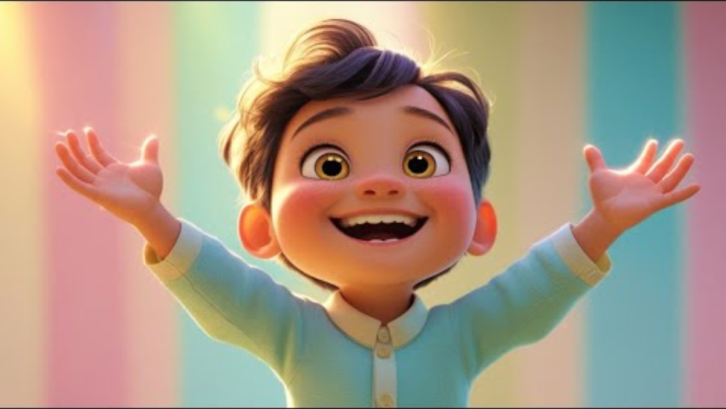
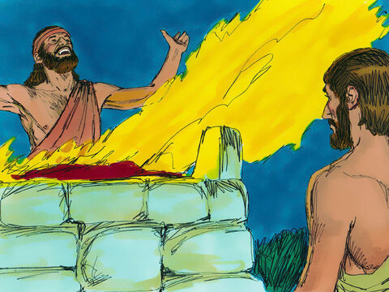
The LORD is PEACE
²⁴ So Gideon built an altar there to worship the Lord. Gideon named the altar The Lord Is Peace. It still stands at Ophrah, where the Abiezrites live.
The Lord is Peace
God had called Gideon, “mighty warrior.” God promised to help him be a mighty warrior. Gideon called God, “The Lord is Peace.” He had faith that God would help them conquer their enemies and give them peace.

Slide 21

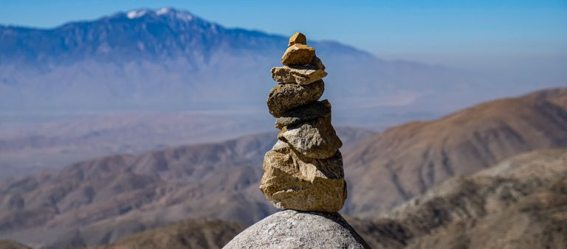
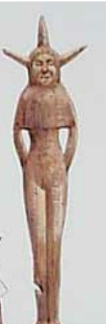
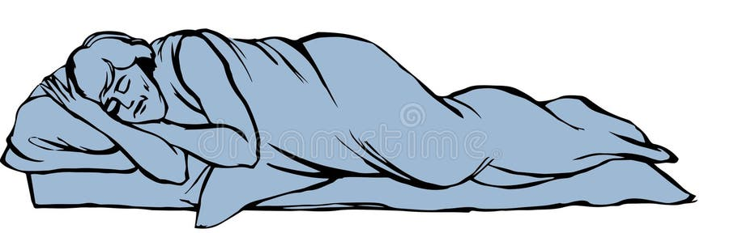
God’s Instructions
Take the bull that belongs to your father and a 2nd bull that is 7 years old.
Use them to pull down your father’s altar to Baal.
Cut down the Asherah idol beside it.
Then build a proper altar to the LORD on the high ground.
Finally, kill and burn the 2nd bull on this altar. Use the wood from the Asherah pole for the fire.
²⁵ That same night the Lord spoke to Gideon. The Lord said, “Take the bull that belongs to your father and a second bull seven years old. Pull down your father’s altar to Baal. Cut down the Asherah idol beside it.
²⁶ Then build an altar to the Lord your God. Build it on this high ground. Lay its stones in the right order. Then kill and burn the bull on this altar. Use the wood from the Asherah idol to burn your offering.”

Slide 22
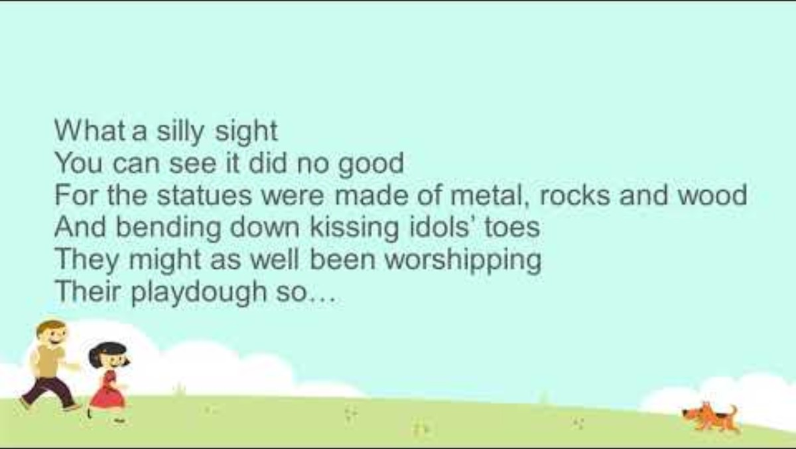
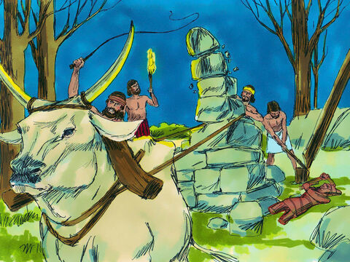
Idols demolished
²⁷ So Gideon got ten of his servants. And he did what the Lord had told him to do. But Gideon was afraid that his family and the men of the city might see him. So, he did it at night, not in the daytime.
Activity: I have a tower over here.
You can demolish it during the song.

Slide 23

Idols demolished
Then, like God had told him, Gideon made a proper altar for God. He knew that this meant the altar should be built with 12 natural stones.
Then he sacrificed the bull on the altar. Gideon obeyed God.
Activity: Build an altar with 12
Let’s Pray

Slide 24
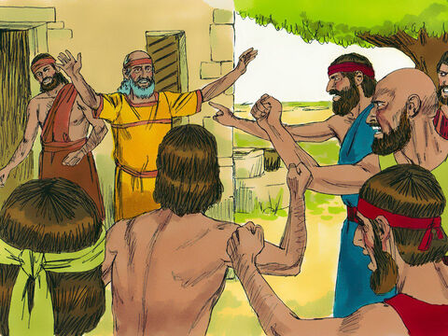
What! Who?
Who did this?
²⁸ The men of the city got up the next morning. They saw that the altar for Baal had been destroyed! And they saw that the Asherah idol beside it had been cut down! They also saw the altar Gideon had built. And they saw the bull that had been sacrificed on it. ²⁹ The men of the city looked at each other and asked, “Who did this?” They asked many questions and looked for the person who had done those things.
Someone told them, “Gideon son of Joash did this.”
Gideon did!

Slide 25
Jerub-Baal
Wait.
Are you going to defend Baal?
If Baal is a god,
let him defend himself!
Bring out your son!
³⁰ So they said to Joash, “Bring your son out. He has pulled down the altar of Baal. He has cut down the Asherah idol beside it. So your son must die!”
³¹ But Joash spoke to the angry crowd around him. He said, “Are you going to take Baal’s side? Are you going to defend Baal? Anyone who takes Baal’s side will be killed by morning! If Baal is a god, let him fight for himself. It’s his altar that has been pulled down.”
³² So on that day Gideon got the name Jerub-Baal. The name means “let Baal fight against him.” They named him this because Gideon pulled down Baal’s altar.
He must die!

Slide 26
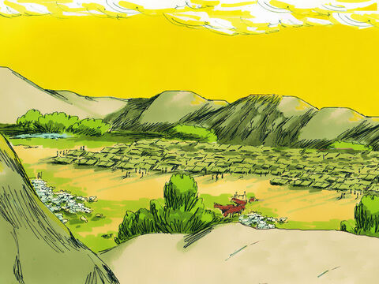
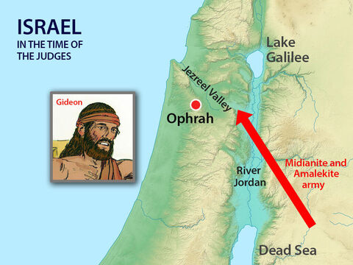
They have come again!
³³ All the Midianites, the Amalekites and other peoples from the east joined together. They came across the Jordan River and camped in the Valley of Jezreel.

Slide 27
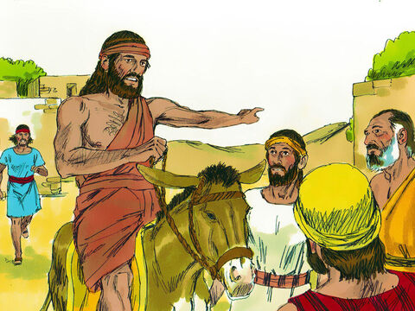


Blow the war horn
Come follow me.
We will fight the Midianites.
The LORD is with us!
He has told me to go fight.
GO. Tell all the men to come.
³⁴ But the Spirit of the Lord entered Gideon! Gideon blew a trumpet to call the Abiezrites to follow him.
³⁵ He sent messengers to all of Manasseh. The people of Manasseh were called to follow Gideon. Gideon also sent messengers to the people of Asher, Zebulun and Naphtali. They also went up to meet Gideon and his men.

Slide 28
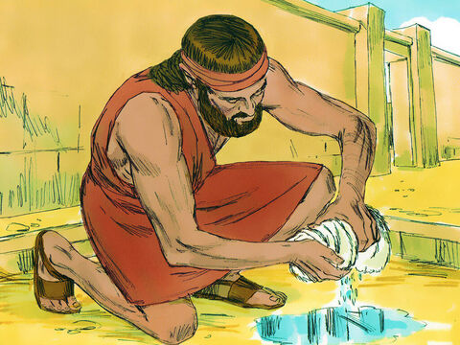
Put out the Fleece
Lord,
You said you would help me save Israel.
Please show me.
I will put this wool out tonight. If it is wet and the ground is dry, I will know you will be with me.
⁶ Then Gideon said to God, “You said you would help me save Israel.
³⁷ I will put some wool on the threshing floor. Let there be dew only on the wool. But let all of the ground be dry.
Then I will know what you said is true. I will know that you will use me to save Israel.”
³⁸ And that is just what happened.
Gideon got up early the next morning and squeezed the wool. He got a full bowl of water from the wool.

Slide 29
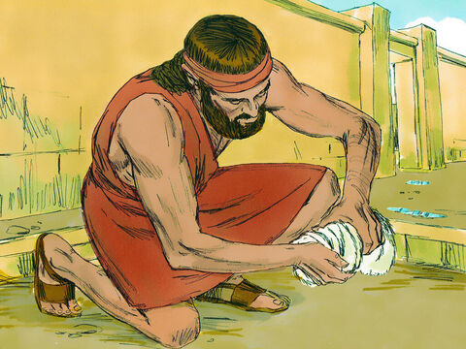
Put out the Fleece - 2
LORD, Don’t be angry with me. Please let me make one more test.
I will put this wool out tonight. If it is dry and the ground is wet, I will know all things are possible.
⁹ Then Gideon said to God, “Don’t be angry with me. Let me ask just one more thing. Please let me make one more test. Let the wool be dry while the ground around it gets wet with dew.”
⁴⁰ That night God did that very thing. Just the wool was dry, but the ground around it was wet with dew.
Try it.
Get some wool or a wool sock.
Also get a sponge and 2 plates.
Put water on the plates.
When you put the sponge on one plate
and the wool on the other.
What do you think will happen?

Slide 30
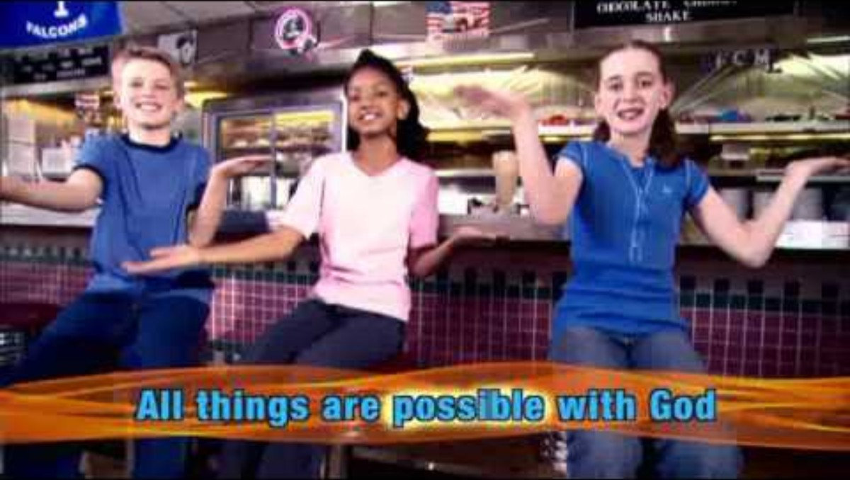

Slide 31
The Lord is with you, mighty warrior!

Slide 32
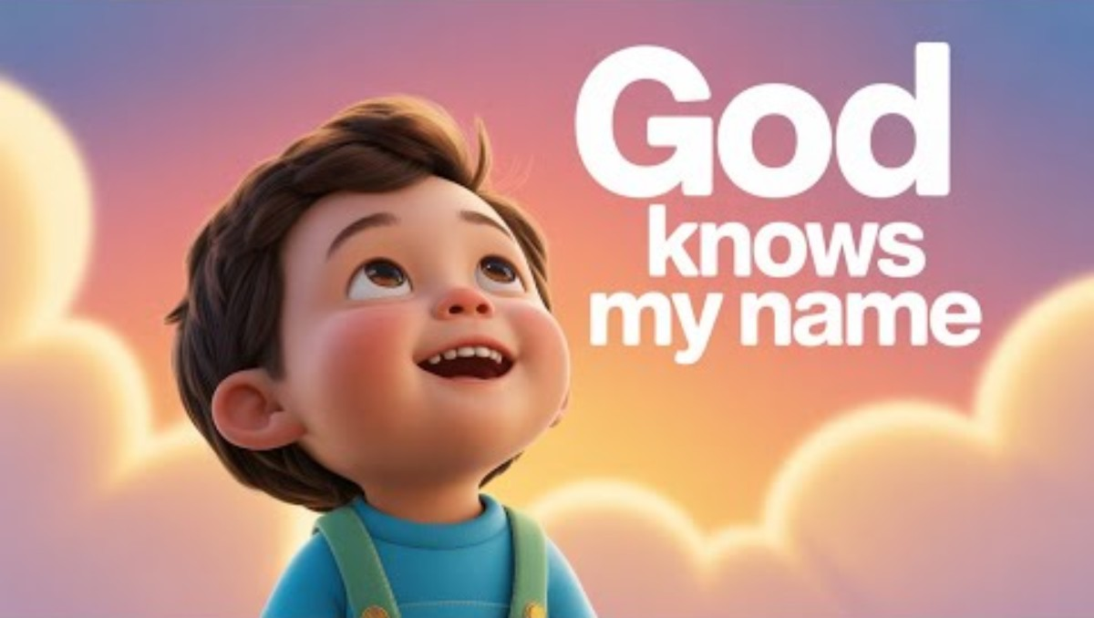
The Lord is with you, mighty warrior!

Slide 33
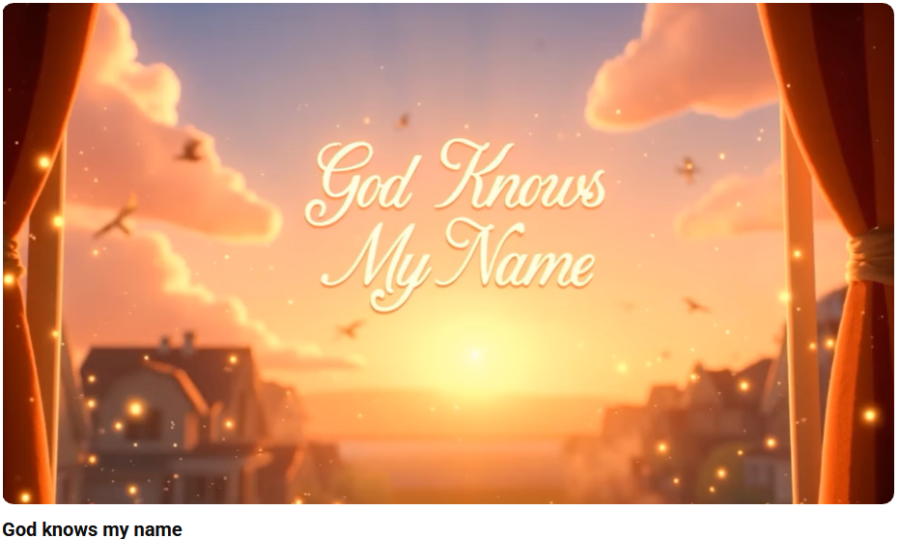
https://www.youtube.com/watch?v=Yk7ttZN5Jvw&list=RDYk7ttZN5Jvw&start_radio=1

Slide 34
