Slide 1
Job Part 2
The Creator, LORD God Almighty Speaks

Slide 2

God is our refuge
and strength,
an ever-present help in trouble.
² Therefore we will not fear, though the earth give way
and the mountains fall into the heart of the sea,
³ though its waters roar and foam
Psalms 46:1-3
Psalms 46:1-3
John 16:33
Jesus said, “I have told you these things,
so that in me you may have peace.
In this world,
you will have trouble.
But take heart!
I have overcome
the world.”
John 16:33

Slide 3
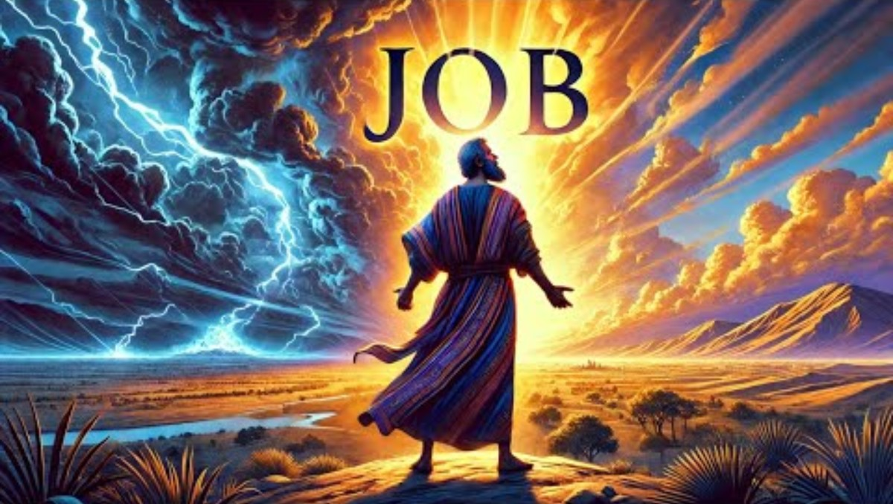
The Story of Job

Slide 4
Why?
Job did something wrong, so he was being punished.
God was testing Job to see if he would be faithful.
God was letting Satan test his theory that if bad things happen to Job (and others), they would curse God.
Why did all these bad things happen to Job?

Slide 5
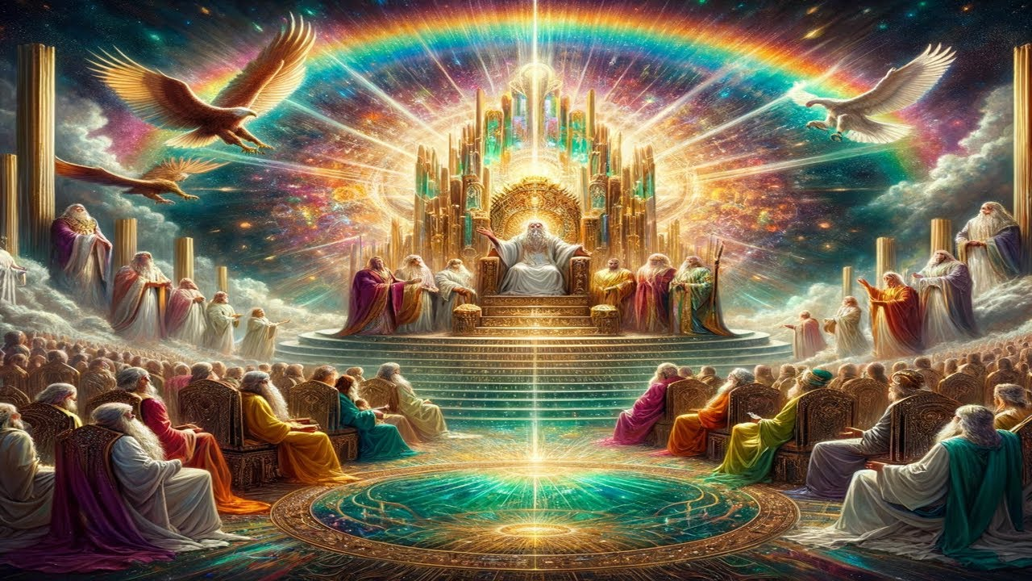
What did God say to Job
Listen to Our Creator, the Greatest Inventor, Scientist, Animal Keeper….
the LORD GOD ALMIGHTY.
the wisest, most merciful, gracious, understanding God.

Slide 6

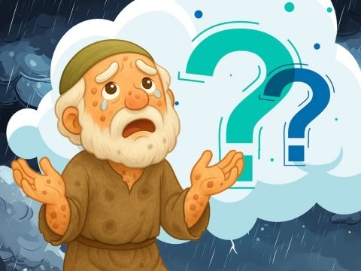

God Speaks
Who is that tries to hide my plans with words without knowledge?
Brace yourself like a man;
I will question you.
And you will answer me.
Were you there when I laid earth’s foundation while the morning stars sang and angels shouted for joy?
Did you set the boundary for the sea?
38 Then the Lord spoke to Job out of the storm. He said:
² “Who is this that obscures my plans
with words without knowledge?
³ Brace yourself like a man;
I will question you,
and you shall answer me.
⁴ “Where were you when I laid the earth’s foundation?
Tell me, if you understand.
⁵ Who marked off its dimensions? Surely you know!
Who stretched a measuring line across it?
⁶ On what were its footings set,
or who laid its cornerstone—
⁷ while the morning stars sang together
and all the angels^{[a]} shouted for joy?
⁸ “Who shut up the sea behind doors
when it burst forth from the womb,
⁹ when I made the clouds its garment
and wrapped it in thick darkness,
¹⁰ when I fixed limits for it
and set its doors and bars in place,
¹¹ when I said, ‘This far you may come and no farther;
here is where your proud waves halt’?...

Slide 7
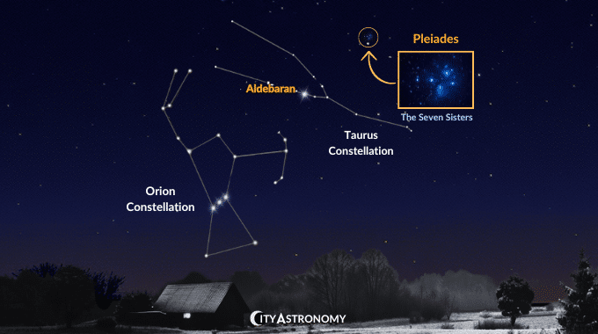
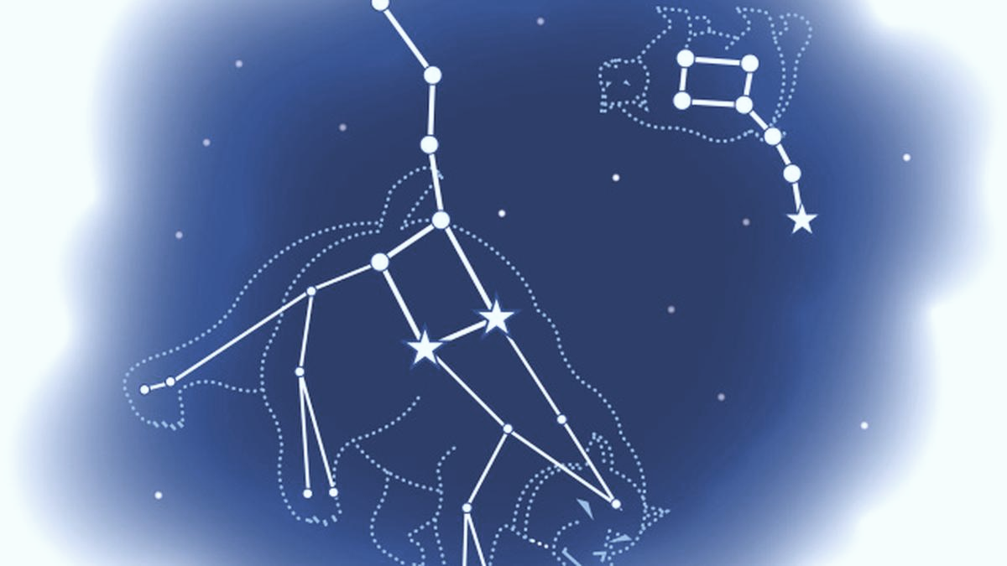
God Made the heavens and universe!
Job 38
³¹ “Can you bind the chains^{[b]} of the Pleiades?
Can you loosen Orion’s belt?
³² Can you bring forth the constellations in their seasons^{[c]}
or lead out the Bear^{[d]} with its cubs?
³³ Do you know the laws of the heavens?
Can you set up God’s^{[e]} dominion over the earth.

Slide 8
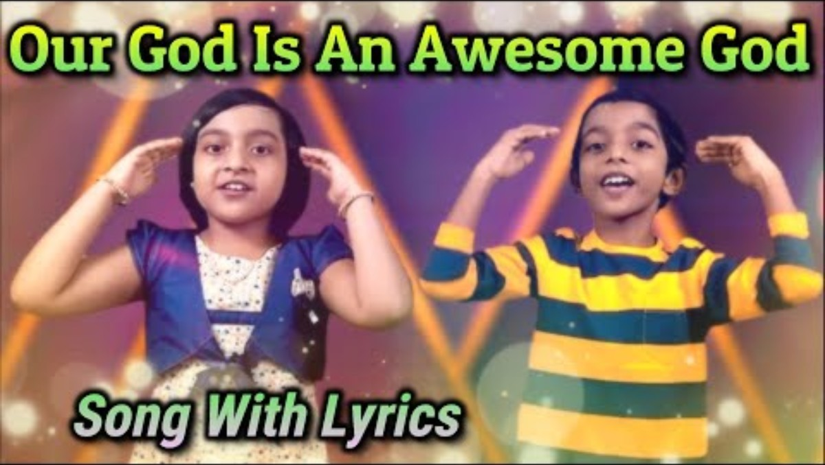
Praise Our Awesome God!

Slide 9
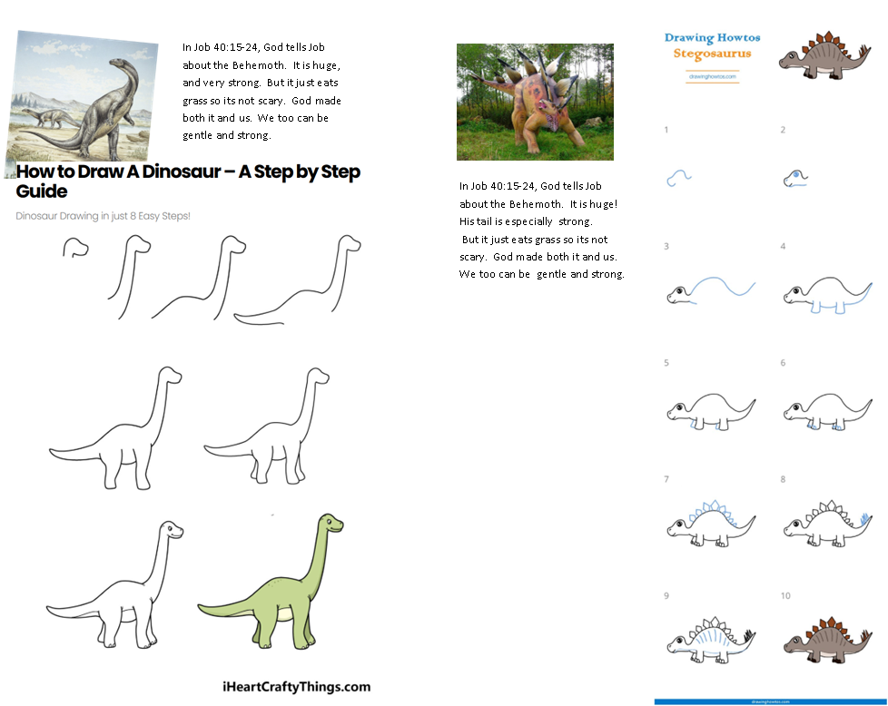
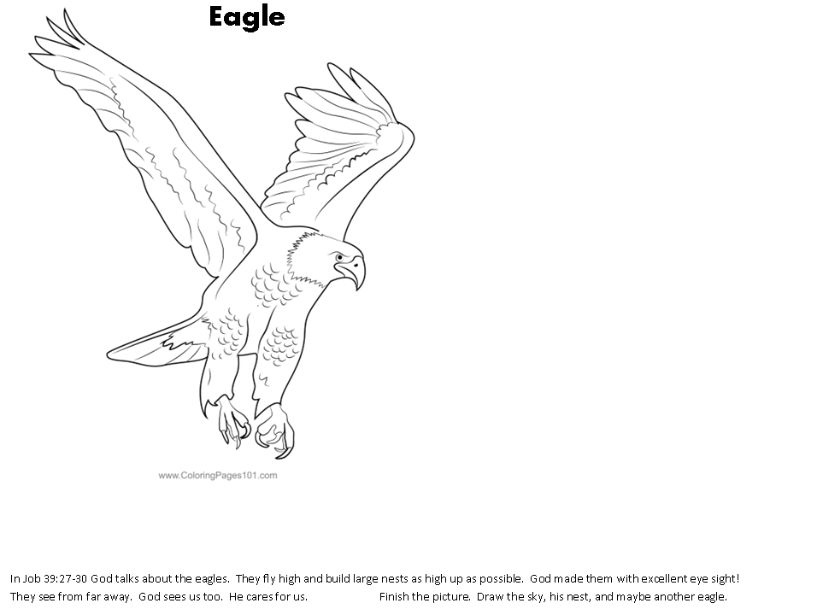
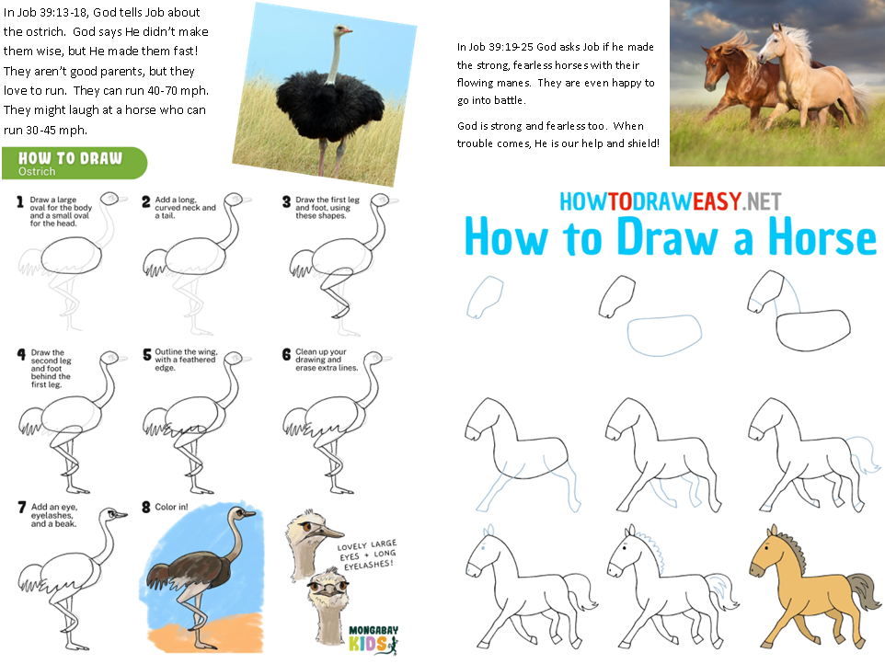
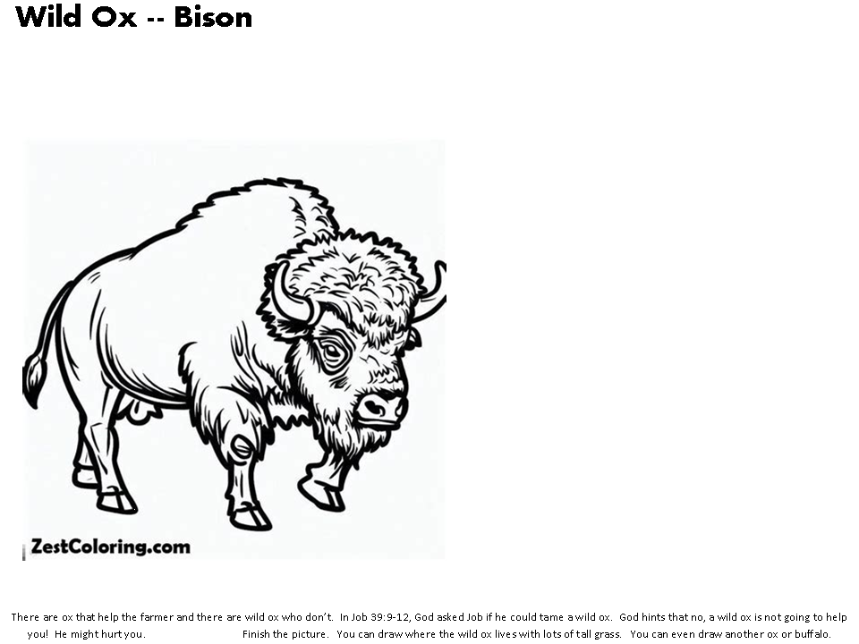
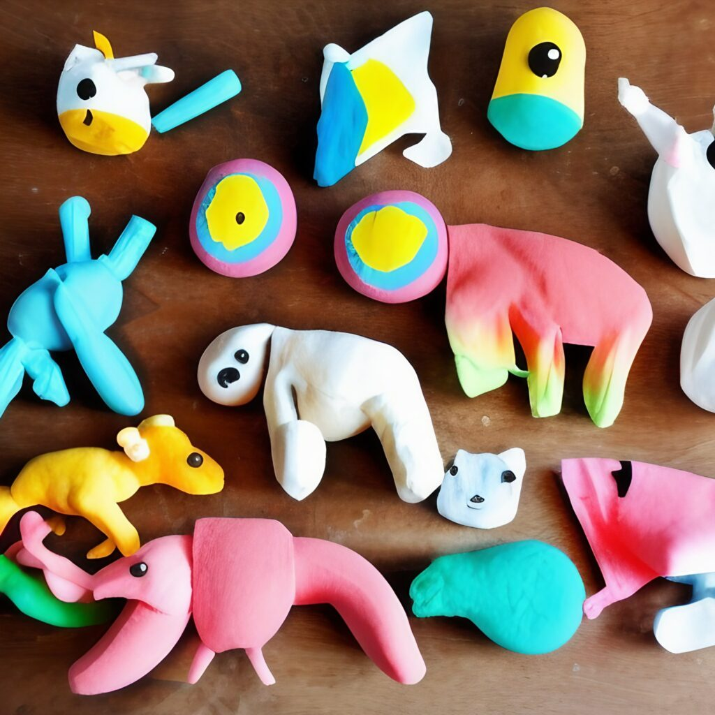
Craft Time
God talks about many animals.
You can choose an animal craft
Color a picture
Draw an animal (or several)
Make an animal out of clay

Slide 10
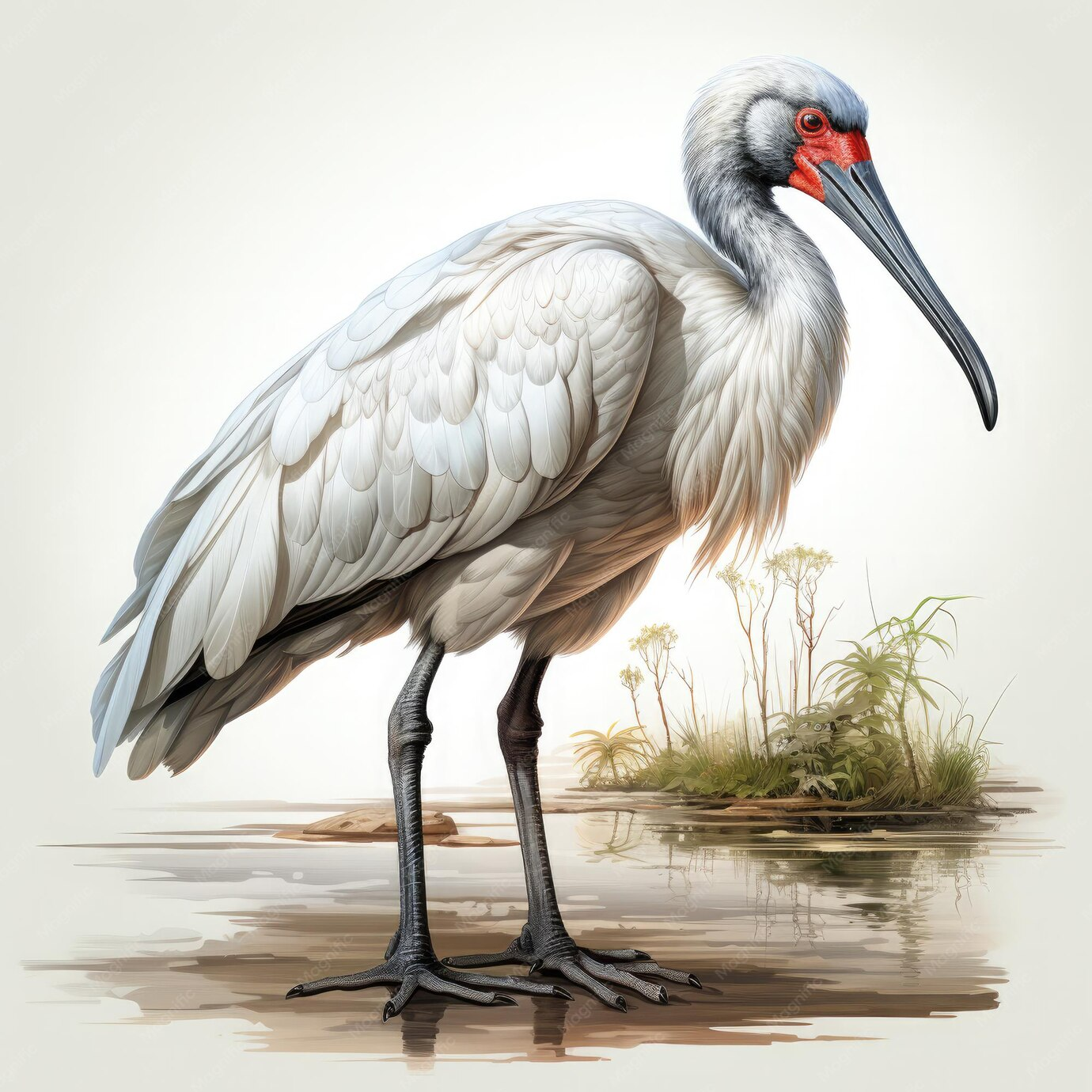
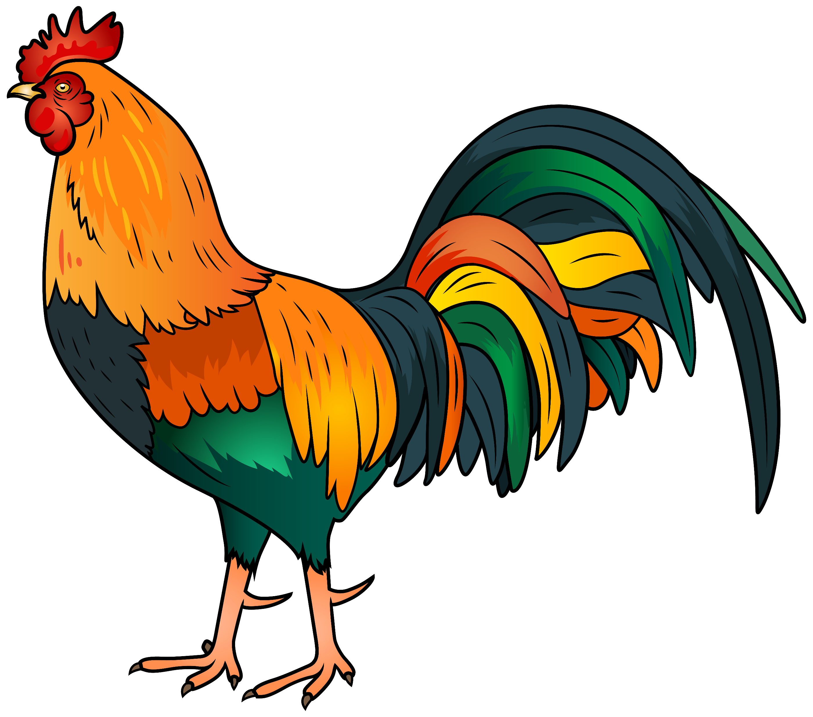
God Speaks
Who gives the ibis wisdom?
Who gives the rooster understanding?
38 Then the Lord spoke to Job out of the storm. He said:
…³⁶ Who gives the ibis wisdom^{[f]}
or gives the rooster understanding?
The Egyptians considered the Ibis to have wisdom, creative and healing powers, however God says that He created the Ibis.
God is the true Creator, Healer, and has all wisdom.

Slide 11
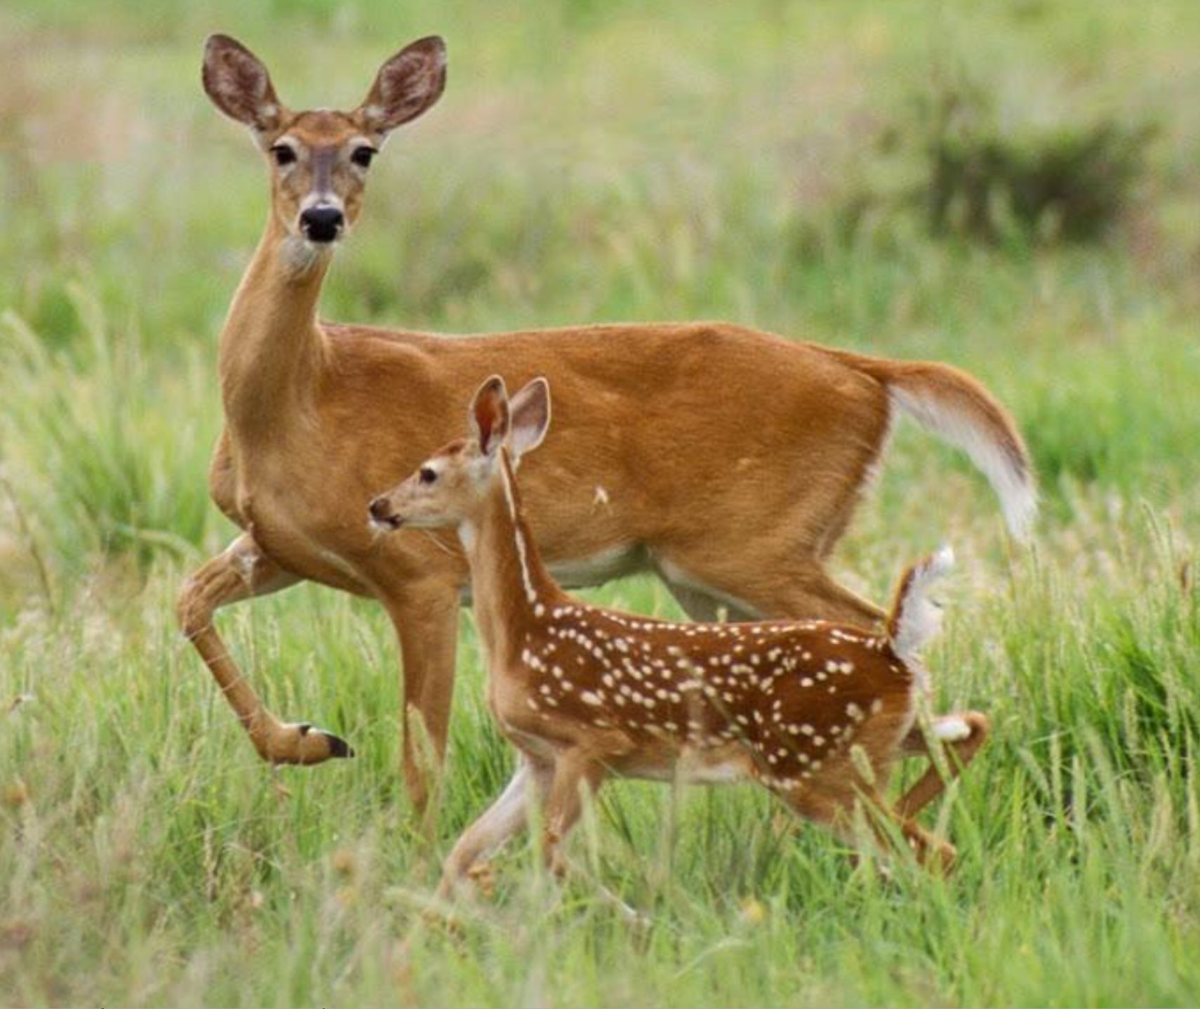
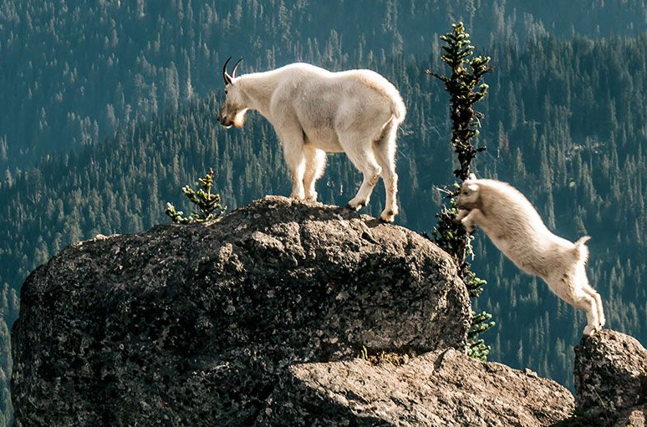
Job, do you know when the deer or mountain goat have their babies?
Do you count the months and know when it is time?
The little ones grow strong and healthy in the wild.
They leave and do not come home again.
Job 39
“Job, do you know when mountain goats have their babies?
Do you watch when female deer give birth?
² Do you count the months until the animals have their babies?
Do you know the time when they give birth?
³ They bend their back legs and have their babies.
Then their labor pains stop.
⁴ Their little ones grow strong and healthy in the wild.
They leave and do not come home again.

Slide 12
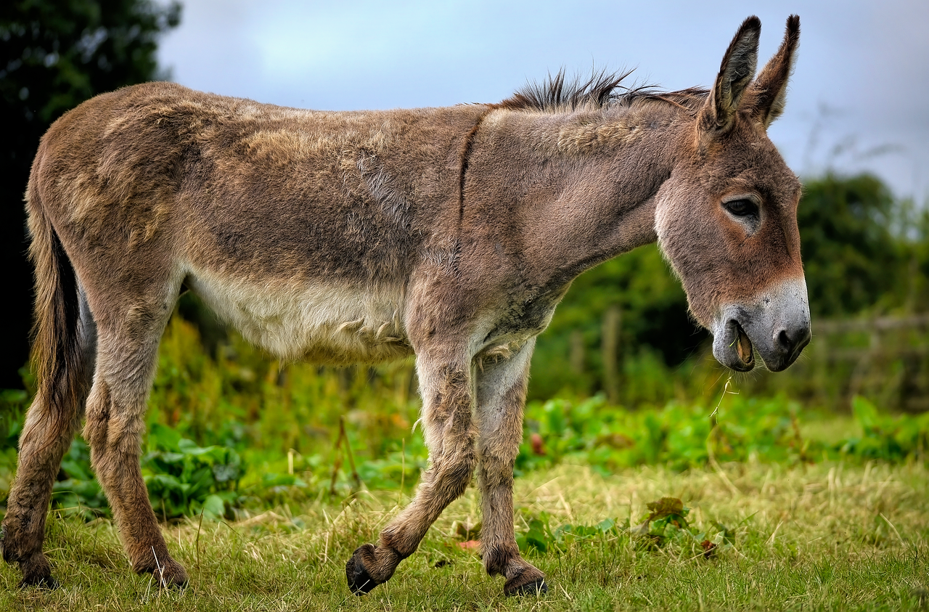
Donkeys
Job 39
⁵ “Who let the wild donkeys go free?
Who untied their ropes?
⁶ I gave them the dry and empty land as their home.
I gave them salt flats to live in.
⁷ They laugh at all the noise in town.
They do not hear the shouts of the donkey drivers.
⁸ They wander over the hills to look for grass.
They search for anything green to eat.

Slide 13
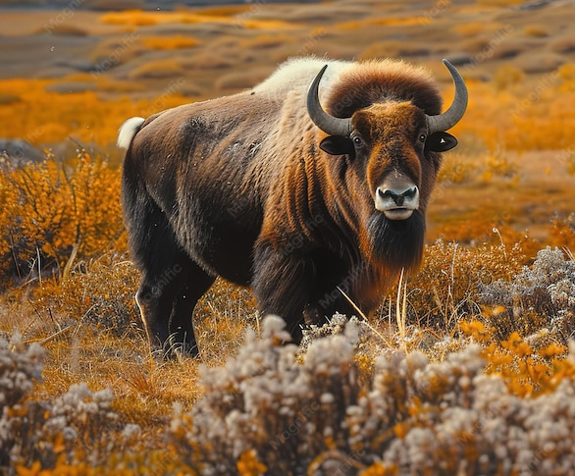
WILD OXEN -- BUFFALO
Job 39
⁹ “Job, will wild oxen agree to serve you?
Will they stay by your feed box at night?
¹⁰ Can you keep them in straight rows with harnesses?
Will they plow the valleys behind you?
¹¹ Will you depend on them for their great strength?
Will you let them do your heavy work?
¹² Can you trust them to haul in your grain?
Will they bring it to your threshing floor?

Slide 14
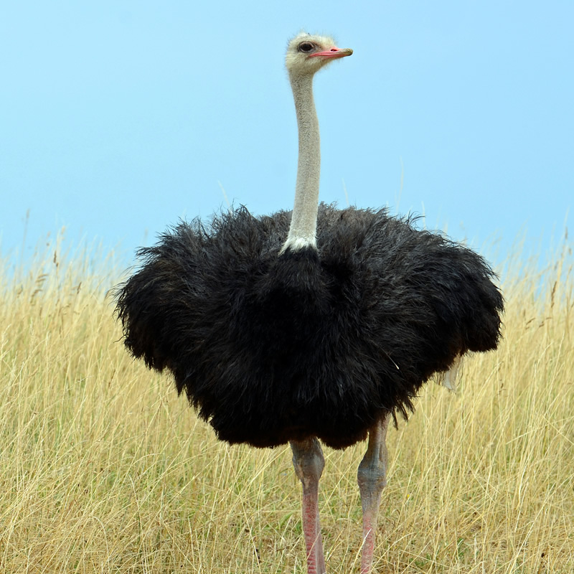
OSTRICH
Job 39
¹³ “The wings of ostriches flap with joy.
But they can’t compare with the wings and feathers of storks.
¹⁴ Ostriches lay their eggs on the ground.
They let them get warm in the sand.
¹⁵ They do not know that something might step on them.
A wild animal might walk all over them.
¹⁶ Ostriches are mean to their little ones.
They treat them as if they did not belong to them.
They do not care that their work was useless.
¹⁷ I did not provide ostriches with wisdom.
I did not give them good sense.
¹⁸ But when they spread their feathers to run,
they laugh at a horse and its rider.

Slide 15
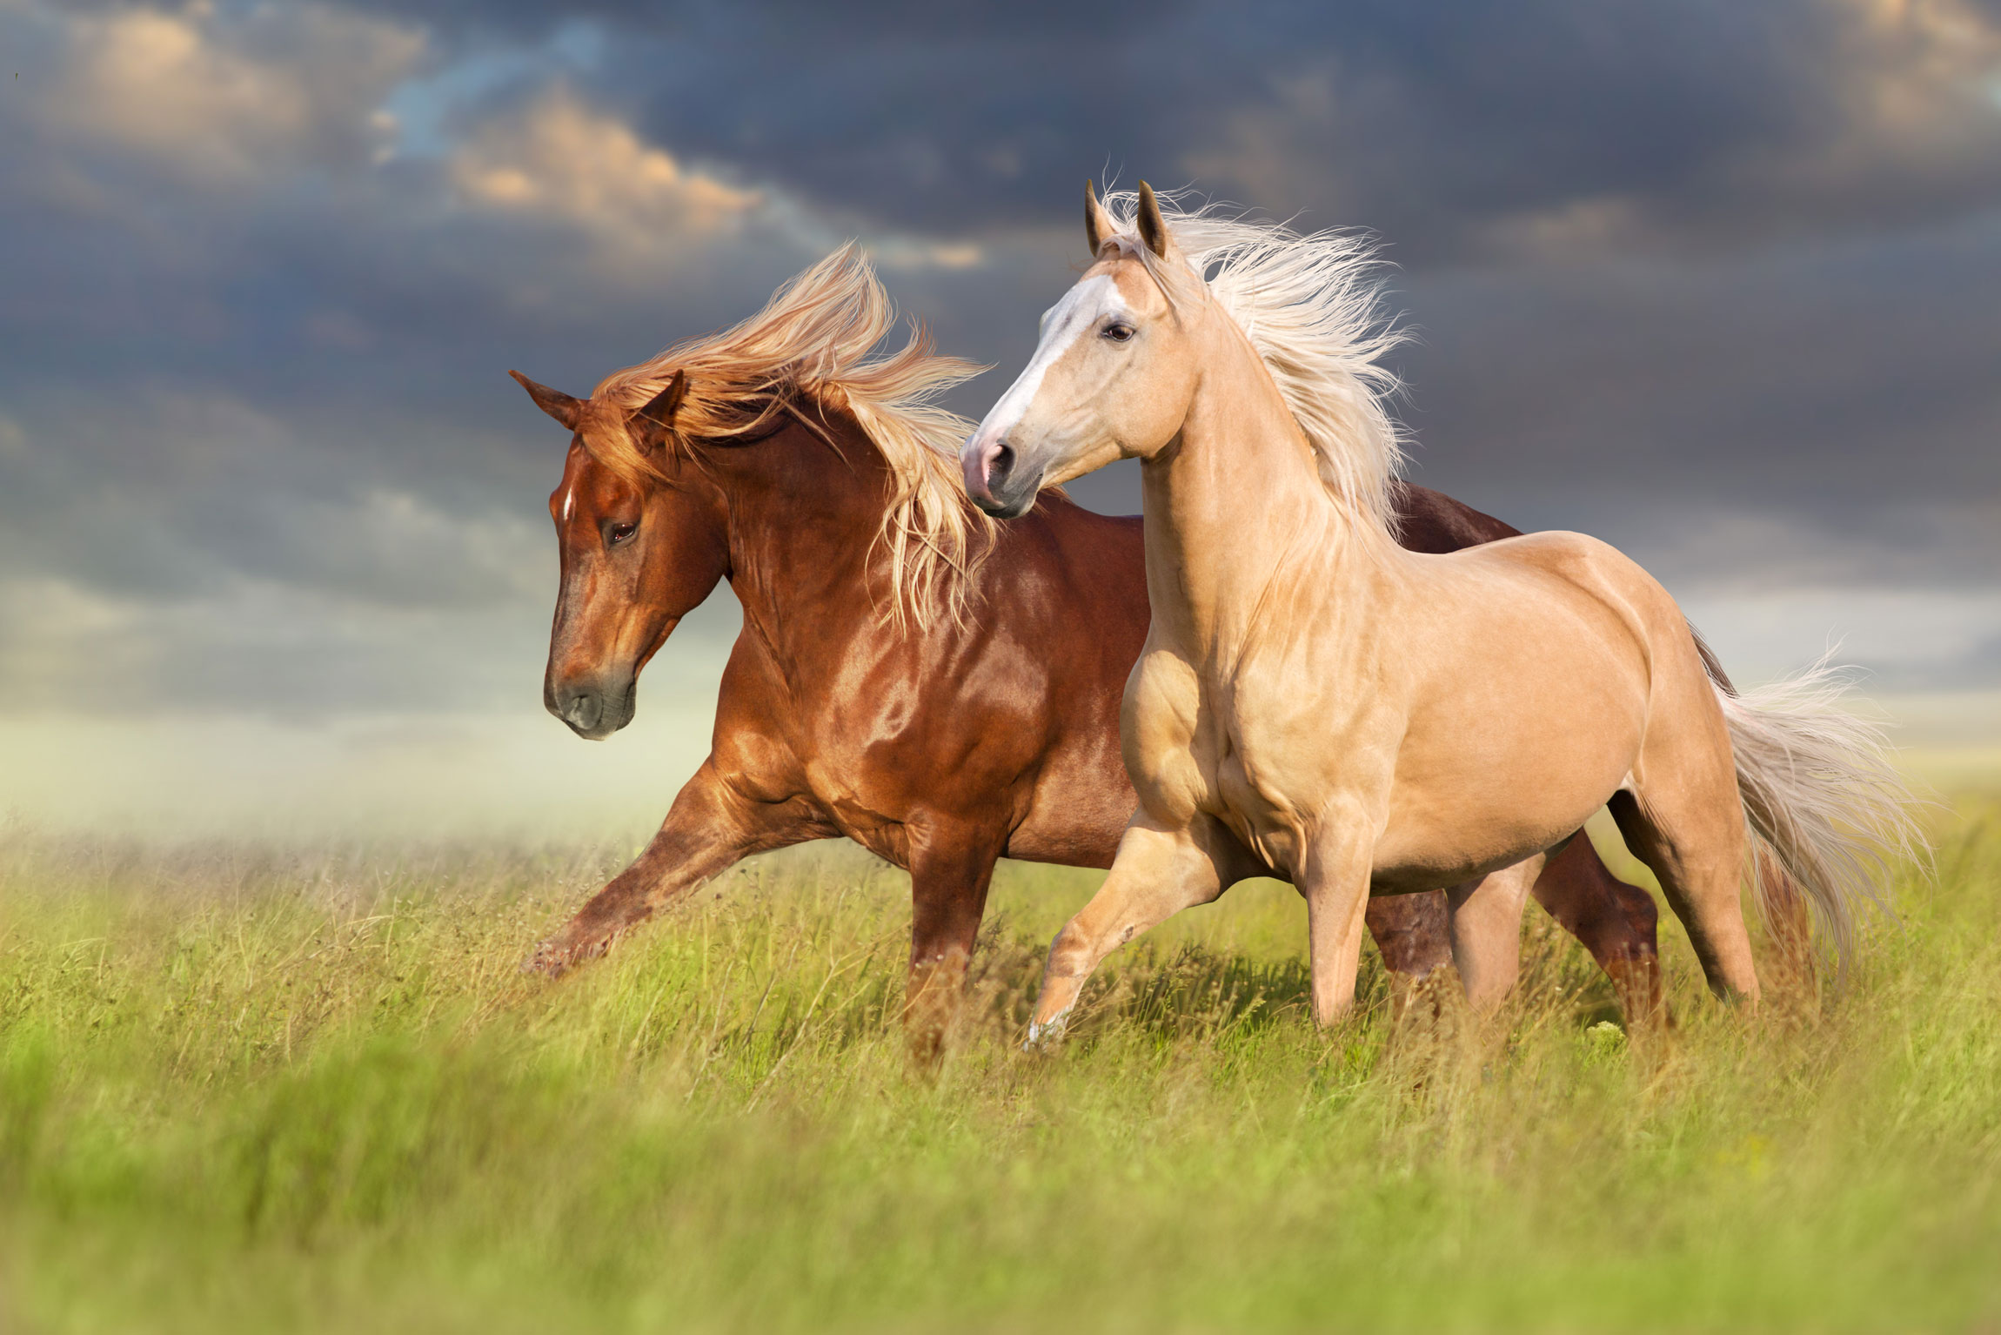
HORSES
Job 39
¹⁹ “Job, do you give horses their strength?
Do you put flowing manes on their necks?
²⁰ Do you make them jump like locusts?
They terrify others with their proud snorting.
²¹ They paw the ground wildly.
They are filled with joy.
They charge at their enemies.
²² They laugh at fear. They are not afraid of anything.
They do not run away from swords.
²³ Many arrows rattle at their sides.
Flashing spears and javelins are also there.
²⁴ They are so excited that they race over the ground.
They can’t stand still when trumpets are blown.
²⁵ When they hear the trumpets they snort, ‘Aha!’
They catch the smells of battle far away.
They hear the shouts of commanders and the battle cries.

Slide 16
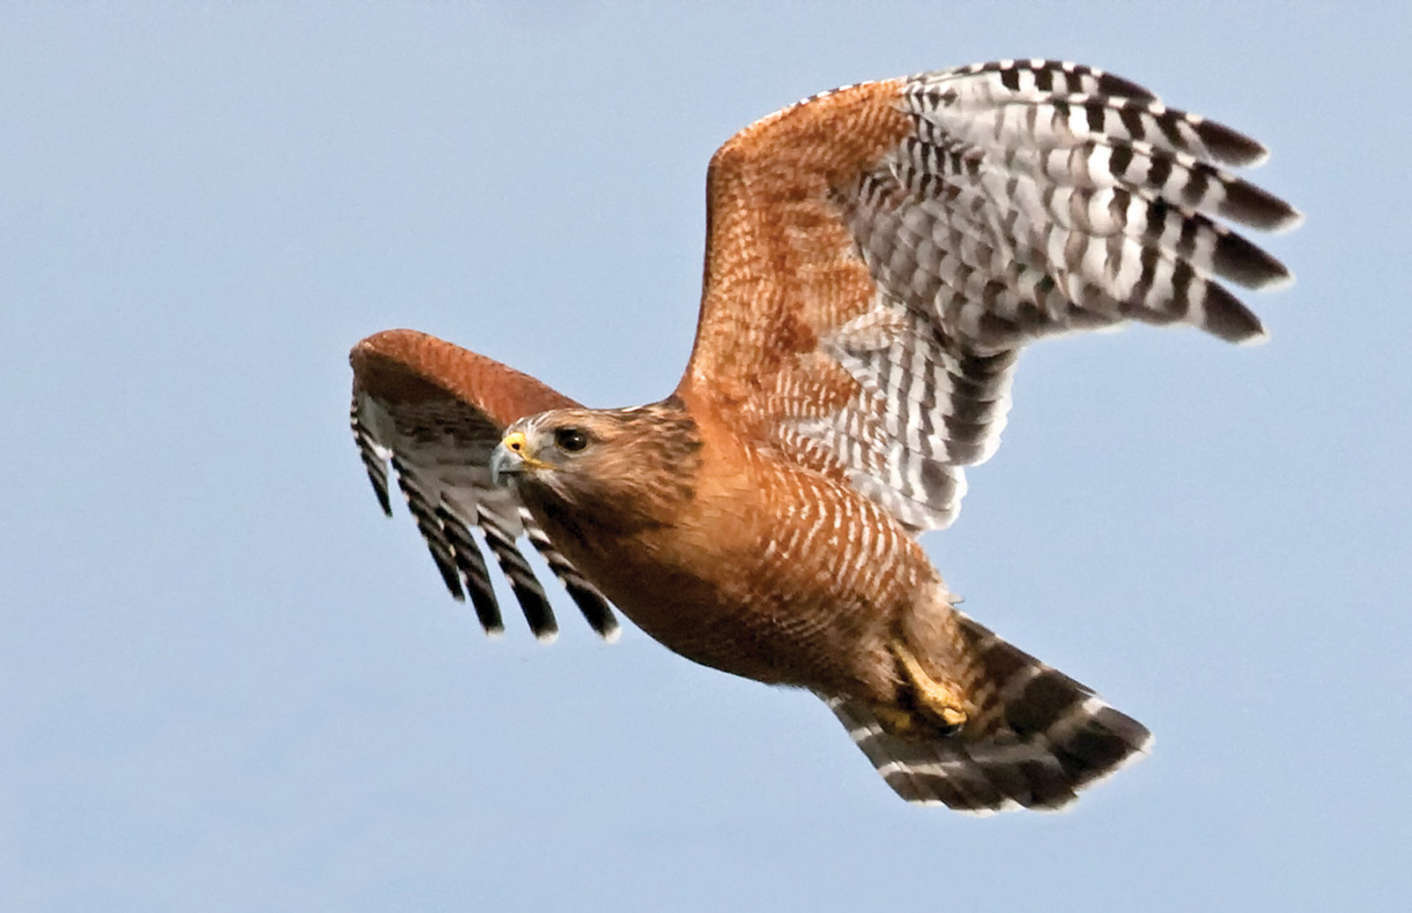
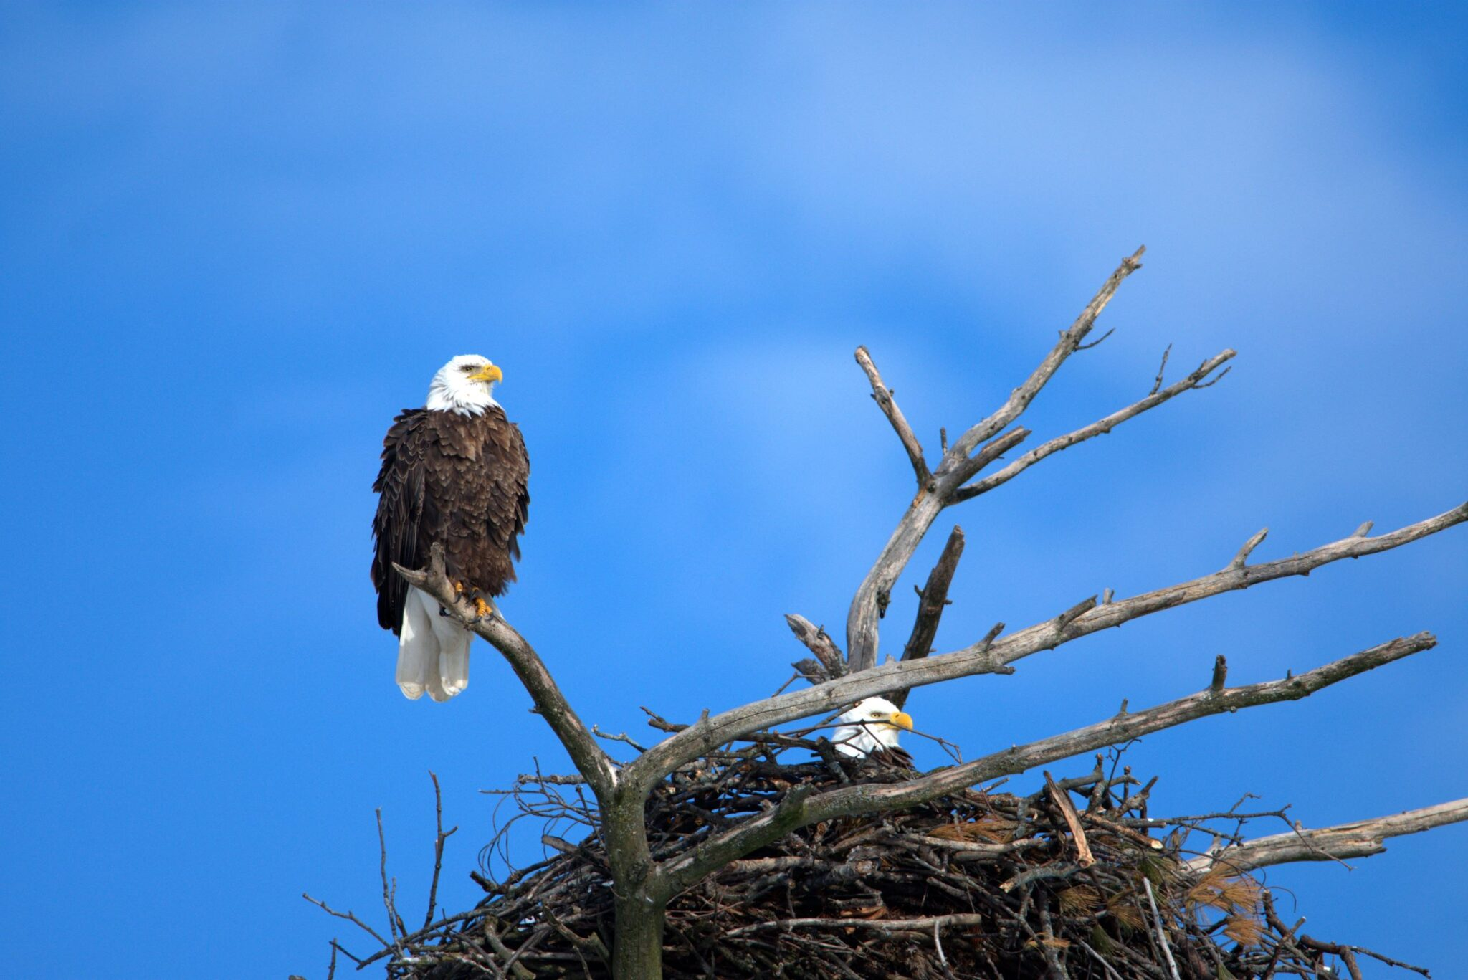
Hawks and eagles
Job 39
²⁶ “Job, are you wise enough to teach hawks where to fly?
They spread their wings and fly toward the south.
²⁷ Do you command eagles to fly so high?
They build their nests as high as they can.
²⁸ They live on cliffs and stay there at night.
High up on the rocks they think they are safe.
²⁹ From there they look for their food.
They can see it from far away.
³⁰ Their little ones like to eat blood.
Eagles gather where they see dead bodies.”

Slide 17
God Speaks
Are you going to say I am not fair?
Do you control all the things in the universe?
Can your voice thunder like mine?
Can you adorn yourself with glory and splendor;
or clothe yourself with honor and majesty?
Will you correct the Almighty?
Let him who will accuse the LORD answer him.
Brace yourself like a man.
I will question you and you will answer me.
40 The Lord said to Job:
² “Will the one who contends with the Almighty correct him?
Let him who accuses God answer him!”
³ Then Job answered the Lord:
⁴ “I am unworthy—how can I reply to you?
I put my hand over my mouth.
⁵ I spoke once, but I have no answer—
twice, but I will say no more.”
⁶ Then the Lord spoke to Job out of the storm:
⁷ “Brace yourself like a man;
I will question you,
and you shall answer me.
⁸ “Would you discredit my justice?
Would you condemn me to justify yourself?
⁹ Do you have an arm like God’s,
and can your voice thunder like his?
¹⁰ Then adorn yourself with glory and splendor,
and clothe yourself in honor and majesty….
LORD, I am unworthy. How can I reply to You?
I put my hand over my mouth.
I spoke once, but I have no answer.
Twice, but I will say no more.

Slide 18
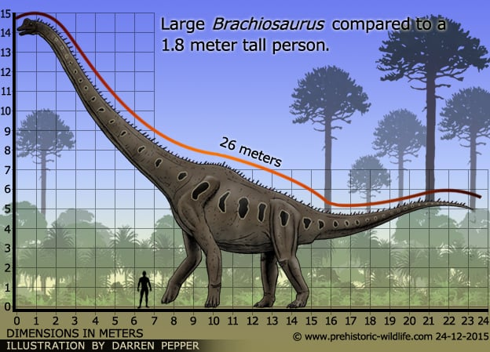
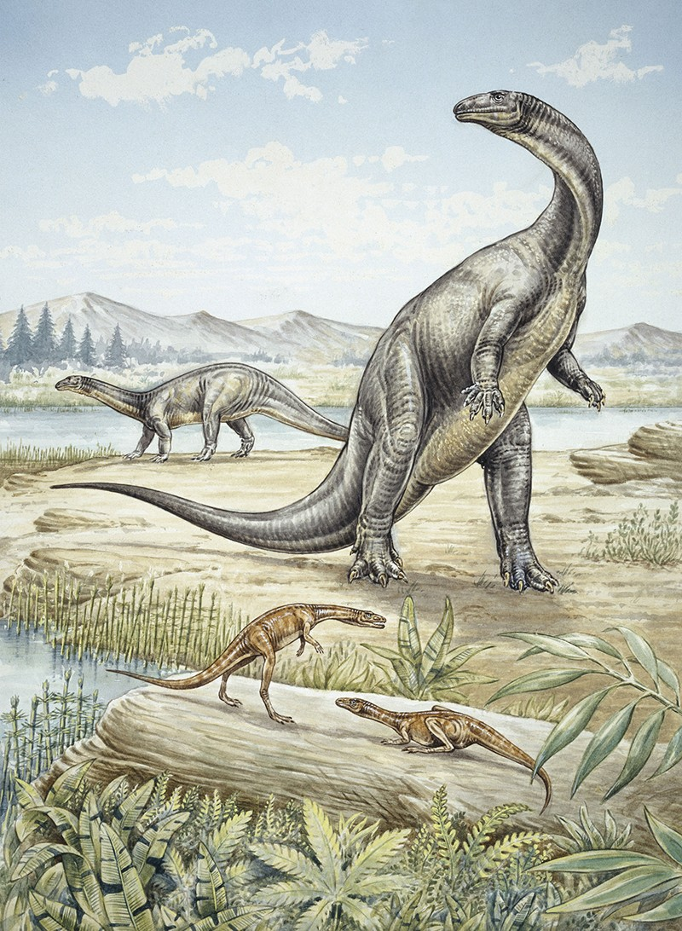
God Speaks
Look at Behemoth, which I made along with you.
See the strength and power in its muscles, bones, thighs, tail, and limbs!
It eats grass. Other animals are not afraid.
But no one can trap it.
Job 40
¹⁵ “Look at Behemoth. It is a huge animal.
I made both of you.
It eats grass like an ox.
¹⁶ Look at the strength it has in its hips!
What power it has in the muscles of its stomach!
¹⁷ Its tail sways back and forth like a cedar tree.
The tendons of its thighs are close together.
¹⁸ Its bones are like tubes made out of bronze.
Its legs are like rods made out of iron.
¹⁹ It ranks first among my works.
I made it. I can approach it with my sword.
²⁰ The hills produce food for it.
All the other wild animals play near it.
²¹ It lies under lotus plants.
It hides in tall grass in the swamps.
²² The lotus plants hide it in their shade.
Poplar trees near streams surround it.
²³ It is not afraid when the river roars.
It is secure even when the Jordan River rushes against its mouth.
²⁴ Can anyone capture it by its eyes?
Can anyone trap it and poke a hole through its nose?
Was the Behemoth a Brachiosaurus which was the largest plant eating animal or maybe it was a Stegosaurus or Ankylosaurus that had very powerful tails.

Slide 19
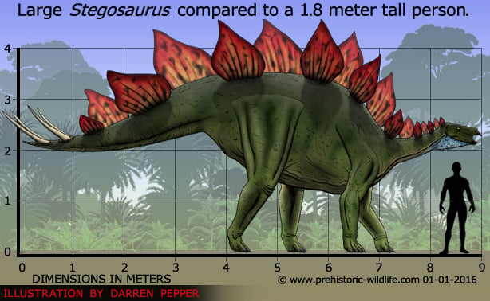
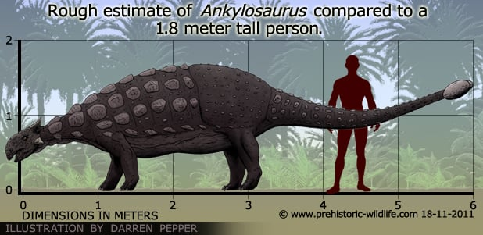
God Speaks
Job 40
¹⁵ “Look at Behemoth. It is a huge animal.
I made both of you.
It eats grass like an ox.
¹⁶ Look at the strength it has in its hips!
What power it has in the muscles of its stomach!
¹⁷ Its tail sways back and forth like a cedar tree.
The tendons of its thighs are close together.
¹⁸ Its bones are like tubes made out of bronze.
Its legs are like rods made out of iron.
¹⁹ It ranks first among my works.
I made it. I can approach it with my sword.
²⁰ The hills produce food for it.
All the other wild animals play near it.
²¹ It lies under lotus plants.
It hides in tall grass in the swamps.
²² The lotus plants hide it in their shade.
Poplar trees near streams surround it.
²³ It is not afraid when the river roars.
It is secure even when the Jordan River rushes against its mouth.
²⁴ Can anyone capture it by its eyes?
Can anyone trap it and poke a hole through its nose?
Was the Behemoth a Brachiosaurus which was the largest plant eating animal or maybe it was a Stegosaurus or Ankylosaurus that had very powerful tails.

Slide 20
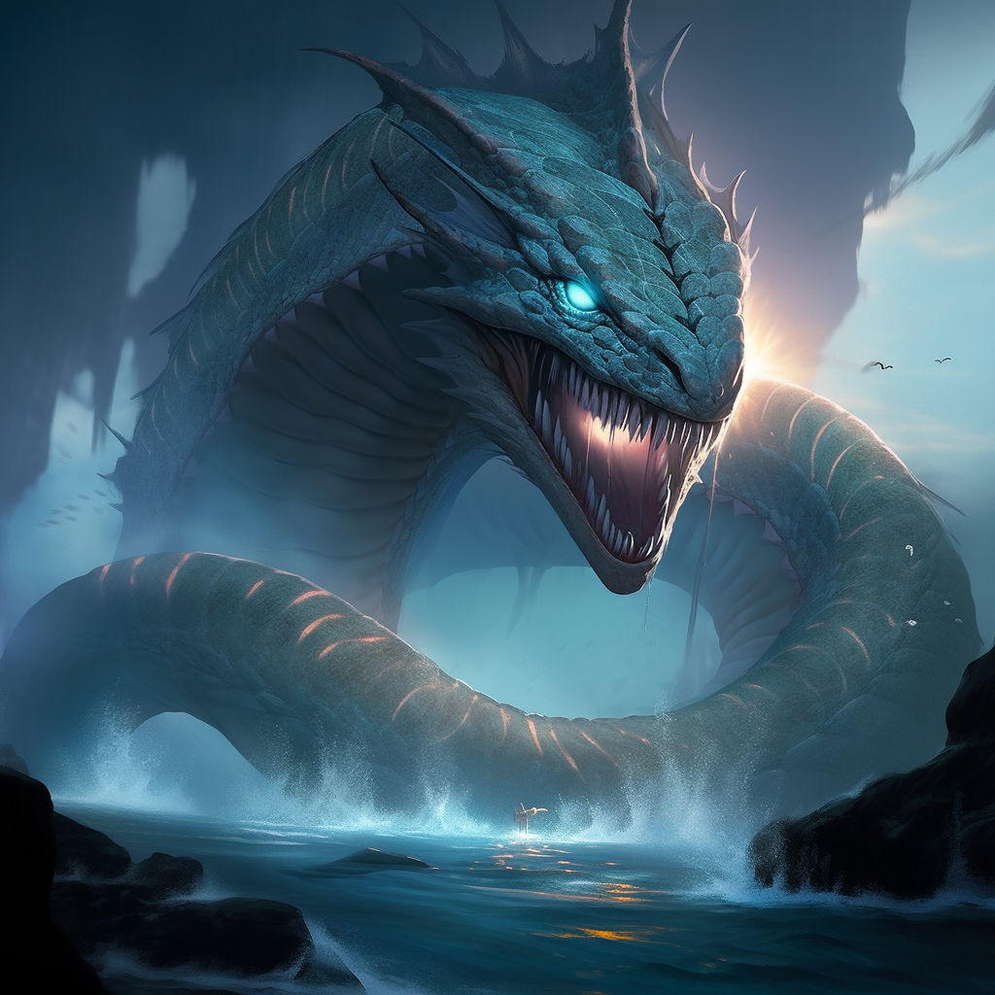
The Leviathan
Job, can you catch a Leviathan?
Can you control it? No. No one can.
Just looking at it will terrify you.
No one dares to wake it up.
So, who can possibly stand up to me?
Who has a claim against me that I must pay?
Everything on earth belongs to me.
I made it.
Job 41
“Job, can you pull Leviathan out of the sea with a fishhook?
Can you tie down its tongue with a rope?
² Can you put a rope through its nose?
Can you stick a hook through its jaw?
³ Will it keep begging you for mercy?
Will it speak gently to you?
⁴ Will it make an agreement with you?
Can you make it your slave for life?
⁵ Can you make a pet out of it like a bird?
Can you put it on a leash for the young women in your house?
⁶ Will traders offer you something for it?
Will they divide it up among the merchants?
⁷ Can you fill its body with harpoons?
Can you throw fishing spears into its head?
⁸ If you touch it, it will fight you.
Then you will remember never to touch it again!
⁹ No one can possibly control Leviathan.
Just looking at it will terrify you.
¹⁰ No one dares to wake it up.
So who can possibly stand up to me?
¹¹ Who has a claim against me that I must pay?
Everything on earth belongs to me.
¹² “Now I will speak about the Leviathan’s legs.
I will talk about its strength and its graceful body.
¹³ Who can strip off its outer coat?
Who would try to pierce its double coat of armor?
¹⁴ Who dares to open its jaws?
Its mouth is filled with terrifying teeth.
¹⁵ Its back has rows of shields
that are close together.
¹⁶ Each one is so close to the next one
that not even air can pass between them.
¹⁷ They are joined tightly to one another.
They stick together and can’t be forced apart.
¹⁸ Leviathan’s snorting throws out flashes of light.
Its eyes shine like the first light of day.
¹⁹ Flames spray out of its mouth.
Sparks of fire shoot out.
²⁰ Smoke pours out of its nose.
It is like smoke from a boiling pot over burning grass.
²¹ Its breath sets coals on fire.
Flames fly out of its mouth.
²² Its neck is very strong.
People run to get out of its way.
²³ Its rolls of fat are close together.
They are firm and can’t be moved.
²⁴ Its chest is as hard as rock.
It is as hard as a lower millstone.
²⁵ When Leviathan rises up,
even mighty people are terrified.
They run away when it moves around wildly.
²⁶ A sword that strikes it has no effect.
Neither does a spear or dart or javelin.
²⁷ It treats iron as if it were straw.
It crushes bronze as if it were rotten wood.
²⁸ Arrows do not make it run away.
Stones that are thrown from slings are like straw hitting it.
²⁹ A club seems like a piece of straw to it.
It laughs when it hears a javelin rattling.
³⁰ Its undersides are like broken pieces of pottery.
It leaves a trail in the mud like a threshing sled.
³¹ It makes the ocean churn like a boiling pot.
It stirs up the sea like perfume someone is making.
³² It leaves a shiny trail behind it.
You would think the ocean had white hair.
³³ Nothing on earth is equal to Leviathan.
That creature is not afraid of anything.
³⁴ It looks down on proud people.
It rules over all those who are proud.”

Slide 21
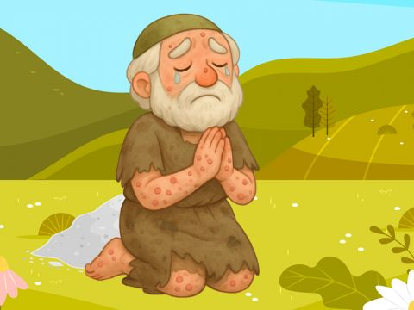
Job Repents and Worships God
42 Then Job replied to the Lord:
² “I know that you can do all things;
no purpose of yours can be thwarted.
³ You asked, ‘Who is this that obscures my plans without knowledge?’
Surely I spoke of things I did not understand,
things too wonderful for me to know.
⁴ “You said, ‘Listen now, and I will speak;
I will question you,
and you shall answer me.’
⁵ My ears had heard of you
but now my eyes have seen you.
⁶ Therefore I despise myself
and repent in dust and ashes.”
LORD, You can do all things.
No purpose of yours can be thwarted.
Surely, I spoke of things I did not understand.
My ears had heard of you,
but now I have seen You.
Forgive me. I am nothing compared to You.

Slide 22
Praise Our Awesome God!

Slide 23
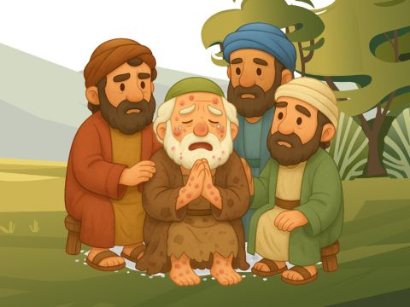
The Friends Repent
Eliphaz, Bildad, and Zophar, You have angered me. You have not spoken truth like Job has.
Now get 7 bulls and 7 rams and take bring them to Job. Job will pray for you and I will accept his prayer and not deal with you according to your folly.
⁷ After the Lord had said these things to Job, he said to Eliphaz the Temanite, “I am angry with you and your two friends, because you have not spoken the truth about me, as my servant Job has. ⁸ So now take seven bulls and seven rams and go to my servant Job and sacrifice a burnt offering for yourselves. My servant Job will pray for you, and I will accept his prayer and not deal with you according to your folly. You have not spoken the truth about me, as my servant Job has.” ⁹ So Eliphaz the Temanite, Bildad the Shuhite and Zophar the Naamathite did what the Lord told them; and the Lord accepted Job’s prayer.
I repent.
Job, please pray for me.
I was foolish
Job, please pray for me.
I did not understand God’s ways.
Job, please pray for me.

Slide 24
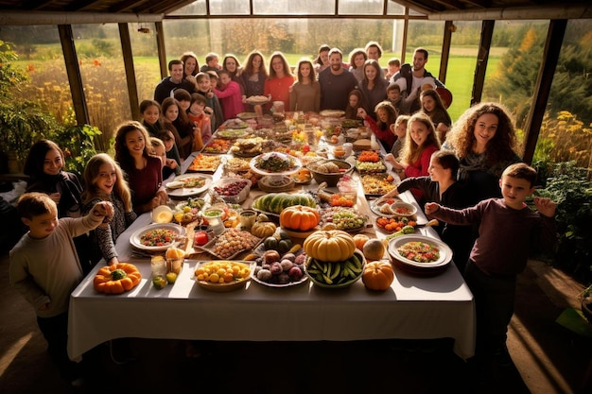
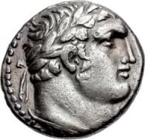
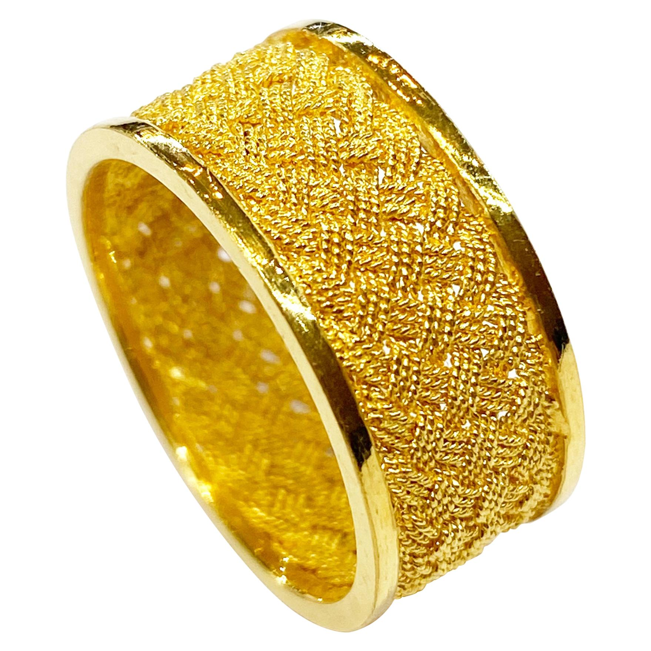
Job Blessed
¹⁰ After Job had prayed for his friends, the Lord restored his fortunes and gave him twice as much as he had before.
¹¹ All his brothers and sisters and everyone who had known him before came and ate with him in his house. They comforted and consoled him over all the trouble the Lord had brought on him, and each one gave him a piece of silver^{[a]} and a gold ring.

Slide 25
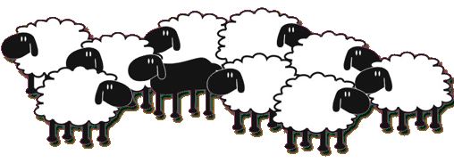
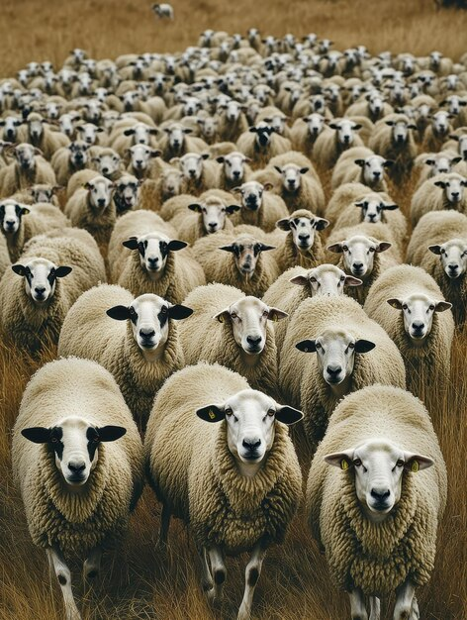
Job Restored
All sheep and shepherds died
7,000 Sheep Before Disaster 14,000 Sheep After
God blessed
¹² The Lord blessed the latter part of Job’s life more than the former part.
He had fourteen thousand sheep, six thousand camels, a thousand yoke of oxen and a thousand donkeys.
The LORD gave and
the LORD has taken away.
May the Name of the LORD
be praised.

Slide 26
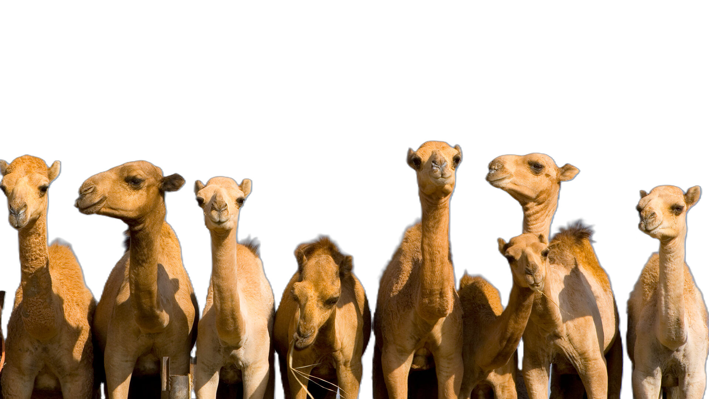
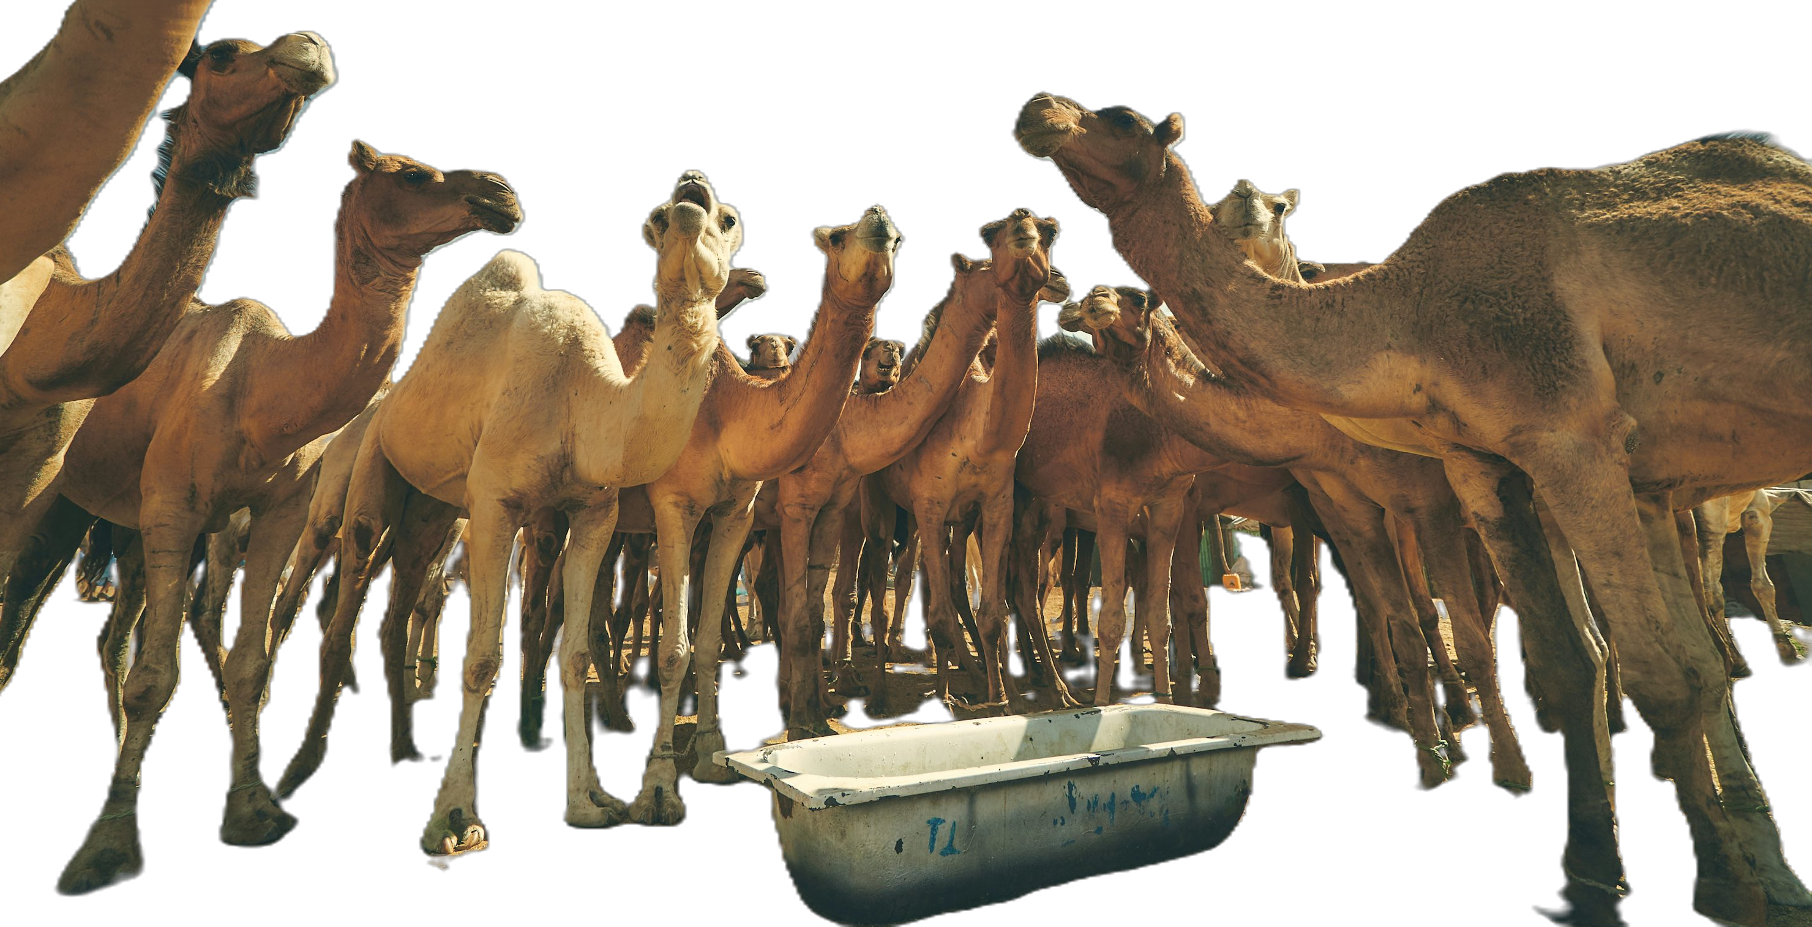
Job Restored
Camels stolen
Servants killed
3,000 camels Before Disaster 6,000 camels After
God blessed
¹² The Lord blessed the latter part of Job’s life more than the former part.
He had fourteen thousand sheep, six thousand camels, a thousand yoke of oxen and a thousand donkeys.

Slide 27
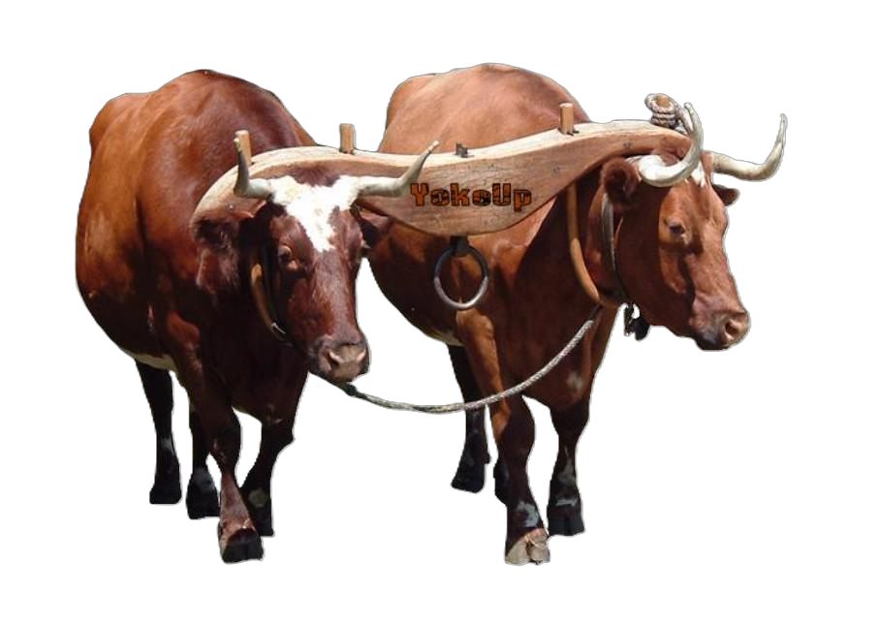
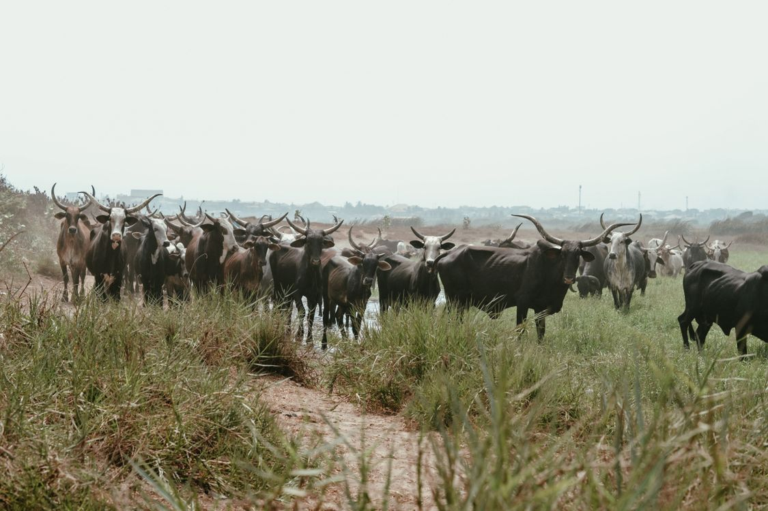
Job Restored
Animals stolen
Servants killed
500 pair of oxen Before Disaster 1,000 yoke of oxen After
God blessed
¹² The Lord blessed the latter part of Job’s life more than the former part.
He had fourteen thousand sheep, six thousand camels, a thousand yoke of oxen and a thousand donkeys.

Slide 28
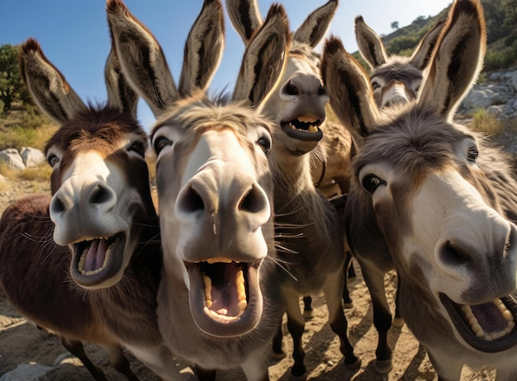
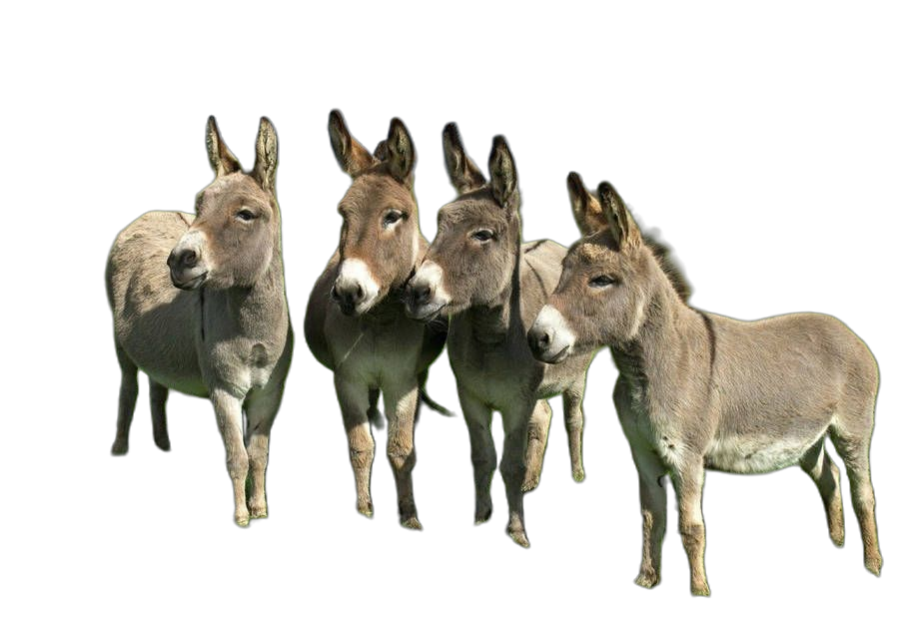
Job Restored
Animals stolen
Servants killed
500 donkeys Before Disaster 1,000 donkeys After
God blessed
¹² The Lord blessed the latter part of Job’s life more than the former part. He had fourteen thousand sheep, six thousand camels, a thousand yoke of oxen and a thousand donkeys.

Slide 29
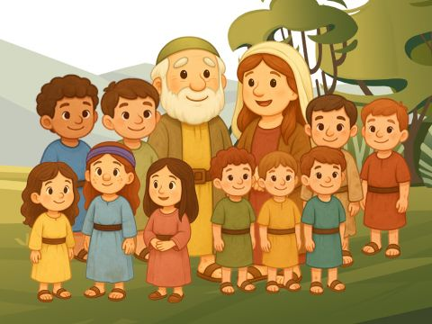
Another family
Children died
7 boys and 3 girls Before Disaster 7 boys and 3 girls After
God blessed
¹³ And he also had seven sons and three daughters. ¹⁴ The first daughter he named Jemimah, the second Keziah and the third Keren-Happuch. ¹⁵ Nowhere in all the land were there found women as beautiful as Job’s daughters, and their father granted them an inheritance along with their brothers.
¹⁶ After this, Job lived a hundred and forty years; he saw his children and their children to the fourth generation. ¹⁷ And so Job died, an old man and full of years.
Jemimah= like a dove, pure, loving; Keziah = beautiful; cinnamon; Keren Happuch= beautiful eyes

Slide 30
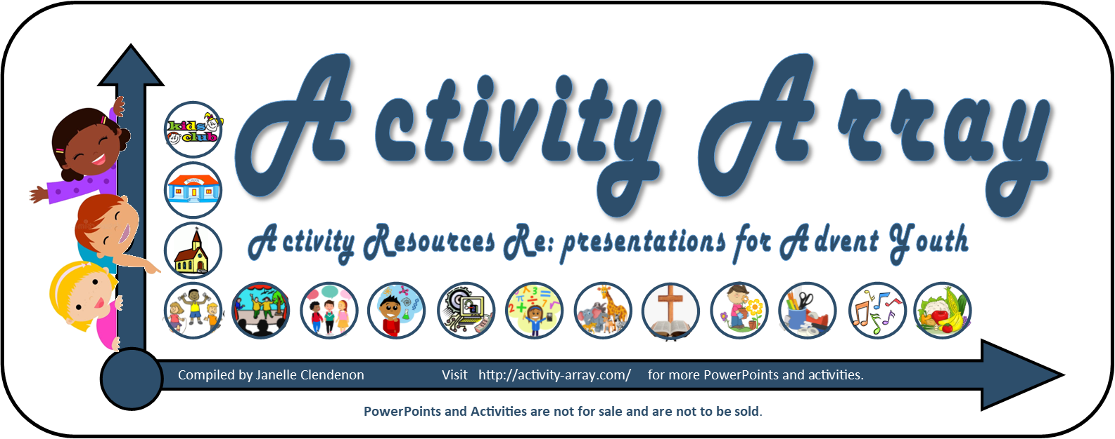
THE END
https://activity-array.com/

