Slide 1
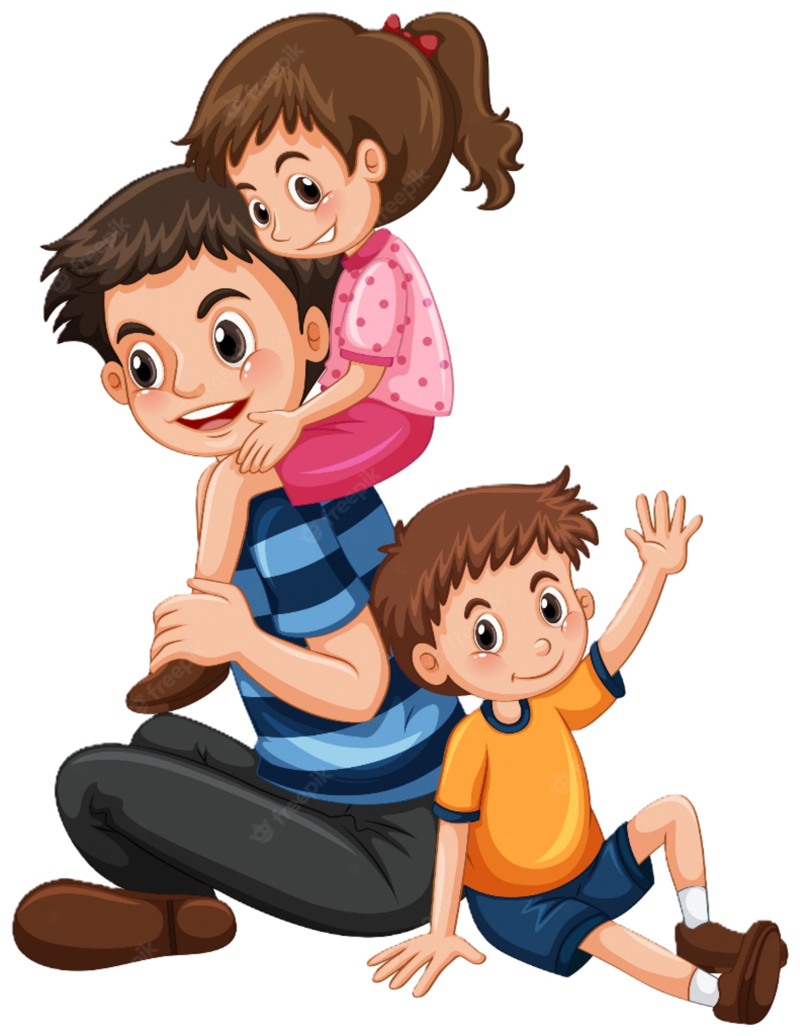
My Dad
Father’s Day Tribute

Slide 2
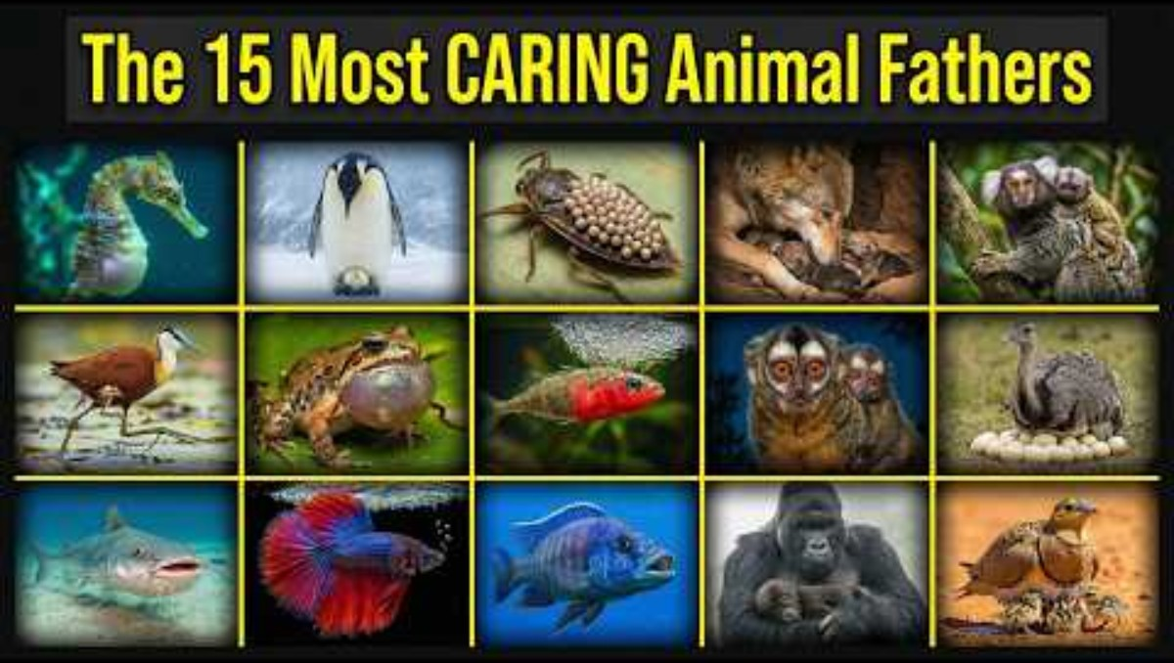

Slide 3
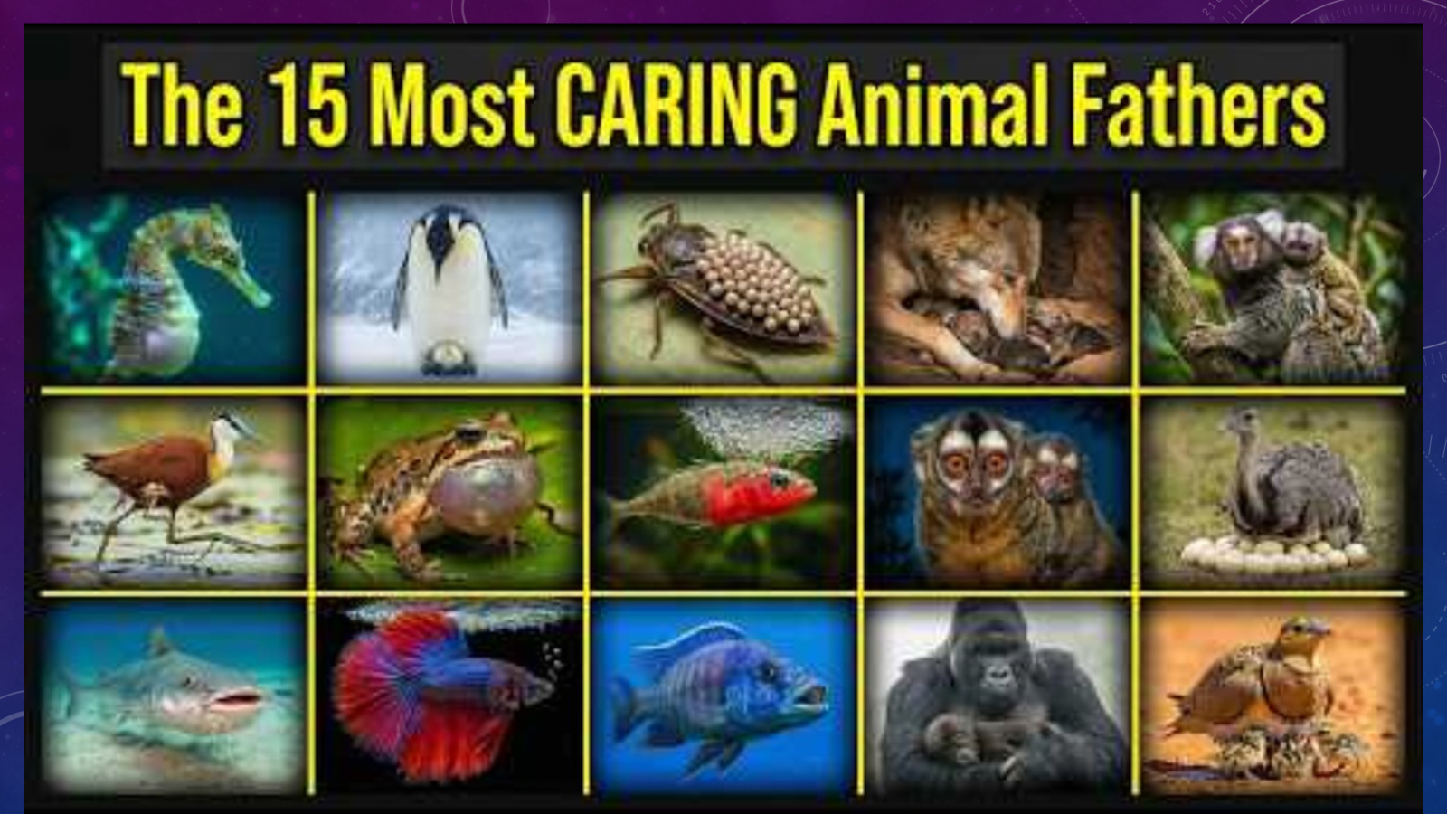
Caring for the unborn
Did you see how many of the animals took care of their eggs and their unborn children?
Which ones took care of their babies even before they were born or hatched?
Job reminded us that by studying God’s creation, we can learn more about God.
Job 12:7-9“God holds them in His hands. But ask the animals, and they will instruct you; ask the birds of the sky, and they will tell you. Or speak to the earth, and it will instruct you; let the fish of the sea inform you. Which of all these does not know that the hand of the Lord has done this?
Sea Horse | Emperor Penguin | Giant Water Bug | Wolf | Common Marmoset
Arican Jicana | Darwin’s frog | 3 Spined Stickleback | Owl Monkey | Greater Rhea
Hardhead Sea Catfish | Beta Fish | Sischild Fish | Mountain Gorilla | Mamakwa Sand Grouse
Our Heavenly Father cares for us too! In fact, He knits us together in our mother’s womb (Psalms 139:13). He is our Creator. God made ways for each human and animal to be cared for while they are young. He keeps us safe.
It’s cool how God gave this responsibility to the dads for some of the animals.

Slide 4
Those dads are faithful steady strong brave dedicated
Expecting a baby Challenge
Through out the next 4 minute video see if can do one or two of the following, which an animal does for hours, days and weeks.
Balance a ball on your feet
Open a small package of gold fish and put them all in your mouth. Hold them there without chewing or swallowing them.
Sit under a frisbee which another person is holding. There’s balloons in the frisbee. If any of the balloons fall, put them back on the frisbee.
Extreme Challenge: Can you do 2 or all 3 of the above at the same time?

Slide 5
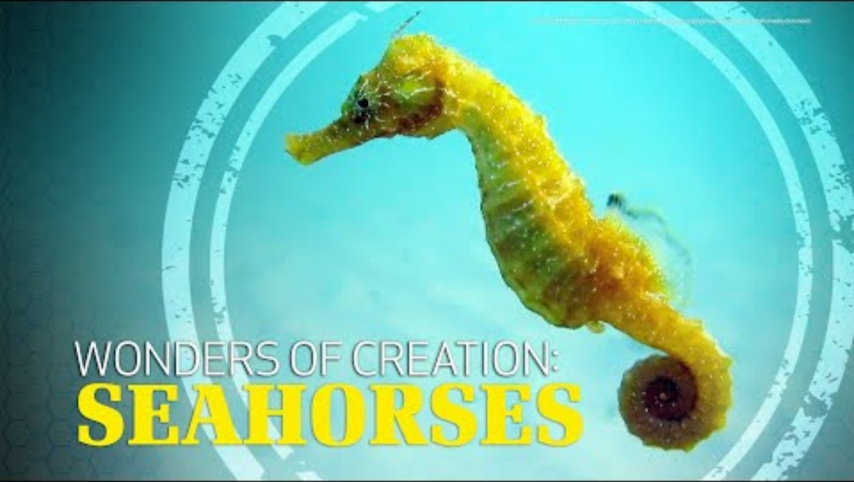

Slide 6
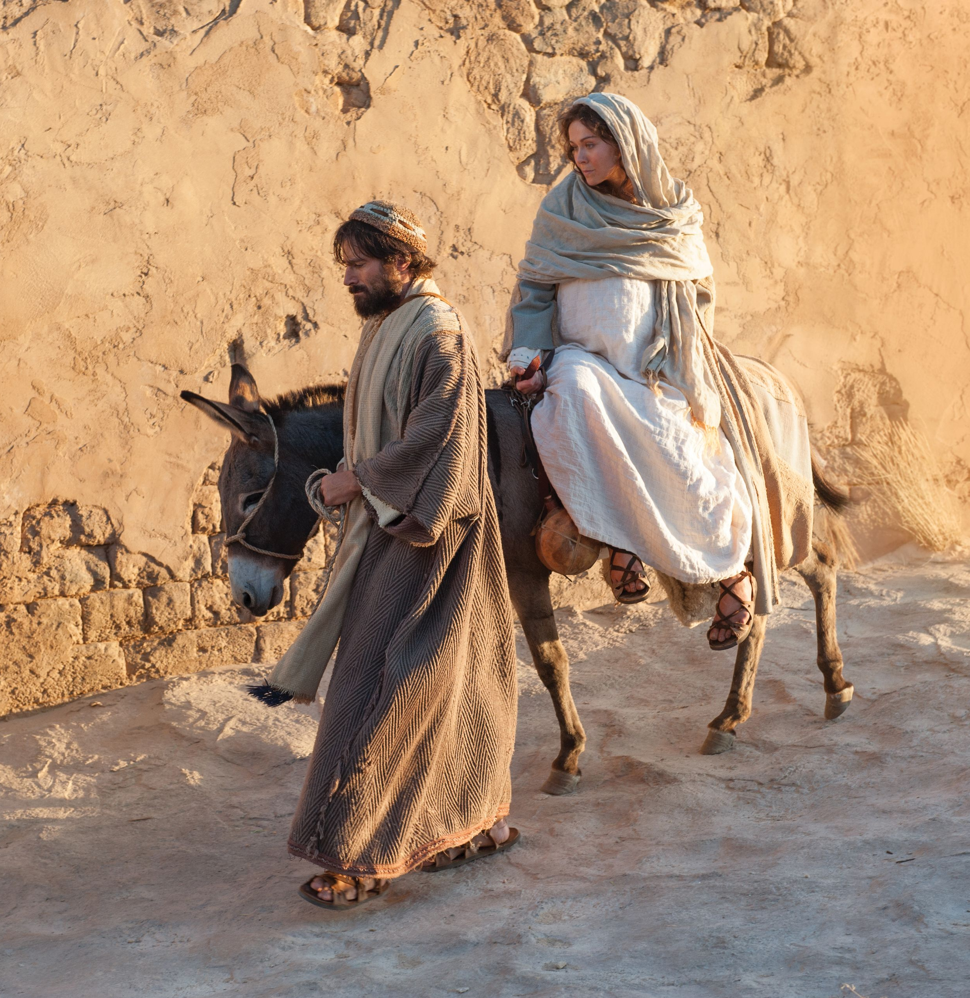
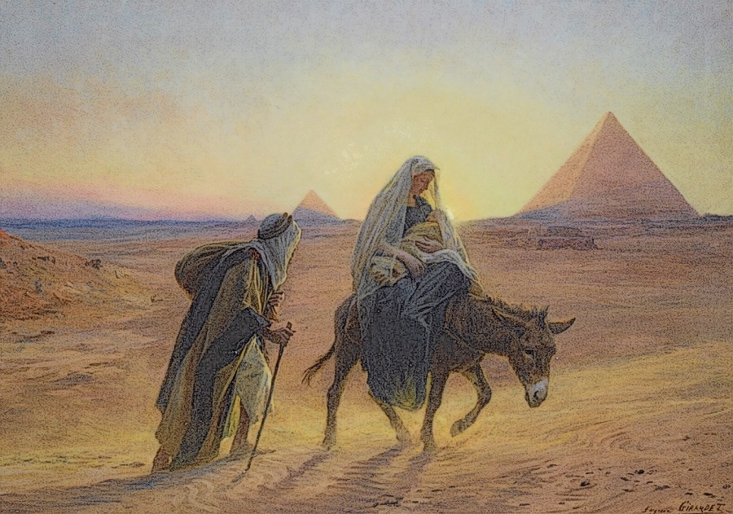
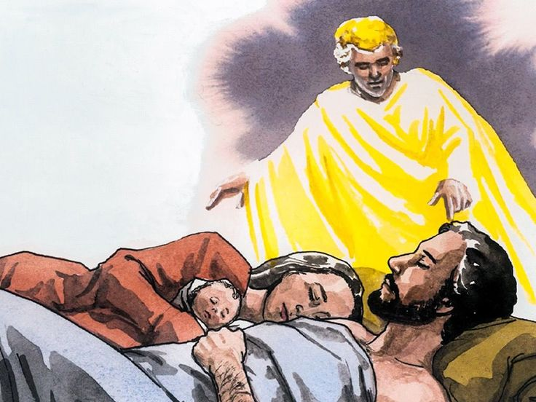
Caring for the Unborn
The Bible, in the book of Matthew, talks about a daddy who cared for a very special baby before he was born. This daddy made sure the mom and baby were safe.
God, our Heavenly Father, made sure He was safe too.
We talk about this story at Christmas time.
Do you know which daddy I’m talking about?
Yes! Joseph took care of Mary and baby Jesus.
Our Heavenly Father sent angels to talk to Joseph and tell him to leave and where to go when it wasn’t safe.

Slide 7
Caring for Little ones
Which fathers protect their little ones from danger?
Some make sure the mothers are safe also before the little ones are born.
God has made men to be strong and brave. Our fathers should protect us.
Our Heavenly Father protects us. God is brave, strong, and faithful! He loves each one of us so much! He sends angels to watch over us.
Sea Horse | Emperor Penguin | Giant Water Bug | Wolf | Common Marmoset
Arican Jicana | Darwin’s frog | 3 Spined Stickleback | Owl Monkey | Greater Rhea
Hardhead Sea Catfish | Beta Fish | Sischild Fish | Mountain Gorilla | Mamakwa Sand Grouse
Psalms 91:9, 11-12,
The Lord is your protection. You have made God Most High your place of safety.
He has put his angels in charge of you. They will watch over you wherever you go. They will catch you with their hands.
They will call to me, and I will answer them. I will be with them in trouble. I will rescue them and honor them.

Slide 8
Those dads are faithful steady strong brave dedicated
Protect the children Challenge
Through out the next 3 minute video see if can do one or two of the following, which an animal does for hours, days and weeks.
Keep your eye on the video, but if you see someone sneaking around, quickly point to them.
Walk around the room carrying felt animals on your back.
Walk around the room carrying 2 books under each arm.

Slide 9
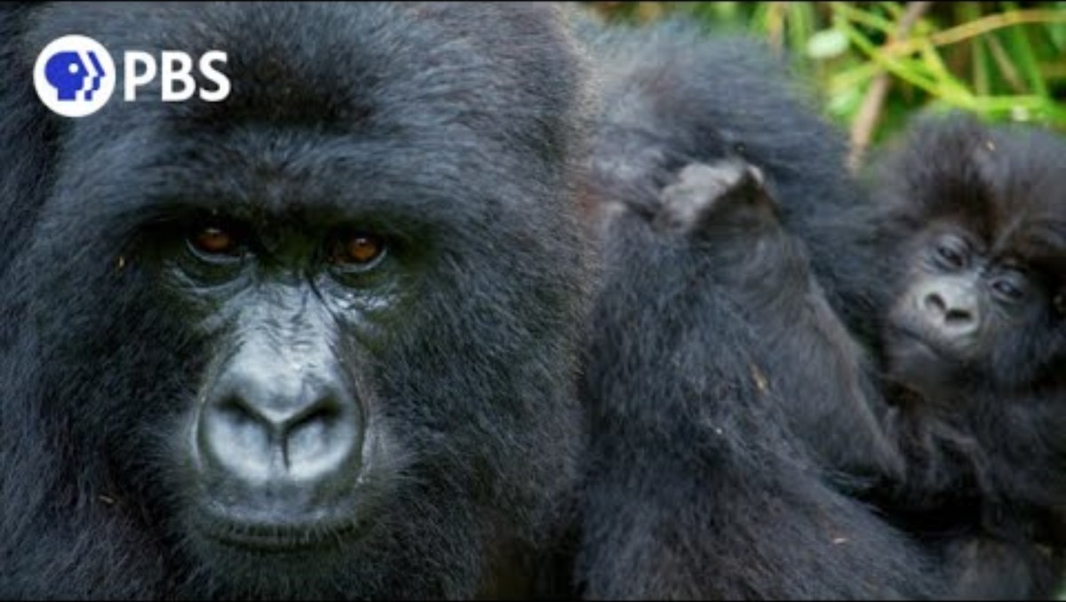
The king of the jungle, the gorilla is an excellent father figure for young gorillas. Male gorillas tend to lead social groups of up to 30 other gorillas, however there is typically only one adult male per troop. This alpha male is in charge of protecting their troop as well as teaching the young how to socialize with other gorillas.
https://wildlifeinformer.com/best-animal-dads/
How did you do on the challenge? Nice!

Slide 10
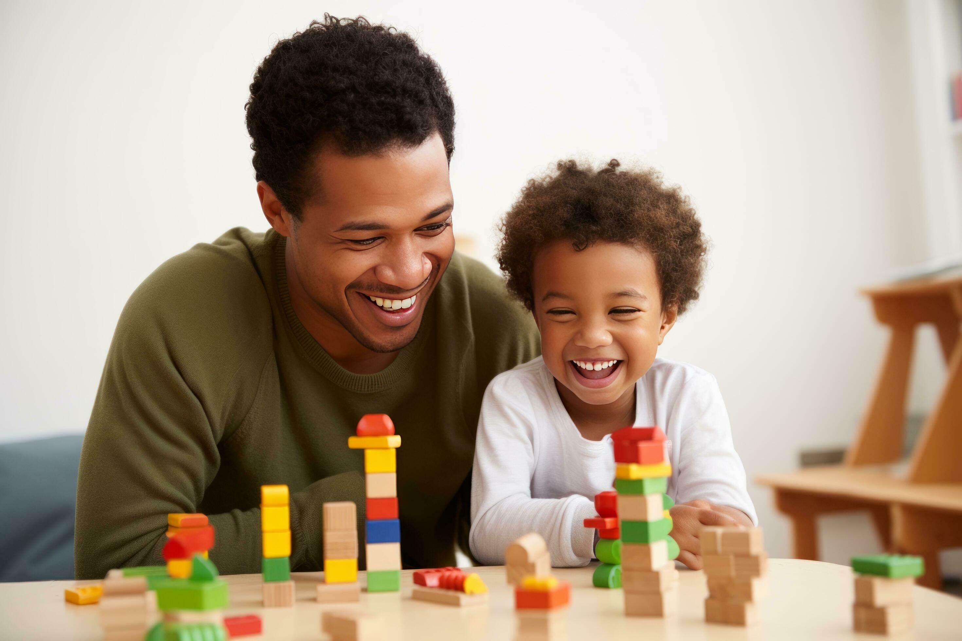
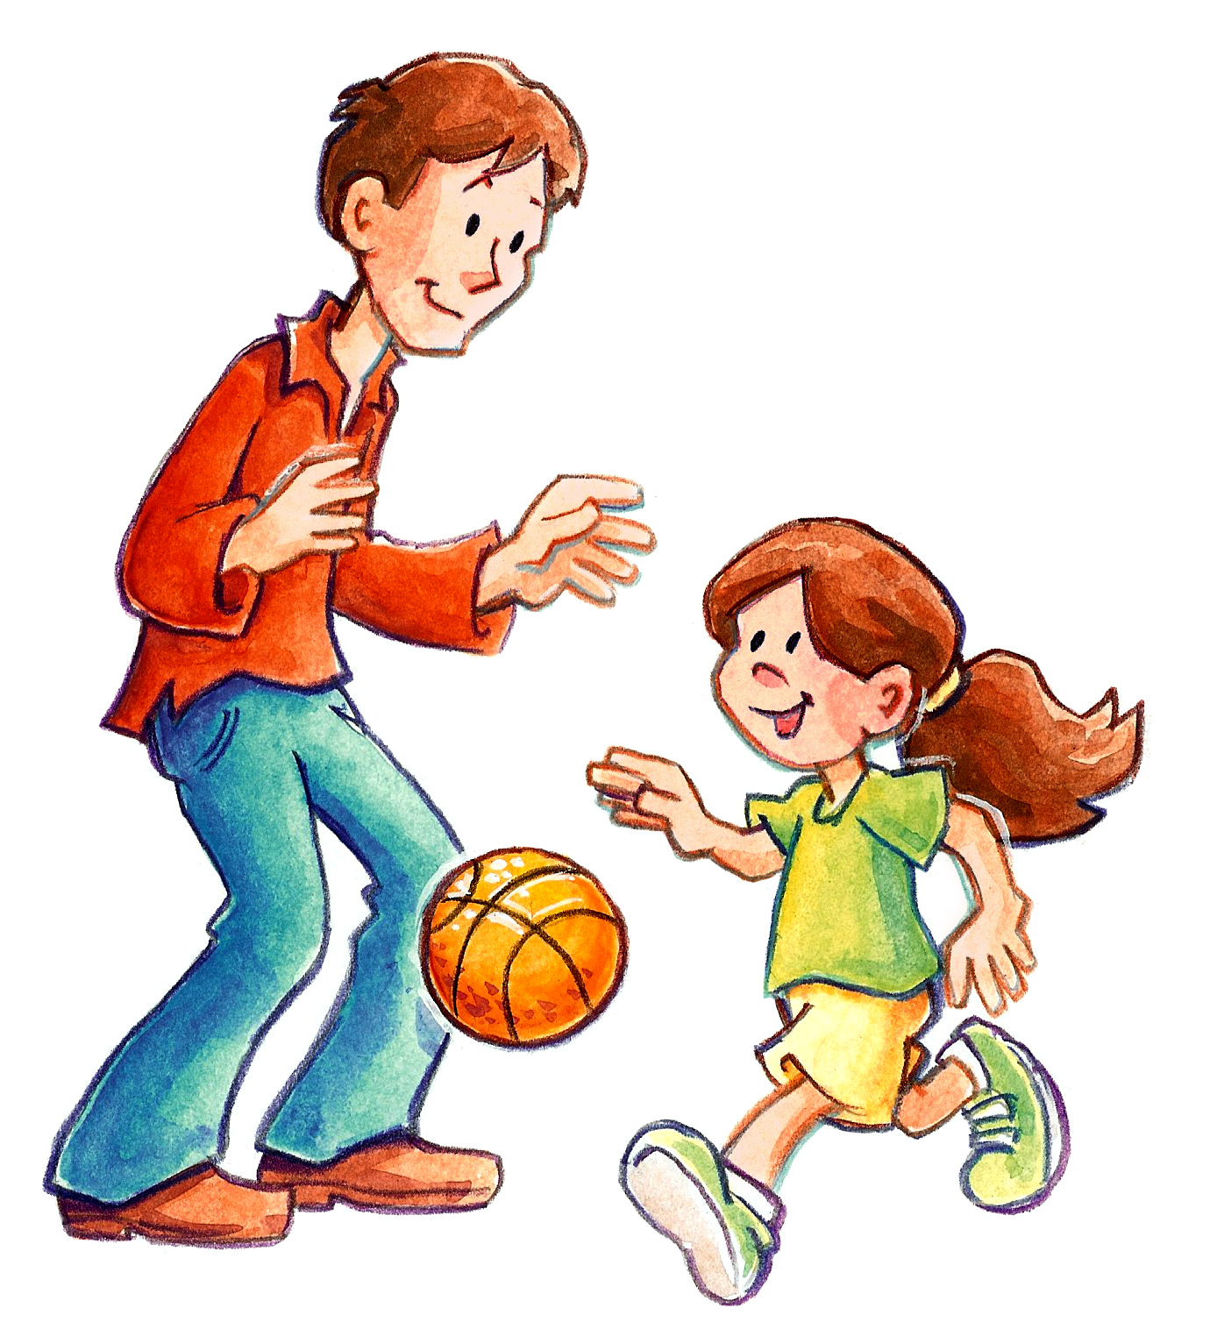
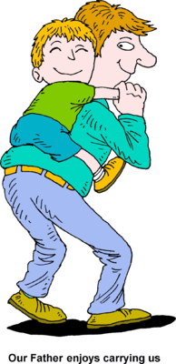
dad
What do you enjoy doing with your dad?
The gorilla reminds me of my dad when we were young. He liked to gently wrestle with us and let us climb on his back. He would give us piggy back rides.
Some dads are like that.

Slide 11
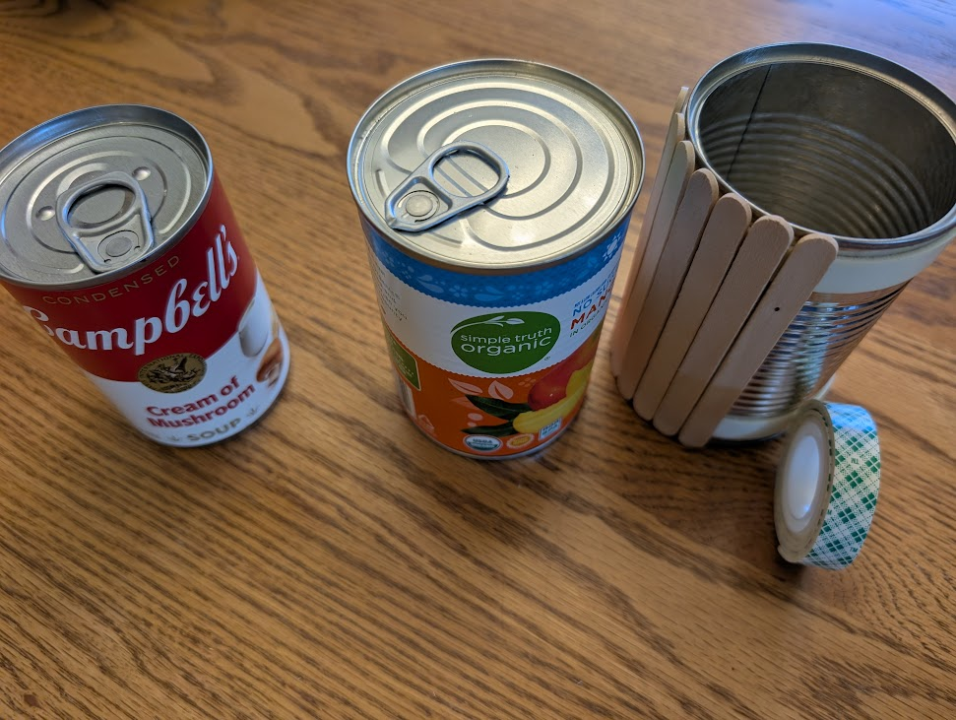
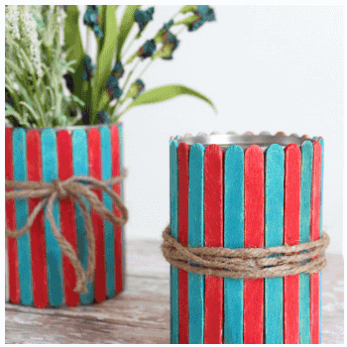
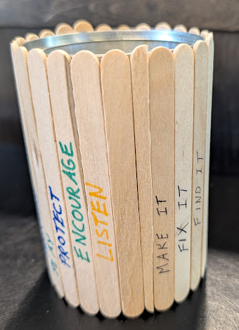
DAD CAN
Gift for Dad – DAD CAN
Clean an aluminum can that has a pull up lid. (This kind don’t have sharp edges from opening it.)
Measure around your can. If you measure in cm, a popsicle stick is 1 cm thick. Choose that many plain or colored popsicle sticks.
On a few write some things that you appreciate that your Dad does (see examples).
D
A
D
C
If you don’t get to see your dad, think about another man who is a special man in your life. You could give this gift (a MAN CAN) to him.
Or think of your Heavenly Father.
You can make it to remind yourself of Him.
PROVIDE
MAKE IT
FIX IT
ENCOURAGE
PROTECT
CARRY ME
HAVE FUN
TEACH ME
FORGIVE
https://athomewithzan.com/tin-can-pencil-holder/

Slide 12


Slide 13
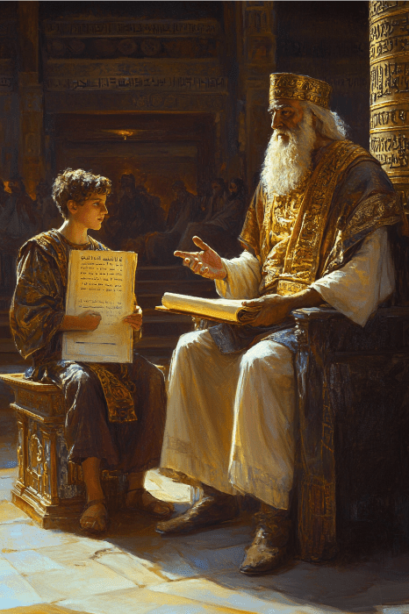
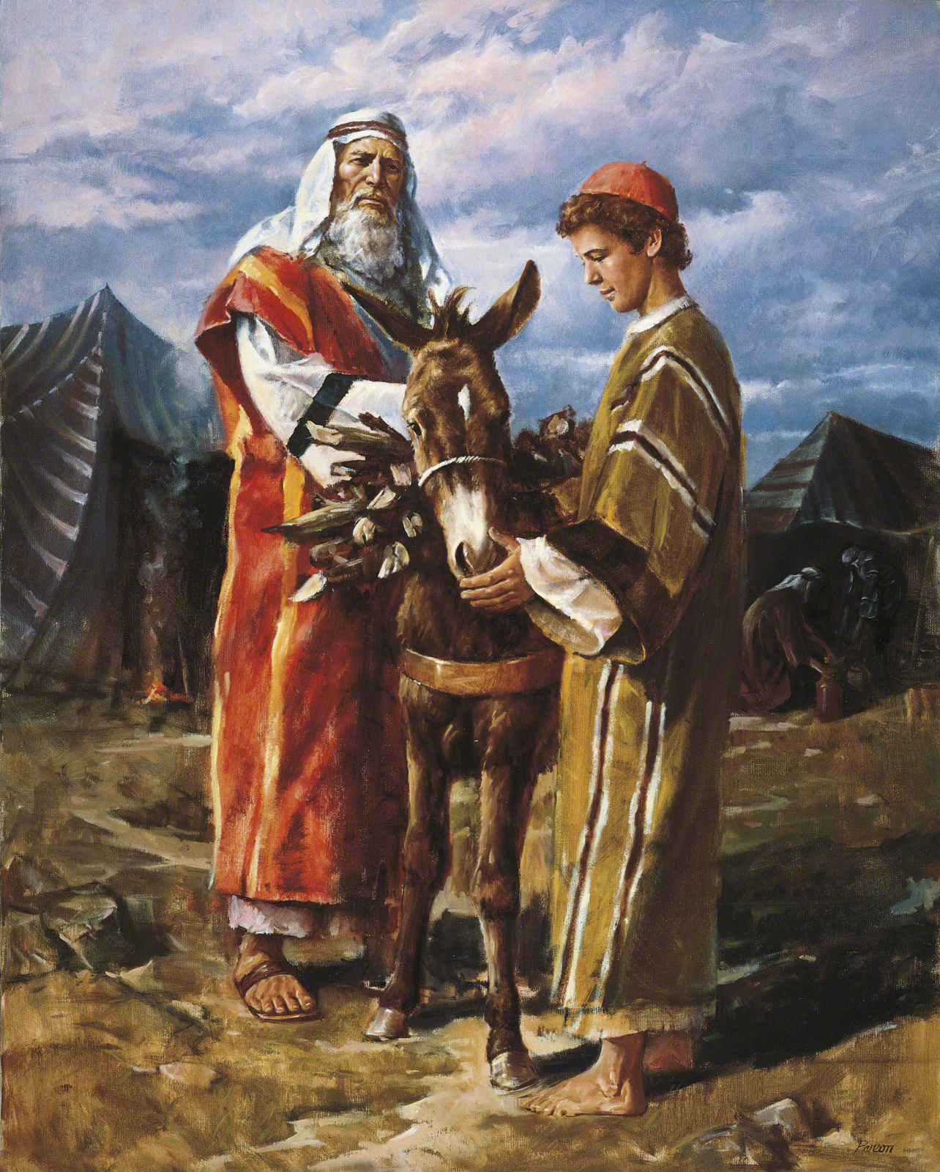
teacher
My child, listen to your father’s teaching.
And do not forget your mother’s advice.
⁹ Their teaching will beautify your life.
It will be like flowers in your hair or a chain around your neck.
Proverbs 1:8-9
King Solomon, the wisest man, taught his son and wrote it down, so we can learn it too. Read Proverbs 2:1-7 and Proverbs 3.
Abraham taught Isaac to know and respect God.
Our Heavenly Father promises to teach us too. We can learn from His Word - the Bible, His second book – nature, and His special gift – the Holy Spirit. All wisdom comes from God.
MAKE IT
FIX IT
ENCOURAGE
TEACH ME

Slide 14
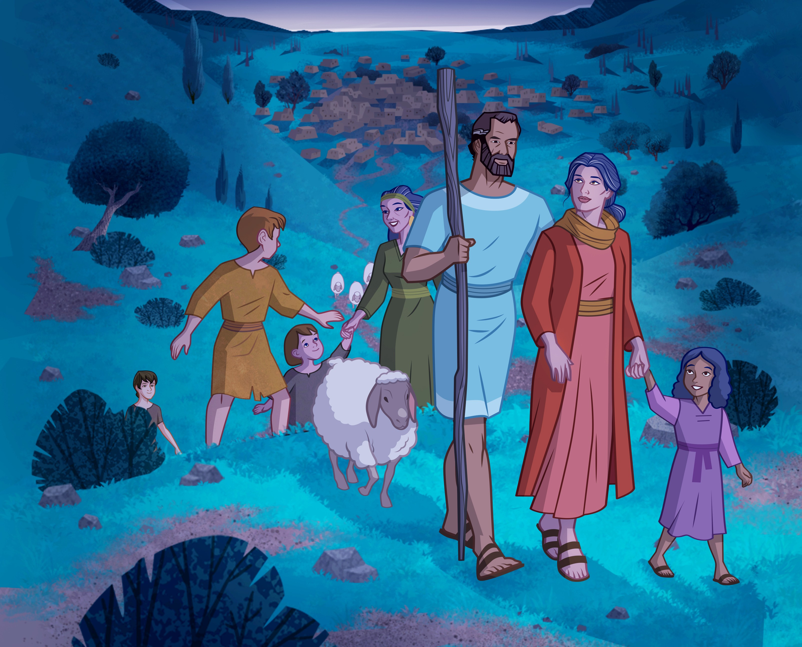
Protector
Jacob protected his family. When he was about ready to meet his brother, Esau, Jacob knew it could be a troubled meeting.
Jacob prayed, he sent gifts to Esau, and he told his family to camp in a couple safe places. Jacob was ready to wrestle and to whatever it took to keep his family safe.
Remember, our Heavenly Father protects us!
PROTECT
CARRY ME
HAVE FUN

Slide 15
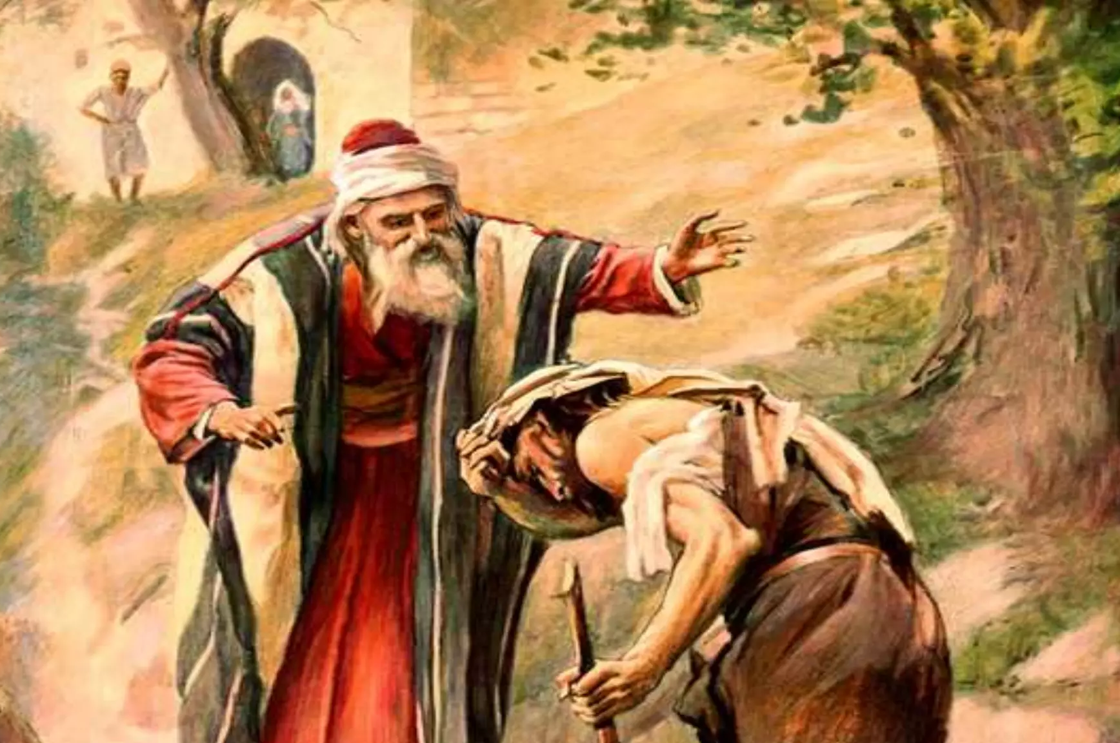
Forgiving, merciful
Jesus told a story of a father with two sons.
One son didn’t respect his father. He left home, made bad choices, and spent his father’s money foolishly.
When he did come home, his dad welcomed him with open arms, forgave him, and even had a party!
Our Heavenly Father truly loves us like that!
PROVIDE
FIX IT
FORGIVE
LOVE & CARE

Slide 16
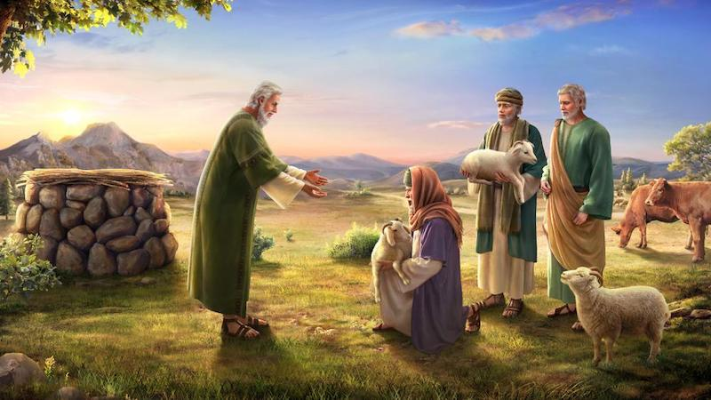
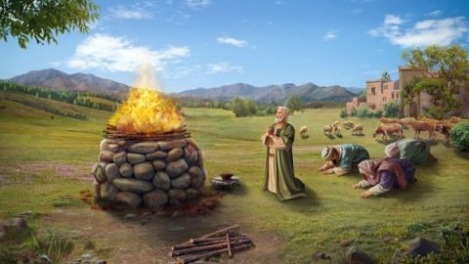
praying
Job prayed for his children.
Being ‘right’ with God was important to him. He regularly asked God to forgive his children.
ENCOURAGE
PRAY
FORGIVE

Slide 17

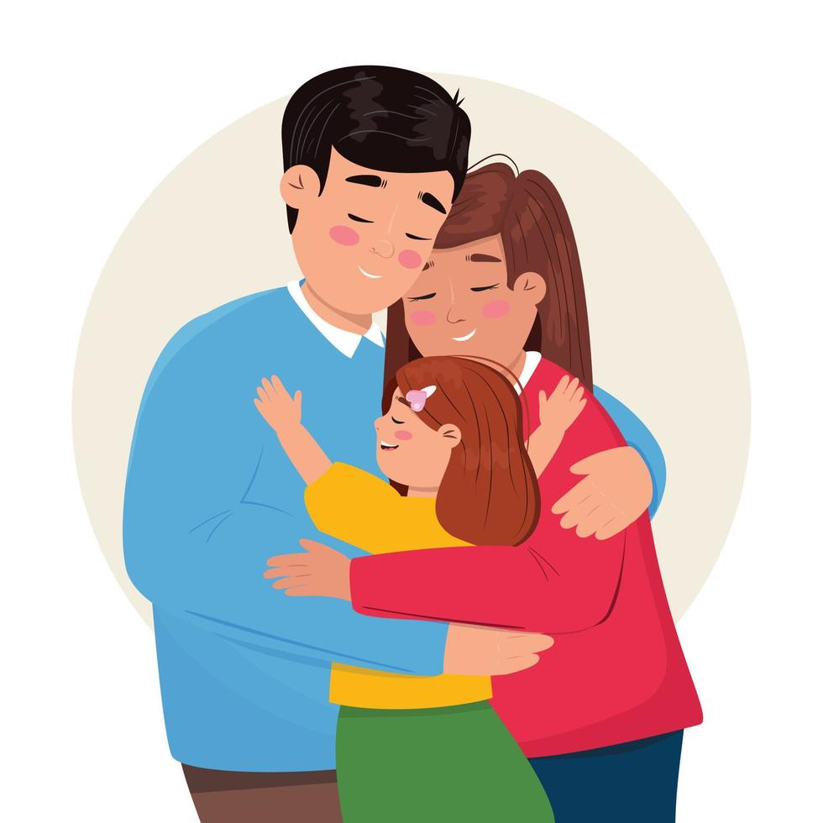

BOYS THINK ABOUT IT
When you are a dad, what kind of father do you want to be?
What do you want to do with your kids?
I challenge you to be a loving father that is there for your kids.
Because you love them:
Protect your family. Provide for them.
Play gently. Challenge and teach your kids.
Help them every way you can.

Slide 18
DAD CAN
Gift for Dad – DAD CAN
To attach popsicle sticks: Wrap double stick foam* tape around the top and bottom of the can then take off the paper covering to expose the other sticky side. (For a Campbell soup can you need 21cm [8.5 inches] x2 of the double stick foam)
Add the letters: DAD CAN and other décor as desired such as cord, foam stickers, wood shapes, etc.
* instead of double stick foam you could use a ‘hot’ glue gun
D
A
D
C
PROVIDE
MAKE IT
FIX IT
ENCOURAGE
PROTECT
HAVE FUN
https://athomewithzan.com/tin-can-pencil-holder/

Slide 19


Slide 20
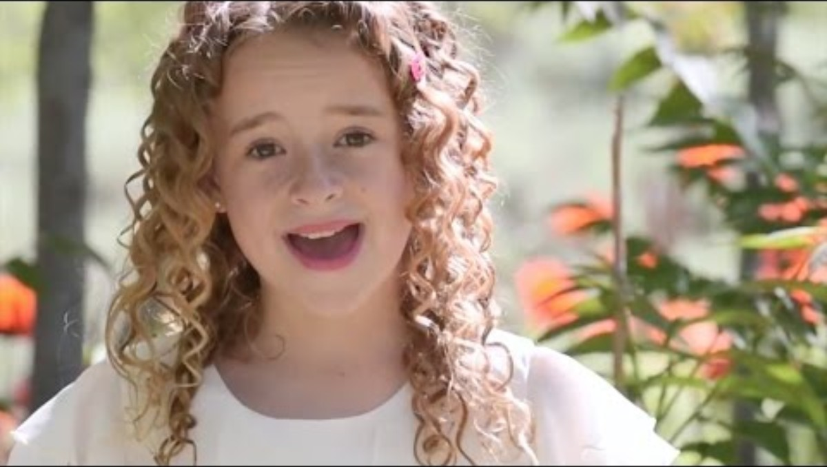

Slide 21


Slide 22
EXTRA EXTRA
OPTIONAL ADDITIONAL SLIDES

Slide 23
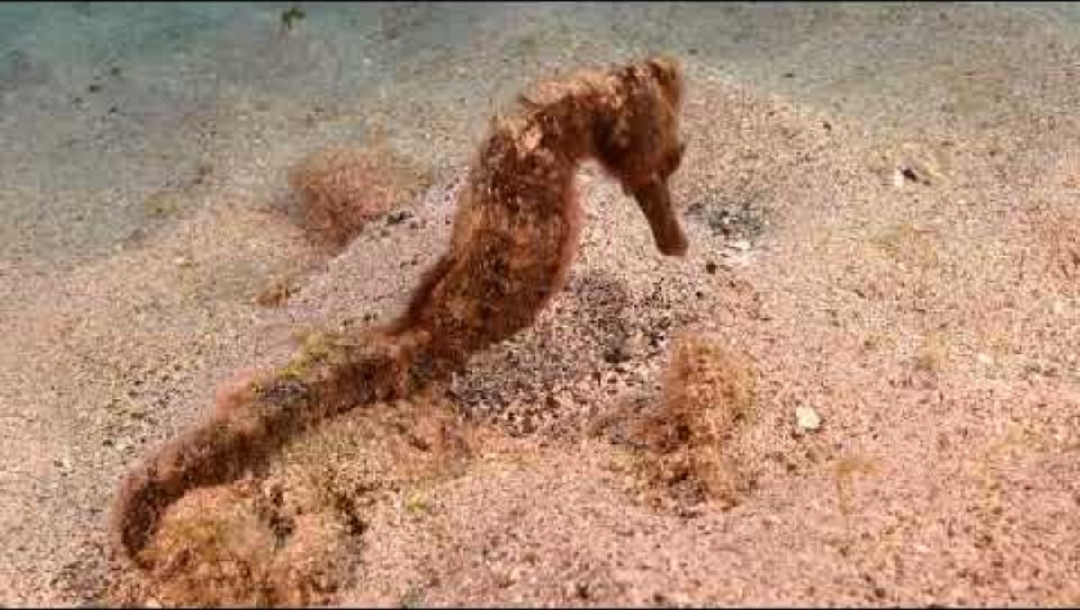

Slide 24
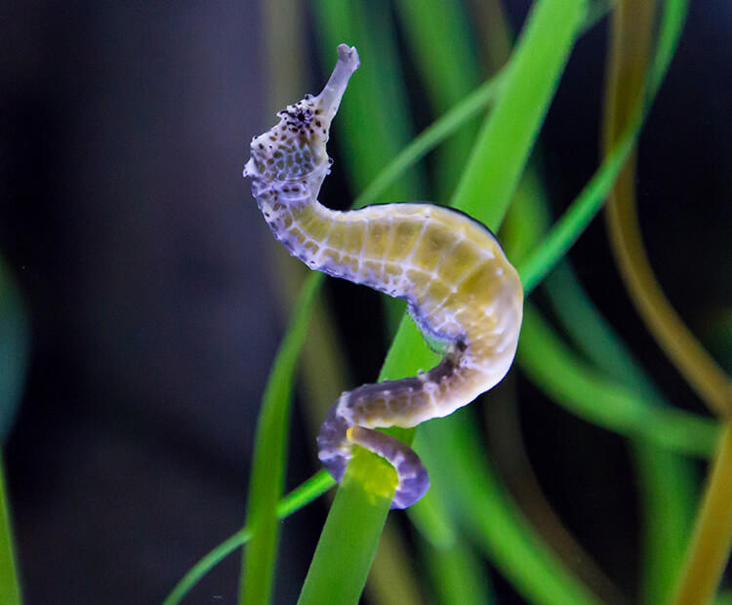
God’s amazing creation, the Seahorse,
Teaches us:
Job had a lot of terrible things happen to him all of a sudden. Some times life get’s really crazy. That’s kind of like a fast current.
What does the seahorse do?
It grabs ahold of a plant. It anchors itself. We, too, can stay calm and faithful by holding onto our faith in God.

Slide 25
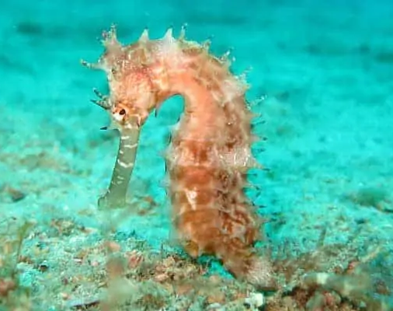
Daddy Seahorse
Male Seahorses take fatherhood to the next level. While nearly all female animals are responsible for giving birth, it is actually the male Seahorses that carry and then birth their babies. Following mating, females will transfer eggs to the male where he will fertilize them and carry them until they are developed enough to be born.
https://wildlifeinformer.com/best-animal-dads/

Slide 26
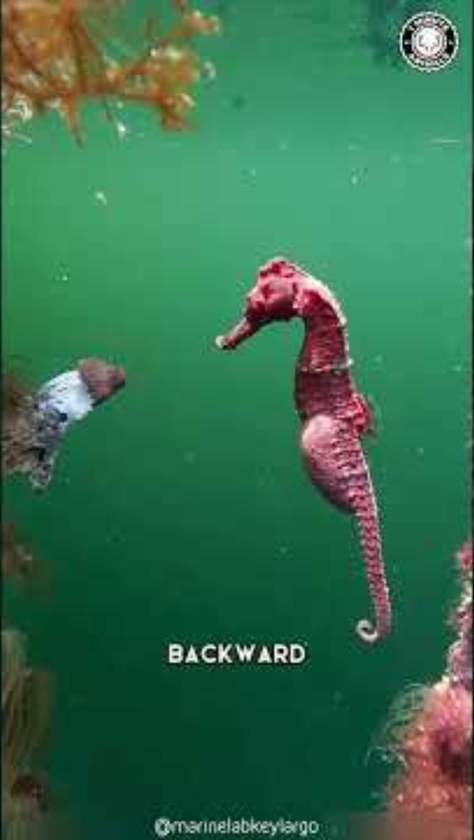
God’s amazing Creation: the Seahorse
It is called a fish, but it doesn’t look like one nor swim like one. God loves making unique animals unlike any in their category.
See that little fin on the back. That is it primary way to move. It moves very slow!
See its tail. It can hang onto things so it can stay near it’s home and be steady even during a swift current or storm.
God thinks of everything!
Praise Him

Slide 27
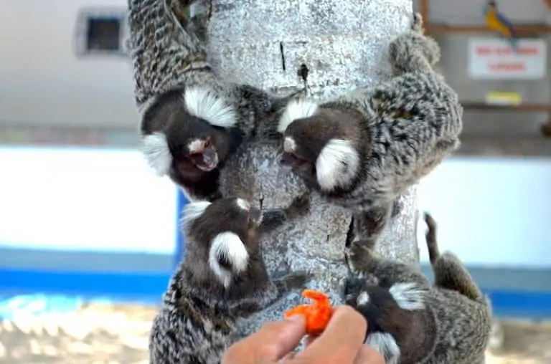
The Common marmoset is a small primate native to East-Central Brazil. These monkeys form small, but tight knit family groups. Interestingly enough, Common marmoset fathers almost act as a midwife during the birth of their offspring and help to clean up the afterbirth. Following the birth, the fathers will help to feed and carry their young and help raise them up.
https://wildlifeinformer.com/best-animal-dads/

Slide 28
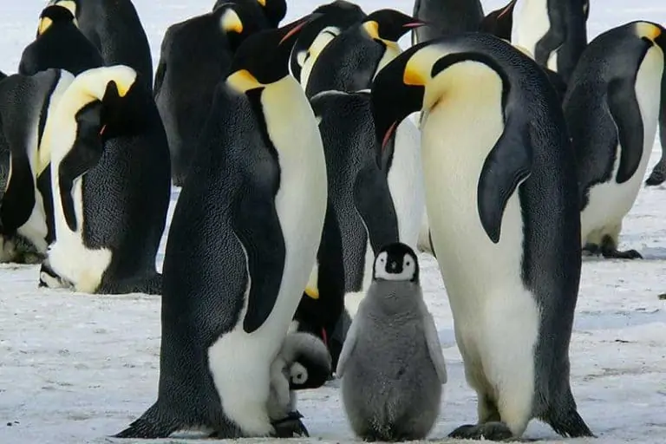
Emperor penguins, the largest species of penguin make incredible fathers! The female only lays a single egg in a breeding season, making it extra important that the egg is well taken care of. The male will incubate the egg for the entire duration, about two months while the mother heads to the ocean to forage for food. Following hatching, the parents split their parenting duties.
https://wildlifeinformer.com/best-animal-dads/

Slide 29
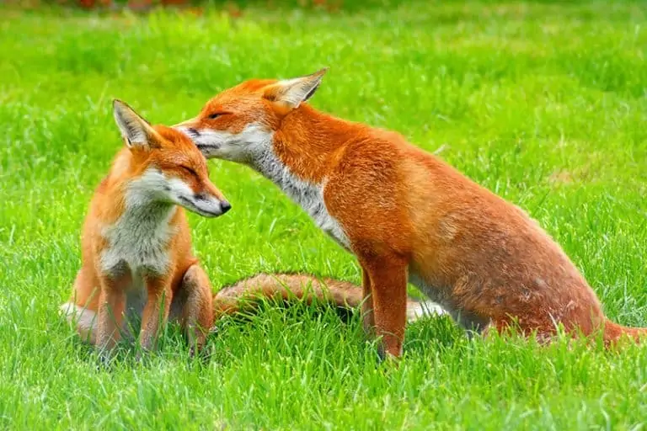
Red fox fathers are both loving and strict. They will bring food to the den after the mother gives birth so that the mother can stay in the den with their kits. Once the kits get to be a bit older, the father will play and run with them. He will also stop bringing food to the den and will instead hide it nearby to teach his young how to find their own food!
https://wildlifeinformer.com/best-animal-dads/

Slide 30
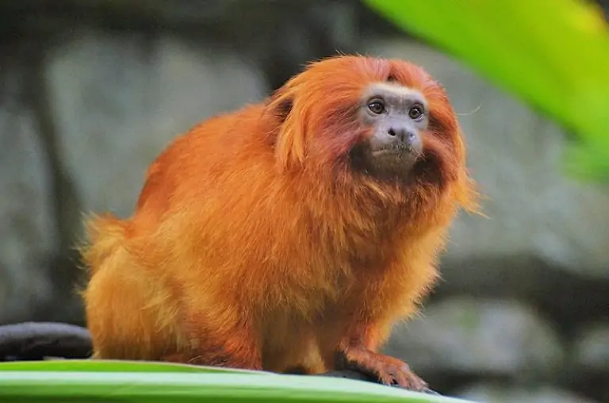
The bond between a baby Golden lion tamarin and father is a tight one! After just a couple of weeks, the babies will be clung to their father’s backs nearly 24/7, only being passed back to their mother every few hours to nurse. Once they are weaned, the father helps to find food for their babies and will even hand-feed them.
https://wildlifeinformer.com/best-animal-dads/

Slide 31
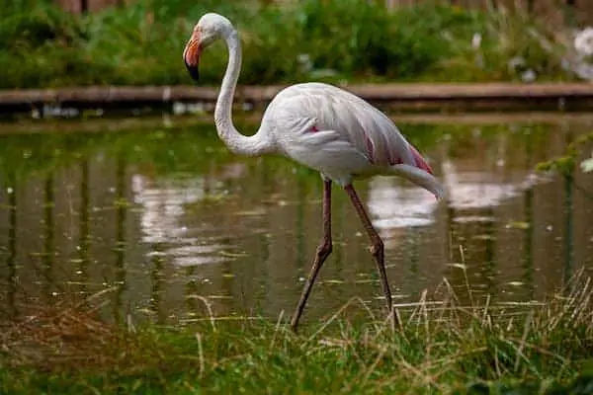
Greater flamingos have co-parenting down to a science. Both parents are involved in building the nest by pushing up mounds in the mud. The female lays a single egg and then they both take turns incubating the egg. The father also helps to feed it’s chick with it’s crop milk, which is a nutrient-rich fluid excreted from the esophagus.
https://wildlifeinformer.com/best-animal-dads/

Slide 32
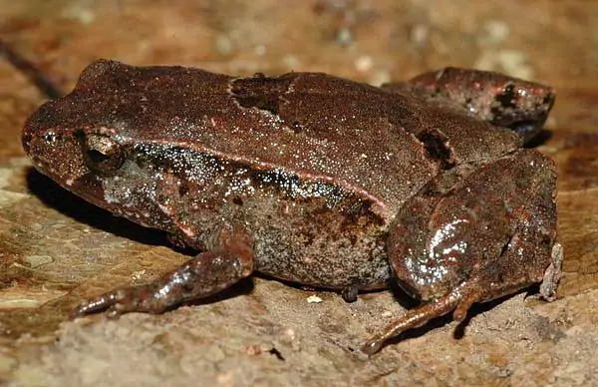
While amphibians don’t get much recognition for being good fathers, the pouched frog is the exception! These frogs, like many other animals found in Australia have a pouch that they use to carry their young in. The mother lays her eggs, and both parents will guard the eggs. Once the eggs hatch and morph into tadpoles, the father will carry them in his pouch while they continue to develop.
https://wildlifeinformer.com/best-animal-dads/

Slide 33
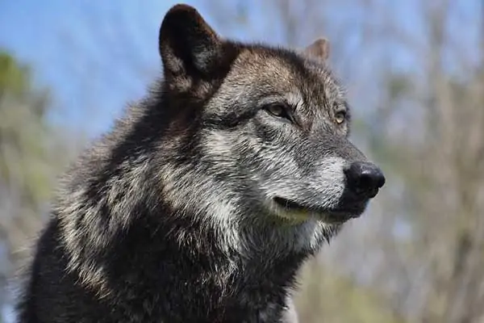
Wolves are apex predators that form packs that are headed by one male that pairs up with one of the females in the pack. This male will watch over his mate and pups by standing guard outside of their den. Gray wolf fathers will also bring back food to their young and even regurgitate it for the young pups. Alpha males are very territorial and will protect their territory to ward off any other unwelcome males or potential threats.
https://wildlifeinformer.com/best-animal-dads/

Slide 34


Slide 35
https://wildlifeinformer.com/best-animal-dads/

