Slide 1


STARS
Pathfinder Honor
Level 1

Slide 2

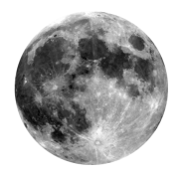
Q: What is the earth’s nearest celestial neighbor?
A: The moon
Q: What is it’s distance from the earth?
A: about 240,000 miles
Click for Q & A

Slide 3
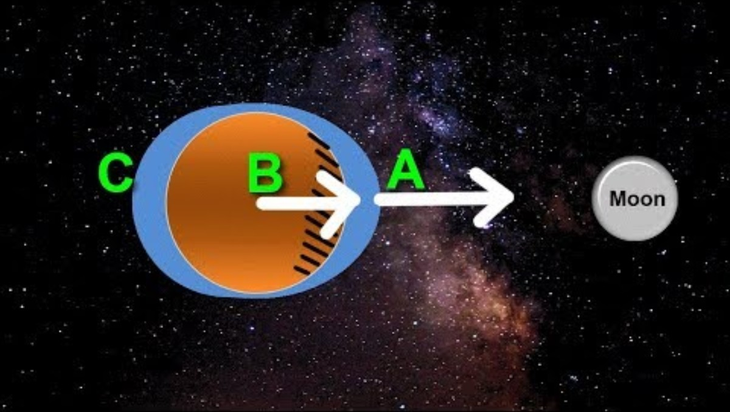
Q: What (object) governs the tide?
A: The moon
Click for Q & A

Slide 4

Q: What causes an eclipse?
A: A shadow of one celestial object falls on another
Click for Q & A

Slide 5
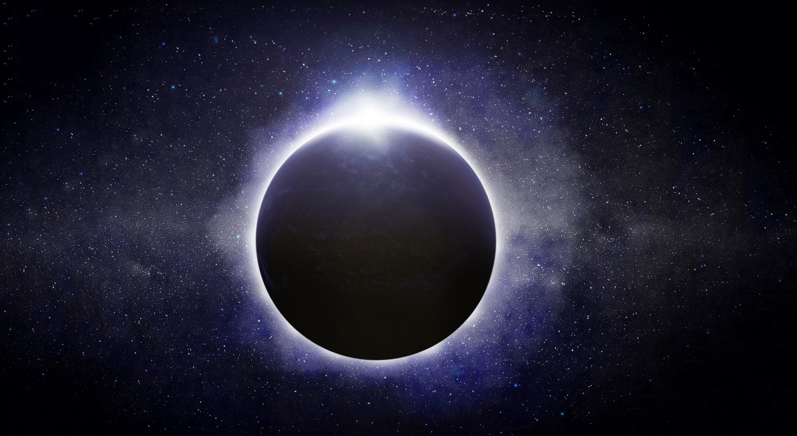
Do it: Showing the relative positions and movements of the earth, sun and moon.
Show how an eclipse happens
Use a light (sun)
small sphere (earth)
tiny sphere (moon)
Move the ‘earth’ around the ‘sun’ and the ‘moon’ around the ‘earth’.
Watch where the light shines on the ‘earth’ and ‘moon’. Explain what you see.

Slide 6

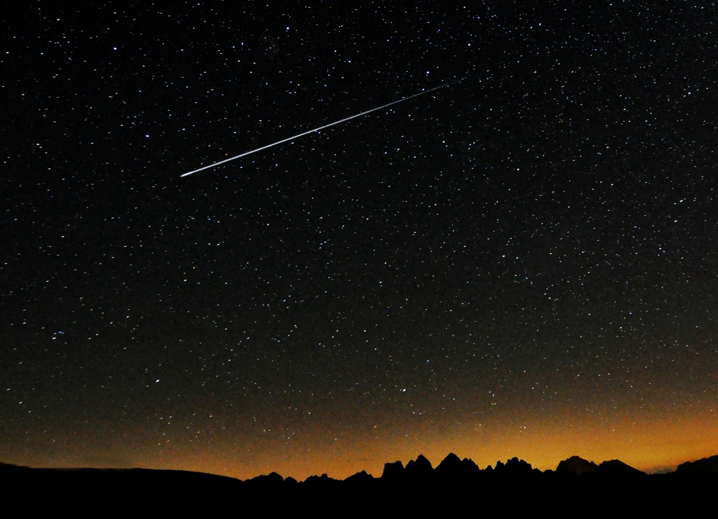
Q: What is a shooting star?
A: Actually it’s not a star. It is a meteor that falls to the earth. When they burn up in the atmosphere they leave a bright, short-lived streak in the sky.
Click for Q & A

Slide 7
Q: How fast does light travel?
Clue: 90x2+6 x1000
A: 186,000 miles per second
Q: How far does light travel in a year?
A: 5.88 trillion miles (Which is a light year)
Click for Q & A

Slide 8
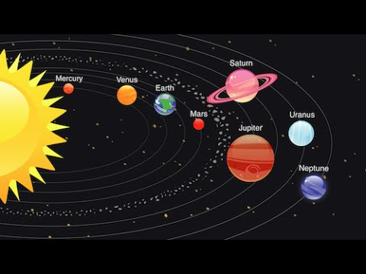
Q: What are the planets? Make a diagram.

Slide 9
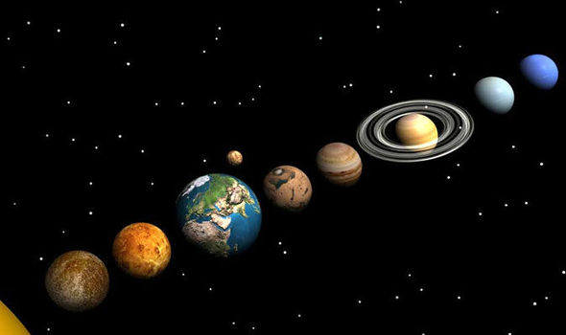
Q: What is the difference between planets and fixed stars?
A: Planet (means wanderer) each have their own orbit around the sun. Stars don’t
Click for Q & A

Slide 10
Constellations
Can you find pictures in the sky?

Slide 11
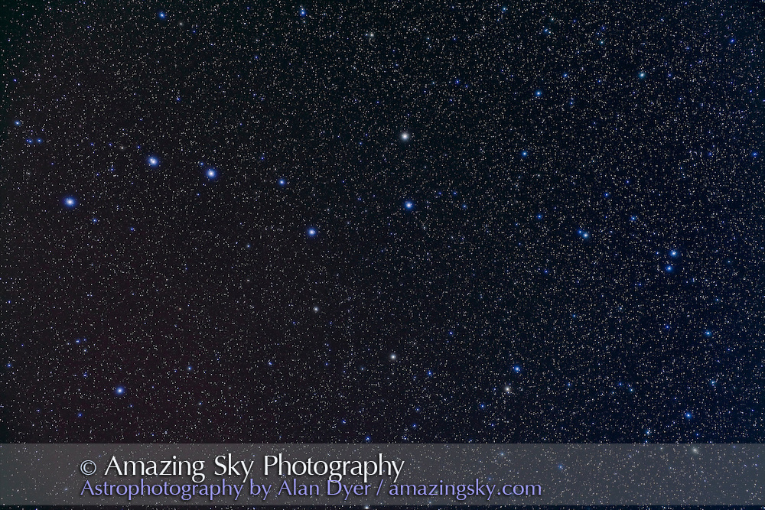
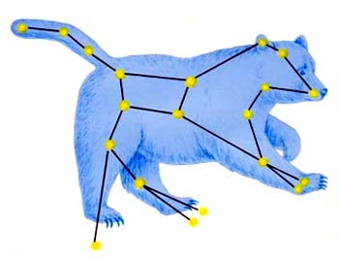
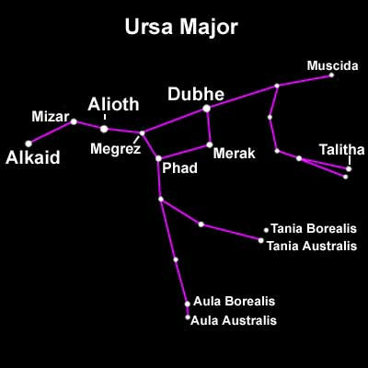
Can you find it?
Big Dipper
Ursa Major
Click for Answer

Slide 12
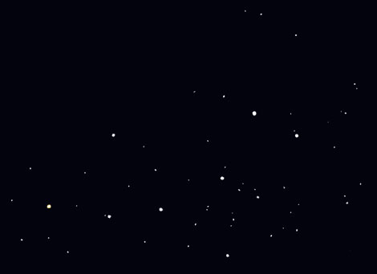
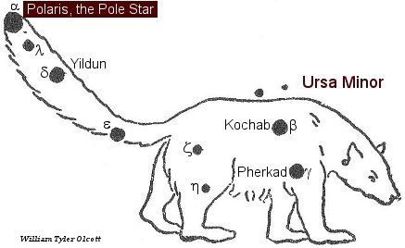
Can you find it?
Little Dipper
Polaris – North Star
Click for Answer
Ursa Minor

Slide 13
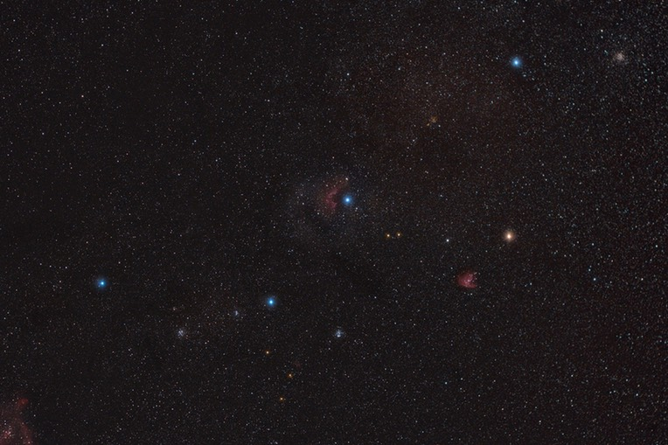
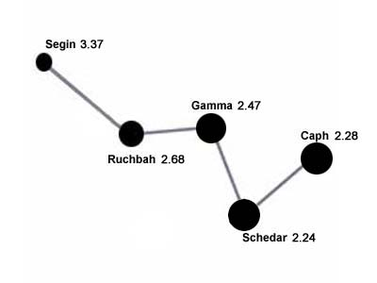
Can you find it?
Gamma
Cassiopeia
Click for Answer

Slide 14
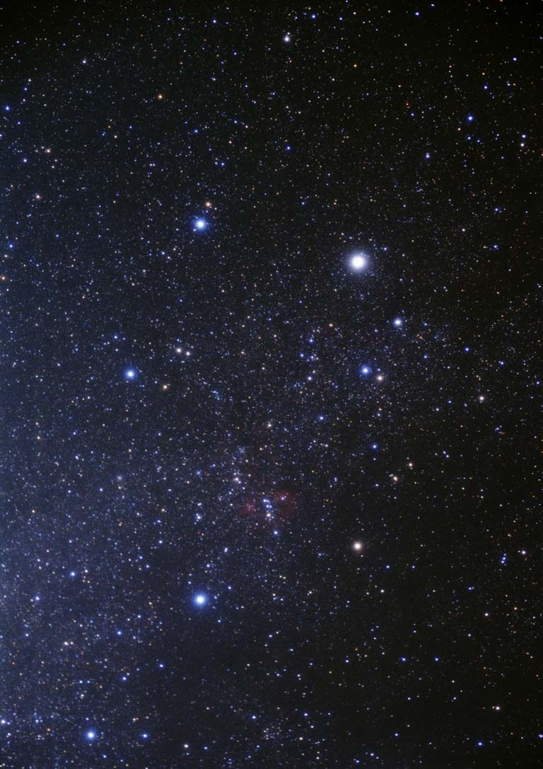
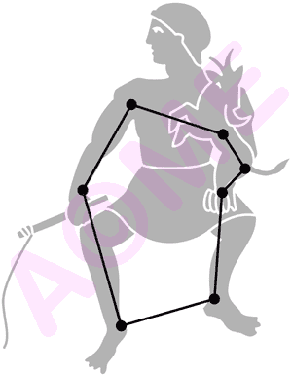
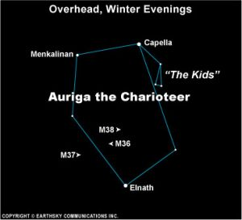
Can you find it?
Auriga
Capella
Click for Answer

Slide 15
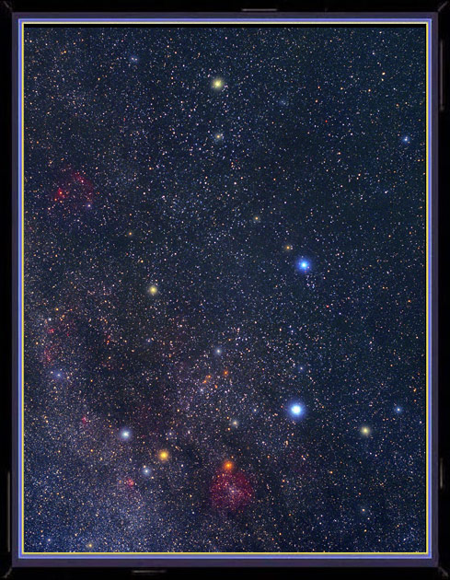
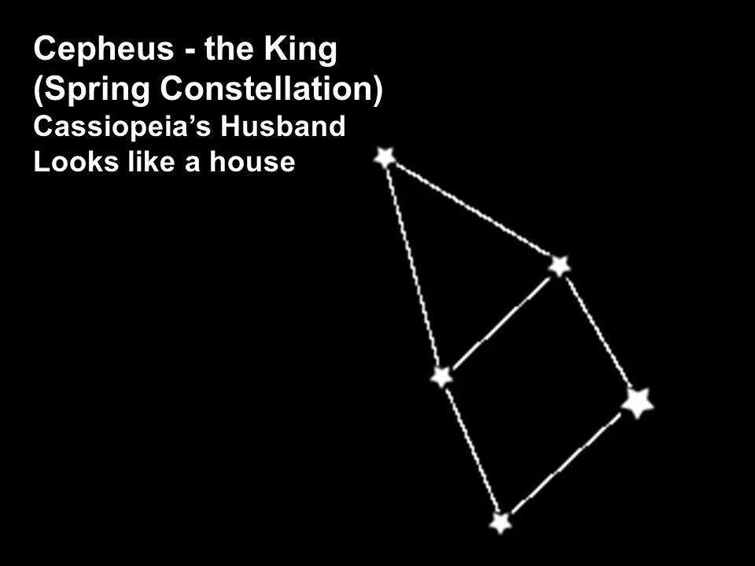
Errai
Can you find it?
Cepheus
Click for Answer

Slide 16
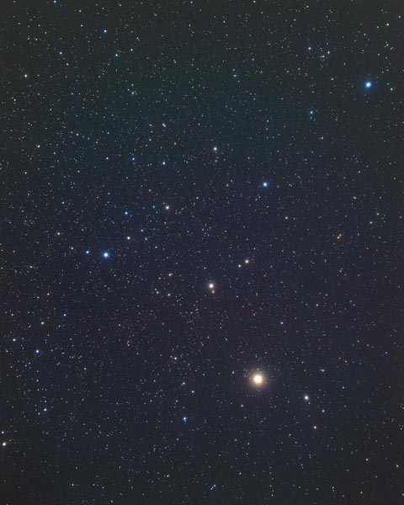
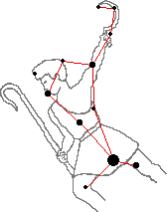
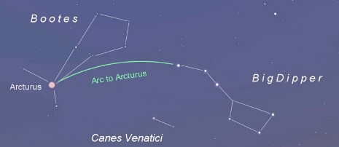
What does the Bible say about Jesus as our Shepherd? Check it out in John 10, Psalms 23, and Isaiah 40
Can you find it?
Bootes
Arcturus
Click for Answer

Slide 17
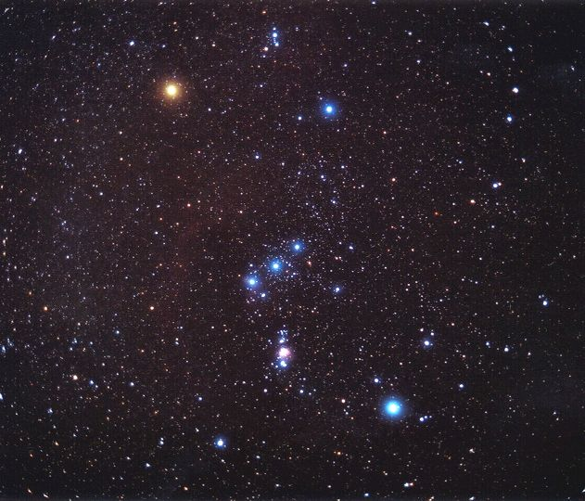
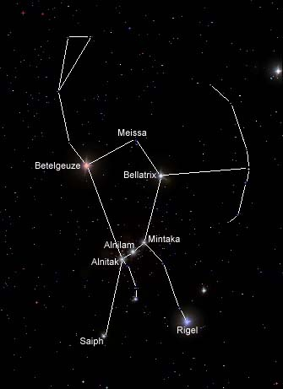
This constellation reminds me of the Armor of God in Ephesians 6:10-18. Jesus is fighting for us. The Battle is the Lord’s. 2 Chronicles 20, Revelation 19:11-16
Betelgeuse
Bellatrix
Can you find it?
Orion
Rigel
Click for Answer

Slide 18
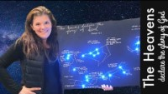
The stars tell the story of Jesus
See more of the Story in the Stars
View last 10 min. (34-43 min.)
Or Story in the Stars (40 min.)

Slide 19
From Ellen White Early Writings p. 41
“The atmosphere parted and rolled back; then we could look up through the open space in Orion, whence came the voice of God. The Holy City will come down through that open space.”

Slide 20
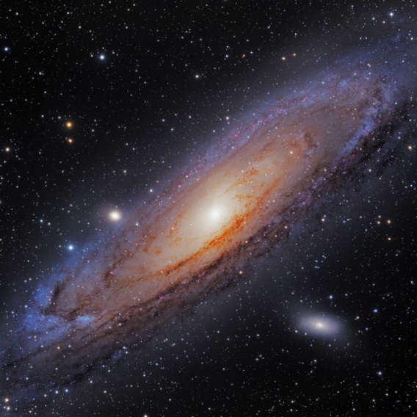
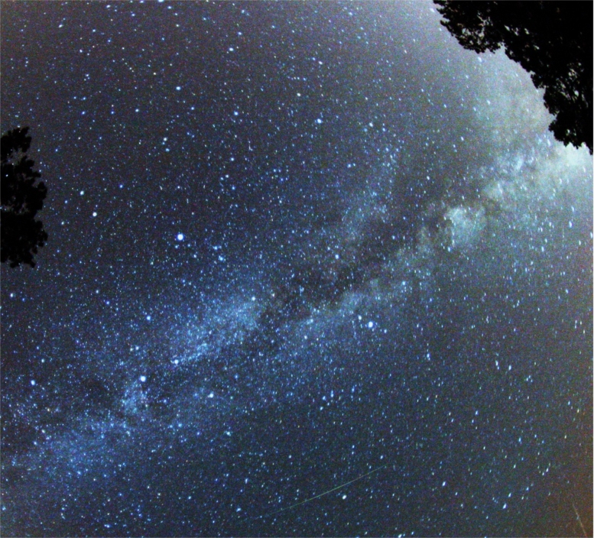


Can you find it?
The Milky Way
Click for Answer

Slide 21
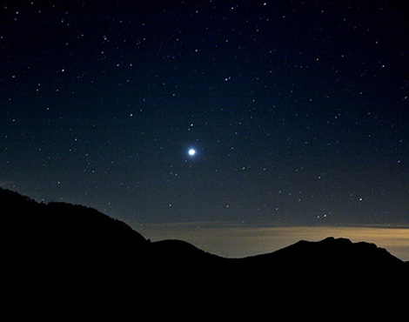
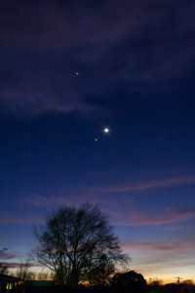
The Morning Star
The Evening Star
Can you find it?
It is actually Venus. It never appears on the opposite horizon from the sun due to its relative location to the sun.
Click for Answer

Slide 22
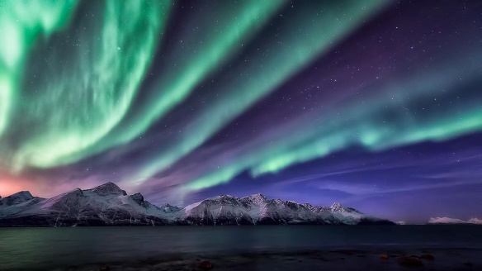
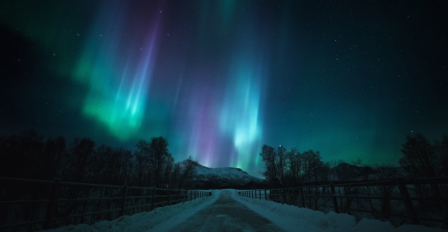
Q: What is the aurora borealis?
Q: What causes it?
The Aurora Borealis (Northern Lights) and Aurora Australis (Southern Lights) are the result of electrons colliding with the upper reaches of Earth's atmosphere. (Protons cause faint and diffuse aurora, usually not easily visible to the human eye.)

Slide 23
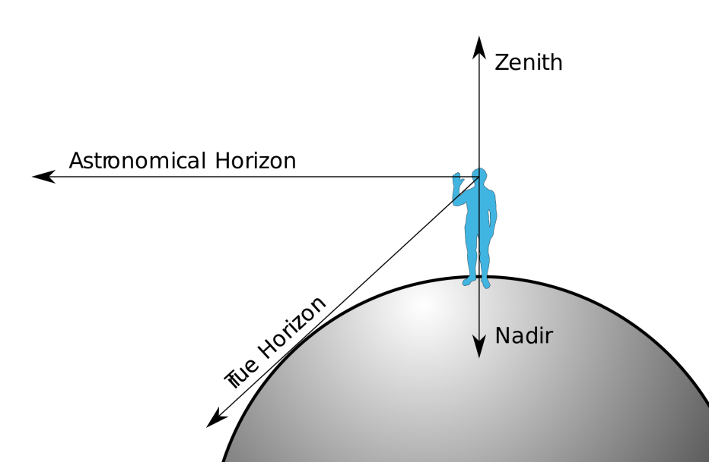
Q: Explain zenith and nadir

Slide 24




Congratulations!
You earned the STAR HONOR

Slide 25
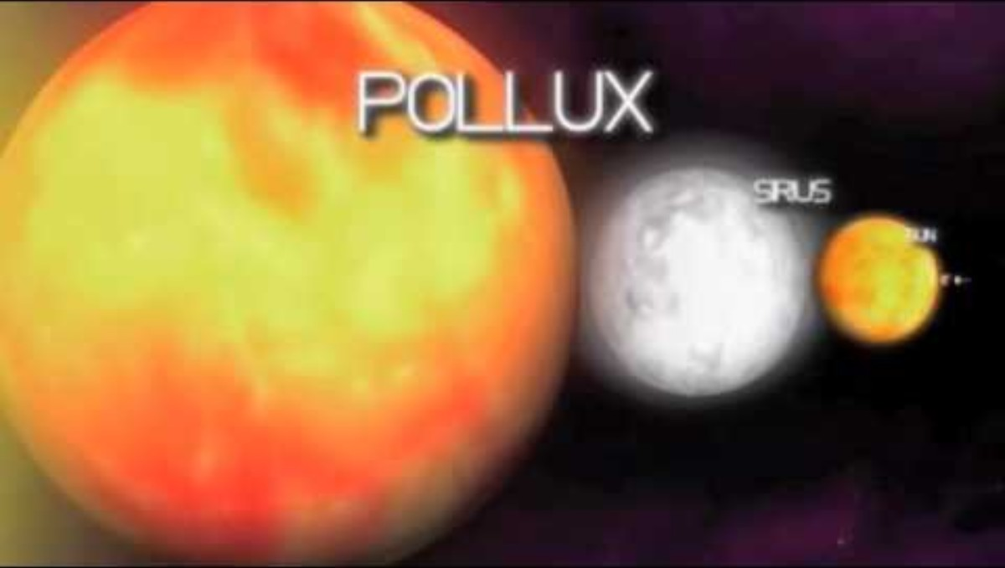
Our Great Creator loves YOU

Slide 26

https://activity-array.com

