Slide 1
Go Philip
Philip Tells the Good New to an Ethiopian
Acts

Slide 2

How, then, can they call on the one they have not believed in? And how can they believe in the one of whom they have not heard? And how can they hear without someone preaching to them? And how can anyone preach unless they are sent? As it is written: “How beautiful are the feet of those who bring good news!” Romans 10:14-15
Matthew
28:19-20
Jesus said: “Therefore, go and make disciples of all nations,
baptizing them in the name of the Father and of the Son
and of the Holy Spirit,
and teaching them to obey everything I have commanded you.
And surely, I am with you always, to the very end of the age.”
Matthew 28:19-20

Slide 3
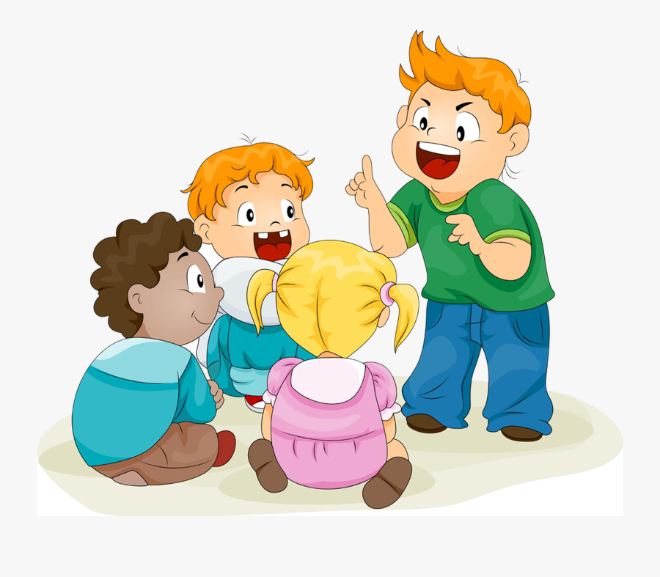
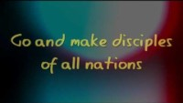
Sing it out GO

Slide 4
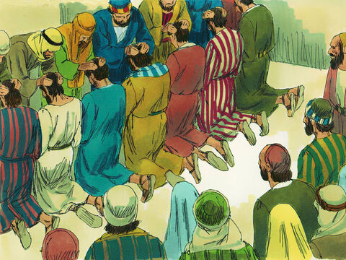
We dedicate you to be deacons and to serve God by continuing to care for the widows and others.
They chose Stephen. He was full of faith and of the Holy Spirit. Philip, Procorus, Nicanor, Timon and Parmenas were chosen too. The group also chose Nicolas from Antioch. He had accepted the Jewish faith. ⁶ The group brought them to the apostles. Then the apostles prayed and placed their hands on them.
⁷ So God’s word spread. The number of believers in Jerusalem grew quickly. Also, a large number of priests began to obey Jesus’ teachings.

Slide 5
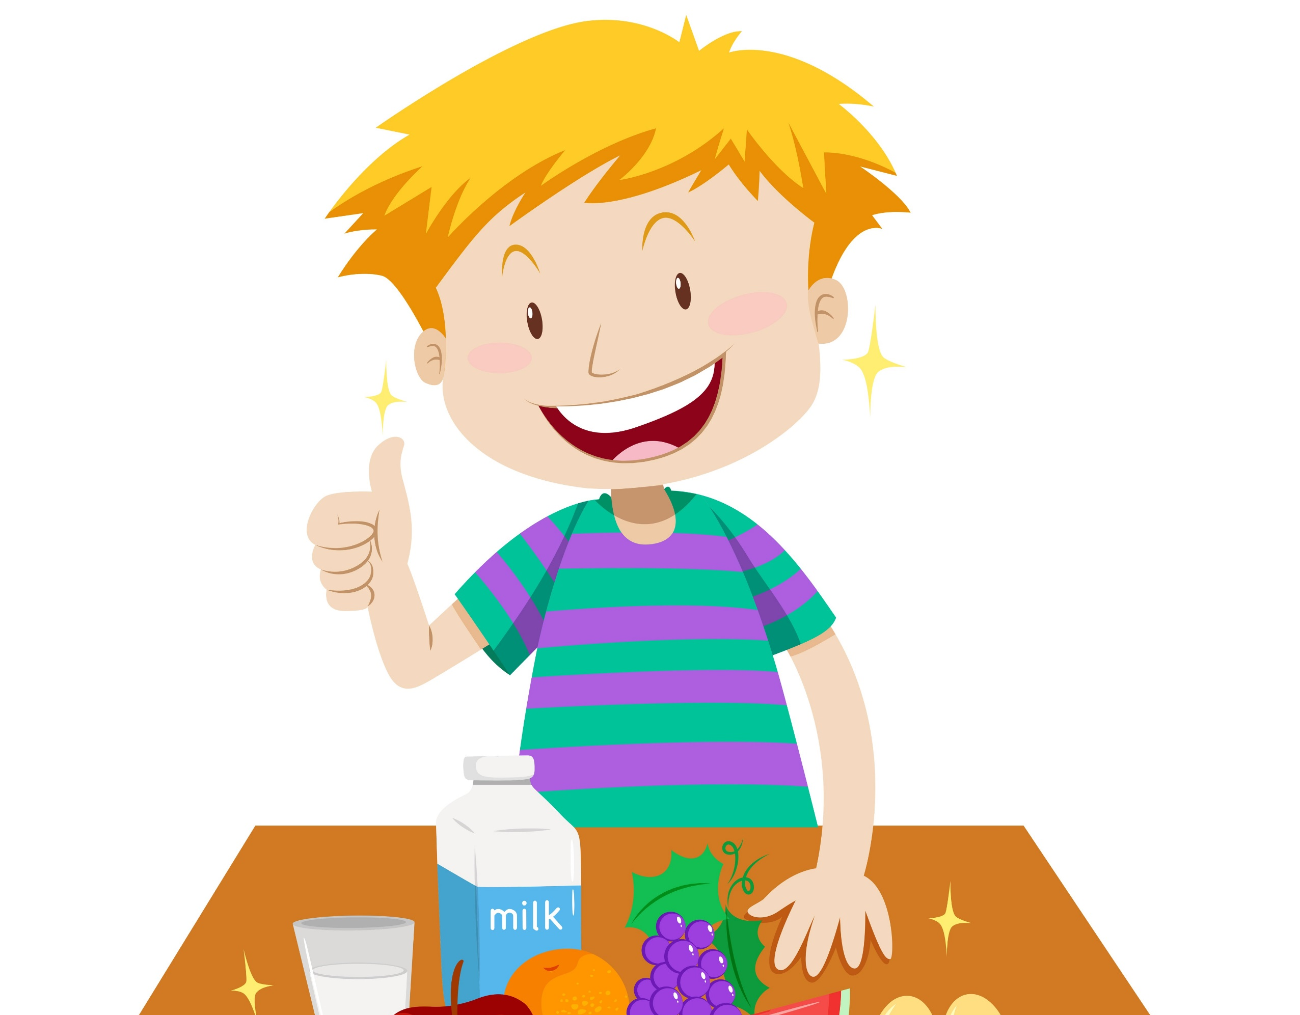
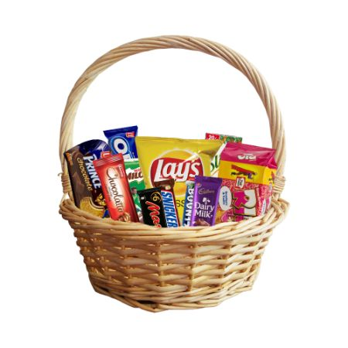
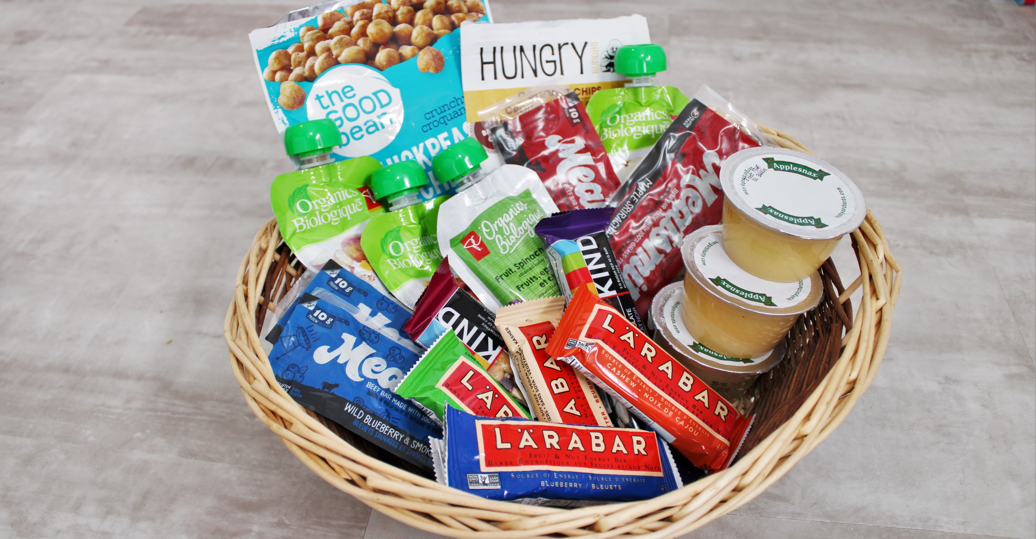
SNACK TIME
You can help others get food, just like the deacons did.
I’m going to chose someone to make sure everyone gets a snack.
You can either call their names so that they can go to the snack basket and get a snack
or you can hold the snack basket out so that they can choose something.
Raise your hand if you want to be chosen.
I choose _____________

Slide 6
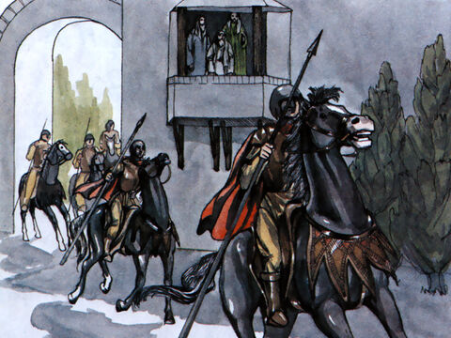
But not everyone liked what the disciples were doing. Not everyone chose to believe in Jesus. Not everyone chose to be loving. These people tried to stop the disciples. They put them in jail. They killed some of them. You can read more about it in Acts 3 and 7

Slide 7
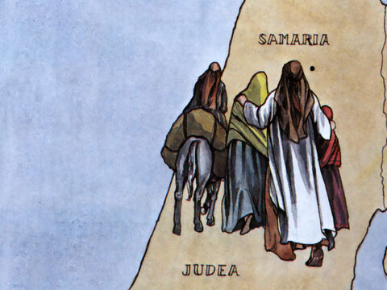
One of the deacons, Stephen, was stoned to death. Yet God was with him and gave him courage.
You can read about it in Acts 7.
On that day a great persecution broke out against the church in Jerusalem, and all except the apostles were scattered throughout Judea and Samaria.
² Godly men buried Stephen and mourned deeply for him.
³ But Saul began to destroy the church. Going from house to house, he dragged off both men and women and put them in prison.
⁴ Those who had been scattered preached the word wherever they went.
No matter where we are, we must tell others the Good News about Jesus!
I am so happy to be saved from sin and have eternal life!
Yes, there’s many who haven’t heard the Good News!
We will tell them!

Slide 8
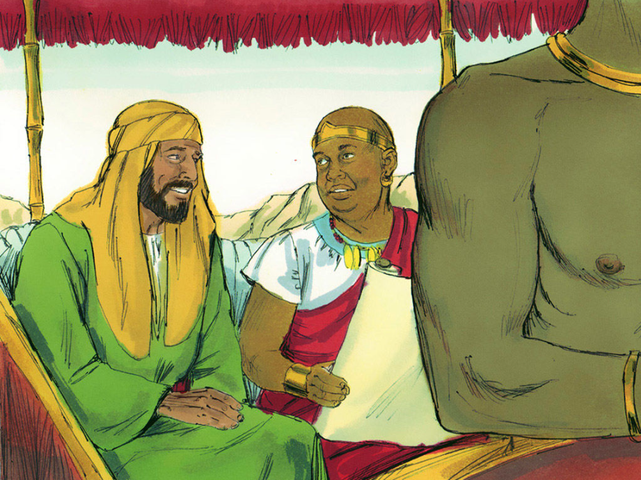
Our story for today: Philip A deacon and a missionary
Philip went where God wanted him to go.
He did what God wanted him to do.
He told people about Jesus and how to be saved from their sin.
He showed God’s love others.

Slide 9
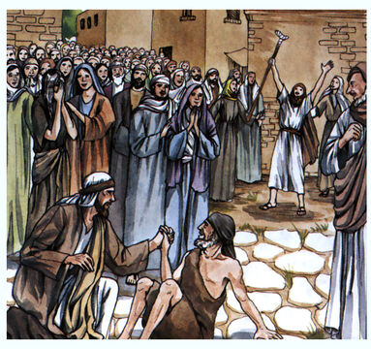
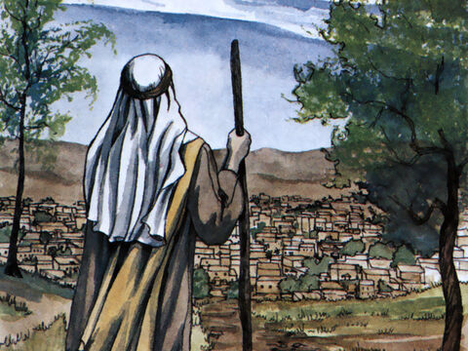
Acts 8
⁵ Philip went down to a city in Samaria and proclaimed the Messiah there. ⁶ When the crowds heard Philip and saw the signs he performed, they all paid close attention to what he said.
⁷ For with shrieks, impure spirits came out of many, and many who were paralyzed or lame were healed. ⁸ So there was great joy in that city.
Praise God!
Praise God!
I’m so happy!
In the name of Jesus Christ, who heals you,
rise up and walk!
Pretend you are sick and are made well.

Slide 10
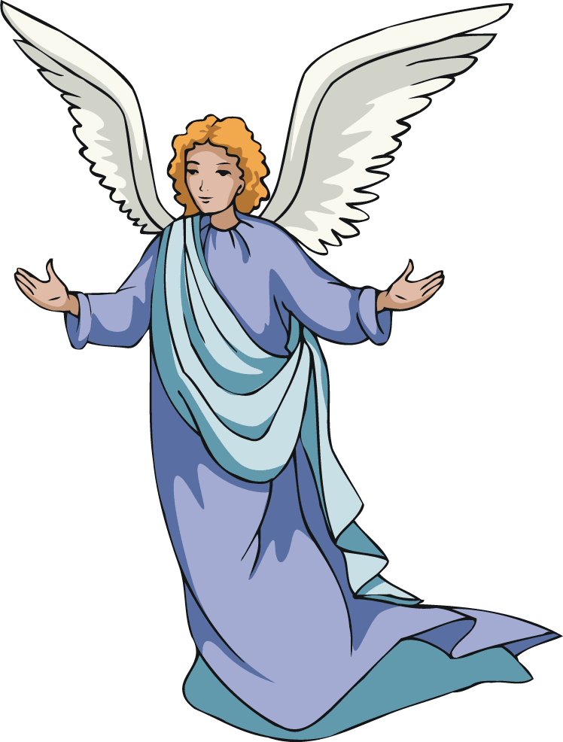
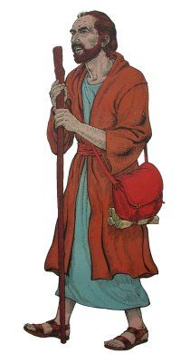
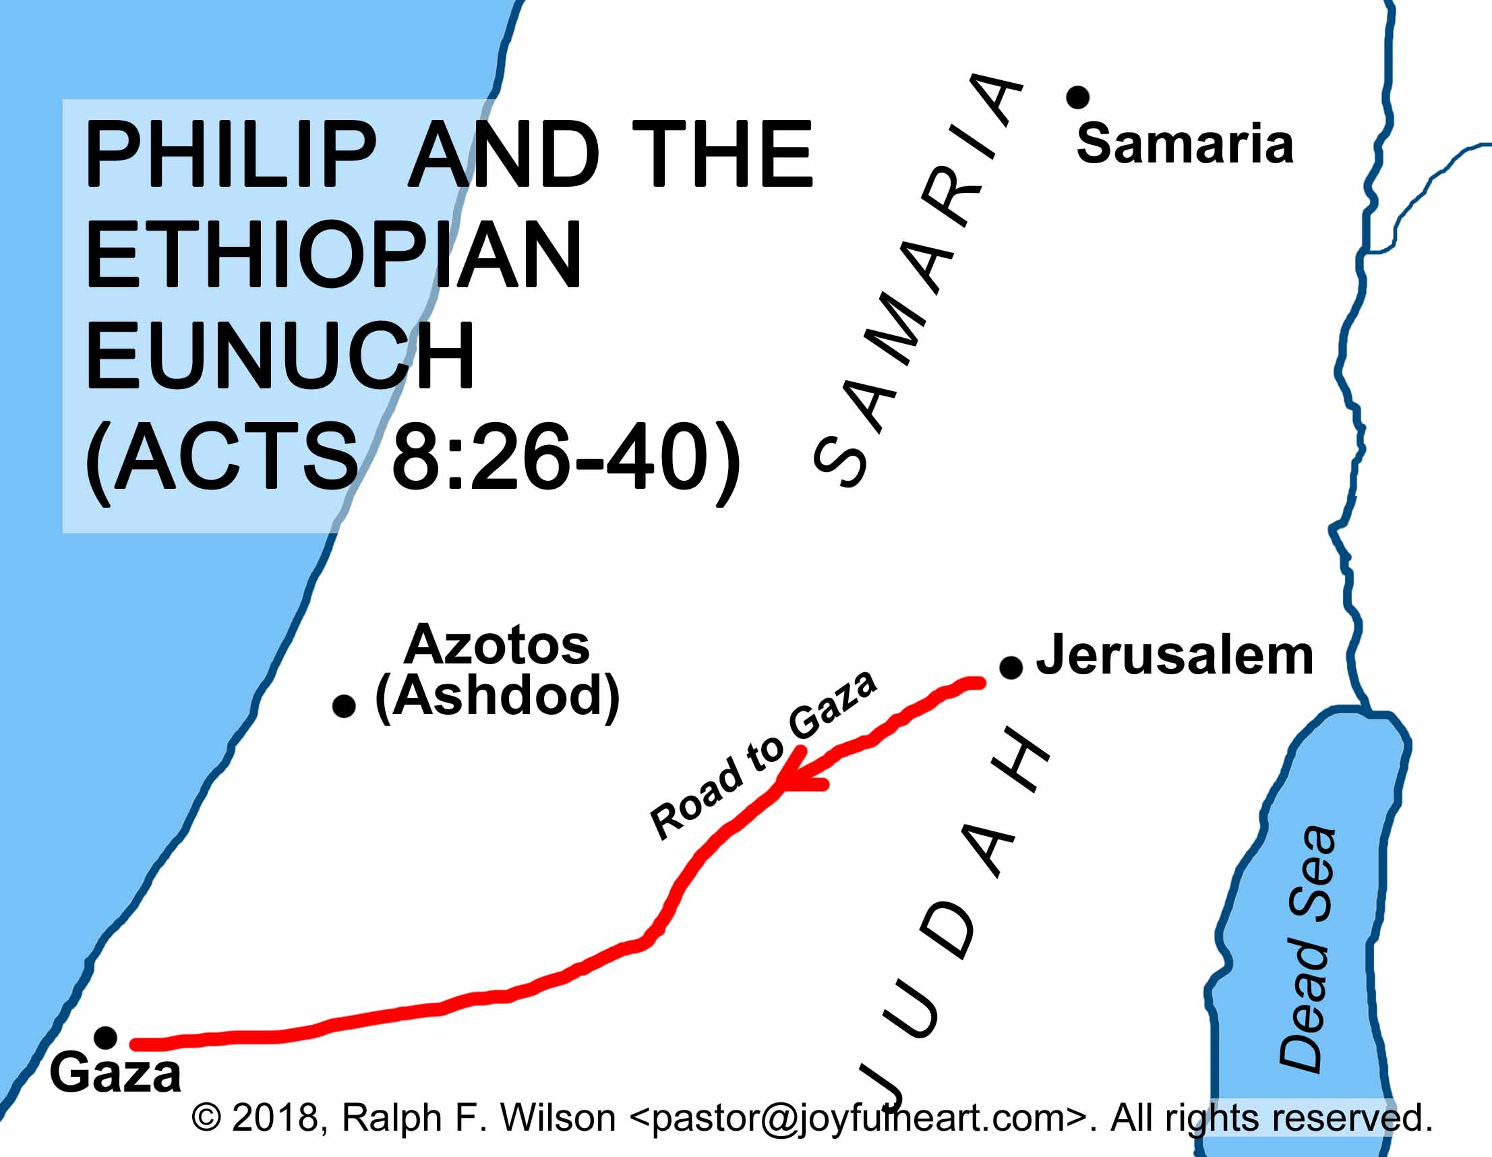
Philip,
Go south to the desert road.
It’s the road that goes down from Jerusalem to Gaza.
OK. I will go.
I wonder who I will meet?
^{Acts 8:26} An angel of the Lord spoke to Philip. “Go south to the desert road,” he said. “It’s the road that goes down from Jerusalem to Gaza.” ²⁷ So Philip started out.
He didn’t ask questions, he just went.
Pretend like you are walking to the road.

Slide 11
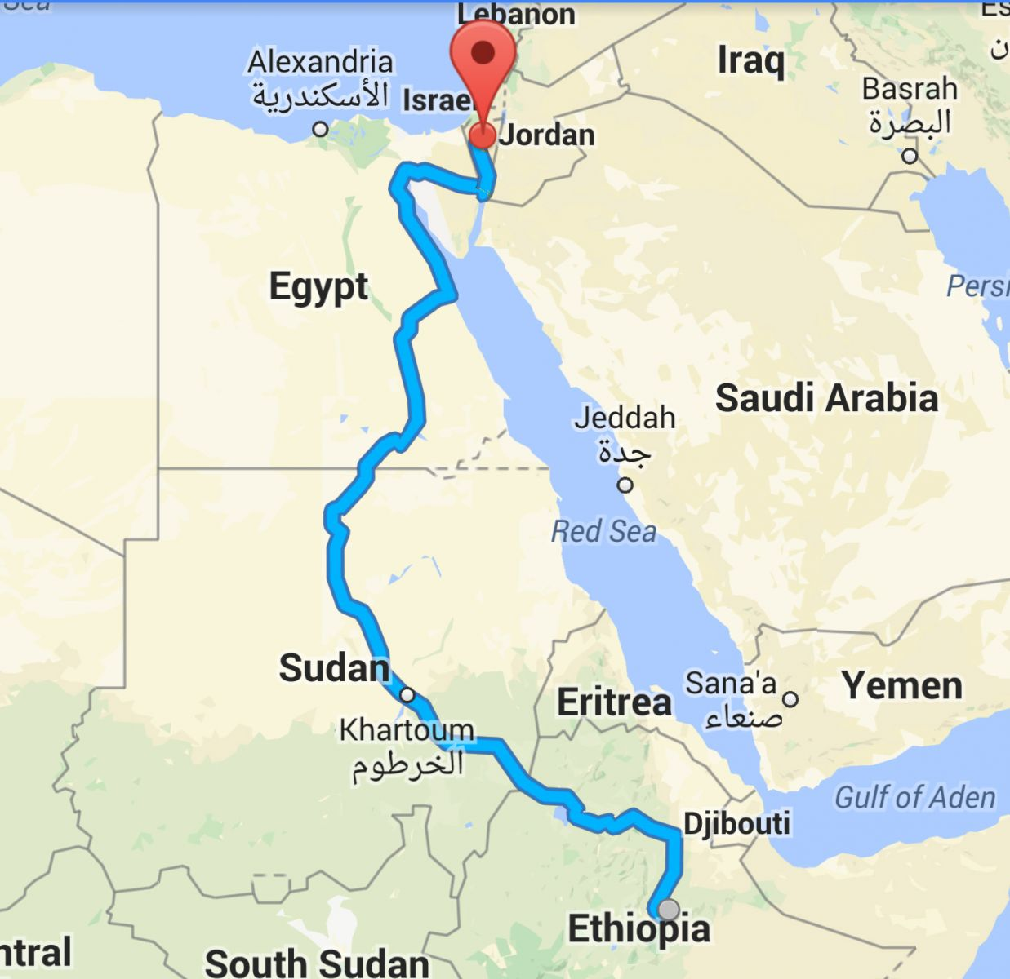
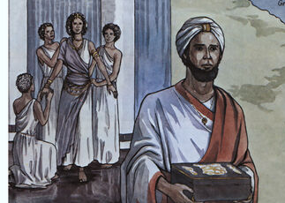
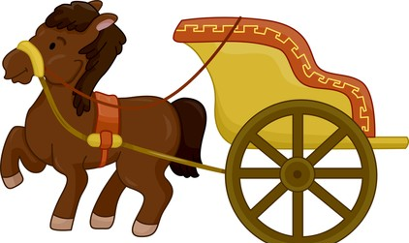
In Ethiopia, there was a man who was in charge of the queen’s money. Weeks before, he had left Ethiopia and had gone to Jerusalem to worship God.

Slide 12
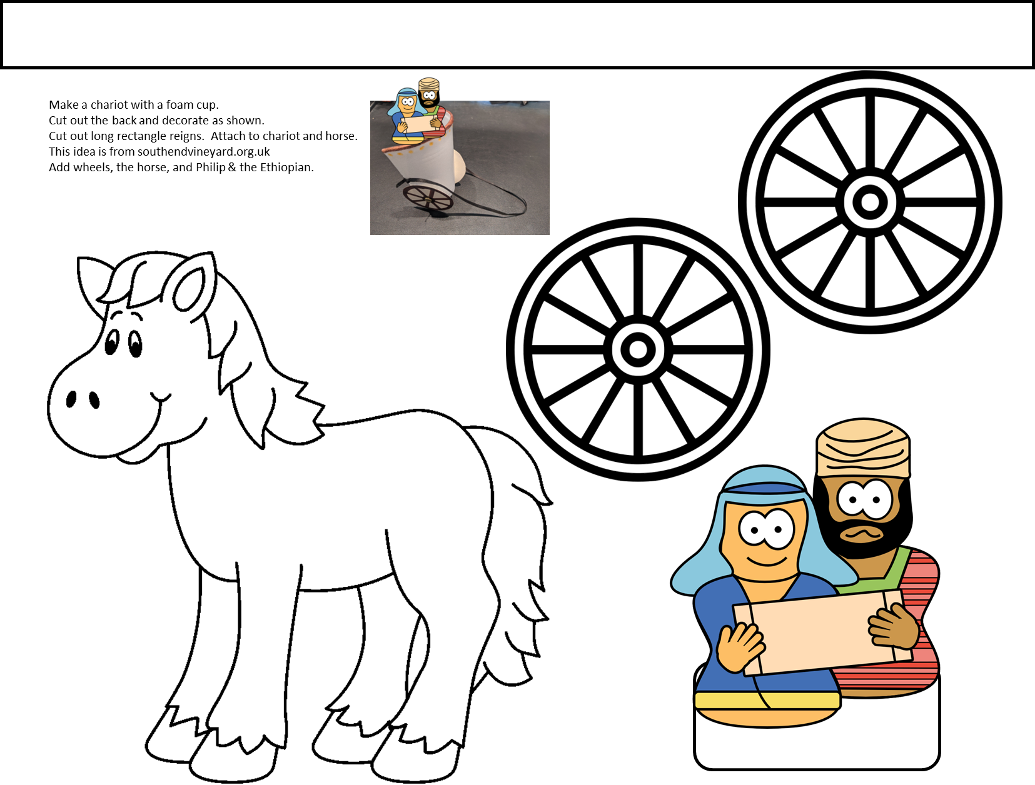
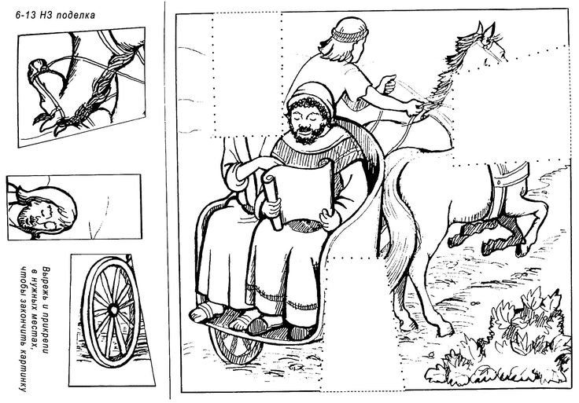
Craft Time Choose option 1 or 2
Cut out the pieces on the left Glue them where they fit on the picture.
https://www.jesus-without-language.net/philip-ethiopian-acts-8-make-2/ characters
Color the horses.
Cut out the wheels, horse, men with a tab, and upper long rectangle for the reigns.
We’ll put them together later.
https://www.pinterest.com/dlackey49/bible-phillip/

Slide 13
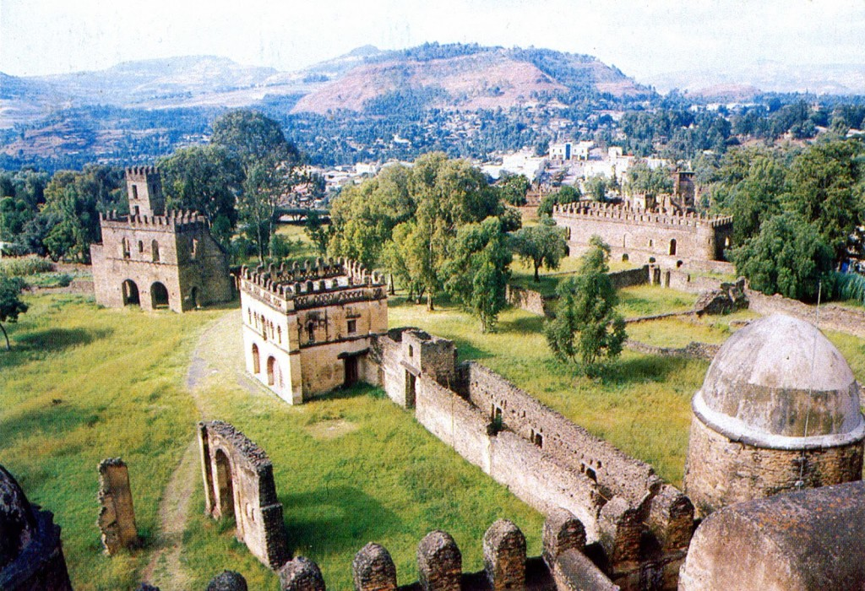
Here is an emperor’s castle in Ethiopia.

Slide 14
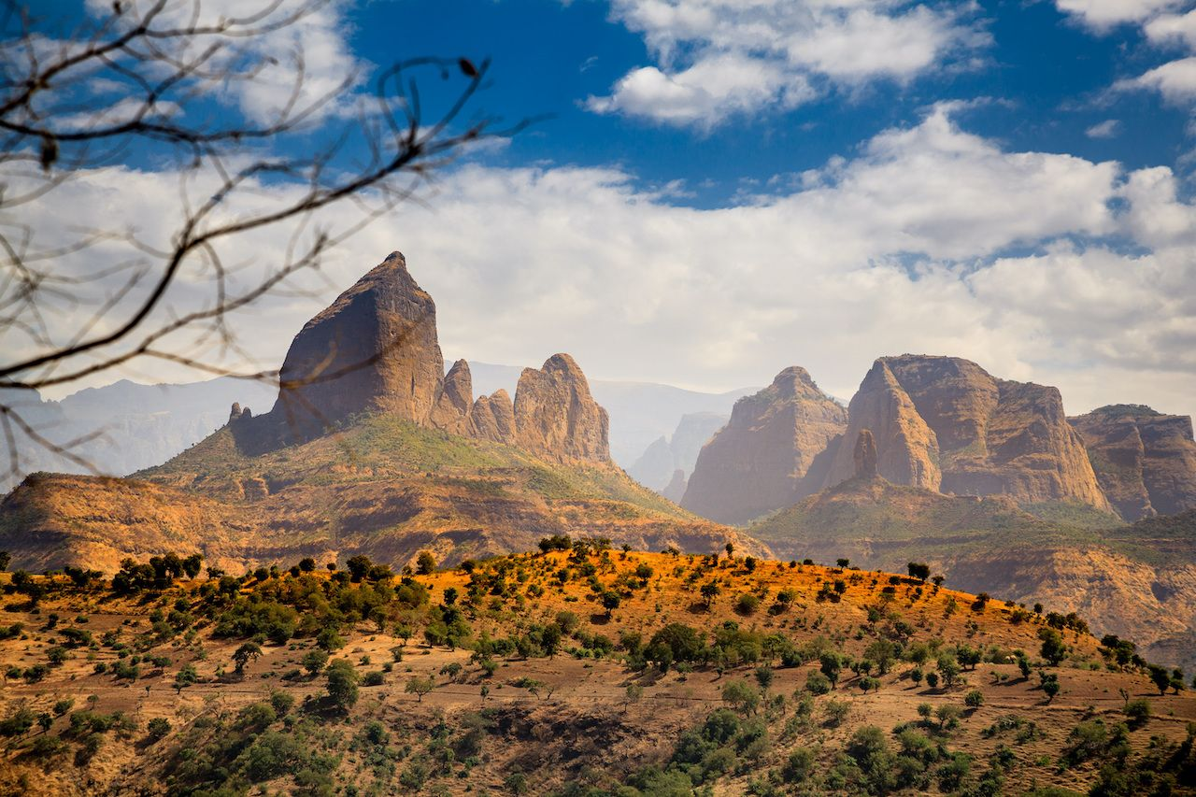
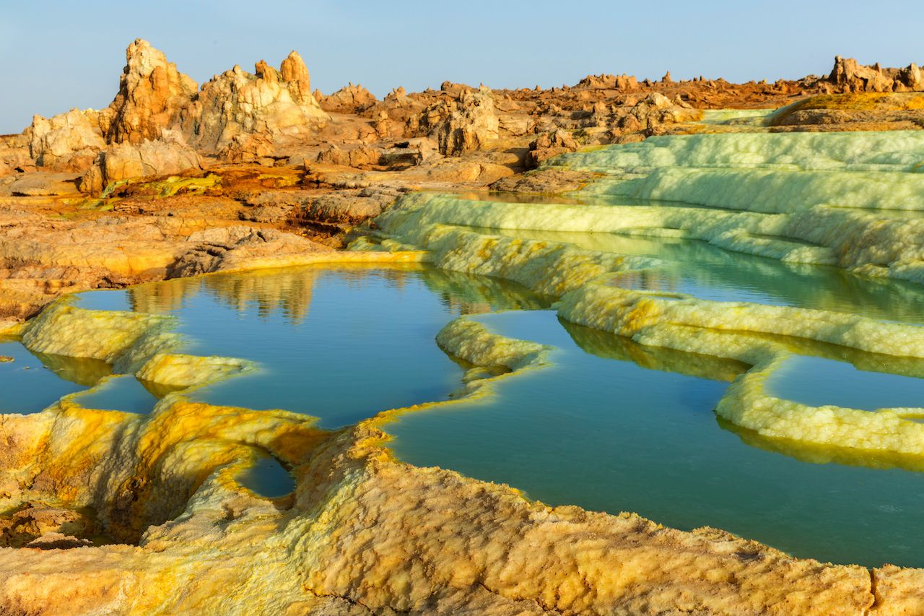
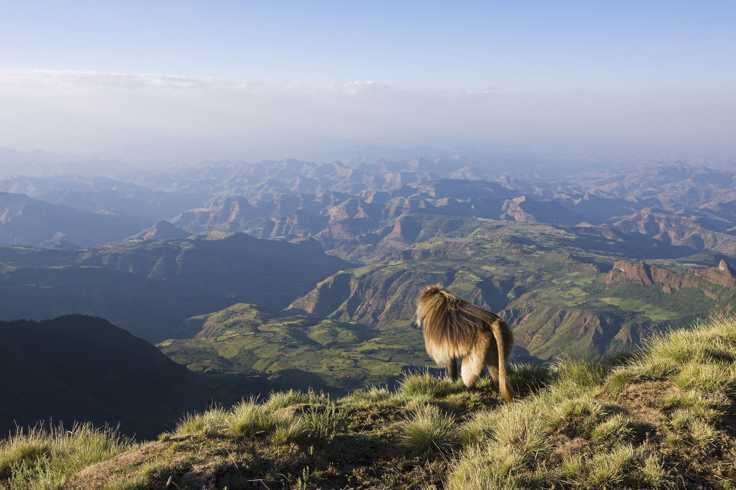
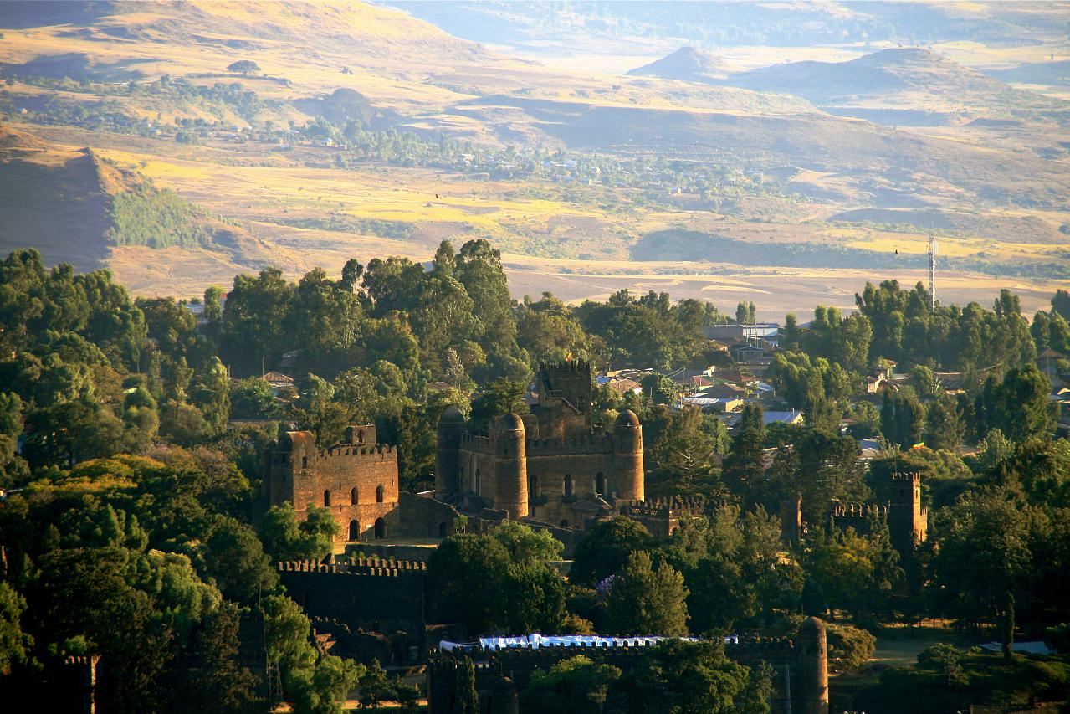
Ethiopia is a beautiful country.

Slide 15
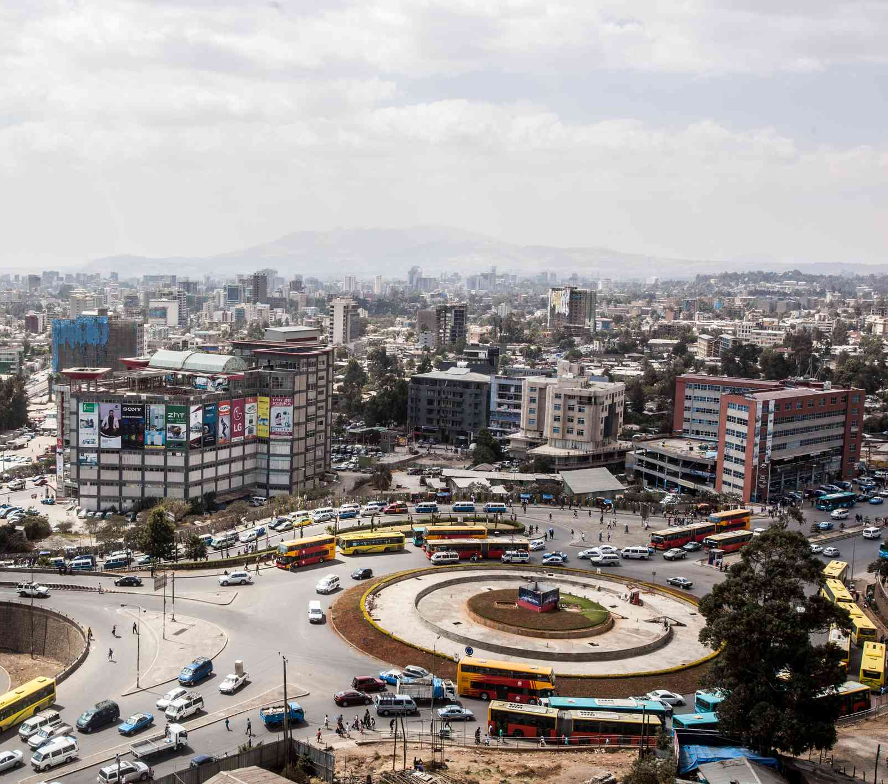
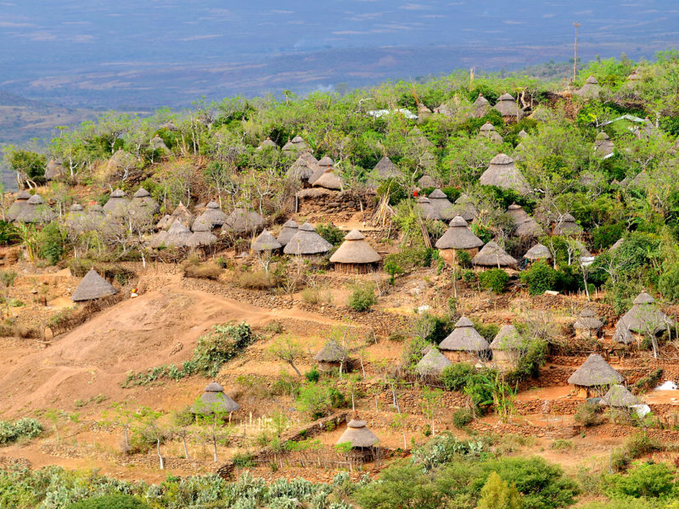
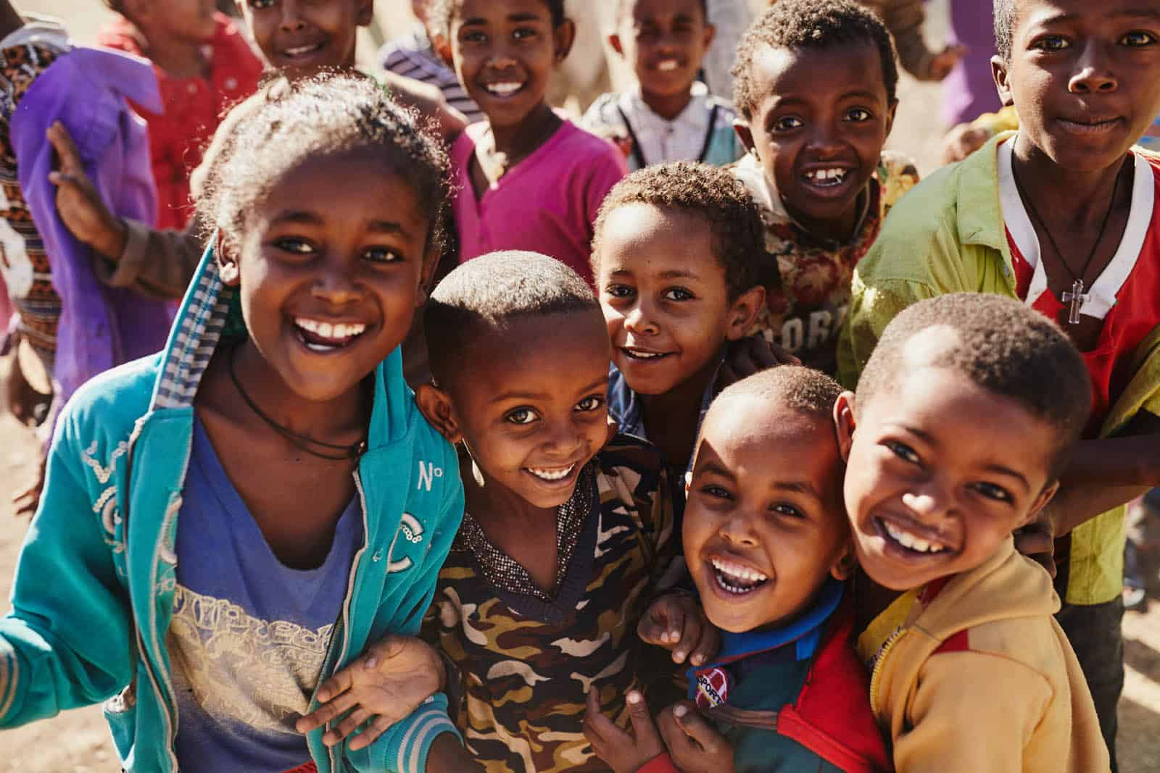
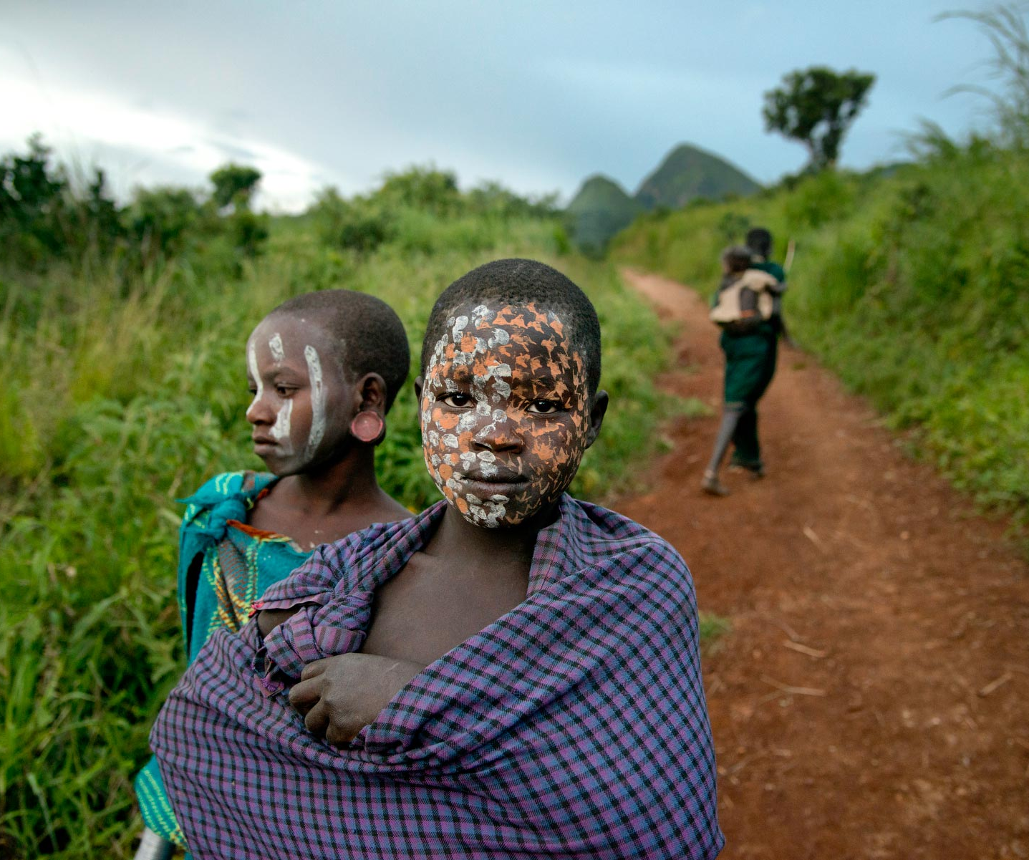
Now there are people that live in big cities and in the country.

Slide 16
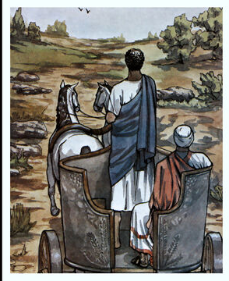
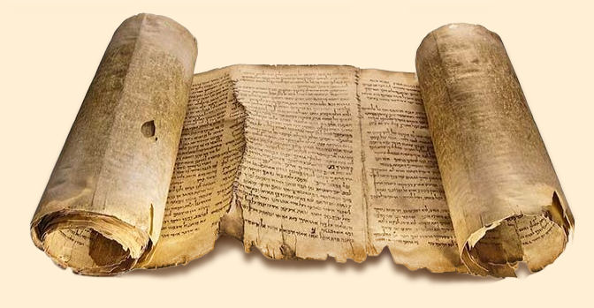
^{Acts 8:28} On his way home he was sitting in his chariot. He was reading the Book of Isaiah the prophet.
I wonder who this is referring to.
Isaiah 53
³ He was despised and rejected by mankind, a man of suffering, and familiar with pain. Like one from whom people hide their faces he was despised, and we held him in low esteem.
Who has believed our message and to whom has the arm of the Lord been revealed? ² He grew up before him like a tender shoot, and like a root out of dry ground. He had no beauty or majesty to attract us to him, nothing in his appearance that we should desire him.

Slide 17
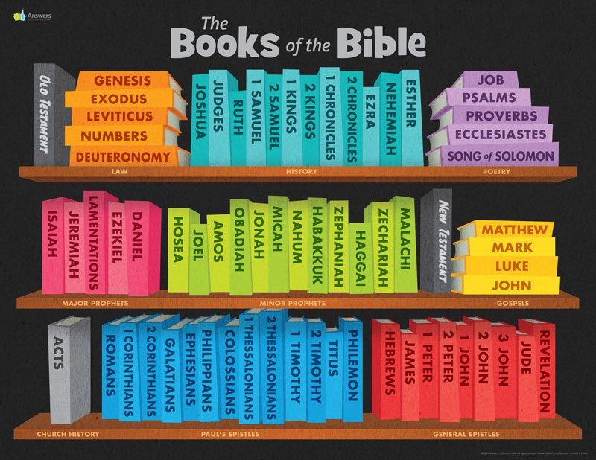
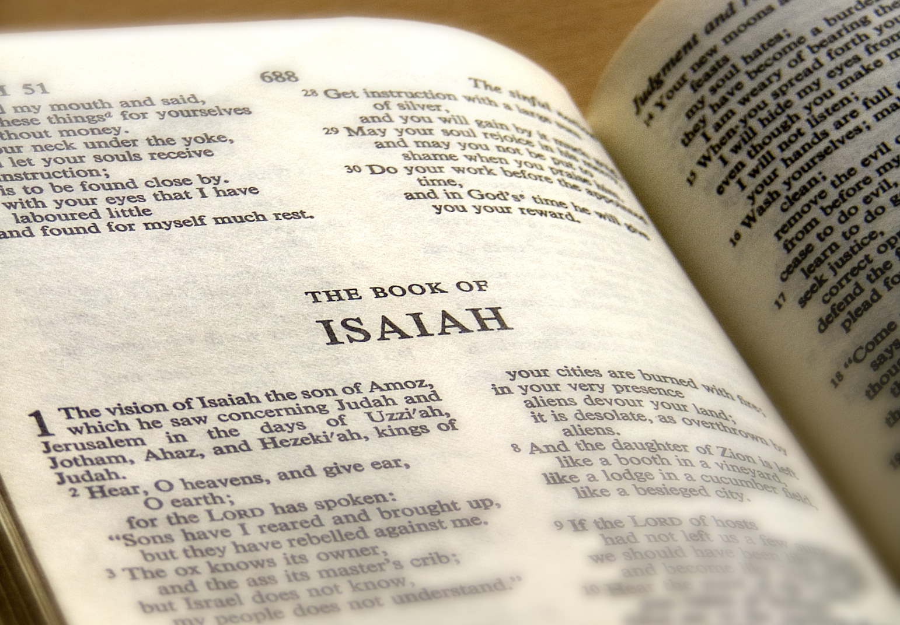
Can you find the book of Isaiah? He was reading Isaiah 53 Let’s find and read Isaiah 53

Slide 18
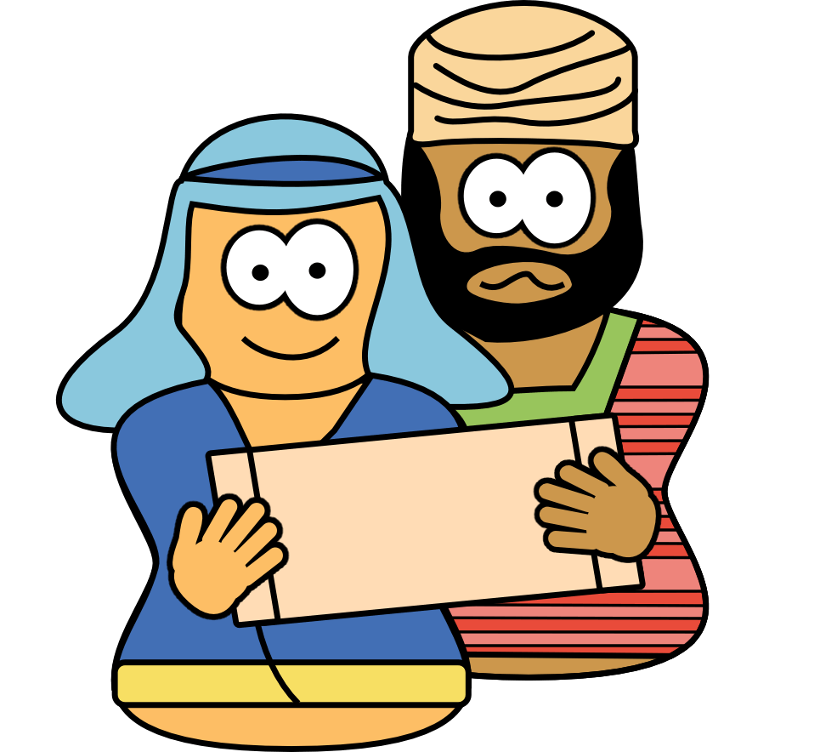
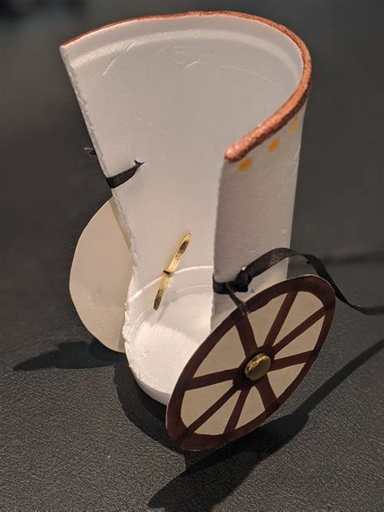
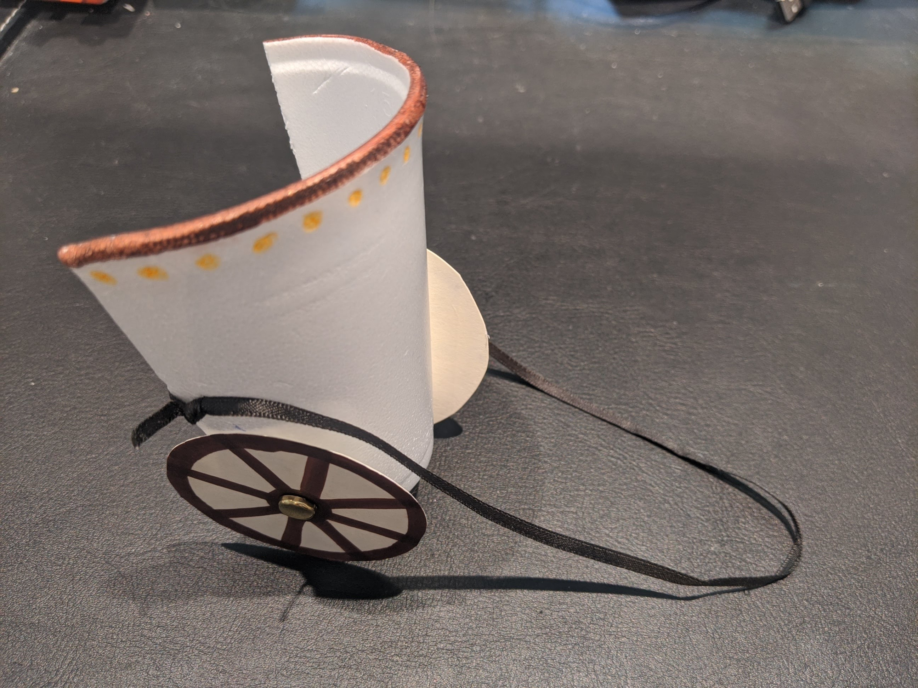
Craft Time Choose option 1
Directions:
Cut a Styrofoam cup as shown to make the chariot.
Attach the wheels, which you cut out, to the chariot as shown with brads.
You can add yarn to the horse’s mane and tail if you wish.
Attach the horse to the chariot with the long paper – the reigns.
Glue the men in the chariot.
You colored the horses and cut out the wheels, men and horses.
Now it’s time to put them together.

Slide 19
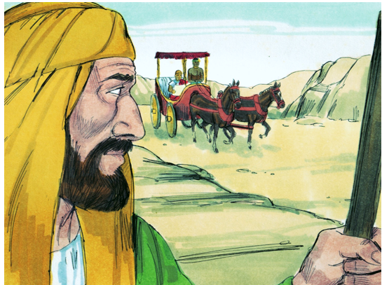
Go to that chariot. Stay near it.
^{Acts 8:29} The Holy Spirit told Philip, “Go to that chariot. Stay near it.”
³⁰ So Philip ran up to the chariot. He heard the man reading Isaiah the prophet.
Pretend you are:
The horse pulling the chariot
The chariot driver or
The Ethiopian reading the Bible.

Slide 20
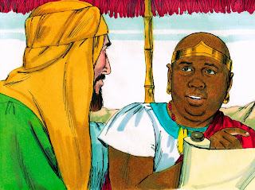
How can I unless someone explains it to me?
Do you know what it means?
Do you understand what you are reading?
^{Acts 8:30} “Do you understand what you’re reading?” Philip asked.
³¹ “How can I?” he said. “I need someone to explain it to me.” So, he invited Philip to come up and sit with him.
Yes, I do.
Pretend you are:
The horse pulling the chariot
The chariot driver or
The Ethiopian reading the Bible.
Please come sit up here and explain it.

Slide 21
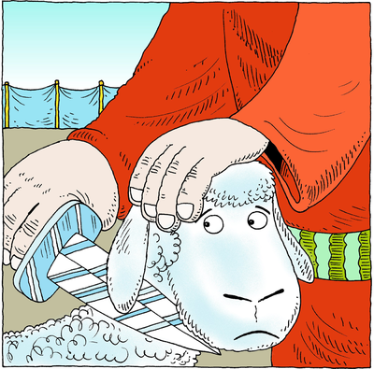
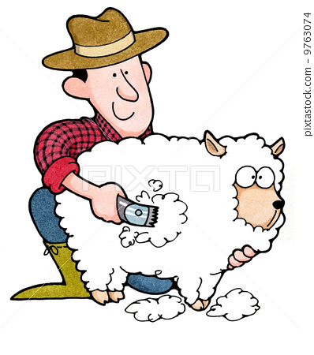
Tell me please.
Who is the prophet talking about?
Is it himself or someone else?
³² Here is the part of Scripture the official was reading. It says,
“He was led like a sheep to be killed. Just as lambs are silent while their wool is being cut off, he did not open his mouth. ³³ When he was treated badly, he was refused a fair trial. Who can say anything about his children? His life was cut off from the earth.” (Isaiah 53:7,8)
³⁴ The official said to Philip, “Tell me, please. Who is the prophet talking about? Himself, or someone else?” ³⁵ Then Philip began with that same part of Scripture. He told him the good news about Jesus.
He is talking about Jesus, the Lamb of God who takes away the sins of the world.
Please tell me more about this Jesus. I didn’t understand what was going on in Jerusalem.

Slide 22
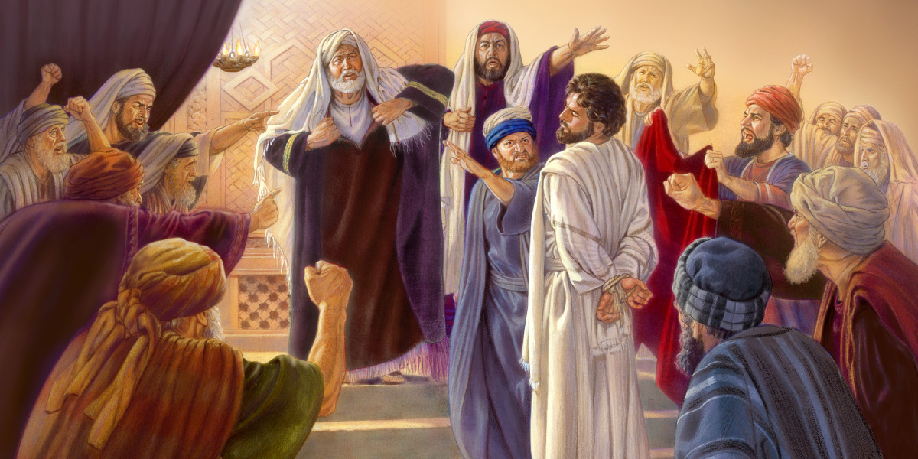
“He was led like a sheep to be killed. Just as lambs are silent while their wool is being cut off, he did not open his mouth. ³³ When he was treated badly, he was refused a fair trial.
Jesus willingly allowed many of the Pharisees
to arrest him in the Garden of Gethsamane and
lead him to be questioned by the council and Pilate.
He was falsely accused, mocked, and beaten.
He did not complain nor cry out.

Slide 23
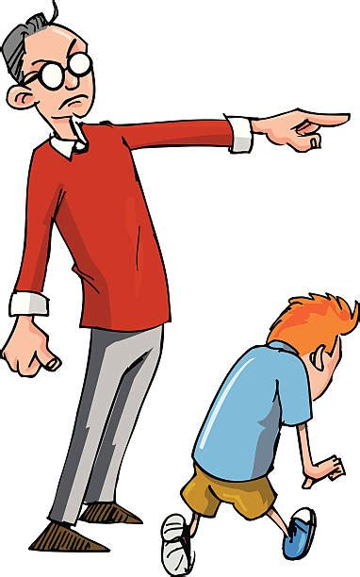
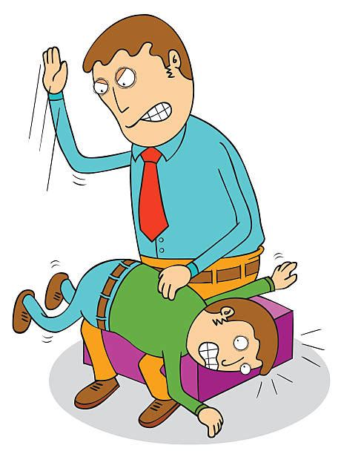
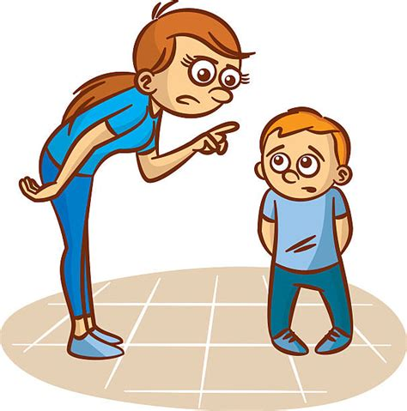
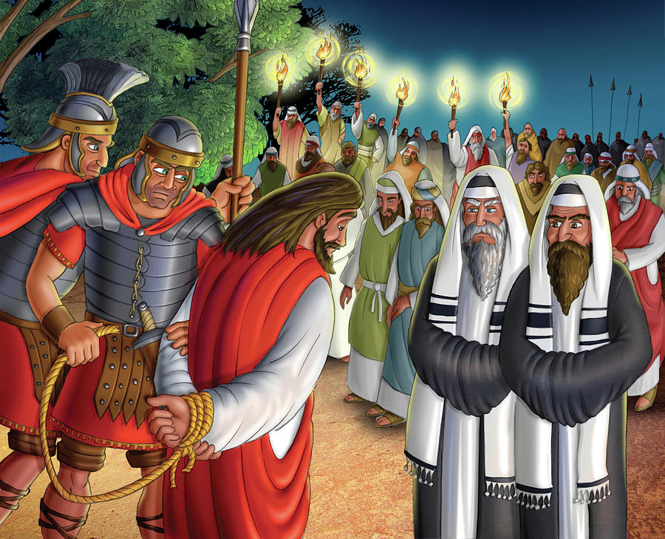
⁶ All of us were like sheep that were lost, each of us going his own way. But the Lord made the punishment fall on him, the punishment all of us deserved.
⁷ “He was treated harshly, but endured it humbly; he never said a word. Like a lamb about to be slaughtered, like a sheep about to be sheared, he never said a word. ⁸ He was arrested and sentenced and led off to die, and no one cared about his fate. He was put to death for the sins of our people….

Slide 24
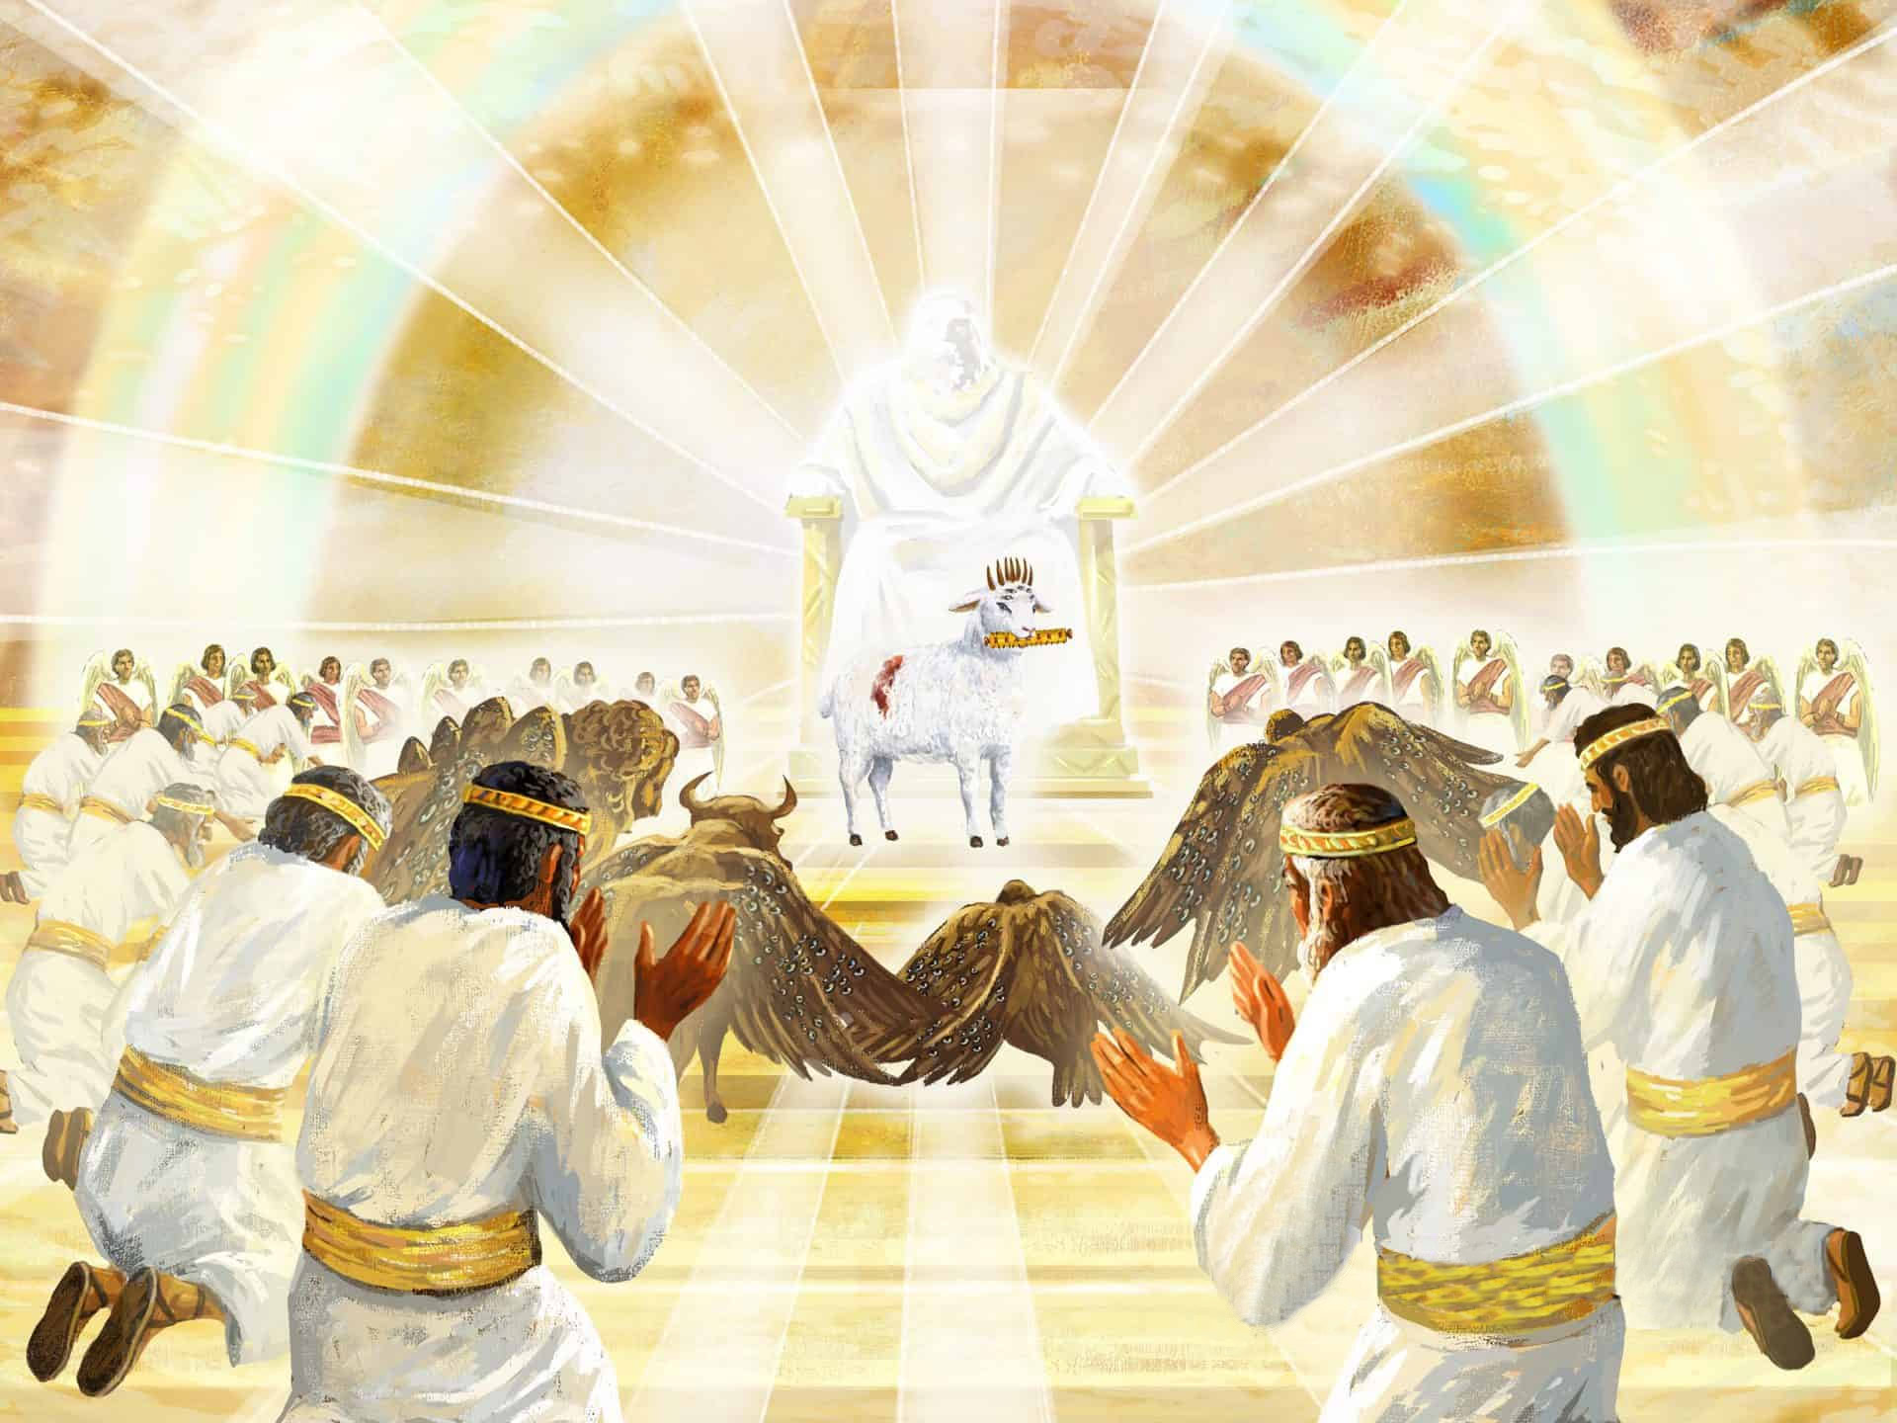
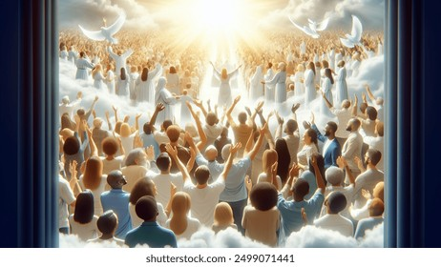
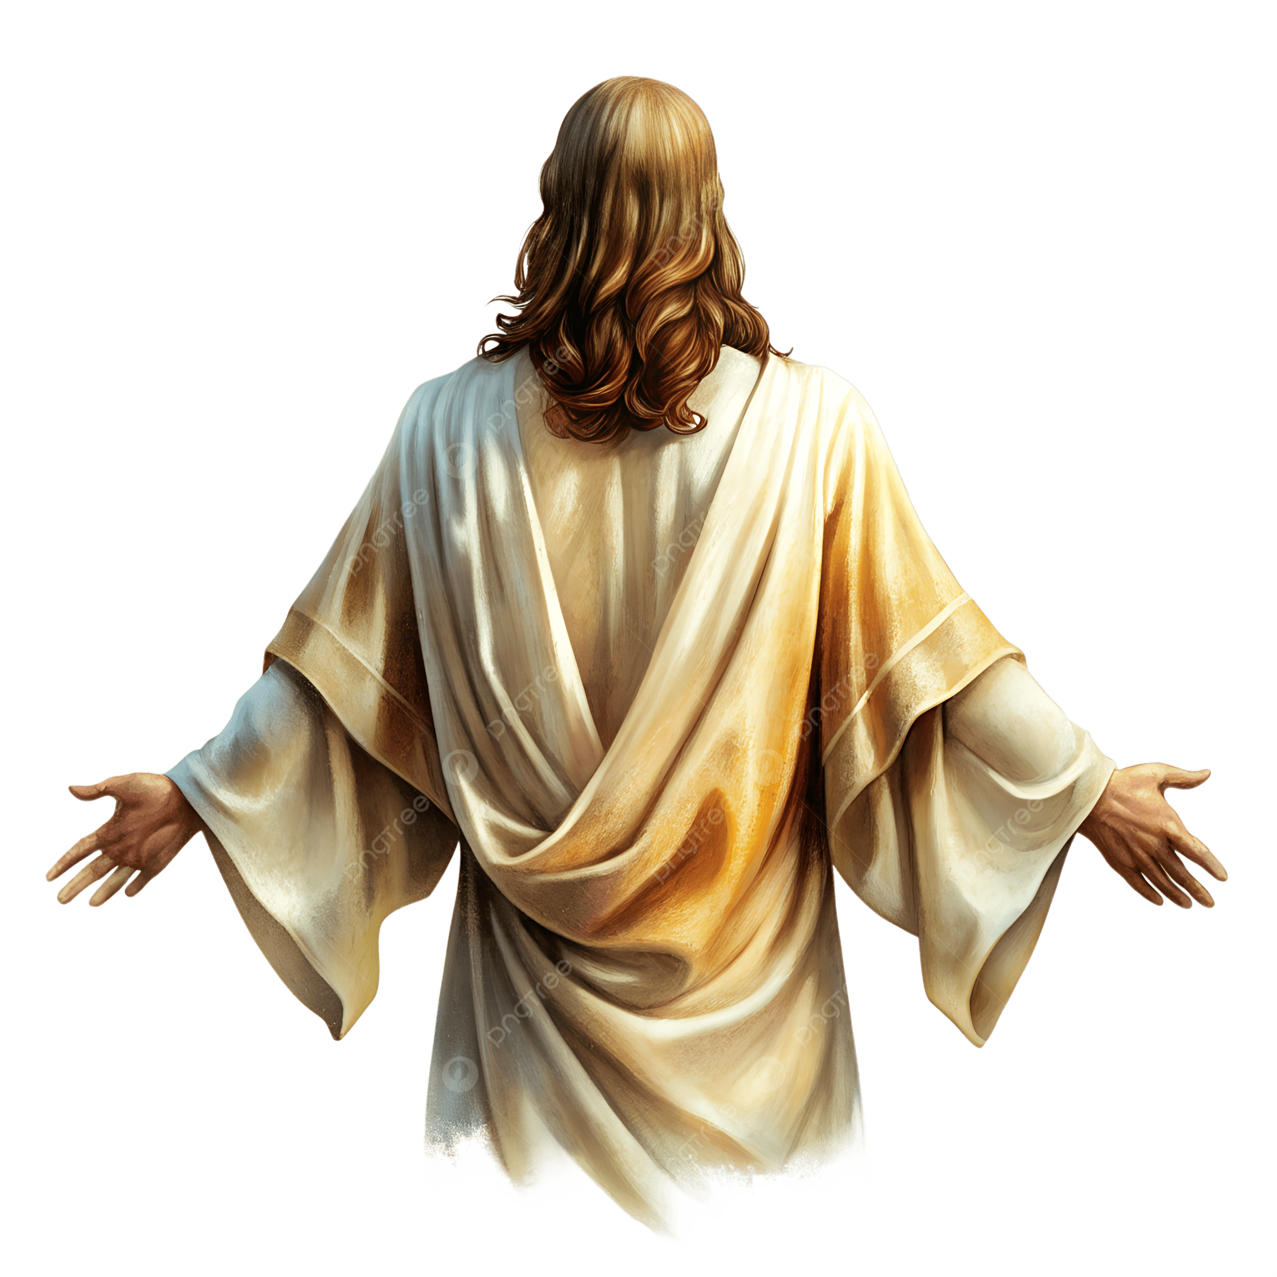
¹⁰ The Lord says,
“It was my will that he should suffer; his death was a sacrifice to bring forgiveness. .
And so, he will see his children; he will live a long life, and through him my purpose will succeed. ¹¹ After a life of suffering, he will again have joy; he will know that he did not suffer in vain. My devoted servant, with whom I am pleased, will bear the punishment of many and for his sake I will forgive them.
Good news translation
Worth is the Lamb who was slain to receive power, wealth, wisdom, and strength, honor, glory, and praise!
We are here
because of Jesus!
Thank you Jesus!
Hallelujah!

Slide 25
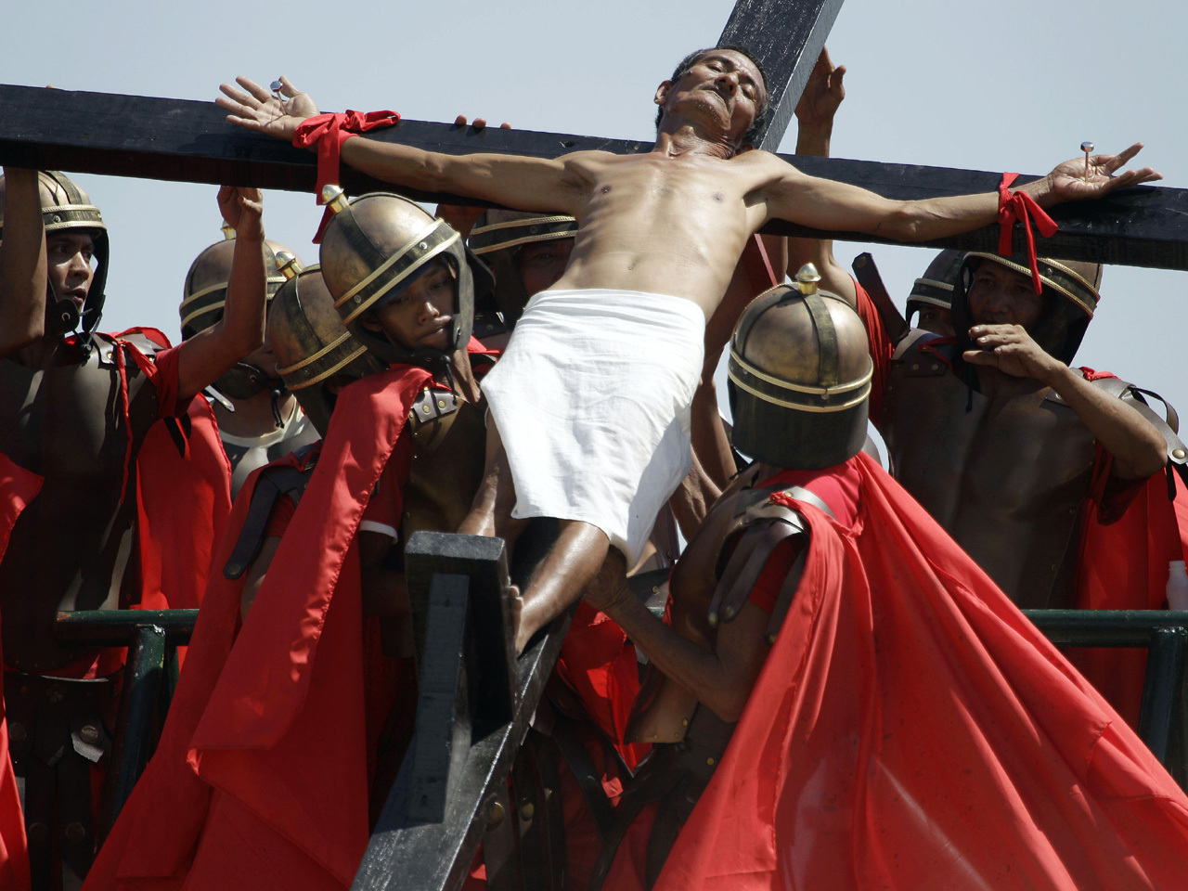
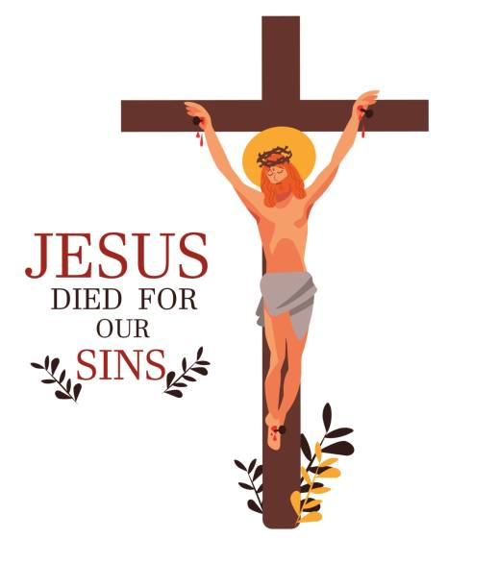
Father, forgive them. They don’t know what they are doing.
Jesus willingly gave up His life for us. He’s perfect.
He took our sins upon himself and died for us.
He was silent. He did not complain or argue.
In fact, He forgave the soldiers crucifying Him.
He died, and was buried, but rose again!
Jesus promises eternal life to those that believe.
If we confess our sins, He is faithful and just to forgive us our sins and cleanse us from all unrighteousness.

Slide 26
I want Jesus to forgive my sins!
Do you want to accept Jesus as you Savior, too?
We can pray.
Jesus will forgive you, too.
He will give you eternal life!
Then let’s pray.
You can ask Jesus to do just that and He will!
Dear Jesus, please forgive me. I have sinned.
I want to follow you and obey you.
I want to be loving, humble and kind like you.
Please help me.
Amen

Slide 27
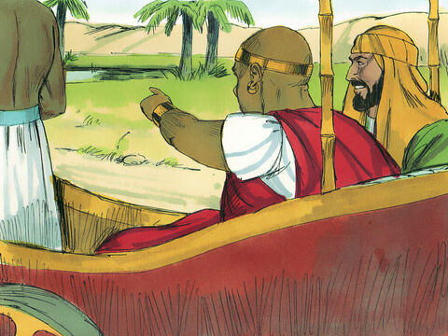
Look! Here is water!
What can stop me from being baptized?
I will baptize you!
³⁶⁻³⁷ As they traveled along the road, they came to some water. The official said, “Look! Here is water! What can stop me from being baptized?” ³⁸ He gave orders to stop the chariot.

Slide 28

I baptize you in the name of
the Holy God Almighty, our Father,
the Son, Jesus, who forgives and cleanses us
and the Holy Spirit who guides us to the truth.
Amen!
Then both Philip and the official went down into the water. Philip baptized him.

Slide 29

³⁹ When they came up out of the water, the Spirit of the Lord suddenly took Philip away.
The official did not see him again. He went on his way full of joy.
I am forgiven!
Praise God!
Let me see your happy faces!

Slide 30

⁴⁰ Philip was seen next at Azotus. From there he traveled all around. He preached the good news in all the towns. Finally he arrived in Caesarea.
I will keep telling others the Good News that Jesus forgives them. God loves us!
Will you
Tell others
The Good News?

Slide 31






GO and TELL MISSION ACTIVITY
Let’s make an invitation card that you can give to other kids that are not here at Sabbath School.
Maybe you will see someone at church.
Or maybe you will see someone at daycare or school or your neighborhood.
Tell them about Jesus and invite them to come to Sabbath School.

Slide 32





GO and TELL MISSION ACTIVITY
What can we make and take to others when we go and tell them about Jesus?
Here are some ideas:

Slide 33
Sing it out GO

Slide 34

Mission Story

Slide 35

Romans 10:14-15
Isaiah 52:6-7

Slide 36

Sing with Cedarmont kids This Little Light of Mine

Slide 37
How, then, can they call on the one they have not believed in? And how can they believe in the one of whom they have not heard? And how can they hear without someone preaching to them? And how can anyone preach unless they are sent? As it is written: “How beautiful are the feet of those who bring good news!” Romans 10:14-15
Therefore, go and make disciples of all nations,
baptizing them in the name of the Father and of the Son
and of the Holy Spirit,
and teaching them to obey everything I have commanded you.
And surely, I am with you always, to the very end of the age.”
Matthew 28:19-20

Slide 38

Sing Light of the World

Slide 39
TIC-TAC-TOE GAME TIME
Optional Activity

Slide 40
Who did God send to talk to the Ethiopian?
TIC TAC TOE
Philip

Slide 41


When Philip heard about Jesus, he believed. Then how did he show that he wanted Jesus to wash his sins away?
Jesus loves you.
Jesus died & rose again.
He forgives you.
I believe
Jesus is my Savior.
TIC TAC TOE
He was baptized

Slide 42

The church chose Philip and 6 other men to do a special work. What were they supposed to do?
TIC TAC TOE
Feed the widows

Slide 43

Where did Philip go to tell others about Jesus?
TIC TAC TOE
Samaria

Slide 44
God had another job for Philip. Which road did he say to go to?
TIC TAC TOE
The road from
Jerusalem to Gaza

Slide 45

Philip saw someone in a chariot reading something. Where was he from?
TIC TAC TOE
Ethiopia

Slide 46

Who did the Ethiopian work for?
TIC TAC TOE
The queen

Slide 47
What was the Ethiopian reading?
TIC TAC TOE
The Bible
Book of Isaiah (53)

Slide 48
The Ethiopian believed in Jesus. He wanted his sin washed away. What did he want Philip to do?
TIC TAC TOE
Baptize him

Slide 49
What happened to Philip after the baptism? Where did he go?
TIC TAC TOE
An angel took him away.
He was next seen
in Azotas

Slide 50


Optional activity
Scroll activity from Bible Fun For Kids
Philip and the Ethiopian MAZE

Slide 51


Slide 52
Leading up to our story for today
(The following slides are optional, but could be moved to the first of the presentation.)

Slide 53
Many people listened to Jesus and followed Him. Later Jesus rose again and then ascended to heaven. The disciples were together praying when the Holy Spirit was sent to them. It appeared as tongues of fire on their heads. Everyone heard them speaking in the language they could understand. That day 3,000 more people believed in Jesus! The Holy Spirit helped the disciples tell others about Jesus. It helped the people want to learn more about Jesus. You can read more about it in Acts 2
Jesus loves you.
Jesus died & rose again.
He forgives you.
I believe
Jesus is my Savior.

Slide 54
More and more people chose to believe in Jesus and be saved. They chose to follow Jesus, to love others, and be faithful to God. The disciples healed others in Jesus’ name. You can read more about it in Acts 3
Jesus loves you.
Jesus died & rose again.
He forgives you.
I believe
Jesus is my Savior.

Slide 55

Some of the people were widows and were poor. The disciples gave them food. But soon there were so many widows that they couldn’t feed them all. They needed help!
There are so many widows to feed!
Acts 6 In those days the number of believers was growing. The Greek Jews complained about the non-Greek Jews. They said that the widows of the Greek Jews were not being taken care of. They weren’t getting their fair share of food each day. ² So the 12 apostles gathered all the believers together. They said, “It wouldn’t be right for us to give up teaching God’s word. And we’d have to stop teaching to wait on tables
The Greek are complaining that their widows aren’t getting fed.
We do need help.
We need more time to tell others about Jesus, too!
Tell everyone to come to a meeting.

Slide 56

Fellow believers in Jesus.
We need help so that all the widows receive care and so that we can continue telling more and more people about Jesus.
So, choose 7 men who wise, kind and full of the Holy Spirit to care for the widows.
Acts 6 ⁶³ Brothers and sisters, choose seven of your men. They must be known as men who are wise and full of the Holy Spirit. We will turn this important work over to them. ⁴ Then we can give our attention to prayer and to teaching God’s word.”
⁵ This plan pleased the whole group.
That’s a great idea!
How about Stephen, Nicolas, and Philip?

