Slide 1
Philip and Simon from Samaria
Gifts from God are FREE and can’t be bought

Slide 2
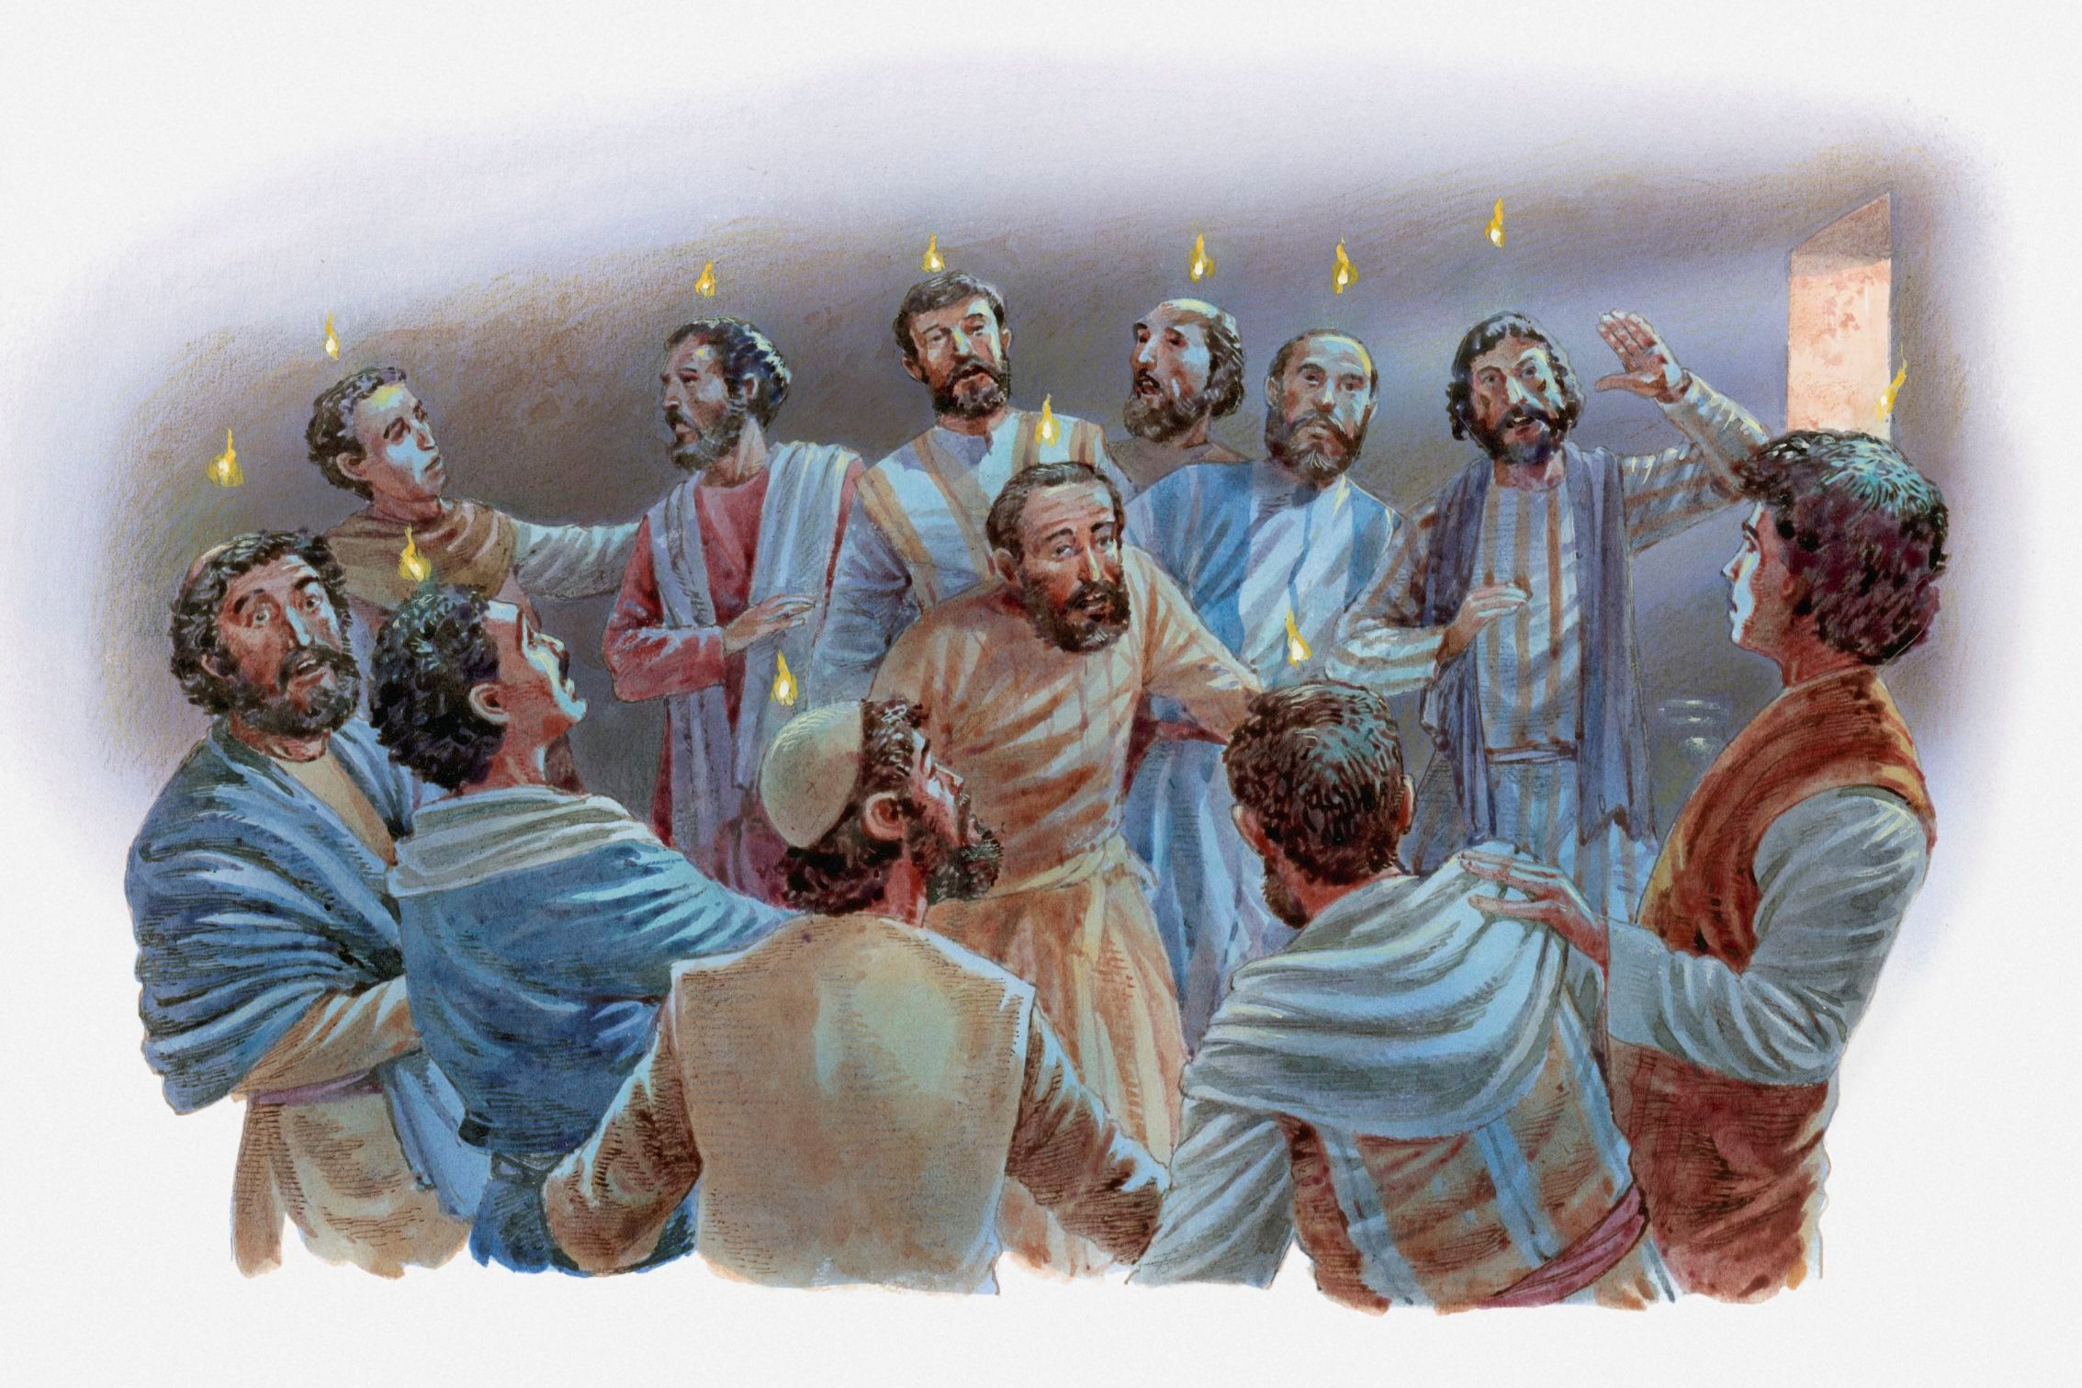
The Holy Spirit Came
REMEMBER
Jesus had promised his disciples and to send the Holy Spirit.
The Holy Spirit would help them learn about God and do awesome things to honor God and help others. He would give them courage, wisdom and power.
Jesus did bless all of His followers with the Holy Spirit.
They taught others about Jesus and did miracles in Jesus’ name.
Hundreds and thousands of people believed that Jesus was the Son of God, the Messiah, and their Savior.

Slide 3
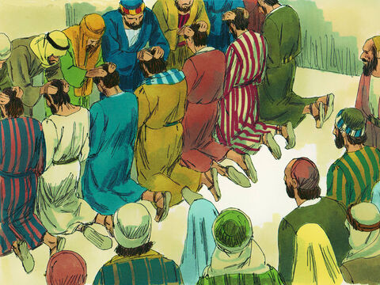
Deacons Dedicated
We dedicate you to be deacons and to serve God by continuing to care for all of the widows and others.
REMEMBER
Acts 6
They chose Stephen. He was full of faith and of the Holy Spirit. Philip, Procorus, Nicanor, Timon and Parmenas were chosen too. The group also chose Nicolas from Antioch. He had accepted the Jewish faith. ⁶ The group brought them to the apostles. Then the apostles prayed and placed their hands on them.
⁷ So God’s word spread. The number of believers in Jerusalem grew quickly. Also, a large number of priests began to obey Jesus’ teachings.

Slide 4
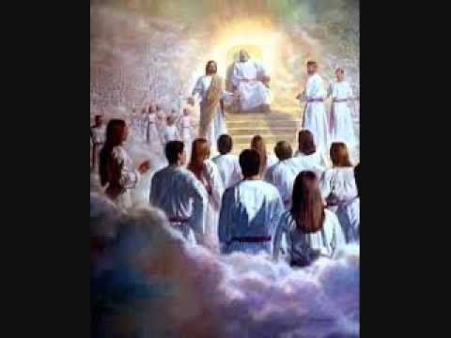
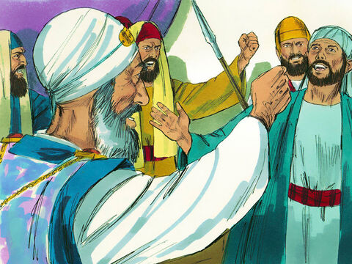
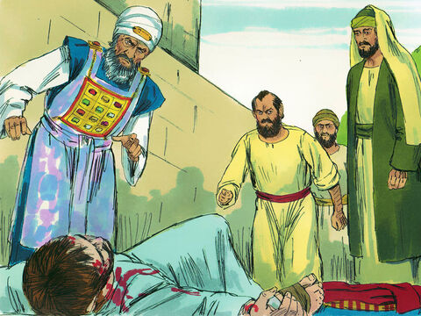
Stephen faithfully testified about Jesus
“Look!” he said.
“I see heaven open. The Son of Man is standing at God’s right hand.”
REMEMBER
Stephen was one of the 7 deacons chosen. He was full of faith, grace, and power from God. He did many miraculous signs in Jesus’ name.
Some synagogue members did not like him. They brought false charges against Stephen.
Even when Stephen told them truth, they got really upset. Stephen faithfully stood up for Jesus. God showed him that Jesus was also standing up for him.
The synagogue leaders stoned Stephen to death. Just before he died, Stephen said, LORD, don’t hold this sin against them.
Lord Jesus receive my spirit.
and
Forgive them for this sin.

Slide 5
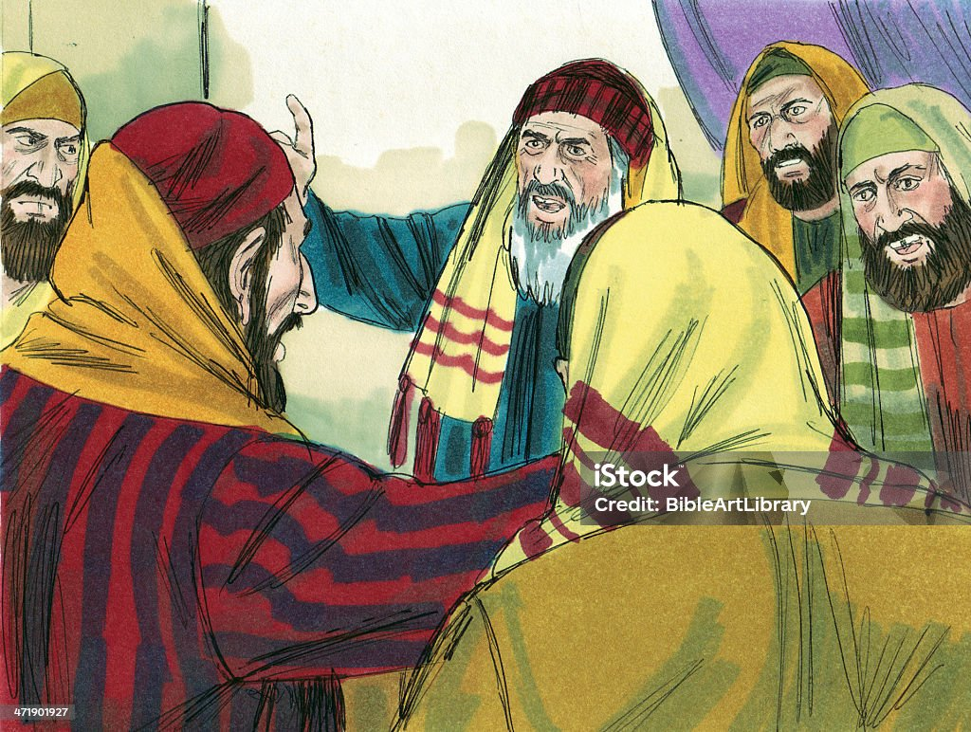
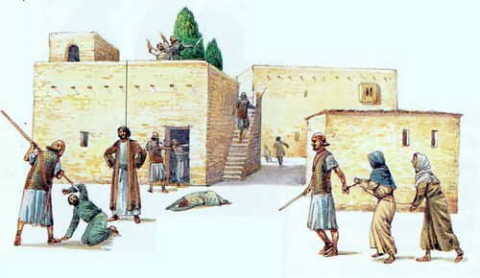
Saul began to persecute the Christians
We must put all those who follow the Way, preach about Jesus, and heal in His name in prison. They must die!
Acts 8:1
On that day a great persecution broke out against the church in Jerusalem, and all except the apostles were scattered throughout Judea and Samaria.
It is not safe here!
We must flee!

Slide 6
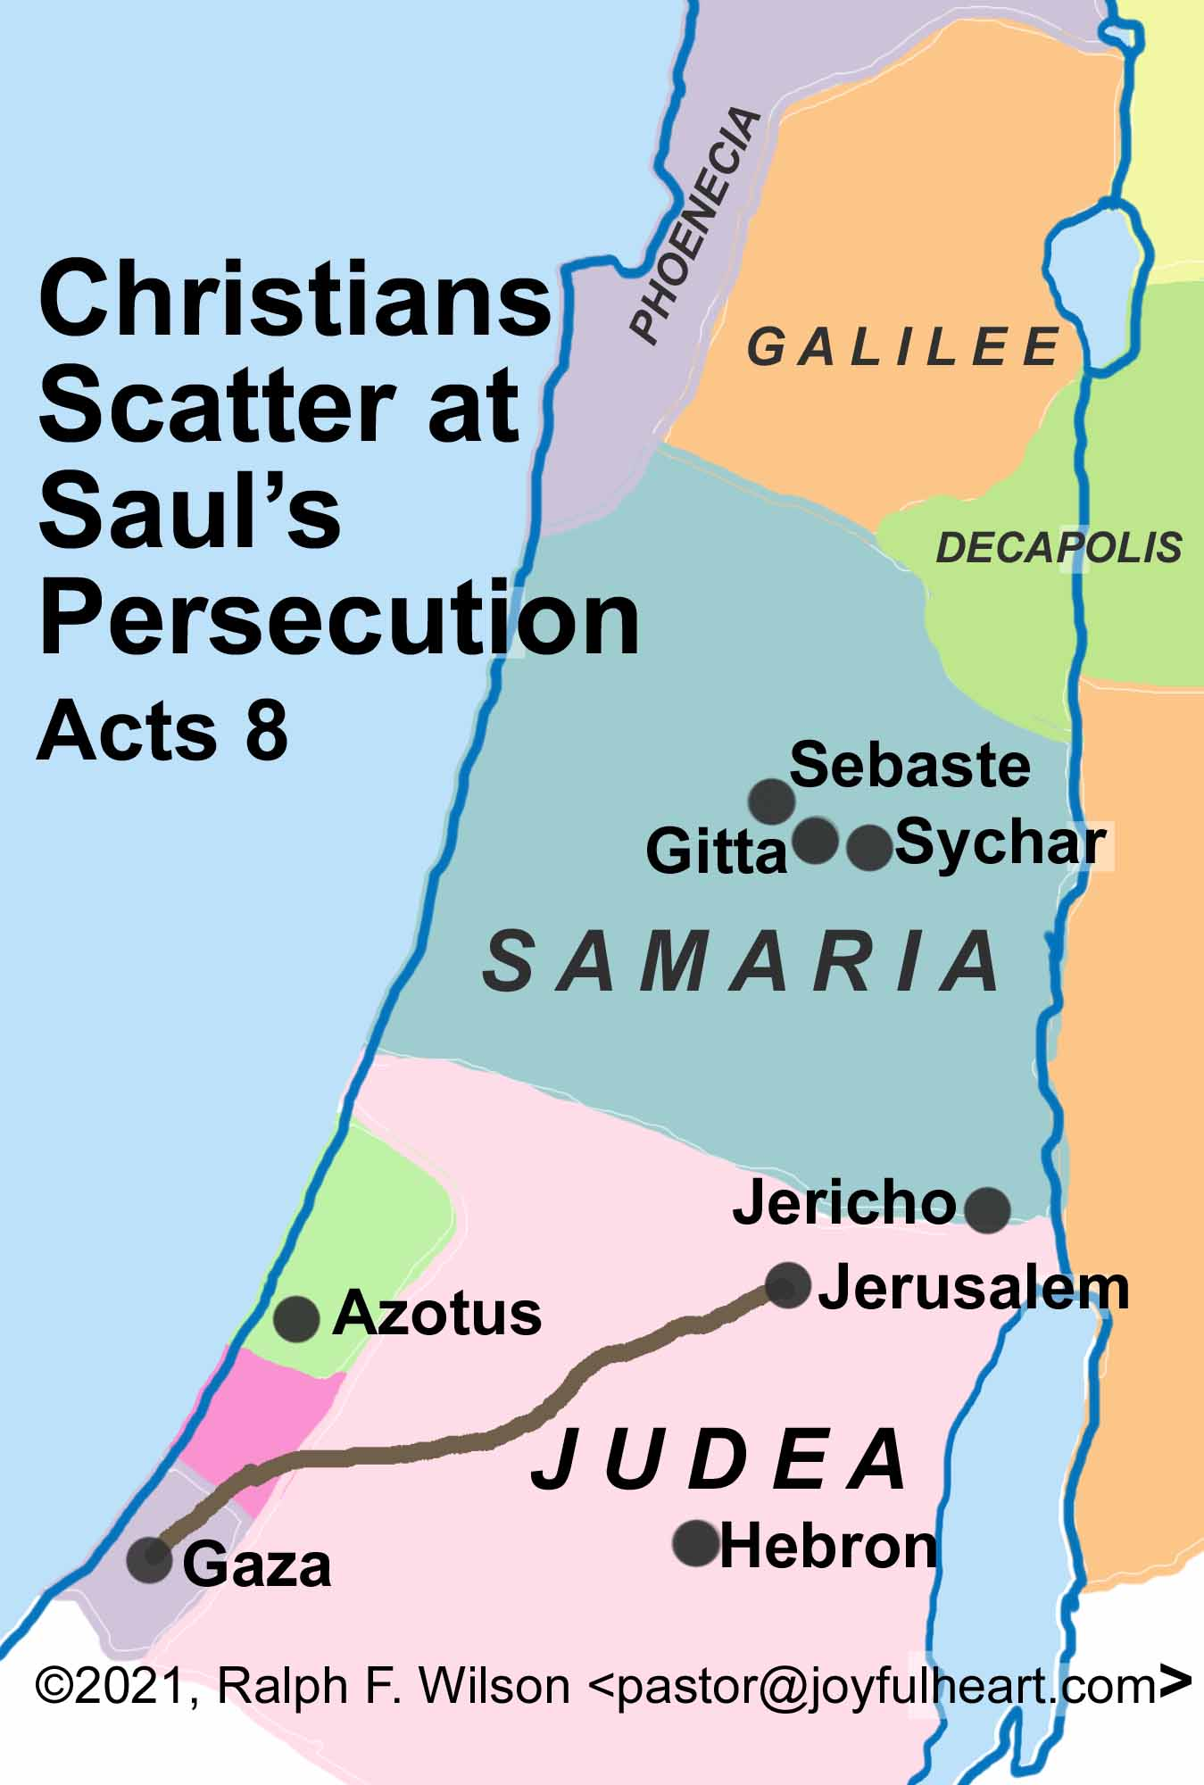
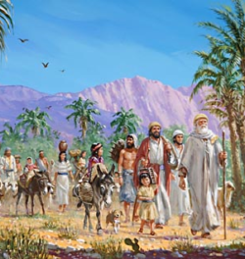
Scattered
“….all except the apostles were scattered throughout Judea and Samaria…..
⁴ Those who had been scattered preached the word wherever they went.

Slide 7
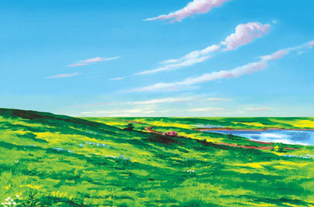
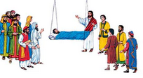

Leave the city
(This activity if for younger students)
On our felt board we have the city of Jerusalem. Stephen had been killed! Now the leaders and Saul were arresting others who were telling others about Jesus.
Jerusalem was now a dangerous place! So, people started to leave the city.
I have some people here. You can put them on the board like they are leaving the city. Look at the direction they are facing. Put them on the board so they are looking away from the city.

Slide 8
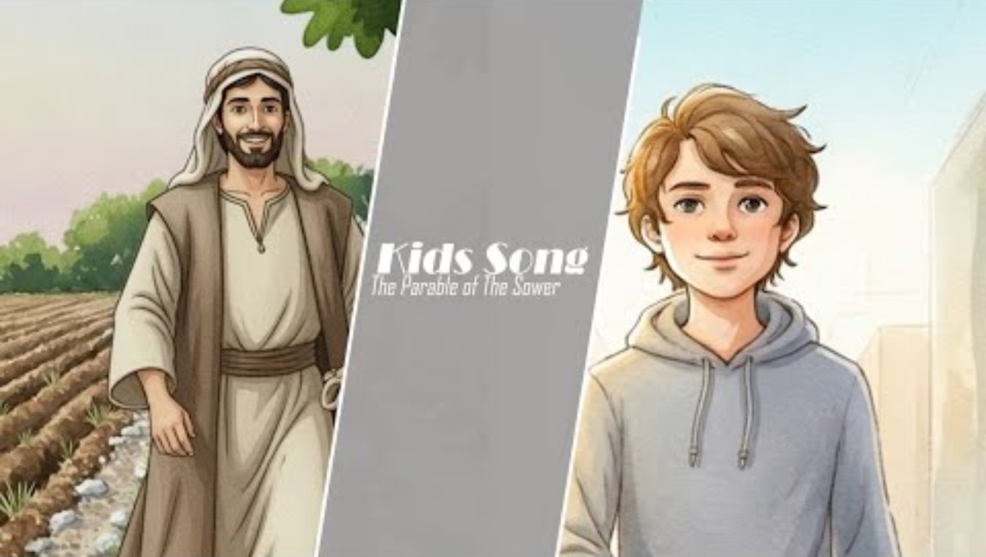
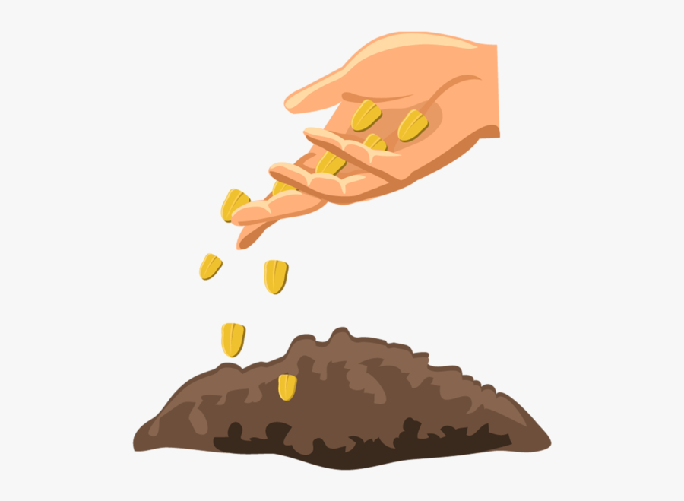
Scattered
⁴ Those who had been scattered preached the word wherever they went.
Matthew
13:1-23
This reminds me of a parable that Jesus told.

Slide 9
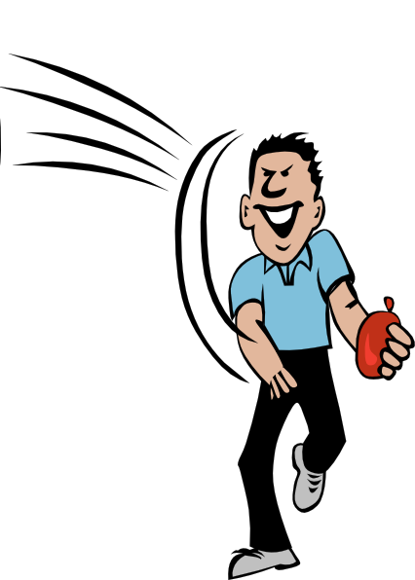
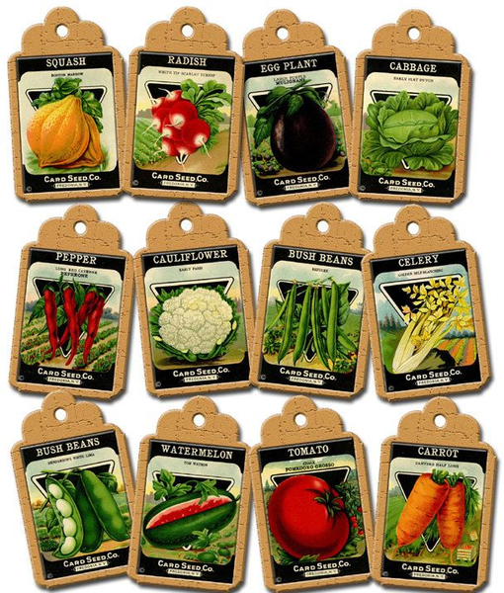
Scattered
(Start throwing seed packets onto the floor here and there.)
The Sower threw seeds here and there and everywhere.
The disciples and others left Jerusalem. They went here and there and everywhere.
They told others about Jesus. They told this person, and that person and the other person even. It didn’t matter what kind of person they were. They told them the good news about Jesus.
Let the kids scatter the packets too.

Slide 10
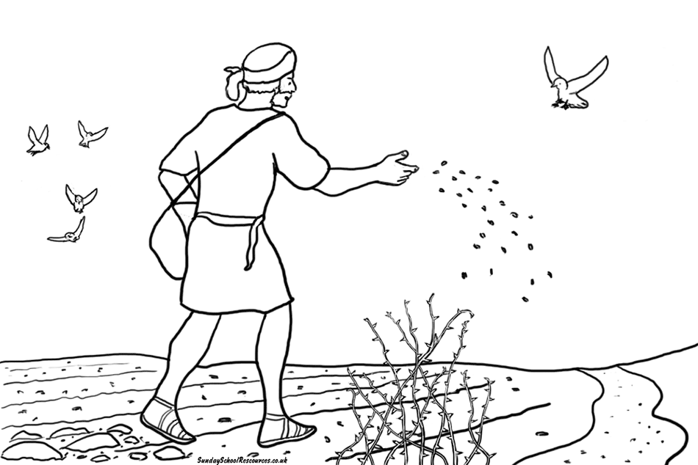
Growing
Now let’s see if you remember what happened to the seeds in the parable.
Some seed fell on the path. And what happened?
(Pretend to be a bird and pick up some of the packets.)
Some seed fell on the rocky ground. What happened?
(Pretend to wilt and pick up some more packets of seeds.)
Where some seeds fell, weeds began to grow. What did the weeds do to the new little plants?
(Pretend to be choked. Pick up more seed packets.
Other seed fell on good soil. What happened?
(Yes! They grew! Pretend to grow. They produced lots of fruit and more seeds – throw more packets)

Slide 11
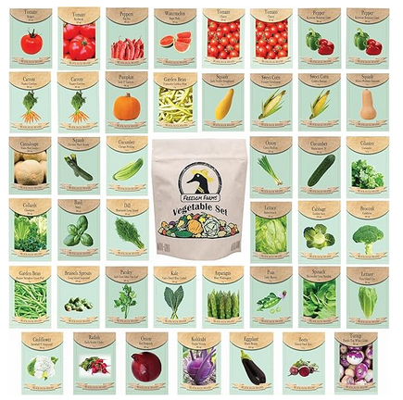
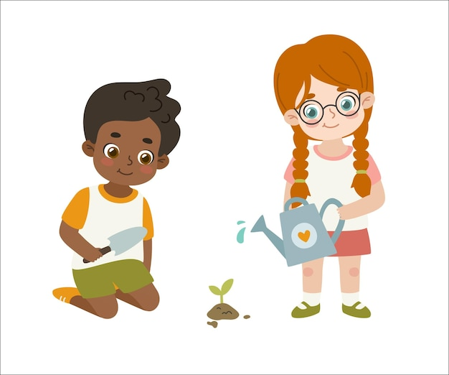
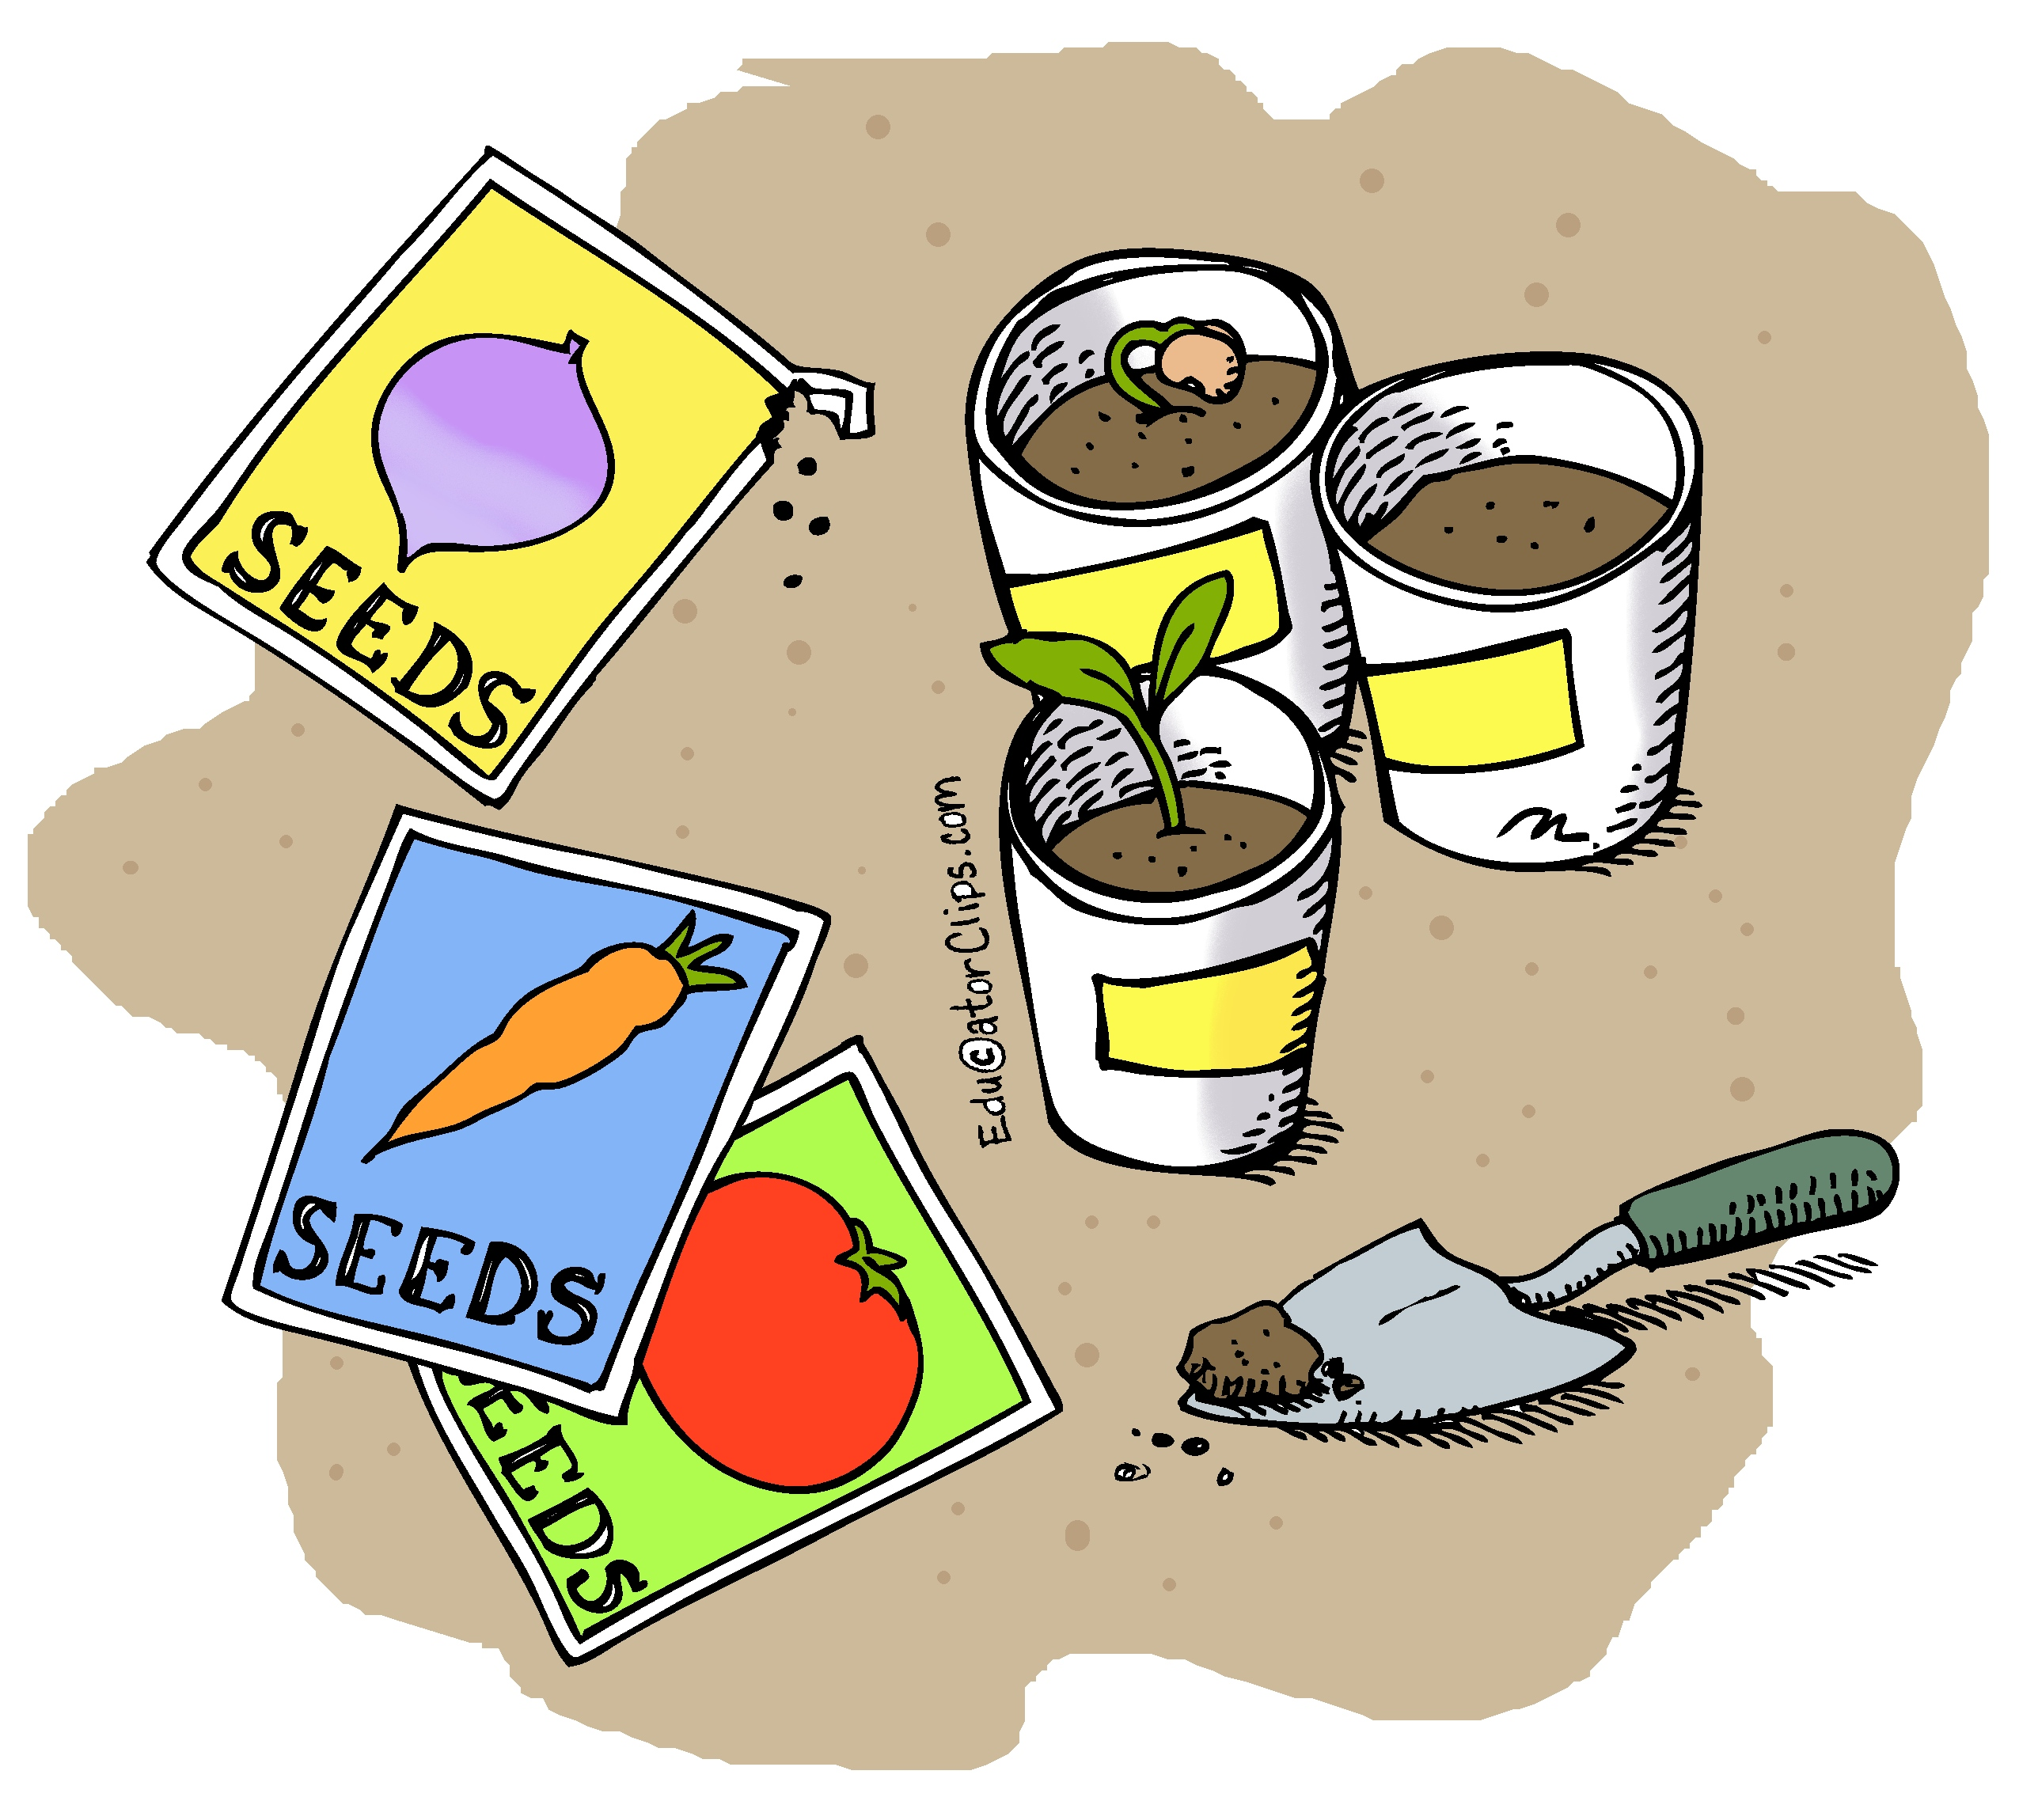
Activity
Have you bean told about Jesus?
Jesus is the Son of God, the Creator of you, me, these seeds, the world and all things! He loves us so much!
Telling others about Jesus is like scattering seed.
You never know who might be ready to hear about Jesus and will accept Him as their Savior.
So, I’m going to give you some seed packets. We’ll put a Bible verse on them with a QR code that will open the Bible to whoever you give it to.
God’s Holy Spirit will water the Word of God. Hopefully they will grow.

Slide 12

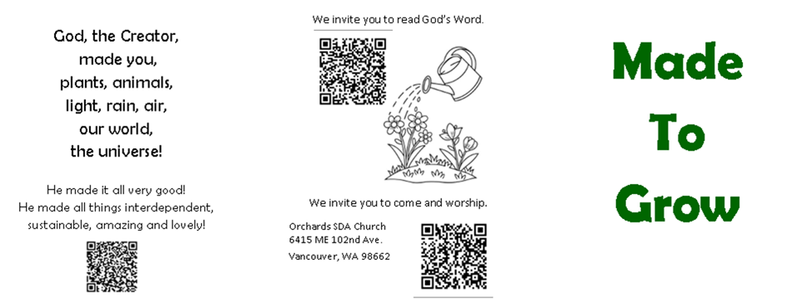
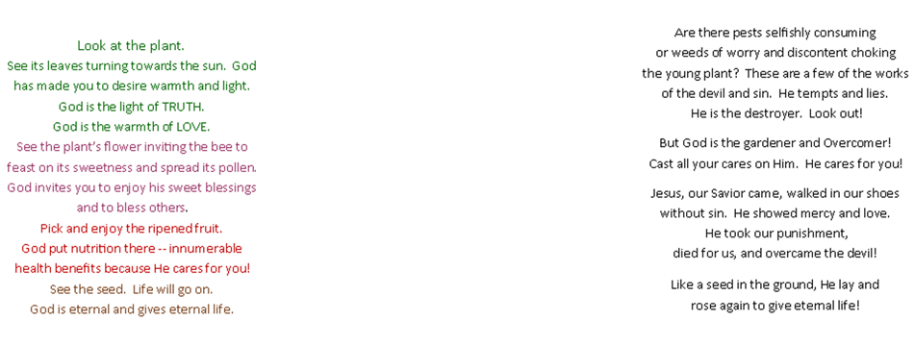
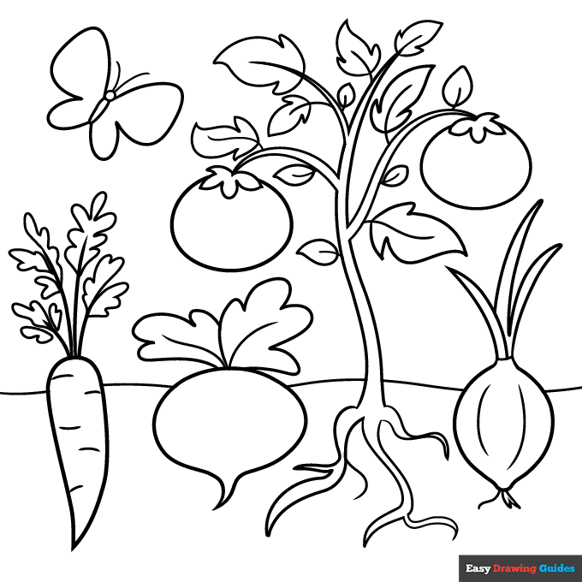


Draw
Directions:
Draw a picture of a plant in the empty place.
You decide what the leaves look like. Plants have all different kinds.
Draw a flower on the plant. You choose what the flower looks like.
Draw a fruit and show some seeds.

Slide 13
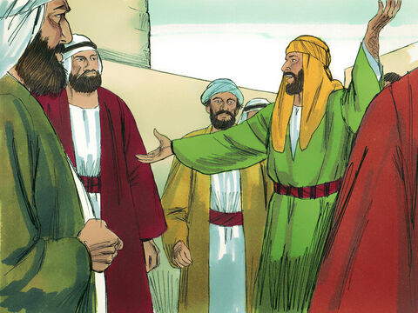
Philip told people in Samaria about Jesus
The Messiah, our Savior has come!
His name is Jesus.
He came to save everyone from their sins. He died and rose again!
^{Acts 8:5} Philip went down to a city in Samaria and proclaimed the Messiah there.
What would you tell others
about Jesus?

Slide 14
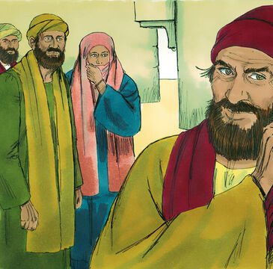
Simon in Samaria
I am the great power of god.
Watch what I can do.
⁹ Now for some time a man named Simon had practiced sorcery in the city and amazed all the people of Samaria. He boasted that he was someone great, ¹⁰ and all the people, both high and low, gave him their attention and exclaimed, “This man is rightly called the Great Power of God.” ¹¹ They followed him because he had amazed them for a long time with his sorcery.
Simon has done many amazing things.
He is rightly called the Great Power of God.

Slide 15
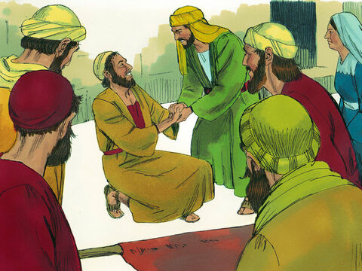
Philip told people in Samaria about Jesus
You are healed by the power of Jesus.
This Philip can do even more amazing things than Simon!
^{Acts 8:6} When the crowds heard Philip and saw the signs he performed, they all paid close attention to what he said. ⁷ For with shrieks, impure spirits came out of many, and many who were paralyzed or lame were healed. ⁸ So there was great joy in that city.
This is amazing!

Slide 16
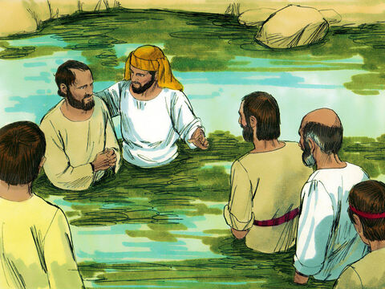
They believed in Jesus and were baptized.
Because you believe Jesus is your Savior and forgives you,
I baptized you in His name, Jesus, the Son of God.
¹² But when they believed Philip as he proclaimed the good news of the kingdom of God and the name of Jesus Christ, they were baptized, both men and women.
¹³ Simon himself believed and was baptized.
I believe that Jesus is a powerful god. I will get baptized too.

Slide 17
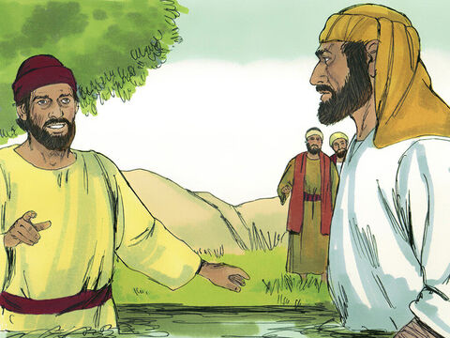
Simon followed Philip
Philip you are doing amazing wonders! I will follow you.
And he followed Philip everywhere, astonished by the great signs and miracles he saw.

Slide 18
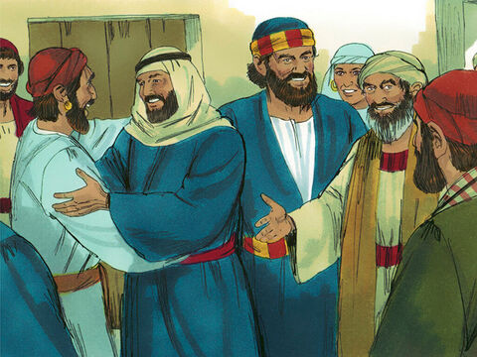
Peter and John came
Peter and John have come!
They are apostles of Jesus.
They were close friends with Jesus and chosen leaders.
¹⁴ When the apostles in Jerusalem heard that Samaria had accepted the word of God, they sent Peter and John to Samaria. ¹⁵ When they arrived, they prayed for the new believers there that they might receive the Holy Spirit, ¹⁶ because the Holy Spirit had not yet come on any of them; they had simply been baptized in the name of the Lord Jesus. ¹⁷ Then Peter and John placed their hands on them, and they received the Holy Spirit.
We’re so glad to be here! We’ve heard many have believed in Jesus and have been baptized!

Slide 19

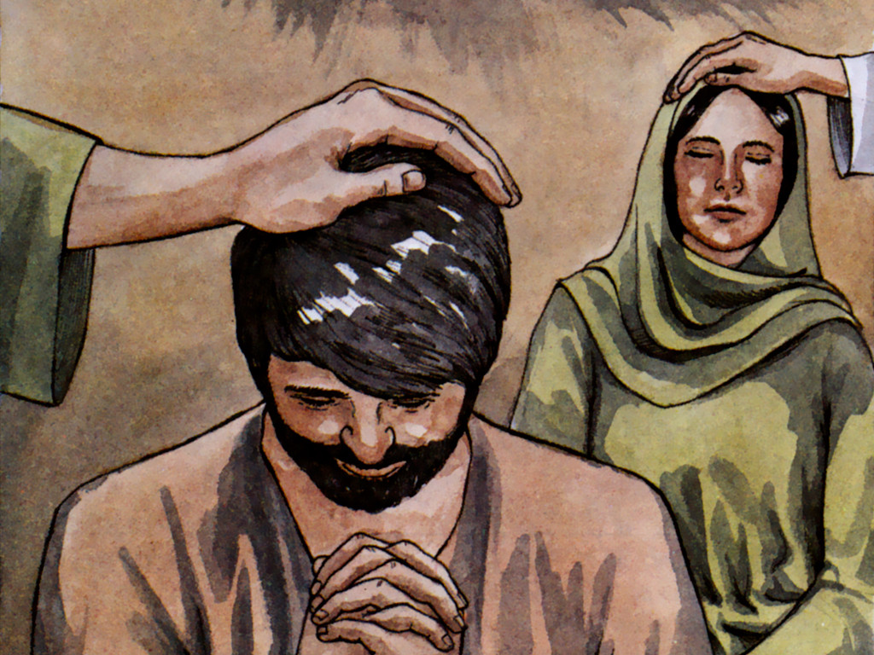
Peter and John came
Heavenly Father, LORD Jesus, please send your Holy Spirit to these believers.
¹⁴ When the apostles in Jerusalem heard that Samaria had accepted the word of God, they sent Peter and John to Samaria. ¹⁵ When they arrived, they prayed for the new believers there that they might receive the Holy Spirit, ¹⁶ because the Holy Spirit had not yet come on any of them; they had simply been baptized in the name of the Lord Jesus. ¹⁷ Then Peter and John placed their hands on them, and they received the Holy Spirit.
Send your special gift, the Holy Spirit and guide these believers to all Truth.
Give them your gracious gifts.

Slide 20
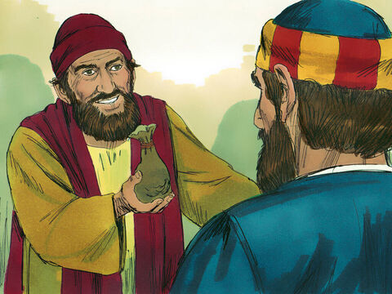
Power Hungry
He doesn’t want the Spirit. He just wants power.
Give me this ability too.
I want to be able to give people the Holy Spirit.
Pray to the LORD for me so that nothing bad will happen to me!
¹⁸ When Simon saw that the Spirit was given at the laying on of the apostles’ hands, he offered them money ¹⁹ and said, “Give me also this ability so that everyone on whom I lay my hands may receive the Holy Spirit.”
²⁰ Peter answered: “May your money perish with you, because you thought you could buy the gift of God with money! ²¹ You have no part or share in this ministry, because your heart is not right before God. ²² Repent of this wickedness and pray to the Lord in the hope that he may forgive you for having such a thought in your heart. ²³ For I see that you are full of bitterness and captive to sin.”
²⁴ Then Simon answered, “Pray to the Lord for me so that nothing you have said may happen to me.”
Repent of this wickedness and pray to the LORD. Hope that He will forgive you for having such a thought in your heart.
I see that you are full of envy, bitterness and captive to sin.
May your money perish with you!
You think you could buy
God’s gift with money! You have no part or share in this ministry!

Slide 21
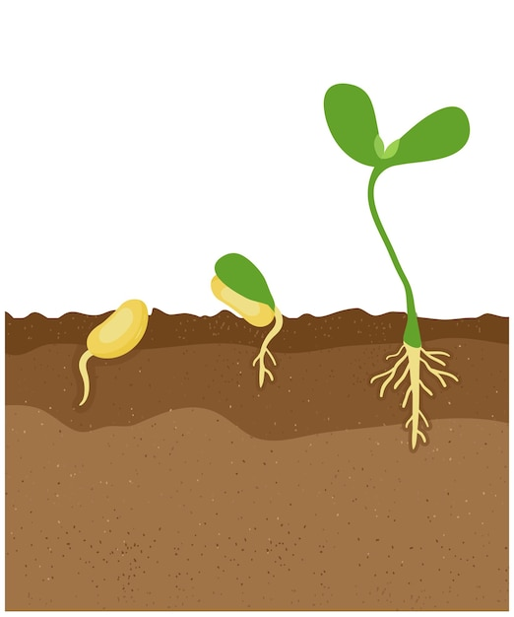
Will money make a seed grow?
No! That is a crazy thought!
God made the sun and earth and He sends the rain to make the seed grow.
We can help by watering the seed and fertilizing the ground and pulling the weeds. But God made the seed so that it will grow.
Be careful Simon! Don’t let the devil take your gospel seed!
Don’t let the weed of envy choke God’s Word given to you!
Take time to reach out to Jesus and get to know him better so you don’t wilt.

Slide 22


Slide 23
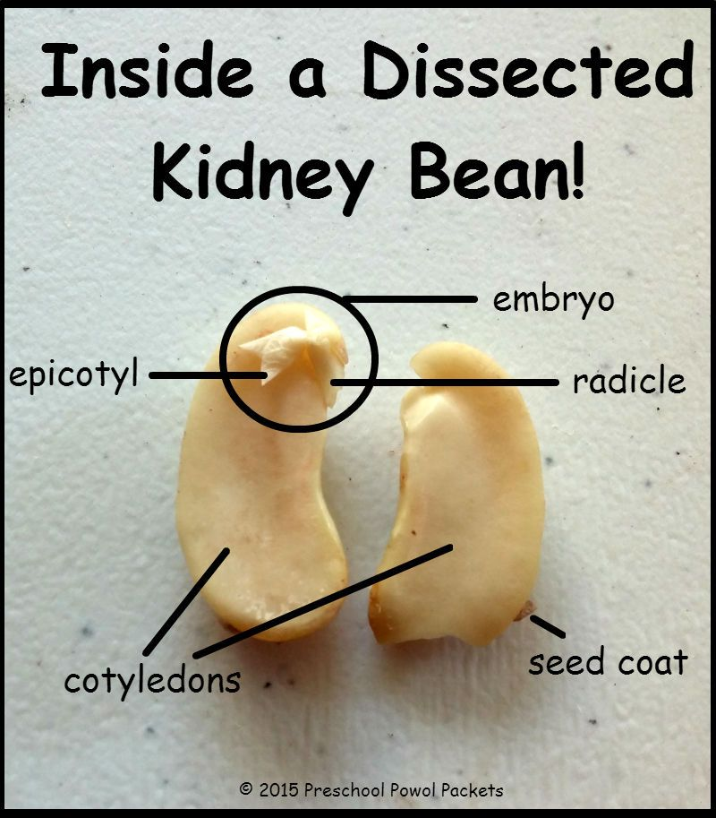
Made to Grow
God made the seeds so that they will grow.
You can look inside these soaked bean seeds to see the little plant ready to grow.
Carefully split them in half lengthwise where the little spot is on their side.
Remember God made you to grow too! He made you to grow to love Jesus more and more each day. He made you to become wise and strong.
leaves
root

Slide 24
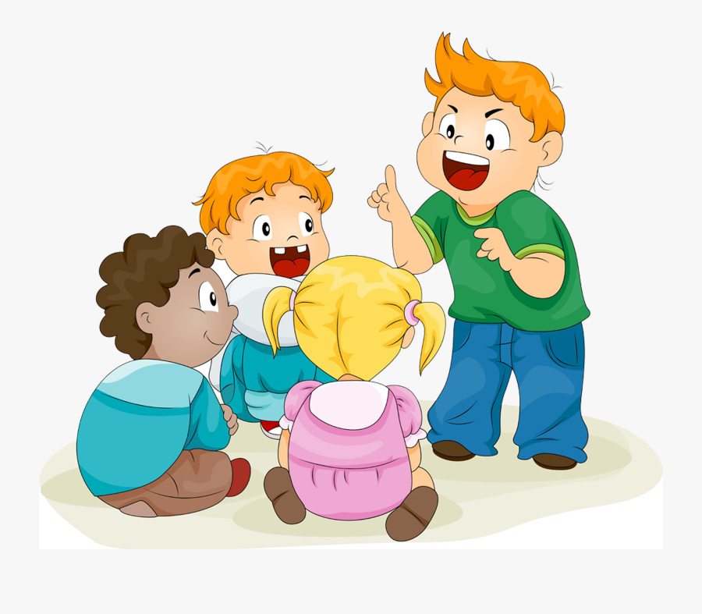
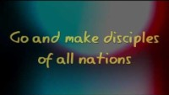
Sing it out GO

Slide 25
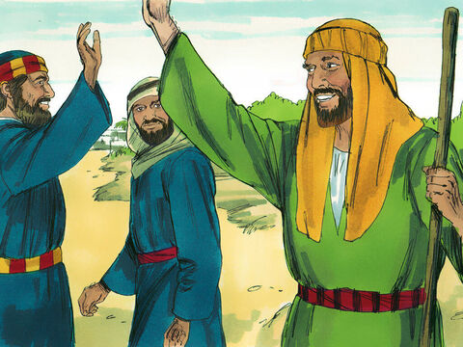
Good –bye Philip. Keep doing your good work and spreading the seeds of the gospel!
²⁵ After they had further proclaimed the word of the Lord and testified about Jesus, Peter and John returned to Jerusalem, preaching the gospel in many Samaritan villages.
Good-bye Peter and John.
Thanks for coming!
You have greatly encouraged us!

Slide 26
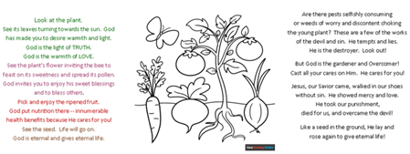
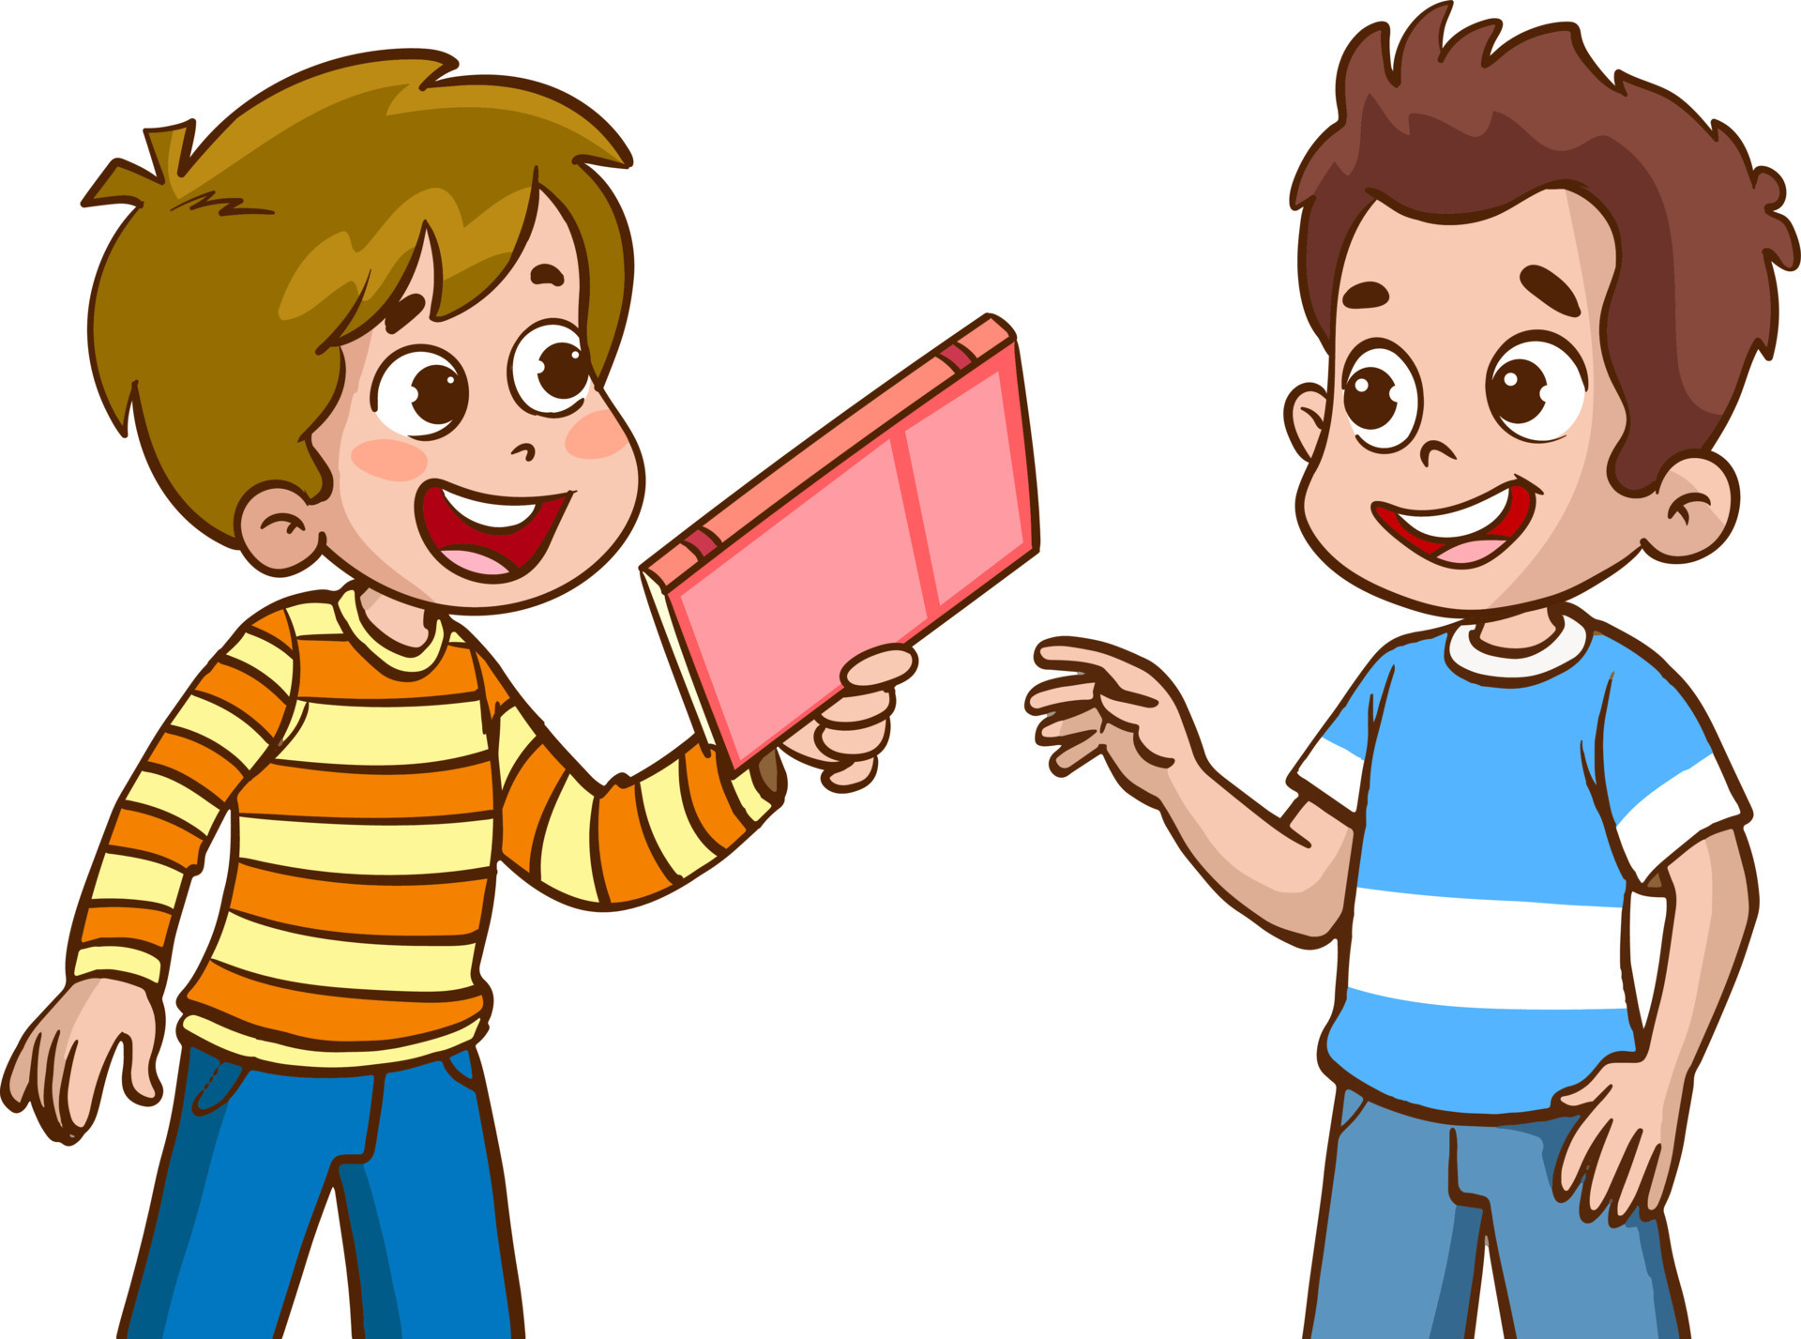
Remember to spread the seeds of God’s love everywhere!
Staple each pamphlet(s) you finished onto a seed packet.
You may take some to give to your neighbors.
Next week I hope we can give some out around the church.

Slide 27

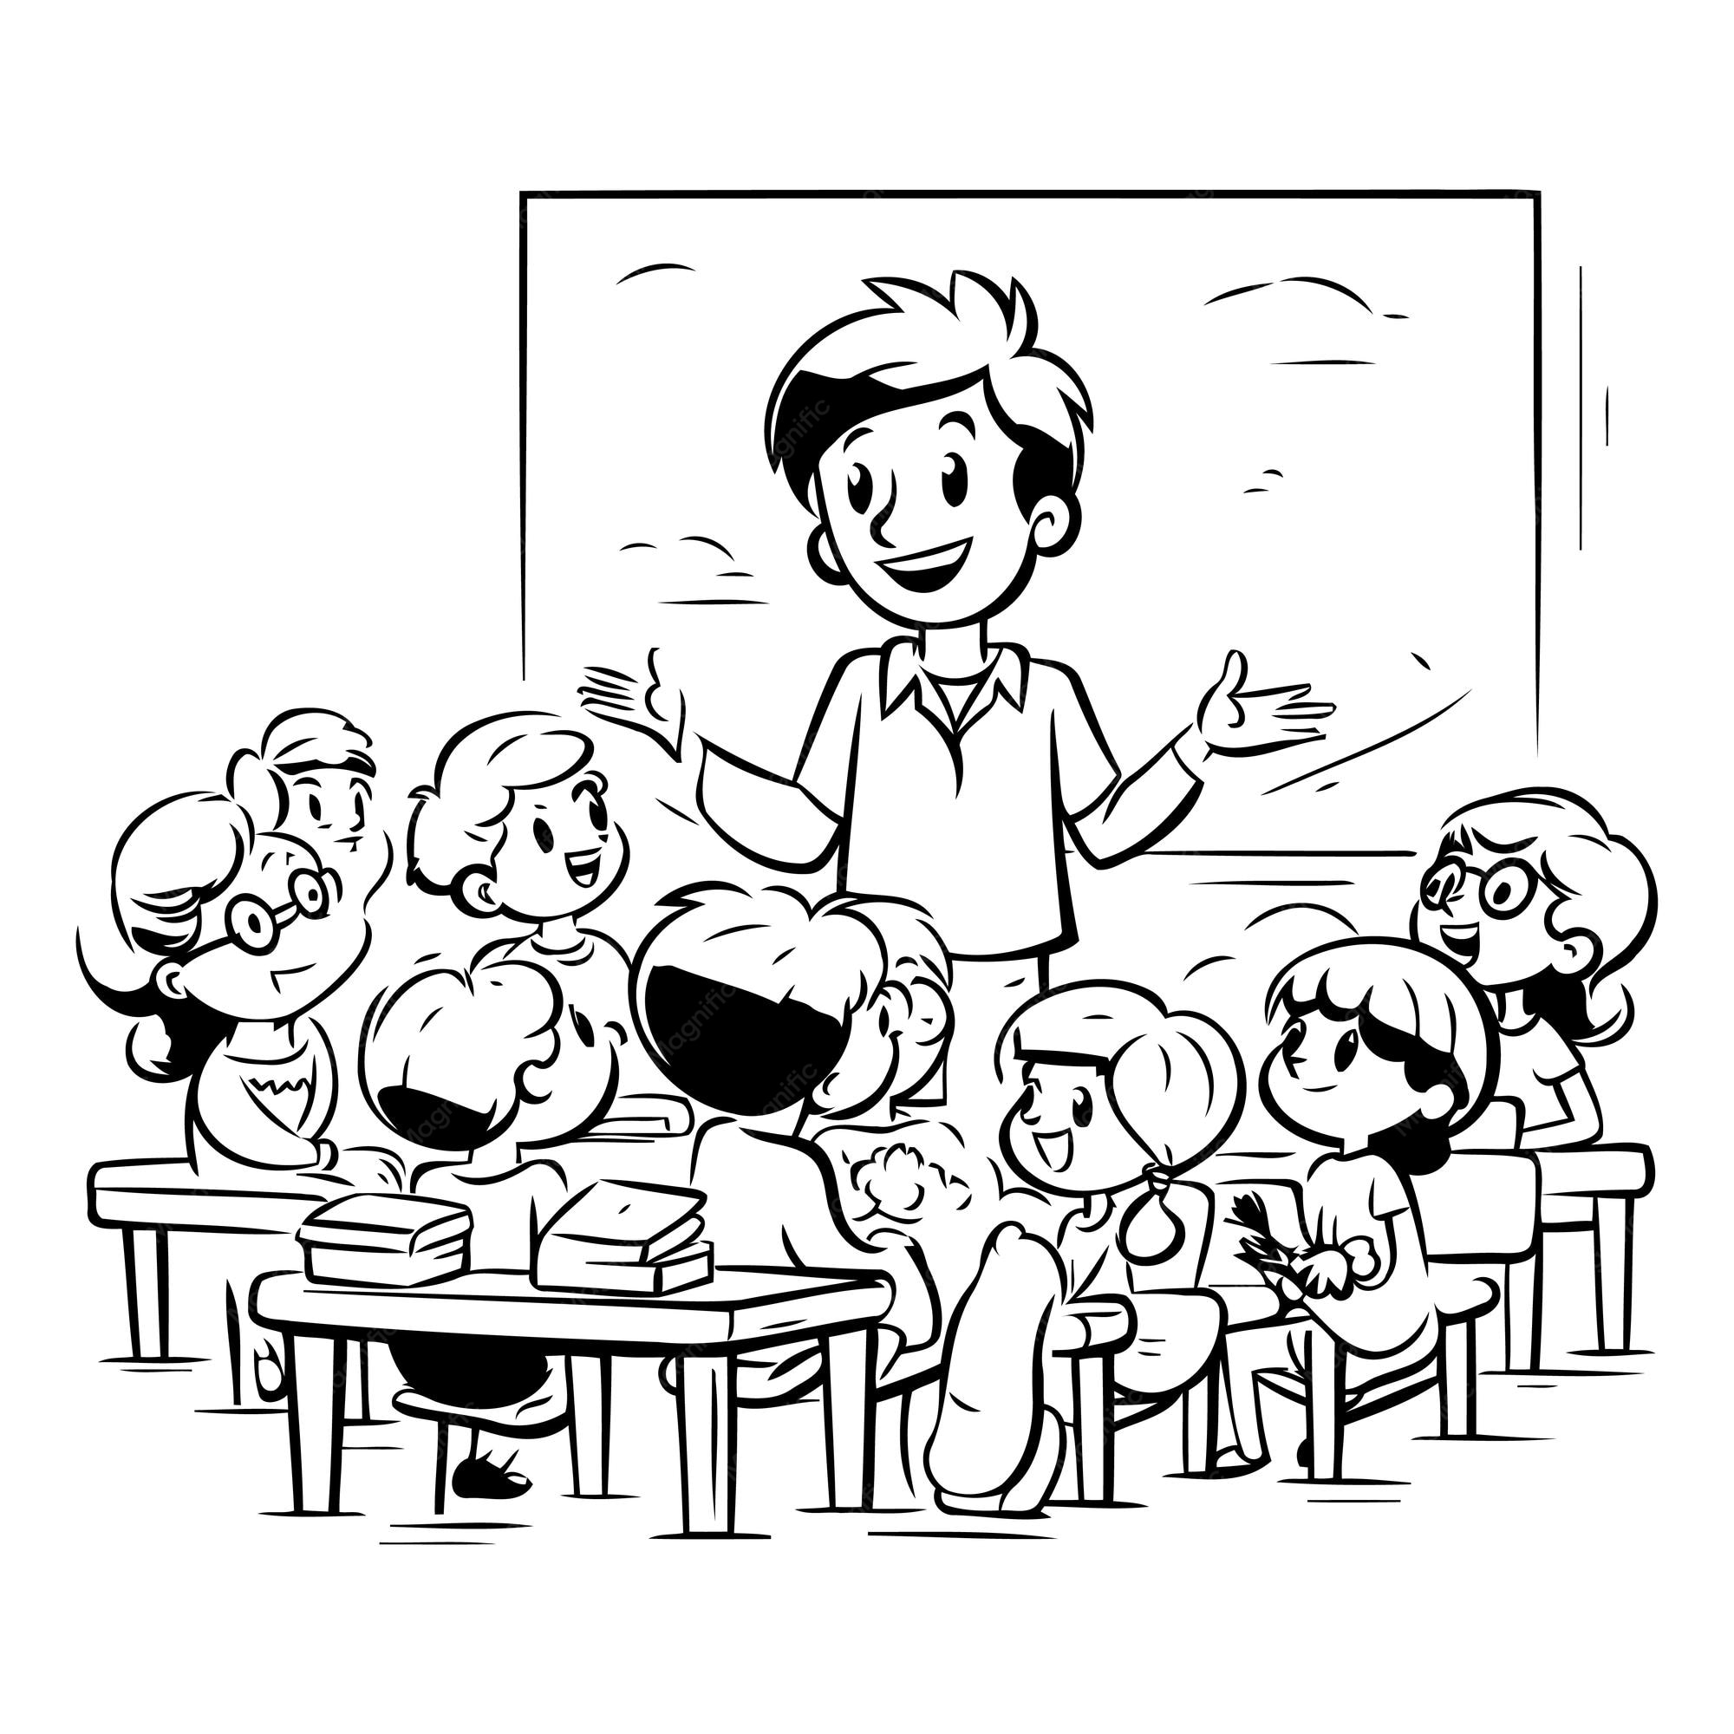
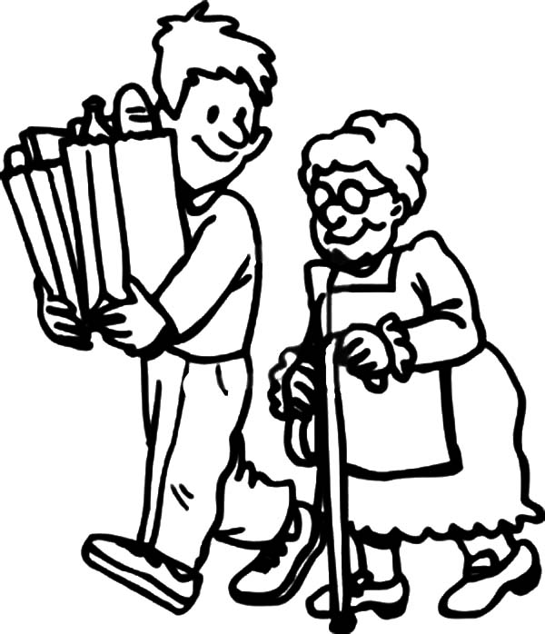

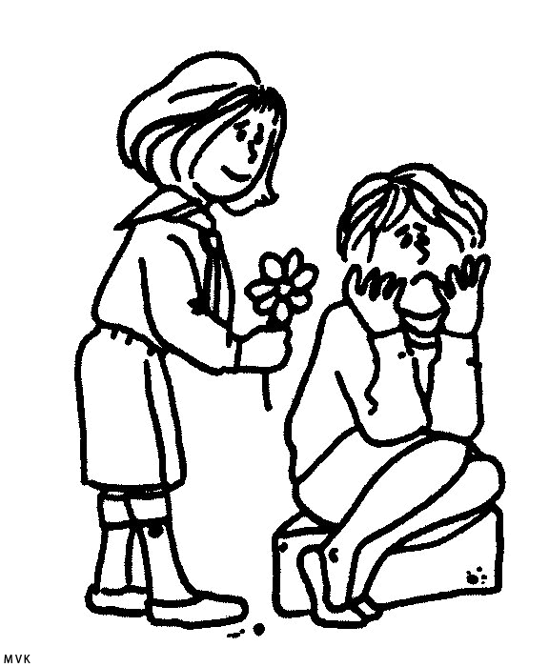
Content
Serving
Each of you should
use whatever gift
you have received
to serve others,
as faithful stewards
of God’s grace
in its various forms.
1 Peter
4:10
Romans
12:4-8
Philip and others were given the Holy Spirit. The Holy Spirit enabled them to share the good news of salvation with others.
Peter, John, and the other apostles were chosen by Jesus and given the Holy Spirit. They were chosen to have leadership responsibility. The Holy Spirit enabled them to not only share the good news but also be God’s way to give the Holy Spirit to others.
God gives different talents and responsibilities to each of us to use to help others and glorify God. They can’t be bought with money, but are a gift generously given by God. But we can ask God for more gifts !

Slide 28
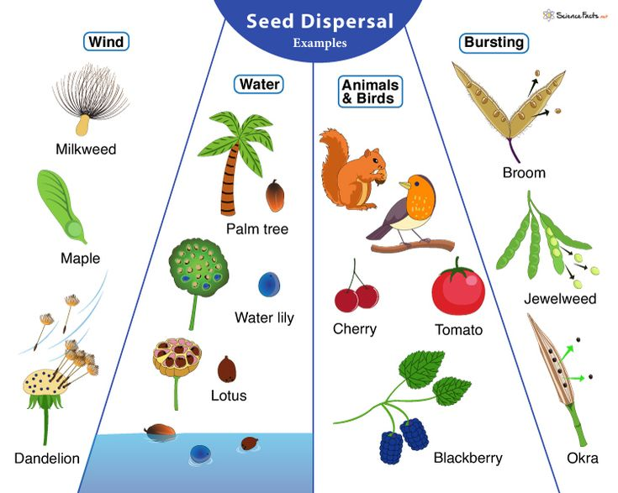
How are seeds spread?
Let’s go outside and see if we can find some seeds!
OR
I have some seeds for you to look at.
Philip and many others spread the gospel – the good news about Jesus wherever they went.

Slide 29
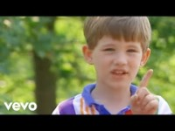
Sing with Cedarmont kids This Little Light of Mine

Slide 30
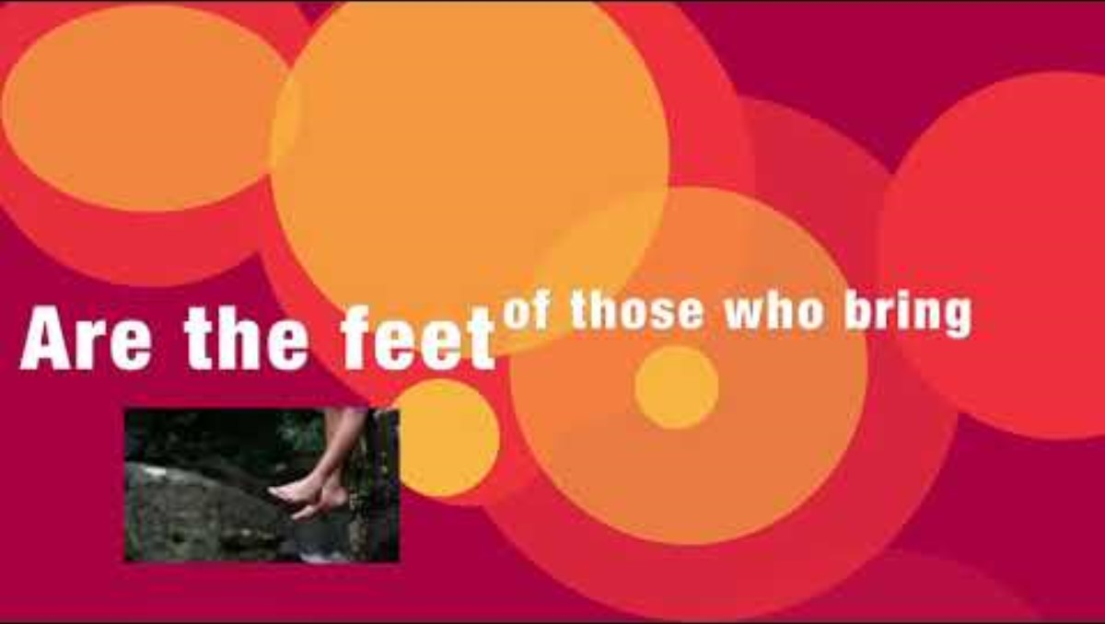
Romans 10:14-15
Isaiah 52:6-7

Slide 31
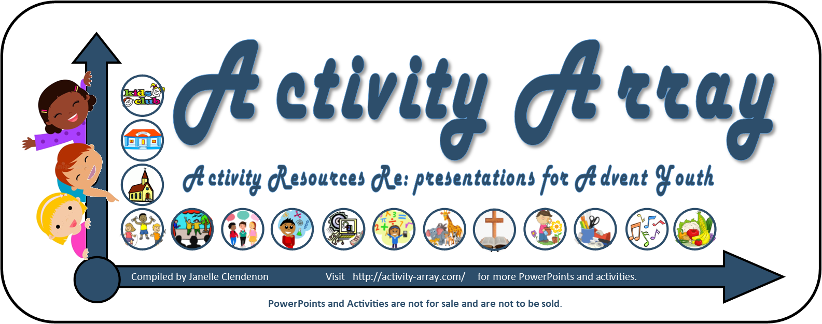
https://activity-array.com/

