Slide 1
Our Father
The Lord’s Prayer

Slide 2
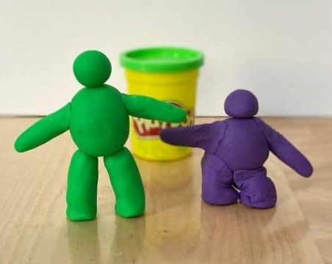
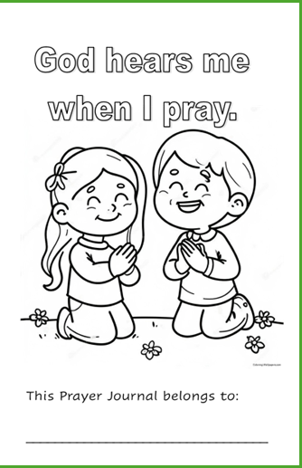
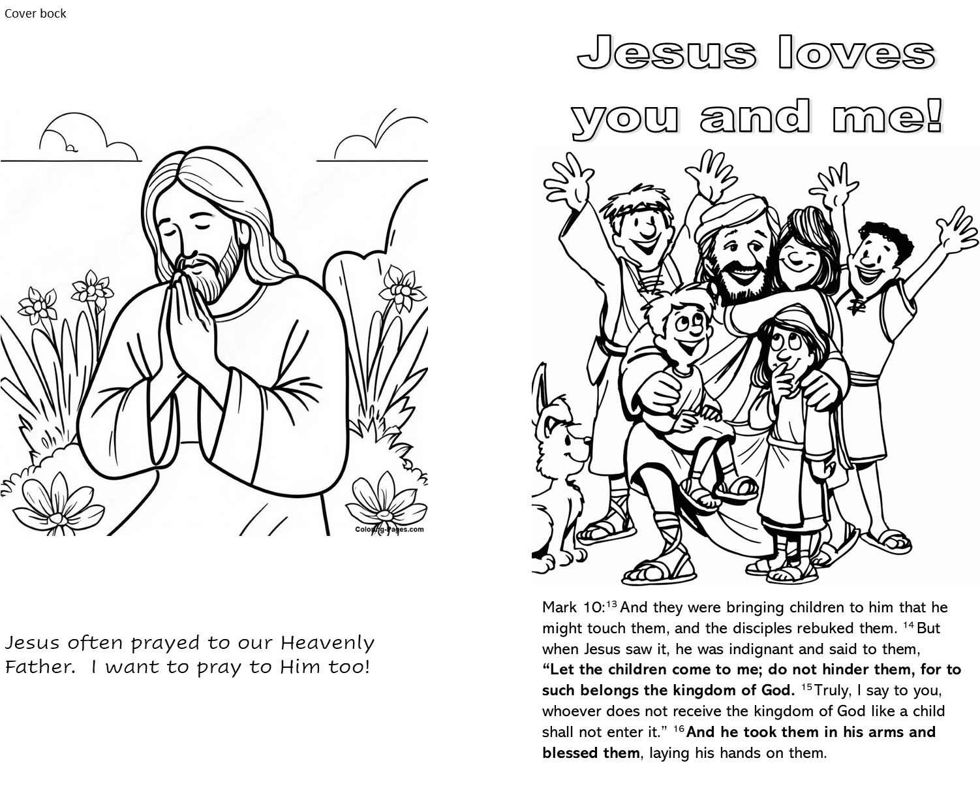
Today you get to make a prayer journal booklet.
You will get the cover and first part today to color.
Next week you will get the second part.
The following week you will get the last part.
We’ll staple all the parts together and you will get to take them home.
Each part has pages that you can write in or draw pictures to answer the questions. If you can’t do that, your parents can help you.
You can color your journal now or wait until you get home.
Today you can also illustrate our stories with playdough.

Slide 3
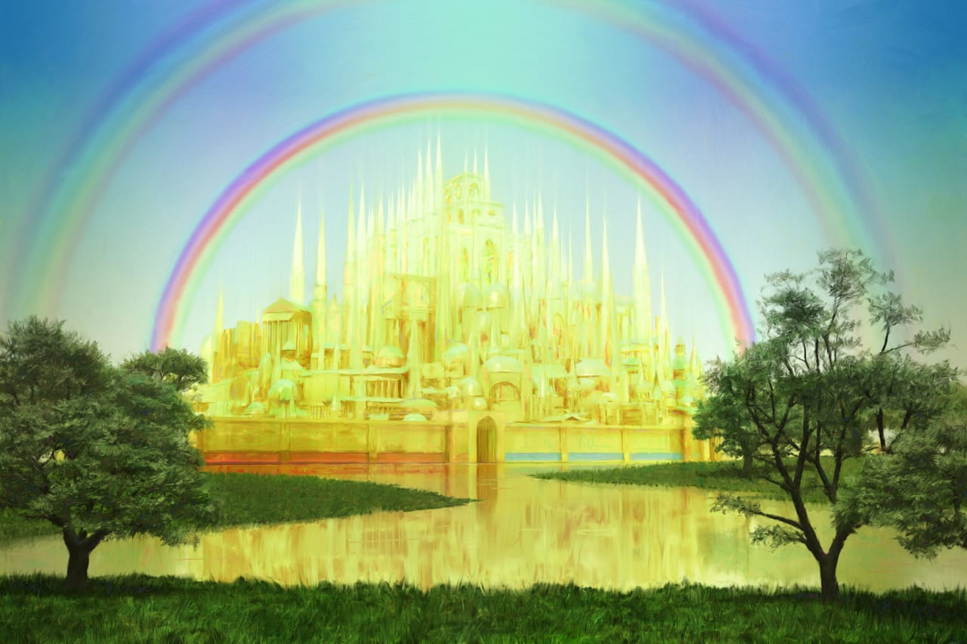
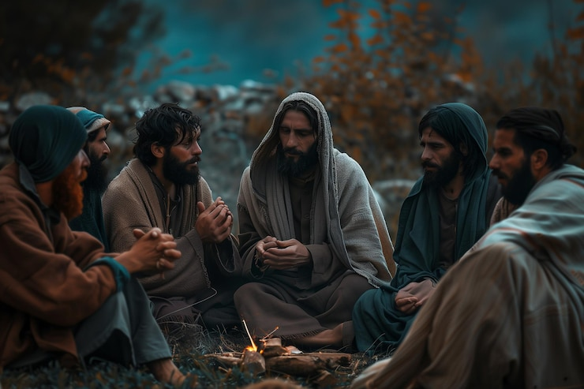


“This, then, is how you should pray:
“‘Our Father in heaven,
Jesus, we know you often go out to pray.
Teach us to pray.
Remember
Where does God the Father live?
Matthew
6:9

Slide 4
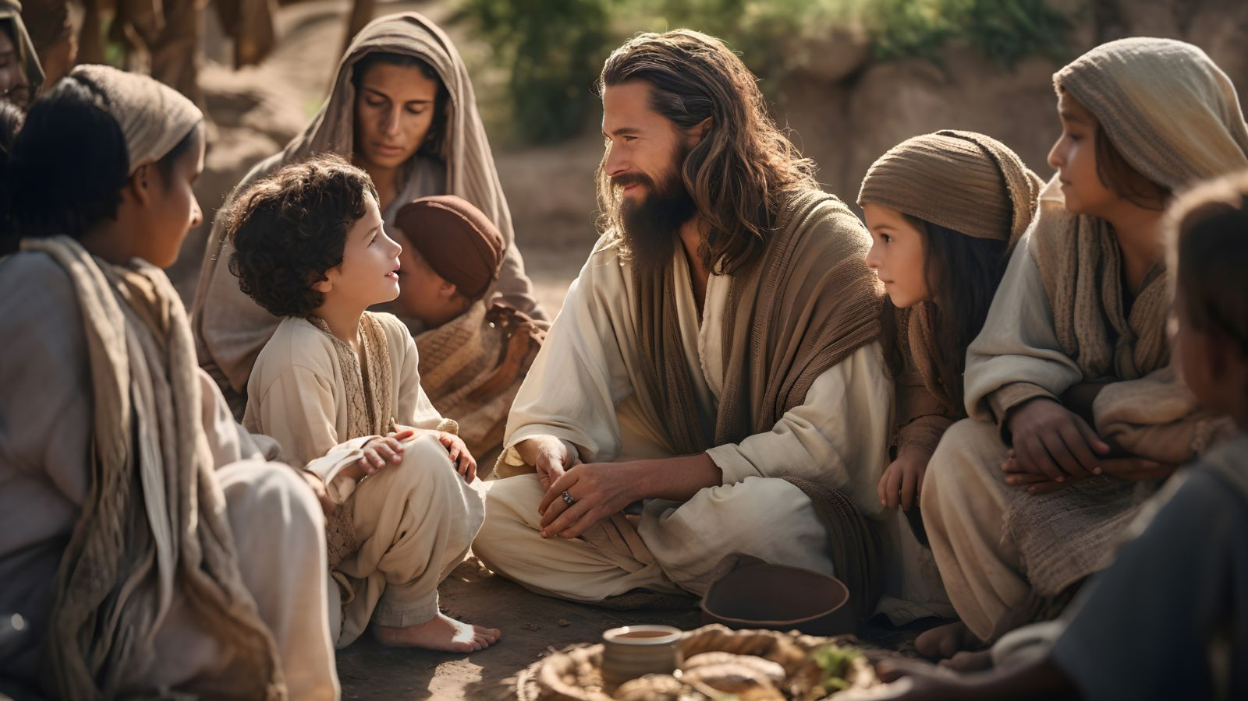
We are God’s creation and children
You can tell your Heavenly Daddy
whatever is on your heart and mind
1 John 3:1
“See what great love the Father has lavished on us, that we should be called children of God! And that is what we are! “
Romans 8:14
“For those who are led by the Spirit of God are the children of God.”
Galatians 3:26
“So, in Christ Jesus you are all children of God through faith,”

Slide 5
We can learn about Our Father in Heaven from the Bible and from nature.
Let’s see what we can learn about fathers and our Heavenly Father.

Slide 6
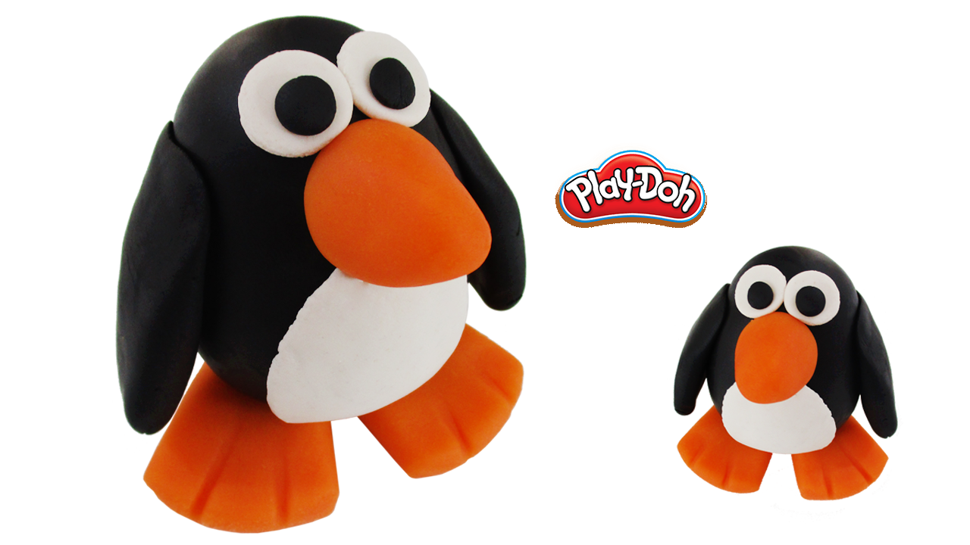
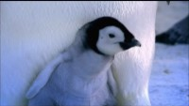
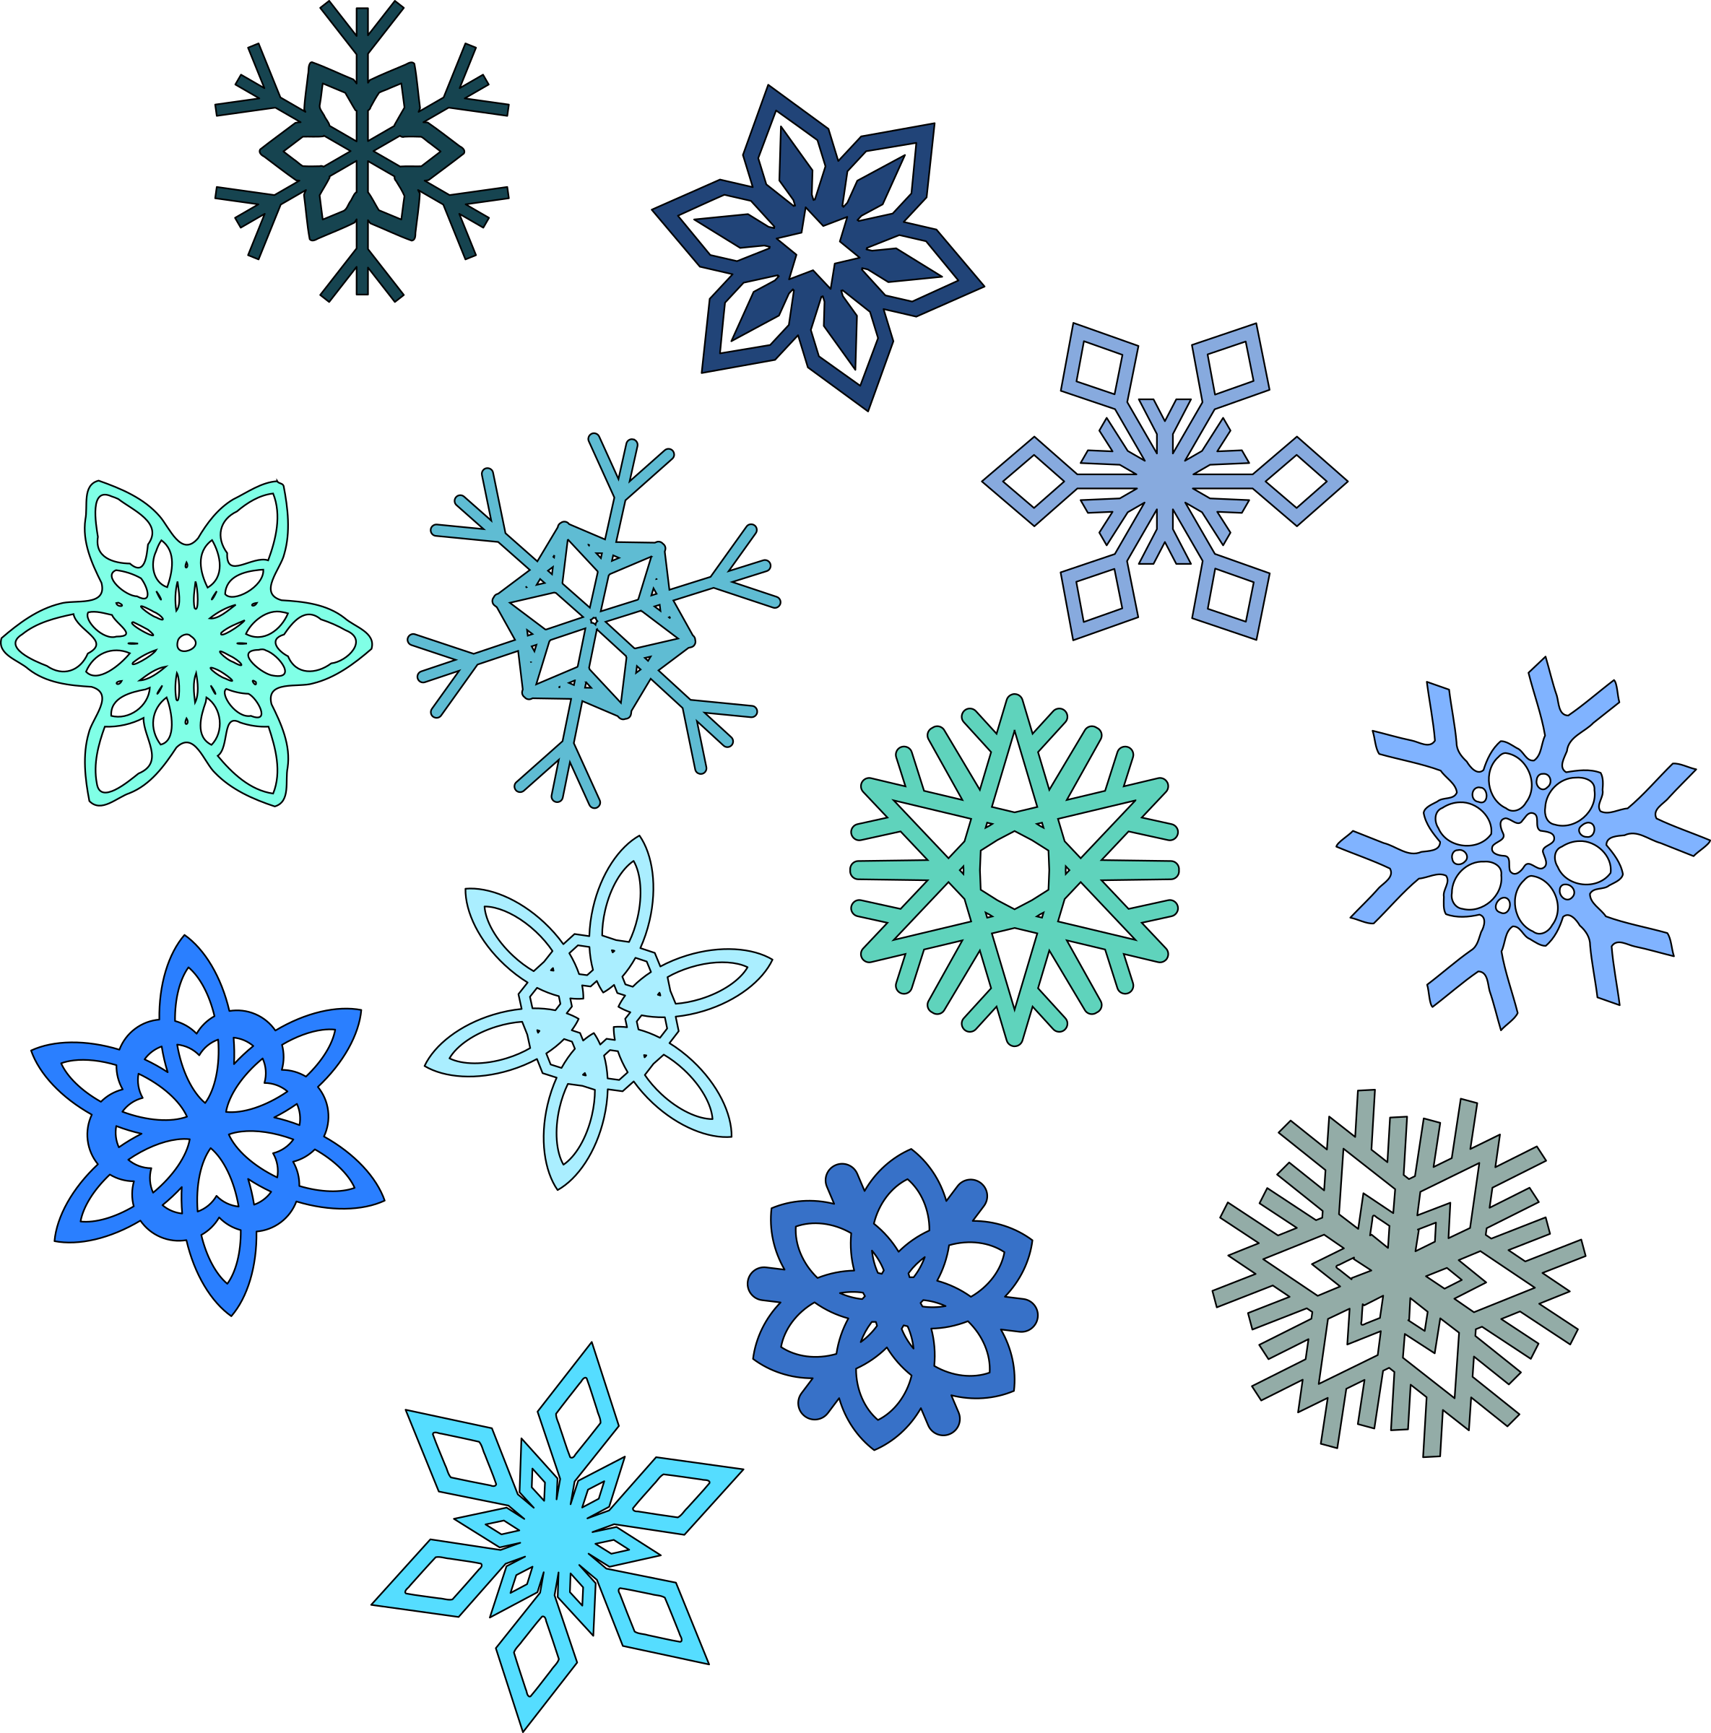
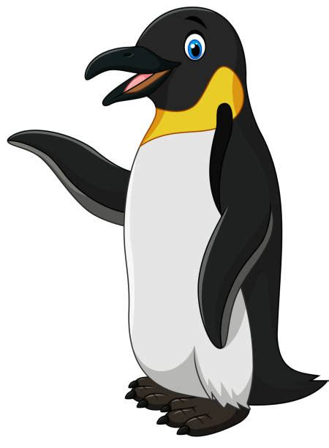

God protects us through the storms and hard times in life. He is strong and faithful!
I’ve kept our egg safe in my little pouch through cold days and blizzards.

Slide 7
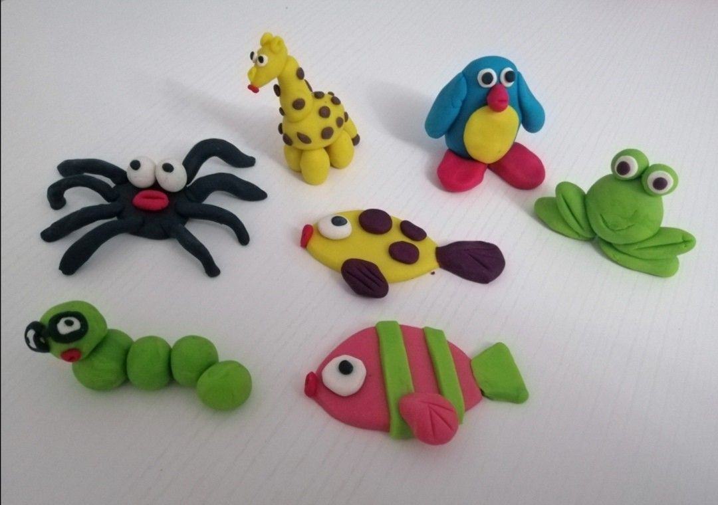
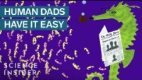
There are some great animal dads!
God is willing to sacrifice a lot for us
He loves and cares for us – just like that!

Slide 8
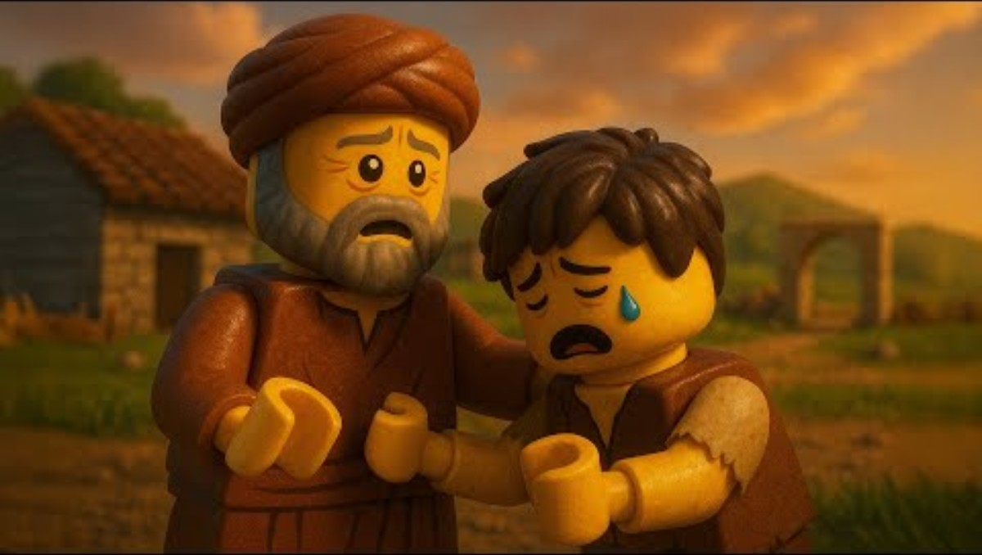
Every child is important to our Heavenly Father!
Jesus loved telling parables to show what God is like. Watch what the Father does in this parable.
God gives us choices.
He loves us.
He forgives us.
He welcomes us home!

Slide 9
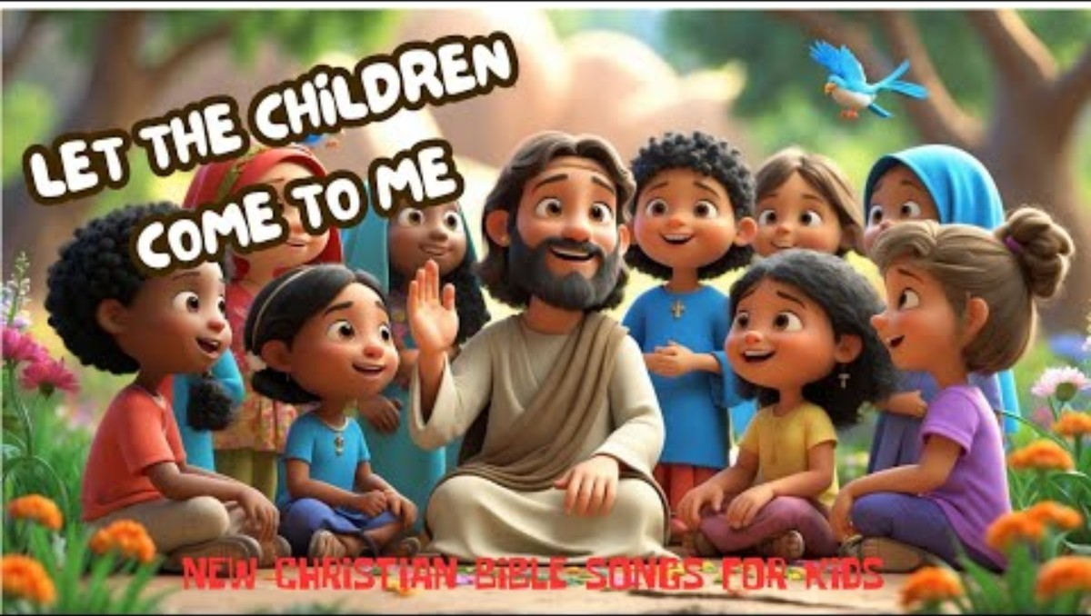
Let the little children come to me
Luke 18
¹⁵ People were also bringing babies to Jesus for him to place his hands on them. When the disciples saw this, they rebuked them. ¹⁶ But Jesus called the children to him and said, “Let the little children come to me, and do not hinder them, for the kingdom of God belongs to such as these. ¹⁷ Truly I tell you, anyone who will not receive the kingdom of God like a little child will never enter it.”

Slide 10
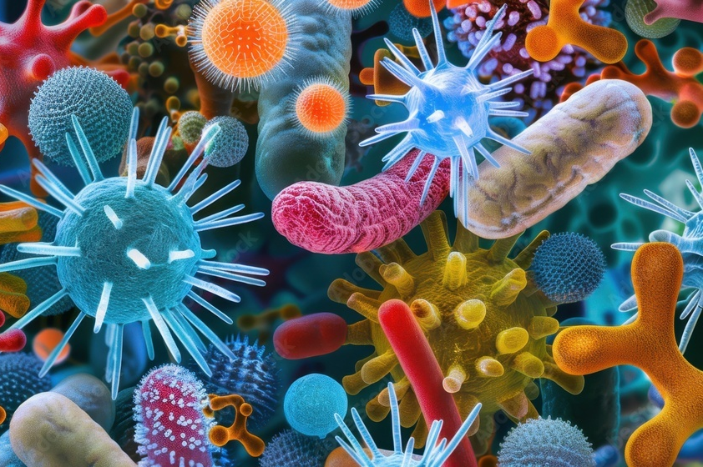
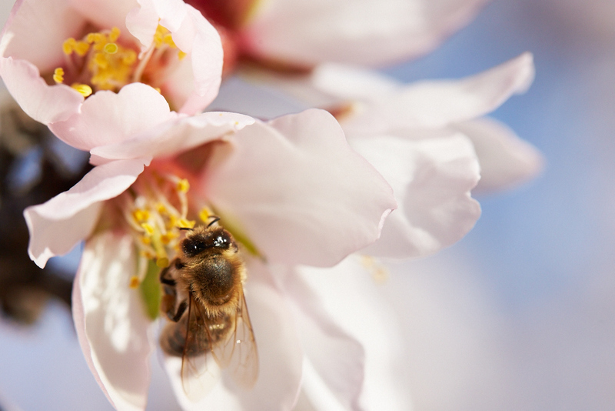
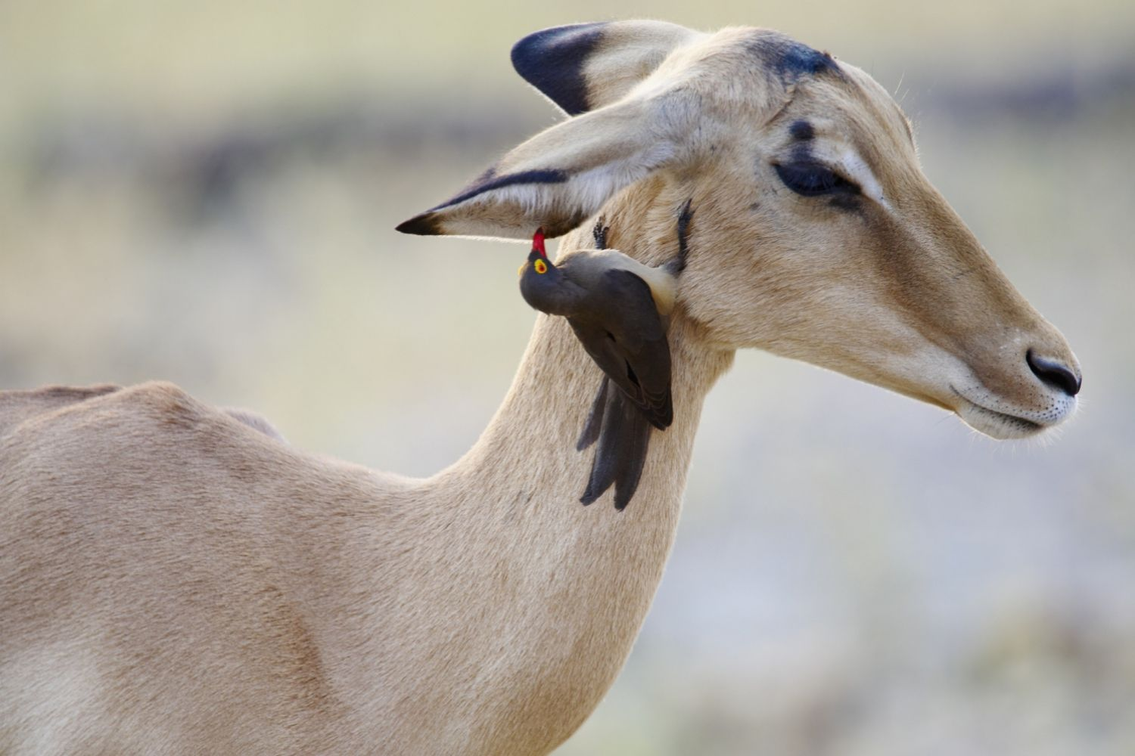
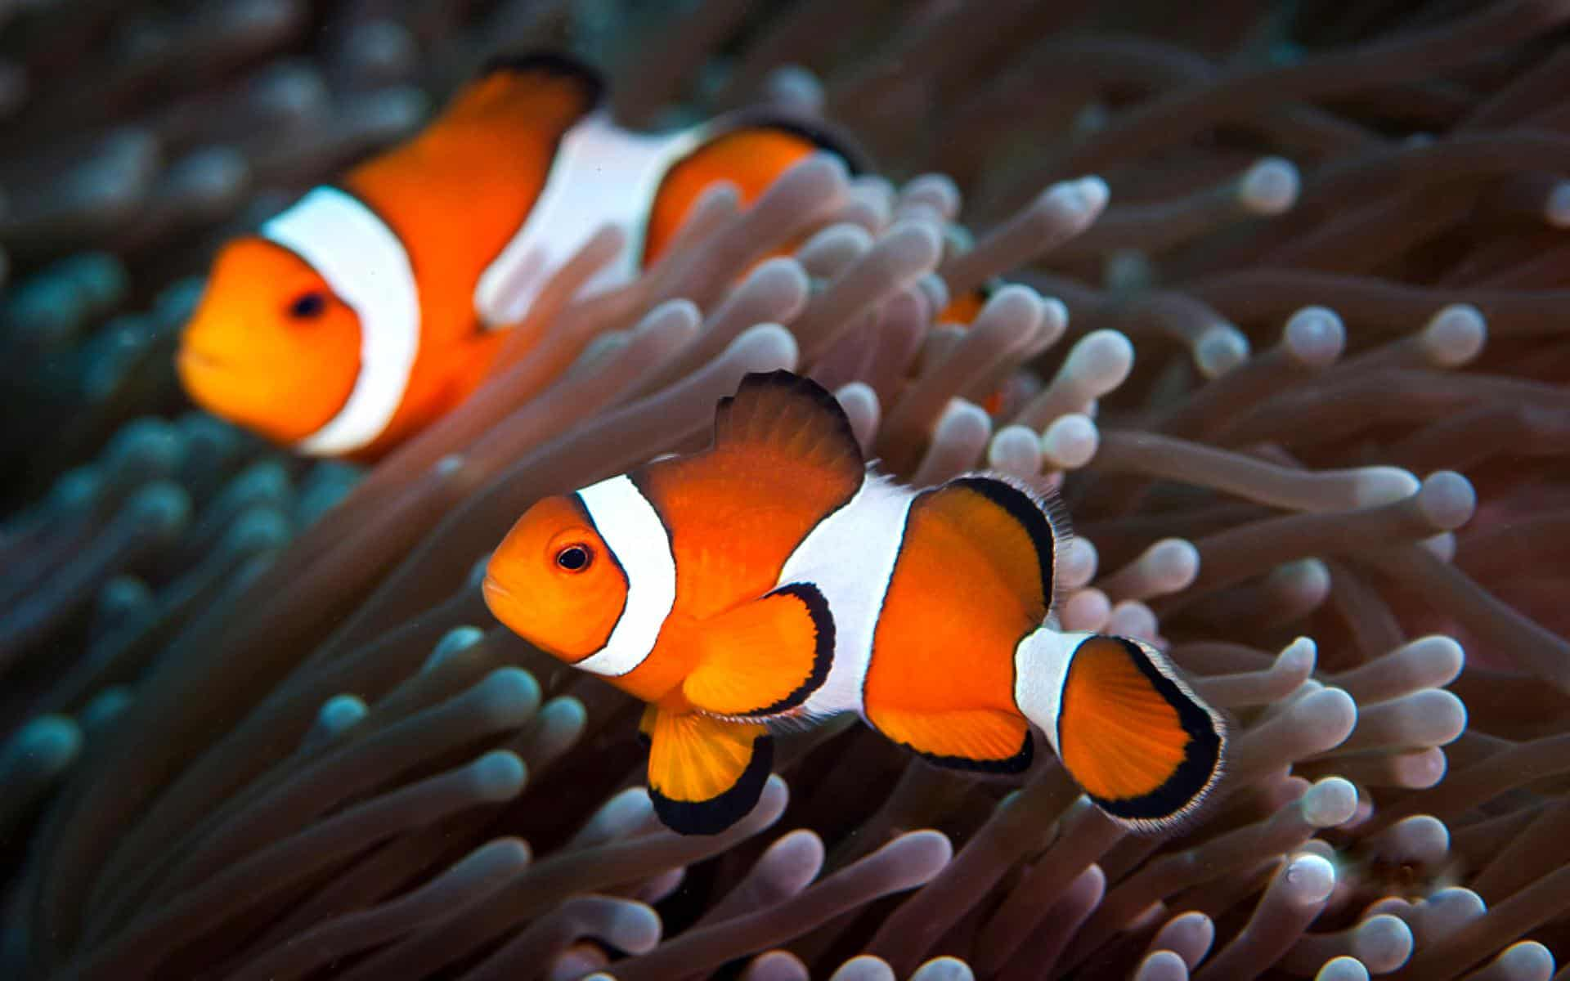
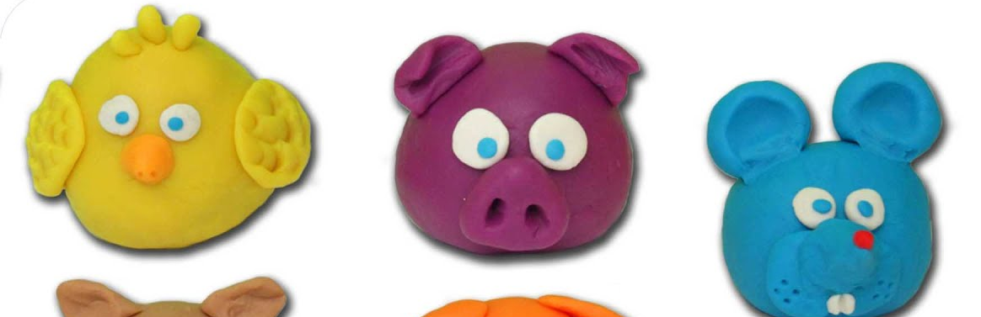
Our Father
Creator & Sustainer
Do you think God
wants to work together with us?
Our Heavenly Father loves to make things. He is the Creator of all things.
When He creates things, he doesn’t just make one thing. He makes many things that will work together. They each need the other and help each other.
Let’s think of some examples.
How do you think these birds called the oxpeckers is helping the impala and helps other grazing animals?
Yes, he eats the pesky ticks, flies, and other bugs. He also warns the animals of danger. And he gets a free ride with lunch!
The sea anemone protects the clownfish and provides shelter.
The clownfish cleans the anemone and protects it from fish that like to eat it. The clownfish’s waste attracts tiny food that they both like to eat.
How do bees and flowers help each other?
Flowers provide nectar. Bees eat the nectar and carry pollen to other flowers which begins the process of making seeds and fruit.
Even in our body there’s very tiny microorganisms that are very necessary for our digestion to break down the food so that all parts of our body receive the nutrition it needs.
There’s others that help us get well and stay well.

Slide 11

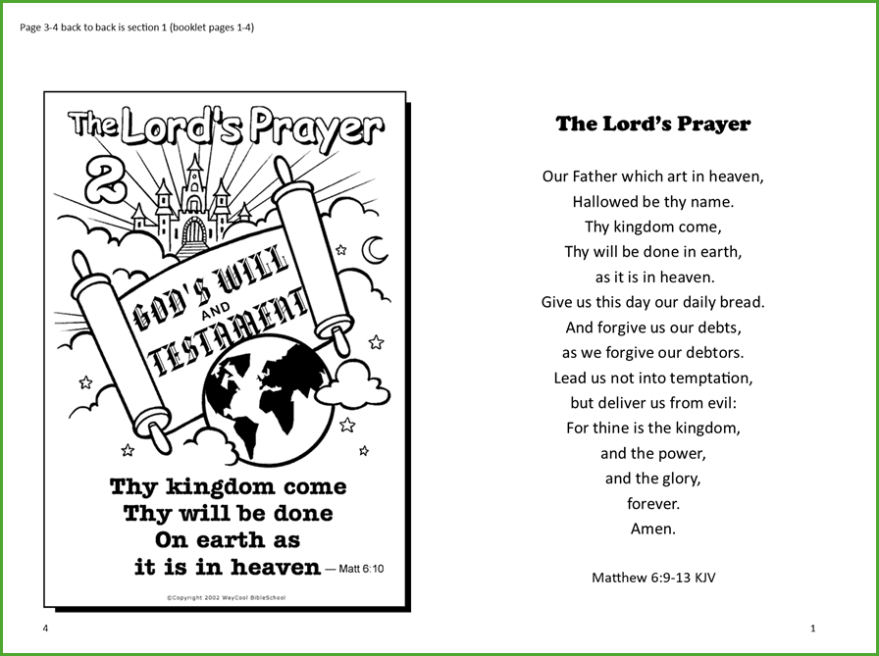
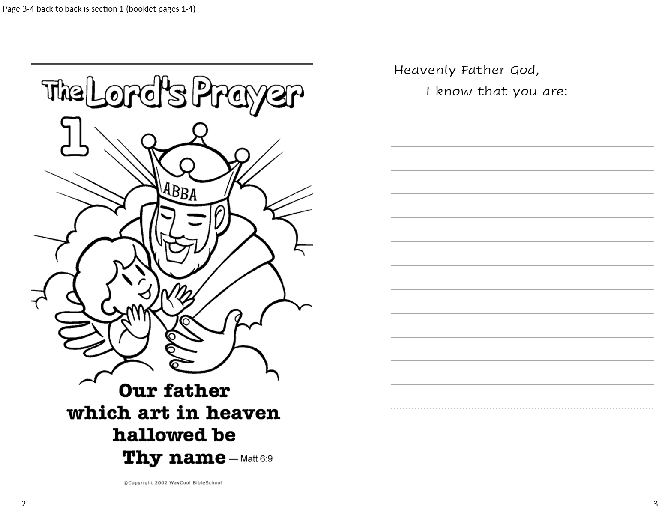

So, what is our Heavenly Father like?

Slide 12
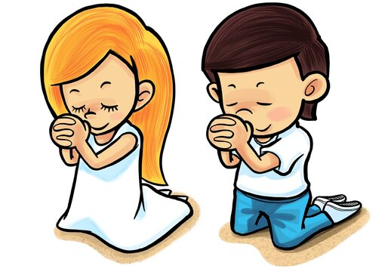
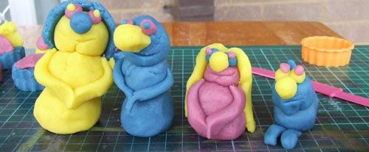
Father
Your name is HOLY
“This, then, is how you should pray:
“‘Our Father in heaven, hallowed be thy name
Our Father in heaven, hallowed be thy name.
Matthew
6:9-10

Slide 13
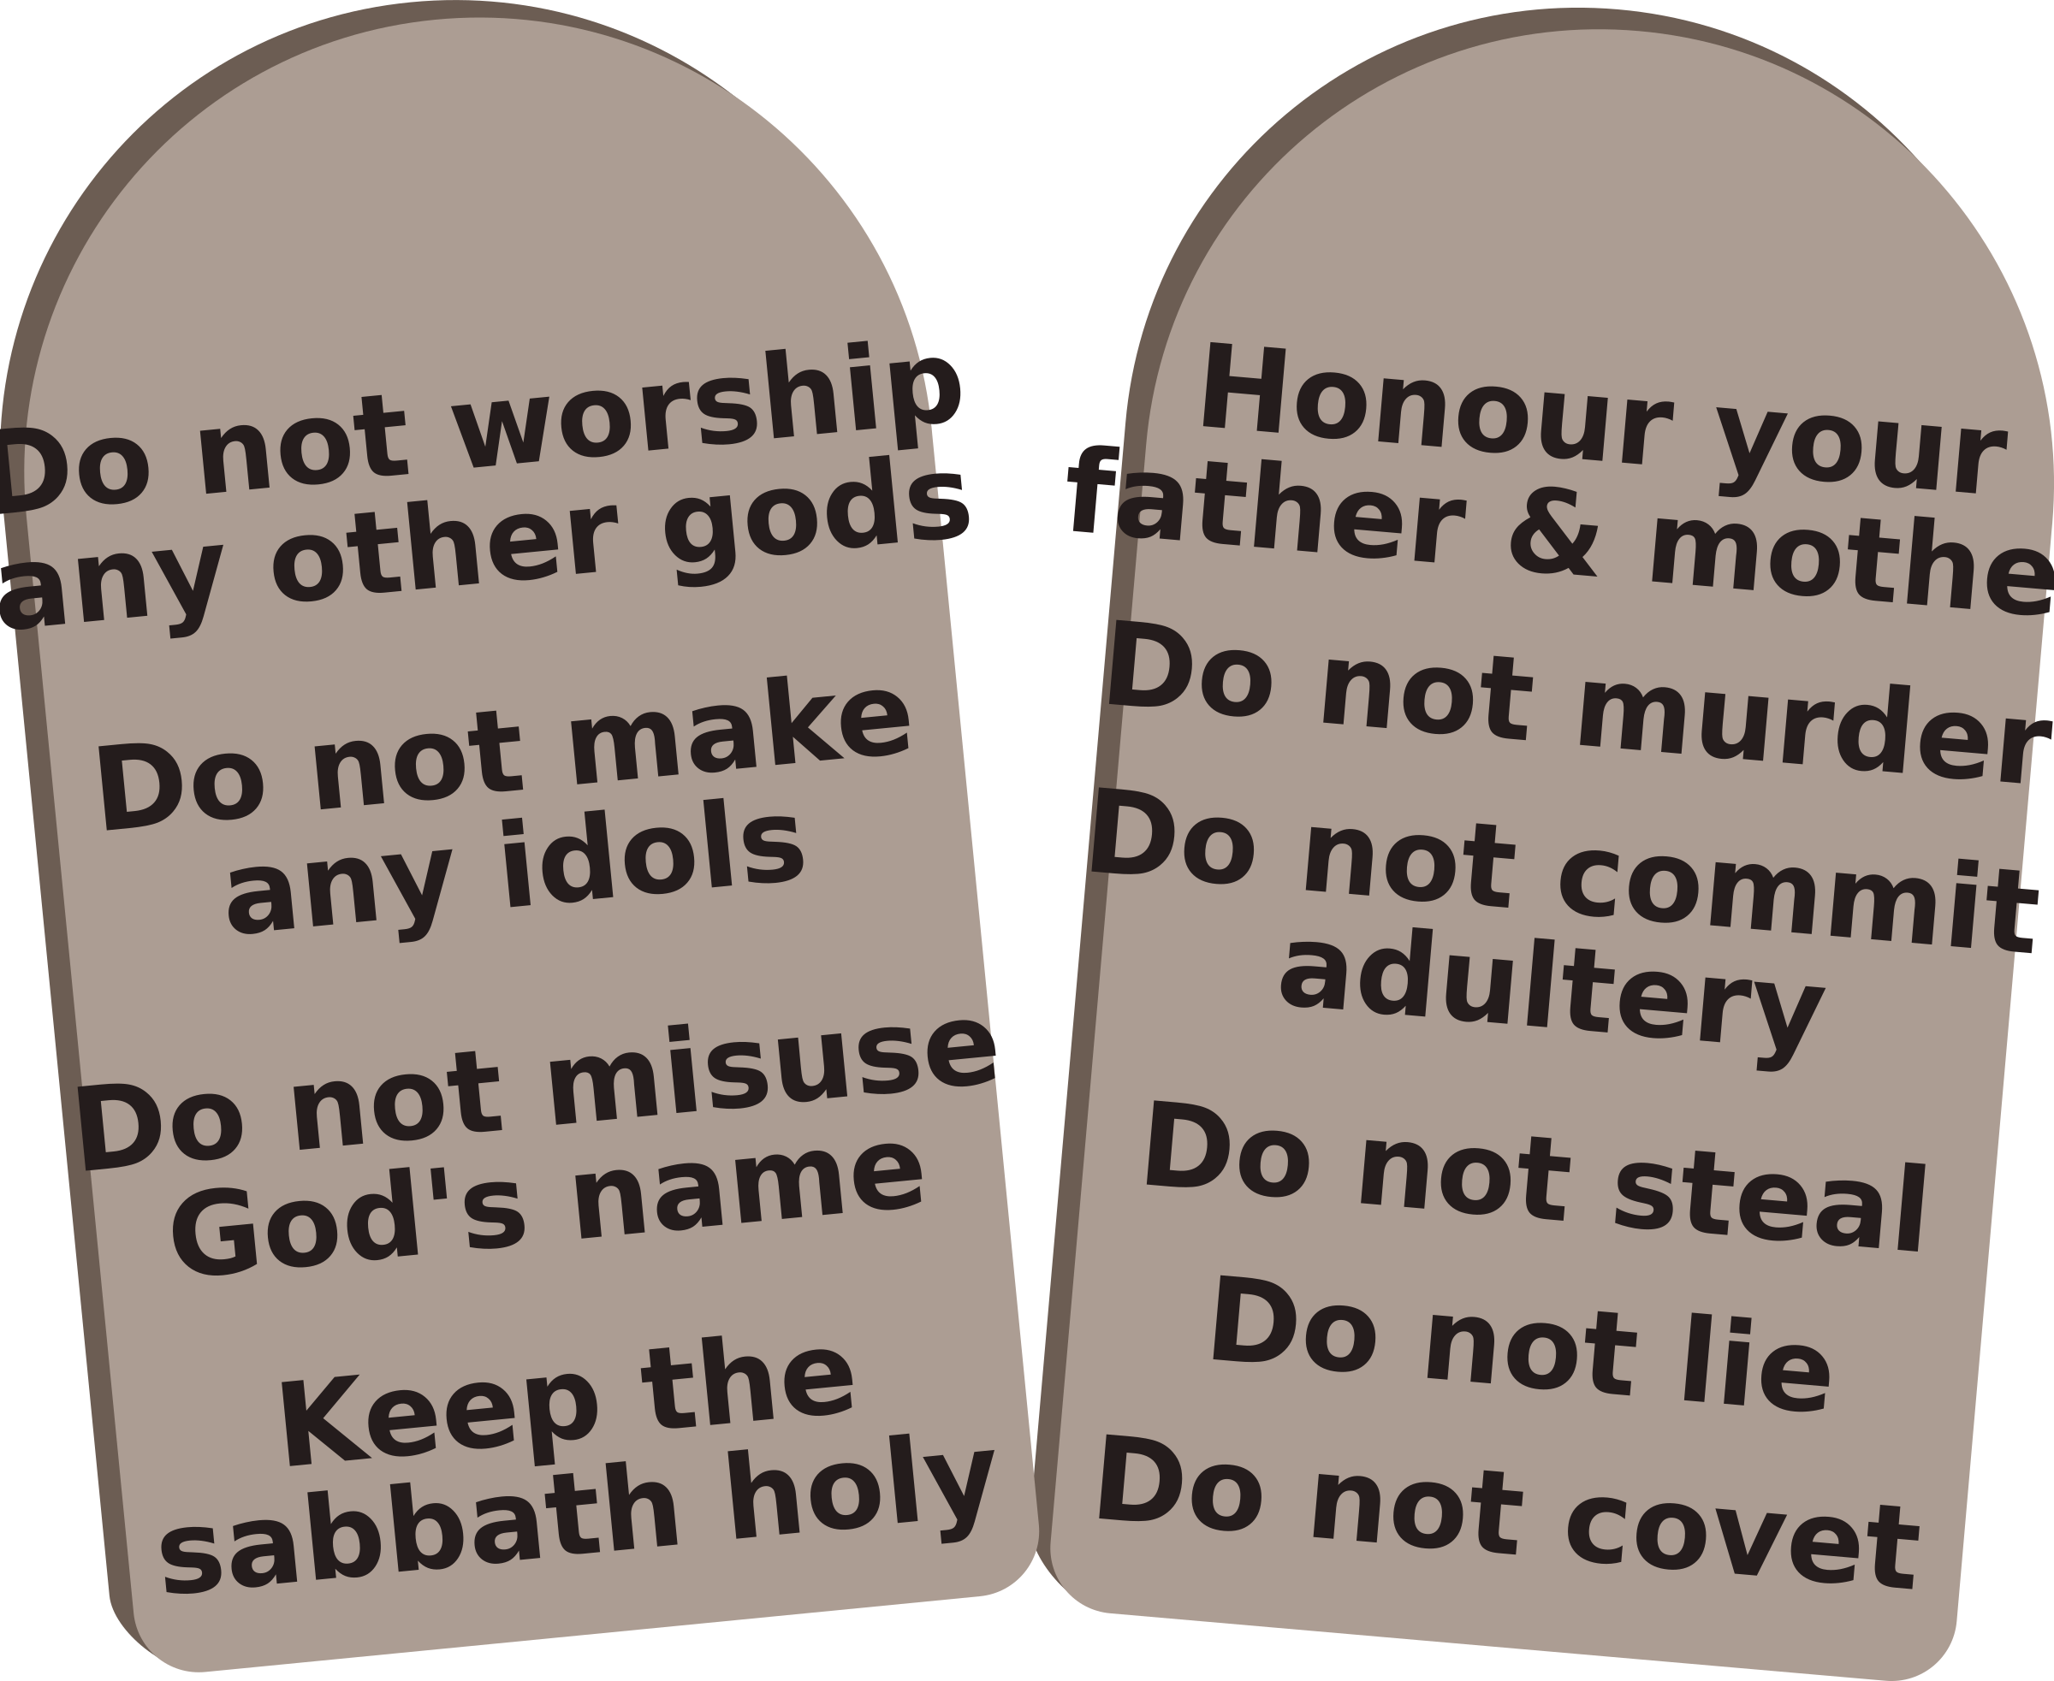
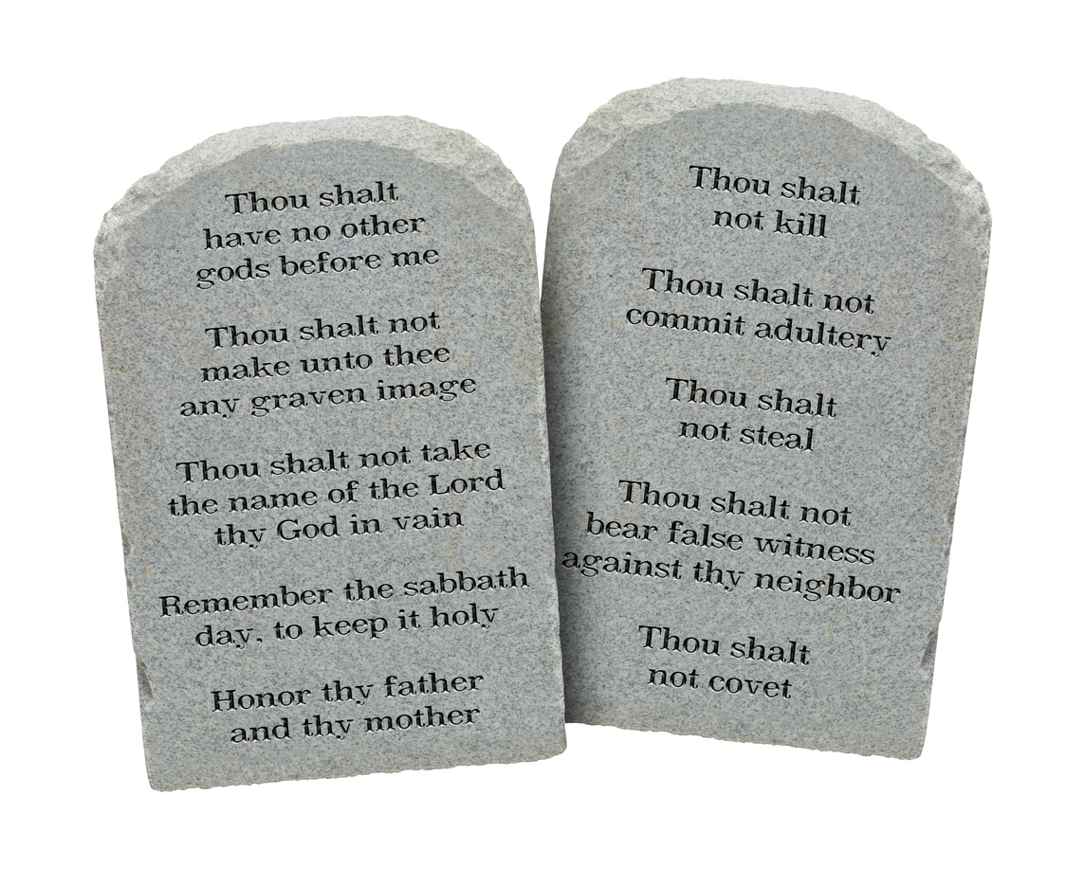
Father
Your name is HOLY
Remember
God is Holy. He is #1!
His name is holy, too.
What do the first commandments say?
Remember God is HOLY.
He is the King of Kings, Sovereign over everything.
His name is YAHWEH. The Lord God Almighty.
Remember to speak His Name reverently. Remember to be very, very respectful.
Never use God’s name as a swear word.

Slide 14
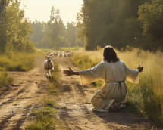
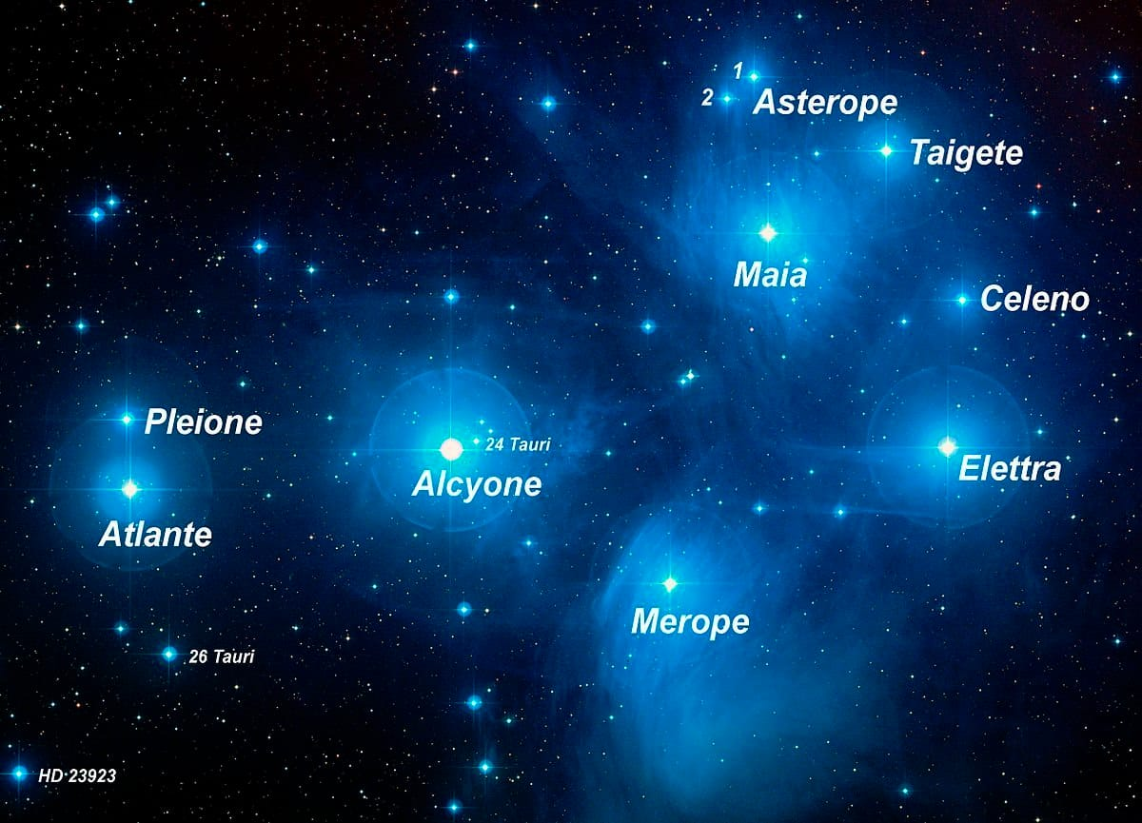
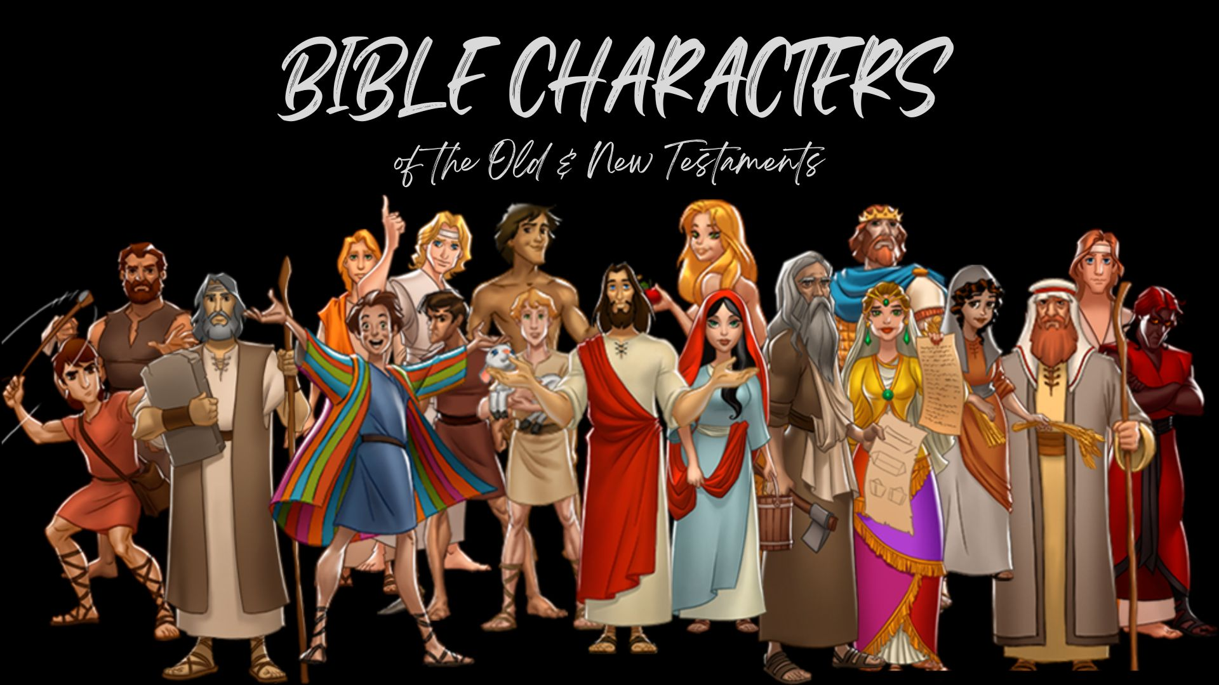
Our Father
Knows Each One
Our Father knows each and every thing he has made. He keeps track of them. He calls them by name.
Remember how God gave Adam the job of naming the animals. That was the first thing God wanted done. It was very important to Him!
One of the first things your parents did was to name you too!
God called them by name
Abraham David Zaccheus
Moses Jesus Cyrus
Nathaniel Jonah Paul
Lift up your eyes and look to the heavens: Who created all these? He who brings out the starry host one by one and calls forth each of them by name. Because of his great power and mighty strength, not one of them is missing.” Isaiah 40:26
Jesus told a parable about himself and us:
The gatekeeper opens the gate for him, and the sheep listen to his voice. He calls his own sheep by name and leads them out. John 10:3

Slide 15
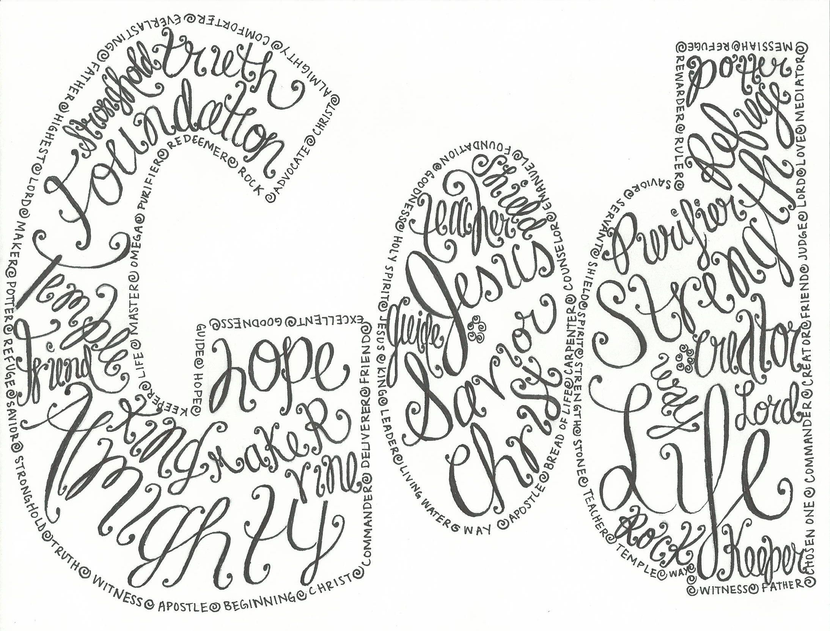
God’s name is HOLY. Use it respectfully.
All of His names are Holy and tell us about Him.

Slide 16
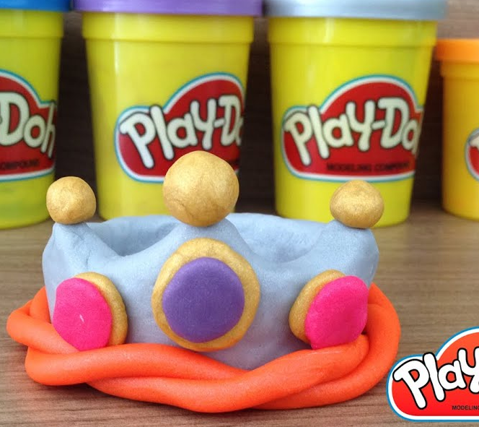
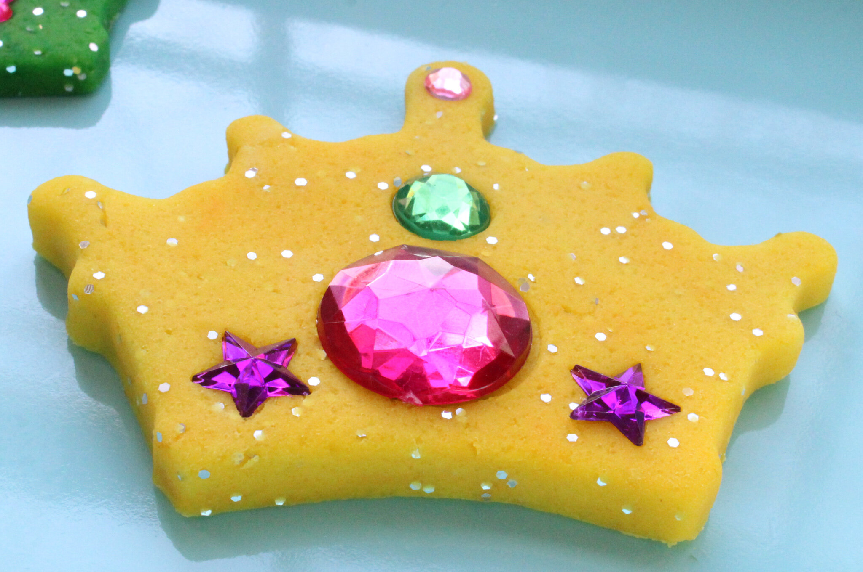
Thy kingdom come
“This, then, is how you should pray:
“‘Our Father in heaven, hallowed be thy name
Thy kingdom come,
Remember God is the KING over all things because HE created all things.
Because God is good, His kingdom is good.
Luke
11:2

Slide 17
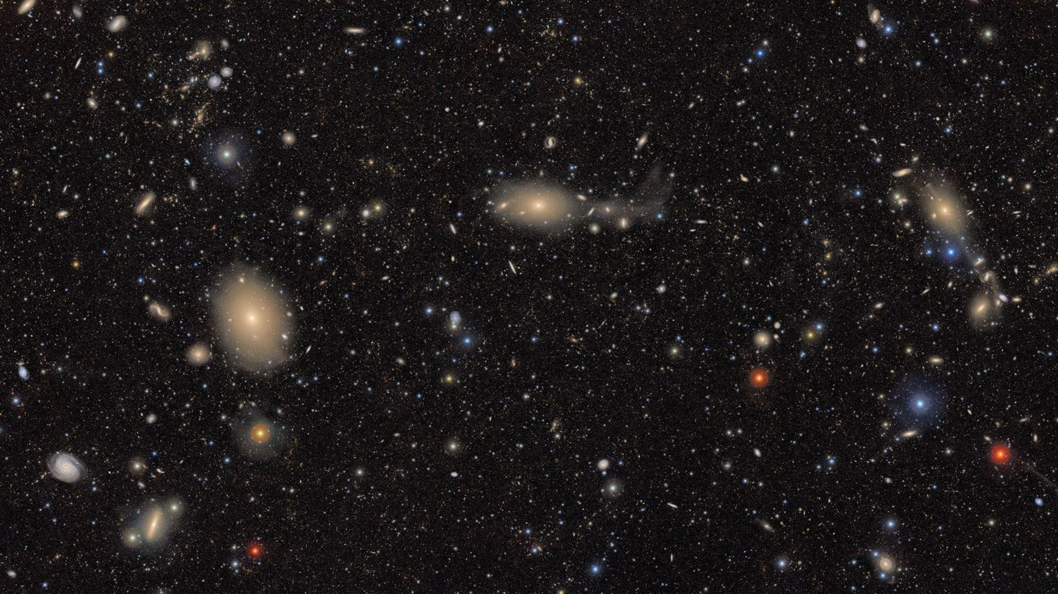
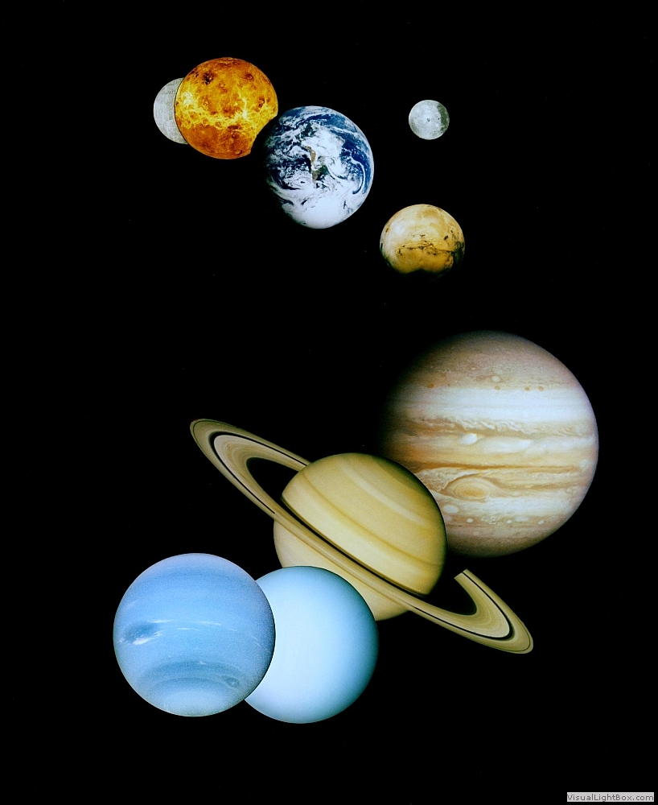
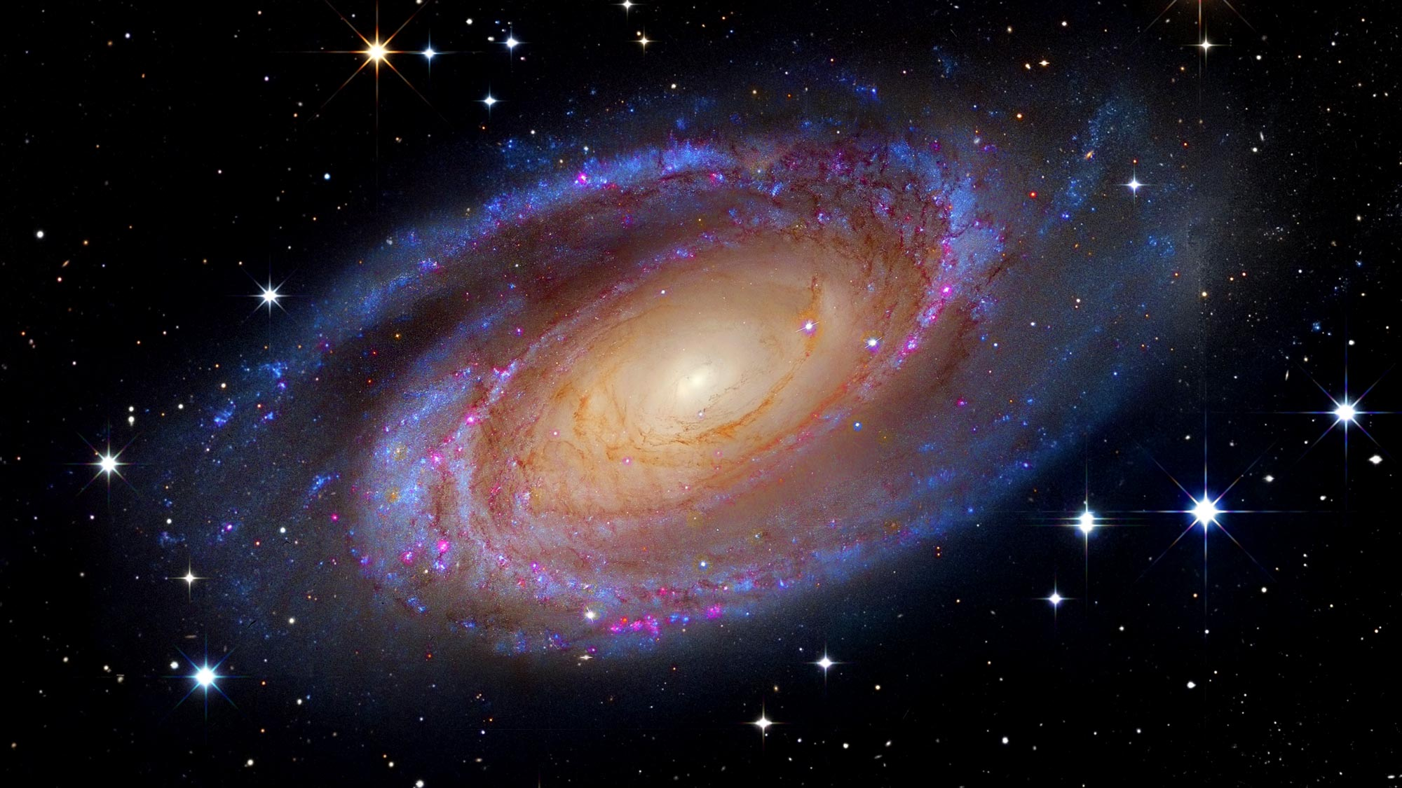
God’s Kingdom is MASSIVE! HUMONGOUS!
There are millions and zillions of galaxies!
We live on a little tiny speck in one of the arms of the Milky Way Galaxy.

Slide 18
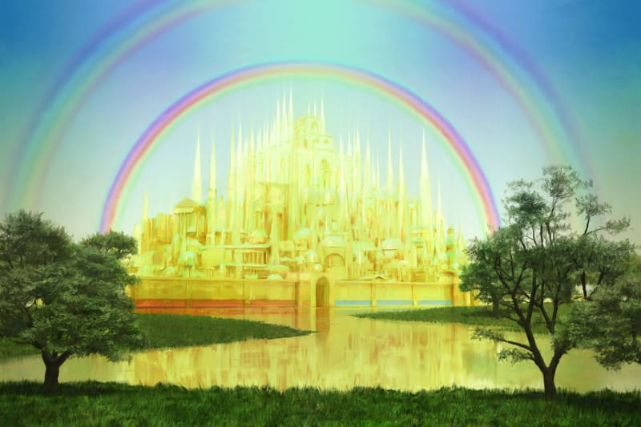
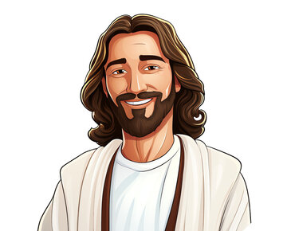

Yet God wants us to be with Him. He wants to be with us!
John 18:36
“Jesus answered, “My kingdom is not of this world. If my kingdom were of this world, my servants would have been fighting, that I might not be delivered over to the Jews. But my kingdom is not from the world.”
Luke 17:20-21
Being asked by the Pharisees when the kingdom of God would come, he answered them, “The kingdom of God is not coming in ways that can be observed, nor will they say, ‘Look, here it is!’ or ‘There!’ for behold, the kingdom of God is in the midst of you.”
My kingdom is not
of this world.
It’s not a nation in the world.
You won’t see it.
Actually, it is within you; in your midst.

Slide 19

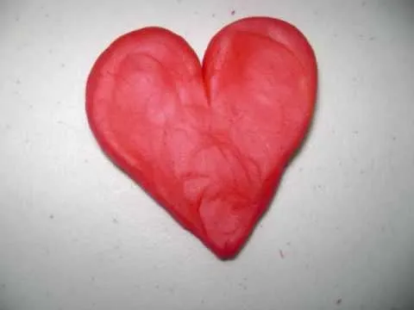
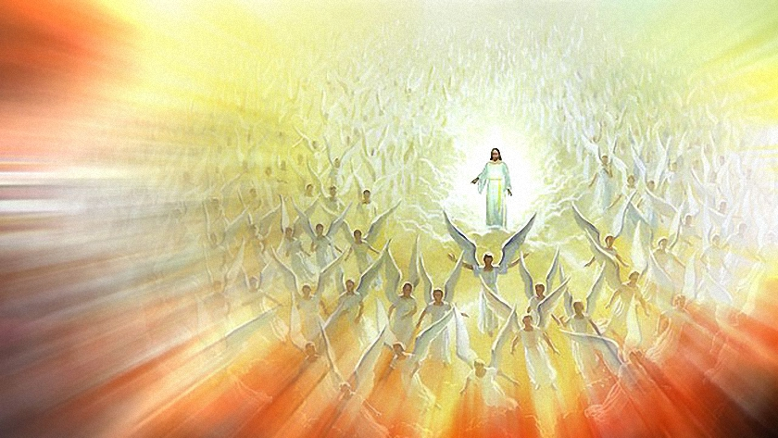
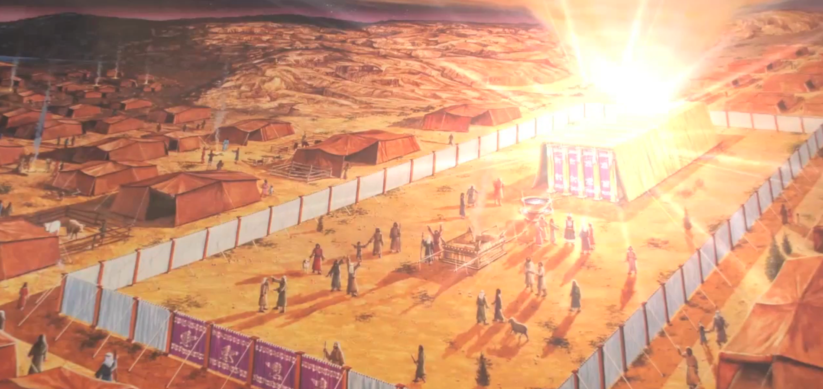
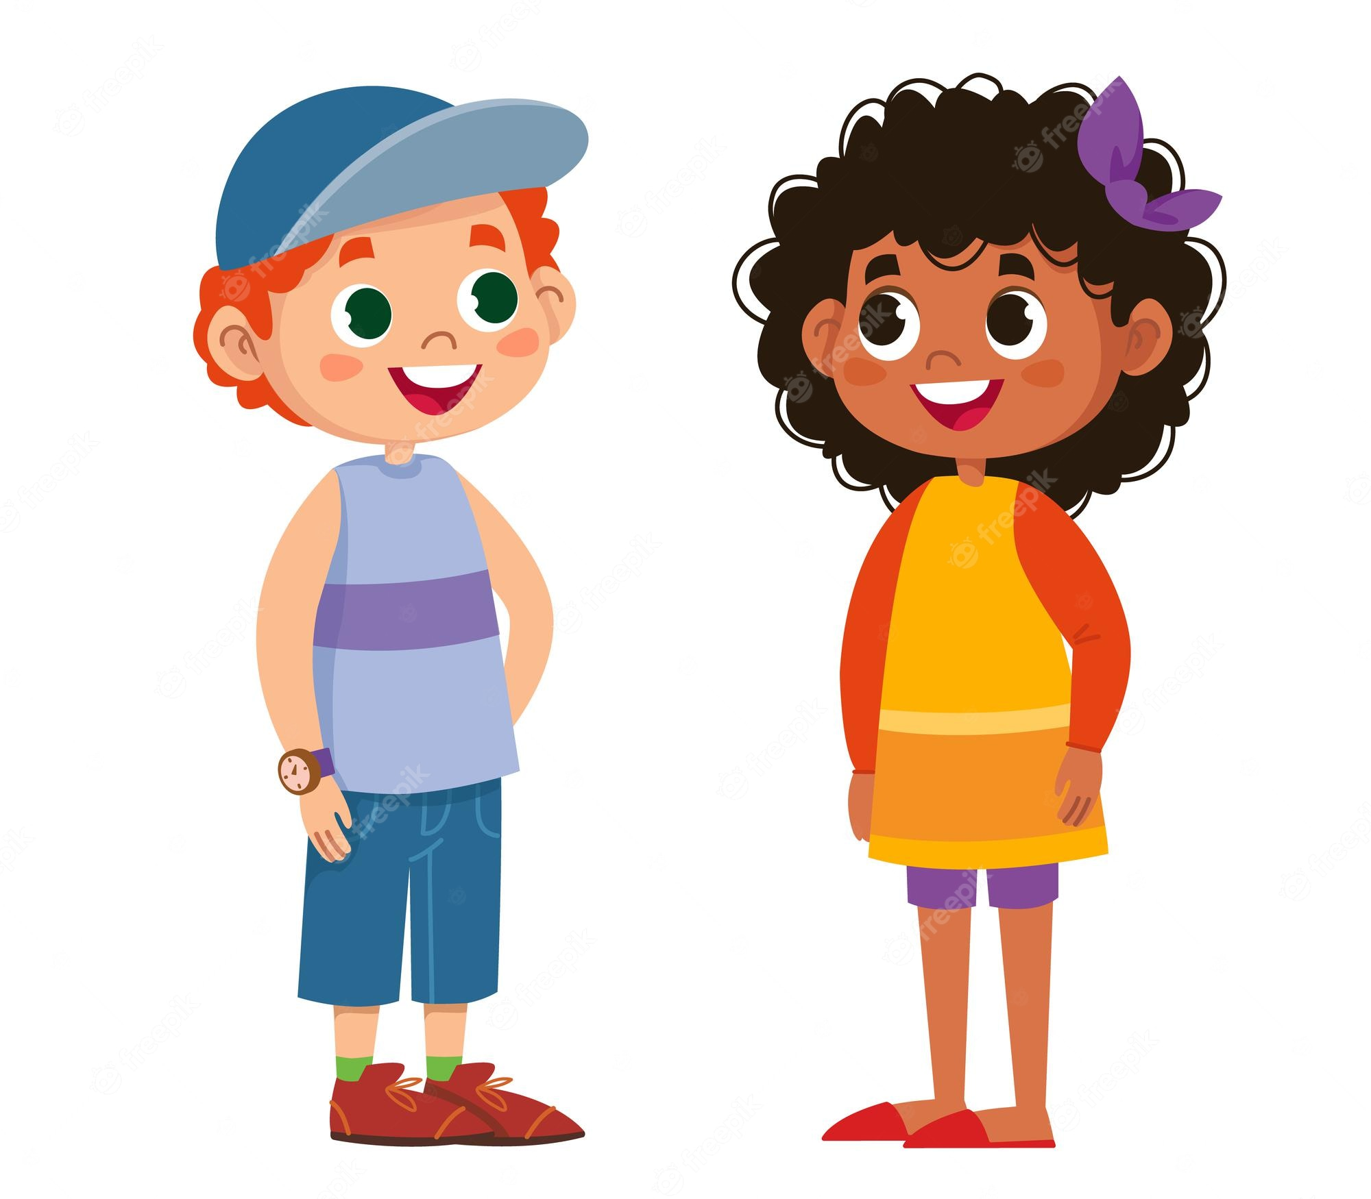
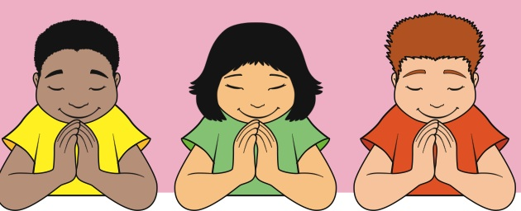
Heavenly Father,
Just like your presence and glory fills heaven and radiates in the universe.
Just like your glory and presence filled the temple.
Please fill my heart and mind with your presence.
Fill me with your love, joy, peace, and strength.
Fill my mind with your words so that I don’t sin against you.
May Your kingdom come on earth, in me as it is in heaven.

Slide 20
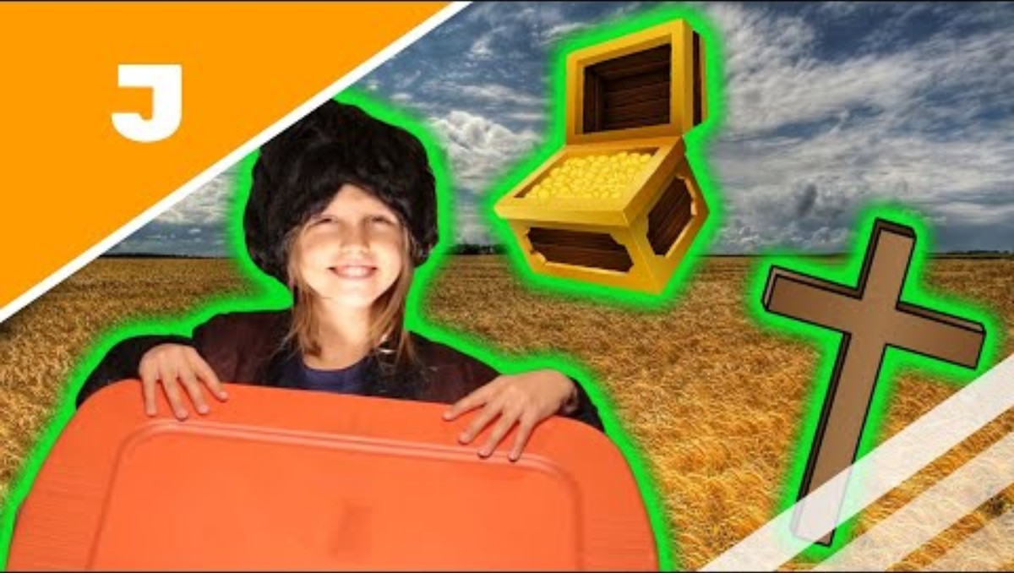
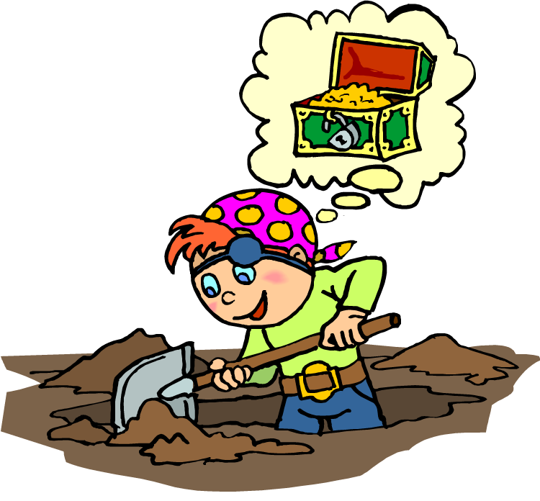
The greatest treasure that gives the greatest joy and peace is….
Matthew 13
⁴⁴ “The kingdom of heaven is like treasure hidden in a field. When a man found it, he hid it again, and then in his joy went and sold all he had and bought that field.
Wahoo!! I found treasure!
It’s the best & most precious thing ever!

Slide 21
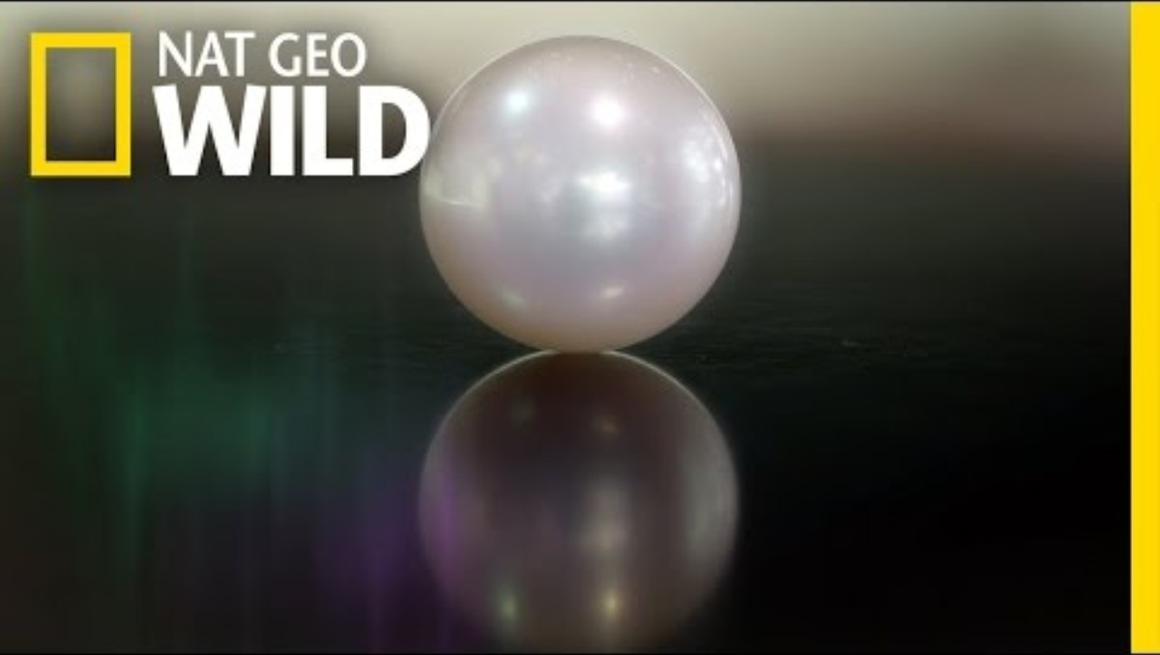
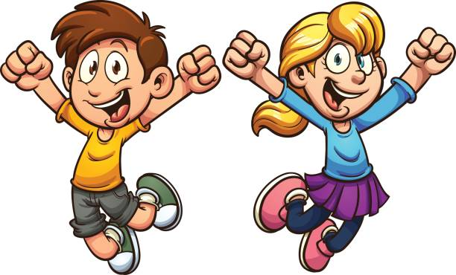

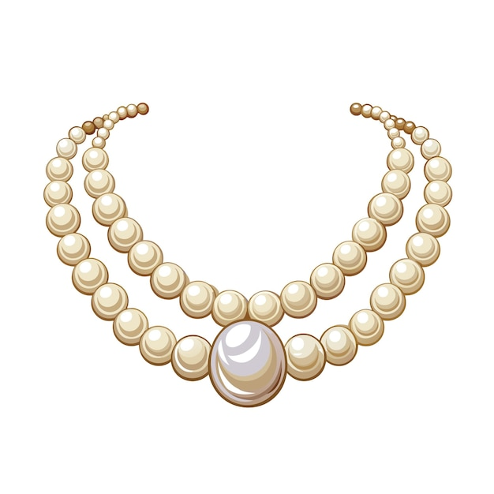
God’s kingdom is very precious!
Matthew 13
⁴⁵ “Again, the kingdom of heaven is like a merchant looking for fine pearls. ⁴⁶ When he found one of great value, he went away and sold everything he had and bought it.
WOW! Look what we found!
It’s the BEST EVER!

Slide 22

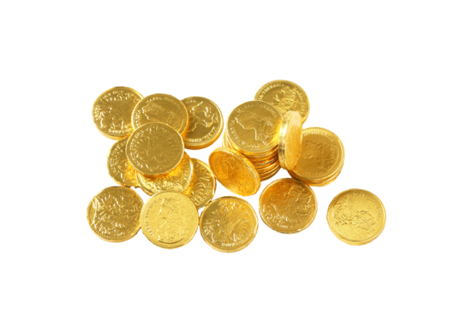
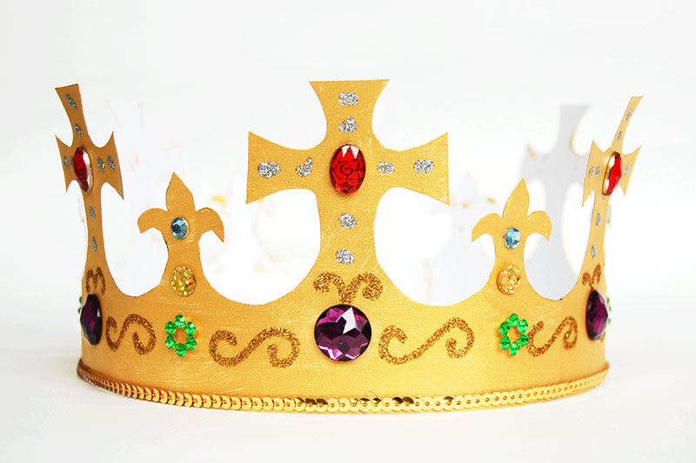
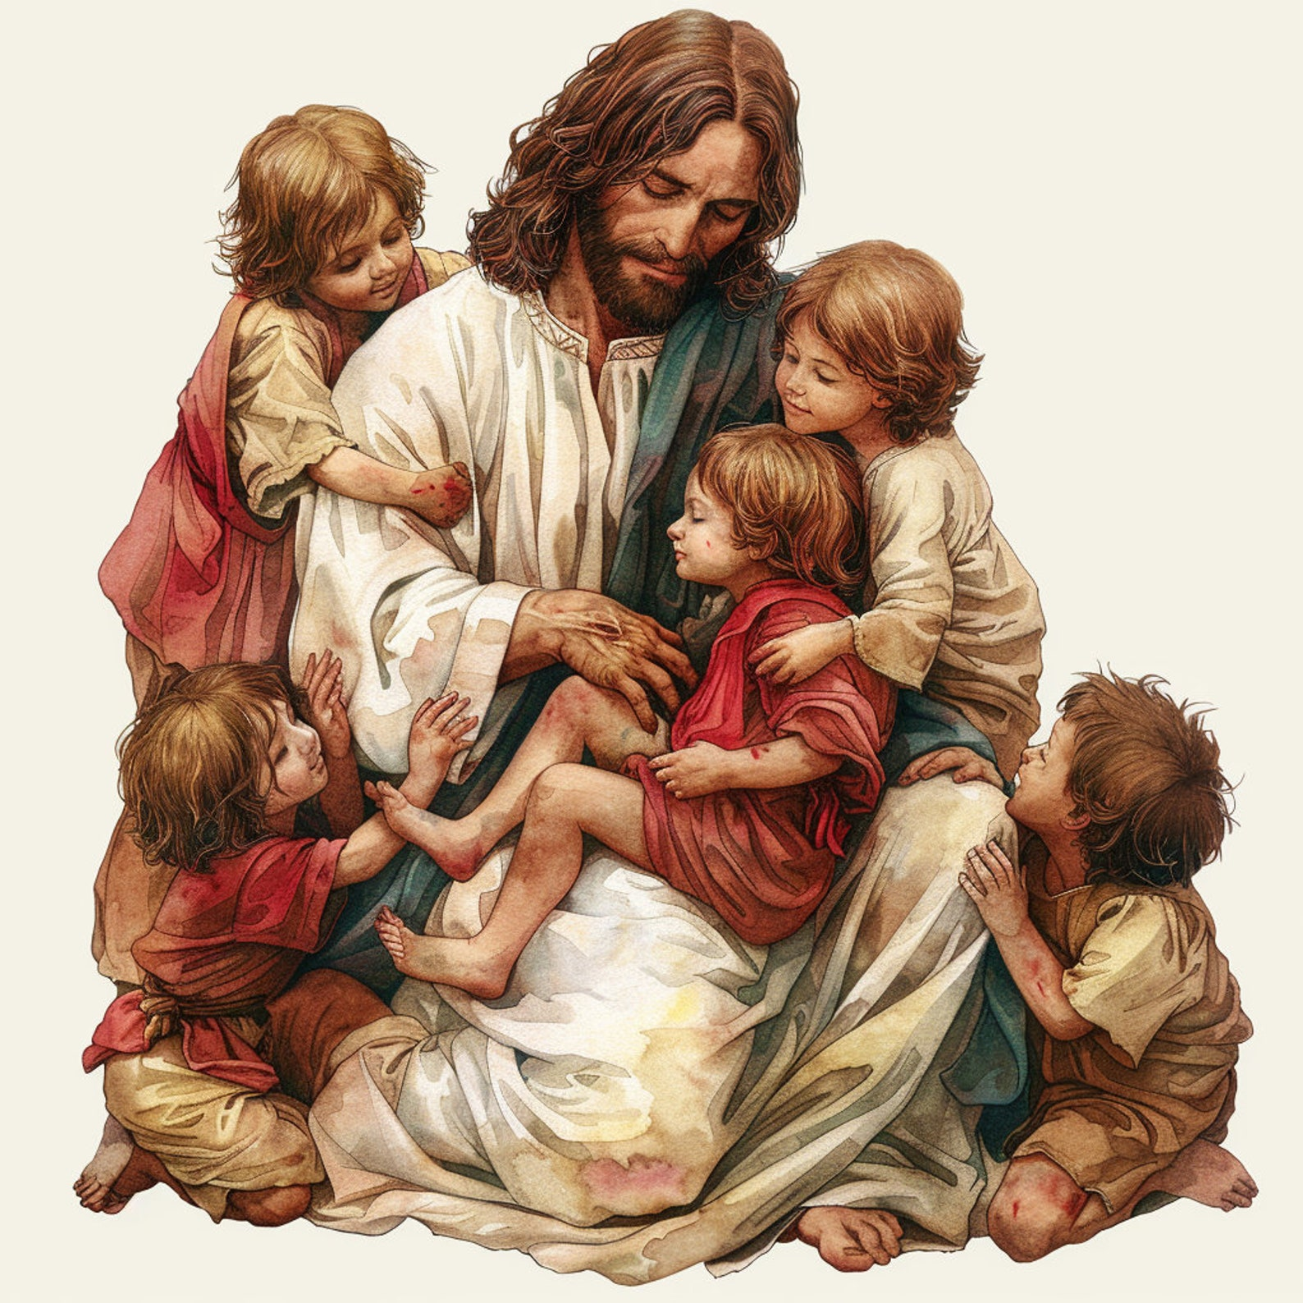
Look in our room for a treasure or make a treasure.
Teacher ideas: Put some chocolate coins, pictures of Jesus or something to remind them of God, and crowns or something to remind them of God’s kingdom.

Slide 23
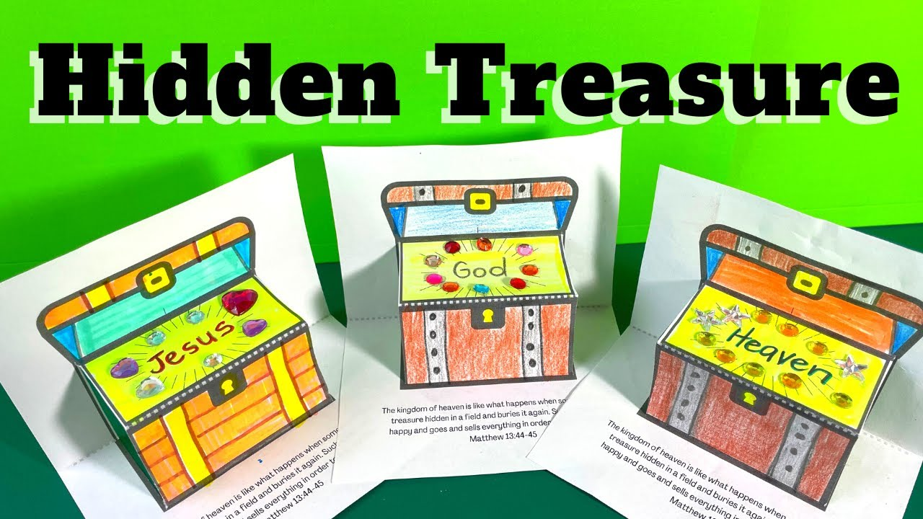


Craft Time – Make a treasure chest.
There’s a lot of ideas online. Choose 1.
https://www.youtube.com/watch?v=G16AJb5w0eU and
https://www.wrightideaswithsusan.com/...

Slide 24


Do you want to be part of God’s kingdom and have the Holy Spirit in your heart? Just be a humble child who LOVES JESUS!
Matthew 18
At that time the disciples came to Jesus and asked, “Who, then, is the greatest in the kingdom of heaven?”
² He called a little child to him, and placed the child among them. ³ And he said: “Truly I tell you, unless you change and become like little children, you will never enter the kingdom of heaven.
⁴ Therefore, whoever takes the lowly position of this child is the greatest in the kingdom of heaven. ⁵ And whoever welcomes one such child in my name welcomes me.

Slide 25

The End

Slide 26
Optional slides and more info
I found this lesson was too long, so moved the following slides to the next program where we talked about God’s will and daily needs vs. wants.

Slide 27
I know You will do the BEST thing.
“This, then, is how you should pray:
“‘Our Father in heaven, hallowed be thy name
Thy kingdom come, Thy will be done on earth as it is in heaven.
We know that God LOVES us so very much.
He knows what will happen now and in the future.
He is FAITHFUL, JUST, & COMPASSIONATE.
He will only do what is best for us.
We can trust that what He wants is the very best thing for us and for others.
Luke
11:2

Slide 28




What is God’s will?
Mark 12
²⁹ Jesus answered, “The most important is, ‘Hear, O Israel: The Lord our God, the Lord is one. ³⁰ And you shall love the Lord your God with all your heart and with all your soul and with all your mind and with all your strength.’ ³¹ The second is this: ‘You shall love your neighbor as yourself.’ There is no other commandment greater than these.”
1 Thessalonians 5:18
Give thanks in all circumstances; for this is the will of God in Christ Jesus for you.
John 6:40
For this is the will of my Father, that everyone who looks on the Son and believes in him should have eternal life, and I will raise him up on the last day.”
Eternal
Life

Slide 29

Object Lesson – My Plan or God’s Plan
Heavenly Father, You are Holy and good, generous and kind.
Please give me _____________
I saw it on TV and it’s really cool and I need it. Thank you.
My Plan
GOD’S PLAN

Slide 30


Slide 31


Object Lesson – My Plan or God’s Plan
Teacher – see last slide

Slide 32


Can you find the treasure in our classroom?
Romans 14:7
For the kingdom of God is not a matter of eating and drinking but of righteousness and peace and joy in the Holy Spirit.
The Holy Spirit is God’s Spirit, His will and character.
The Holy Spirit draws us to Jesus.
The Holy Spirit teaches us about God and His desires.
Can you find the treasure in our classroom?
Teacher note:: put bubble wands in the treasure chest

Slide 33


Prayers and
God’s Names
The Bible has many prayers from many people. Many start their prayers praising God and recognizing how God has helped them in the past.
Be respectful
Praise God
Remember what He has done in the past
Remember He loves you!
“Lord, the great and awesome God, who keeps his covenant of love with those who love him and keep his commandments,…
Daniel 9
Daniel
King David
Our Father, mighty Deliverer, we humbly come before You, seeking Your protection and rescue…..
Psalms 3

