Slide 1
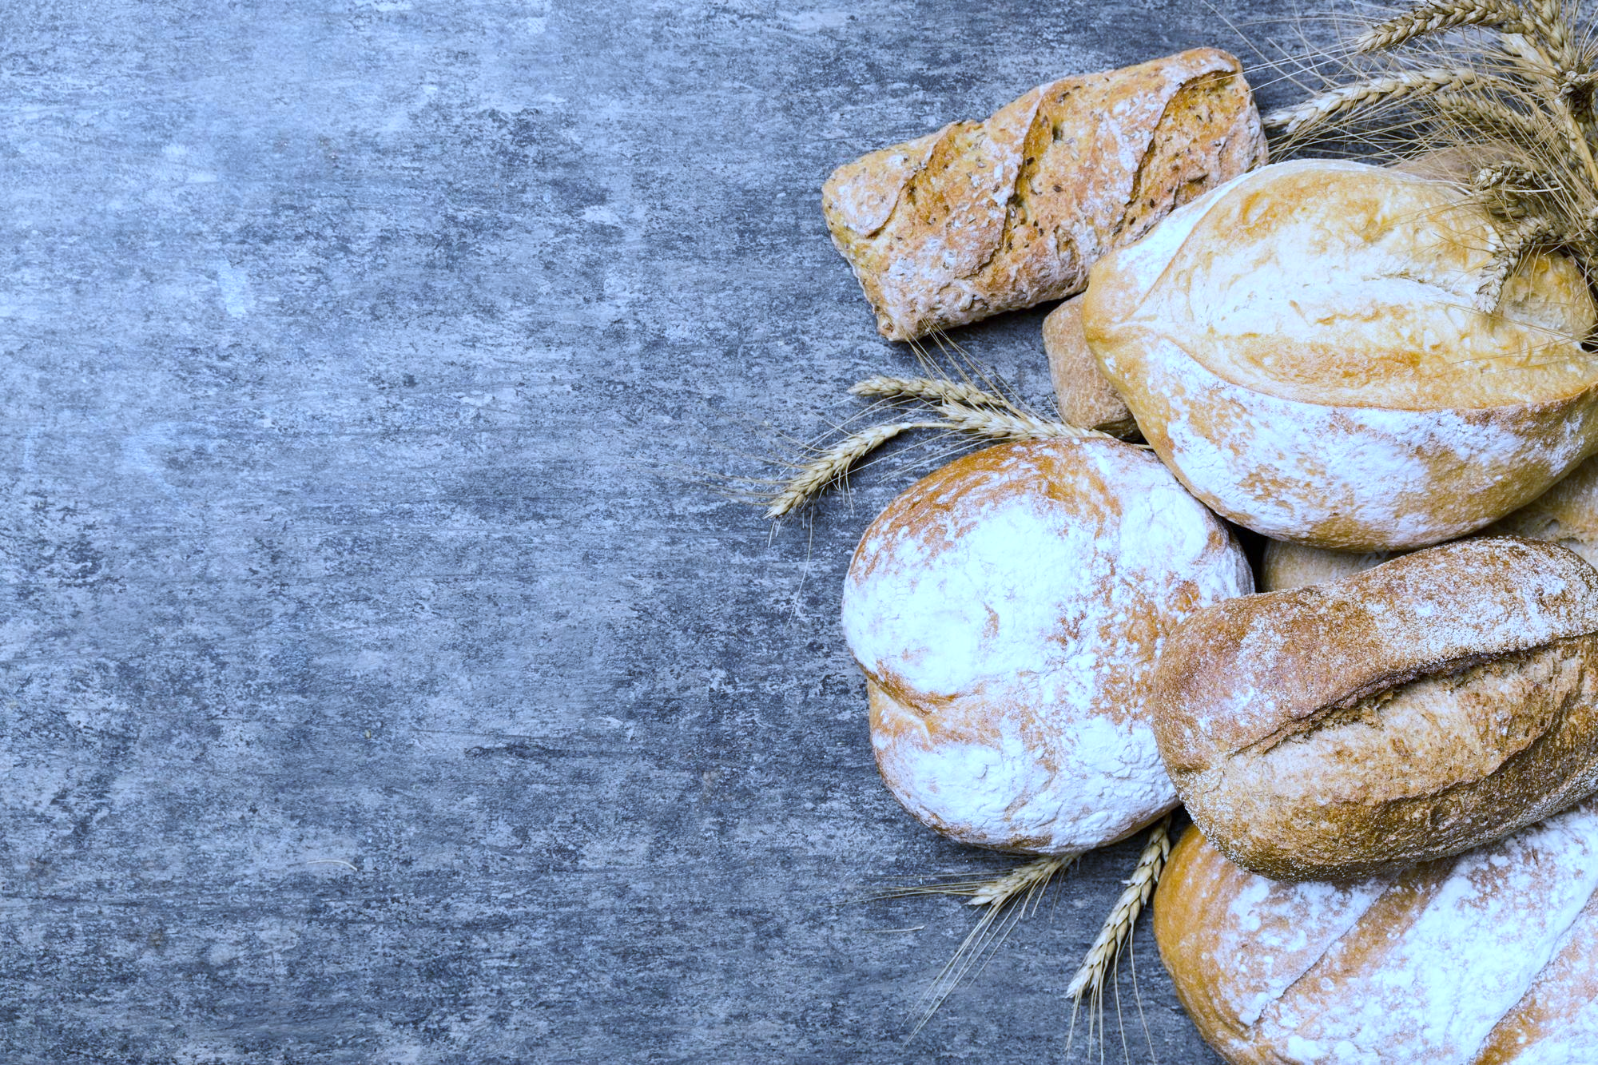
The Lord’s Prayer part 2
Thy Will & Daily Bread
Trusting God who Provides All Things

Slide 2
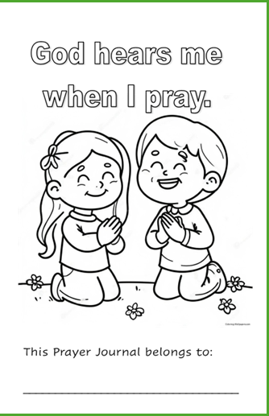
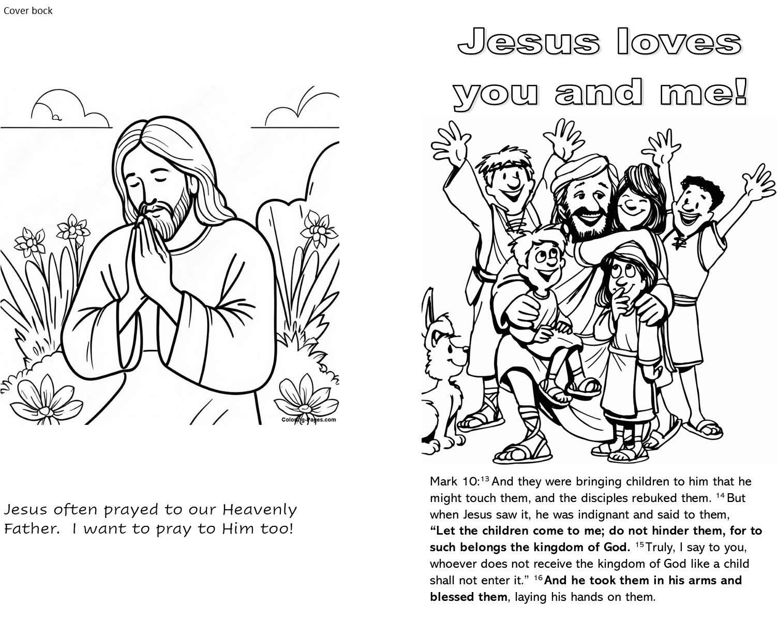
Today you get to continue making a prayer journal booklet.
If you didn’t get the first part last week, I have that part for you
Next week you will get the second part.
The following week you will get the last part.
We’ll staple all the parts together and you will get to take them home.
At Home: I hope you take time to think about the Lord’s Prayer. Each part has pages that you can write in or draw pictures to answer the questions. If you can’t do that, your parents can help you.

Slide 3

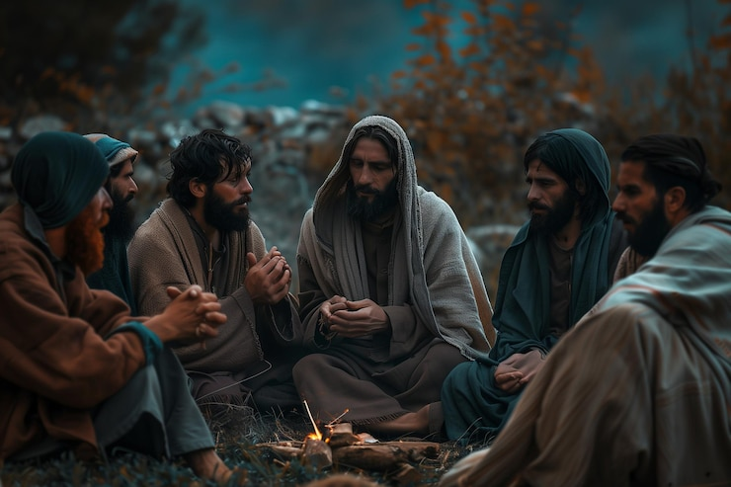
God Provides
Lord, teach us to pray like John taught his disciples.
Luke 11
Now Jesus was praying in a certain place, and when he finished, one of his disciples said to him,
“Lord, teach us to pray, as John taught his disciples.”
Matthew 6
…your Father knows what you need before you ask him. ⁹ Pray then like this:
“Our Father in heaven,
hallowed be your name.
¹⁰ Your kingdom come,
your will be done,
on earth as it is in heaven.
¹¹ Give us this day our daily bread,
“This, then, is how you should pray:
“‘Our Father in heaven, hallowed be thy name
Thy kingdom come, Thy will be done on earth as it is in heaven.

Slide 4
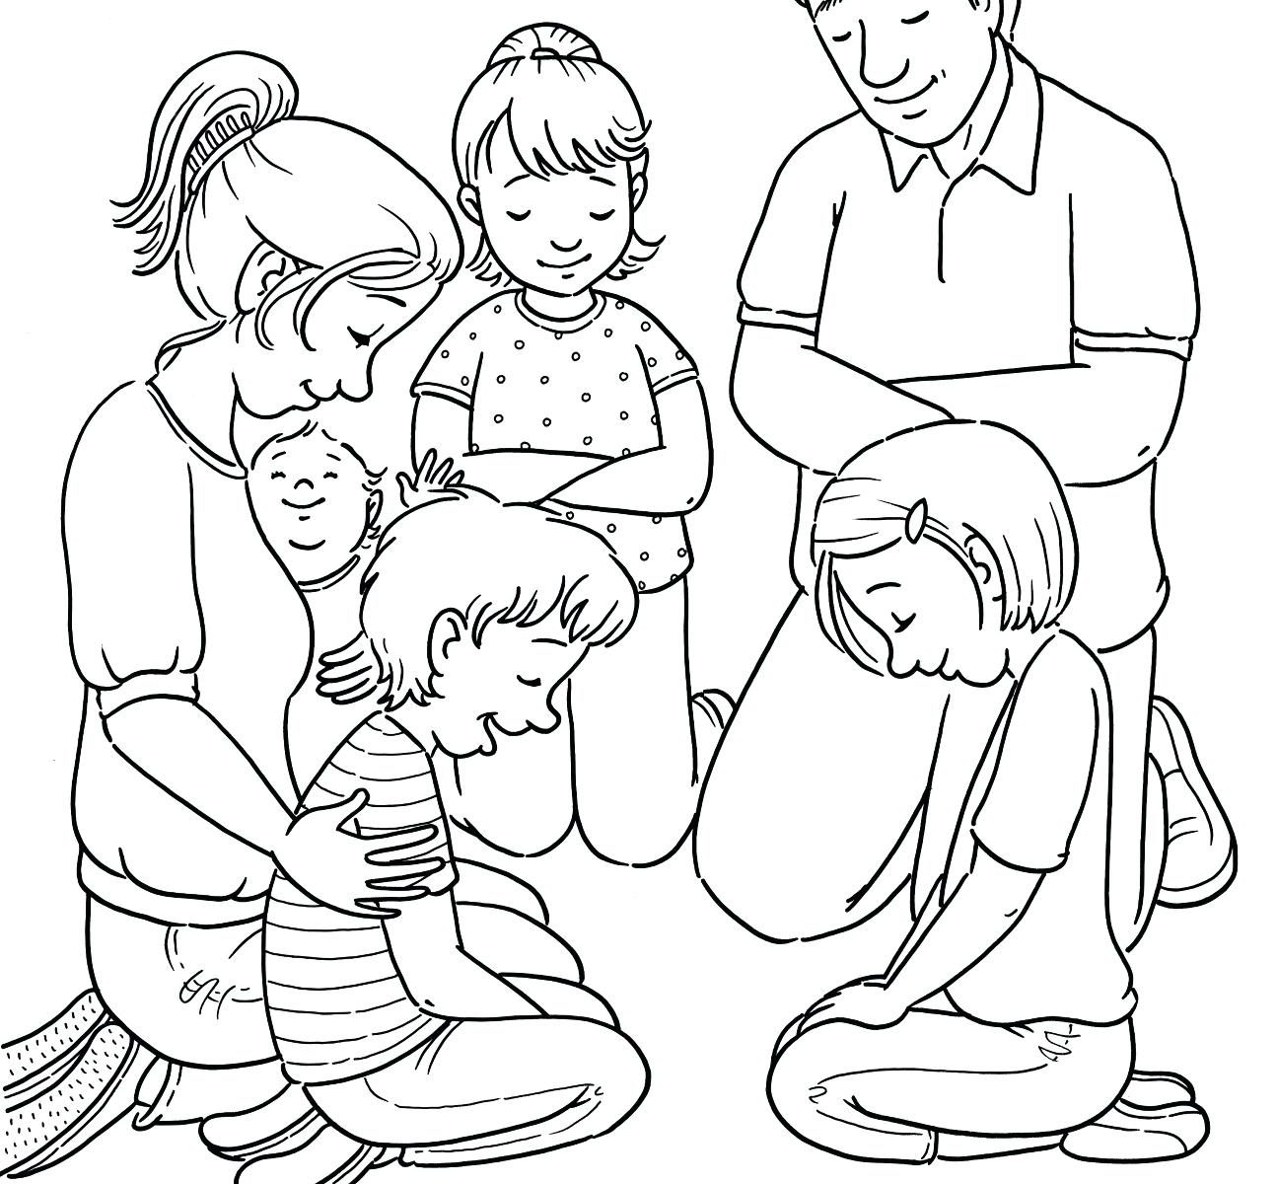
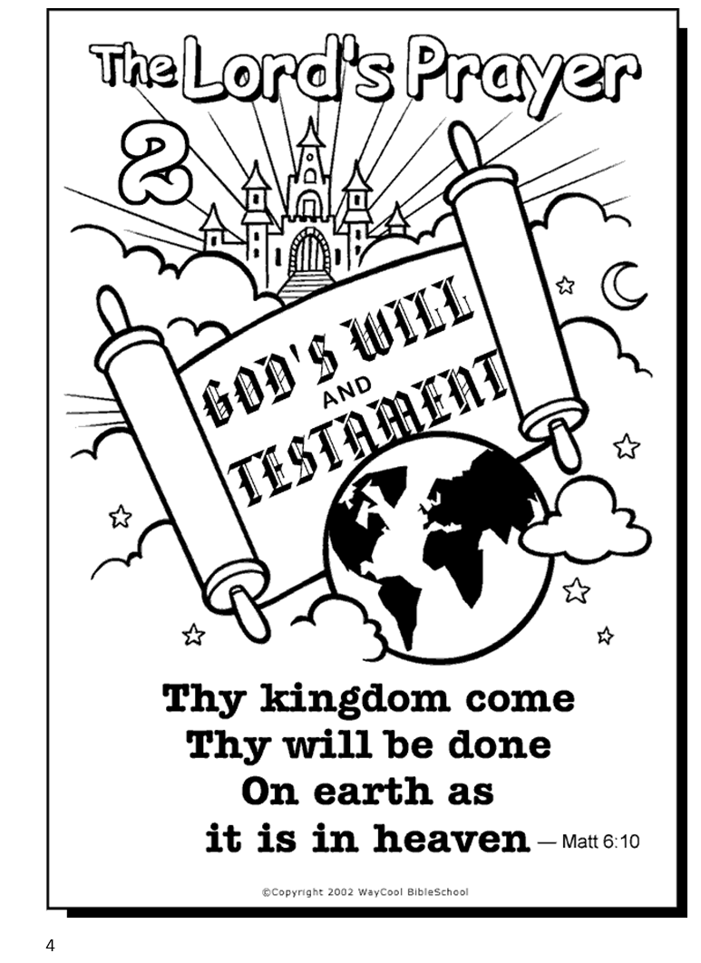
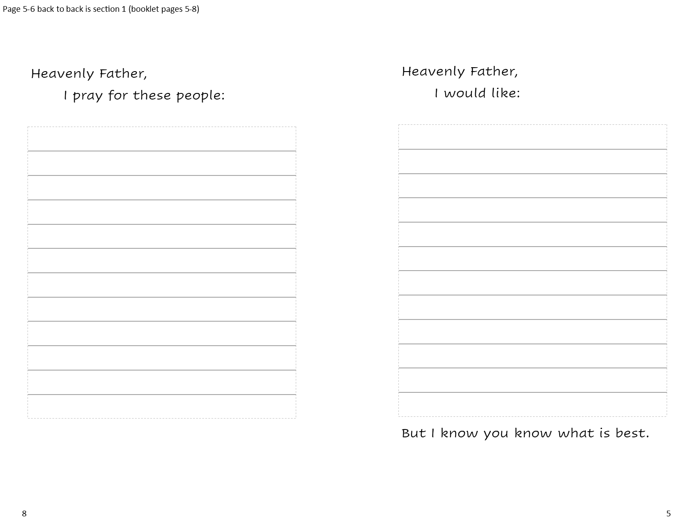

Slide 5

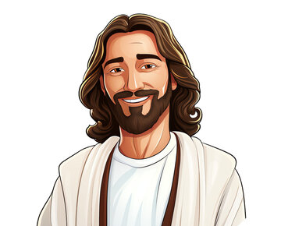
God Loves and Cares for us.
He generously gives what we need.
Thy will be done
Remember last week we talked about how God is our loving Heavenly Father. He cares deeply for us. He is faithful. We can trust Him.
Jeremiah 29:11
¹¹ I say this because I know the plans that I have for you.” This message is from the Lord. “I have good plans for you. I don’t plan to hurt you. I plan to give you hope and a good future.
So, what is God’s will?
Can we trust someone who has good plans for us; to give us hope and a good future?
I know the plans that I have for you.”
“I have good plans for you. I don’t plan to hurt you. I plan to give you hope and a good future

Slide 6


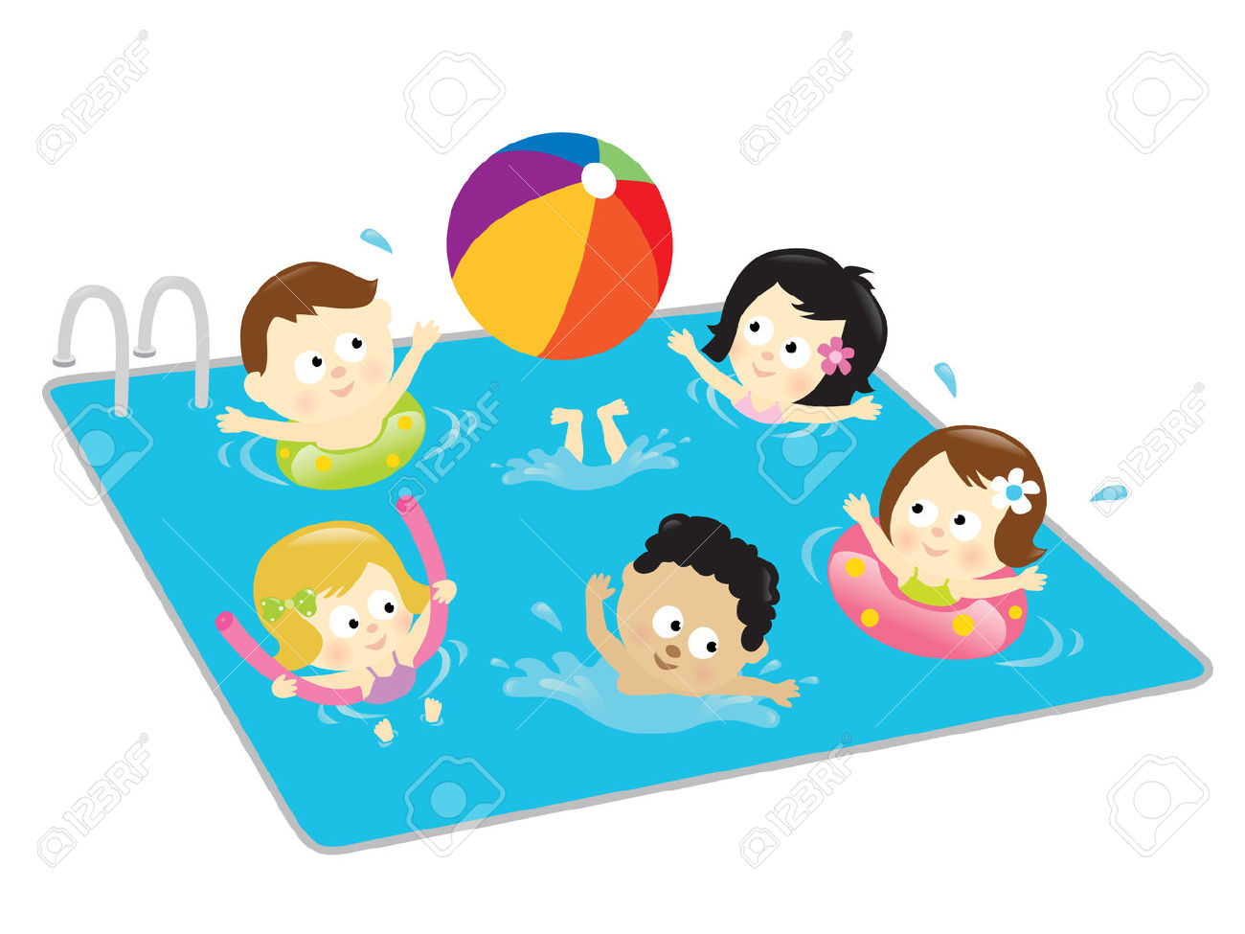
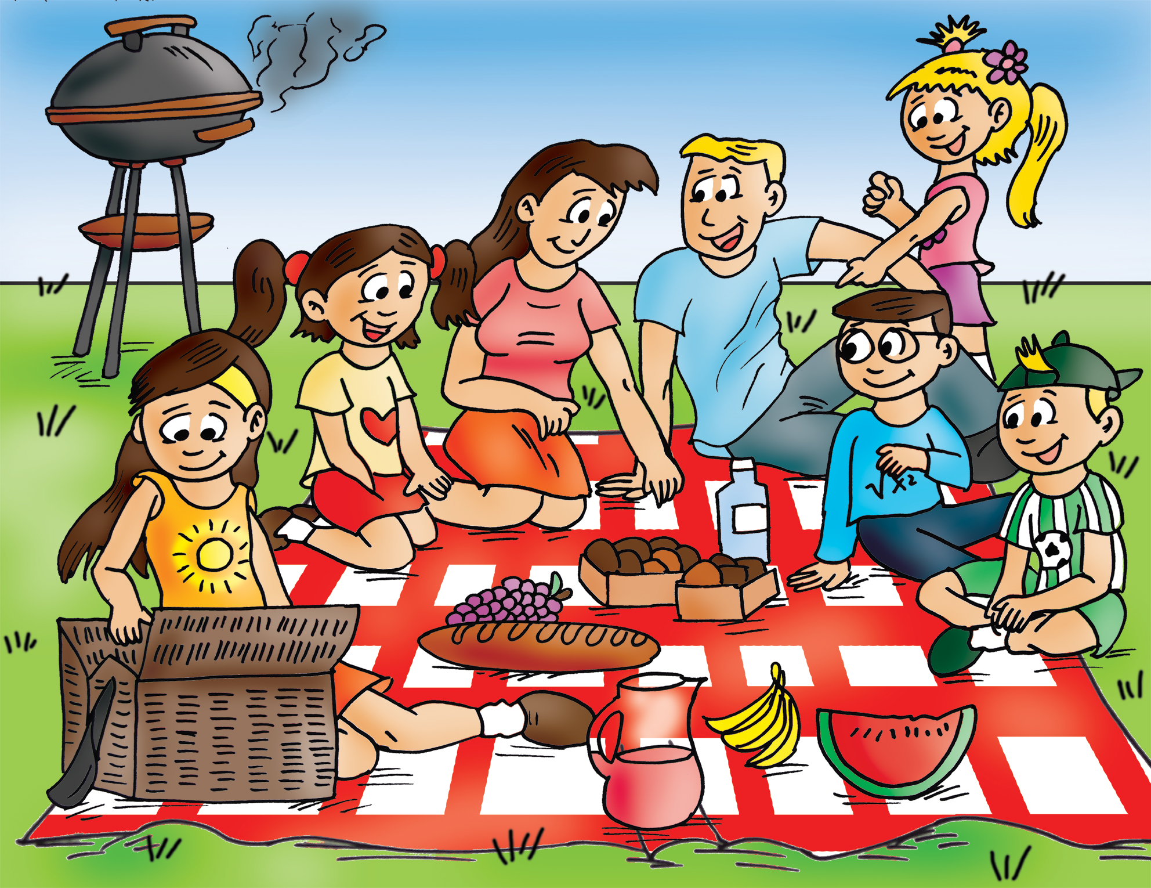
What are your plans?
What do you want to do this summer?
What do you want to do when you grow up?
God has given you capabilities and things you enjoy doing.
You can use these to help others and earn money.

Slide 7
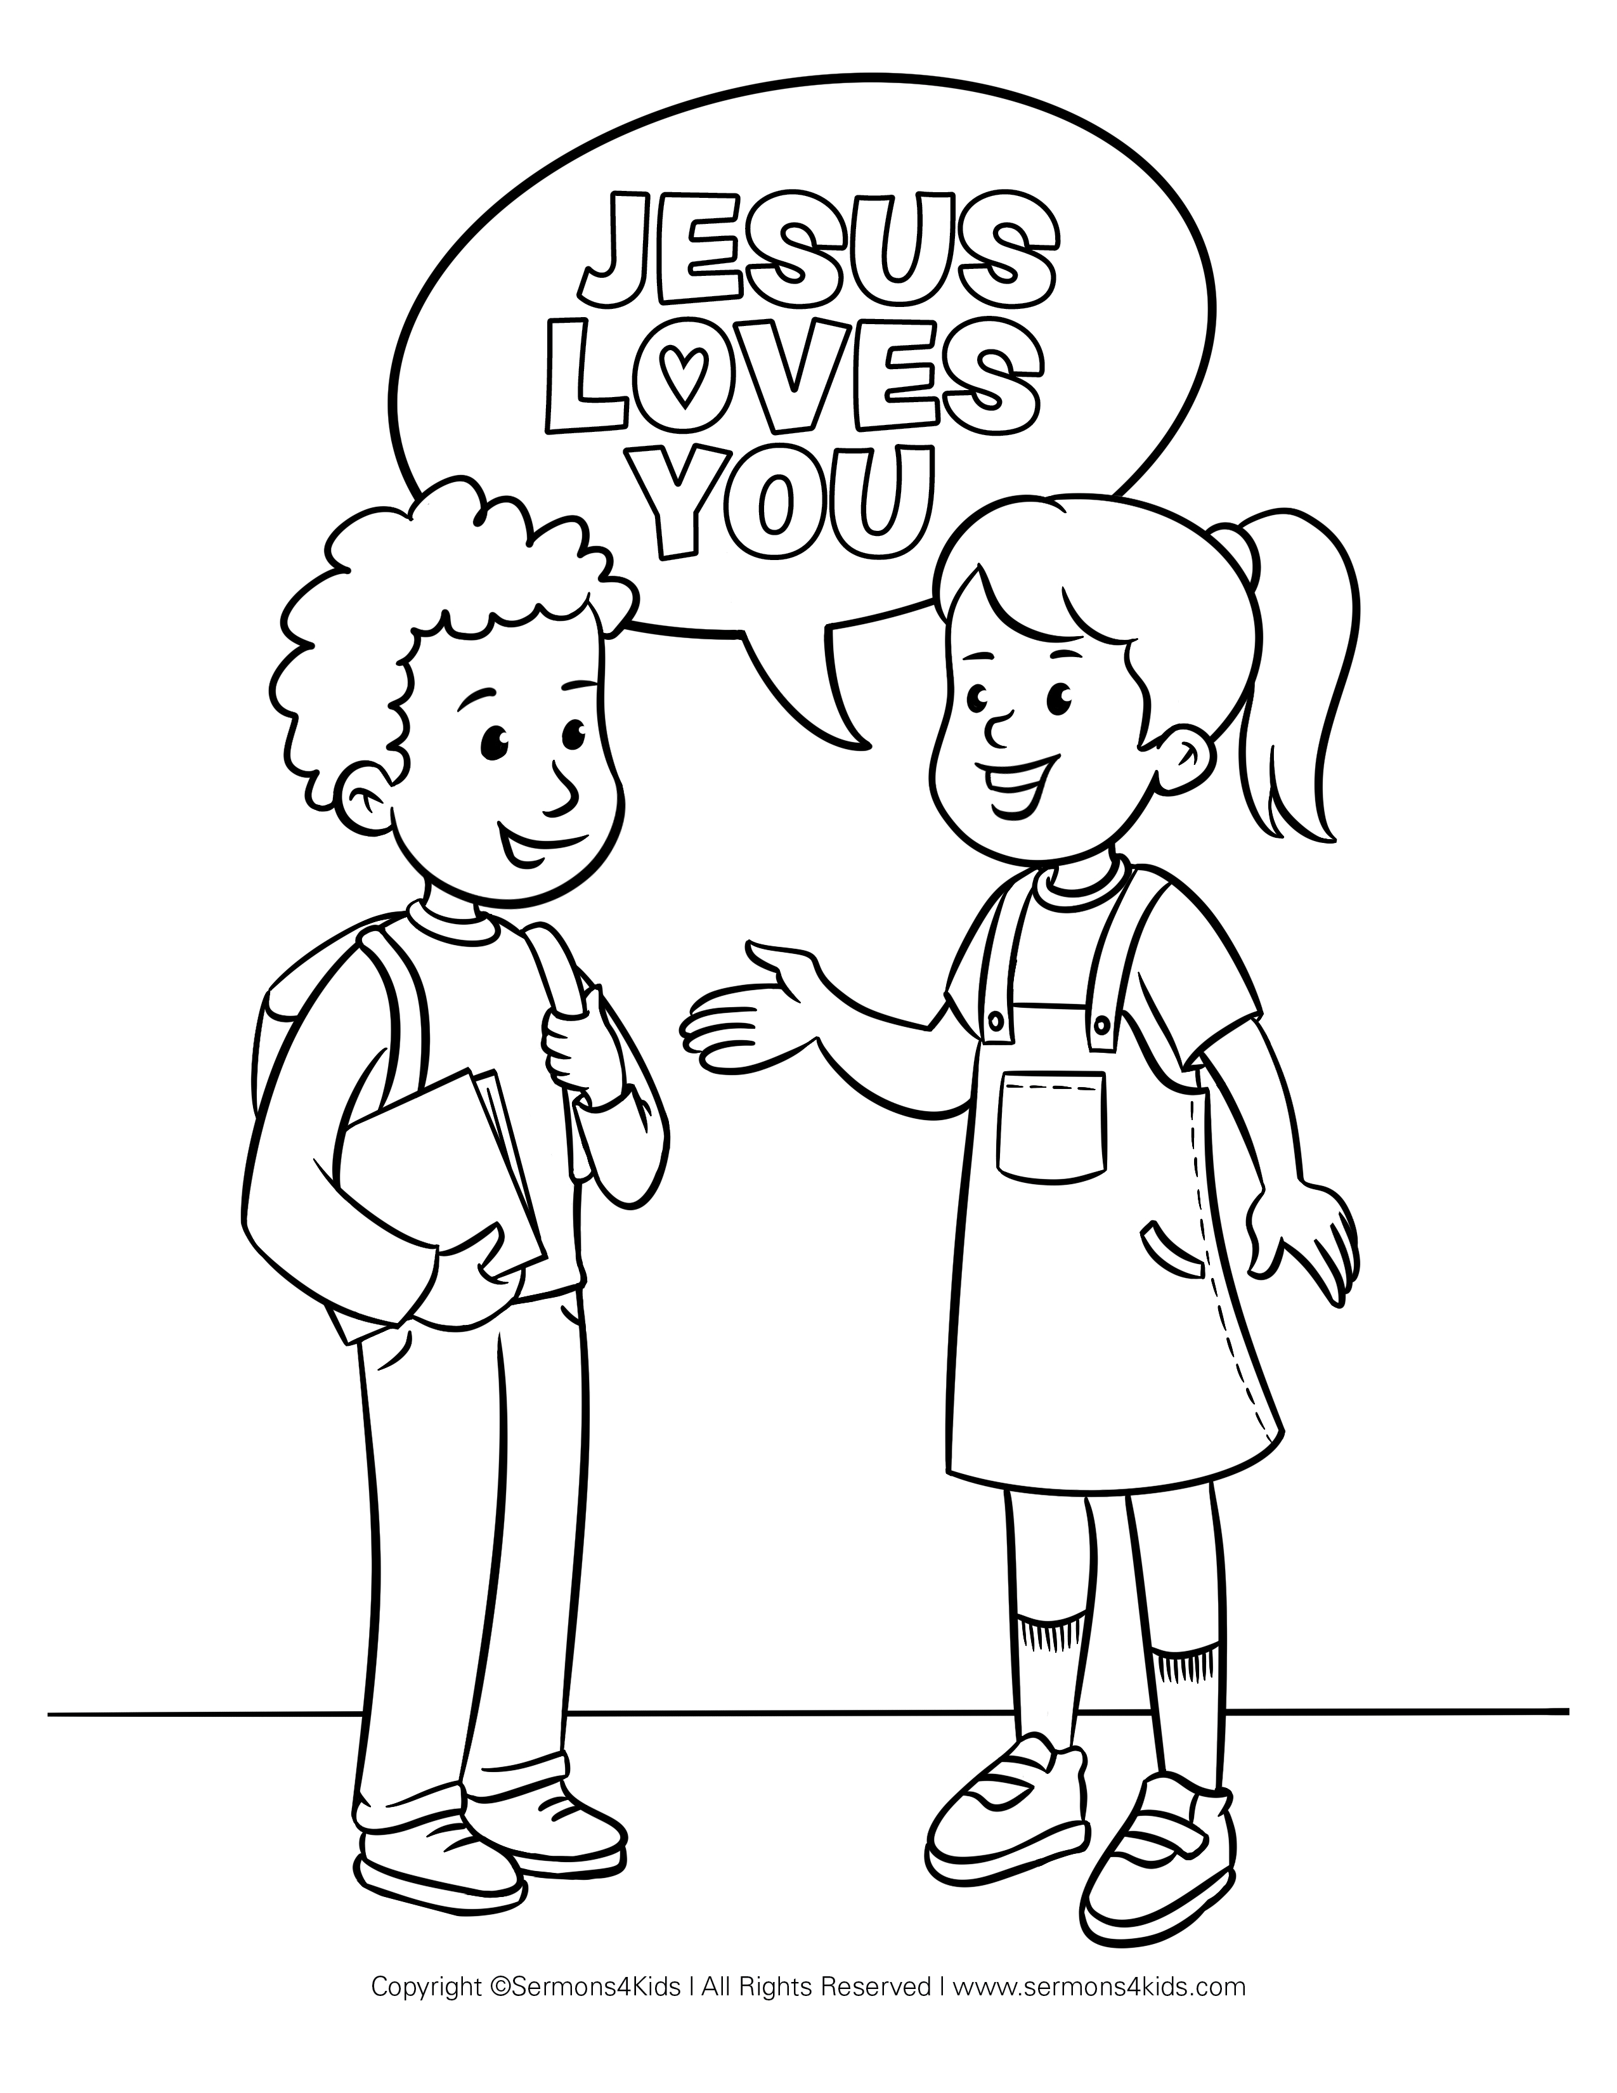
What are God’s plans?
He made you with special abilities to help others and share the good news of His LOVE and FORGIVENESS.
He wants you to have JOY, LOVE, HOPE, and PEACE
God has AWESOME ETERNAL PLANS for you and me.
Jesus is preparing a place for us.
We get to live eternally with Him in the best world ever!

Slide 8

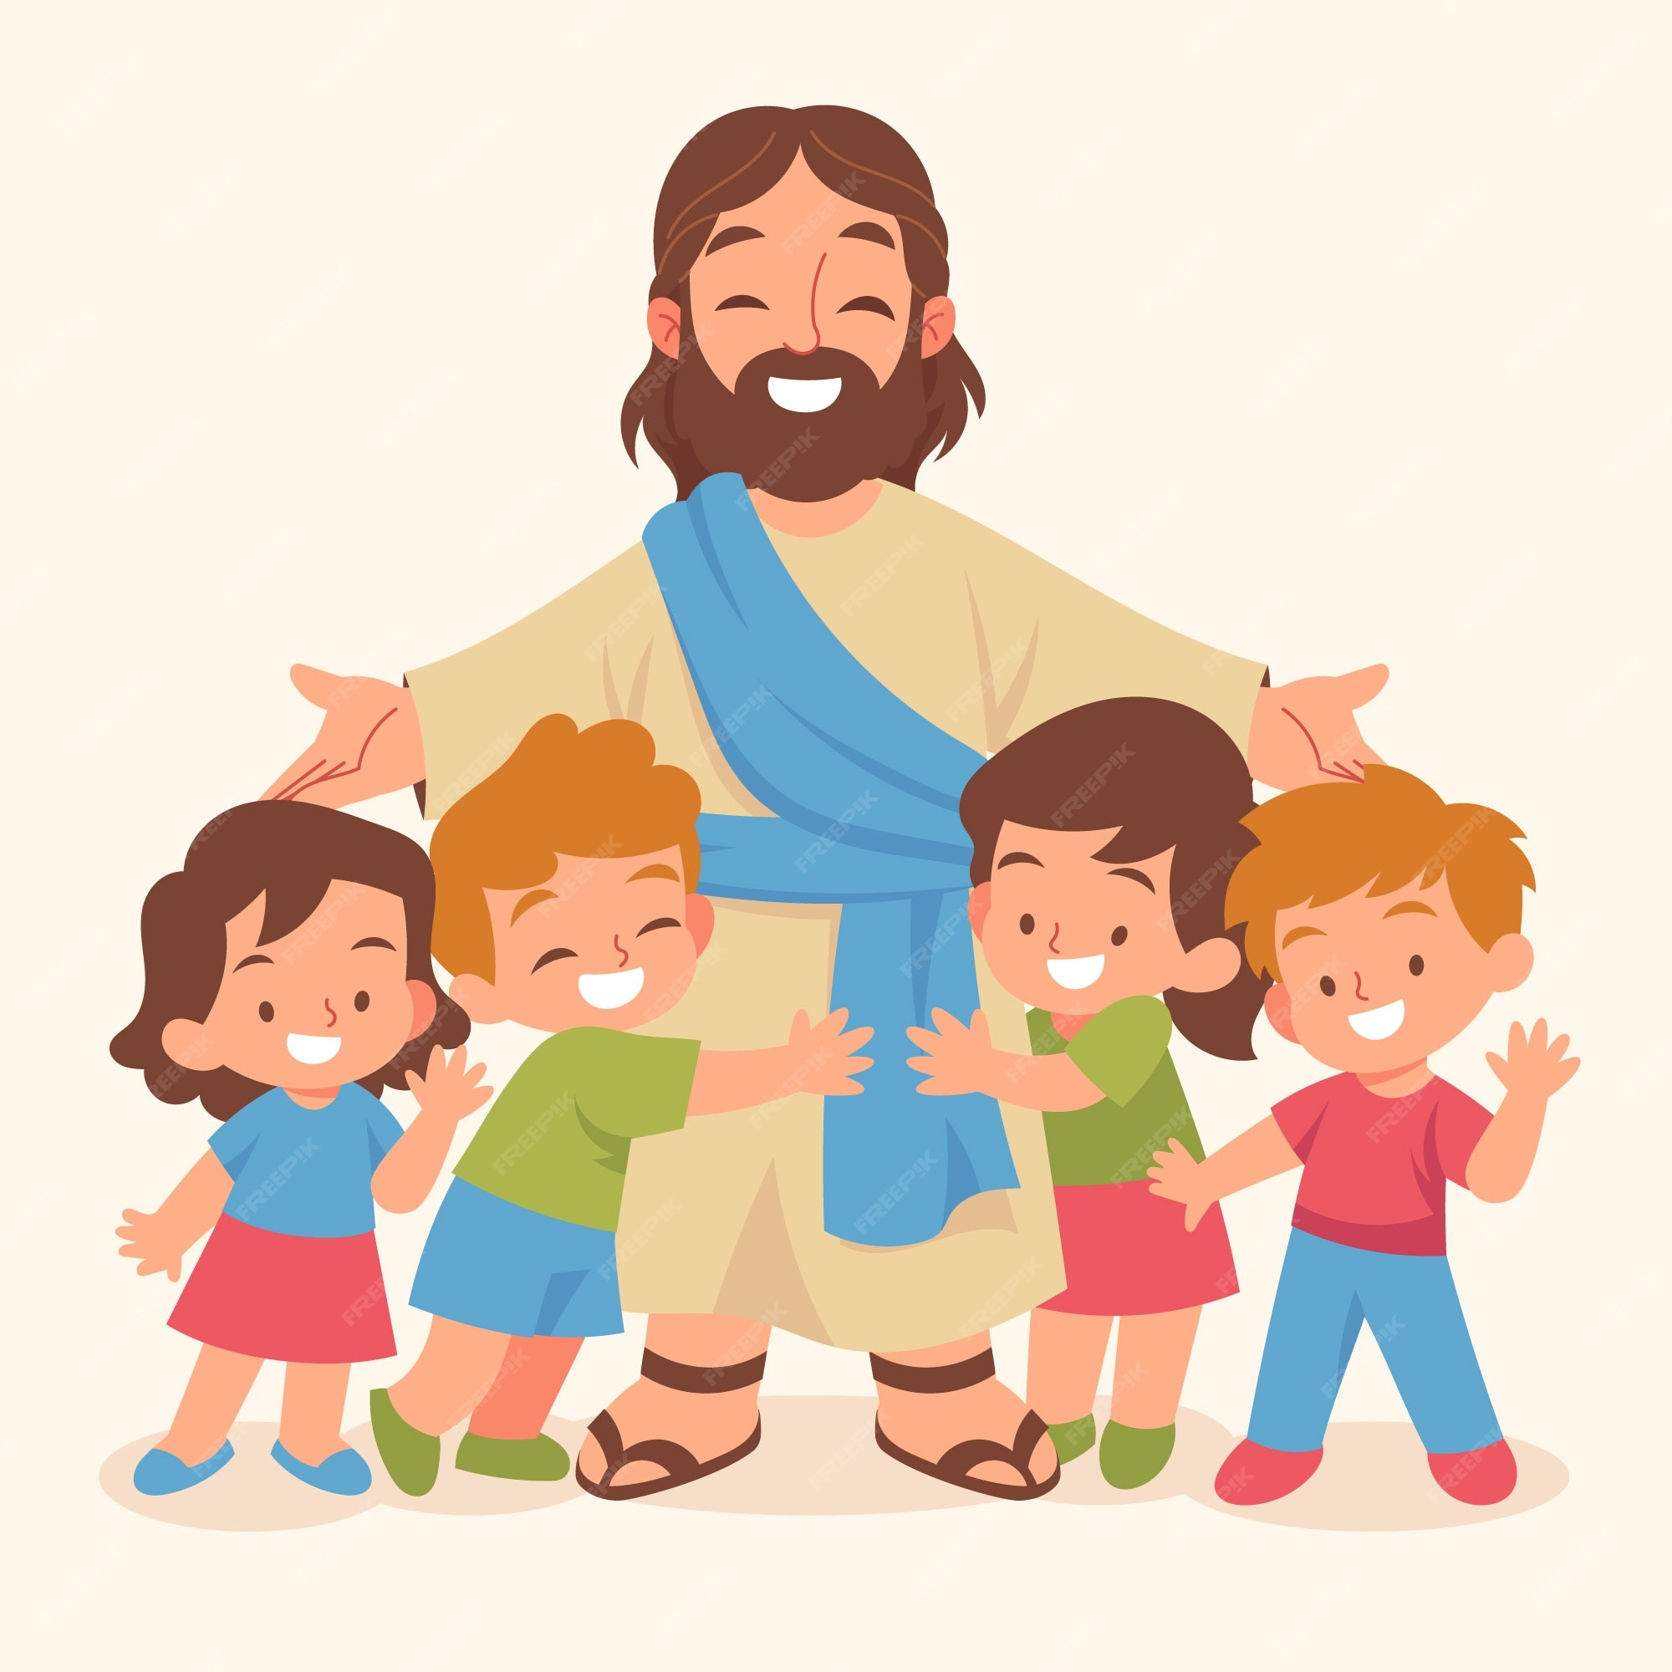



What is God’s will?
Mark 12
²⁹ Jesus answered, “The most important is, ‘Hear, O Israel: The Lord our God, the Lord is one. ³⁰ And you shall love the Lord your God with all your heart and with all your soul and with all your mind and with all your strength.’ ³¹ The second is this: ‘You shall love your neighbor as yourself.’ There is no other commandment greater than these.”
1 Thessalonians 5:18
Give thanks in all circumstances; for this is the will of God in Christ Jesus for you.
John 6:40
For this is the will of my Father, that everyone who looks on the Son and believes in him should have eternal life, and I will raise him up on the last day.”
Eternal
Life

Slide 9
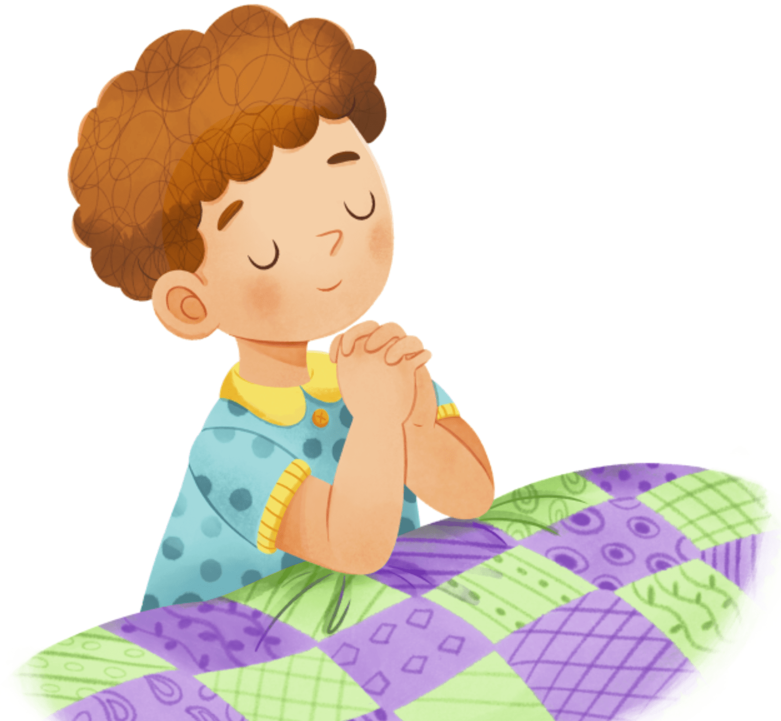
Object Lesson (option 1) – My Plan or God’s Plan
Heavenly Father, You are Holy and good, generous and kind.
Please give me _____________
I saw it on TV and it’s really cool and I need it or maybe I want it.
Thank you.
My Plan
GOD’S PLAN
Ummmm
Your will be done.
You know what is best.
In Jesus name, Amen.

Slide 10
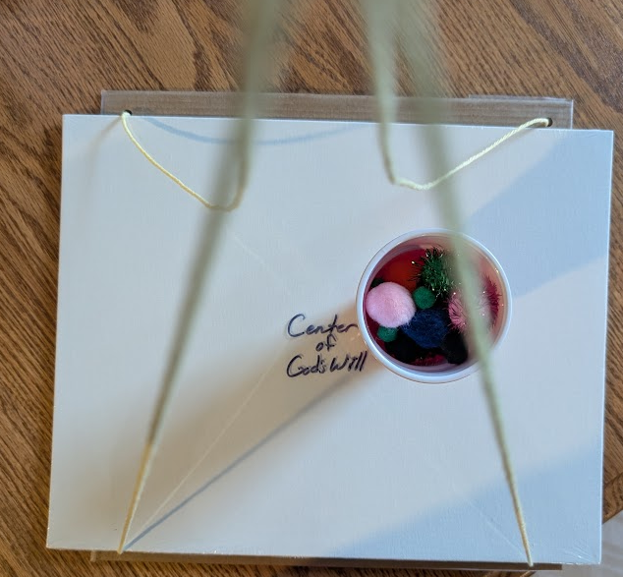
Object Lesson (option 2) –
In the center of God’s Will
Heavenly Father, You are Holy and good, generous and kind.
Please give me _____________
I saw it on TV and it’s really cool and I need it or maybe I want it.
Thank you.
Ummmm
Your will be done.
You know what is best.
In Jesus name, Amen.
See video at end

Slide 11


Slide 12
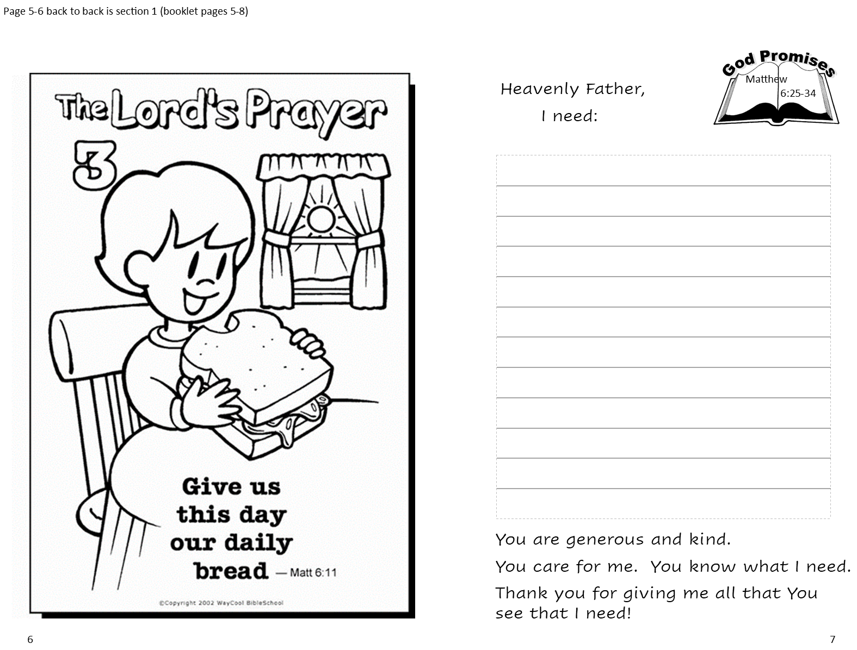
Continue your journal

Slide 13
God Provides
Lord, teach us to pray like John taught his disciples.
Luke 11
Now Jesus was praying in a certain place, and when he finished, one of his disciples said to him,
“Lord, teach us to pray, as John taught his disciples.”
Matthew 6
…your Father knows what you need before you ask him. ⁹ Pray then like this:
“Our Father in heaven,
hallowed be your name.
¹⁰ Your kingdom come,
your will be done,
on earth as it is in heaven.
¹¹ Give us this day our daily bread,
“This, then, is how you should pray:
“‘Our Father in heaven, hallowed be thy name
Thy kingdom come, Thy will be done on earth as it is in heaven. Give us this our daily bread.

Slide 14
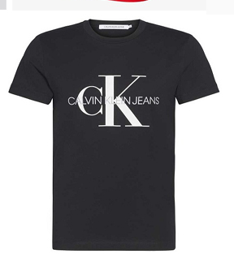
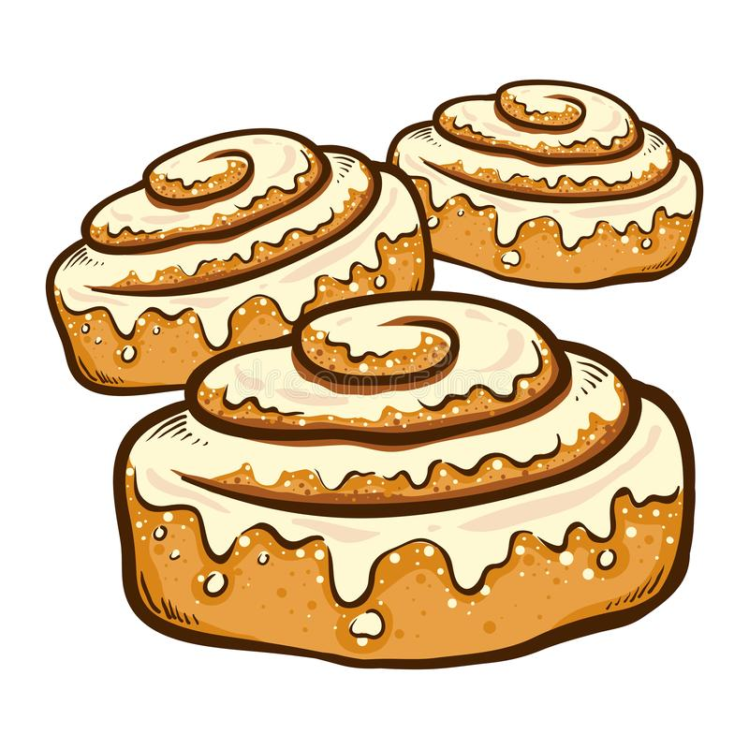


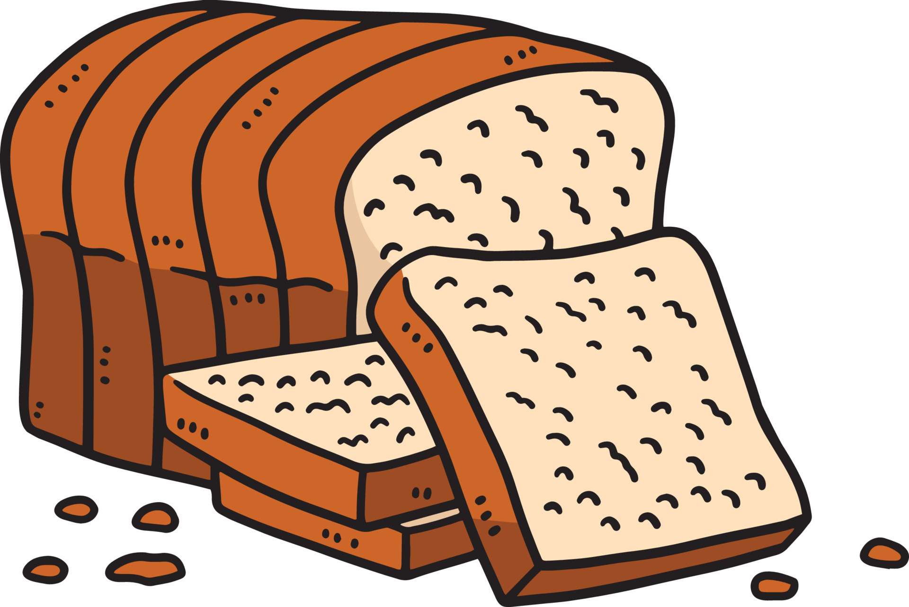
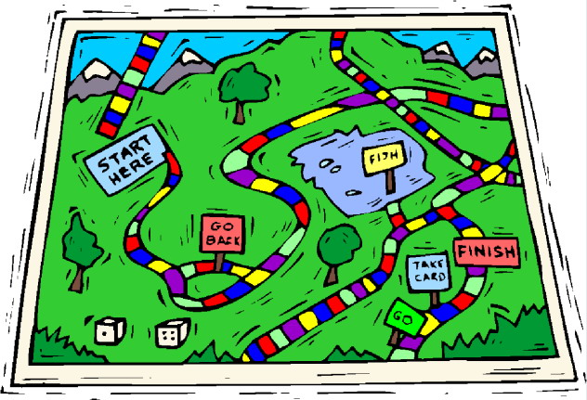
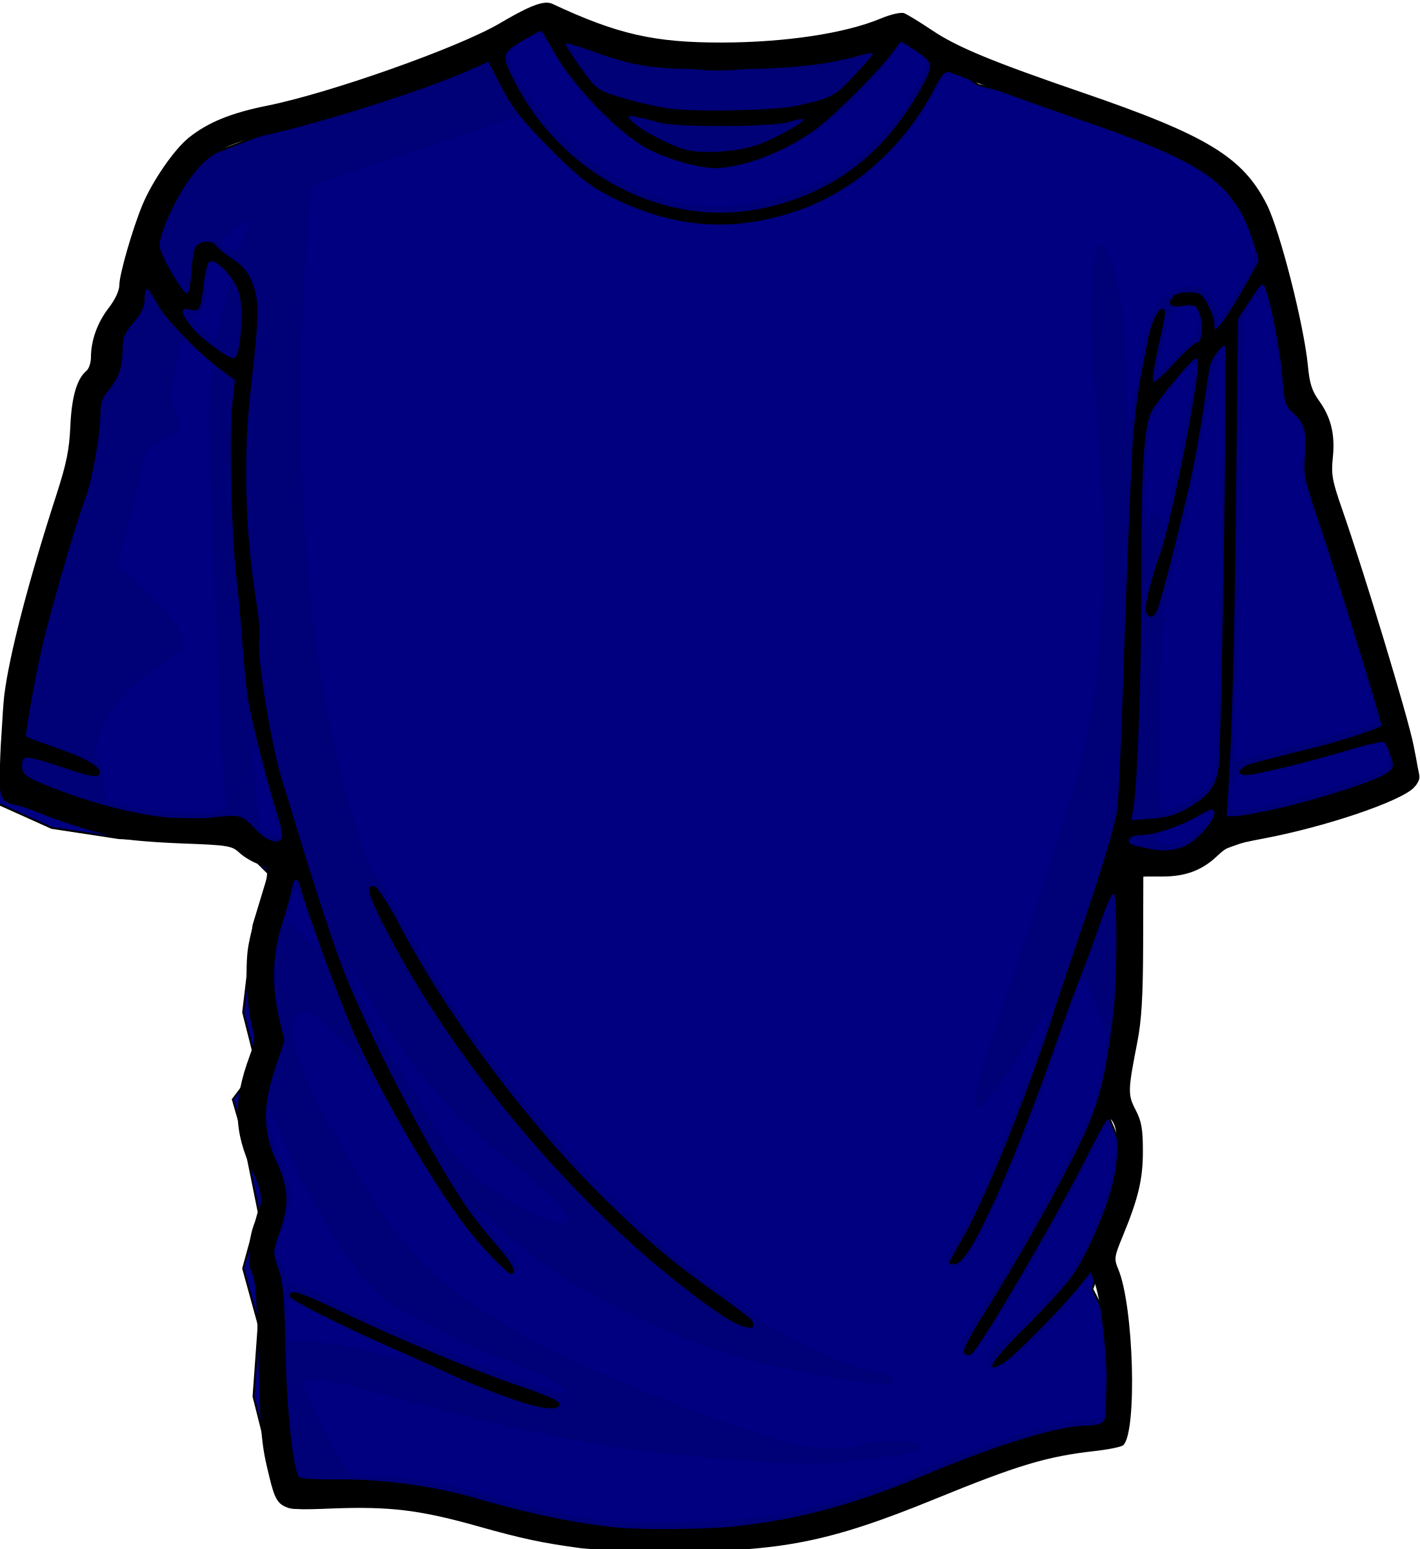

Is it a NEED or a WANT?
It is necessary for life, health, or to do a required task.
It is just for fun or something special. It is not required.

Slide 15
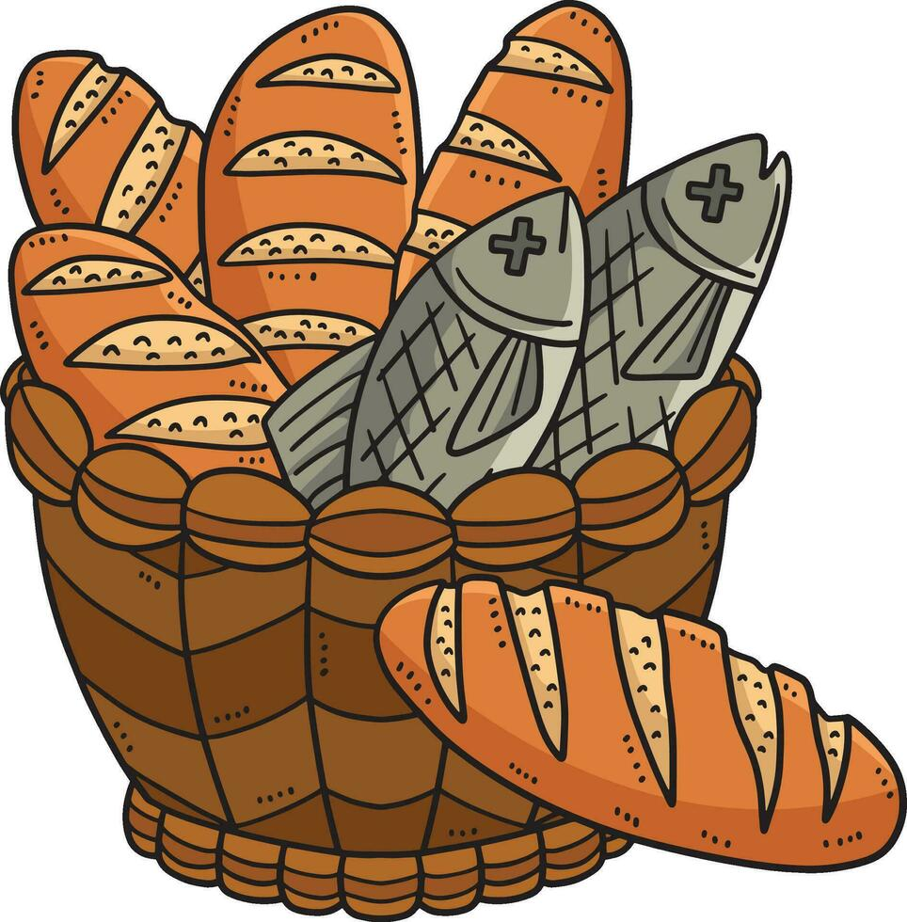
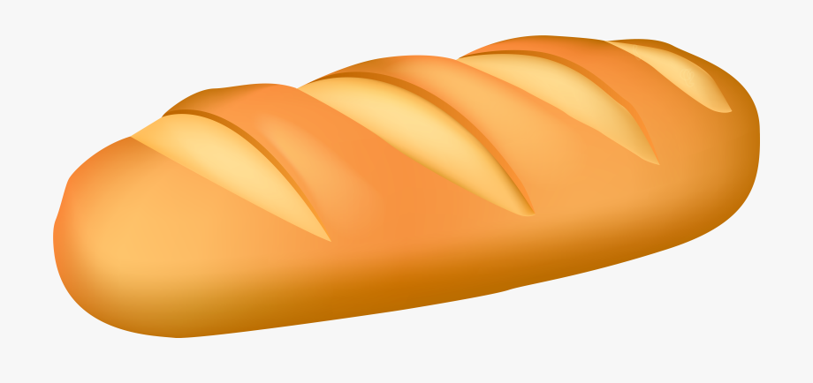
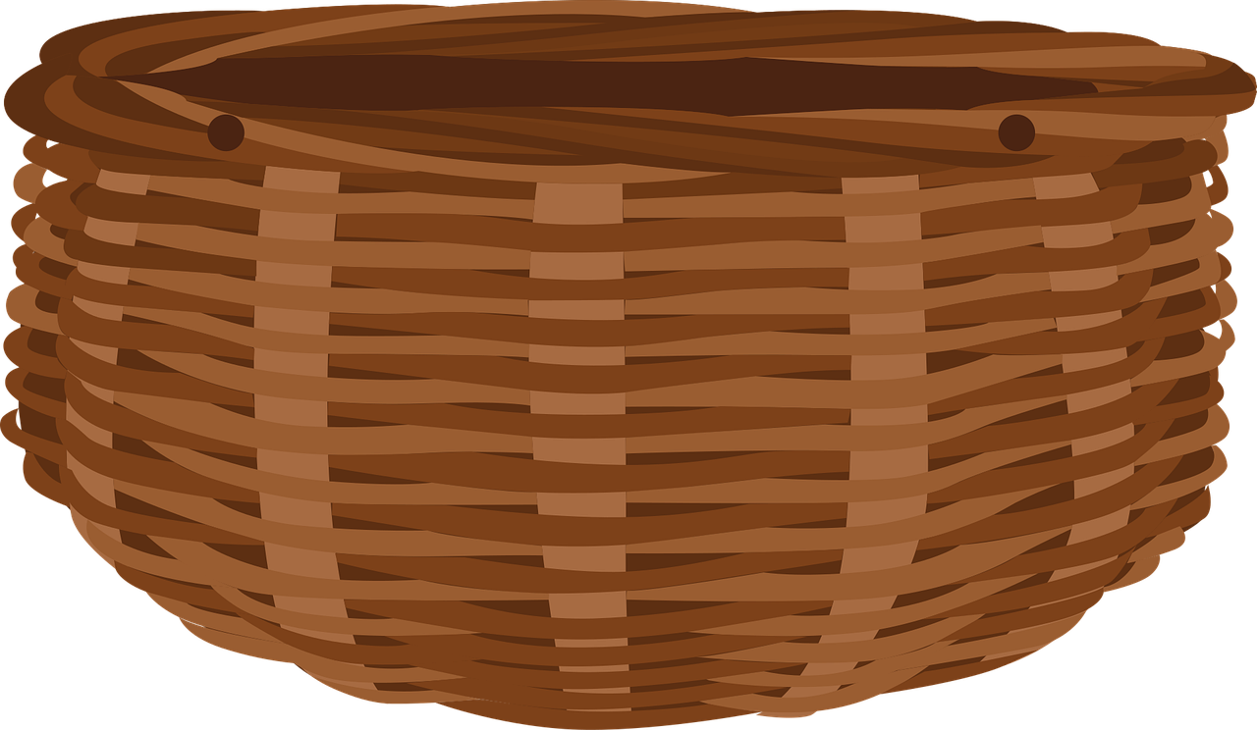
Remember that God provides
Do you remember?
What stories do these baskets remind you of?
Read about it in
Matthew 15:32-38
Read about it in
Matthew 14:13-21

Slide 16
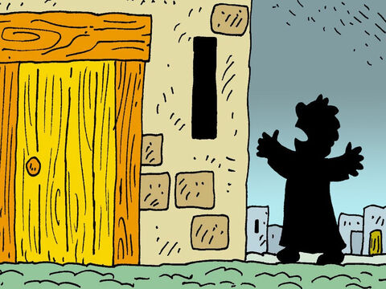
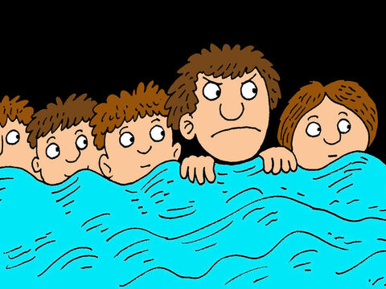
When you pray remember God will answer your prayer. Even more than….
⁵ Then Jesus said to them, “Suppose you have a friend. You go to him at midnight and say, ‘Friend, lend me three loaves of bread. ⁶ A friend of mine on a journey has come to stay with me. I have no food to give him.’ ⁷ And suppose the one inside answers, ‘Don’t bother me. The door is already locked. My children and I are in bed. I can’t get up and give you anything.’ ⁸ I tell you, that person will not get up. And he won’t give you bread just because he is your friend. But because you keep bothering him, he will surely get up. He will give you as much as you need.
Friend, may I have some bread. I have hungry guests.
Don’t bother me.
We’re already in bed!
We’re trying to sleep!
Please! They are hungry!
Please! I have nothing!
OK OK I’m coming.
Your heavenly Father is much more willing to give you all that you need.
He is generous, kind, and compassionate.

Slide 17
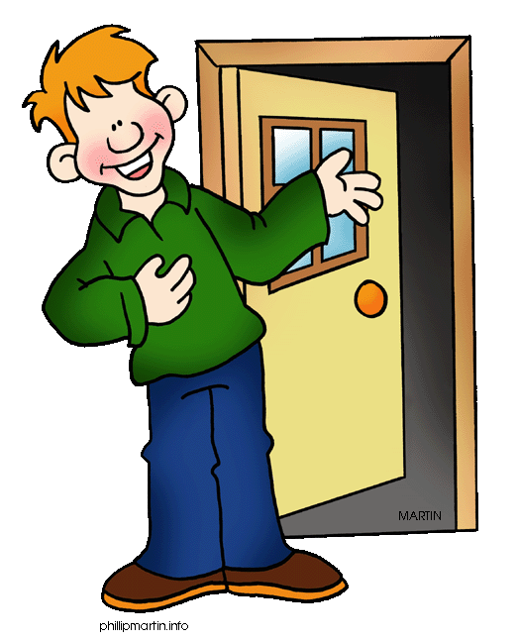

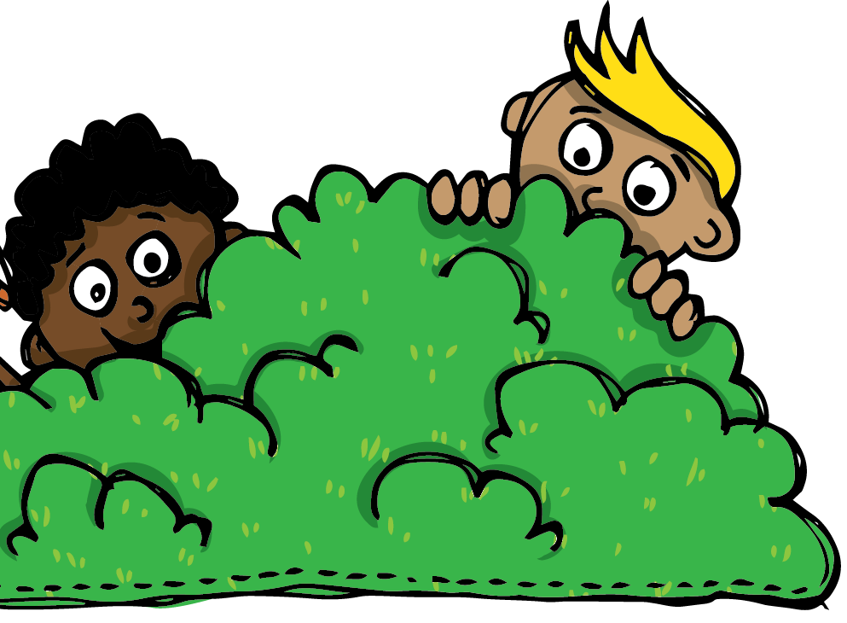
Ask, Seek, Knock
Give us this day our daily bread.
Luke 11
⁹ And I tell you,
ask, and it will be given to you;
seek, and you will find;
knock, and it will be opened to you.
¹⁰ For everyone who asks receives, and the one who seeks finds, and to the one who knocks it will be opened.
Ask and it will be given to you.
Seek and you will find.
Knock and the door will be opened to you.
Knock on a door
Ask for a snack
Look for a snack

Slide 18

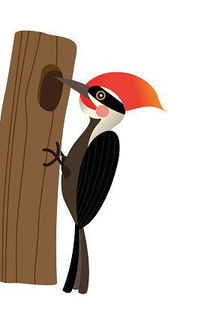
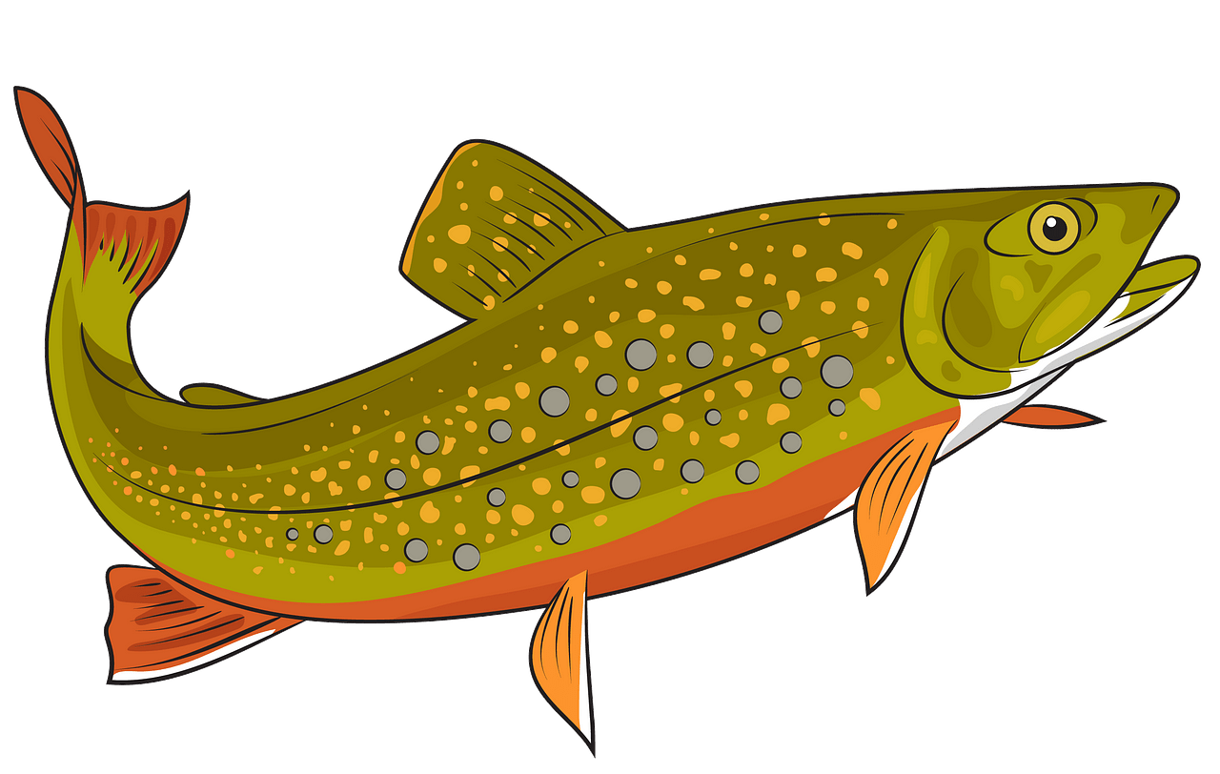
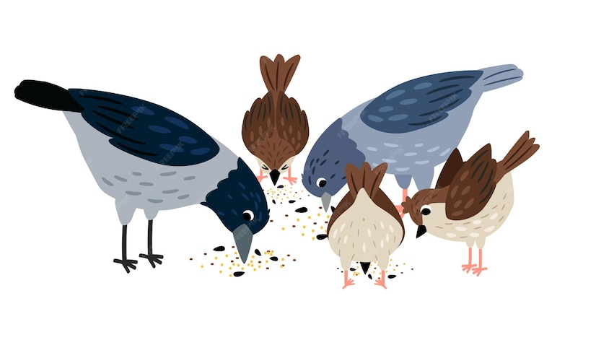
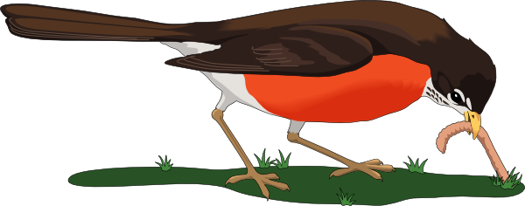
Matthew 5
²⁵ “So, I tell you, don’t worry about the things you need to live—what you will eat, drink, or wear.
Life is more important than food, and the body is more important than what you put on it.
²⁶ Look at the birds. They don’t plant, harvest, or save food in barns, but your heavenly Father feeds them.
Don’t you know you are worth much more than they are? ²⁷ You cannot add any time to your life by worrying about it.
Don’t worry about what you will eat.
See how your Father feeds the birds!
You are worth much more than they are.
Your Father will provide.

Slide 19
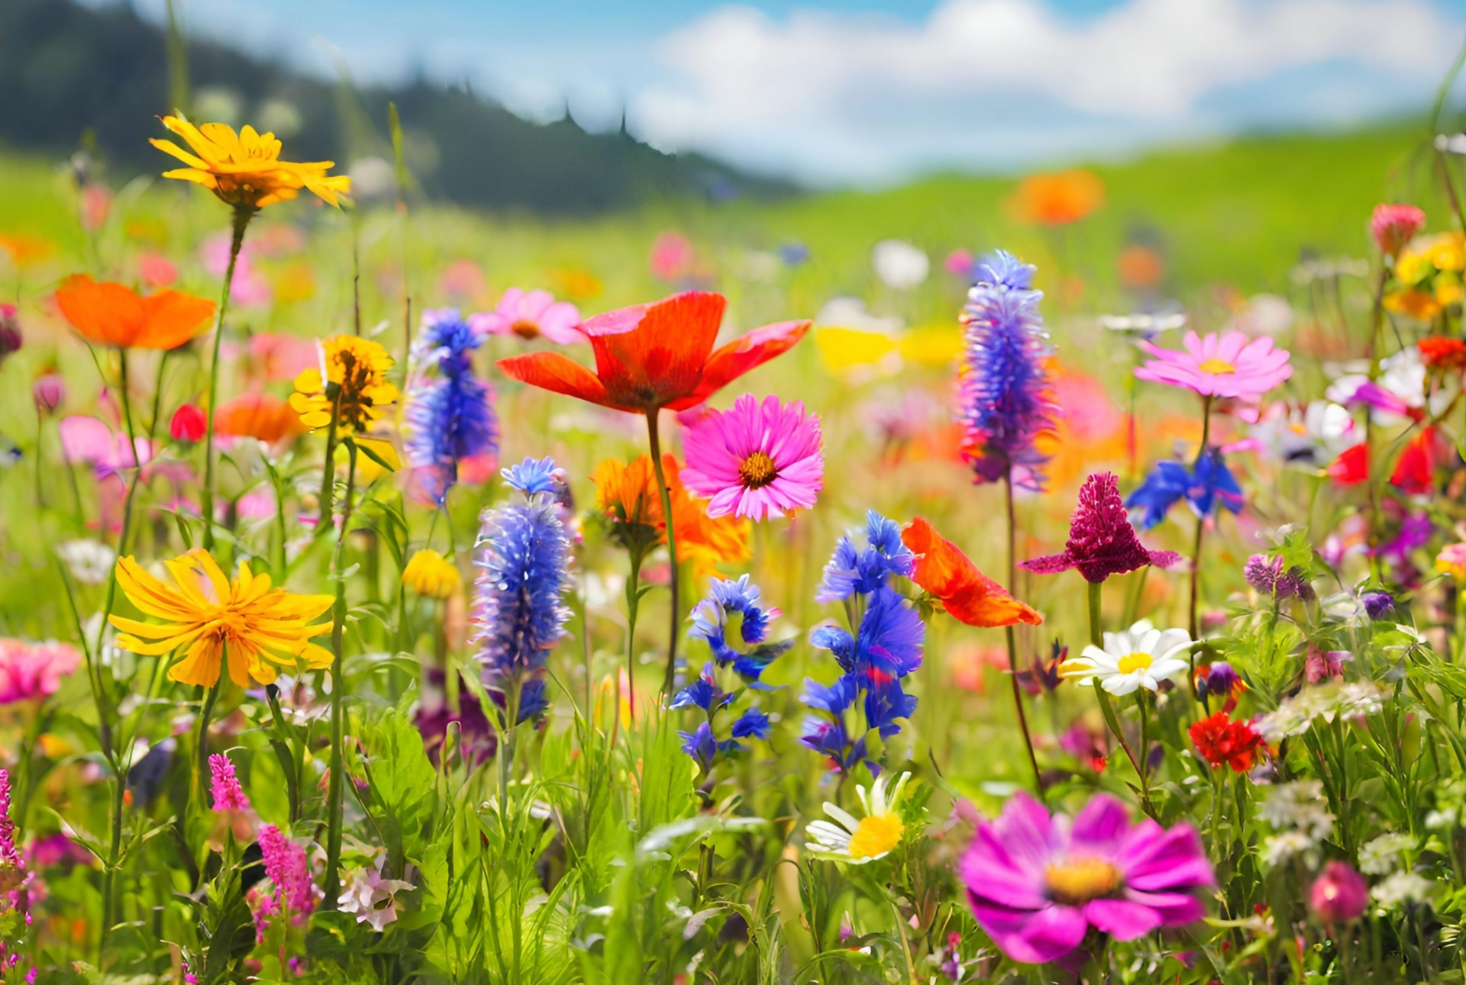
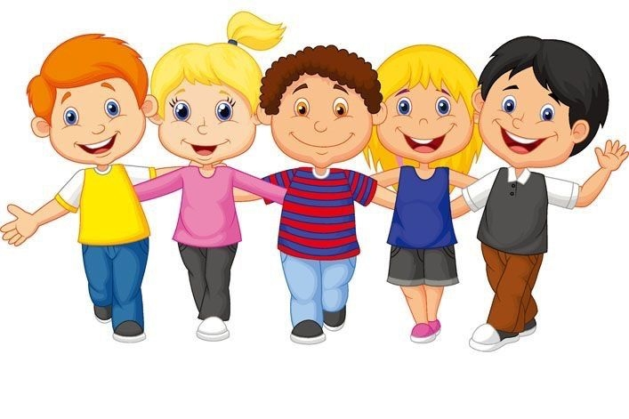
God will provide
Matthew 5
²⁸ “And why do you worry about clothes? Look at the wildflowers in the field. See how they grow. They don’t work or make clothes for themselves.
²⁹ But I tell you that even Solomon, the great and rich king, was not dressed as beautifully as one of these flowers.
³⁰ If God makes what grows in the field so beautiful, what do you think he will do for you? It’s just grass—one day it’s alive, and the next day someone throws it into a fire. But God cares enough to make it beautiful. Surely he will do much more for you. Your faith is so small!
Look how God how God clothes the field with beautiful flowers! He loves beauty!
He will clothe you too.

Slide 20
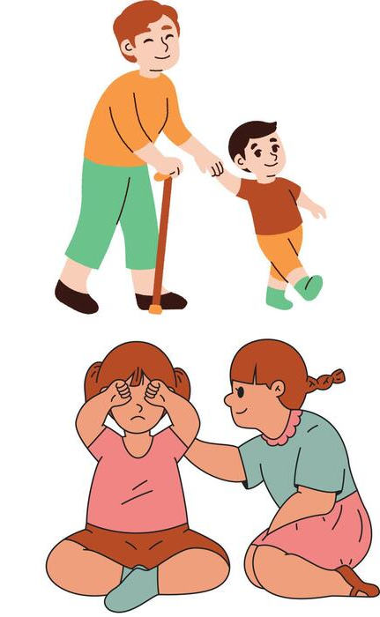

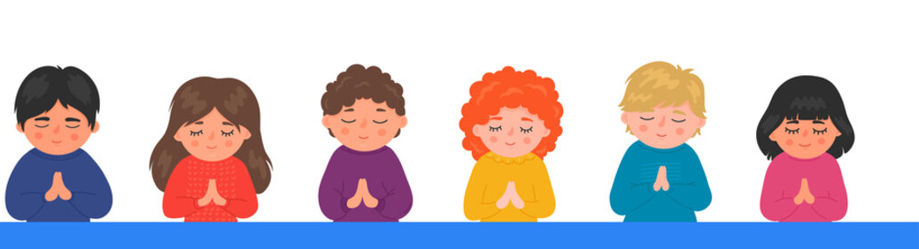
Seek first His Kingdom
Matthew 5
³¹ “Don’t worry and say, ‘What will we eat?’ or ‘What will we drink?’ or ‘What will we wear?’ ³² That’s what those people who don’t know God are always thinking about.
Don’t worry, because your Father in heaven knows that you need all these things.
³³ What you should want most is God’s kingdom and doing what he wants you to do. Then he will give you all these other things you need.
³⁴ So don’t worry about tomorrow. Each day has enough trouble of its own. Tomorrow will have its own worries.
Your Father in heaven knows that you need these things.
Seek first His kingdom.
He will give you all these things.
Don’t worry about tomorrow.

Slide 21
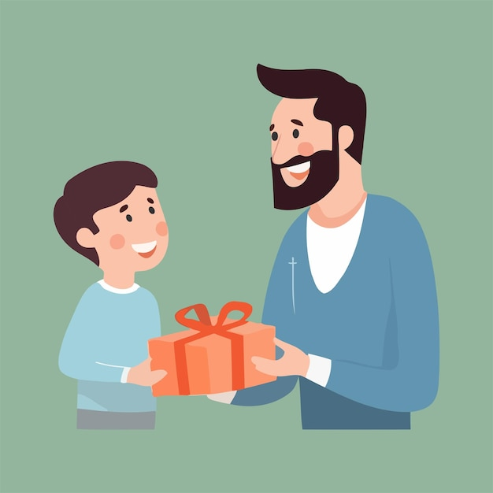
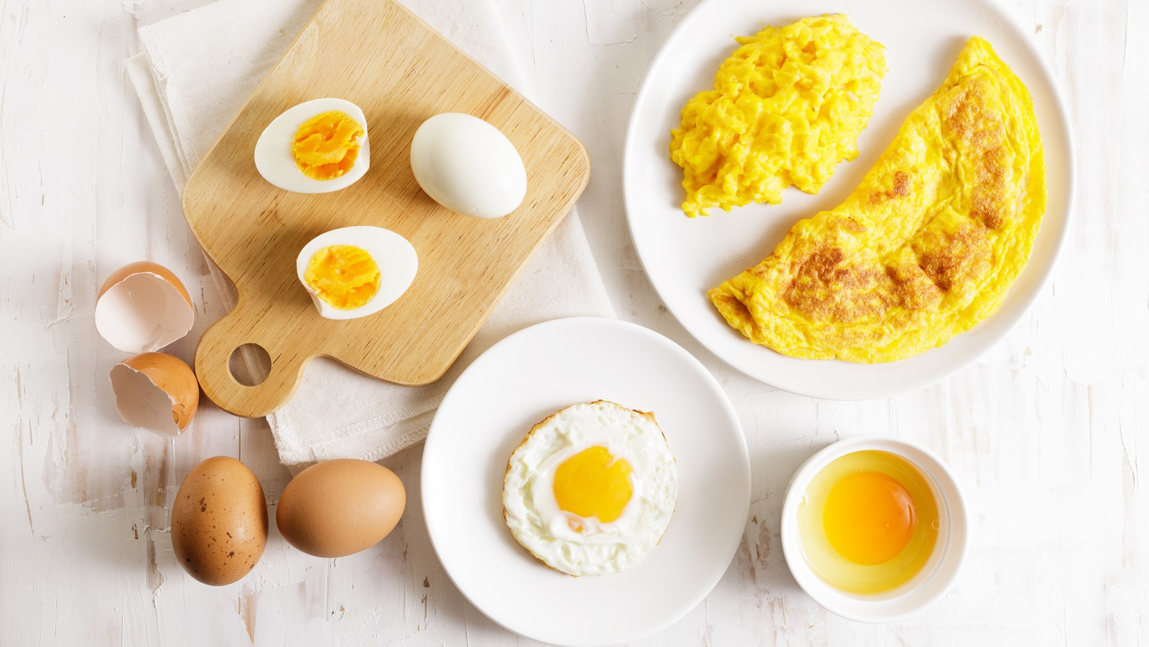
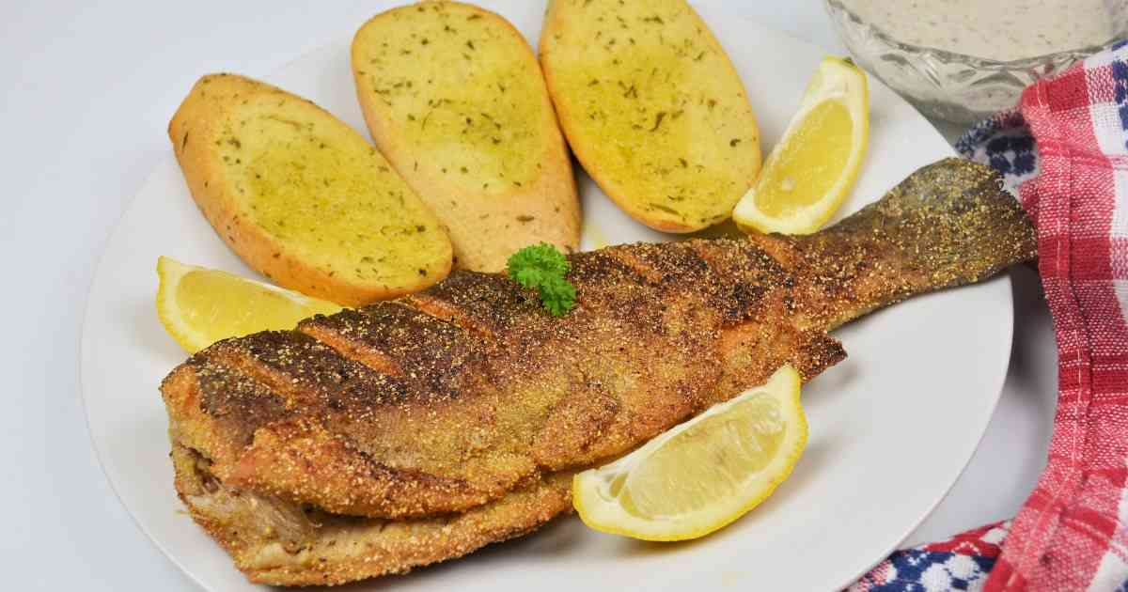
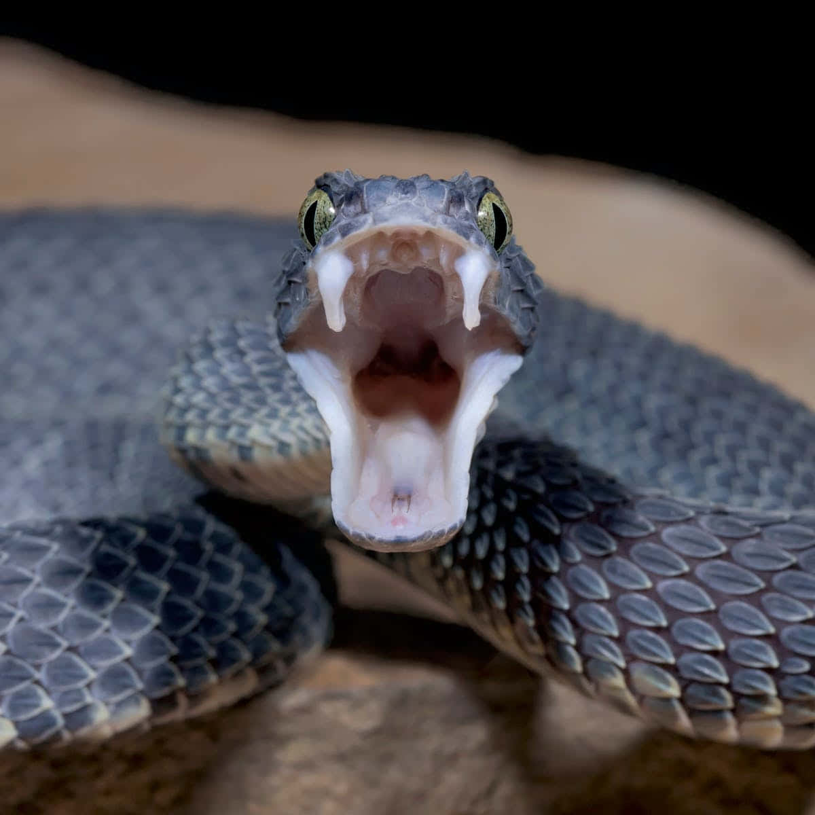
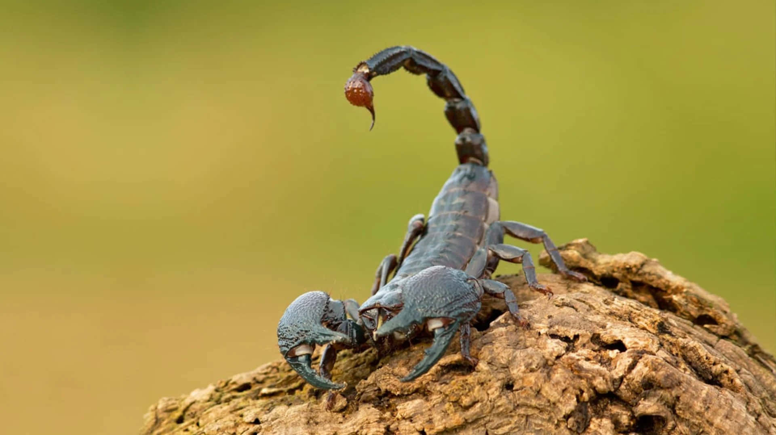
Our generous Heavenly Father gives GREAT gifts!
Luke 11
¹¹ What father among you, if his son asks for^{[d]} a fish,
will instead of a fish give him a serpent;
¹² or if he asks for an egg,
will give him a scorpion?
¹³ If you then, who are evil, know how to give good gifts to your children, how much more will the heavenly Father give the Holy Spirit to those who ask him!”
And the best gift of all is the Holy Spirit!

Slide 22
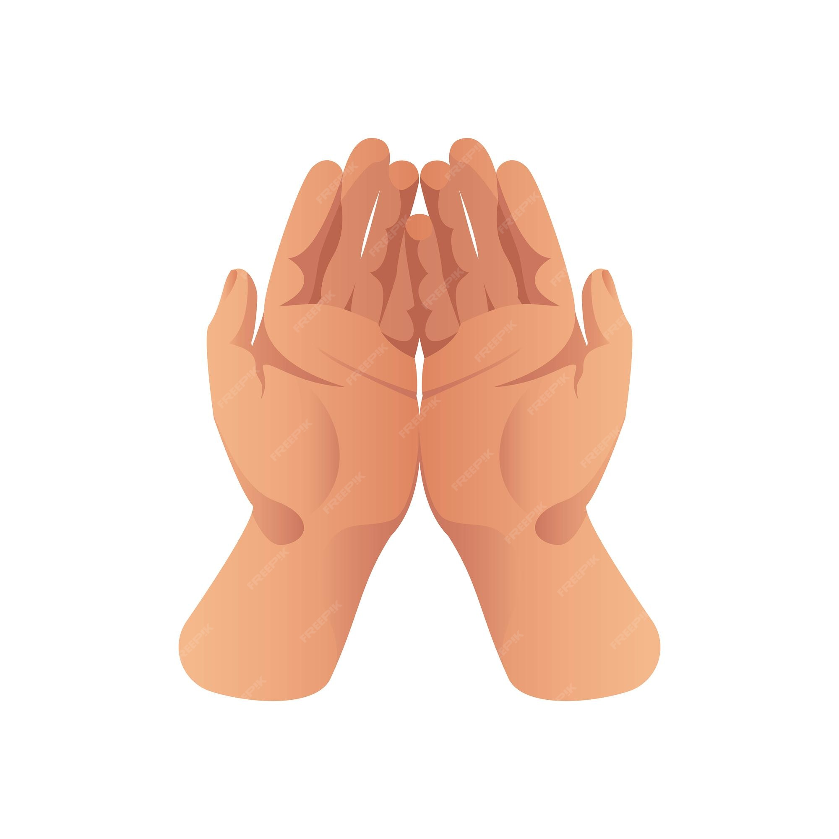

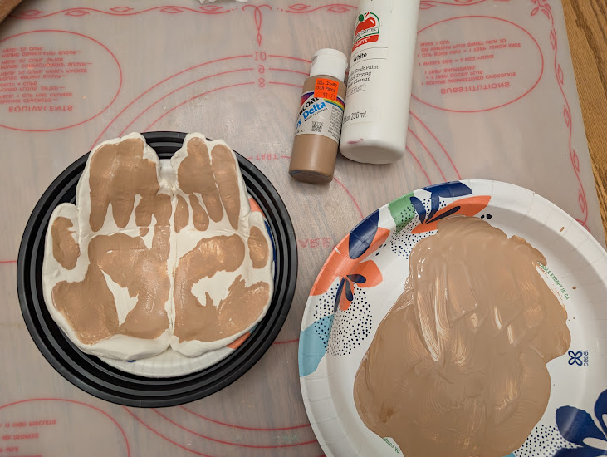
CRAFT TIME
So, open your hands and open your hearts,
let God fill them with His GOOD GIFTS.
Directions:
Get a ball of air-dry clay that’s quite big, so that it just fits into your hands.
Roll it out about ¼ to ½ inch thick.
Place your right hand on the left side of the dough, face down, & fingers together. Press down to make a handprint. While there:
With a table knife, cut around the palm and fingers except do not cut the right side of your pinky & palm.
Place your left hand on the right side of the dough in the same way. Put it so that it’s pinky is next to the other palm print pinky. Then cut around it the same way as before.
Carefully, using a metal spatula, loosen the hand prints, removing excess clay.
Optional: place hands in paint. Place the hands on the prints as you did above, leaving paint handprints.
Carefully, using the metal spatula, lift the palm prints and carefully put them in a bowl so that it looks like your hands are open to receive a gift.
Let dry the required amount of time.
Remove from bowl. You can use them as a bowl for special trinkets.

Slide 23
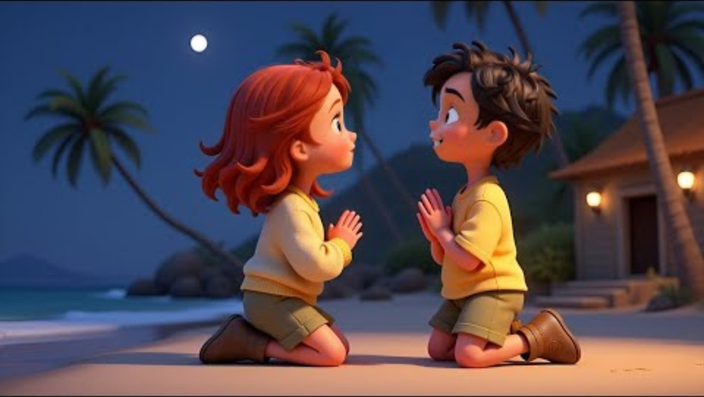

Slide 24


Slide 25
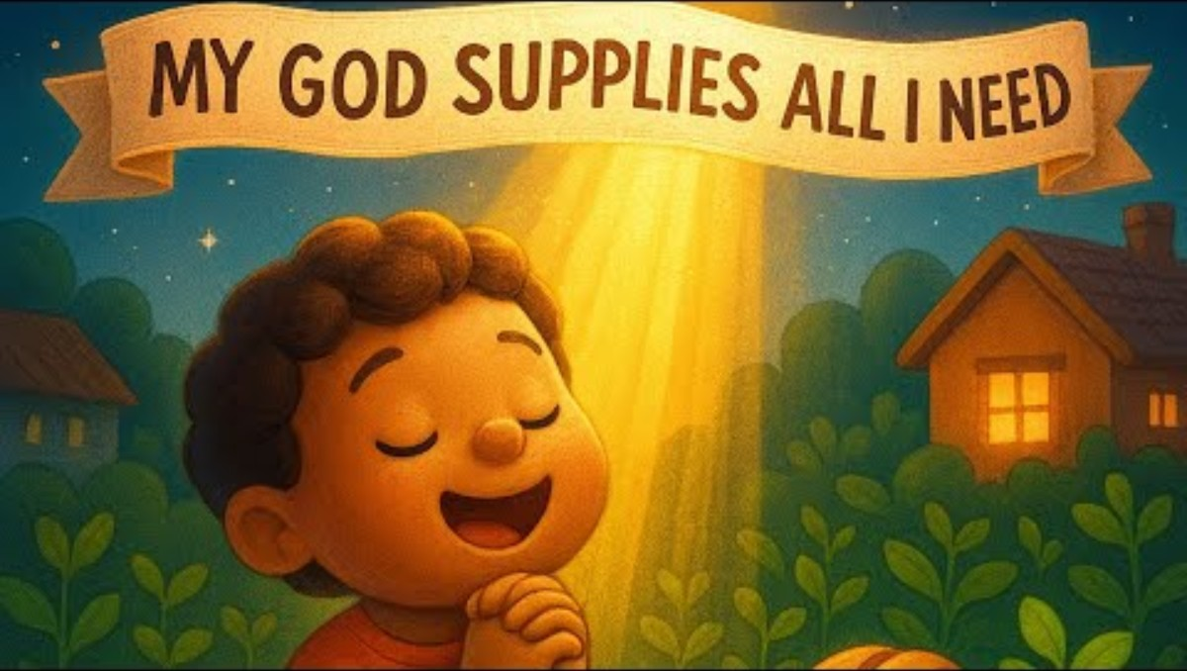

Slide 26
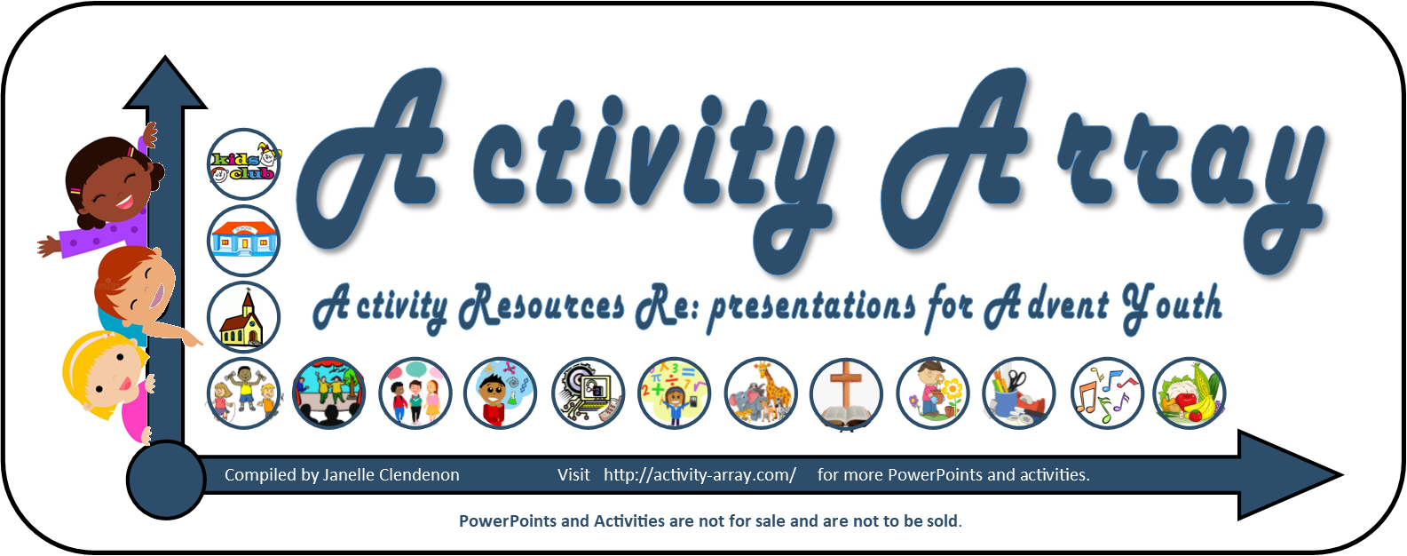
The End

Slide 27
EXTRA EXTRA
eX
Extra slides and information

Slide 28
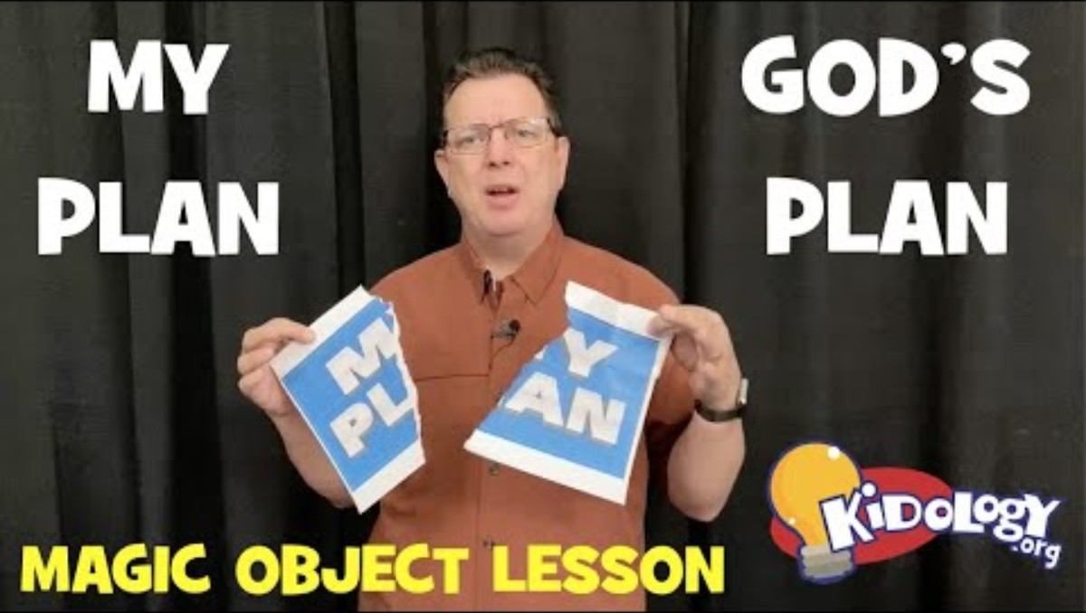
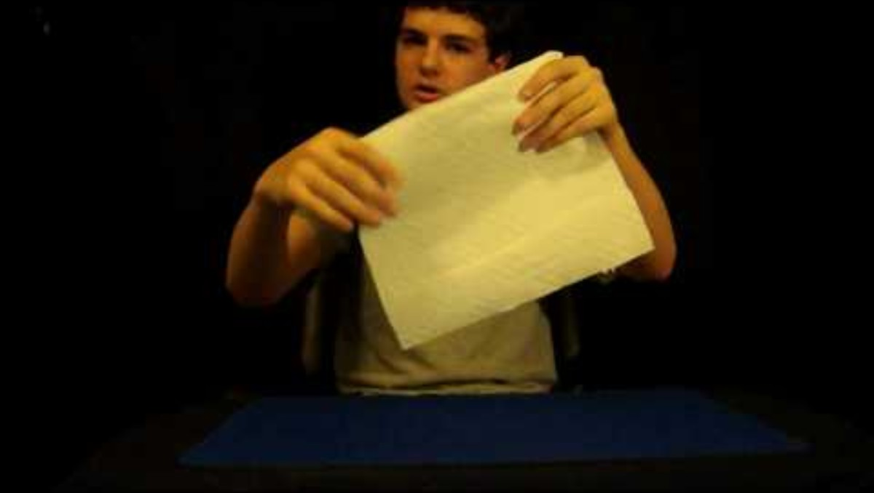
Object Lesson – My Plan or God’s Plan
Teacher – watch how to do it

Slide 29
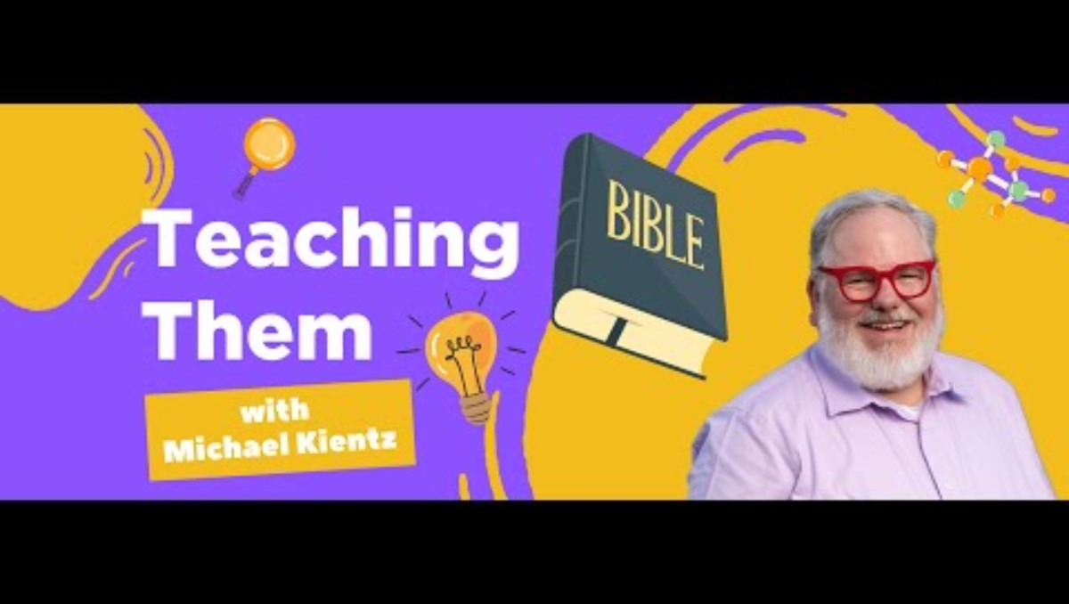
Object Lesson – My Plan or God’s Plan
Teacher – watch how to do it
https://www.youtube.com/watch?v=9uWcsD3SJFI&t=1s
My revisions:
I found the cardboard bent so I had to use a board. I used a light weight, simple, painter’s board.
I wanted to do it inside, so instead of using water, I used pom poms in a cup and talked about wanting different things while putting them inside the cup.

