Slide 1

Jesus’ ascension
And the Great Commission

Slide 2

What can go up to the sky?
Have you ever gone up really high?
What was it like?

Slide 3
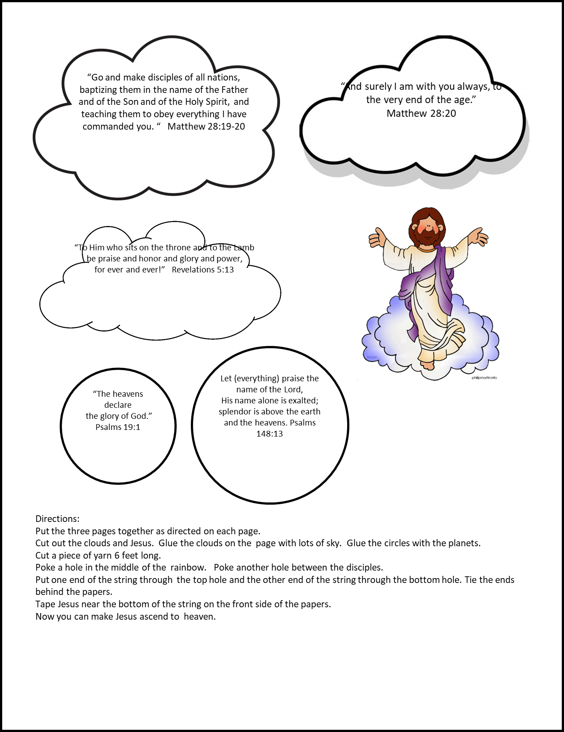
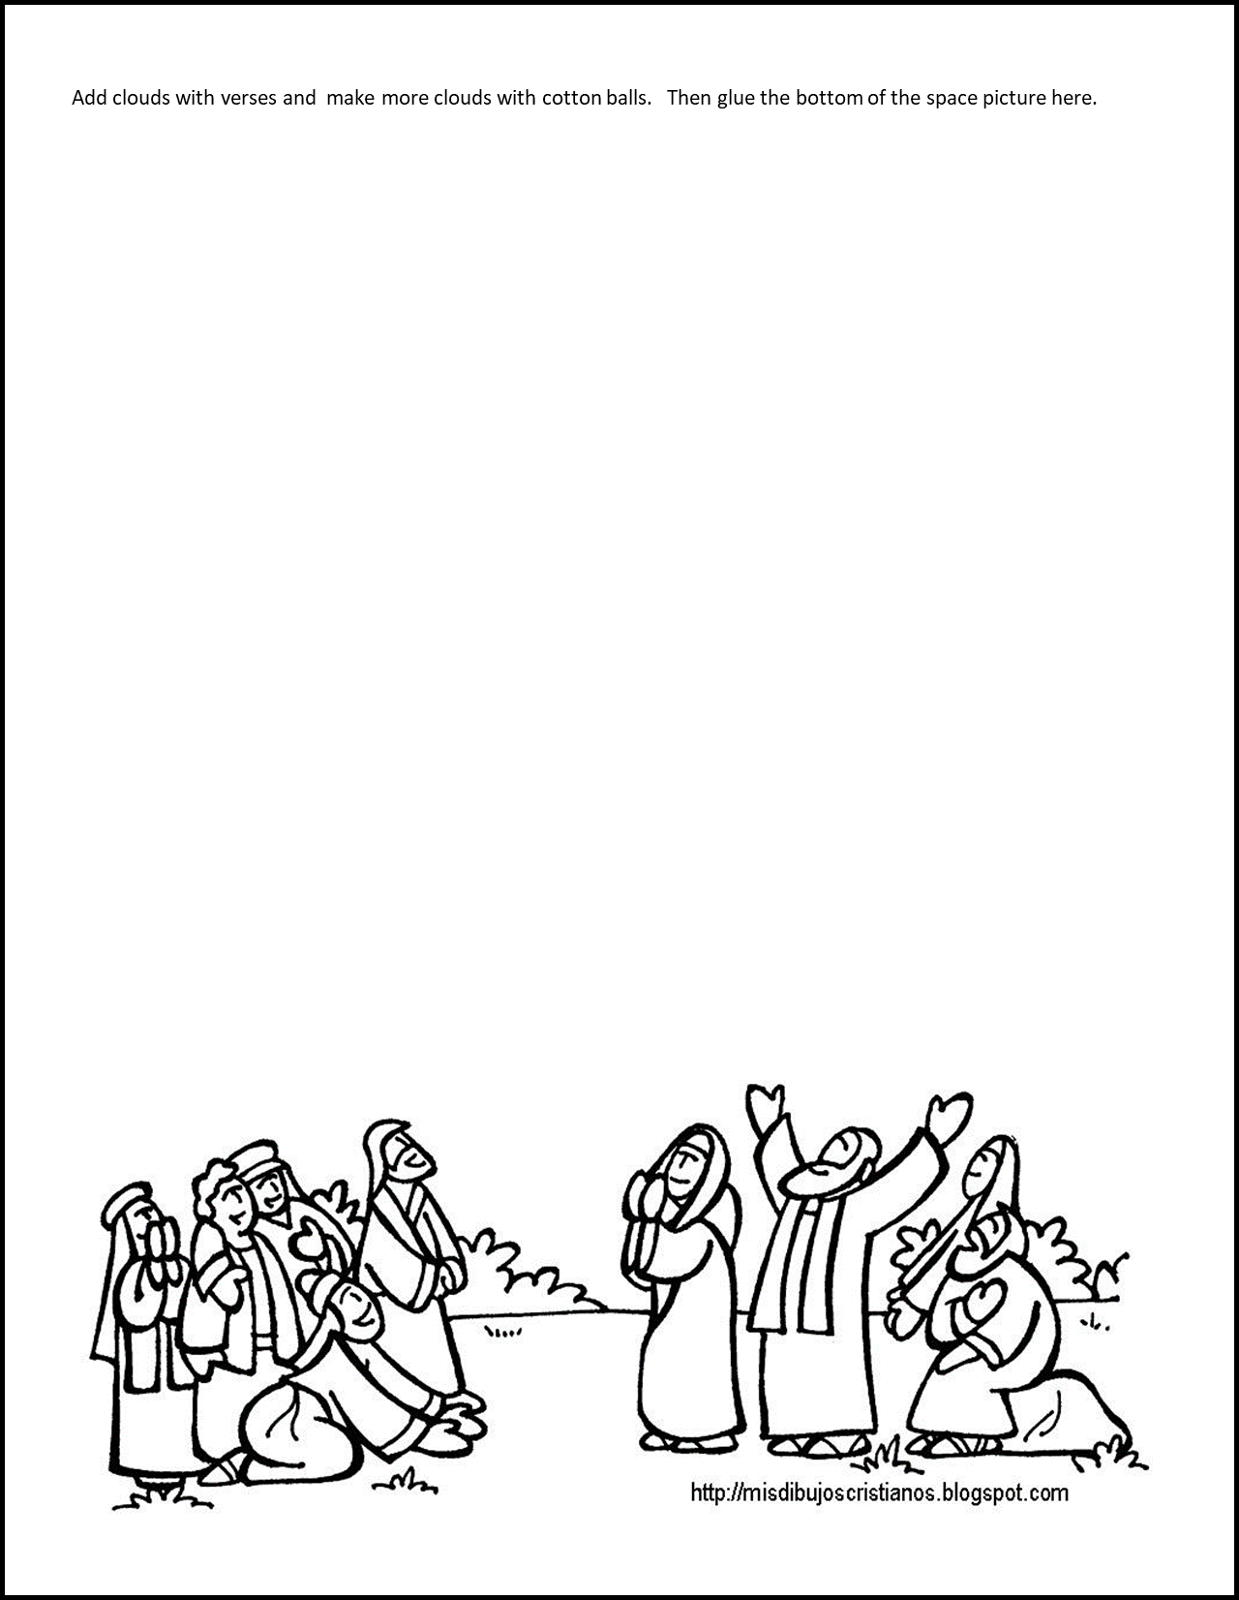
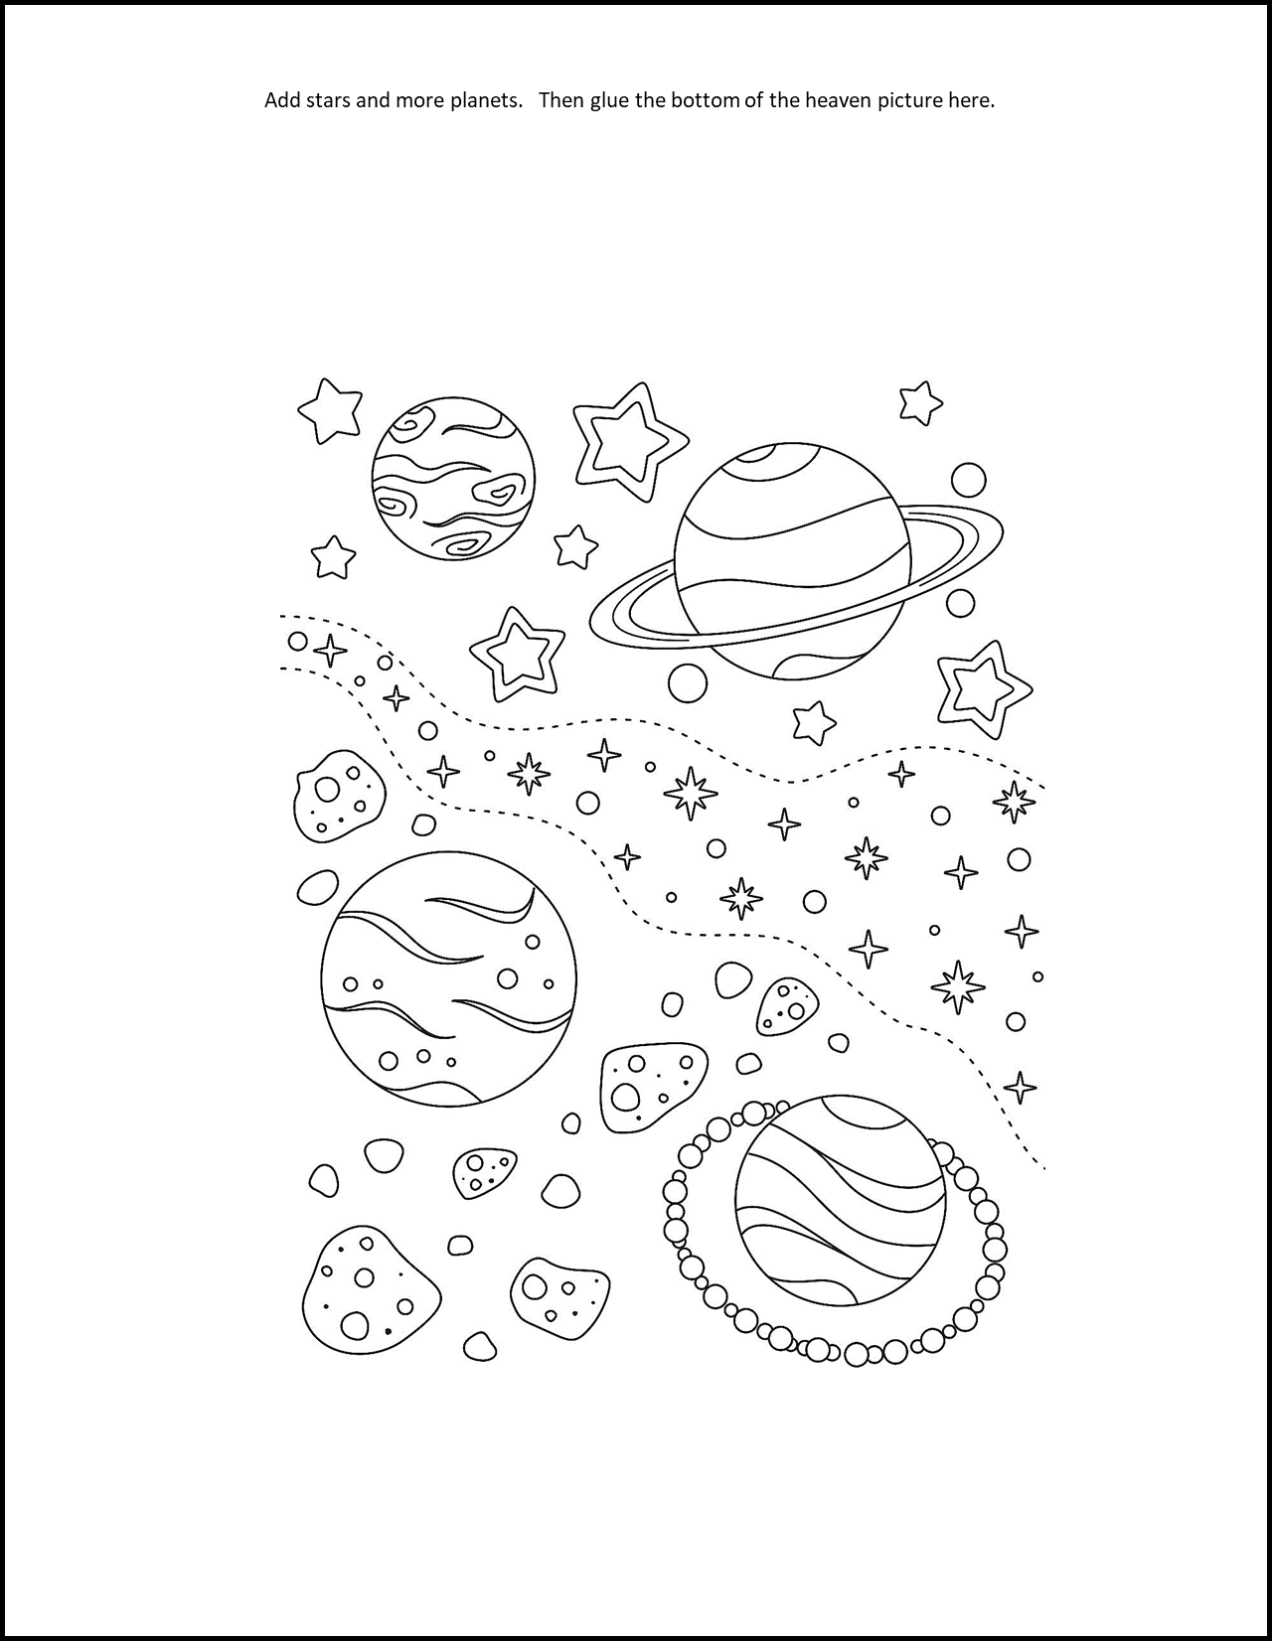
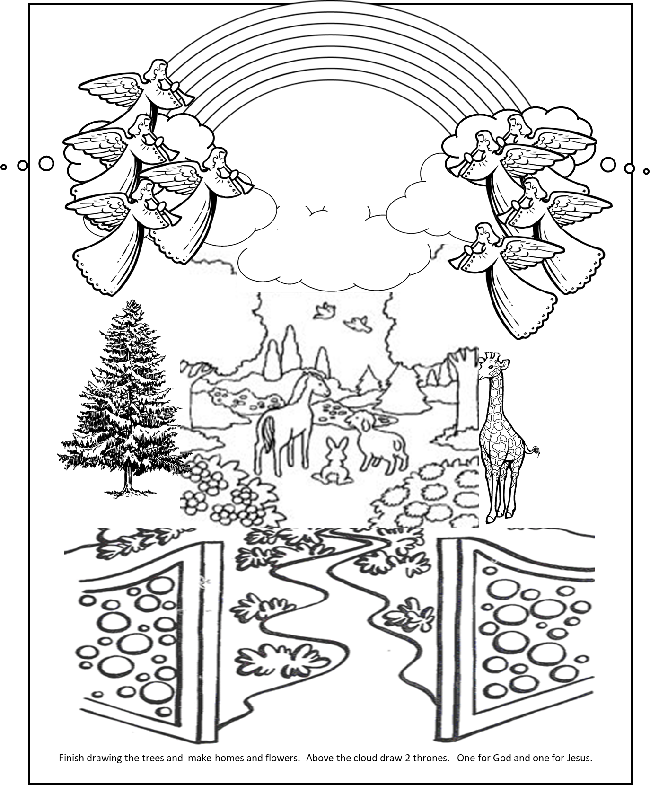
Craft Time – Part 1 – Color the pages

Slide 4
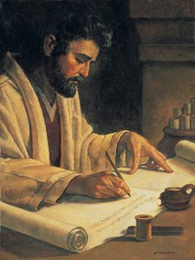
Dear Theophilus,
In Acts, we read a letter that Luke wrote. Acts 1 tells us:
1 In my former book, Theophilus, I wrote about all that Jesus began to do and to teach ² until the day he was taken up to heaven, after giving instructions through the Holy Spirit to the apostles he had chosen. ³ After his suffering, he presented himself to them and gave many convincing proofs that he was alive. He appeared to them over a period of forty days and spoke about the kingdom of God.
After Jesus rose again, He gave many convincing proofs that He was alive.
He appeared to His many disciples over a period of 40 days. He spoke about the kingdom of God.

Slide 5
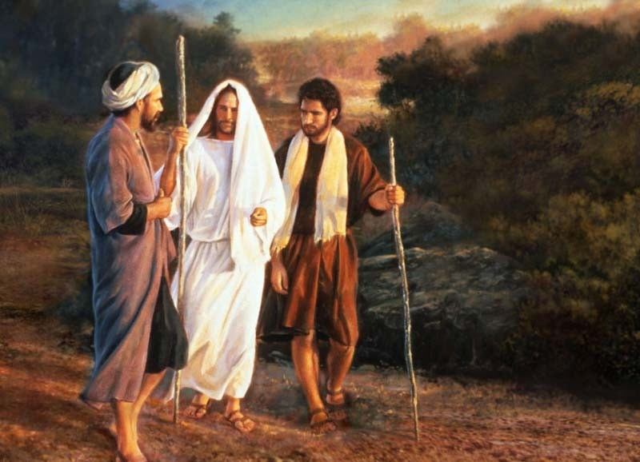
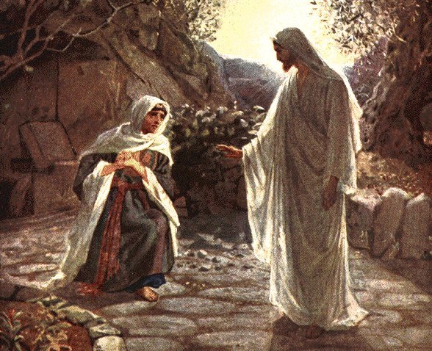
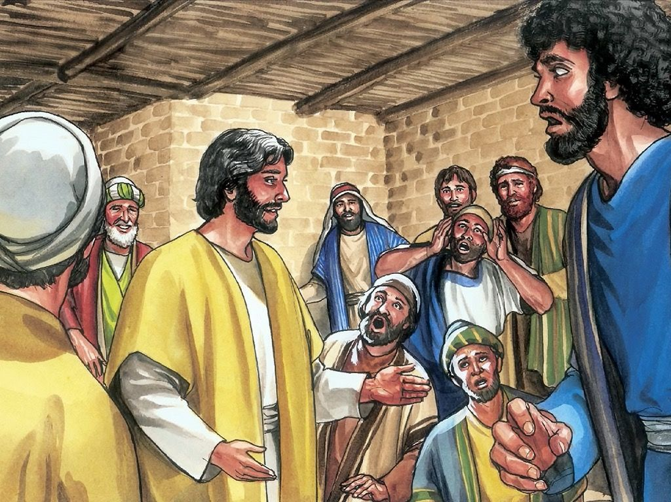
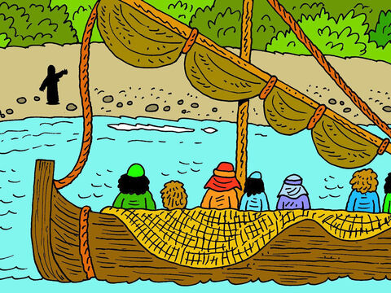
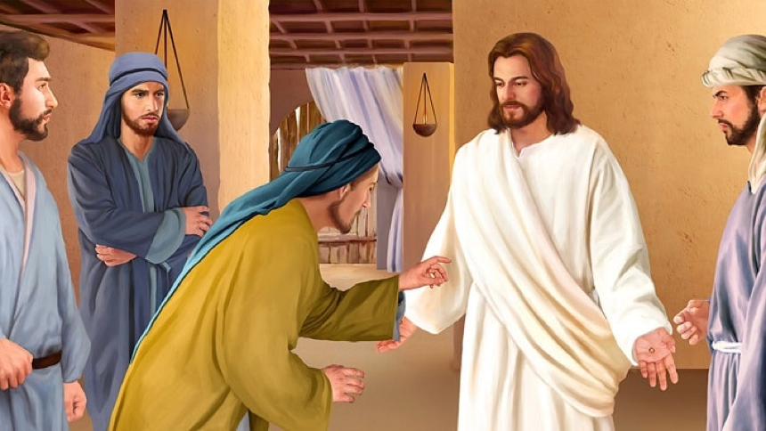
Remember Jesus came to see His friends.

Slide 6
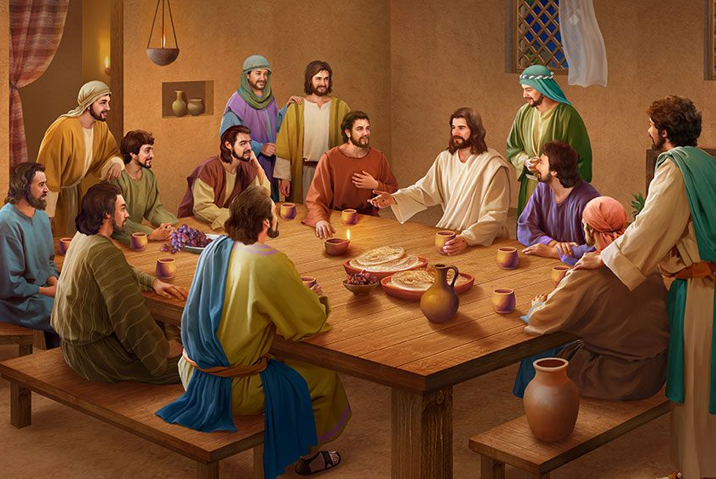
Wait for the gift – the Holy Spirit
Don’t leave Jerusalem. Stay in the city.
Wait for the gift my Father will give you.
He will give you the Holy Spirit which will clothe you with power from on high.
Luke 24:
⁴⁹ I am going to send you what my Father has promised; but stay in the city until you have been clothed with power from on high.”
Acts 1:
⁴ On one occasion, while he was eating with them, he gave them this command: “Do not leave Jerusalem, but wait for the gift my Father promised, which you have heard me speak about. ⁵ For John baptized with^{[a]} water, but in a few days you will be baptized with^{[b]} the Holy Spirit.”

Slide 7
God’s Kingdom
That is not for you to know.
But I want you to know that when you receive the Holy Spirit. Go tell everyone what you know about me. You are my witnesses.
Then will you restore the kingdom to Israel?
Acts 1:
⁶ Then they gathered around him and asked him, “Lord, are you at this time going to restore the kingdom to Israel?”
⁷ He said to them: “It is not for you to know the times or dates the Father has set by his own authority.
⁸ But you will receive power when the Holy Spirit comes on you; and you will be my witnesses in Jerusalem, and in all Judea and Samaria, and to the ends of the earth.”

Slide 8
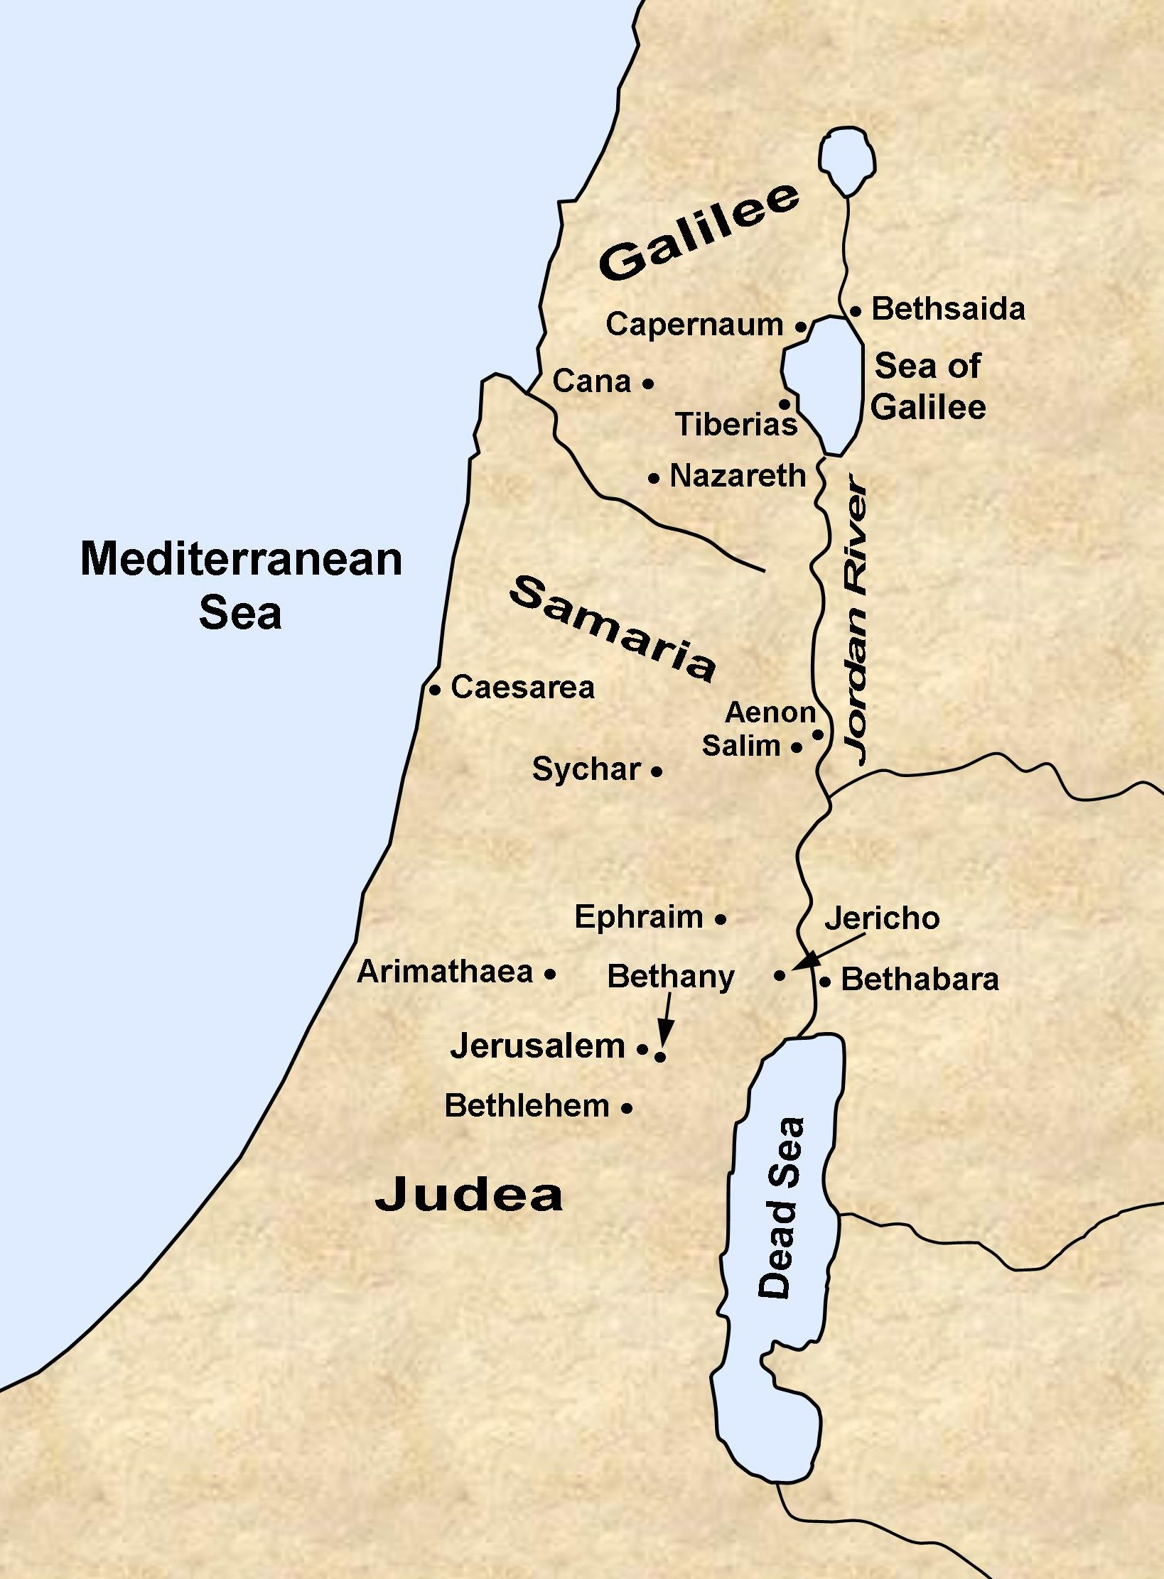
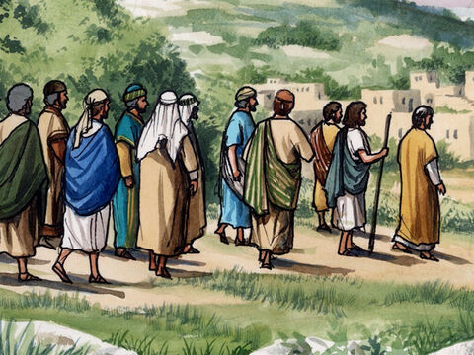
Let’s go to Bethany
Matthew wrote:
⁵⁰ When he had led them out to the vicinity of Bethany, ….

Slide 9
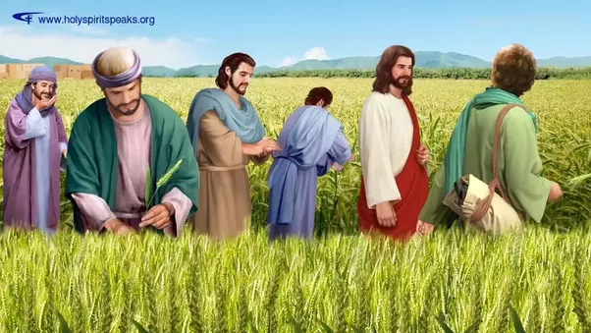
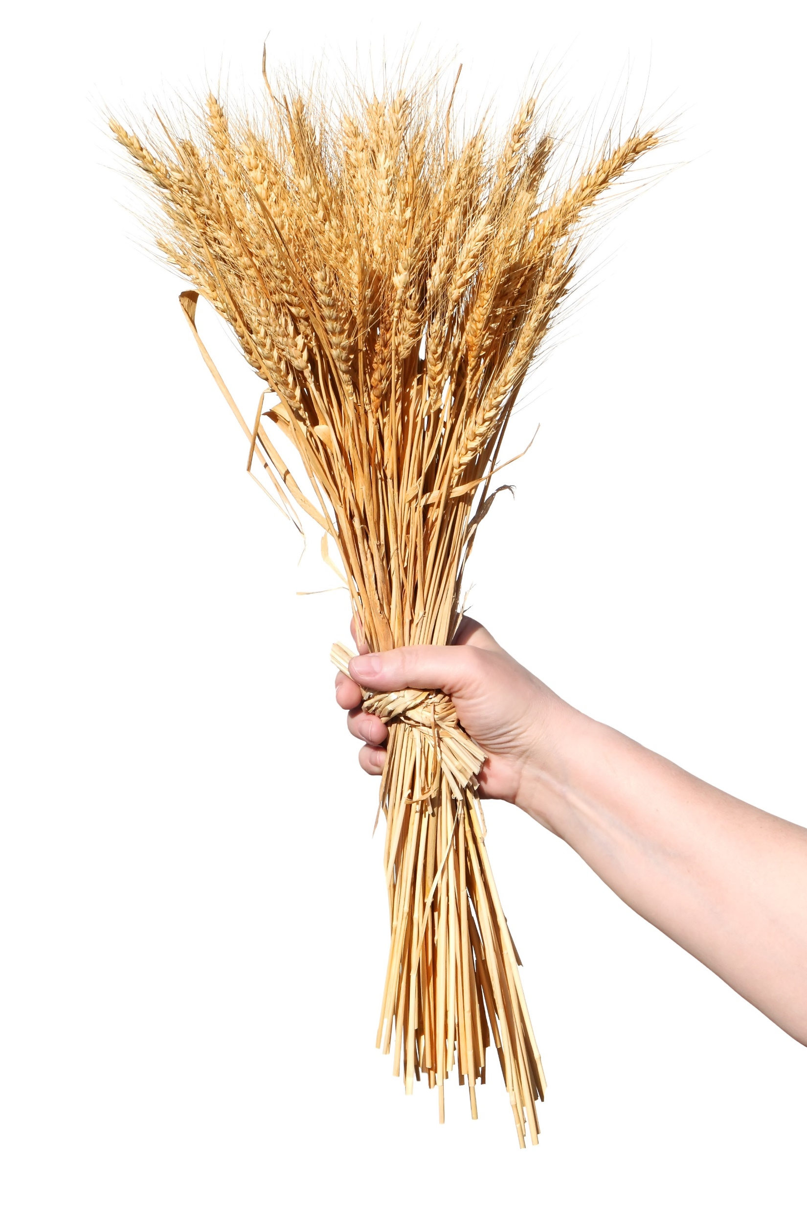
Wave Sheaf Celebration – It’s harvest time!
The fields are ripe for harvest. The people are ready to hear the good news!
I am like the first sheaf of grain. I rose again to give life.
I give you eternal life and will come again to take you up with me.
In Mark 16, we read:
¹⁵ He said to them, “Go into all the world and preach the gospel to all creation.
In Matthew 28, we read:
¹⁸ Then Jesus came to them and said, “All authority in heaven and on earth has been given to me. ¹⁹ Therefore go and make disciples of all nations, baptizing them in the name of the Father and of the Son and of the Holy Spirit, ²⁰ and teaching them to obey everything I have commanded you. And surely I am with you always, to the very end of the age.”
“All authority in heaven and on earth has been given to me. Therefore go and make disciples of all nations, baptizing them in the name of the Father and of the Son and of the Holy Spirit, and teaching them to obey everything I have commanded you. And surely I am with you always, to the very end of the age.”

Slide 10
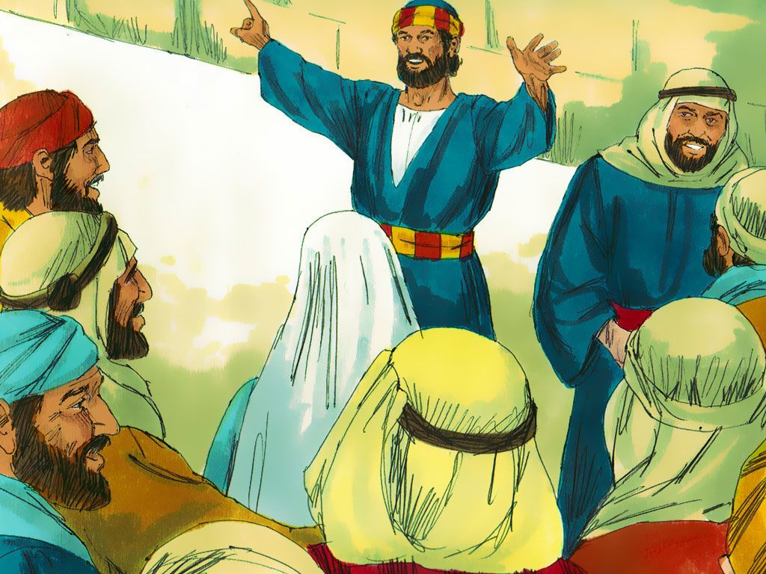
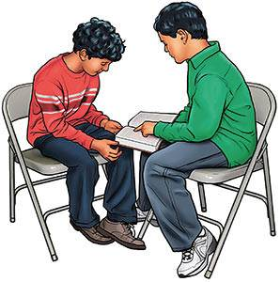
Tell others about Jesus
“Therefore, go and make disciples
of all nations,
baptizing them in the name
of the Father and
of the Son and
of the Holy Spirit,
and teaching them to obey everything
I have commanded you.
And surely, I am with you always,
to the very end of the age.”
Matthew 28:19-20

Slide 11
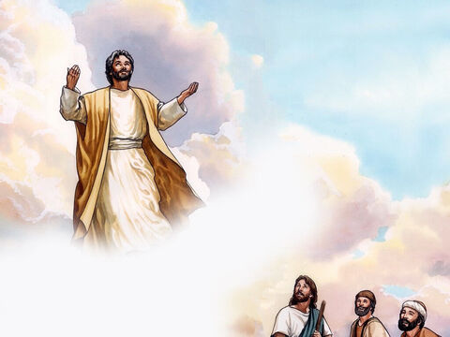
Matthew wrote:
I give you my blessing.
You will be strong and courageous.
You will be loving and kind.
Matthew wrote:
⁵⁰ When he had led them out to the vicinity of Bethany, He lifted up his hands and blessed them. ⁵¹ While he was blessing them, he left them and was taken up into heaven.
In Acts we read:
⁹ After he said this, he was taken up before their very eyes, and a cloud hid him from their sight.

Slide 12
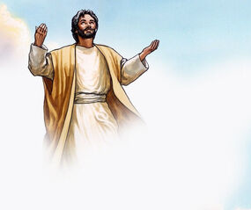
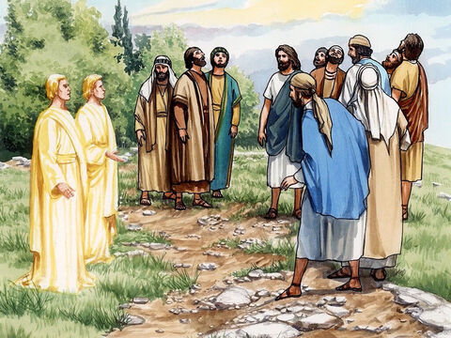
Jesus will come back
Men of Galilee,
Why are you looking into the sky. This same Jesus will come back the same way you have seen Him go up into heaven.
Acts 1 tells us:
¹⁰ They were looking intently up into the sky as he was going, when suddenly two men dressed in white stood beside them. ¹¹ “Men of Galilee,” they said, “why do you stand here looking into the sky? This same Jesus, who has been taken from you into heaven, will come back in the same way you have seen him go into heaven.”

Slide 13
Craft Time – Part 2 – Cut out the pieces on this page

Slide 14

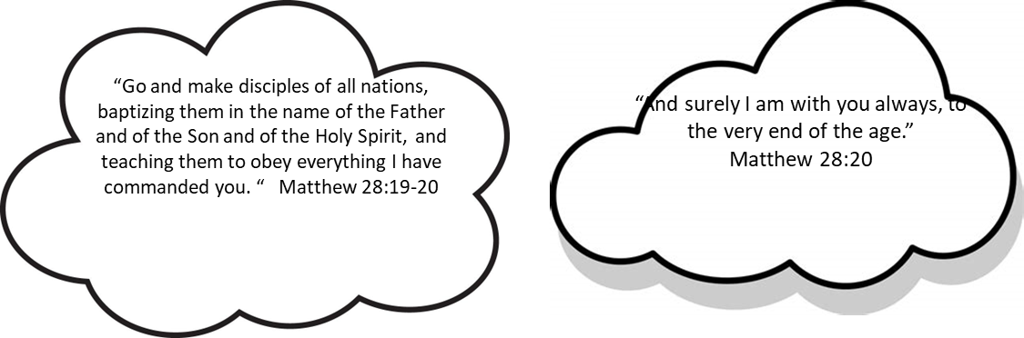
Craft Time – Part 3 – Add clouds to the disciple page.

Slide 15
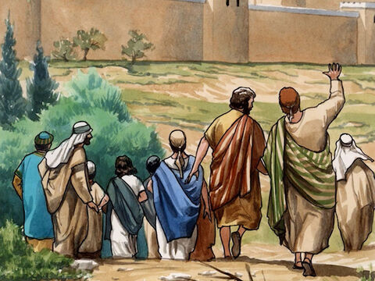
They worshipped Jesus with JOY
Praise God!
Jesus is coming back again!
Luke 24 tells us:
⁵² Then they worshiped him and returned to Jerusalem with great joy.

Slide 16
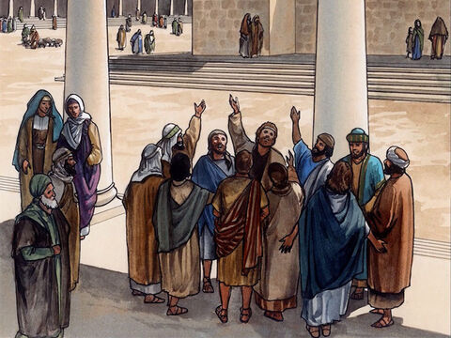
They worshipped Jesus
Luke 24 tells us:
⁵³ And they stayed continually at the temple, praising God.
-- while they waited for the promised gift, the Holy Spirit

Slide 17

Hallelu Hallelu Hallelujah Praise Ye the Lord

Slide 18
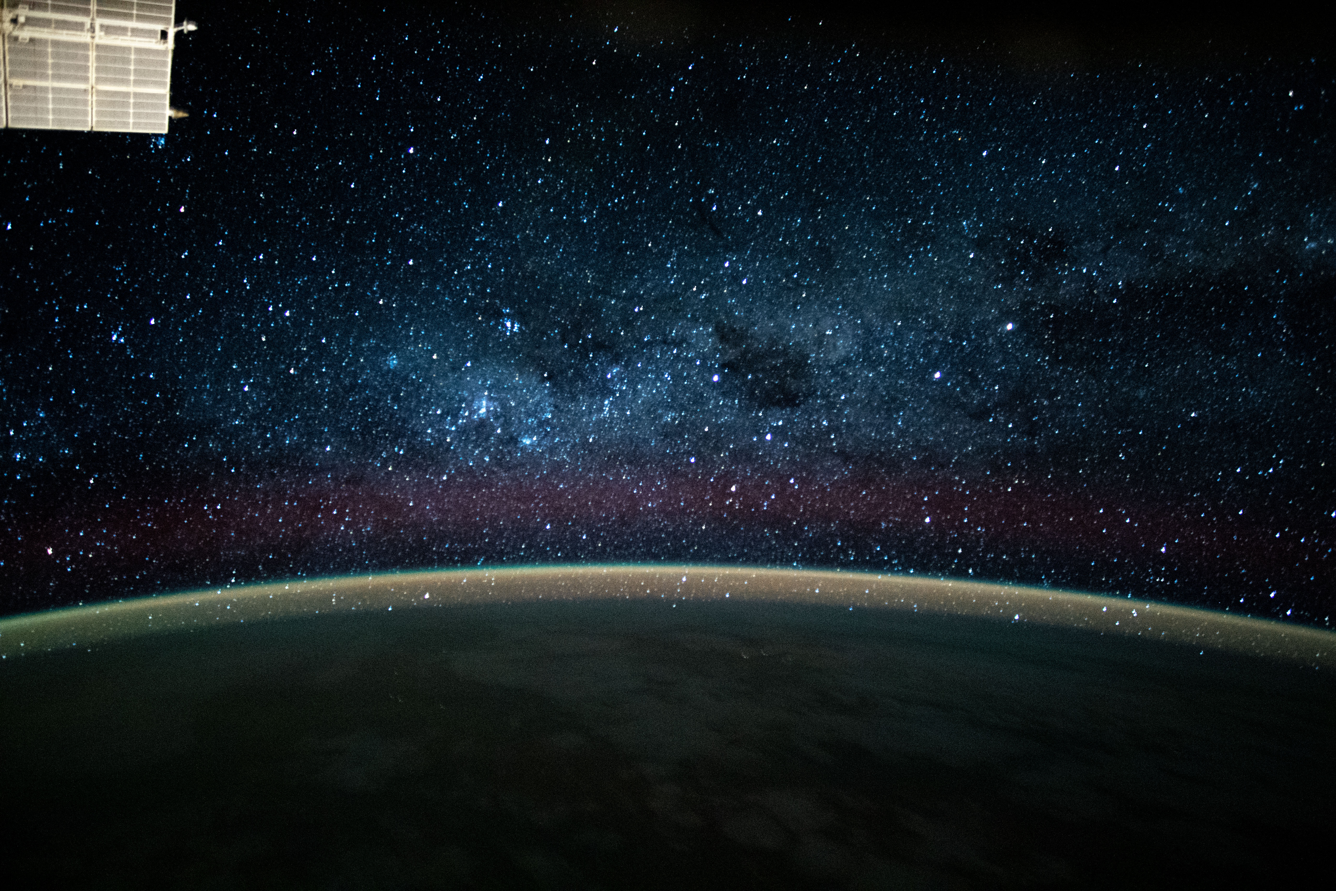
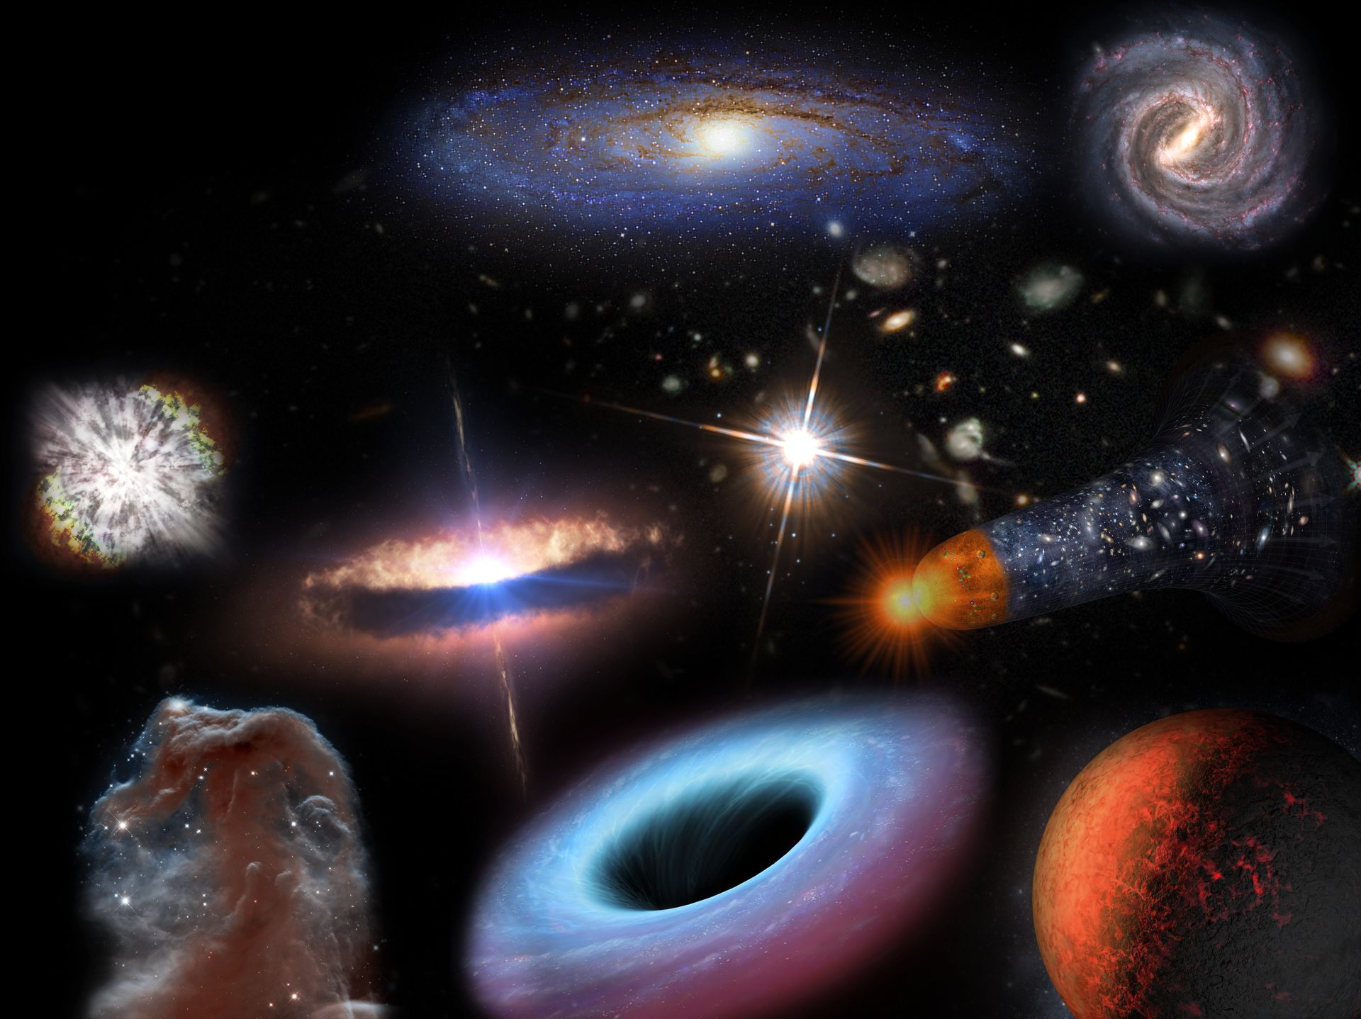
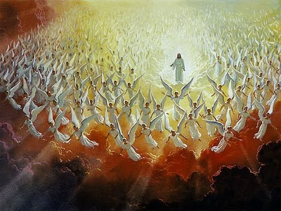
Meanwhile …. Angels came to travel up with Jesus. They went up past the stars and all the galaxies.

Slide 19



Craft Time – Part 4 – Add stars and planets

Slide 20
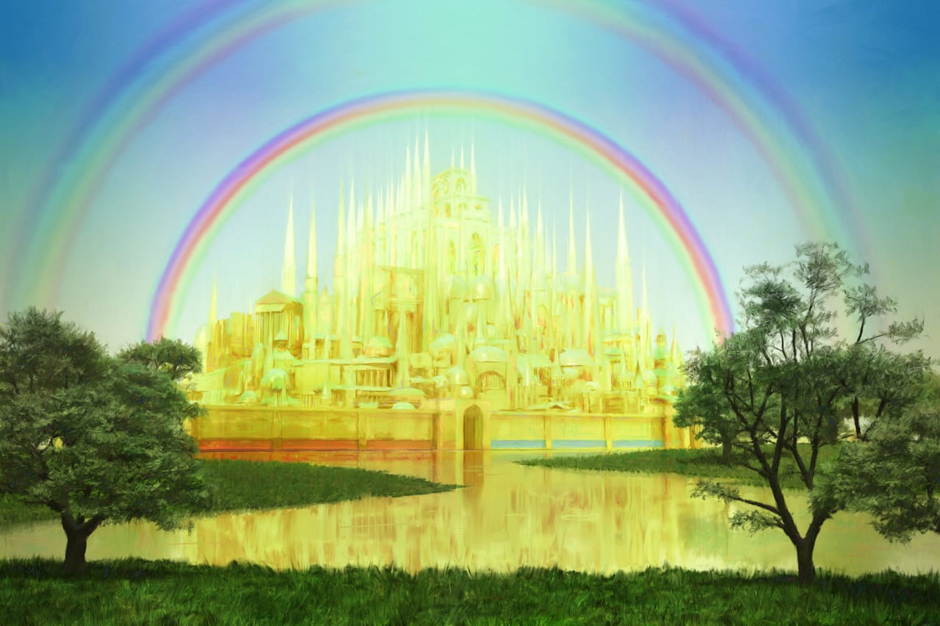
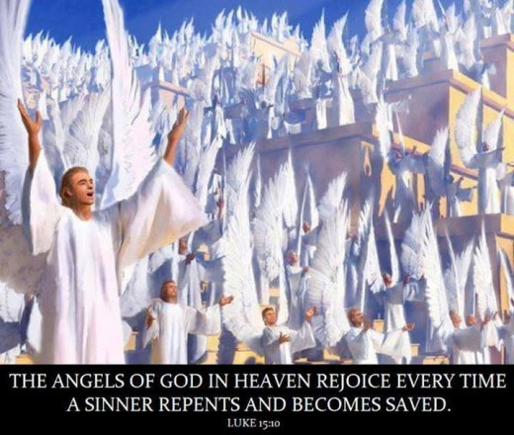
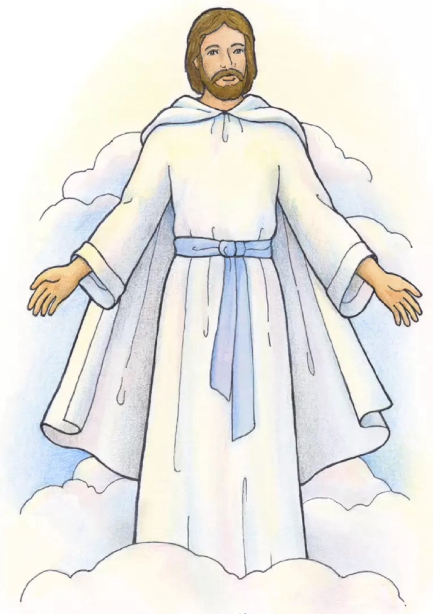
They came to heaven and the New Jerusalem. We can read about their welcome in Psalms 24 and Revelations 5
Lift up your heads, you gates; be lifted up, you ancient doors, that the King of glory may come in.
Lift up your heads, you gates; be lifted up, you ancient doors, that the King of glory may come in.
The Lord strong and mighty, the Lord mighty in battle.
Who is this King of Glory?
The Lord Almighty— He is the King of glory!
Who is this King of Glory?

Slide 21


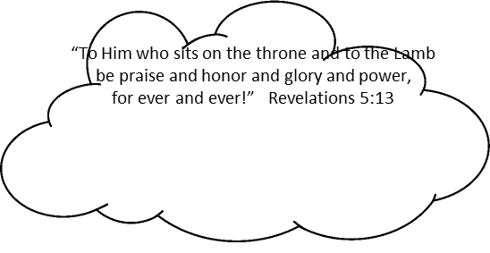
Craft Time – Part 5 – Color and draw 2 thrones

Slide 22
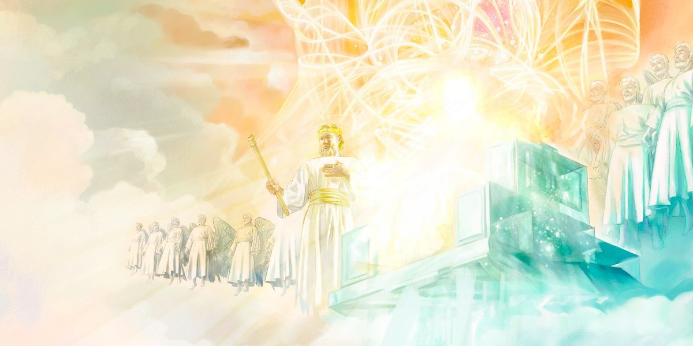
“Worthy is the Lamb, who was slain, to receive power and wealth and wisdom and strength and honor and glory and praise!”
“To Him who sits on the throne and to the Lamb be praise and honor and glory and power, for ever and ever!”
In Revelations 5 we read

Slide 23

Worthy , Worthy is the Lamb

Slide 24
We read in Mark 16:
^{19 ….} the Lord Jesus …, was taken up into heaven and He sat at the right hand of God.

Slide 25
Now, just as He promised (in John 14:1-3), Jesus is preparing a place for us. He is listening and answering our prayers.

Slide 26

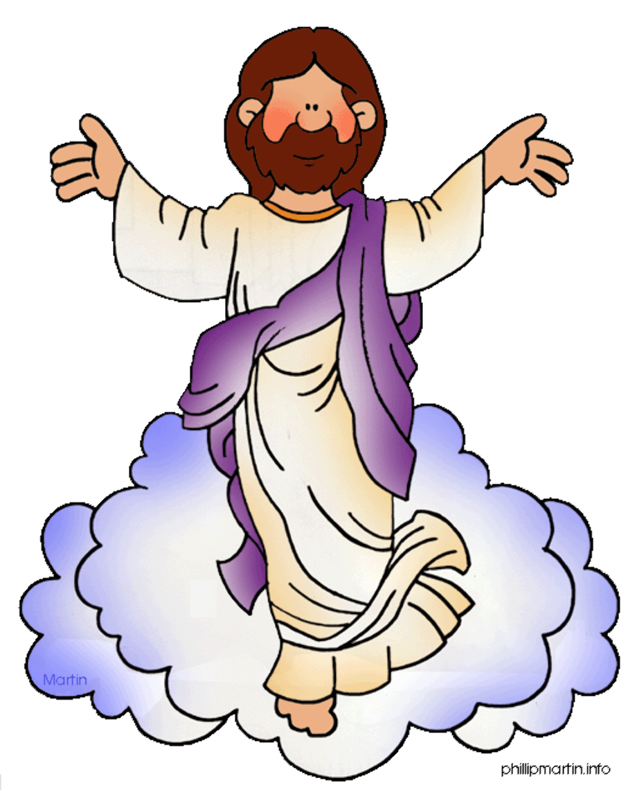
Craft Time – Part 6 – Put the pages together
Directions:
Put the three pages together as directed on each page.
Cut out the clouds and Jesus. Glue the clouds on the page with lots of sky. Glue the circles with the planets.
Cut a piece of yarn 6 feet long.
Poke a hole in the middle of the rainbow. Poke another hole between the disciples.
Put one end of the string through the top hole and the other end of the string through the bottom hole. Tie the ends behind the papers.
Tape Jesus near the bottom of the string on the front side of the papers.
Now you can make Jesus ascend to heaven.

Slide 27

Praise de Lord Rancho Avalancha

Slide 28

Hallelu, Hallelu, Hallelujah
Praise Ye the Lord

Slide 29

Rejoice in the Lord Always

Slide 30
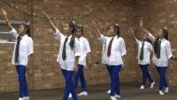
Worthy is the Lamb

Slide 31
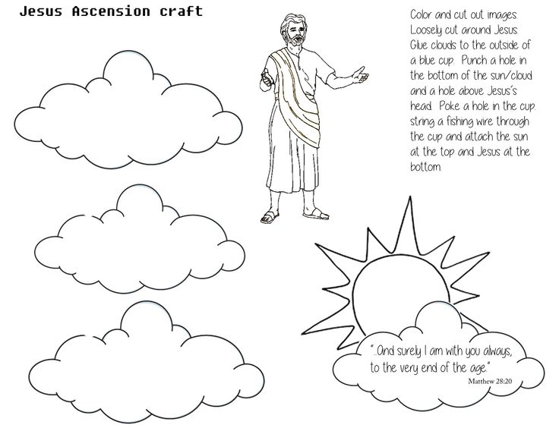

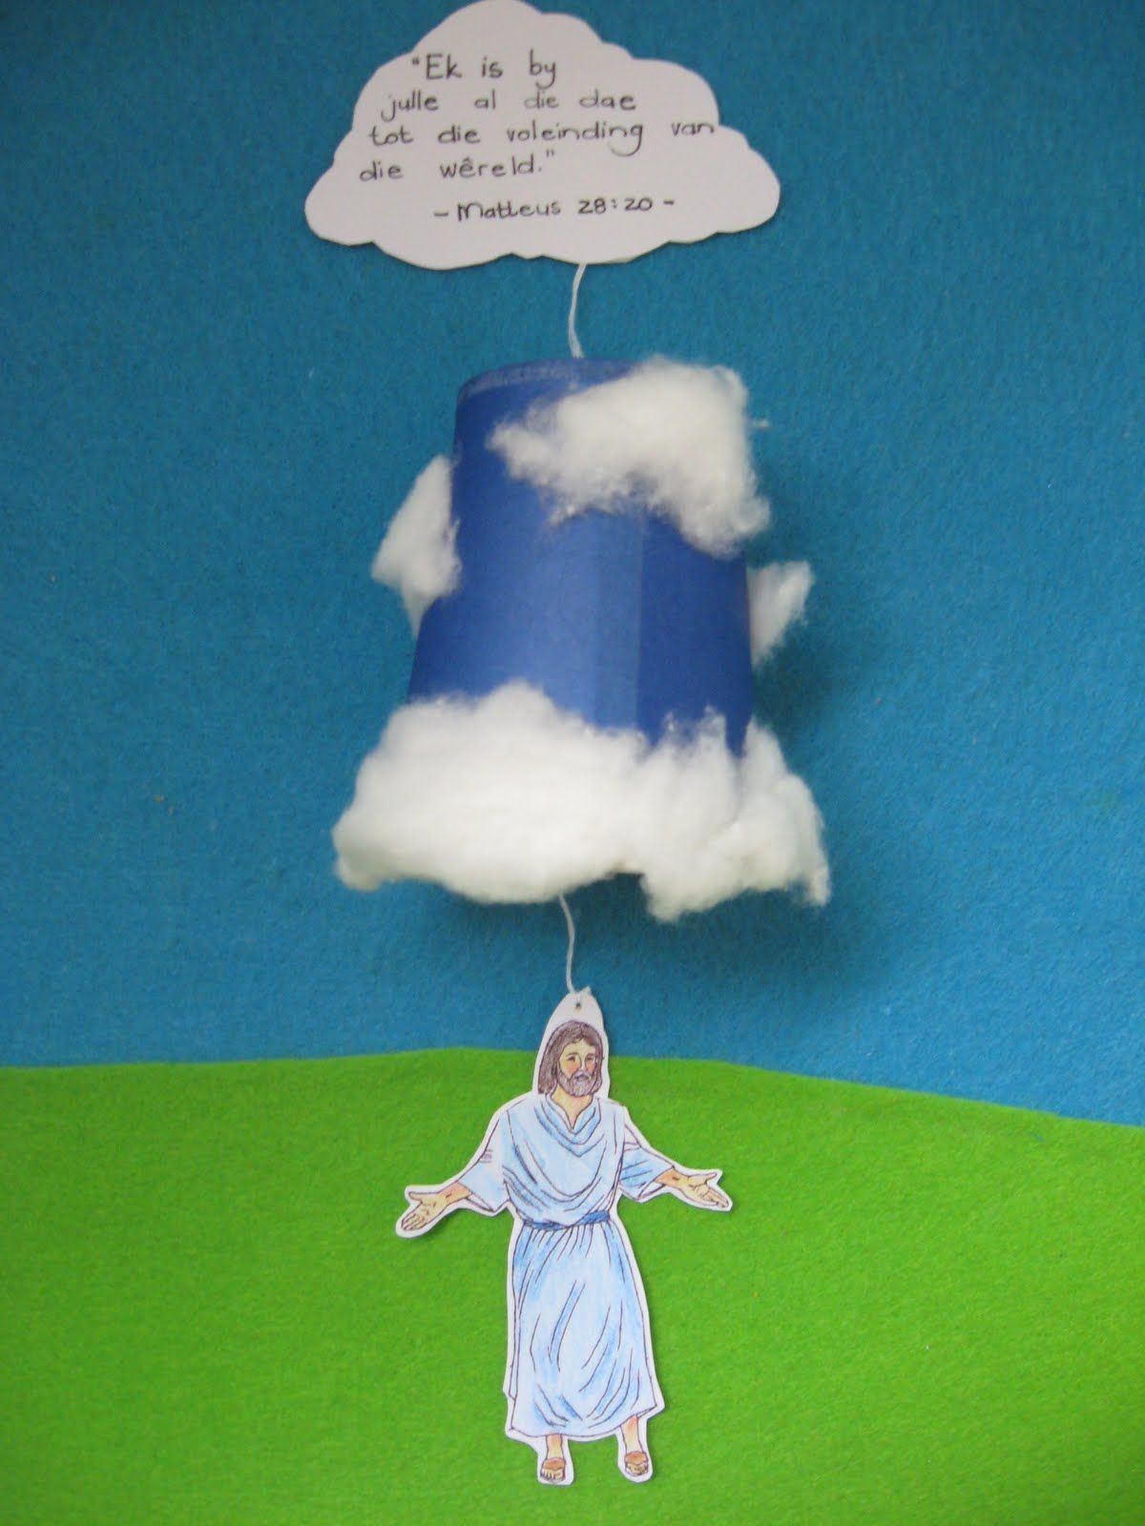
Craft Time
https://www.pinterest.com/pin/450008187743189576/

Slide 32
Hallelu Hallelu Hallelujah Praise Ye the Lord

