Slide 1
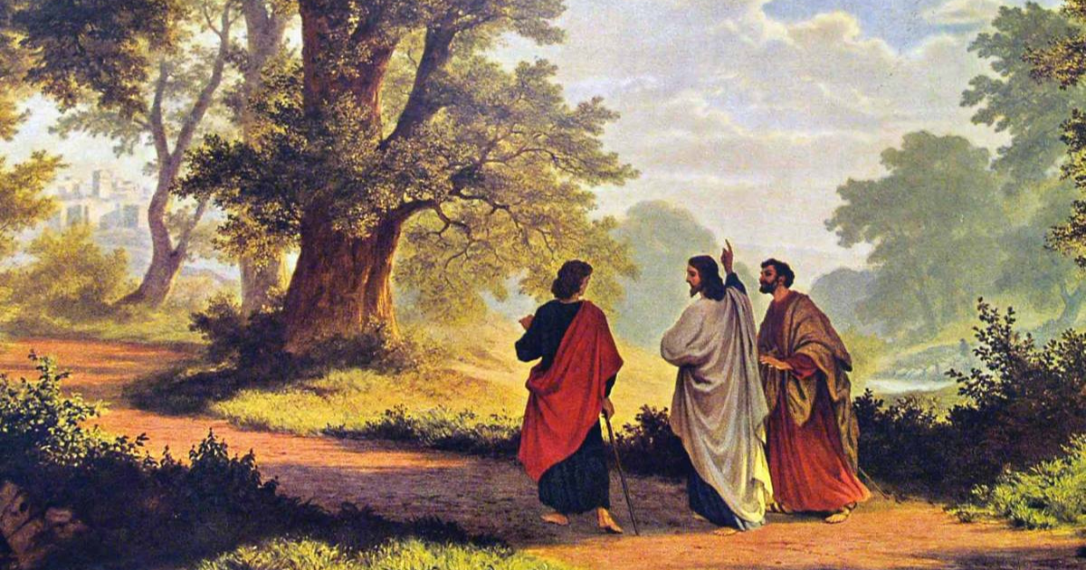
Walk to Emmaus
Luke 24:13:34,
Savior Souvenirs and Prophecies of Jesus

Slide 2
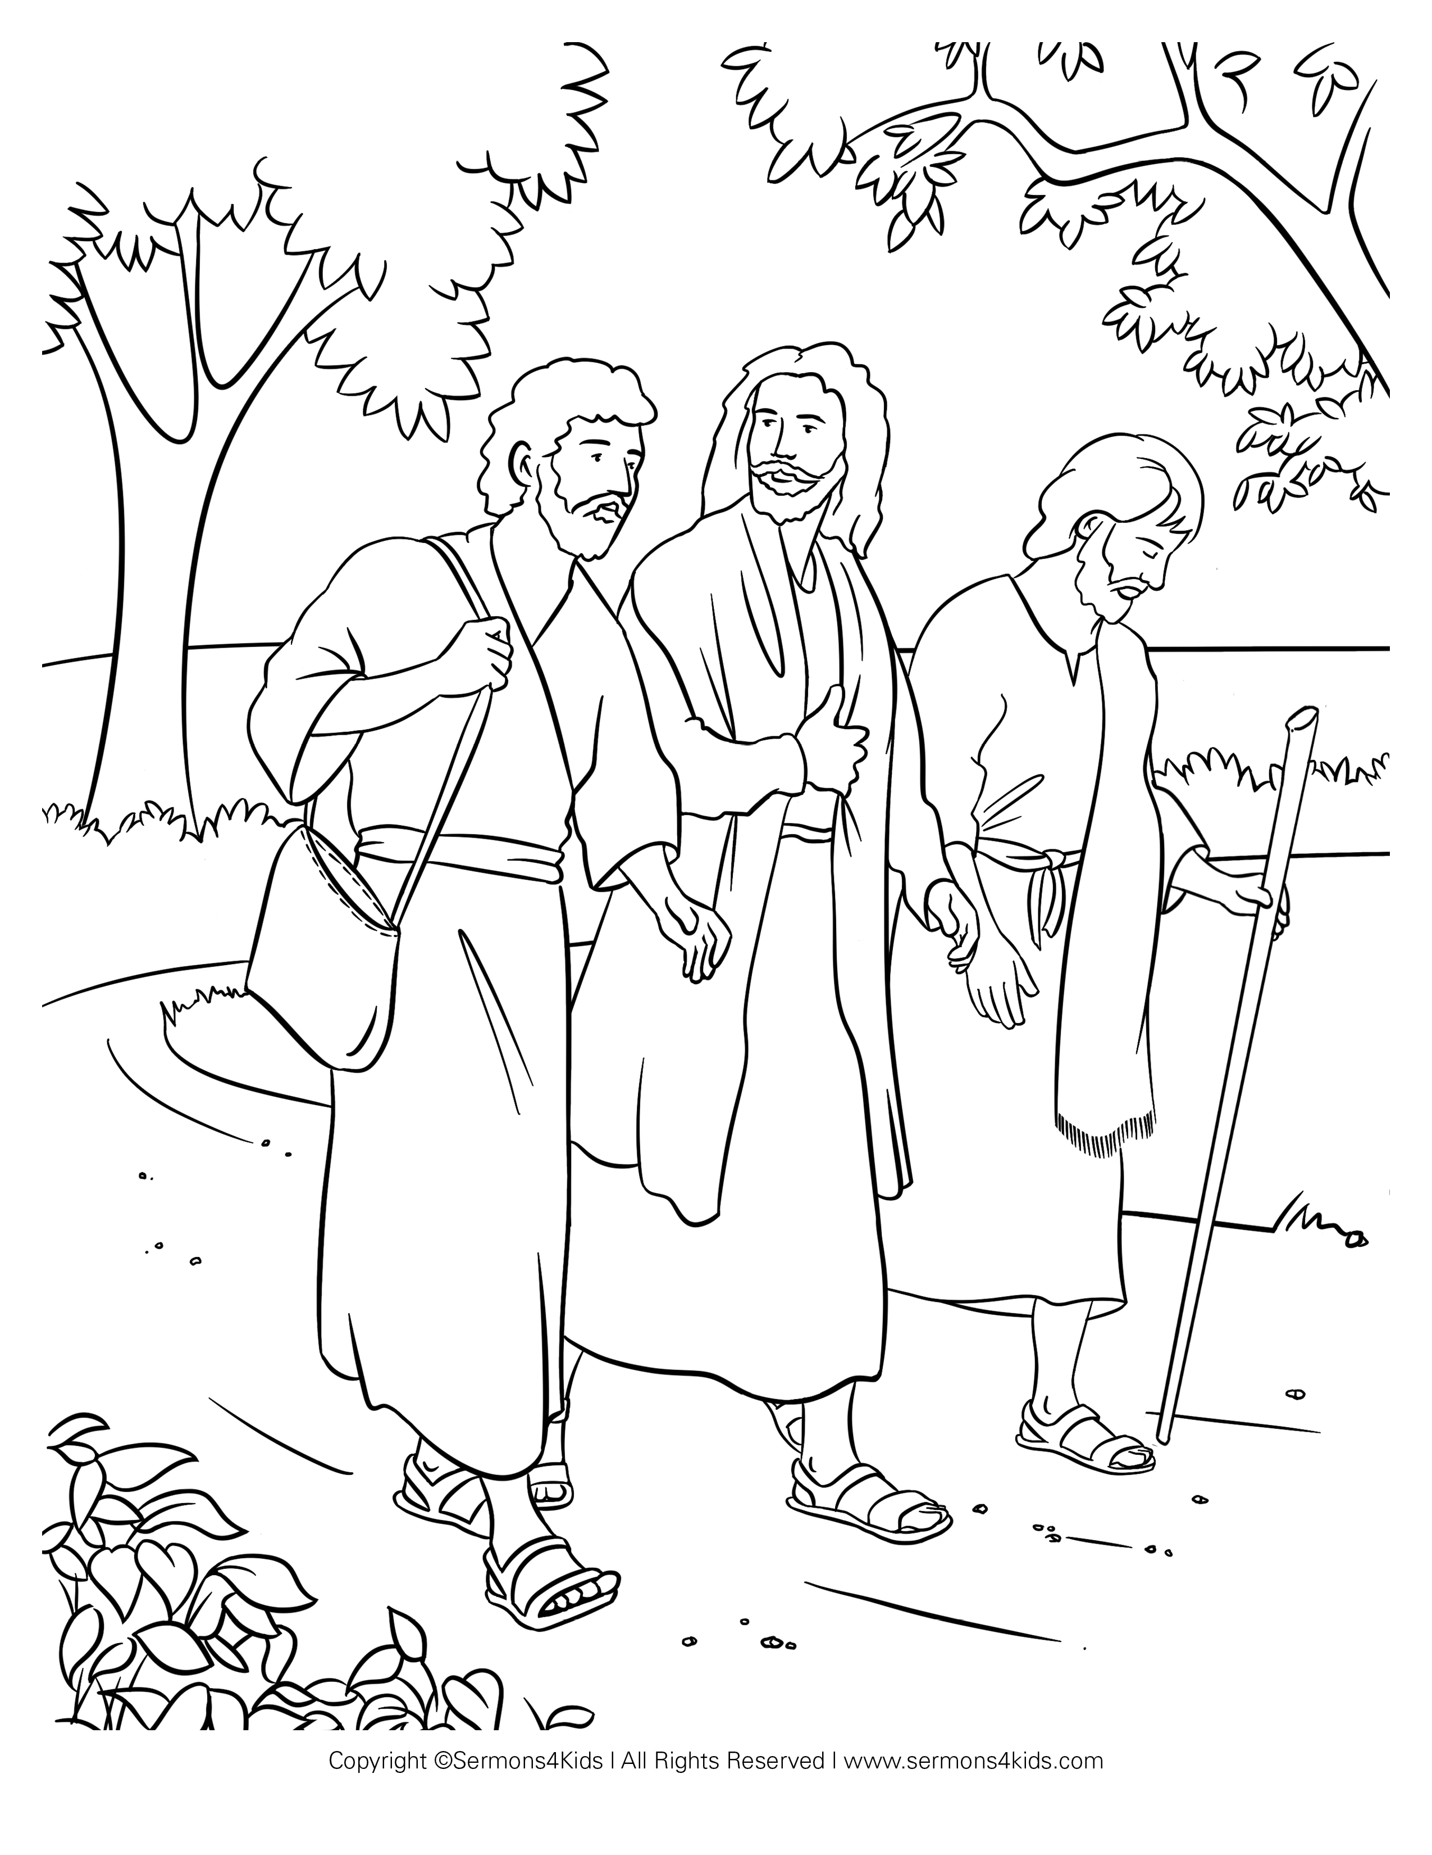

Luke 24:44-46

Slide 3
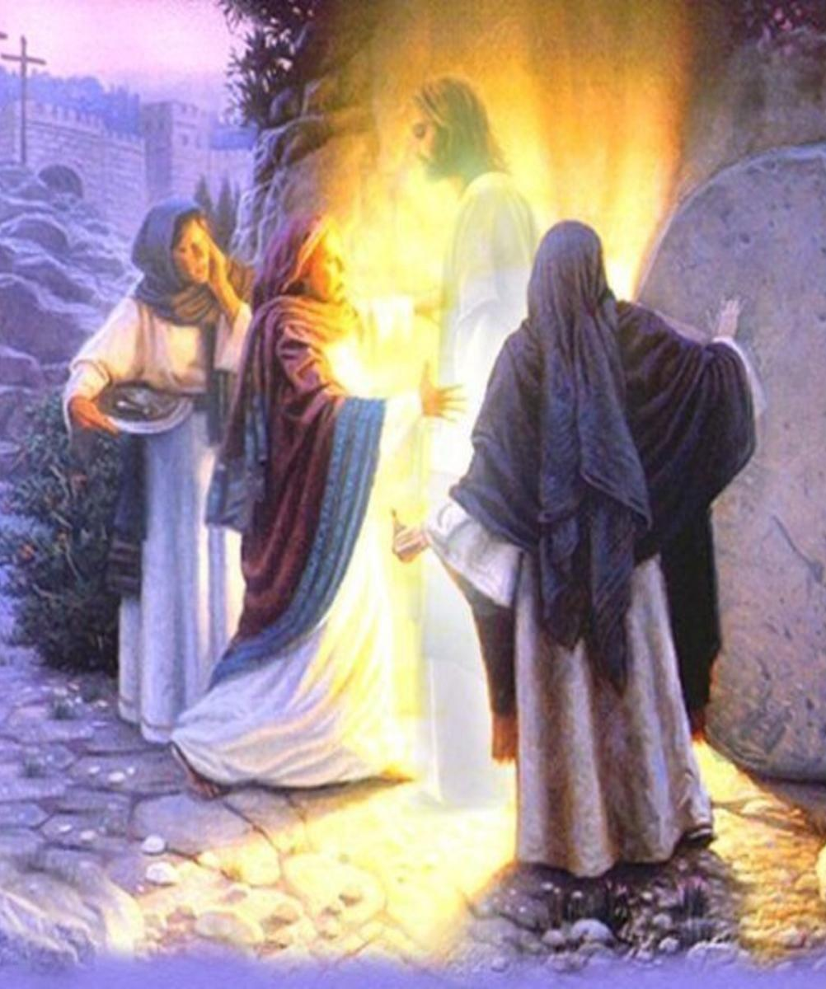
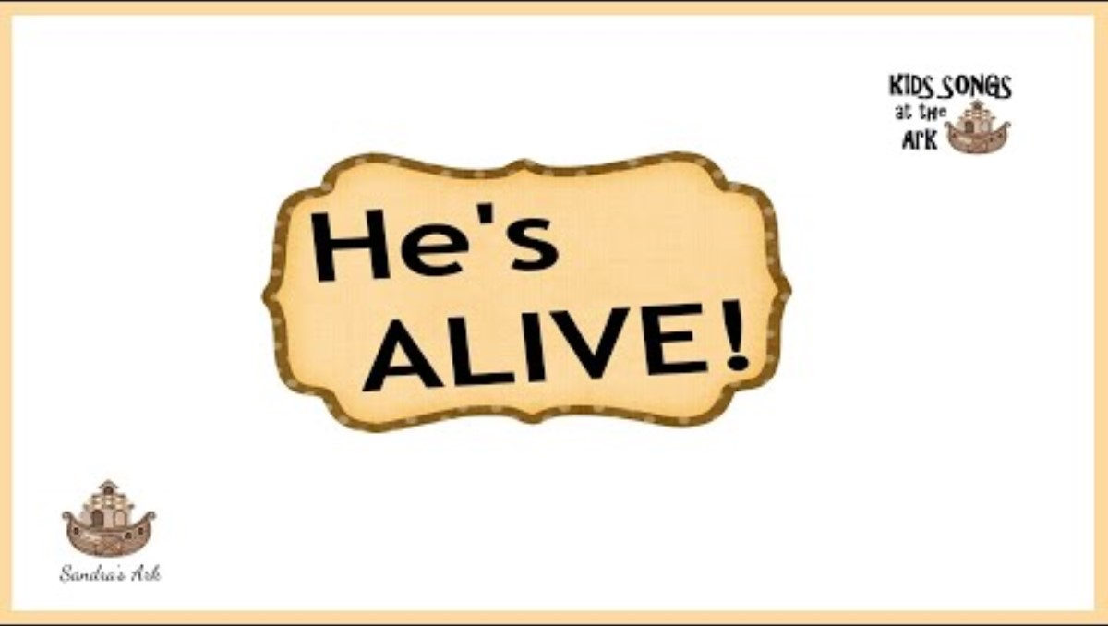
Jesus rose again!

Slide 4
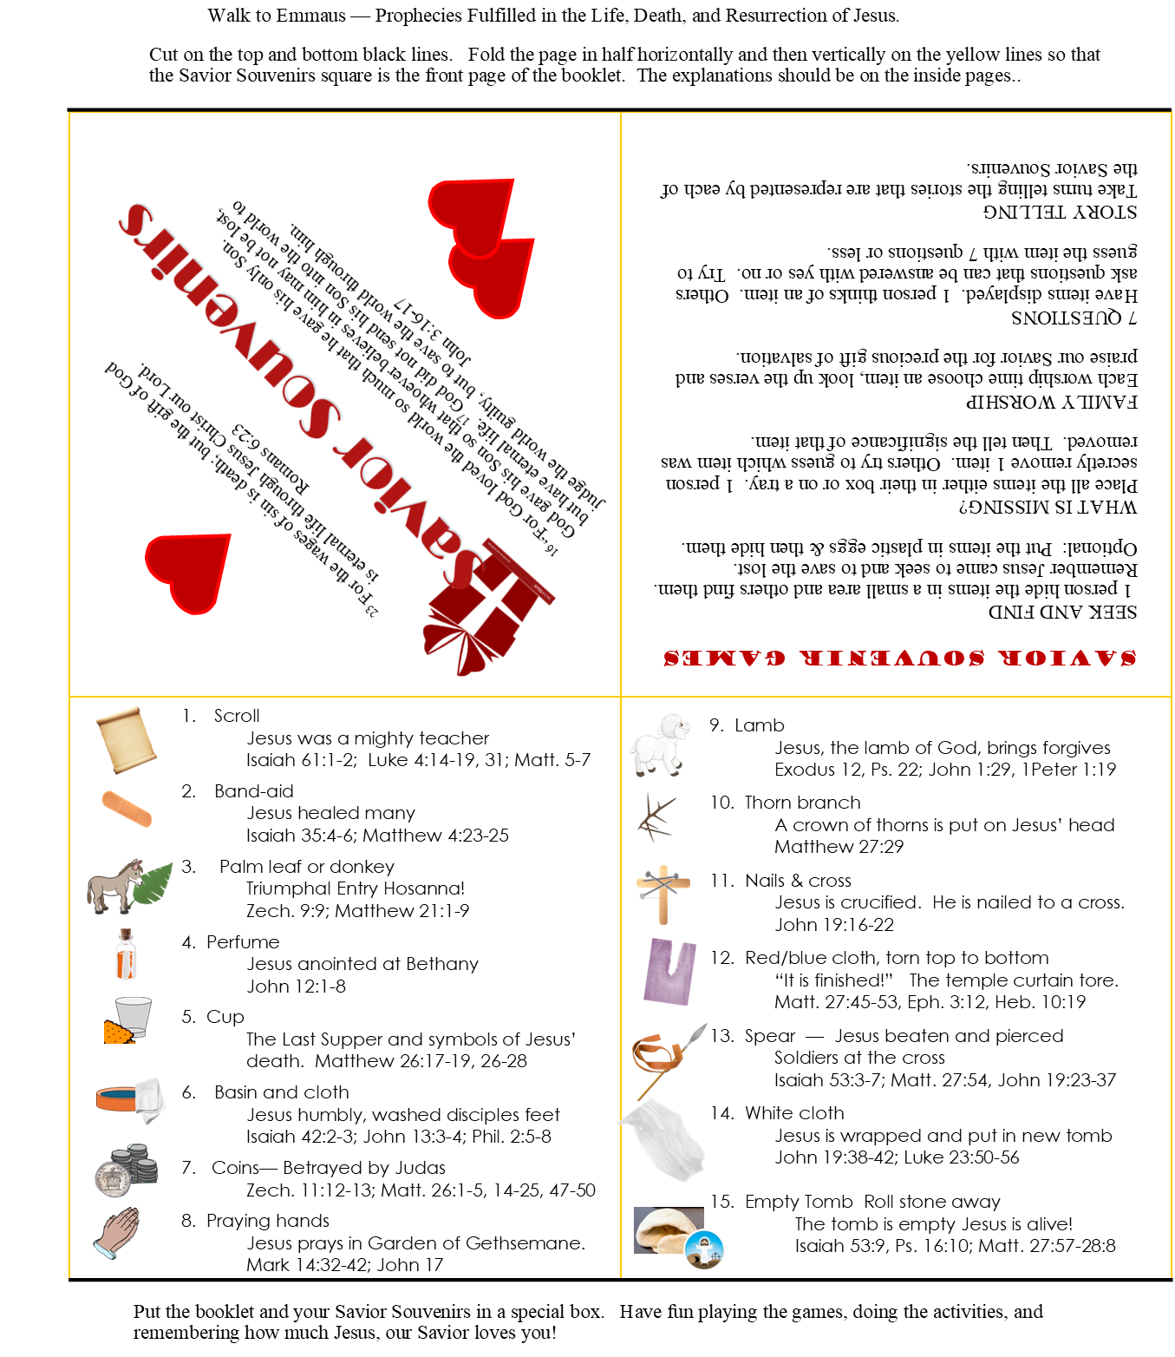

Savior Souvenirs
Here is a paper that will help you remember the prophecies and stories that show how Jesus fulfilled those prophecies. It also has some games you can play with the Savior Souvenir objects.
Today we’re going to give you some objects to put in a special box that will remind you of Jesus’ life, death, and resurrection.
Jesus did this to give you the best gift of all – the gift of salvation: forgiveness and eternal life!

Slide 5
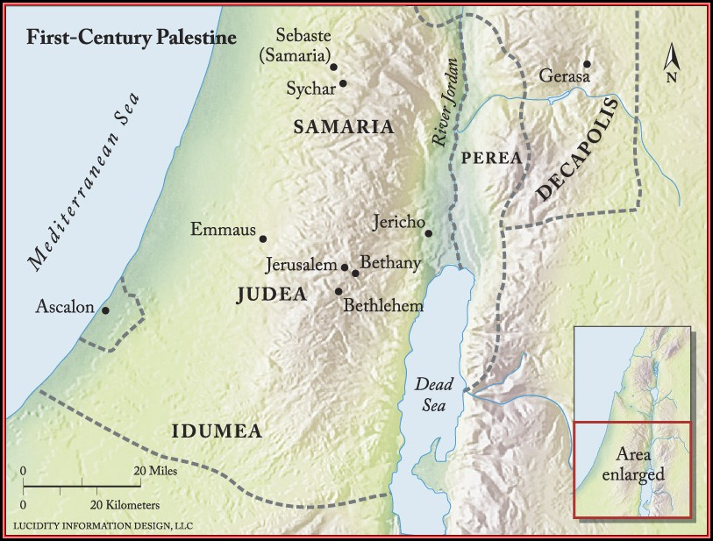
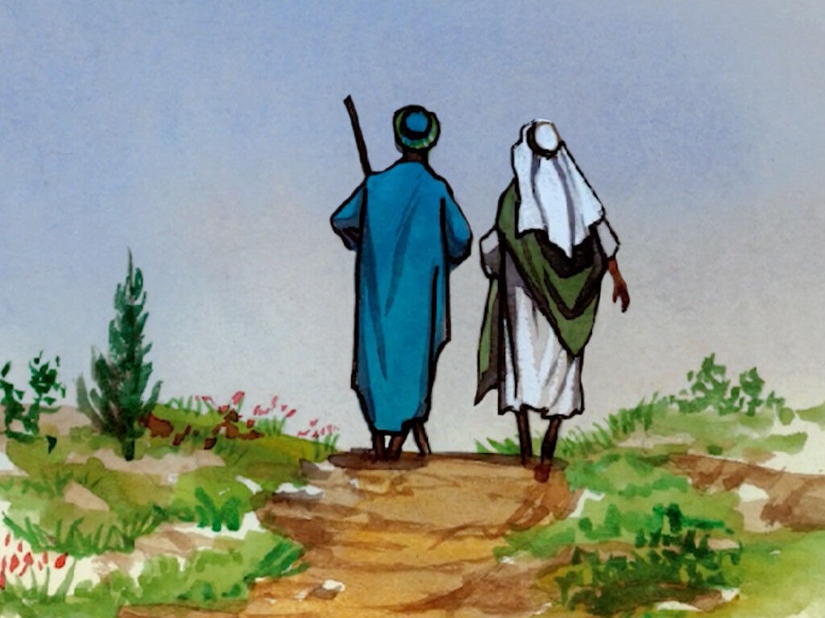
Luke 24
¹³ That same day two of Jesus’ followers were walking to the village of Emmaus, seven miles^{[c]} from Jerusalem.

Slide 6
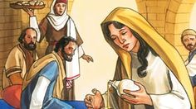
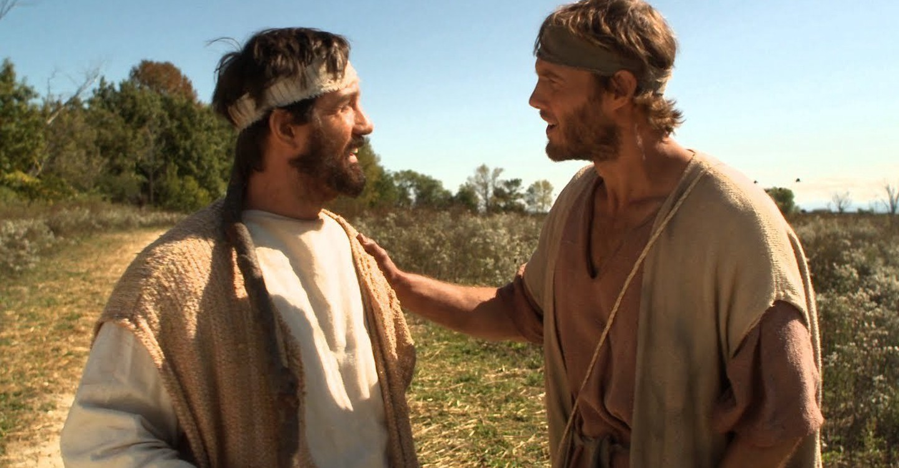
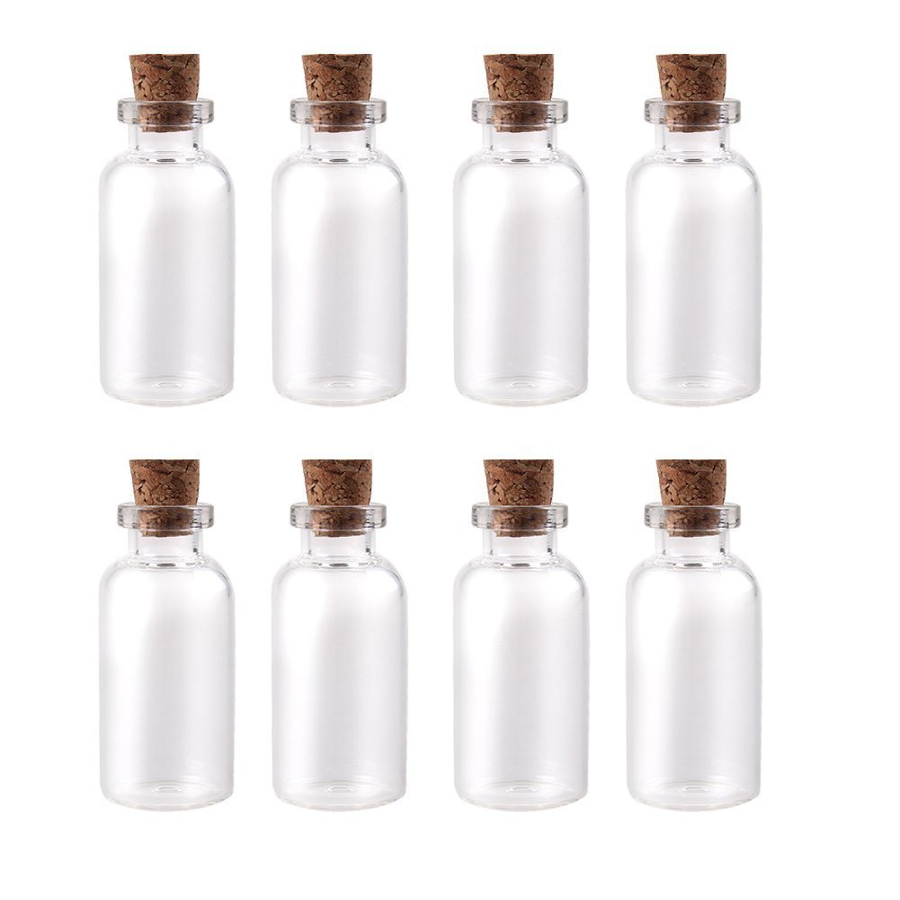
Walk and Talk
Things have been so crazy these last few weeks!
You are so right!
It’s hard to understand.
I feel like I’ve been on an emotional rollercoaster!
¹⁴ As they walked along they were talking about everything that had happened.
Oh, it smelled so divine!
That wonderful, EXPENSIVE, perfume – pure nard!
But, Jesus said she was anointing him – not as a king, but for his burial!
Remember while we were at Bethany celebrating Simon’s healing, Mary came with that….
John 12:1-8

Slide 7
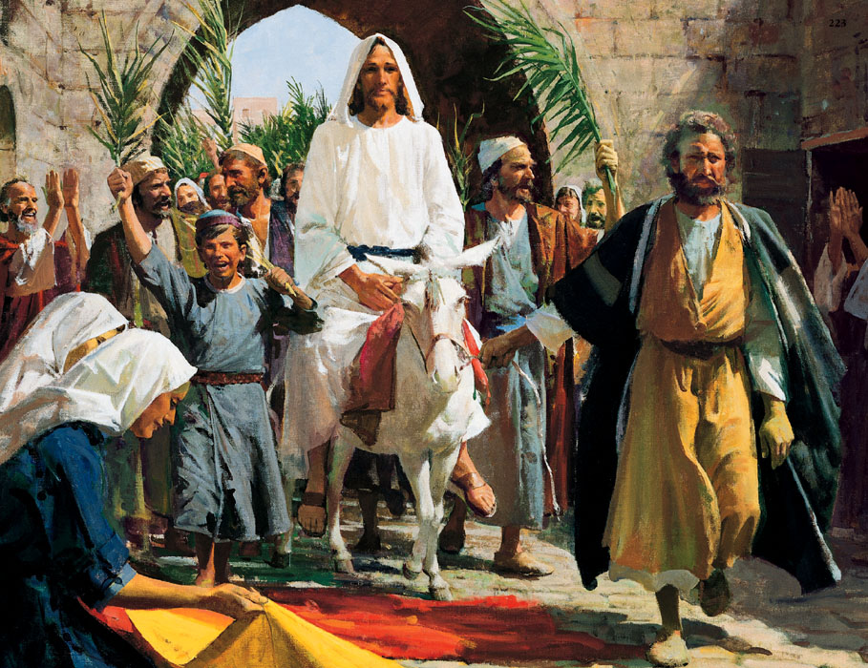


Luke 24
That’s strangely true.
And just last week Jesus came to Jerusalem, riding on a donkey – just like a king!
Yes! We all were so excited!
Everyone sang,
“Hosanna, to the Son of David!”
¹⁴ As they walked along they were talking about everything that had happened.
We thought he would be crowned king for sure!
Zechariah 9:9; Matthew 21:6-9

Slide 8
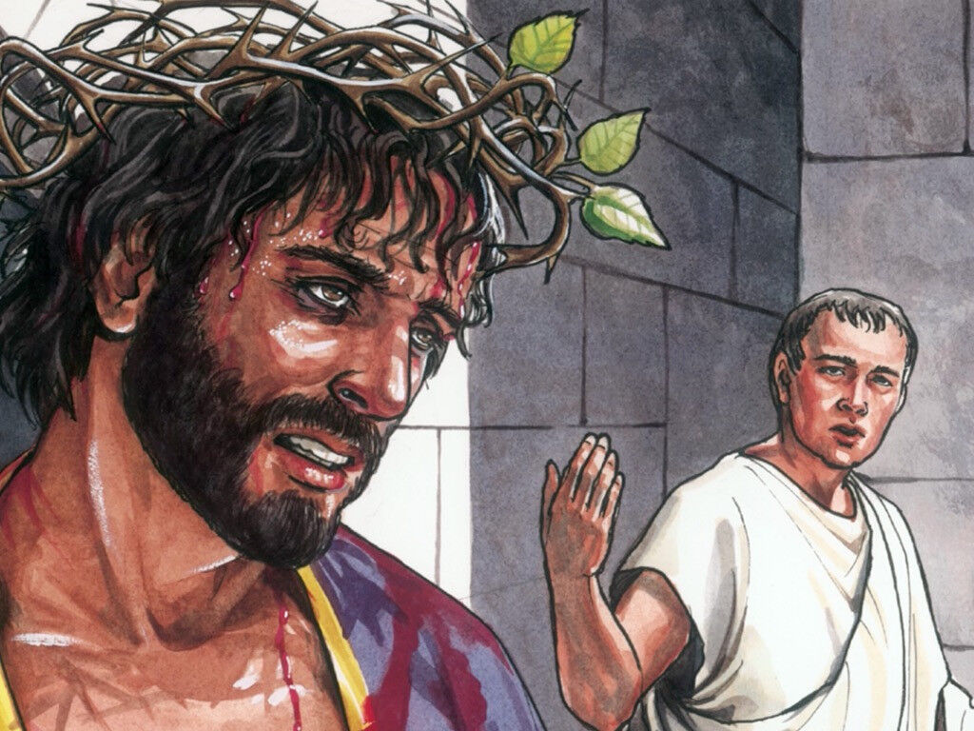


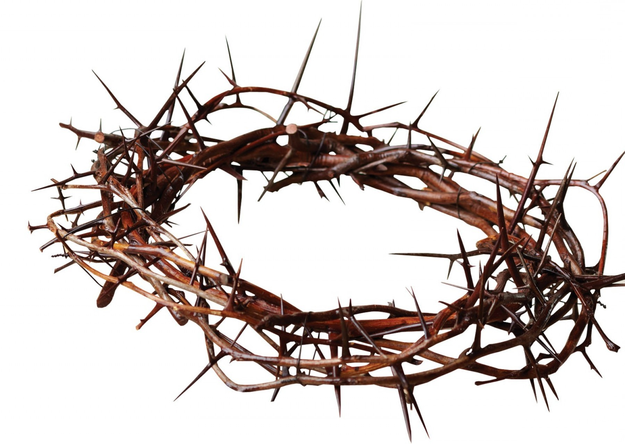
But no one accepted him in Jerusalem!
Just a few days later they put a crown
of thorns on him and crucified him!
The message Pilate had nailed to the cross even said, “Jesus of Nazareth, the king of the Jews”
I just don’t understand!?
The prophecies say that the Messiah would come and be king and bring peace to our nation.
Right?
That’s my understanding.
I’m so confused!
He saved others,
Why didn’t he save himself?
Matthew 27:29

Slide 9
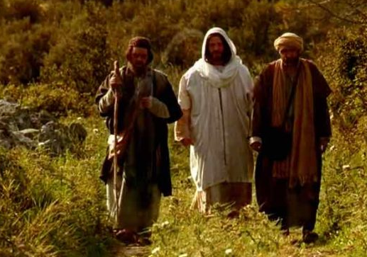
On the way
What are you discussing so intently as you walk along?
¹⁵ As they talked and discussed these things, Jesus himself suddenly came and began walking with them. ¹⁶ But God kept them from recognizing him.
¹⁷ He asked them, “What are you discussing so intently as you walk along?”
They stopped short, sadness written across their faces.
¹⁸ Then one of them, Cleopas, replied, “You must be the only person in Jerusalem who hasn’t heard about all the things that have happened there the last few days.”
You don’t know?!
You must be the only person in all Jerusalem who hasn’t heard about all the things that have happened there the last few days!

Slide 10
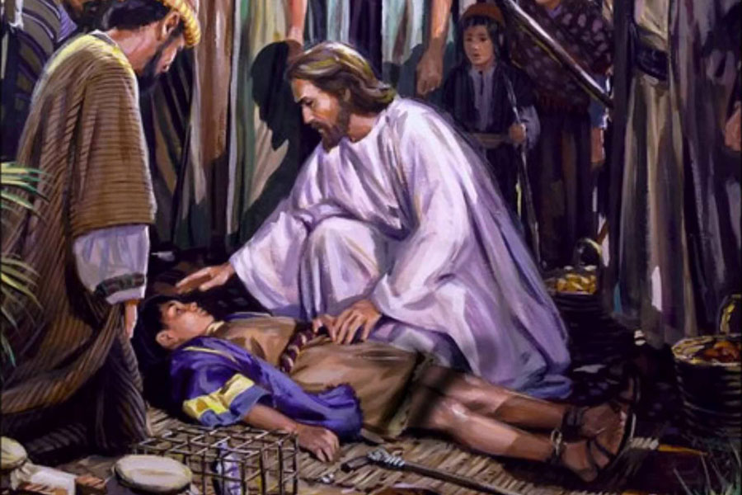
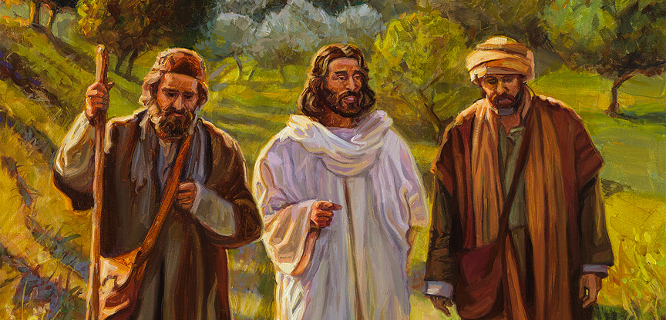
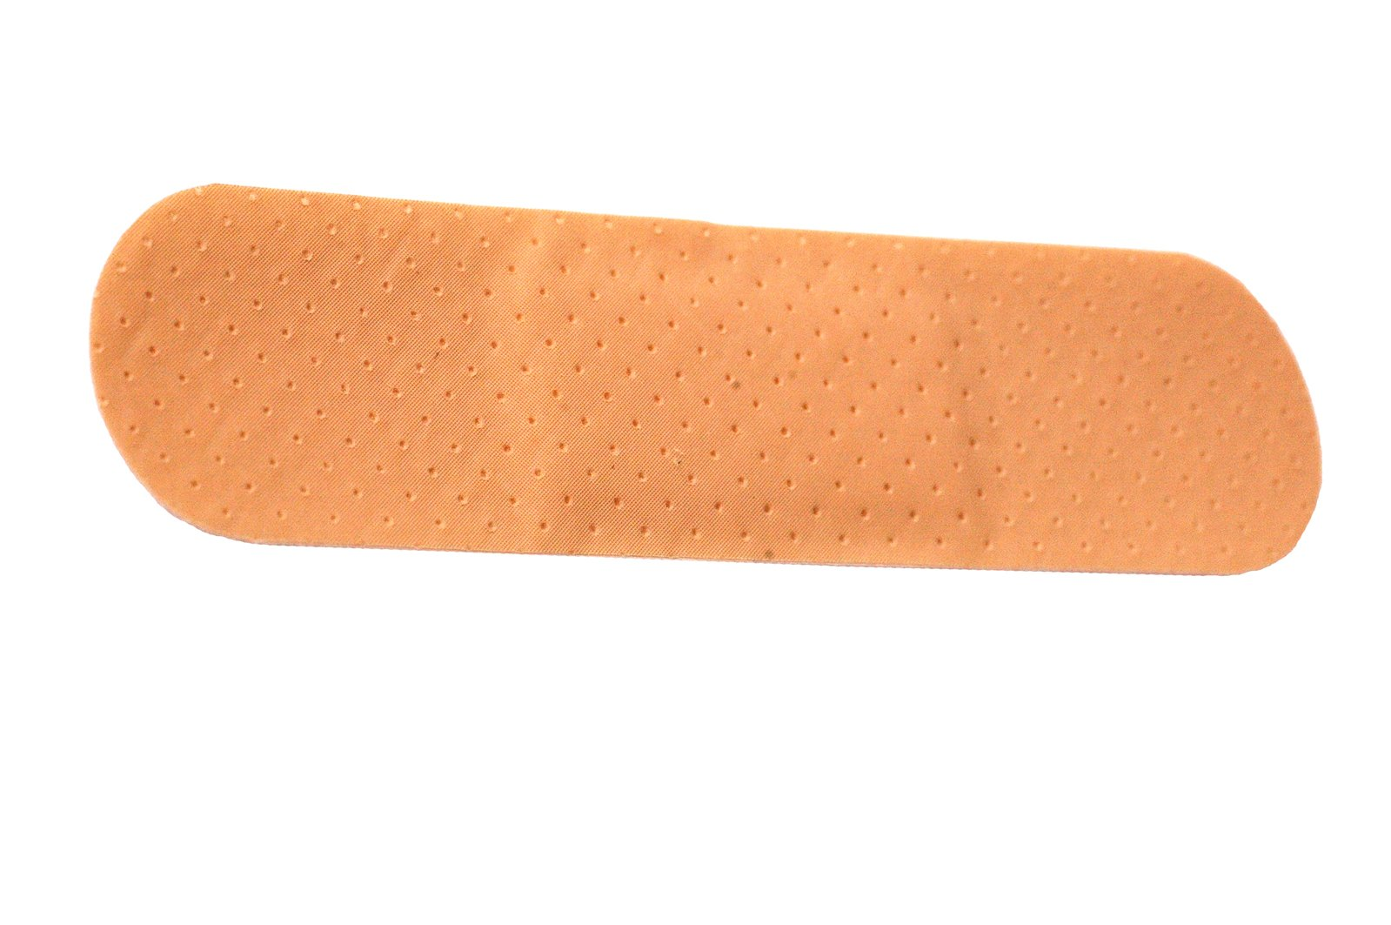
On the way
What things?
¹⁹ “What things?” Jesus asked.
“The things that happened to Jesus, the man from Nazareth,” they said. “He was a prophet who did powerful miracles, and he was a mighty teacher in the eyes of God and all the people.
The things that happened to Jesus, the man from Nazareth.
He was a prophet who did powerful miracles…
Isaiah 35:4-6; Matthew 4:23-25

Slide 11
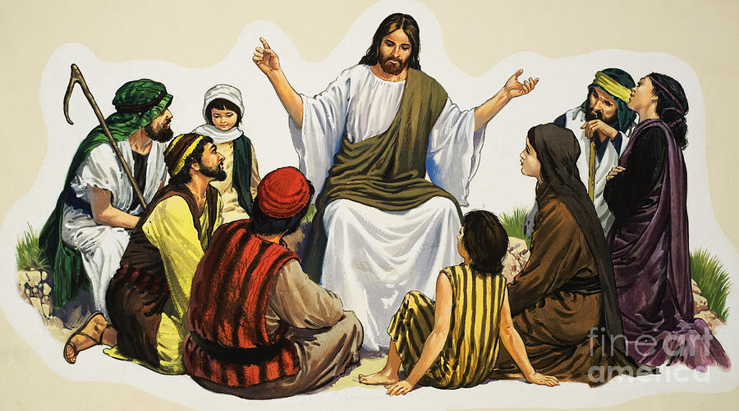

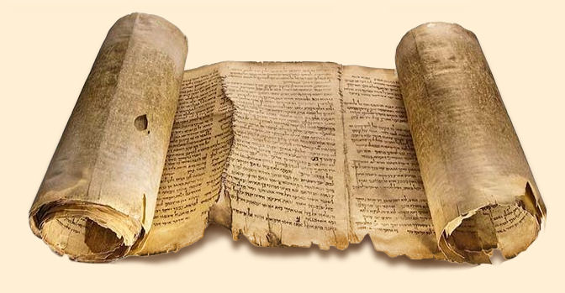
On the way
¹⁹ “What things?” Jesus asked.
“The things that happened to Jesus, the man from Nazareth,” they said. “He was a prophet who did powerful miracles, and he was a mighty teacher in the eyes of God and all the people.
… and he was a mighty teacher in the eyes of God and all the people.
Luke 4:14-19, 31; Matthew 5-7

Slide 12
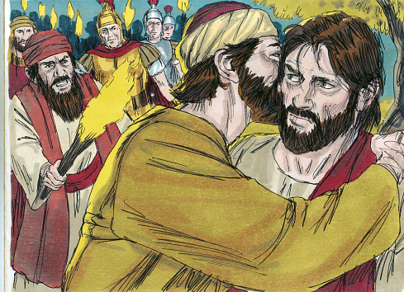
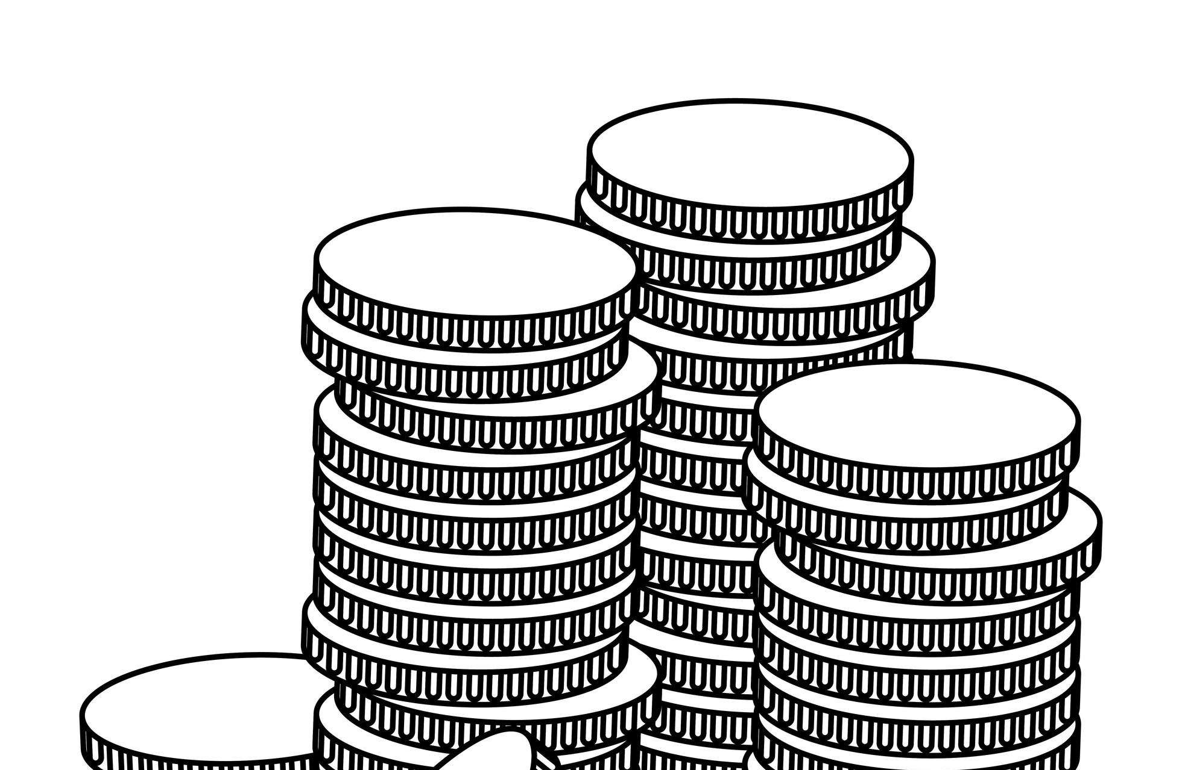
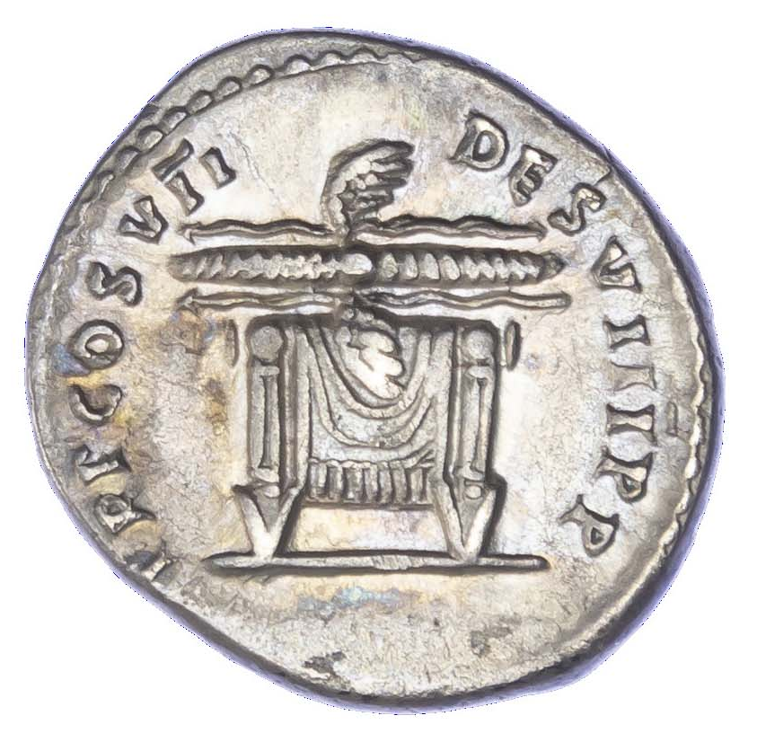
Then one of his trusted disciples, Judas, betrayed him and for 30 pieces of silver he took the leaders to the secret place where Jesus and his disciples were in the garden. He betrayed Jesus, with a kiss!
Zechariah 11:12-13; Matthew 26:1-5, 14-16, 20-25, 47-50

Slide 13
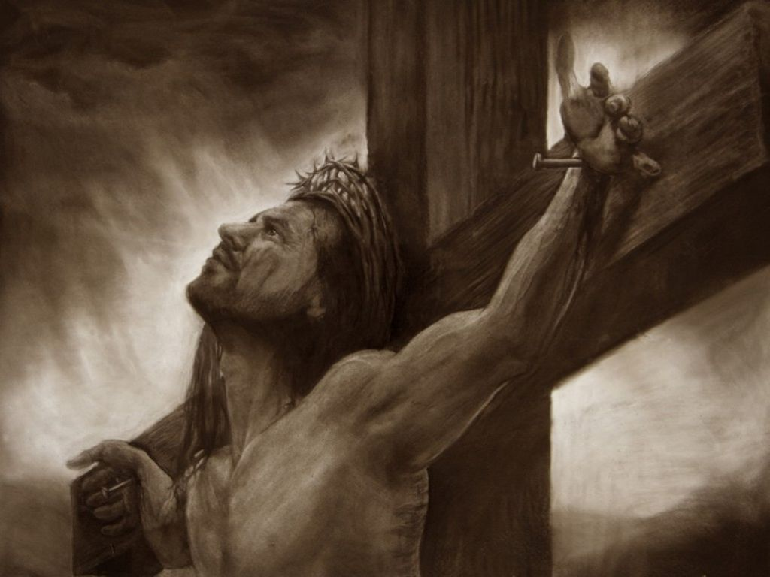

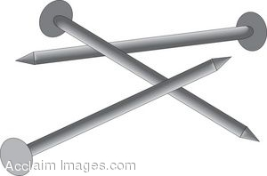
Have you not heard?
²⁰ But our leading priests and other religious leaders handed him over to be condemned to death, and they crucified him. ²¹ We had hoped he was the Messiah who had come to rescue Israel.
But our leading priests handed him over to be crucified!
We had hoped he was the Messiah who had come to rescue Israel!

Slide 14
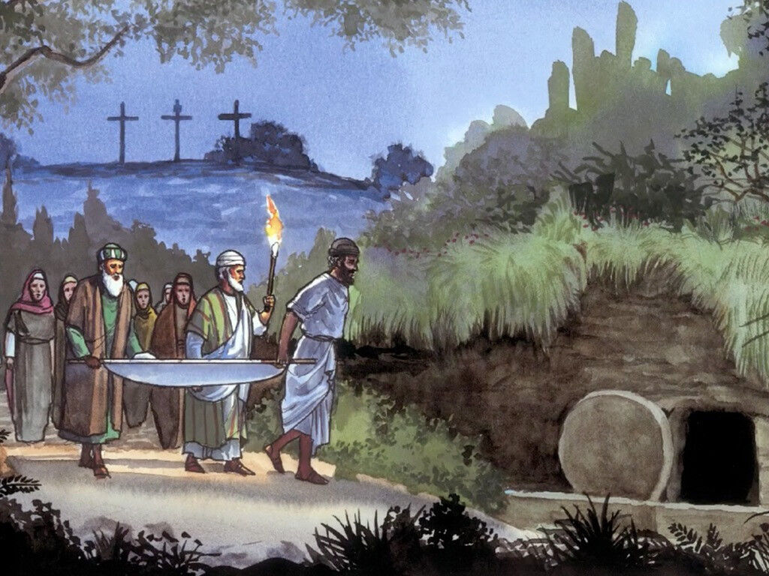

Jesus was crucified!
Josephus and Nicodemus took him off the cross and laid him in a tomb.
Soldiers guarded it.
This Passover and Festival of Unleavened Bread has been so different – so sad!
John 19:38-42, Luke 23:50-56

Slide 15
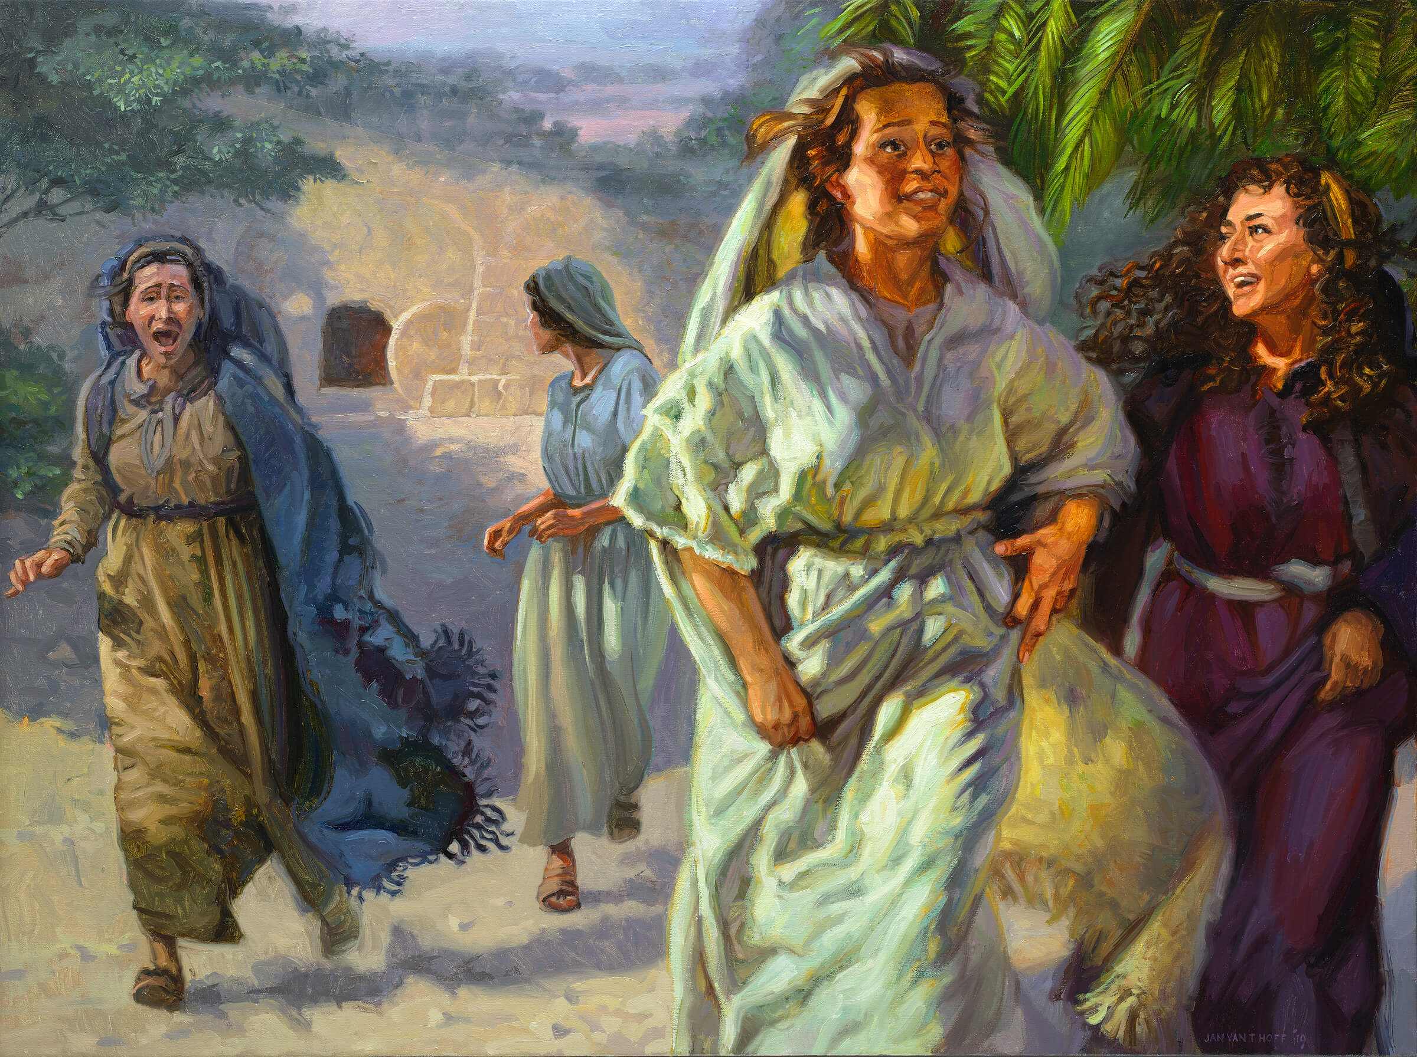
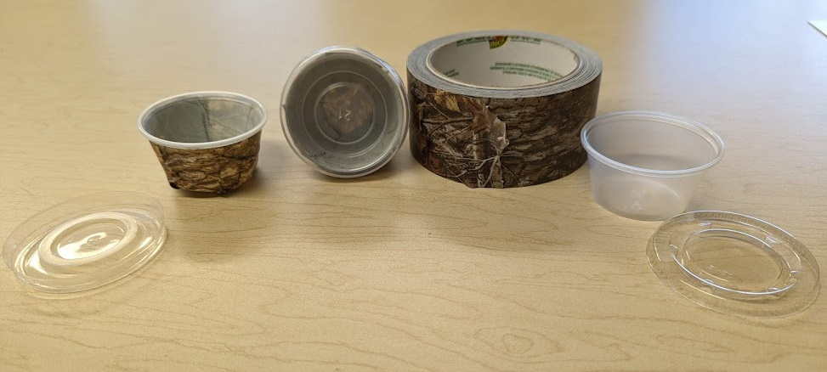
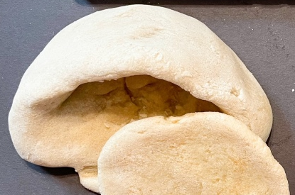
The tomb is empty
This all happened three days ago. ²² “Then some women from our group of his followers were at his tomb early this morning, and they came back with an amazing report. ²³ They said his body was missing, and they had seen angels who told them Jesus is alive! ²⁴ Some of our men ran out to see, and sure enough, his body was gone, just as the women had said.”
This all happened
3 days ago.
Then, this morning, some women came back with the report that his tomb was empty!
They said angels told them that Jesus is alive!
Peter and John ran to see.
It was true, the tomb was empty!
His grave clothes were there.
Jesus wasn’t!

Slide 16
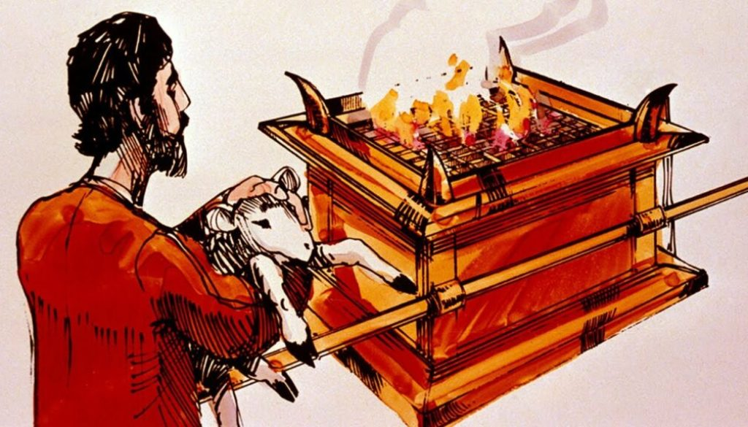
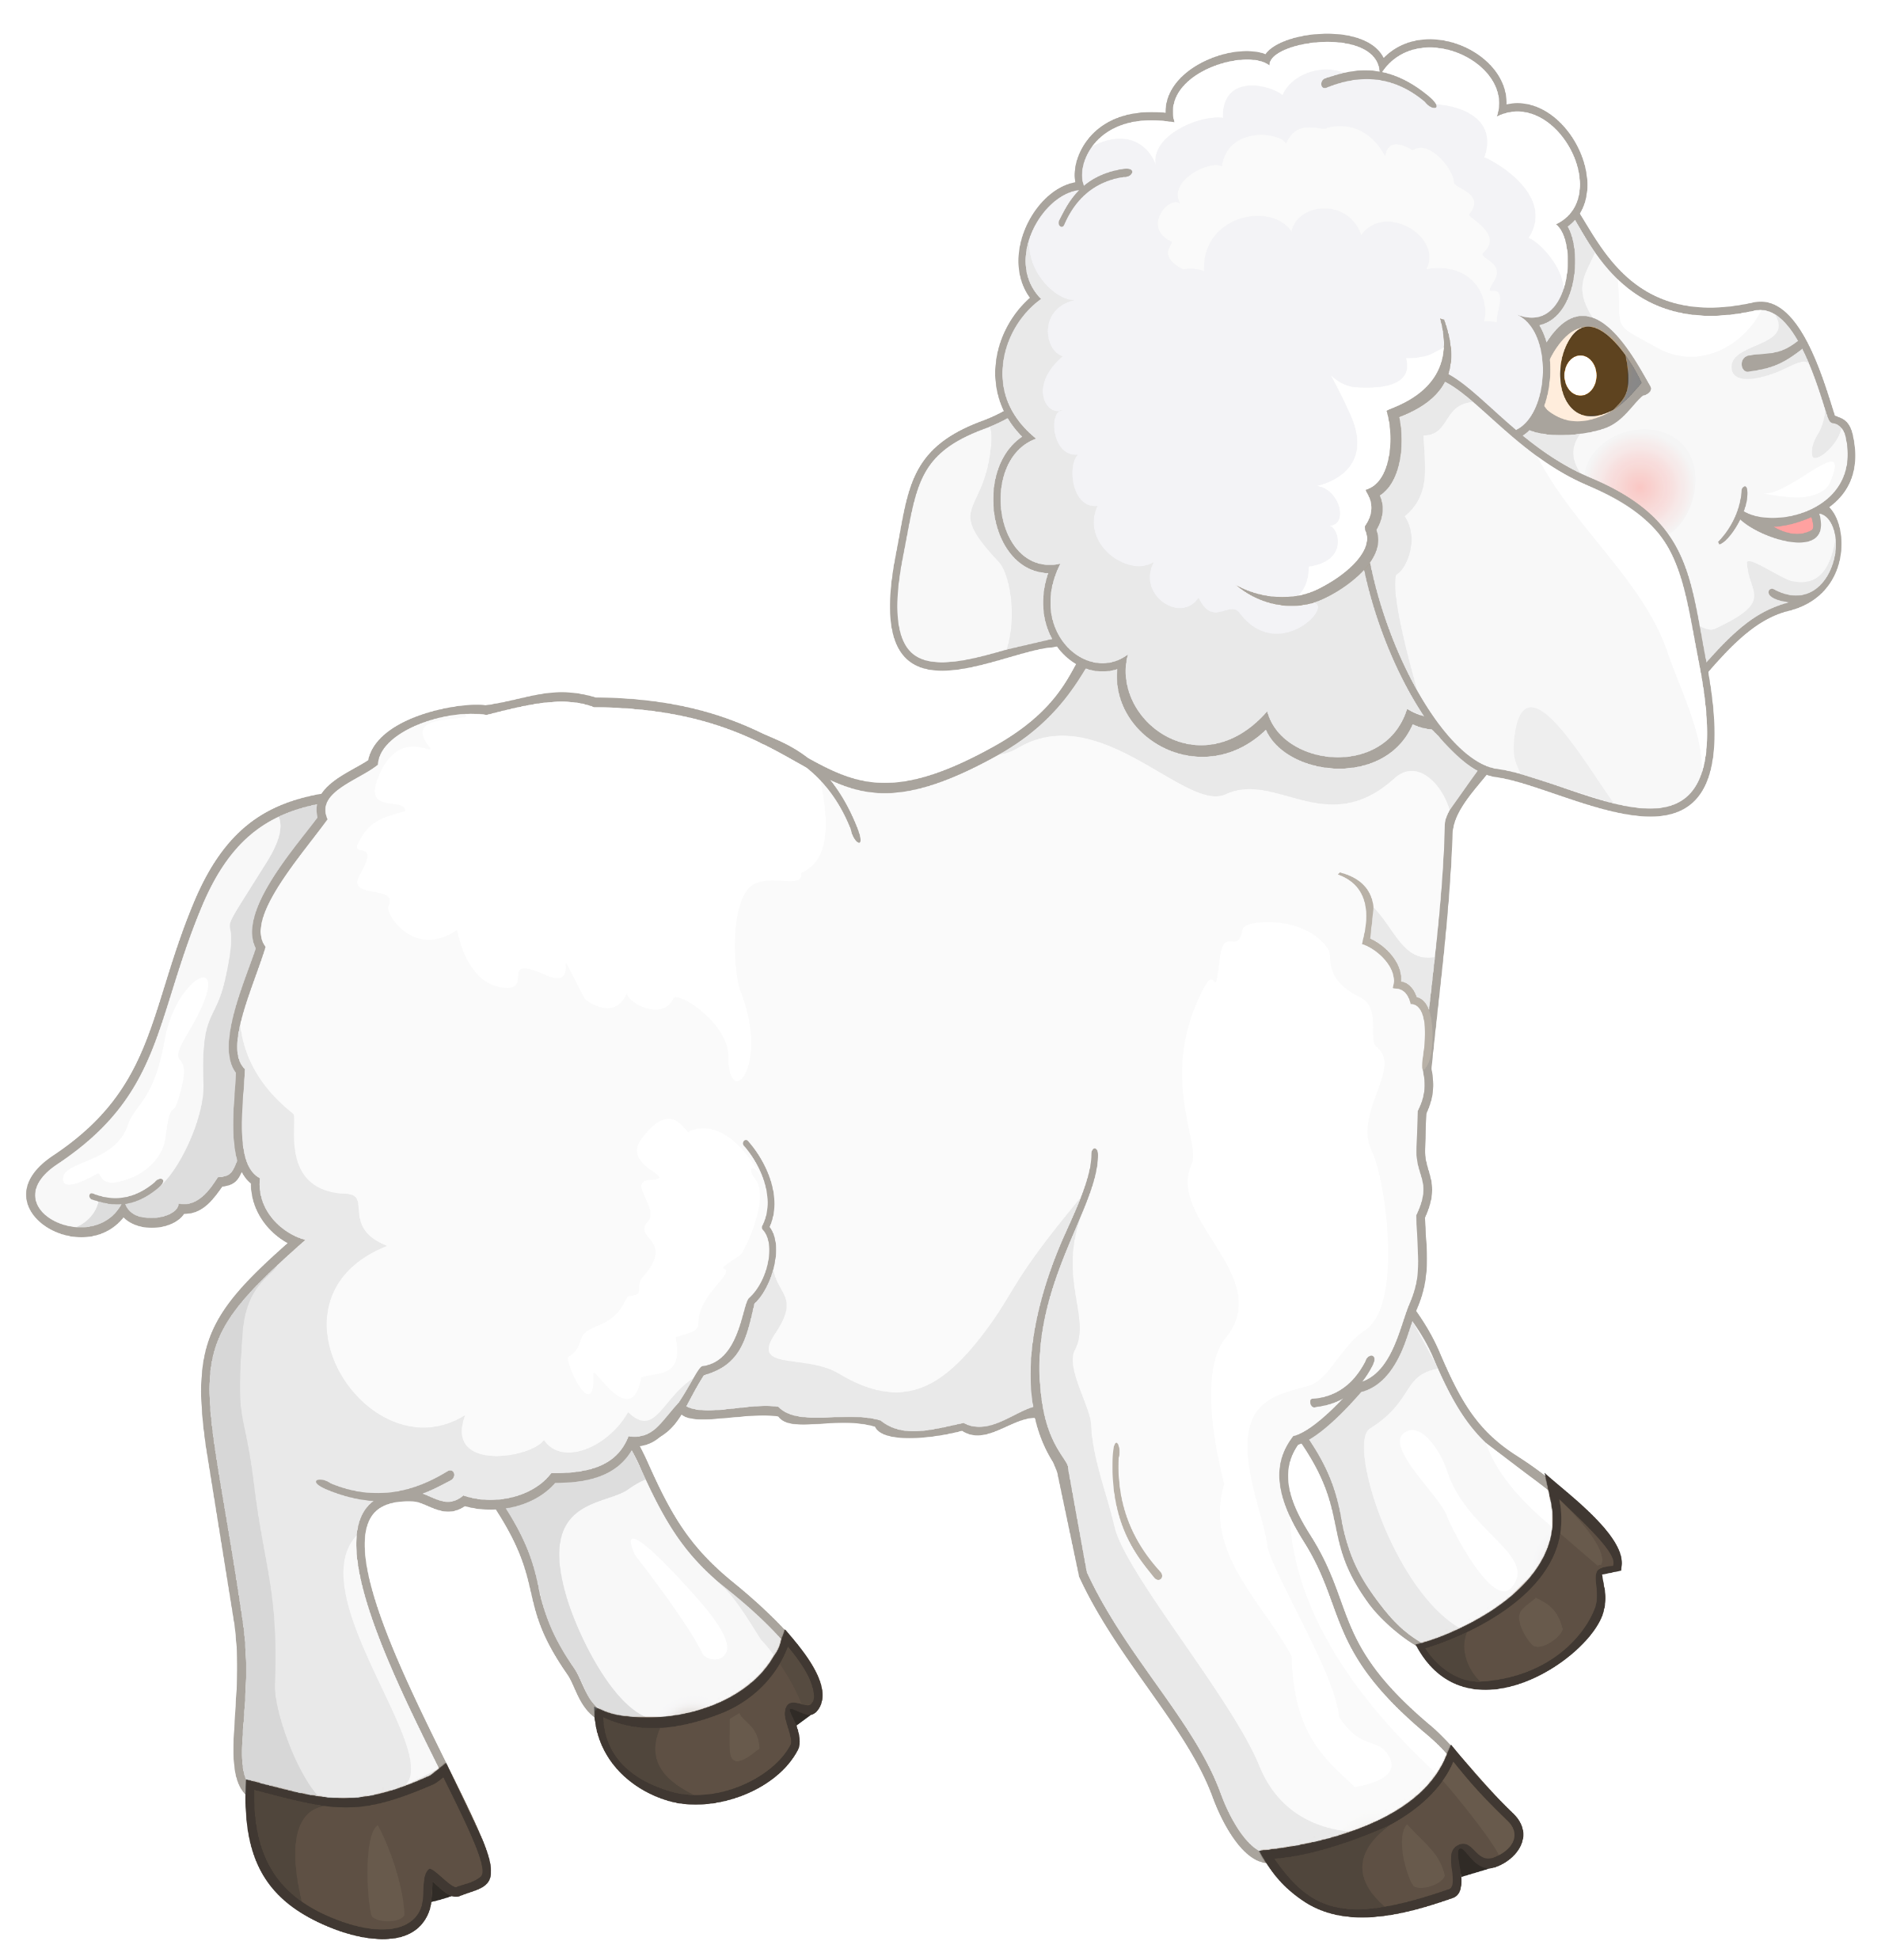
Jesus teaches
You find it so hard to believe all that the prophets wrote in the scriptures.
What happened was clearly predicted in the scriptures.
²⁵ Then Jesus said to them, “You foolish people! You find it so hard to believe all that the prophets wrote in the Scriptures. ²⁶ Wasn’t it clearly predicted that the Messiah would have to suffer all these things before entering his glory?” ²⁷ Then Jesus took them through the writings of Moses and all the prophets, explaining from all the Scriptures the things concerning himself.
When you sin, do you not bring a lamb to the temple and sacrifice it?
This points to the Messiah, the Lamb of God,
Who takes away the sin of the world.
Isaiah said, “he was led like a lamb to the slaughter.
And as a sheep is silent before his shearers,
He did not open his mouth.
Yes, we put our hands on the lamb and confess our sin – placing our sin on the lamb.
The lamb dies instead of us.
Exodus 12, Psalms 22; Heb. 9:14, 1 Peter 1:19

Slide 17

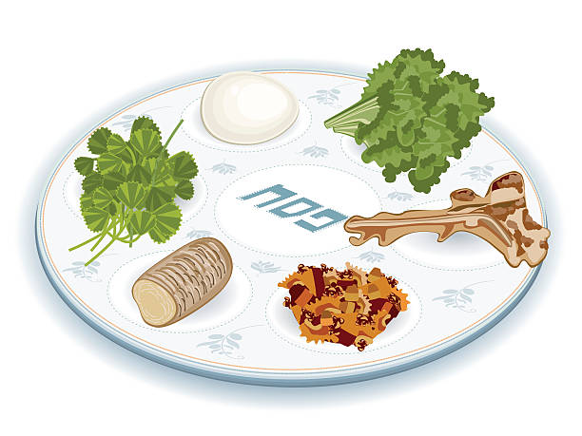
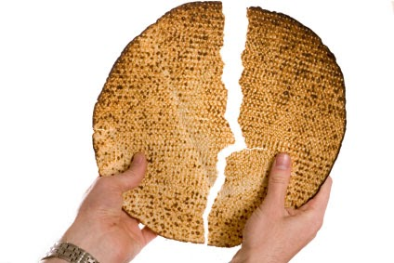


Also remember the Passover. The Passover lamb’s blood you put on the door post saved you.
You drink the grape wine juice.
Doesn’t it remind you that God gave you freedom, God brought you out of Egypt and made you a nation?
The Messiah redeems you and brings freedom from sin. He is establishing a covenant and nation of those faithful to God.
Remember how the unleavened bread is broken. That is like the Messiah who is sinless and broken for you.
Luke 22:19-20; 1 Cor. 5:7

Slide 18
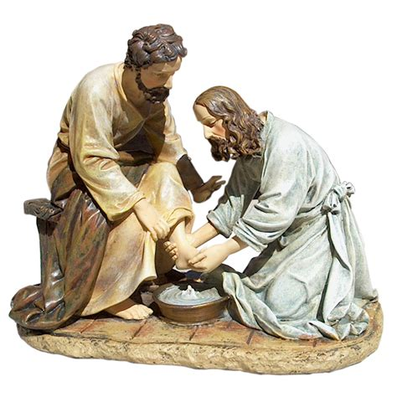

The Messiah, humbly, came to serve.
Like he washed the disciples’ feet?
Isaiah 42:2-3; Matt. 11:28-30, John 13:3-4; Philippians 2:5-8

Slide 19
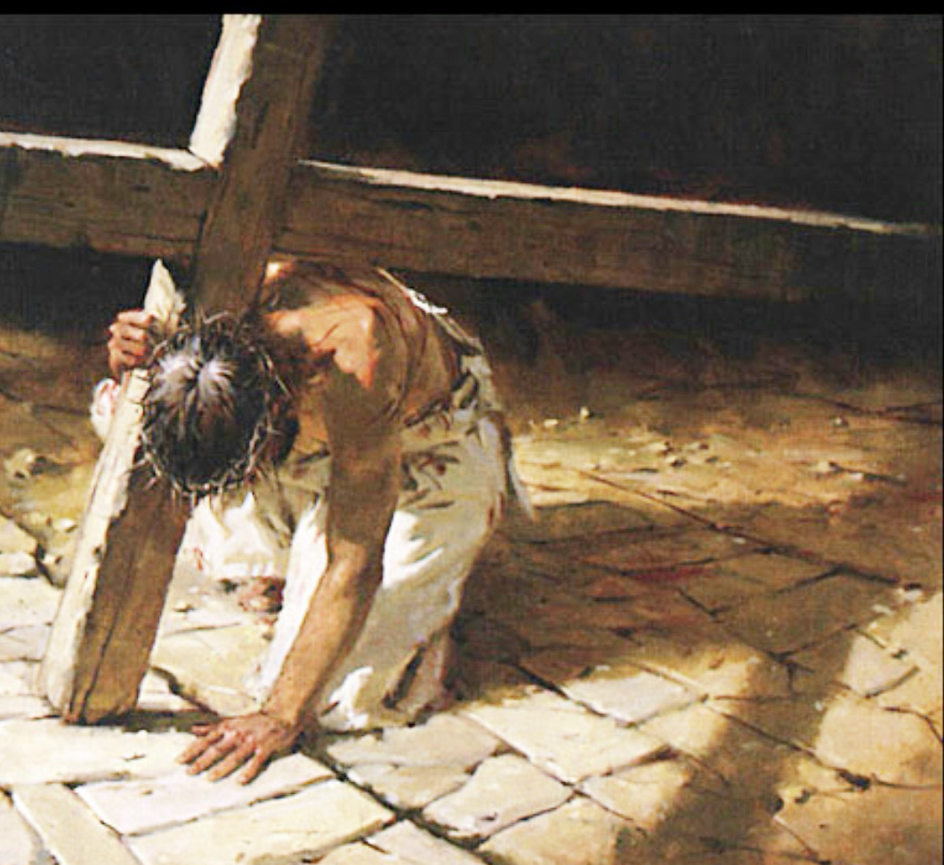

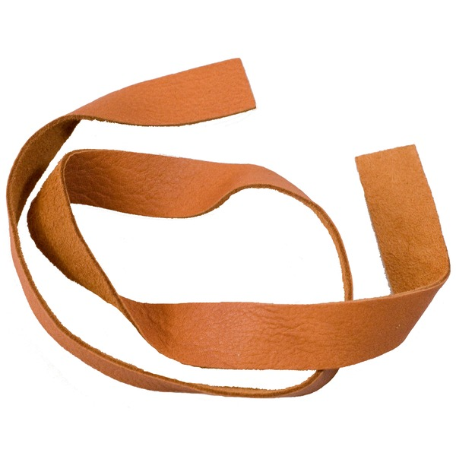
Isaiah wrote that the Messiah would be despised, rejected, beaten, and pierced.
(Isaiah 53)
This was part of God’s plan.
It’s Messiah’s will and decision to take sin upon himself and pay the penalty for your sin.
Jesus was beaten terribly!
His wounds were terrible!
I saw them as he carried the cross.
Isaiah continued… “we thought he was being punished for his sins, but
he was pierced for our rebellion,
he was crushed for our sins.”
Isaiah 53:3-7; Mark 15:15-22

Slide 20
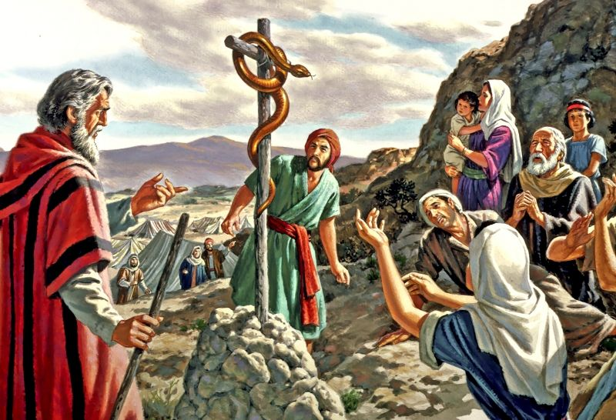
Remember when the Israelites were being bitten by snakes, Moses put a bronze snake on a pole.
If they looked at it, they were healed.
The Messiah too was lifted up.
Being lifted up, He will draw all men unto himself.
… lifted up on a cross.
So, if we look to him, we are healed and forgiven?
Numbers 21:9; John 3:14-18, 12:23

Slide 21
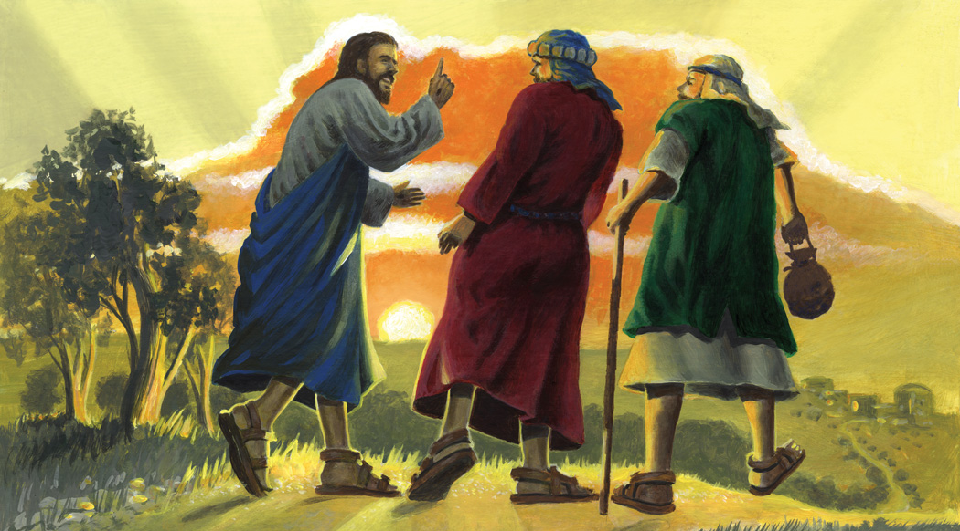
Please stay with us
Good night. We’ll talk later.
Wait. It’s getting late.
Please stay the night with us.
²⁸ By this time they were nearing Emmaus and the end of their journey. Jesus acted as if he were going on, ²⁹ but they begged him, “Stay the night with us, since it is getting late.” So he went home with them.
Ok. I will come with you.

Slide 22
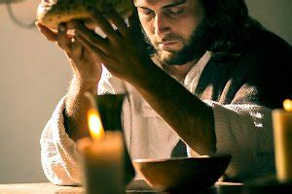
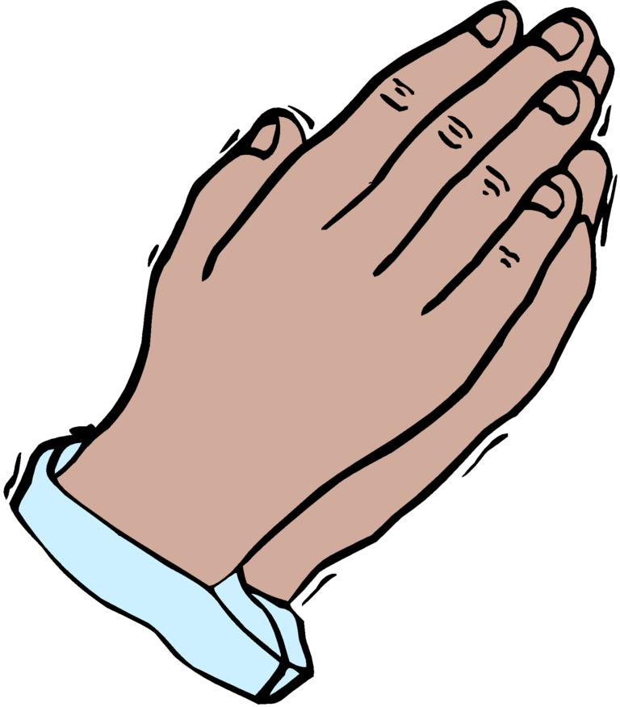
Jesus prayed
Heavenly Father bless this bread may it nourish us.
Bring understanding and wisdom, too.
Your kingdom come. Your will be done on earth as it is
in heaven. Amen.
Jesus prayed
³⁰ As they sat down to eat,^{[d]} he took the bread and blessed it.
Before Jesus was led away to be crucified, He prayed in the Garden.
He prayed that God’s will be done. God gave him strength and courage. Isaiah 42:2-3,
Jesus prays for us now, too. John 17:20-23; Hebrews 7:25

Slide 23
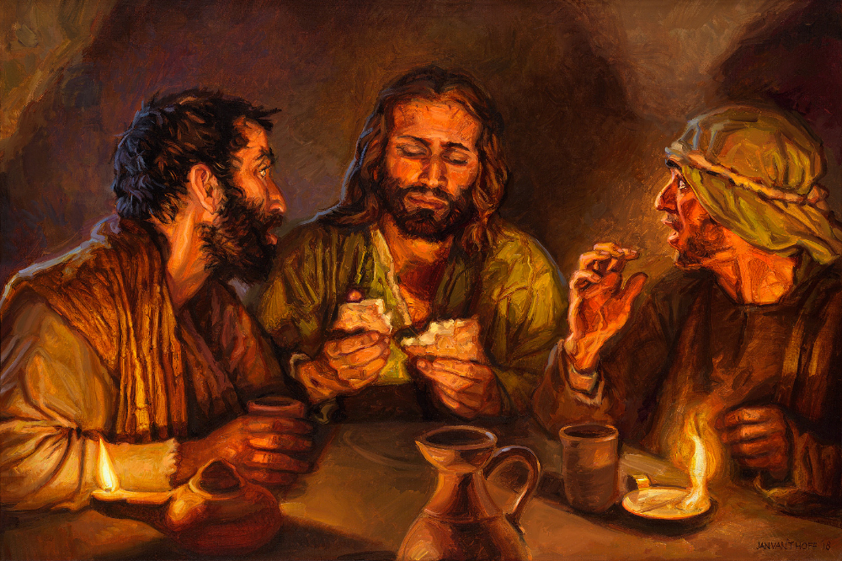
Sharing bread – snack time
It’s Jesus!
It’s Jesus!
³⁰ As they sat down to eat,^{[d]} he took the bread and blessed it. Then he broke it and gave it to them.

Slide 24
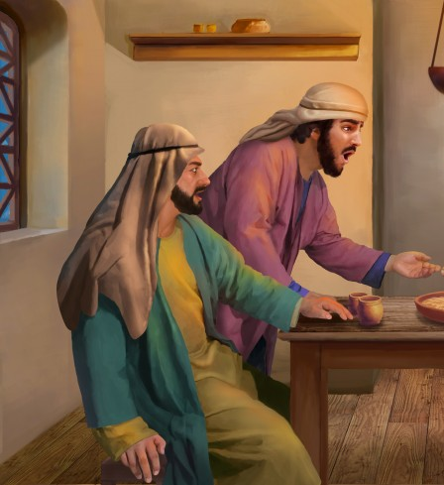
It was Jesus!
He’s gone!
³¹ Suddenly, their eyes were opened, and they recognized him.
And at that moment he disappeared!

Slide 25
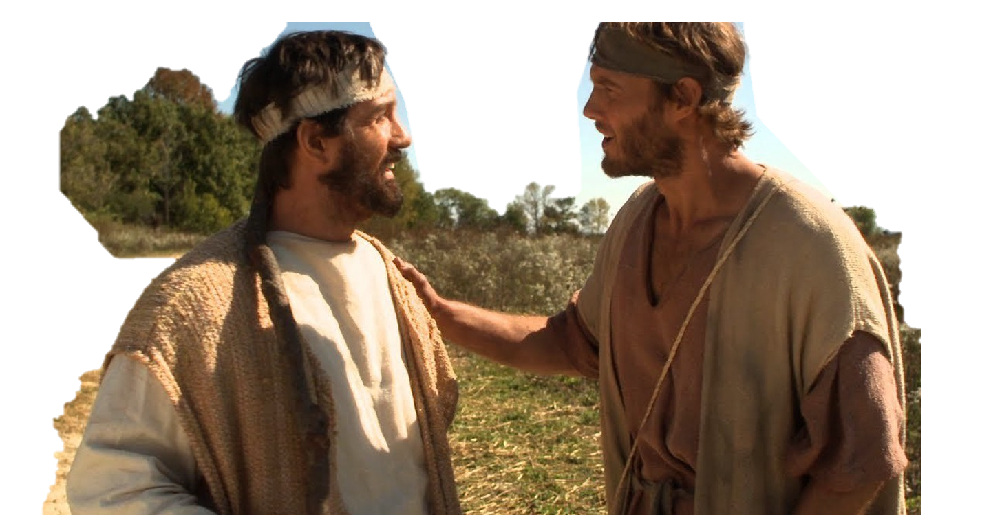
We must go tell the others!
Even though it is getting very late and dark, we must go tell the others! Hurry!
Were we not amazed as he explained the scriptures to us?!
³² They said to each other, “Didn’t our hearts burn within us as he talked with us on the road and explained the Scriptures to us?”
³³ And within the hour they were on their way back to Jerusalem.

Slide 26
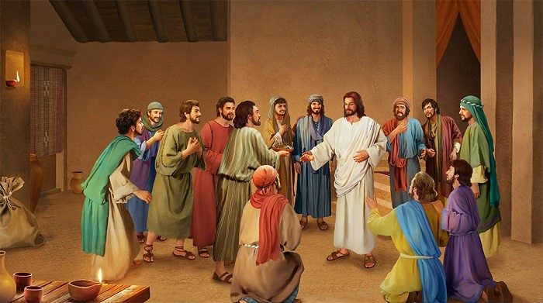
Jesus explained everything to us!
We were talking along the road to Emmaus.
Someone came and talked with us. We didn’t know who it was at the time.
He explained all that’s happened from the scriptures!
It’s true. Jesus is alive!
He appeared to Peter!
There they found the eleven disciples and the others who had gathered with them, ³⁴ who said, “The Lord has really risen! He appeared to Peter.^{[e]}”
³⁵ Then the two from Emmaus told their story of how Jesus had appeared to them as they were walking along the road, and how they had recognized him as he was breaking the bread.
It was late. He came to eat and stay with us. But when he broke the bread, we finally recognized him. It was Jesus!
Then he disappeared!

Slide 27
Look, It’s really me
Peace be with you
Why are you so frightened?
Why are you doubting?
Look at my hands.
Look at my feet. Touch me.
See it is really me, Jesus!
³⁶ And just as they were telling about it, Jesus himself was suddenly standing there among them. “Peace be with you,” he said. ³⁷ But the whole group was startled and frightened, thinking they were seeing a ghost!
³⁸ “Why are you frightened?” he asked. “Why are your hearts filled with doubt? ³⁹ Look at my hands. Look at my feet. You can see that it’s really me. Touch me and make sure that I am not a ghost, because ghosts don’t have bodies, as you see that I do.” ⁴⁰ As he spoke, he showed them his hands and his feet.

Slide 28
Look, It’s really me
Do you have anything here to eat?
⁴¹ Still they stood there in disbelief, filled with joy and wonder. Then he asked them, “Do you have anything here to eat?” ⁴² They gave him a piece of broiled fish, ⁴³ and he ate it as they watched.
Here is some broiled fish.
It’s not a ghost.
It’s Jesus!

Slide 29
Wait for the Holy Spirit
When I was with you before, I told you that everything in the law of Moses, the prophets, and Psalms must be fulfilled.
It was written a long time ago that the Messiah would suffer and die and rise from the dead on the 3rd day. Here I AM. Believe me
⁴⁴ Then he said, “When I was with you before, I told you that everything written about me in the law of Moses and the prophets and in the Psalms must be fulfilled.” ⁴⁵ Then he opened their minds to understand the Scriptures. ⁴⁶ And he said, “Yes, it was written long ago that the Messiah would suffer and die and rise from the dead on the third day.

Slide 30
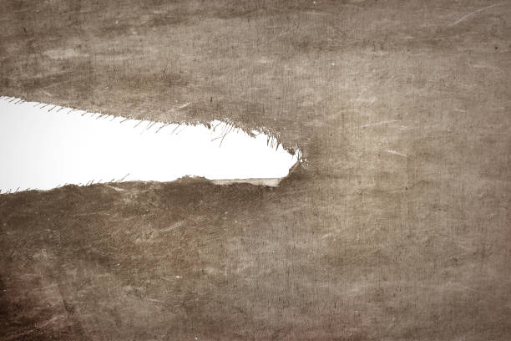
Lord, we heard that the curtain in the temple was torn in two from the top.
What is the meaning of this?
You need not be afraid. Your sins are forgiven. You may pray to God with confidence.
The way is open.
Matthew 27:51; Ephesians 3:12, Heb. 10:19

Slide 31



Wait for the Holy Spirit
It was also written that this message will be told everywhere on earth.
Everyone may have forgiveness for their sins.
You are my witnesses.
I will send the Holy Spirit, just as my Father promised. Stay here in the city.
Pray and wait for the Holy Spirit to
fill you with power from heaven.
⁴⁷ It was also written that this message would be proclaimed in the authority of his name to all the nations,^{[f]} beginning in Jerusalem: ‘There is forgiveness of sins for all who repent.’ ⁴⁸ You are witnesses of all these things.
⁴⁹ “And now I will send the Holy Spirit, just as my Father promised. But stay here in the city until the Holy Spirit comes and fills you with power from heaven.”
Holy Spirit
Yes LORD. We will! Thank you!

Slide 32
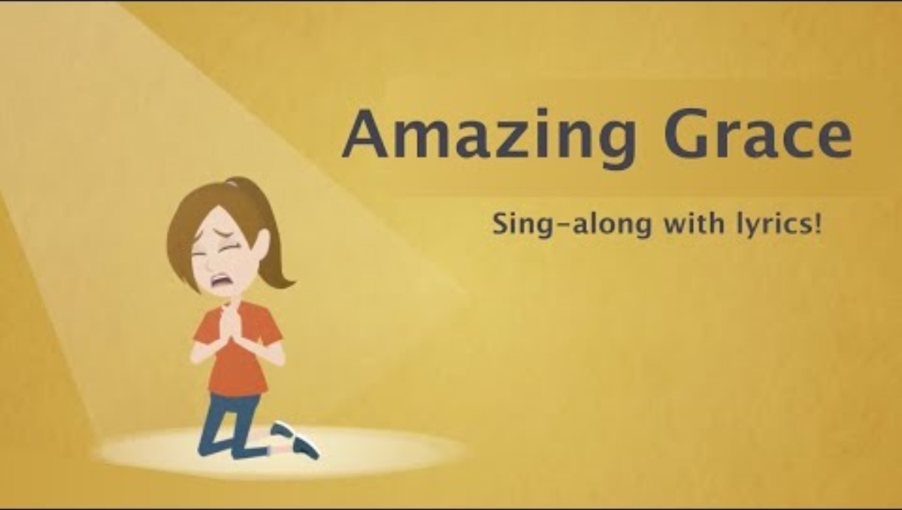

Slide 33


Slide 34
