Slide 1
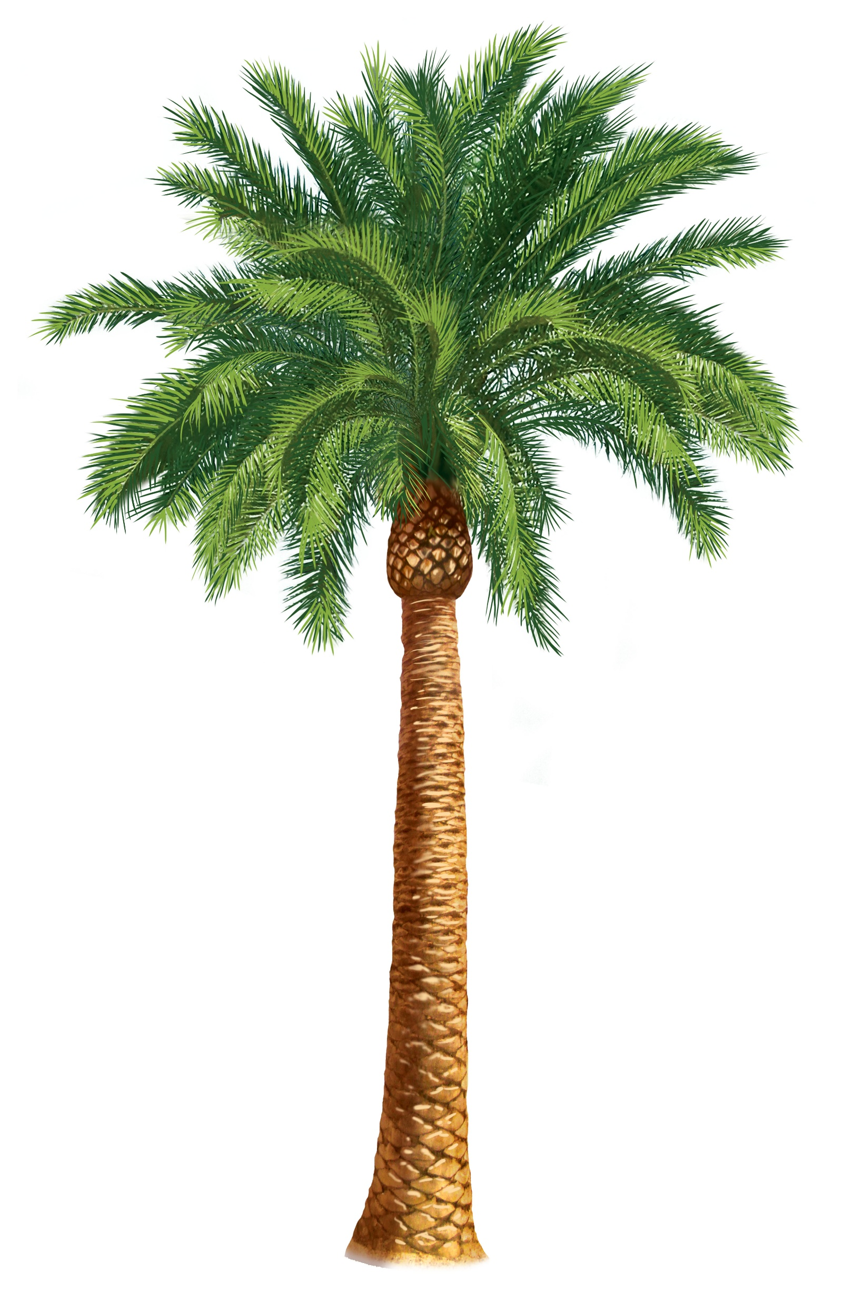
Triumphant Entry
Jesus Enters Jerusalem Like a King
Matthew 21:1-11 Mark 11:1-11 Luke 19:28-40 John 12:12-19

Slide 2
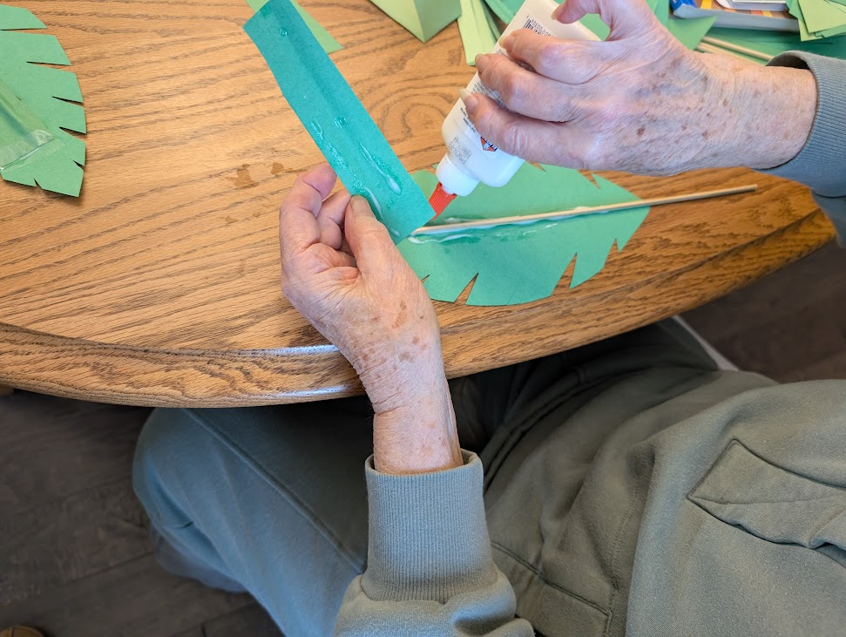
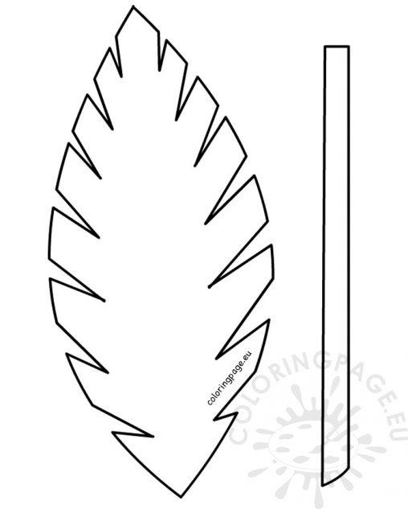
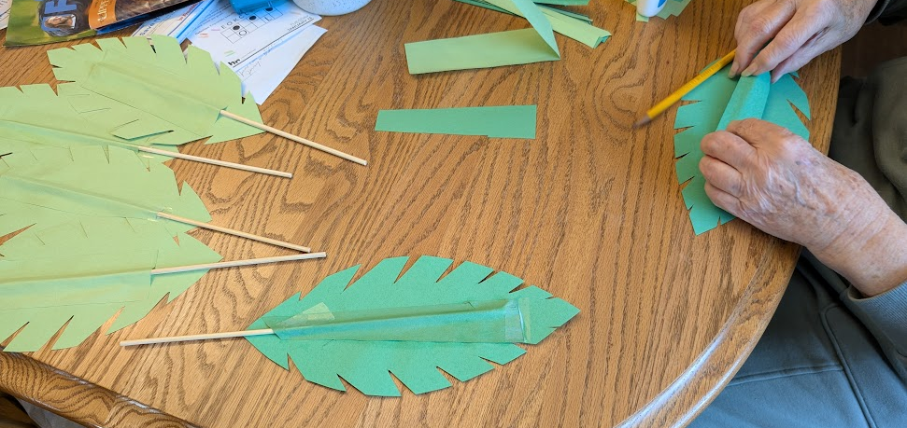
For our Bible story today, you will need a palm branch. You can make one.
Directions:
Color the palm branch green (if it is not copied on green paper)
Cut it out.
Tape a dowel or kabob stick (with the point on the leaf) on it so that you can hold the leaf.
You can cover the stick with the green stem.
https://coloringpage.eu/palm-branch-template-2/

Slide 3
Have you ever been saved or delivered from something?
Afterwards, were you relieved? Happy? Feeling blessed?

Slide 4
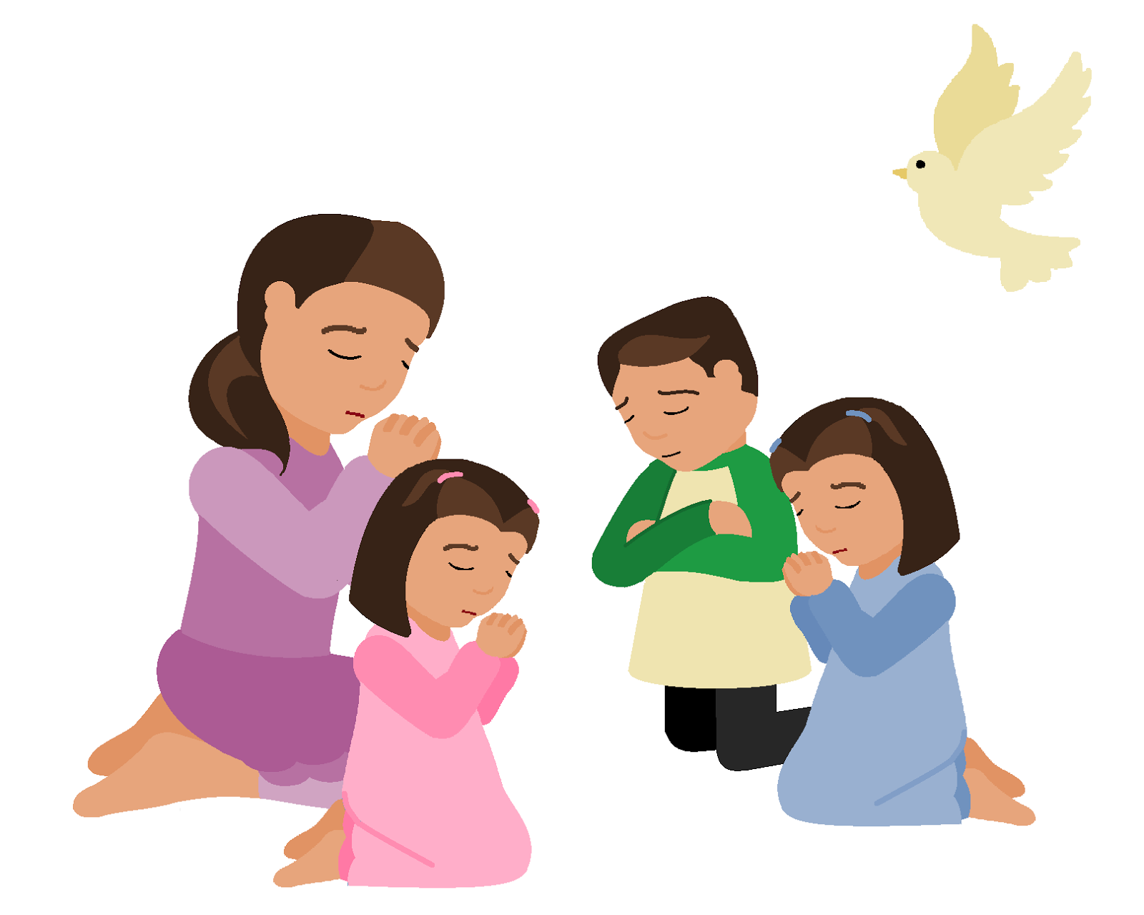

Remember
Our Father who is in heaven….
Forgive us our debts…
Lead us not into temptation…
Deliver us from evil
For thine is the kingdom….
Today, in our story, some recognized that it is Jesus who forgives,
It is Jesus who delivers us.
Jesus is our Savior!
Some accepted Jesus as King.
Hosanna!
Lord save us!

Slide 5
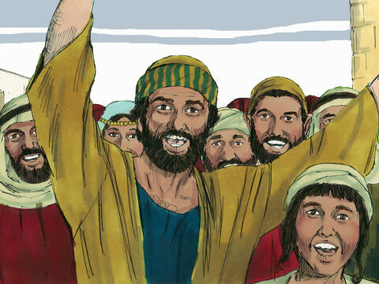
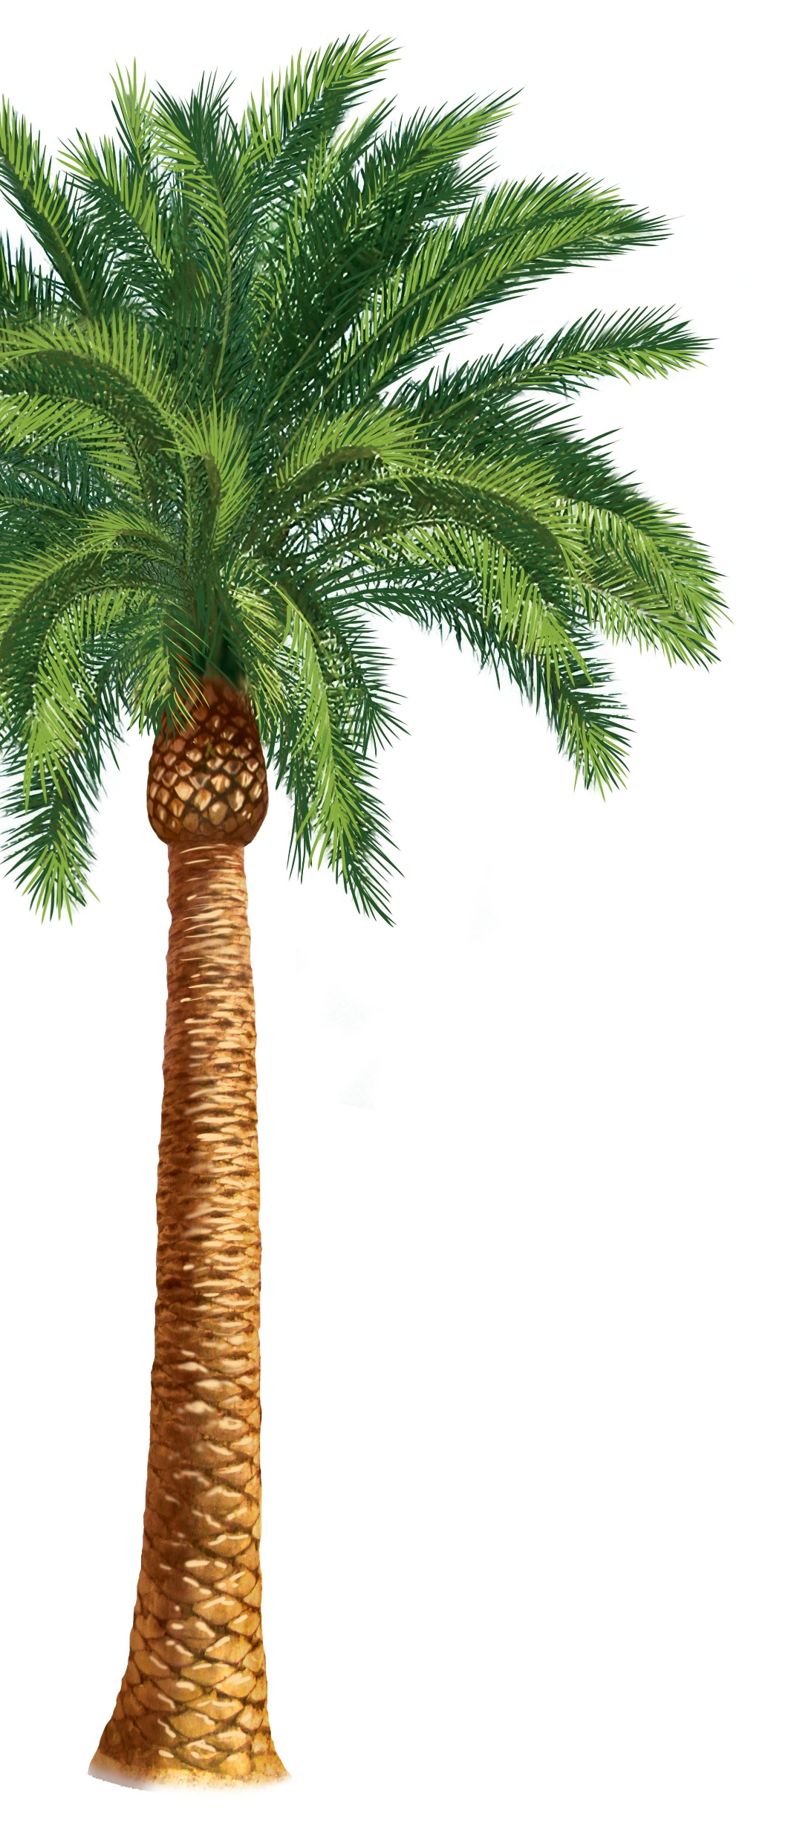
3 ½ years after Jesus’ baptism
Jesus had healed many people.
He had told many stories.
He had done many miracles.
Many people loved Jesus!
Now it was a special time
of the year. Celebration time!
The people would celebrate times that God had given them freedom and conquered their enemies.
He had conquered the Egyptians at the Red Sea.
He had conquered the people in Canaan and given the Israelites the Promised Land.
It was the Passover Festival and everyone who could came to Jerusalem.

Slide 6

Each year people came to Jerusalem for the Passover.
As the people came into Jerusalem, they would greet each other with by saying,
Psalms
118:25-29
Blessed is he
who comes in the name of the Lord. From the house of the Lord, we bless you.
Give thanks to the Lord,
for He is good; His love endures for ever.
It was a time to remember how God had saved and delivered them.

Slide 7
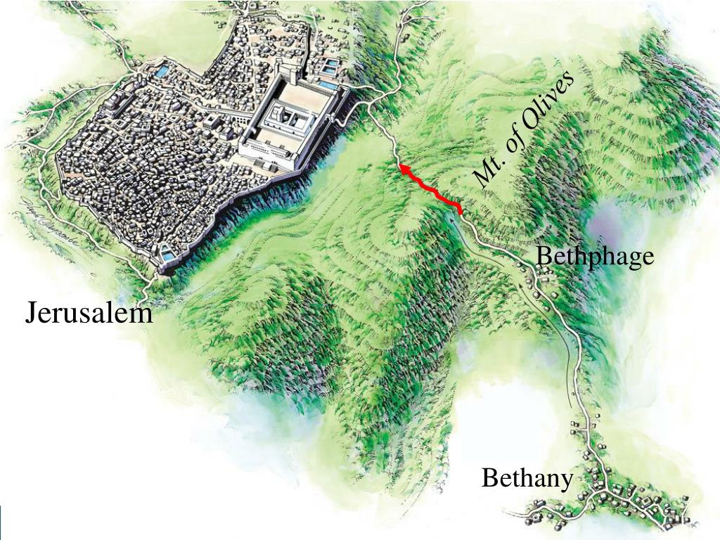
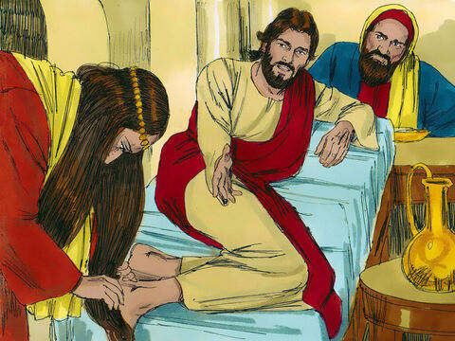
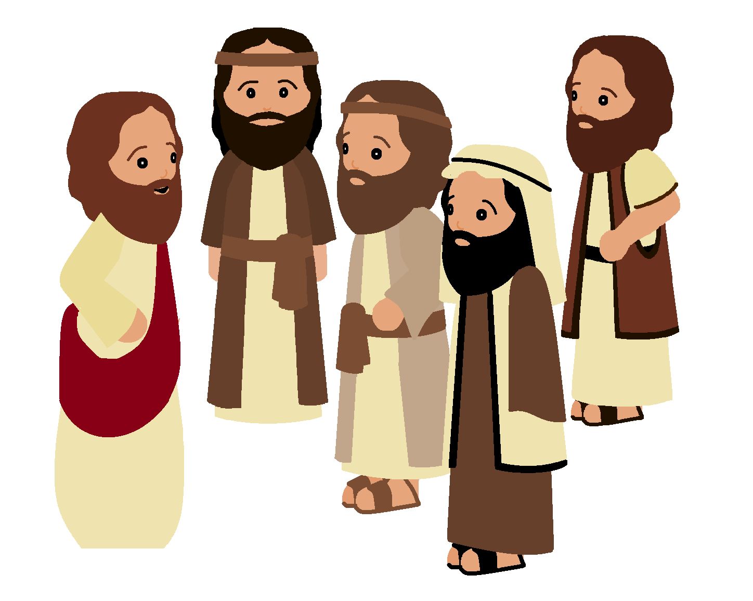
Let’s Go to Jerusalem
Jesus and His disciples headed towards Jerusalem also.
Jesus told His disciples that He would suffer and die in Jerusalem.
They stopped in Bethany where Mary, Martha, and Lazarus lived. There He had raised Lazarus back to life. This time they had a party there. During that time Mary anointed Jesus’ feet.
I will suffer and die soon.
She is doing a beautiful thing and will be remembered for this.
She is preparing me for burial.

Slide 8
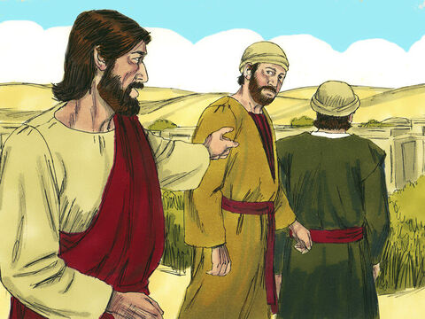
They got close to Bethphage.
If anyone asks you, “Why are you doing this?” say,
“The Lord needs it and will send it back here shortly.”’
‘‘Go to the village ahead of you, and just as you enter it,
you will find a colt tied there, which no one has ever ridden. Untie it and bring it here
Matthew 21:1 Mark 11:2-3
Now when they drew near Jerusalem, and came to Bethphage, at the Mount of Olives, then Jesus sent two disciples, ² saying to them, …

Slide 9
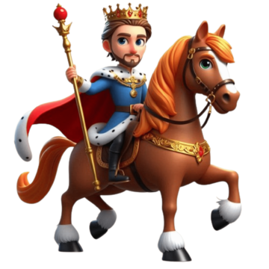
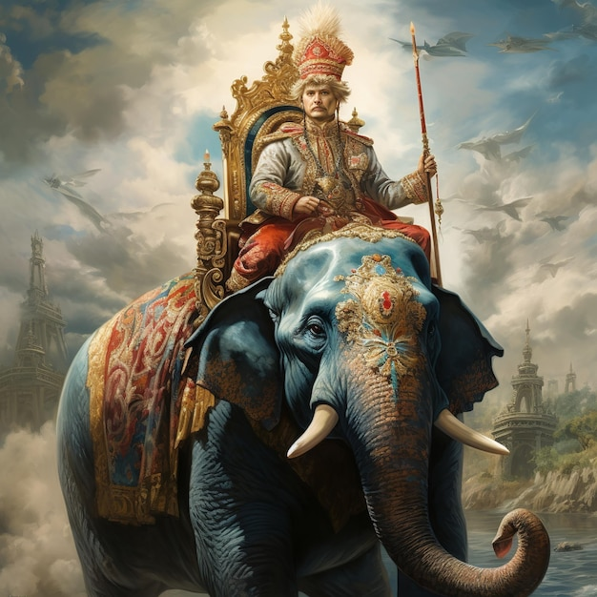
Prophesy fulfilled
Most kings would choose a mighty stallion horse, an elephant, or a camel.
But Jesus chose a lowly donkey. Jesus is a humble king full of mercy.
All this was done that it might be fulfilled which was spoken by the prophet, saying:
⁵ “Tell the daughter of Zion, ‘Behold, your King is coming to you, Lowly, and sitting on a donkey, A colt, the foal of a donkey.’ ”
Zechariah 9:9

Slide 10
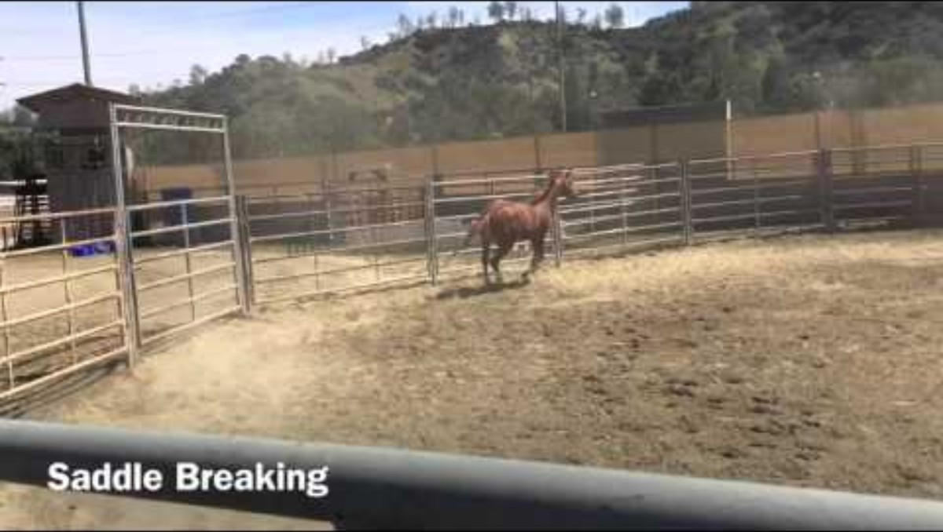
How do you get a young colt who has never been ridden, ready to accept a rider?
Jesus didn’t do anything like that. The colt had never been ridden, but Jesus just got on and rode him.

Slide 11
‘‘Go to the village ahead of you, and just as you enter it,
you will find a colt tied there, which no one has ever ridden. Untie it and bring it here
If anyone asks you, “Why are you doing this?” say,
“The Lord needs it and will send it back here shortly.”’
You can act out our story. Two of you can go get the donkey.
(We have a board donkey. Or a child could pretend to be it.)

Slide 12
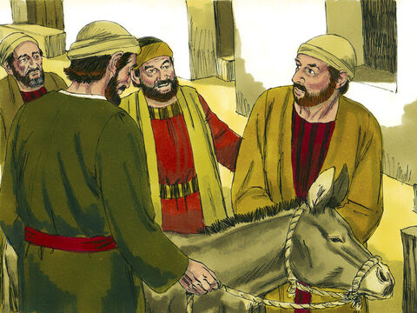
Why are you
untying the colt?
The LORD needs it.
He will return it shortly.
Mark 11
⁴ They went and found a colt outside in the street, tied at a doorway. As they untied it, ⁵ some people standing there asked, ‘What are you doing, untying that colt?’ ⁶ They answered as Jesus had told them to, and the people let them go.
OK
You can take it.
You can act out our story. Ask for the donkey.

Slide 13
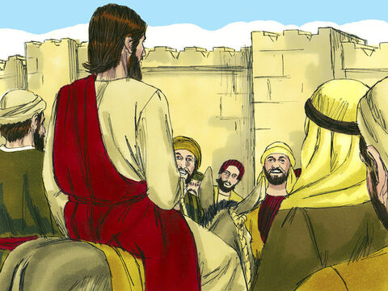
Jesus sat on the donkey
Mark 11
⁷ When they brought the colt to Jesus and threw their cloaks over it, he sat on it.
Put some cloaks on the donkey.
The person playing the part of Jesus can sit on the donkey.

Slide 14
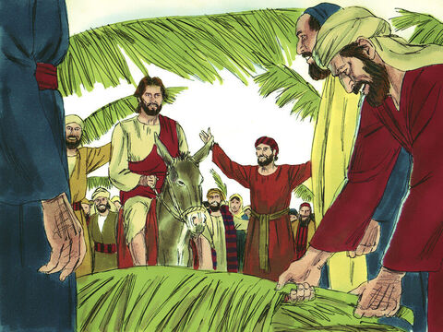
Hosanna!
Blessed is He who comes in the name of the Lord.
Hosanna!
Save us. Deliver us.
Jesus Saves!
Jesus Delivers!
Hosanna in the highest heaven!
Mark 11
⁸ Many people spread their cloaks on the road, while others spread branches they had cut in the fields. ⁹ Those who went ahead and those who followed shouted,
‘Hosanna!^{[a]}’
‘Blessed is he who comes in the name of the Lord!’^{[b]}
¹⁰ ‘Blessed is the coming kingdom of our father David!’
‘Hosanna in the highest heaven!’
Blessed is the coming kingdom of our father David!
You can act out our story. Some can put cloaks on the ground.
Get branches to wave. Praise Jesus by saying one of the quotes.

Slide 15

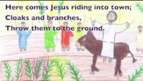
Listen and cut out your craft or Sing Songs for Palm Sunday, Holy Week and Easter #1 Cloaks and Branches

Slide 16
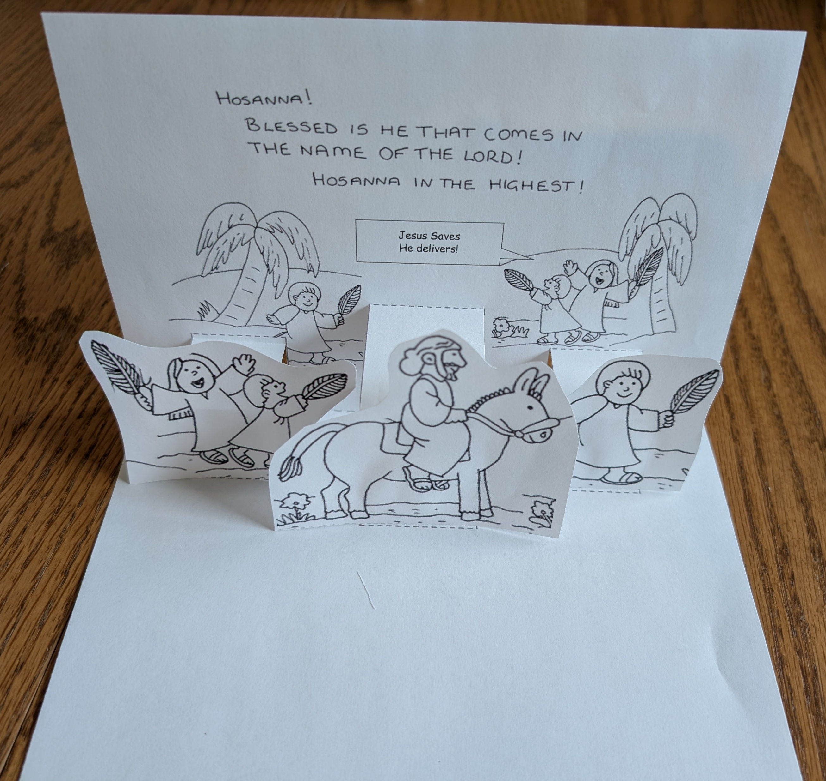
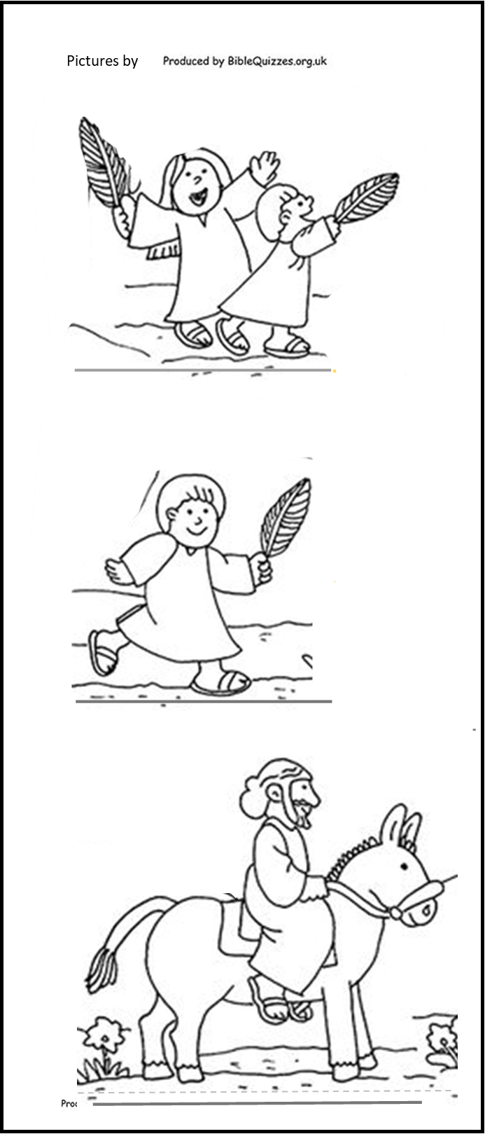
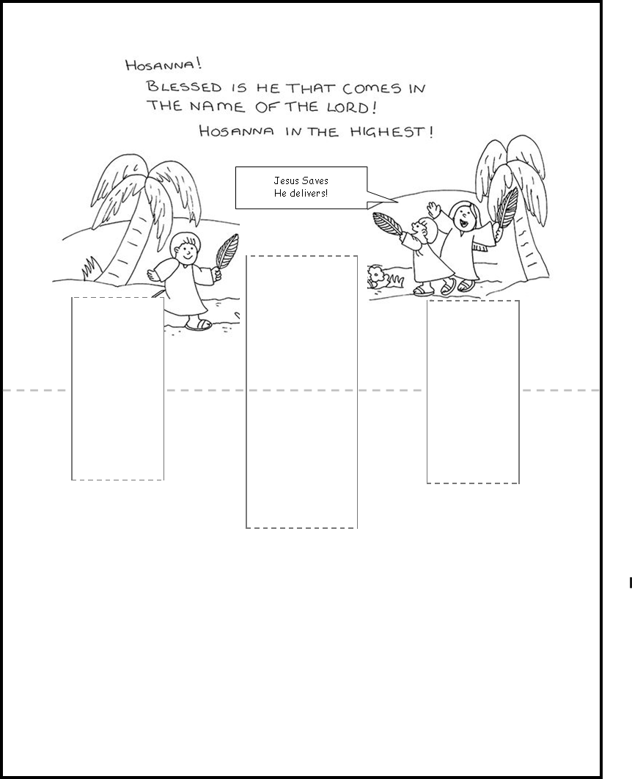
Craft Time -- Card with Pop-up figures
Directions:
Color the pictures

Slide 17
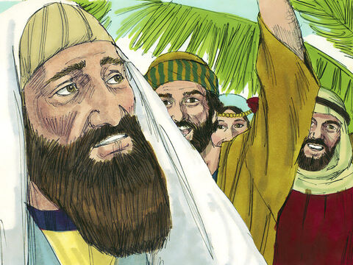
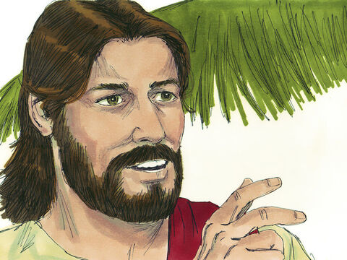
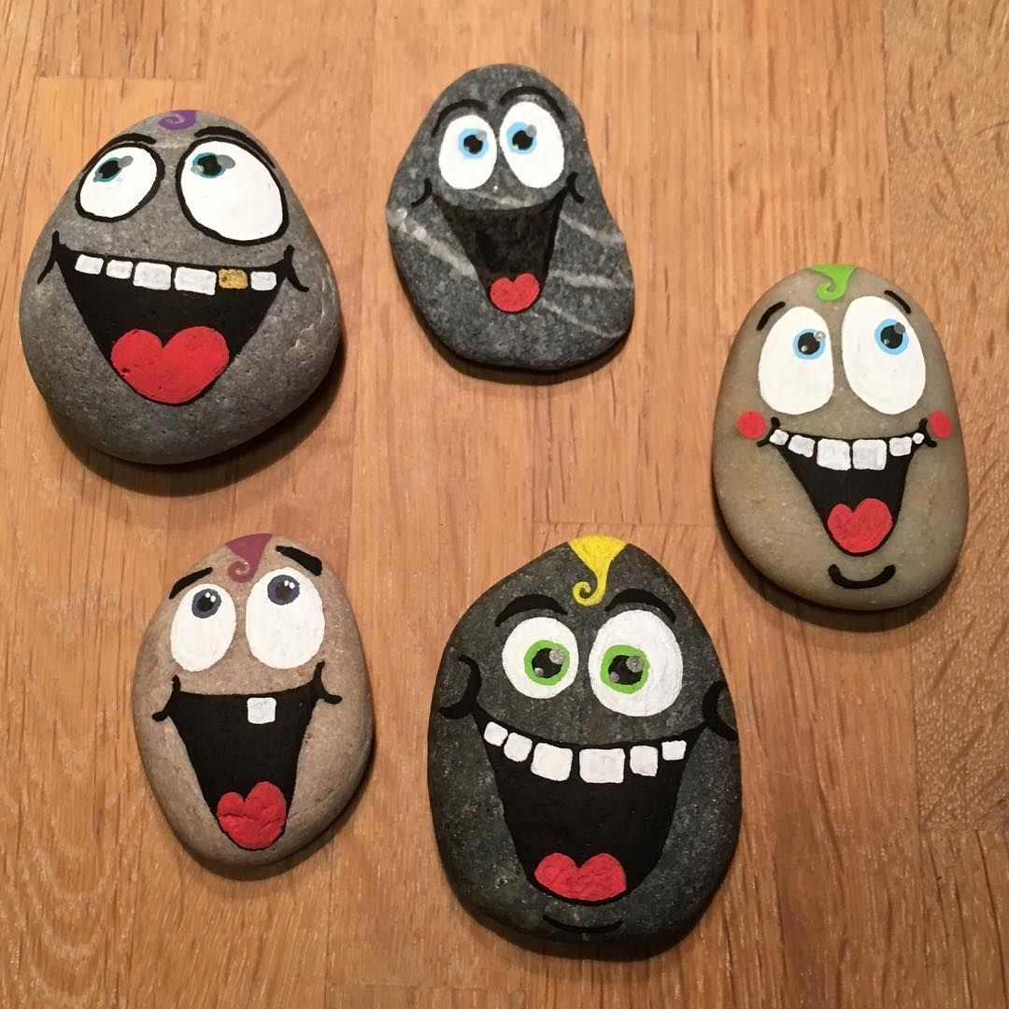
However, not everyone accepted Jesus as the Messiah and Savior.
Teacher,
Rebuke your disciples!
I tell you if they keep quiet, the stones will cry out.
Luke 19
³⁹ Some of the Pharisees in the crowd said to Jesus, ‘Teacher, rebuke your disciples!’
⁴⁰ ‘I tell you,’ he replied, ‘if they keep quiet, the stones will cry out.’
Hosanna!
Blessed is the coming kingdom of our father David!
Blessed is He who comes in the name of the Lord.

Slide 18
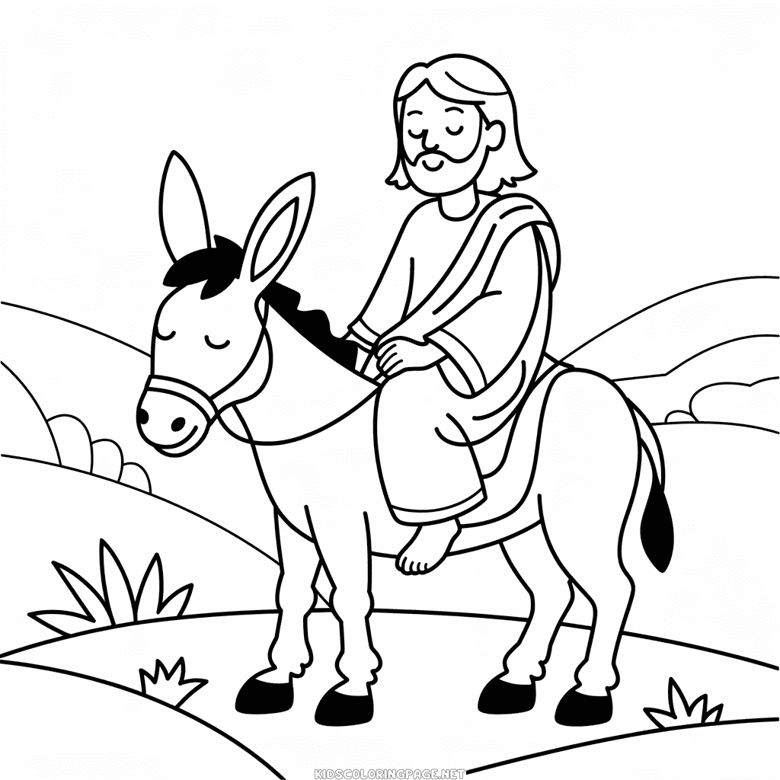

Jesus wept
Luke 19
⁴¹ As he approached Jerusalem and saw the city,
he wept over it.

Slide 19
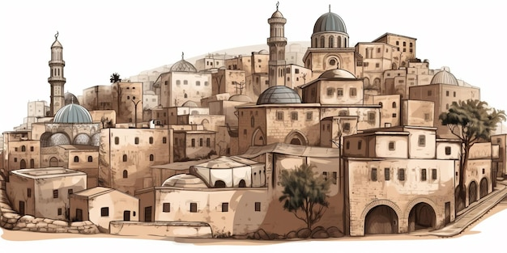
The leader’s reply made Jesus sad.
“Jerusalem, Jerusalem,
you who kill the prophets and stone those sent to you,
how often I have longed to gather your children together,
as a hen gathers her chicks under her wings,
and you were not willing.
If only you knew what would bring you peace!
But it is hidden from you.
Some day enemies will encircle the city.
They will build ramps to the city. They will destroy everything because you didn’t recognize the time of God’s coming to you.
Teacher,
Rebuke your disciples!
Luke 19
⁴¹ As he approached Jerusalem and saw the city, he wept over it ⁴² and said, ‘If you, even you, had only known on this day what would bring you peace – but now it is hidden from your eyes. ⁴³ The days will come upon you when your enemies will build an embankment against you and encircle you and hem you in on every side. ⁴⁴ They will dash you to the ground, you and the children within your walls. They will not leave one stone on another, because you did not recognise the time of God’s coming to you.’
Matthew 23:37
“Jerusalem, Jerusalem, you who kill the prophets and stone those sent to you, how often I have longed to gather your children together, as a hen gathers her chicks under her wings, and you were not willing.

Slide 20
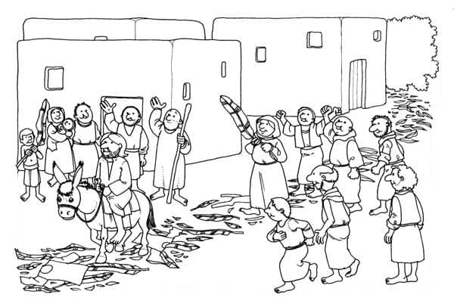
Jesus entered Jerusalem
Blessed is He who comes in the name of the Lord.
Jesus Saves!
Jesus Delivers!
Hosanna!
Save us. Deliver us.
Who is this?
This is Jesus, the prophet from Nazareth in Galilee.
Matthew 21
¹⁰ When Jesus entered Jerusalem, the whole city was stirred and asked, ‘Who is this?’
¹¹ The crowds answered, ‘This is Jesus, the prophet from Nazareth in Galilee.’

Slide 21

What is your response? Do you accept Jesus as the Savior? How has Jesus delivered you?
Psalms
146

Slide 22
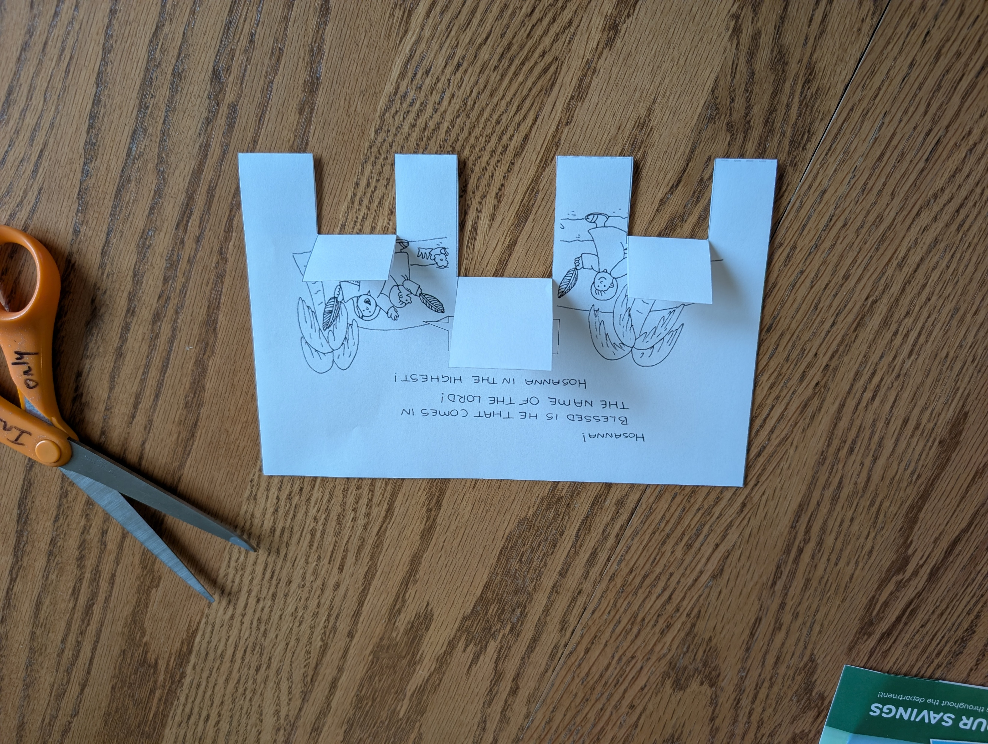
Craft Time -- Card with Pop-up figures
Directions:
Color the pictures
Fold this page in half so that you can see the picture and lines
Cut on the solid straight lines.
Fold on the dotted lines

Slide 23
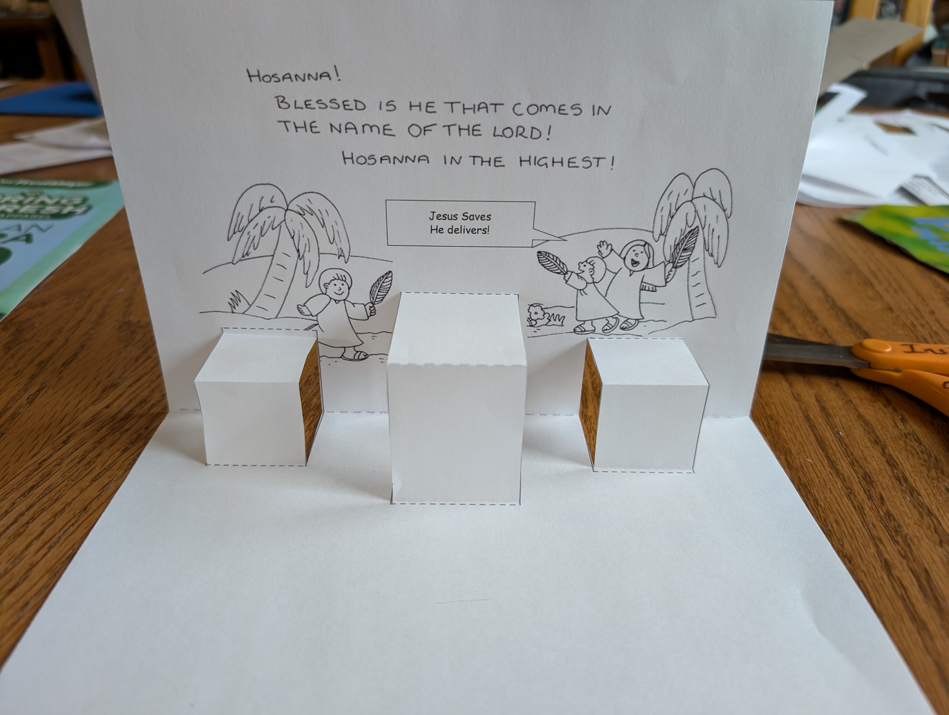
Craft Time -- Card with Pop-up figures
Directions:
Color the pictures
Fold this page in half so that you can see the picture and lines
Cut on the solid straight lines.
Fold on the dotted lines
Now take the back half of the page and fold it to the front.
Fold the tabs as shown
This is the inside of the card.

Slide 24
Craft Time -- Card with Pop-up figures
Directions:
Color the pictures
Fold this page in half so that you can see the picture and lines
Cut on the solid straight lines.
Fold on the dotted lines
Now take the back half of the page and fold it to the front.
Fold the tabs as shown
This is the inside of the card.
The Hosanna palm is the outside of the card.
Glue the inside to the outside. Make sure the words of the outside are glued to the back of the words on the front.
Hosanna!
Lord save us!

Slide 25
Craft Time -- Card with Pop-up figures
Directions:
Color the pictures
Fold this page in half so that you can see the picture and lines
Cut on the solid straight lines.
Fold on the dotted lines
Now take the back half of the page and fold it to the front.
Fold the tabs as shown
This is the inside of the card.
The Hosanna palm is the outside of the card.
Glue the inside to the outside. Make sure the words of the outside are glued to the back of the words on the front.
Glue the figures on the tabs as shown.
You can add a message at the bottom . You could also add a pathway, cloaks, flowers, etc.
Happy Easter

Slide 26
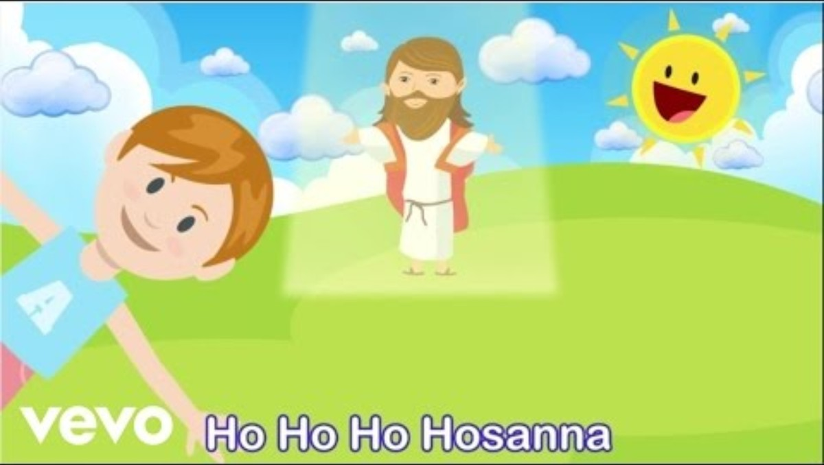
Ho Ho Hosanna

Slide 27
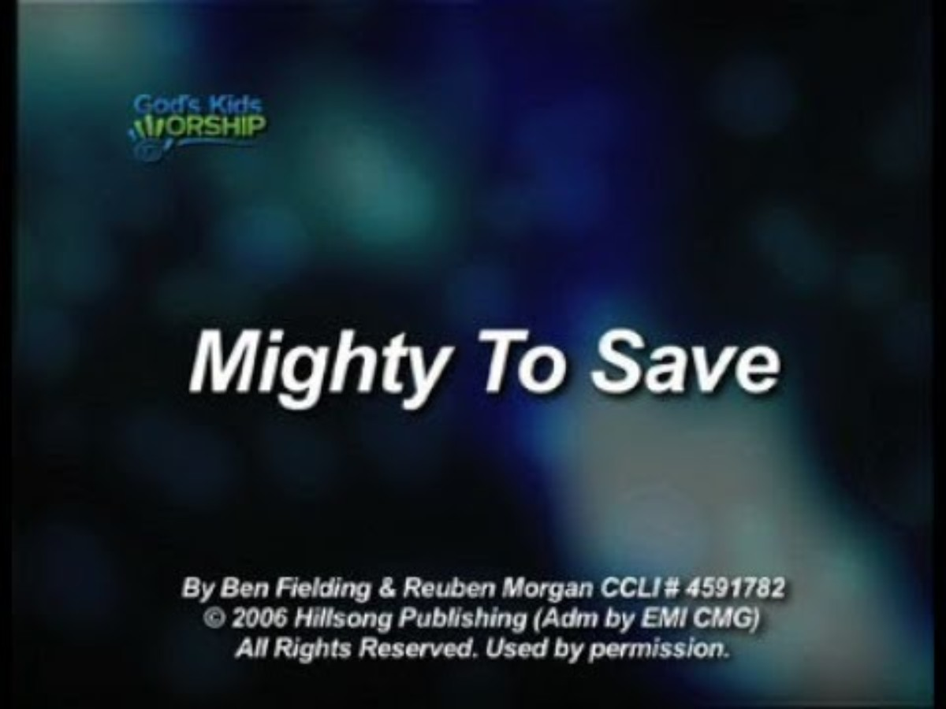
Mighty to Save

Slide 28
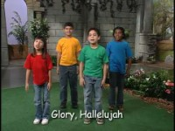
Sing with us King of Kings

Slide 29

Praise the Lord!

Slide 30

Object Lesson

Slide 31

The End

Slide 32
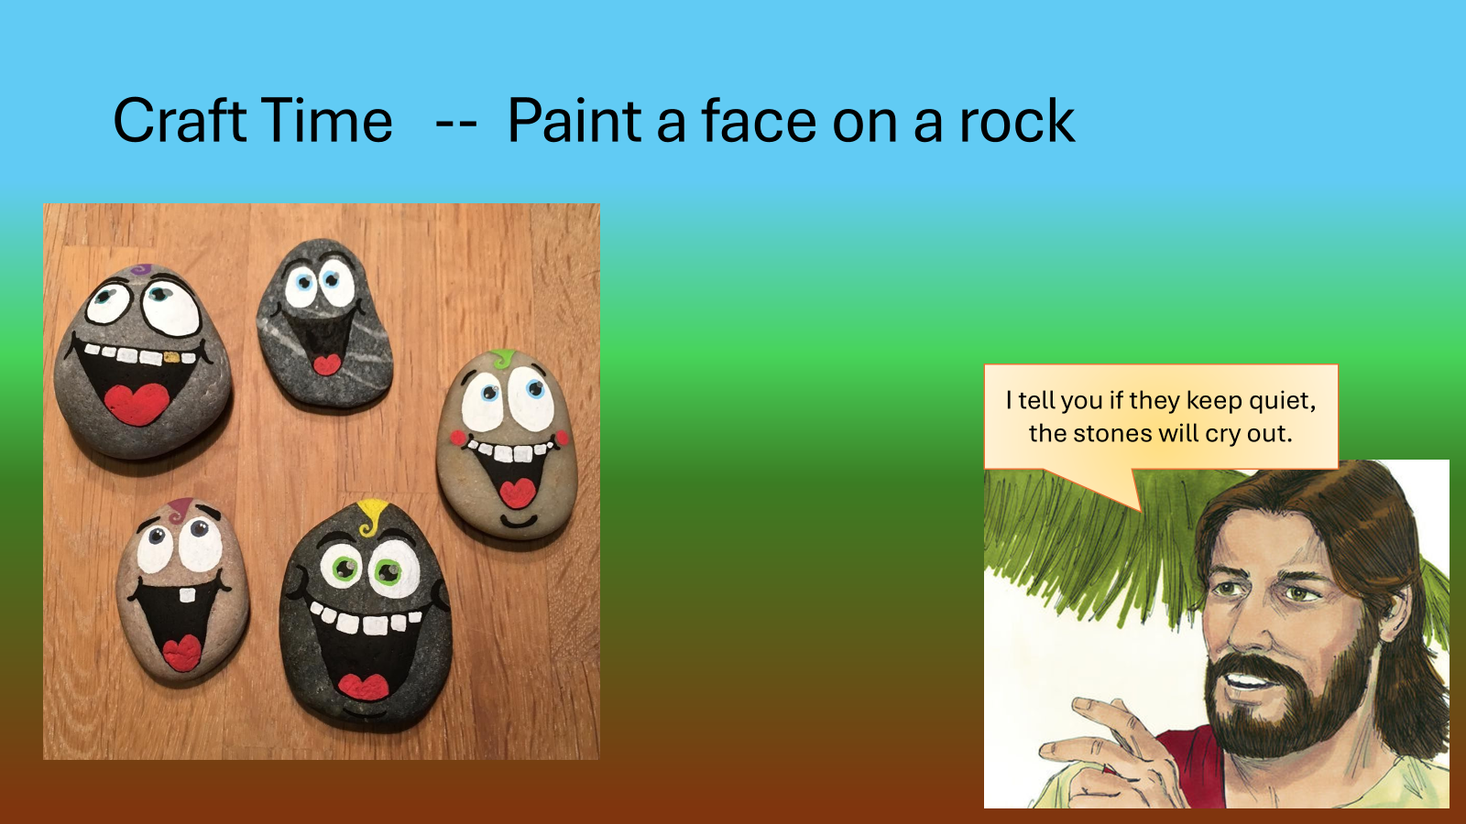
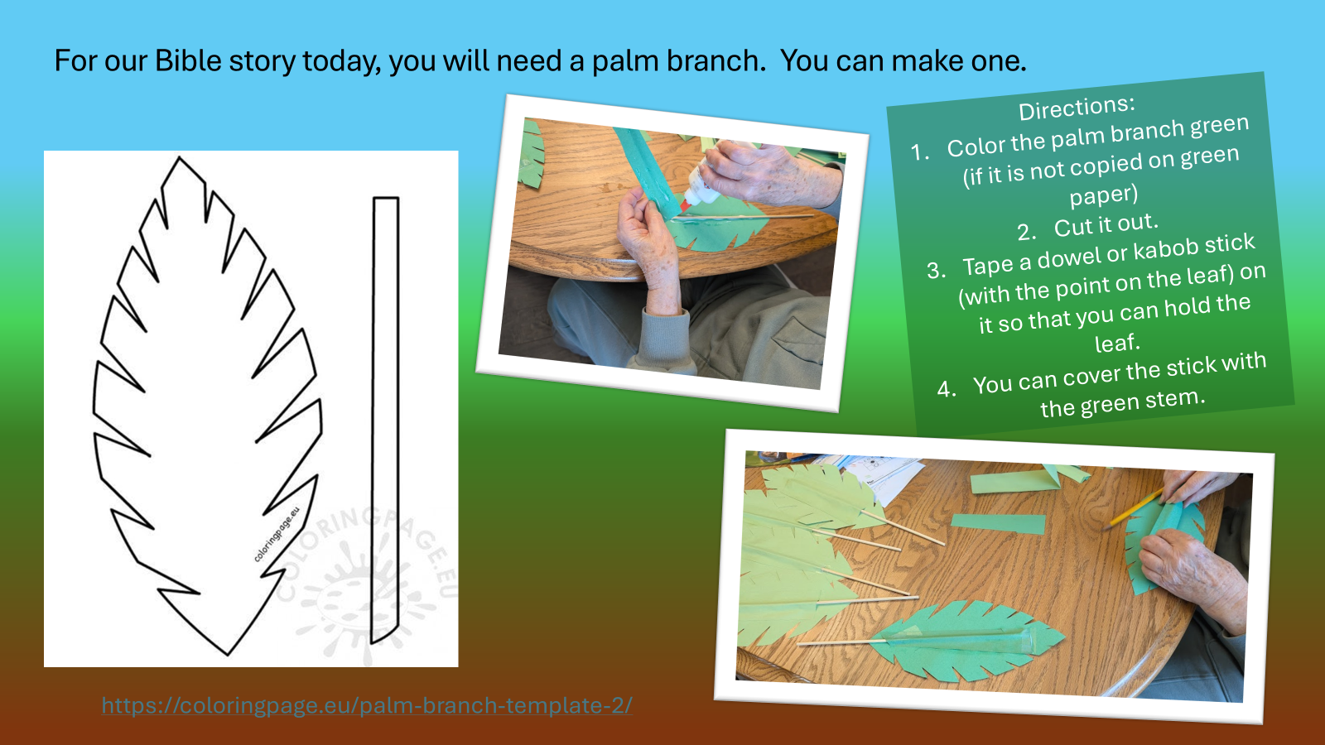
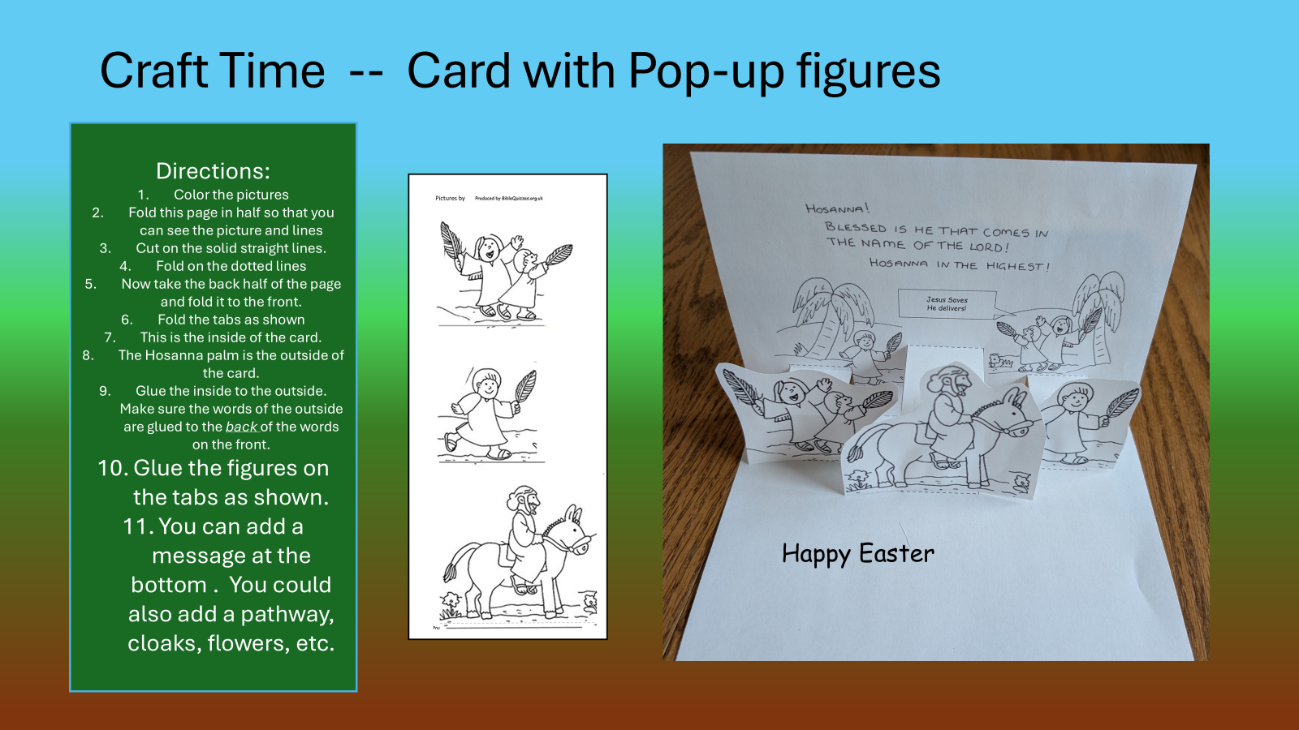
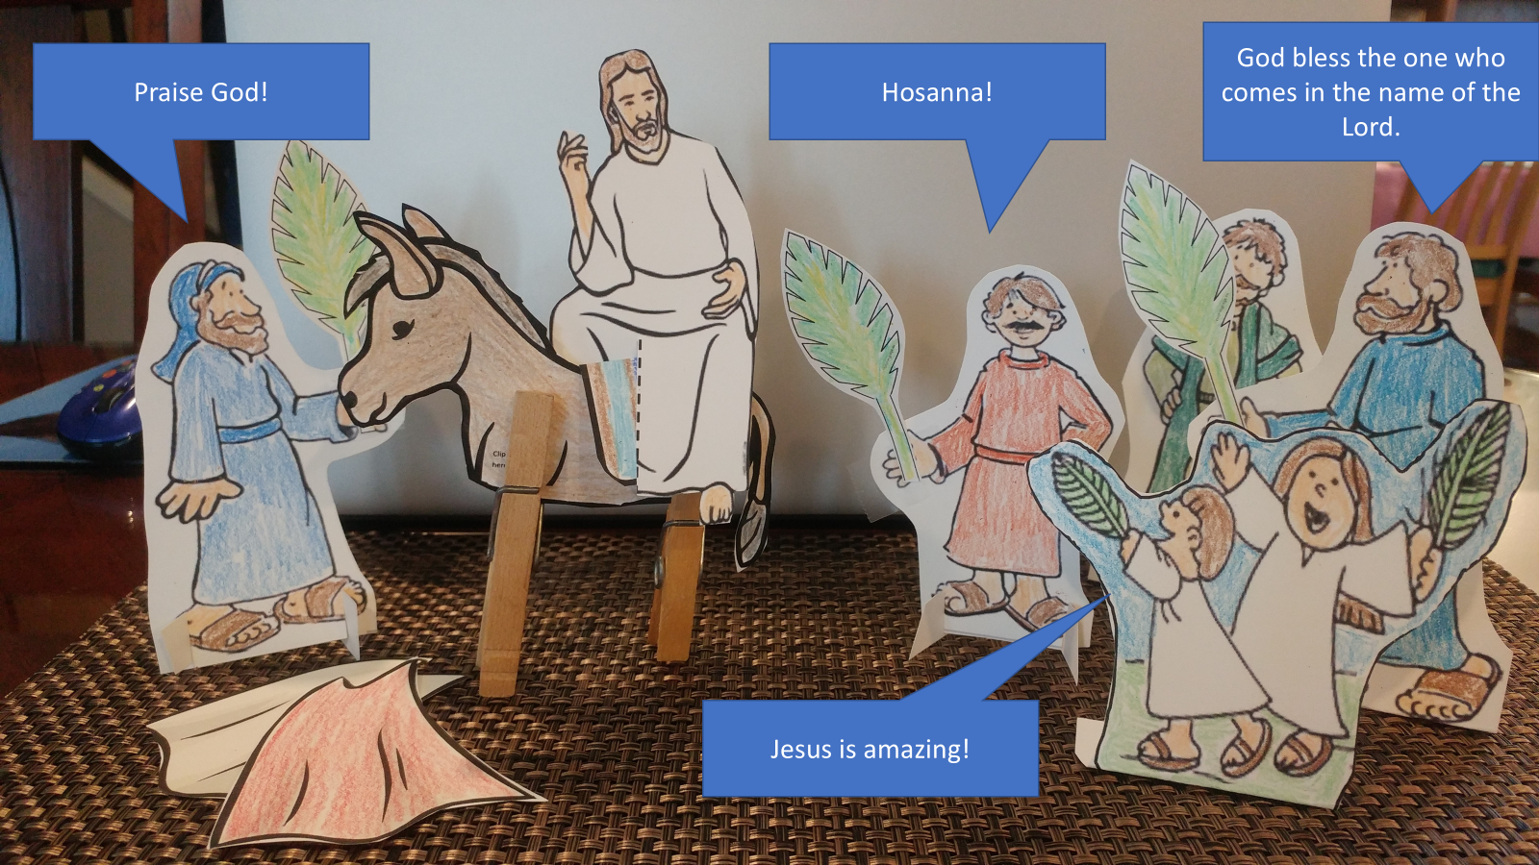
Craft Options
Palm Branches (or have them done already and put in trees for kids to get)
Painted Rocks
Card with pop-up figures
Stand up puppets

Slide 33
Craft Time -- Paint a face on a rock
I tell you if they keep quiet, the stones will cry out.

Slide 34



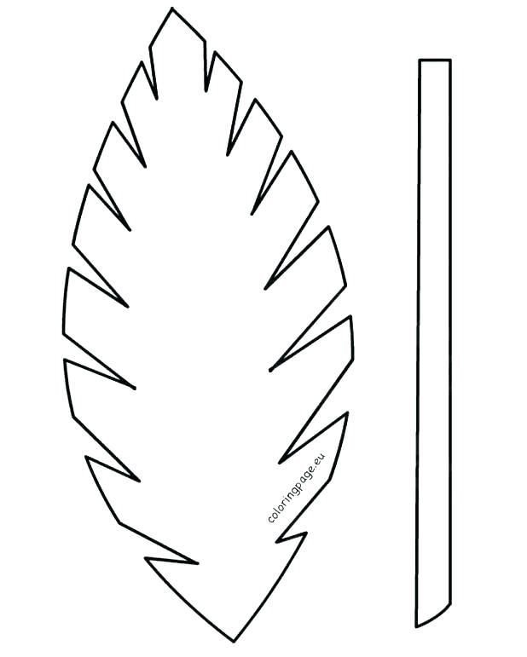
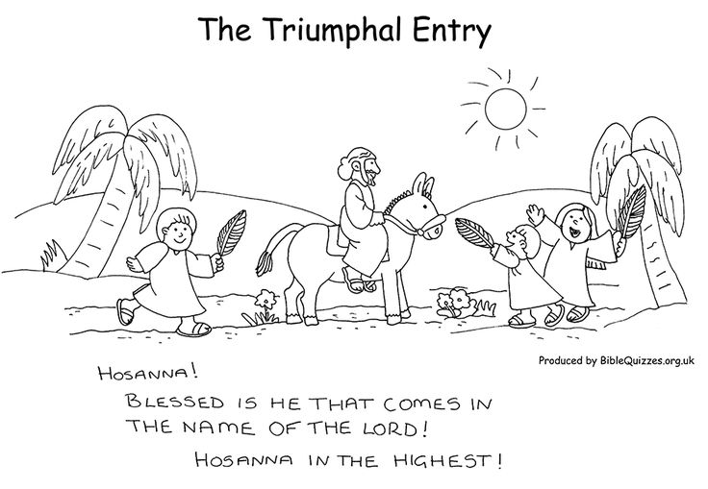
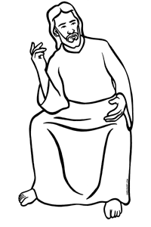
CRAFT TIME
Color
Cut out the figures
We will use the figures to retell the story.
Clip clothespin here
Clip clothespin here
RETELL STORY OPTION 1 –
ACTION FIGURES

Slide 35
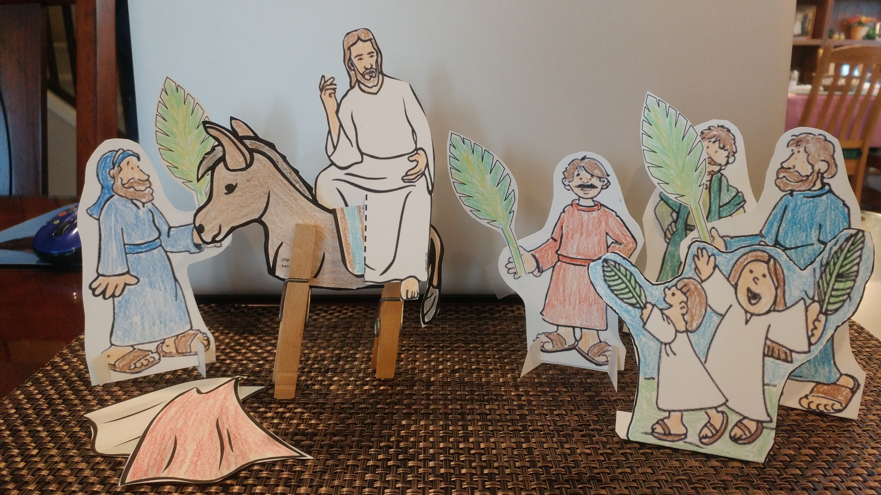
God bless the one who comes in the name of the Lord.
Praise God!
Hosanna!
Jesus is amazing!

