Slide 1
He is Alive!
Just as He said!
The Risen Lord visits the Disciples
Luke 24

Slide 2
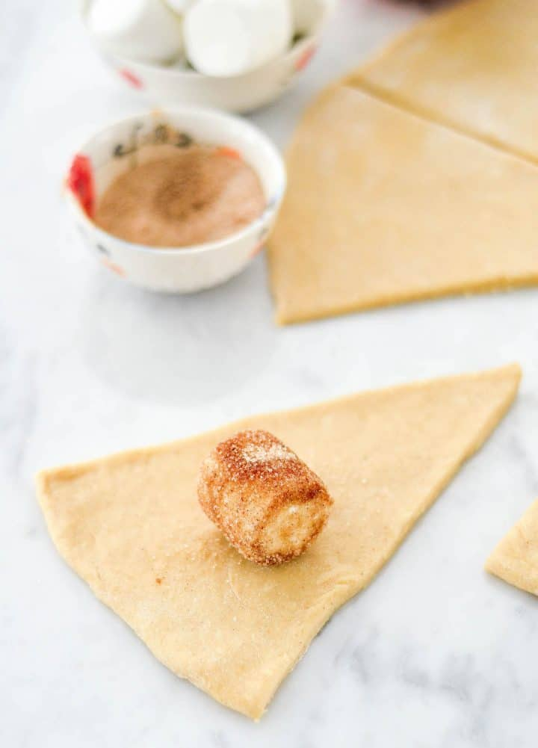
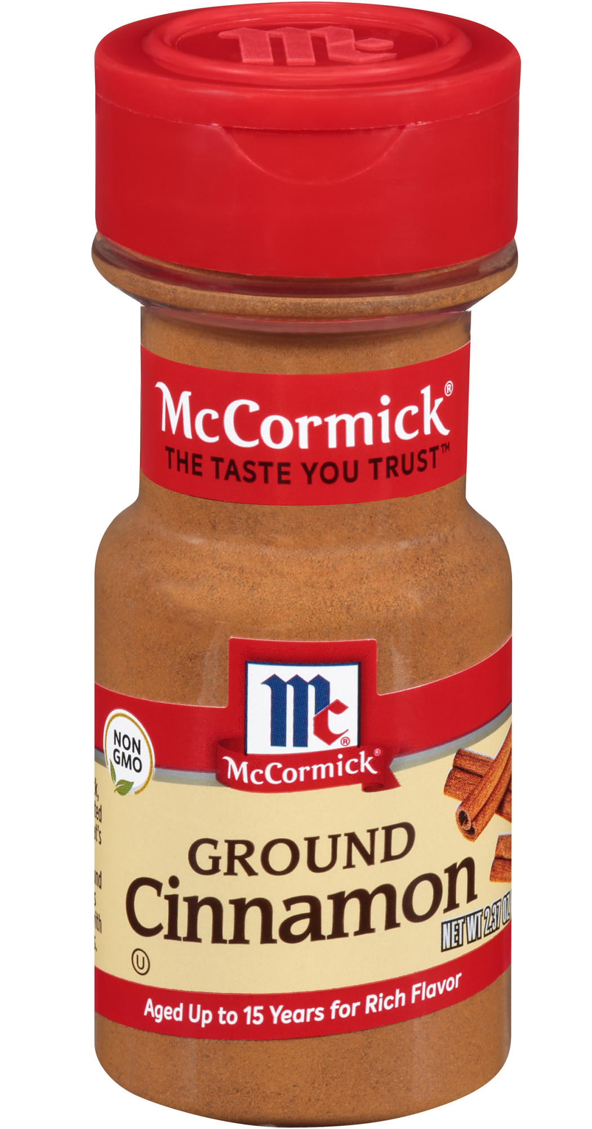
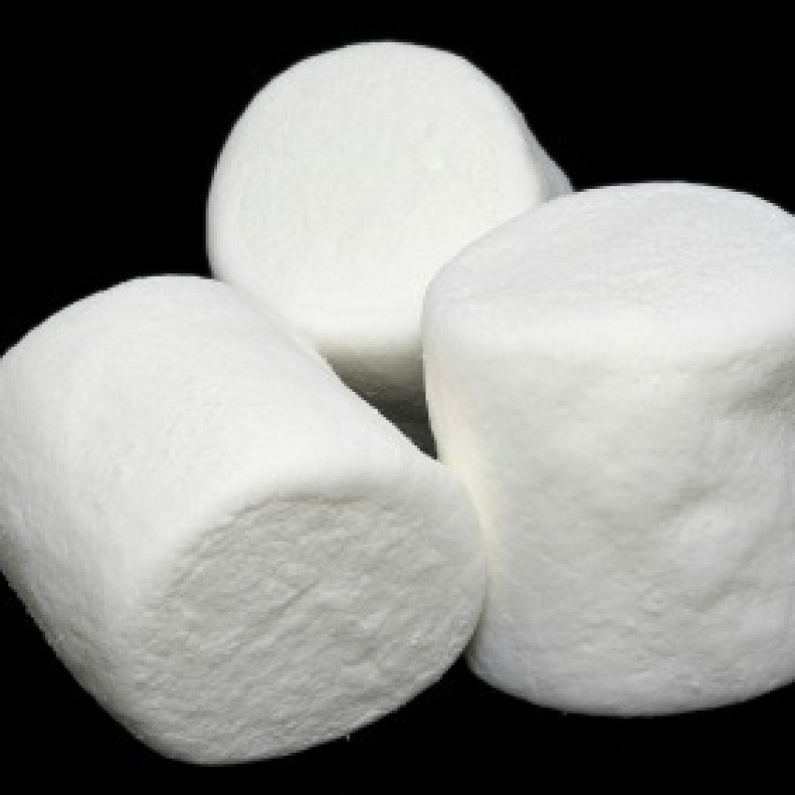
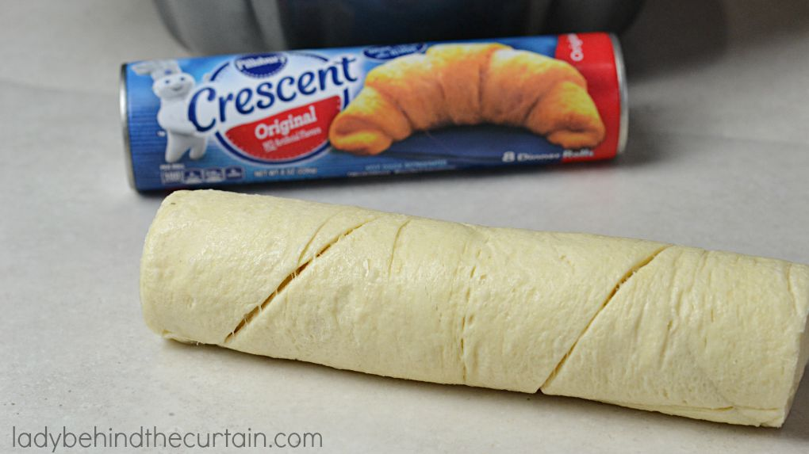
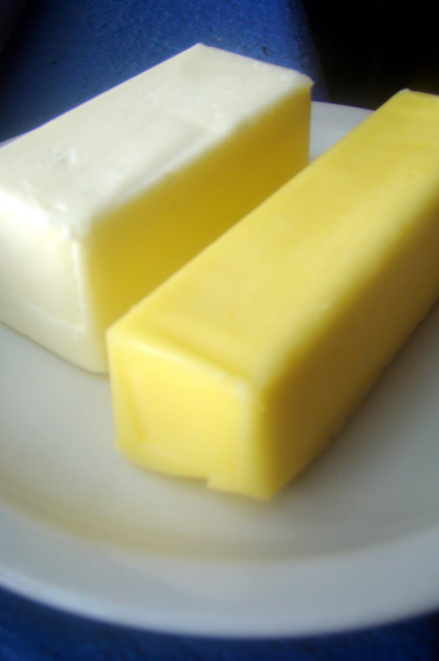
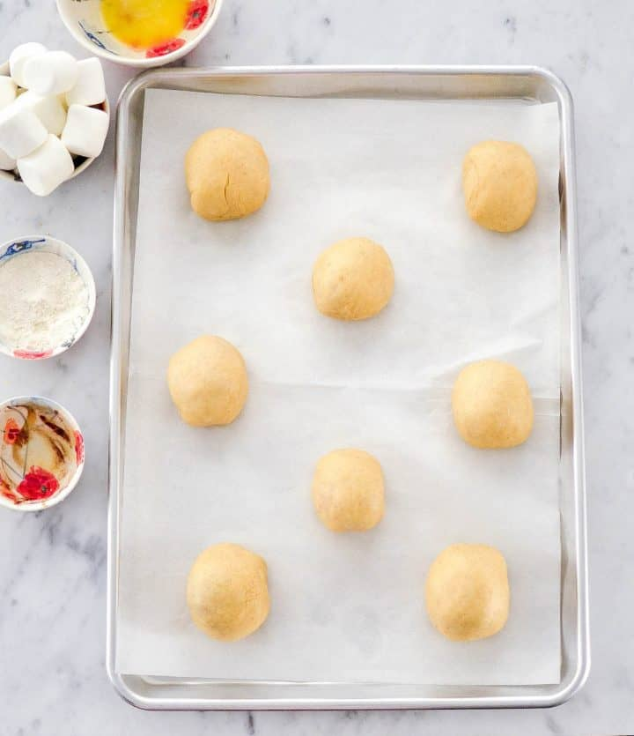
Today we are going to make Resurrection Rolls.
You need:
Marshmallow
Croissant bread
Melted butter/margarine
Cinnamon spice
Roll the marshmallow in butter and then in spice
Wrap a Croissant around the marshmallow. Make sure it is totally covered!
Remember how Jesus died and then they wrapped him in spices and cloths and laid him in the tomb.
While you make yours, I will read John 19:38-42
Homemade recipe at https://joyfoodsunshine.com/homemade-resurrection-rolls/

Slide 3
Make your resurrection roll and put it on a pan
Jesus was crucified and died
^{John 19:38} Later Joseph asked Pilate for Jesus’ body. Joseph was from the town of Arimathea. He was a follower of Jesus. But he followed Jesus secretly because he was afraid of the Jewish leaders. After Pilate gave him permission, Joseph came and took the body away. ³⁹ Nicodemus went with Joseph. He was the man who had earlier visited Jesus at night. Nicodemus brought some mixed spices that weighed about 75 pounds. ⁴⁰ The two men took Jesus’ body. They wrapped it in strips of linen cloth, along with the spices. That was the way the Jews buried people. ⁴¹ At the place where Jesus was crucified, there was a garden. A new tomb was there. No one had ever been put in it before. ⁴² That day was the Jewish Preparation Day, and the tomb was nearby. So they placed Jesus there.
Write your name next to your roll.
Bake according to directions.
While they are baking let’s ….

Slide 4
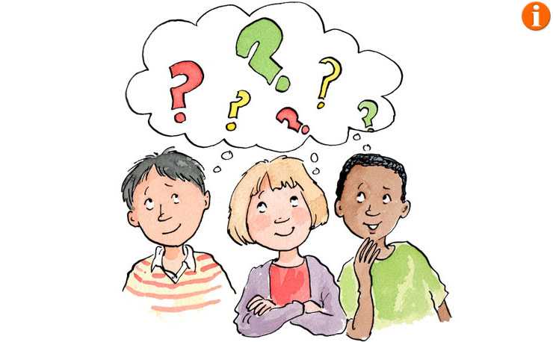
Who said it?
Can you guess who is talking?
In a minute everyone close your eyes.
When I touch your shoulder you can tell us something you did this week.
We’ll try to guess who said it.

Slide 5
Who said it?
Who do you think said this?

Slide 6

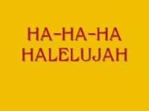
Gift from God
To you!

Slide 7
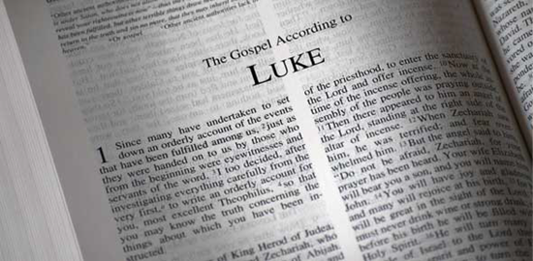
You can find our story today in
Luke 24
Let’s read Luke 24:6-7

Slide 8
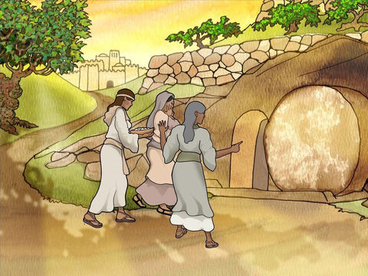
Early Sunday morning the women went to the tomb….
REMEMBER
24 Very early on the first day of the week, the women came to the tomb where Jesus’ body was laid. They brought the spices they had prepared.
² They found that the stone had been rolled away from the entrance of the tomb. ³ They went in, but they did not find the body of the Lord Jesus.

Slide 9
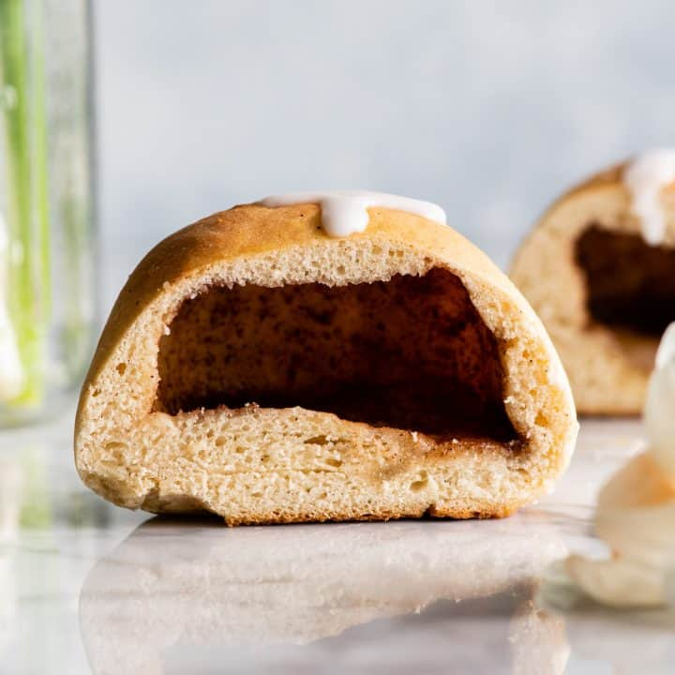
The tomb is empty!
Our Resurrection Rolls are baked and ready!
You may take a bite.
What do you see inside?

Slide 10
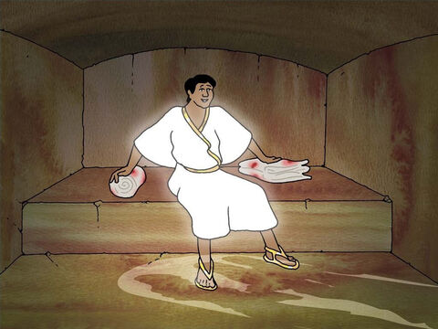
Where is Jesus?
REMEMBER
Why are you looking for Jesus among the dead?
He has risen
like He said!
⁴ While they were wondering about this, two men in shining clothes suddenly stood beside them.
⁵ The women were very afraid; they bowed their heads to the ground. The men said to the women, “Why are you looking for a living person here? This is a place for the dead. ⁶ Jesus is not here. He has risen from death! Do you remember what he said in Galilee? ⁷ He said that the Son of Man must be given to evil men, be killed on a cross, and rise from death on the third day.” ⁸ Then the women remembered what Jesus had said.

Slide 11
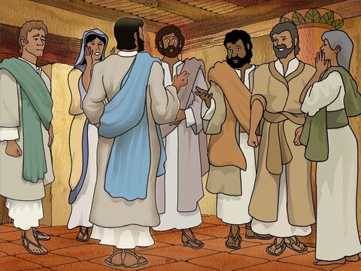
Guess what we saw!
⁹ The women left the tomb and told all these things to the 11 apostles and the other followers. ¹⁰ These women were Mary Magdalene, Joanna, Mary the mother of James, and some other women. The women told the apostles everything that had happened at the tomb. ¹¹ But they did not believe the women. It sounded like nonsense.

Slide 12
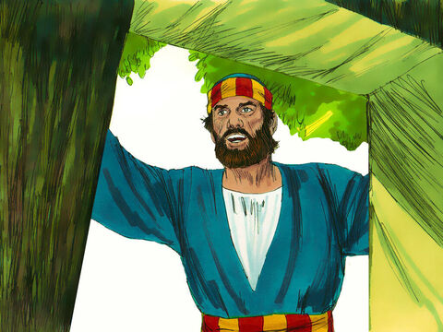
What happened?
Where is Jesus?
What happened?
¹² But Peter got up and ran to the tomb. He looked in, but he saw only the cloth that Jesus’ body had been wrapped in. Peter went away to be alone, wondering about what had happened.

Slide 13
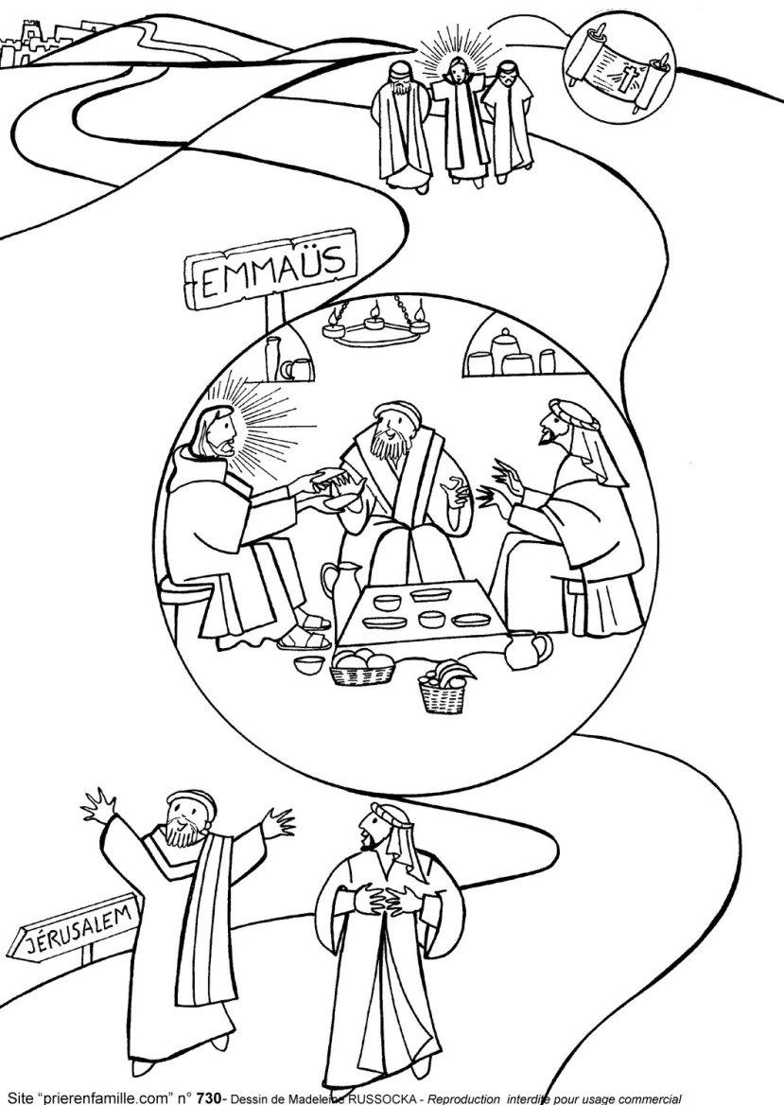
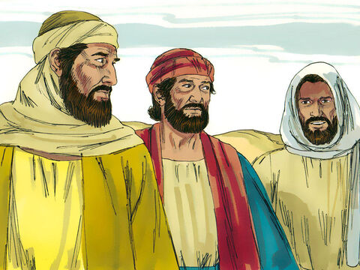
Do you want to act out the story, color or look and listen?
I followed Jesus
I am Cleopas
I am Jesus

Slide 14
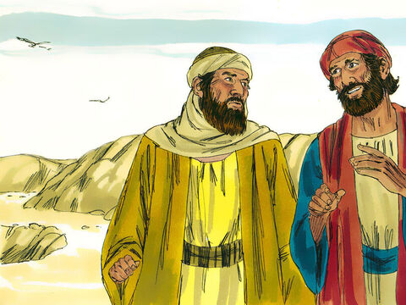
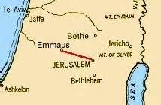
Jesus walked with two of his friends
The ladies and Peter went to the tomb and it was empty.
Where is Jesus?
What happened?
I thought Jesus was the Messiah, but then he was crucified.
Why didn’t he save himself?
I don’t know.
¹³ That same day two of Jesus’ followers were going to a town named Emmaus. It is about seven miles from Jerusalem.
¹⁴ They were talking about everything that had happened.
I don’t know.

Slide 15
Jesus walked with two of his friends
What are you talking about?
¹⁵ While they were discussing these things, Jesus himself came near and began walking with them. (but they didn’t recognize him)
¹⁷ Jesus asked them, “What are you talking about as you walk along?”

Slide 16
Jesus walked with two of his friends
You must be the only one in Jerusalem that doesn’t know what has happened!
What things?
They stood still, and their faces were sad. ¹⁸ One of them was named Cleopas. He said to Jesus, “Are you the only person visiting Jerusalem who doesn’t know? Don’t you know about the things that have happened there in the last few days?”
¹⁹ “What things?” Jesus asked.
“About Jesus of Nazareth,” they replied. “He was a prophet. He was powerful in what he said and did in the sight of God and all the people. ²⁰ The chief priests and our rulers handed Jesus over to be sentenced to death. They nailed him to a cross. ²¹ But we had hoped that he was the one who was going to set Israel free. Also, it is the third day since all this happened. ²² Some of our women amazed us too. Early this morning they went to the tomb. ²³ But they didn’t find his body. So they came and told us what they had seen. They saw angels, who said Jesus was alive. ²⁴ Then some of our friends went to the tomb. They saw it was empty, just as the women had said. They didn’t see Jesus’ body there.”

Slide 17
“About Jesus of Nazareth,” they replied. “He was a prophet. He was powerful in what he said and did in the sight of God and all the people. ²⁰ The chief priests and our rulers handed Jesus over to be sentenced to death. They nailed him to a cross. ²¹ But we had hoped that he was the one who was going to set Israel free. Also, it is the third day since all this happened. ²² Some of our women amazed us too. Early this morning they went to the tomb. ²³ But they didn’t find his body. So they came and told us what they had seen. They saw angels, who said Jesus was alive. ²⁴ Then some of our friends went to the tomb. They saw it was empty, just as the women had said. They didn’t see Jesus’ body there.”
Jesus was crucified.
This is the 3rd day.
This morning some women told us the tomb was empty!
Others went and saw it too.
You are slow to understand.

Slide 18
Jesus walked with two of his friends
Didn’t the Messiah have to suffer all these things and then receive his glory?
Listen to what is written in the Bible….
²⁵ Jesus said to them, “How foolish you are! How long it takes you to believe all that the prophets said! ²⁶ Didn’t the Messiah have to suffer these things and then receive his glory?” ²⁷ Jesus explained to them what was said about himself in all the Scriptures. He began with Moses and all the Prophets.

Slide 19
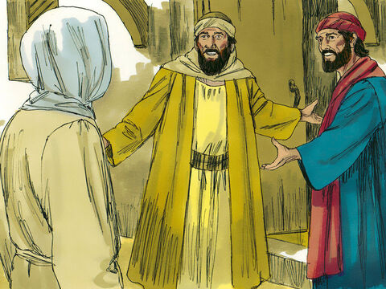
It’s late.
Please stay with us!
Please stay with us.
It’s getting late.
Come eat with us.
²⁸ They approached the village where they were going. Jesus kept walking as if he were going farther. ²⁹ But they tried hard to keep him from leaving. They said, “Stay with us. It is nearly evening. The day is almost over.” So he went in to stay with them.

Slide 20
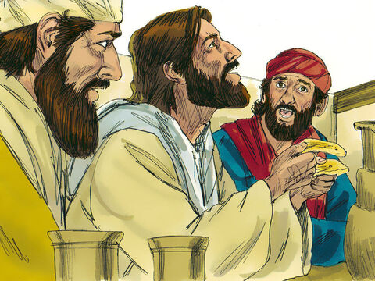
It’s Jesus!
³⁰ He joined them at the table. Then he took bread and gave thanks. He broke it and began to give it to them. ³¹ Their eyes were opened, and they recognized him. But then he disappeared from their sight.

Slide 21
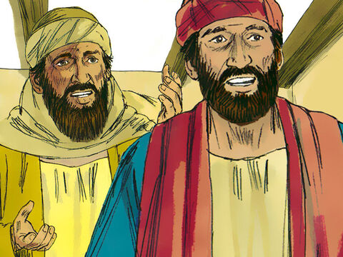
We must go tell the others!
Jesus is alive!
Quickly, we must go tell the others!
He explained what the scriptures meant!
³² They said to each other, “He explained to us what the Scriptures meant. Weren’t we excited as he talked with us on the road?”
³³ They got up and returned at once to Jerusalem.
They ran 7 miles
Back to Jerusalem

Slide 22
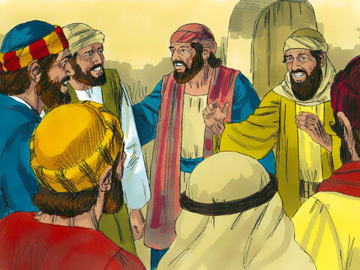
It’s true! It’s true!
Jesus is alive! We saw him!
He broke the bread!
He explained what the scriptures meant!
³² They said to each other, “He explained to us what the Scriptures meant. Weren’t we excited as he talked with us on the road?”
³³ They got up and returned at once to Jerusalem.
There they found the 11 disciples and those with them. They were all gathered together. ³⁴ They were saying, “It’s true! The Lord has risen! He has appeared to Simon!”
³⁵ Then the two of them told what had happened to them on the way. They told how they had recognized Jesus when he broke the bread.
It is true! The Lord has appeared to Simon Peter!

Slide 23
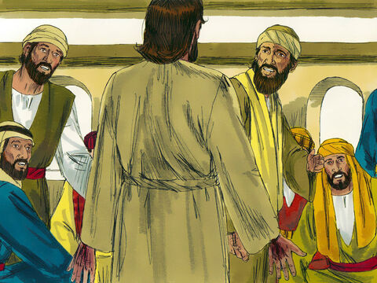
Jesus is alive
May you have peace.
Why are you confused?
Look it’s me!
See my hands and feet. Touch me.
³⁶ The disciples were still talking about this when Jesus himself suddenly stood among them. He said, “May you have peace!”
³⁷ They were surprised and terrified. They thought they were seeing a ghost. ³⁸ Jesus said to them, “Why are you troubled? Why do you have doubts in your minds? ³⁹ Look at my hands and my feet. It’s really me! Touch me and see. A ghost does not have a body or bones. But you can see that I do.”

Slide 24
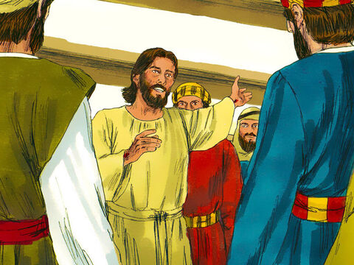
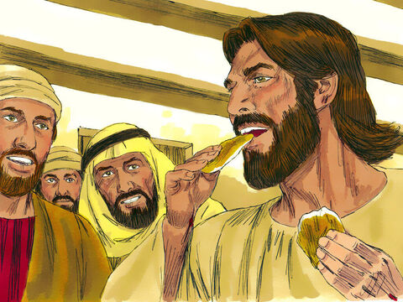
See. It’s really me!
⁴⁰ After he said that, he showed them his hands and feet. ⁴¹ But they still did not believe it. They were amazed and filled with joy.
So Jesus asked them, “Do you have anything here to eat?” ⁴² They gave him a piece of cooked fish. ⁴³ He took it and ate it in front of them.
Do you have something to eat?

Slide 25
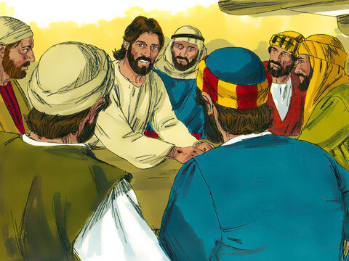
You are my witnesses
Let me help you understand. It’s just like it is written. The Messiah will suffer and then rise again on the 3rd day.
⁴⁴ Jesus said to them, “This is what I told you while I was still with you. Everything written about me in the Law of Moses, the Prophets and the Psalms must come true.”
⁴⁵ Then he opened their minds so they could understand the Scriptures. ⁴⁶ He told them, “This is what is written. The Messiah will suffer. He will rise from the dead on the third day.
⁴⁷ His followers will preach in his name. They will tell others to turn away from their sins and be forgiven. People from every nation will hear it, beginning at Jerusalem. ⁴⁸ You have seen these things with your own eyes.
⁴⁹ I am going to send you what my Father has promised. But for now, stay in the city. Stay there until you have received power from heaven.”
You are my witnesses.
Tell others that I died for their sins. They are forgiven.
But wait until I send you the Holy Spirit as I have promised to do.

Slide 26
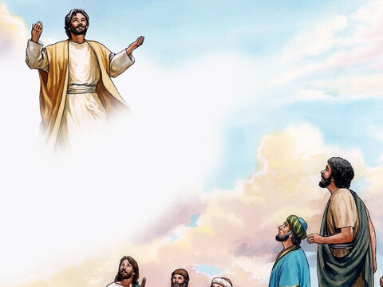
Bless you
⁵⁰ Jesus led his disciples out to the area near Bethany. Then he lifted up his hands and blessed them.
⁵¹ While he was blessing them, he left them. He was taken up into heaven.
⁵² Then they worshiped him. With great joy, they returned to Jerusalem. ⁵³ Every day they went to the temple, praising God.

Slide 27
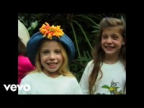
Praise God for His gift!

Slide 28
Gift from God
To you!

Slide 29

Praise God for His gift!

Slide 30
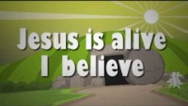
Praise God for His gift!

Slide 31
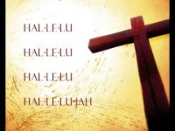
Gift from God
To you!

Slide 32

Praise God for His gift!

Slide 33
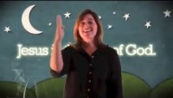
Praise God for His gift!

