Slide 1
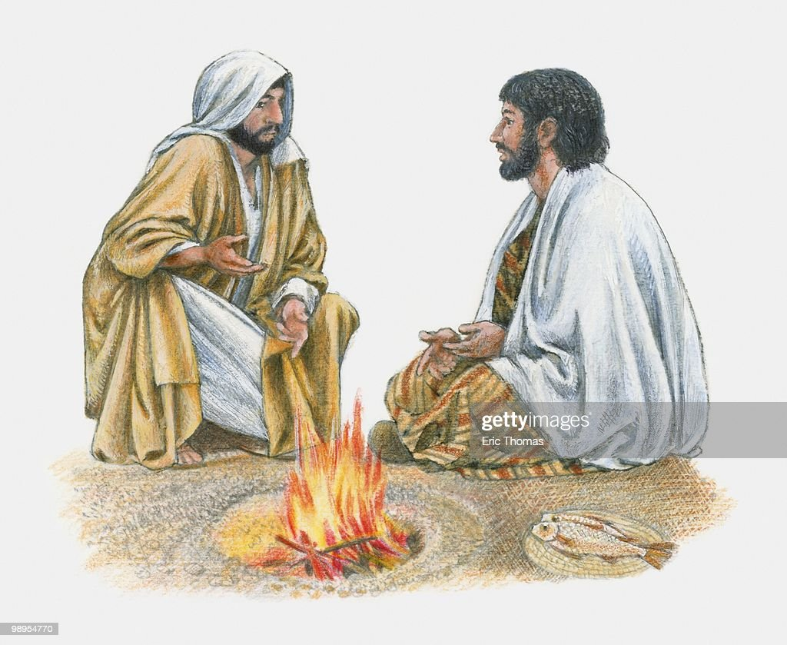
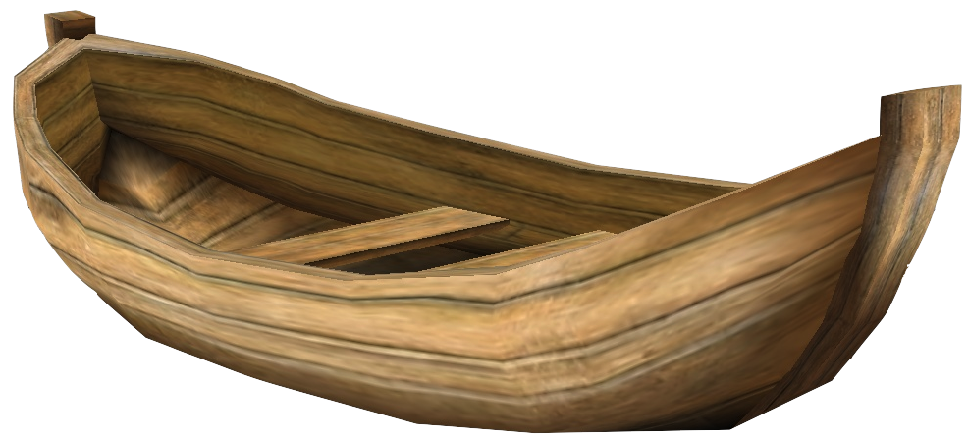
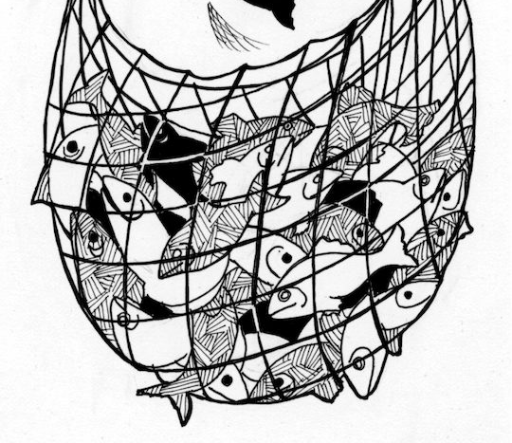
Breakfast by the Sea
John 21

Slide 2
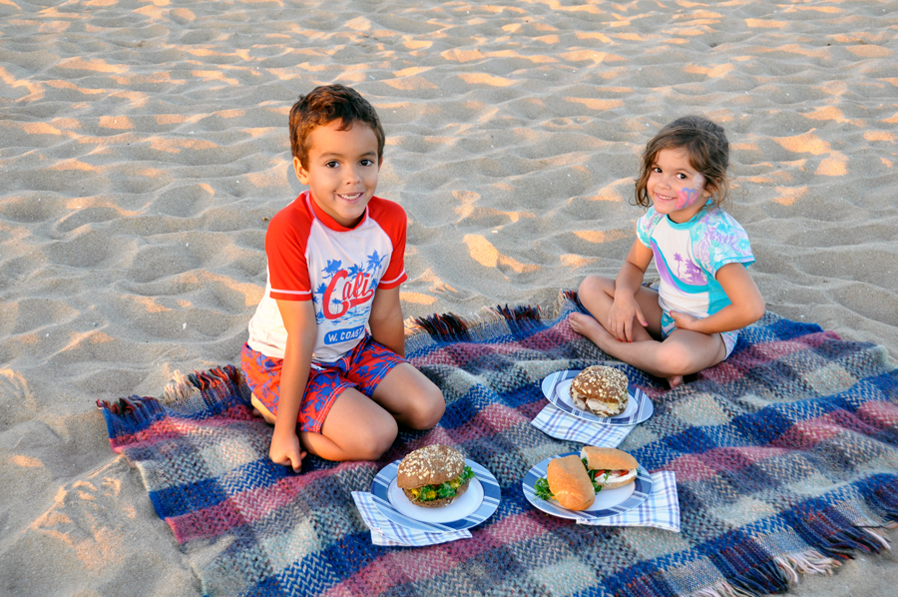
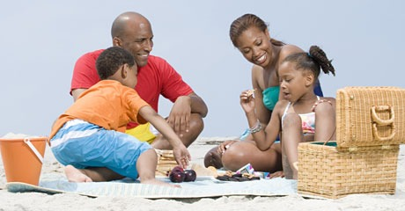
Have you ever had a picnic on a beach?
Tell me about it.

Slide 3

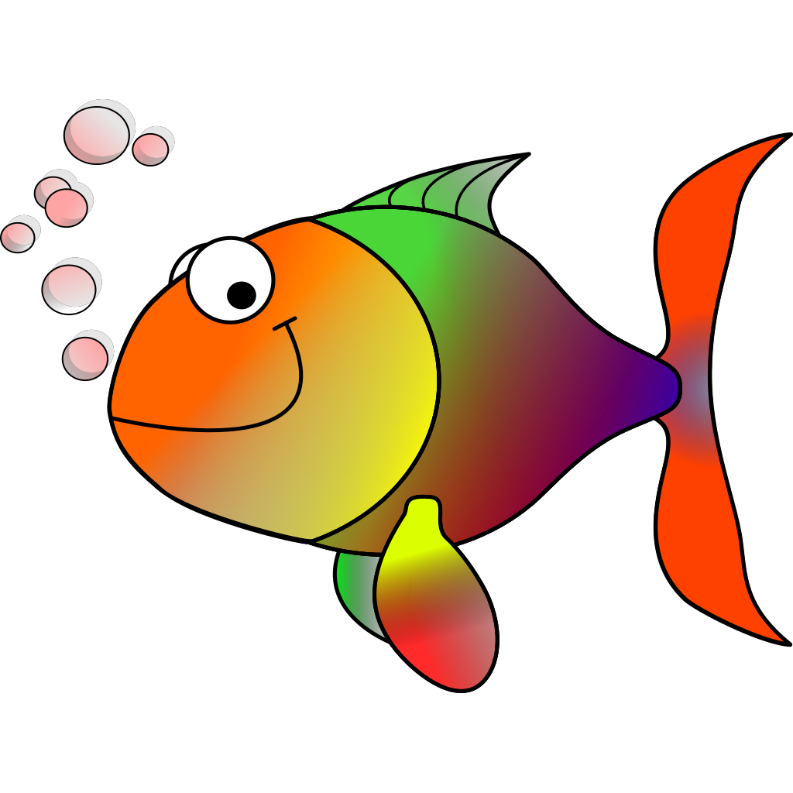

GAME TIME
Make 2 teams
Team 1 – Rainbow Fish Team Team 2 – Pufferfish Team

Slide 4

GAME TIME
RAINBOW FISH TEAM
QUESTION #1
During the Lord’s Supper, Jesus told His disciples to remember Him when they ate two things. What were they?
We eat them at communion.
Bread and grape juice

Slide 5
GAME TIME
PUFFERFISH TEAM
QUESTION # 2
During the Lord’s supper, Jesus washed the disciples
_ _ _ _
Feet

Slide 6
GAME TIME
RAINBOW FISH TEAM
QUESTION #3
During the Lord’s supper, Jesus said told one of His disciples that he would deny Him 3 times.
What was the disciple’s name?
Peter

Slide 7
GAME TIME
PUFFERFISH TEAM
QUESTION #4
In the Garden of Gethsemane, Jesus prayed, “Father God, is there another way? If it is possible to let this cup pass from me. But, Your _ _ _ _
_ _ _ _ _ _.
Your will be done

Slide 8
GAME TIME
RAINBOW FISH TEAM
QUESTION #5
In the Garden of Gethsemane, while Jesus prayed, what did the disciples do?
Sleep

Slide 9
GAME TIME
PUFFERFISH TEAM
QUESTION #6
The temple leaders and a disciples came and took Jesus. They wanted to kill him.
Who betrayed Jesus with a kiss and led the leaders to Jesus?
Judas

Slide 10
GAME TIME
RAINBOW FISH TEAM
QUESTION #7
While the leaders and Judas were getting Jesus, Peter took out his sword and cut off one of the servants’ _ _ _.
Jesus healed the servant.
What did Peter cut off?
ear

Slide 11
GAME TIME
PUFFERFISH TEAM
QUESTION #10
The leaders took Jesus to a courtyard. They were trying to find something Jesus did wrong. A servant saw Peter and said he was a disciple. Peter said, “No” How many times did he deny knowing Jesus?
Three times

Slide 12
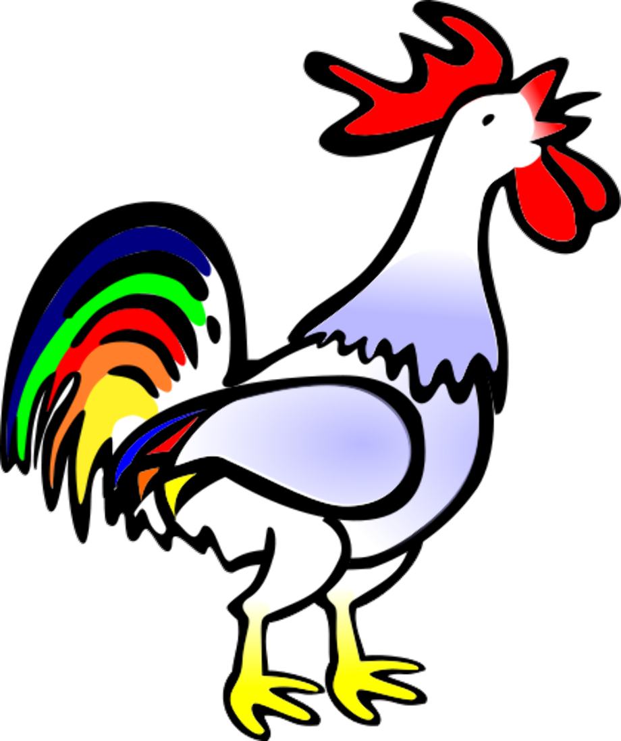
GAME TIME
RAINBOW FISH TEAM
QUESTION #11
Peter denied Jesus 3 times and then he heard something that reminded him that Jesus had told him that this would happen. What animal did he hear?
A rooster crowed!

Slide 13
GAME TIME
PUFFERFISH TEAM
QUESTION #12
Jesus was crucified. He died for you and me because He loves us. On what did He die?
Bonus: Where did He die?
On a cross
At Golgatha

Slide 14

Jesus is Alive!

Slide 15

Alive, Alive
The Stone’s Been Rolled Away

Slide 16
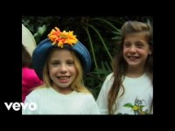
My Jesus is Alive

Slide 17

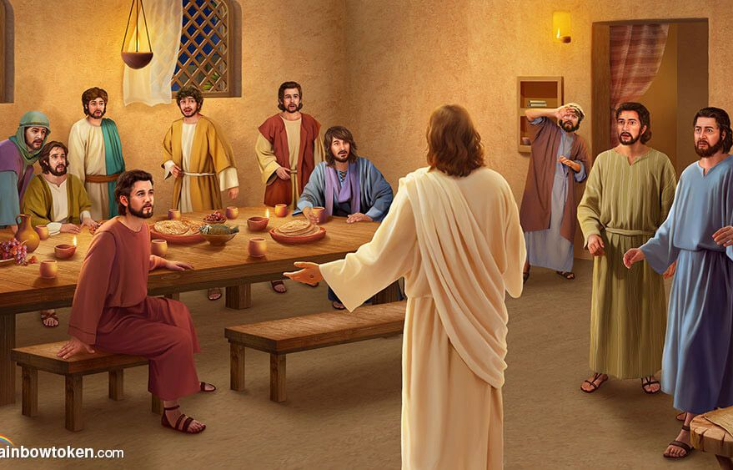
Let’s read more of what John wrote >>
God loves you!
We saw Jesus
We heard Him
We touched Him
We are witnesses that He is Alive!
He loves us all
He is with us all!
1 John 1
God is with you!
That which was from the beginning, (That’s Jesus!)
which we have heard,
which we have seen with our eyes, which we have looked at
and our hands have touched
—this we proclaim concerning the Word of life. (That’s Jesus!)
² The life appeared; we have seen it and testify to it,
and we proclaim to you the eternal life, (Jesus gives us eternal life!)
which was with the Father and has appeared to us.
³ We proclaim to you what we have seen and heard,
so that you also may have fellowship with us.
And our fellowship is with the Father and with his Son, Jesus Christ.

Slide 18
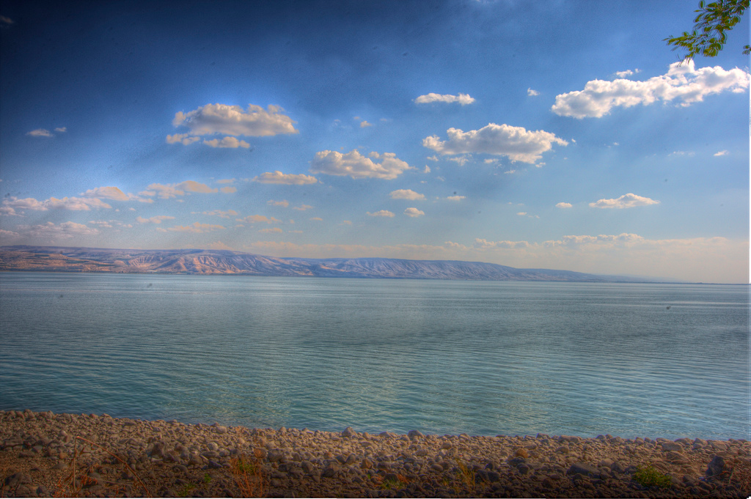
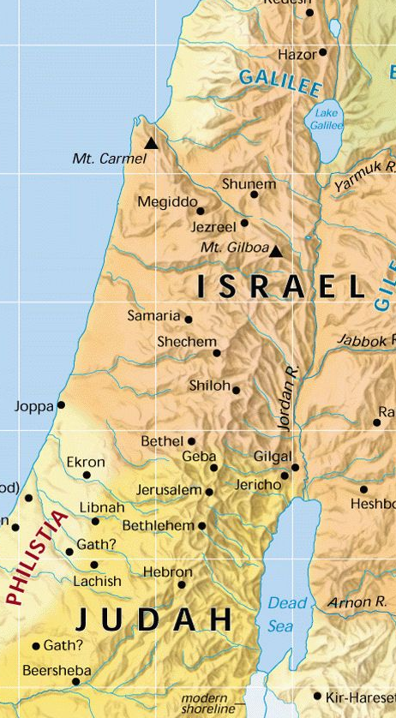
STORY TIME
Our story happens on the Lake of Galilee
after Jesus rose again and visited his disciples a couple times.

Slide 19
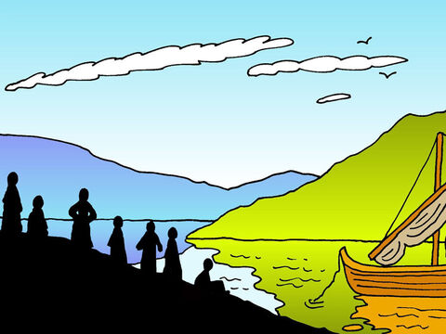
John 21
Let’s go fishing!
Afterward Jesus appeared again to his disciples, by the Sea of Galilee.^{[a]} It happened this way:
² Simon Peter, Thomas (also known as Didymus^{[b]}), Nathanael from Cana in Galilee, the sons of Zebedee, and two other disciples were together. ³ “I’m going out to fish,” Simon Peter told them, and they said, “We’ll go with you.” So they went out
I’m going fishing
We’ll come with you

Slide 20
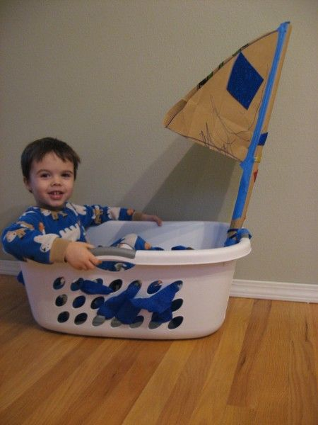
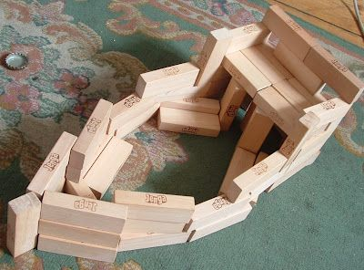
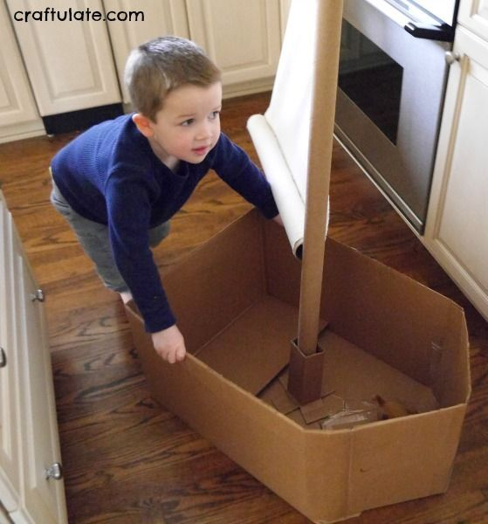
Make a boat and get inside.
Throw a net out. Let’s go fishing!

Slide 21
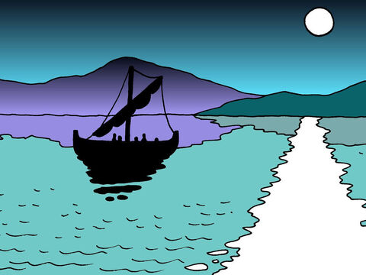
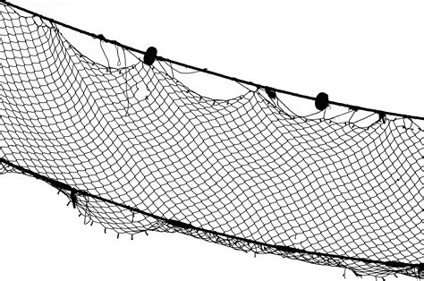
They fished all night
So, they went out and got into the boat, but that night they caught nothing.
Try fishing here.
NO FISH
Try fishing there.
On the right side.
Try fishing there.
On the left side.
NO FISH
NO FISH

Slide 22
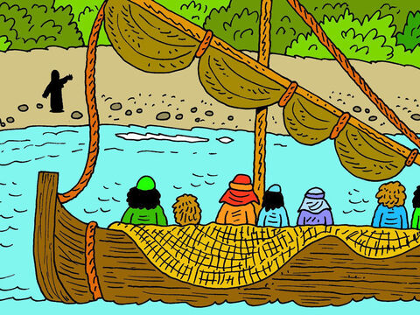
Hi friends!
Friends, Have you caught any fish?
⁴ Early in the morning, Jesus stood on the shore, but the disciples did not realize that it was Jesus.
⁵ He called out to them, “Friends, haven’t you any fish?”
“No,” they answered.
No! We haven’t

Slide 23
Throw your net on the right
Throw your net on the right side of the boat and you will find some.
⁶ He said, “Throw your net on the right side of the boat and you will find some.”

Slide 24
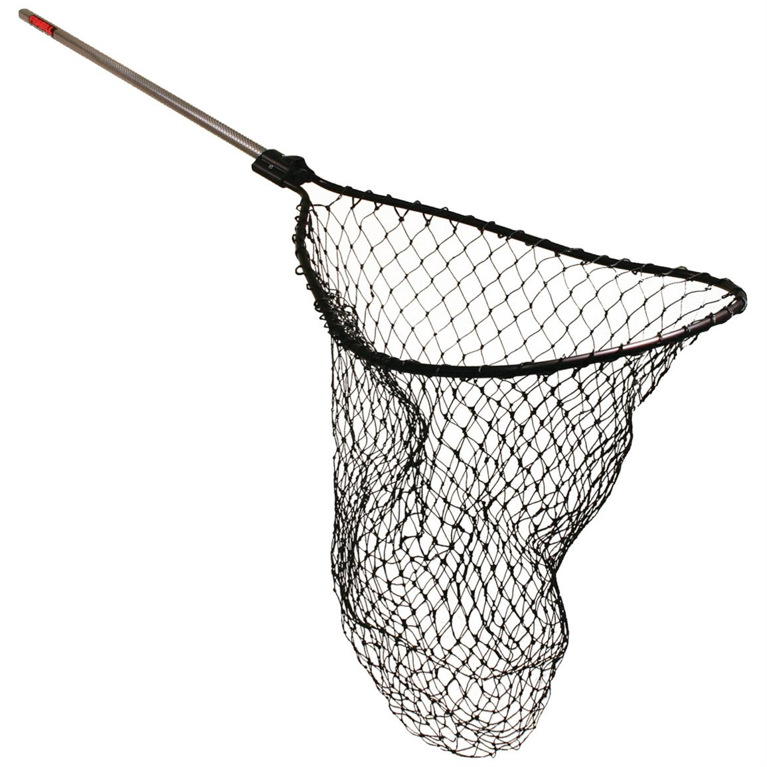
Follow Jesus’ directions.
Throw out your net on the right side.

Slide 25
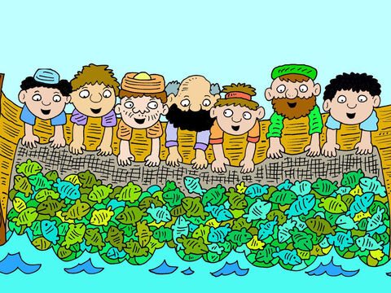
Throw your net on the right
WOW!
WOW!
WOW!
WOW!
When they did, they were unable to haul the net in because of the large number of fish.

Slide 26
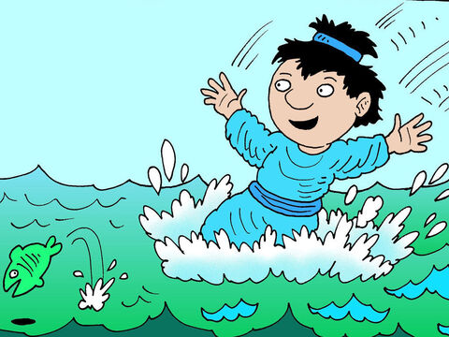

It is the LORD!
It is the LORD!
I must see Jesus!
⁷ Then the disciple whom Jesus loved said to Peter, “It is the Lord!”
As soon as Simon Peter heard him say, “It is the Lord,” he wrapped his outer garment around him (for he had taken it off) and jumped into the water.
⁸ The other disciples followed in the boat, towing the net full of fish, for they were not far from shore, about a hundred yards.

Slide 27
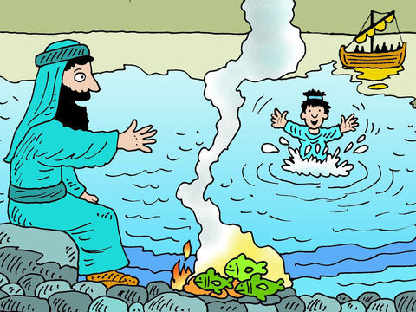
Bring some of your fish
Jesus!
Welcome!
⁹ When they landed, they saw a fire of burning coals there with fish on it, and some bread.
Breakfast is almost ready

Slide 28
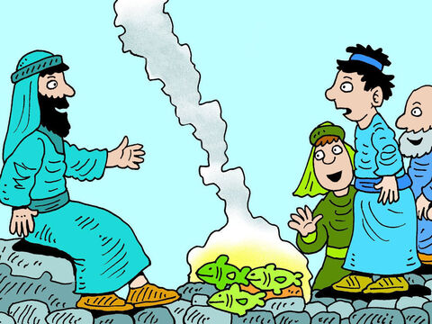
Bring some of your fish
OK!
Bring some of your fish
¹⁰ Jesus said to them, “Bring some of the fish you have just caught.” ¹¹ So Simon Peter climbed back into the boat and dragged the net ashore.

Slide 29
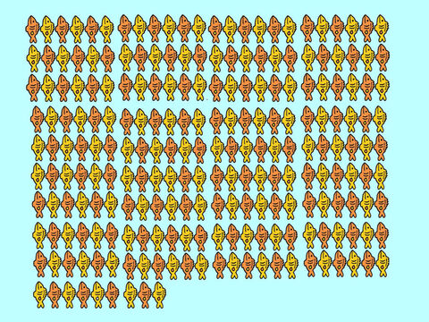
How many fish?
5 | 10 | 15 | 20
25 | 30 | 35 | 40
45 | 50 | 55 | 60
65 | 70 | 75 | 80
85 | 90 | 95 | 100
105 | 110 | 115 | 120
125 | 130 | 135 | 140
145 | 150 | 153
It was full of large fish, 153, but even with so many the net was not torn.

Slide 30
God is AMAZING! He can do AWESOME things!
God will take care of us!

Slide 31
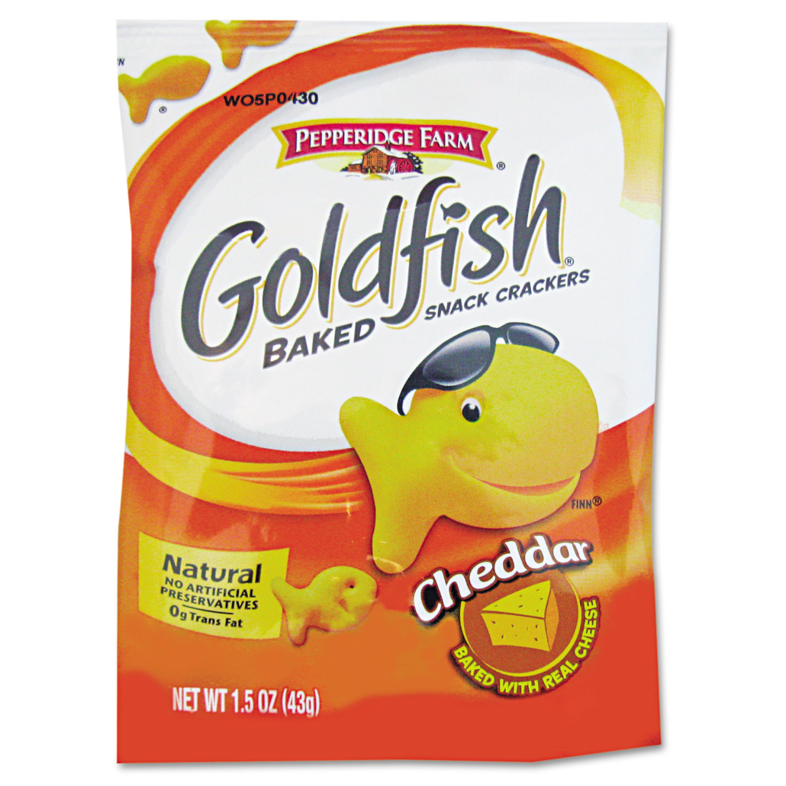
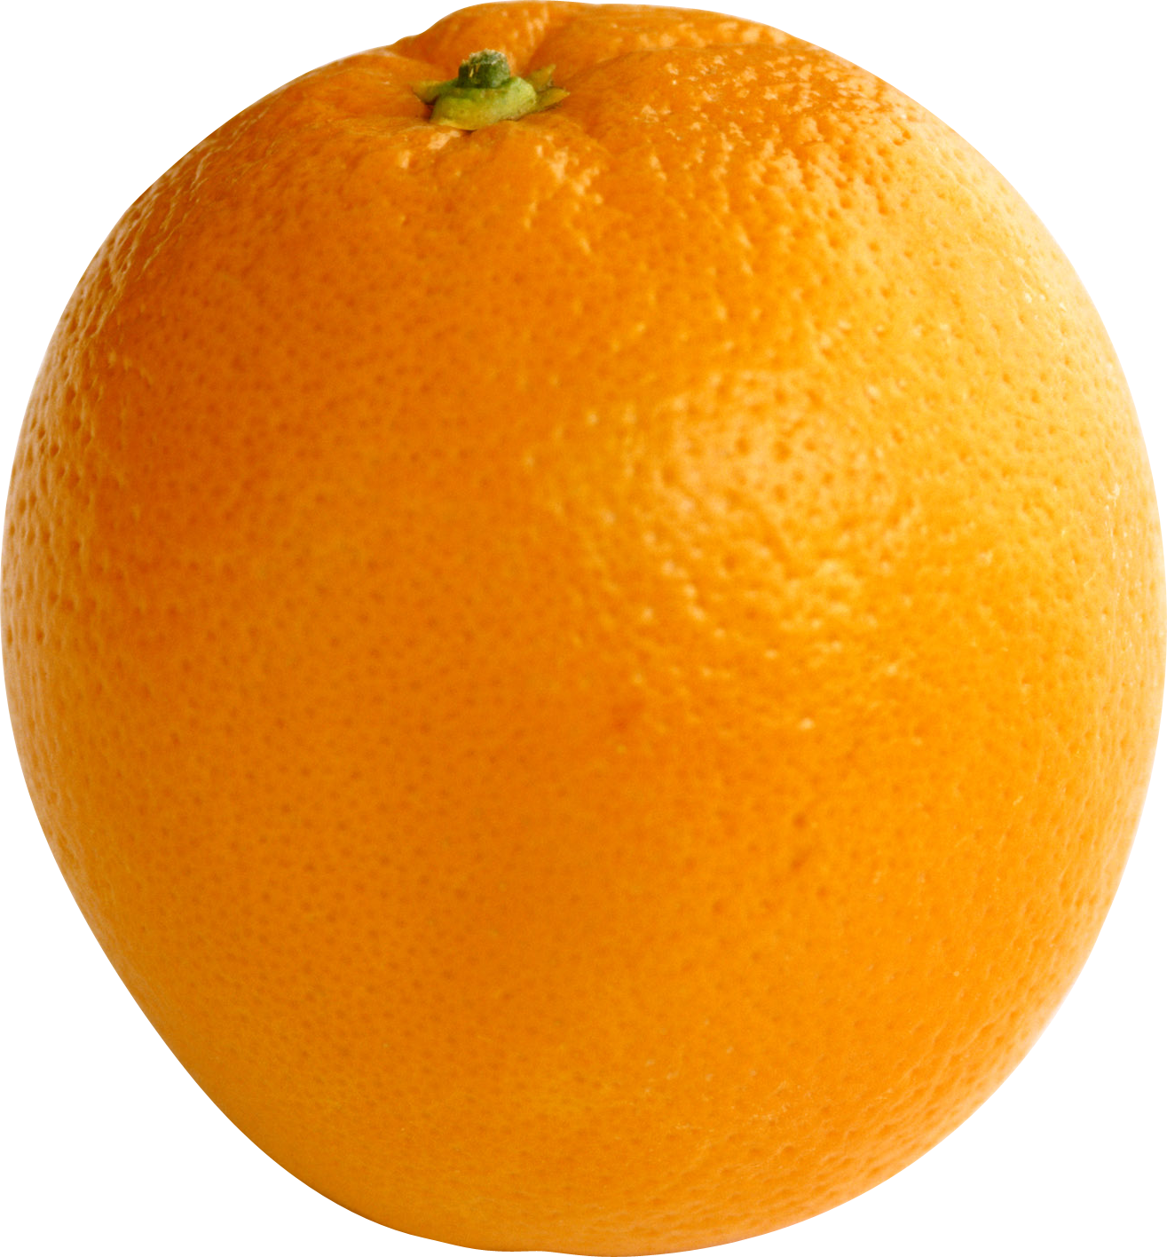
Come have breakfast
SNACK TIME!
Come have some breakfast!
SNACK TIME
¹² Jesus said to them, “Come and have breakfast.” None of the disciples dared ask him, “Who are you?” They knew it was the Lord.
¹³ Jesus came, took the bread and gave it to them, and did the same with the fish.
¹⁴ This was now the third time Jesus appeared to his disciples after he was raised from the dead.

Slide 32
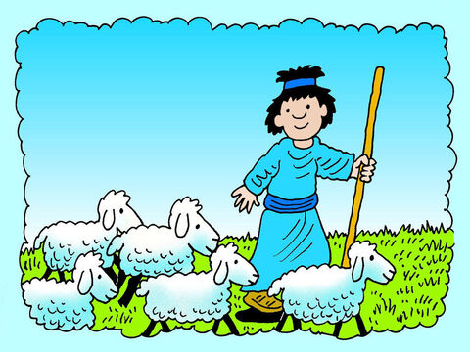
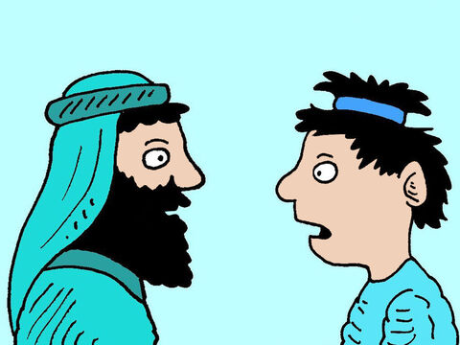
Jesus talks with Peter
Yes, LORD
You know that I love you.
Peter, do you love me more than these?
¹⁵ When they had finished eating, Jesus said to Simon Peter, “Simon son of John, do you love me more than these?”
“Yes, Lord,” he said, “you know that I love you.”
Jesus said, “Feed my lambs.”
Feed my lambs.

Slide 33
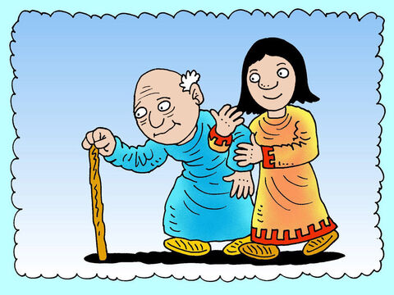
Jesus talks with Peter
Yes, LORD
You know that I love you.
Peter, do you love me?
¹⁶ Again Jesus said, “Simon son of John, do you love me?”
He answered, “Yes, Lord, you know that I love you.”
Jesus said, “Take care of my sheep.”
Take care of my sheep

Slide 34
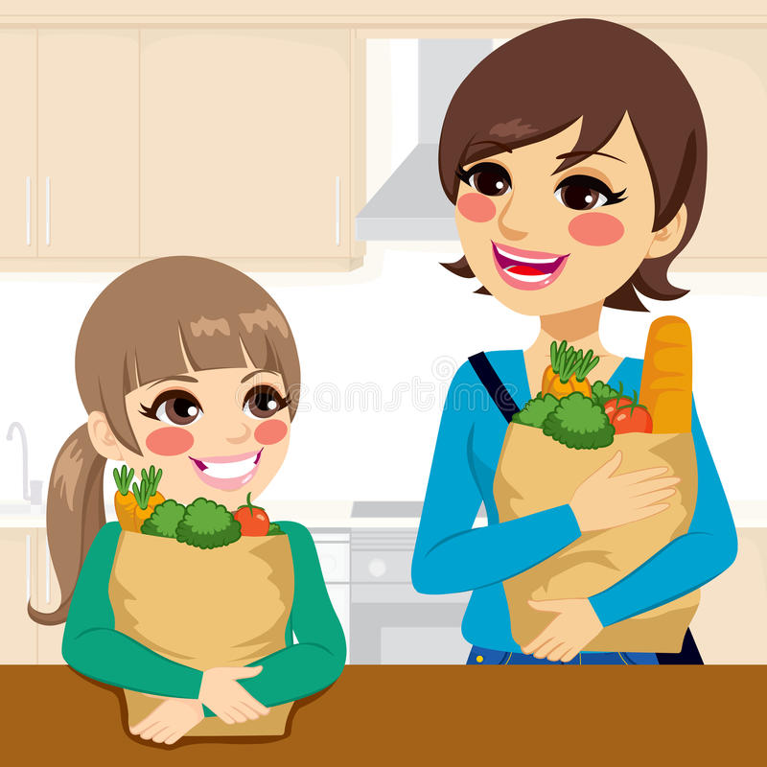
Jesus talks with Peter
Lord, You know that I love you!
Peter, do you love me?
¹⁷ The third time he said to him, “Simon son of John, do you love me?”
Peter was hurt because Jesus asked him the third time, “Do you love me?” He said, “Lord, you know all things; you know that I love you.”
Jesus said, “Feed my sheep.
Feed my sheep

Slide 35
Love God
Love and care for one another
^{Dig deeper}
^{Read}
^{1 Peter 5:1-2}

Slide 36
Jesus talks with Peter
Peter, you will be strong and when you are old you will choose to die rather than deny me.
Help me to do so, LORD.
¹⁸ Very truly I tell you, when you were younger you dressed yourself and went where you wanted; but when you are old you will stretch out your hands, and someone else will dress you and lead you where you do not want to go.” ¹⁹ Jesus said this to indicate the kind of death by which Peter would glorify God. Then he said to him, “Follow me!”
Follow Me!

Slide 37
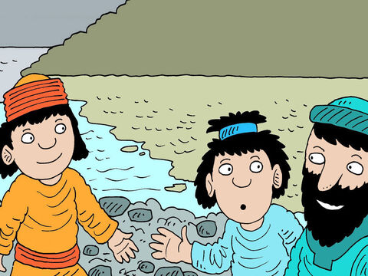
What about John?
If I want him to remain alive until I come again, that is not your concern. Just follow me.
What about John?
²⁰ Peter turned and saw that the disciple whom Jesus loved was following them. (This was the one who had leaned back against Jesus at the supper and had said, “Lord, who is going to betray you?”) ²¹ When Peter saw him, he asked, “Lord, what about him?”
²² Jesus answered, “If I want him to remain alive until I return, what is that to you? You must follow me.” ²³ Because of this, the rumor spread among the believers that this disciple would not die. But Jesus did not say that he would not die; he only said, “If I want him to remain alive until I return, what is that to you?”

Slide 38



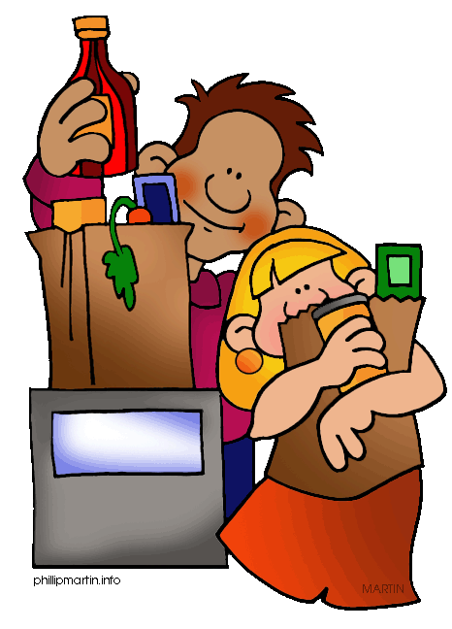
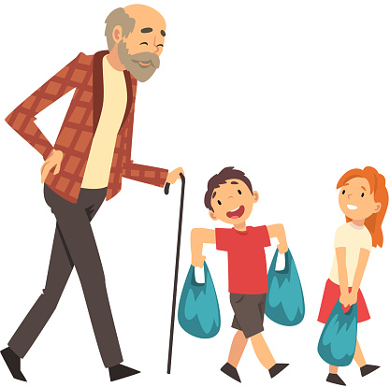

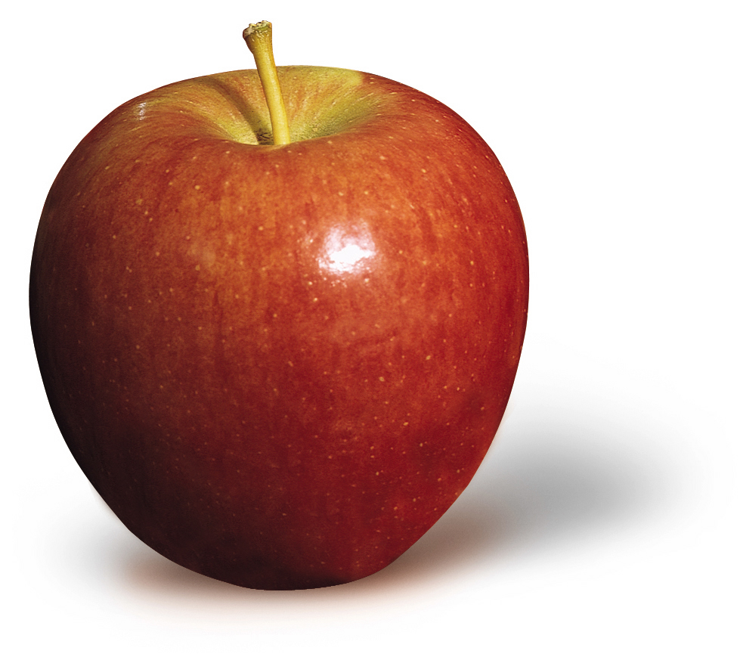
Jesus fed the disciples.
He told Peter to feed “My lambs” and “My sheep”
Jesus wants us to take care of each other and to tell others about Him.
Let’s make a net of food to give to someone.
We’ll include a special message, too.

Slide 39

Oh, Friend Do you Love Jesus?

Slide 40
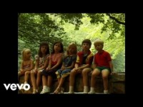
Oh, How I love Jesus

Slide 41
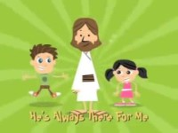
Jesus is My Best Friend

Slide 42
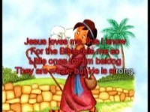
Jesus forgives me – Amazing Grace
Jesus loves me

Slide 43
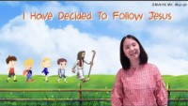
I will follow Jesus

Slide 44
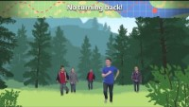
No Turning Back

Slide 45
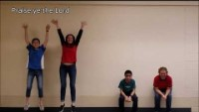
Hallelujah Praise Ye the Lord

