Slide 1

Jesus Gives His Life
Savior Souvenirs
Arrested in Gethsemane
Tried
Crucified
Buried
RISES AGAIN
So that we may have Eternal life!

Slide 2
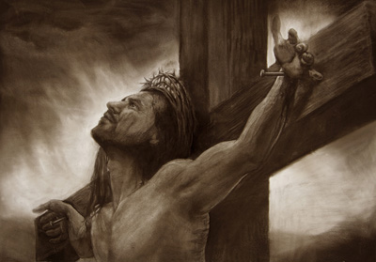
Jesus gave his life for us
7
The wages of sin is death
But the gift of God is eternal life!
Romans 6:23
For God so loved the world
That He gave His only begotten son
That whoever believes in Him
Should not perish, but have eternal life.
John 3:16

Slide 3
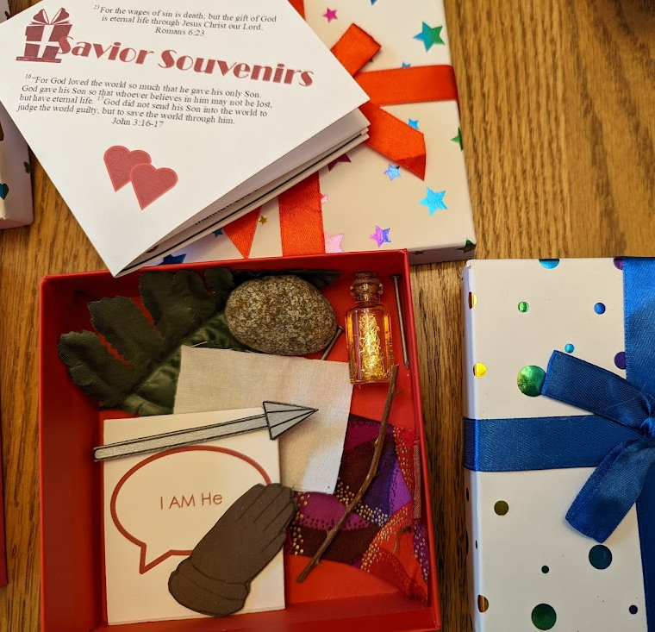
Today we are going to put together a special gift box of
Savior Souvenirs
Jesus gave us the best gifts of all
-- forgiveness and eternal life!
Thank you Jesus!
Alternatively, you could place the souvenirs in a treasure chest OR each souvenir in an egg like the Resurrection Eggs

Slide 4
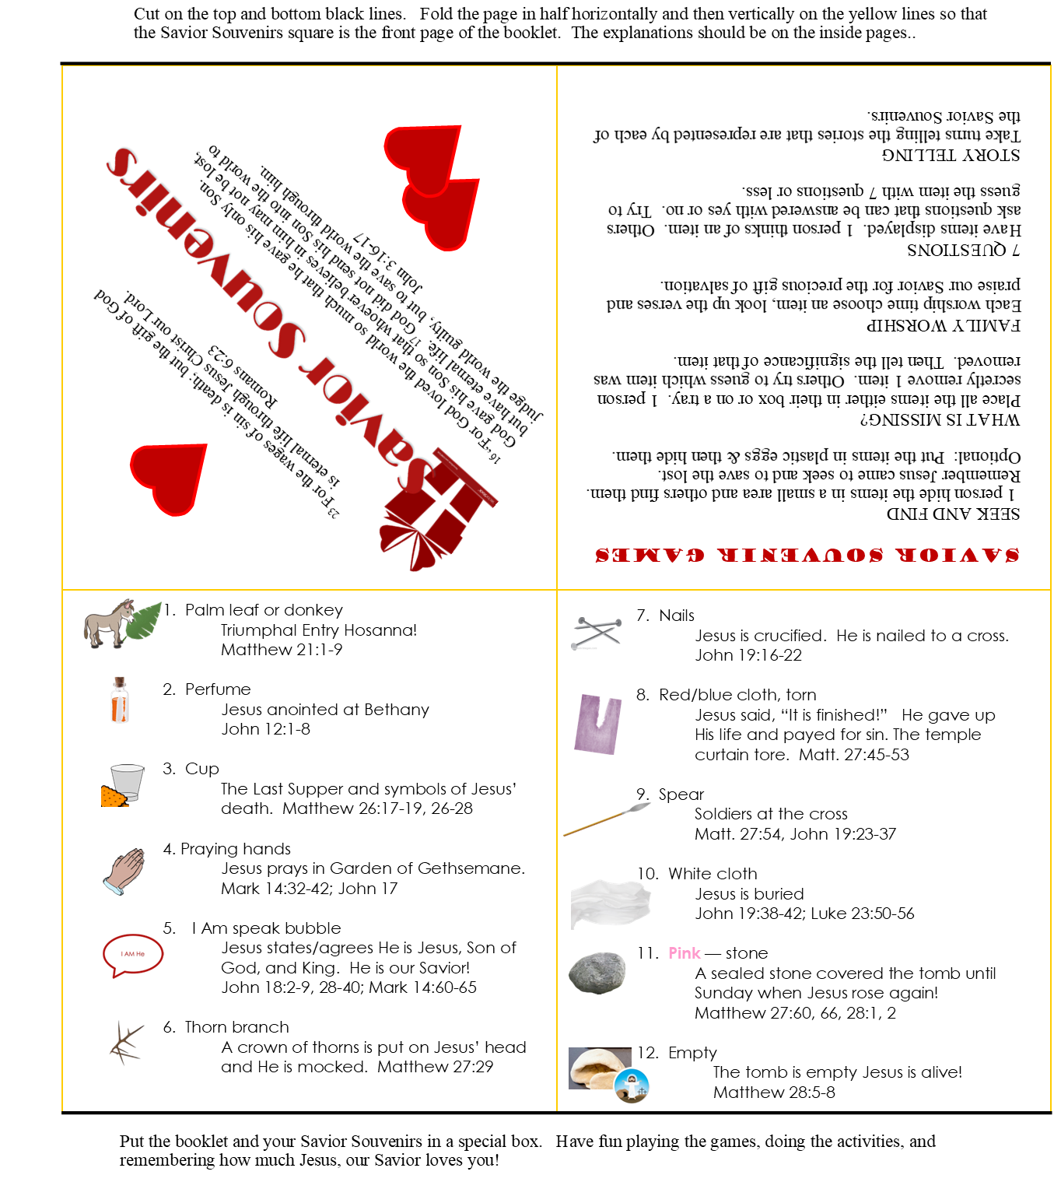

Directions: 1. Cut on the top and bottom black lines. 2. Fold the page in half horizontally 3. Fold the page in half vertically on the yellow lines so that the Savior Souvenirs square is the front page of the booklet. The explanations should be on the inside pages.. Put the booklet and your Savior Souvenirs in a special box. Have fun playing the games, doing the activities, and remembering how much Jesus, our Savior loves you!
Savior Souvenirs

Slide 5
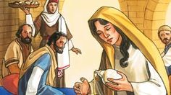
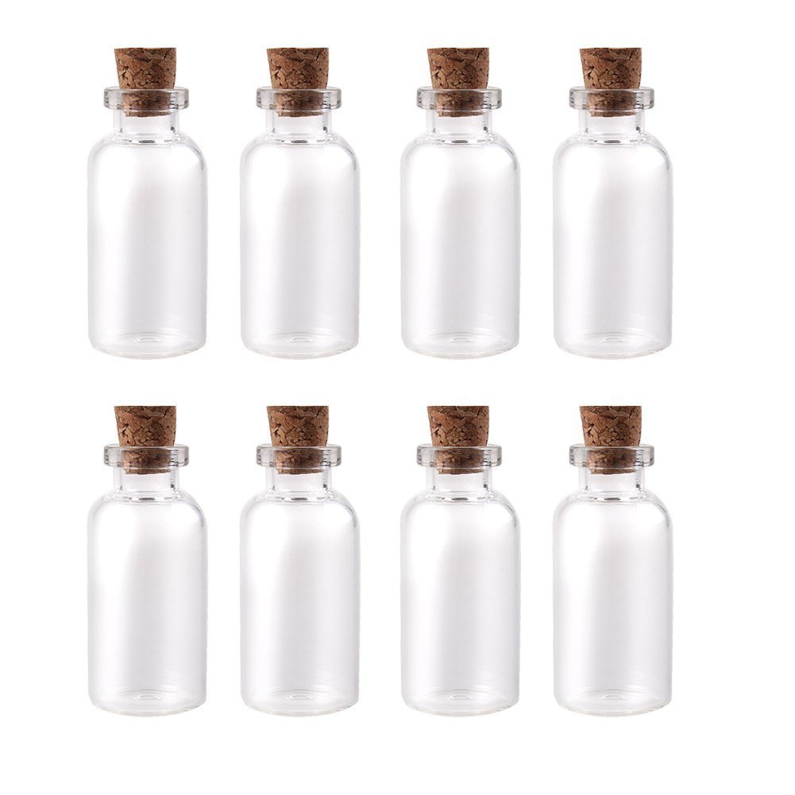
Perfume
Smell the perfume
Our bottle has glitter
Shake it!
1
Mary anointed Jesus’ feet
^{Mark 14:3} Jesus was in Bethany. He was at dinner in the house of Simon, who had a harmful skin disease. While Jesus was there, a woman came to him. She had an alabaster jar filled with very expensive perfume, made of pure nard. The woman opened the jar and poured the perfume on Jesus’ head (and feet).
Prep note on note page
Notes:
I bought small bottles as pictured at the dollar store.
Using a funnel, I put in a little glitter and then sprayed in some perfume into each bottle. Then I hot-glued the corks in to prevent spillage.
When dry, I sprayed a bit of perfume on the cork.

Slide 6
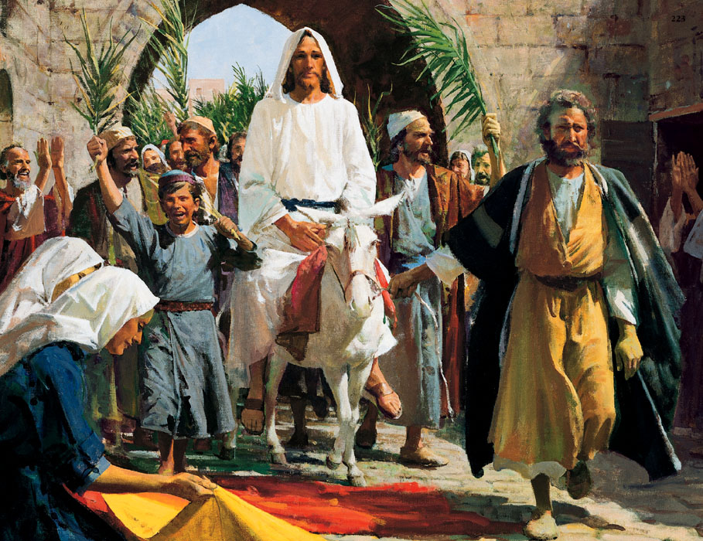

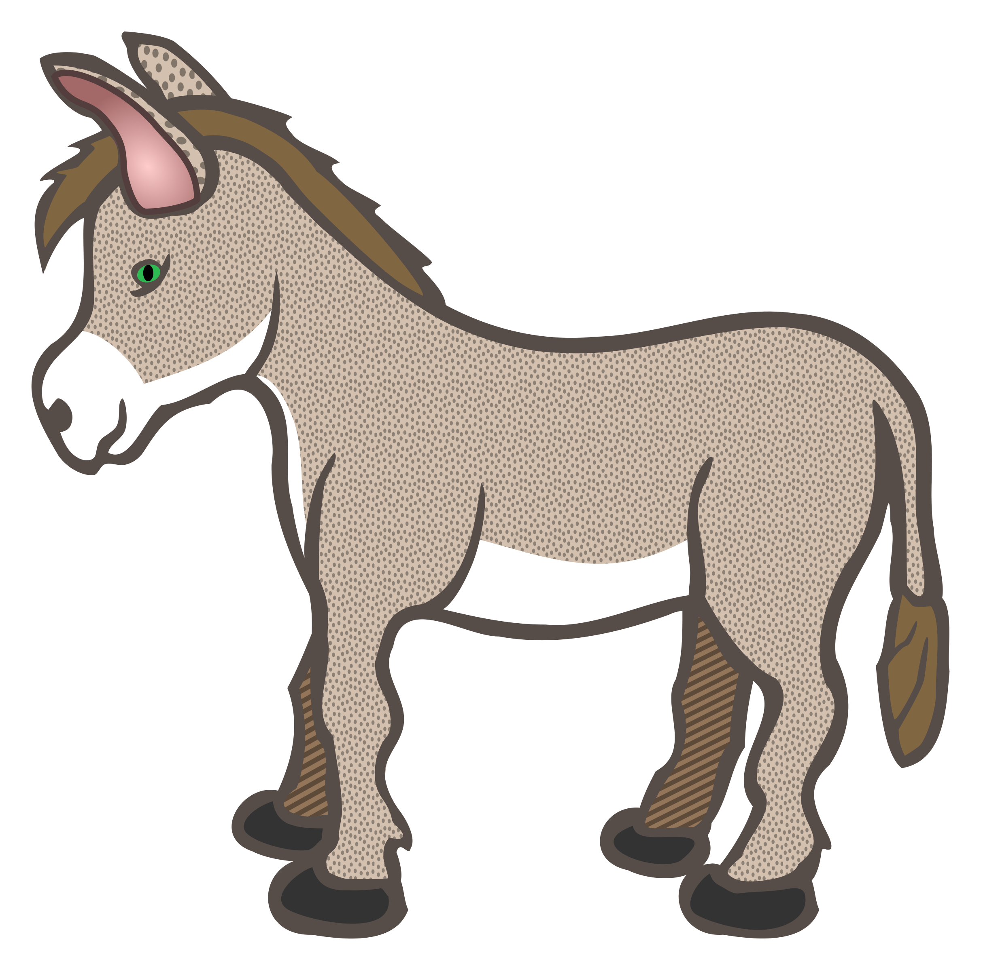
Donkey or Leaf
Scavenger hunt:
Find a leaf
Is it near a tree?
2
Triumphal Entry
^{Mark 11:7} The followers brought the colt to Jesus. They put their coats on the colt, and Jesus sat on it. ⁸ Many people spread their coats on the road. Others cut branches in the fields and spread the branches on the road. ⁹ Some of the people were walking ahead of Jesus. Others were following him. All of them were shouting,
“Praise God! God bless the One who comes in the name of the Lord! Psalm 118:26 ¹⁰ God bless the kingdom of our father David! That kingdom is coming! Praise to God in heaven!”

Slide 7

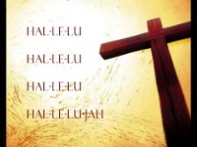
Let’s make a parade as we sing. Wave your leaf!

Slide 8
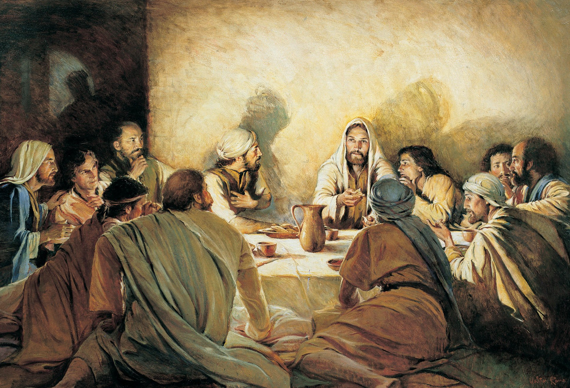


Cup and cracker
Put some purple playdough in the cup. Make a cracker out of a bit of yellow pllaydough.
3
Jesus Celebrated the Passover – The Lord’s Supper
^{Mark 14:22} While they were eating, Jesus took some bread. He thanked God for it and broke it. Then he gave it to his followers and said, “Take it. This bread is my body.”
²³ Then Jesus took a cup. He thanked God for it and gave it to the followers. All the followers drank from the cup.
²⁴ Then Jesus said, “This is my blood which begins the new^{[a]} agreement that God makes with his people. This blood is poured out for many. ²⁵ I tell you the truth. I will not drink of this fruit of the vine^{[b]} again until that day when I drink it new in the kingdom of God.”

Slide 9
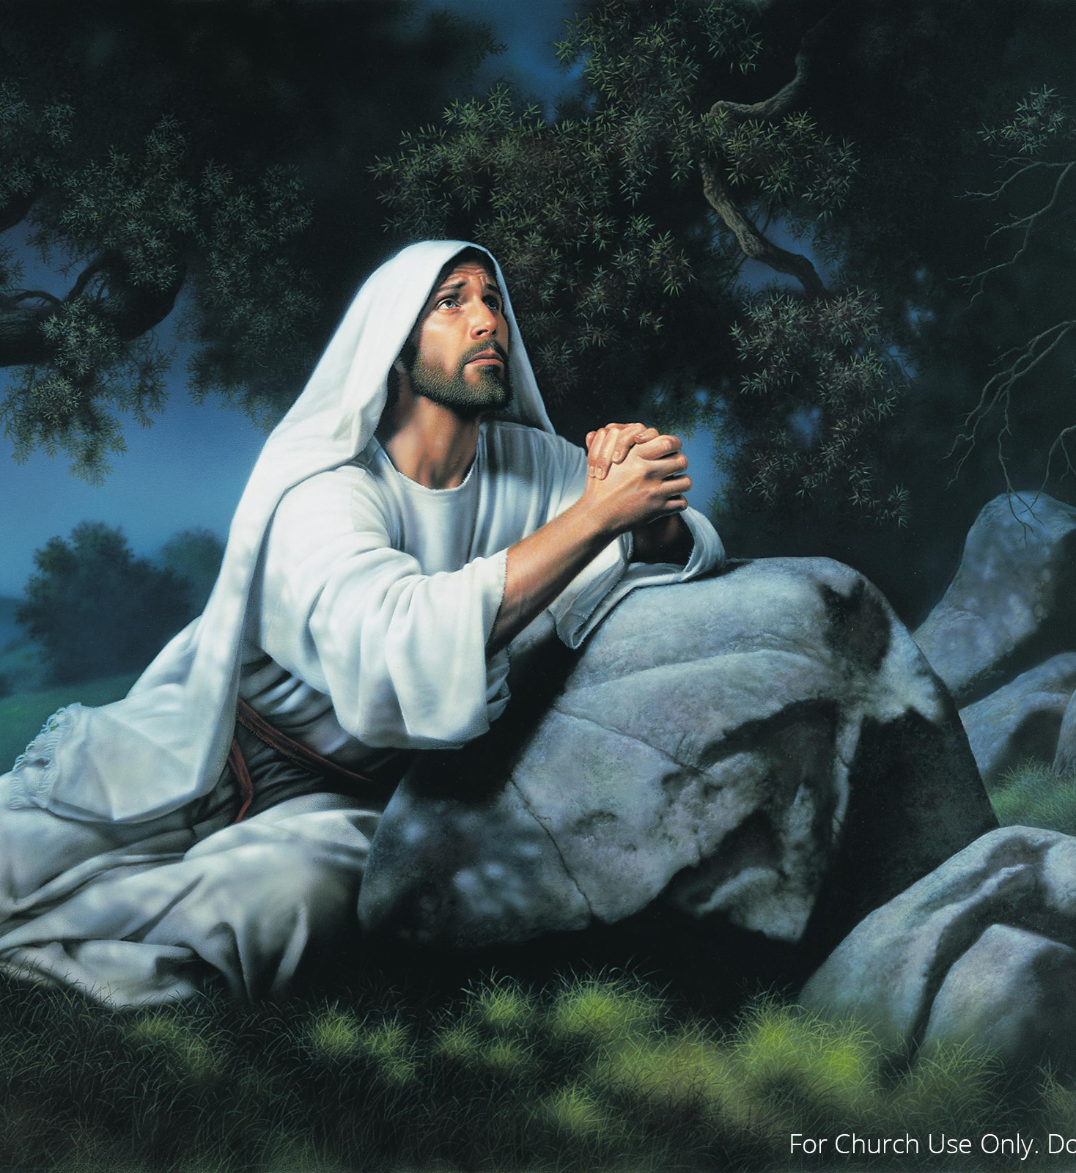
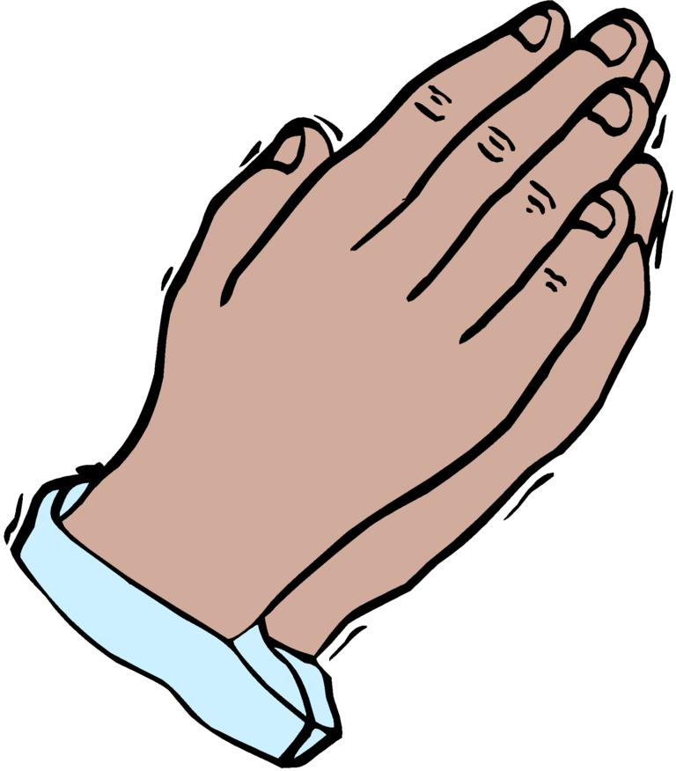
Praying Hands
I have some praying hands for you.
4
Jesus Prayed for you & me
John 14 tells us how Jesus prayed for his disciples, his followers, and all believers.
Jesus prayed for himself
^{Mark 14:32} Jesus and his followers went to a place called Gethsemane. …³⁴ He said to them, “I am full of sorrow. My heart is breaking with sadness. Stay here and watch.”
³⁵ Jesus walked a little farther away from them. Then he fell on the ground and prayed. He prayed that, if possible, he would not have this time of suffering. ³⁶ He prayed, “Abba,^{[c]} Father! You can do all things. Let me not have this cup^{[d]} of suffering. But do what you want, not what I want.”

Slide 10
Praying Hands
Let’s pray
4
Heavenly Father,
Some times our parents ask us to do things that we don’t want to do.
Some times we don’t want to do what you want us to do.
Some times it seems like its just too hard or just not fun.
But Jesus please help us to want to do what is right. Help us to obey You.
We do want to honor You. We do want to do what is right. Please make us strong, courageous, kind, and loving. Fill us with your Holy Spirit. Thankyou.
In Jesus name, we pray.
Amen.

Slide 11
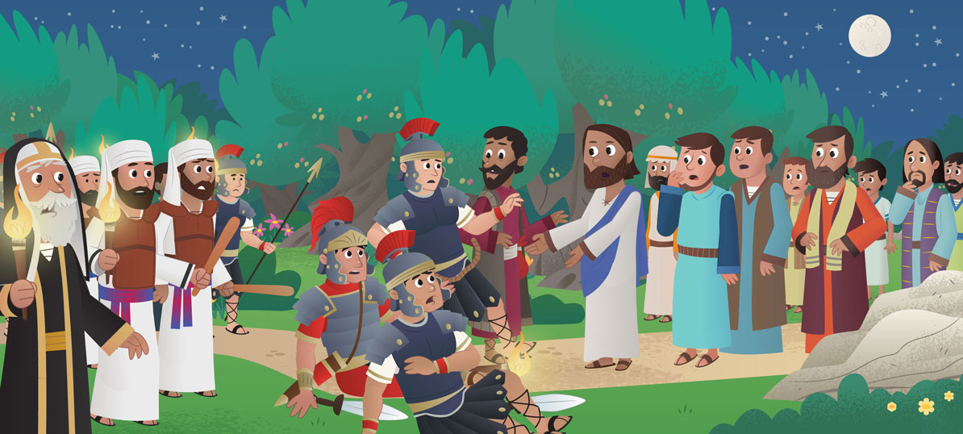
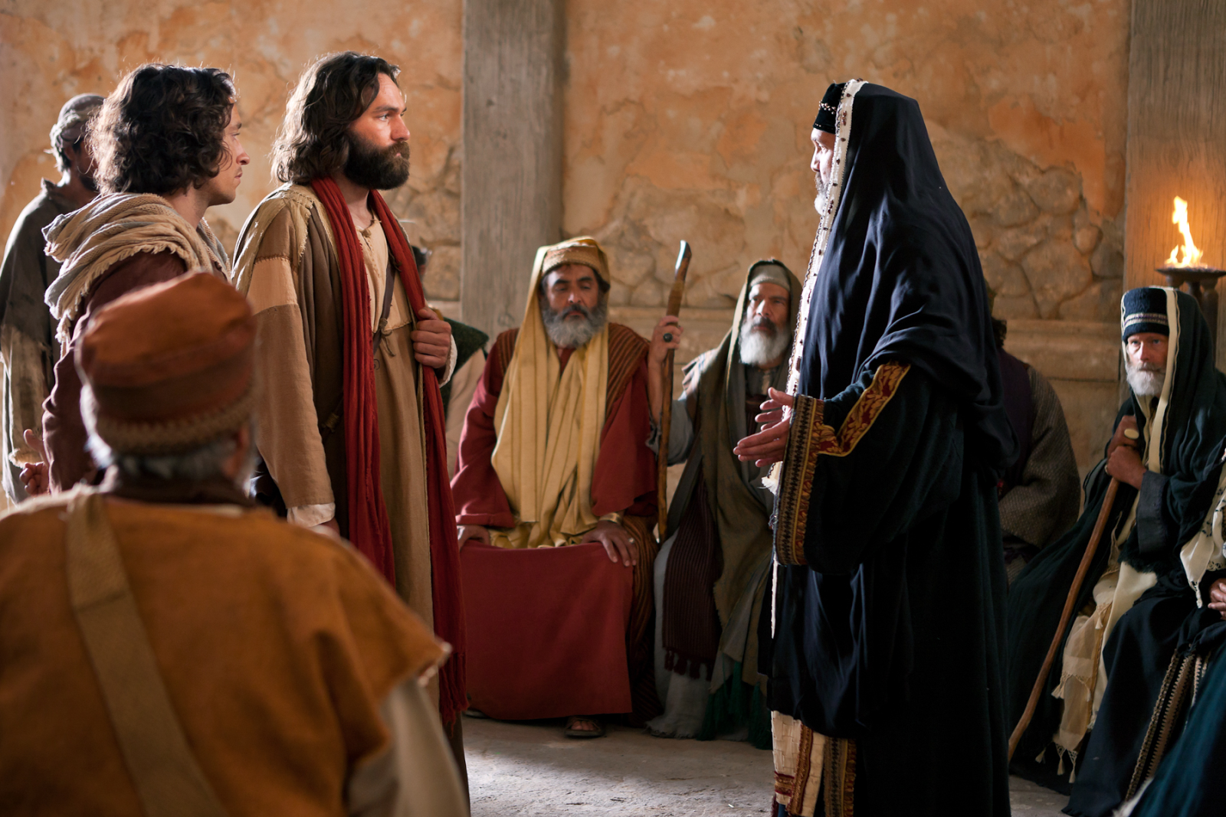
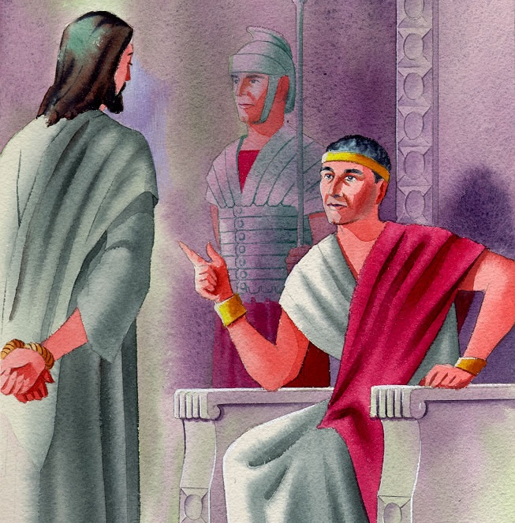
I Am
Cut out the conversation bubble
5
3 times Jesus said “I AM”
In the garden of Gethsemane, He asked, “who are you looking for? They said, “Jesus of Nazareth.” Jesus said, “I AM He. Everyone fell back because that was the name God had given Moses to tell who He was. Yet Jesus encouraged them to take him. (John 18:1-9)
In front of the Sanhedrin, the High Priest asked Jesus if he was the Son of God. Jesus said, “I Am. You will see me at His right hand.” The Priest tore his robe. They condemned Jesus. [Mk 14:60-65]
Then they took Jesus to Pilate. Pilate asked, “Are you the king of the Jews?” Jesus said, I AM the King. My kingdom is in heaven now.” (John 18:28-40) Pilate wanted to set him free.
But God was keeping a promise, “I am your Messiah.” Jesus chose to give His life for us.
I AM He
I AM He
I AM
I AM

Slide 12
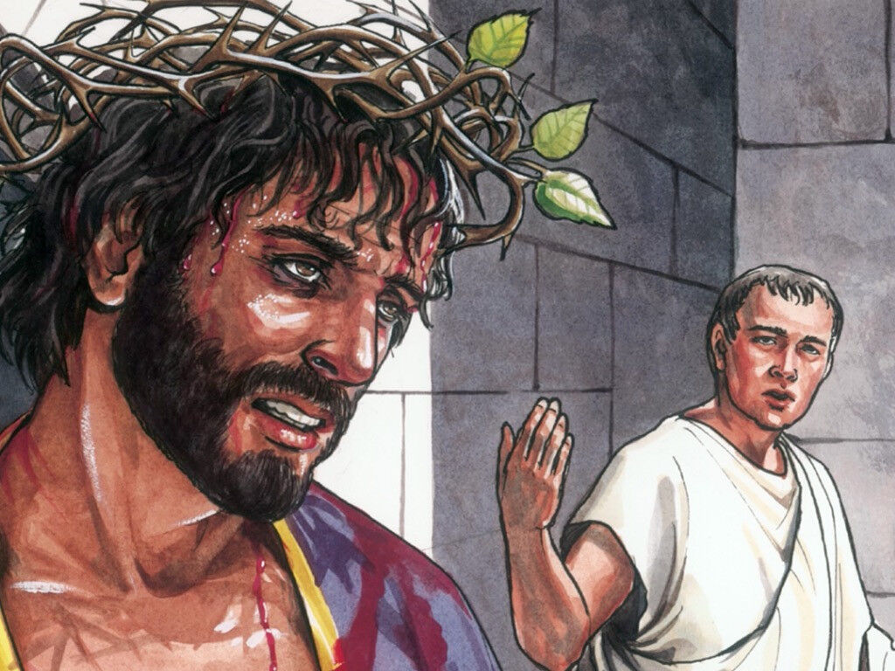

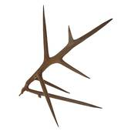
Thorny branch
Scavenger hunt:
Find a thorny branch
6
Crown of Thorns
…¹⁶ Pilate’s soldiers took Jesus into the governor’s palace (called the Praetorium). They called all the other soldiers together. ¹⁷ They put a purple robe on Jesus. Then they used thorny branches to make a crown. They put it on his head. ¹⁸ Then they called out to him, “Hail, King of the Jews!” ¹⁹ The soldiers beat Jesus on the head many times with a stick. They also spit on him. Then they made fun of him by bowing on their knees and worshiping him. ²⁰ After they finished making fun of him, the soldiers took off the purple robe and put his own clothes on him again. Then they led Jesus out of the palace to be killed on a cross.

Slide 13

Were they honoring God?
6
NO!
At any time Jesus could have said, “STOP!”
But He didn’t.
Because HE LOVES YOU and ME
He willingly did this because He wanted to take our punishment!
He wanted to pay the debt of sin and die for us!
At any time God could have sent thousands of armies of angels to stop them and rescued Jesus.
But He didn’t.
Because HE LOVES YOU and ME

Slide 14
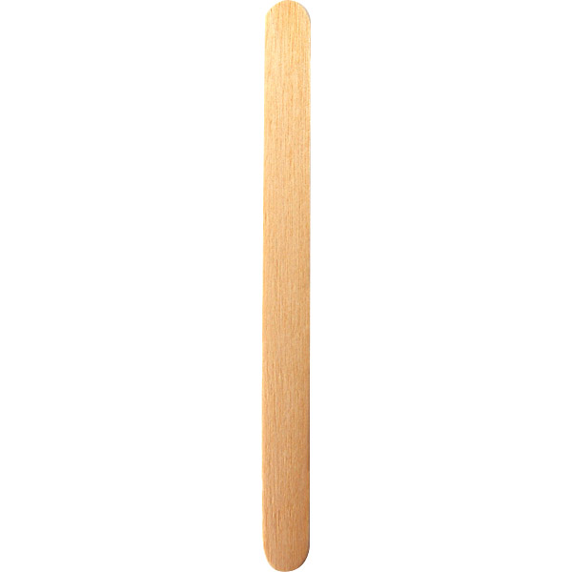
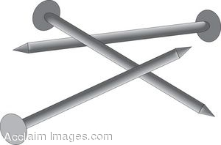
Nails
Scavenger hunt:
Find 2 or 3 nails
Can you make a cross?
7
Crucified
^{Luke 23:26} The soldiers led Jesus away….. ³² There were also two criminals led out with Jesus to be killed. ³³ Jesus and the two criminals were taken to a place called the Skull. (Golgotha)
There the soldiers nailed Jesus to his cross. They also nailed the criminals to their crosses, one beside Jesus on the right and the other beside Jesus on the left.
³⁴ Jesus said, “Father, forgive them. They don’t know what they are doing.”[
Father forgive them!
They don’t know what they are doing.

Slide 15
Jesus gave his life for us
7
The wages of sin is death
But the gift of God is eternal life!
Romans 6:23
For God so loved the world
That He gave His only begotten son
That whoever believes in Him
Should not perish, but have everlasting life.
John 3:16

Slide 16
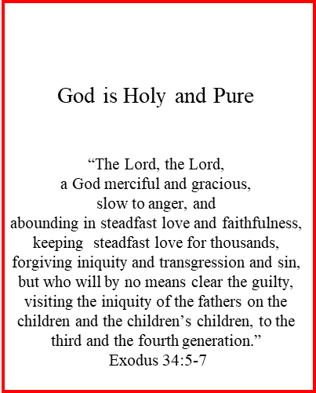
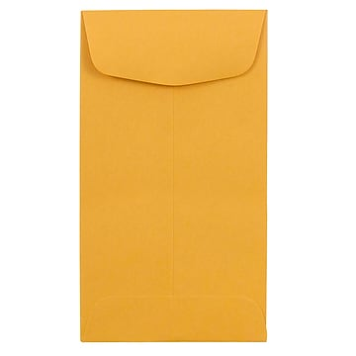
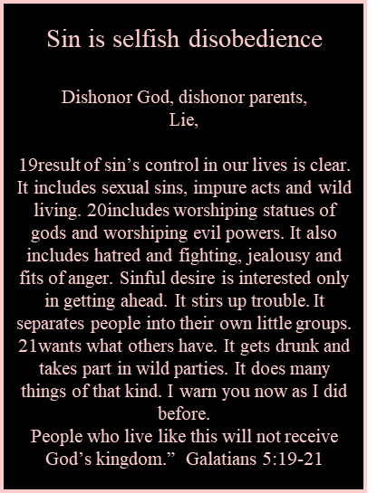

Jesus took on our sins
8
Why have you forsaken me?
^{Mark 15:33} At noon the whole country became dark. This darkness lasted for three hours. ³⁴ At three o’clock Jesus cried in a loud voice, “Eloi, Eloi, lema sabachthani?” This means “My God, my God, why have you left me alone?”…
God and Jesus are one.
But Jesus took on our sin.
Because God is holy and sin is not, Sin separates us from God.
But Jesus did away with our sin.
God and Jesus are one. We can be with them.
Put the 2 white papers together.
Put the black paper on the Jesus paper.
Take the God paper away from the Jesus paper
Put the black sin paper in the envelope.

Slide 17
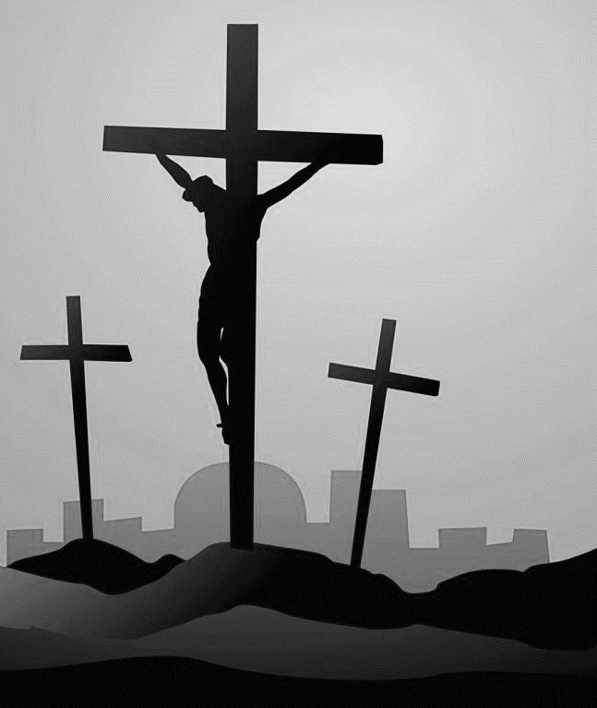
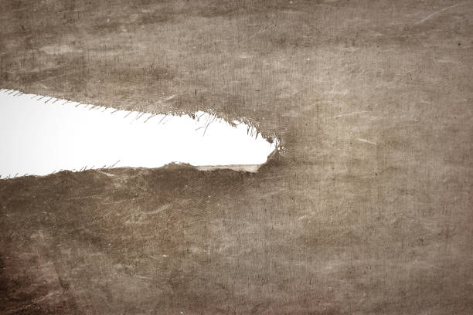
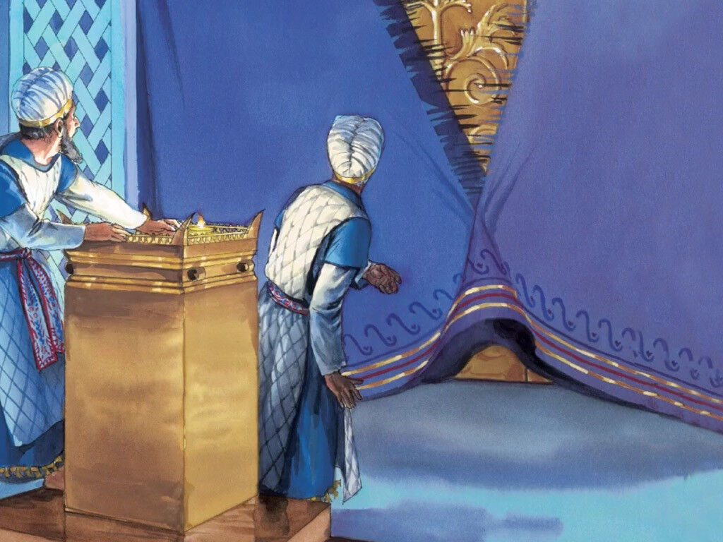
Veil torn
Rip the cloth
It is finished!
8
The debt of sin is paid
It is Finished!
^{John 19:28} Later, Jesus knew that everything had now been finished. He also knew that what Scripture said must come true. So he said, “I am thirsty.” ²⁹ A jar of wine vinegar was there. So they soaked a sponge in it. They put the sponge on the stem of a hyssop plant. Then they lifted it up to Jesus’ lips. ³⁰ After Jesus drank, he said, “It is finished.” Then he bowed his head and died.
^{Matthew 27:51} Then the curtain in the Temple split into two pieces. The tear started at the top and tore all the way down to the bottom.
Also, the earth shook and rocks broke apart. ⁵² The graves opened, and many of God’s people who had died were raised from death. ⁵³ They came out of the graves after Jesus was raised from death. They went into the holy city, and many people saw them.
The sacrifice is complete.
The work God has given me to do here is done!

Slide 18
Let’s pray
Dear Jesus,
We sin. Sometimes we do bad things. We don’t honor you.
Please forgive us.
Forgive us for not being kind.
Forgive us for lying,
taking things away from others, disobeying….
You died for us and took our punishment.
Thank you!
Thank you for forgiving us and washing us clean.
Amen

Slide 19

You are forgiven!
Your sin
Is
Gone!

Slide 20

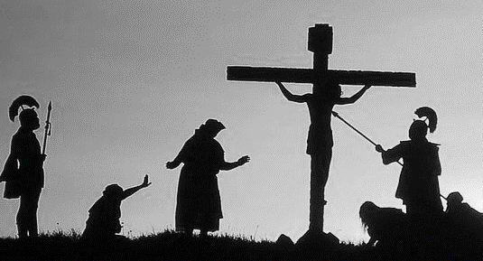
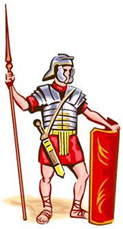
Spear
Scavenger hunt:
Find or Make
A spear
9
He really was the Son of God!
Soldiers at the Cross
^{Matthew 27:54} The army officer and the soldiers guarding Jesus saw this earthquake and everything else that happened. They were very frightened and said, “He really was the Son of God!”
^{John 19:31} This day was Preparation Day. The next day was a special Sabbath day. The Jews did not want the bodies to stay on the cross on the Sabbath day. So they asked Pilate to order that the legs of the men be broken^{[d]} and the bodies be taken away.
³² So the soldiers came and broke the legs of the first man on the cross beside Jesus. Then they broke the legs of the man on the other cross beside Jesus. ³³ But when the soldiers came to Jesus, they saw that he was already dead. So they did not break his legs. ³⁴ But one of the soldiers stuck his spear into Jesus’ side. At once blood and water came out.
³⁵ (The one who saw this happen has told about it. The things he says are true. He knows that he tells the truth. He told about it so that you also can believe.) ³⁶ These things happened to make the Scripture come true: “Not one of his bones will be broken.”^{[e]} ³⁷ And another Scripture said, “They will look at the one they have stabbed.”^{[f]}

Slide 21
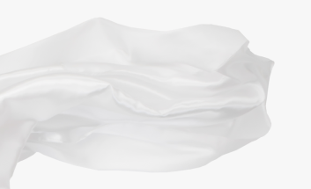
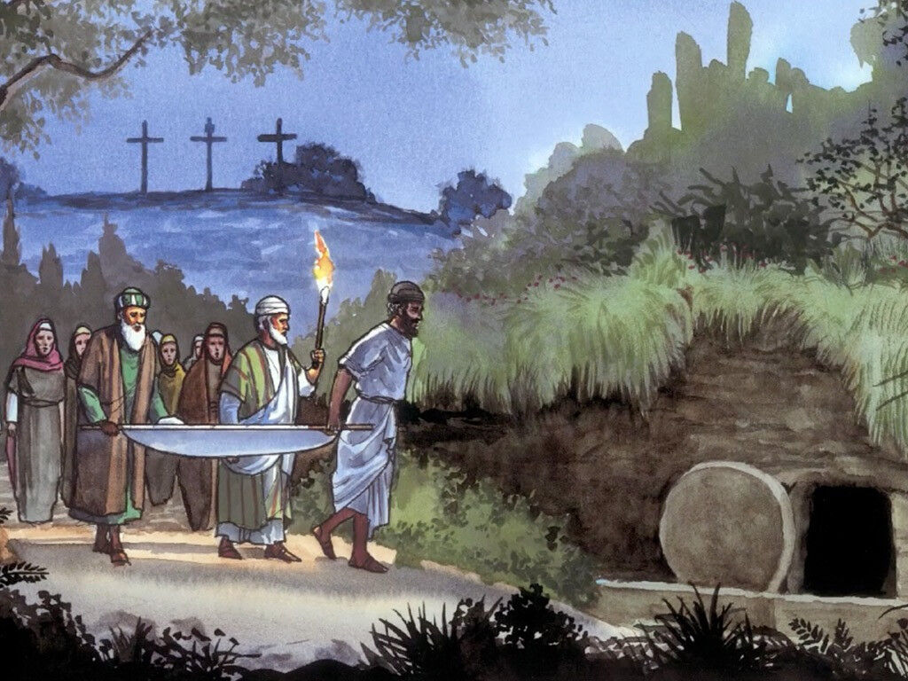
White Cloth
Scavenger hunt:
Find a white cloth
Wrap it around your finger then put it in your box
10
Buried
^{John 19:38} Later, a man named Joseph from Arimathea asked Pilate if he could take the body of Jesus. (Joseph was a secret follower of Jesus, because he was afraid of the Jews.) Pilate gave his permission. So Joseph came and took Jesus’ body away. ³⁹ Nicodemus went with Joseph. Nicodemus was the man who earlier had come to Jesus at night. He brought about 75 pounds of spices. This was a mixture of myrrh and aloes. ⁴⁰ These two men took Jesus’ body and wrapped it with the spices in pieces of linen cloth. (This is how the Jews bury people.) ⁴¹ In the place where Jesus was killed, there was a garden. In the garden was a new tomb where no one had ever been buried. …
^{Mark 15:46} Joseph bought some linen cloth, took the body down from the cross and wrapped it in the linen. He put the body in a tomb that was cut in a wall of rock. Then he closed the tomb by rolling a very large stone to cover the entrance.
^{Luke 23:55} The women who had come from Galilee with Jesus followed Joseph. They saw the tomb and saw inside where the body of Jesus was laid. ⁵⁶ Then the women left to prepare perfumes and spices.
On the Sabbath day they rested, as the law of Moses commanded.

Slide 22
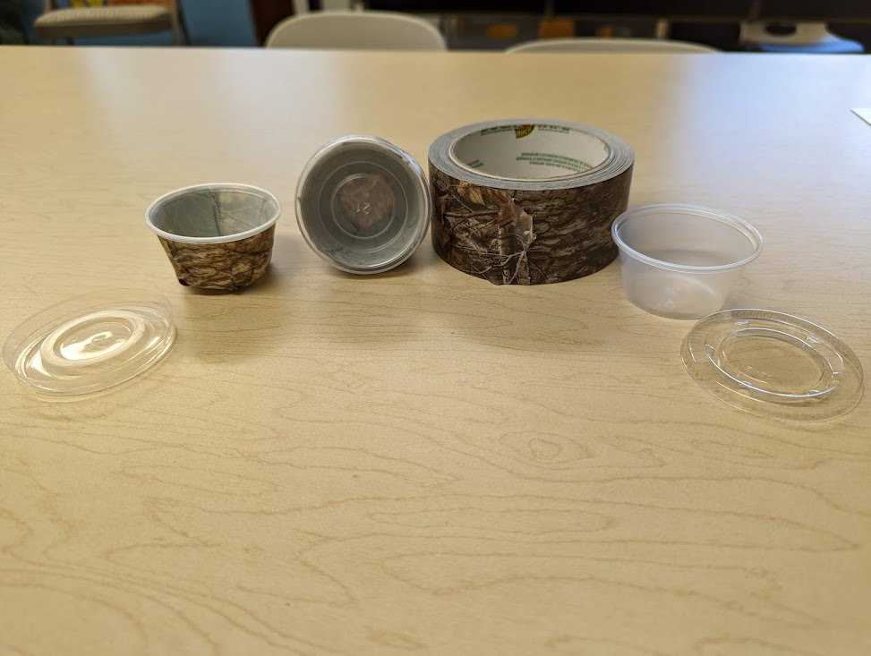
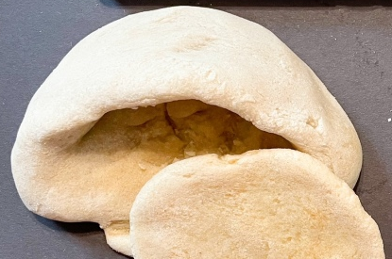
Let’s make the tomb souvenir
Option 1:
Use a 2 oz condiment cup
Tear or cut off an 8 inch strip of duct tape (or other tape)
Stick the duct tape onto the outside of the condiment cup
Option 2:
Use playdough
Make a sphere
Put your thumb in the middle and pinch the inside and outside to make a tomb.

Slide 23

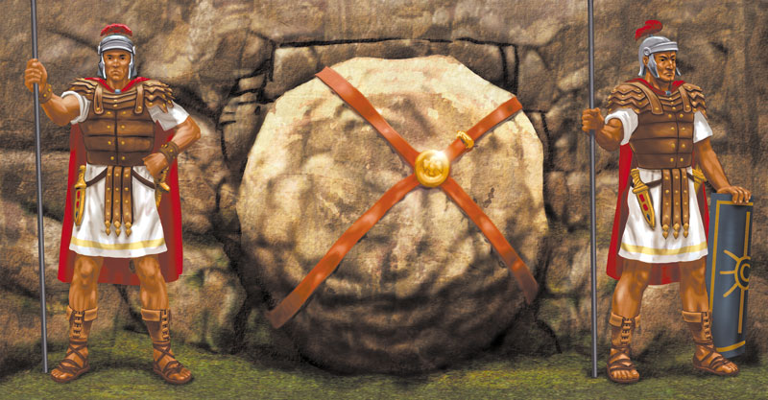
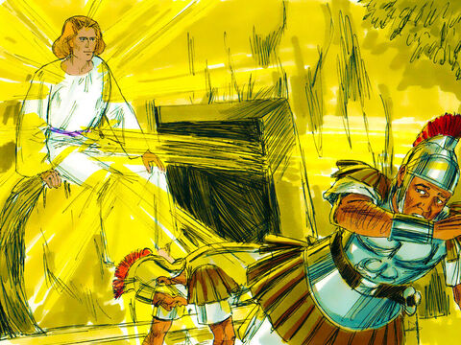
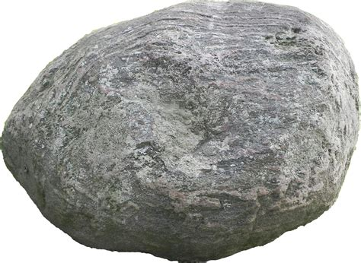
Stone
Scavenger hunt:
Find a small rock this big
Sealed and Guarded
^{Matthew 27:65} Pilate said, “Take some soldiers and go guard the tomb the best way you know.” ⁶⁶ So they all went to the tomb and made it safe from thieves. They did this by sealing the stone in the entrance and then putting soldiers there to guard it.
11
Opened!
Matthew 28 The day after the Sabbath day was the first day of the week. At dawn on the first day, …
² At that time there was a strong earthquake. An angel of the Lord came down from heaven. The angel went to the tomb and rolled the stone away from the entrance. Then he sat on the stone. ³ He was shining as bright as lightning. His clothes were white as snow. ⁴ The soldiers guarding the tomb were very frightened of the angel. They shook with fear and then became like dead men.

Slide 24
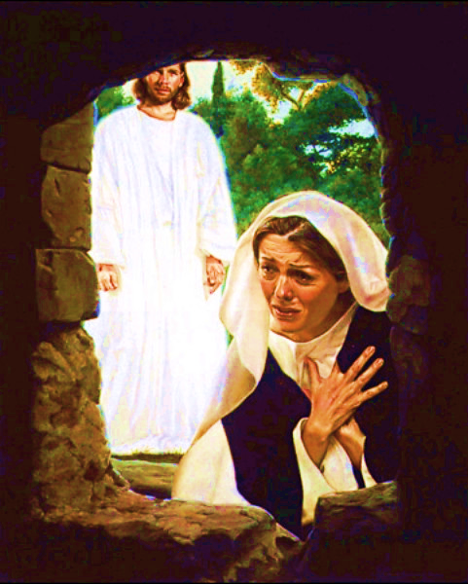
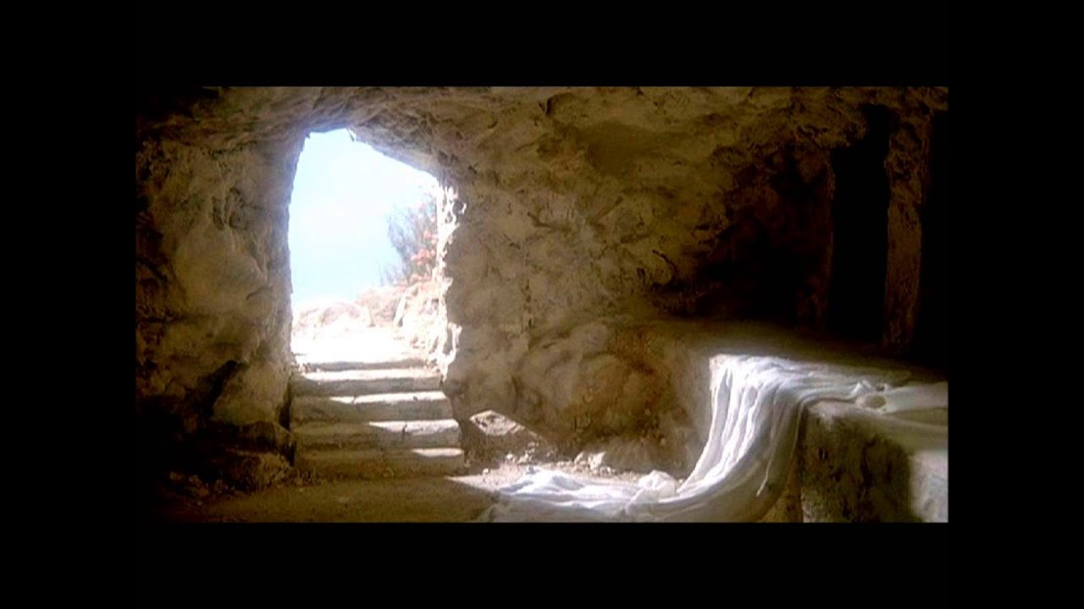
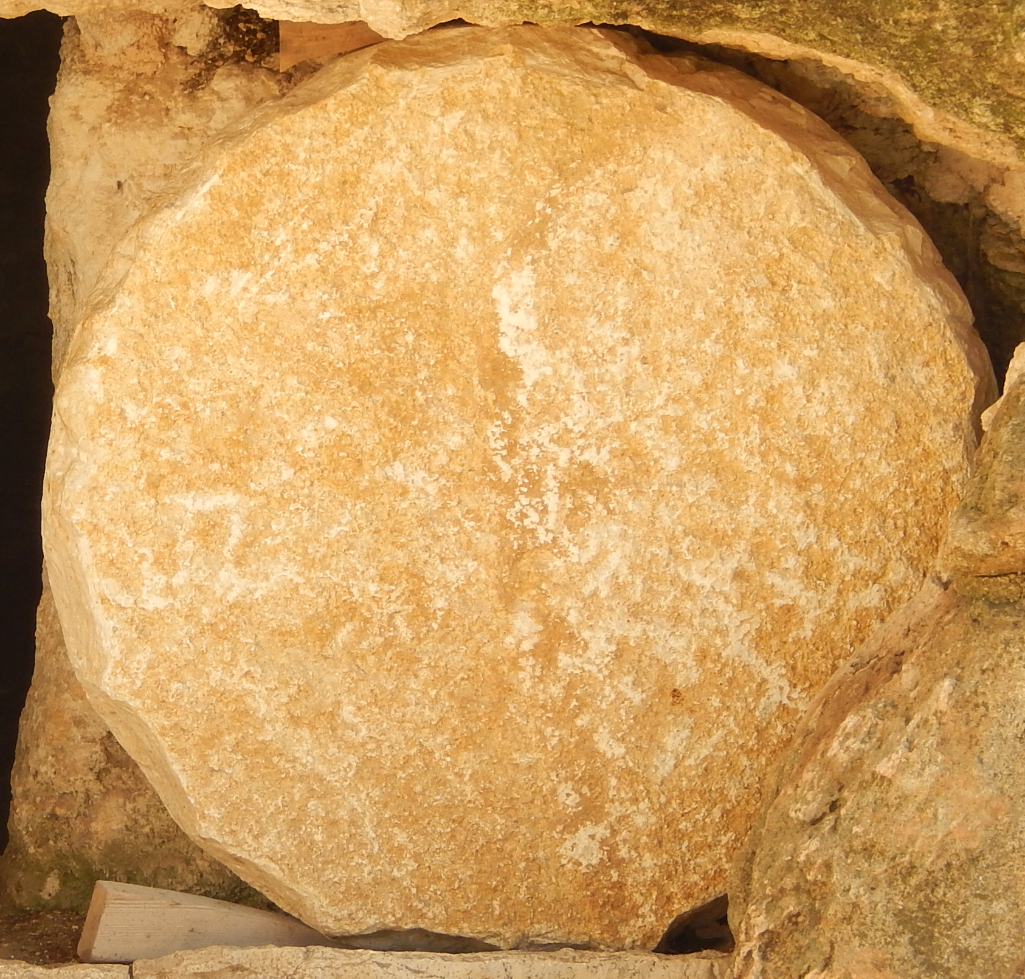
Empty Tomb
12
Make an empty tomb
Add stickers on the lid.
Jesus is ALIVE!
John 20 Early on the first day of the week, Mary Magdalene went to the tomb. It was still dark. Mary saw that the large stone had been moved away from the tomb. ² So Mary ran to Simon Peter and the other follower (the one Jesus loved). Mary said, “They have taken the Lord out of the tomb. We don’t know where they have put him.”
³ So Peter and the other follower started for the tomb. ⁴ They were both running, but the other follower ran faster than Peter. So the other follower reached the tomb first. ⁵ He bent down and looked in. He saw the strips of linen cloth lying there, but he did not go in. ⁶ Then following him came Simon Peter. He went into the tomb and saw the strips of linen lying there. ⁷ He also saw the cloth that had been around Jesus’ head. The cloth was folded up and laid in a different place from the strips of linen. ⁸ Then the other follower, who had reached the tomb first, also went in. He saw and believed. …
¹⁰ Then the followers went back home. ¹¹ But Mary stood outside the tomb, crying. …
¹⁶ Jesus said to her, “Mary.”
Mary turned toward Jesus and said in the Jewish language,^{[a]} “Rabboni.” (This means Teacher.)
¹⁷ Jesus said to her, “Don’t hold me. I have not yet gone up to the Father. But go to my brothers and tell them this: ‘I am going back to my Father and your Father. I am going back to my God and your God.’”
Front sticker

Slide 25
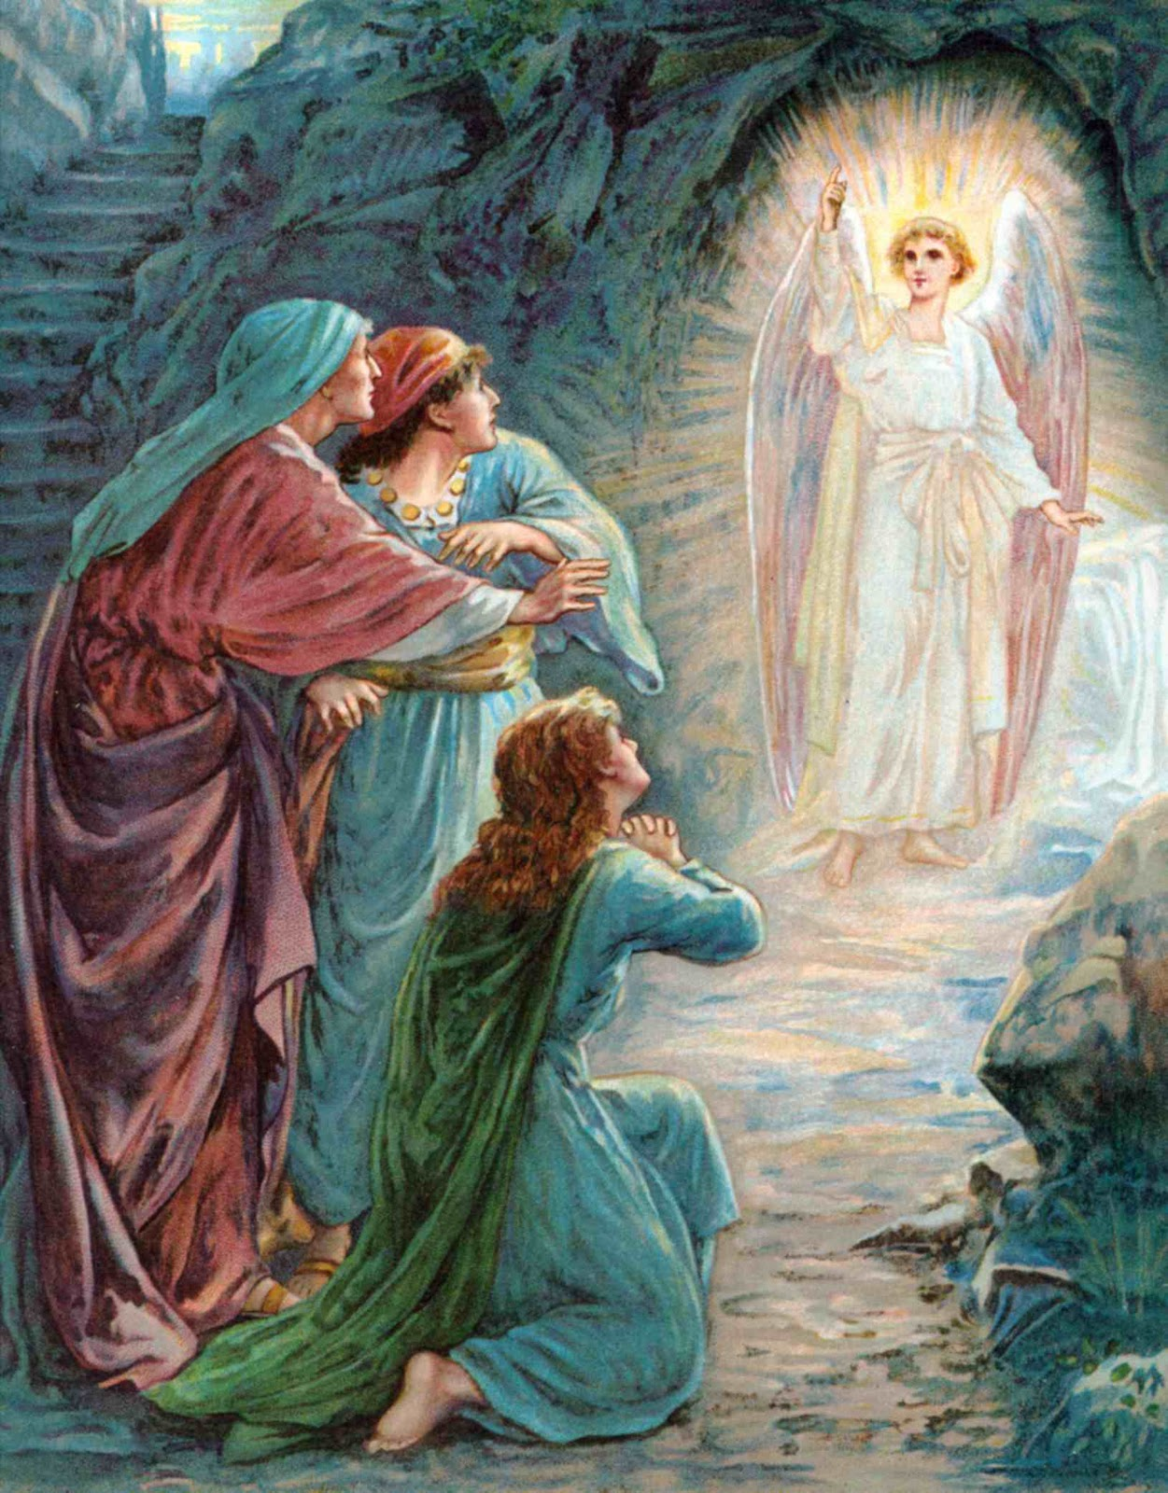
Empty empty tomb, empty egg or sticker
12
Make an empty tomb
Jesus has risen like He said!
Back sticker
Front sticker
Option 1:
Put the rock sticker on the front of the lid.
Put the angel sticker on the back of the lid.

Slide 26

Gift from God
To you!
He’s alive again
Yeah the stones been rolled away
He’s alive again
He’s no longer where he lay
He’s alive again
I can hear the angel say
Let all the world rejoice
Everyone lift up your voice…
Let all the world rejoice
HE’S ALIVE!
Start 2:12

Slide 27
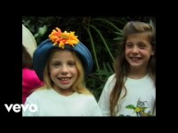
Praise God for His gift!

Slide 28
Jesus gave his life for us
7
The wages of sin is death
But the gift of God is eternal life!
Romans 6:23
For God so loved the world
That He gave His only begotten son
That whoever believes in Him
Should not perish, but have eternal life.
John 3:16

Slide 29
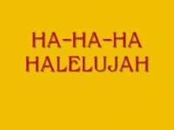
Gift from God
To you!

Slide 30
Gift from God
To you!

Slide 31

The END
https://activity-array.com

