Slide 1
Jesus Prays in gethsemane
Matthew 26:36-46, Luke 22, John 17

Slide 2
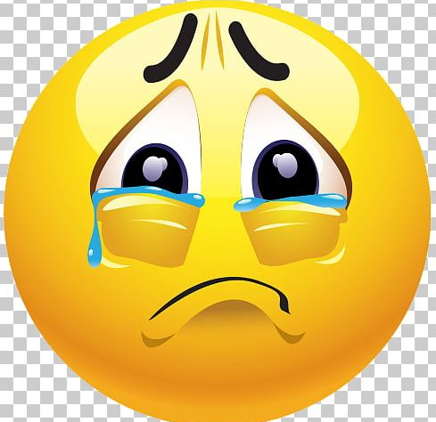


It was going to be a sad day
Have you ever had a hard day or very sad day?

Slide 3
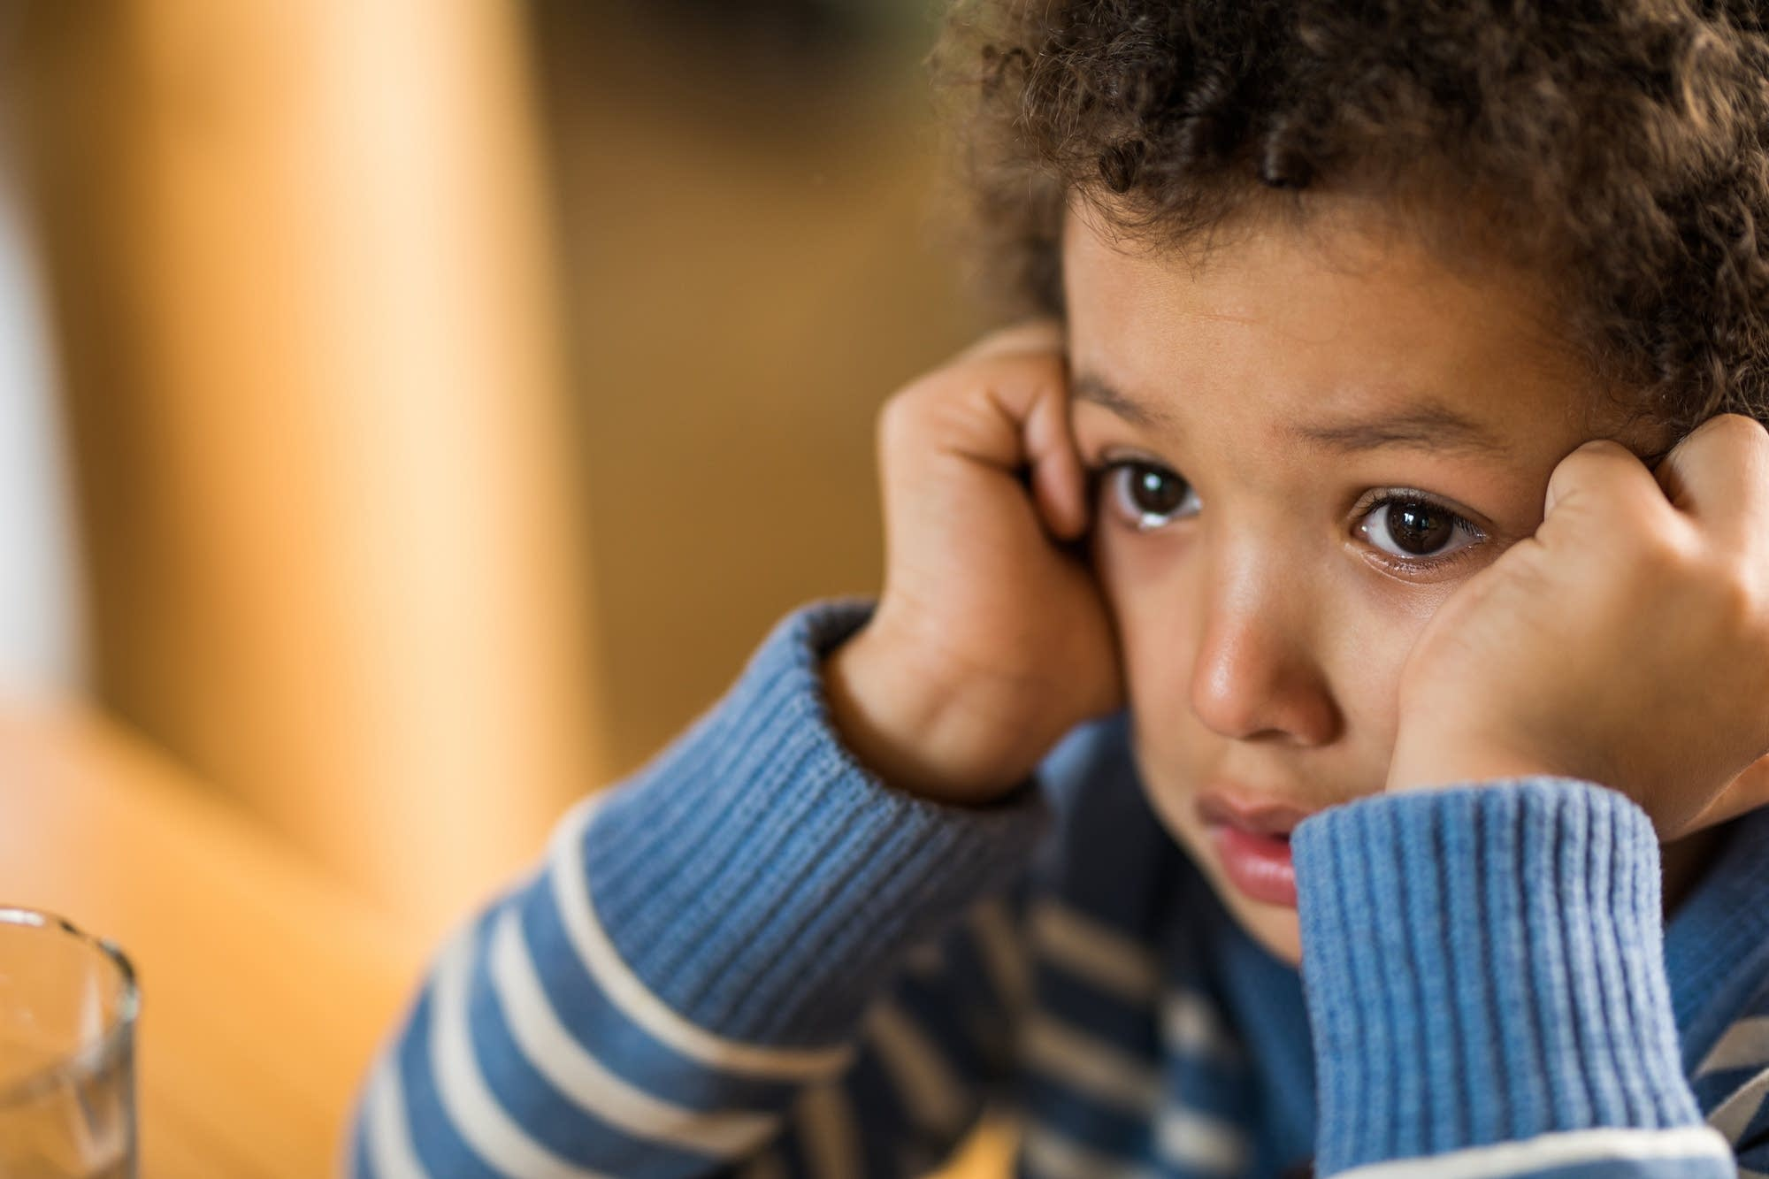
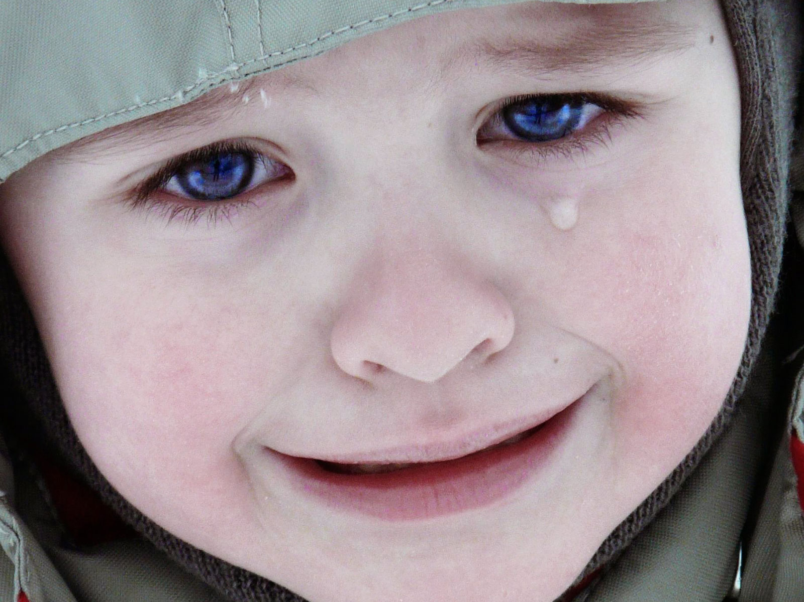
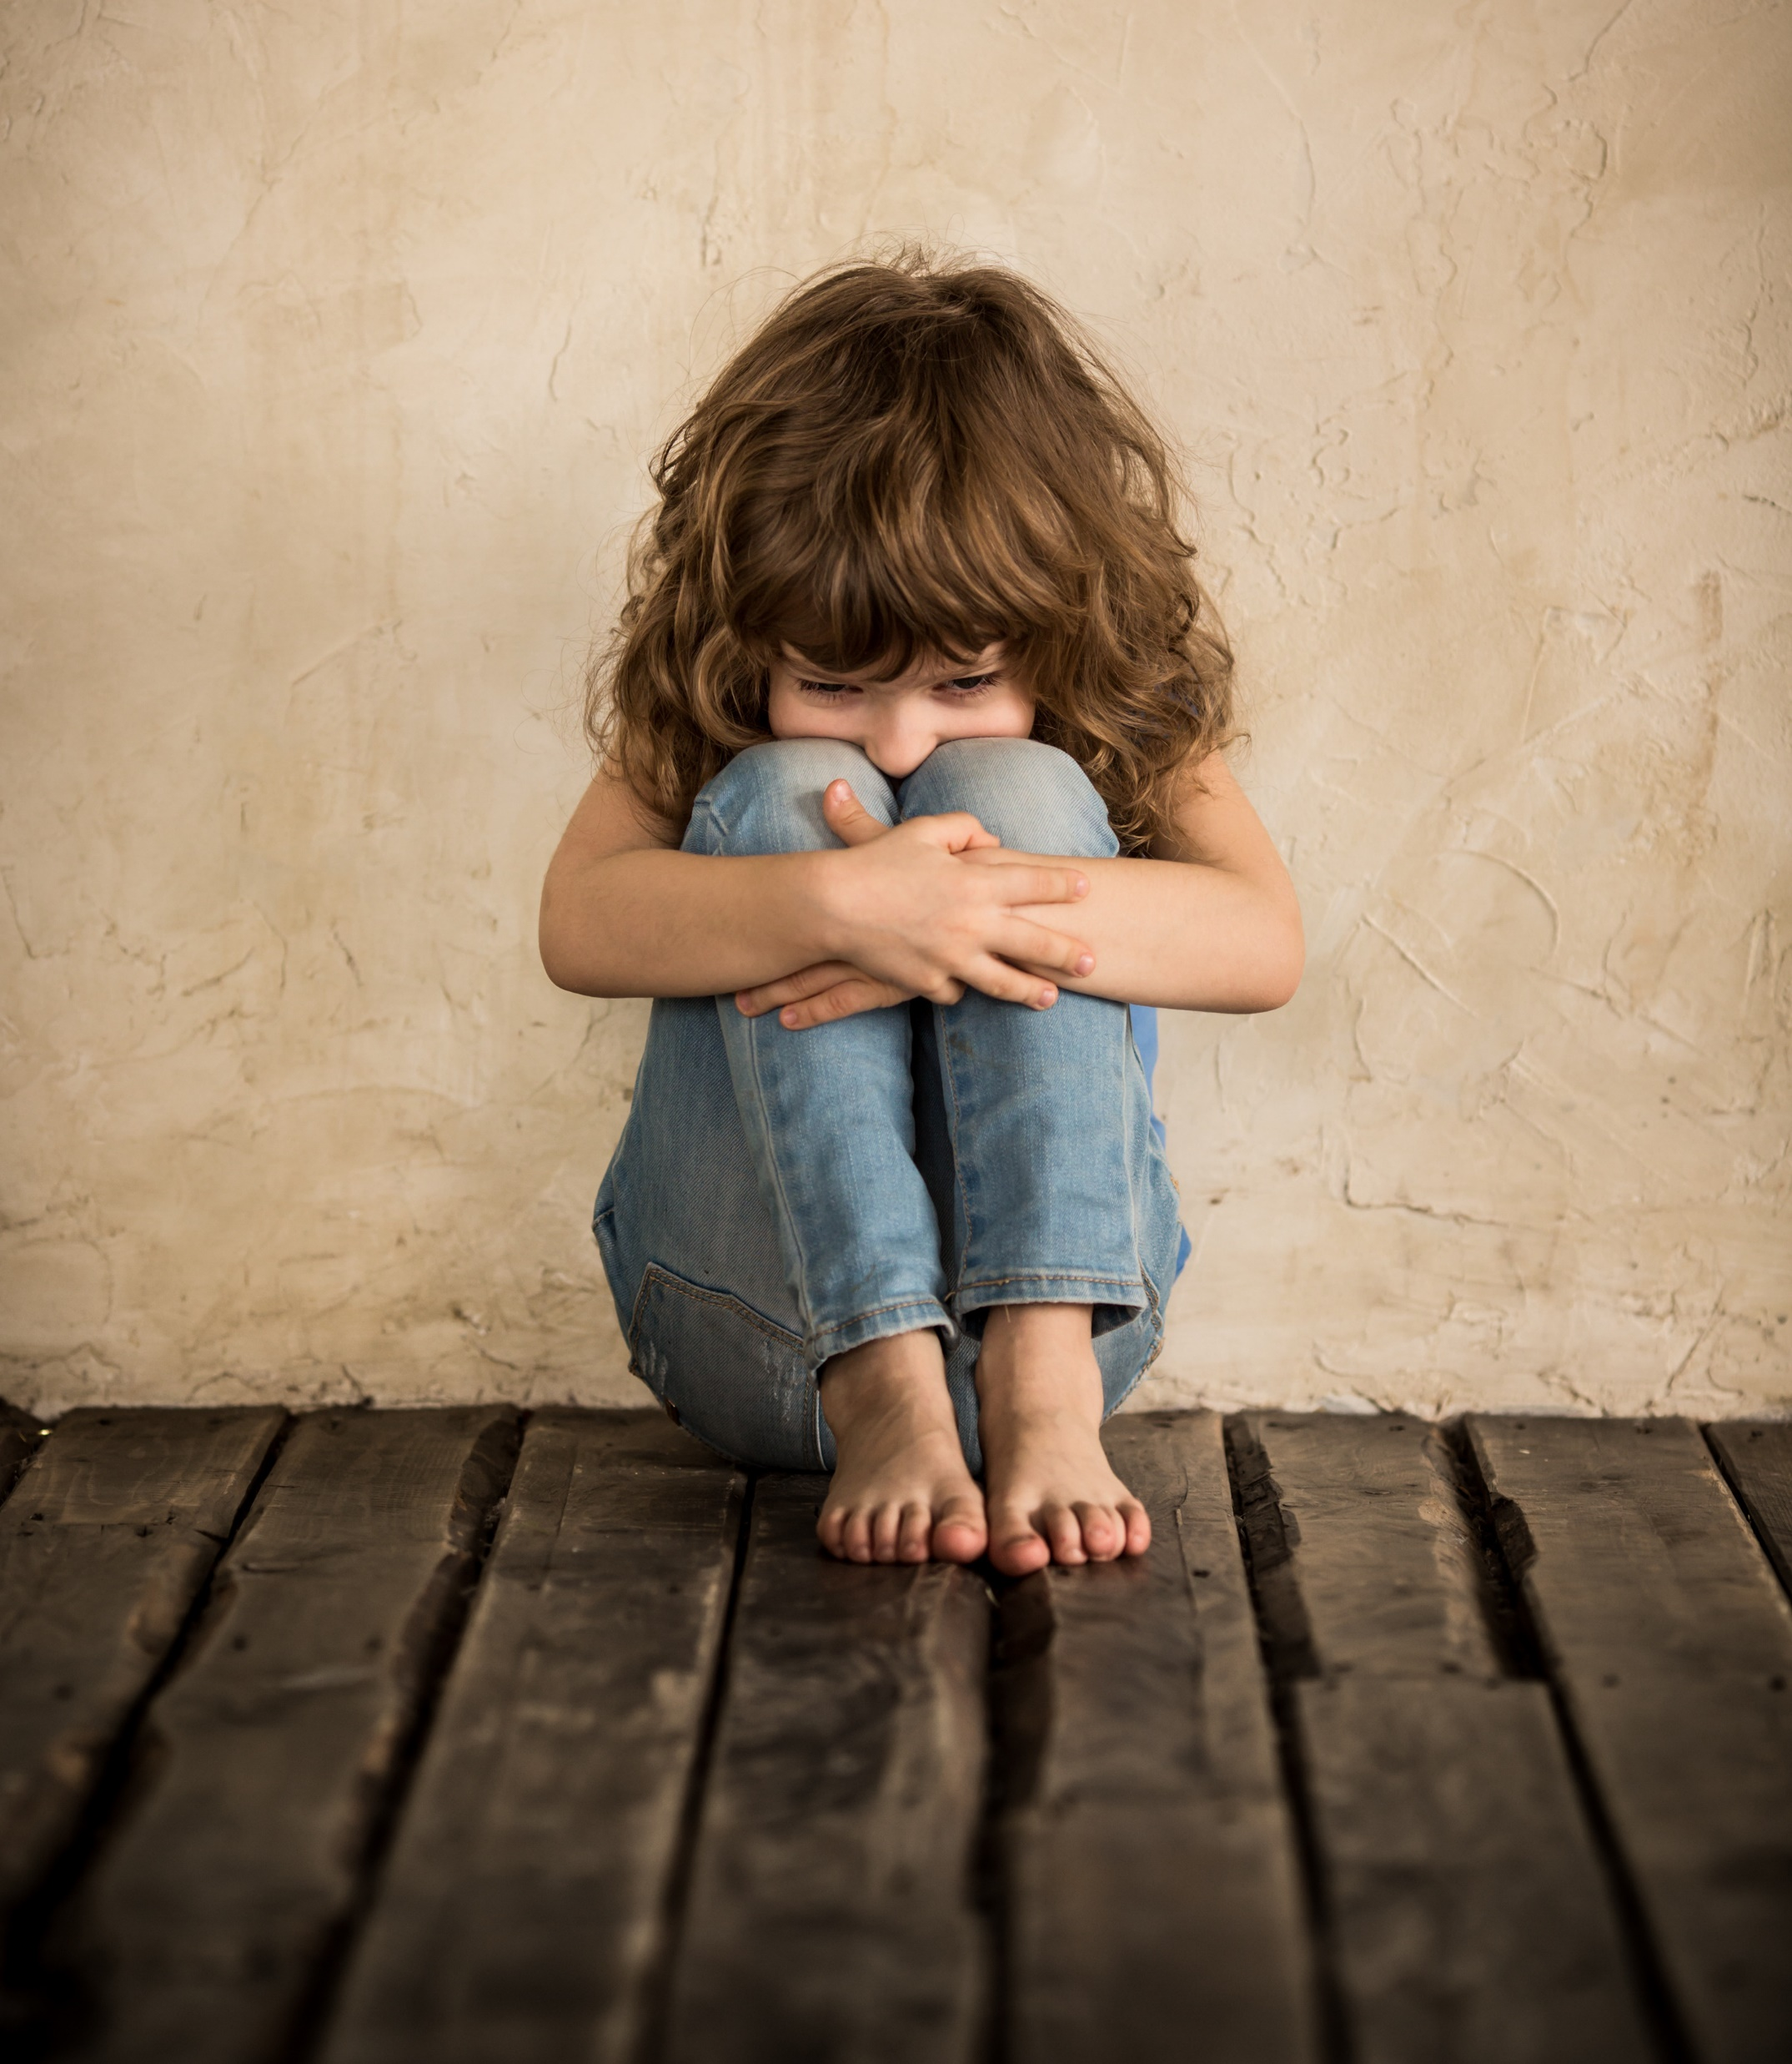
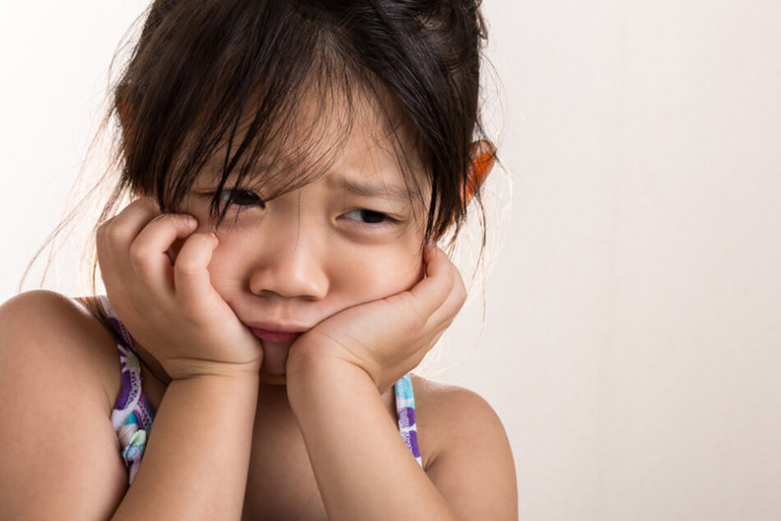
Sad Times
When you are sad, what do you want others to do?
Pray for you
Be with you
Leave you alone
Give you a hug
Send a card
Comfort you
Or ________________

Slide 4
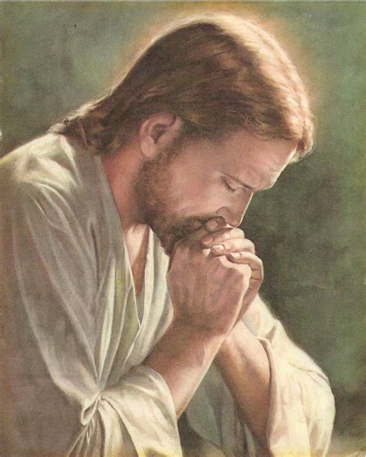
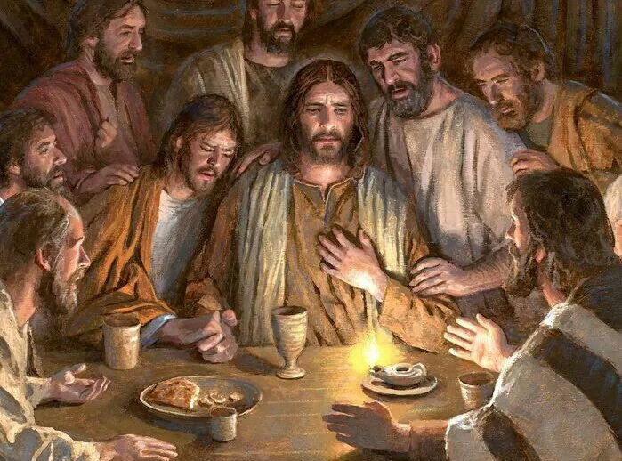
Jesus knew what to do –
He prayed.
And he comforted His friends.

Slide 5
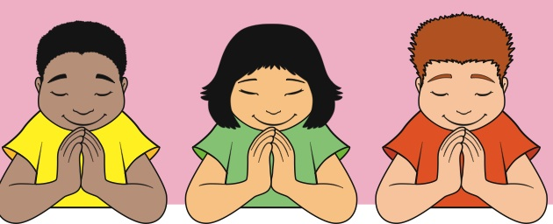
What do you want to talk to God about?
Let’s pray

Slide 6

The Lord’s Prayer
Our Father,
Which art in heaven,
Hallowed be thy name
Thy kingdom come
Thy will be done
On earth as it is in heaven
Give this day our daily bread
And forgive us our debts as we forgive our debtors.
Lead us not into temptation,
but deliver us from evil..
Tor thine is the kingdom and the power and the glory forever.
Amen.

Slide 7
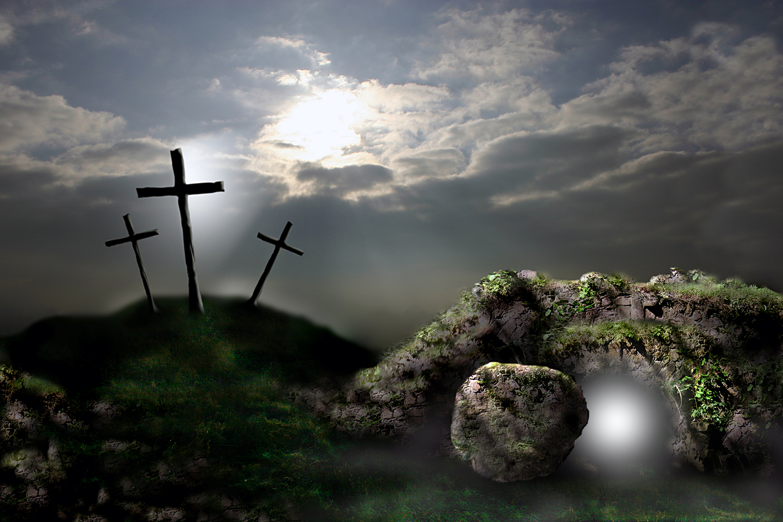
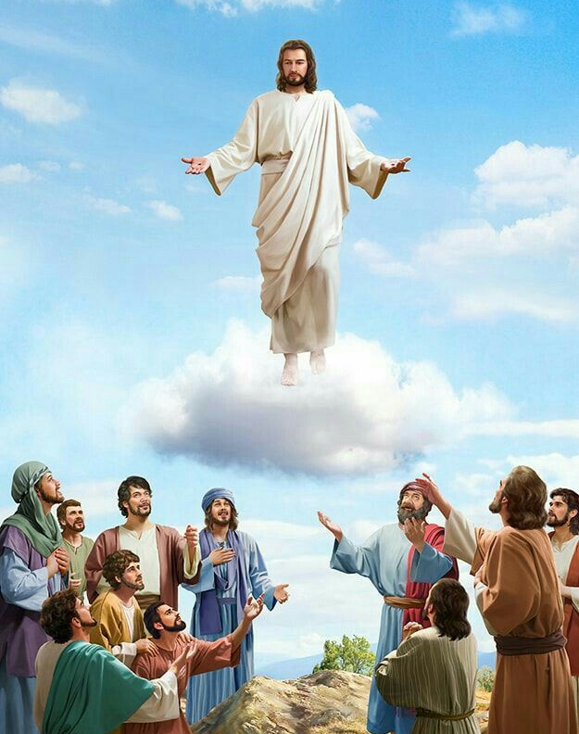
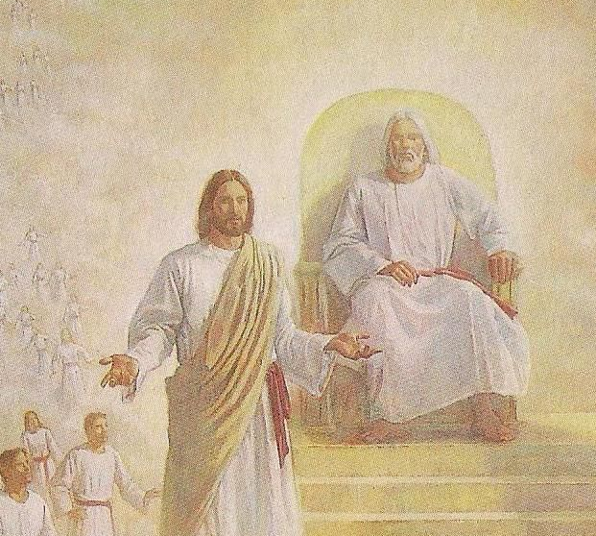
Jesus knew that He would suffer and die.
Jesus had never sinned. He was perfect.
Jesus chose to take our sins upon himself.
Jesus knew that these sins would separate Him from God for a bit.
Jesus knew that He would live again.
Jesus knew that He would go back to heaven.
Jesus knew that all of this would bring glory and praise to God.
Knowing all of this, Jesus wanted His disciples and friends to know that He cared for them.
So, he told them….

Slide 8

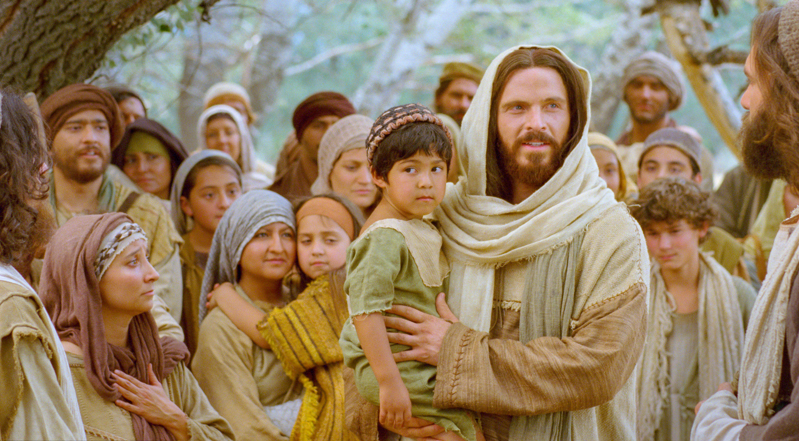
I love you – each one of you!
I will continue to care for you!

Slide 9

Jesus Loves Me – Sing Hosanna

Slide 10
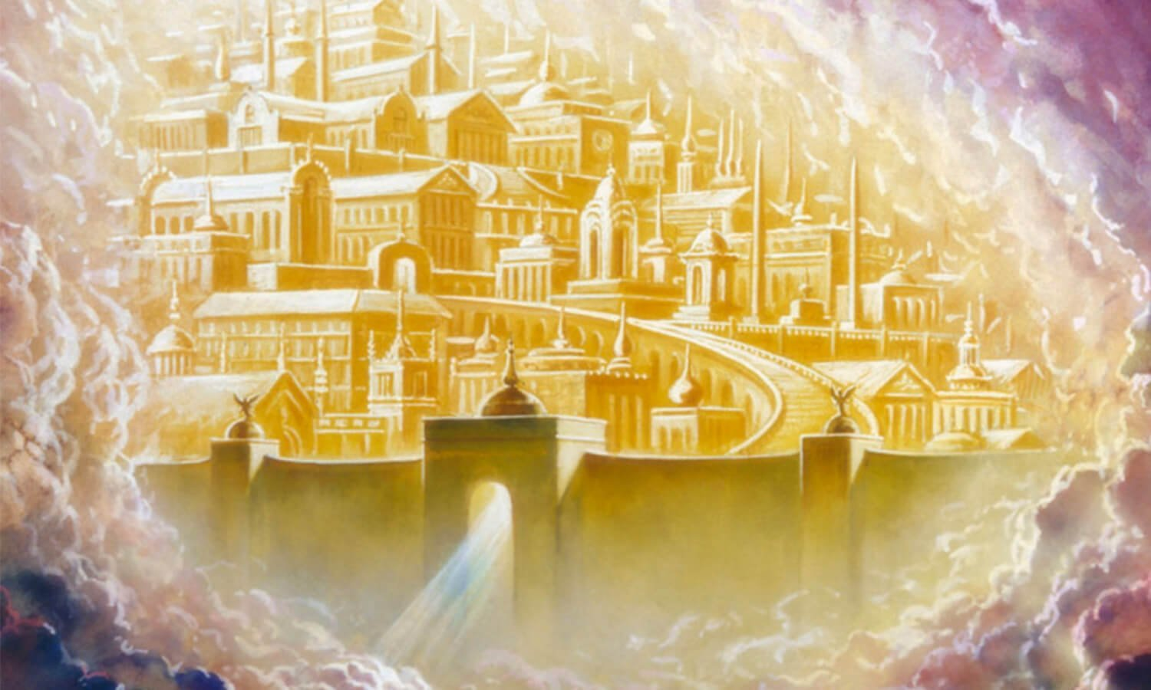
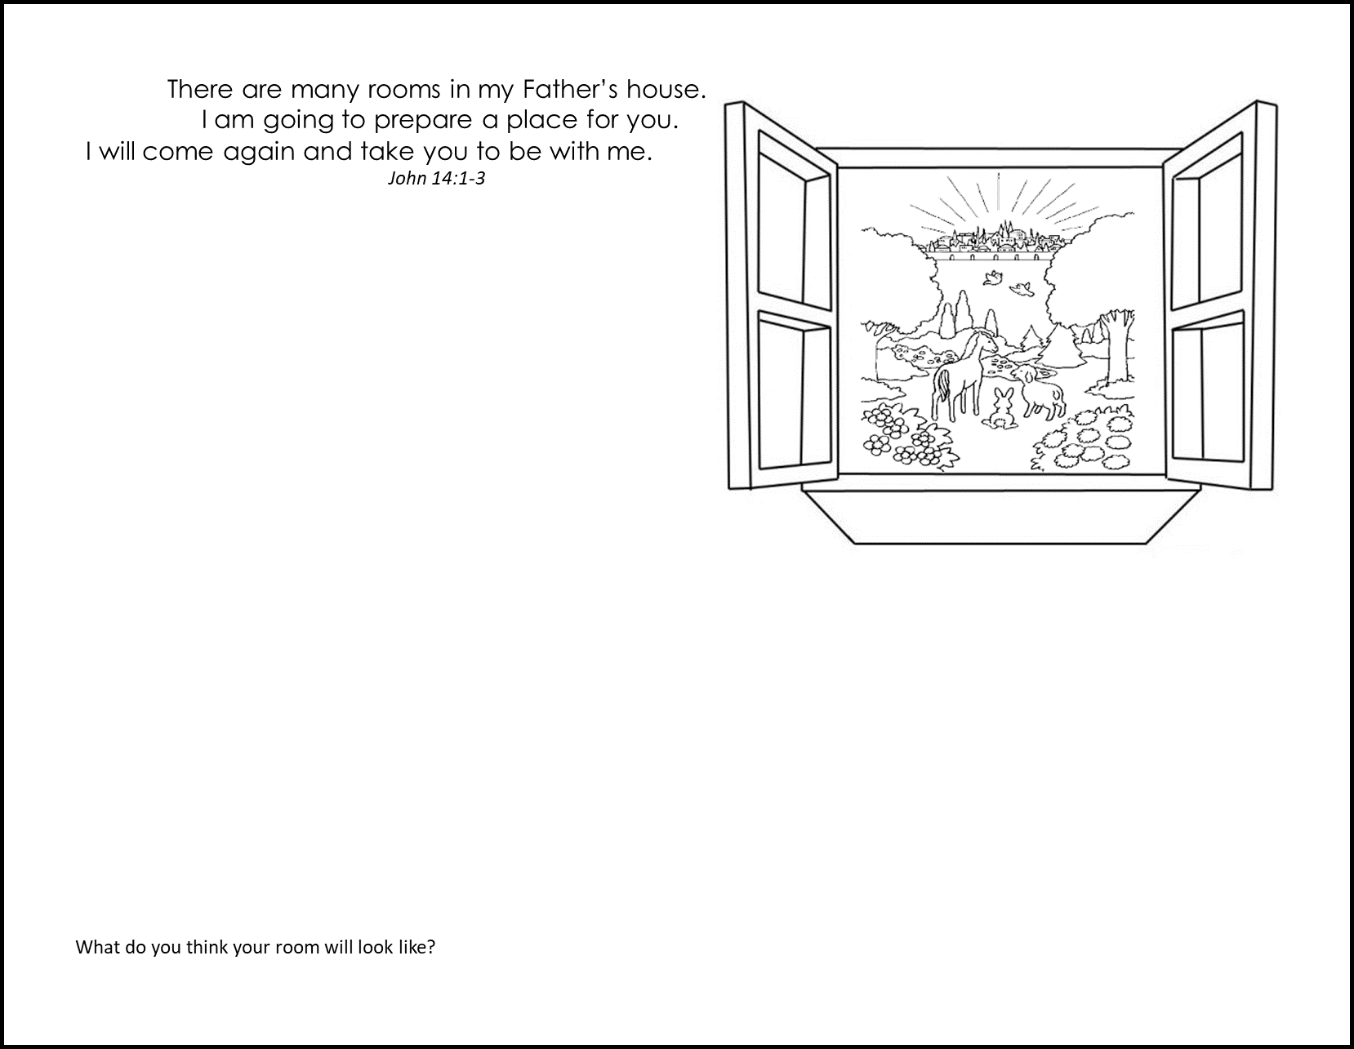
Jesus said,
I will …
There are many rooms in my Father’s house.
I am going to prepare a place for you.
I will come again
and take you to be with me.
John 14
“Do not let your hearts be troubled. You believe in God. Believe in me also.
² There are many rooms in my Father’s house. If this were not true, would I have told you that I am going there? Would I have told you that I would prepare a place for you there? ³ If I go and do that, I will come back. And I will take you to be with me. Then you will also be where I am.
⁴ You know the way to the place where I am going.”
Design your room.

Slide 11
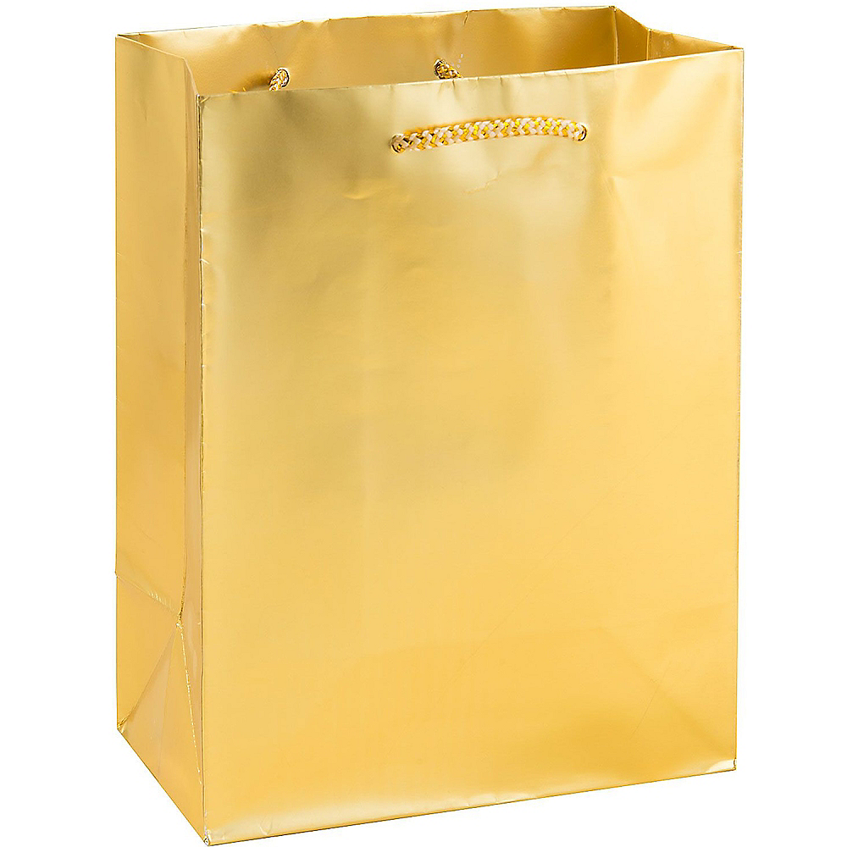
Jesus said,
I will …
I will not leave you all alone.
I will be with you.
I leave my peace with you.
Don’t worry. Do not be afraid.
My Father will also send the Holy Spirit.
John 14
¹⁸ I will not leave you like children who don’t have parents. I will come to you.
But the Father will send the Friend in my name to help you. …
²⁷ I leave my peace with you. I give my peace to you. I do not give it to you as the world does. Do not let your hearts be troubled. And do not be afraid.
The Holy Spirit is like….

Slide 12
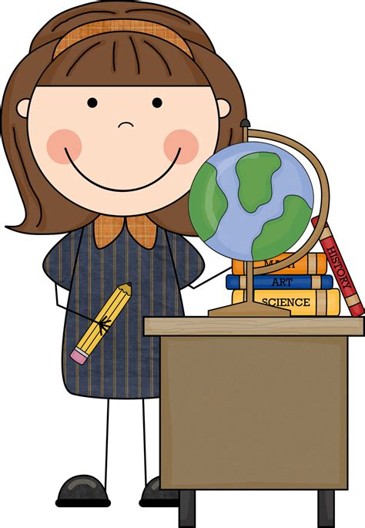
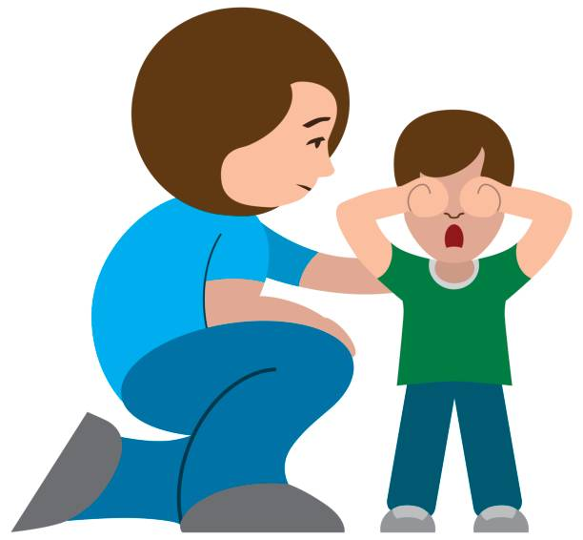
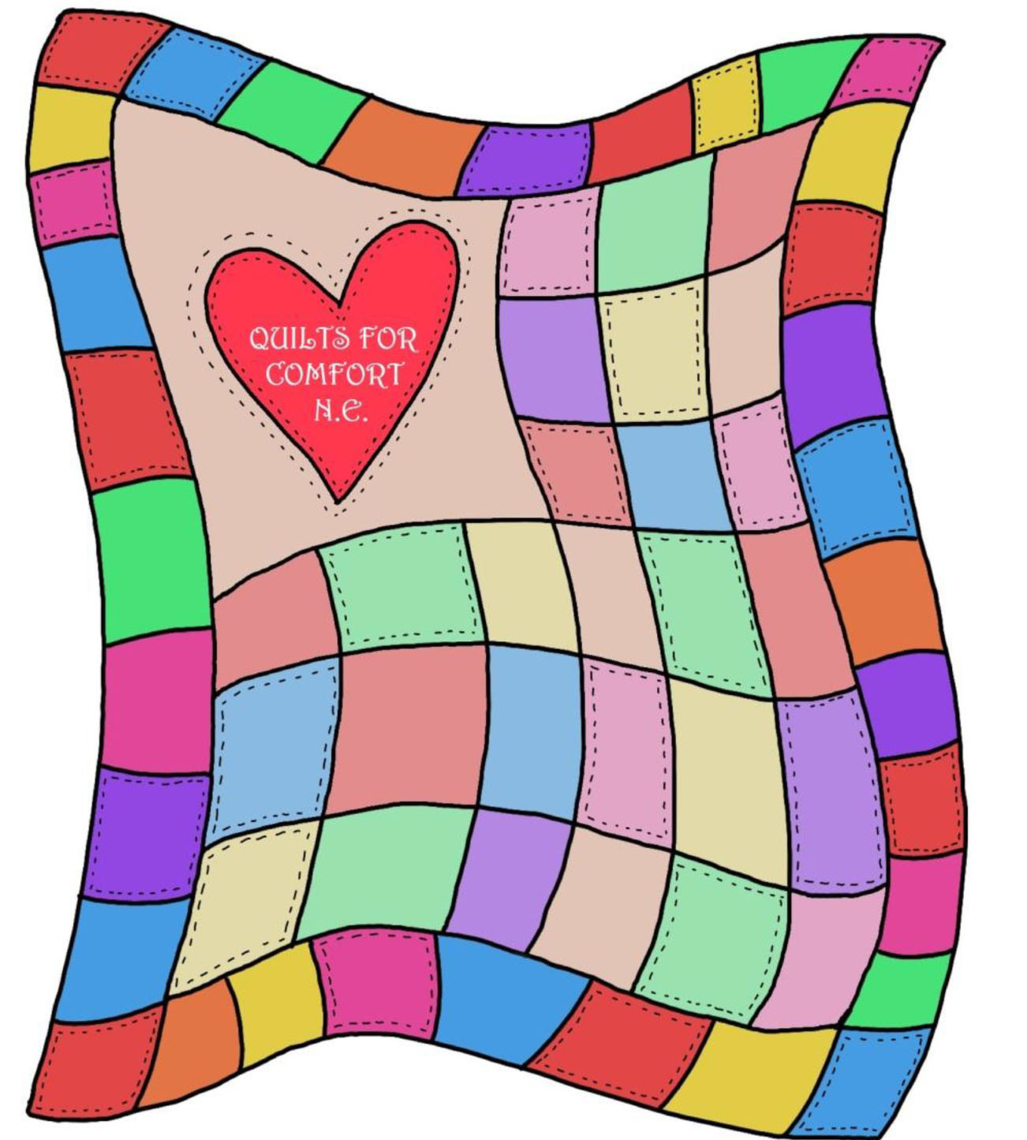
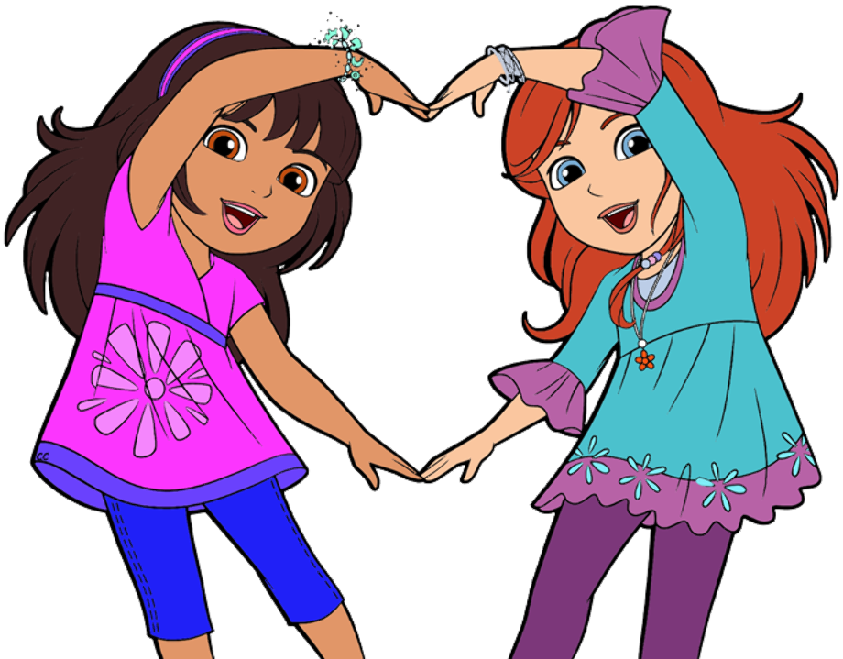

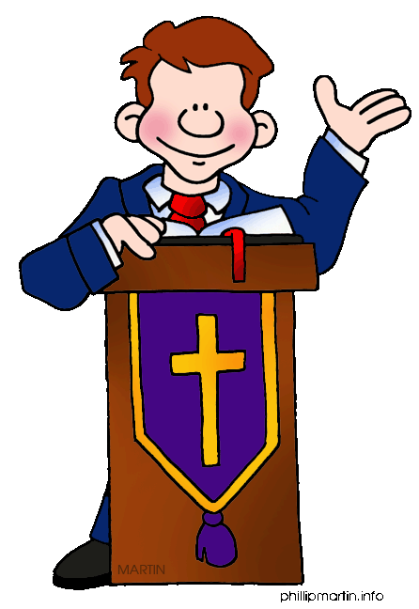
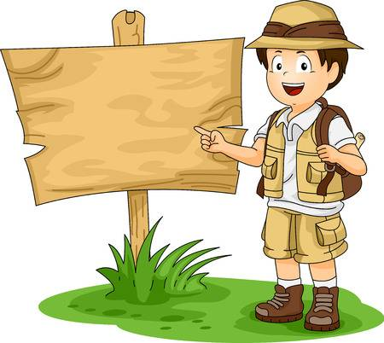
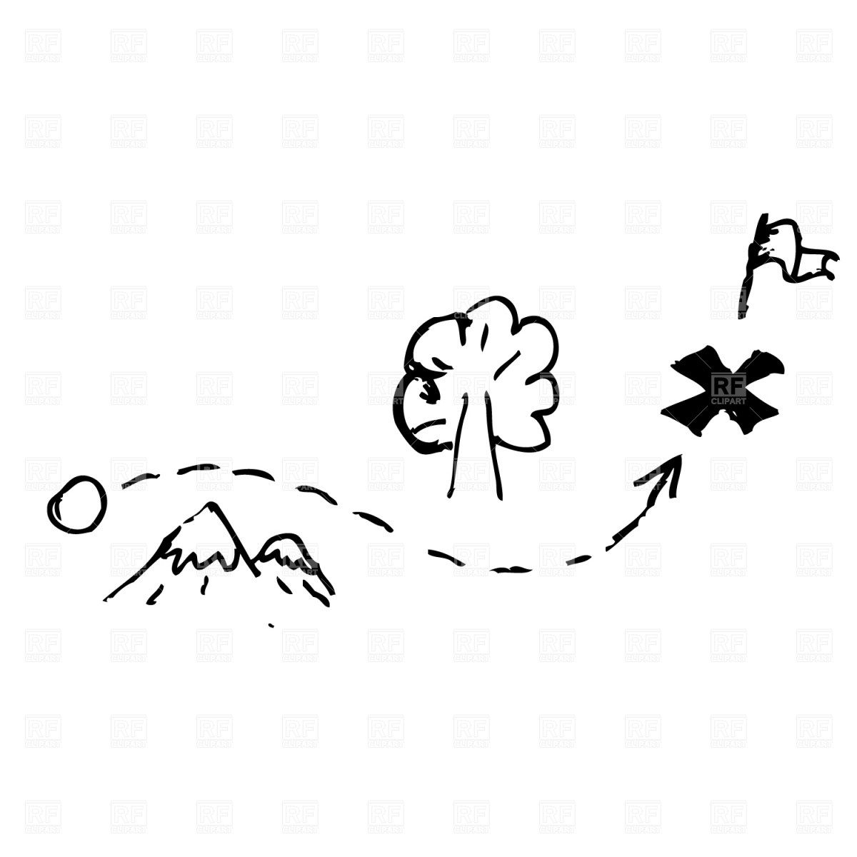
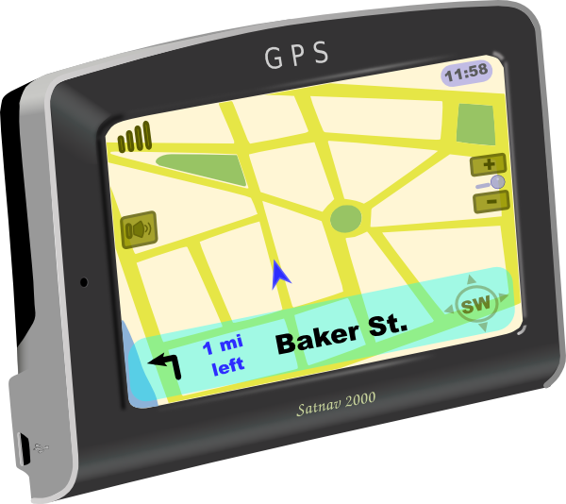
The Holy Spirit will….
A comforter
A teacher
Friend
John 14
But the Father will send the Friend in my name to help you. The Friend is the Holy Spirit. He will teach you all things. He will remind you of everything I have said to you.
John 16
¹³ But when he, the Spirit of truth, comes, he will guide you into all the truth.
Read more in John 14 & 16
This is truth
This is
truth
The Holy Spirit is like….
A guide
Teacher: take objects from a bag

Slide 13
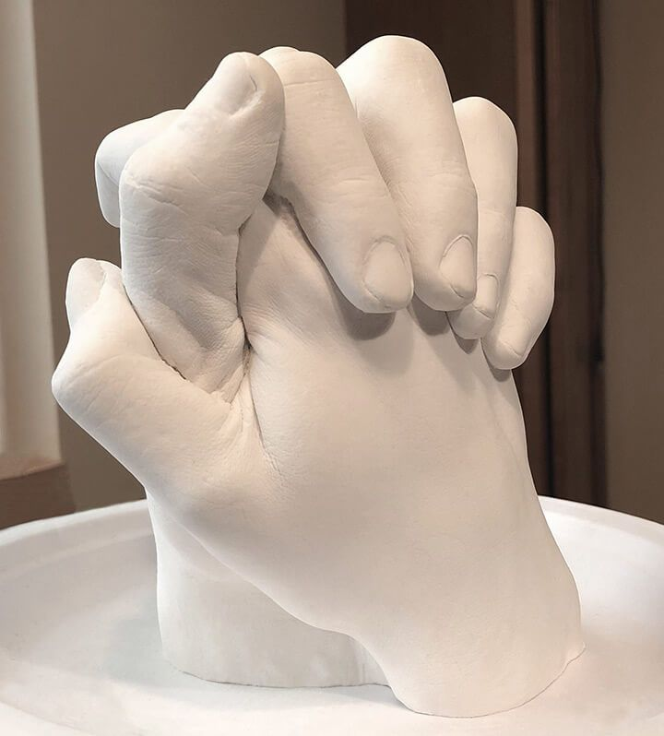
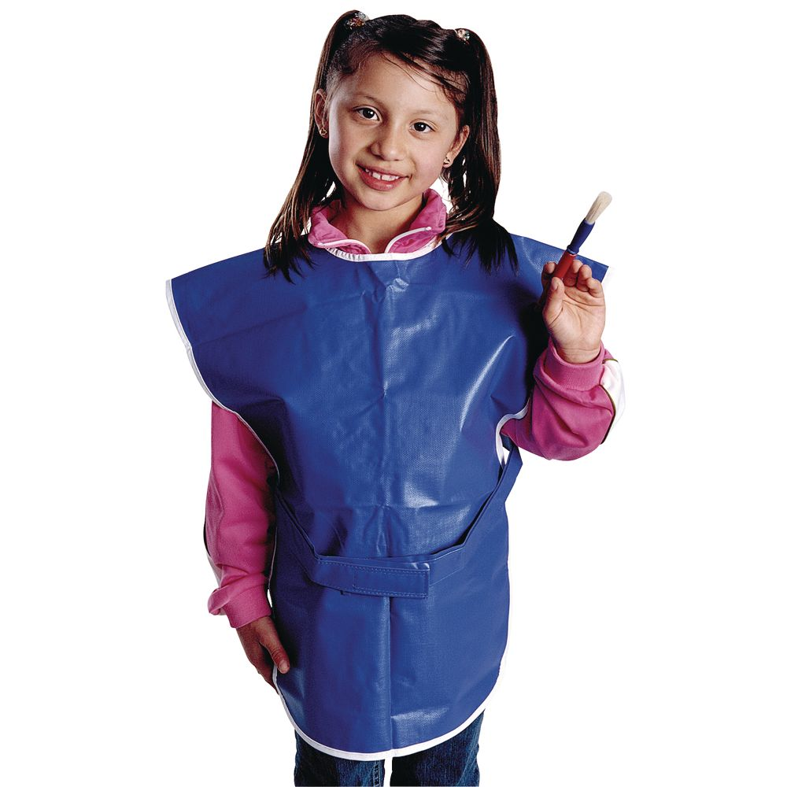
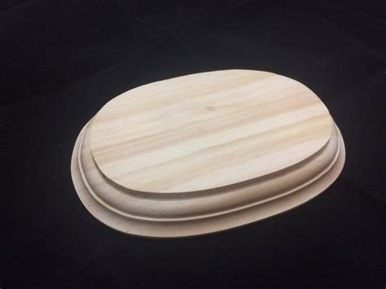
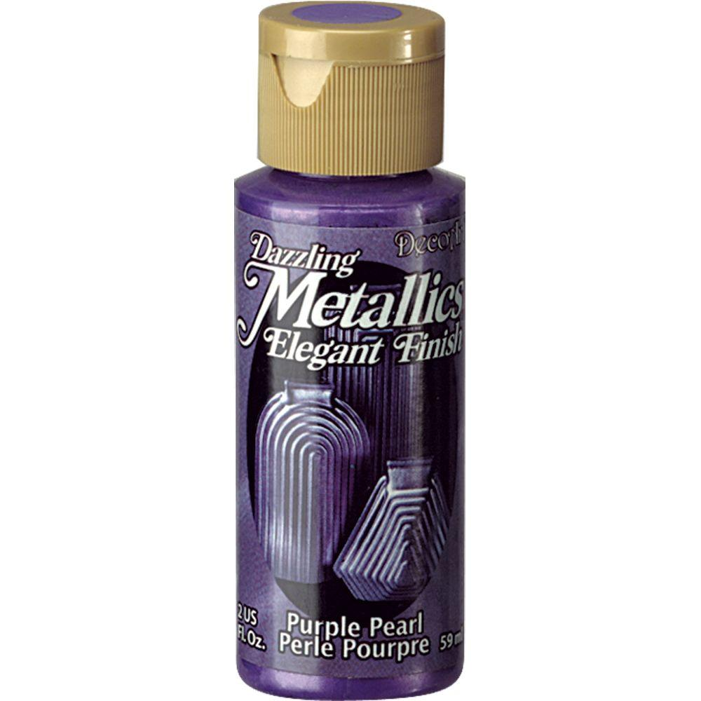
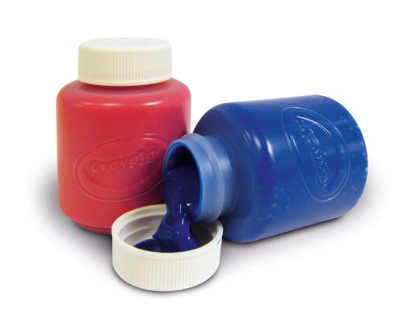
Craft time – Paint base
Put on a paint smock/shirt/bag
Paint your base.
Later I will put your folded hands casting on the base.

Slide 14
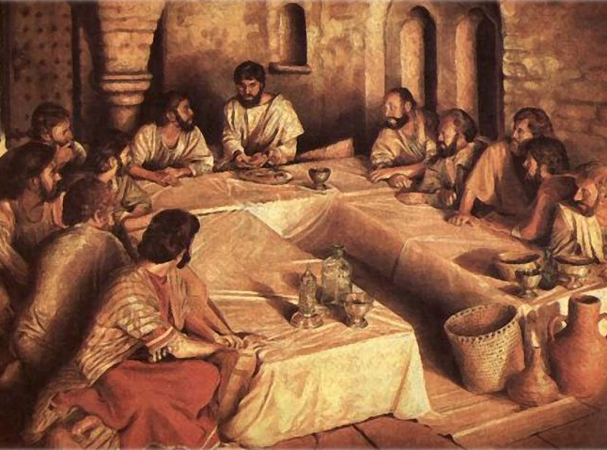
Love one another
Love one another. This way others will know that you are my disciples. You will glorify God.
^{John 13}
³⁴ “I give you a new command. Love one another. You must love one another, just as I have loved you. ³⁵ If you love one another, everyone will know you are my disciples.”
John 14
¹⁵ “If you love me, obey my commands.
John 15
⁹ “Just as the Father has loved me, I have loved you. Now remain in my love. ¹⁰ If you obey my commands, you will remain in my love. In the same way, I have obeyed my Father’s commands and remain in his love. ¹¹ I have told you this so that you will have the same joy that I have. I also want your joy to be complete. ¹² Here is my command. Love one another, just as I have loved you. ¹³ No one has greater love than the one who gives their life for their friends.

Slide 15
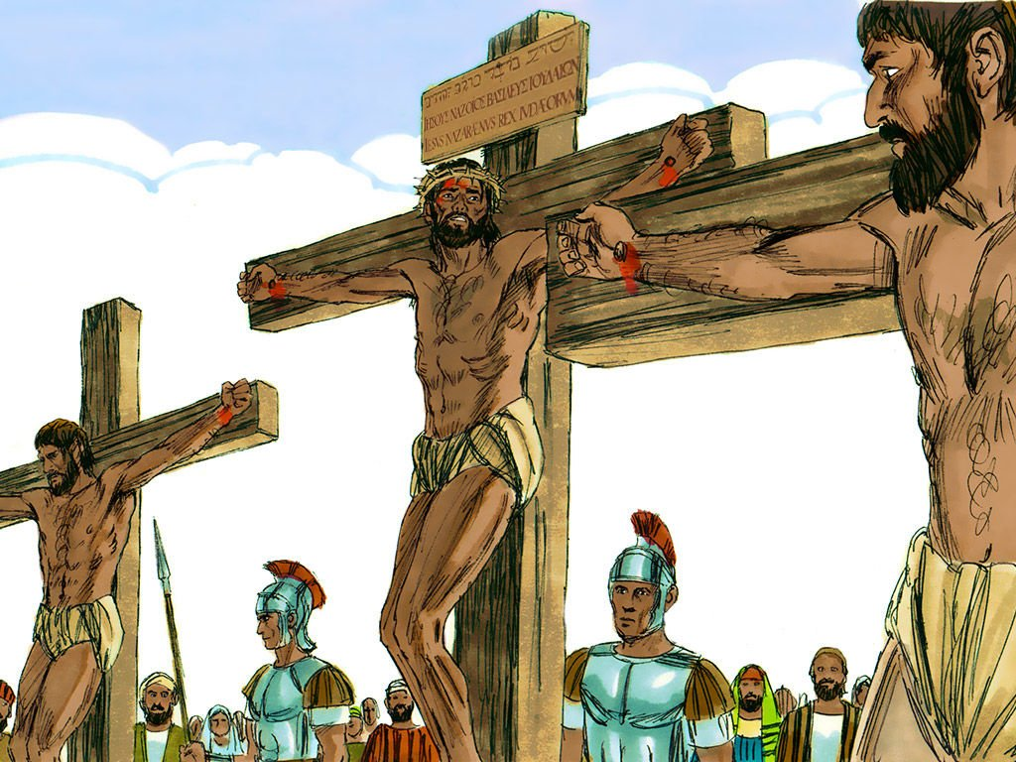
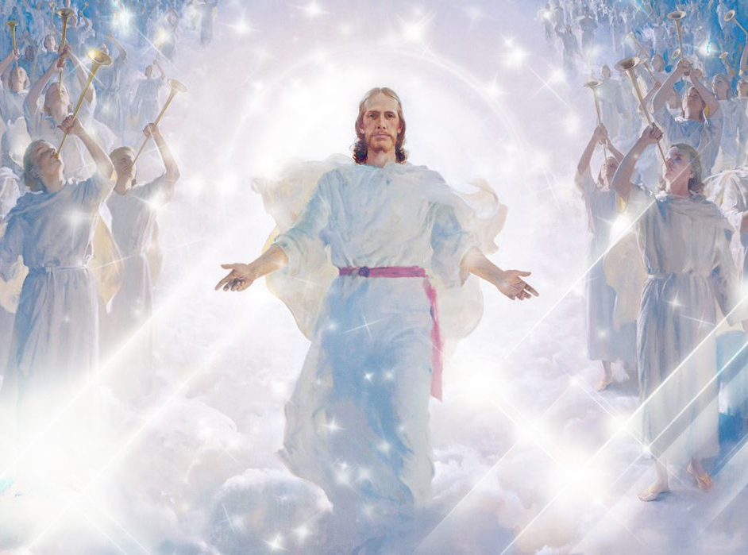
Jesus prays for himself
John 17
Forgive me
Remember me
After Jesus said this, he looked toward heaven and prayed. He said,
“Father, the time has come. Bring glory to your Son. Then your Son will bring glory to you. ² You gave him authority over all people. He gives eternal life to all those you have given him. ³ And what is eternal life? It is knowing you, the only true God, and Jesus Christ, whom you have sent. ⁴ I have brought you glory on earth. I have finished the work you gave me to do. ⁵ So now, Father, give glory to me in heaven where your throne is. Give me the glory I had with you before the world began.
He is the Son of God.
Father the time has come.
I have finished the work you gave me to do.
I will give eternal life to all you have given me.
Help others to see our love and glory so that I can glorify you.

Slide 16
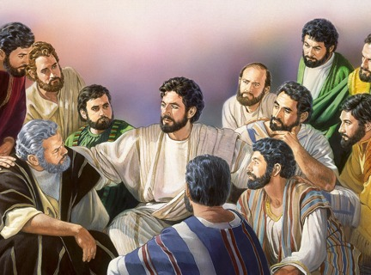
Jesus prays for the disciples
Father, I pray for the disciples which you have given me.
They believe me and the words you have given me.
Protect them.
Unify them just as You, Father and I are one.
⁶ “I have shown you to the disciples you gave me out of the world. They were yours. You gave them to me. And they have obeyed your word. ⁷ Now they know that everything you have given me comes from you. ⁸ I gave them the words you gave me. And they accepted them. They knew for certain that I came from you. They believed that you sent me. ⁹ I pray for them. I am not praying for the world. I am praying for those you have given me, because they are yours. ¹⁰ All I have is yours, and all you have is mine. Glory has come to me because of my disciples. ¹¹ I will not remain in the world any longer. But they are still in the world, and I am coming to you. Holy Father, keep them safe by the power of your name. It is the name you gave me. Keep them safe so they can be one, just as you and I are one. ¹² While I was with them, I guarded them. I kept them safe through the name you gave me. None of them has been lost, except the one who was headed for ruin. It happened so that Scripture would come true.

Slide 17
Jesus prays for the disciples
The world hates them, as it hated me.
I’m not praying that you take them out of the world, but that you will keep them safe from the evil one.
Use the truth to make them holy.
I am coming to you now.
Give them the joy that I have.
¹³ “I am coming to you now. But I say these things while I am still in the world. I say them so that those you gave me can have the same joy that I have. ¹⁴ I have given them your word. The world has hated them. That’s because they are not part of the world any more than I am. ¹⁵ I do not pray that you will take them out of the world. I pray that you will keep them safe from the evil one. ¹⁶ They do not belong to the world, just as I do not belong to it. ¹⁷ Use the truth to make them holy. Your word is truth. ¹⁸ You sent me into the world. In the same way, I have sent them into the world. ¹⁹ I make myself holy for them so that they too can be made holy by the truth.

Slide 18
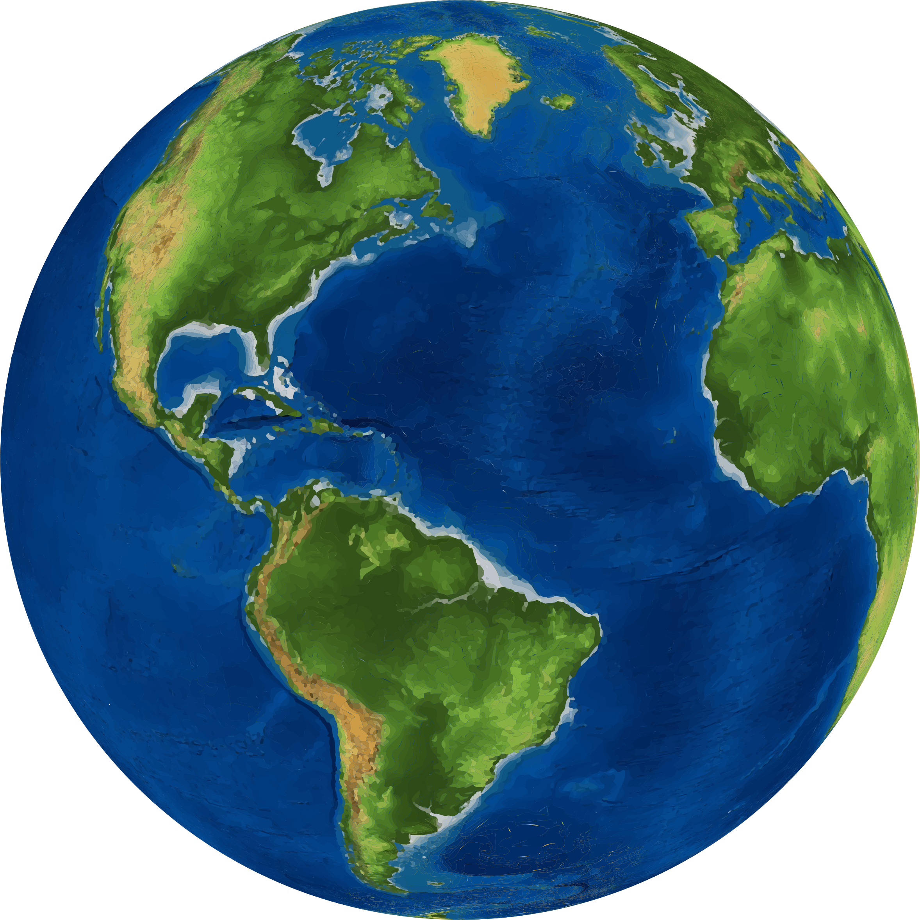
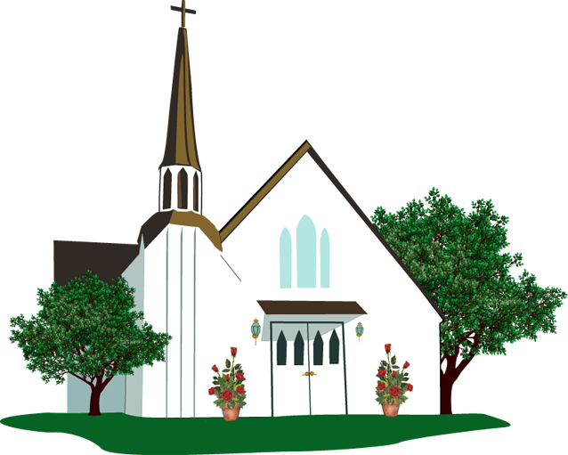

Jesus prays for future believers
Father, I also pray for all who will believe in me.
I pray that they will have unity. I want them to stay connected to us.
I will be in them just as you are in me.
I want them to be with me and to see the glory you have given me.
²⁰ “I do not pray only for them. I pray also for everyone who will believe in me because of their message. ²¹ Father, I pray they will be one, just as you are in me and I am in you. I want them also to be in us. Then the world will believe that you have sent me. ²² I have given them the glory you gave me. I did this so they would be one, just as we are one. ²³ I will be in them, just as you are in me. This is so that they may be brought together perfectly as one. Then the world will know that you sent me. It will also show the world that you have loved those you gave me, just as you have loved me.
²⁴ “Father, I want those you have given me to be with me where I am. I want them to see my glory, the glory you have given me. You gave it to me because you loved me before the world was created.

Slide 19
Jesus continued…
Father, You are Holy.
The world doesn’t know you, but I know you.
I will help the believers know you too.
Then our love will be in them.
²⁵ “Father, you are holy. The world does not know you, but I know you. Those you have given me know you have sent me. ²⁶ I have shown you to them. And I will continue to show you to them. Then the love you have for me will be in them. I myself will be in them.”

Slide 20
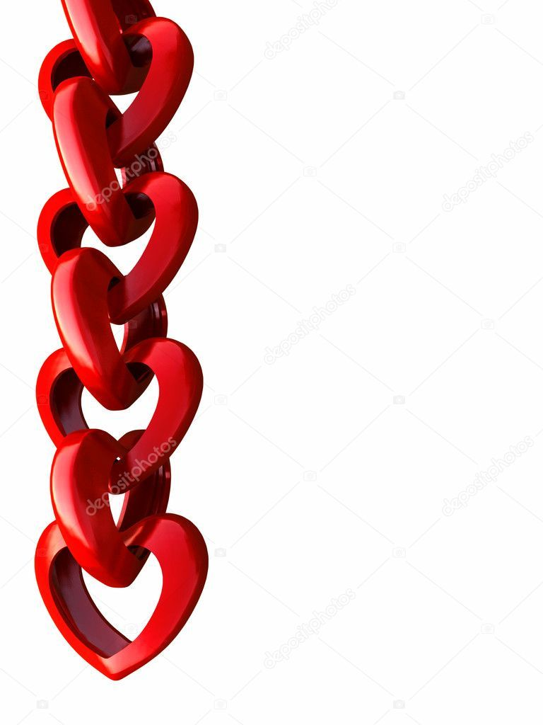
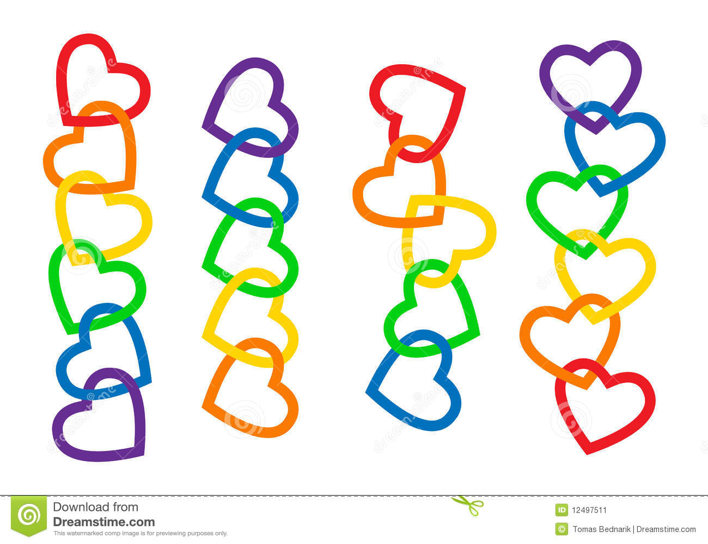
I believe in God.
I want to stay connected to Jesus and love others like Jesus wants me to.
Do you?
When we are connected in love to Jesus, we have unity!

Slide 21
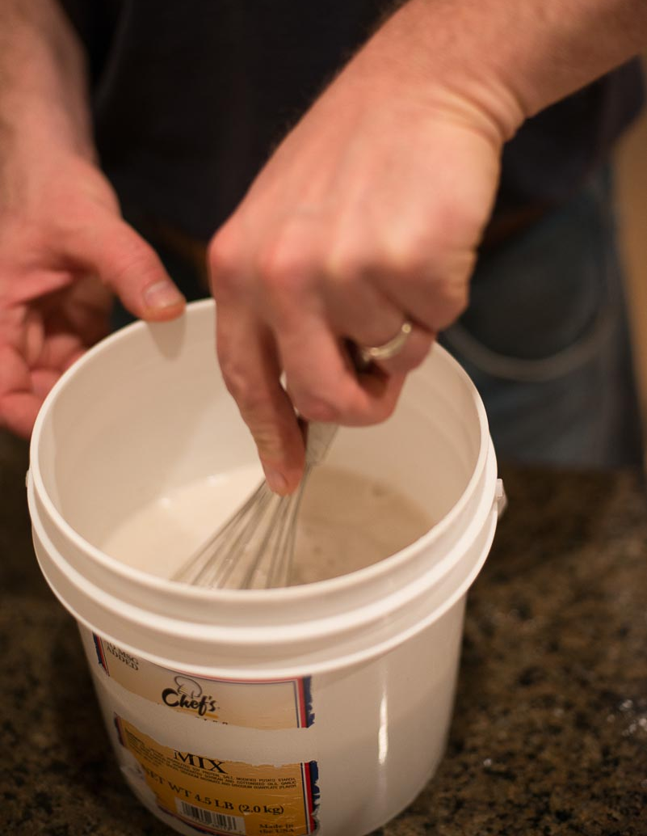
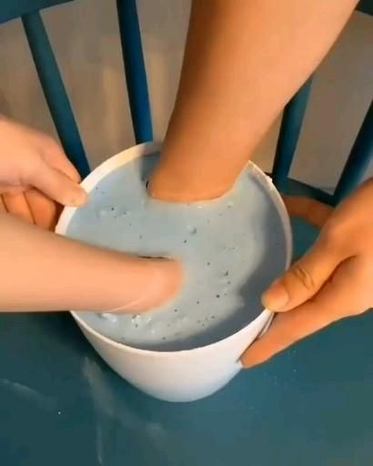
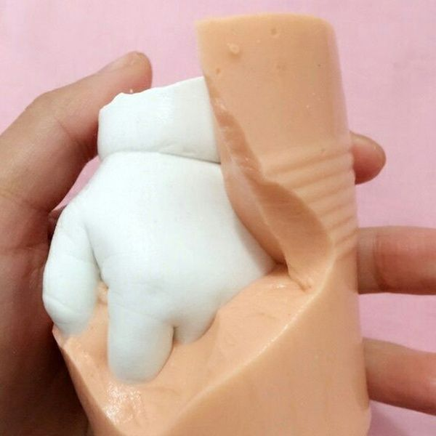
Craft time – Praying hands - 1
Making the mold Directions:
Begin by filling one of the buckets with room temperature water and pouring the entire bag of molding powder in your hand casting kit into the bucket little by little.
Mix it vigorously for around a minute and tap the bucket to release air bubbles.
Place your hand into the bucket. Touch the bottom, lift slightly, and move your hand into the desired position. Make sure you're not touching the bucket's sides.
Hold the position as the mixture begins to harden. You'll notice the color fading into a lighter tone as it sets. This process should only take around 3 to 5 minutes.
WHILE YOU’RE HOLDING STILL, WE’LL CONTINUE OUR STORY
To check if it's hardened, tap the surface. If it feels solid, gently wiggle your hand out of the mold.
One option for hand casting kit

Slide 22
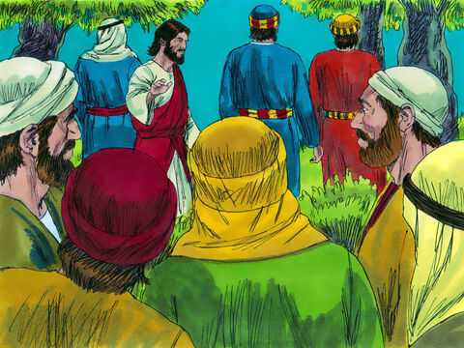
Please Pray with me
Matthew 26
³⁶ Then Jesus went with his disciples to a place called Gethsemane.
He said to them, “Sit here while I go over there and pray.”

Slide 23
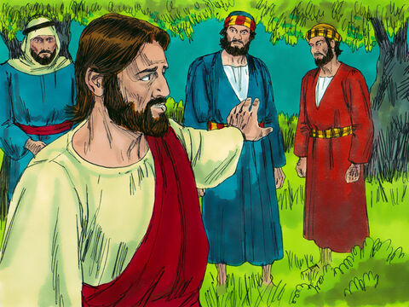
Please Pray with me
Matthew 26
³⁷ He took Peter and the two sons of Zebedee along with him. He began to be sad and troubled.
³⁸ Then he said to them, “My soul is very sad. I feel close to death. Stay here. Keep watch with me.”

Slide 24
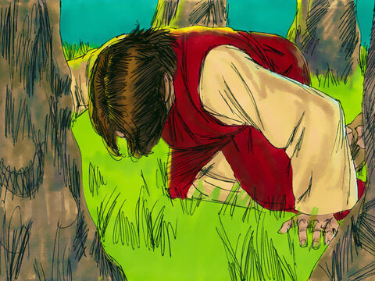
Is there another way?
³⁹ He went a little farther. Then he fell with his face to the ground. He prayed, “My Father, if it is possible, take this cup of suffering away from me. But let what you want, be done, not what I want.”
But I want to do it your way.
Your will be done.

Slide 25
Jesus took all of our sin upon himself
killing
pride
You know how God hates sin. Now He hates you.
lying
stealing
disrespect
disobey
selfishness
You look really bad!
No one will like you now.
I’m sure the devil tried to discourage Jesus. He tried to make Jesus not want to give His life and provide a way for us to be forgiven.
You don’t have to do this!
God loves the sinner. That is why I’m here.
We will show our love no matter what.

Slide 26
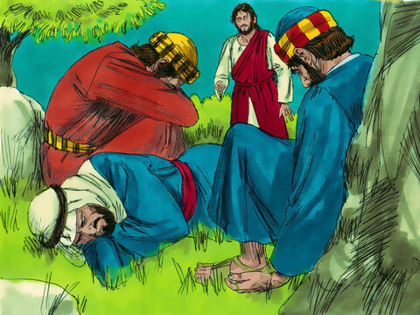
Watch and pray
⁴⁰ Then he returned to his disciples and found them sleeping. “Couldn’t you men keep watch with me for one hour?” he asked Peter.
⁴¹ “Watch and pray. Then you won’t fall into sin when you are tempted. The spirit is willing, but the body is weak.”

Slide 27
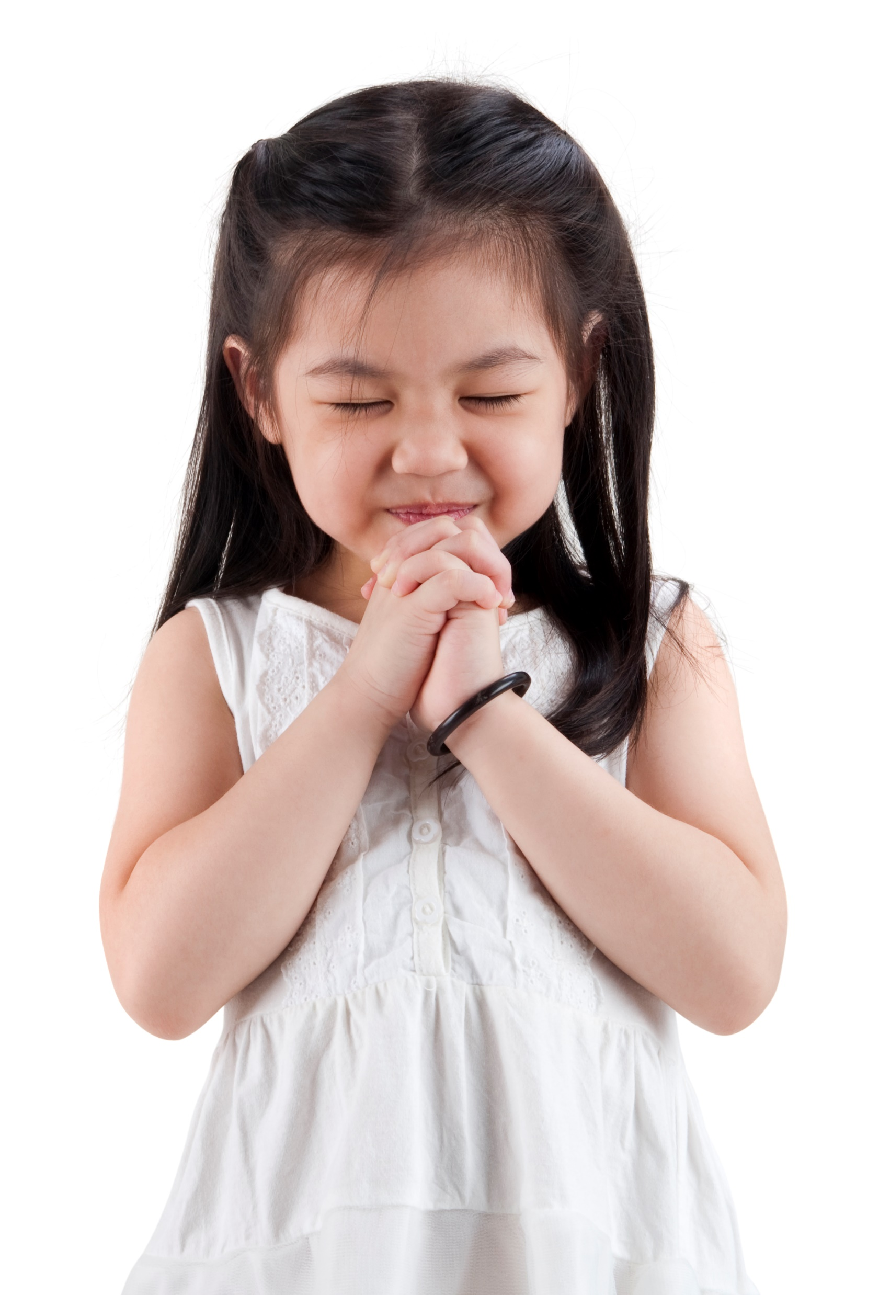
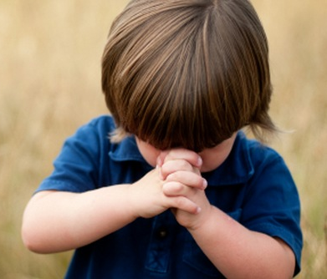

What should we do when we are tempted to do wrong?
Lord,
Help me to do what is right and good.
In Jesus’ name I pray,
Amen
“Watch and pray. Then you won’t fall into sin when you are tempted. The spirit is willing, but the body is weak.”
Dear Jesus
I am weak, but you are strong.
You can help me.
Amen

Slide 28
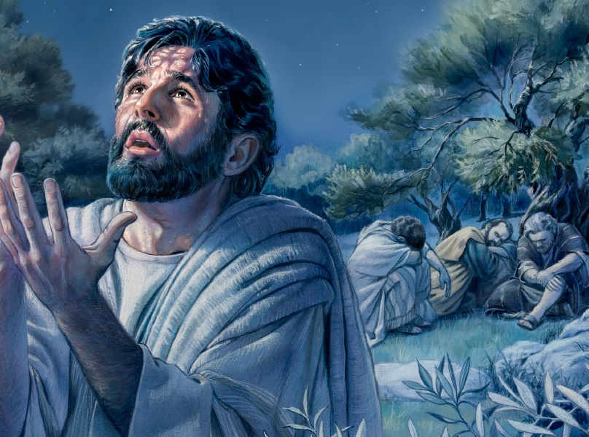
If this is the way you want it, Your will be done
⁴² Jesus went away a second time. He prayed, “My Father, is it possible for this cup to be taken away? But if I must drink it, may what you want be done.”
⁴³ Then he came back. Again, he found them sleeping. They couldn’t keep their eyes open. ⁴⁴ So he left them and went away once more. For the third time he prayed the same thing.

Slide 29
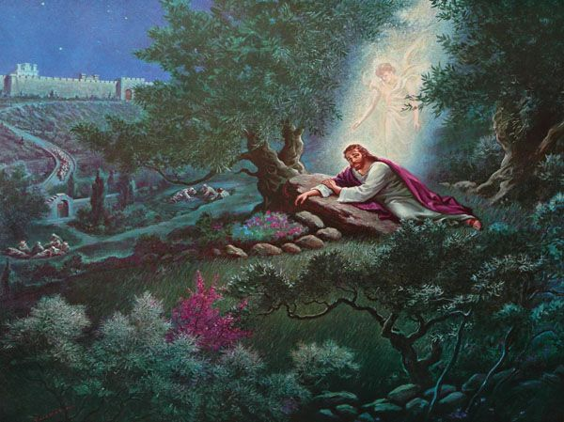
God strengthens Jesus
Luke 22
⁴³ An angel from heaven appeared to Jesus and gave him strength. ⁴⁴ Because he was very sad and troubled, he prayed even harder. His sweat was like drops of blood falling to the ground.

Slide 30

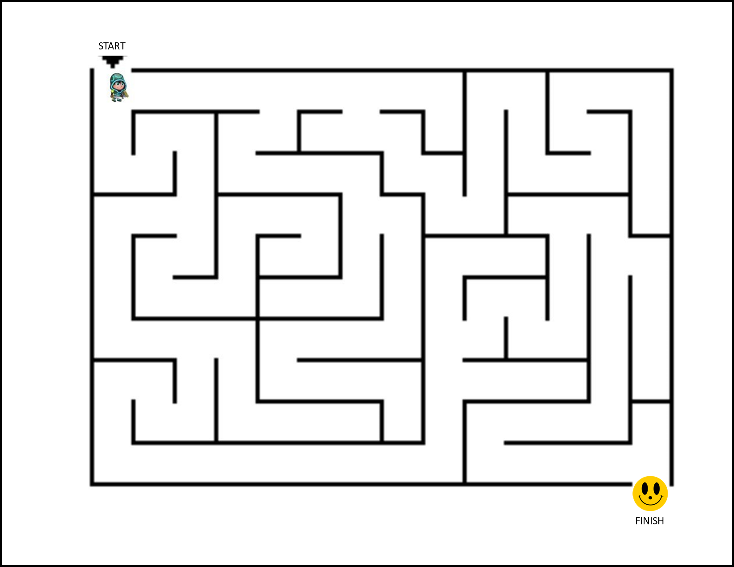

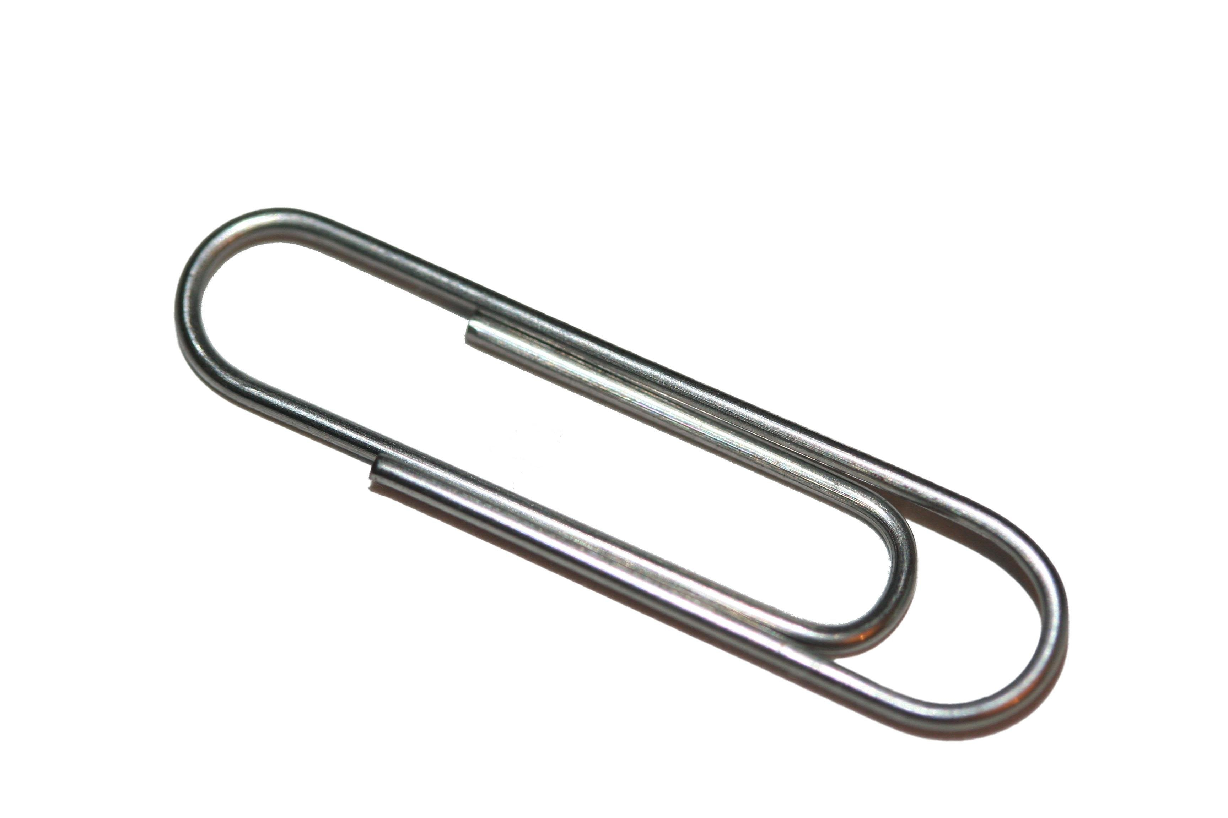
Object lesson: Thy will be done
See note page for lesson
Notes:
Object Lesson – Thy will be done
Point: In the Lord’s prayer and as He prayed in the Garden of Gethsemane, Jesus prayed, “Thy will be done.” Jesus chose to do what God wanted Him to do. We should too! We should do what God wants us to do.
Bible verses: Matthew 6:(9-10) “‘Our Father in heaven, hallowed be your name, ¹⁰ your kingdom come, your will be done, on earth as it is in heaven.” And Matthew 26:39 “Going a little farther, he fell with his face to the ground and prayed, “My Father, if it is possible, may this cup be taken from me. Yet not as I will, but as you will.”
Objects: a simple maze copied on card stock paper, page protector, paper clip, magnet
Set-up: Put the copy of the maze into the page protector. Put a magnet (loose) in the page protector on top of the maze then tape the top of the page protector. Prepare one for each child or for a few children to come up and demonstrate.
Object lesson talk: I have a challenge for you. (Option 1) Here is a maze for each of you.
(Option 2) I need a couple volunteers. (choose a couple) Here is a maze for each of you.
(Without touching the paper clip, make it go through the maze between the correct lines from start to finish.
That’s an easy maze. Was it easy to do? (No the clip kept sliding the wrong way or too far.)
Maybe this will help you. (Give each a magnet.) Can use this to make the clip go the right way?
The magnet represents God. The clip is connected to the magnet like we should stay connected to God. God knows what is best for us. He knows the way to happiness. If we choose to stay connected to Him and let Him direct us, we are doing His will. Another way to say that is that we are going where He wants us to go and doing what He wants us to do. We are doing His will.
Jesus prayed in the Garden of Gethsemane just before He was going to die on the cross. He prayed, “My Father, if it is possible, may this cup be taken from me. Yet not as I will, but as you will.” Even though it would hurt and be a really hard thing to do, Jesus wanted to do what God wanted. This is what He had come to earth to do.
Do you remember the Lord’s Prayer? Jesus taught us to pray: “‘Our Father in heaven, hallowed be your name, ¹⁰ your kingdom come, your will be done, on earth as it is in heaven.” We should do God’s will just like the angels in heaven do God’s will. They are quick to obey Him and respect His decisions.
Do you want to respect and obey God by doing His will?

Slide 31
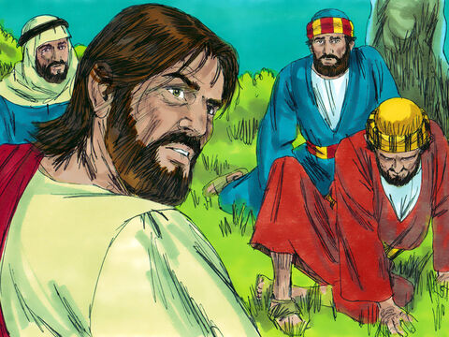
Get up!
It’s time!
⁴⁵ Then he returned to the disciples. He said to them, “Are you still sleeping and resting? Look! The hour has come. The Son of Man is about to be handed over to sinners. ⁴⁶ Get up! Let us go! Here comes the one who is handing me over to them!”
We will continue our story next week……

Slide 32

Whisper a prayer
Whisper a prayer
In the morning
Whisper a prayer
At noon
Whisper a prayer
In the evening
To keep your heart in tune
Other verses:
God answers prayer
Jesus may come

Slide 33

Oh, How He Loves You and Me

Slide 34
Jesus Loves Me – Sing Hosanna

Slide 35

Thy Will Be Done

Slide 36


Teacher – after class add plaster
Plaster Hands Directions:
Add water to the other bucket and pour the entire bag of casting powder in your hand casting kit into it little by little as you stir it.
Continue stirring until it has a smooth and paint-like consistency.
Pour the mixture into the mold until it's filled halfway. Tilt and rotate the bucket at a 45-degree angle to make sure the mixture spreads around and prevents air bubbles from being trapped around the fingertips.
Fill the mold up with the remaining mixture and tap the sides to release air bubbles.
Put mounting bolts into wet plaster wrists and through a piece of cardstock paper. This paper can be your guide later for making the holes in the wood base for the bolts to go into.
More Wikipedia instructions

Slide 37
Finish Praying hands - 3
Finish Plaster Hands Directions:
Check your molding kit after 3 to 5 hours and if it feels solid, turn the bucket upside down.
Carefully peel the mold away from the casting, and leave it to dry for 24 hours.
Use the demolding stick to remove any bubbles.
Place your cast on the wooden stand included in your hand casting kit to display it in your home.

