Slide 1
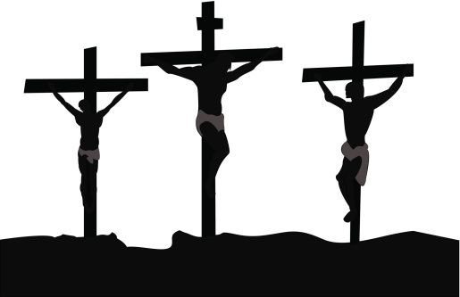
And Dies for Us
Jesus offers forgiveness

Slide 2


Have you ever had a very sad day?
What happened?
How did you feel?
Jesus had a very sad day.

Slide 3
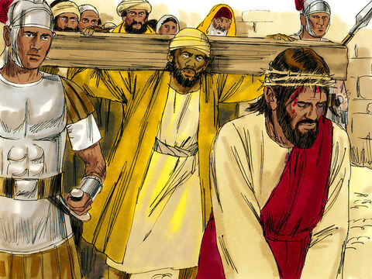
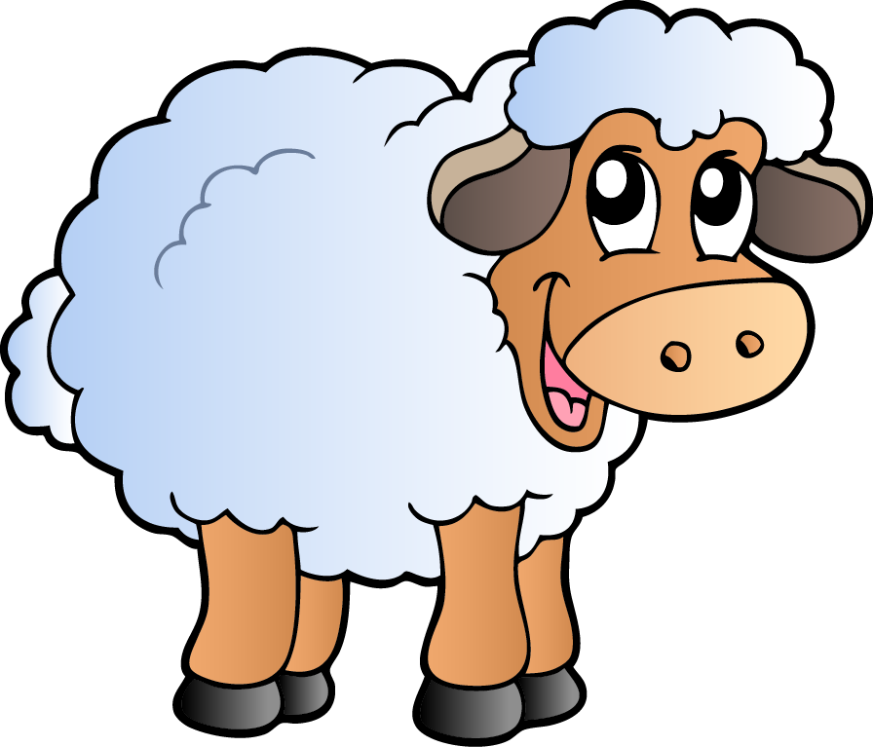
Luke 23:26-27 A sad day
I will do this for Jesus.
Remember the leaders wanted to kill Jesus.
They convinced Pilate to have him crucified.
Mark 15
²¹ A certain man from Cyrene, Simon, the father of Alexander and Rufus, was passing by on his way in from the country, and they forced him to carry the cross. ²² They brought Jesus to the place called Golgotha (which means “the place of the skull”).
I have chosen to take my people’s punishment
Simon was a helper.

Slide 4
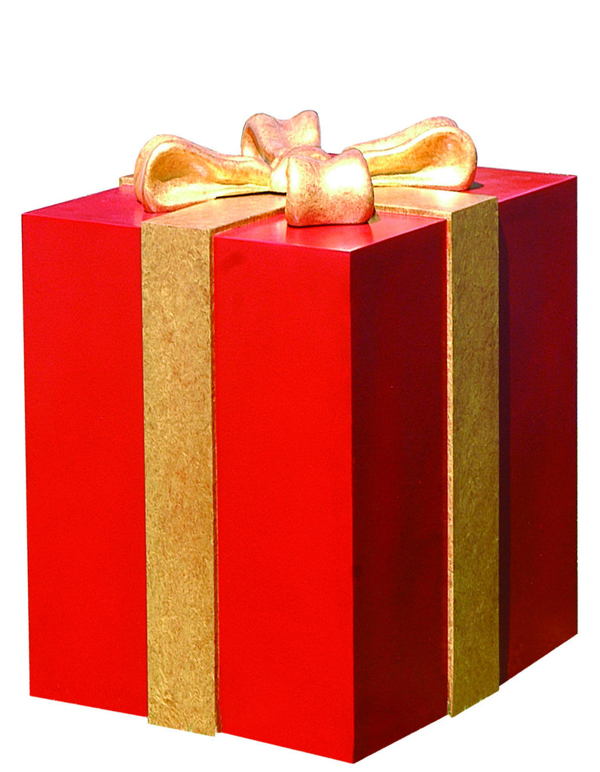
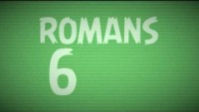
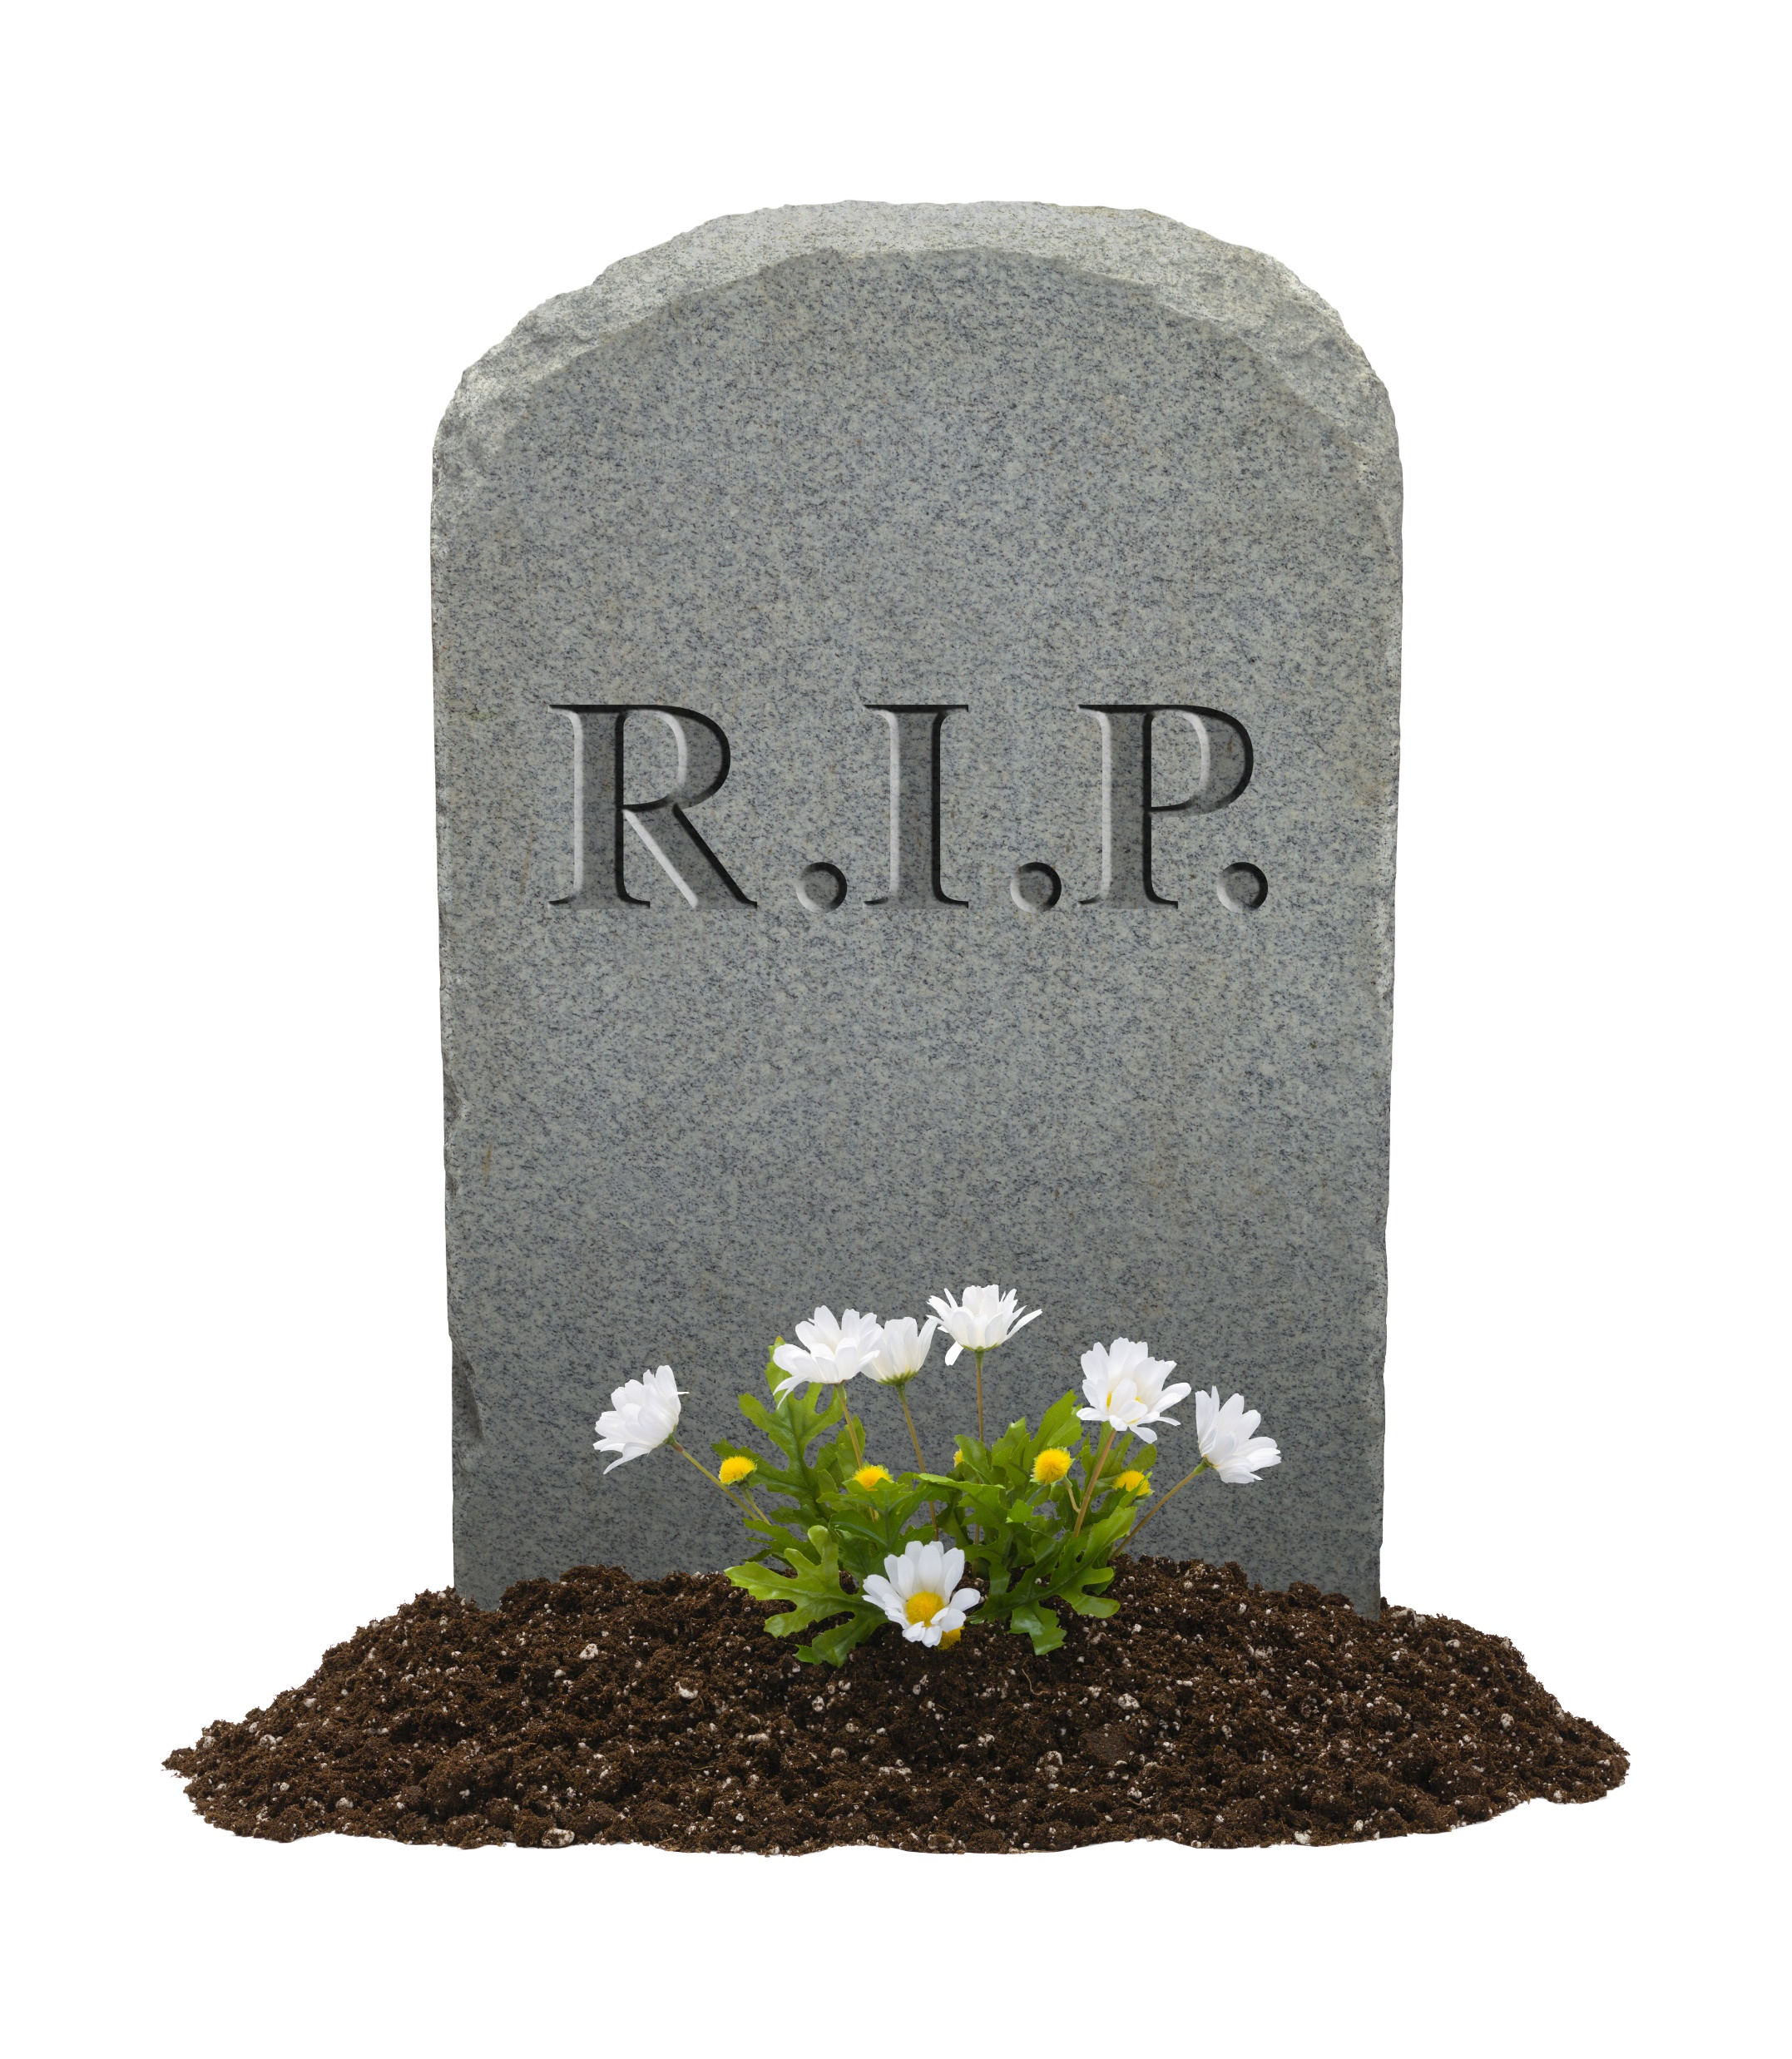
Romans 6:23
But the
Gift of God
Is
Eternal life
For the
Wages of sin
is death

Slide 5
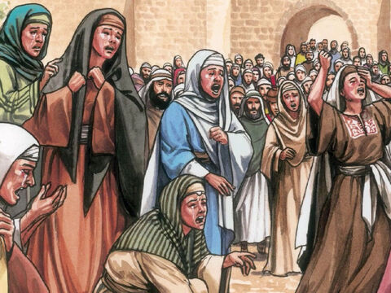
Many people cried
Matthew 27
²⁷ A large number of people followed him, including women who mourned and wailed for him. ….
I would cry. Would you cry?
It was a very sad day.

Slide 6
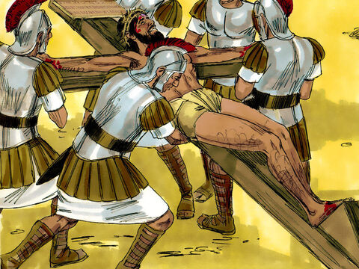
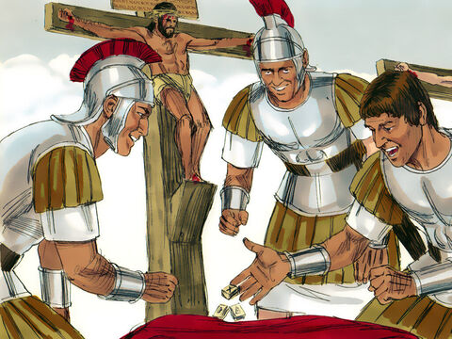
They put Jesus on a cross like he was the worst sinner. Jesus forgave them!
Luke 23
³² Two other men, both criminals, were also led out with him to be executed.
³³ When they came to the place called the Skull, they crucified him there, along with the criminals—one on his right, the other on his left.
³⁴ Jesus said, “Father, forgive them, for they do not know what they are doing.”^{[c]}
And they divided up his clothes by casting lots.
Father, forgive them.
They don’t know what they are doing.

Slide 7
What does forgiveness mean?

Slide 8
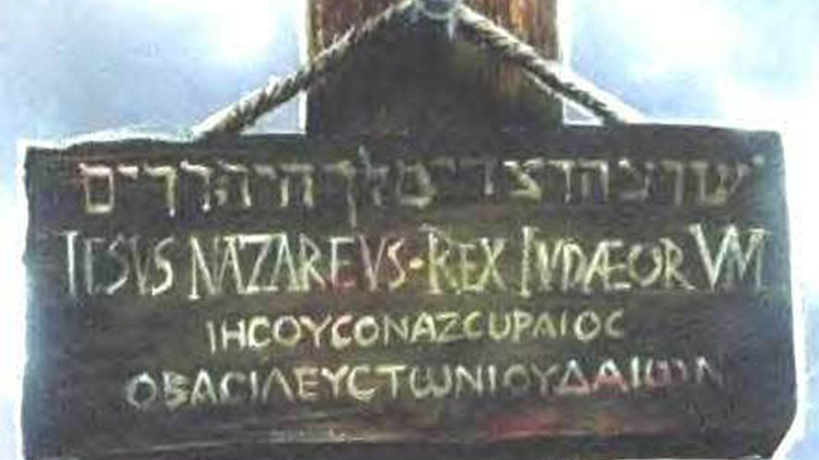
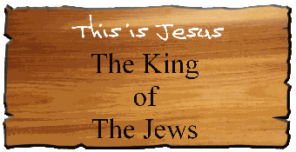
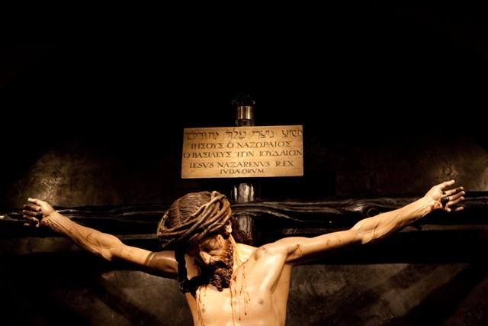
King Jesus loves us so much!
John 19
¹⁹ Pilate had a notice prepared and fastened to the cross. It read: jesus of nazareth, the king of the jews. ²⁰ Many of the Jews read this sign, for the place where Jesus was crucified was near the city, and the sign was written in Aramaic, Latin and Greek. ²¹ The chief priests of the Jews protested to Pilate, “Do not write ‘The King of the Jews,’ but that this man claimed to be king of the Jews.”
²² Pilate answered, “What I have written, I have written.”
Our King, Jesus, loves us so much that He came to take our punishment and die for us.

Slide 9
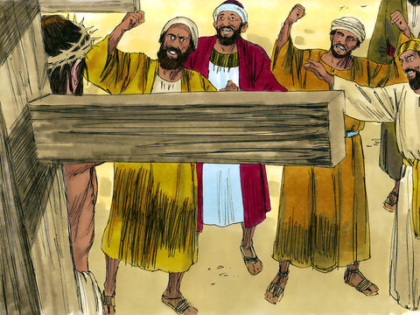
They mocked Jesus
He saved others, let him save himself if he is the Messiah.
Luke 23
³⁵ The people stood watching, and the rulers even sneered at him. They said, “He saved others; let him save himself if he is God’s Messiah, the Chosen One.”
³⁶ The soldiers also came up and mocked him. They offered him wine vinegar ³⁷ and said, “If you are the king of the Jews, save yourself.”
Jesus didn’t save himself
because He was dying
to save us. He took our punishment.

Slide 10

John 3:16 song

Slide 11
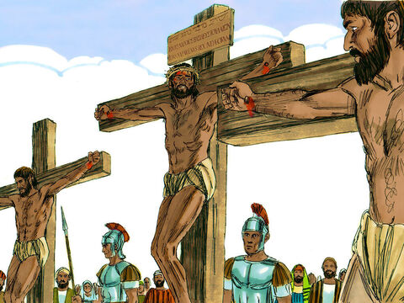
A criminal believed in Jesus
Don’t you fear God?
We are getting the punishment we deserve, but this man has done nothing wrong!
Aren’t you the Messiah! Save yourself and us!
I forgive your sins.
You will be with me in heaven.
Luke 23
³⁹ One of the criminals who hung there hurled insults at him: “Aren’t you the Messiah? Save yourself and us!”
⁴⁰ But the other criminal rebuked him. “Don’t you fear God,” he said, “since you are under the same sentence? ⁴¹ We are punished justly, for we are getting what our deeds deserve. But this man has done nothing wrong.”
⁴² Then he said, “Jesus, remember me when you come into your kingdom.^{[d]}”
⁴³ Jesus answered him, “Truly I tell you, today you will be with me in paradise.”
All who believe will go to heaven to be with Jesus.
He is coming to get us!

Slide 12

John 3:16-17 song

Slide 13
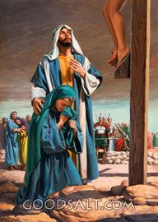
Jesus took care of his mother, Mary
John, my mom is your mom.
Mom, John will be your son.
John 19
²⁵ Near the cross of Jesus stood his mother, his mother’s sister, Mary the wife of Clopas, and Mary Magdalene.
²⁶ When Jesus saw his mother there, and the disciple whom he loved standing nearby, he said to her, “Woman, here is your son,” ²⁷ and to the disciple, “Here is your mother.” From that time on, this disciple took her into his home.

Slide 14

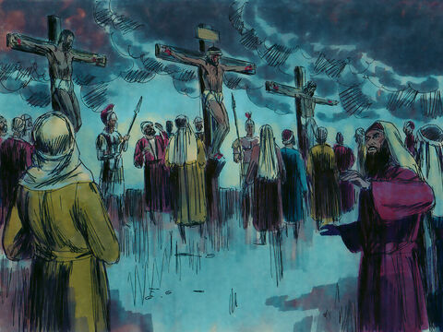
In the middle of the day, God sent darkness to cover the sad, sad scene.
Luke 23
⁴⁴ It was now about noon, and darkness came over the whole land until three in the afternoon, ⁴⁵ for the sun stopped shining.

Slide 15
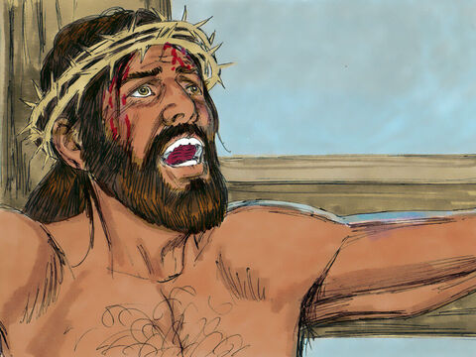
The result of sin is death. We sin. But Jesus took our punishment; the result of sin -- death.
My God, my God why have you forsaken me?
Father, into your hands I commit my spirit.
Matthew 27
⁴⁶ About three in the afternoon Jesus cried out in a loud voice, “Eli, Eli,^{[c]} lema sabachthani?” (which means “My God, my God, why have you forsaken me?”).^{[d]}
⁴⁷ When some of those standing there heard this, they said, “He’s calling Elijah.”
⁴⁸ Immediately one of them ran and got a sponge. He filled it with wine vinegar, put it on a staff, and offered it to Jesus to drink. ⁴⁹ The rest said, “Now leave him alone. Let’s see if Elijah comes to save him.”
⁵⁰ And when Jesus had cried out again in a loud voice, he gave up his spirit.
Luke 23
⁴⁶ Jesus called out with a loud voice, “Father, into your hands I commit my spirit.”^{[e]} When he had said this, he breathed his last.
Jesus was separated from God because sin separates us from God and Jesus was carrying our sin.

Slide 16
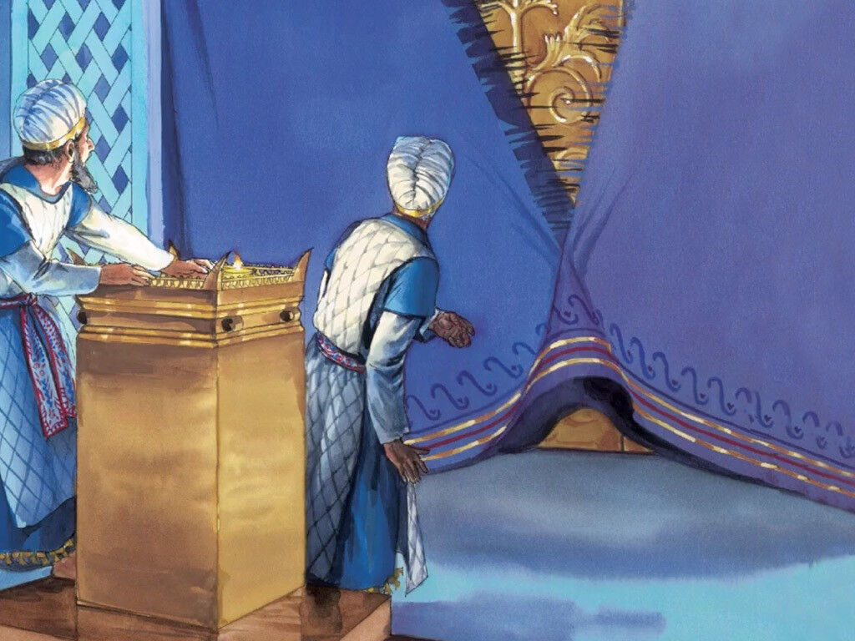
Jesus opened the way to the Most Holy Place. The sacrifices were done.
Matthew 27
⁵¹ At that moment the curtain of the temple was torn in two from top to bottom.
The earth shook, the rocks split ⁵² and the tombs broke open. The bodies of many holy people who had died were raised to life. ⁵³ They came out of the tombs after Jesus’ resurrection and^{[e]} went into the holy city and appeared to many people.

Slide 17
Jesus opened the way to the Most Holy Place. The sacrifices were done.
Matthew 27
⁵¹ At that moment the curtain of the temple was torn in two from top to bottom.
The earth shook, the rocks split ⁵² and the tombs broke open. The bodies of many holy people who had died were raised to life. ⁵³ They came out of the tombs after Jesus’ resurrection and^{[e]} went into the holy city and appeared to many people.

Slide 18
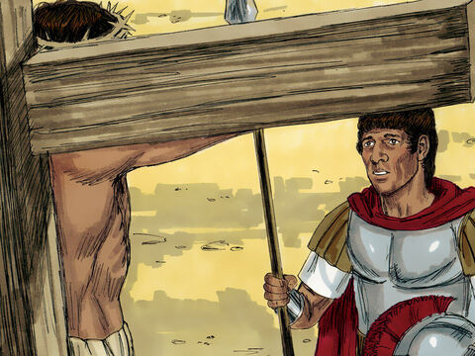
A centurion soldier believed in Jesus
Surely this was the Son of God!
Matthew 27
⁵⁴ When the centurion and those with him who were guarding Jesus saw the earthquake and all that had happened, they were terrified, and exclaimed, “Surely he was the Son of God!”

Slide 19
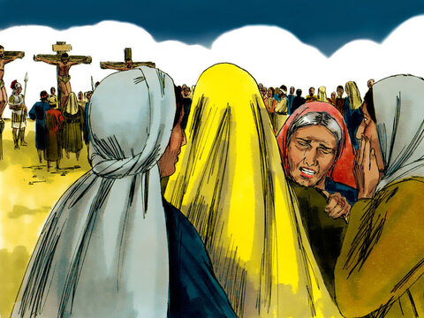
The women stayed near Jesus
Matthew 27
⁵⁵ Many women were there, watching from a distance. They had followed Jesus from Galilee to care for his needs. ⁵⁶ Among them were Mary Magdalene, Mary the mother of James and Joseph,^{[f]} and the mother of Zebedee’s sons.

Slide 20
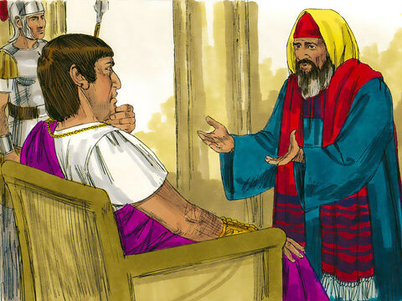
Jesus died
We don’t want the bodies left on the crosses during the Sabbath. Please break their legs and take them down.
John 19
³¹ Now it was the day of Preparation, and the next day was to be a special Sabbath. Because the Jewish leaders did not want the bodies left on the crosses during the Sabbath, they asked Pilate to have the legs broken and the bodies taken down.
³² The soldiers therefore came and broke the legs of the first man who had been crucified with Jesus, and then those of the other. ³³ But when they came to Jesus and found that he was already dead, they did not break his legs. ³⁴ Instead, one of the soldiers pierced Jesus’ side with a spear, bringing a sudden flow of blood and water.
³⁵ The man who saw it has given testimony, and his testimony is true. He knows that he tells the truth, and he testifies so that you also may believe. ³⁶ These things happened so that the scripture would be fulfilled: “Not one of his bones will be broken,”^{[c]} ³⁷ and, as another scripture says, “They will look on the one they have pierced.”^{[d]}

Slide 21
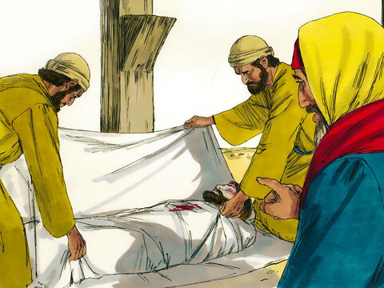
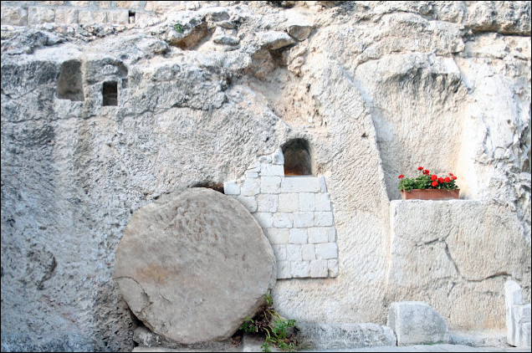
Joseph & Nicodemeus buried Jesus in his tomb.
Matthew 27
⁵⁷ As evening approached, there came a rich man from Arimathea, named Joseph, who had himself become a disciple of Jesus.
Luke 23
⁵⁰ Now there was a man named Joseph, a member of the Council, a good and upright man, ⁵¹ who had not consented to their decision and action. He came from the Judean town of Arimathea, and he himself was waiting for the kingdom of God.
Matthew 27
⁵⁸ Going to Pilate, he asked for Jesus’ body, and Pilate ordered that it be given to him. ⁵⁹ Joseph took the body, wrapped it in a clean linen cloth, ⁶⁰ and placed it in his own new tomb that he had cut out of the rock. He rolled a big stone in front of the entrance to the tomb and went away. ⁶¹ Mary Magdalene and the other Mary were sitting there opposite the tomb.
John 19
³⁹ He was accompanied by Nicodemus, the man who earlier had visited Jesus at night. Nicodemus brought a mixture of myrrh and aloes, about seventy-five pounds. ⁴⁰ Taking Jesus’ body, the two of them wrapped it, with the spices, in strips of linen. This was in accordance with Jewish burial customs. ⁴¹ At the place where Jesus was crucified, there was a garden, and in the garden a new tomb, in which no one had ever been laid. ⁴² Because it was the Jewish day of Preparation and since the tomb was nearby, they laid Jesus there.

Slide 22
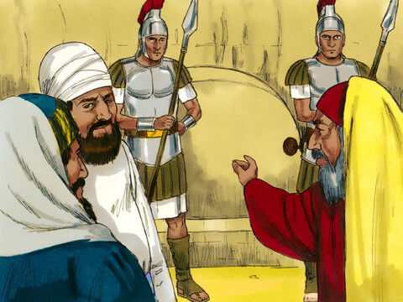
Soldiers guarded the tomb.
Matthew 27
⁶² The next day, the one after Preparation Day, the chief priests and the Pharisees went to Pilate. ⁶³ “Sir,” they said, “we remember that while he was still alive that deceiver said, ‘After three days I will rise again.’ ⁶⁴ So give the order for the tomb to be made secure until the third day. Otherwise, his disciples may come and steal the body and tell the people that he has been raised from the dead. This last deception will be worse than the first.”
⁶⁵ “Take a guard,” Pilate answered. “Go, make the tomb as secure as you know how.” ⁶⁶ So they went and made the tomb secure by putting a seal on the stone and posting the guard.

Slide 23
It was a very sad day, but that’s not the end of the story! Next week we’ll learn about the happiest day!
Jesus rested in the tomb during the Sabbath.
His work was done.
What do you think will happen next?

Slide 24




CRAFT TIME – From the Crafty Classroom see link
Using looped painter’s tape, tape the cross onto black paper.
Color around the cross as shown with chalk
Remove the cross and add the heart

Slide 25
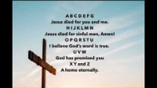
A-B-C-D-E-F-G Jesus Died For You And Me

Slide 26

Sing: Jesus Died for All The Children of the World

Slide 27

Sing: Romans 5:8

Slide 28
John 3:16-17 song

Slide 29
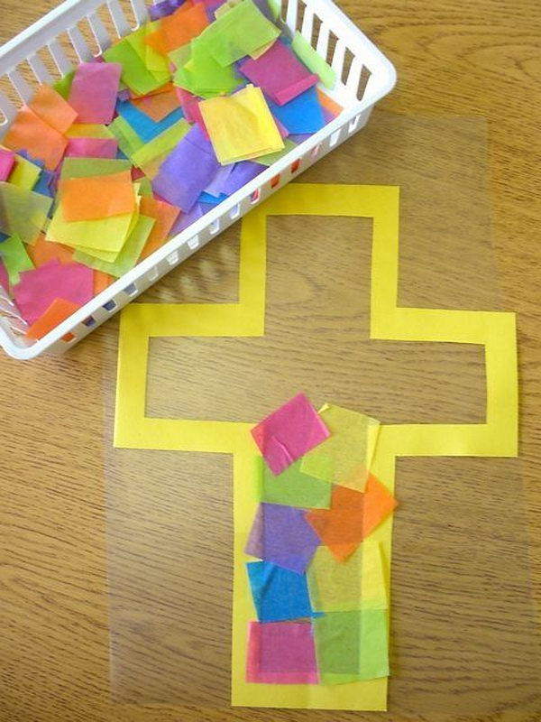
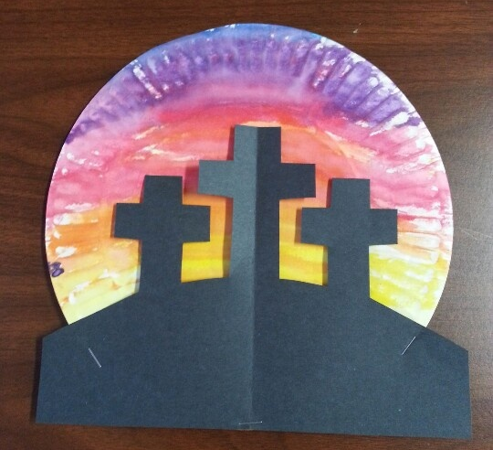
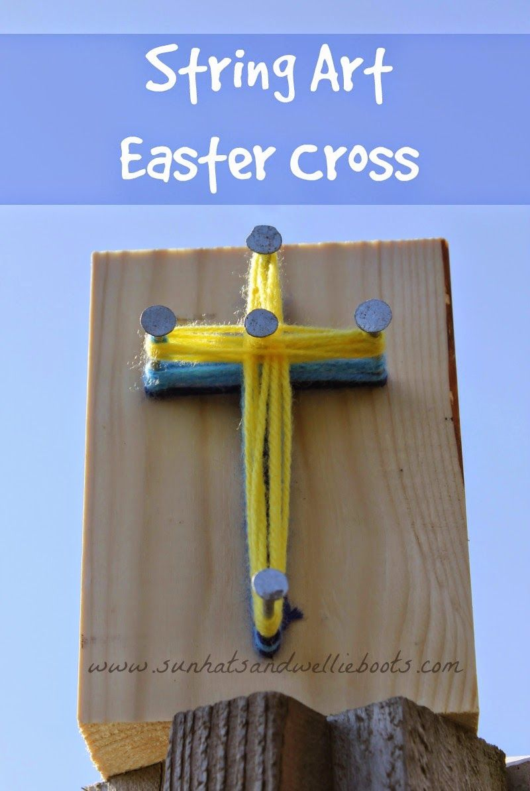

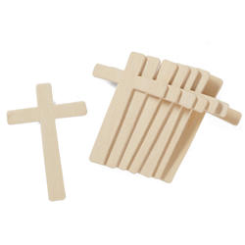
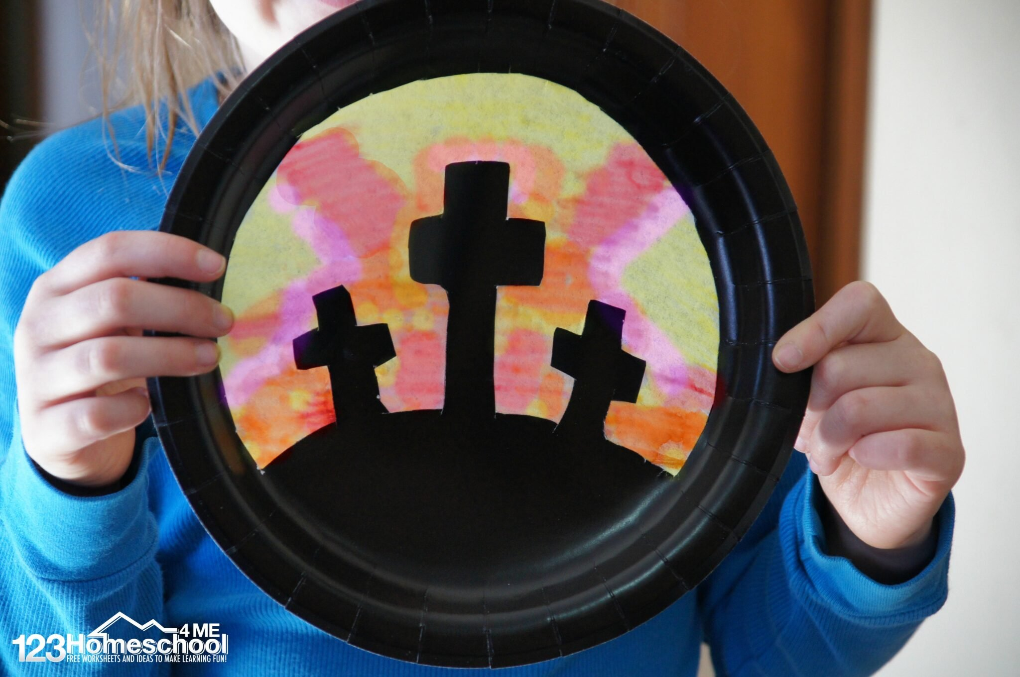
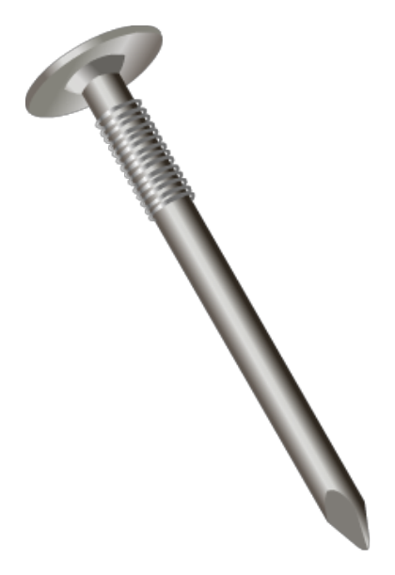
MORE Craft ideas to choose from
Teacher: replace this slide with one (your choice) from the end of the presentation.
Pound 4 or 5 nails in board. Wrap string on nails as shown.
Optional: add sign to top:
My King
Died for me.
For God so loved the world that he gave his one and only Son, that whoever believes in him shall not perish but have eternal life.
John 3:16
Paint a paper plate with sunset colors. Then add cross silhouette.
The nails didn’t hold Jesus to the cross.
His love did!
Put cross outline on clear contact paper, add tissue paper squares, then cover with clear contact paper.
Or this idea from 123 Homeschool

Slide 30
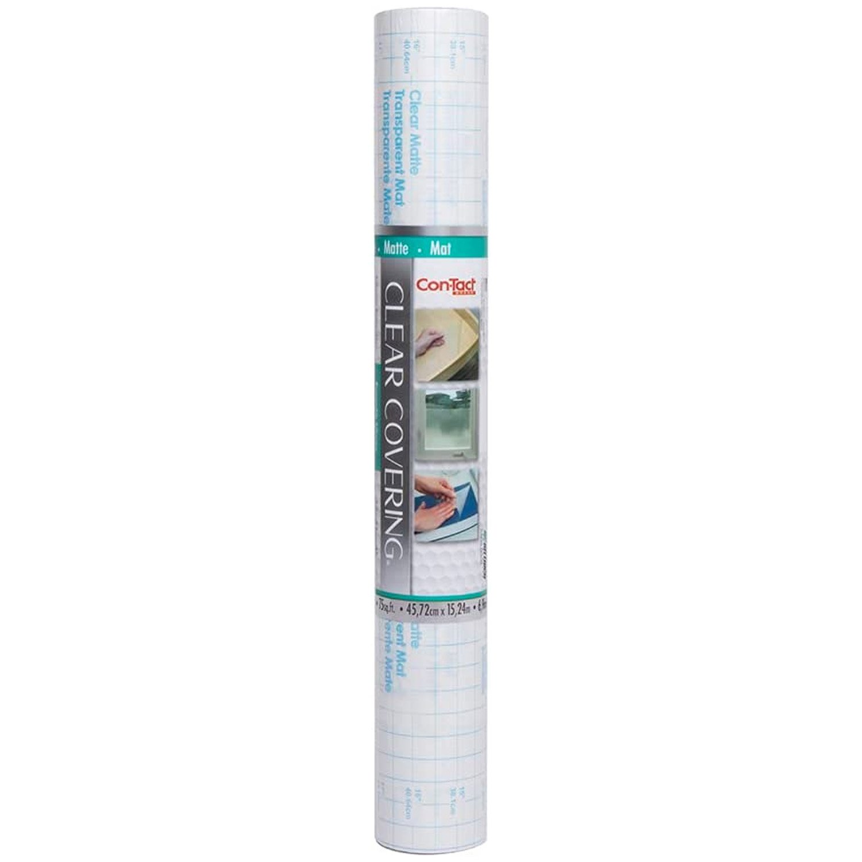



Craft Time – you may start your craft while I tell our story
Put cross outline on clear contact paper,
add tissue paper squares,
then cover with clear contact paper.

Slide 31

Craft TIME – you may start your craft while I tell our story
Paint a paper plate with sunset colors.
Then add cross silhouette.
Add Bible verse: John 3:16 or Romans 5:8
For God so loved the world that he gave his one and only Son, that whoever believes in him shall not perish but have eternal life.
John 3:16
For God so loved the world that he gave his one and only Son, that whoever believes in him shall not perish but have eternal life.
John 3:16
But God demonstrates his own love for us in this: While we were still sinners, Christ died for us.
Romans 5:8

Slide 32
Craft TIME – you may start your craft while I tell our story
Or this idea from 123 Homeschool
Color a coffee filter with water based pens or dot markers.
Spritz the coffee filter with water.
Draw the cross outline on the back of a black plate.
Cut out the space around and above the crosses.
Glue the coffee filter behind the plate.
Add Bible verse: John 3:16 or Romans 5:8
For God so loved the world that he gave his one and only Son, that whoever believes in him shall not perish but have eternal life.
John 3:16
But God demonstrates his own love for us in this: While we were still sinners, Christ died for us.
Romans 5:8
For God so loved the world that he gave his one and only Son, that whoever believes in him shall not perish but have eternal life.
John 3:16

Slide 33
Craft TIME – you may start your craft while I tell our story
Pound 4 or 5 nails in board.
Wrap string on nails as shown.
Optional: add a sign (choose 1)
For God so loved the world that he gave his one and only Son, that whoever believes in him shall not perish but have eternal life.
John 3:16
My King
Died for me.
The nails didn’t hold Jesus to the cross.
His love did!
But God demonstrates his own love for us in this: While we were still sinners, Christ died for us.
Romans 5:8
Jesus loves me

Slide 34
Craft ideas – you may start your craft while I tell our story
Optional: paint cross
Glue 2 nails on the cross
Glue on a heart with message
The nails didn’t hold Jesus to the cross.
His love did!
Jesus loves me

