Slide 1
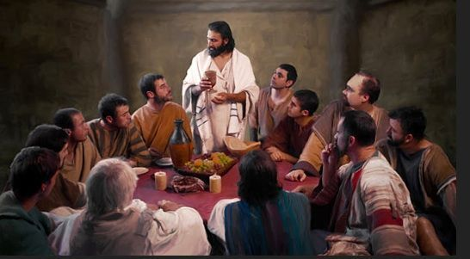
Jesus Celebrates the Passover
Jesus is our Messiah, Savior, redeemer luke 22:7-30 & John 13

Slide 2
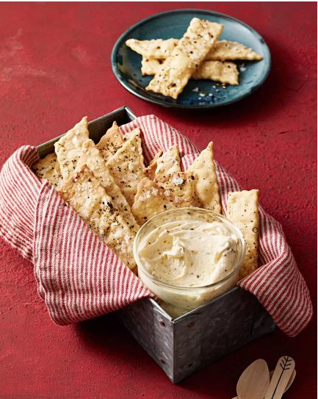
optional Bake some crackers – unleavened bread OR use purchased crackers
Cracker Recipe:
2 cups flour*
1 teaspoon sugar
¾ teaspoon fine salt
Mix well in food processor
Add 3 Tablespoons olive* oil
Pulse in processor until dough forms.
Divide in half.
On floured surface, roll out each half very thinly.
Cut into 1x3 inch strips and place on parchment –lined baking sheets.
Brush with oil.
Sprinkle on sea salt & pepper*
BAKE 425 until brown – about 13 minutes
https://www.rachaelraymag.com/recipe/homemade-olive-oil-crackers

Slide 3
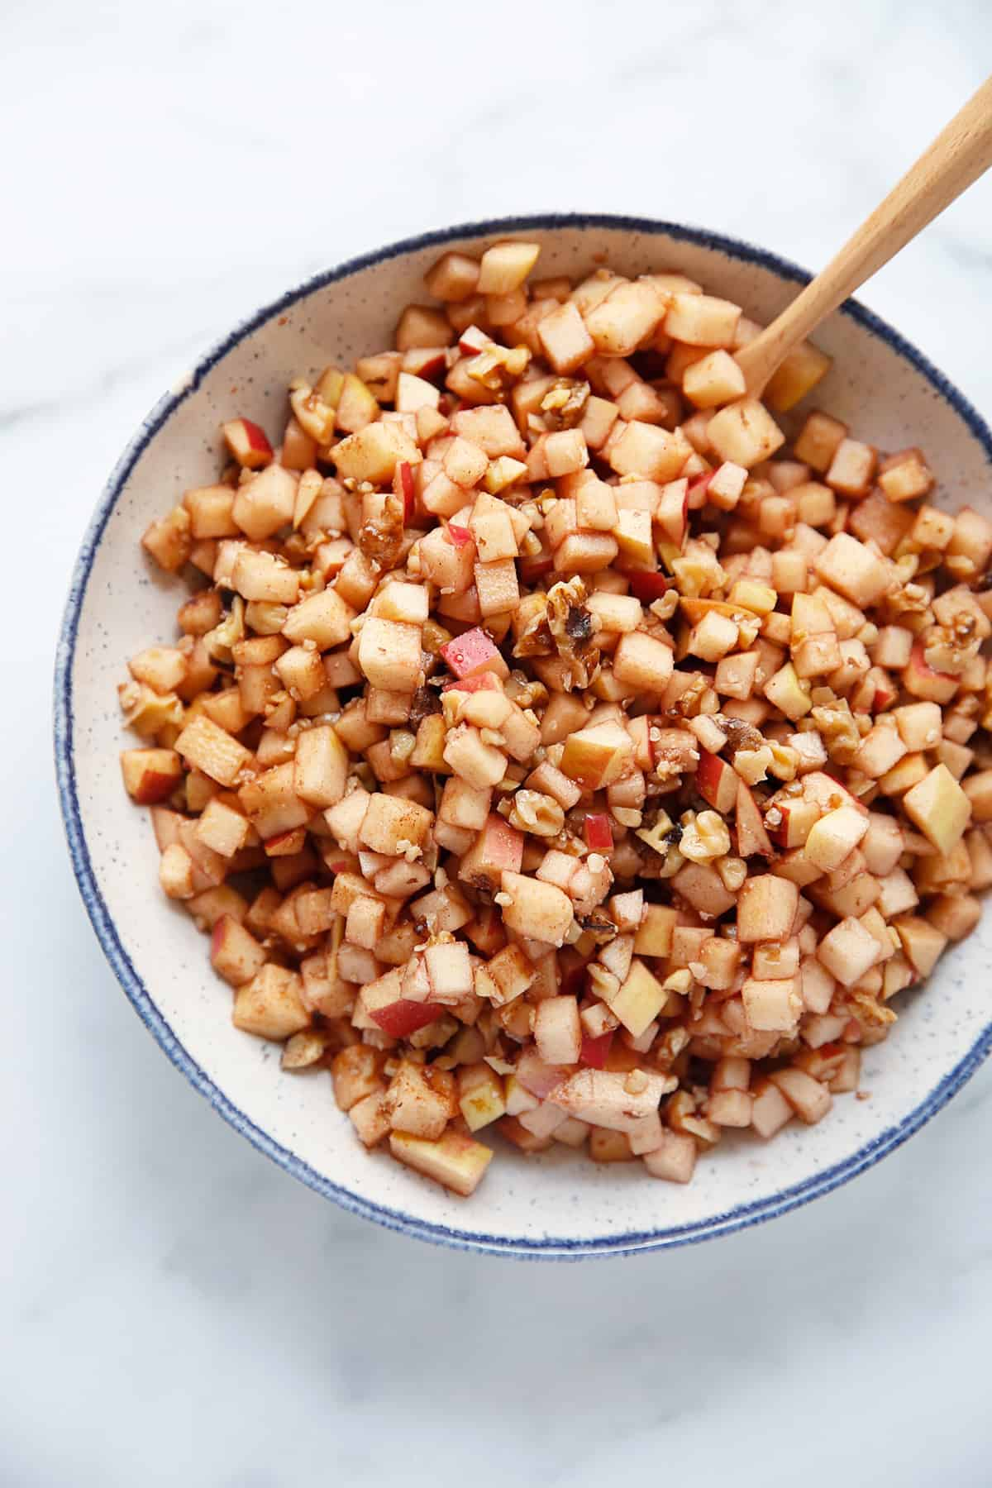

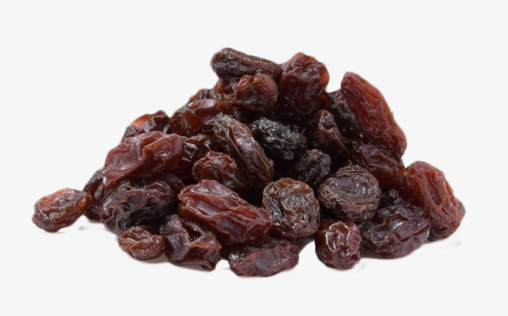
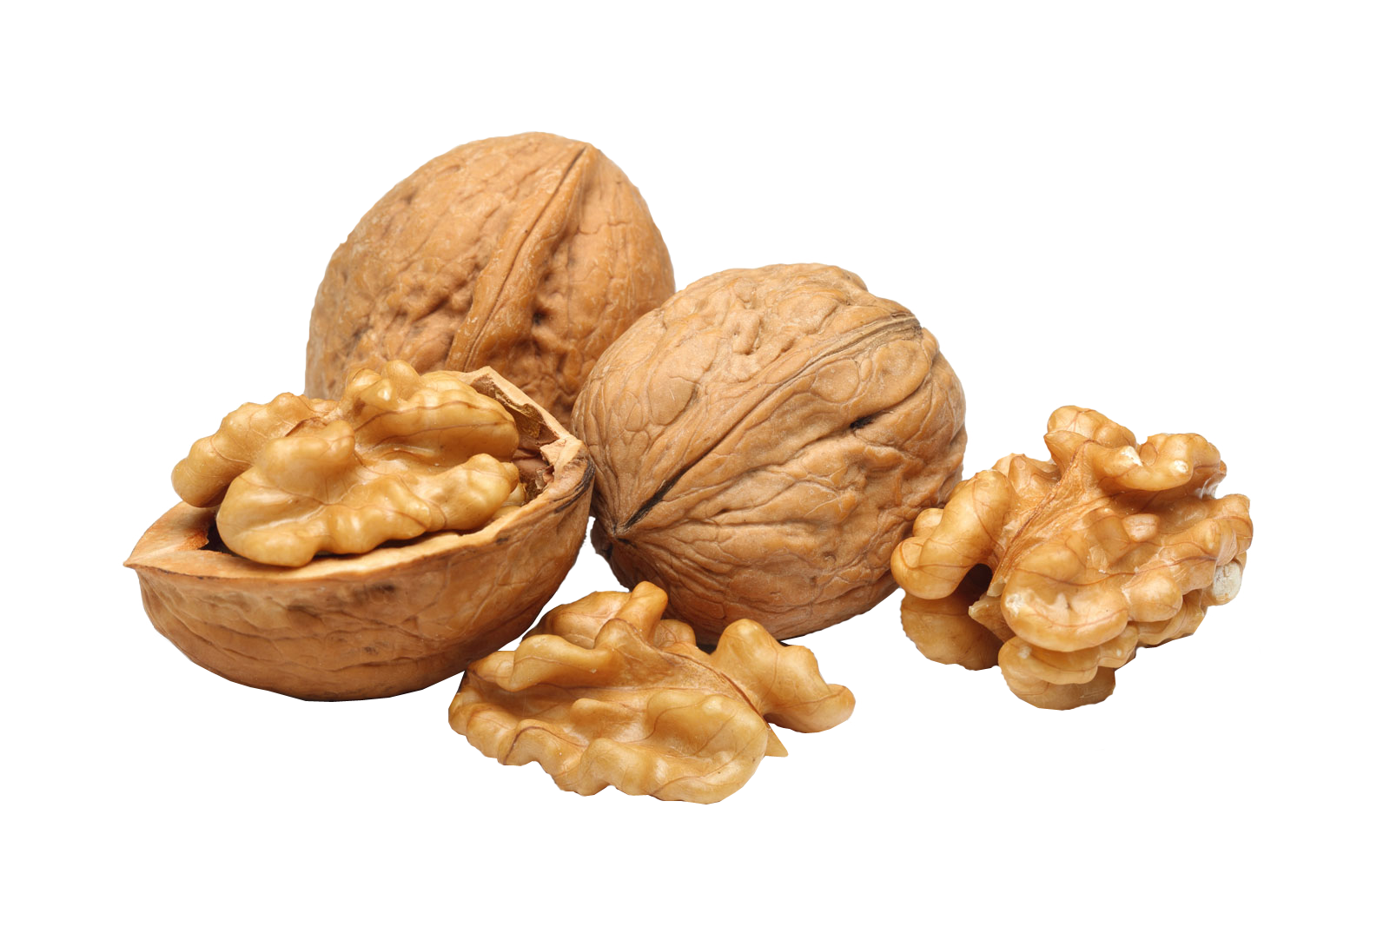
Make charoset – fruit nut paste – to depict brick mortar
Ingredients:
1 finely chopped apple (remove core)
1 finely chopped pear (remove core)
½ cup finely chopped walnuts
1 teaspoon cinnamon or more
2 Tablespoons grape juice
1 teaspoon lemon juice (or more)
½ cup raisins and/or cranberries (optional
Mix and let sit for a few hours.
Leftovers can be wrapped with pie crust to make tarts

Slide 4
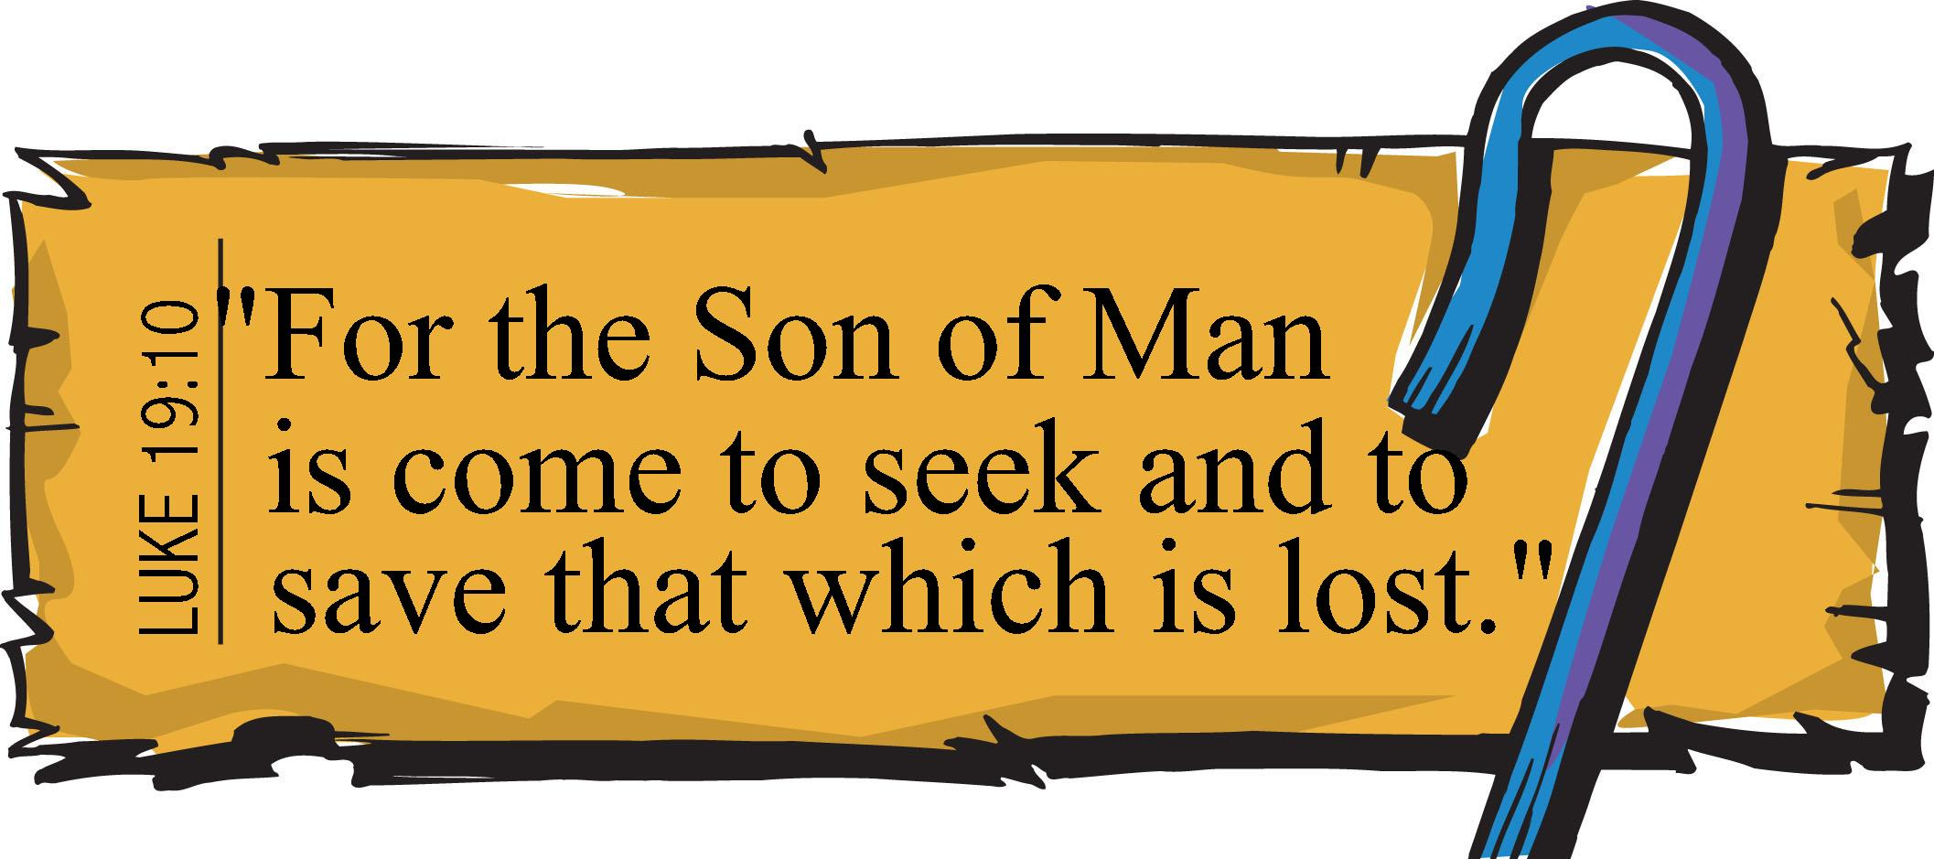
JESUS SAVES
John 3:16-17
Hebrews 12:2
¹⁶ For God so loved the world, that he gave his only begotten Son, that whosoever believeth in him should not perish, but have everlasting life.
¹⁷ For God sent not his Son into the world to condemn the world; but that the world through him might be saved.
”Looking unto Jesus the author and finisher of our faith;
who for the joy that was set before him
endured the cross,
despising the shame,
and is set down at the right hand of the throne of God.”

Slide 5
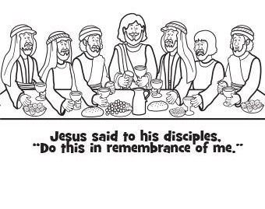
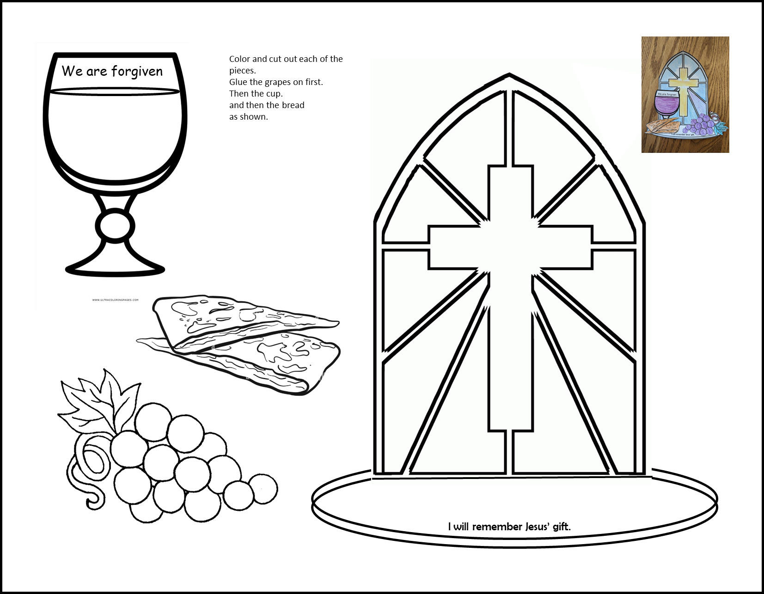

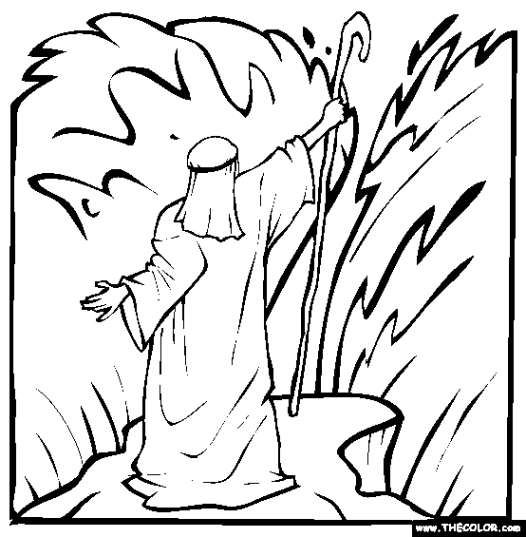

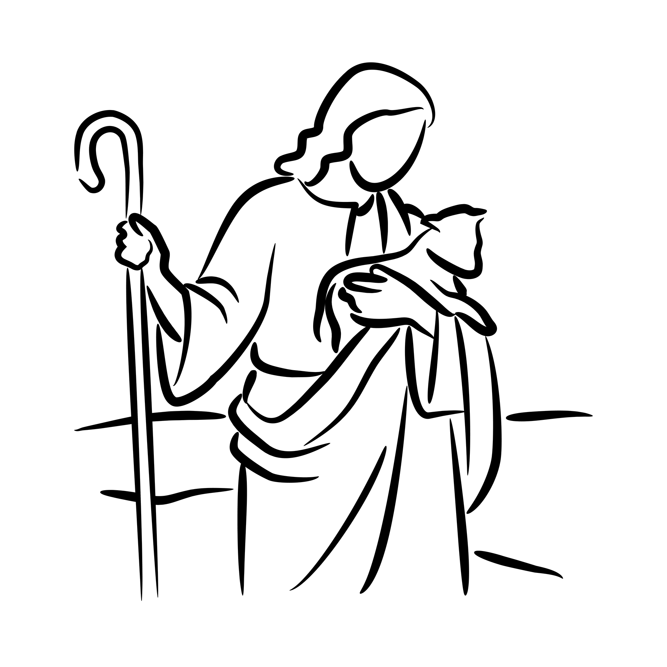
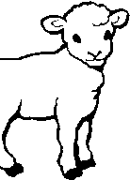
Optional coloring pages

Slide 6
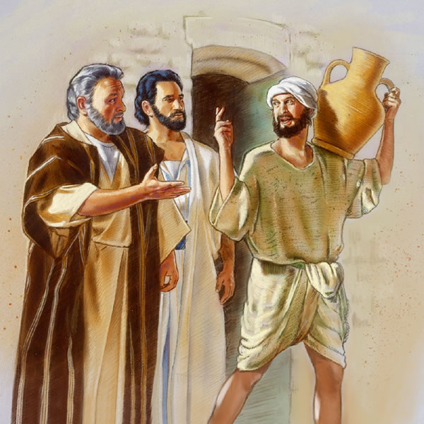
Let’s get ready Let’s follow Jesus – the living water to where he has everything ready for us!
^{Luke 22:7} The Day of Unleavened Bread came. This was the day the Passover lambs had to be sacrificed. ⁸ Jesus said to Peter and John, “Go and prepare the Passover meal for us to eat.”
⁹ They asked, “Where do you want us to prepare it?”
Jesus said to them, ¹⁰ “Listen! After you go into the city, you will see a man carrying a jar of water. Follow him into the house that he enters. ¹¹ Tell the person who owns that house, ‘The Teacher asks that you please show us the room where he and his followers may eat the Passover meal.’ ¹² Then he will show you a large room upstairs. This room is ready for you. Prepare the Passover meal there.”
¹³ So Peter and John left. Everything happened as Jesus had said. So they prepared the Passover meal.

Slide 7
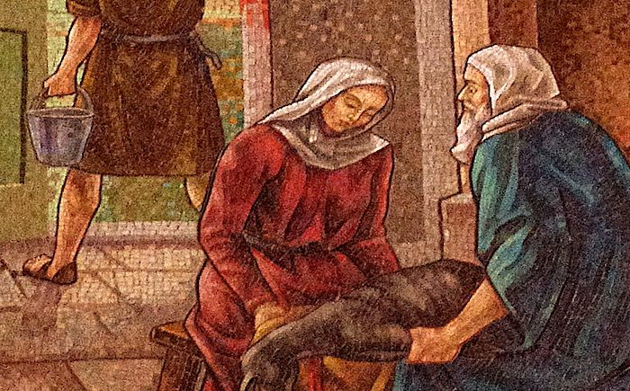
they went to prepare for the Passover as god directed moses to write in exodus 12
³ Tell the whole community of Israel that on the tenth day of this month each man is to take a lamb^{[a]} for his family, one for each household…..⁵ The animals you choose must be year-old males without defect, and you may take them from the sheep or the goats.
⁶ Take care of them until the fourteenth day of the month, when all the members of the community of Israel must slaughter them at twilight.
⁷ Then they are to take some of the blood and put it on the sides and tops of the doorframes of the houses where they eat the lambs.
⁸ That same night they are to eat the meat roasted over the fire, along with bitter herbs, and bread made without yeast.

Slide 8
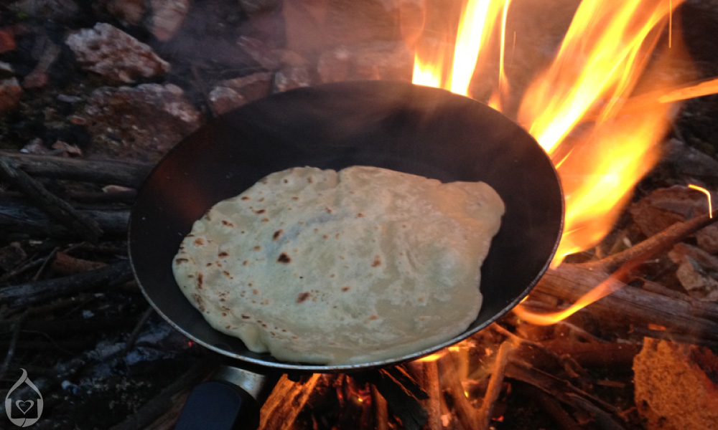
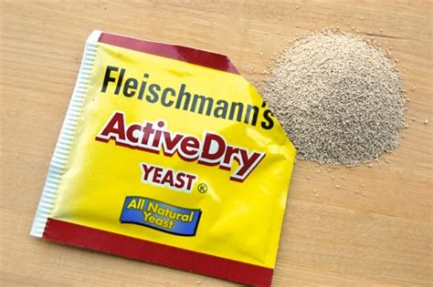
they went to prepare for the Passover as god directed moses to write in exodus 12
¹⁴ “You are always to remember this day. Celebrate it with a feast to the Lord. Your descendants are to honor the Lord with this feast from now on.
¹⁵ For this feast you must eat bread made without yeast for seven days.
On the first day of this feast, you are to remove all the yeast from your houses.
{yeast represents sin}
²⁶ When your children ask you, ‘Why are we doing these things?’ ²⁷ you will say, ‘This is the Passover sacrifice to honor the Lord. When we were in Egypt, the Lord passed over the houses of Israel. The Lord killed the Egyptians, but he saved our homes.’”

Slide 9
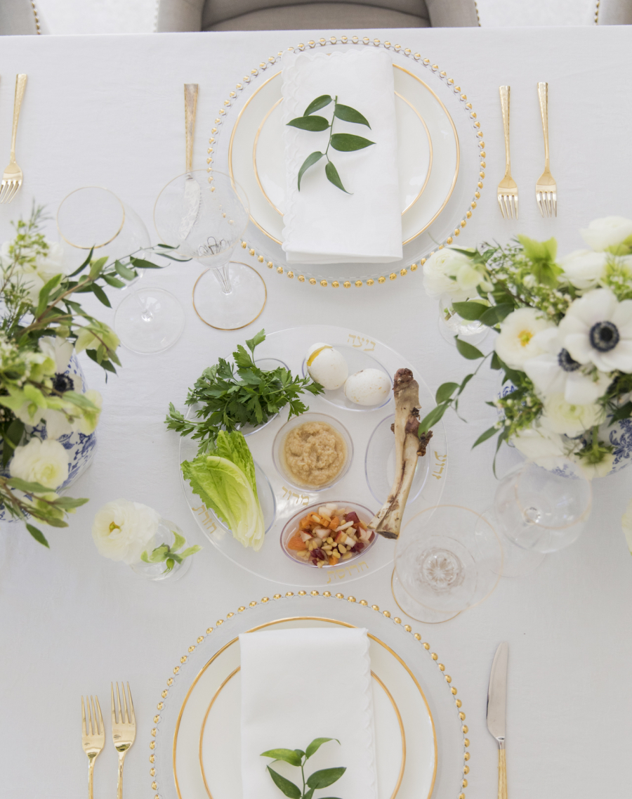
Let’s get ready
Put 2 candlesticks in the center
Add a pretty bouquet if you wish
For each person set a place, cup, and a pretty napkin
Set a napkin in front of the leader and put three unleavened matzo breads in it, one in each fold.
Set grape juice by the leader
Here is a Passover Plate also with:
Lamb bone – roasted lamb
Egg – Jesus desires to be with us
Horseradish/parsley --Bitter herbs – bitter slavery in Egypt
Apple-pear-nut paste like brick mortar
Vegetable (potato/onion/lettuce)
Salt water

Slide 10

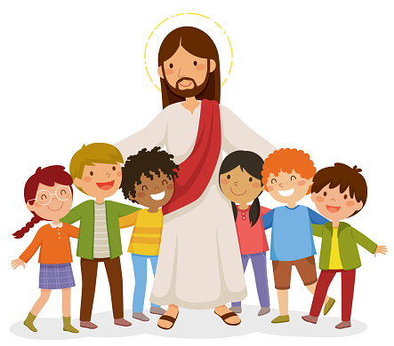
His Banner Over me is love
LOVE
He invites me to His banqueting table His banner over me is love…

Slide 11
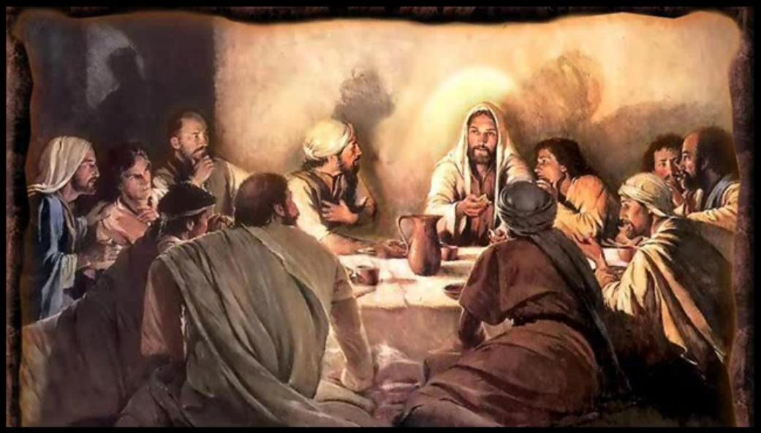
Jesus and his disciples came to celebrate the passover
I am eager to eat this Passover with you!

Slide 12
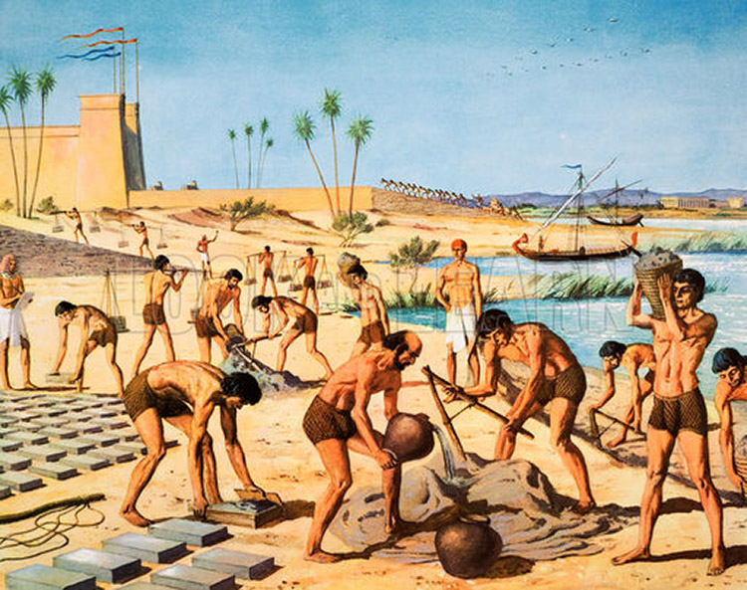
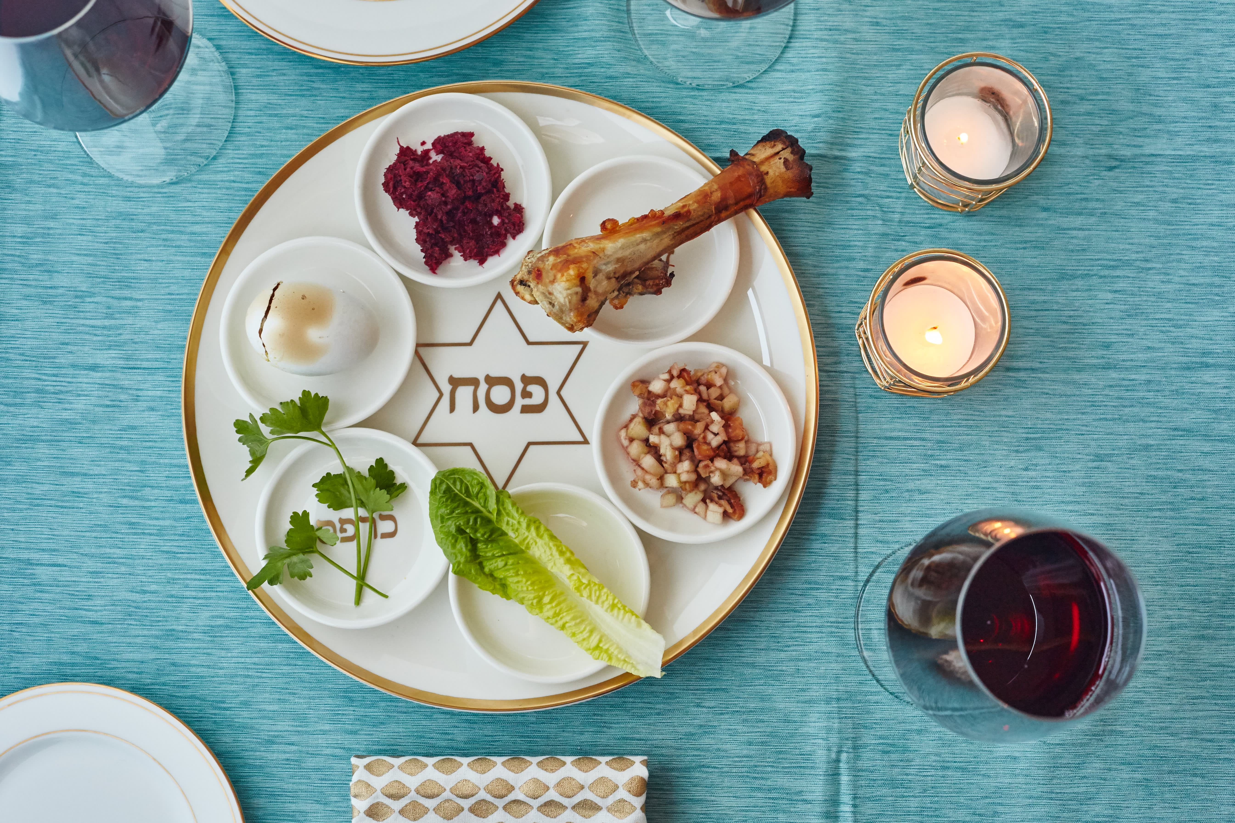
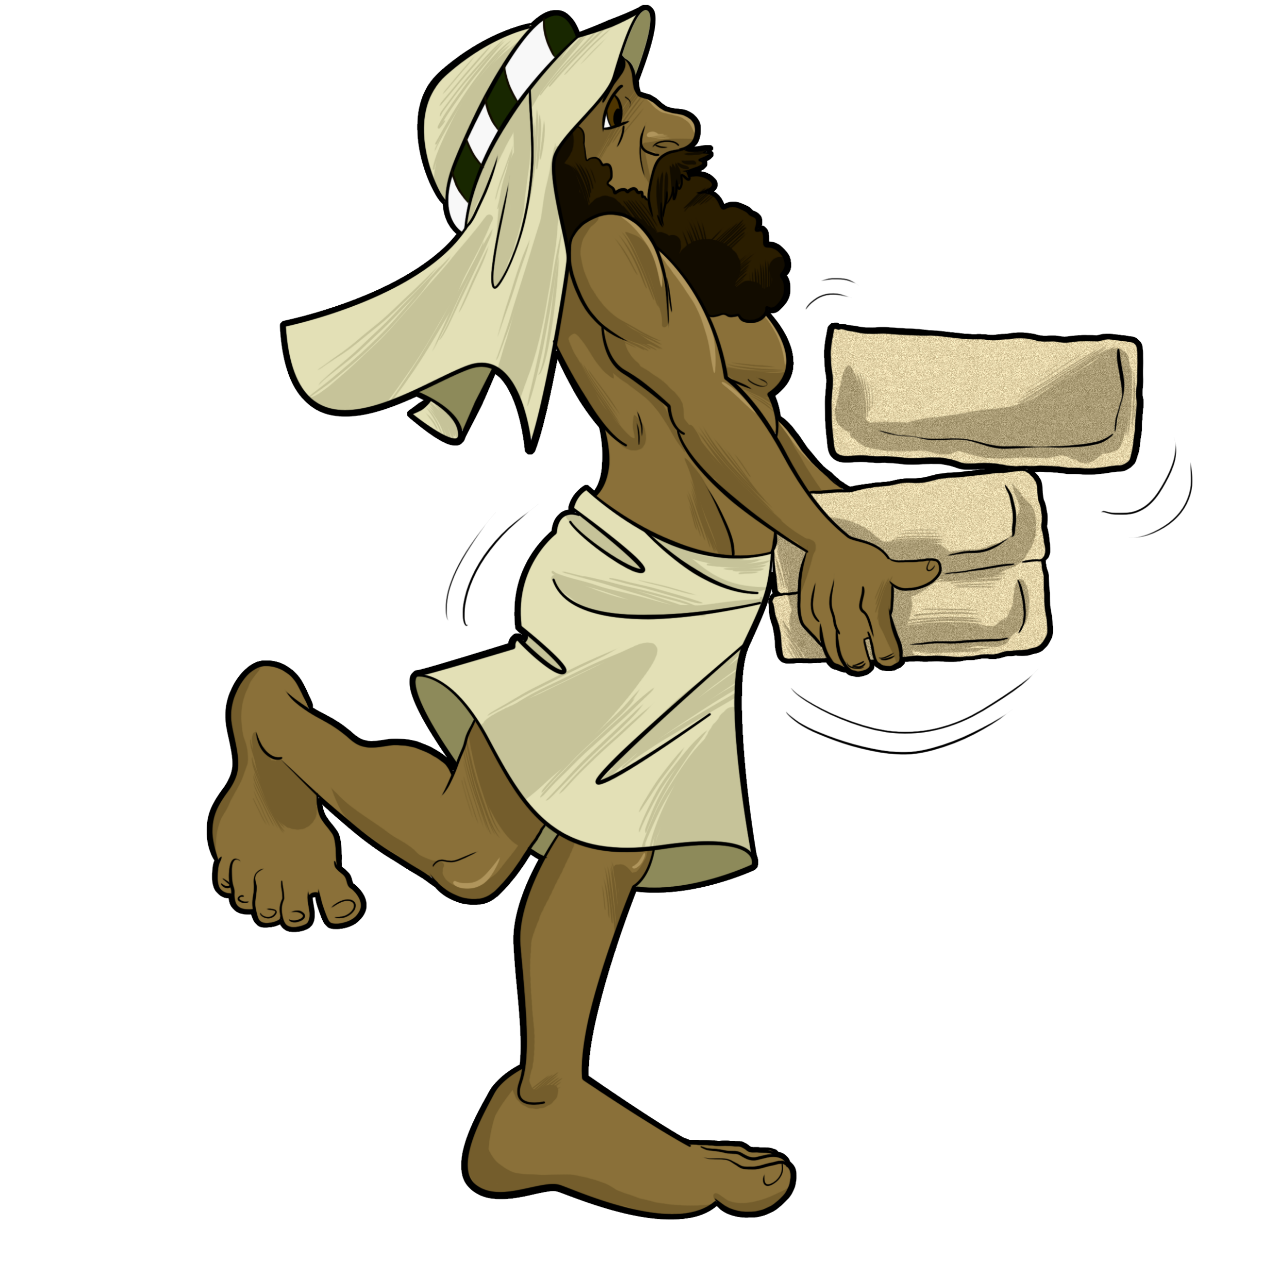
Dip the parsley in the salt water – slavery was bitter and they cried put some Charoset fruit nut mixture between a couple crackers and eat it -- They had to build with mortar & bricks
Remember Israel were slaves in Egypt. They had to make bricks and build big buildings for Pharoah.
They labor was hard! They were beaten. They cried.
They cried out to God in prayer.
^{God heard them}

Slide 13
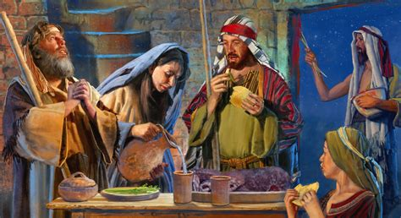
Remember the first Passover meal
Remember the first Passover:
The last plague was that the first born son would die unless they:
Killed a lamb and put its blood on the door frame.
They roasted the lamb and ate it for supper.
They also quickly made unleavened bread crackers and ate them too.
They ate standing up, ready to leave as soon as Pharoah said they could go.

Slide 14
Eat the egg -- Jesus Desires to be with us & give us life Jesus knew he would die like the Passover lamb eat the veggie lamb
¹⁴ When the time came, Jesus and the apostles were sitting at the table.
¹⁵ He said to them, “I wanted very much to eat this Passover meal with you before I die.
¹⁶ I will never eat another Passover meal until it is given its true meaning in the kingdom of God.”
--- NEWS FLASH ---
No more lambs are sacrificed! Because Jesus, the Lamb of God, died for us.

Slide 15
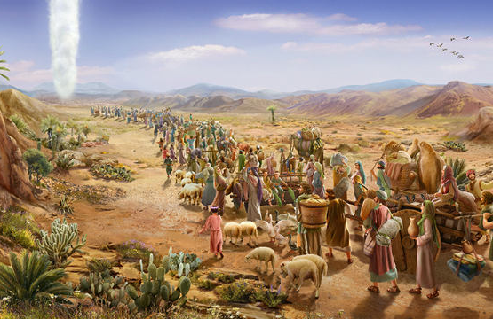
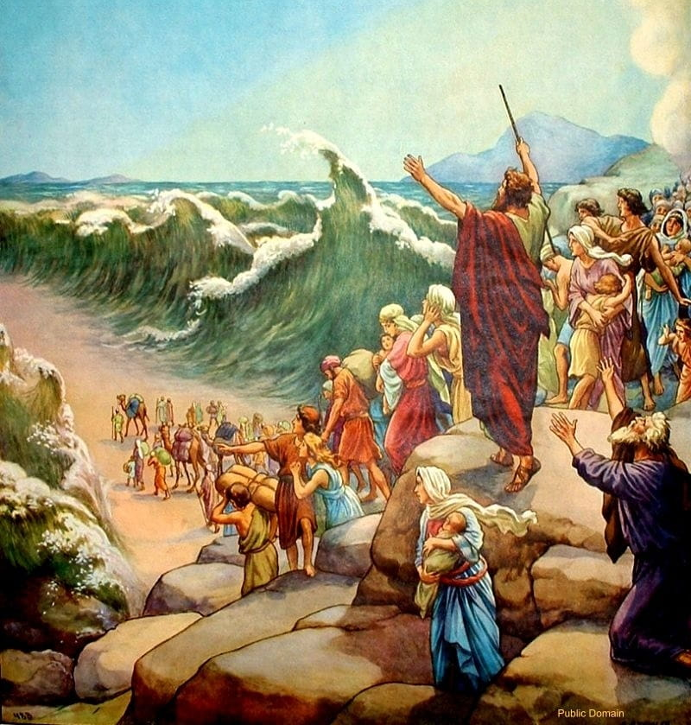
Remember how God took the Israelites out of egypt? Do you remember how he set them free? Tell me

Slide 16
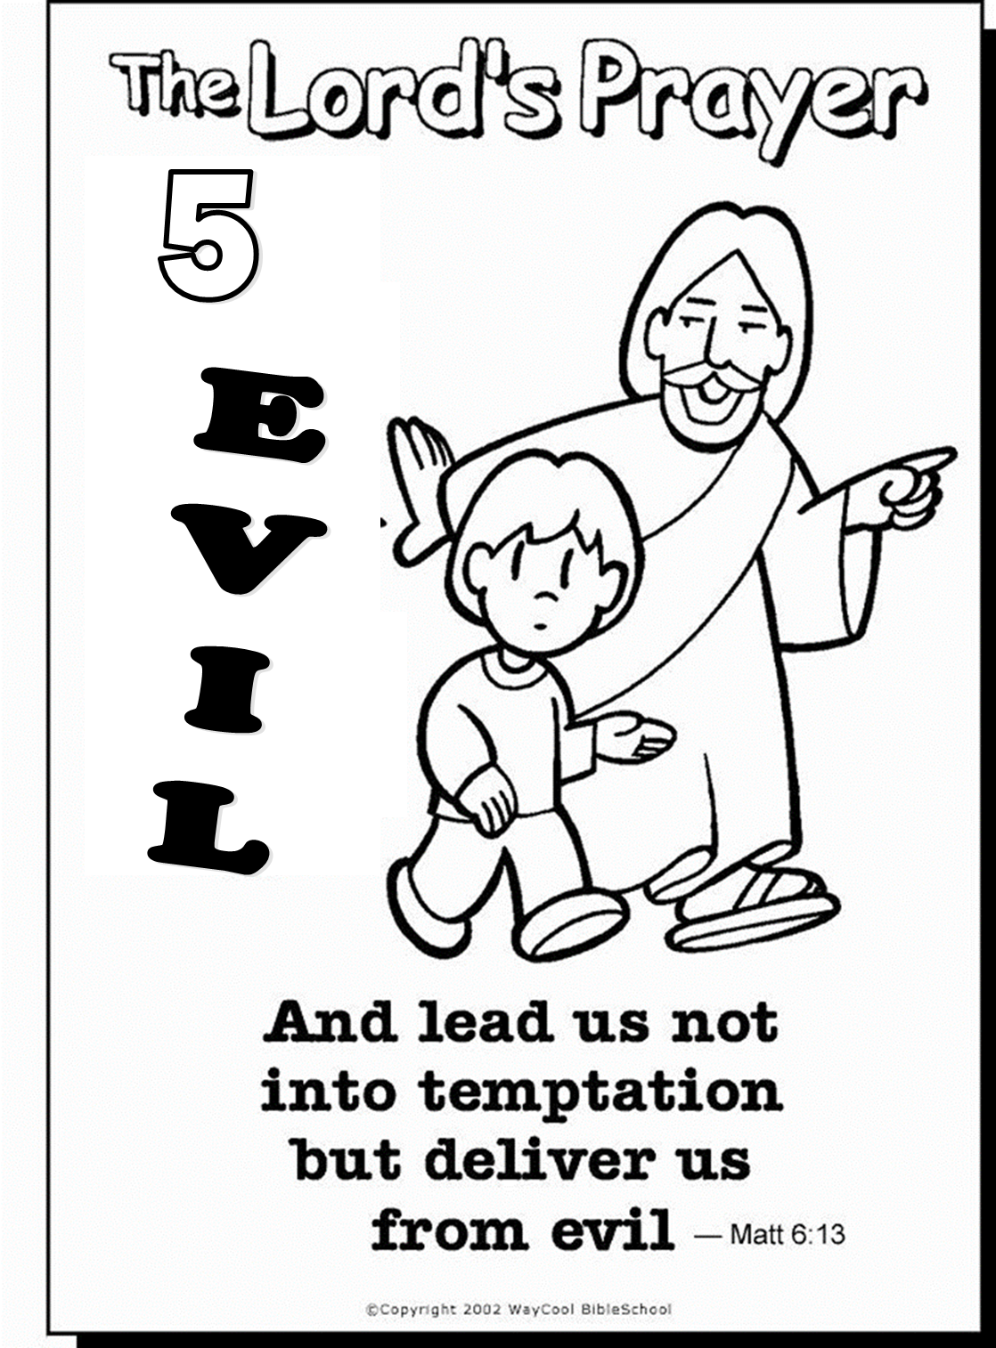
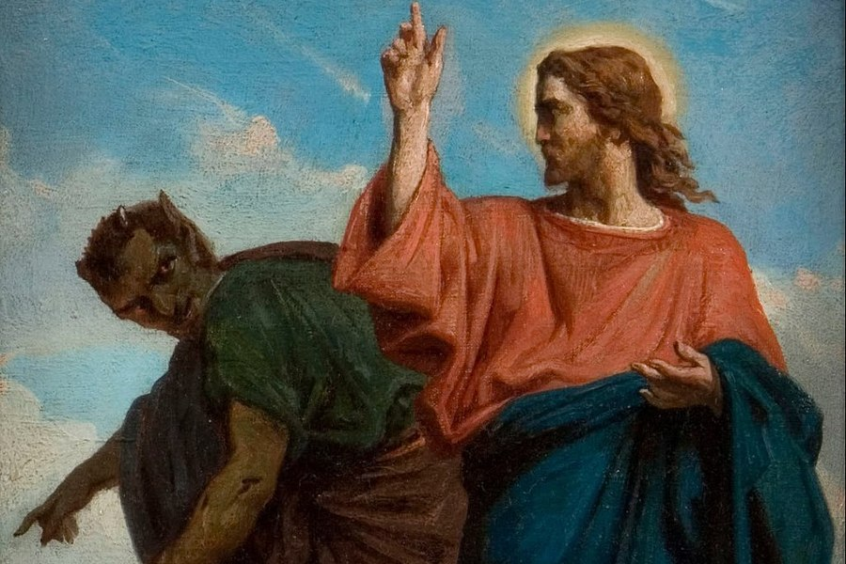

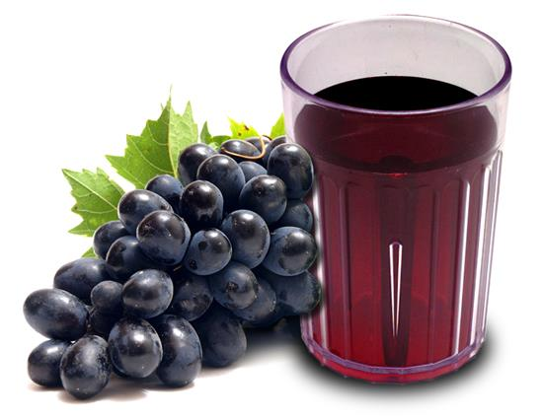
JESUS WINS Jesus overcame the devil.. He will help us to overcome temptation also. With Jesus, we are strong!
Jesus sets us free.
We are free!
You too can drink some grape juice
Remember we aren’t slaves to sin.

Slide 17
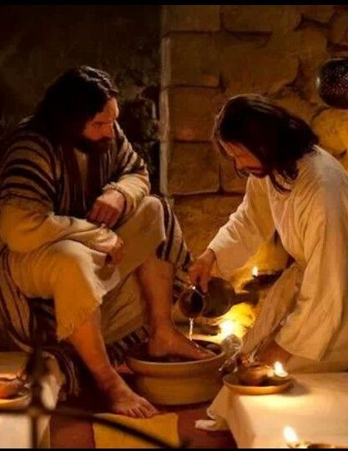
Jesus served by washing the disciple’s feet Jesus is the one who cleanses us from sin
If I don’t wash your feet, you have nothing to do with me..
Lord don’t wash my feet.
John 13
³ Jesus knew that the Father had given him power over everything. He also knew that he had come from God and was going back to God.
⁴ So during the meal Jesus stood up and took off his outer clothing. Taking a towel, he wrapped it around his waist. ⁵ Then he poured water into a bowl and began to wash the followers’ feet. He dried them with the towel that was wrapped around him…..
¹² When he had finished washing their feet, he put on his clothes and sat down again. Jesus asked, “Do you understand what I have just done for you? ¹³ You call me ‘Teacher’ and ‘Lord.’ And this is right, because that is what I am. ¹⁴ I, your Lord and Teacher, have washed your feet. So you also should wash each other’s feet. ¹⁵ I did this as an example for you. So you should do as I have done for you. ¹⁶ I tell you the truth. A servant is not greater than his master. A messenger is not greater than the one who sent him. ¹⁷ If you know these things, you will be happy if you do them.
Then wash
all of me!
You have had a bath, you only need your feet washed.

Slide 18


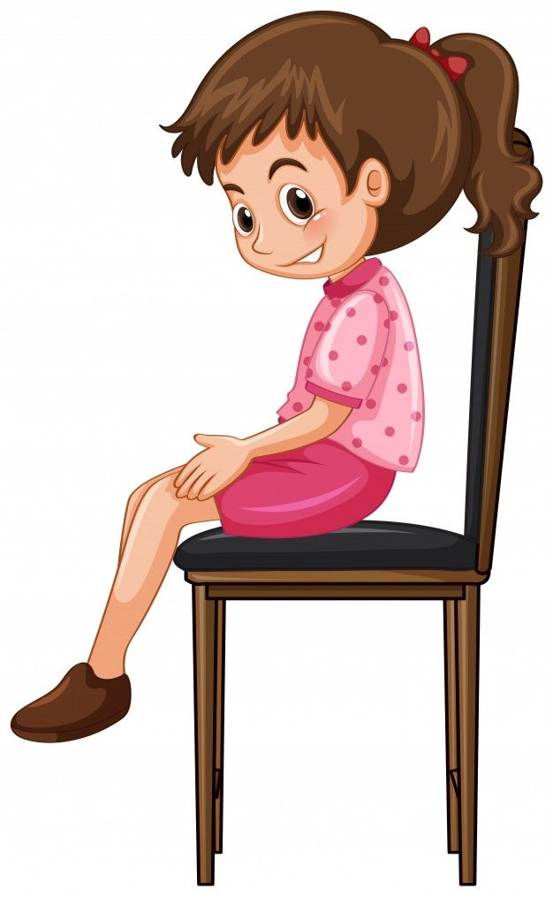


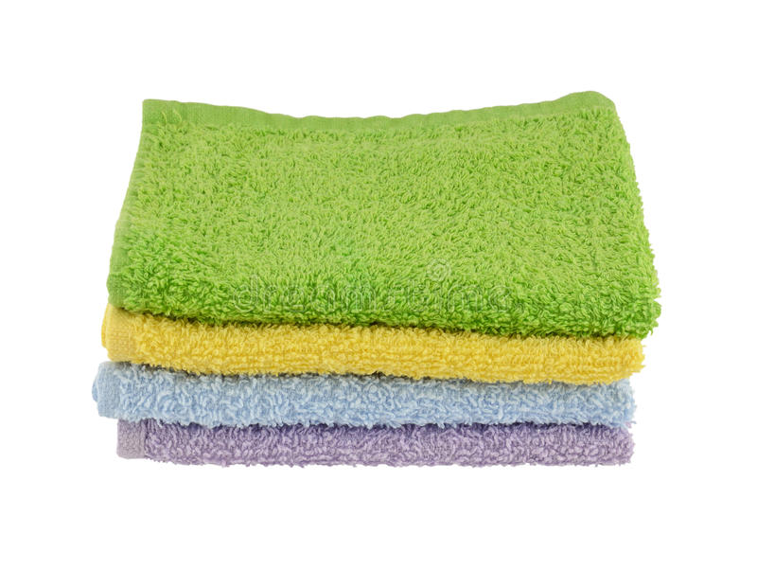

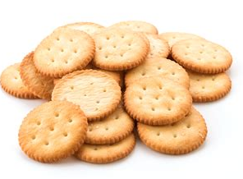
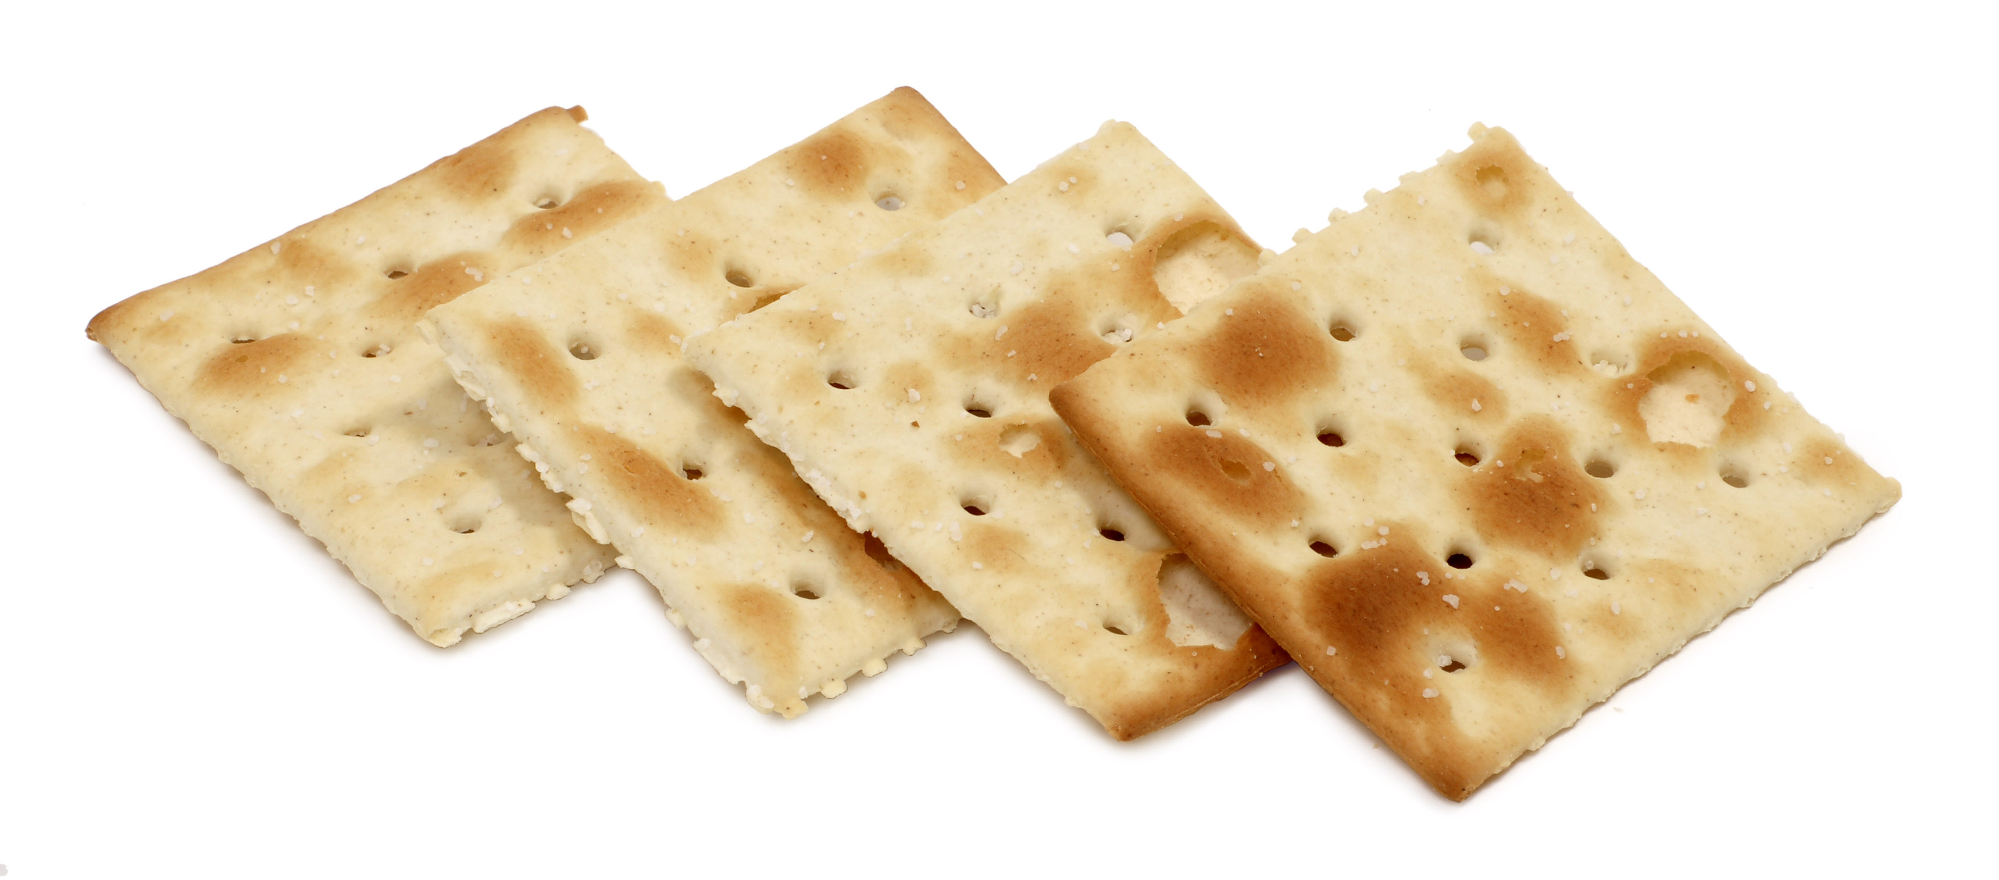
Jesus came to serve us. Serve one another.
Jesus encouraged His disciples to serve one another.
We can serve one another by:
Wash each other’s feet
Wash each other’s hands
Give someone else a cup of grape juice.
Pass out crackers to everyone
Pour a little bit of juice in someone else’s cup everyone serve one until everyone has some juice
Pass out Crackers to everyone

Slide 19
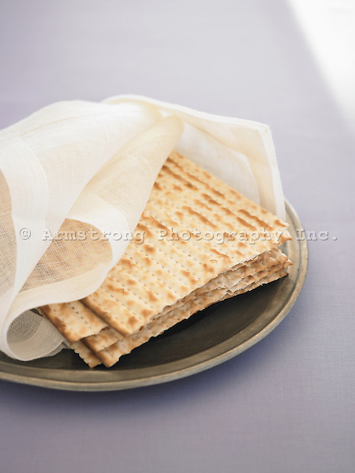
I have some crackers in my napkin
I have 2 crackers in my napkin, but 1 is hiding.
Who can find it?
These crackers represent
God the Father
God the Son, Jesus – He came to earth to save us (Did you find that cracker?)
God the Spirit

Slide 20
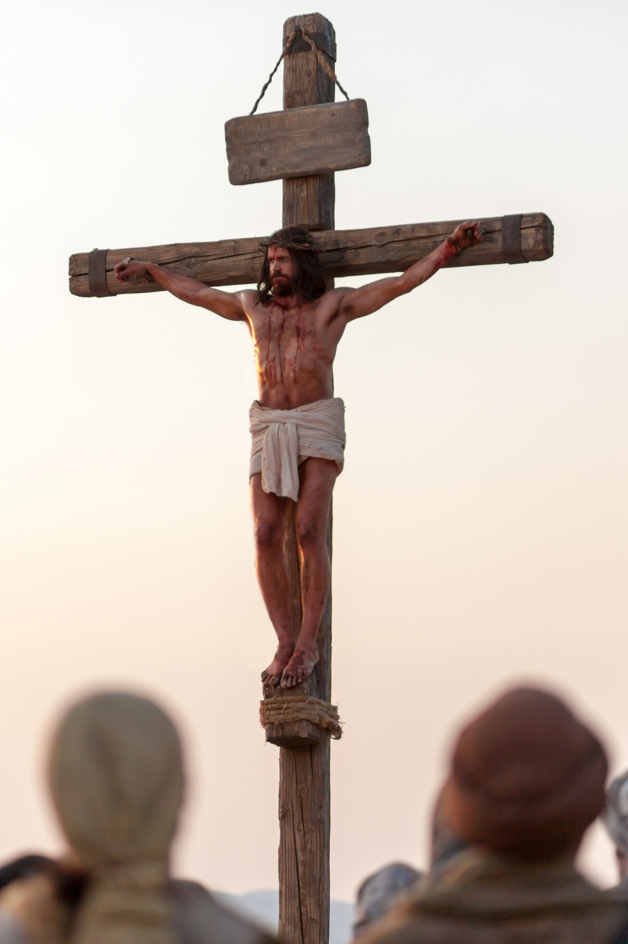
We remember that jesus died for us he is the Passover lamb
Jesus knew He was the Passover lamb.
He was willing to lay down His life.
He was willing to pay the price for our sin – death.
He was willing to die for us.

Slide 21
I will save you Jesus took our sins upon himself. He took our punishment and died for us. He has saved us from our sin and death.
Jesus Saves!
¹⁷ Then Jesus took a cup.
He gave thanks to God for it and said, “Take this cup and give it to everyone here.
¹⁸ I will not drink again from the fruit of the vine until God’s kingdom comes.”
You too can drink some grape juice
Remember Jesus is coming again!
Then we will celebrate with Him!

Slide 22
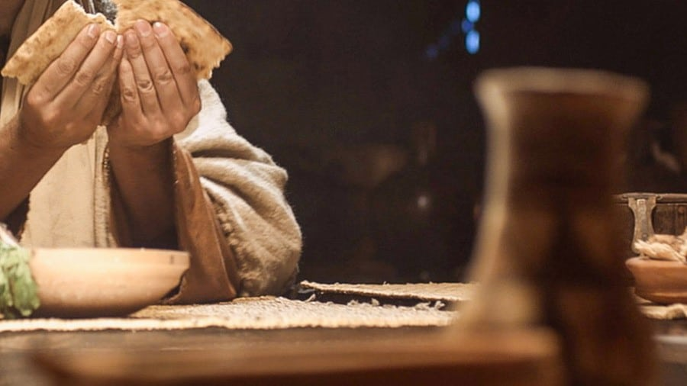
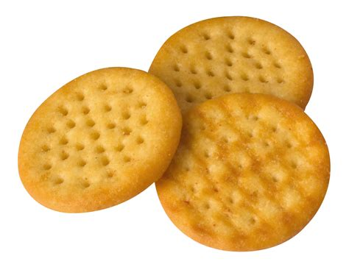
Jesus came to give his life for us. He took our punishment. The wages of sin is death, but the gift of god is eternal life Romans 6:23
¹⁹ Then Jesus took some bread.
He thanked God for it, broke it, and gave it to the apostles.
Then Jesus said, “This bread is my body that I am giving for you. Do this to remember me.”
You too can eat some crackers.
Remember Jesus gave His life for us.

Slide 23
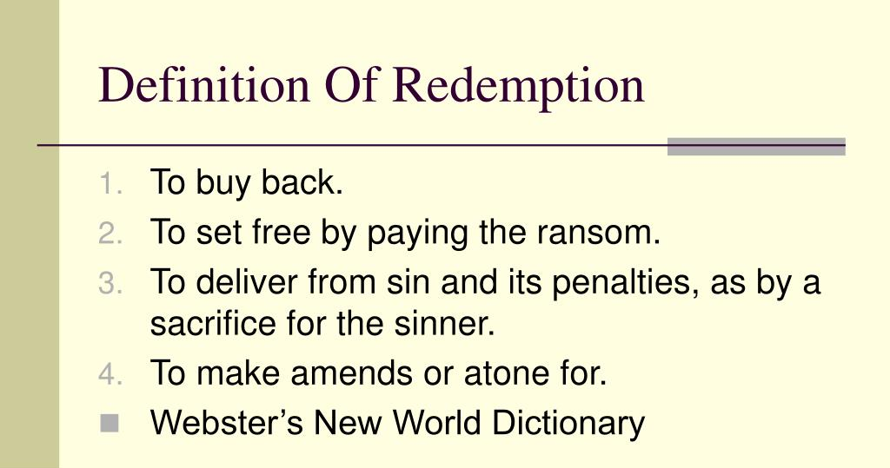
I will redeem you. You are my children. We are family. Jesus will restore this earth and give us our recreated home – Rev. 22
You are my children.
Love one another
as I have loved you.
²⁰ In the same way, after supper, Jesus took the cup and said, “This cup shows the new agreement that God makes with his people. This new agreement begins with my blood which is poured out for you.”
Drink some more grape juice.
Remember Jesus redeems us.
He quenches our thirst.
His sweet love fills us.

Slide 24
I have Redeemed you -- I will give you land, the promised land Jesus is our redeemer
Jesus and His disciples drank together to remember that Jesus came to redeem us.
We are redeemed!
We are children of God!
Pour a little bit of juice in someone else’s cup everyone serve one until everyone has some juice then give the toast

Slide 25

I’ve Been Redeemed

Slide 26
His Banner Over me is love
LOVE
Jesus is mine and I am His. His banner over me is love.
Jesus is the vine and we are the branches. His banner over me is love.

Slide 27

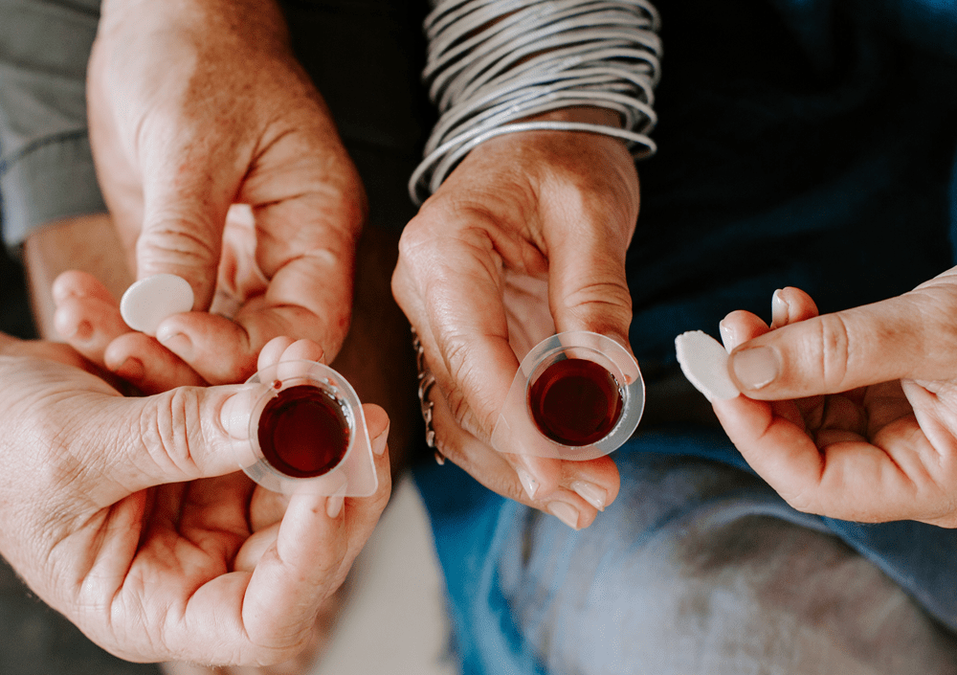
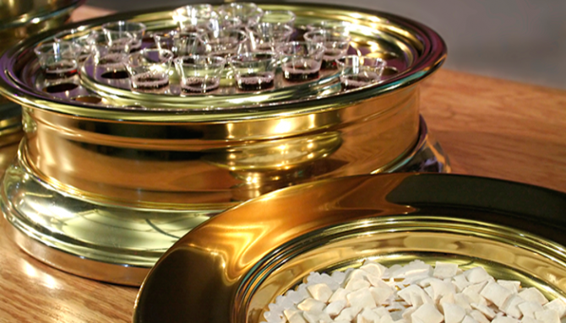
Now we remember Jesus’ death every time we participate in communion

Slide 28
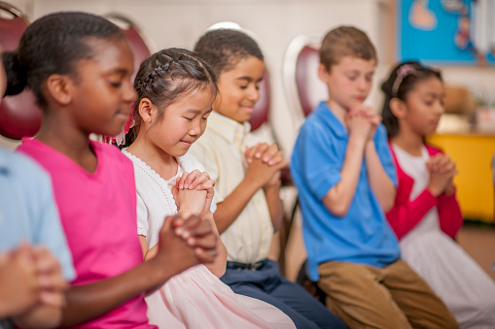
Let’s pray
Dear Jesus,
Thank you for coming to this earth.
Thank you for showing us your love.
Please forgive us for the wrong things we’ve done.
Thank you for forgiving us and saving us!
We love you!
In Jesus name we pray
Amen

Slide 29
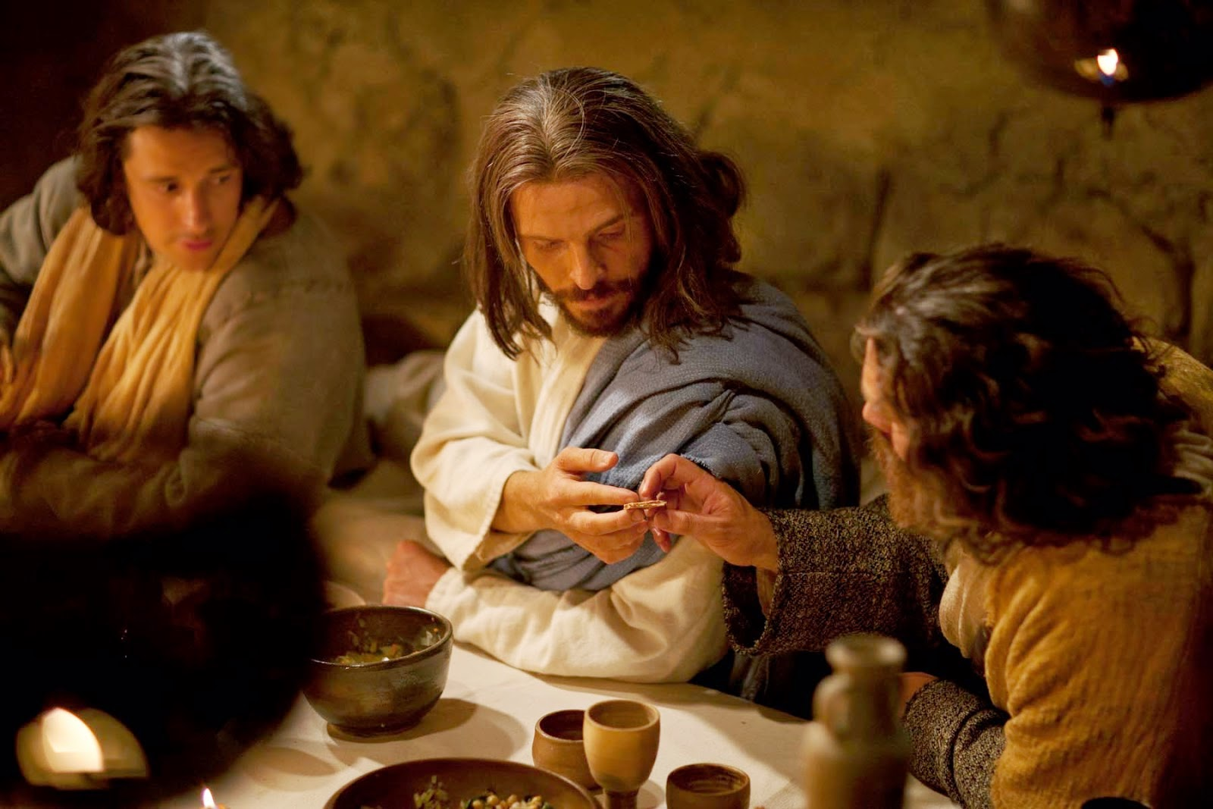
Jesus knew that judas would betray him
Who will betray you Lord?
It is the one whom I give this bread to .
²¹ Jesus said, “One of you will turn against me. His hand is by my hand on the table.
²² The Son of Man will do what God has planned. But how terrible it will be for that man who gives the Son of Man to be killed.”
²³ Then the apostles asked each other, “Which one of us would do that to Jesus?”
Judas, quickly, go do what you are going to do.

Slide 30
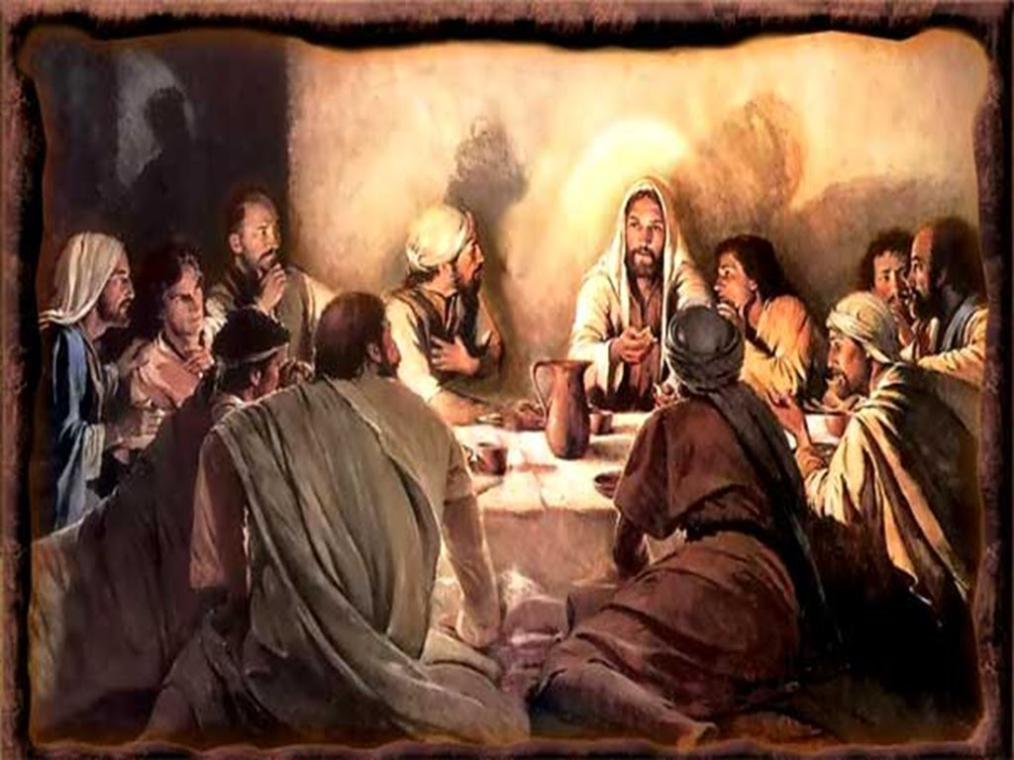
Who is most important? -- the one who serves
²⁴ Then the apostles began to argue about which one of them was the most important.
²⁵ But Jesus said to them, “The kings of the world rule over their people. Men who have authority over others are called ‘very important.’
²⁶ But you must not be like that. The greatest among you should be like the youngest, and the leader should be like the servant. ²⁷ Who is more important: the one sitting at the table or the one serving him? You think the one at the table is more important. But I am like a servant among you!

Slide 31
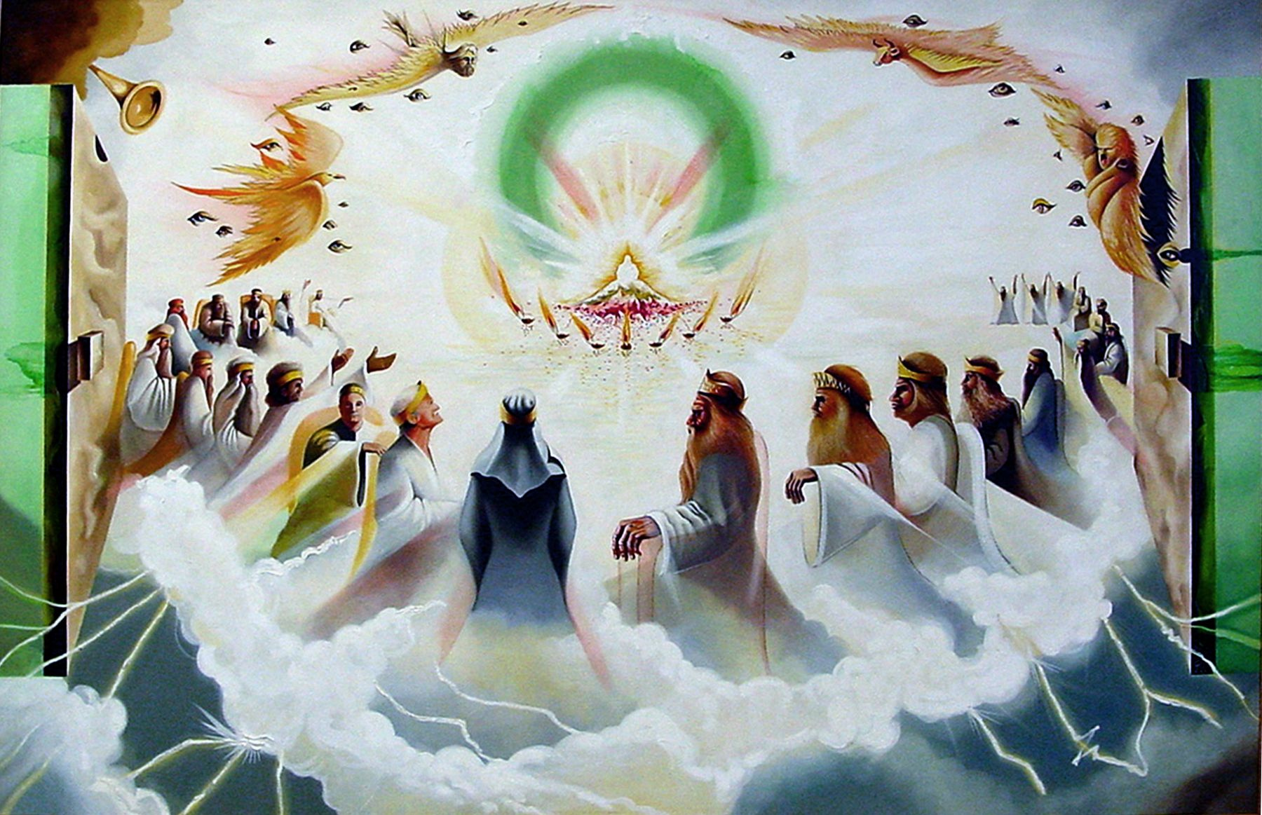
Jesus is king He will give the disciples thrones too
²⁸ “You men have stayed with me through many struggles.
²⁹ My Father has given me the power to rule.
I also give you authority to rule with me. ³⁰ You will eat and drink at my table in my kingdom. You will sit on thrones and judge the 12 tribes of Israel.

Slide 32
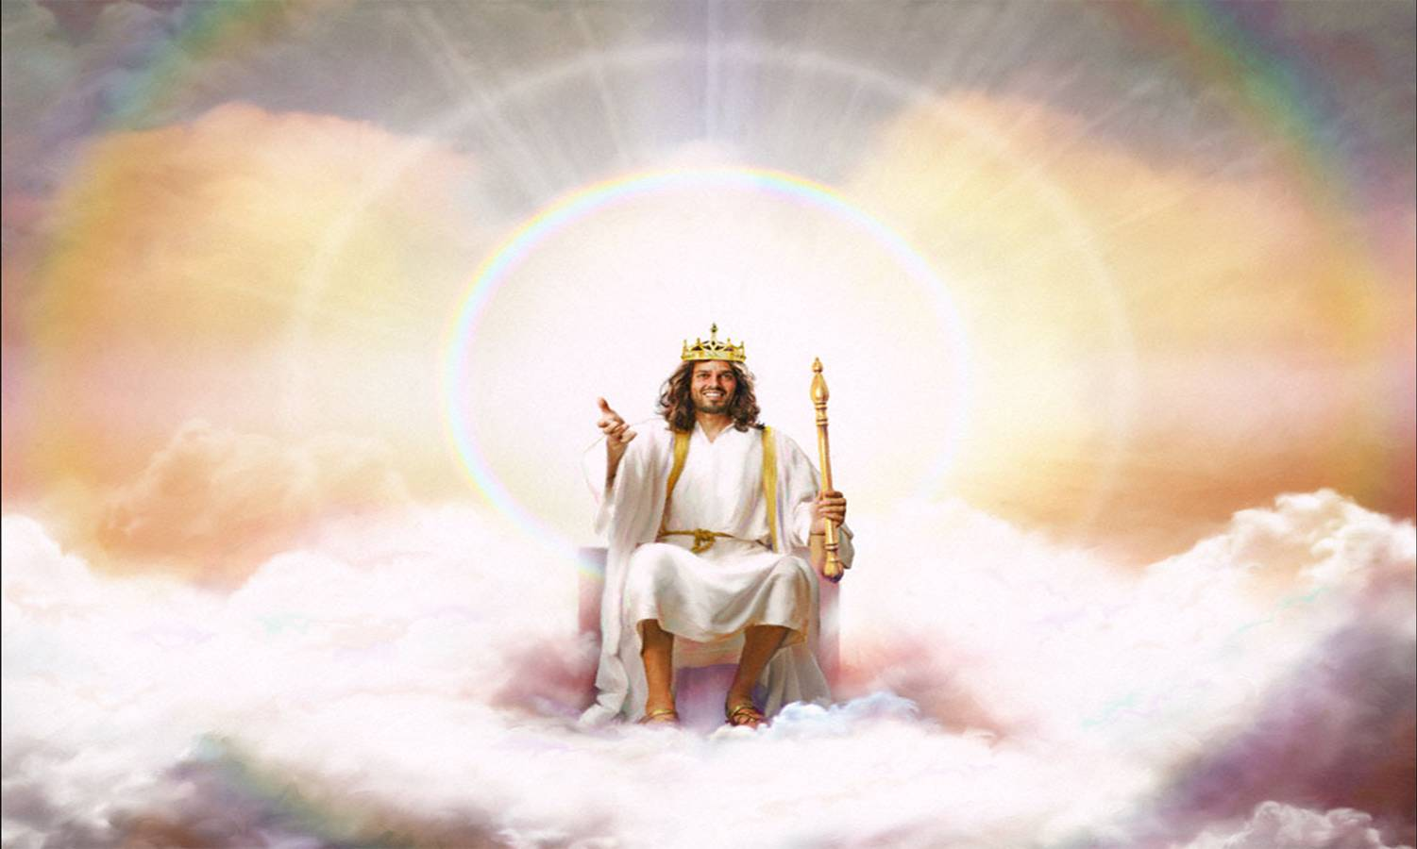
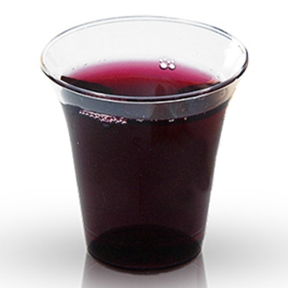
I will take you as a nation
God is our King!
We are part of His kingdom.
Drink one last cup of grape juice
We are part of God’s Kingdom.
He is the King of kings and Lord of Lords!

Slide 33
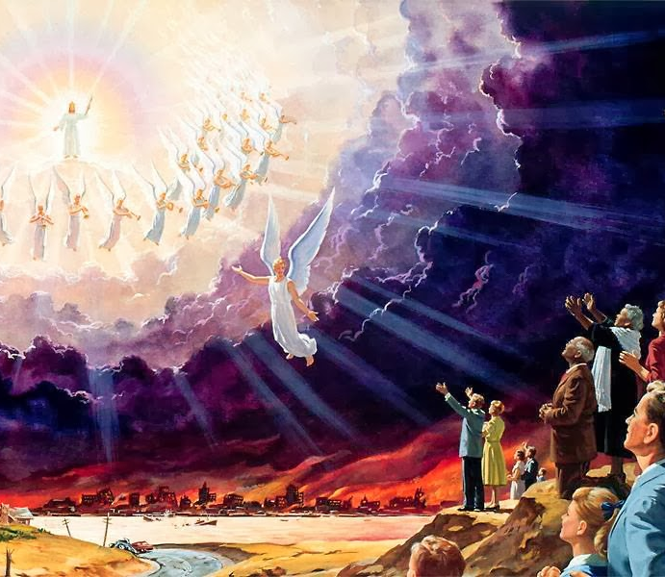
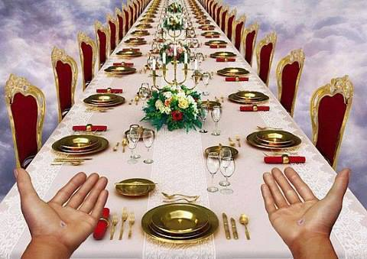
Look forward to the final Passover meal
We look forward to the final Passover Meal.
Jesus is coming again.
He will take us to Heaven, our promised land where we will be FREE and live happily ever after, eternally!
^{Jesus said:}
^{Luke 22:16} I will never eat another Passover meal until it is given its true meaning in the kingdom of God.”

Slide 34
His Banner Over me is love
LOVE
He invites me to His banqueting table. His banner over me is love.
Jesus is the vine and we are the branches. His banner over me is love.

Slide 35
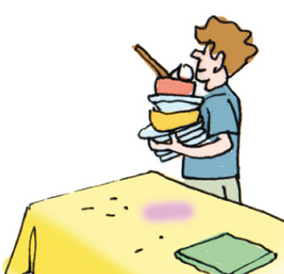


Serve one another that’s what good leaders do
Let’s serve one each other.
Who would like to:
Pick up the garbage and throw it away?
Put away the other things on our table. I will show you where to put them.
Wash the tables.

Slide 36
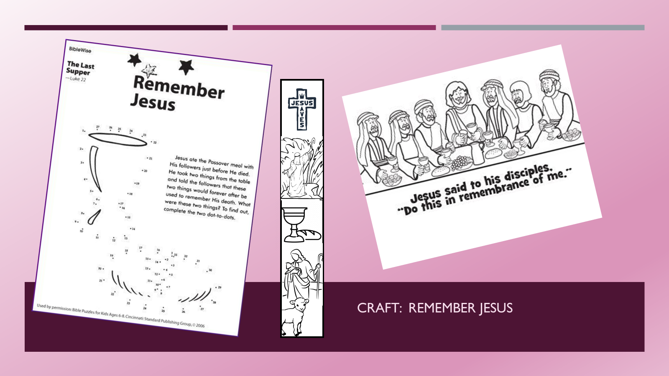
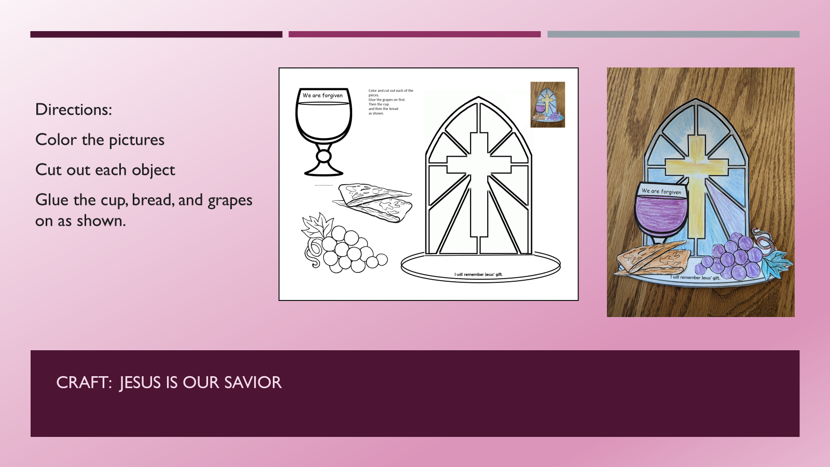

Choose Craft

Slide 37

Craft: Jesus is our savior
Directions:
Color the pictures
Cut out each object
Glue the cup, bread, and grapes on as shown.

Slide 38

Craft: Jesus is our savior download here: http://sabbathschoolcrafts.com/2021/01/09/a-special-supper/
Directions:
Color the picture
Cut around the edges
Fold the table tabs up
Bring the disciples around the table and glue them on the tabs
Put the dishes on the table

Slide 39

Craft: Remember jesus

Slide 40

Remember We look forward to the Final Passover
The Picnic in Heaven
Get ready!
Jesus is coming again!

Slide 41
His Banner Over me is love
LOVE

Slide 42

PASSOVER
Remember God Saved His People From Pharoah
Let My People Go
^{Exodus 12:26} When your children ask you, ‘Why are we doing these things?’ ²⁷ you will say, ‘This is the Passover sacrifice to honor the Lord. When we were in Egypt, the Lord passed over the houses of Israel. The Lord killed the Egyptians, but he saved our homes.’”

Slide 43
I’ve Been Redeemed

Slide 44
JESUS SAVES
John 3:16-17
Hebrews 12:2
¹⁶ For God so loved the world, that he gave his only begotten Son, that whosoever believeth in him should not perish, but have everlasting life.
¹⁷ For God sent not his Son into the world to condemn the world; but that the world through him might be saved.
”Looking unto Jesus the author and finisher of our faith;
who for the joy that was set before him
endured the cross,
despising the shame,
and is set down at the right hand of the throne of God.”

Slide 45

The End

