Slide 1
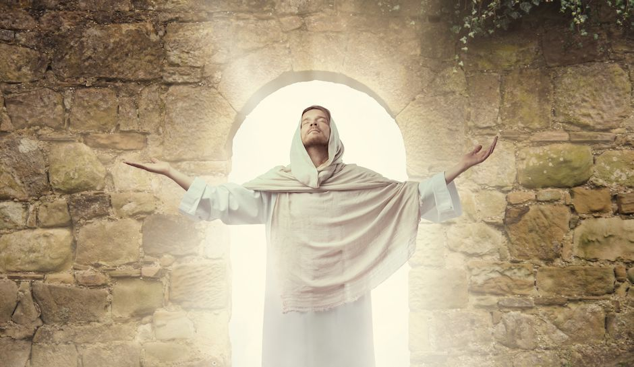
Jesus Rises Again
He rose again just like He said
Matthew 28, Mark 16, John 20

Slide 2
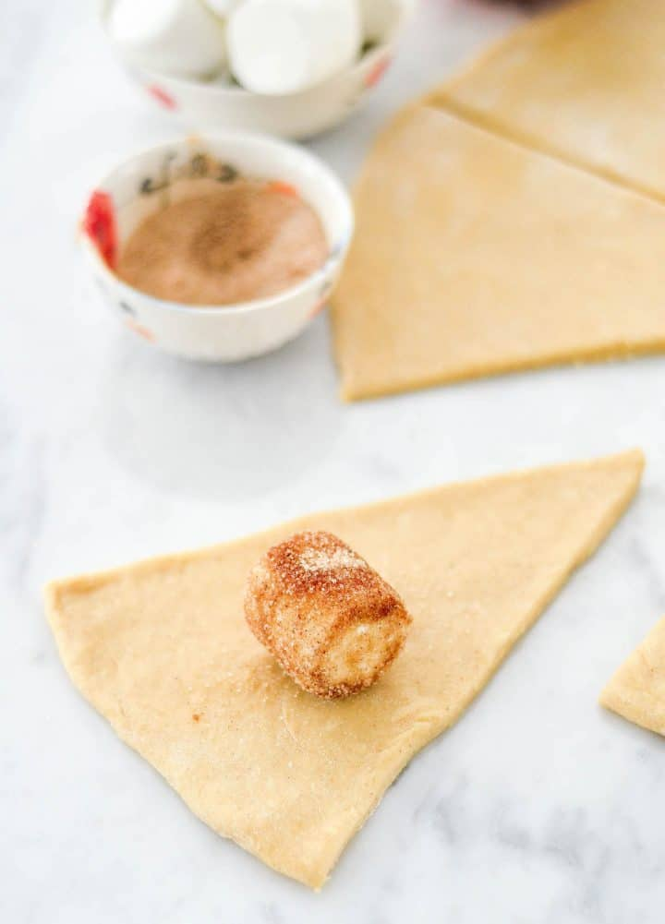
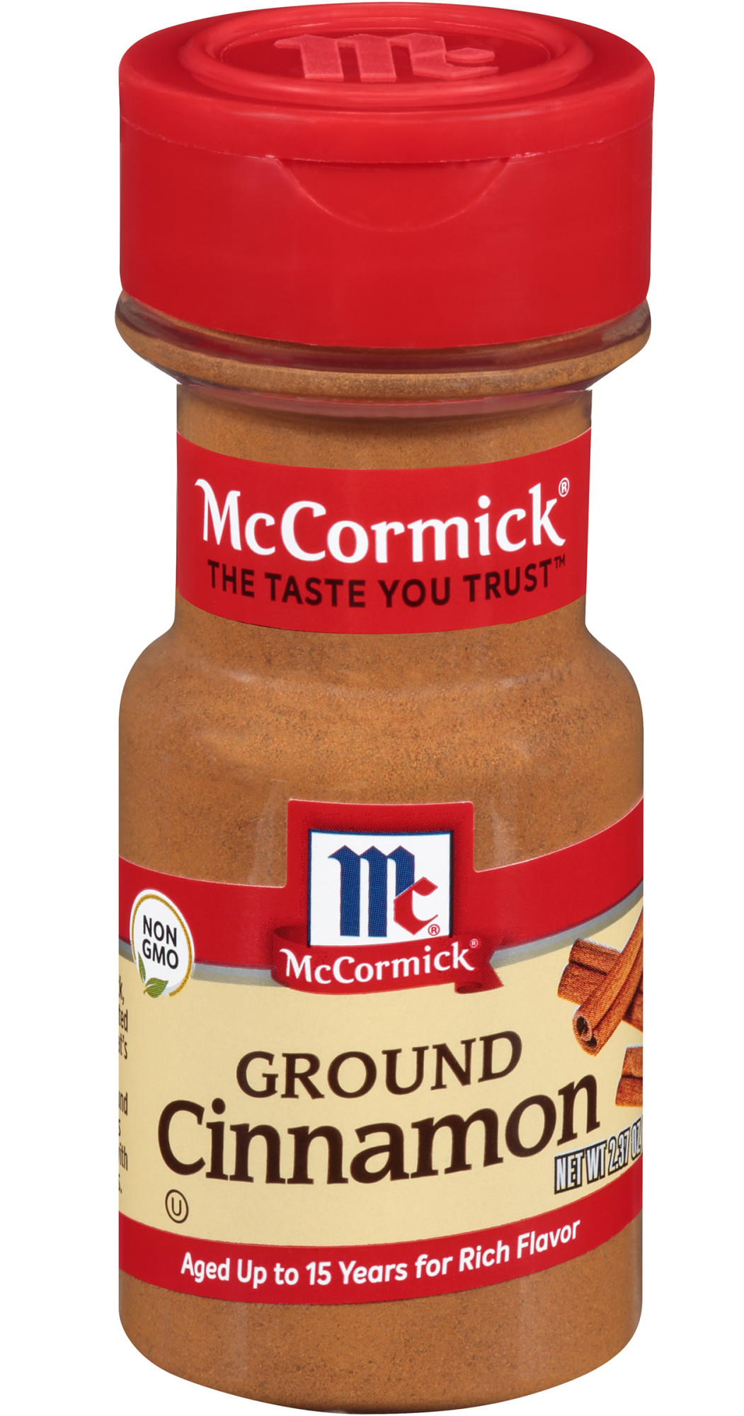
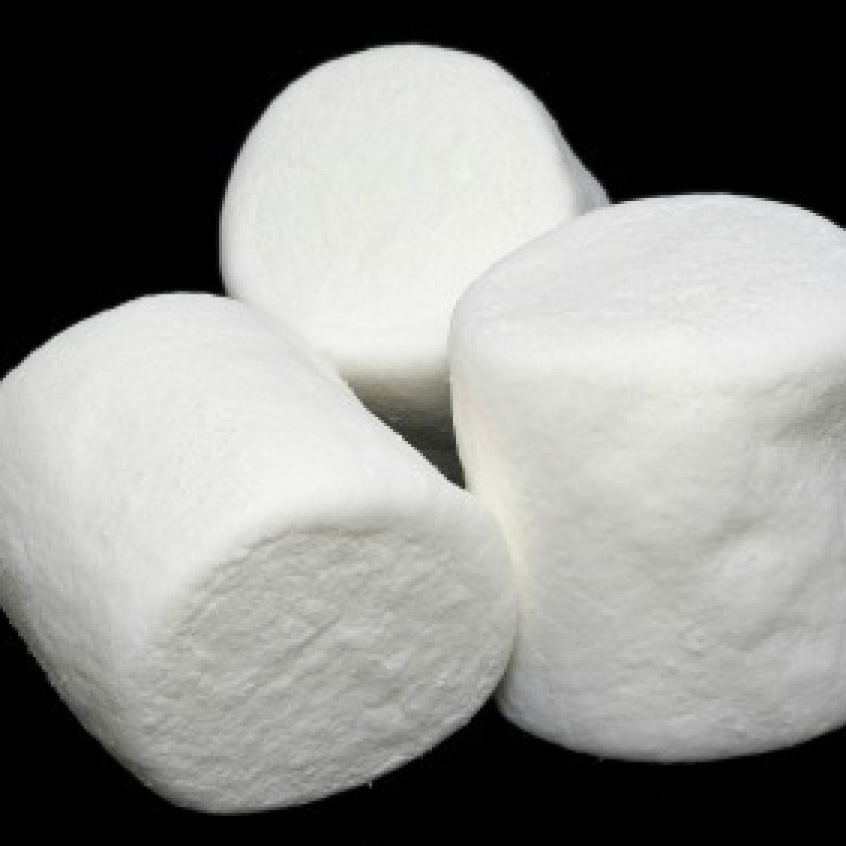
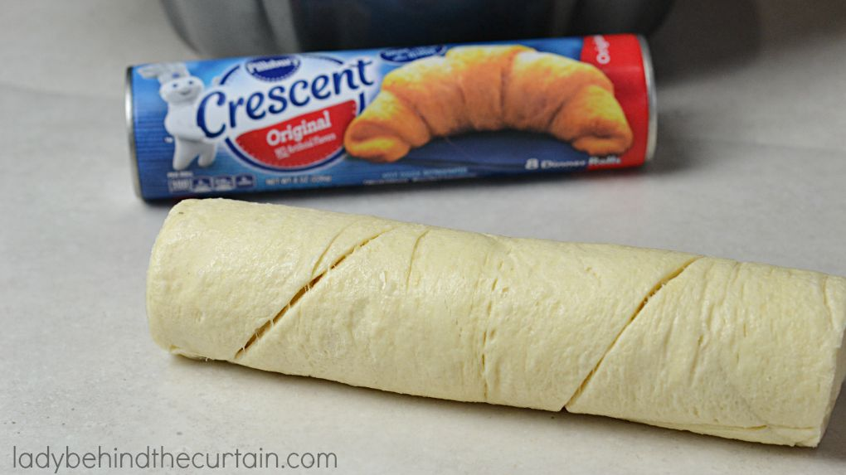
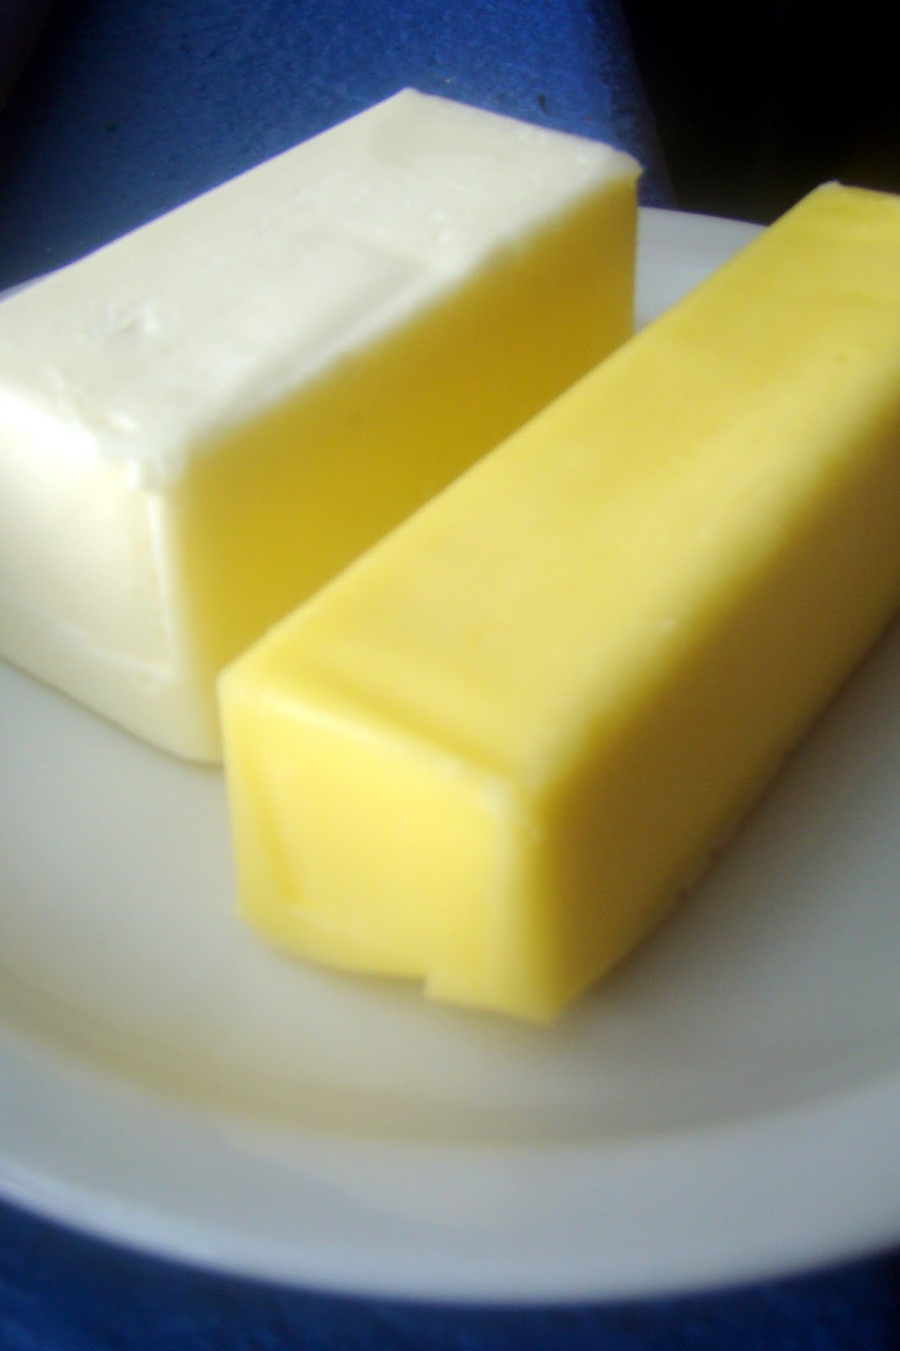
Today we are going to make Resurrection Rolls.
Optional:
You need:
Marshmallow
Croissant bread
Melted butter/margarine
Cinnamon spice
Roll the marshmallow in butter and then in spice
Wrap a Croissant around the marshmallow. Make sure it is totally covered!
Remember how Jesus died and then they wrapped him in spices and cloths and laid him in the tomb.
While you make yours, I will read John 19:38-42
Homemade recipe at https://joyfoodsunshine.com/homemade-resurrection-rolls/

Slide 3
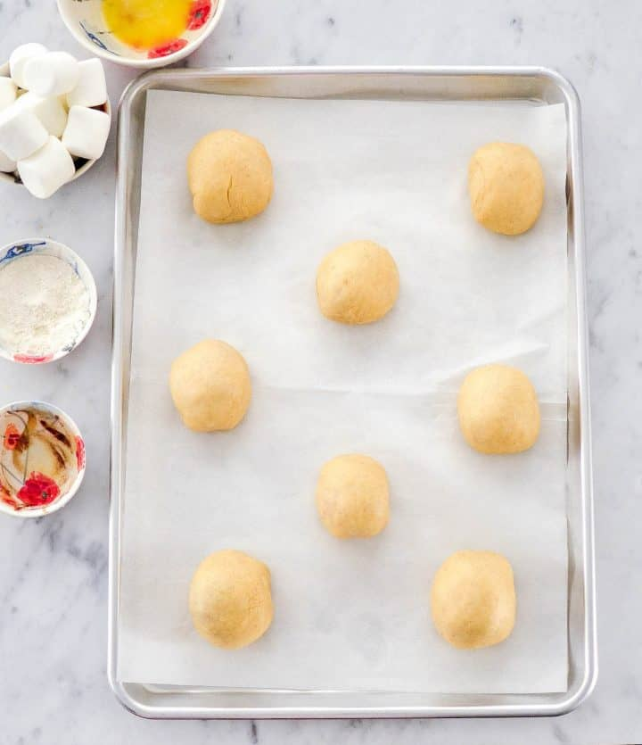
Make your resurrection roll and put it on a pan
Jesus was crucified and died
^{John 19:38} Later Joseph asked Pilate for Jesus’ body. Joseph was from the town of Arimathea. He was a follower of Jesus. But he followed Jesus secretly because he was afraid of the Jewish leaders. After Pilate gave him permission, Joseph came and took the body away. ³⁹ Nicodemus went with Joseph. He was the man who had earlier visited Jesus at night. Nicodemus brought some mixed spices that weighed about 75 pounds. ⁴⁰ The two men took Jesus’ body. They wrapped it in strips of linen cloth, along with the spices. That was the way the Jews buried people. ⁴¹ At the place where Jesus was crucified, there was a garden. A new tomb was there. No one had ever been put in it before. ⁴² That day was the Jewish Preparation Day, and the tomb was nearby. So they placed Jesus there.
Write your name next to your roll.
Bake according to directions.
While they are baking let’s ….

Slide 4


John 3:16 “For God so loved the world, that he gave his only Son,
that whoever believes in him should not perish but have eternal life.”
Praise God for His gift!

Slide 5
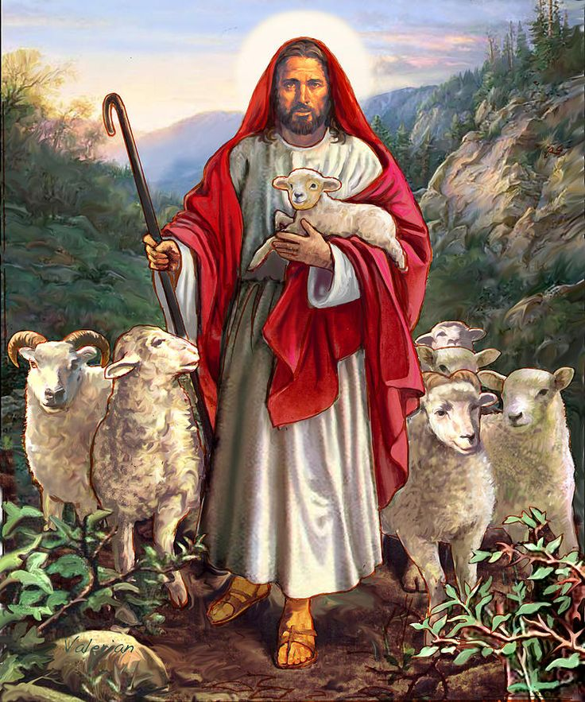
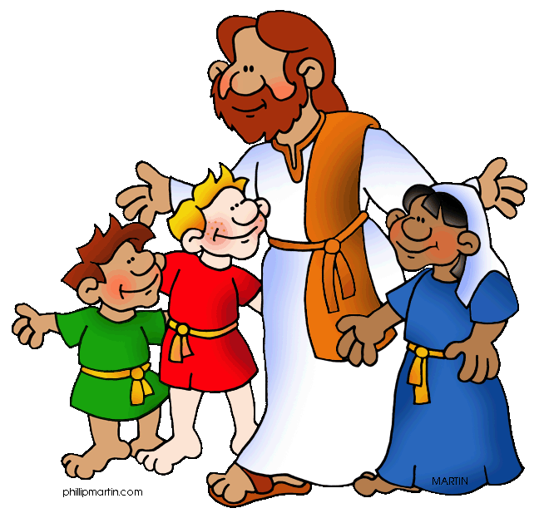
Jesus had been talking to the Pharisees when He said:
John 10
¹¹ “I am the good shepherd. The good shepherd lays down his life for the sheep…..
¹⁴ “I am the good shepherd; I know my sheep and my sheep know me— ¹⁵ just as the Father knows me and I know the Father—and I lay down my life for the sheep. …
¹⁷ The reason my Father loves me is that I lay down my life—only to take it up again. ¹⁸ No one takes it from me, but I lay it down of my own accord. I have authority to lay it down and authority to take it up again. This command I received from my Father.”
Last week we talked about Jesus dying on a cross.
He was taking our punishment and dying for us.
But Jesus did not stay dead!

Slide 6

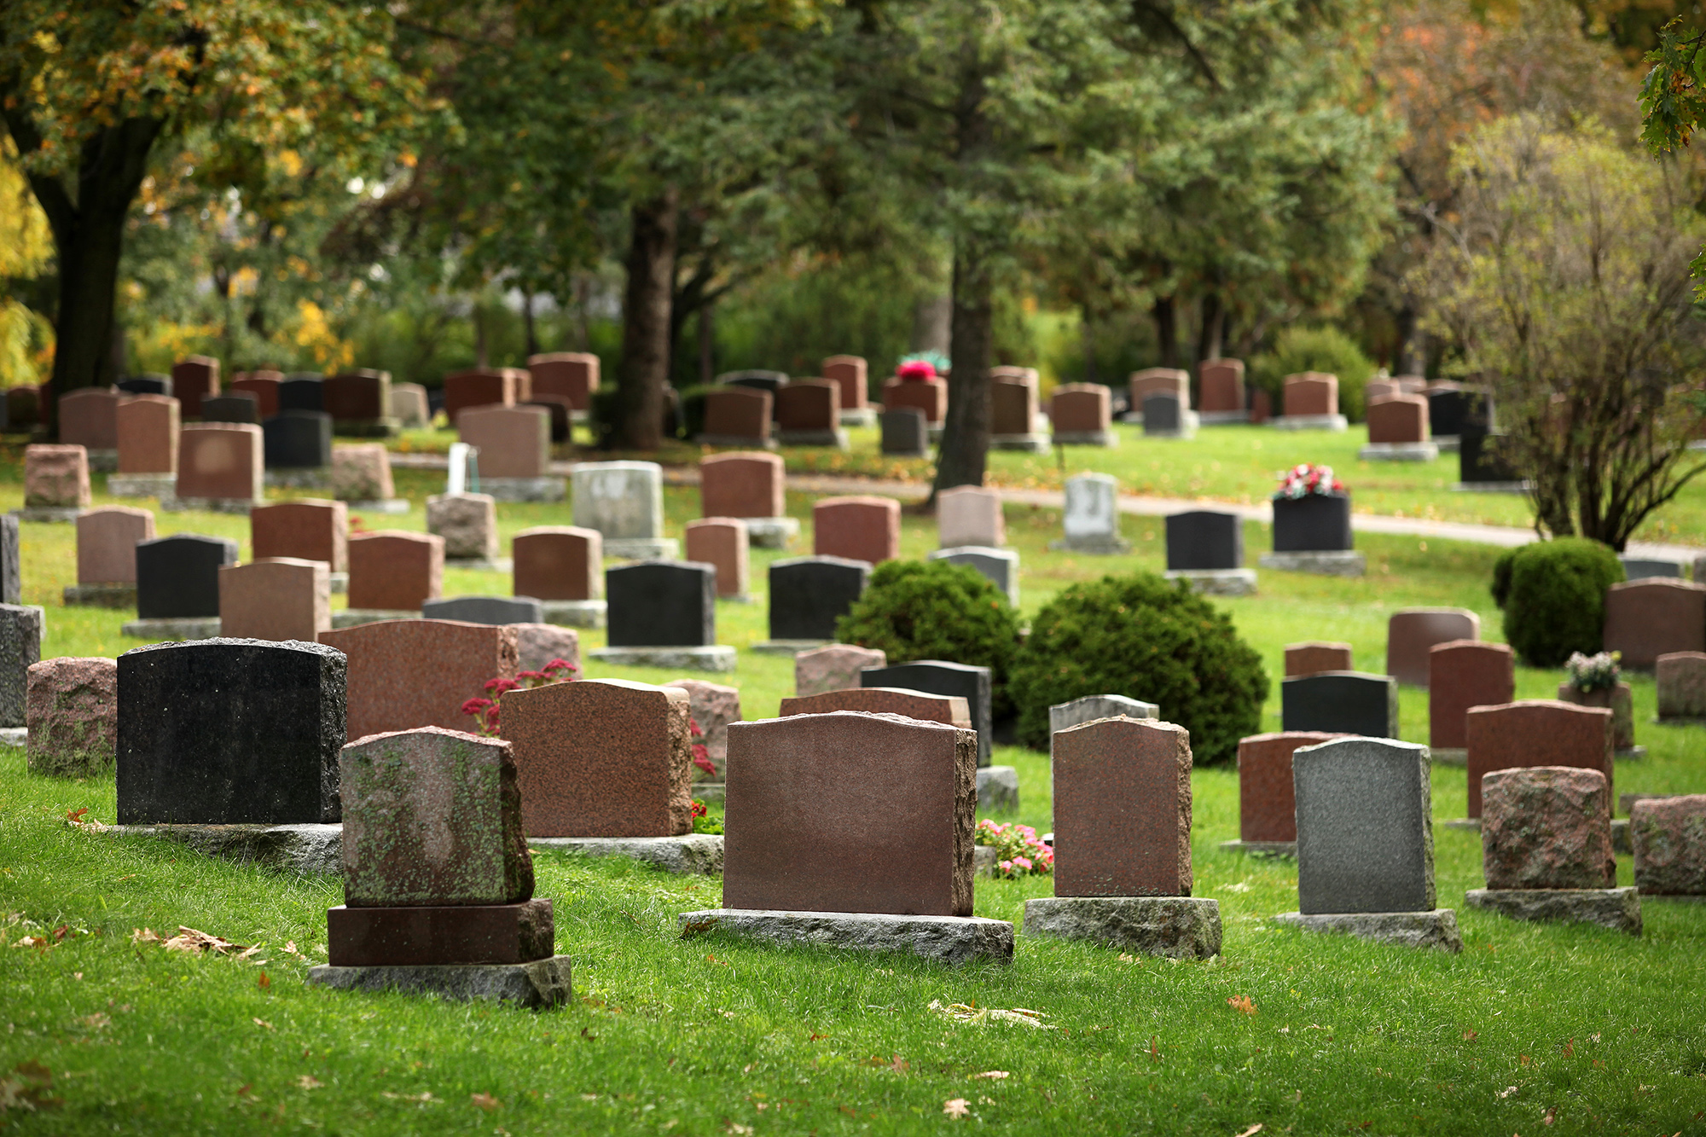
Have you ever had someone who died?
It is very sad! But we have hope!
Remember Jesus said:
“I am the resurrection
and the life.
The one who believes in me will live, even though they die.” John 11:25

Slide 7
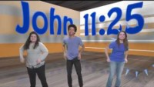
Praise God for His gift!

Slide 8
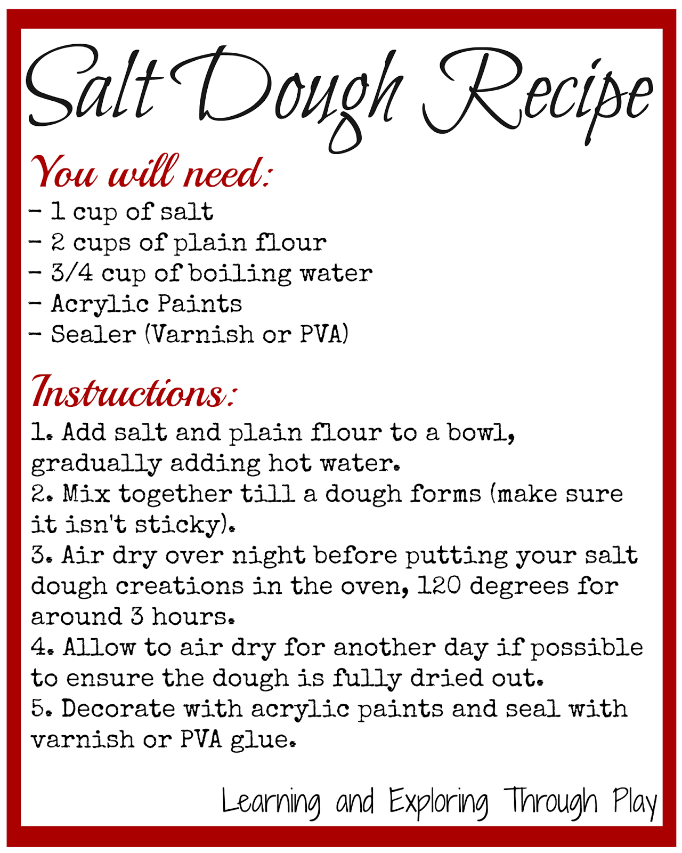
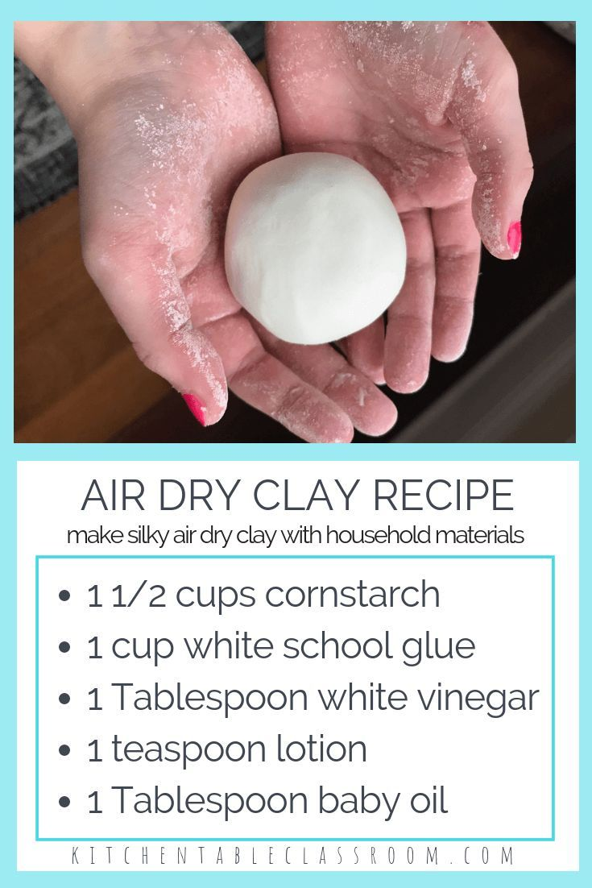
Let’s use dough to make our story today.
Salt Dough Recipe for individuals:
We will make 2 batches for each person (1 blackish and 1 greenish)
1/2 cup flour in 1 bowl + 1/2 cup flour in 2nd bowl
1/4 cup salt for 1st bowl + 1/4 cup salt in 2nd
1 T oil in each bowl
1/4 cup water in each bowl
Mix the above well in each bowl then:
Add 1 tiny drop of black/brown paint to 1st bowl & mix
Add 1 tiny drop of green paint to 2nd bowl & mix
You can do the above ahead of time. or 9:30-9:45
We will use the dough to make a Resurrection center piece

Slide 9
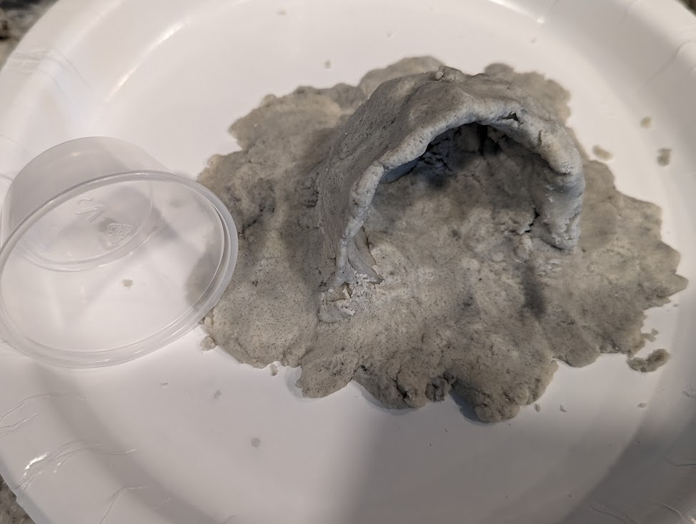
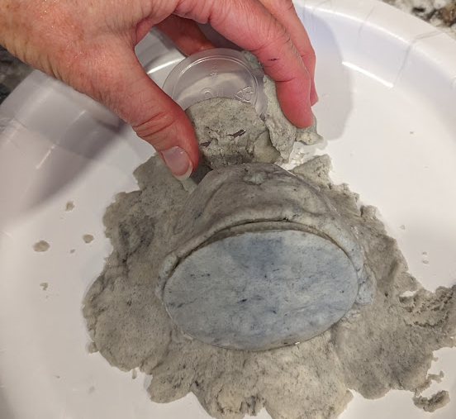
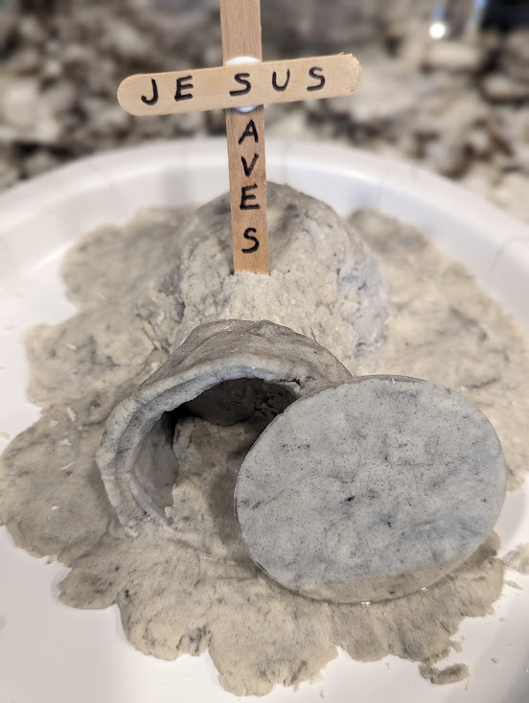
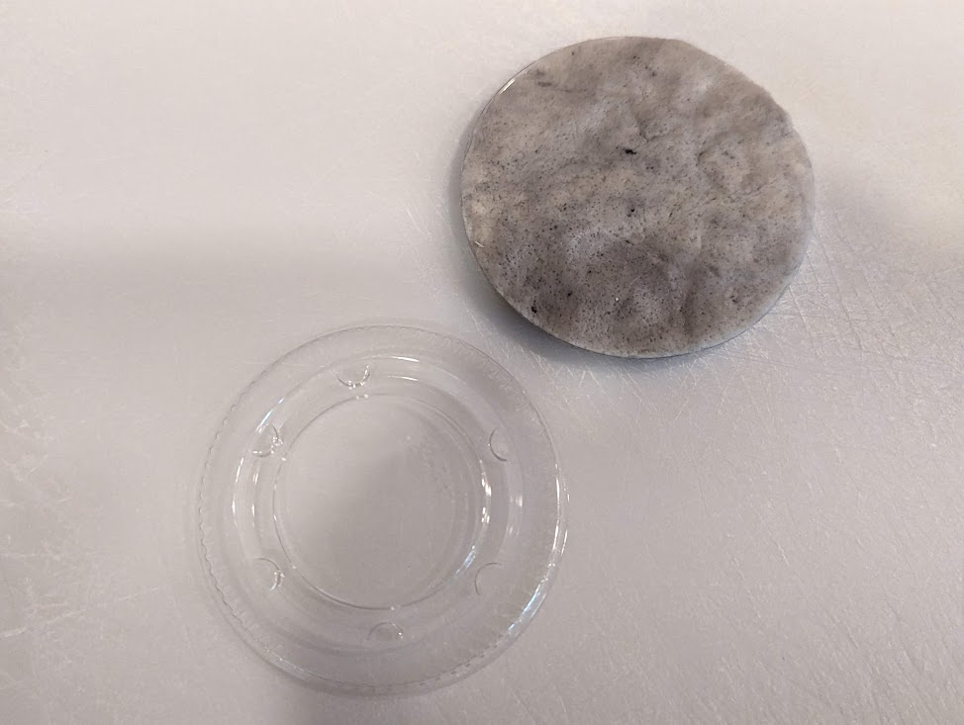
Let’s use dough to make our story today. First let’s make a tomb. Remember Jesus died on a cross. Nicodemus and his friend Joseph laid Jesus in a tomb. The leaders made sure soldiers guarded the tomb. DO IT: PUT DOUGH OVER A CUP (ON IT’S SIDE) OR BOWL (UPSIDE DOWN)
We used 2 oz
mini cups with lids.

Slide 10
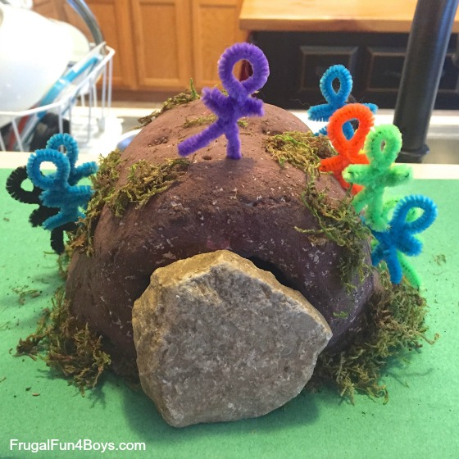
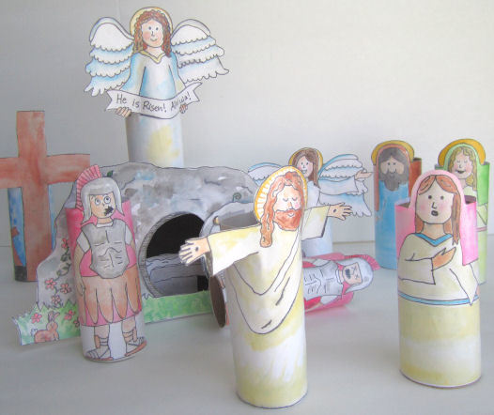
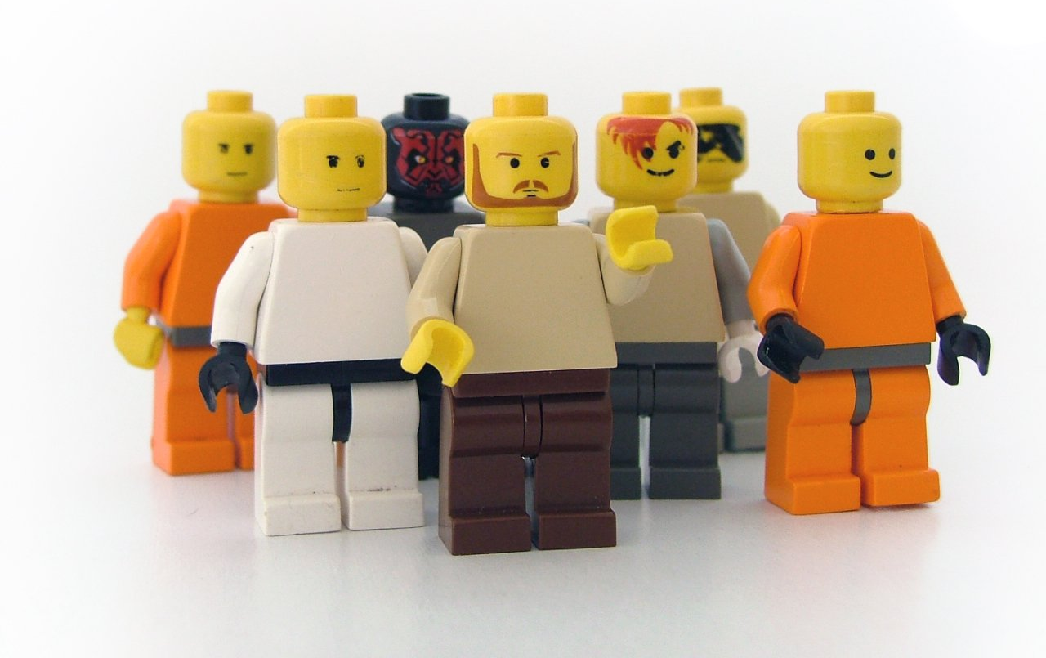
We need people for our story. You can use Lego people, make people with pipe-cleaners, or use paper people. You can use your people to act out the story while we tell it.
Printable resurrection set

Slide 11
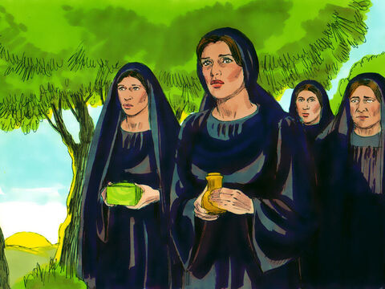
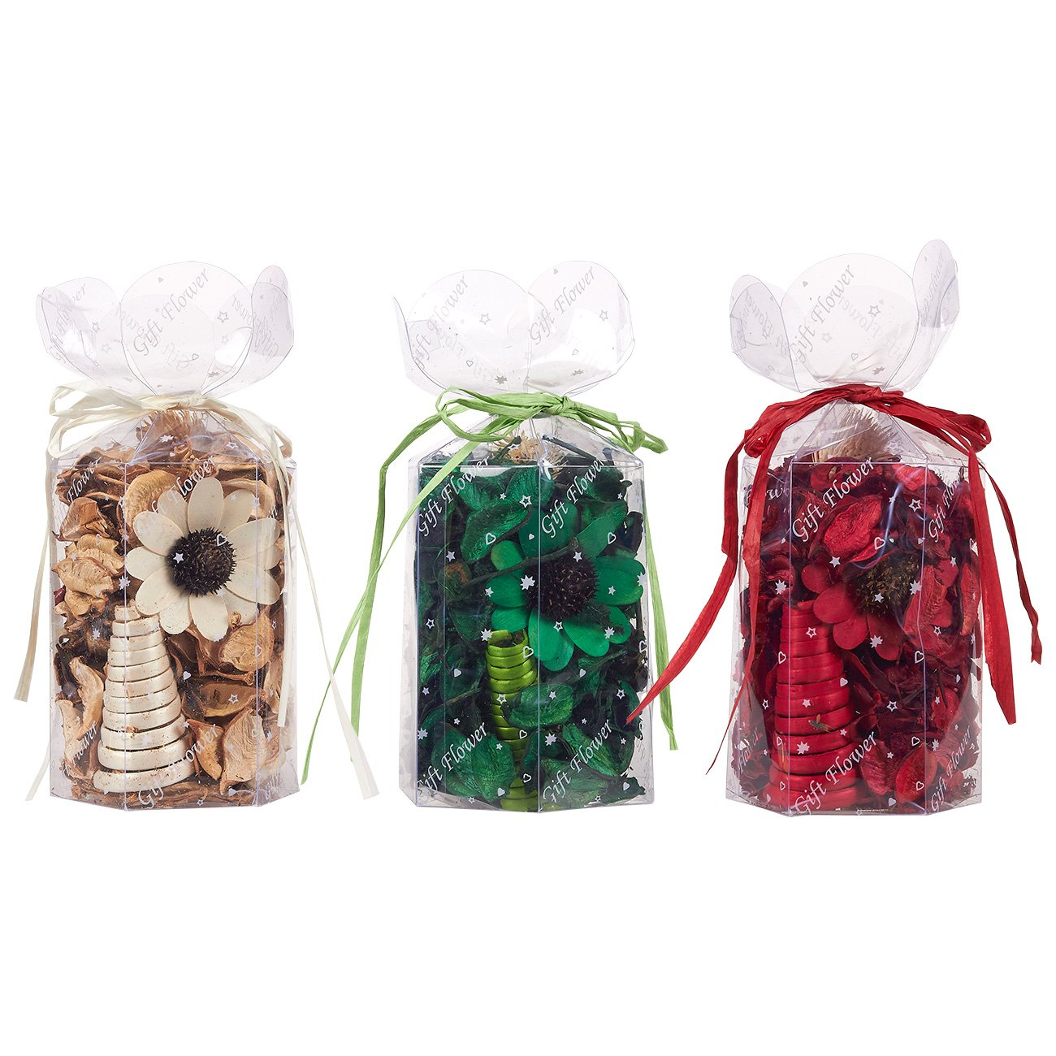
Early Sunday morning the women went to the tomb….
I wish we could have put these spices on Jesus earlier, but we didn’t have time. I’m glad we can now.
Who will roll away the heavy stone in front of the tomb?
Oh no! I have no idea how we’ll be able to do that!
Mark 16
When the Sabbath was over, Mary Magdalene, Mary the mother of James, and Salome bought spices so that they might go to anoint Jesus’ body.
² Very early on the first day of the week, just after sunrise, they were on their way to the tomb ³ and they asked each other, “Who will roll the stone away from the entrance of the tomb?”
I have some spices you can smell and put in a potpourri bag.

Slide 12
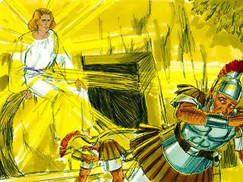
Before the women got to the tomb…..
Matthew 28
² There was a violent earthquake, for an angel of the Lord came down from heaven and, going to the tomb, rolled back the stone and sat on it. ³ His appearance was like lightning, and his clothes were white as snow.
⁴ The guards were so afraid of him that they shook and became like dead men.
EARTHQUAKE!
(shake your chair – earthquake) A BRIGHT ANGEL
(shine a bright light – hide face) Soldiers fall
(fall on the ground)
Get up! Run!
We must tell the chief priests and leaders what happened!
JESUS AROSE!
JESUS IS ALIVE AGAIN!

Slide 13

Praise God for His gift!

Slide 14
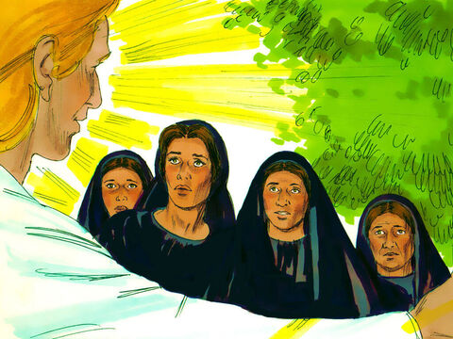
Jesus is gone!
Do not be afraid.
I know you are looking for Jesus, who was crucified.
Matthew 28
⁵ The angel said to the women, “Do not be afraid, for I know that you are looking for Jesus, who was crucified….

Slide 15
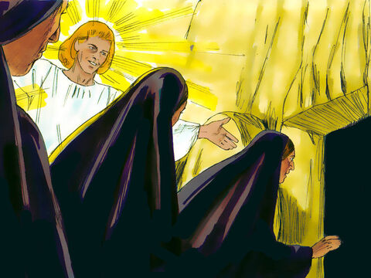
Jesus has risen!
Come and see the place where he lay.
Jesus is not here. He has risen, just as He said!
Matthew 28
⁵ The angel said to the women, “….⁶ He is not here; he has risen, just as he said. Come and see the place where he lay.

Slide 16
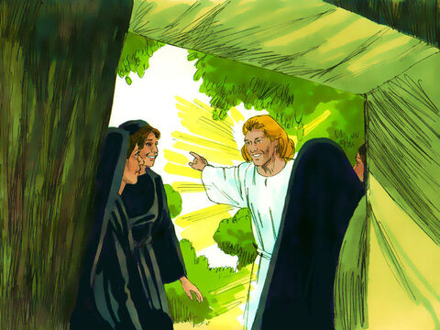
Jesus is alive!
Jesus has risen from the dead.
Go quickly and tell His disciples!
Matthew 28
^{…..7} Then go quickly and tell his disciples: ‘He has risen from the dead and is going ahead of you into Galilee. There you will see him.’ Now I have told you.”

Slide 17
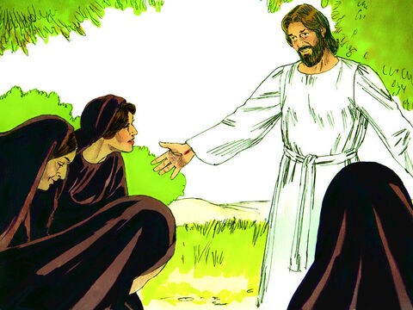
Go tell the disciples!
Greetings!
Do not be afraid.
Go tell my disciples that I will meet them in Galilee.
Matthew 28
⁸ So the women hurried away from the tomb, afraid yet filled with joy, and ran to tell his disciples.
⁹ Suddenly Jesus met them. “Greetings,” he said.
They came to him, clasped his feet and worshiped him.
¹⁰ Then Jesus said to them, “Do not be afraid. Go and tell my brothers to go to Galilee; there they will see me.”
LORD You are our Savior! How awesome you are!

Slide 18
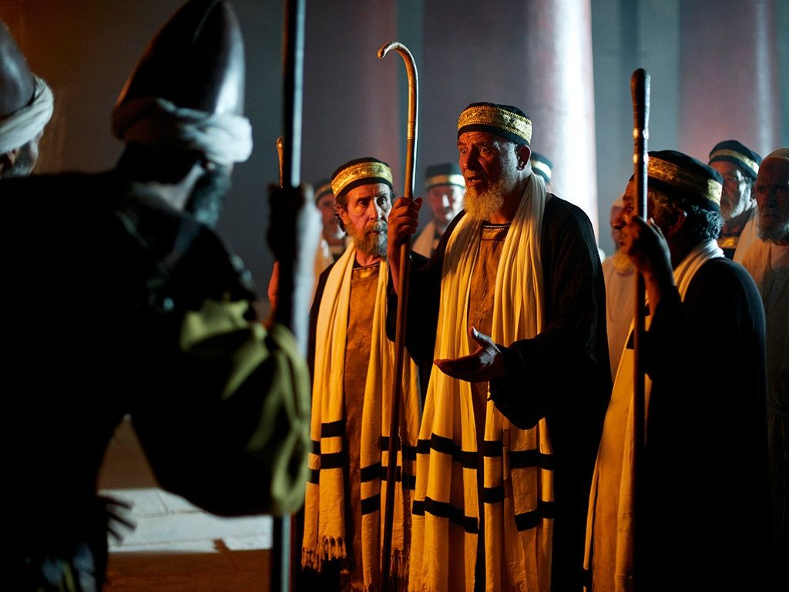
Meanwhile, the soldiers were telling the priests…
There was an earthquake, a bright angel! Jesus rose again! The tomb is empty.
We’ll give you lots of money if you don’t tell anybody about that!
Just say the disciples stole him.
Matthew 28
¹¹ While the women were on their way, some of the guards went into the city and reported to the chief priests everything that had happened.
¹² When the chief priests had met with the elders and devised a plan, they gave the soldiers a large sum of money, ¹³ telling them, “You are to say, ‘His disciples came during the night and stole him away while we were asleep.’ ¹⁴ If this report gets to the governor, we will satisfy him and keep you out of trouble.” ¹⁵ So the soldiers took the money and did as they were instructed. And this story has been widely circulated among the Jews to this very day.

Slide 19
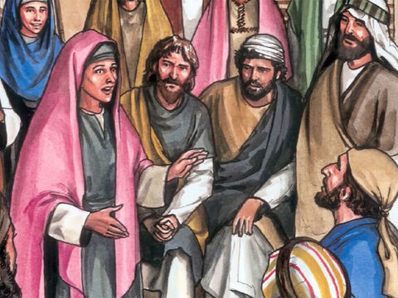
Jesus is gone!
Jesus is not in the tomb!
John 20
² So Mary ran to Simon Peter and another disciple, the one Jesus loved.
She said, “They have taken the Lord out of the tomb! We don’t know where they have put him!”

Slide 20
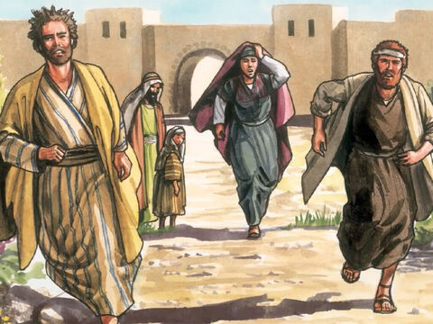
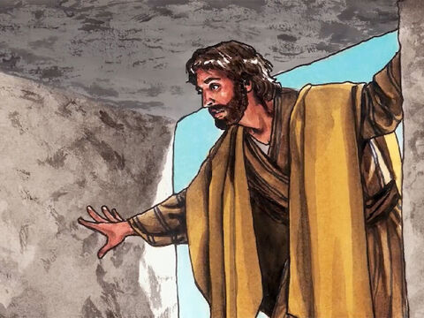
Hurry! Let’s go see!
⁴ Both of them were running. The other disciple ran faster than Peter. He reached the tomb first. ⁵ He bent over and looked in at the strips of linen lying there. But he did not go in.
³ So Peter and the other disciple started out for the tomb.

Slide 21
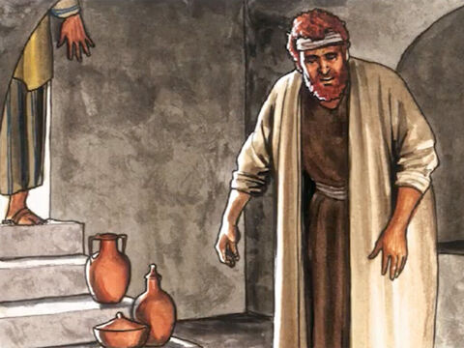
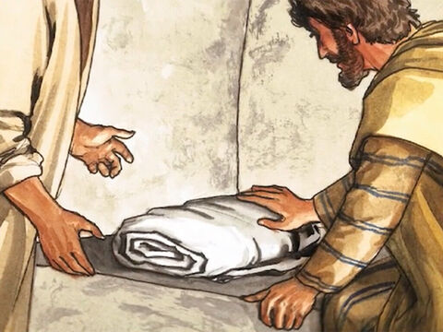
What happened?
⁶ Then Simon Peter came along behind him. He went straight into the tomb.
He saw the strips of linen lying there. ⁷ He also saw the funeral cloth that had been wrapped around Jesus’ head. The cloth was still lying in its place. It was separate from the linen.
⁸ The disciple who had reached the tomb first also went inside.
He saw and believed.

Slide 22
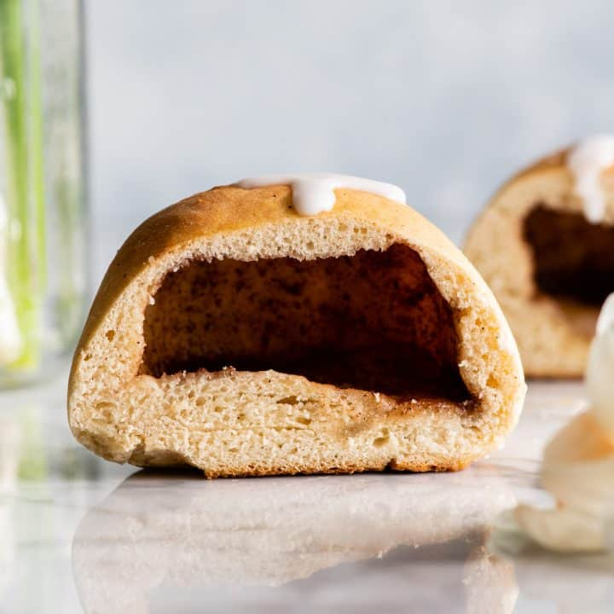
The tomb is empty!
Our Resurrection Rolls are baked and ready!
You may take a bite.
What do you see inside?

Slide 23
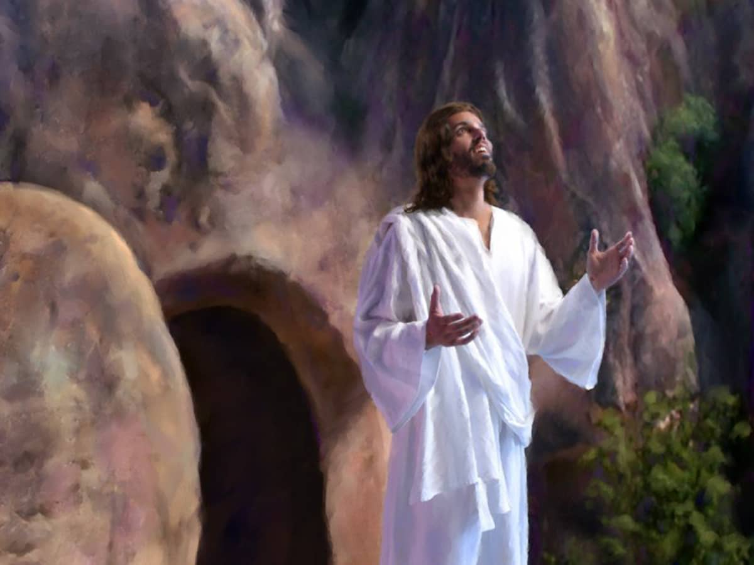
“Jesus has risen, just like He said.” Matthew 28:6
“Jesus said to her, “I am the resurrection and the life. The one who believes in me will live, even though they die.” John 20:31

Slide 24
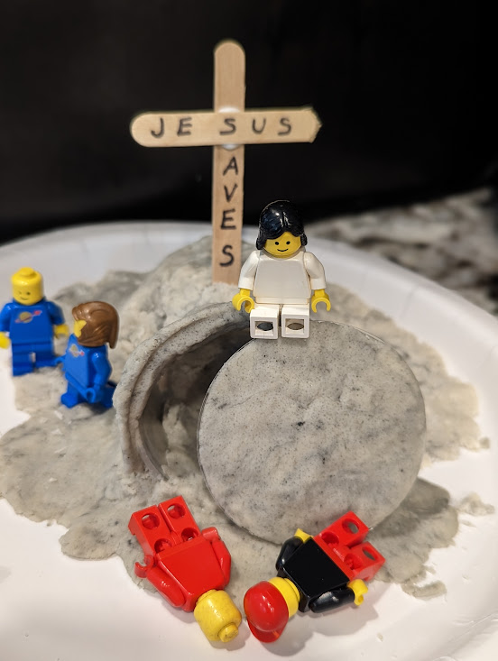
Let’s make a sign for your tomb craft.
Jesus is Alive
and gives me
Eternal life!
“Jesus has risen, just like He said.” Matthew 28:6

Slide 25

Praise God for His gift!

Slide 26

Object Lesson – Jesus gives us new life Like a butterfly gets a new life
A caterpillar hatches from an egg; we are born.
A caterpillar grows and GROWS; we grow and GROW, TOO.
A caterpillar makes a cocoon and rests.
Jesus wants us to rest and trust in Him.
It comes out a butterfly! It spreads joy and pollen.
Jesus gives us new life and eternal life!
We spread the good news that Jesus loves us!

Slide 27

Object Lesson Craft or gift – a butterfly
New life in Jesus craft

Slide 28
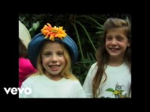
Praise God for His gift!

Slide 29
John 3:16 “For God so loved the world, that he gave his only Son,
that whoever believes in him should not perish but have eternal life.”
Praise God for His gift!

Slide 30
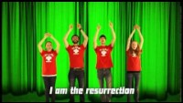
John 11:25 “I am the resurrection and the life.
The one who believes in me will live, even though they die.”
Praise God for His gift!

Slide 31
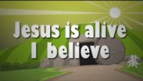
Praise God for His gift!

Slide 32

Gift from God
To you!

Slide 33
Praise God for His gift!

Slide 34

Praise God for His gift!

Slide 35
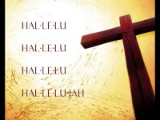
Gift from God
To you!

Slide 36
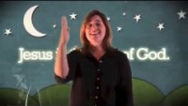
Praise God for His gift!

Slide 37


