Slide 1
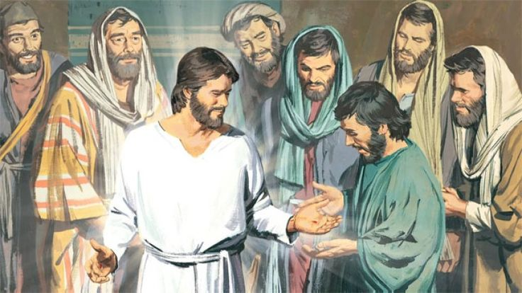
Jesus is Alive!
The Risen Lord visits the Disciples
John 20
BELIEVE IT

Slide 2
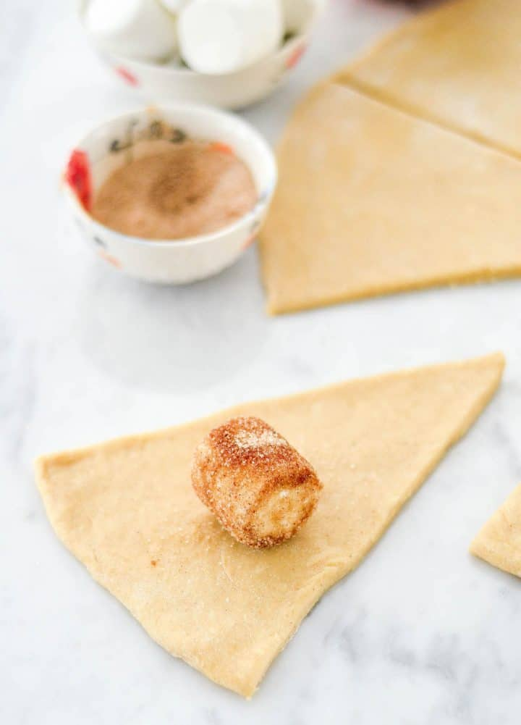
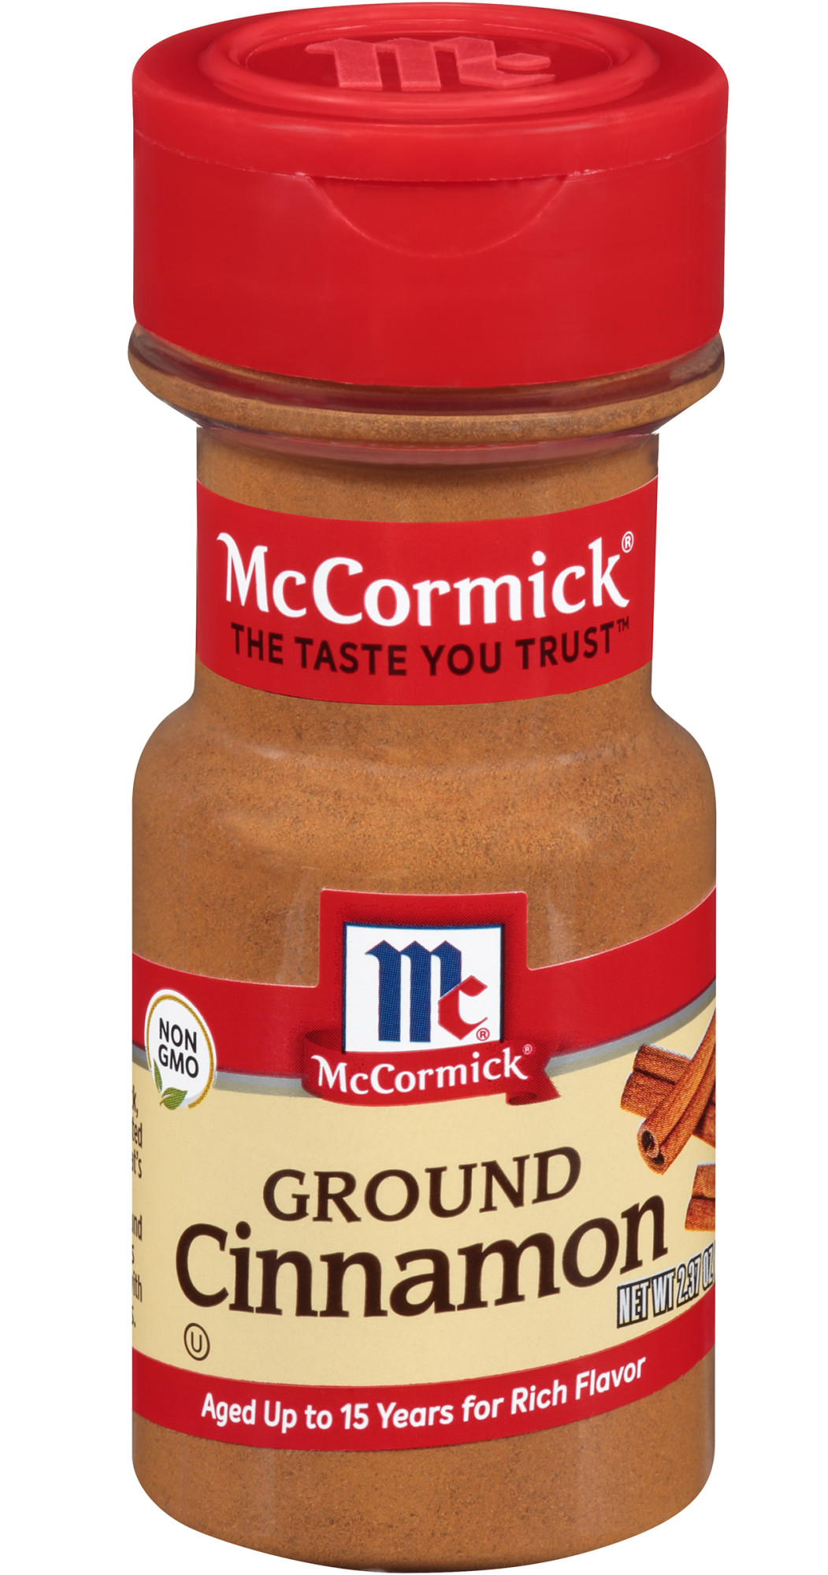
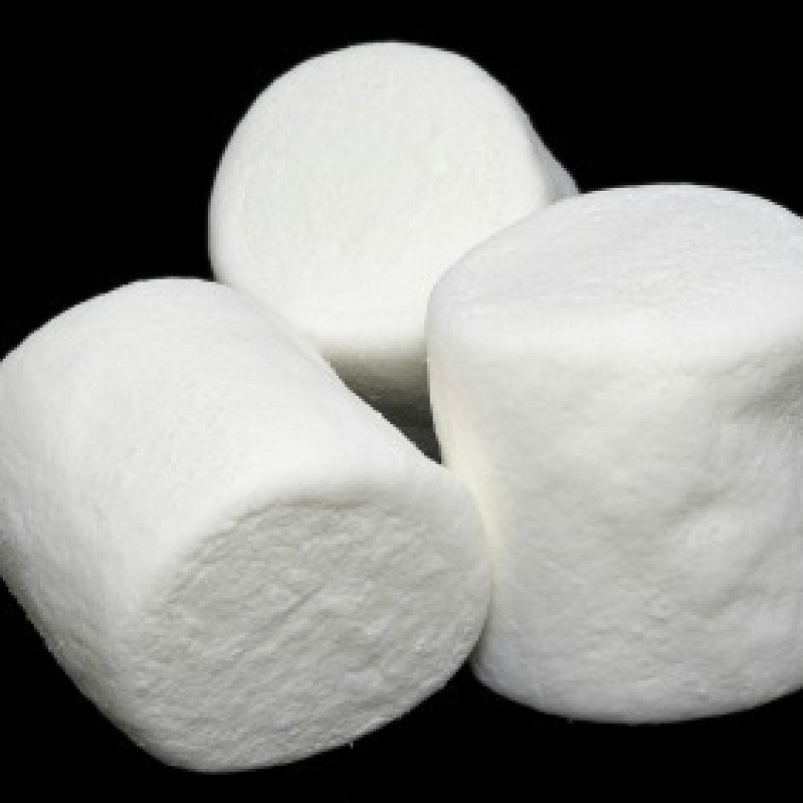
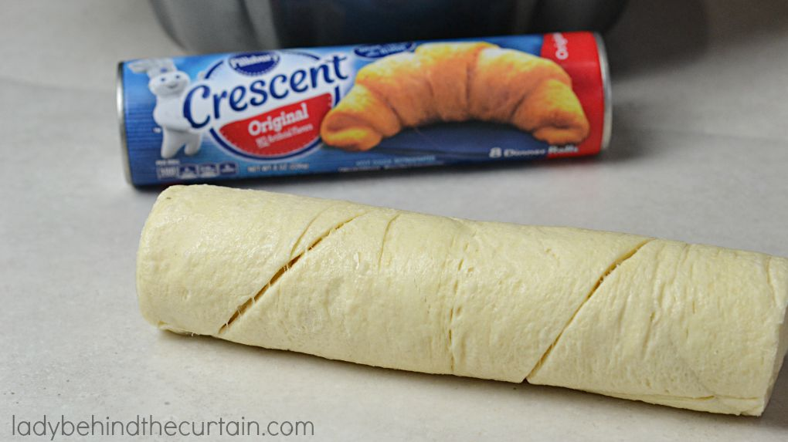
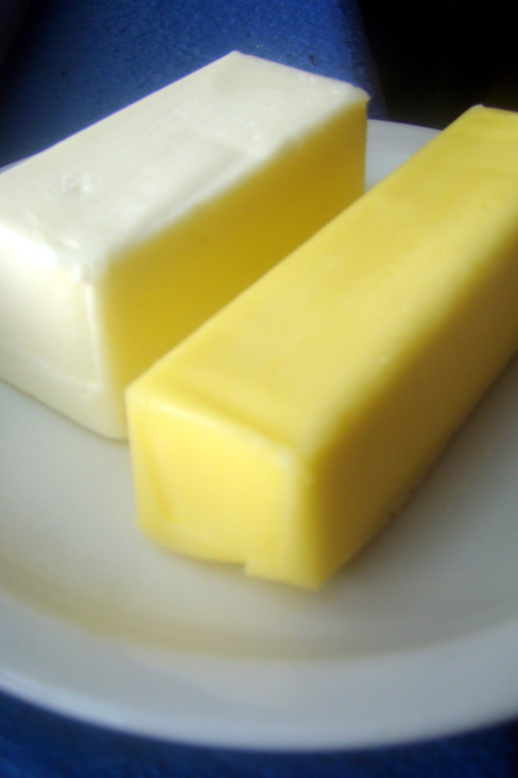
Today we are going to make Resurrection Rolls.
You need:
Marshmallow
Croissant bread
Melted butter/margarine
Cinnamon spice
Roll the marshmallow in butter and then in spice
Wrap a Croissant around the marshmallow. Make sure it is totally covered!
Remember how Jesus died and then they wrapped him in spices and cloths and laid him in the tomb.
While you make yours, I will read John 19:38-42
Homemade recipe at https://joyfoodsunshine.com/homemade-resurrection-rolls/

Slide 3
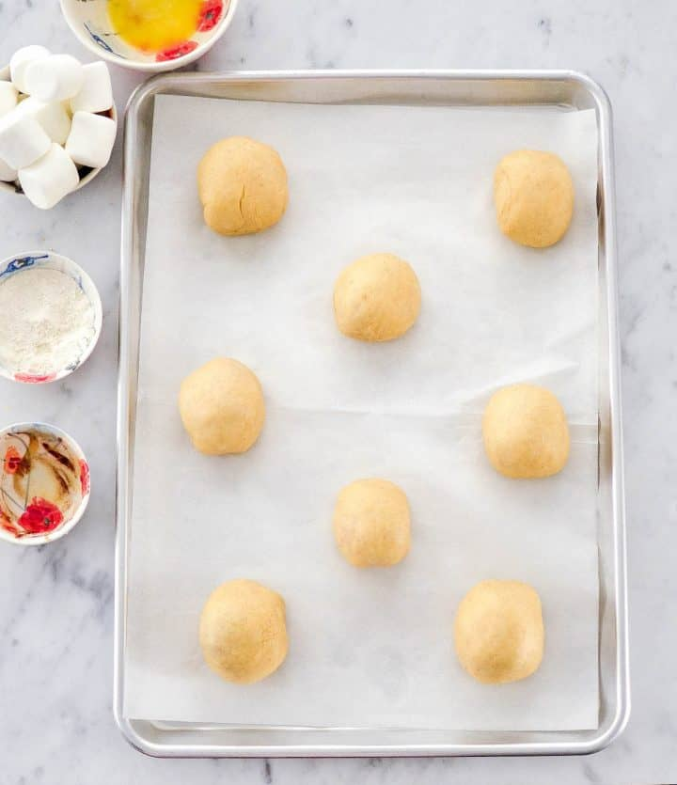
Make your resurrection roll and put it on a pan
Jesus was crucified and died
^{John 19:38} Later Joseph asked Pilate for Jesus’ body. Joseph was from the town of Arimathea. He was a follower of Jesus. But he followed Jesus secretly because he was afraid of the Jewish leaders. After Pilate gave him permission, Joseph came and took the body away. ³⁹ Nicodemus went with Joseph. He was the man who had earlier visited Jesus at night. Nicodemus brought some mixed spices that weighed about 75 pounds. ⁴⁰ The two men took Jesus’ body. They wrapped it in strips of linen cloth, along with the spices. That was the way the Jews buried people. ⁴¹ At the place where Jesus was crucified, there was a garden. A new tomb was there. No one had ever been put in it before. ⁴² That day was the Jewish Preparation Day, and the tomb was nearby. So they placed Jesus there.
Write your name next to your roll.
Bake according to directions.
While they are baking let’s ….

Slide 4

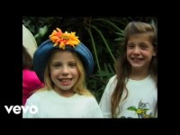
Praise God for His gift!

Slide 5
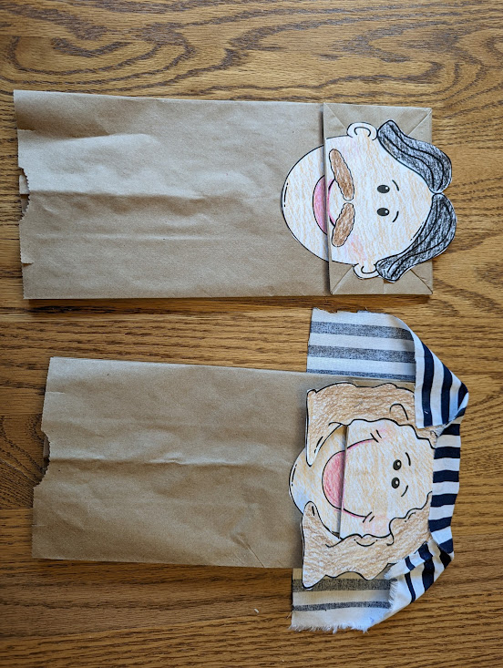
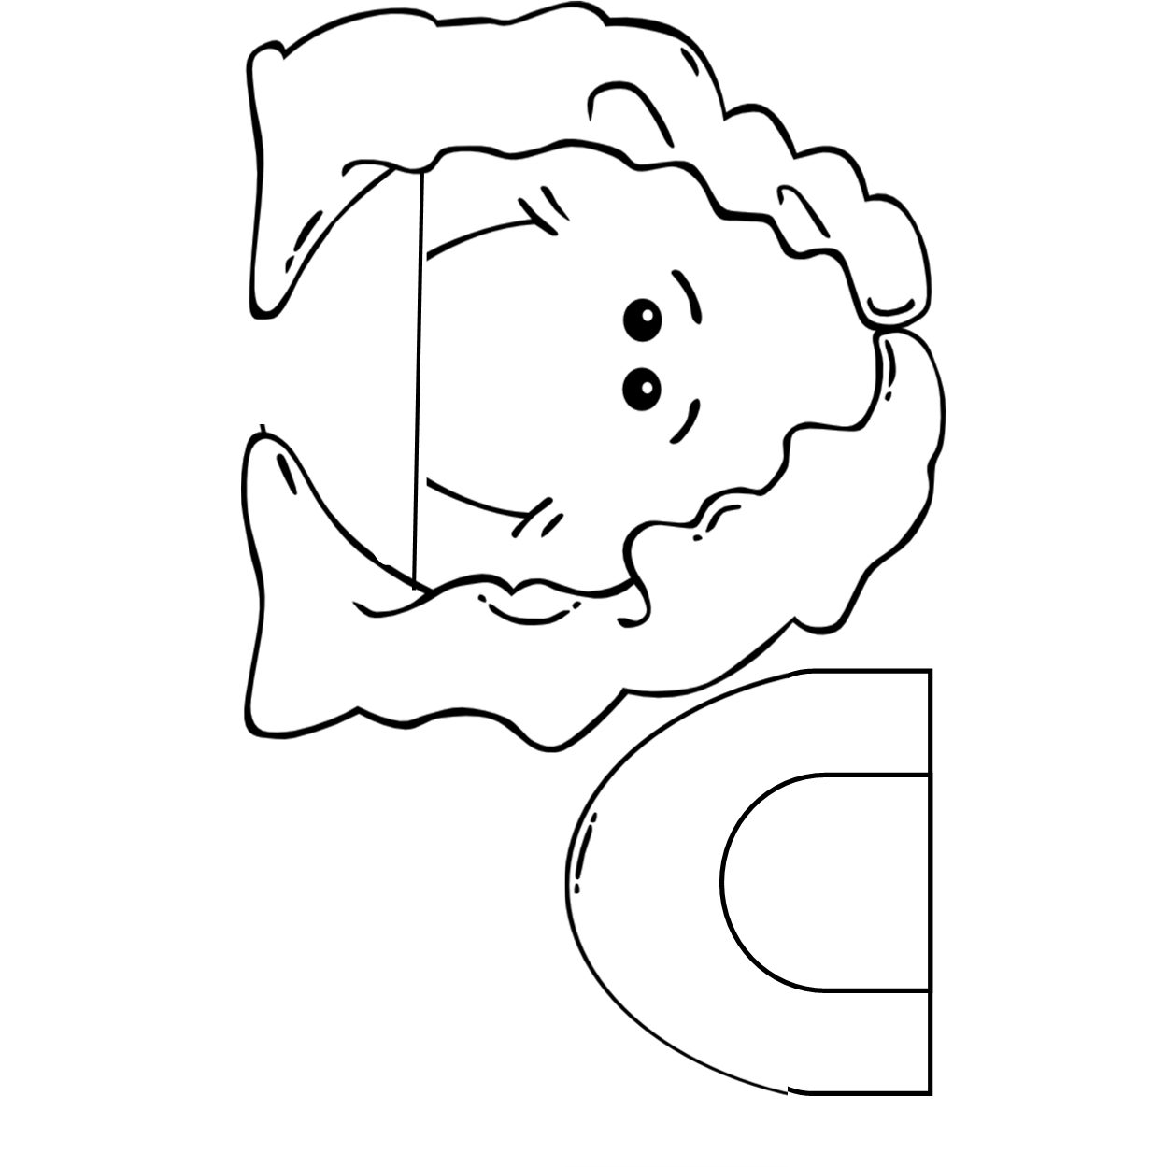
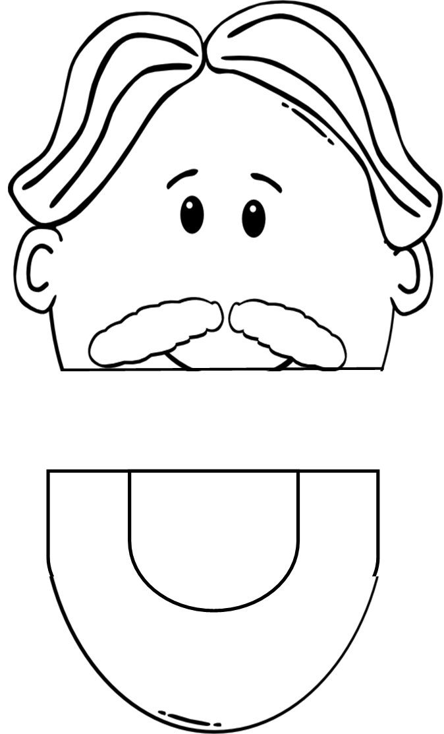
When you are done making your Resurrection roll you can color a face for your sack puppet.

Slide 6
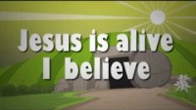
Praise God for His gift!

Slide 7


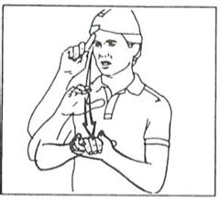
Today the key word is Unscramble the word or use the clues to guess it.
BLVIEEE
BELIEVE
Whenever you hear the word BELIEVE say “I BELIEVE” and make the sign for believe

Slide 8
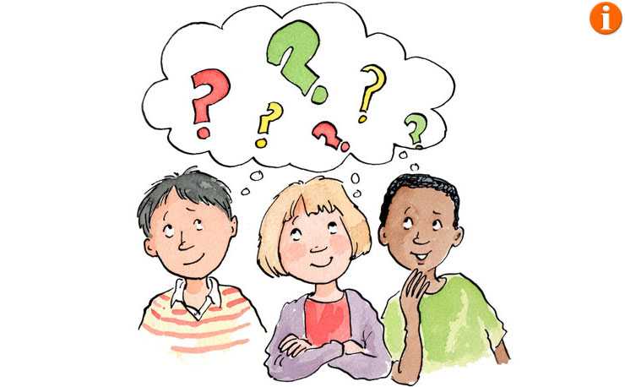
Think about it. You might want to write them down or draw pictures to help you remember. TELL US: 2 true things about yourself and 1 thing that is not true. We will try to guess which one is not true.
Example:
I have 2 children and 2 cats
I have repelled down a mountain
I rode in a hot air balloon

Slide 9
Believe it or not
Is it true
or false?
If you drop something it falls up.
The sun rises in the West in the morning.
April is a winter month. It often snows.
A dandelion is yellow before it is fluffy white.
The moon travels around our earth.

Slide 10
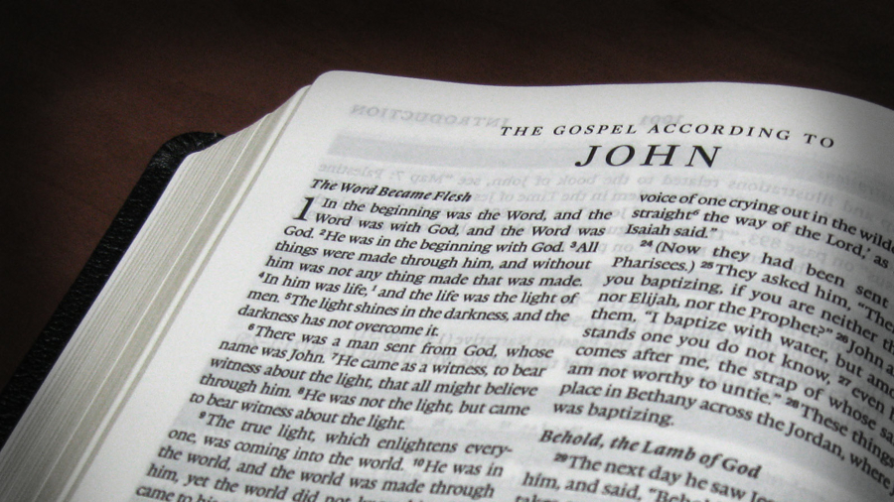
You can find our story today in John 20
Let’s find and read John 20:31 that’s our memory verse

Slide 11
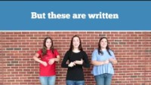
“But these are written that you may believe that Jesus is the Messiah, the Son of God, and that by believing you may have life in his name.” John 20:31

Slide 12
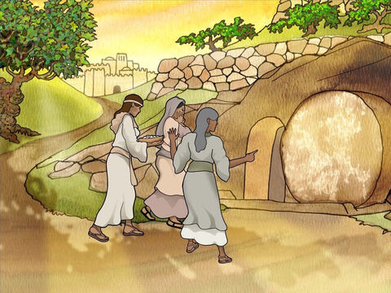
Early Sunday morning the women went to the tomb….
REMEMBER
20 Early on the first day of the week, Mary Magdalene went to the tomb. It was still dark. She saw that the stone had been moved away from the entrance.

Slide 13
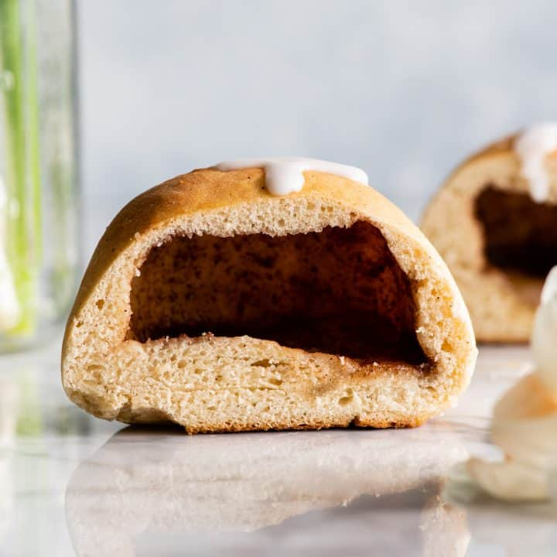
The tomb is empty!
Our Resurrection Rolls are baked and ready!
You may take a bite.
What do you see inside?

Slide 14
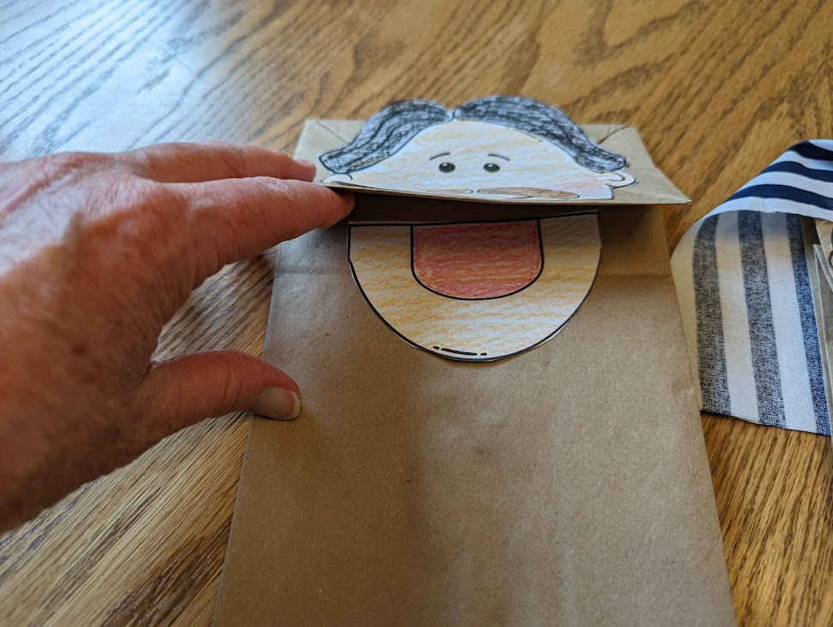
Today we’re going to make little bag puppets. They can help tell the story.
Color and cut out the face
Lift the flap of the paper bag and glue the mouth part under the flap. Make sure the straight part of the mouth is up to the fold under the flap.
Glue the face part on the ‘bottom’ part of the bag as shown. Make sure the face and mouth part match.
Add yarn hair, googly eyes, or cloth as desired.

Slide 15
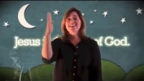
Praise God for His gift!

Slide 16
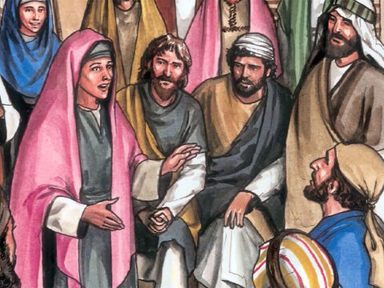
Jesus is gone!
They have taken the Lord out of the tomb!
We don’t know where they have taken him!
20 Early on the first day of the week, Mary Magdalene went to the tomb. It was still dark. She saw that the stone had been moved away from the entrance.
² So she ran to Simon Peter and another disciple, the one Jesus loved. She said, “They have taken the Lord out of the tomb! We don’t know where they have put him!”

Slide 17
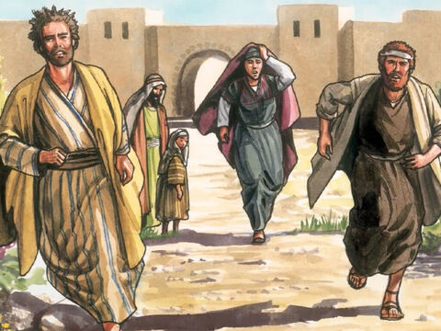
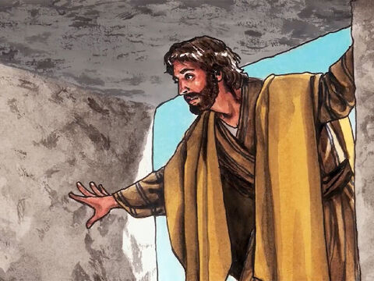
Hurry! Let’s go see!
⁴ Both of them were running. The other disciple ran faster than Peter. He reached the tomb first. ⁵ He bent over and looked in at the strips of linen lying there. But he did not go in.
³ So Peter and the other disciple started out for the tomb.

Slide 18
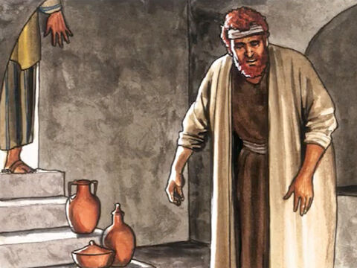
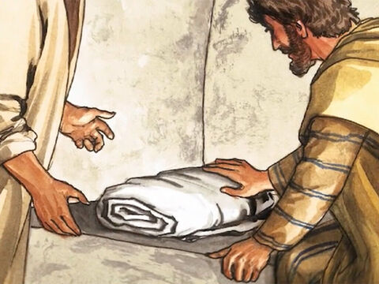
What happened?
⁶ Then Simon Peter came along behind him. He went straight into the tomb.
He saw the strips of linen lying there. ⁷ He also saw the funeral cloth that had been wrapped around Jesus’ head. The cloth was still lying in its place. It was separate from the linen.
⁸ The disciple who had reached the tomb first also went inside. He saw and believed.
⁹ They still did not understand from Scripture that Jesus had to rise from the dead.

Slide 19
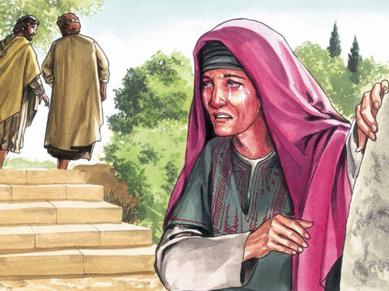
Where is Jesus?
¹⁰ Then the disciples went back to where they were staying.
¹¹ But Mary stood outside the tomb crying. As she cried, she bent over to look into the tomb.

Slide 20
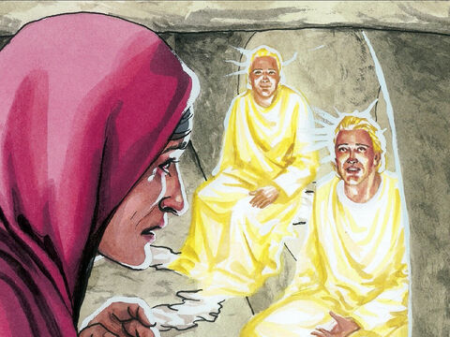
Why are you crying?
They have taken my Lord away.
I don’t know where they have put him?
Woman, why are you crying?
¹² She saw two angels dressed in white. They were seated where Jesus’ body had been. One of them was where Jesus’ head had been laid. The other sat where his feet had been placed.
¹³ They asked her, “Woman, why are you crying?”
“They have taken my Lord away,” she said. “I don’t know where they have put him.”

Slide 21
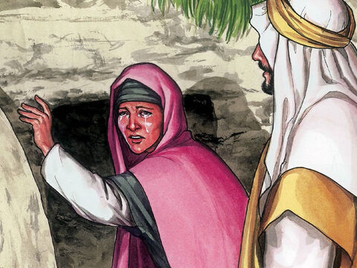
How was Mary feeling?
Woman, why are you crying?
Who are you looking for?
Sir did you carry him away?
Tell me where you put him.
¹⁴ Then she turned around and saw Jesus standing there. But she didn’t realize that it was Jesus.
¹⁵ He asked her, “Woman, why are you crying? Who are you looking for?”
She thought he was the gardener. So she said, “Sir, did you carry him away? Tell me where you put him. Then I will go and get him.”

Slide 22
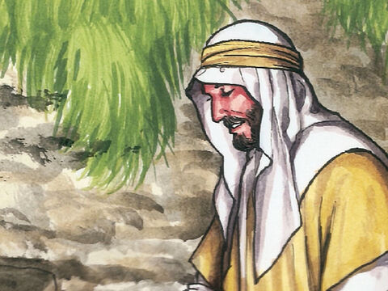
Mary
Don’t hold on to me.
I’m going to my Father and your Father, to my God and your God.
¹⁶ Jesus said to her, “Mary.”
She turned toward him. Then she cried out in the Aramaic language, “Rabboni!” Rabboni means Teacher.
¹⁷ Jesus said, “Do not hold on to me. I have not yet ascended to the Father. Instead, go to those who believe in me. Tell them, ‘I am ascending to my Father and your Father, to my God and your God.’ ”
Teacher!

Slide 23
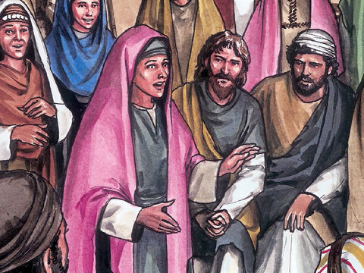
I have seen the Lord!
¹⁸ Mary Magdalene went to the disciples with the news. She said, “I have seen the Lord!” And she told them that he had said these things to her.

Slide 24
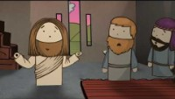
Jesus visited his disciples
Movie time

Slide 25
“But these are written that you may believe that Jesus is the Messiah, the Son of God, and that by believing you may have life in his name.” John 20:31

Slide 26
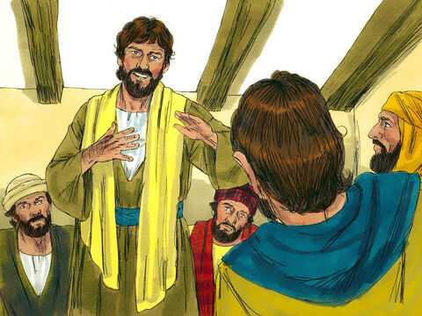
Thomas wasn’t there when Jesus came
I won’t believe it until I see and touch his hands and side.
Thomas,
We saw the Lord!
He talked with us!
^{John 20:24} Thomas was one of the 12 disciples. He was also called Didymus. He was not with the other disciples when Jesus came. ²⁵ So they told him, “We have seen the Lord!”
But he said to them, “First I must see the nail marks in his hands. I must put my finger where the nails were. I must put my hand into his side. Only then will I believe.”
It’s true.
He showed us his hands!

Slide 27
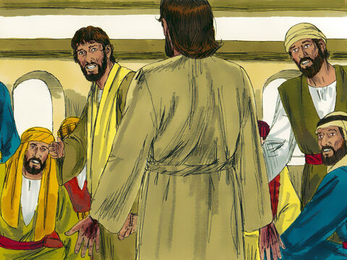
Peace be to you!
Touch my hands and side.
Look and see.
Stop doubting and believe.
²⁶ A week later, Jesus’ disciples were in the house again. Thomas was with them.
Even though the doors were locked, Jesus came in and stood among them.
He said, “May peace be with you!” ²⁷ Then he said to Thomas, “Put your finger here. See my hands. Reach out your hand and put it into my side. Stop doubting and believe.”

Slide 28
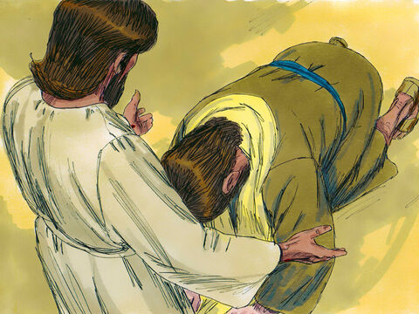
My Lord and my God!
My Lord and my God!
²⁸ Thomas said to him, “My Lord and my God!”
²⁹ Then Jesus told him, “Because you have seen me, you have believed. Blessed are those who have not seen me but still have believed.”
Because you have seen me,
you believe.
Blessed are those who have not seen me,
but still believe!

Slide 29
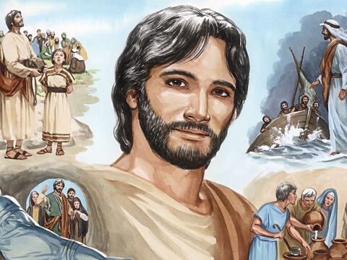
Believe it. Jesus is Alive! He is the Messiah, He is the Son of God! He is our Savior!
³⁰ Jesus performed many other signs in front of his disciples. They are not written down in this book.
³¹ But these are written so that you may believe that Jesus is the Messiah, the Son of God.
If you believe this, you will have life because you belong to him.

Slide 30
Do you believe that:
God loves you
Jesus took your punishment
He died for you.
Jesus rose again
Now you can have eternal life.

Slide 31
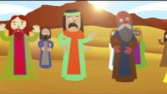
Jesus ascended to heaven
Movie time

Slide 32
“But these are written that you may believe that Jesus is the Messiah, the Son of God, and that by believing you may have life in his name.” John 20:31

Slide 33
Praise God for His gift!

Slide 34
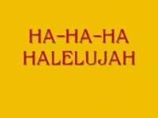
Gift from God
To you!

Slide 35
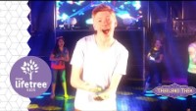
Praise God for His gift!

Slide 36
Praise God for His gift!

Slide 37
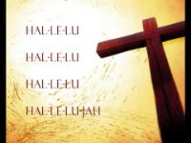
Gift from God
To you!

Slide 38

Praise God for His gift!

Slide 39
Praise God for His gift!

