Slide 1
Two Rich Men’s Response
Zacchaeus
Luke 18 & 19

Slide 2



Describe a rich person
Notes:
https://treesandwoods.com/what-sycamore-seeds-look-like/
Can you identify the American sycamore? The best way to tell is to look at the sycamore seeds, bark, and leaves. When the tree is young, it has dark patches of green bark, but as it ages, the bark becomes a lighter color. The leaves are heart-shaped, and the undersides of the leaves have tiny hairs that can irritate your skin. You may also notice seeds growing from its branches on warm days—they look like round brown balls with a small tail.
The sycamore tree is an excellent choice for landscaping in coastal areas because of its tolerance to salt and poor soil.
If these seeds start falling from a tree near you, take note! They will soon sprout, and every seed can grow into a new tree. Let’s learn more about sycamore seeds in this post.
They look like little puffy balls of fuzz. These fluffy white seeds on the tree’s branches are very soft and light, making them perfect for holding in your hand or even wearing as a necklace.
The seed pods have a hard outer covering protecting their seeds from insects and other predators while also allowing them to float on water without getting wet themselves. It makes it possible to transport them long distances through bodies of water such as rivers or streams before settling in the soil where they will grow into trees again.
Sycamore trees are a very versatile and useful tree that can be found all over the United States. They provide shelter and food for a wide variety of animals, including squirrels and deer.

Slide 3
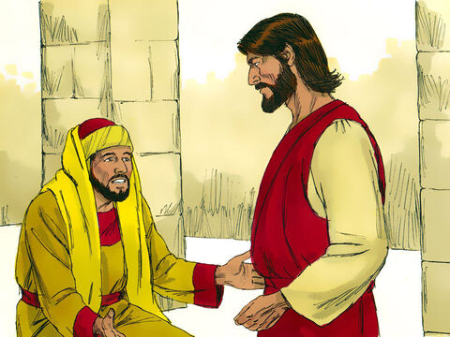
Luke 18:18-23
Why do you call me good?
No one is good, except God alone.
Good teacher,
What must I do to inherit eternal life?
18 A certain ruler asked him, “Good teacher, what must I do to inherit eternal life?”
19 “Why do you call me good?” Jesus answered. “No one is good—except God alone.
20 You know the commandments: ‘You shall not commit adultery, you shall not murder, you shall not steal, you shall not give false testimony, honor your father and mother.’”
21 “All these I have kept since I was a boy,” he said.
You know the commandments:
Be faithful to your spouse.
Don’t murder.
Don’t steal.
Honor your mom and dad.
I have kept these since I was a boy.

Slide 4
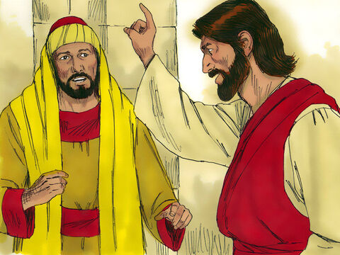
A rich man
You still lack one thing.
Give to the poor and you will have treasure in heaven.
Then come and follow me.
22 When Jesus heard this, he said to him, “You still lack one thing. Sell everything you have and give to the poor, and you will have treasure in heaven. Then come, follow me.”

Slide 5
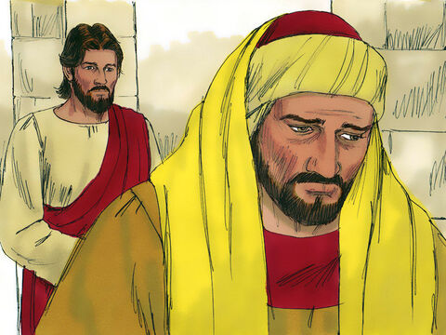
A rich man
23 When he heard this, he became very sad, because he was very wealthy.
24 Jesus looked at him and said, “How hard it is for the rich to enter the kingdom of God!
Is it hard to give precious things to others?

Slide 6

Give a Little
– a Little More

Slide 7
What can we give?
Notes:
https://treesandwoods.com/what-sycamore-seeds-look-like/
Can you identify the American sycamore? The best way to tell is to look at the sycamore seeds, bark, and leaves. When the tree is young, it has dark patches of green bark, but as it ages, the bark becomes a lighter color. The leaves are heart-shaped, and the undersides of the leaves have tiny hairs that can irritate your skin. You may also notice seeds growing from its branches on warm days—they look like round brown balls with a small tail.
The sycamore tree is an excellent choice for landscaping in coastal areas because of its tolerance to salt and poor soil.
If these seeds start falling from a tree near you, take note! They will soon sprout, and every seed can grow into a new tree. Let’s learn more about sycamore seeds in this post.
They look like little puffy balls of fuzz. These fluffy white seeds on the tree’s branches are very soft and light, making them perfect for holding in your hand or even wearing as a necklace.
The seed pods have a hard outer covering protecting their seeds from insects and other predators while also allowing them to float on water without getting wet themselves. It makes it possible to transport them long distances through bodies of water such as rivers or streams before settling in the soil where they will grow into trees again.
Sycamore trees are a very versatile and useful tree that can be found all over the United States. They provide shelter and food for a wide variety of animals, including squirrels and deer.

Slide 8
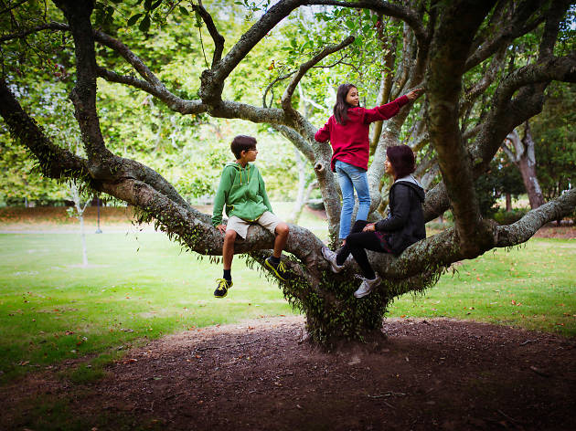
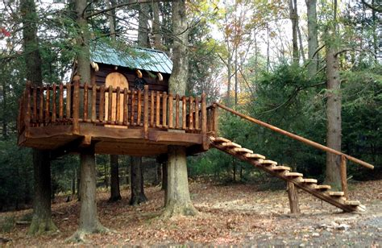
Have you ever climbed a tree or played in a tree house?
Tell me about it.
Notes:
https://treesandwoods.com/what-sycamore-seeds-look-like/
Can you identify the American sycamore? The best way to tell is to look at the sycamore seeds, bark, and leaves. When the tree is young, it has dark patches of green bark, but as it ages, the bark becomes a lighter color. The leaves are heart-shaped, and the undersides of the leaves have tiny hairs that can irritate your skin. You may also notice seeds growing from its branches on warm days—they look like round brown balls with a small tail.
The sycamore tree is an excellent choice for landscaping in coastal areas because of its tolerance to salt and poor soil.
If these seeds start falling from a tree near you, take note! They will soon sprout, and every seed can grow into a new tree. Let’s learn more about sycamore seeds in this post.
They look like little puffy balls of fuzz. These fluffy white seeds on the tree’s branches are very soft and light, making them perfect for holding in your hand or even wearing as a necklace.
The seed pods have a hard outer covering protecting their seeds from insects and other predators while also allowing them to float on water without getting wet themselves. It makes it possible to transport them long distances through bodies of water such as rivers or streams before settling in the soil where they will grow into trees again.
Sycamore trees are a very versatile and useful tree that can be found all over the United States. They provide shelter and food for a wide variety of animals, including squirrels and deer.

Slide 9
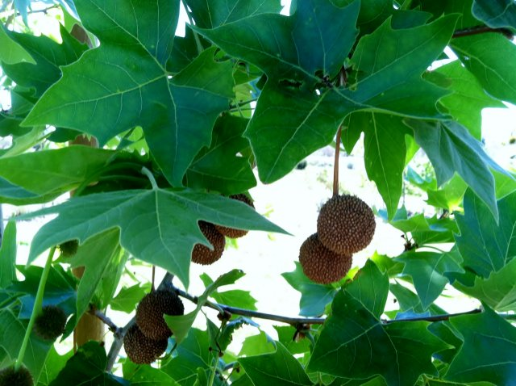
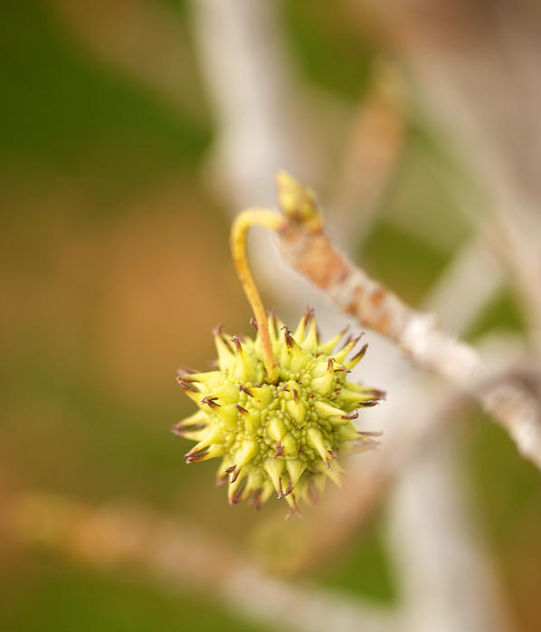
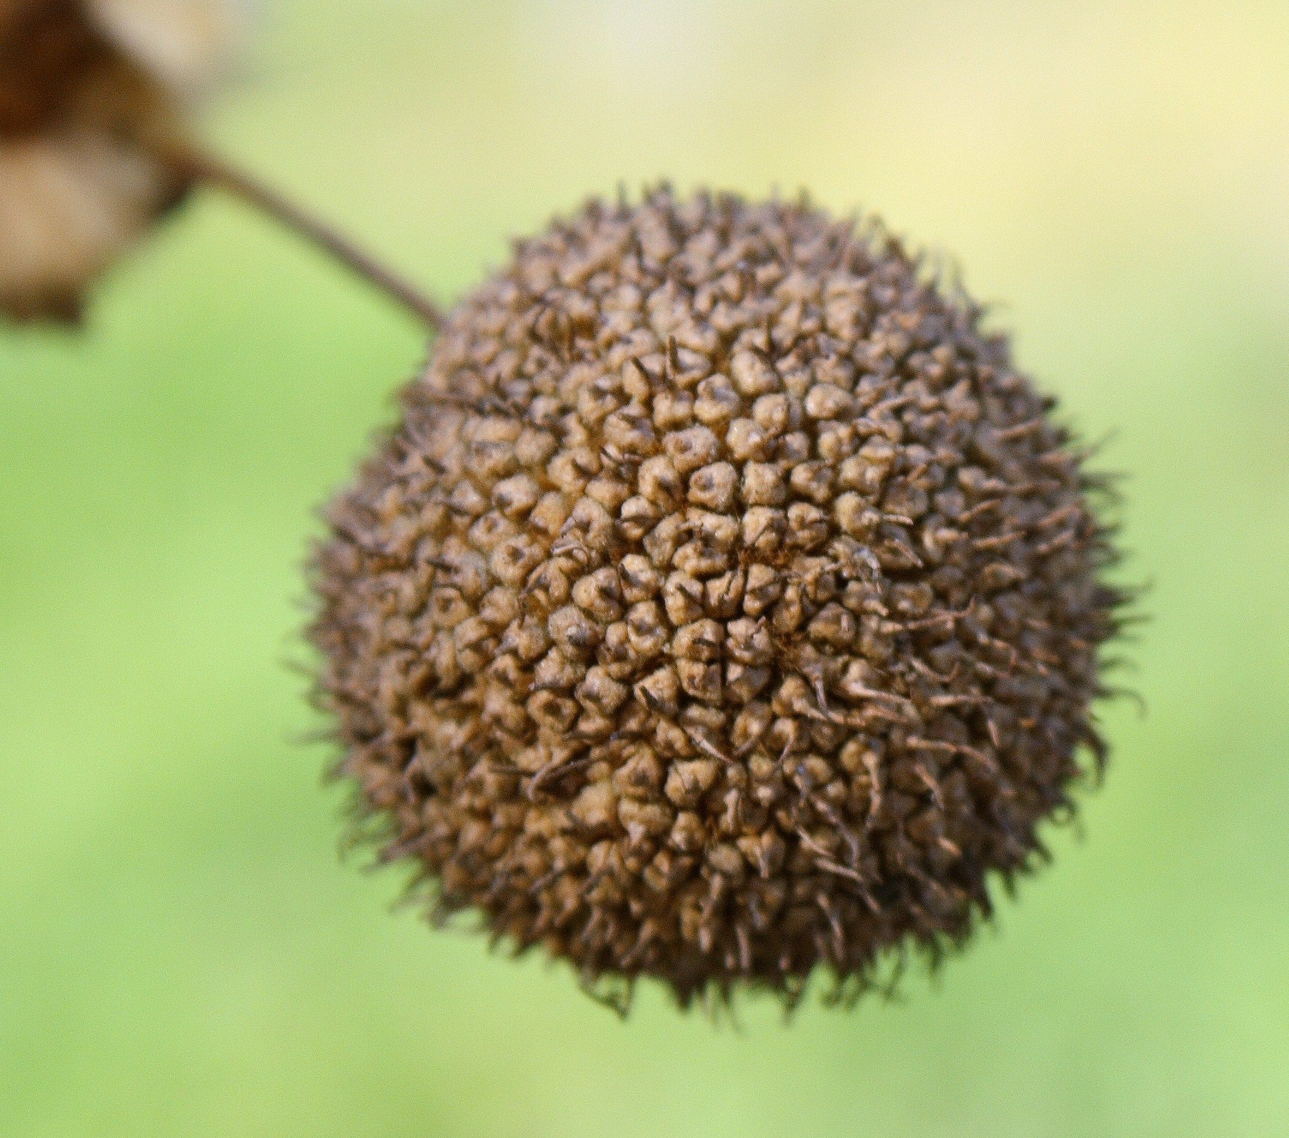
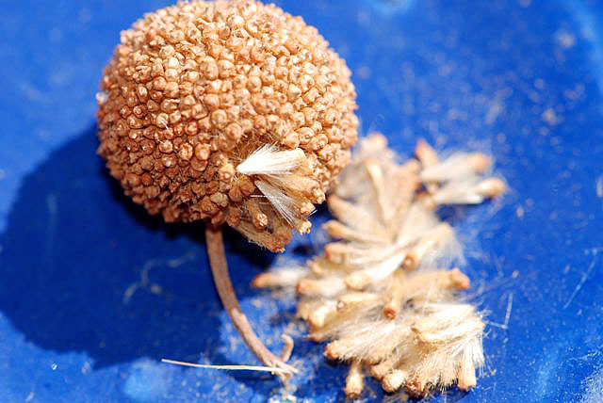
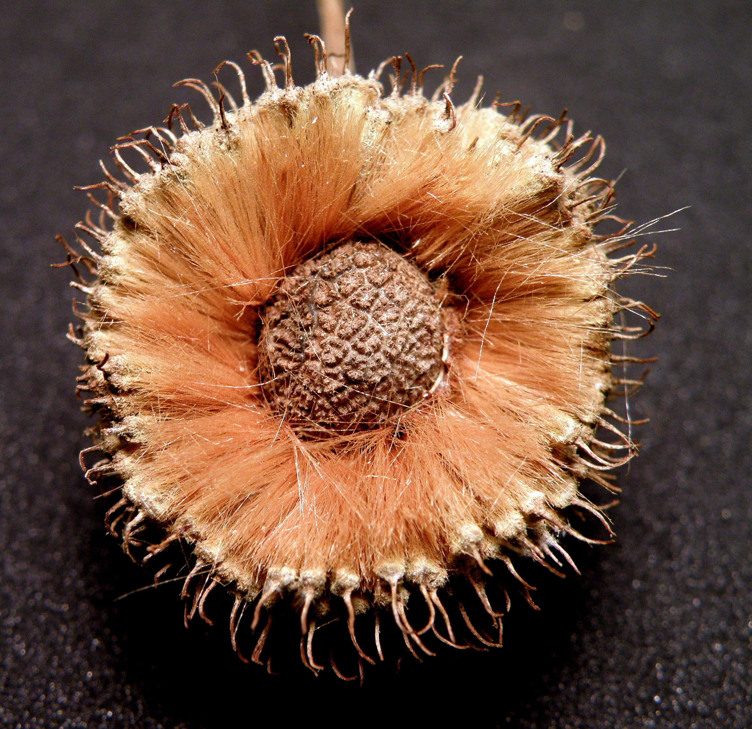
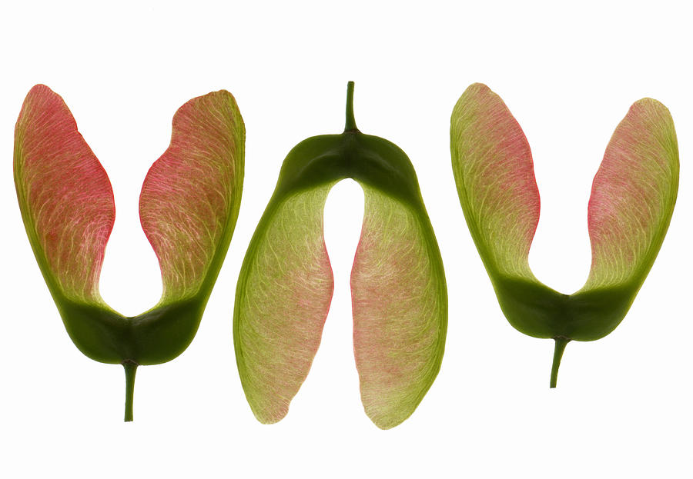
Have you seen a sycamore tree?
The Fruit
Seeds
This page has notes.
Notes:
https://treesandwoods.com/what-sycamore-seeds-look-like/
Can you identify the American sycamore? The best way to tell is to look at the sycamore seeds, bark, and leaves. When the tree is young, it has dark patches of green bark, but as it ages, the bark becomes a lighter color. The leaves are heart-shaped, and the undersides of the leaves have tiny hairs that can irritate your skin. You may also notice seeds growing from its branches on warm days—they look like round brown balls with a small tail.
The sycamore tree is an excellent choice for landscaping in coastal areas because of its tolerance to salt and poor soil.
If these seeds start falling from a tree near you, take note! They will soon sprout, and every seed can grow into a new tree. Let’s learn more about sycamore seeds in this post.
They look like little puffy balls of fuzz. These fluffy white seeds on the tree’s branches are very soft and light, making them perfect for holding in your hand or even wearing as a necklace.
The seed pods have a hard outer covering protecting their seeds from insects and other predators while also allowing them to float on water without getting wet themselves. It makes it possible to transport them long distances through bodies of water such as rivers or streams before settling in the soil where they will grow into trees again.
Sycamore trees are a very versatile and useful tree that can be found all over the United States. They provide shelter and food for a wide variety of animals, including squirrels and deer.

Slide 10

Tell me about a sycamore tree

Slide 11
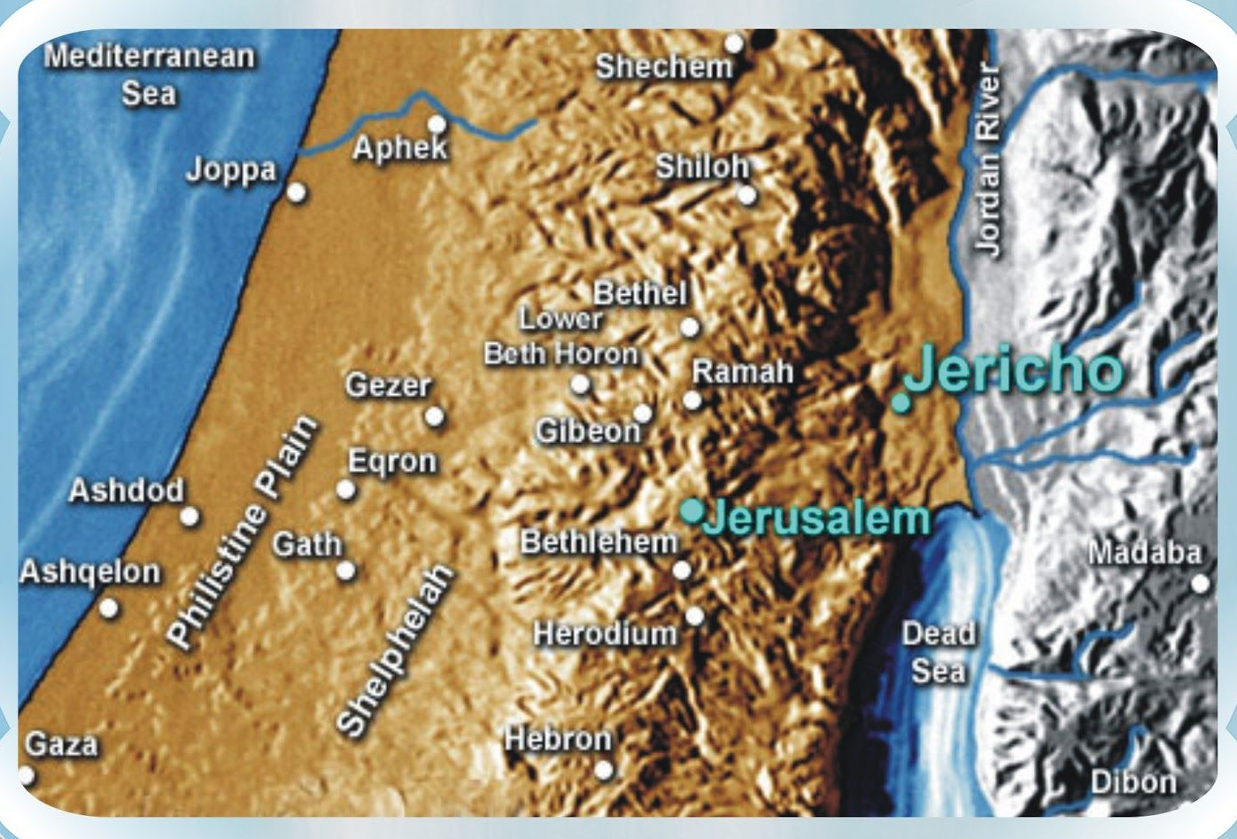
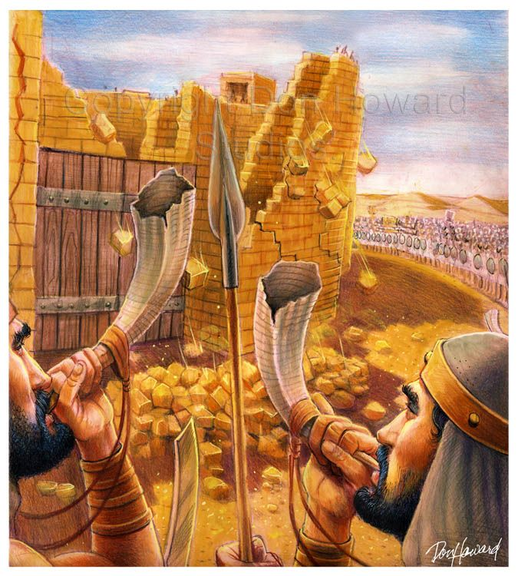
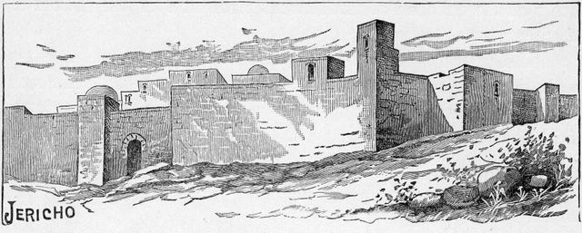
Luke 19
Jesus entered Jericho
and was passing through.
What do you
remember
about Jericho?

Slide 12
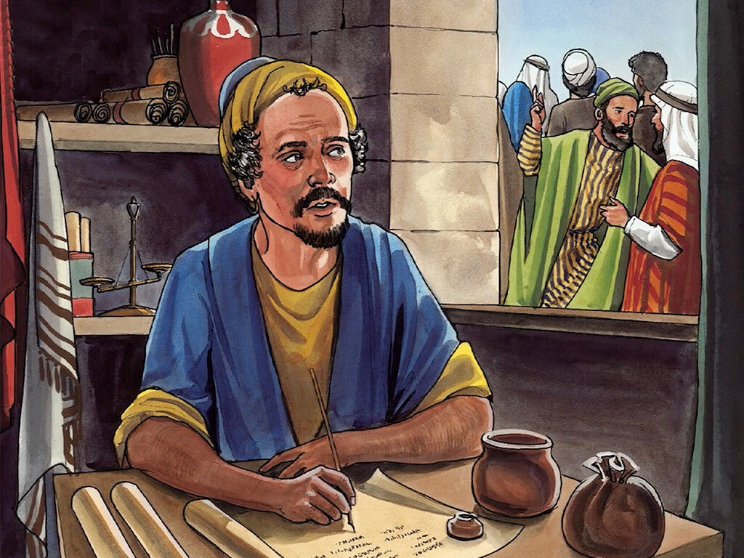
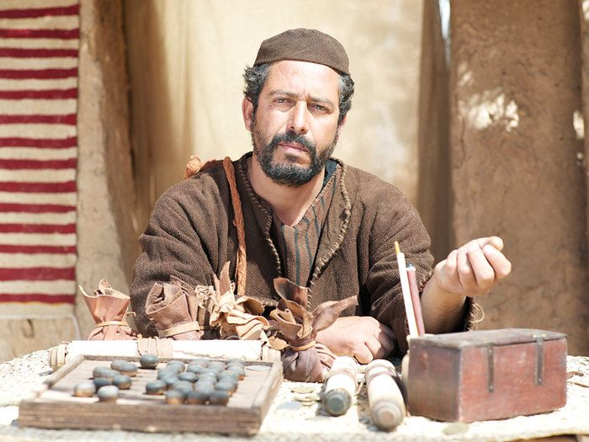
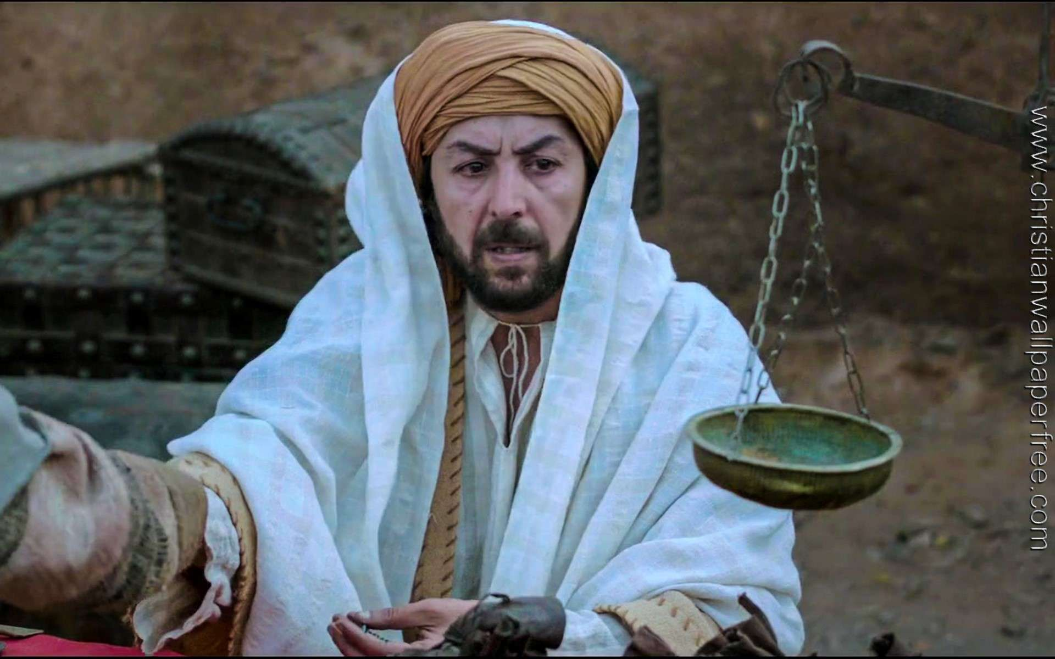
Luke 19
I’ll find out as soon as I’m done checking this tax record.
I wonder what is going on out there?
19 Jesus entered Jericho and was passing through.
2 A man was there by the name of Zacchaeus; he was a chief tax collector and was wealthy.

Slide 13
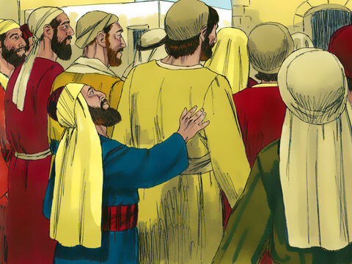
Luke 19
We all want to see Jesus.
3 He wanted to see who Jesus was, but because he was short. He could not see over the crowd.
Jesus is here!
I want to see him.
I wish I wasn’t so short!
Excuse me.
I want to see Jesus
They probably won’t let me through because I’m a tax collector.

Slide 14
Luke 19
4 So he ran ahead and climbed a sycamore-fig tree to see him, since Jesus was coming that way.
Now how am I going to see Jesus?
There’s that sycamore tree!

Slide 15
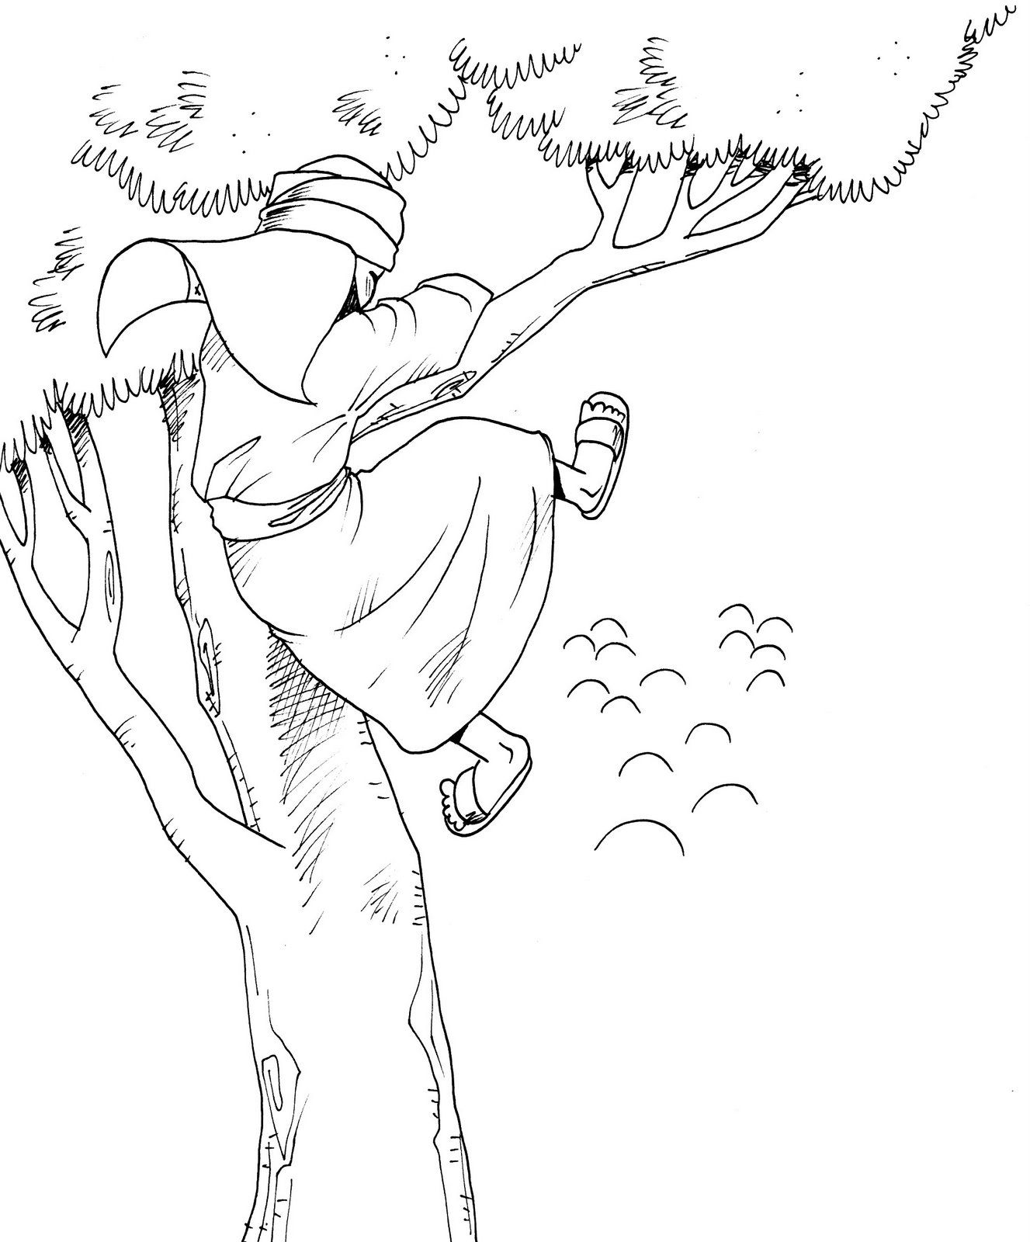
Luke 19
Zaccheus climbed up the tree.
That was not something grown men did – especially not grown rich men in long wealthy robes!
Pretend you are climbing a tree.

Slide 16
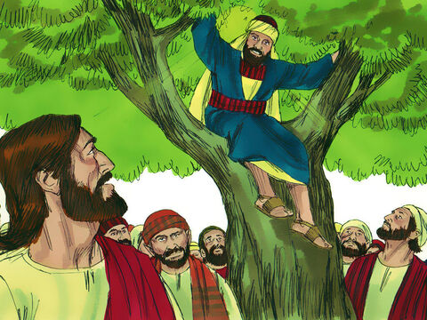
Luke 19
I would love that!
Please come right now.
Zacchaeus
Come down immediately.
I must stay at your house today.
5 When Jesus reached the spot, he looked up and said to him, “Zacchaeus, come down immediately. I must stay at your house today.”
6 So he came down at once and welcomed him gladly.

Slide 17

Zacchaeus was a Wee Little Man

Slide 18
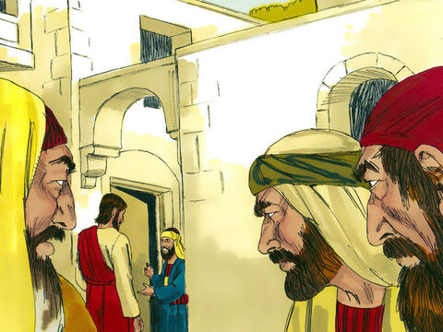
Luke 19
6 So he came down at once and welcomed Jesus gladly.
7 All the people saw this and began to mutter, “Jesus has gone to be the guest of a sinner.”
Welcome!
Rest in my home and we will eat soon.
Thank you!
He has gone to be the guest of a sinner!

Slide 19
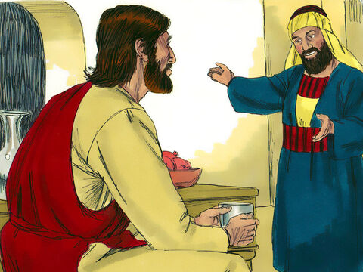
Luke 19
Here and now, I will give half of my possessions to the poor.
8 But Zacchaeus stood up and said to the Lord, “Look, Lord! Here and now, I give half of my possessions to the poor, and if I have cheated anybody out of anything, I will pay back four times the amount.”
And if I have cheated anyone, I will pay back 4 times the amount.

Slide 20
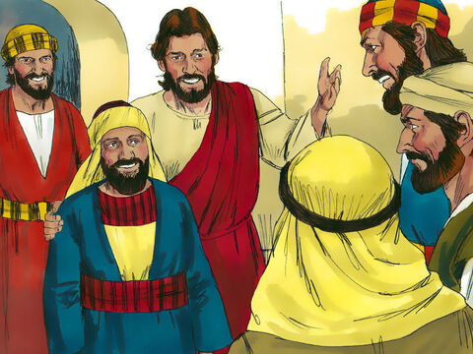
Luke 19
Today salvation has come to this house.
This man is a son of Abraham too!
For I have come to seek and to save the lost.
9 Jesus said to him, “Today salvation has come to this house, because this man, too, is a son of Abraham.
10 For the Son of Man came to seek and to save the lost.”

Slide 21

Father Abraham
(option 1)
Zaccheus was called a child of Abraham because he, too, had faith in Jesus and God.

Slide 22

Seek and to Save
Luke 19:10
Jesus came to seek and to save the lost. He found Zaccheus in a tree. He welcomed him into His kingdom!

Slide 23
Two rich men – Two responses
One wanted to stay rich and went away sad with an empty heart.
The other generously gave of his riches and welcomed Jesus into his heart and home.

Slide 24

Matthew 6:24
6:29-34
“No one can serve
two masters.
Either you will
hate the one and love the other, or you will be devoted to the one
and despise the other. You cannot serve both God and money.”
Matt. 6:24

Slide 25
Zacchaeus’ heart was soft and ready to be planted with the love of God.
The Fruit
Like this
Seeds
This page has notes.
Notes:
https://treesandwoods.com/what-sycamore-seeds-look-like/
Can you identify the American sycamore? The best way to tell is to look at the sycamore seeds, bark, and leaves. When the tree is young, it has dark patches of green bark, but as it ages, the bark becomes a lighter color. The leaves are heart-shaped, and the undersides of the leaves have tiny hairs that can irritate your skin. You may also notice seeds growing from its branches on warm days—they look like round brown balls with a small tail.
The sycamore tree is an excellent choice for landscaping in coastal areas because of its tolerance to salt and poor soil.
If these seeds start falling from a tree near you, take note! They will soon sprout, and every seed can grow into a new tree. Let’s learn more about sycamore seeds in this post.
They look like little puffy balls of fuzz. These fluffy white seeds on the tree’s branches are very soft and light, making them perfect for holding in your hand or even wearing as a necklace.
The seed pods have a hard outer covering protecting their seeds from insects and other predators while also allowing them to float on water without getting wet themselves. It makes it possible to transport them long distances through bodies of water such as rivers or streams before settling in the soil where they will grow into trees again.
Sycamore trees are a very versatile and useful tree that can be found all over the United States. They provide shelter and food for a wide variety of animals, including squirrels and deer.

Slide 26
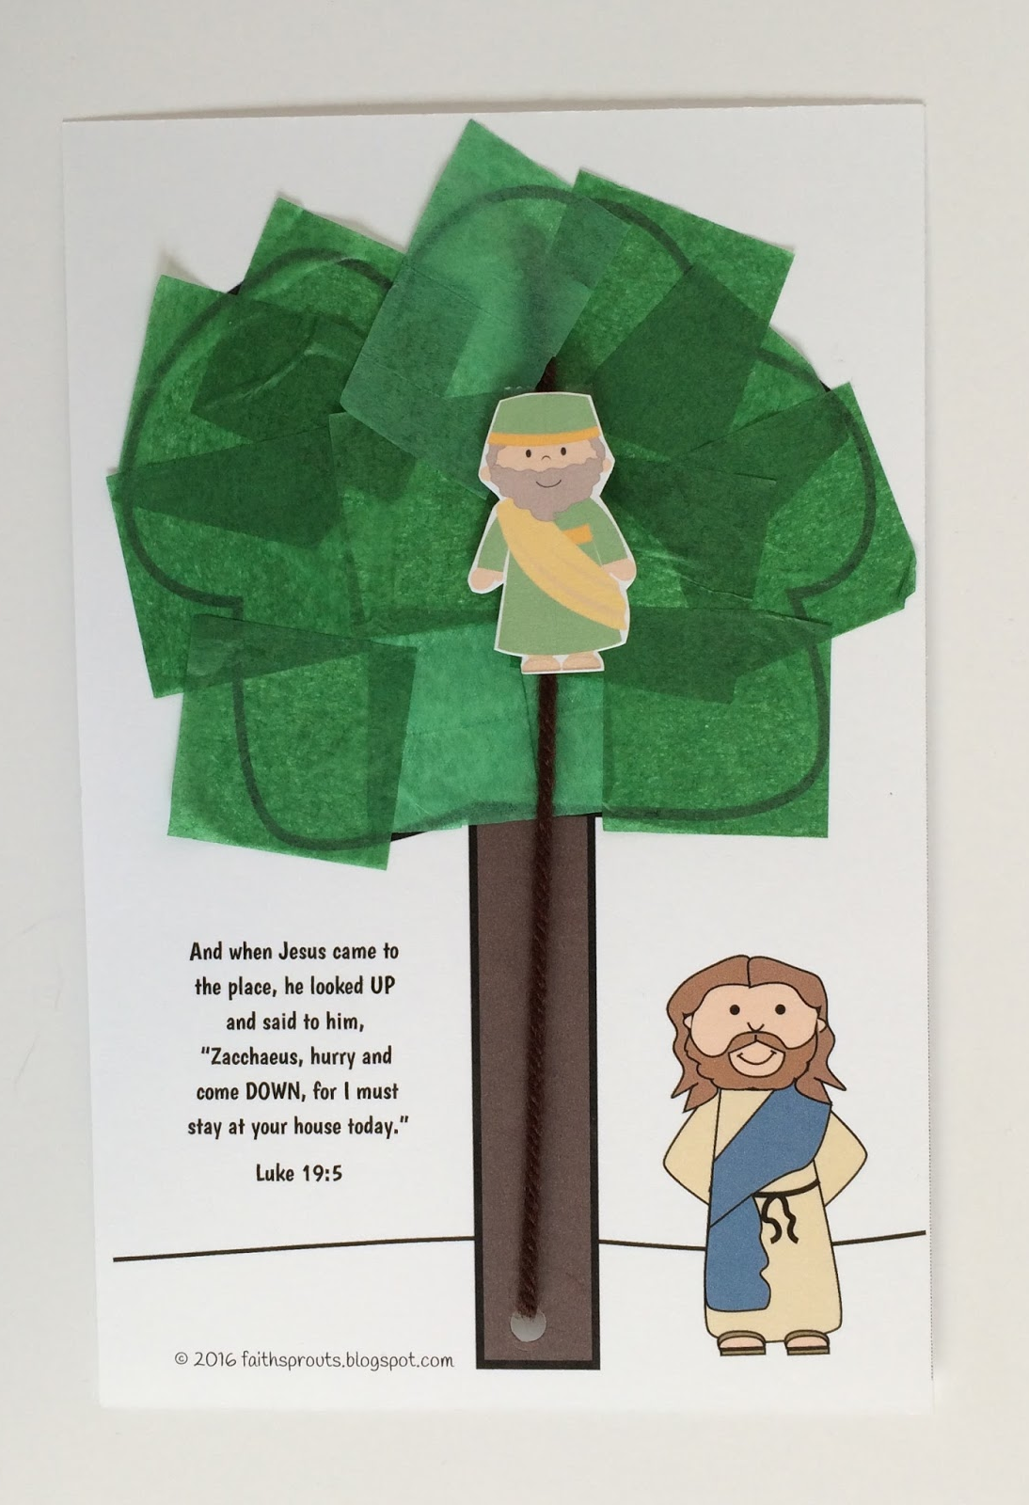
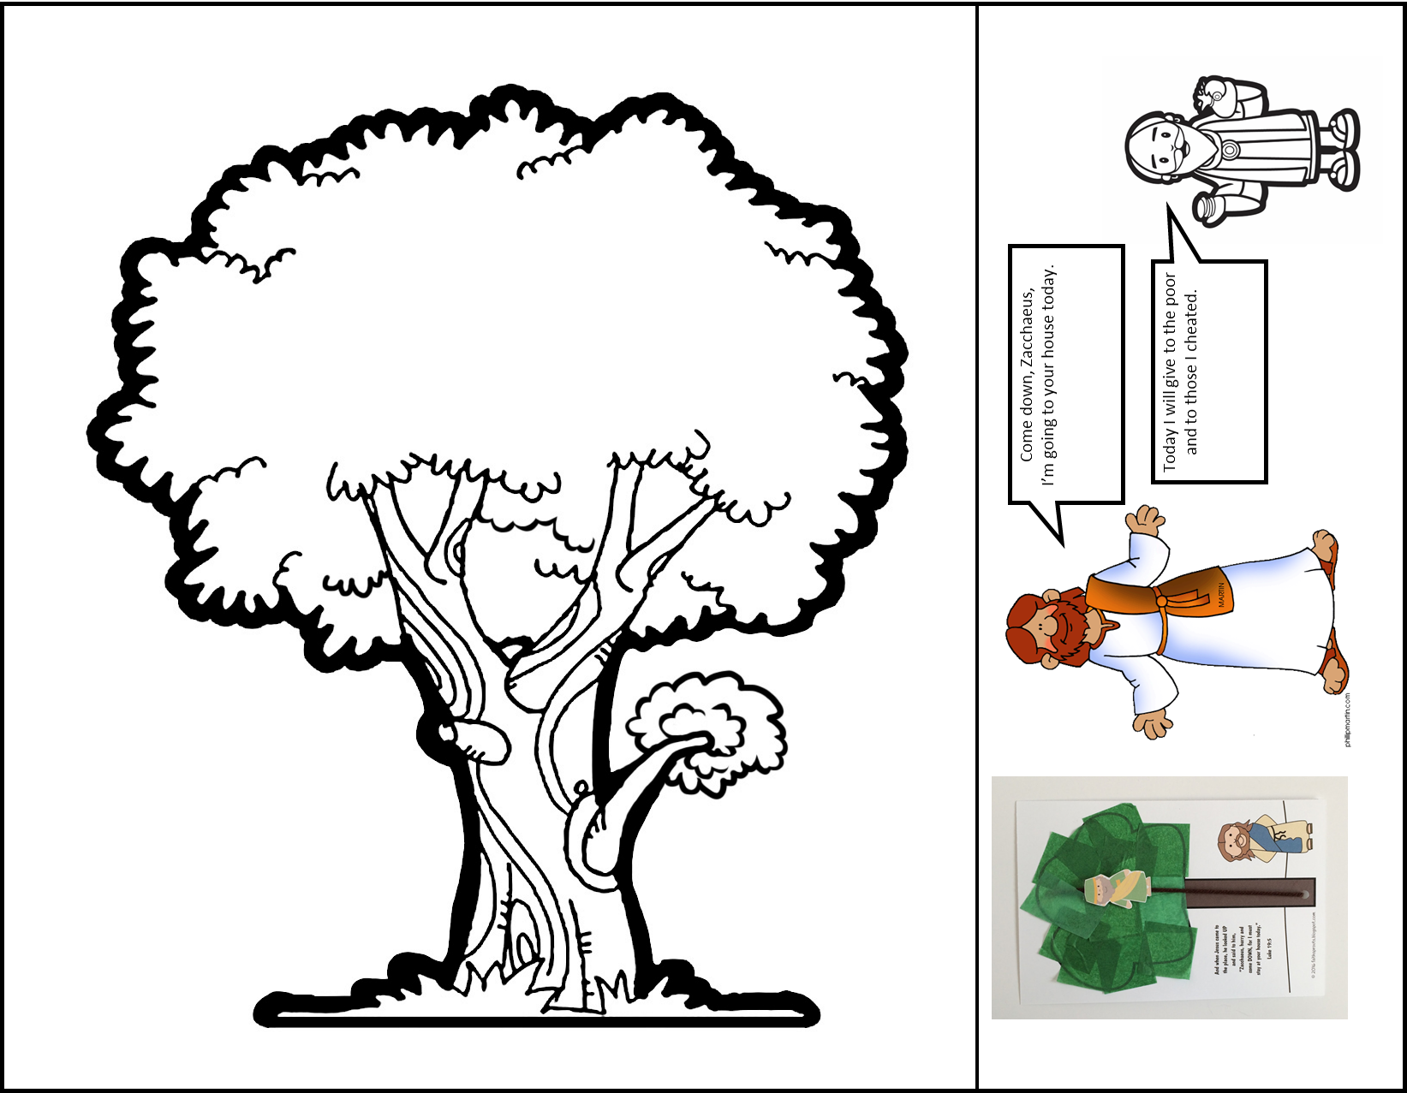
Craft Time
Cut on the straight line beside the tree.
Color Zacchaeus and the tree trunk
Cut out Jesus, Zacchaeus, and the conversation bubbles.
Either color the tree leaves or add green tissue paper.
Punch a hole at the base of the tree and the top of the tree.
Put a piece of yarn through both holes and tie them behind the picture.
Attach Zacchaeus to the yarn.
Add the conversation bubbles to the right and left of the tree. Make sure Jesus’ words are pointing at him.
Idea from Faith Sprouts link

Slide 27

Father Abraham
(option 2)

Slide 28

The End
https://activity-array.com/

