Slide 1
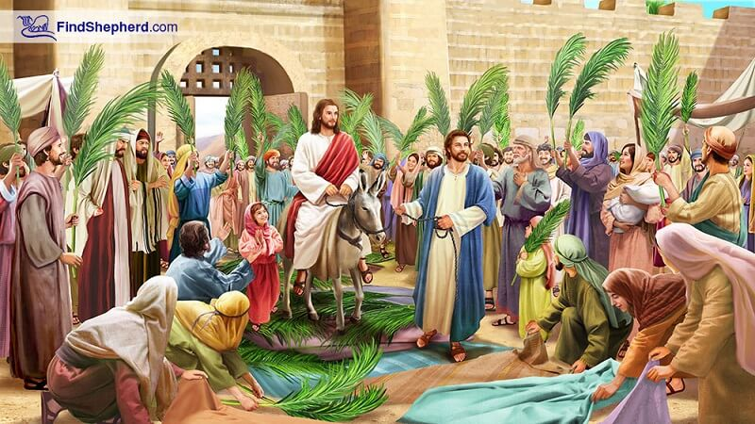
HOSANNA
Jesus’ Triumphal Entry – Jesus Enters Jerusalem Like a King
Matthew 21:1-11 Mark 11:1-11 Luke 19:28-40 John 12:12-19

Slide 2


What do you do when you are excited!?
EXCITING

Slide 3

Object Lesson

Slide 4


GOD IS
HIS
WORK IS
EXCITING
PRAISE HIM IN PRAYER

Slide 5

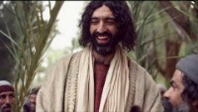
Mark told the story this way Mark 11:1-14

Slide 6
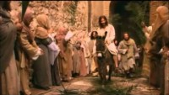
John told it this way – John 12:12-19

Slide 7
Retell Story
OPTION 1: Color story figures to use in retelling
OPTION 2: Make Palm branches to use in skit
or do both

Slide 8
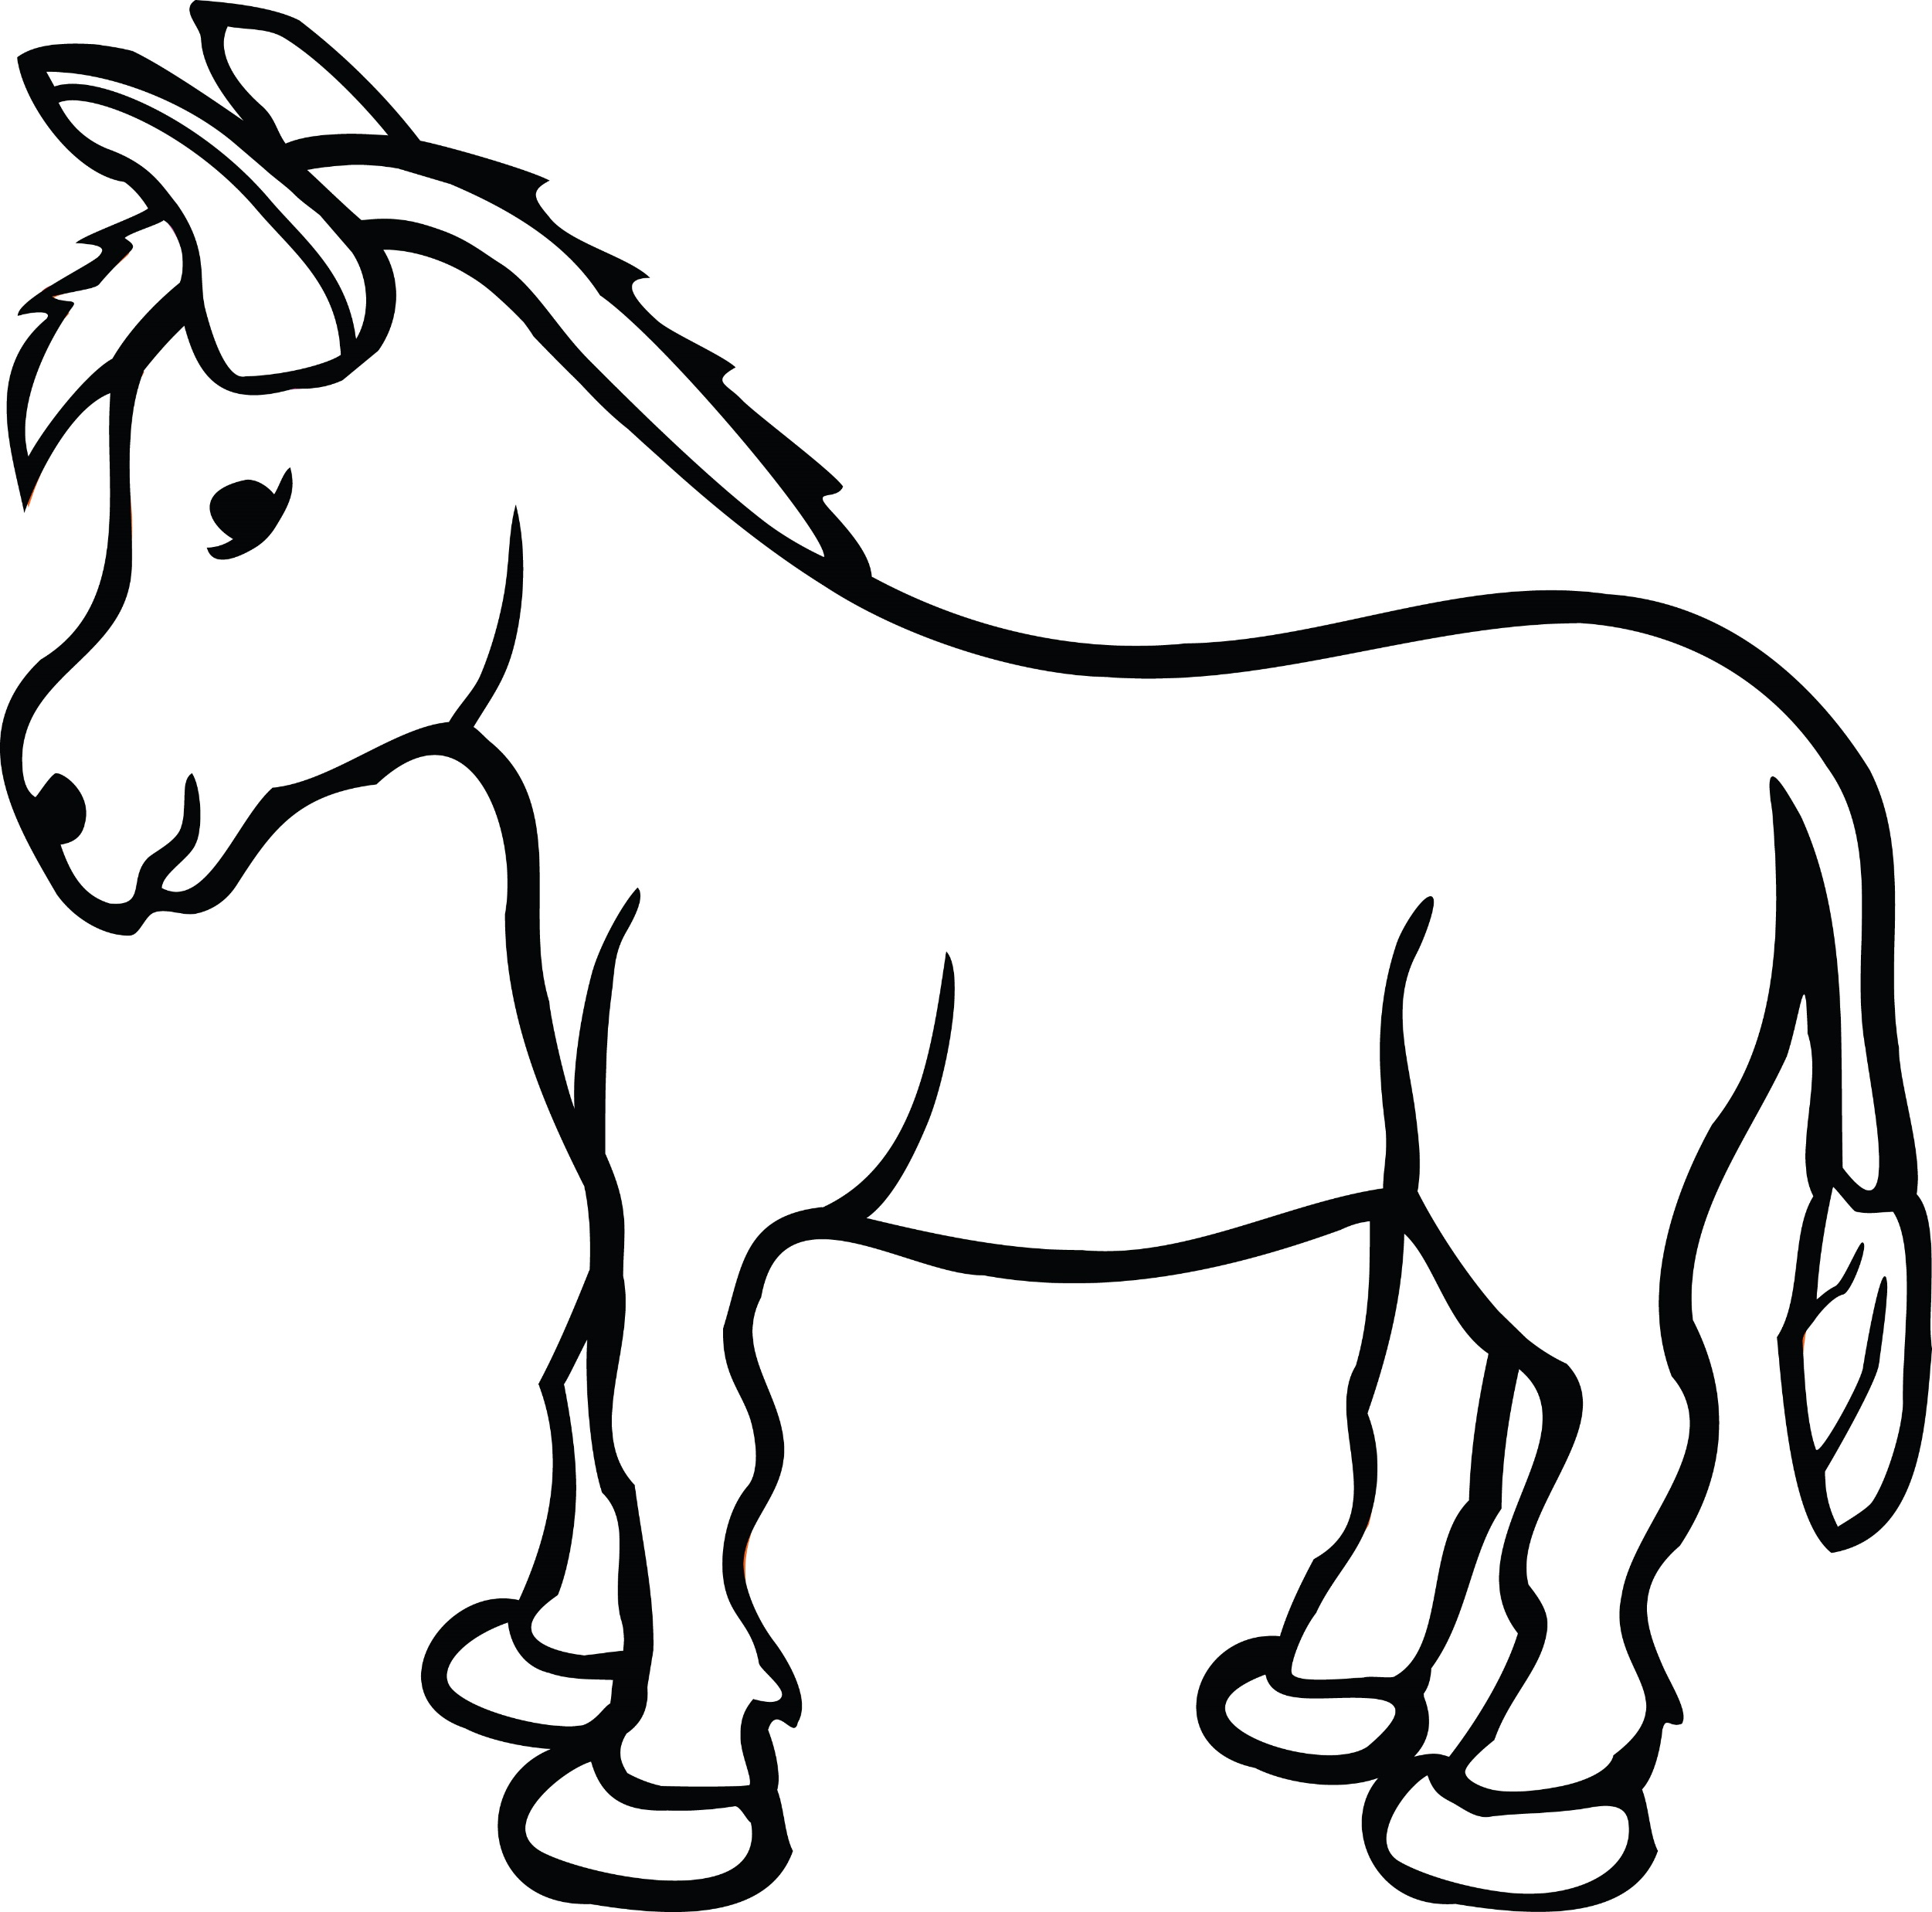
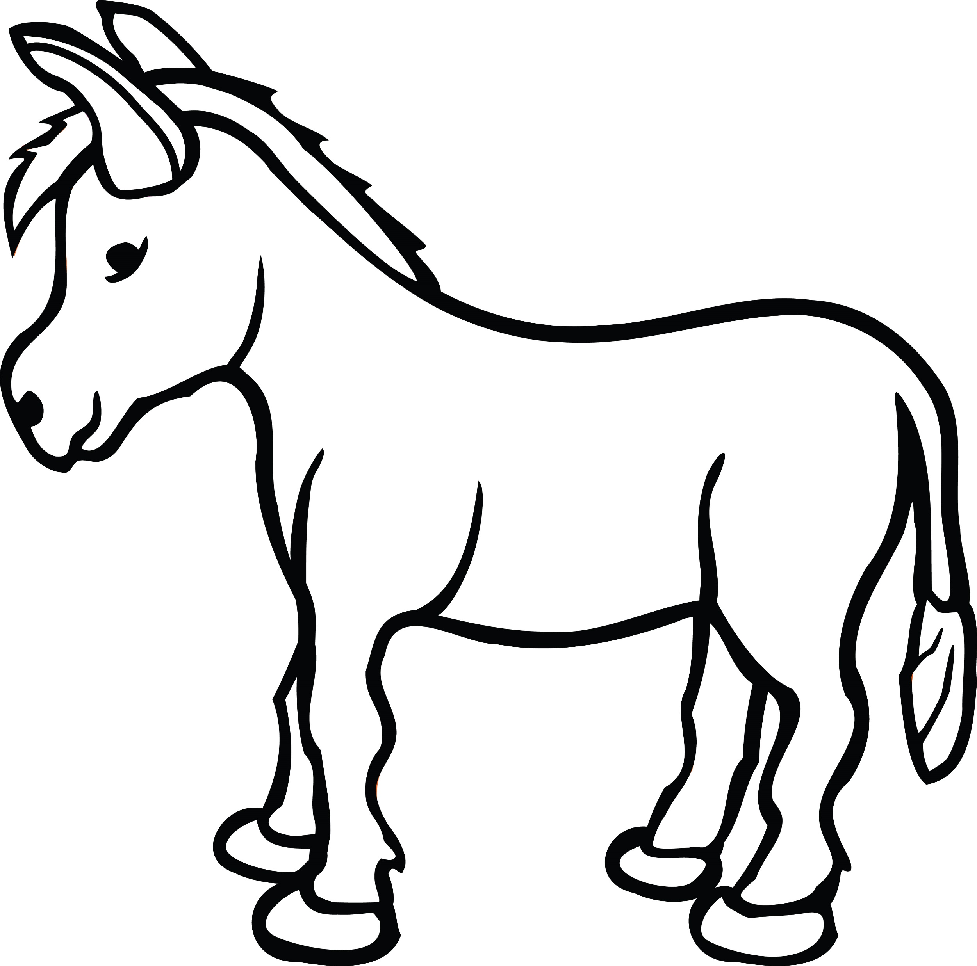

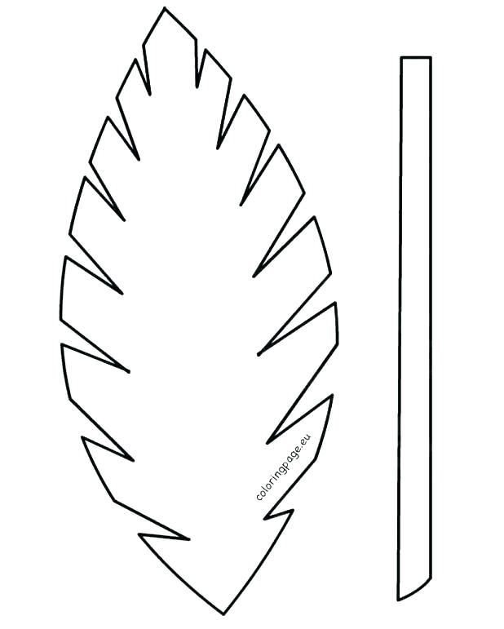
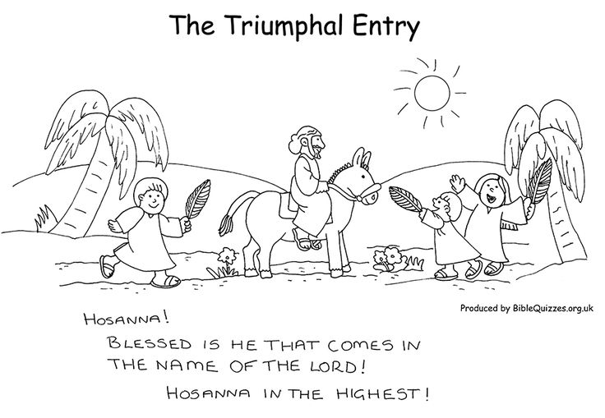
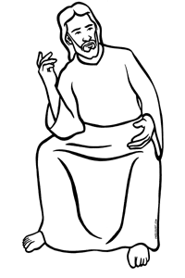
CRAFT TIME
Color
Cut out the figures
We will use the figures to retell the story.
Clip clothespin here
Clip clothespin here
RETELL STORY OPTION 1 –
ACTION FIGURES

Slide 9


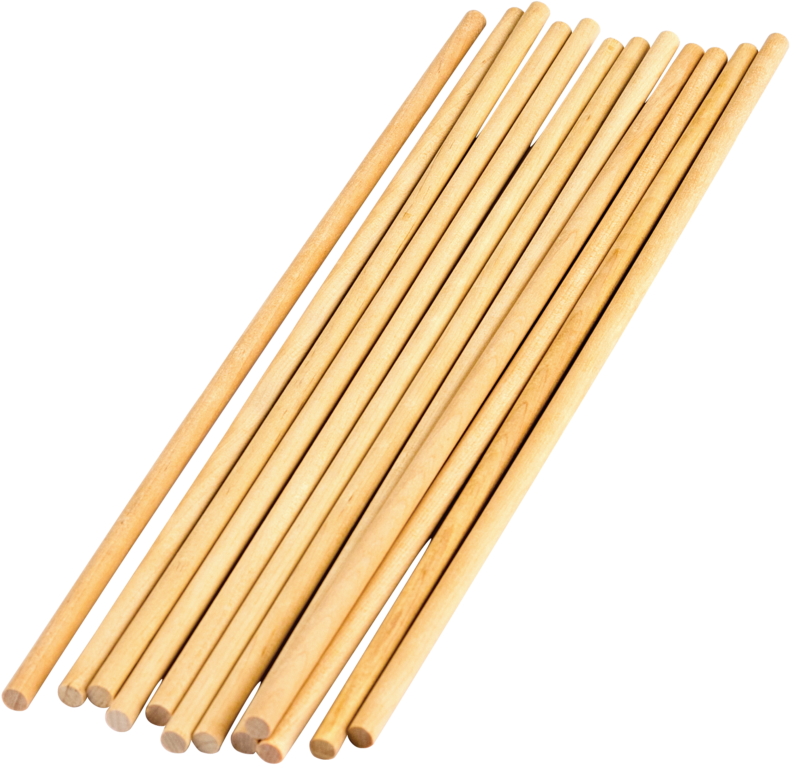

CRAFT TIME
Color (if not printed on green paper)
Cut out leaf and stem
Attach leaf and stem and attach a skewer or small dowel for stability
RETELL STORY OPTION 2 –
PALM BRANCHES AND SKIT

Slide 10
GOD IS
HIS
WORK IS
EXCITING
PRAISE HIM IN SONG

Slide 11
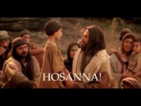
Listen and color your craft Hosanna - A Palm Sunday Song

Slide 12
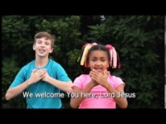
Listen and do your craft or Sing Hosanna Praise is Rising

Slide 13
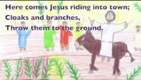
Listen and cut out your craft or Sing Songs for Palm Sunday, Holy Week and Easter #1 Cloaks and Branches

Slide 14
Retell Story
OPTION 1: Retell with colored figures
OPTION 2: Use palm branches in a skit
Characters: Jesus, 2 disciples, donkey owner, crowd

Slide 15
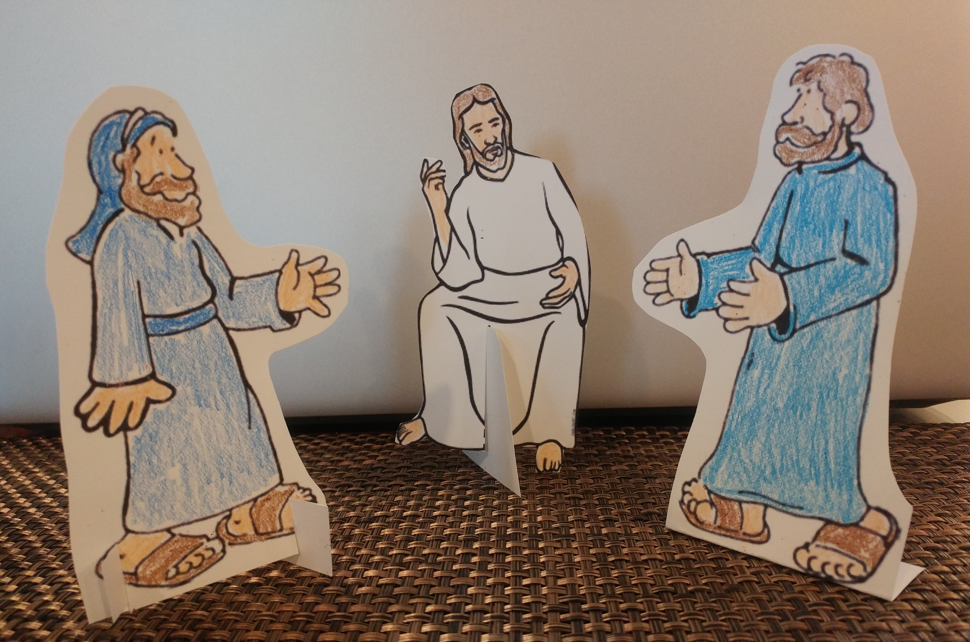
“Go into the town you can see there.
When you enter the town, you will find a young donkey tied there that no one has ever ridden. Untie it, and bring it here to me.
If anyone asks you why you are taking the donkey, you should say, ‘The Master needs it.’”
Yes Master. We’ll go.

Slide 16
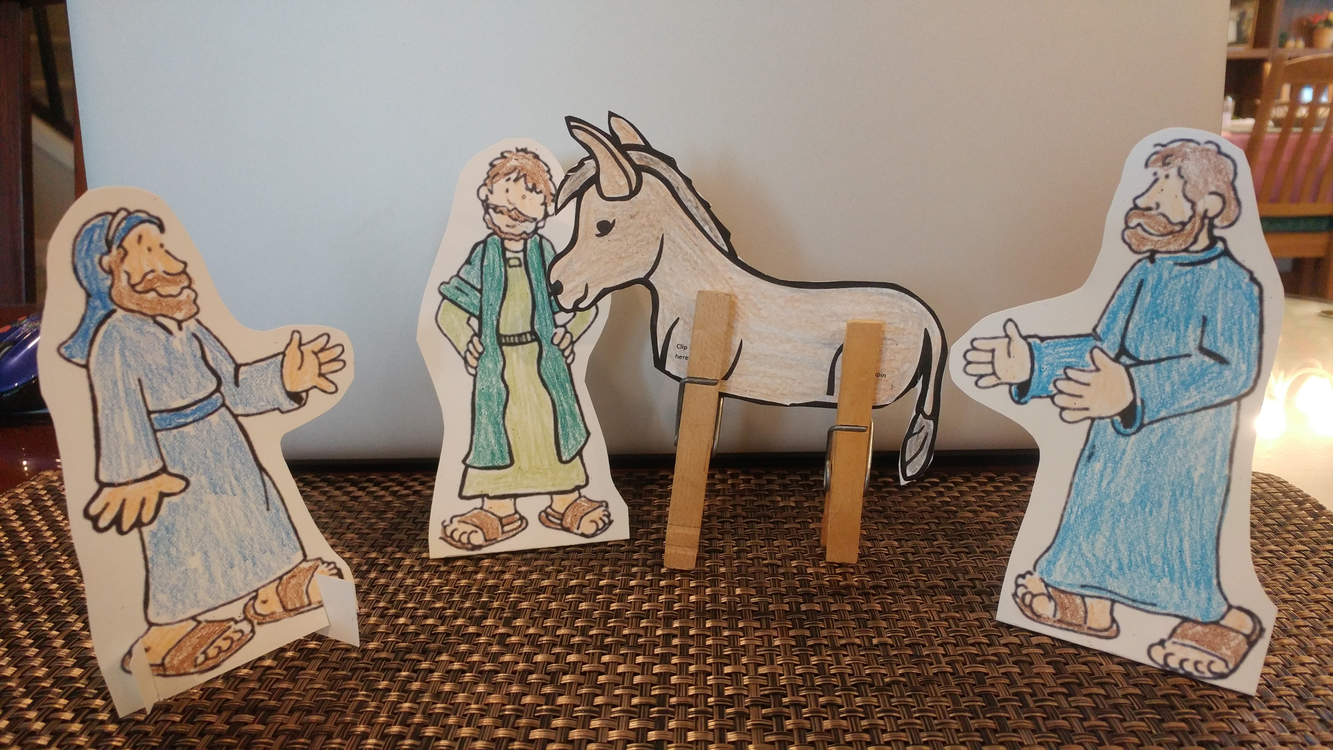
Why are you untying the donkey?
The Master needs it.

Slide 17
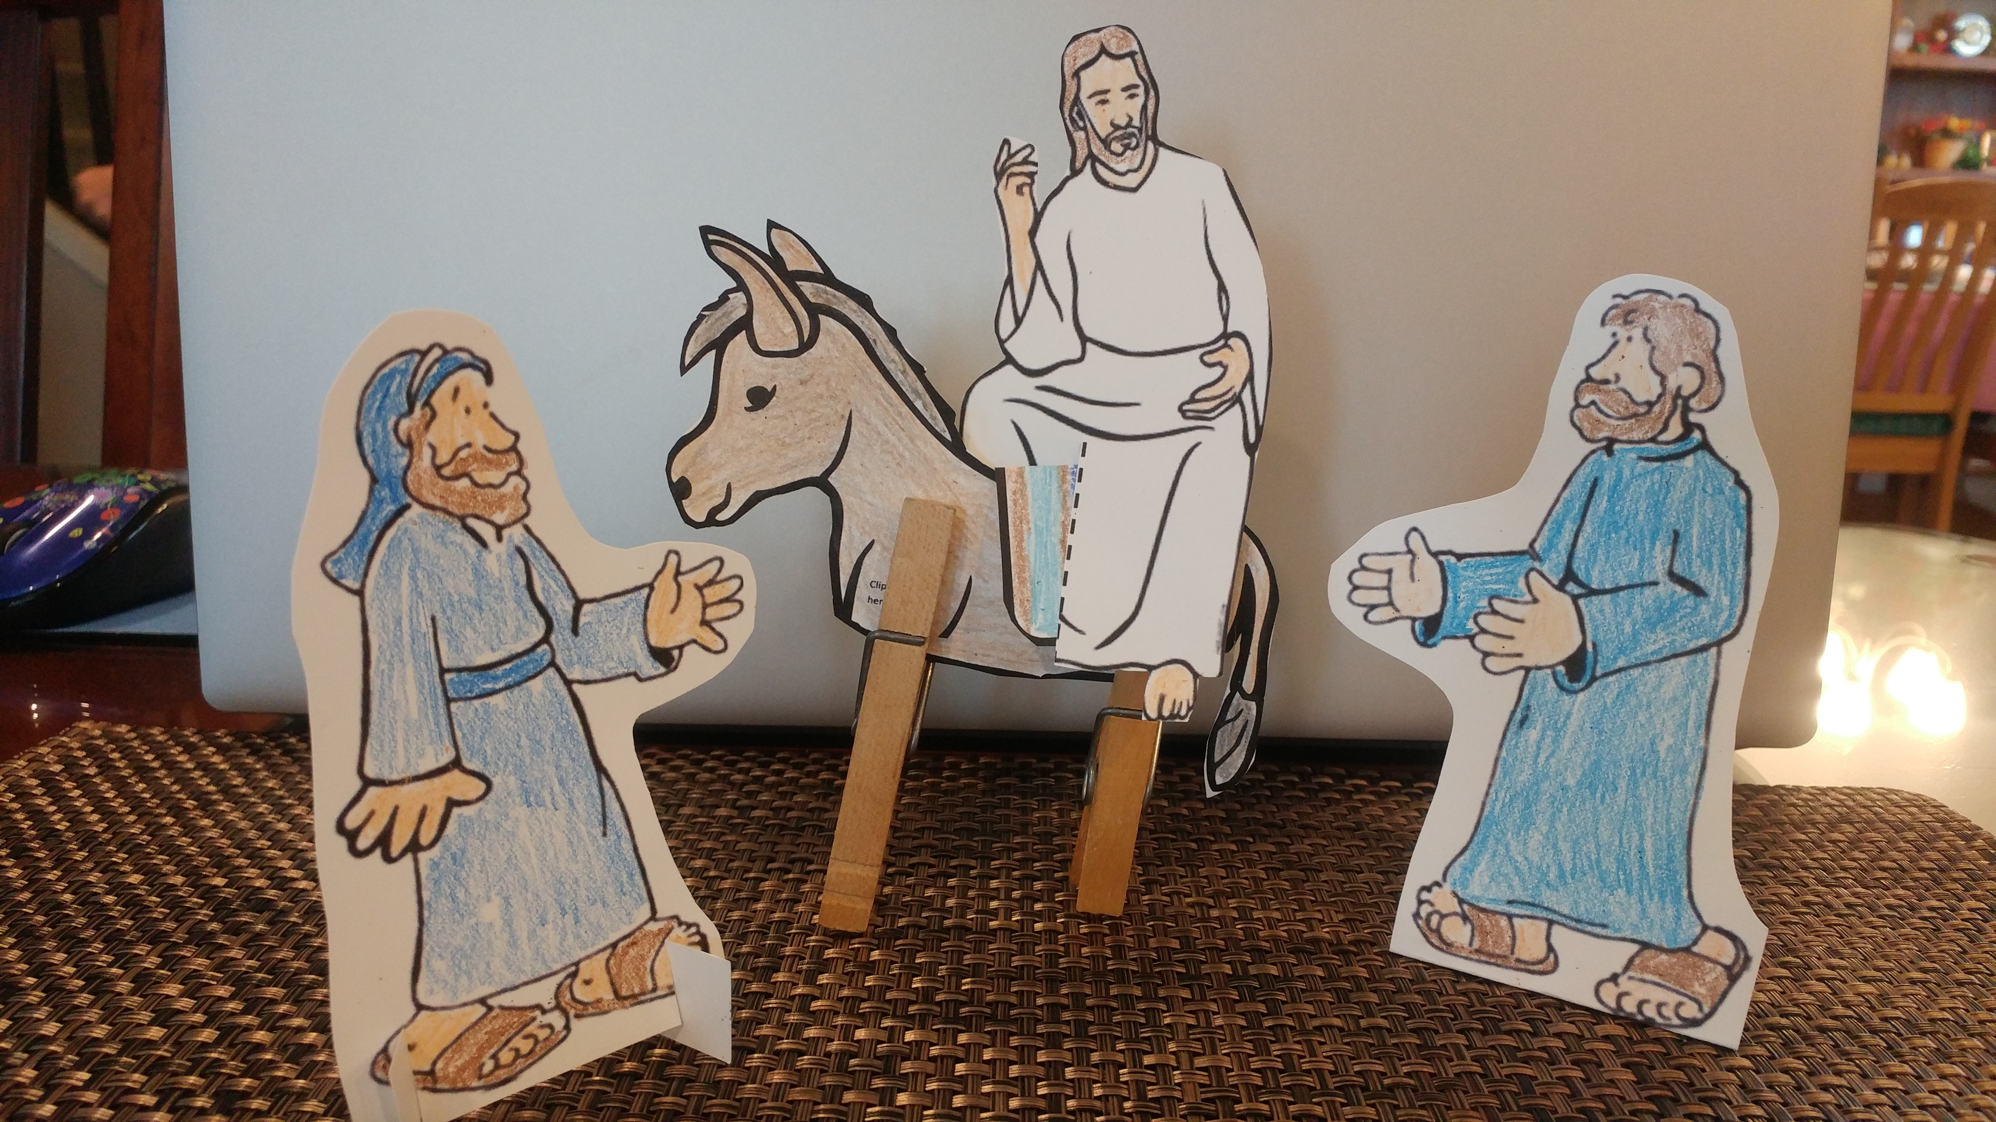
I put a blanket on the donkey for you.
We’re ready to go.

Slide 18
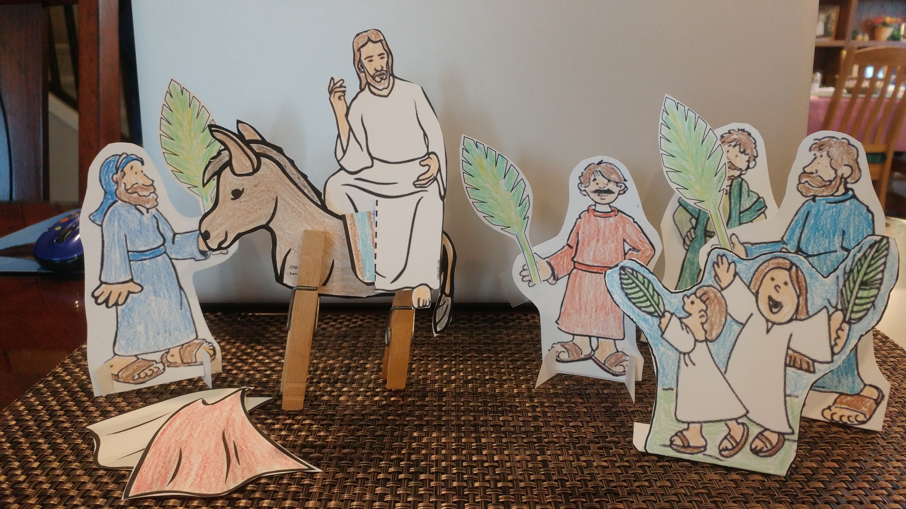
God bless the one who comes in the name of the Lord.
Praise God!
Hosanna!
Jesus is amazing!

Slide 19
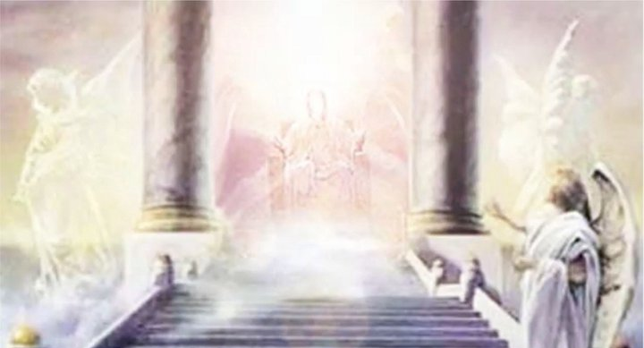
Welcome Home
Just one week later Jesus died for us.
He rose again, visited with the disciples and
then went back to heaven.
This time it was the angels who sang praises!
And shouted praises.

Slide 20
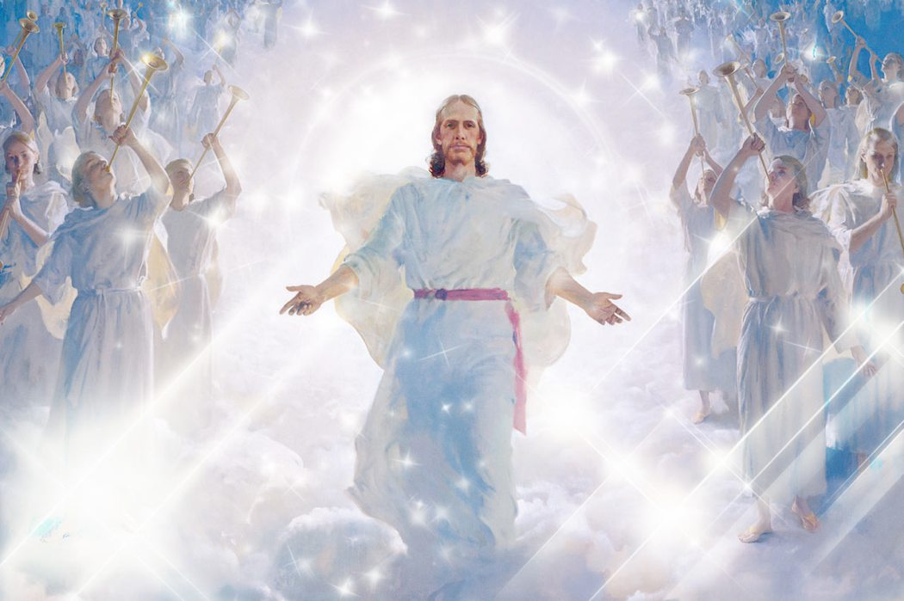
Lift up your heads, O you gates! And be lifted up, you everlasting doors! And the King of glory shall come in.
Who is this King of glory?
The Lord strong and mighty, The Lord mighty in battle.
Psalms 24:7-10
HEAVENLY TRIUMPHAL ENTRY
Lift up your heads, O you gates! Lift up, you everlasting doors! And the King of glory shall come in.
Who is this King of glory?
The Lord of hosts, He is the King of glory.

Slide 21
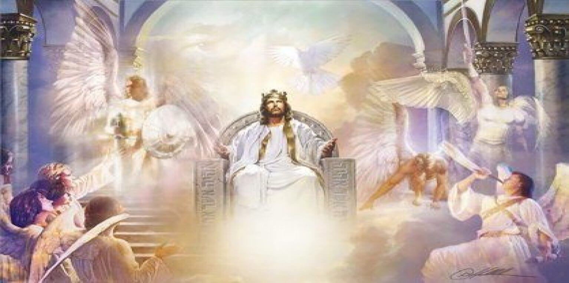
All power, wealth, wisdom, and strength belong to the Lamb who was slain. He is worthy to receive honor, glory, and praise!”
Revelation
5:12-13
“All praise and honor
and glory and power forever and ever
to the one who sits on the throne and to the Lamb!”

Slide 22
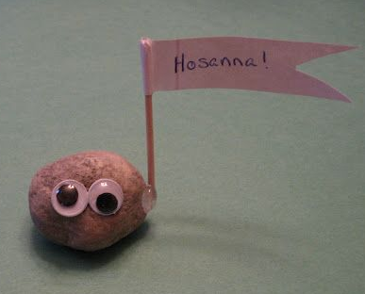
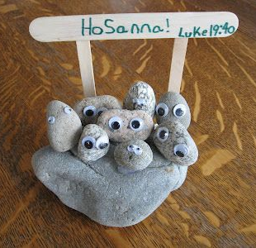
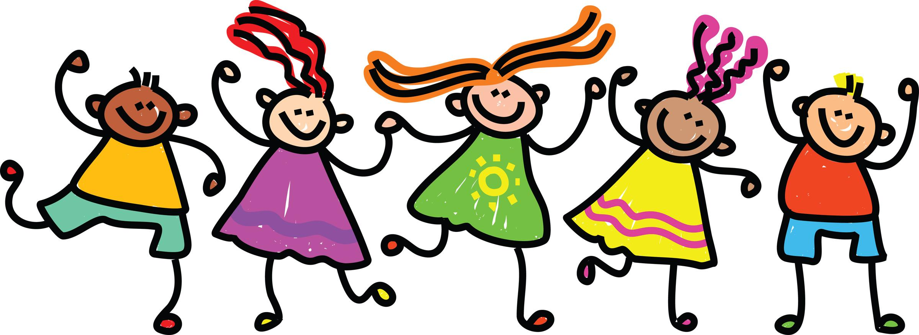
Luke adds:
³⁹ Some of the Pharisees said to Jesus, “Teacher, tell your followers not to say these things.”
⁴⁰ But Jesus answered, “I tell you, if my followers didn’t say them, these stones would shout them.”
JESUS IS AMAZING!
GOD BLESS HIS KINGDOM!
PRAISE GOD
EXTRA Craft Idea

Slide 23
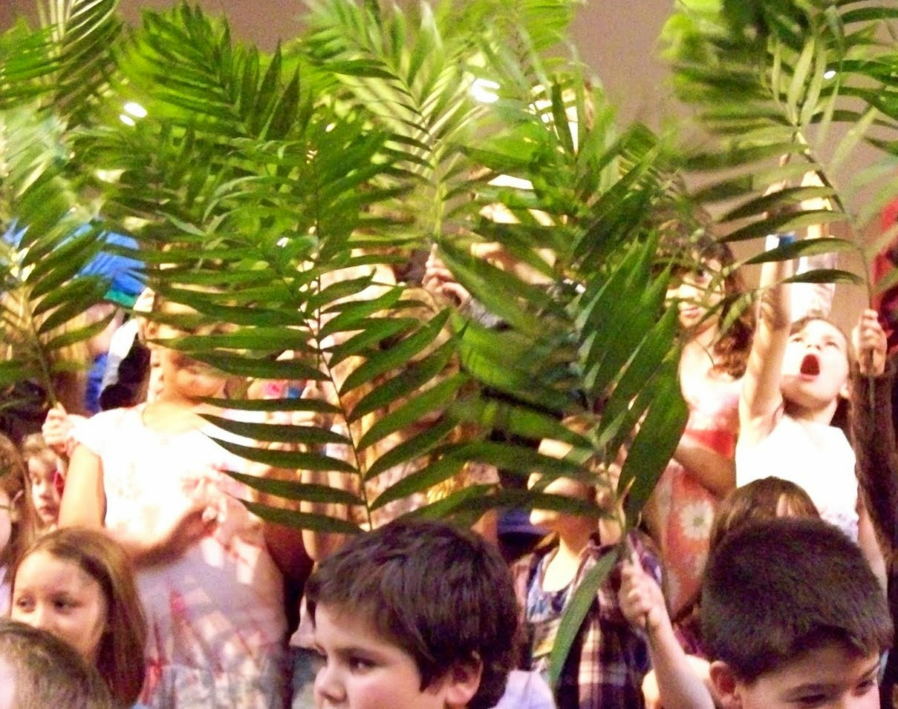
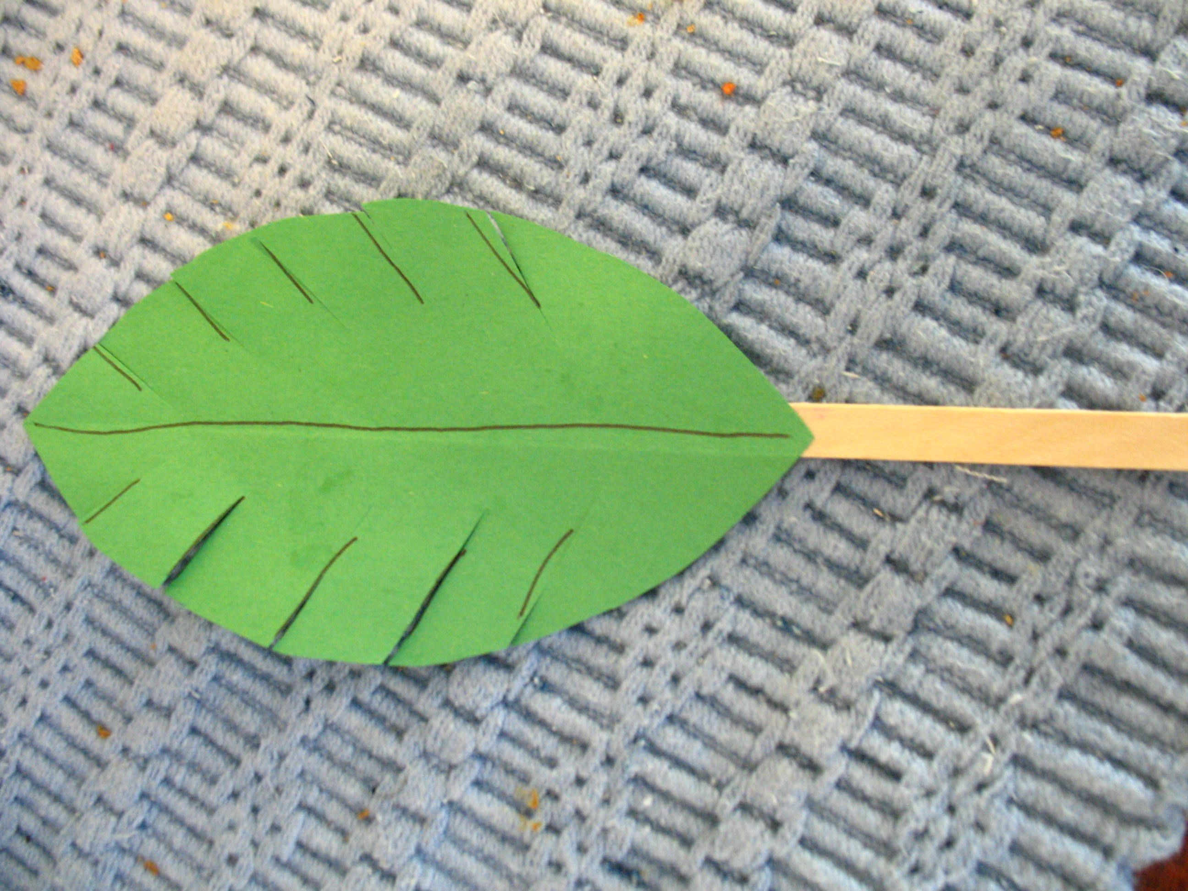
Now it is our turn to praise the Lord! Let’s have a parade and sing!

Slide 24
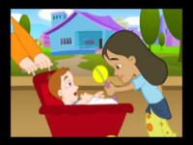
Sing with us Ho-Ho Hosanna Ha-Ha Hallelujah - song

Slide 25

Sing with us Ho-Ho Hosanna Ha-Ha Hallelujah - song

Slide 26
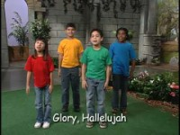
Sing with us King of Kings

Slide 27

Sing with us -- Time to move If You're Happy and You Know It! | Barefoot Books Singalong

Slide 28
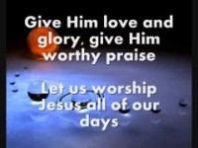
Sing with us Praise Him All Ye Little Children

Slide 29
EXTRA
Bible Reading
Skit

Slide 30
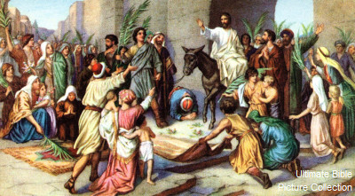
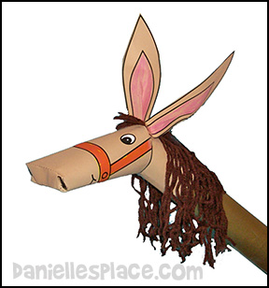
Skit from ministry-to-children.com Donkey idea: Danielle’s Place
Triumphal Entry: Luke 19:28-38 Characters: Narrator, Jesus, Owner, Disciples (at least 2), the rest of the class can be the crowds Props: donkey (picture or cut out) and coats or cloth to put on donkey ——————————————————————————— (Jesus and disciples walk to the front of the room)
Narrator: He was going on ahead, going up to Jerusalem. When He approached Bethphage and Bethany, near the mount that is called Olivet, He sent two of the disciples, saying, Jesus: (pointing to where the donkey is) Go into the village ahead of you; there, as you enter, you will find a colt tied on which no one yet has ever sat; untie it and bring it here. If anyone asks you, ‘Why are you untying it?’ you shall say, ‘The Lord has need of it.'” Narrator: So those who were sent went away and found it just as He had told them. As they were untying the colt, its owners said to them, Owner: Why are you untying the colt? Disciple: The Lord has need of it. (owner nods head in agreement) Narrator: They brought it to Jesus, and they threw their coats on the colt and put Jesus on it. As He was going, they were spreading their coats on the road. (Jesus walks around with the donkey while crowd is praising Him) Narrator: As soon as He was approaching, near the descent of the Mount of Olives, the whole crowd of the disciples began to praise God joyfully with a loud voice for all the miracles which they had seen, shouting: Crowd: Blessed is the King who comes in the name of the Lord; Peace in heaven and glory in the highest!

Slide 31
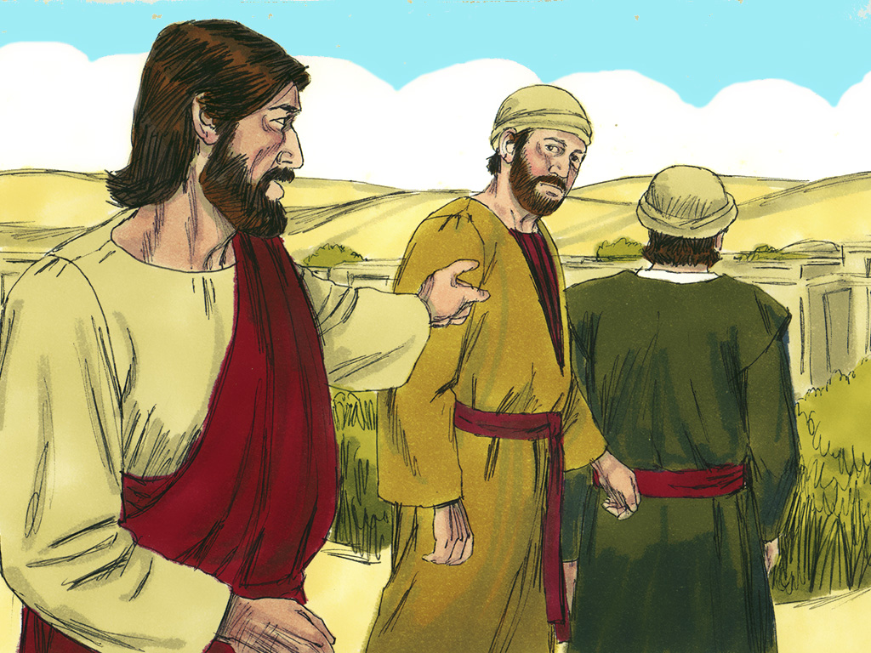
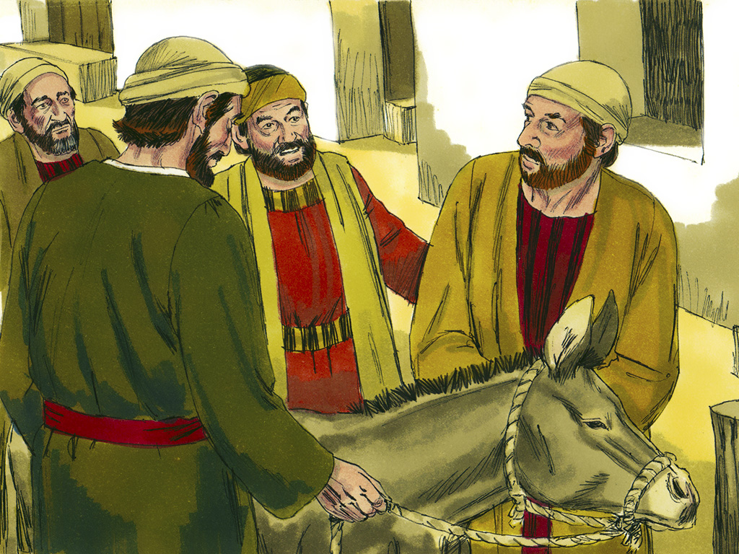
Go get the donkey Luke 11:28-34
²⁸ After Jesus said these things, he continued traveling toward Jerusalem. ²⁹ He came near Bethphage and Bethany, towns near the hill called the Mount of Olives. He sent out two of his followers. ³⁰ He said, “Go into the town you can see there. When you enter the town, you will find a young donkey tied there that no one has ever ridden. Untie it, and bring it here to me. ³¹ If anyone asks you why you are taking the donkey, you should say, ‘The Master needs it.’”
³² The two followers went into town. They found the donkey exactly like Jesus told them.
³³ They untied it, but its owners came out. They said to the followers, “Why are you untying our donkey?”
³⁴ The followers answered, “The Master needs it.”

Slide 32
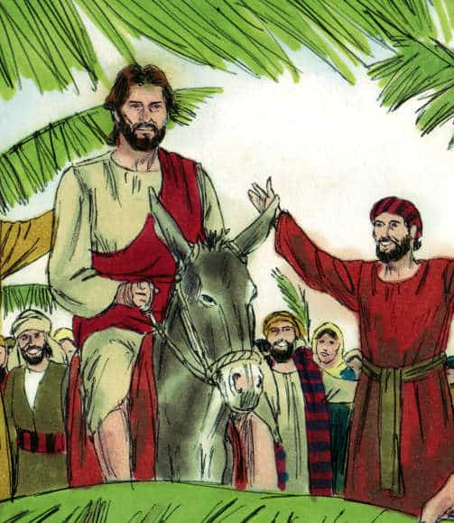
Jesus Rides People shout praises Mark 11:7-10
⁷ The followers brought the donkey to Jesus. They put their coats on it, and Jesus sat on it. ⁸ Many people spread their coats on the road for Jesus. Others cut branches in the fields and spread the branches on the road. ⁹ Some of them were walking ahead of Jesus. Others were walking behind him. Everyone shouted,
“‘Praise[ Him!’ ‘Welcome! God bless the one who comes in the name of the Lord!’
¹⁰ “God bless the kingdom of our father David. That kingdom is coming! Praise to God in heaven!”

Slide 33
Jesus Rides People shout praises Luke 19:17-40
³⁷ Jesus was coming close to Jerusalem. He was already near the bottom of the Mount of Olives. The whole group of followers was happy. They were very excited and praised God. They thanked God for all the powerful things they had seen. ³⁸ They said,
“‘Welcome! God bless the king who comes in the name of the Lord.’
Peace in heaven and glory to God!”
³⁹ Some of the Pharisees said to Jesus, “Teacher, tell your followers not to say these things.”
⁴⁰ But Jesus answered, “I tell you, if my followers didn’t say them, these stones would shout them.”

Slide 34

https://activity-array.com/

