Slide 1
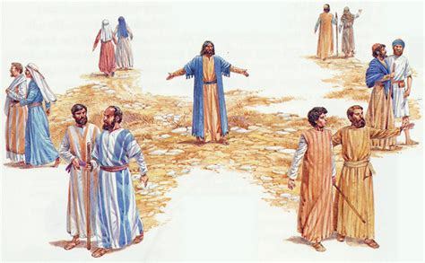
Two by Two
Spreading the Good News
Matthew 13

Slide 2


Do you have some good news?
Have you learned something exciting?

Slide 3
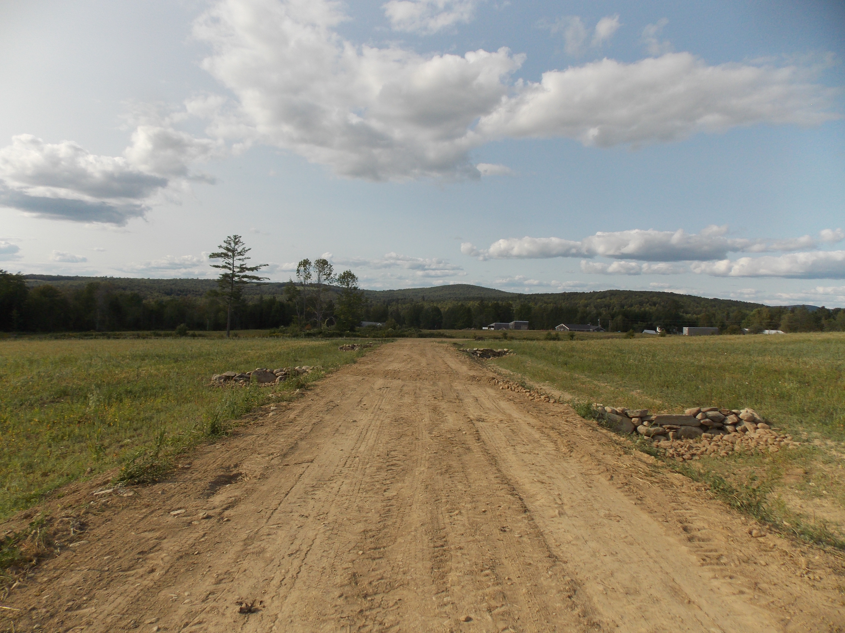
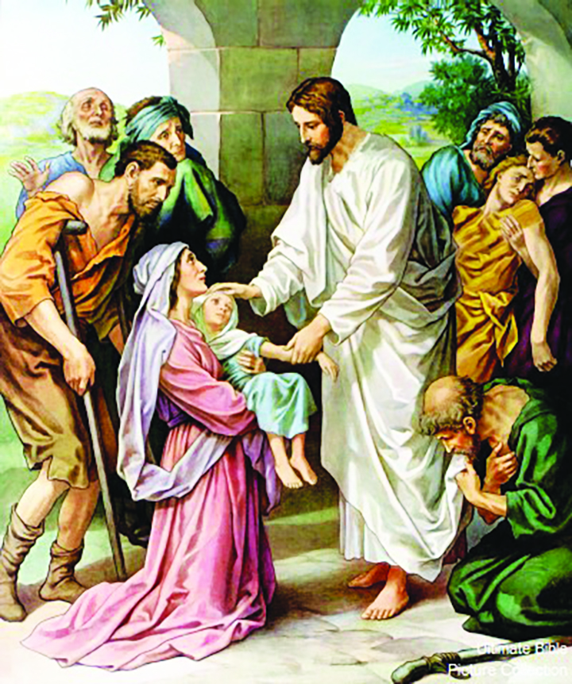
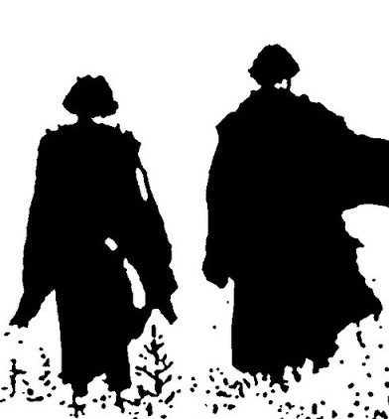

Matthew 9:35-36
³⁵ Jesus went through all the towns and villages, teaching in their synagogues, proclaiming the good news of the kingdom and healing every disease and sickness.
³⁶ When he saw the crowds, he had compassion on them, because they were harassed and helpless, like sheep without a shepherd.

Slide 4
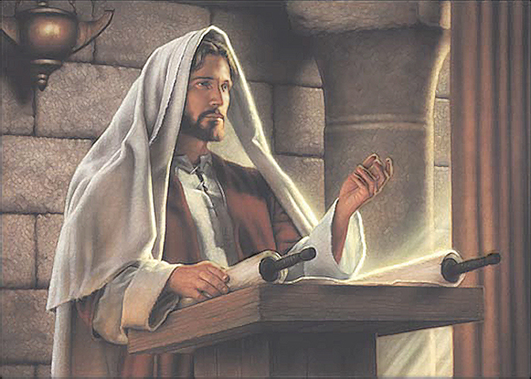
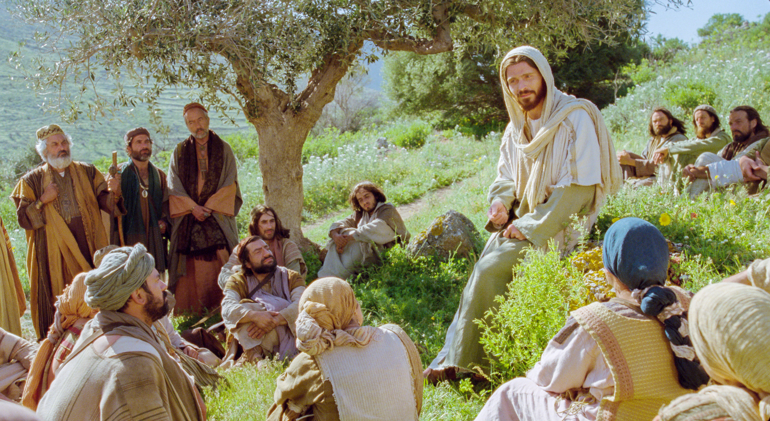
Jesus taught the people
I have come to
Bring good news, heal the broken hearted, and set the captive free.
Love your neighbor. Love your enemies.
Do good to those who hate you.
Don’t worry about tomorrow. God cares for you.
Ask and you will receive.

Slide 5
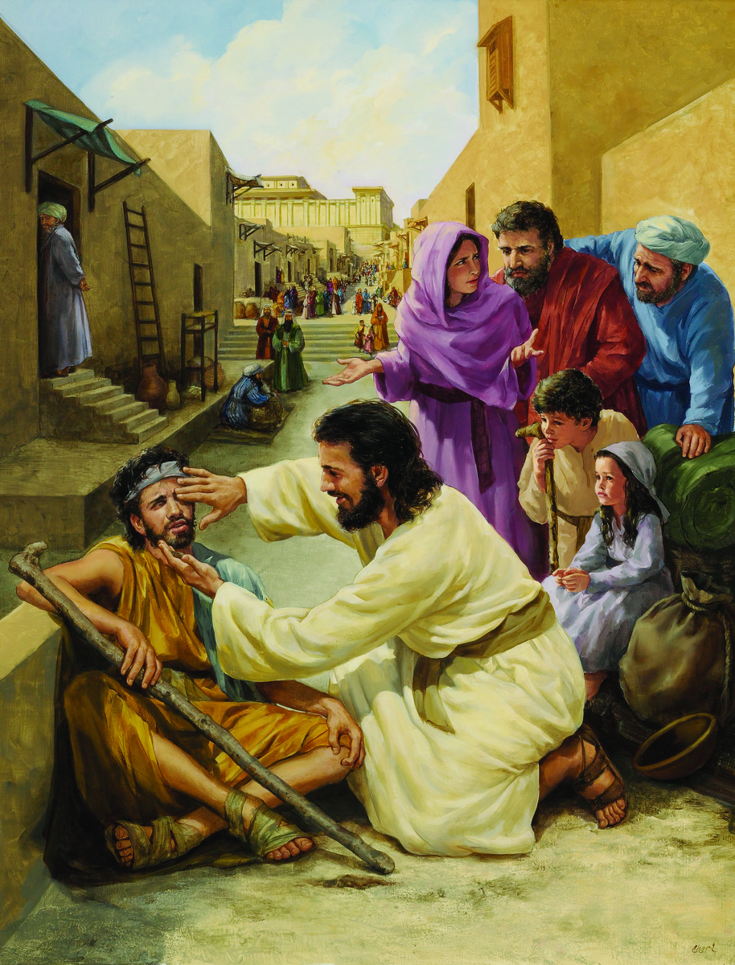
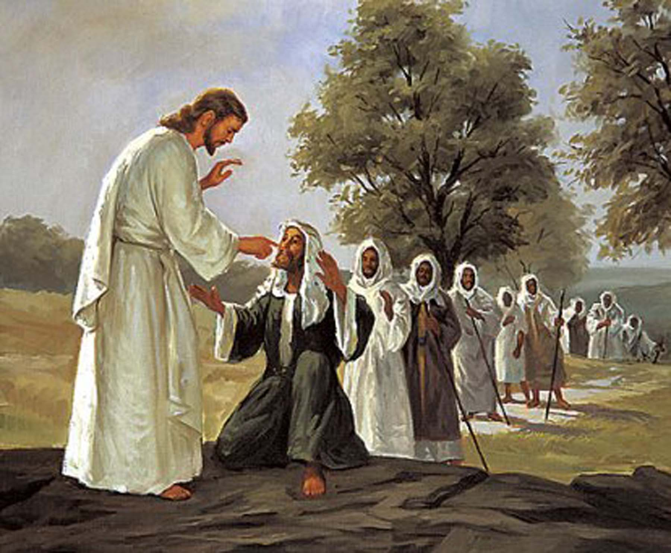
Jesus healed the sick

Slide 6
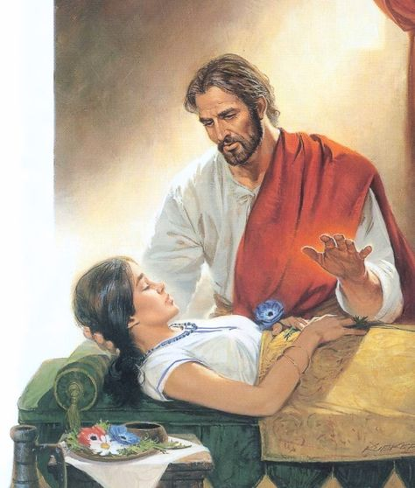
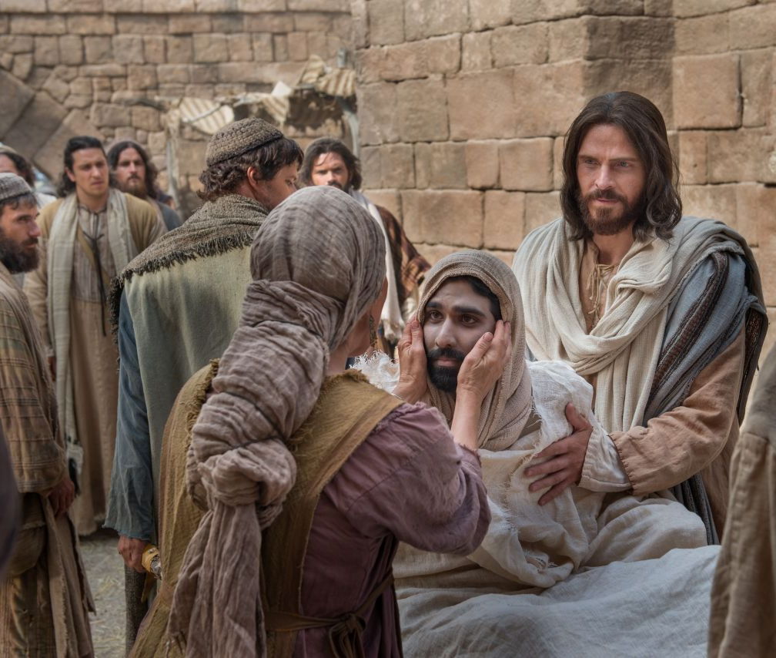
Jesus raised some who died

Slide 7
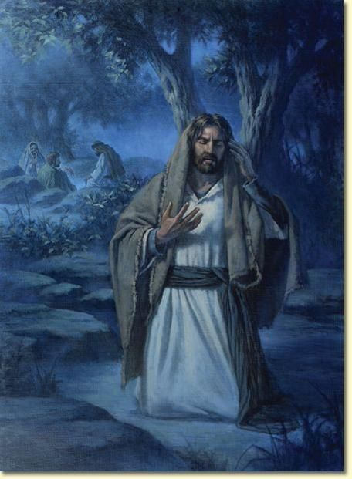
Jesus prayed
He talked to God
Heavenly Father,
Who shall I pick to be our special helpers, the apostles.
Let’s
Pray
Luke 6
¹² One of those days Jesus went out to a mountainside to pray, and spent the night praying to God.
¹³ When morning came, he called his disciples to him and chose twelve of them, whom he also designated apostles

Slide 8
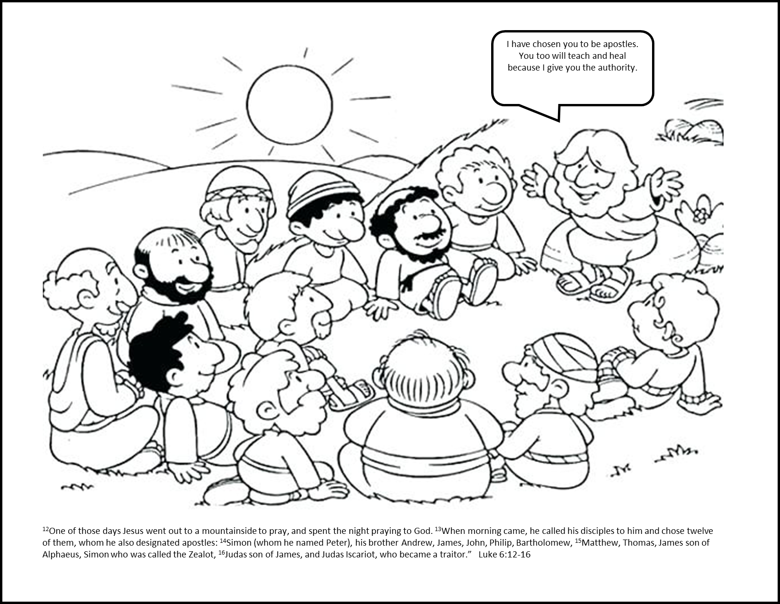

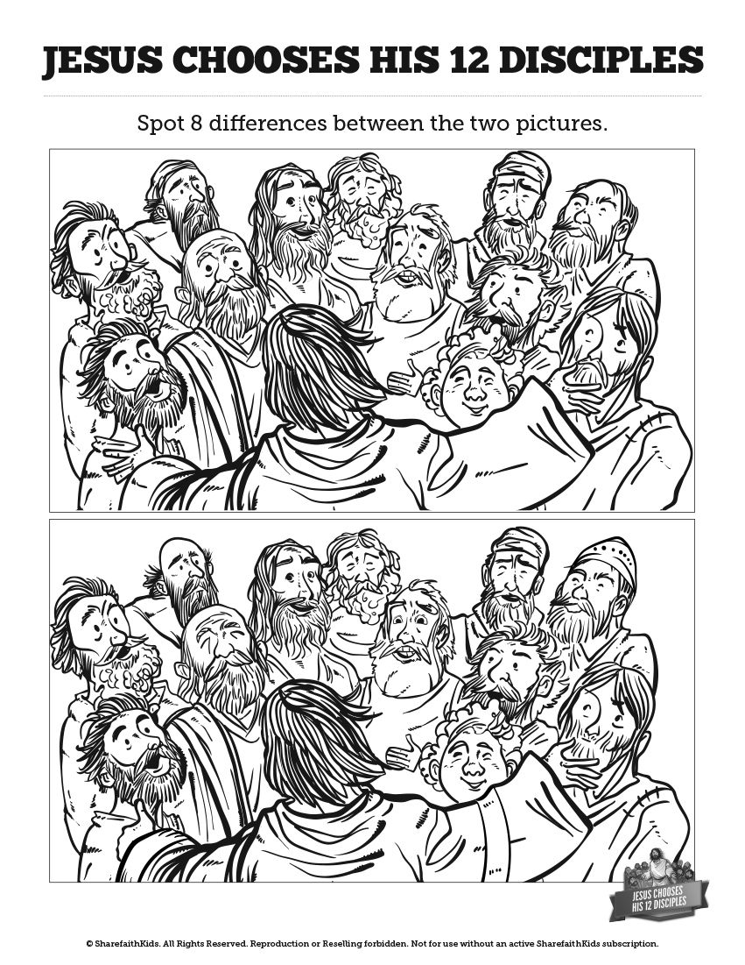
You may color and listen to our story

Slide 9
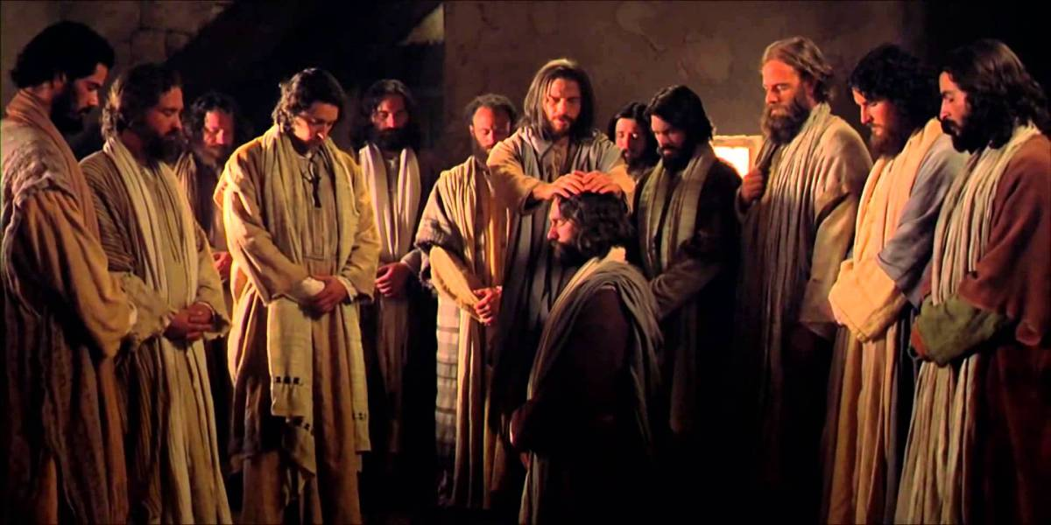
Jesus chose 12 disciples to be apostles
I choose each of you to be a leader and missionary. You also will heal and preach.
Mark 3
¹³ Jesus went up on a mountainside and called to him those he wanted, and they came to him. ¹⁴ He appointed twelve apostles that they might be with him and that he might send them out to preach ¹⁵ and to have authority to drive out demons.
¹⁶ These are the twelve he appointed: Simon (to whom he gave the name Peter), ¹⁷ James son of Zebedee and his brother John (to them he gave the name Boanerges, which means “sons of thunder”), ¹⁸ Andrew, Philip, Bartholomew, Matthew, Thomas, James son of Alphaeus, Thaddaeus, Simon the Zealot ¹⁹ and Judas Iscariot, who betrayed him.
Judas
Peter
Andrew
James
Thomas
James
Thaddaeus
Philip
Matthew
John
Simon
Bartholomew

Slide 10
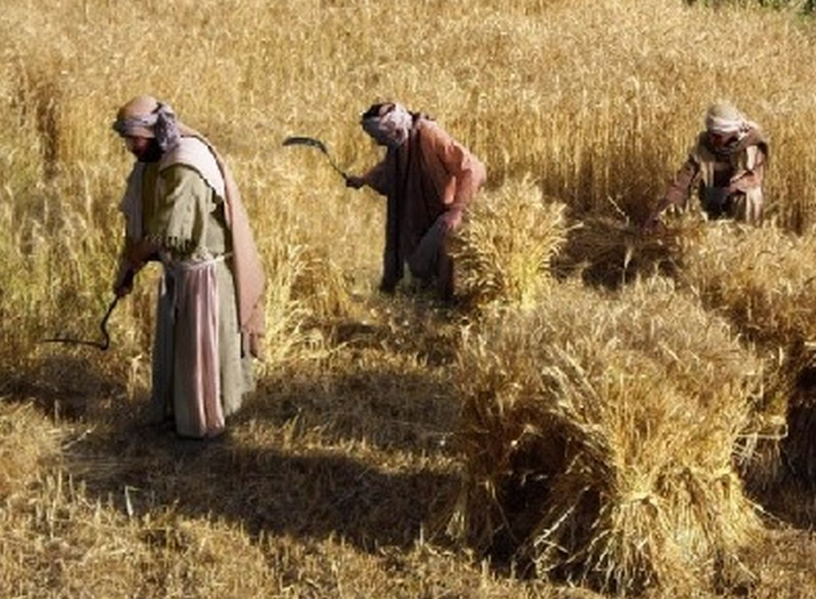
Who will go work?
Who will tell others the good news?
Matthew 9
³⁷ Then he said to his disciples, “The harvest is plentiful but the workers are few.
³⁸ Ask the Lord of the harvest, therefore, to send out workers into his harvest field.”

Slide 11
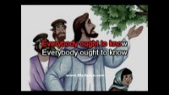
Everybody Ought To Know
Who Jesus is
Start at 0:22

Slide 12
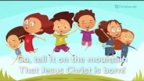
Go Tell It On the Mountain and Everywhere

Slide 13
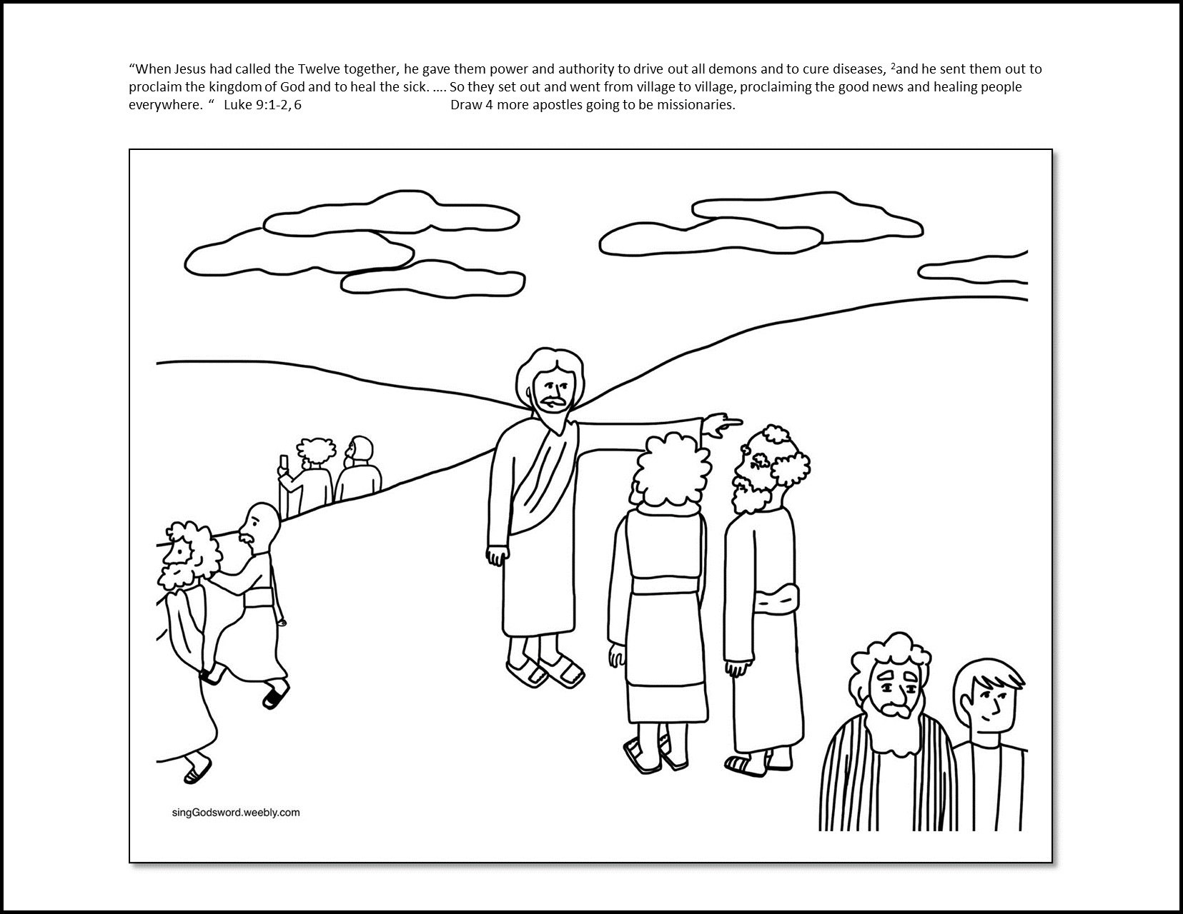
You may color and listen to our story
Draw 4 more apostles going to tell others the Good News and heal the sick.

Slide 14
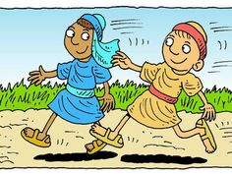
Go out two by two
Mark 6
Then Jesus went around teaching from village to village. ⁷ Calling the Twelve to him, he began to send them out two by two and gave them authority over impure spirits.

Slide 15
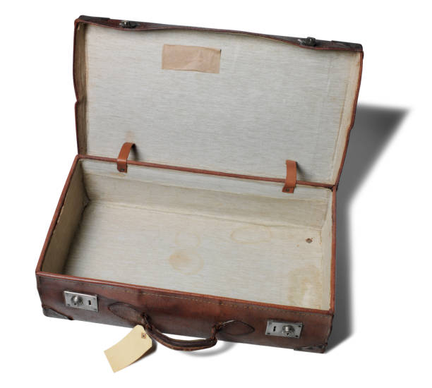
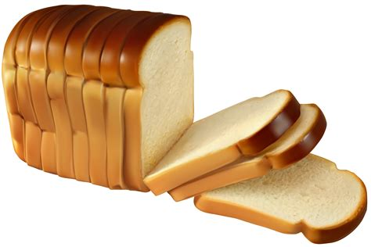
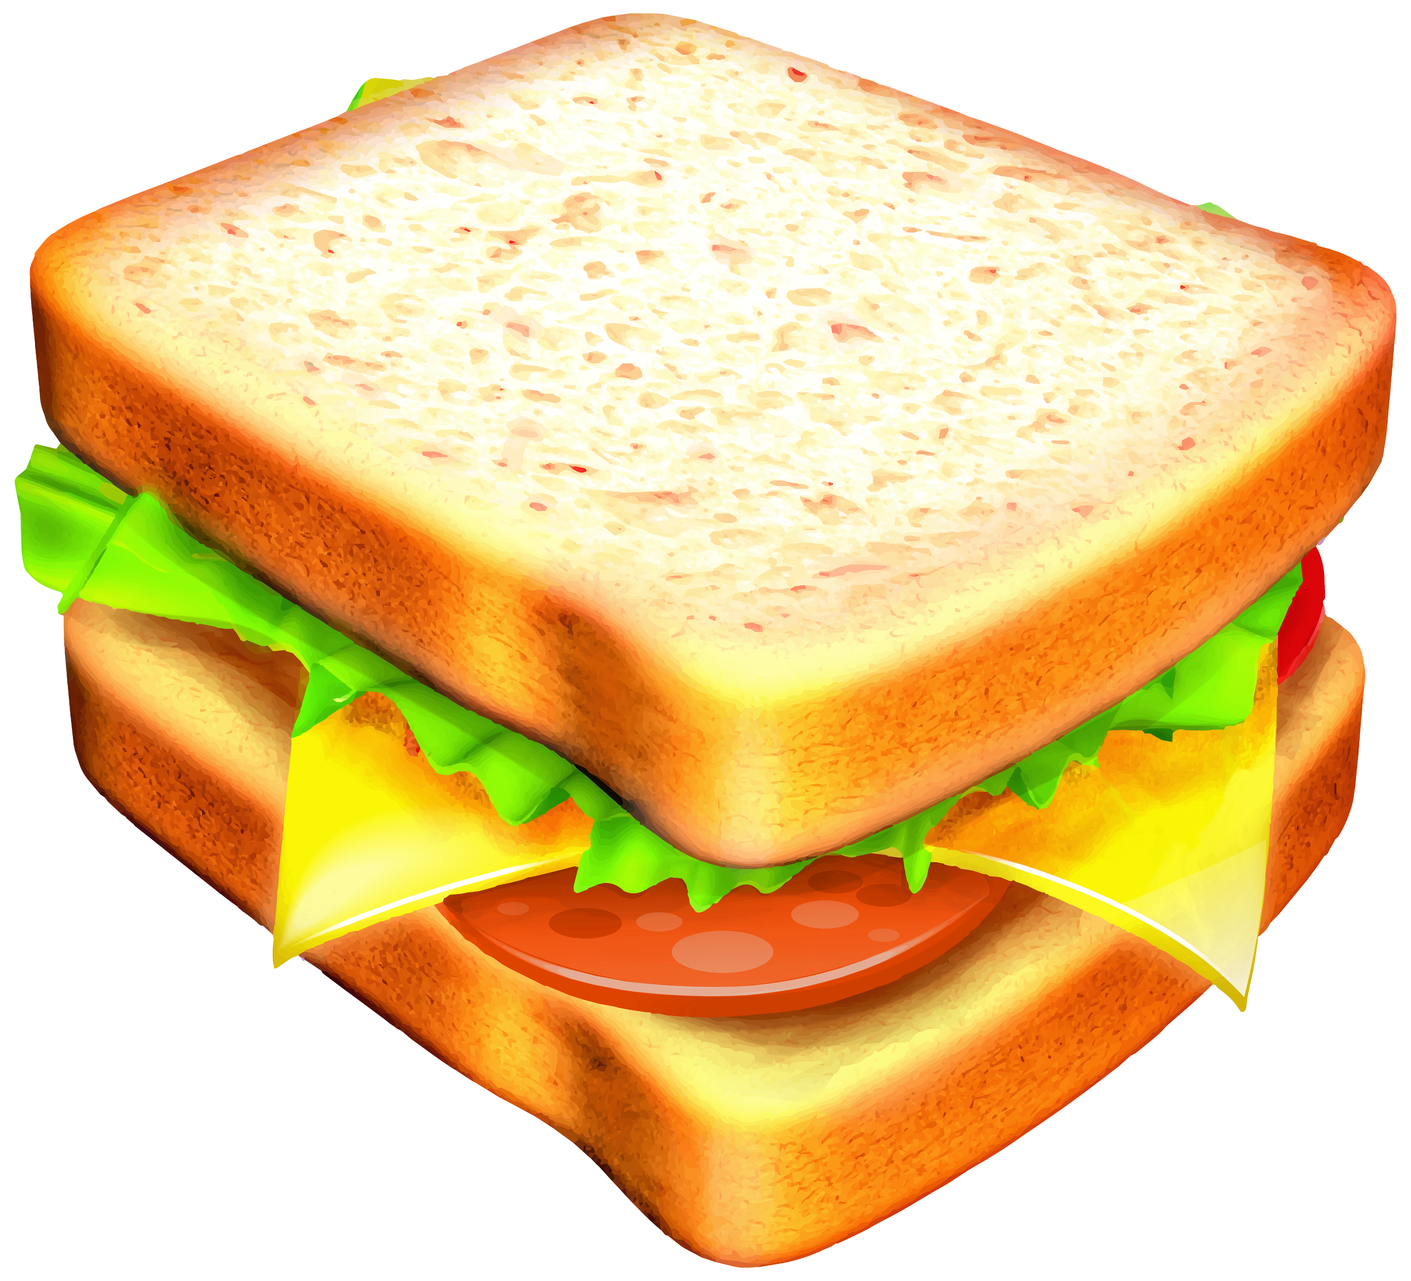

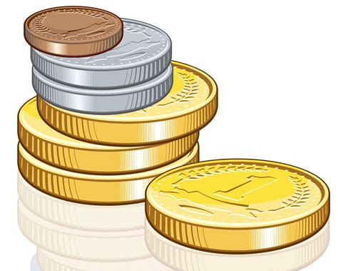
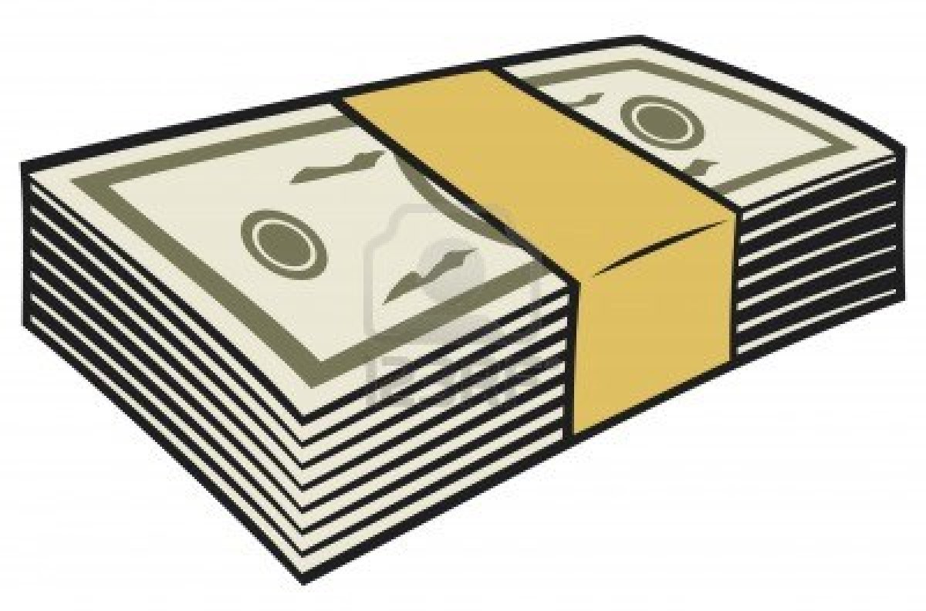
Don’t take anything with you.
Mark 6
⁸ These were his instructions: “Take nothing for the journey except a staff—no bread, no bag, no money in your belts. ⁹ Wear sandals but not an extra shirt.

Slide 16
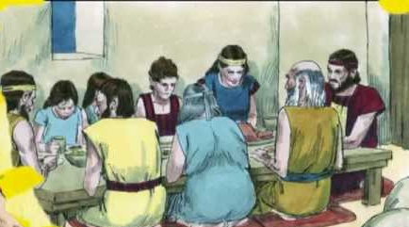
The worker is worth his keep.
Look for a family to stay with.
¹⁰ Whenever you enter a house, stay there until you leave that town. ¹¹ And if any place will not welcome you or listen to you, leave that place and shake the dust off your feet as a testimony against them.”
Thank you for allowing us to stay at your home.
Thank you for the wonderful meals!

Slide 17
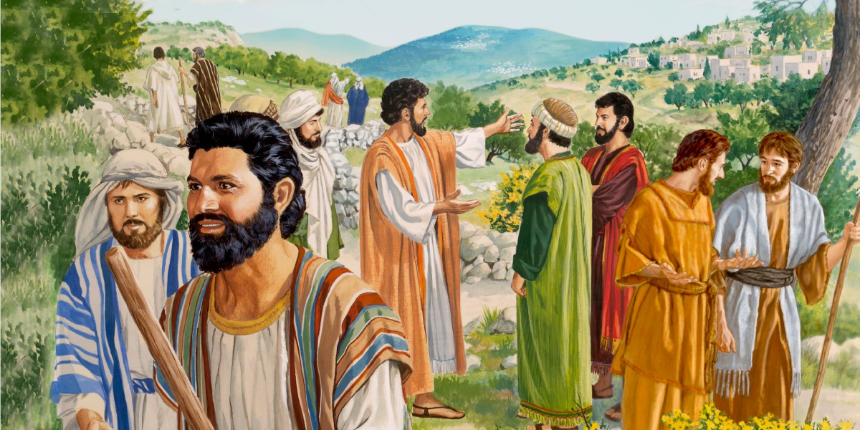
You will be my workers.
You will go.
I give you authority.
Go heal the sick, raise the dead,
cleanse those with leprosy, and
drive out demons.
Tell everyone the good news,
The kingdom of heaven is near.
Matthew 10
Jesus called his twelve disciples to him and gave them authority to drive out impure spirits and to heal every disease and sickness.
⁵ These twelve Jesus sent out with the following instructions: “Do not go among the Gentiles or enter any town of the Samaritans. ⁶ Go rather to the lost sheep of Israel. ⁷ As you go, proclaim this message: ‘The kingdom of heaven has come near.’ ⁸ Heal the sick, raise the dead, cleanse those who have leprosy,^{[a]} drive out demons. Freely you have received; freely give.

Slide 18
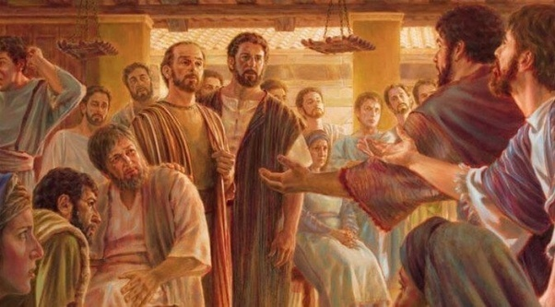
They went and did what Jesus told them to do.
The kingdom of heaven is near.
Repent.
I can walk!
I am healed!
God loves you!
Mark 6
¹² They went out and preached that people should repent. ¹³ They drove out many demons and anointed many sick people with oil and healed them.

Slide 19
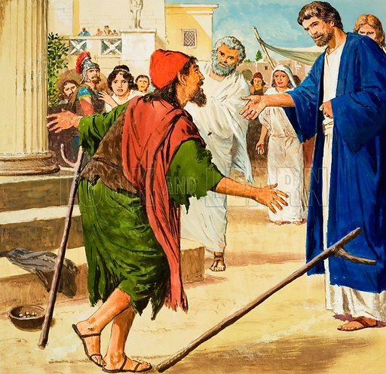
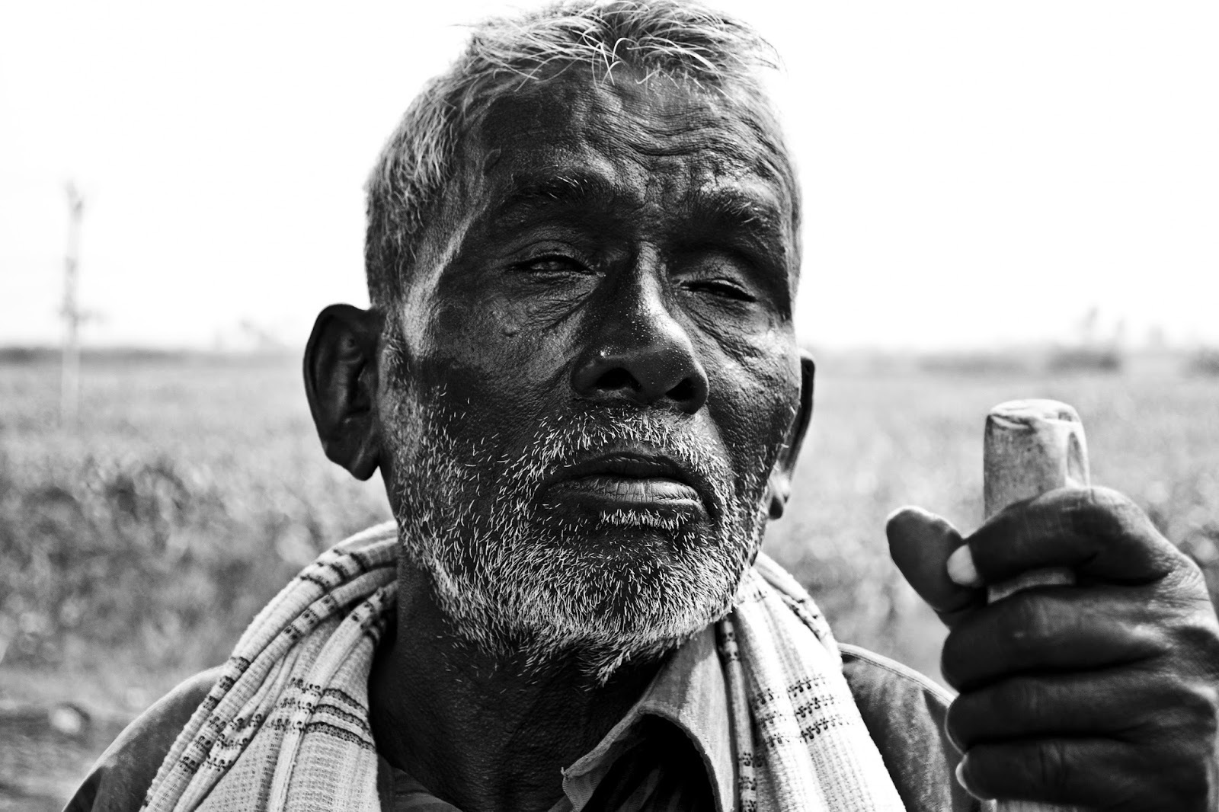
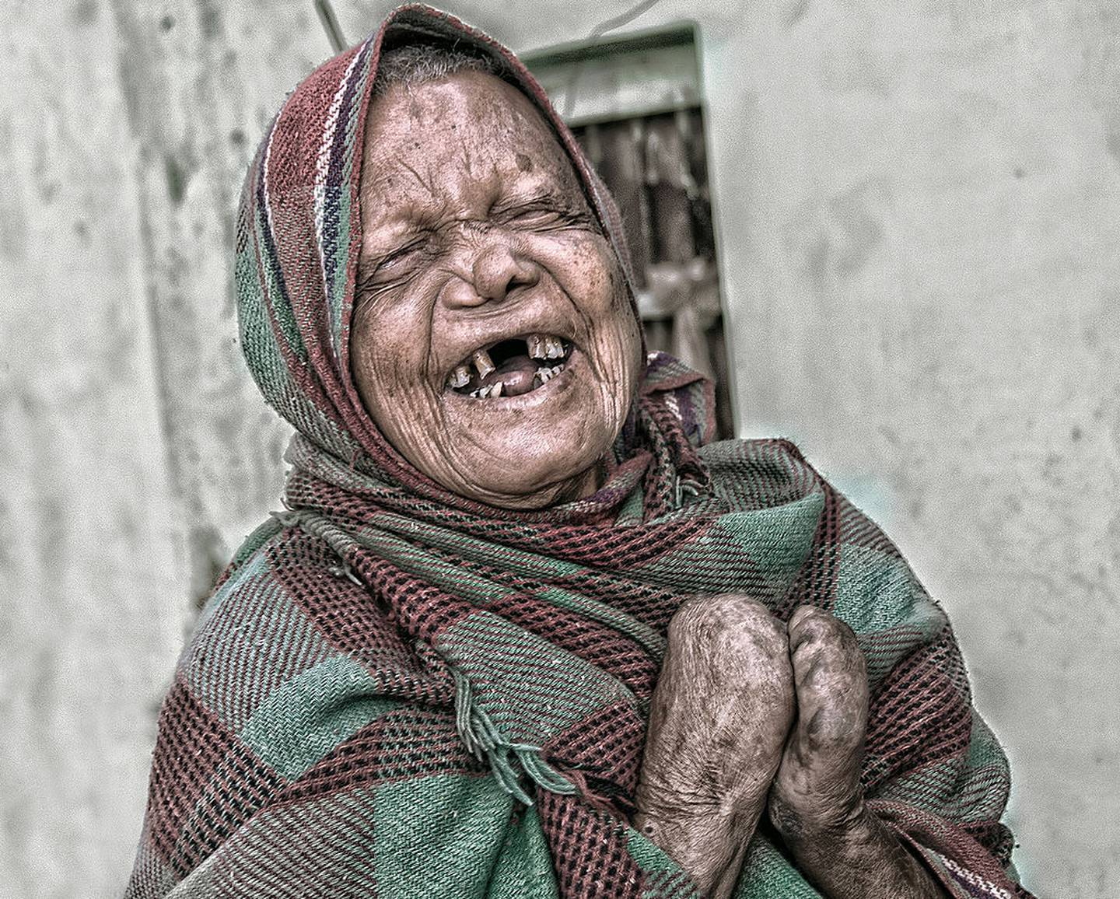
Let’s pretend
You can each have a turn to be an ‘apostle’.
The rest can choose 1 & pretend that you:
Are blind and can’t see
Are lame and can’t walk
Are dead
Have leprosy with sores on your skin
The apostles will heal you.
Then you can praise God!

Slide 20
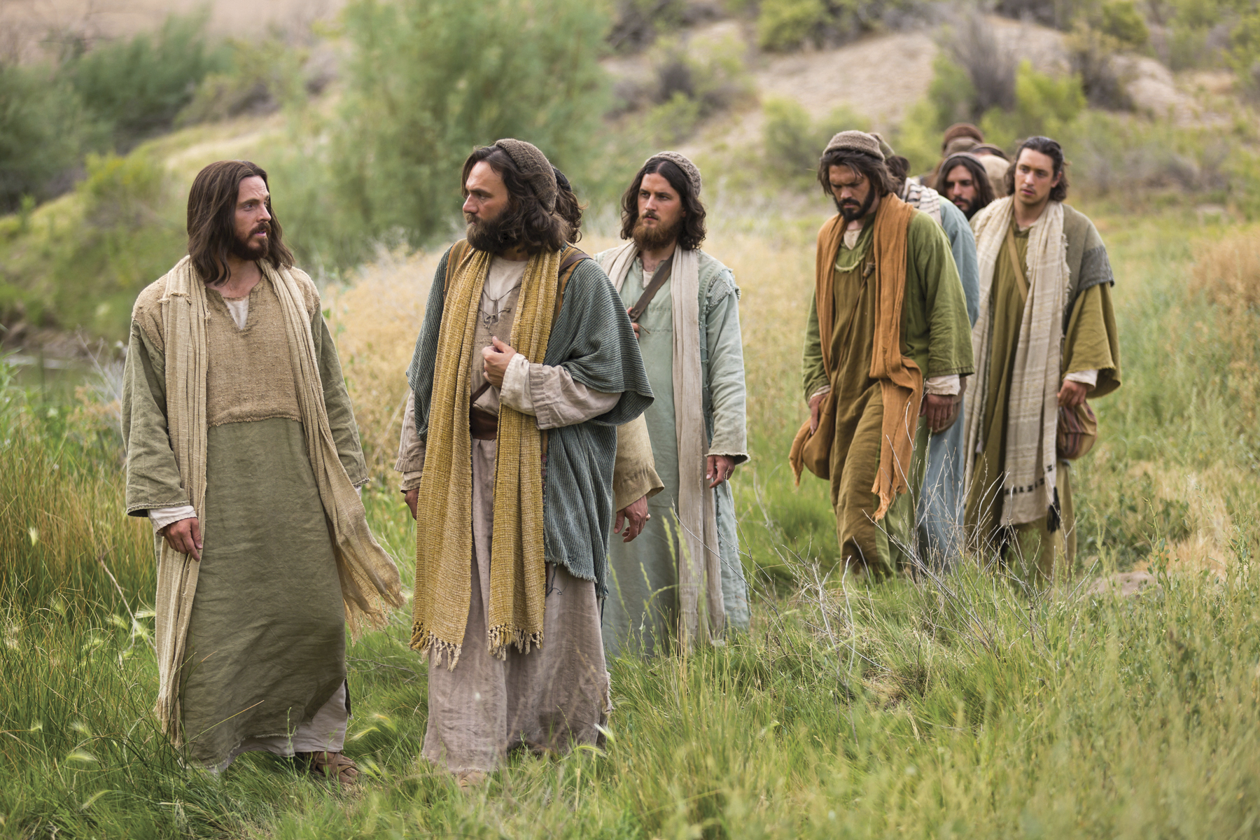
Come and rest
We told them that the kingdom of heaven is near. They repented.
We told the stories you have told us.
Mark 6
³⁰ The apostles gathered around Jesus and reported to him all they had done and taught. ³¹ Then, because so many people were coming and going that they did not even have a chance to eat, he said to them, “Come with me by yourselves to a quiet place and get some rest.”
The blind, saw.
The lame walked.
The sick were healed.

Slide 21

Praise God

Slide 22
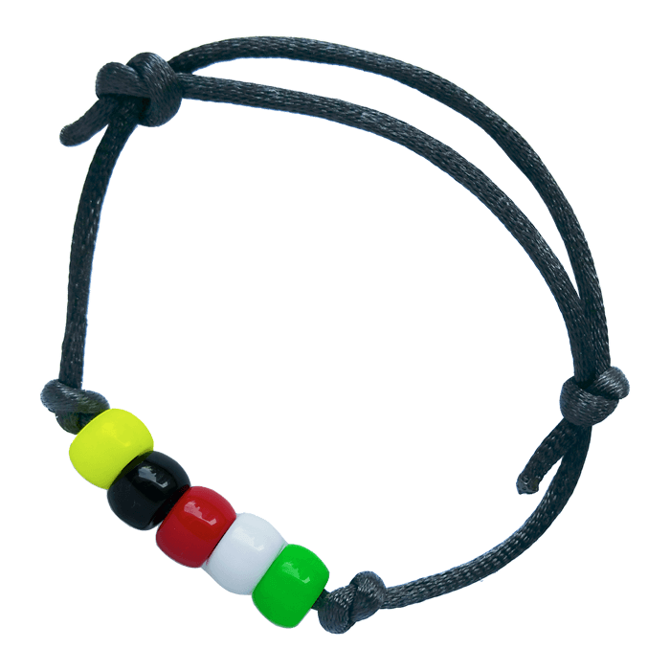
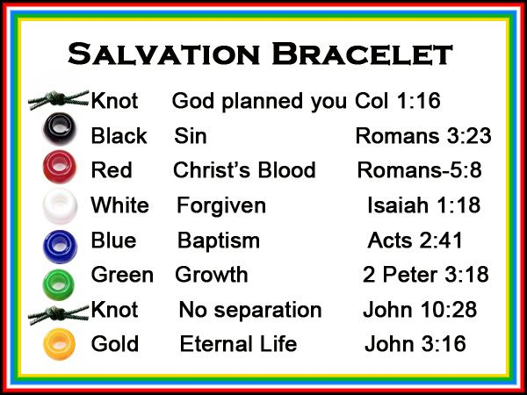

Craft Time
Wordless Gospel Book
How to explain and make the Wordless Gospel book can be found at this link Let the Little Child Come
Basically the colors stand for:
Black: Without God and Jesus, there is sin, darkness and death
Red: God and Jesus love us so much! Jesus came to this earth and took our punishment, He died for us on a cross.
White: If we confess our sins, Jesus forgives us and makes us pure and clean.
Green: God and the Holy Spirit will help us grow to be more and more faithful loving, respectful, and helpful. We become like our friend Jesus.
Gold: heaven and eternal life
https://www.etsy.com/listing/1765136257/wordless-gospel-little-book-printable

Slide 23
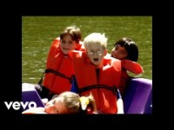
Everybody Ought To Know
Who Jesus is

Slide 24
God has important things for you to do too.
So, what do you like to do or do well:
God gives you hints as to His plan for your life.
He has given you things you do well and things you like to do.
You can use these talents to help others, show them God’s love, and introduce Jesus to others.
Read
Talk
Listen
Pray
Sing
Play an instrument
Fix things
Build or create things
Math
Science
Care for animals
Grow things
Organize things
Cook
Help others
Give directions
Play games
Technology
Other: ________

Slide 25
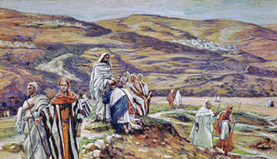

Later Jesus sent 72 followers to do the same thing.
I have chosen you 72 disciples to go.
Go to the villages.
Tell them that the kingdom of heaven is near.
Heal the sick.
Read about it in Luke 10:1-12

Slide 26
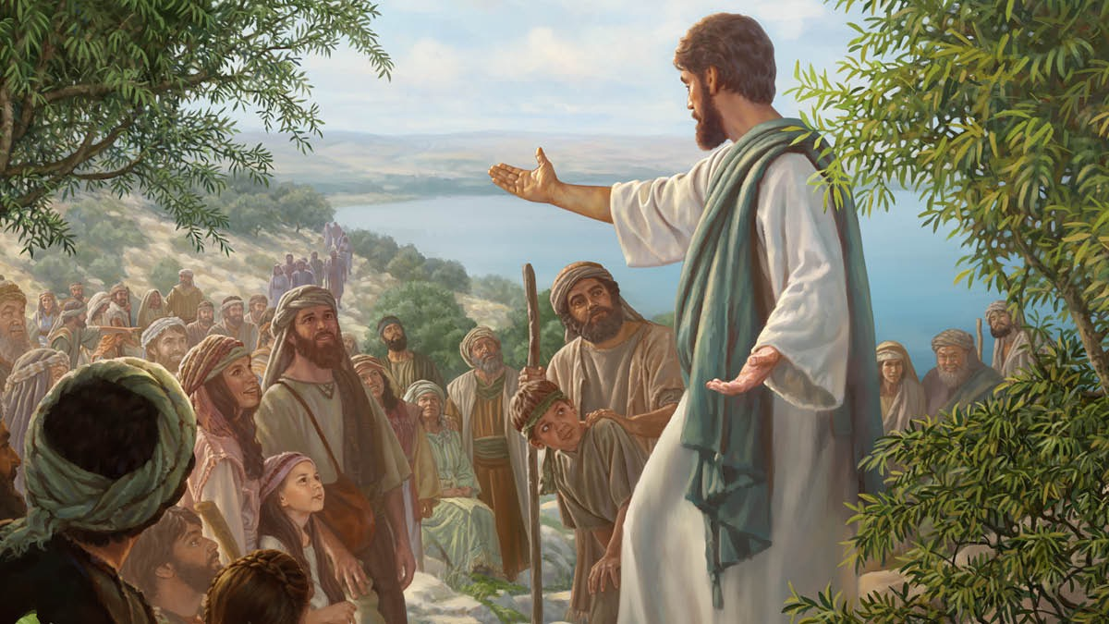
After Jesus rose again, He told his followers:
“Go everywhere in the world.
Tell the Good News to everyone.
Read about it in Mark 16:15

Slide 27
More people need to hear. Go, I am sending you.
Luke 10
After this the Lord appointed seventy-two others and sent them two by two ahead of him to every town and place where he was about to go.
² He told them, “The harvest is plentiful, but the workers are few. Ask the Lord of the harvest, therefore, to send out workers into his harvest field.
³ Go! I am sending you out like lambs among wolves.
⁴ Do not take a purse or bag or sandals; and do not greet anyone on the road.
I have chosen you 72 disciples to go.
Go to the villages.
Tell them that the kingdom of heaven is near.
Heal the sick.

Slide 28
More people need to hear. Go, I am sending you.
Thank you for allowing us to stay at your home.
Thank you for the wonderful meals!
Luke 10
⁵ “When you enter a house, first say, ‘Peace to this house.’ ⁶ If someone who promotes peace is there, your peace will rest on them; if not, it will return to you. ⁷ Stay there, eating and drinking whatever they give you, for the worker deserves his wages. Do not move around from house to house.
⁸ “When you enter a town and are welcomed, eat what is offered to you. ⁹ Heal the sick who are there and tell them, ‘The kingdom of God has come near to you.’ ¹⁰ But when you enter a town and are not welcomed, go into its streets and say, ¹¹ ‘Even the dust of your town we wipe from our feet as a warning to you. Yet be sure of this: The kingdom of God has come near.’ ¹² I tell you, it will be more bearable on that day for Sodom than for that town.

Slide 29
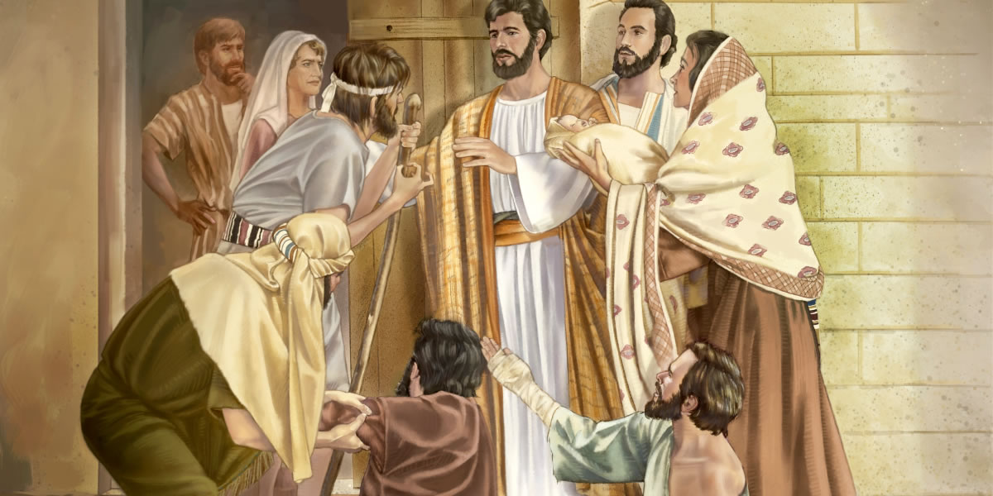
Many heard the message. Many were healed
In Jesus’ name,
walk
Two by Two, you can each have a turn to be one of the 72 disciples.
The rest can choose 1 & pretend that you:
Are blind and can’t see
Are lame and can’t walk
Are dead
Have leprosy with sores on your skin
When you are ‘healed’,
you can praise God!

Slide 30
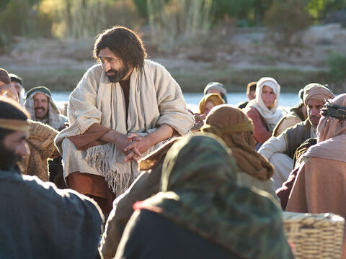
Praise God!
Do not rejoice that the spirits submit to you, but rejoice that your names are written in heaven!
Lord Jesus,
Even the demons submit to us in your name!
Luke 10
¹⁷ The seventy-two returned with joy and said, “Lord, even the demons submit to us in your name.”
¹⁸ He replied, “I saw Satan fall like lightning from heaven. ¹⁹ I have given you authority to trample on snakes and scorpions and to overcome all the power of the enemy; nothing will harm you. ²⁰ However, do not rejoice that the spirits submit to you, but rejoice that your names are written in heaven.”
²¹ At that time Jesus, full of joy through the Holy Spirit, said, “I praise you, Father, Lord of heaven and earth, because you have hidden these things from the wise and learned, and revealed them to little children. Yes, Father, for this is what you were pleased to do.
I praise You, Father, Lord of heaven and earth!

Slide 31
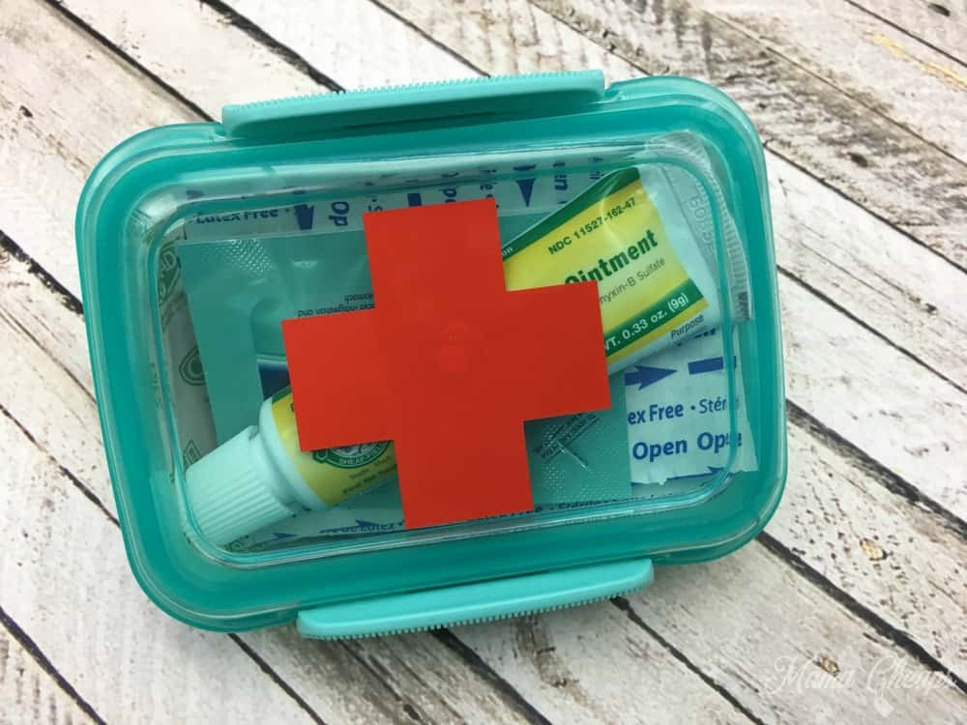
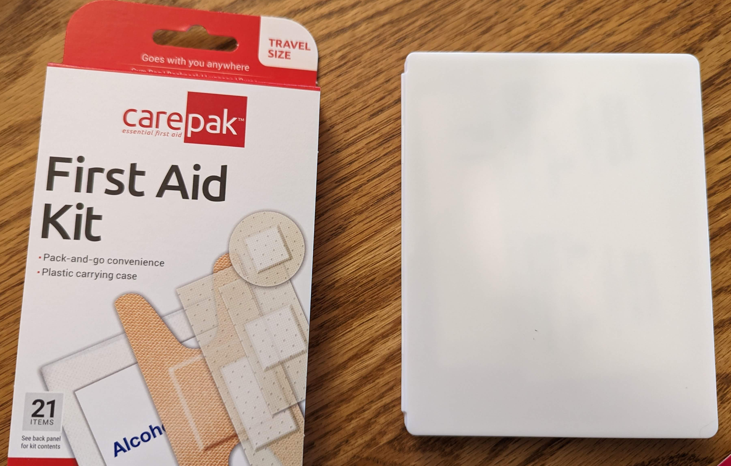

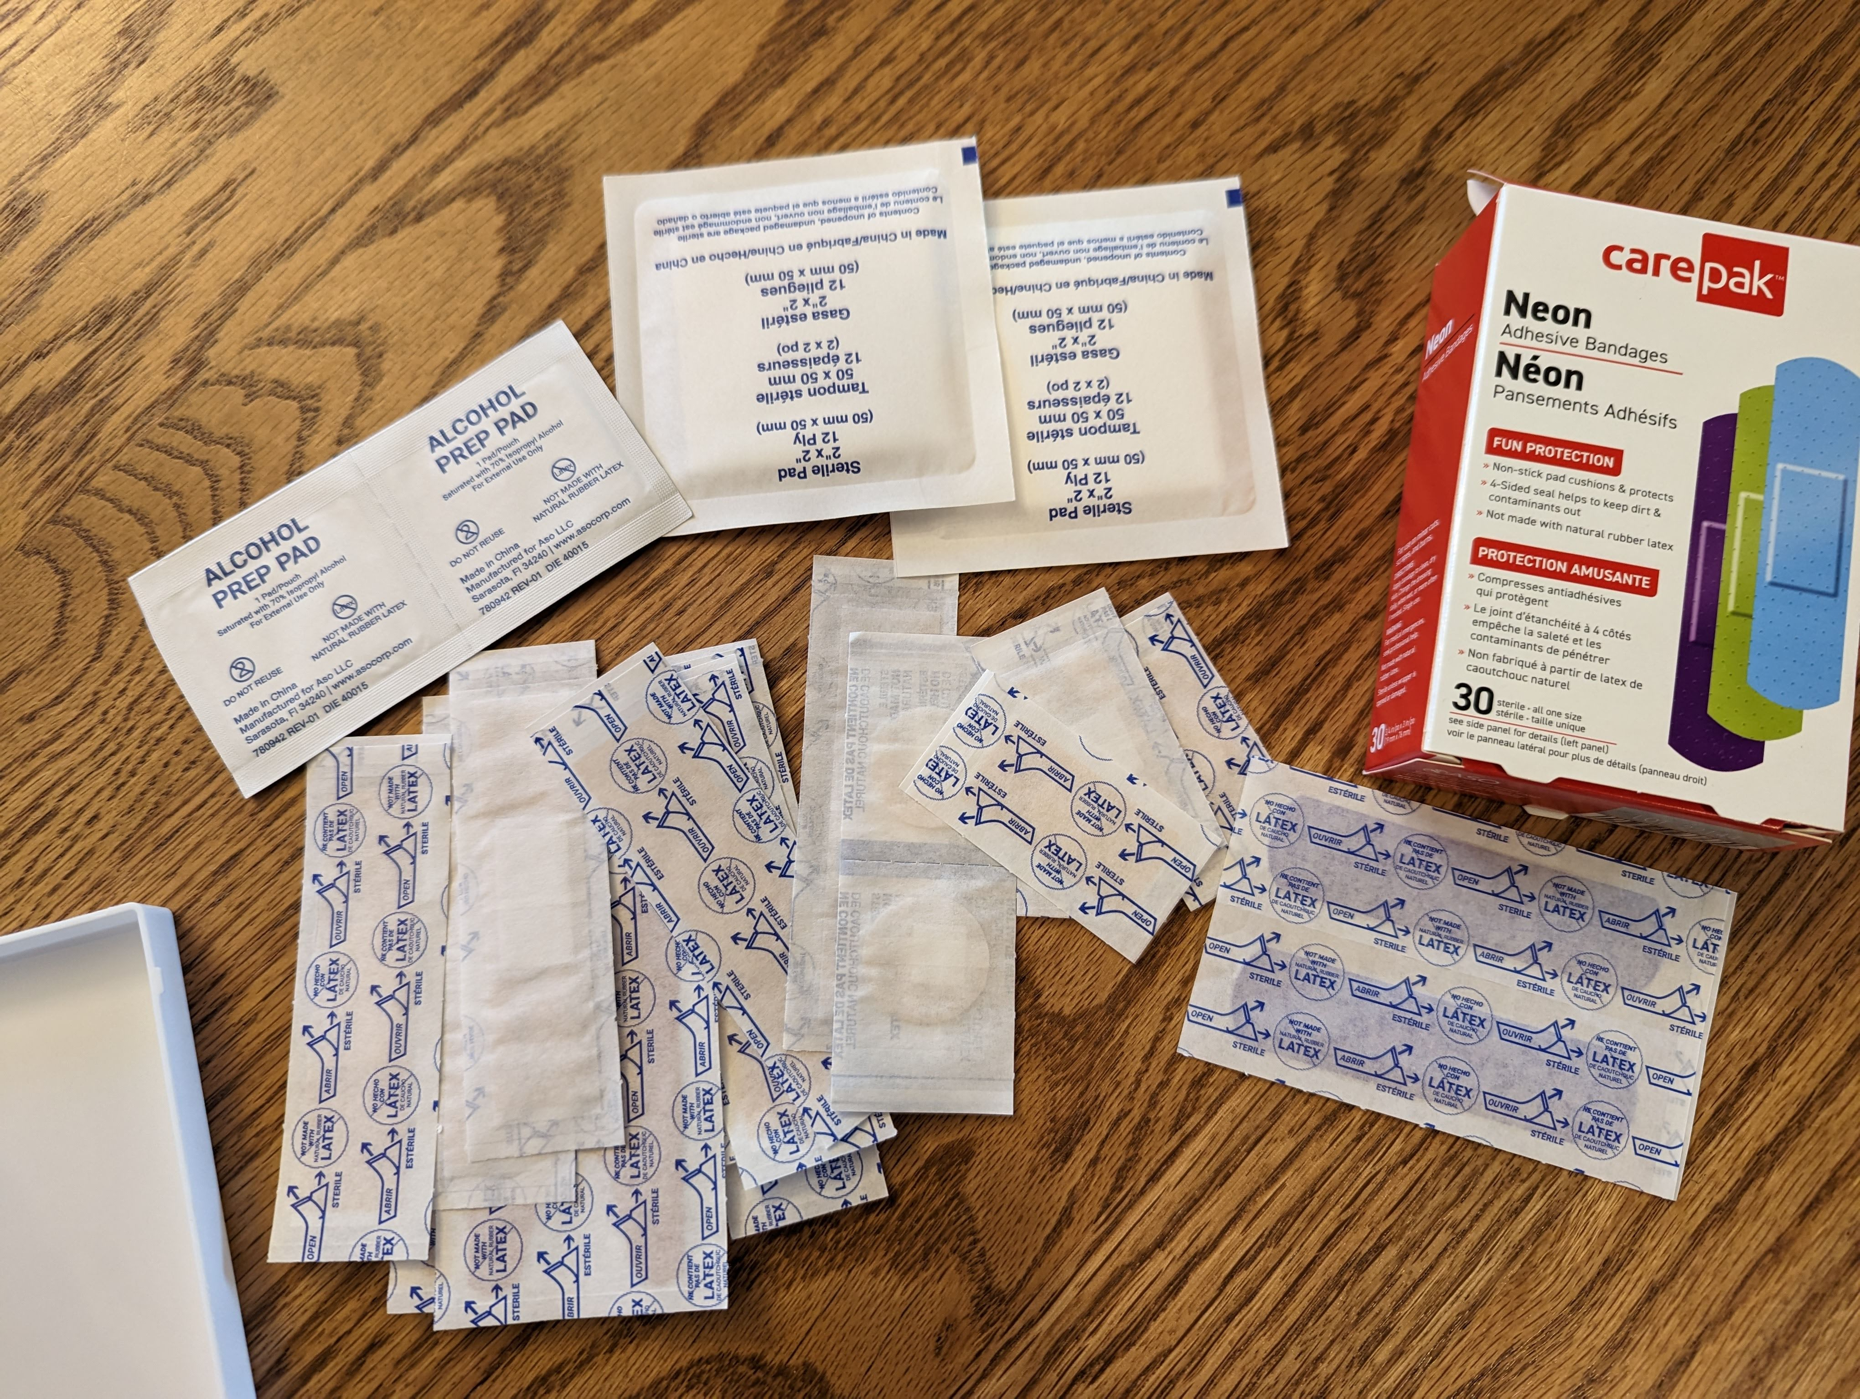
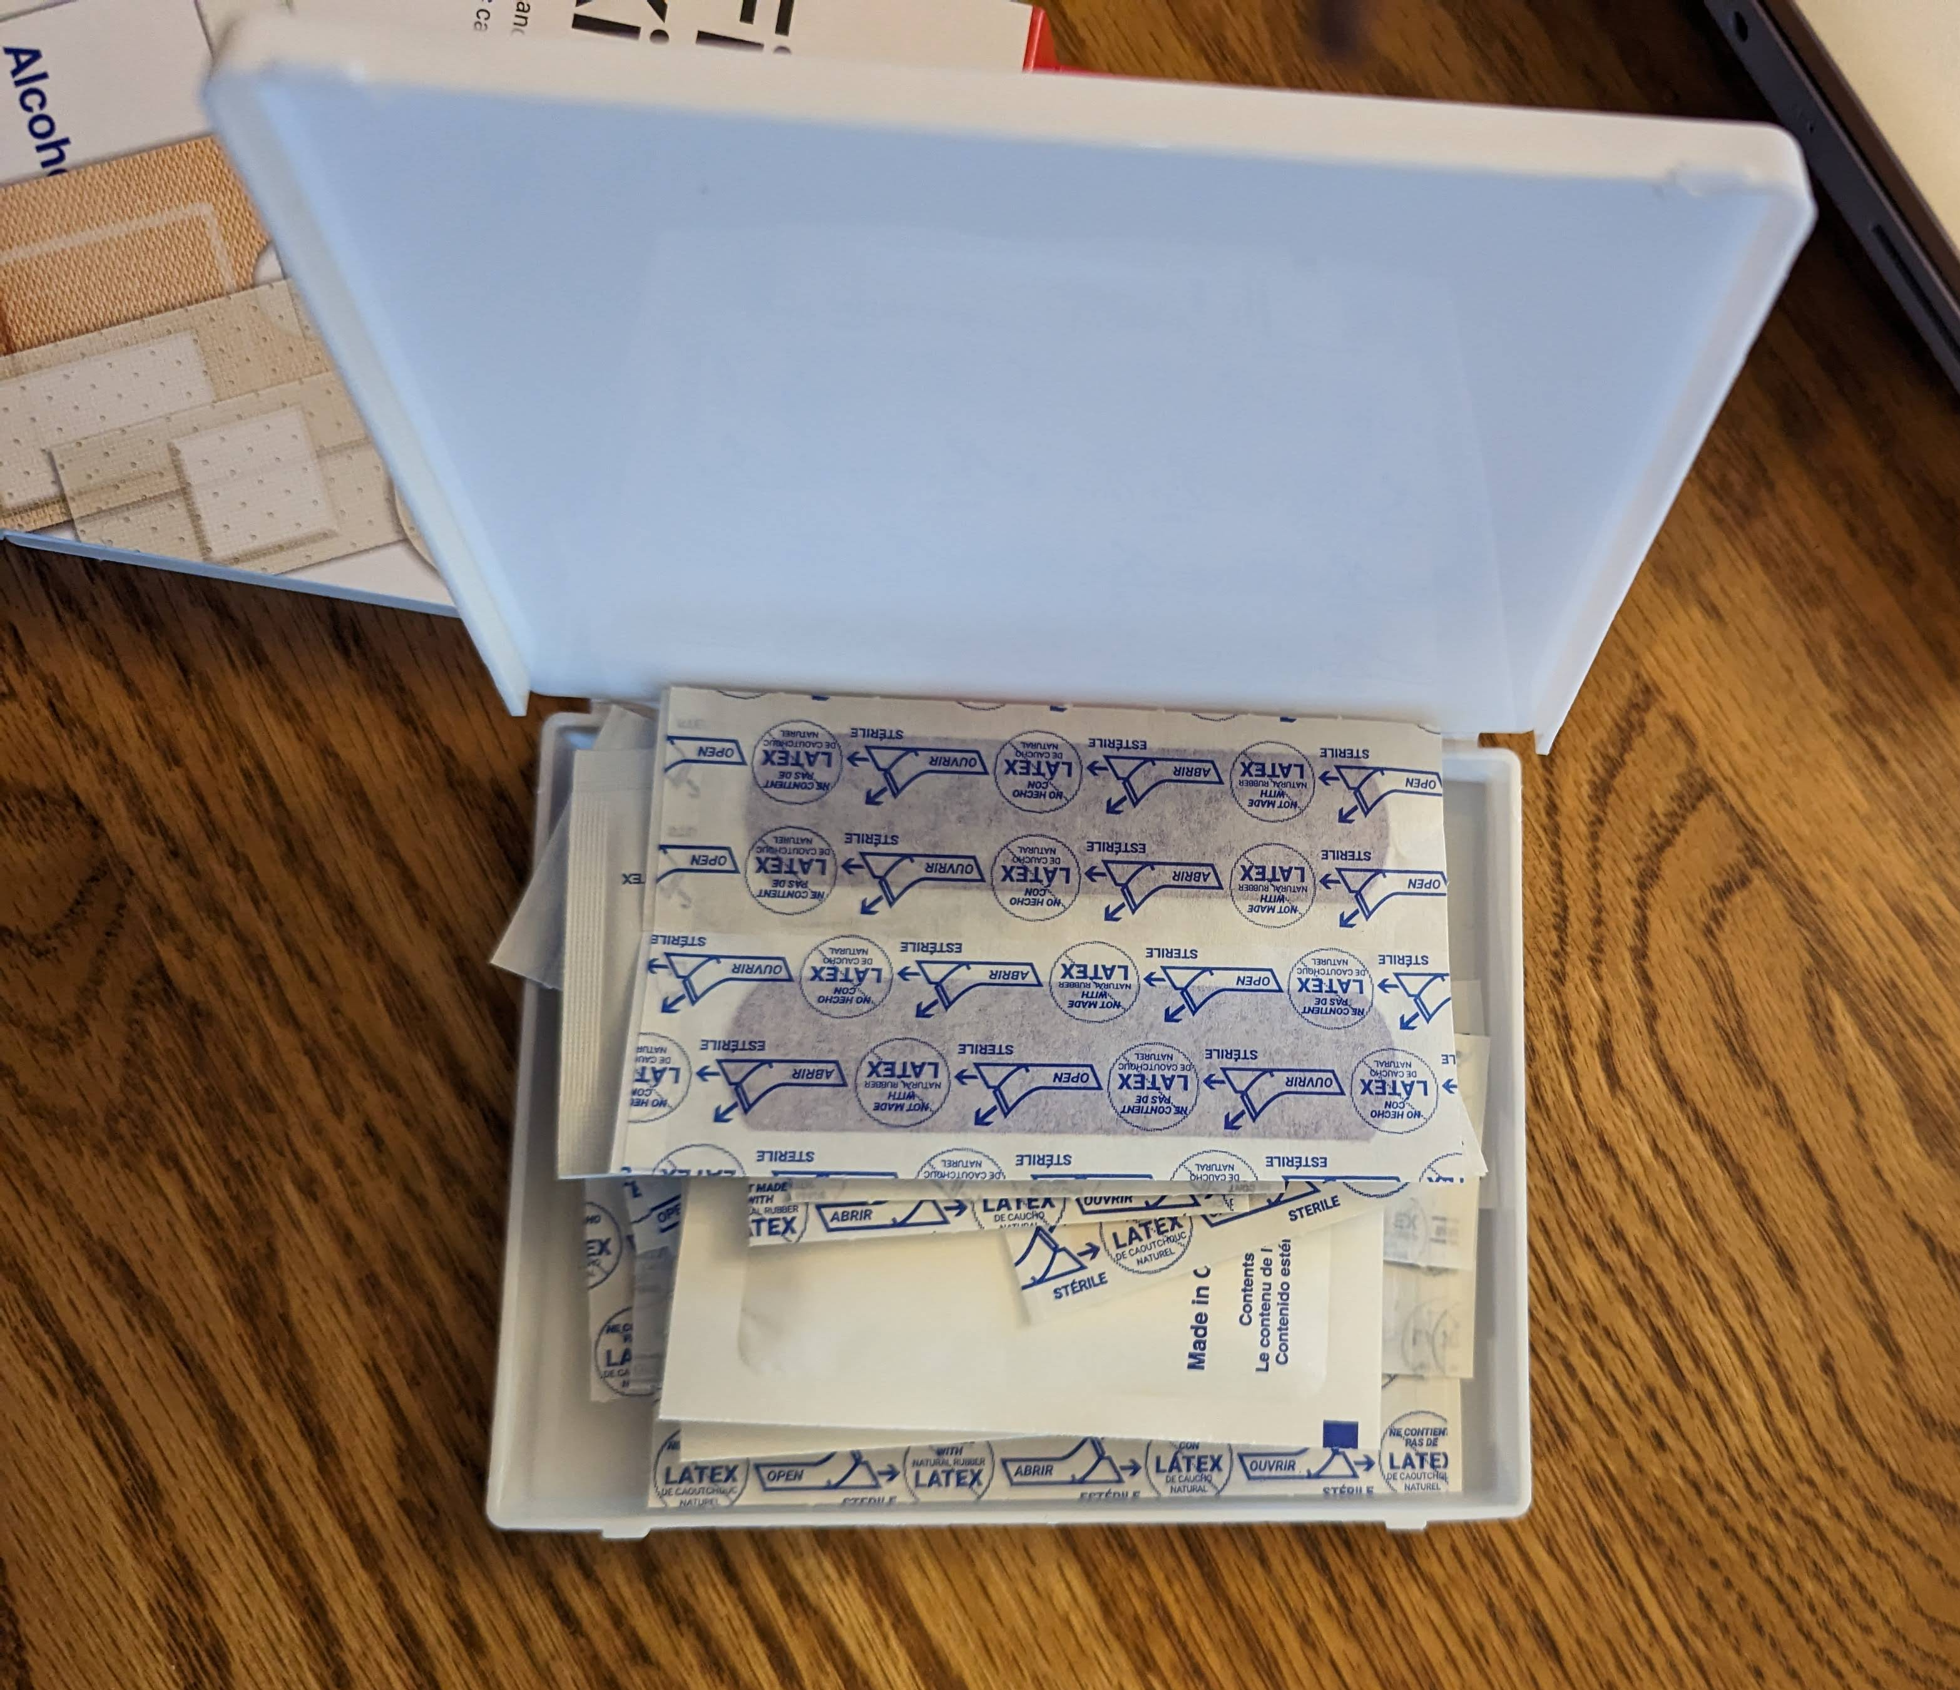
Craft Time
Make a first aid kit
Put the following items in this special box:
Band-aids
Ace bandage
Kleenex
Ointment or wipes
Add stickers on your box
You can use these items to help others get well and feel better.

Slide 32
Praise God

Slide 33

The End
Find more PowerPoint Presentations like this at:
https://activity-array.com/

