Slide 1
Nicodemus visits Jesus
John 3
New Life in Jesus

Slide 2
Spring is the time of new life. What new life have you seen? Have you seen new buds & blossoms? Have you seen baby animals? Tell me about it. Later we will go outside and look for some more signs of new life.

Slide 3
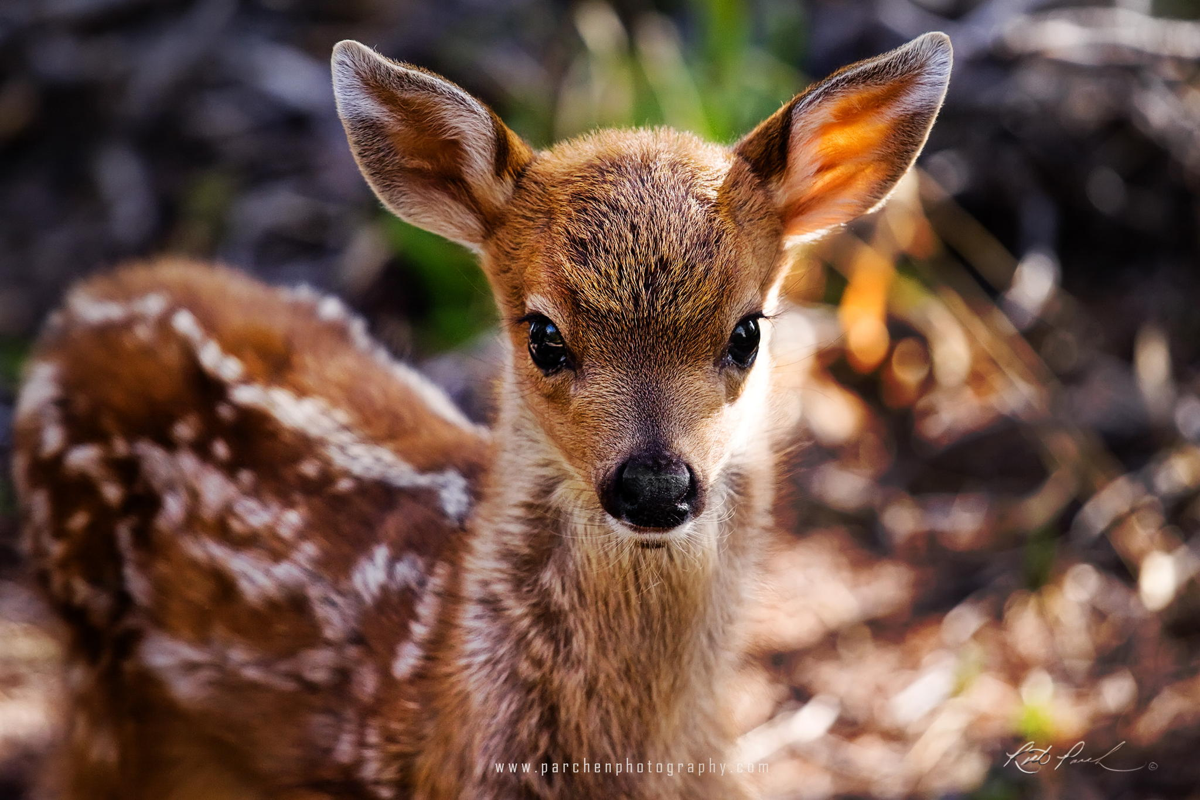
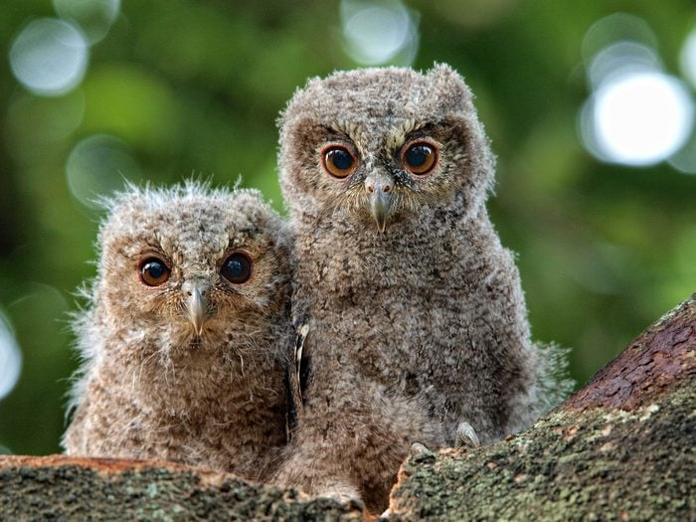
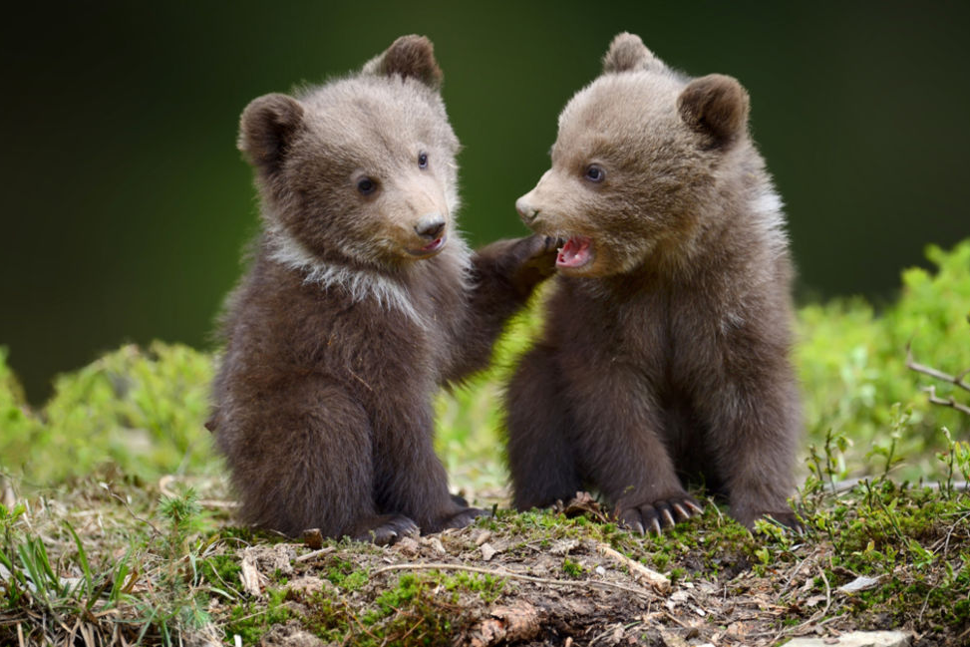
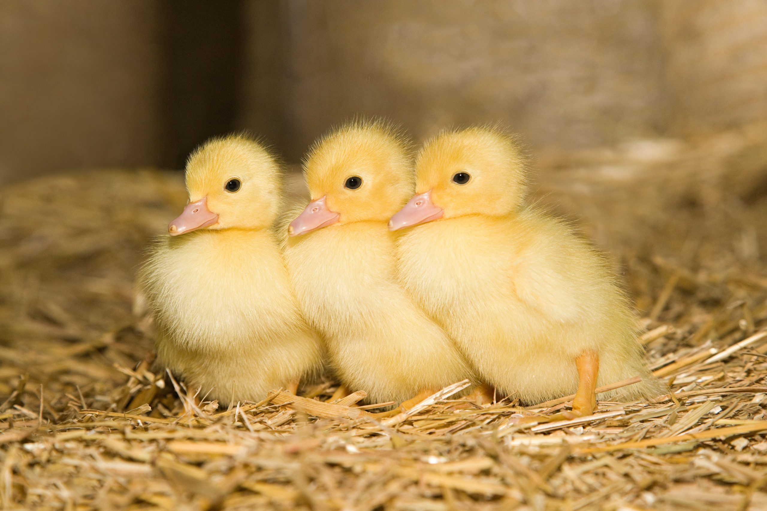
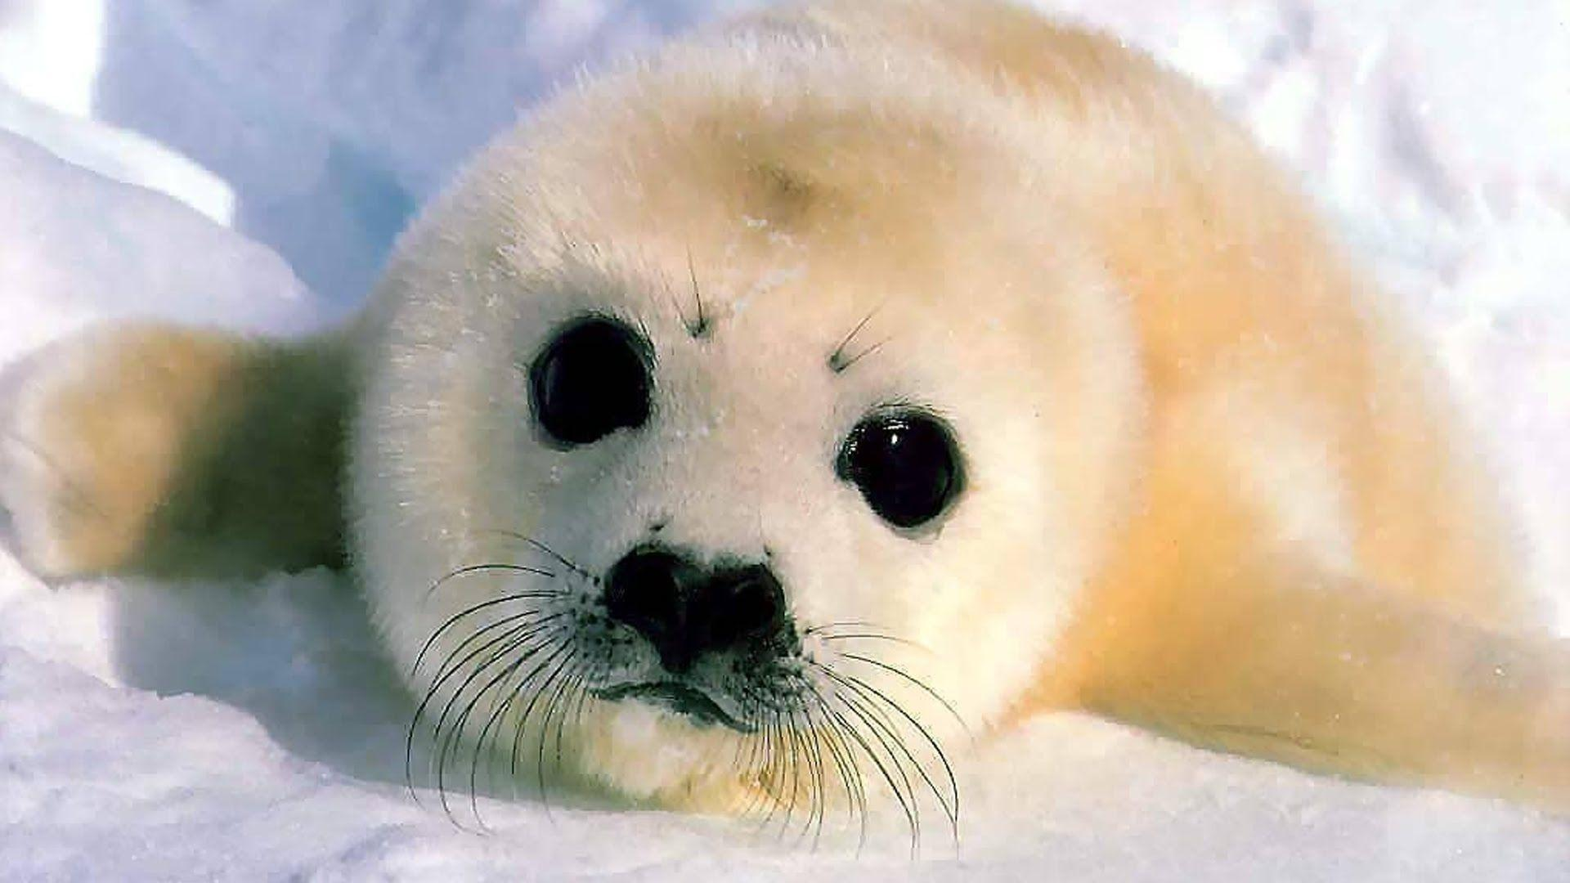
Look for new life
Chick
Owlet
(Go outside?)
Spring is a time of new life.
That’s when animals have their babies.
Do you know what this baby animal is called?
Pup
Cub
Fawn

Slide 4
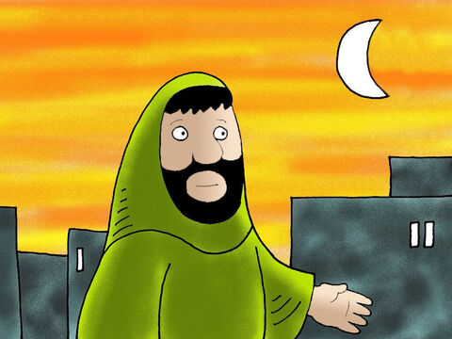
John 3
Now there was a Pharisee, a man named Nicodemus who was a member of the Jewish ruling council. ² He came to Jesus at night

Slide 5
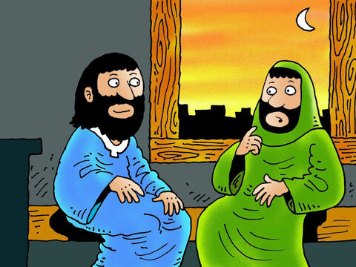
If God wasn’t with you, you couldn’t do all the miracles you are doing.
Rabbi, we know that you are a teacher that has come from God.
God is with you.
There was a Pharisee named Nicodemus. He was one of the Jewish rulers.
² He came to Jesus at night and said, “Rabbi, we know that you are a teacher who has come from God. We know that God is with you. If he weren’t, you couldn’t do the signs you are doing.”

Slide 6
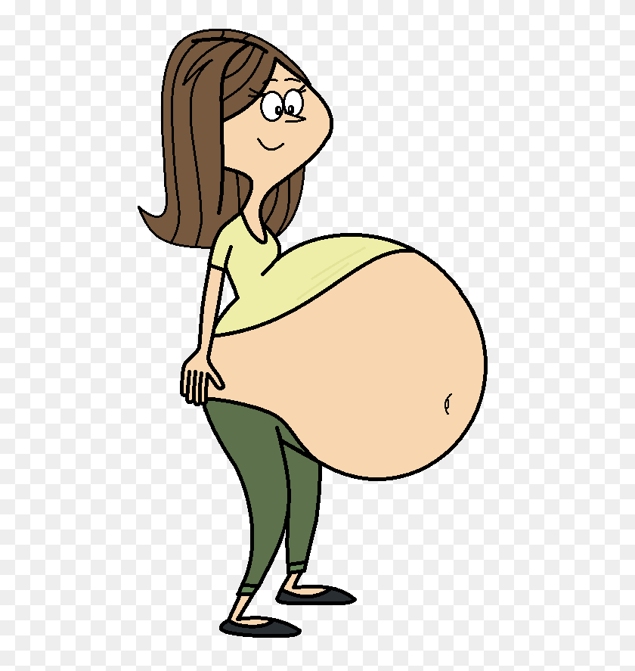
What I’m about to tell you is true.
No one can see God’s kingdom unless they are born again.
How can someone be born when they are old? They can’t go back inside their mother!
³ Jesus replied, “What I’m about to tell you is true. No one can see God’s kingdom unless they are born again.”
⁴ “How can someone be born when they are old?” Nicodemus asked. “They can’t go back inside their mother! They can’t be born a second time!”

Slide 7
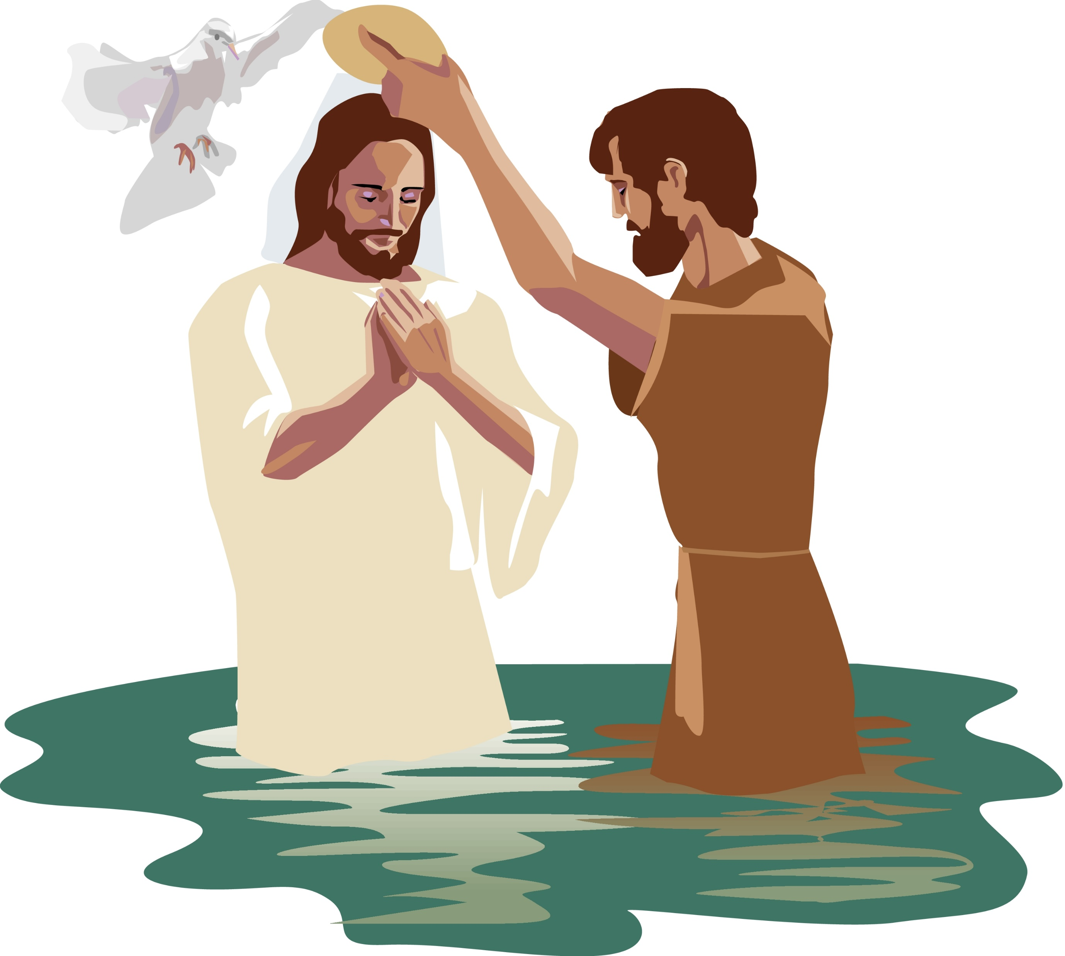
What I’m about to tell you is true.
No one can enter God’s kingdom unless they are born with water and spirit
Humans can reproduce only human life, but the Holy Spirit gives birth to spiritual life.
⁵ Jesus answered, “What I’m about to tell you is true. No one can enter God’s kingdom unless they are born with water and the Holy Spirit.
⁶ People give birth to people. But the Spirit gives birth to spirit.
⁷ You should not be surprised when I say, ‘You must all be born again.’
So don’t be surprised when I say, “You must be born again.”

Slide 8
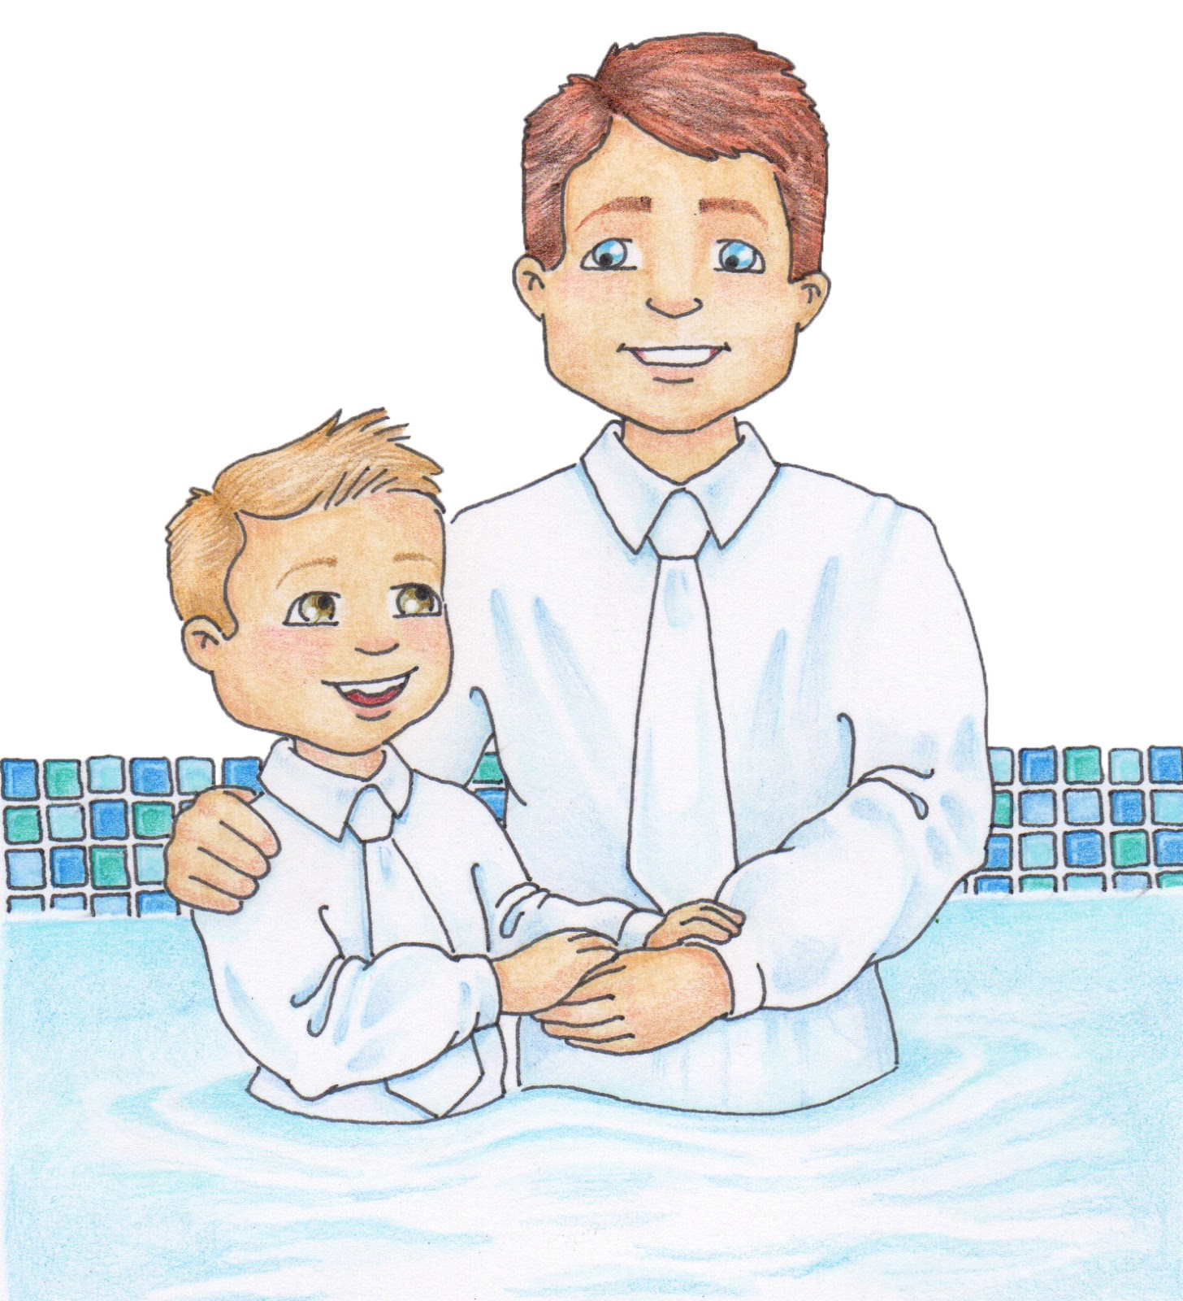
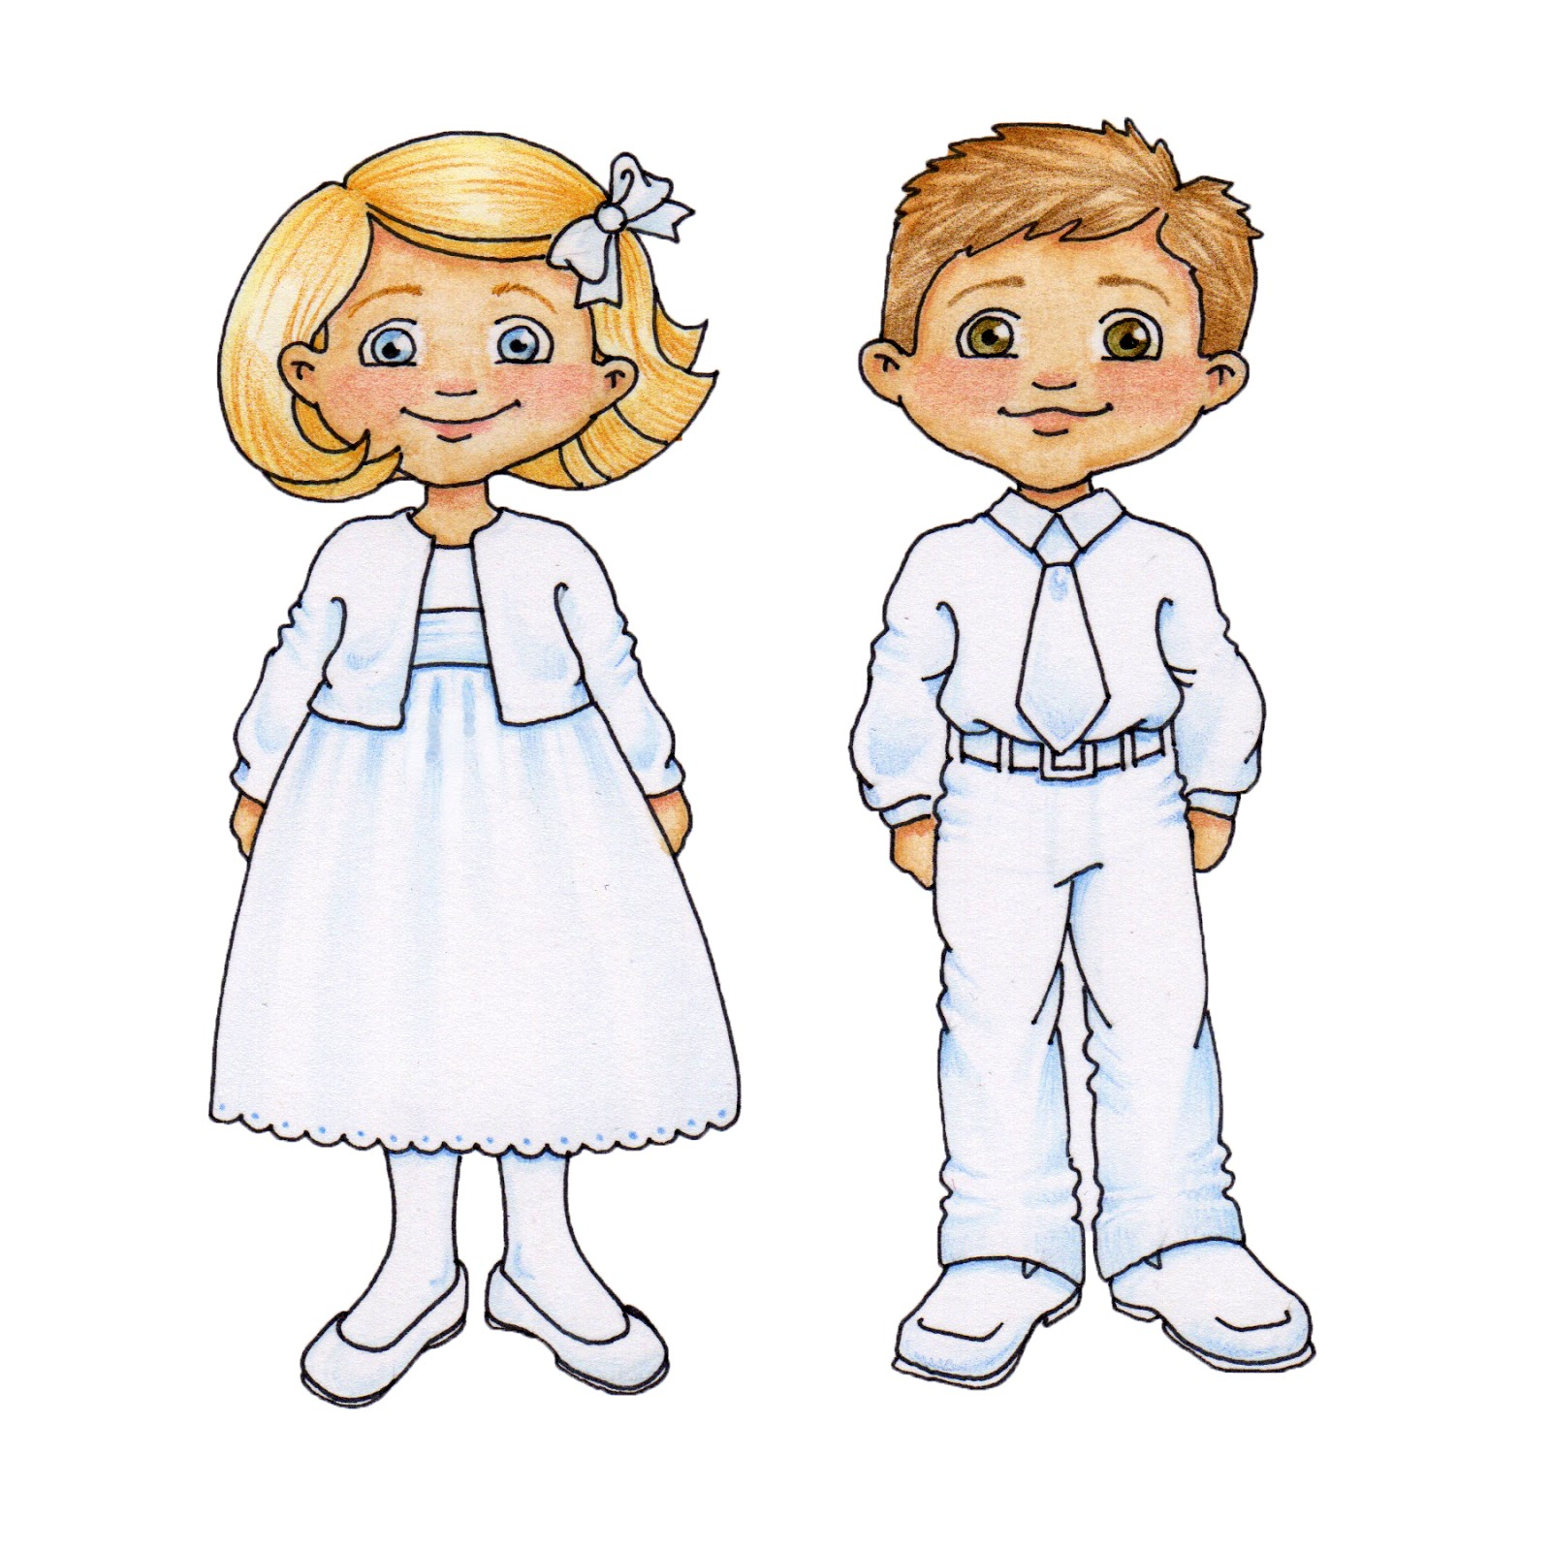
New Life
I want to grow to be more and more like Jesus – loving, helpful, patient, obedient ….
It is the Holy Spirit who draws us to accept Jesus as our Savior.
We get baptized to show that we have accepted Jesus as our Savior. It shows that our sins have been washed away and we are starting a new life doing what God wants us to do.
Jesus puts the Holy Spirit within us.
The Holy Spirit changes our lives so that we become more like Jesus – loving, patient, kind, and full of joy.
I accept Jesus as my Savior. I know He will wash my sins away.
That is why I’m being baptized.

Slide 9



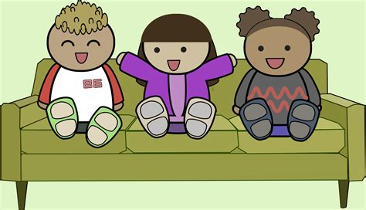
⁸ The wind blows where it wants to. You hear the sound it makes. But you can’t tell where it comes from or where it is going. It is the same with everyone who is born with the Spirit.”
The wind blows where it wants to. You hear the sound it makes (when you’re inside), but you don’t know where it came from or where it is going.
action: Turn on a hidden fan
It is the same with everyone who is born with the Spirit.
(You can’t explain it. You don’t understand it unless you experience it.)

Slide 10
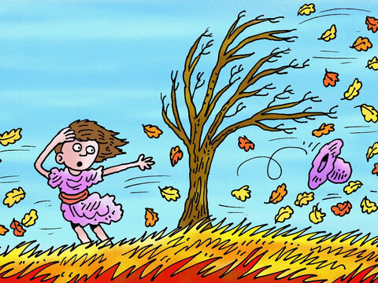
You can know the direction of the wind if you are out in it. You have to experience it.
It is the same with being born spiritually, you have to experience it.
When you are reborn, you experience the Holy Spirit working in your life and want to do what God wants you to do.
Turn on fan – blow on children. Let them play in the wind with ribbons.

Slide 11
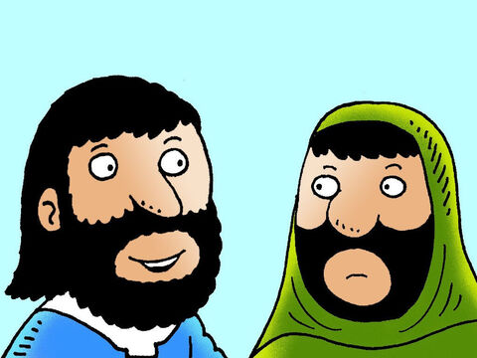
Understand and Believe
You are Israel’s teacher.
Don’t you understand these things?
How can this be?
We speak about things we know about.
I have spoken about earthly things, yet you don’t believe.
How will you believe if I speak of heavenly things?
I have come from heaven. I know heavenly things.
⁹ “How can this be?” Nicodemus asked.
¹⁰ “You are Israel’s teacher,” said Jesus. “Don’t you understand these things? ¹¹ What I’m about to tell you is true. We speak about what we know. We are witnesses about what we have seen. But still you people do not accept what we say. ¹² I have spoken to you about earthly things, and you do not believe. So how will you believe if I speak about heavenly things? ¹³ No one has ever gone into heaven except the one who came from heaven. He is the Son of Man.

Slide 12
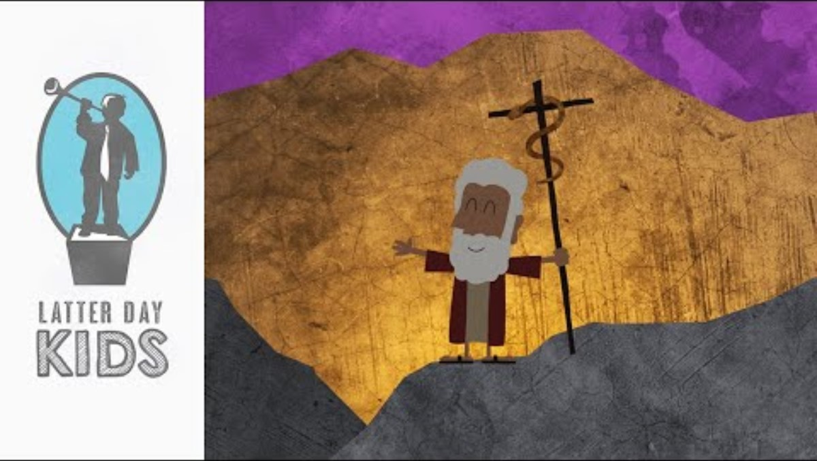
Remember this story?
¹⁴ Moses lifted up the snake in the desert. In the same way, the Son of Man must also be lifted up. ¹⁵ Then everyone who believes may have eternal life in him.”
Moses lifted up a bronze snake on a pole in the desert.
When the people were bitten, they could look at the bronze snake and were healed. Jesus was lifted up on a cross.
Satan, the devil is sometimes called a serpent. He wants us to sin.
If we sin, we can turn and remember that Jesus died so that we can be forgiven and have eternal life.

Slide 13

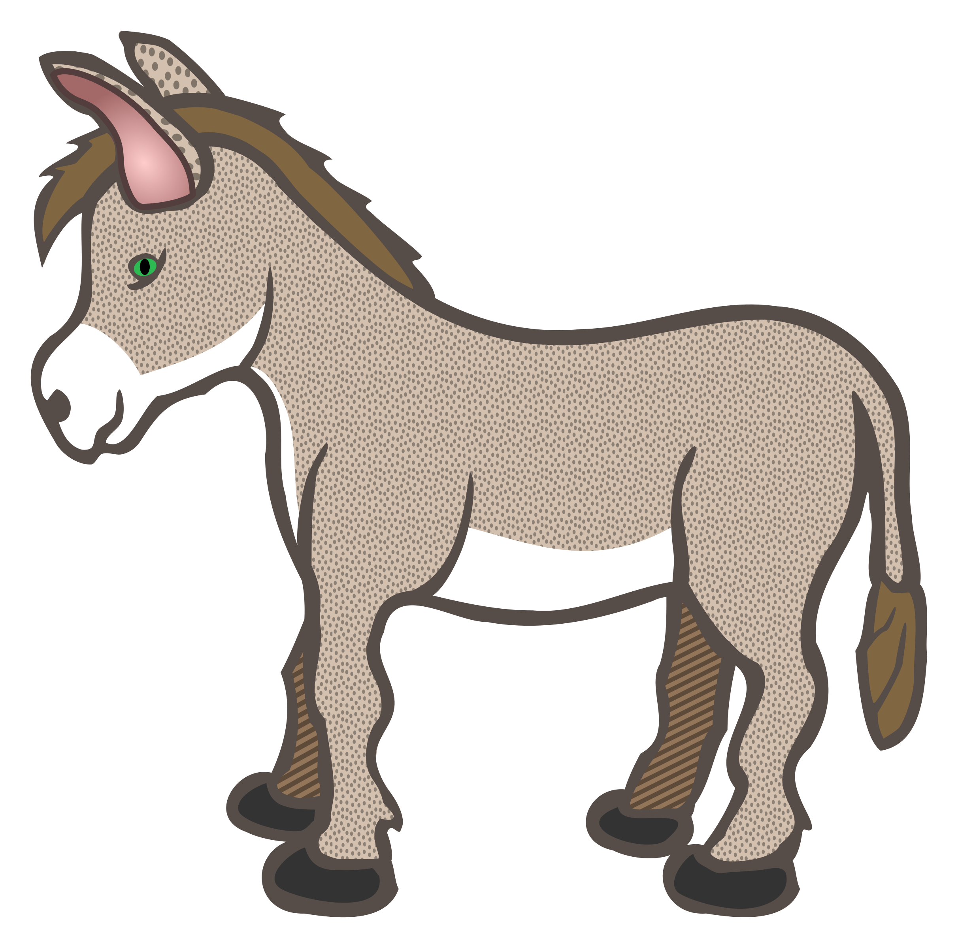


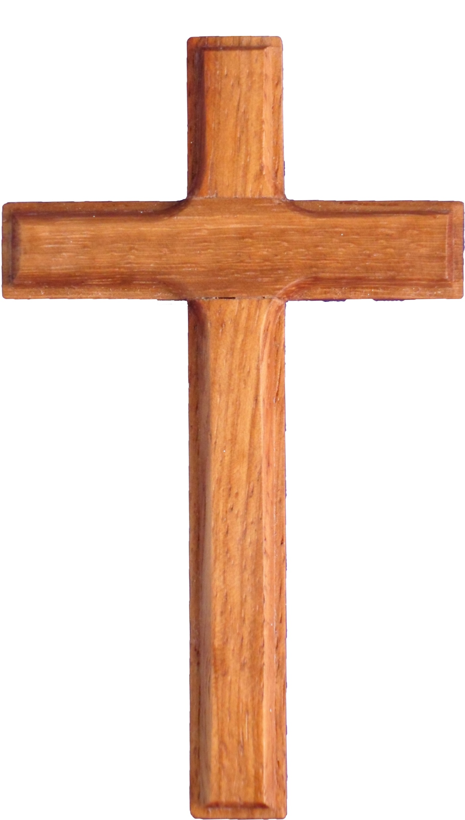
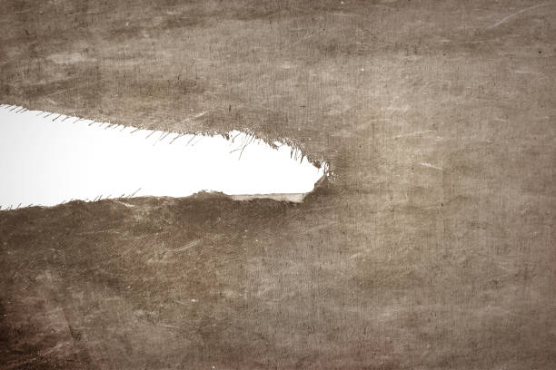

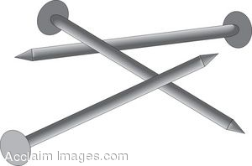




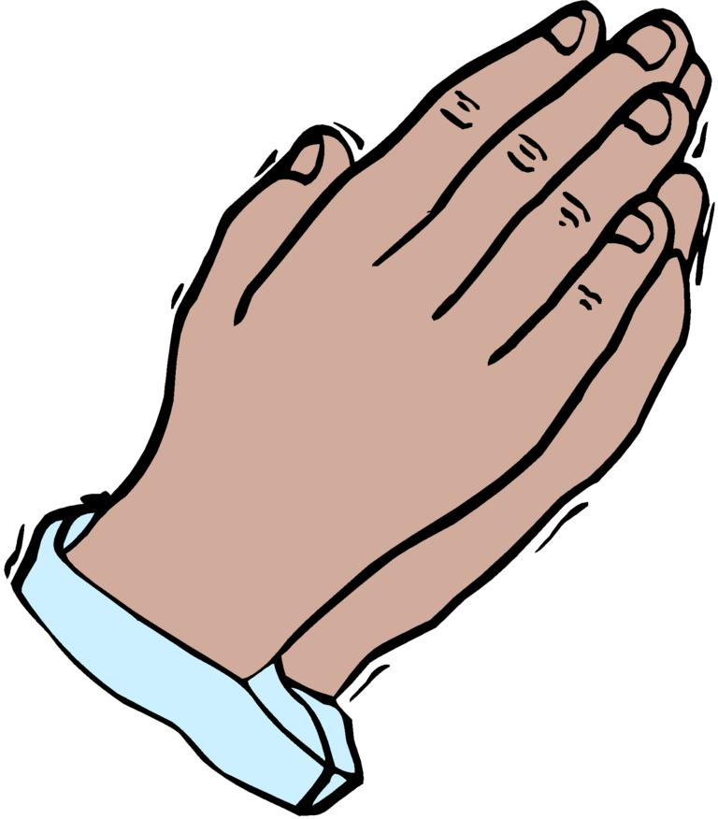
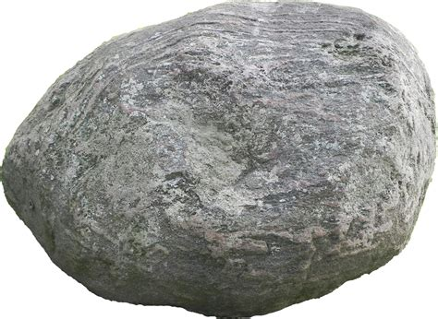

Help me tell the story of Jesus’ death as I show you the Savior Souvenirs
¹⁶ God so loved the world that he gave his one and only Son. Anyone who believes in him will not perish but will have eternal life.
Jesus paid the price for sin. He was lifted up on the cross.
Sin brings death like the serpents brought death. Jesus died for us.
Jesus rose again! He lives forever! He gives us eternal life!
He promised to come back and take us to live with Him forever!
Do you want this gift? Just turn to Jesus and ask. He will give it to you.
Objects from Savior Souvenirs – see note page

Slide 14
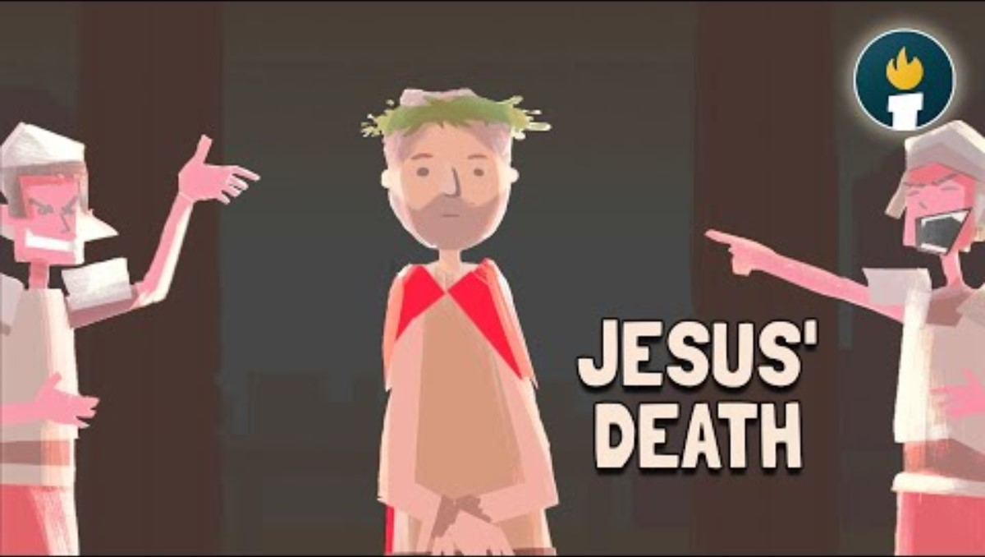
Remember this story?
Option 2
¹⁶ God so loved the world that he gave his one and only Son. Anyone who believes in him will not perish but will have eternal life.
Jesus paid the price for sin. He was lifted up on the cross.
Sin brings death like the serpents brought death. Jesus died for us.
Jesus rose again! He lives forever! He gives us eternal life!
He promised to come back and take us to live with Him forever!
Do you want this gift? Just turn to Jesus and ask. He will give it to you.

Slide 15
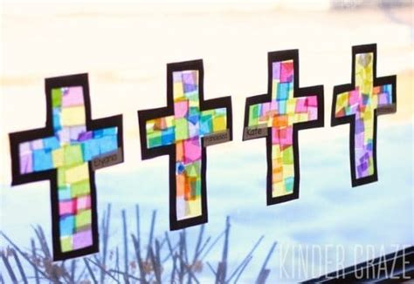

Craft Time
Stick the black cross on a piece of clear contact paper.
Fill it in by sticking pieces of tissue paper on the contact paper also.
Put another piece of clear contact paper over it all.
Cut out around the black border of the cross.

Slide 16
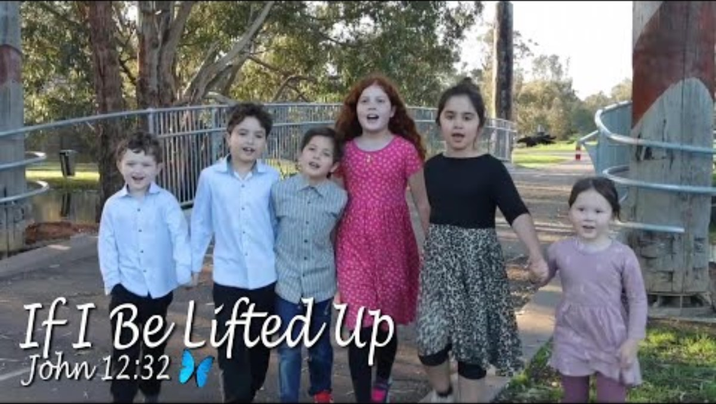

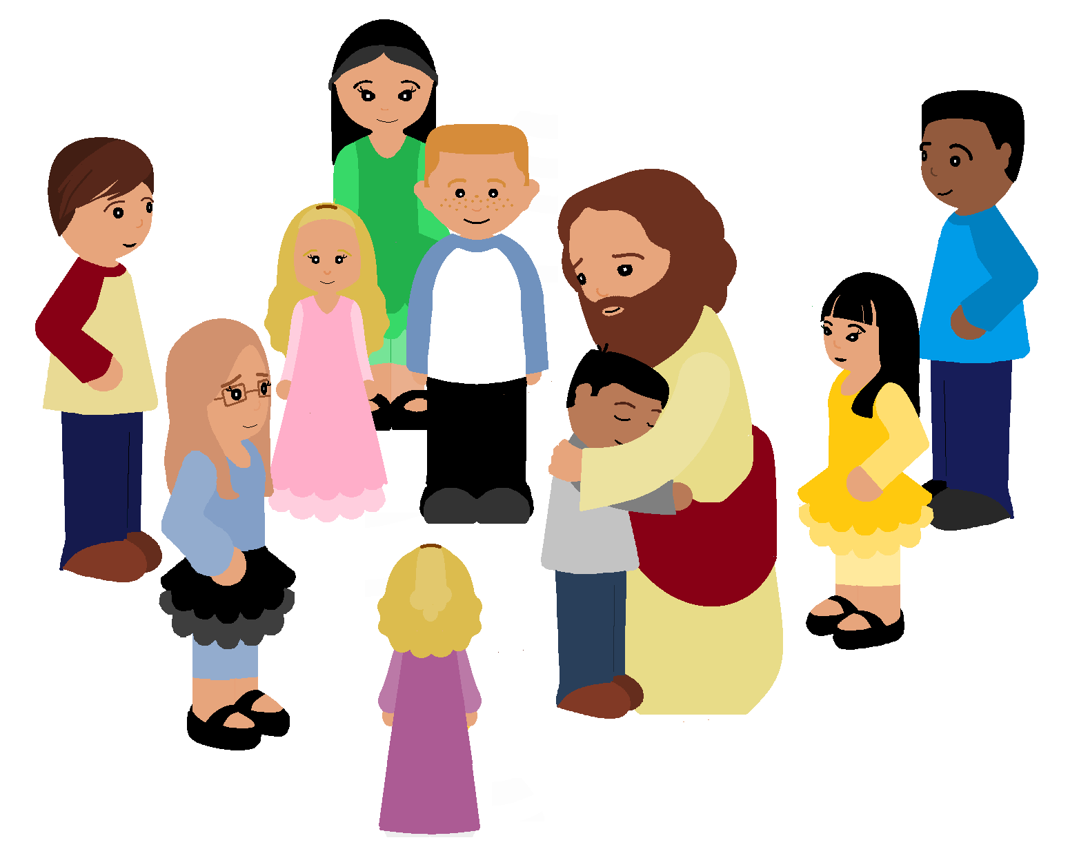
If I Be Lifted Up

Slide 17

For God so loved the world that He gave His only begotten Son that whoever believes in Him will not perish but have everlasting life.
John 3:16
John 3:16-17

Slide 18
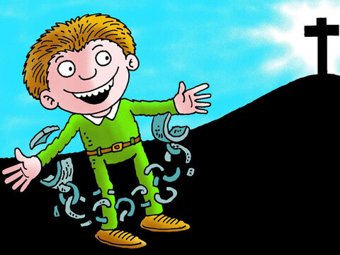
We are FREE. We are SAVED.
Because Jesus came to save us and set us free!
God did not send His Son into the world to judge the world.
He sent His Son to SAVE the world!
All who believe in Him are not condemned.
Those who don’t believe stand condemned.
¹⁷ God did not send his Son into the world to judge the world. He sent his Son to save the world through him.
¹⁸ Anyone who believes in him is not condemned. But anyone who does not believe stand condemned already. They have not believed in the name of God’s one and only Son.

Slide 19
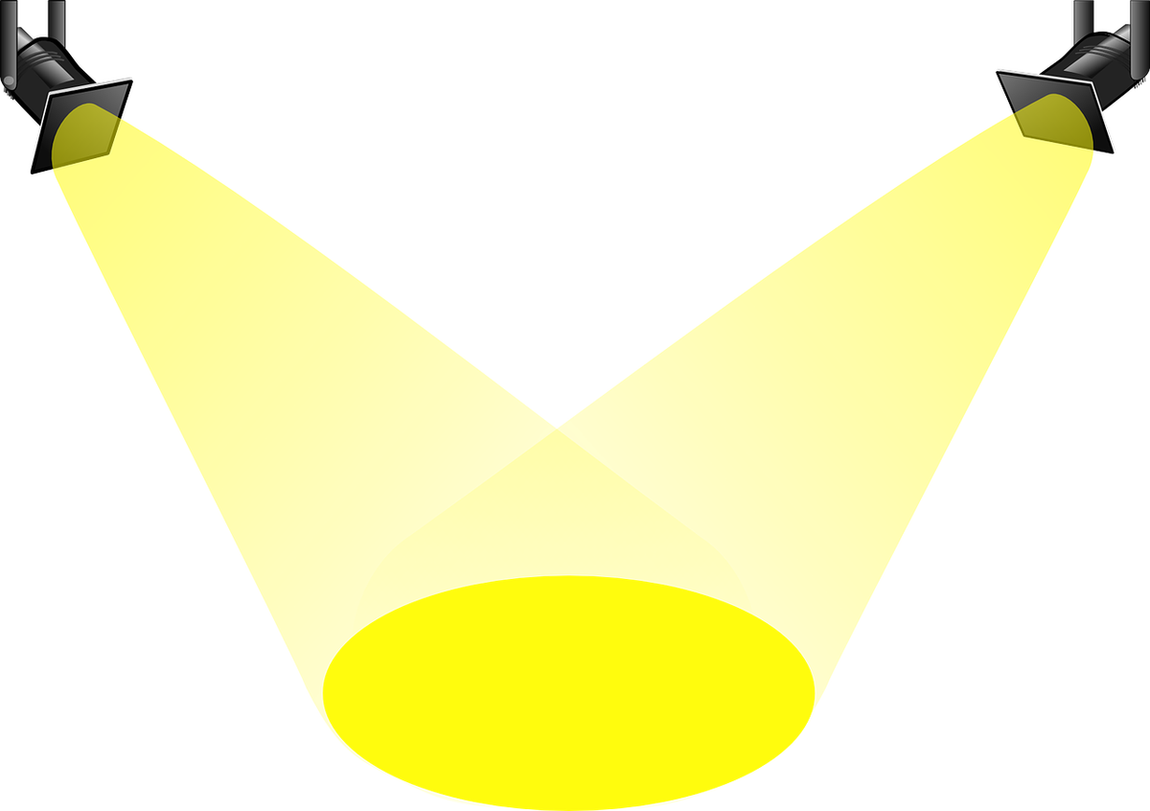

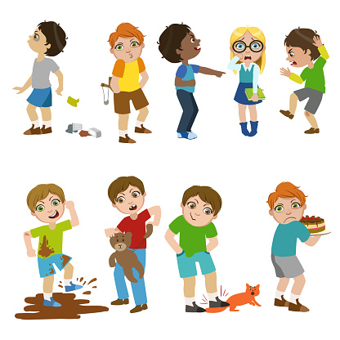
God’s light shines truth
Those who love truth come into the light of God of God’s truth. They live by the truth with God’s help.
Others can see God’s power.
This lifts up and glorifies God.
¹⁹ Here is the verdict. Light has come into the world, but people loved darkness instead of light. They loved darkness because what they did was evil.
²⁰ Everyone who does evil deeds hates the light. They will not come into the light. They are afraid that what they do will be seen.
²¹ But anyone who lives by the truth comes into the light. They live by the truth with God’s help. They come into the light so that it will be easy to see their good deeds.
Which children are being kind and good? How?

Slide 20
Craft Time
, “…the Son of Man must also be lifted up. ¹⁵ Then everyone who believes may have eternal life in him.” John 3:14, 15
Put the cross up on the window and remember to lift Jesus’ name up – Praise Him and give Him the glory.
and let the light shine through and remember…..
Everyone who lives by the truth comes into the light so that others see that God is helping them to obey Him.
For God so loved the world that He gave His only begotten Son that whoever believes in Him will not perish but have everlasting life.
John 3:16

Slide 21
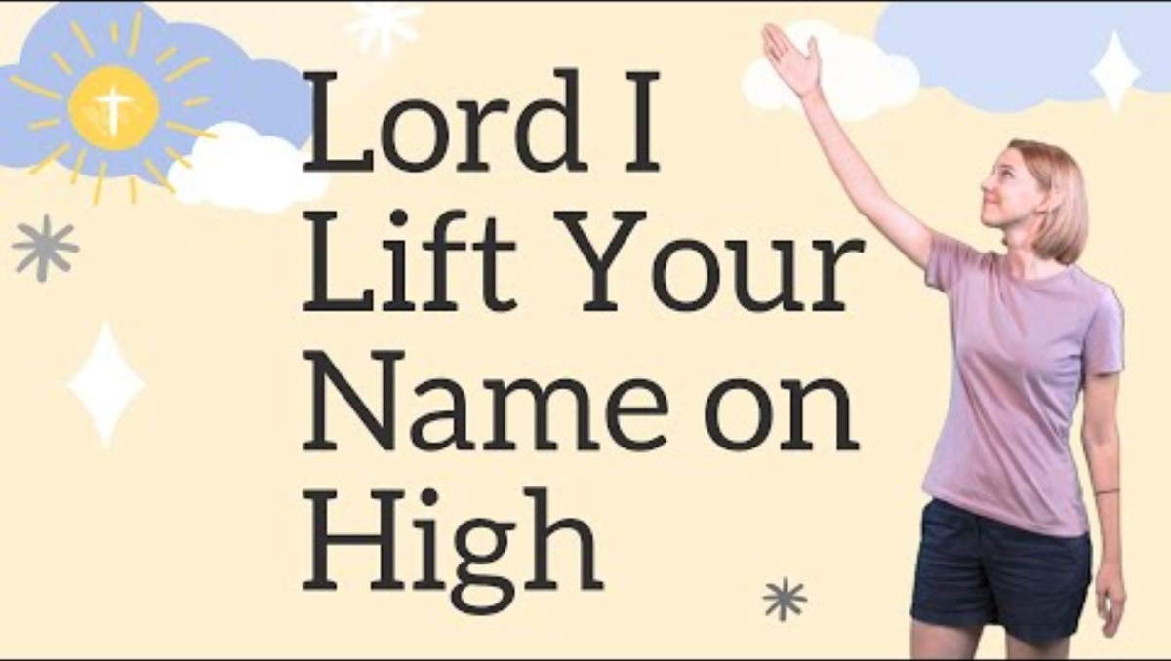
LORD, I Lift Your Name on High

Slide 22
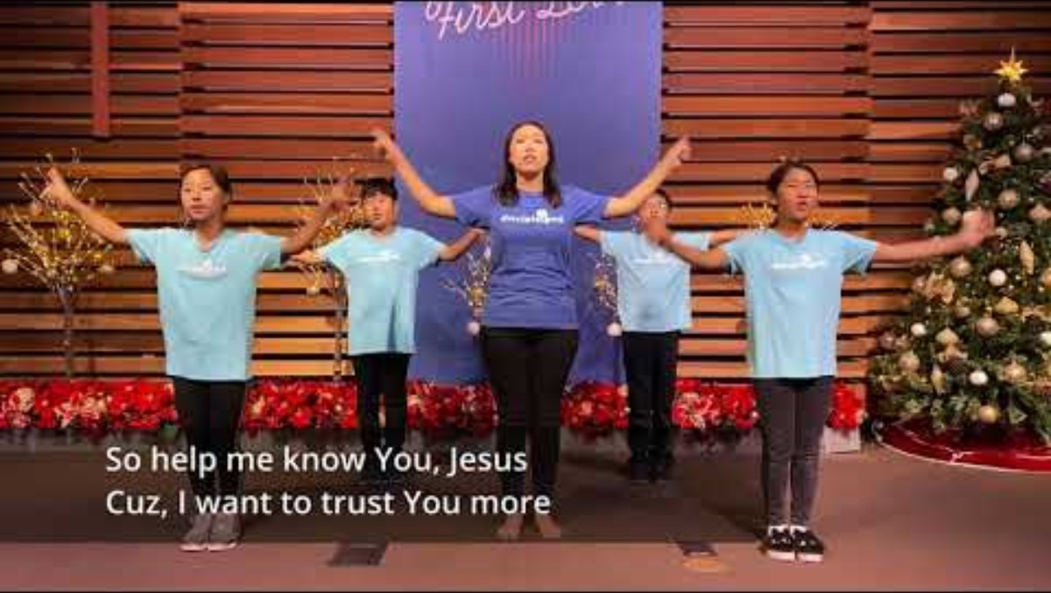
John 3:16

Slide 23
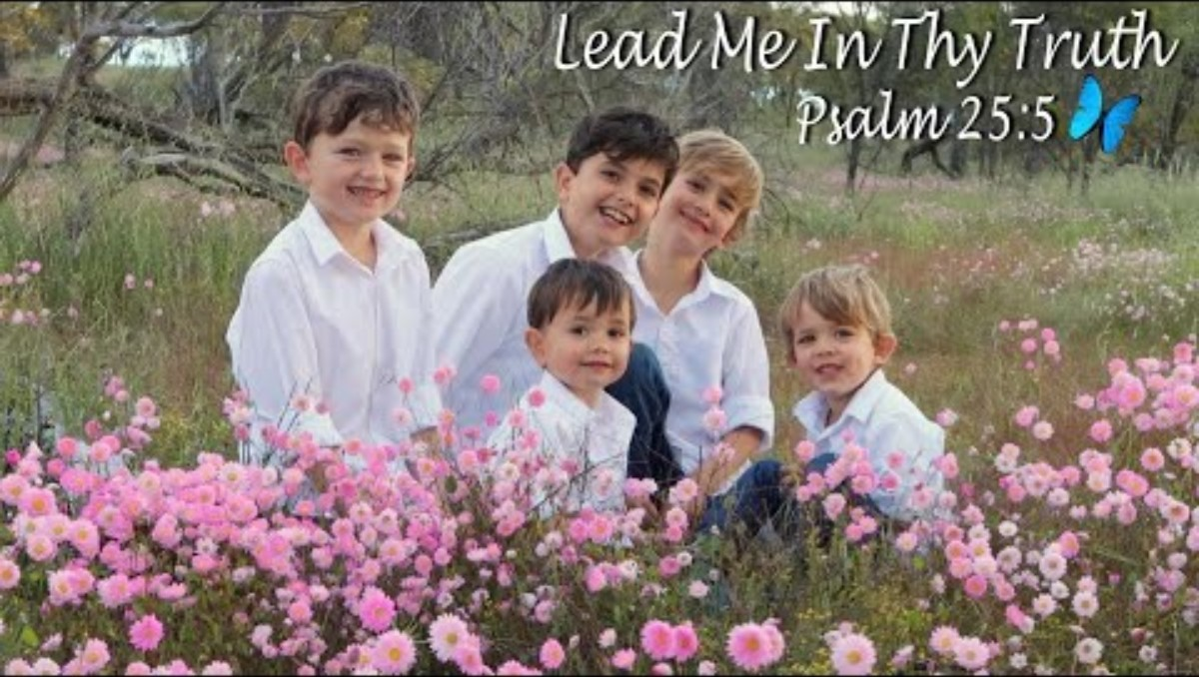

Slide 24
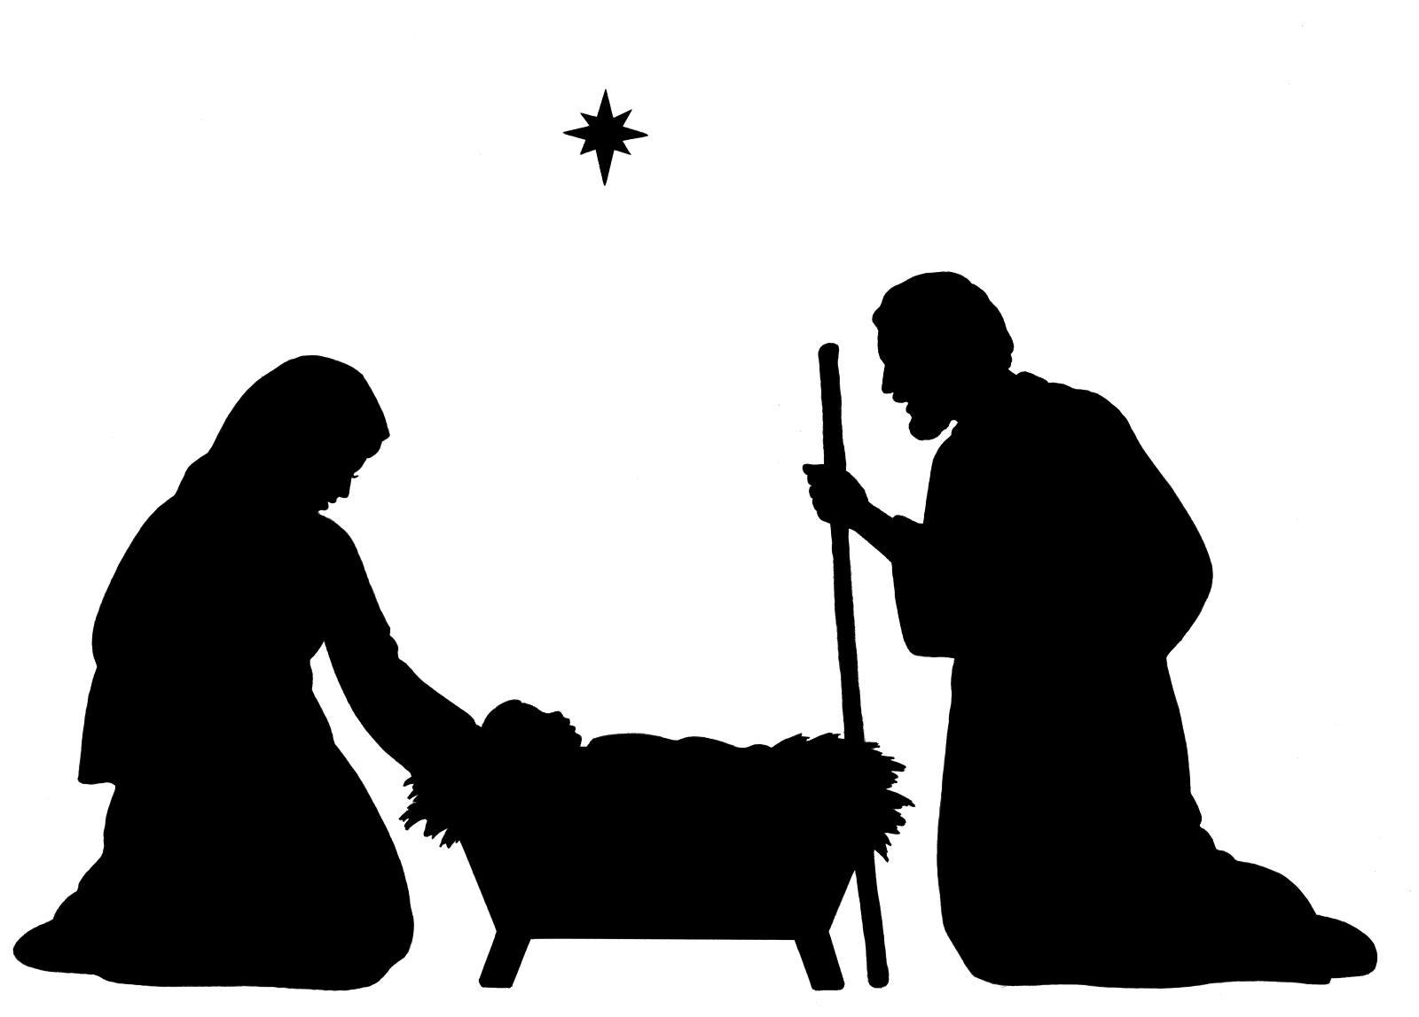

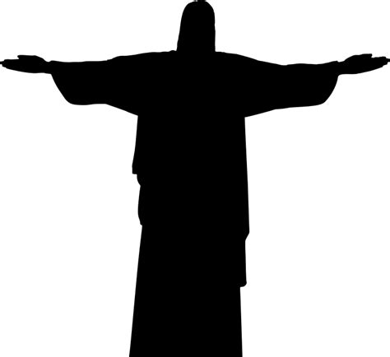

^{16 ”}God so loved the world that He gave His one and only Son. Anyone who believes in him will not perish but will have eternal life. ¹⁷ God did not send his Son into the world to judge the world. He sent His Son to save the world through Him.” John 3:16-17 ³⁶ Anyone who believes in the Son has eternal life. Anyone who does not believe in the Son will not have life.” John 3:36

Slide 25

You can find more PowerPoints like this on: https://activity-array.com/
The End

