Slide 1
Blind man receives sight
John 9

Slide 2

What was the blind man’s name?
What was Bartimaeus doing?
What did Bartimaeus want?
Jesus told the people to
“_ _ _ _ him.”
Mark 10:46-52
And
Luke 18:35-45r
Jesus said,
“Your _ _ _ _ _ has healed you.

Slide 3
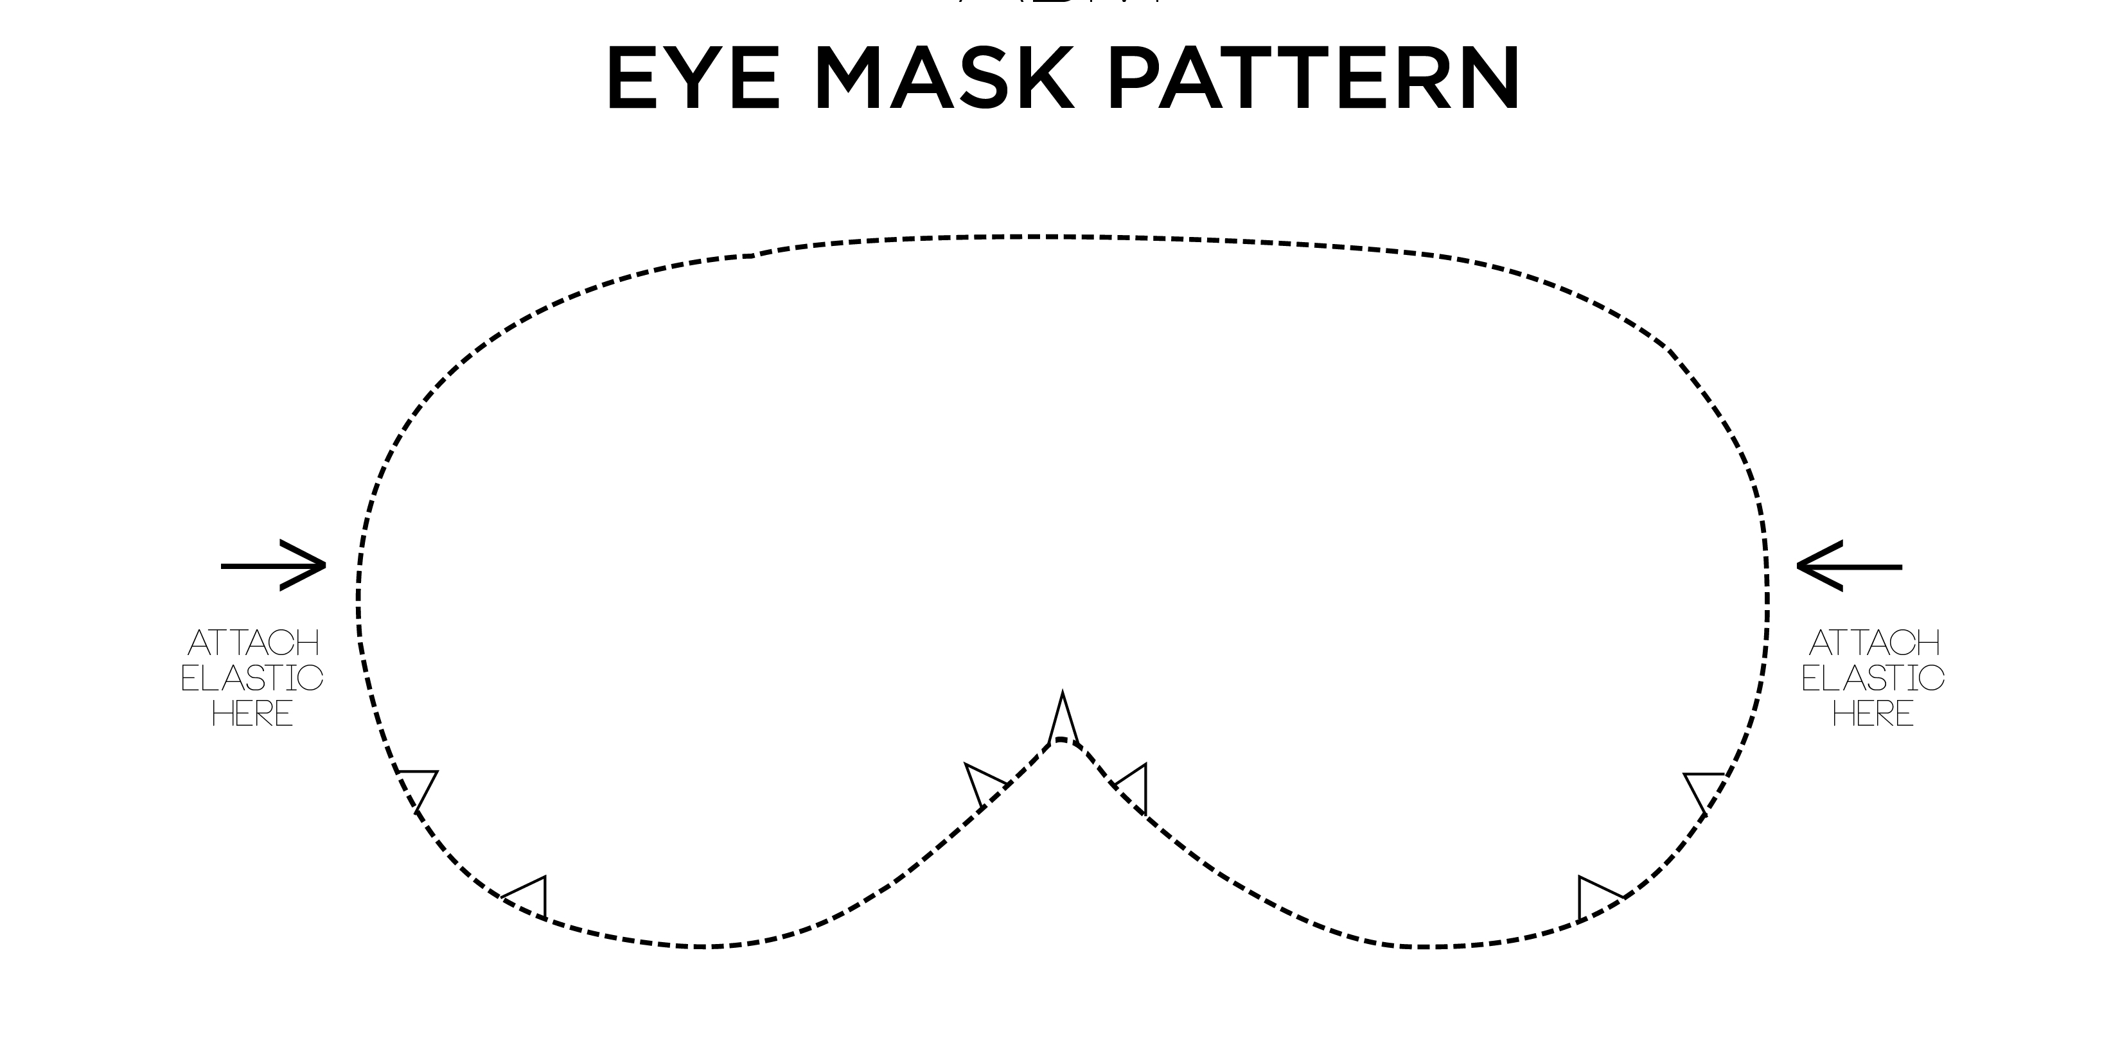
Craft time
Print on cardstock
or cut mask out of felt
Add elastic to mask
Use them for the obstacle activity
I once was blind,
But now I see!
John 9:25

Slide 4

Tell us more about we see

Slide 5
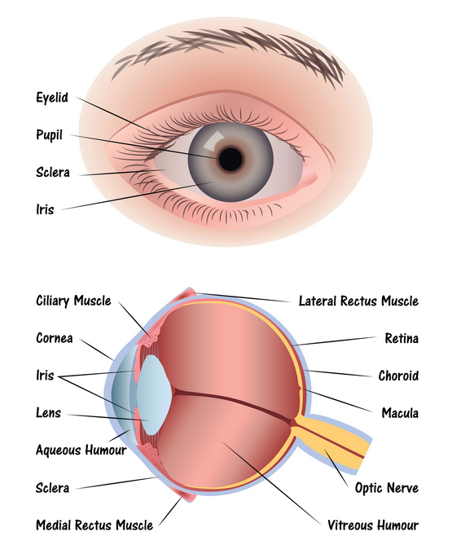


This is interesting….
Another name for a student is a pupil. You might see a cartoon of a pupil student who understands something like this. The light bulb indicates he understands.
The black part of the eye is called the pupil. It lets in light.
I understand!
The pupil

Slide 6
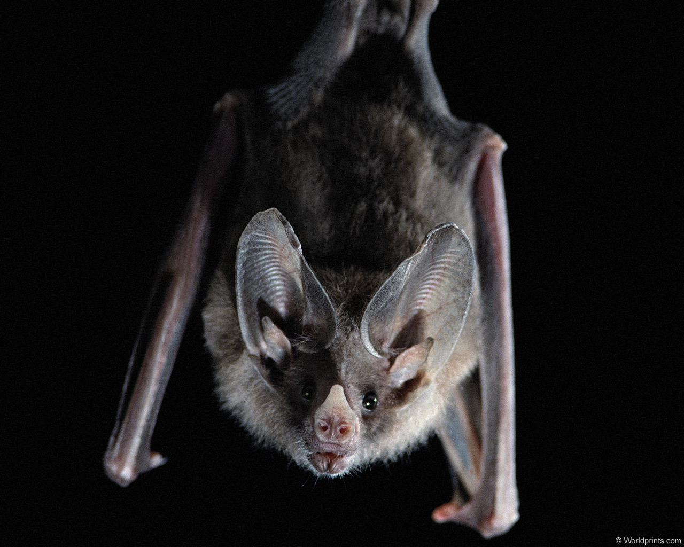
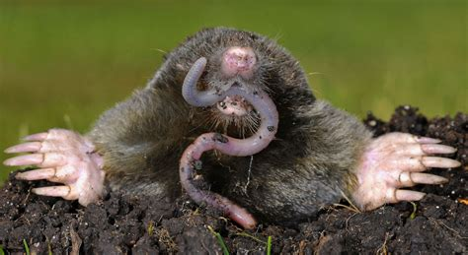
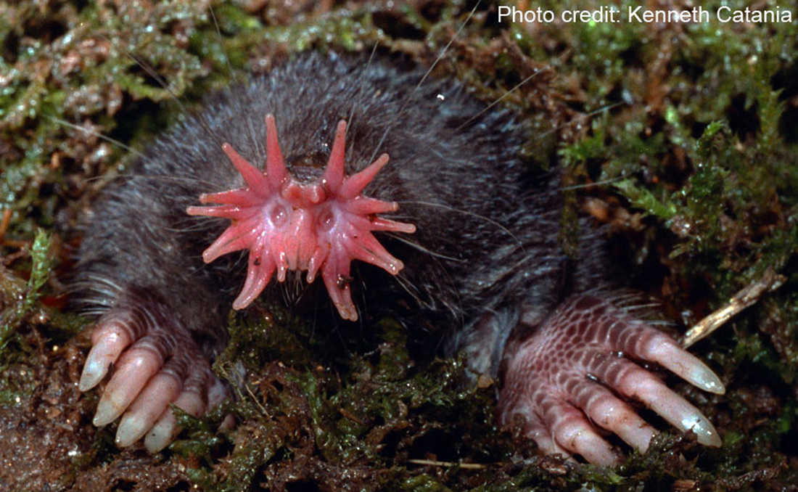
That reminds me of a blind animal
– who do you think is blind?
Bats are NOT blind. Their eyes can see very well at night. They have great hearing too. They use echo-location to pin- point the exact location of their prey.
Most moles are NOT totally blind. They can detect light even if their eyes are covered with fur or skin.
They eat a lot of worms and grubs. They often paralyze worms with their saliva and then store them for later.
The star nosed mole doesn’t even have eyes!
It’s star nose quickly touches everything and maps out what’s ahead.
There are other animals that live deep in the dark sea or caves that are blind, too.

Slide 7
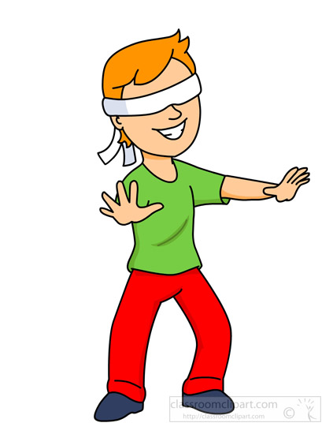
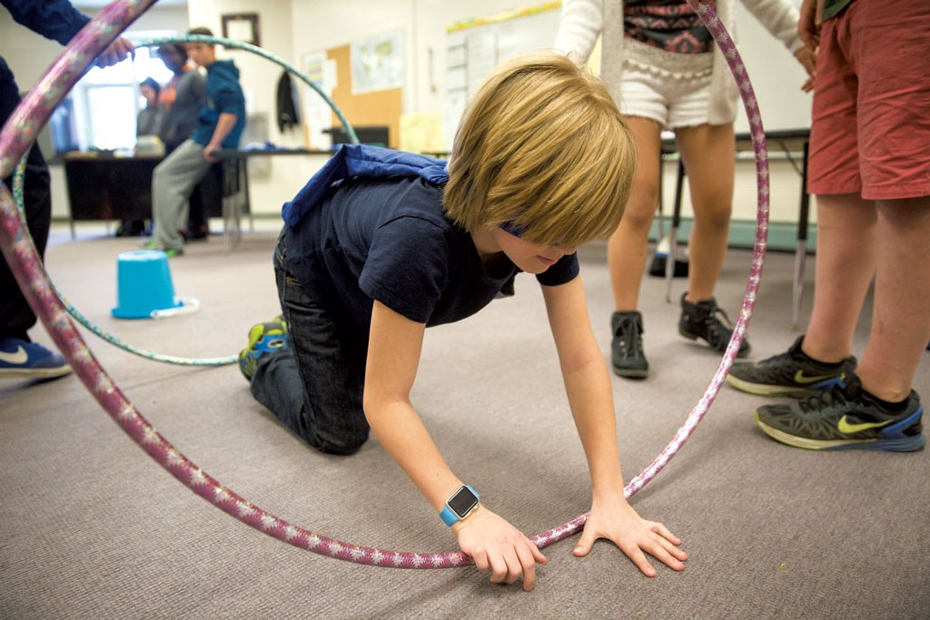

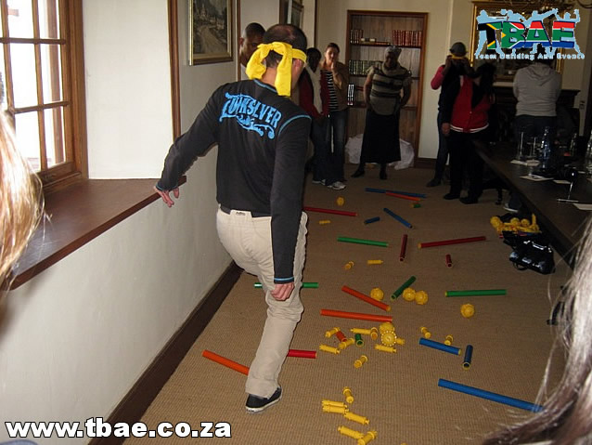
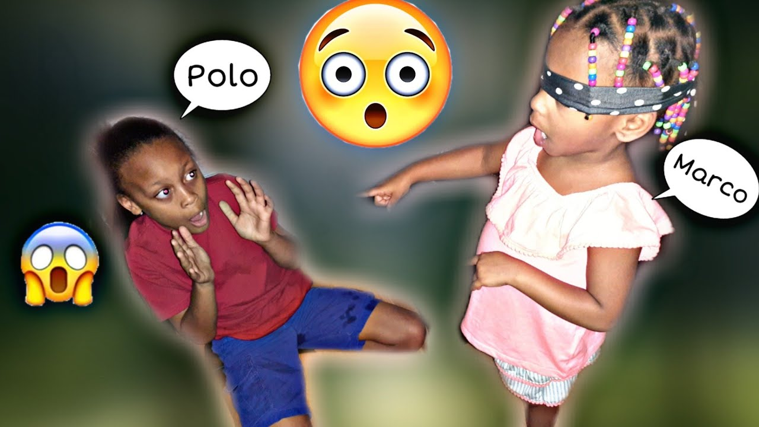
Blindfolded Activity
There was a blind man who sat begging by the road.
What would it be like to be blind?
Choose an activity:
Go through an obstacle course blind with guide
Play Marco Polo tag
Guess the object, blindfolded

Slide 8
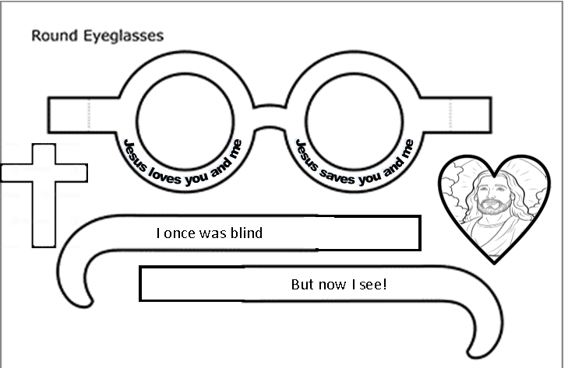
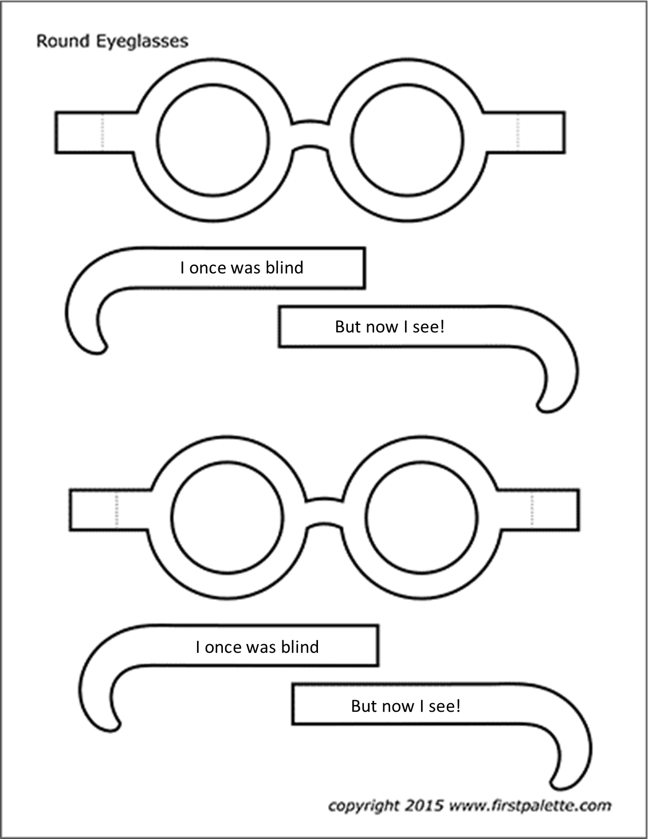
Craft time
Color the glasses.
Later we’ll glue or tape the heart and cross on the top side of the glasses.

Slide 9
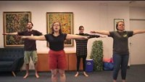
Blind Man
Sat by the Road

Slide 10
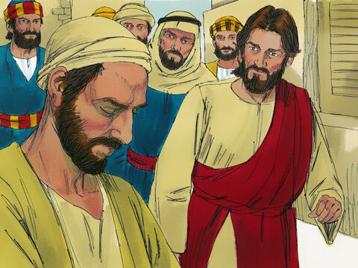
John 9
Neither. This happened so that the works of God might be shown.
Who sinned, this man or his parents?
9 As he went along, he saw a man blind from birth. ² His disciples asked him, “Rabbi, who sinned, this man or his parents, that he was born blind?”
³ “Neither this man nor his parents sinned,” said Jesus, “but this happened so that the works of God might be displayed in him.
⁴ As long as it is day, we must do the works of him who sent me. Night is coming, when no one can work. ⁵ While I am in the world, I am the light of the world.”
I am the Light of the world. I am doing God’s works here and now.

Slide 11
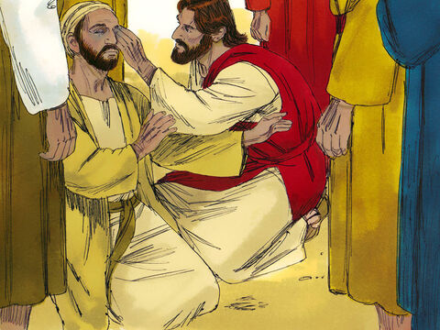
John 9
Go wash in the
Pool of Siloam
⁶ After saying this, he spit on the ground, made some mud with the saliva, and put it on the man’s eyes. ⁷ “Go,” he told him, “wash in the Pool of Siloam” (this word means “Sent”).

Slide 12
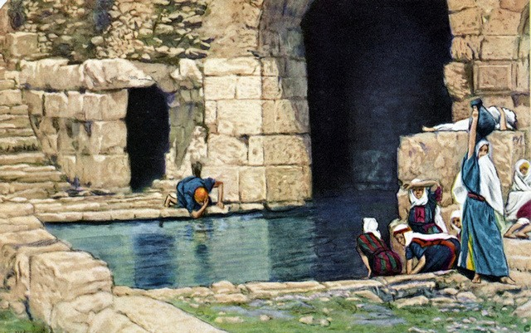
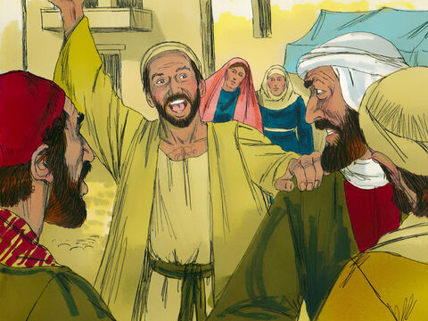
John 9
So, the man went and washed, and came home seeing.
I can see!

Slide 13
John 9
Is this the man who was begging by the road?
No, he only looks like him.
⁸ His neighbors and those who had formerly seen him begging asked, “Isn’t this the same man who used to sit and beg?” ⁹ Some claimed that he was.
Others said, “No, he only looks like him.”
But he himself insisted, “I am the man.”
¹⁰ “How then were your eyes opened?” they asked.
¹¹ He replied, “The man they call Jesus made some mud and put it on my eyes. He told me to go to Siloam and wash. So I went and washed, and then I could see.”
¹² “Where is this man?” they asked him.
“I don’t know,” he said.
I am the man.
Jesus put mud on my eyes and told me to go wash at the pool of Siloam. I went.
Now I can see!
How then were your eyes opened? How is it that you can now see?

Slide 14
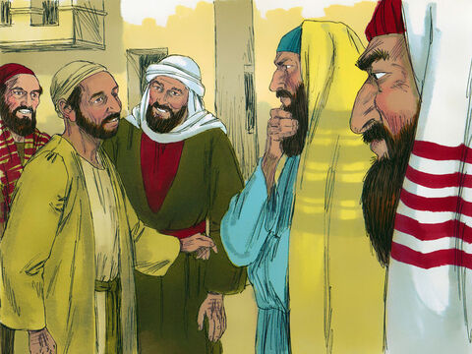
John 9
How did you receive your sight?
¹³ They brought to the Pharisees the man who had been blind.
¹⁴ Now the day on which Jesus had made the mud and opened the man’s eyes was a Sabbath.
¹⁵ Therefore the Pharisees also asked him how he had received his sight.
“He put mud on my eyes,” the man replied, “and I washed, and now I see.”
¹⁶ Some of the Pharisees said, “This man is not from God, for he does not keep the Sabbath.”
The man is not from God.
He does not keep the Sabbath.
He put mud on my eyes, I washed, and now I see.

Slide 15
John 9
How can a sinner perform miracles?
But others asked, “How can a sinner perform such signs?” So, they were divided.
¹⁷ Then they turned again to the blind man, “What have you to say about him? It was your eyes he opened.”
The man replied, “He is a prophet.”
He is a prophet.
What do you think about him? He opened your eyes.

Slide 16
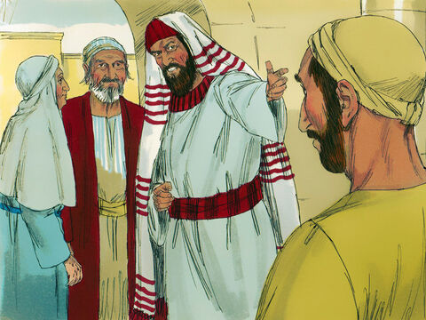
John 9
Is this your son?
We know he is our son.
We know he was born blind.
Ask him how he can now see.
¹⁸ They still did not believe that he had been blind and had received his sight until they sent for the man’s parents. ¹⁹ “Is this your son?” they asked. “Is this the one you say was born blind? How is it that now he can see?”
²⁰ “We know he is our son,” the parents answered, “and we know he was born blind. ²¹ But how he can see now, or who opened his eyes, we don’t know. Ask him. He is of age; he will speak for himself.”
²² His parents said this because they were afraid of the Jewish leaders, who already had decided that anyone who acknowledged that Jesus was the Messiah would be put out of the synagogue. ²³ That was why his parents said, “He is of age; ask him.”
Is this the one you say was born blind?
How is it now that he can see?

Slide 17
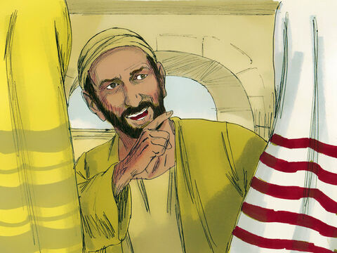
John 9
I don’t know if he is a sinner or not. But I do know that I was blind and that now I see!
Now tell us the truth. We know this man is a sinner!
²⁴ A second time they summoned the man who had been blind. “Give glory to God by telling the truth,” they said. “We know this man is a sinner.”
²⁵ He replied, “Whether he is a sinner or not, I don’t know. One thing I do know. I was blind but now I see!”
²⁶ Then they asked him, “What did he do to you? How did he open your eyes?”
²⁷ He answered, “I have told you already and you did not listen. Why do you want to hear it again? Do you want to become his disciples too?”
What did he do to you?
How did he open your eyes?
I told you already.
You didn’t listen.
Do you want to be his disciple, too?

Slide 18
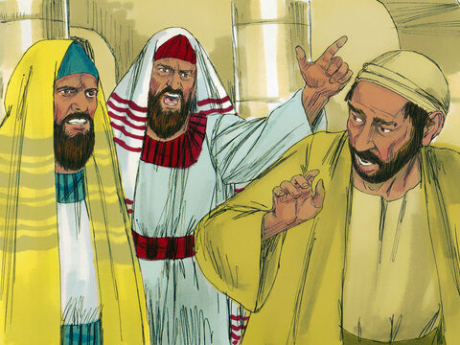
John 9
That’s remarkable.
He opened my eyes. We know sinners don’t do miracles!
You are this fellow’s disciple. We follow Moses!
We don’t even know where this man comes from!
²⁸ Then they hurled insults at him and said, “You are this fellow’s disciple! We are disciples of Moses! ²⁹ We know that God spoke to Moses, but as for this fellow, we don’t even know where he comes from.”
³⁰ The man answered, “Now that is remarkable! You don’t know where he comes from, yet he opened my eyes. ³¹ We know that God does not listen to sinners. He listens to the godly person who does his will. ³² Nobody has ever heard of opening the eyes of a man born blind. ³³ If this man were not from God, he could do nothing.”
³⁴ To this they replied, “You were steeped in sin at birth; how dare you lecture us!” And they threw him out.
You have been a blind sinner since birth!
How dare you lecture us!
GET OUT!

Slide 19
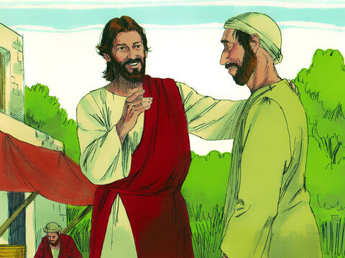
John 9
Do you believe in the Son of Man, the Messiah?
³⁵ Jesus heard that they had thrown him out, and when he found him, he said, “Do you believe in the Son of Man?”
³⁶ “Who is he, sir?” the man asked. “Tell me so that I may believe in him.”
³⁷ Jesus said, “You have now seen him; in fact, he is the one speaking with you.”
Who is he, sir?
Tell me so that I may believe in him.
You have seen him.
He is speaking to you.

Slide 20
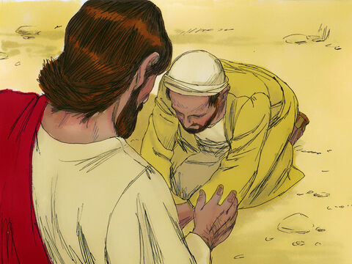
John 9
You are the Messiah.
Praise God!
I have come so that the blind will see.
³⁸ Then the man said, “Lord, I believe,” and he worshiped him.
³⁹ Jesus said, “For judgment I have come into this world, so that the blind will see and those who see will become blind.”
Many who see are truly blind.

Slide 21
John 9
What?!
Are we blind?
⁴⁰ Some Pharisees who were with him heard him say this and asked, “What? Are we blind too?”
⁴¹ Jesus said, “If you were blind, you would not be guilty of sin; but now that you claim you can see, your guilt remains.
Pharisees, if you were spiritually blind, and didn’t know better,
you would not be guilty.
But, you claim you can see, yet don’t
So, you are guilty.

Slide 22

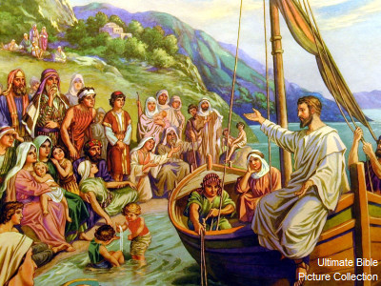
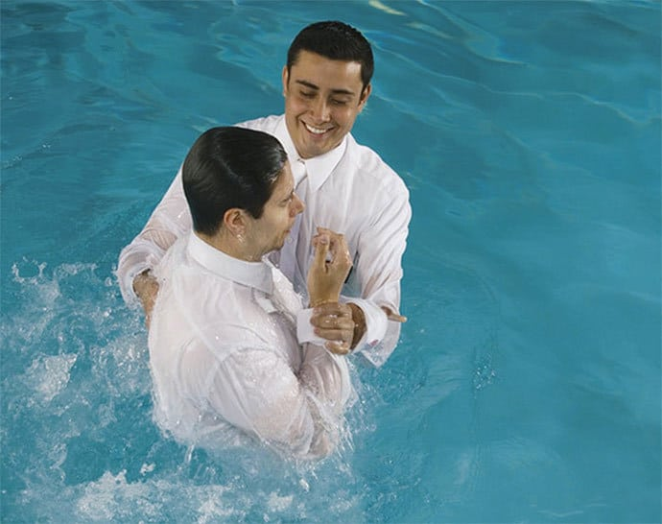
John 9
I am sending you to them
¹⁸ to open their eyes
and turn them from darkness to light,
and from the power of Satan to God,
so that they may receive
forgiveness of sins
and a place among those who are sanctified by faith in me.’
Acts 26:17-18
Acts 26:17-18:
The LORD opens the eyes of the blind.
Psalms 146:8

Slide 23
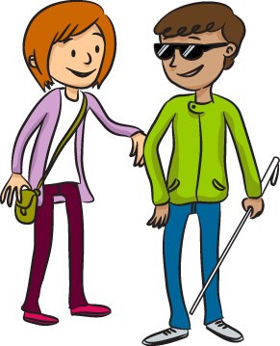
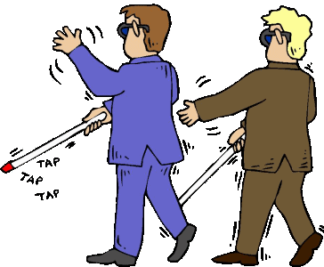
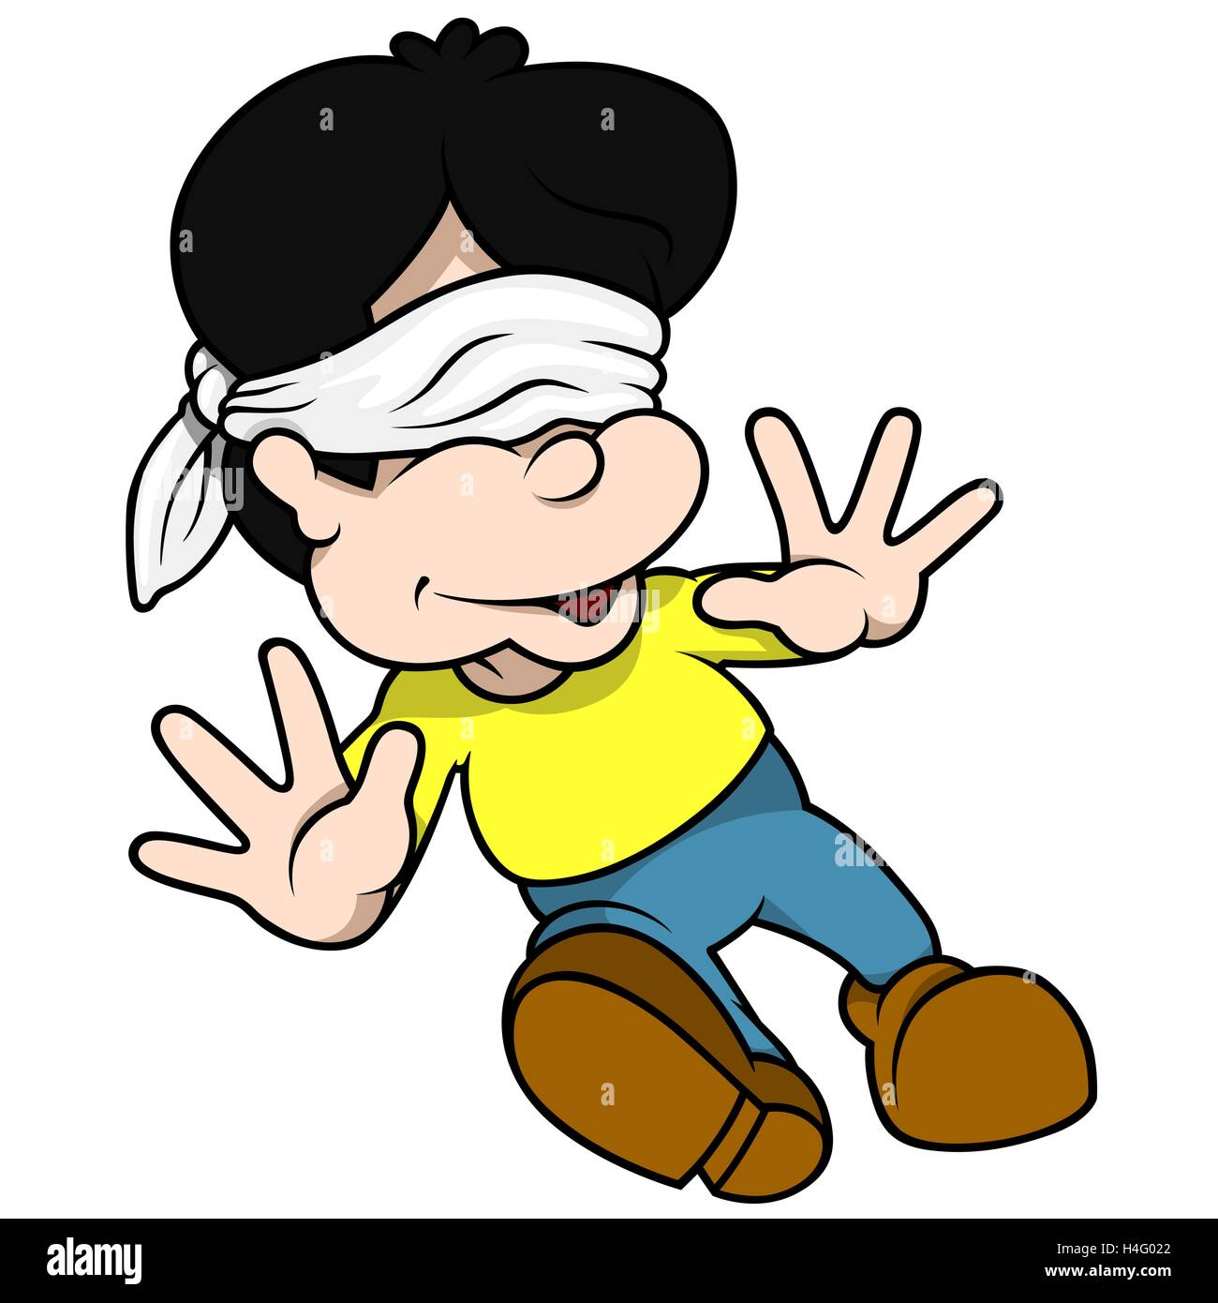
BLIND
What does it mean to be spiritually blind?
Even when Jesus was here on earth there were those who saw Him, but were blind.
  But didn’t see or understand that Jesus was the Messiah.
  They didn’t see or think that they were sinners and needed to repent.
  They didn’t see or understand the light of truth that Jesus talked about.
Have you heard about Jesus?
Yeah, but that’s just a fantasy tale.
Some say that Jesus IS the truth and only His Word is THE TRUTH.
That’s ridiculous! I have my truth and you have your truth.
I didn’t do anything wrong. I don’t need to apologize.
Blind
Blind
Blind

Slide 24
So be a good pupil
Let God’s light of truth in
Another name for a student is a pupil. You might see a cartoon of a pupil student who understands something like this. The light bulb indicates he understands.
The black part of the eye is called the pupil. It lets in light.
I understand!
The pupil

Slide 25
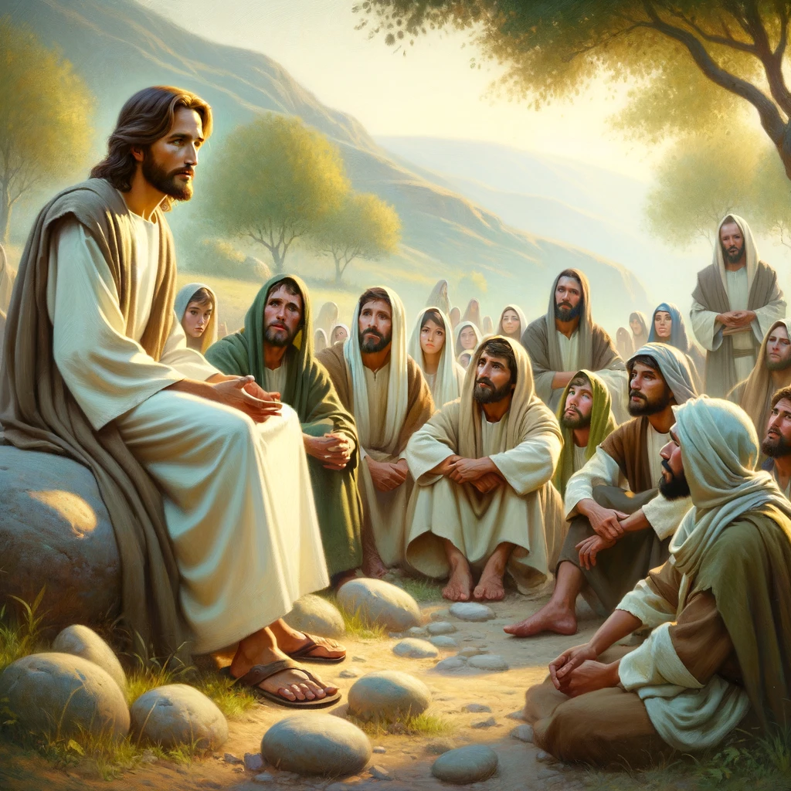

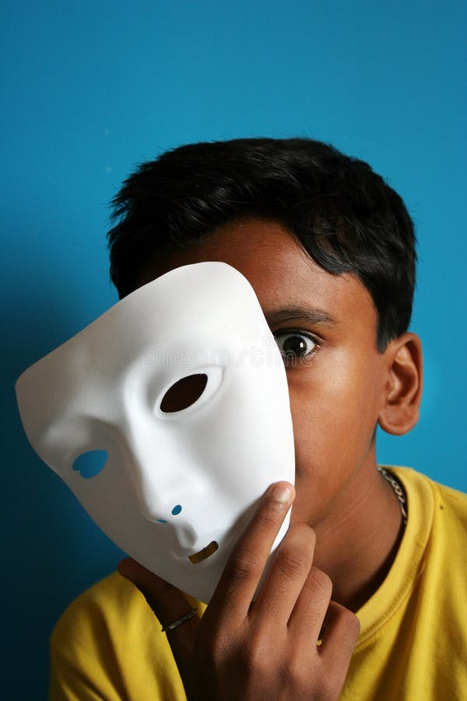


Can you see?
Isaiah wrote what God told him to say:
^{42:19, 20 “}Who is blind… you have seen many things, but do not pay attention.”
^{43:8,10,12, 14 “}Lead out those who are blind… so that they may know and believe me and understand that I am He…, the LORD,… the Savior,
I have revealed and saved and proclaimed”… I Am God, your Creator, Redeemer, and King.
^{43:25} “I am He who blots out your transgression and remembers your sins no more.” ^{44:2,3} I will help you. I will pour out my Spirit…
Do you understand who Jesus is?
Who is Jesus?
Tell me more about Him.
What does He teach or say is true?

Slide 26
Craft time
Color the glasses.
Later we’ll glue or tape the heart and cross on the top side of the glasses. Remember “to see” is to understand who Jesus is and what He says.

Slide 27
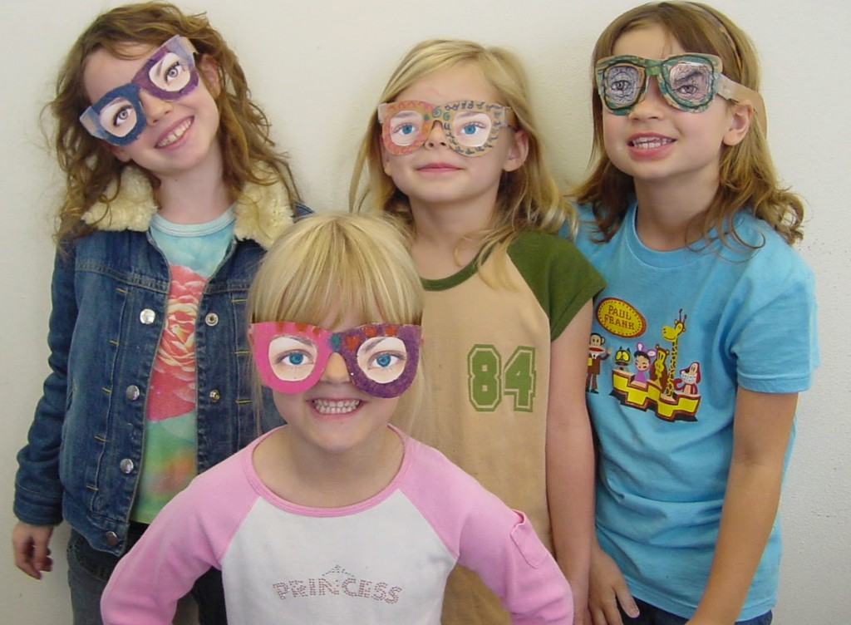
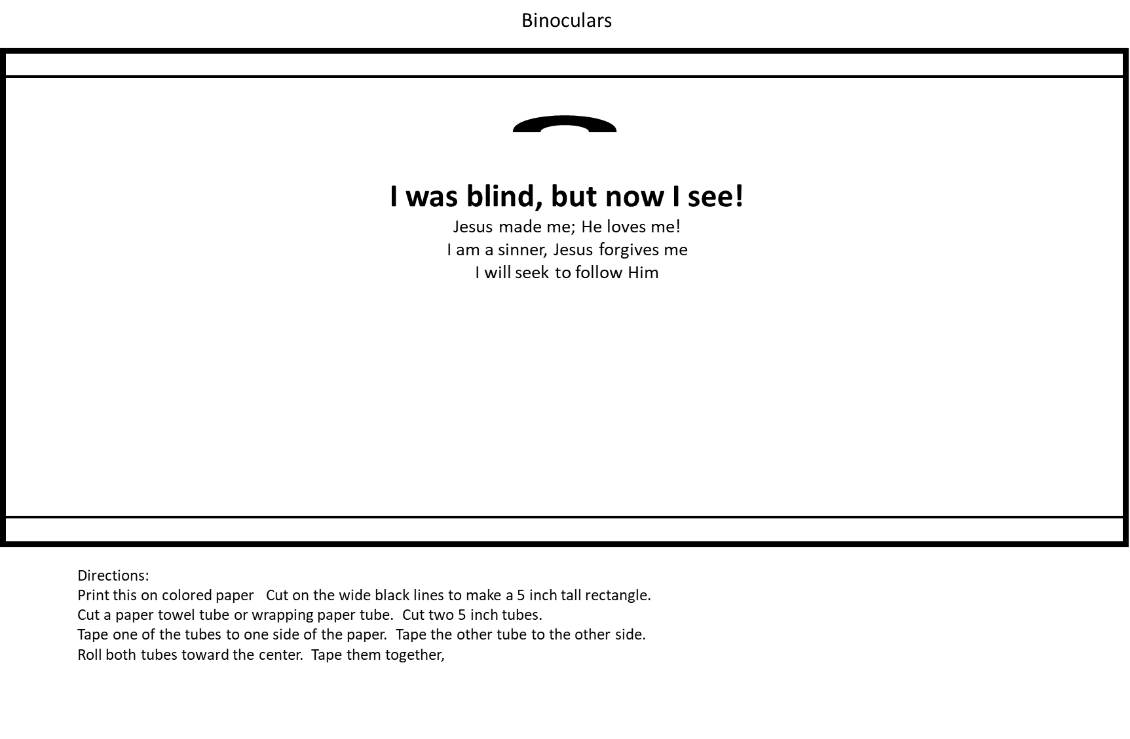

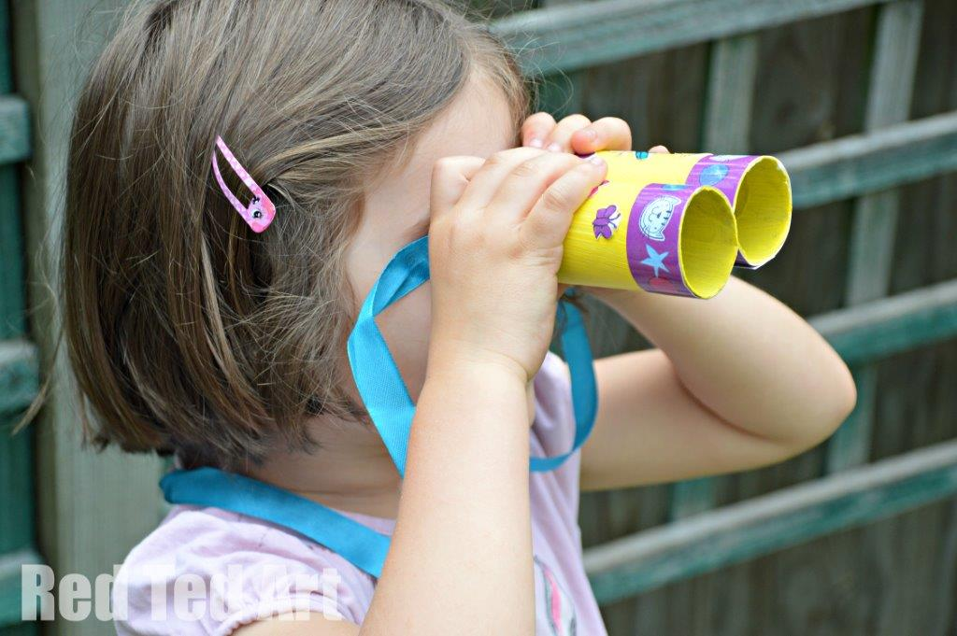
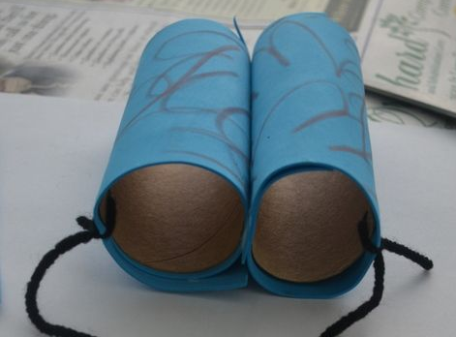
Craft time choose one or more to do
Decorate with colors, foam stickers, jewels, etc.
BINOCULAR Directions:
Print this on colored paper Cut on the wide black lines to make a 5 inch tall rectangle.
Cut a paper towel tube or wrapping paper tube. Cut two 5 inch tubes.
Tape one of the tubes to one side of the paper. Tape the other tube to the other side.
Roll both tubes toward the center. Tape them together.
I once was blind,
But now I see!
John 9:25

Slide 28


Slide 29

How would you describe color to a blind person

Slide 30
Blind Man
Sat by the Road

Slide 31
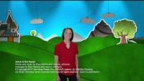
Jesus is the healer

Slide 32
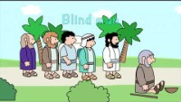
Blind Man
Sat by the Road

Slide 33

I’ve got a river of life flowing out of me

Slide 34
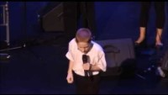
Open the Eyes of my heart
I want to see YOU

Slide 35
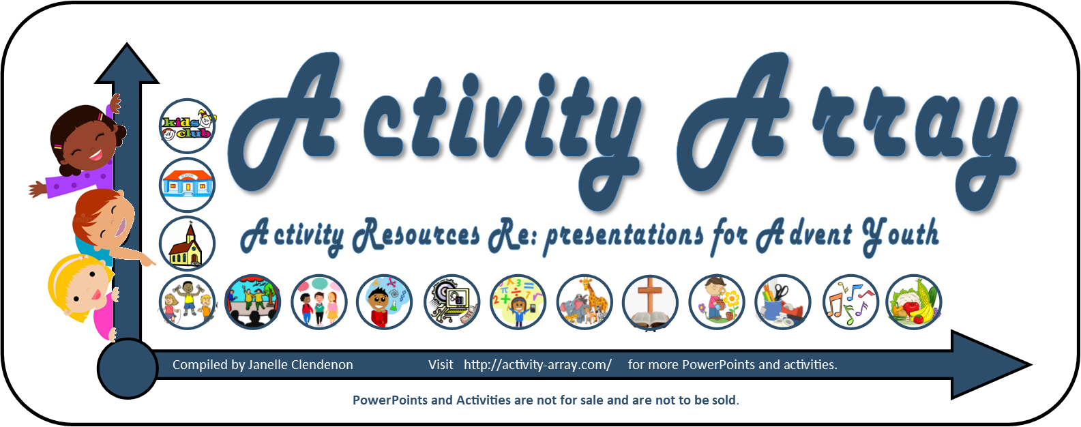
https://activity-array.com/

