Slide 1
The Faith of a Canaanite Woman and Jesus Feeds 4,000
Matthew 15:21-39 and Mark 7:31-8:13
Blessed are (all) those who hunger and thirst for righteousness
For they will be filled.

Slide 2
What is your favorite bread?
What do you like putting on bread?

Slide 3
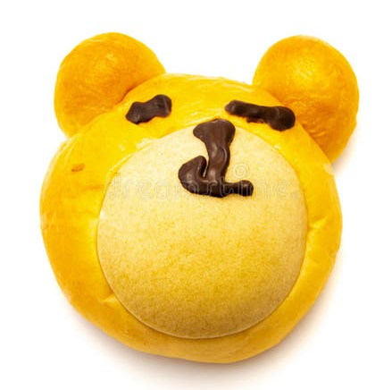
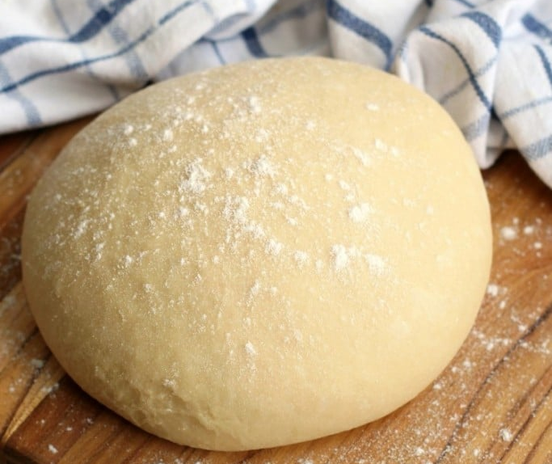
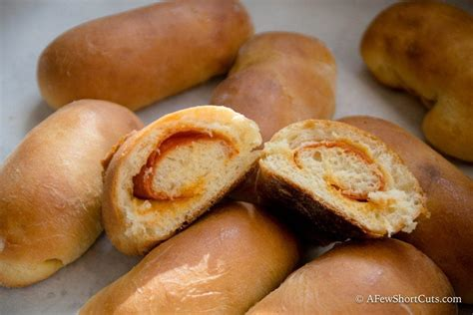
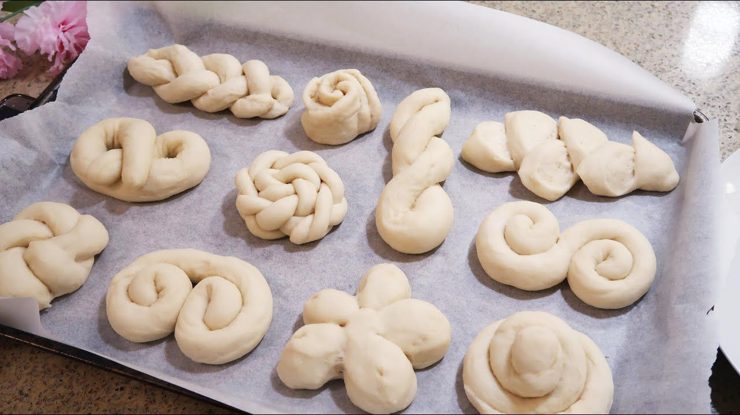
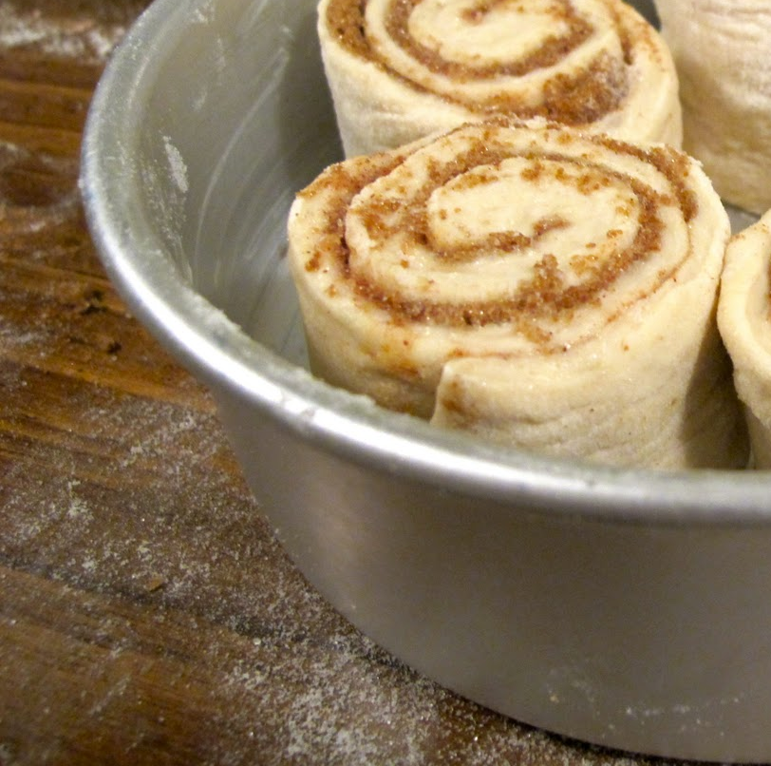
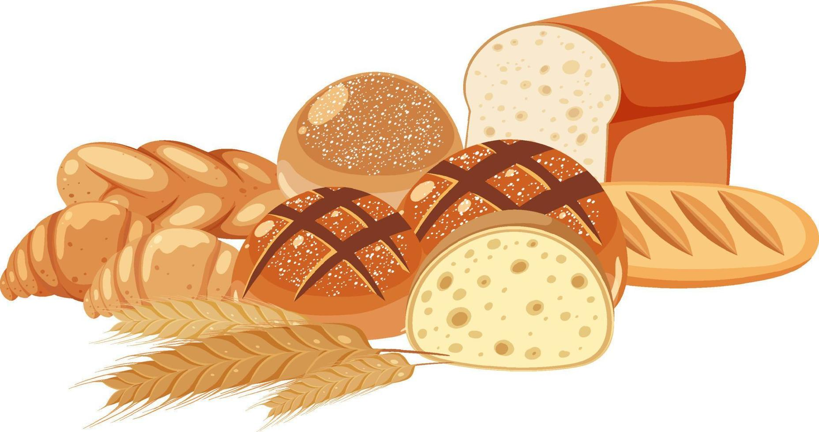
Today we’ll look at a couple stories that mention bread.
Here is some dough that you can form.
You could make an animal face
Roll
Cinnamon roll
Pretzel or other fancy design
I have some things you can add
Cinnamon sugar
Raisins
Sesame seeds
Cheese
We’ll bake it and eat it later.
Ideas:

Slide 4

Talking about food….. Let’s talk about the mouth

Slide 5

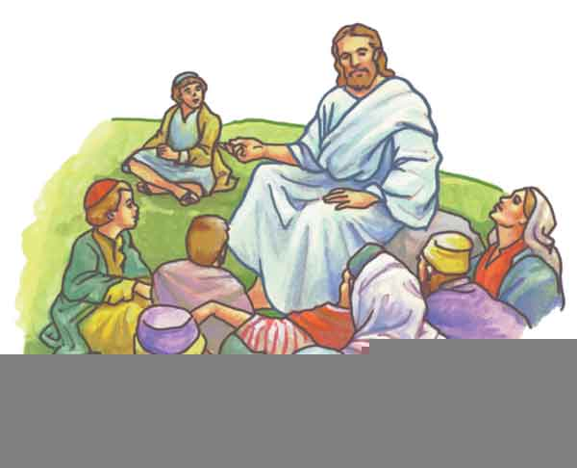
Blessed are those who hunger and thirst
for righteousness, for they will be filled.
Matthew 5:6
Then Jesus declared,
“I am the bread of life. Whoever comes to Me
will never go hungry, and whoever believes in me will never be thirsty.
John 6:36
Matthew
5:6
John 6:36
Jesus taught the people.
Find out one of the things He told them while teaching them on a mountain.

Slide 6
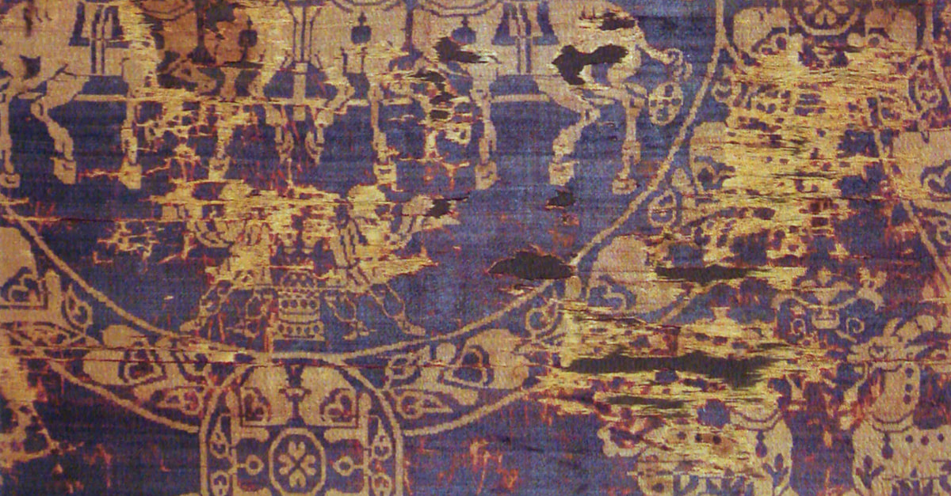
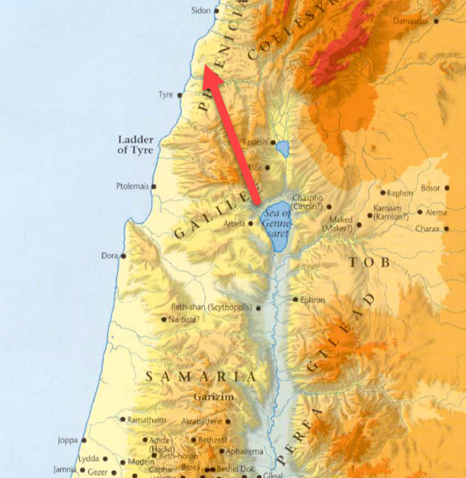
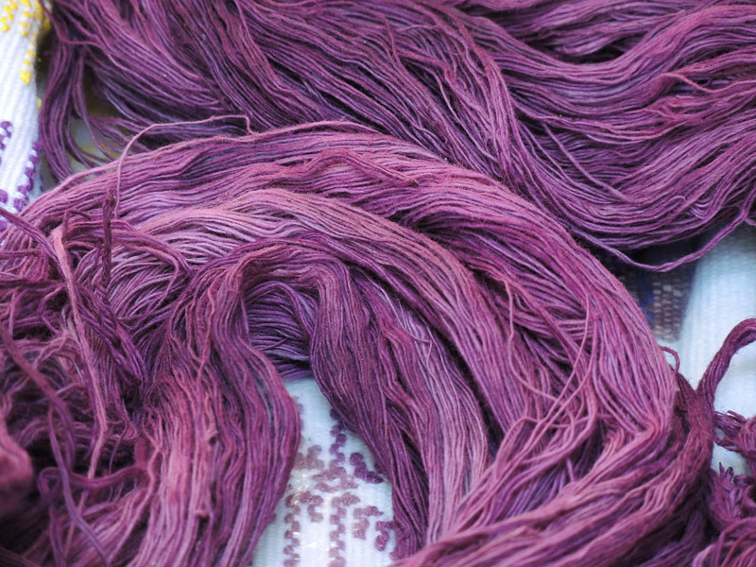

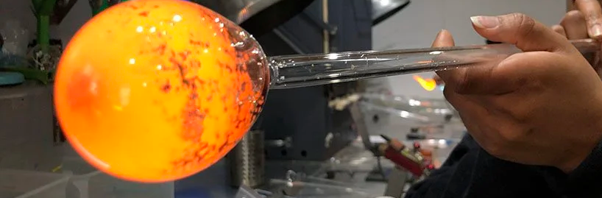
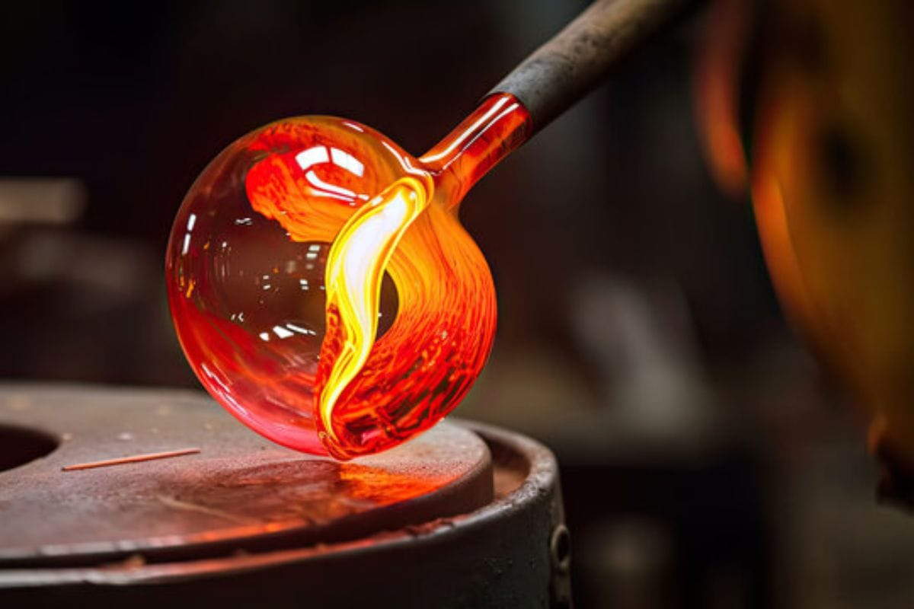
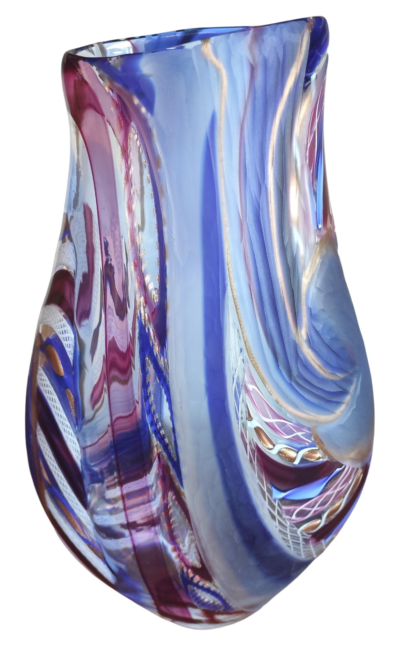

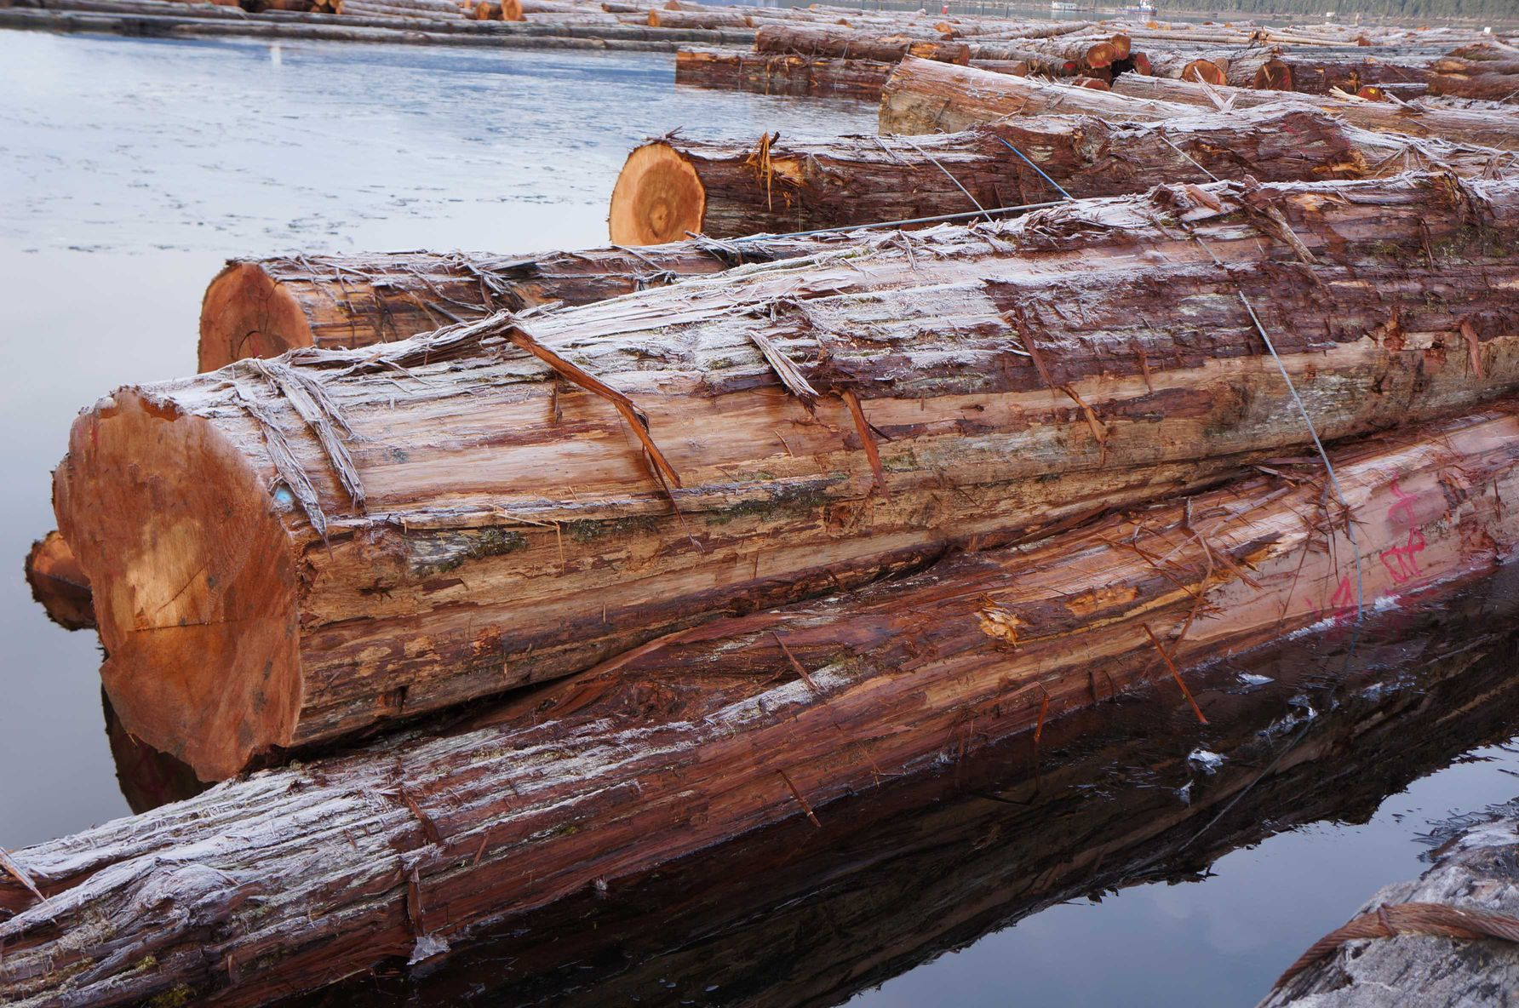
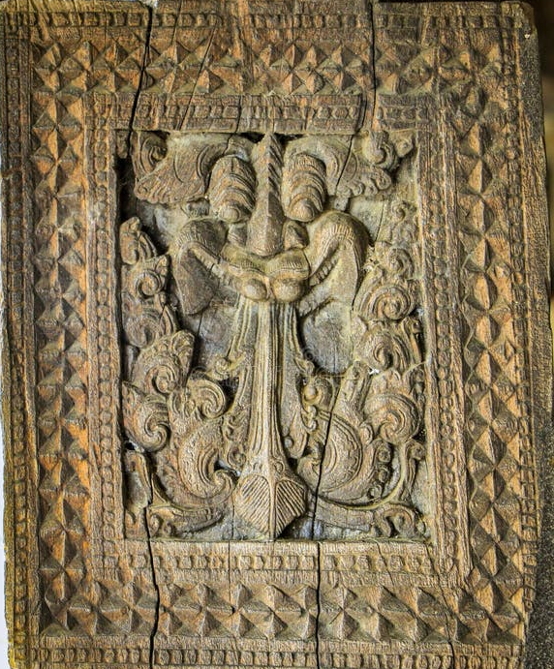
Sidon
Matthew 15
²¹ Leaving that place, Jesus withdrew to the region of Tyre and Sidon.
Tyre and Sidon
600 years before this Tyre and the nearby city of Sidon were very rich in goods and knowledge. They knew how to navigate the seas better than anybody else. They were master traders and brought wonderful things to their city and traded them with the world.
They developed the alphabet, standard weights and measures. The Romans and others used and further developed these. Our alphabet is based on these letters.
Only they knew how to dye material purple using purple mollusk shells. It was very expensive and only kings and rich people wore it.
They were the first and only ones who knew how to blow glass to make beautiful containers and other things.
They were very good artisans! Awesome in embroidery, carving ivory, wood, and stone. They had jewels from all over the world!
They had the desired large, strong, and fragrant cedars of Lebanon
Countries from all over wanted what they made and traded!
They had a strong, tall fort on an island, but didn’t have a strong army. They were strong in diplomacy and making agreements.
They became proud in their wealth and understanding.
Tyre

Slide 7

Sidon
Matthew 15
²¹ Leaving that place, Jesus withdrew to the region of Tyre and Sidon.
Tyre and Sidon
But their PRIDE became their DOWNFALL. They didn’t trust in God, they trusted in their wealth, wisdom, and resources.
God gave Ezekiel the prophesy of their end. No one believed that the prophecy could ever come true, but It happened just as God said. Nebuchadnezzar’s attack fulfilled the prophecy.
Tyre
We want to hunger and thirst for righteousness – Thanking God for His blessings and worshipping the LORD
Tyre and Sidon
Out story happens 500 years after Tyre was destroyed because of their pride. Now Jesus is coming to town to offer healing and grace.

Slide 8
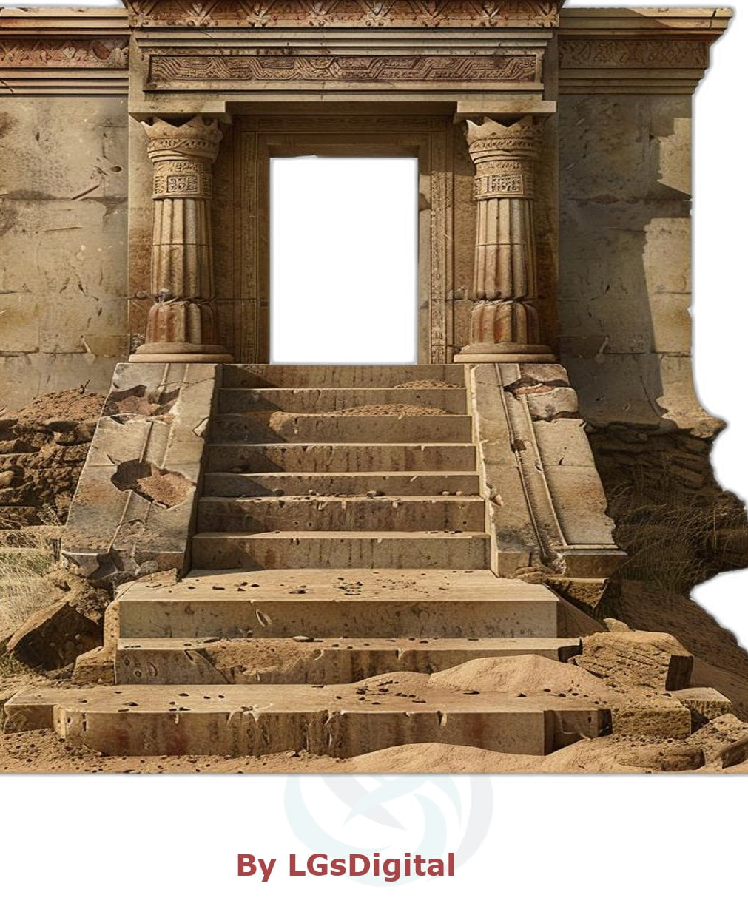
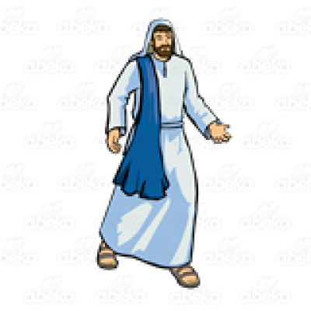
Going to the Canaanites in Phoenicia
Sidon
Tyre
Jesus left the land of Israel and traveled a long ways to the land of Phoenicia.
Mark 7
He entered a house and did not want anyone to know it; yet he could not keep his presence secret. ²⁵ In fact, as soon as she heard about him, a woman whose little daughter was possessed by an impure spirit came and fell at his feet. ²⁶ The woman was a Greek, born in Syrian Phoenicia. She begged Jesus to drive the demon out of her daughter.

Slide 9
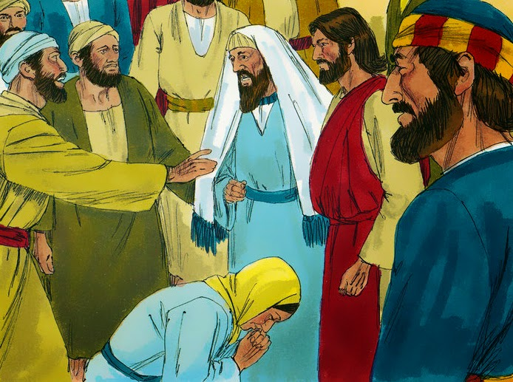
A woman wants Jesus’ help
(Jesus said nothing)
Send her away.
She keeps crying out.
Matthew 15
²² A Canaanite woman from that vicinity came to him, crying out, “Lord, Son of David, have mercy on me! My daughter is demon-possessed and suffering terribly.”
²³ Jesus did not answer a word.
So, his disciples came to him and urged him, “Send her away, for she keeps crying out after us.”
This was a test.
Would the disciples want to help?
LORD, Son of David, have mercy on me!
My daughter is demon- possessed and suffering terribly.

Slide 10
A TEST
Exactly!
So why are we here?
I was sent only to the lost sheep of Israel.
Matthew 15
²⁴ He answered, “I was sent only to the lost sheep of Israel.”
²⁵ The woman came and knelt before him. “Lord, help me!” she said.
Do you think the disciples passed the test?
LORD, help me!

Slide 11
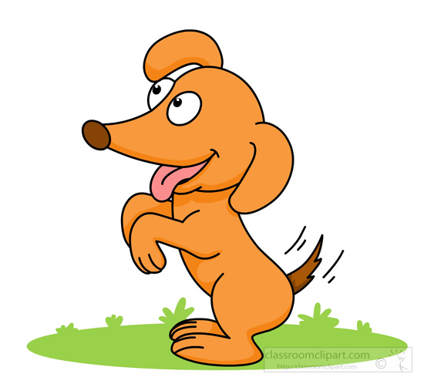
FAITH
Woman, you have great faith! Your request is granted.
It is not right to take the children’s bread and toss it to the dogs.
Matthew 15
²⁶ He replied, “It is not right to take the children’s bread and toss it to the dogs.”
²⁷ “Yes it is, Lord,” she said. “Even the dogs eat the crumbs that fall from their master’s table.”
²⁸ Then Jesus said to her, “Woman, you have great faith! Your request is granted.”
And her daughter was healed at that moment.
Jesus was taking the Israelites and disciples’ point of view
She didn’t want her daughter to have the impure spirit. She was hungry and thirsty for righteousness.
Yes, it is, Lord.
Even the dogs eat the crumbs that fall from their master’s table.

Slide 12
Is the Bible only for Jews?
Did Jesus come to
only save the Jews?
NO!
For God so loved the WORLD
that He gave
His Only begotten Son
that WHOEVER believes in Him
shall not perish, but have
Everlasting life! .
God said: “It is too small a thing for you to be my servant to restore the tribes of Jacob and bring back those of Israel I have kept. I will also make you a light for the Gentiles, that my salvation may reach to the ends of the earth.”

Slide 13
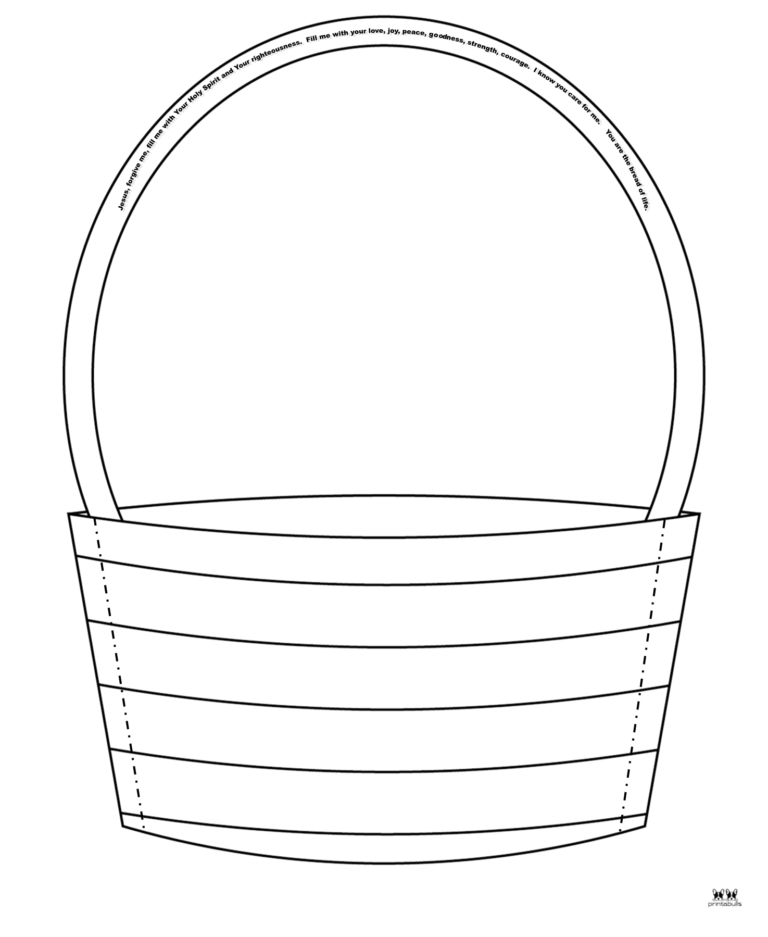
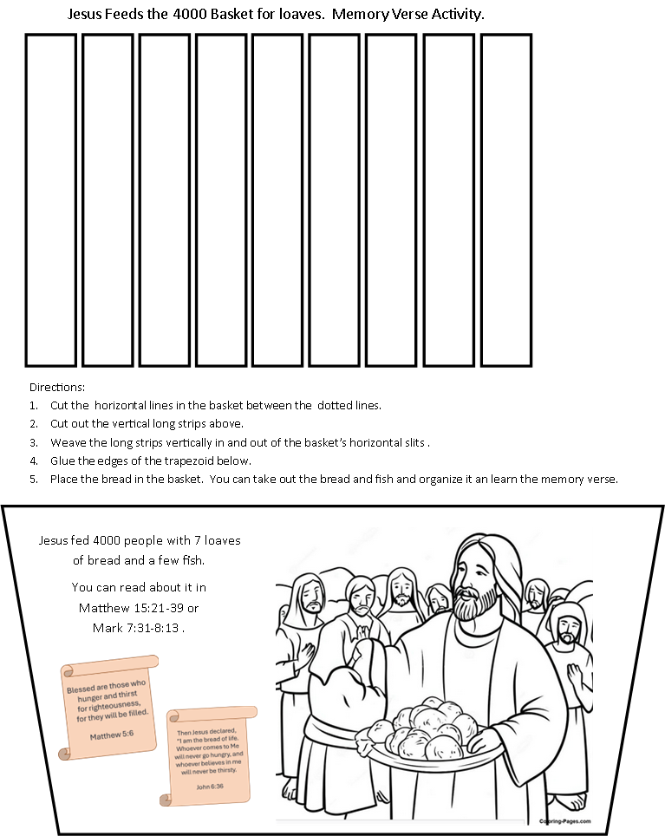
CRAFT
Directions:
Color the basket, strips to weave, and hexagon.
Cut out the basket, strips to weave, and hexagon.

Slide 14
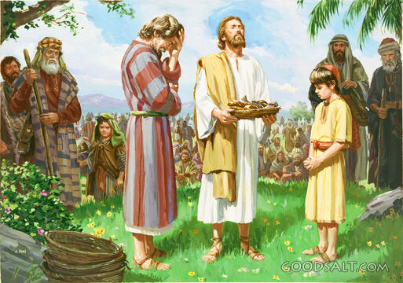
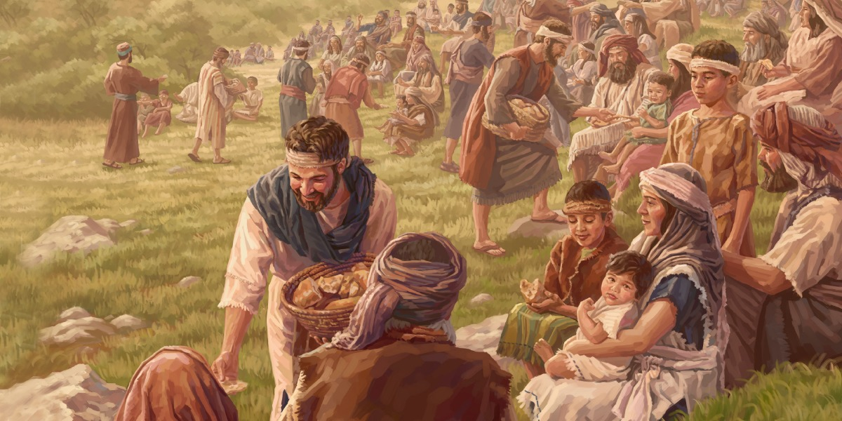
Feeding Israelites
Do you remember the story about when Jesus fed the 5,000 with just a boy’s lunch of 5 loaves of bread and 2 fish?
Tell me what happened.
Our stories today happened after Jesus fed the 5,000 Israelites.
Remember now Jesus is visiting the people outside Isreal……

Slide 15
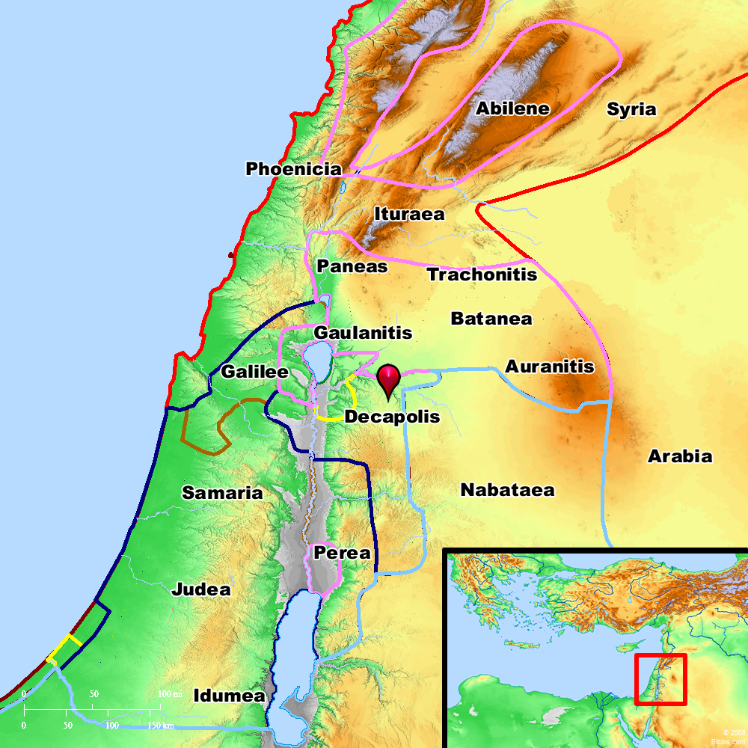
Jesus travels East to the 10 Cities
Mark 7
³¹ Then Jesus left the vicinity of Tyre and went through Sidon, down to the Sea of Galilee and into the region of the Decapolis.[

Slide 16
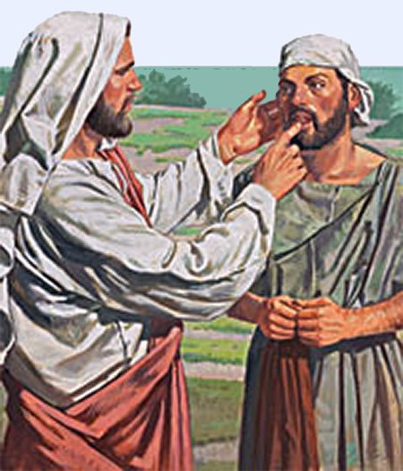
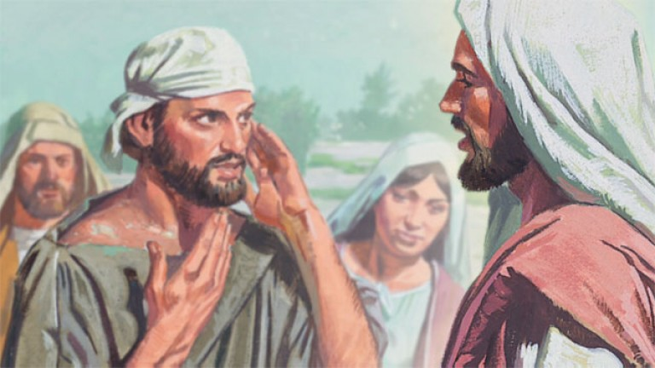
A Deaf and Mute man Healed!
Be opened!
Jesus, please heal this man. He can’t hear nor can he talk.
Mark 7
³² There some people brought to him a man who was deaf and could hardly talk, and they begged Jesus to place his hand on him.
³³ After he took him aside, away from the crowd, Jesus put his fingers into the man’s ears. Then he spit and touched the man’s tongue. ³⁴ He looked up to heaven and with a deep sigh said to him, “Ephphatha!” (which means “Be opened!”). ³⁵ At this, the man’s ears were opened, his tongue was loosened and he began to speak plainly.
³⁶ Jesus commanded them not to tell anyone. But the more he did so, the more they kept talking about it. ³⁷ People were overwhelmed with amazement. “He has done everything well,” they said. “He even makes the deaf hear and the mute speak.”
I can hear!
Thank you Jesus!

Slide 17
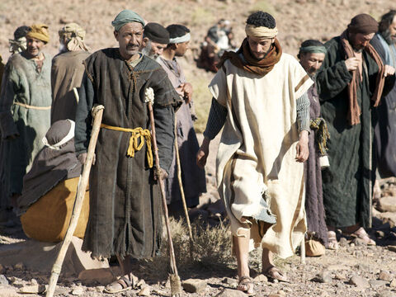
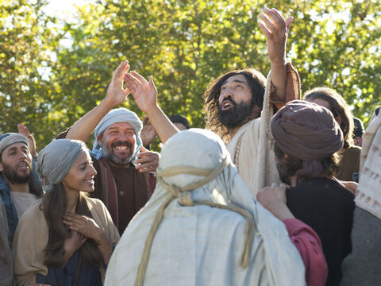
Near the Sea of Galilee, a crowd gathered
Matthew 15
²⁹ Jesus left there and went along the Sea of Galilee. Then he went up on a mountainside and sat down. ³⁰ Great crowds came to him, bringing the lame, the blind, the crippled, the mute and many others, and laid them at his feet; and he healed them. ³¹ The people were amazed when they saw the mute speaking, the crippled made well, the lame walking and the blind seeing. And they praised the God of Israel.

Slide 18
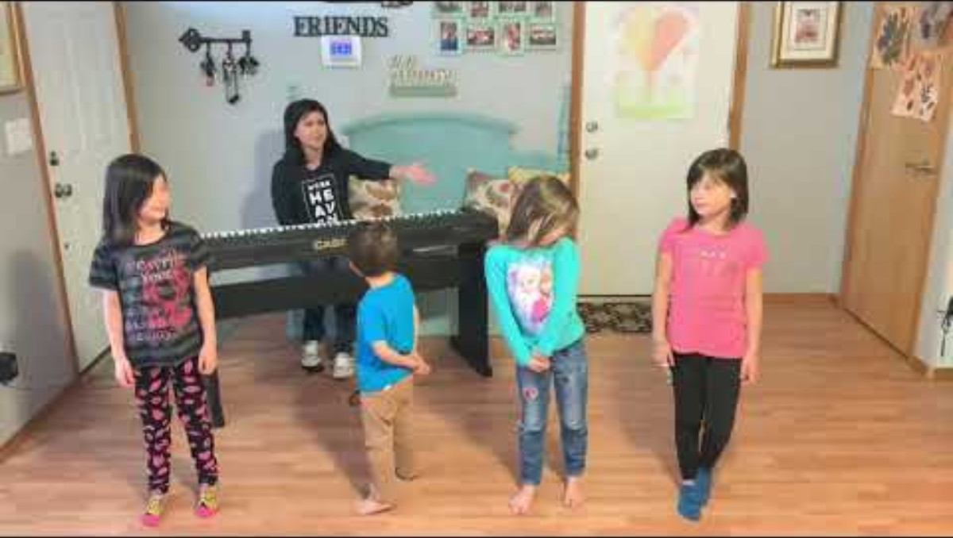
Spring up Oh Well I’ve Got a River of Life

Slide 19
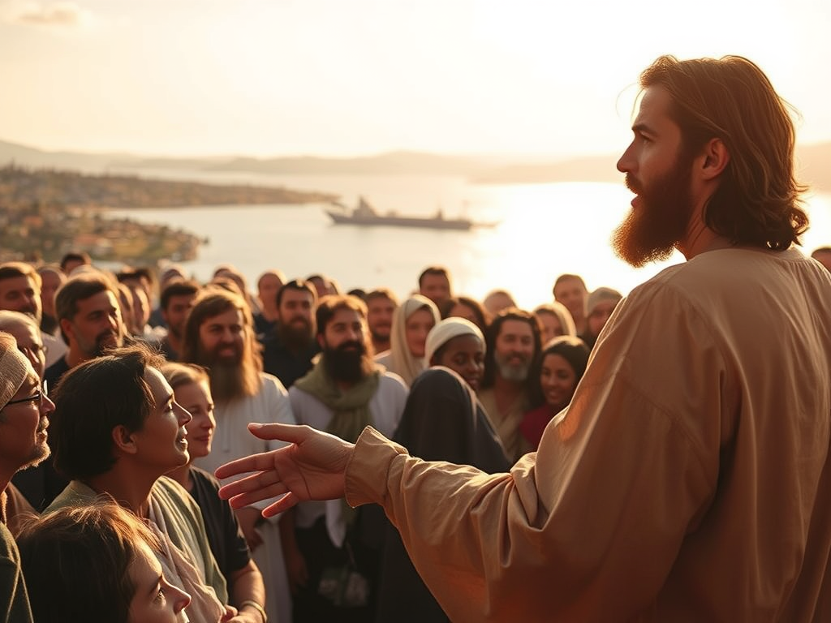
With Jesus for 3 days
Peter, Andrew, James, John, Matthew, come here.
These people have been here for 3 days and have had nothing to eat.
I don’t want to send them away hungry. They may collapse on the way.
The people were hungry and thirsty for righteousness. They stayed with Jesus for 3 days!
Matthew 15
³² Jesus called his disciples to him and said, “I have compassion for these people; they have already been with me three days and have nothing to eat. I do not want to send them away hungry, or they may collapse on the way.”

Slide 20
Jesus has compassion
Where could we get enough bread in this remote place to feed such a large crowd?
Matthew 15
³³ His disciples answered, “Where could we get enough bread in this remote place to feed such a crowd?”
³⁴ “How many loaves do you have?” Jesus asked.
“Seven,” they replied, “and a few small fish.”
Do you think the disciples remembered Jesus feeding the 5000?
How many loaves do you have?
7 loaves of bread and a few small fish.

Slide 21
Jesus feeds the crowd
Everybody sit down.
We will eat.
Matthew 15
³⁵ He told the crowd to sit down on the ground.
Snack
Time!
Let’s eat the bread you made! YUM!

Slide 22
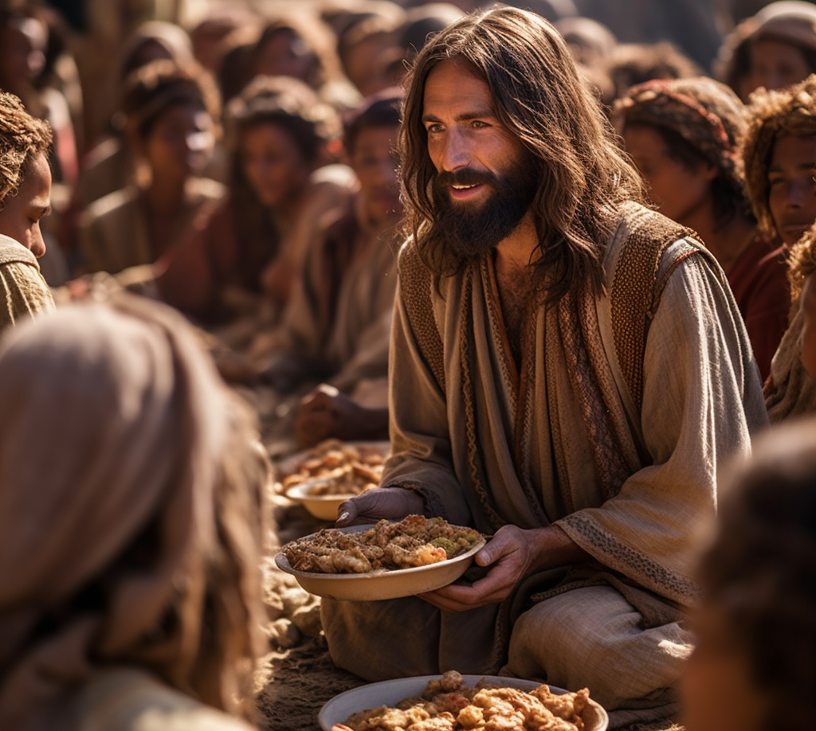

With Jesus for 3 days
Matthew 15
³⁶ Then he took the seven loaves and the fish, and when he had given thanks, he broke them and gave them to the disciples, and they in turn to the people.
³⁷ They all ate and were satisfied.
Jesus healed and fed those who were not Israelites in the same way He did the israelites!

Slide 23
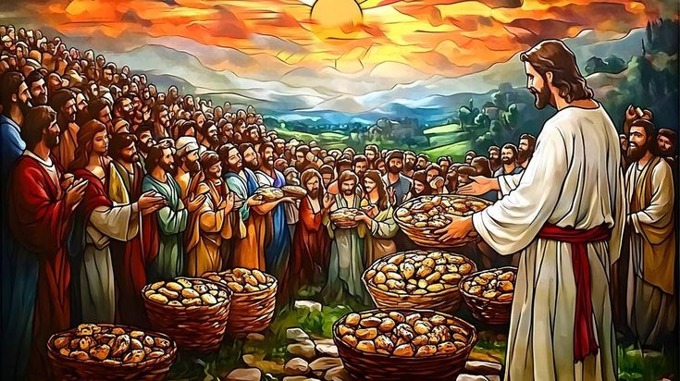
Food left over
Matthew 15
³⁷ They all ate and were satisfied. Afterward the disciples picked up seven basketfuls of broken pieces that were left over.
³⁸ The number of those who ate was four thousand men, besides women and children.
³⁹ After Jesus had sent the crowd away, he got into the boat and went to the vicinity of Magadan.
How many baskets of food were left over after everyone was full?

Slide 24


Activity
Blessed are
Cut out the memory verse loaves and fish.
Mix them up.
Work together to put them in the correct order.
This will be a take home activity after they finish the craft.
be filled
those who
hunger and thirst
for righteousness
Matthew 5:6
for they will

Slide 25
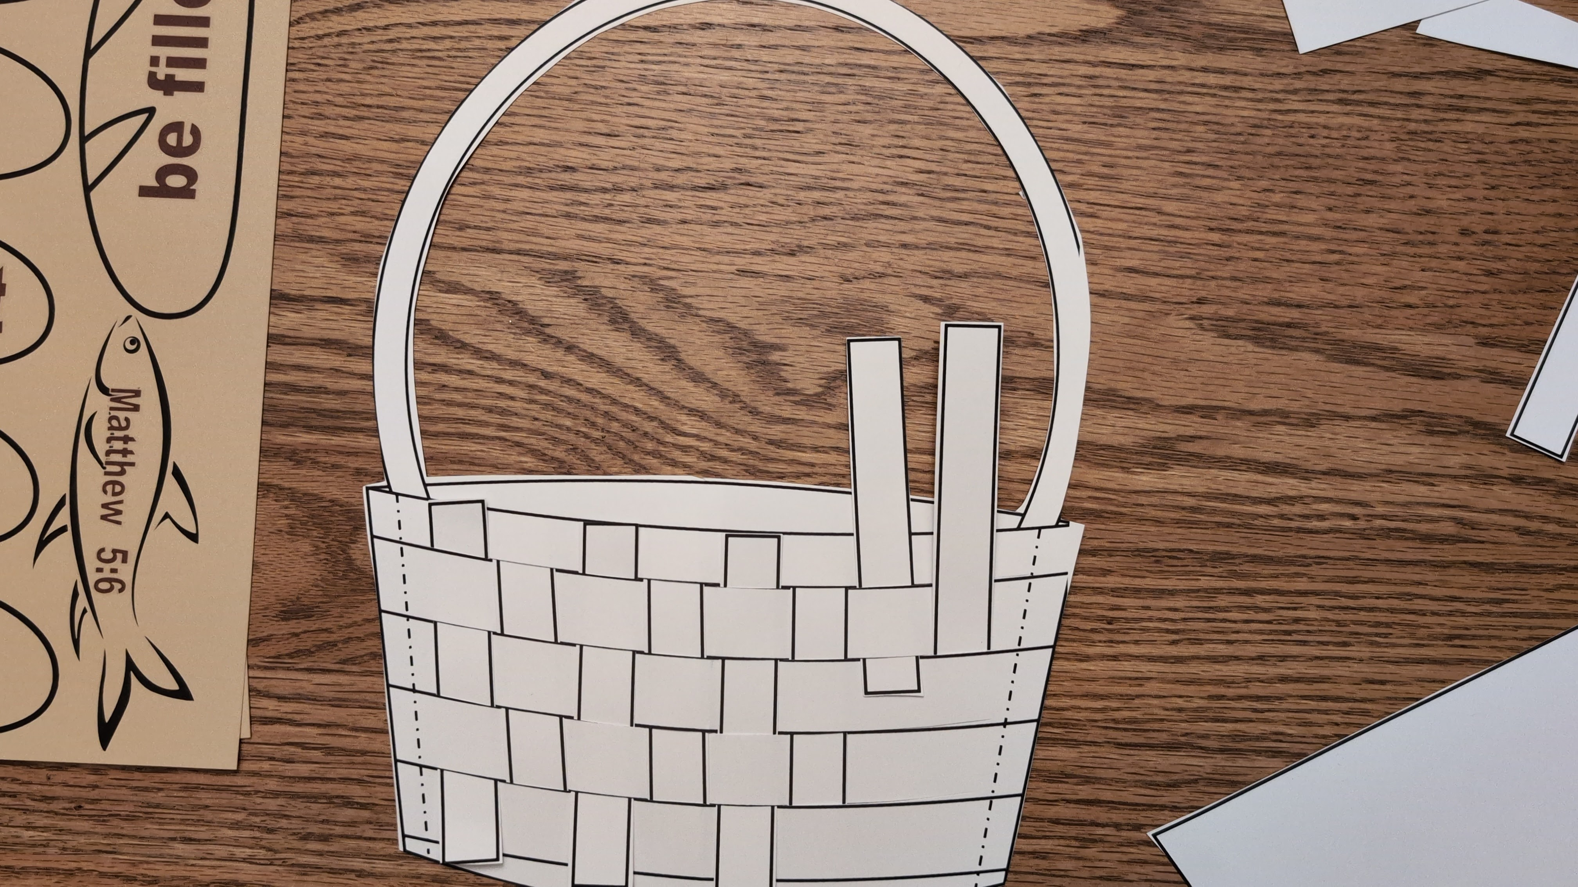
CRAFT
Directions:
Color the basket, strips to weave, and hexagon.
Cut out the basket, strips to weave, and hexagon.
Cut the horizontal lines on the basket from one dotted line to the other. The easy way to do this is to fold it in half and cut the lines to the dotted line.
Weave the strips in the basket.
Glue the tops and bottoms of the strips to the basket so they won’t come out.
Turn the basket over. Put glue on bottom and sides of the basket then put the trapezoid on it, glueing it on the back of the basket as shown.
Cut out the bread and fish. They can go in the basket.
Take them out and put the memory verse in order.

Slide 26


Slide 27
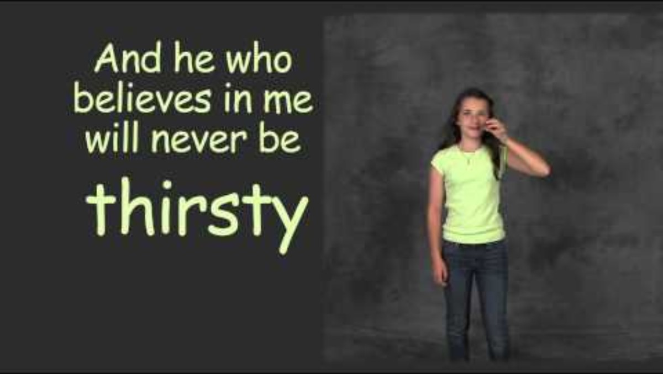

Slide 28


Slide 29
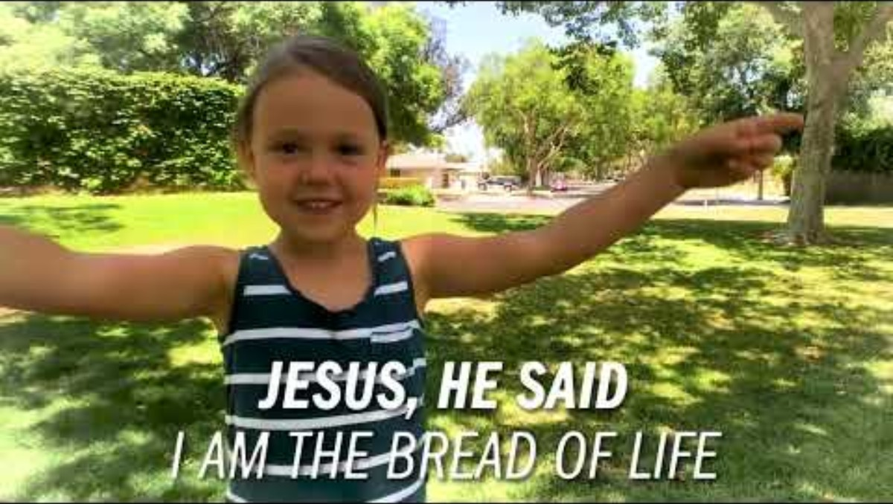

Slide 30
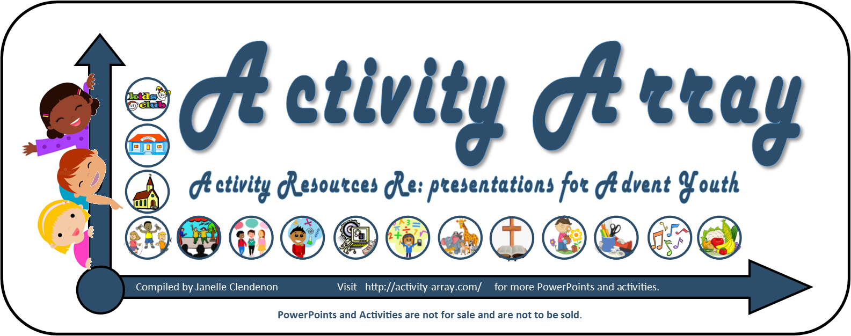
THE END
There’s more at: https://activity-array.com/

