Slide 1
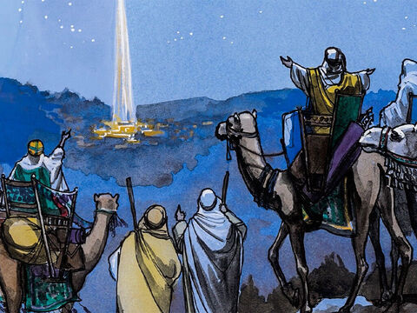
Wise men still seek Him Led by His light
Matthew 2

Slide 2

Do you like to get gifts? What kinds of gifts do you like? Do you enjoy giving gifts? Besides buying gifts, we can make them. Another great gift is to give our time or to do something for someone.

Slide 3
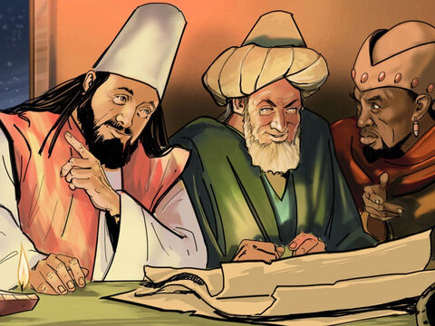
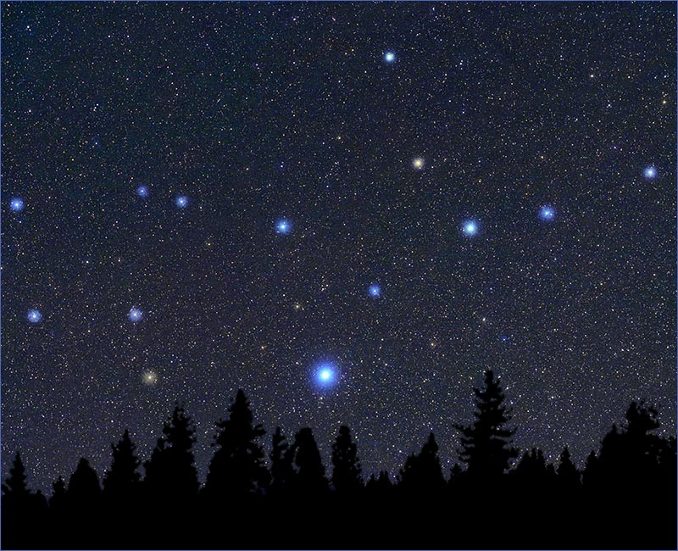
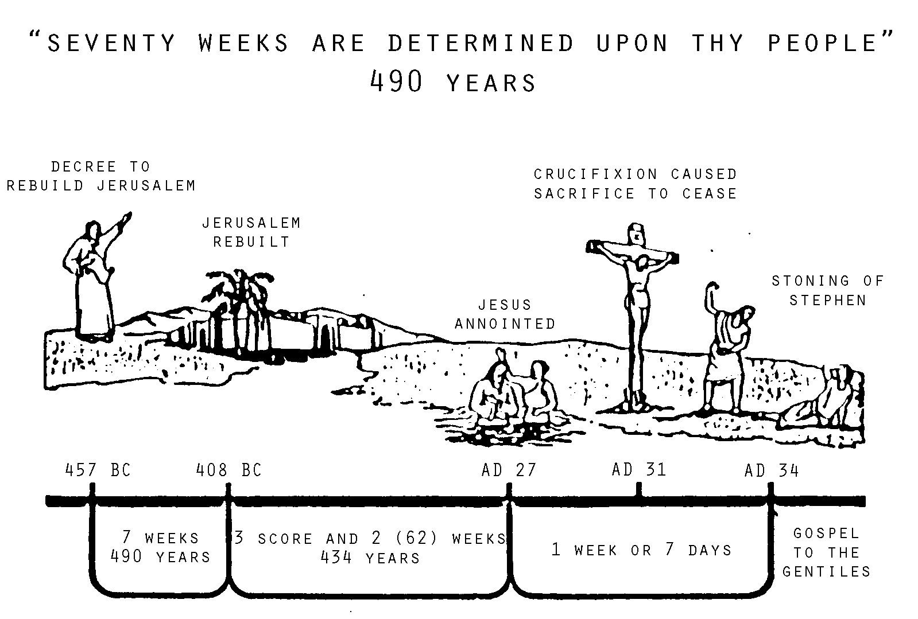

There is a NEW STAR.
A king is born
According to Daniel’s prophecies it is time for the king to be born in Israel.
Let’s go see him!
Read more about it
in Daniel 9:22-27

Slide 4
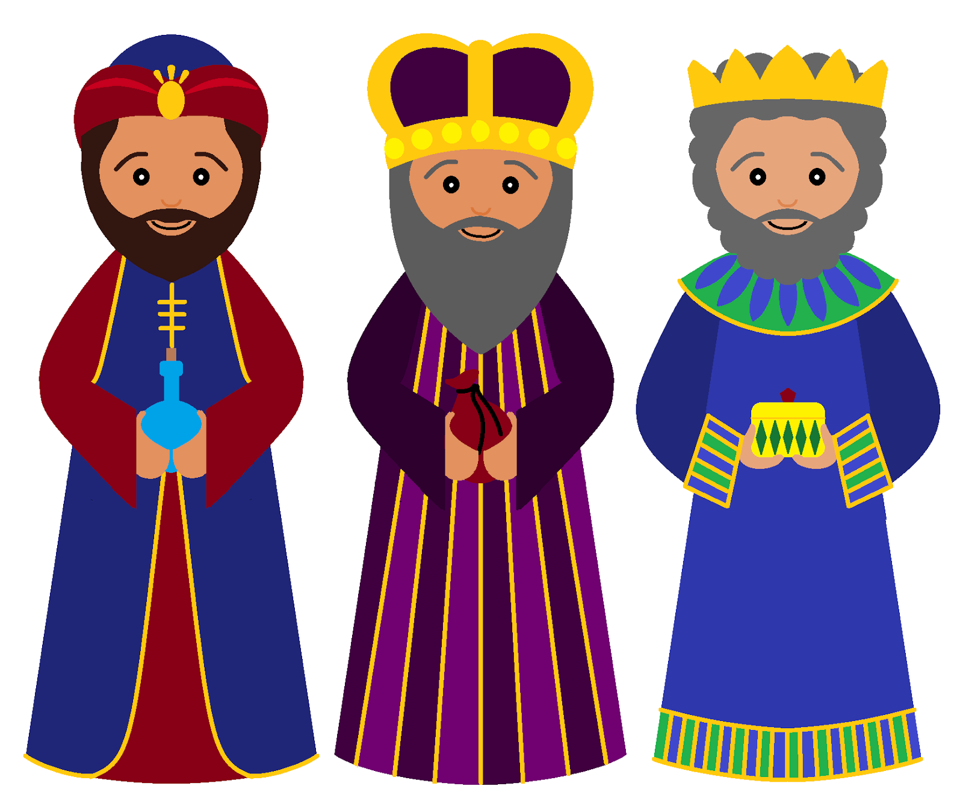
In what book of the Bible can we find the story of the wise men?
CLUES:
It’s not in Luke, though he tells the rest of the story about Jesus’ birth. He wanted everyone to know that God loves each of us and is near to even the ordinary and unloved.
It’s not in John, though he tells how God’s Word became flesh, Jesus. Jesus is God. Jesus is Immanuel, God with us. God is always with us and cares for us every day!
It’s in the first Gospel book.
It starts with “M”
Matthew wanted to make sure that you know that Jesus is the King of kings! Even the wise kings of the east worshipped Him!

Slide 5
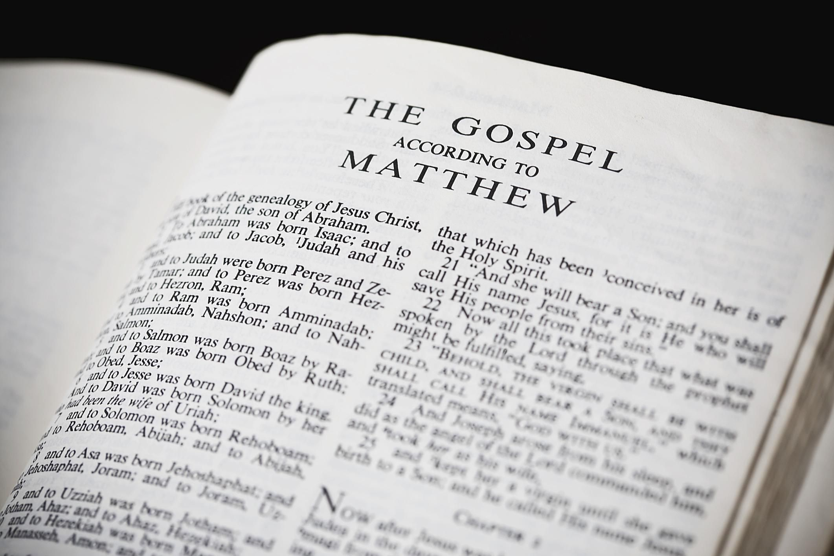
Let’s find the book of Matthew read Matthew 2:1-2

Slide 6
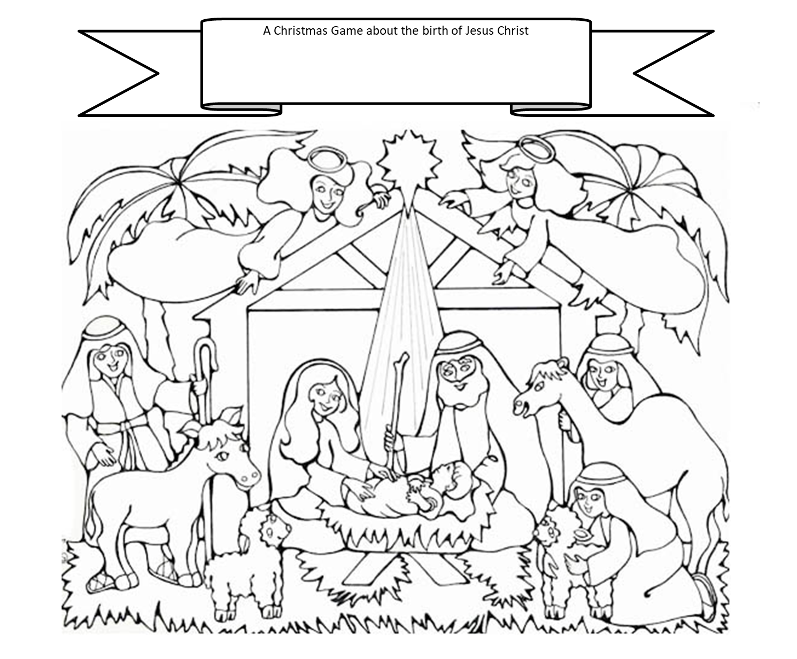
You can help tell the story by acting it out. Listen closely to what is read so you can do it.
Who do you want to be?
Wiseman 1
Wiseman 2
Wiseman 3
Joseph
Mary
Herod
Priest
Name your game
You may also color a picture to go on the front of your game.

Slide 7
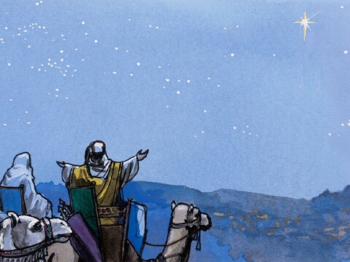
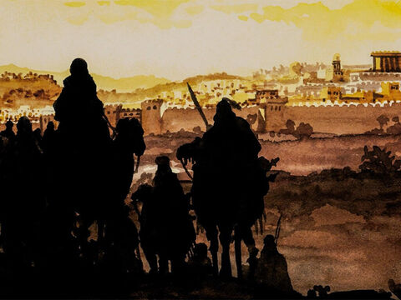
There’s Jerusalem
The Wise Men Visit Jesus
2 Jesus was born in Bethlehem in Judea. This happened while Herod was king of Judea. After Jesus’ birth, Wise Men from the east came to Jerusalem.

Slide 8
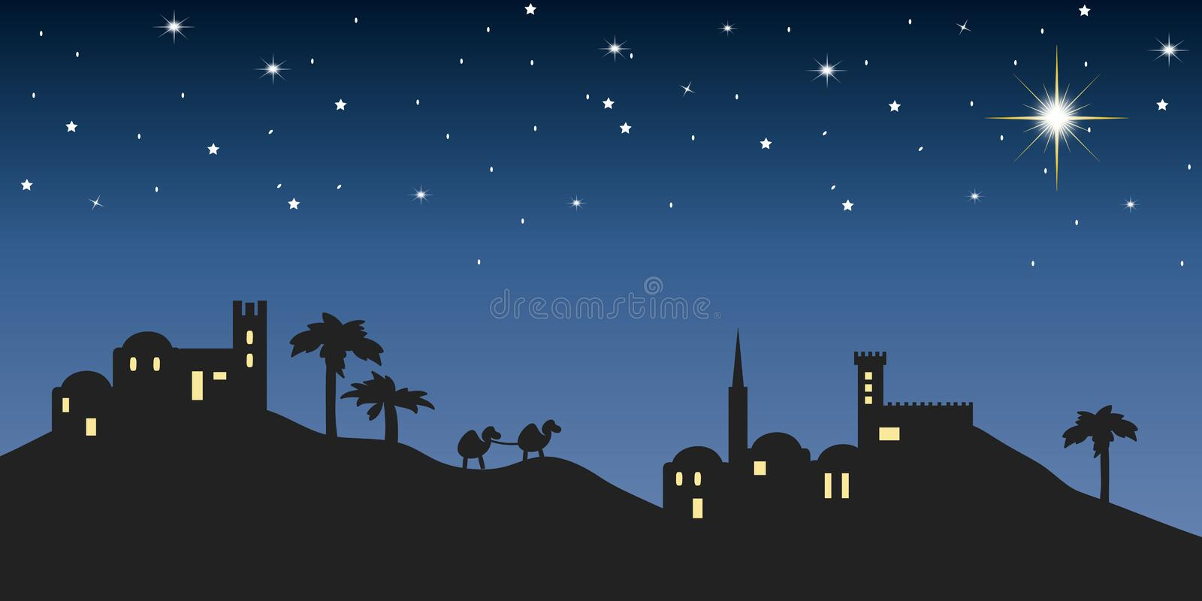
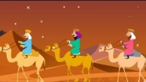
We Three Kings

Slide 9
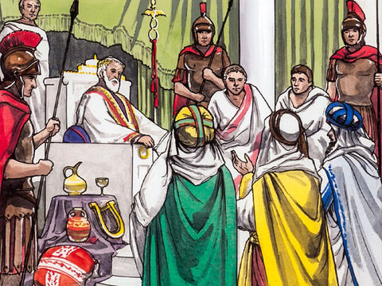
Where is the King?
What?!
A new king?
I won’t allow this!
Wise Men from the east came to Jerusalem. ² They asked, “Where is the child who has been born to be king of the Jews? We saw his star when it rose. Now we have come to worship him.”
³ When King Herod heard about it, he was very upset. Everyone in Jerusalem was troubled too.
Where is the new born King?
We followed his star
We have come to worship Him..

Slide 10
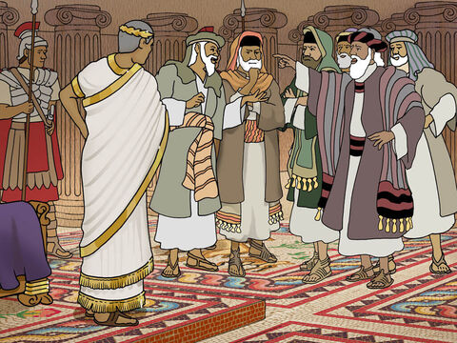
Where is the Messiah to be born?
Where is the Messiah to be born?
Micah wrote
He will be born
In Bethlehem.
⁴ So Herod called together all the chief priests of the people. He also called the teachers of the law. He asked them where the Messiah was going to be born. ⁵ “In Bethlehem in Judea,” they replied. “This is what the prophet has written. He said,
⁶ “ ‘But you, Bethlehem, in the land of Judah, are certainly not the least important among the towns of Judah. A ruler will come out of you. He will rule my people Israel like a shepherd.’ ” (Micah 5:2)

Slide 11
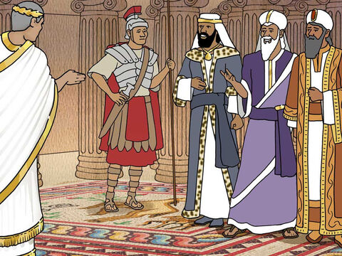
Go search
Go search carefully for the babe and tell me where to find him so I can worship him.
We will sir. Thank you.
⁷ Then Herod secretly called for the Wise Men.
He found out from them exactly when the star had appeared.
⁸ He sent them to Bethlehem. He said, “Go and search carefully for the child. As soon as you find him, report it to me. Then I can go and worship him too.”

Slide 12
Look! Follow the star!
The star has shown us the way.
Hallelujah!
We are almost there
to worship the promised One!
⁹ After the Wise Men had listened to the king, they went on their way.
The star they had seen when it rose went ahead of them.
It finally stopped over the place where the child was. ¹⁰ When they saw the star, they were filled with joy. ¹¹ The Wise Men went to the house.

Slide 13
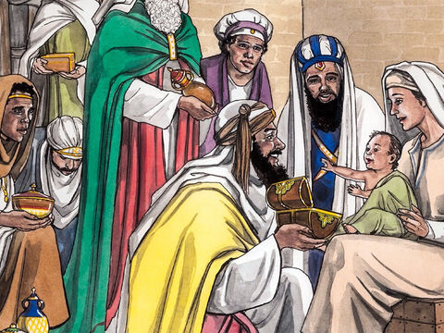
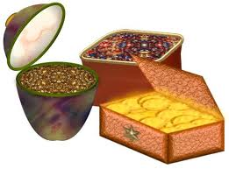
Oh precious Baby!
¹¹ The Wise Men went to the house.
There they saw the child with his mother Mary. They bowed down and worshiped him.
Then they opened their treasures. They gave him gold, frankincense and myrrh.
My Lord and King,
We brought you gold
Frankincense
And myrrh.

Slide 14
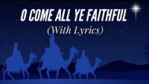
O Come Let Us Adore Him

Slide 15
GOLD
GIFTS FIT FOR A KING
FRANKINCENSE
MYRRH
Riches – Money of greatest value
Incense used in the sanctuary for worship.
Fragrant resin used in perfumes, medicine, and incense, and embalming
Jesus is
King
High Priest
Savior

Slide 16
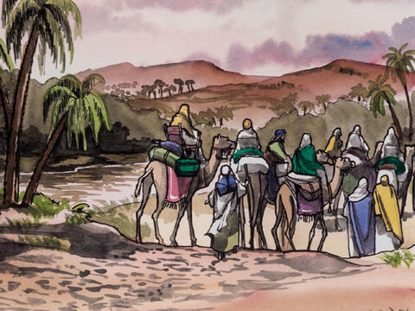
Let’s go home
Go home a different way.
Herod wants to harm baby Jesus
Praise God!
We saw our Savior!
¹² But God warned them in a dream not to go back to Herod. So they returned to their country on a different road.

Slide 17
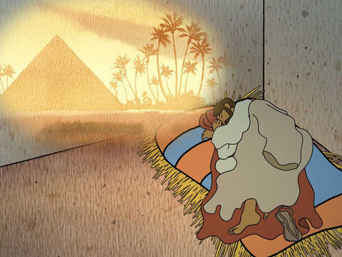
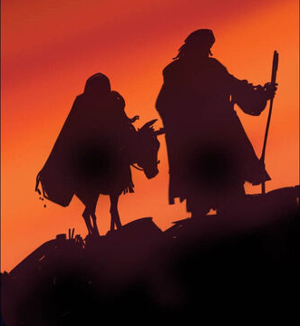
Quickly. Get up.
Go to Egypt.
Herod wants to kill Jesus.
G0!
¹³ When the Wise Men had left, Joseph had a dream. In the dream an angel of the Lord appeared to Joseph. “Get up!” the angel said. “Take the child and his mother and escape to Egypt. Stay there until I tell you to come back. Herod is going to search for the child. He wants to kill him.”
¹⁴ So Joseph got up. During the night, he left for Egypt with the child and his mother Mary. ¹⁵ They stayed there until King Herod died. So the words the Lord had spoken through the prophet came true. He had said, “I brought my son out of Egypt.” (Hosea 11:1)
HURRY!
GET UP!

Slide 18
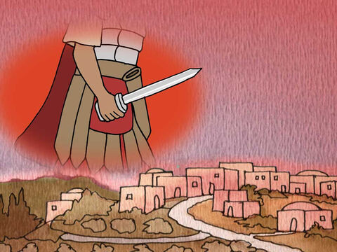
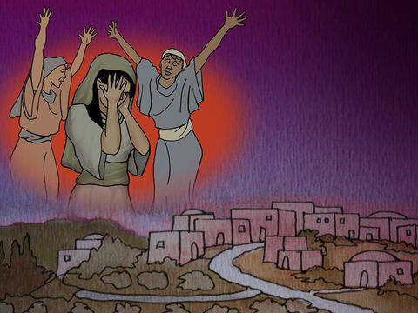
Oh No!
¹⁶ Herod realized that the Wise Men had tricked him. So he became very angry. He gave orders about Bethlehem and the area around it. He ordered all the boys two years old and under to be killed. This agreed with the time when the Wise Men had seen the star. ¹⁷ In this way, the words Jeremiah the prophet spoke came true. He had said,
¹⁸ “A voice is heard in Ramah. It’s the sound of crying and deep sadness. Rachel is crying over her children. She refuses to be comforted, because they are gone.” (Jeremiah 31:15)
That’s
horrible!
So Sad!
Waaa

Slide 19
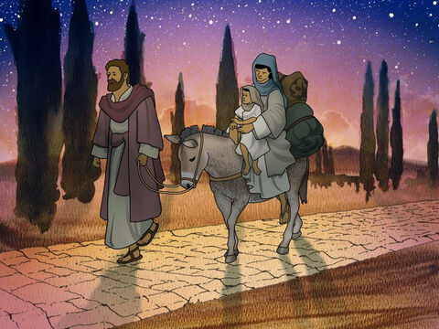
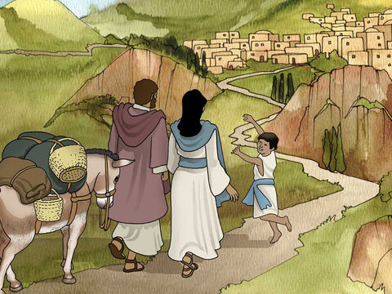
There’s our home!
Nazareth!
God has kept us safe! Praise Him
¹⁹ After Herod died, Joseph had a dream while he was still in Egypt. In the dream an angel of the Lord appeared to him. ²⁰ The angel said, “Get up! Take the child and his mother. Go to the land of Israel. The people who were trying to kill the child are dead.”
²¹ So Joseph got up. He took the child and his mother Mary back to the land of Israel. ²² But then he heard that Archelaus was king of Judea. Archelaus was ruling in place of his father Herod. This made Joseph afraid to go there. Joseph had been warned in a dream. So he went back to the land of Galilee instead. ²³ There he lived in a town called Nazareth. So what the prophets had said about Jesus came true. They had said that he would be called a Nazarene.

Slide 20

Craft PART 1
DIRECTIONS
Cut out the Announcement Cards
Write in how many spaces to move forward. Choose 1, 2, or 3
These are your last cards
Answer this question: If you had a box of gold, What would you do? Then go forward ____ spaces | Answer this question: What animal have you ridden or would like to ride? Then go forward ____ spaces
Prophecies, a star and a dream directed the Wise Men Tell everyone What tells you where to go or how to get there? Then go forward ____ spaces | Sing: Twinkle, Twinkle Little Star Then go forward ____ spaces
Tell everyone: A birthday or Christmas memory What was your favorite gift? Then go forward ____ spaces | Tell everyone: What gift you would like to give Jesus Then go forward ____ spaces

Slide 21

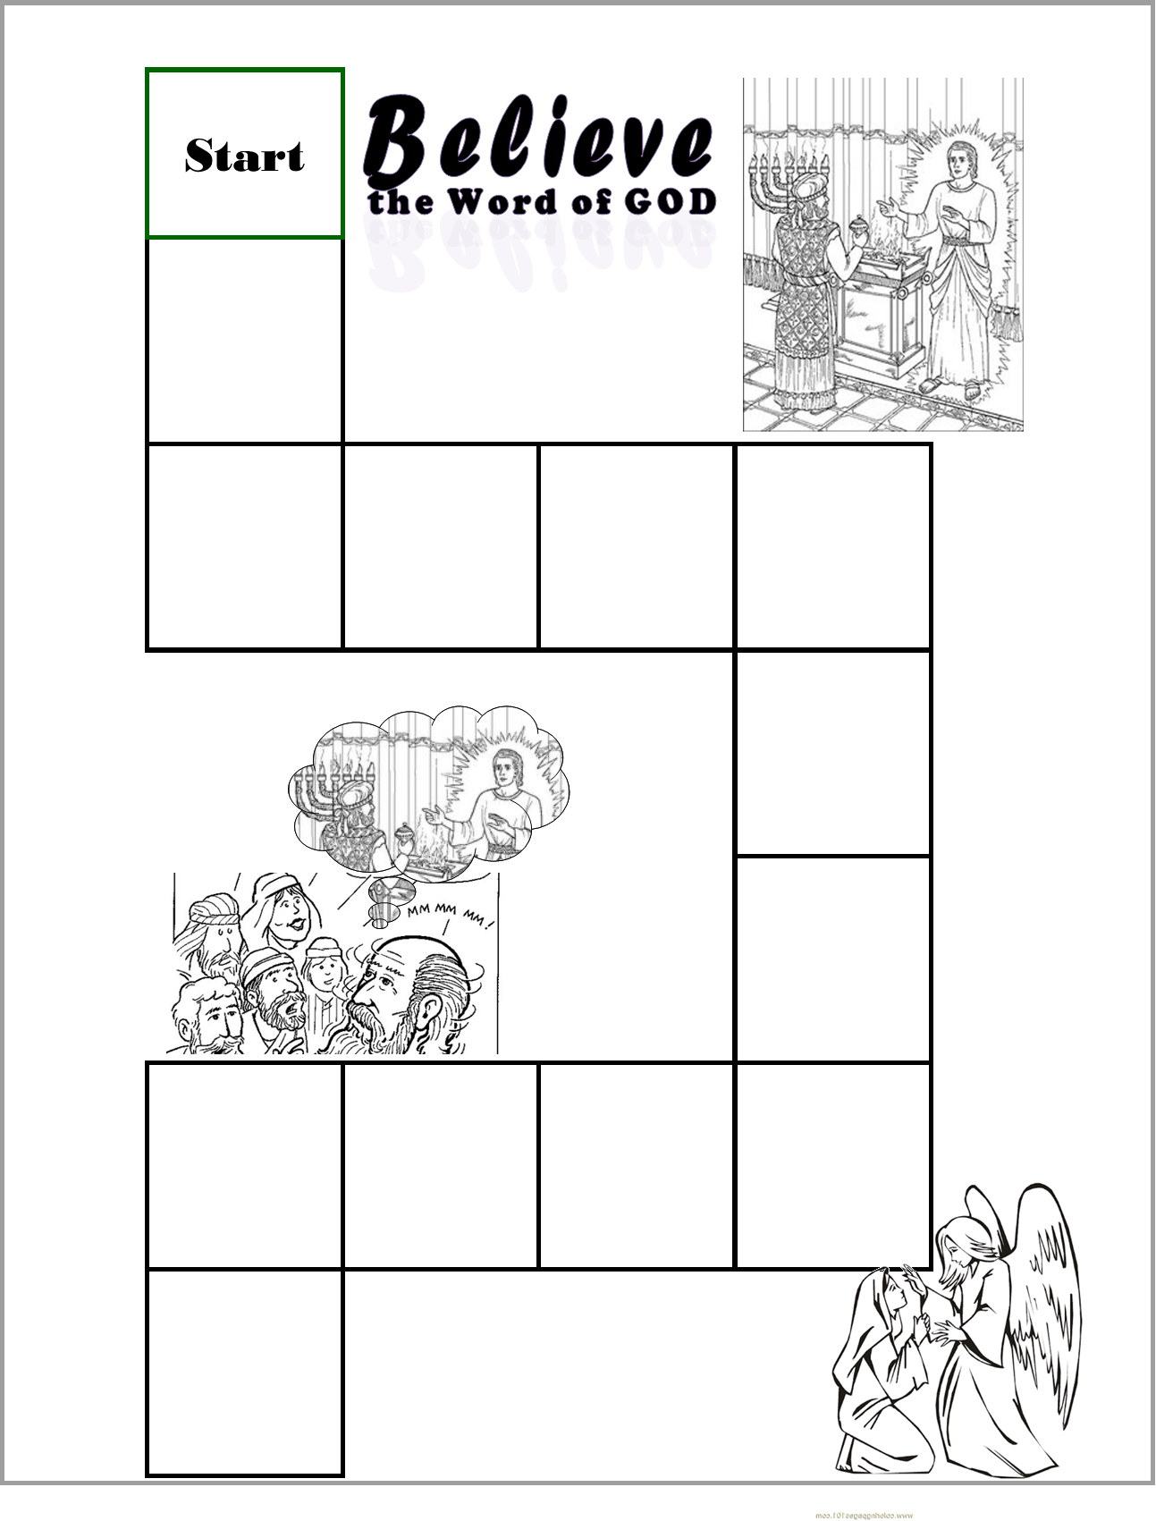
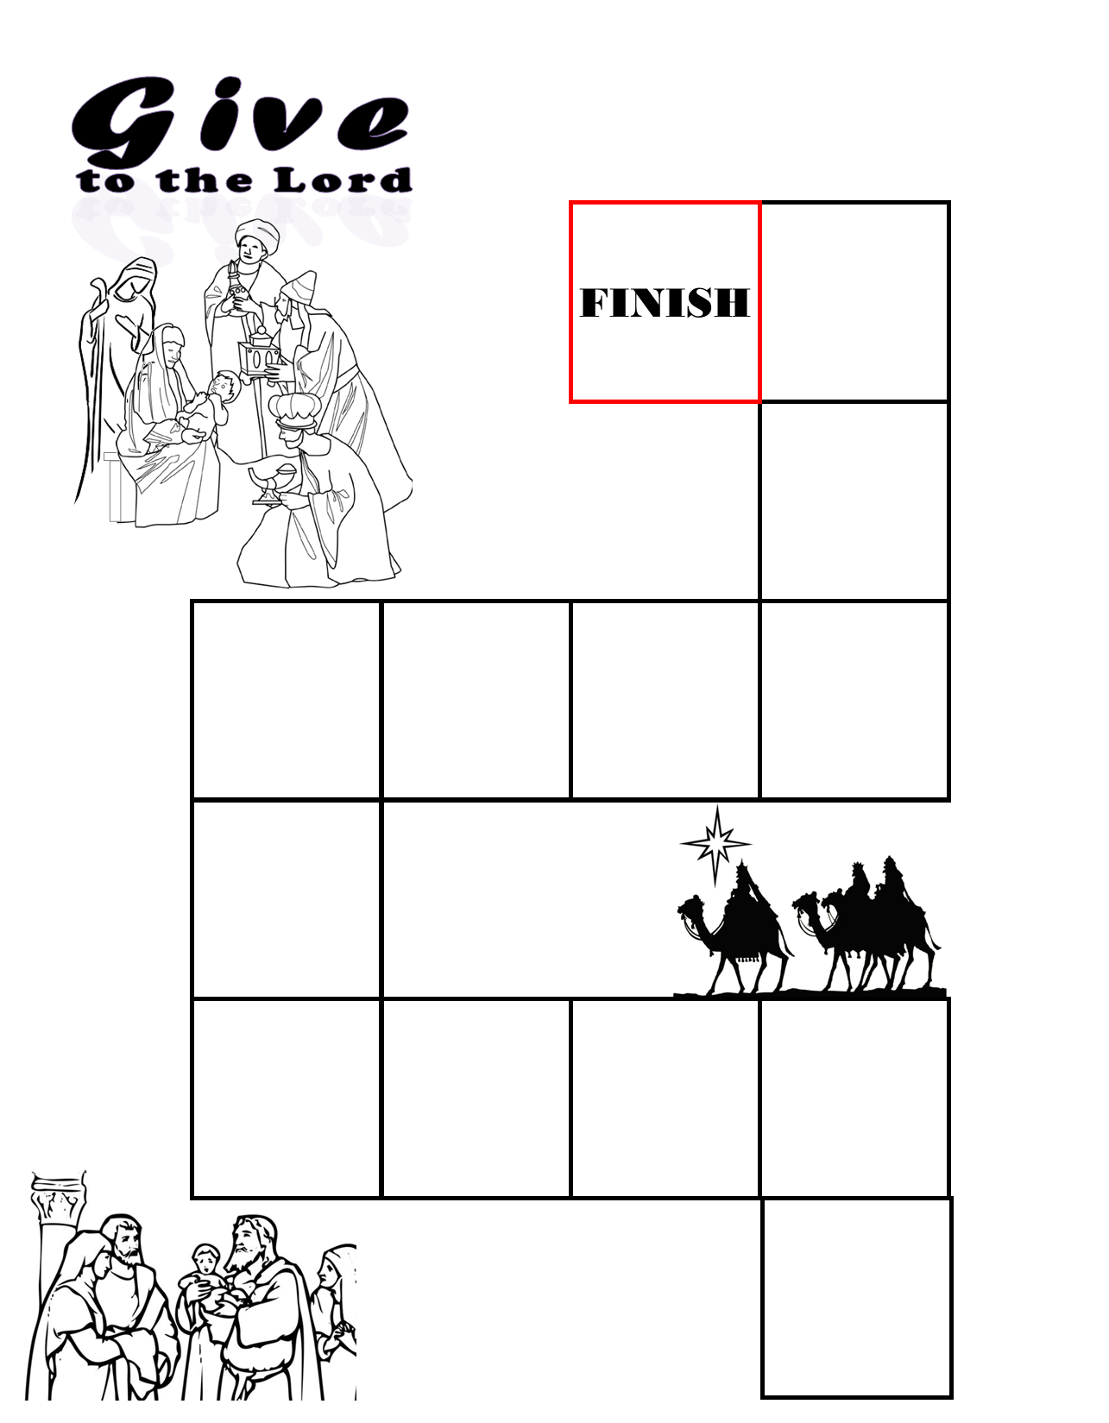
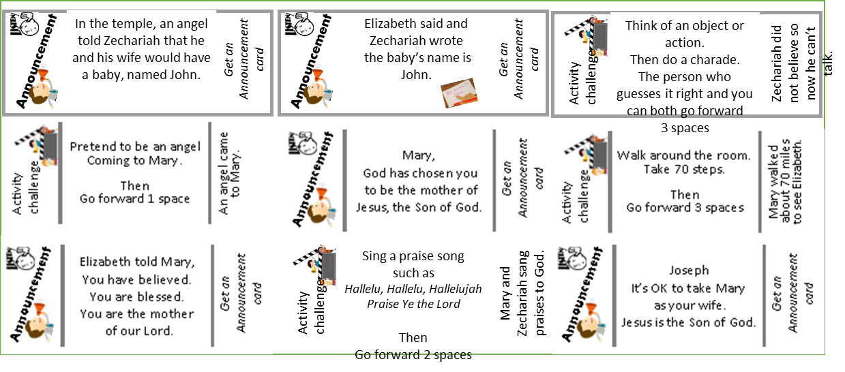
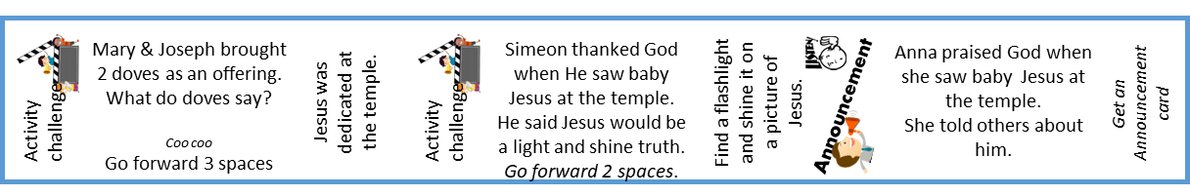
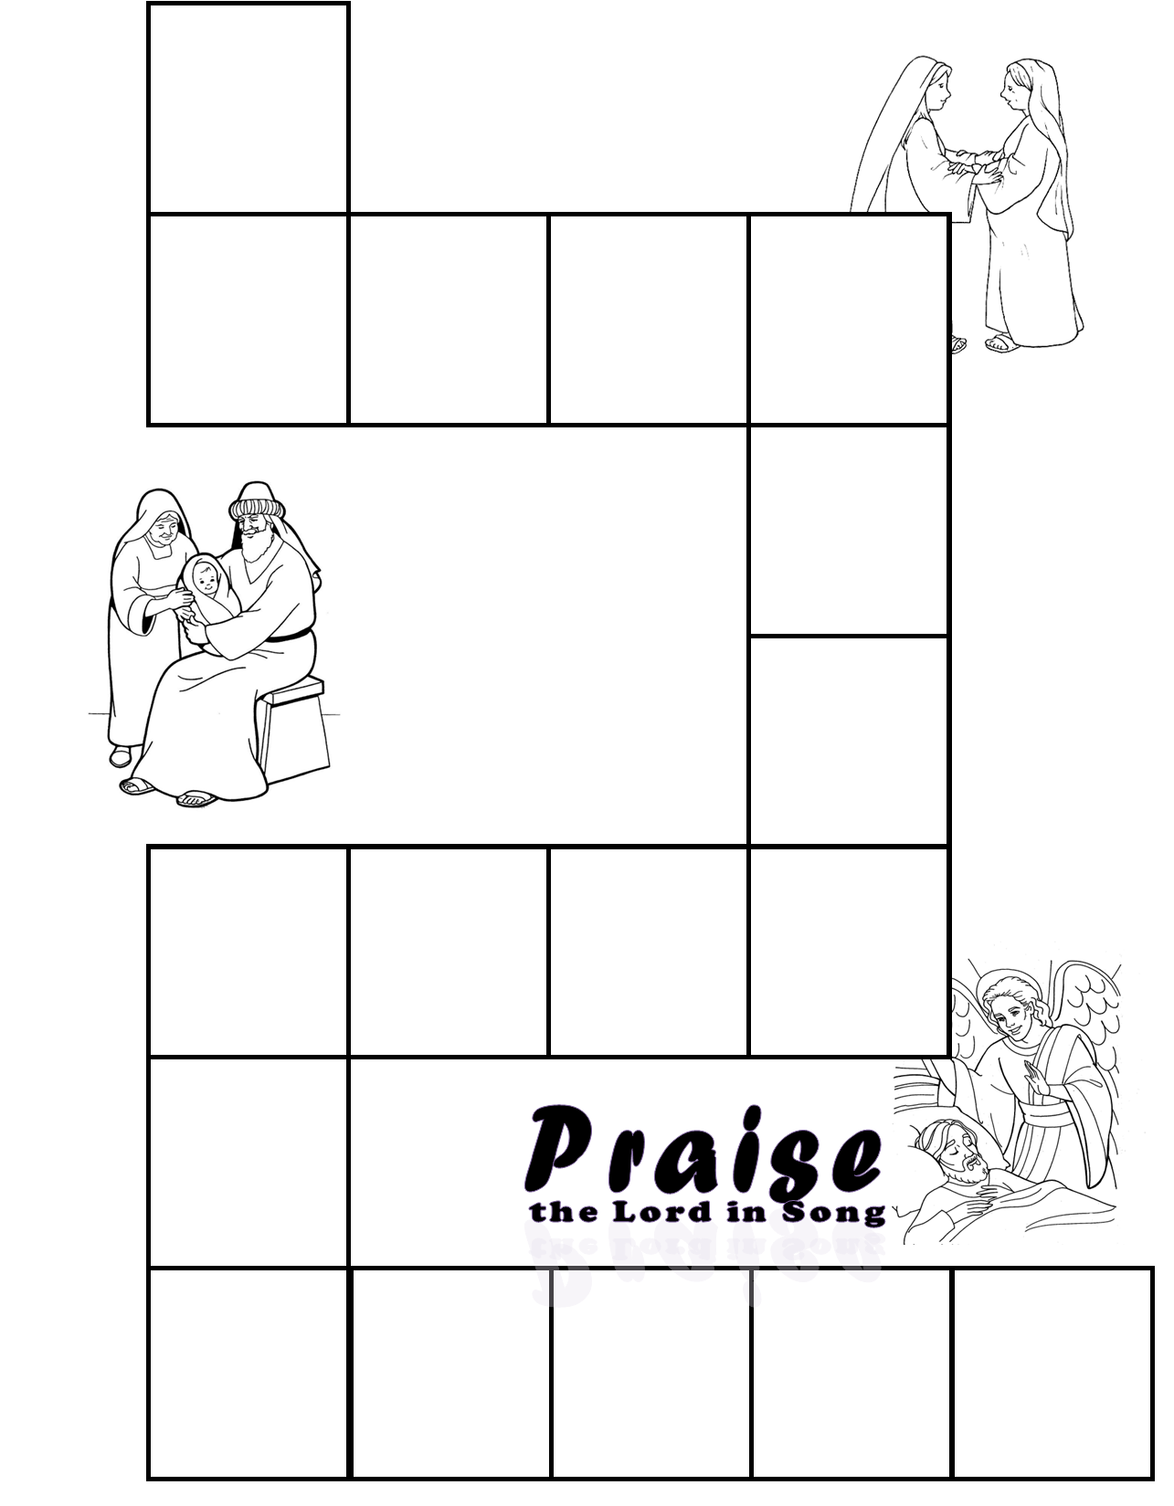
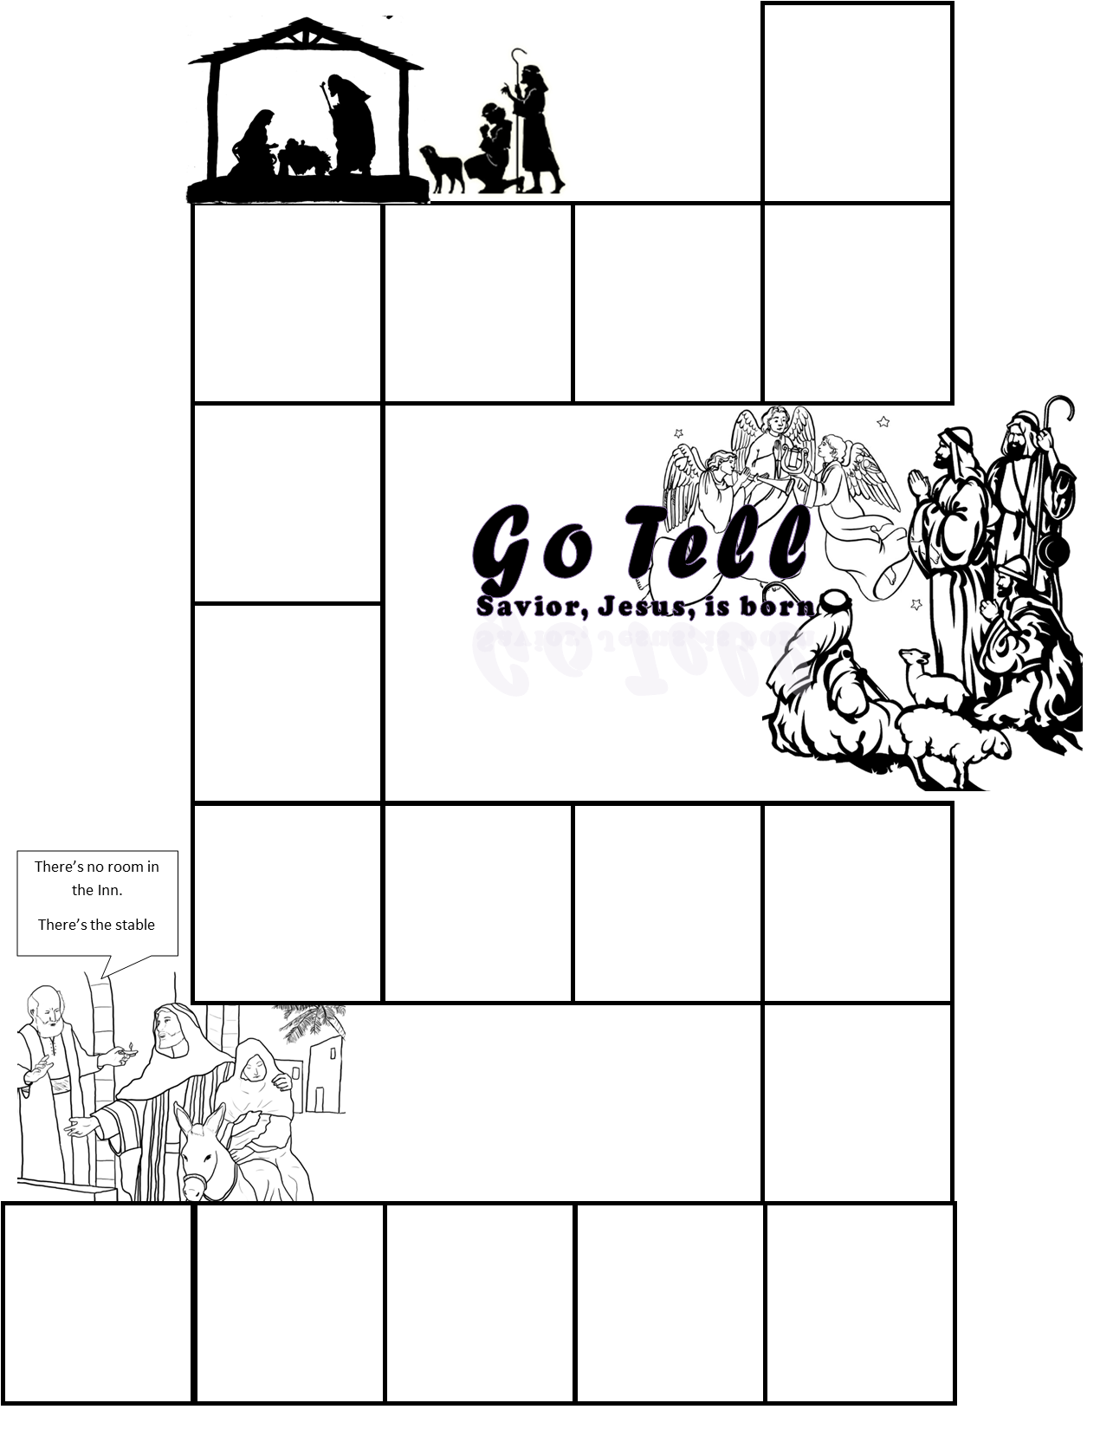
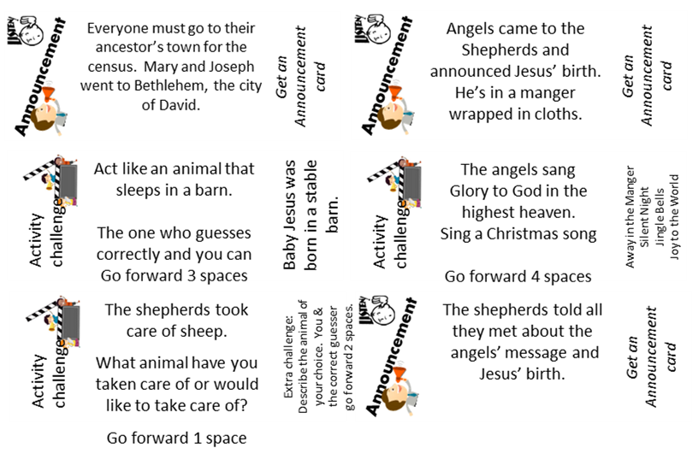
Craft PART 2
DIRECTIONS
Prepare the playing board part 3: Glue this page on the left side of a manila folder so that the bottom right corner is near the bottom right corner of the left side of the folder.
Put on the activity stickers like this: (click to see where)
Write in your own directions on 2 squares if you wish.
Note: We will be adding the final stickers and cards of the game next week.

Slide 22
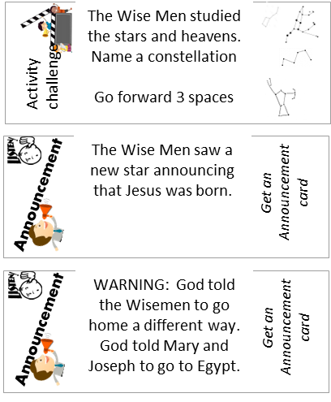

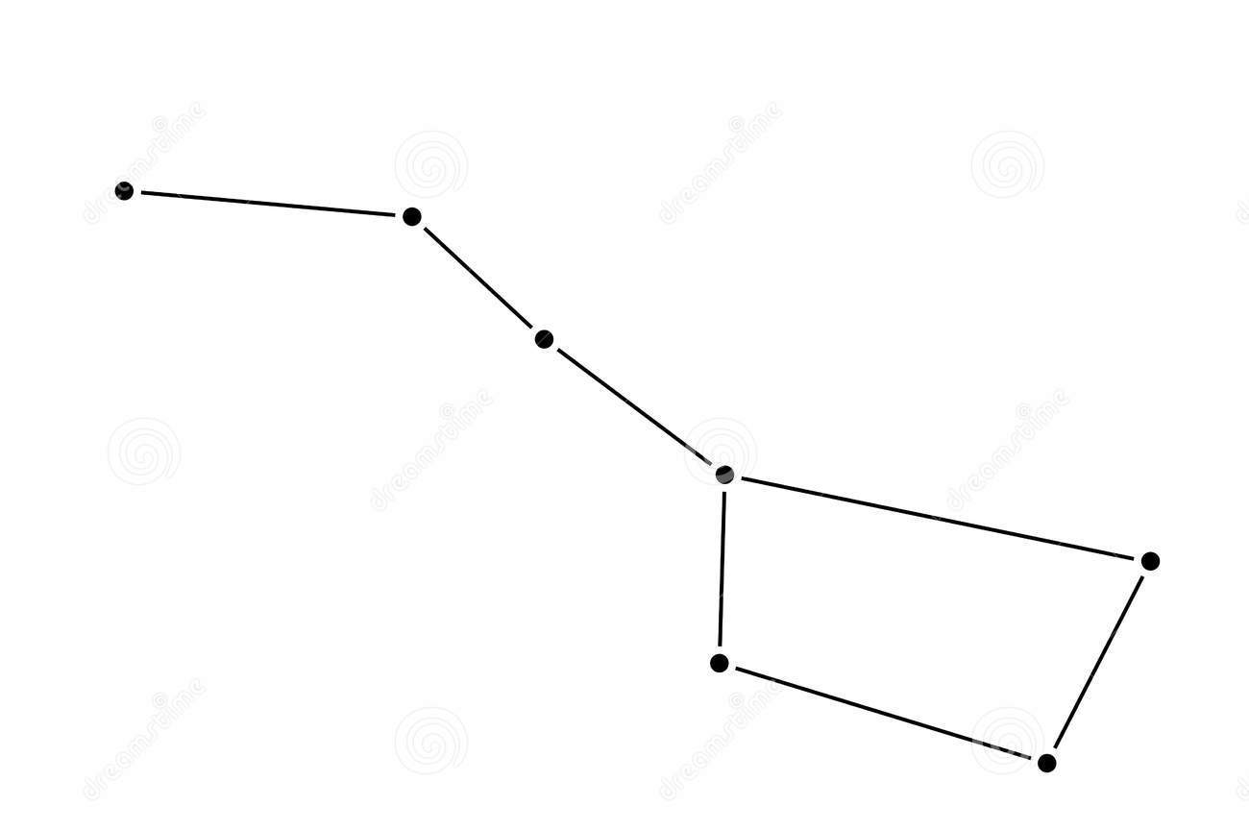
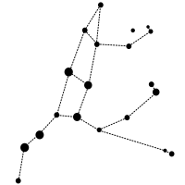
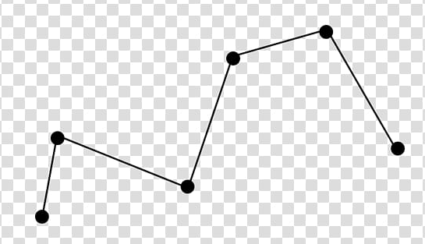
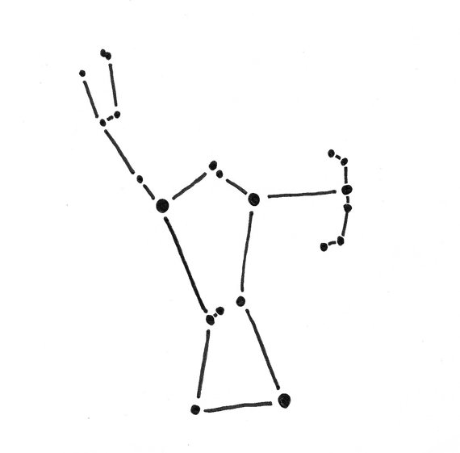


Craft PART 2
DIRECTIONS
Prepare the playing board part 3: Glue this page on the left side of a manila folder so that the bottom right corner is near the bottom right corner of the left side of the folder.
Put on the activity stickers like this: (click to see where)
Write in your own directions on 2 squares if you wish.
Note: We will be adding the final stickers and cards of the game next week.
The Wise Men studied the stars and heavens.
Name a constellation
Go forward 3 spaces
Activity
challenge
The Wise Men saw a new star announcing that Jesus was born.
Get an
Announcement card
Announcement
WARNING: God told the Wisemen to go home a different way.
God told Mary and
Joseph to go to Egypt.
Get an
Announcement card
Announcement

Slide 23

Sing Joy to the World

Slide 24
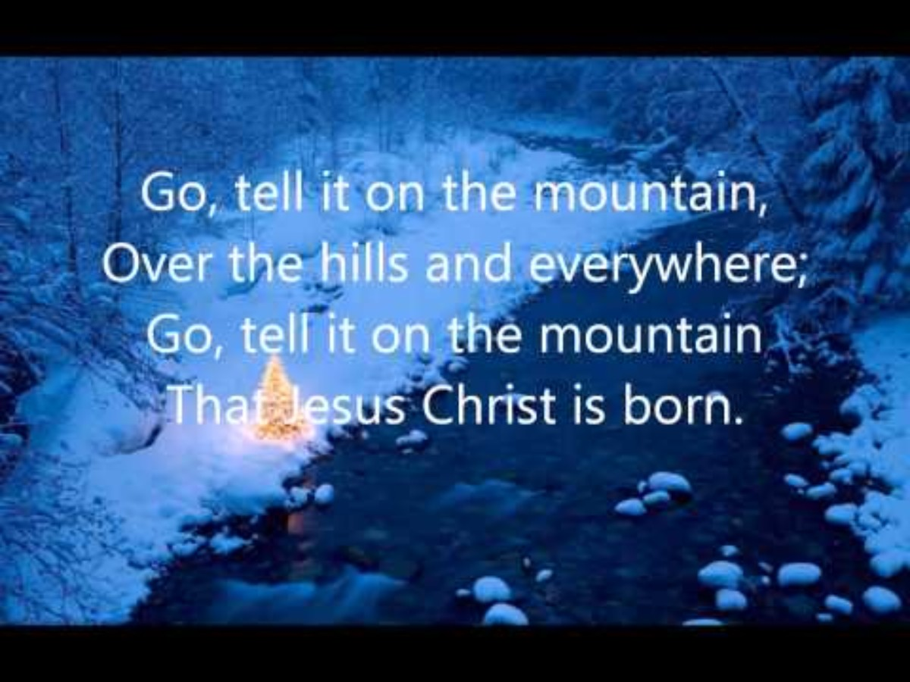
Sing Go Tell It on The Mountain

Slide 25

https://activity-array.com/

Slide 26
Breakfast Option
One year we did breakfast and then I had the following slides playing for background music. You could move these slides to where you want, if you wish to do that option,

Slide 27

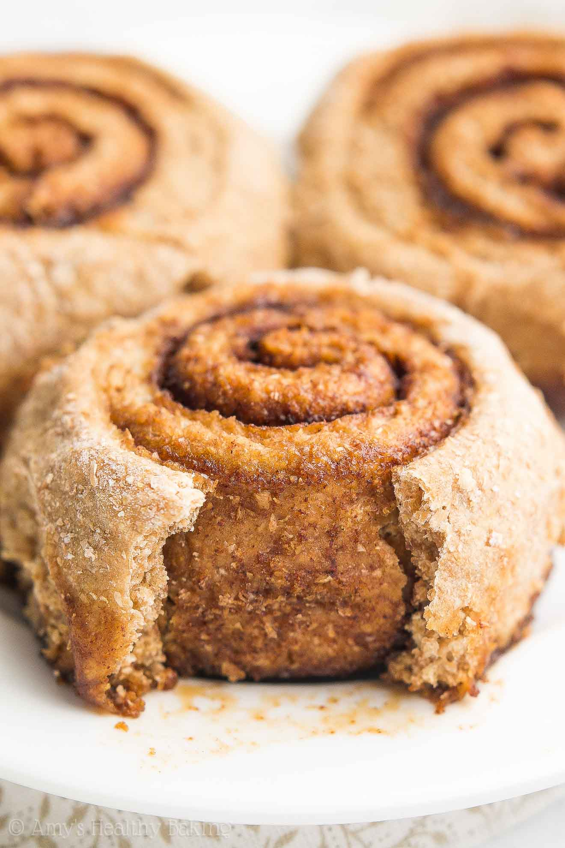
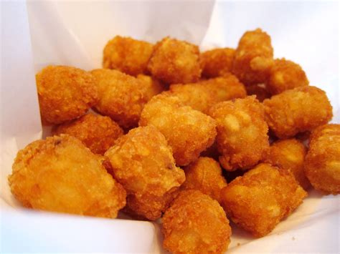
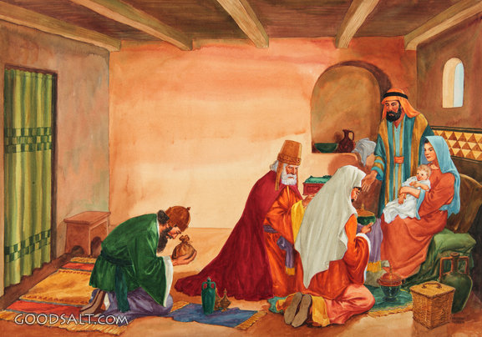
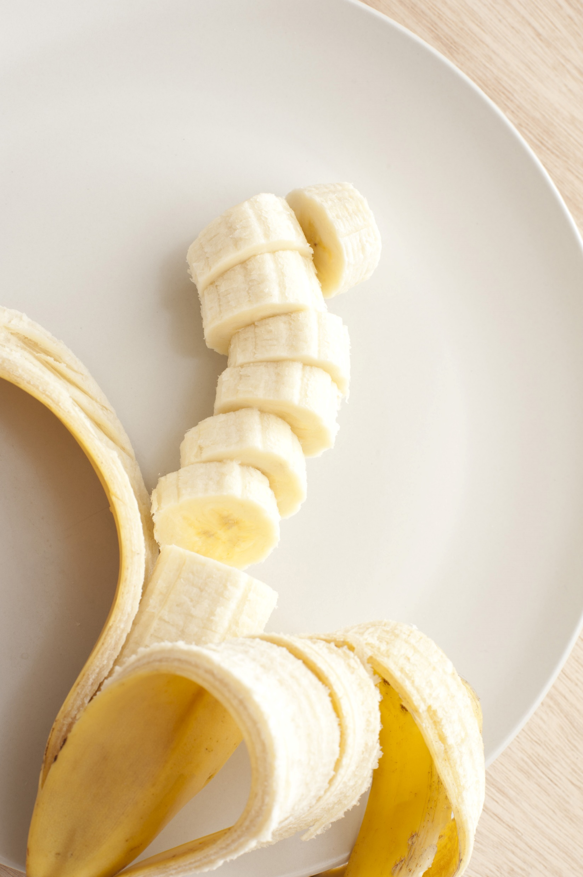
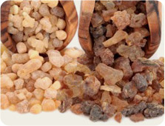
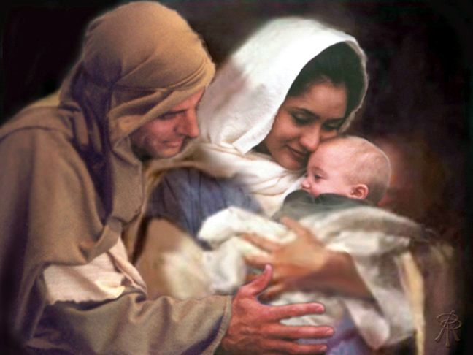
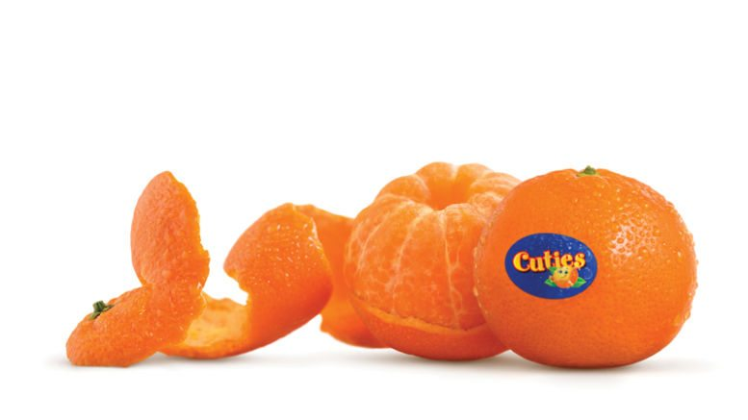
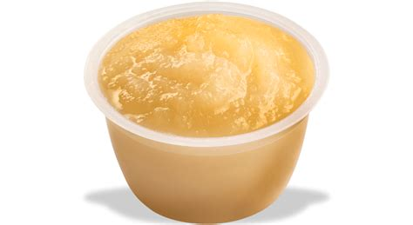
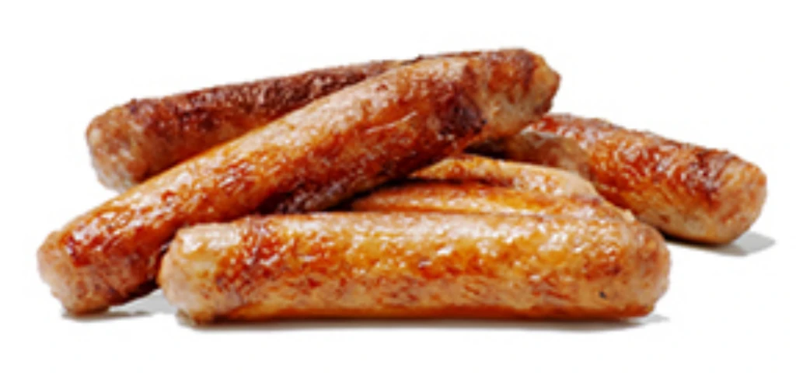
Breakfast
Just like the wisemen,
We wrapped up some spices for you.
They found Him very
a-pealing.
They worshiped Jesus.
The little tot the wisemen sought was baby Jesus.
Orange you glad that Jesus came!
Link up to Him. He wants to be with you forever!
No sauce
about it, you are the apple of HIS eye.
He loves YOU!

Slide 28
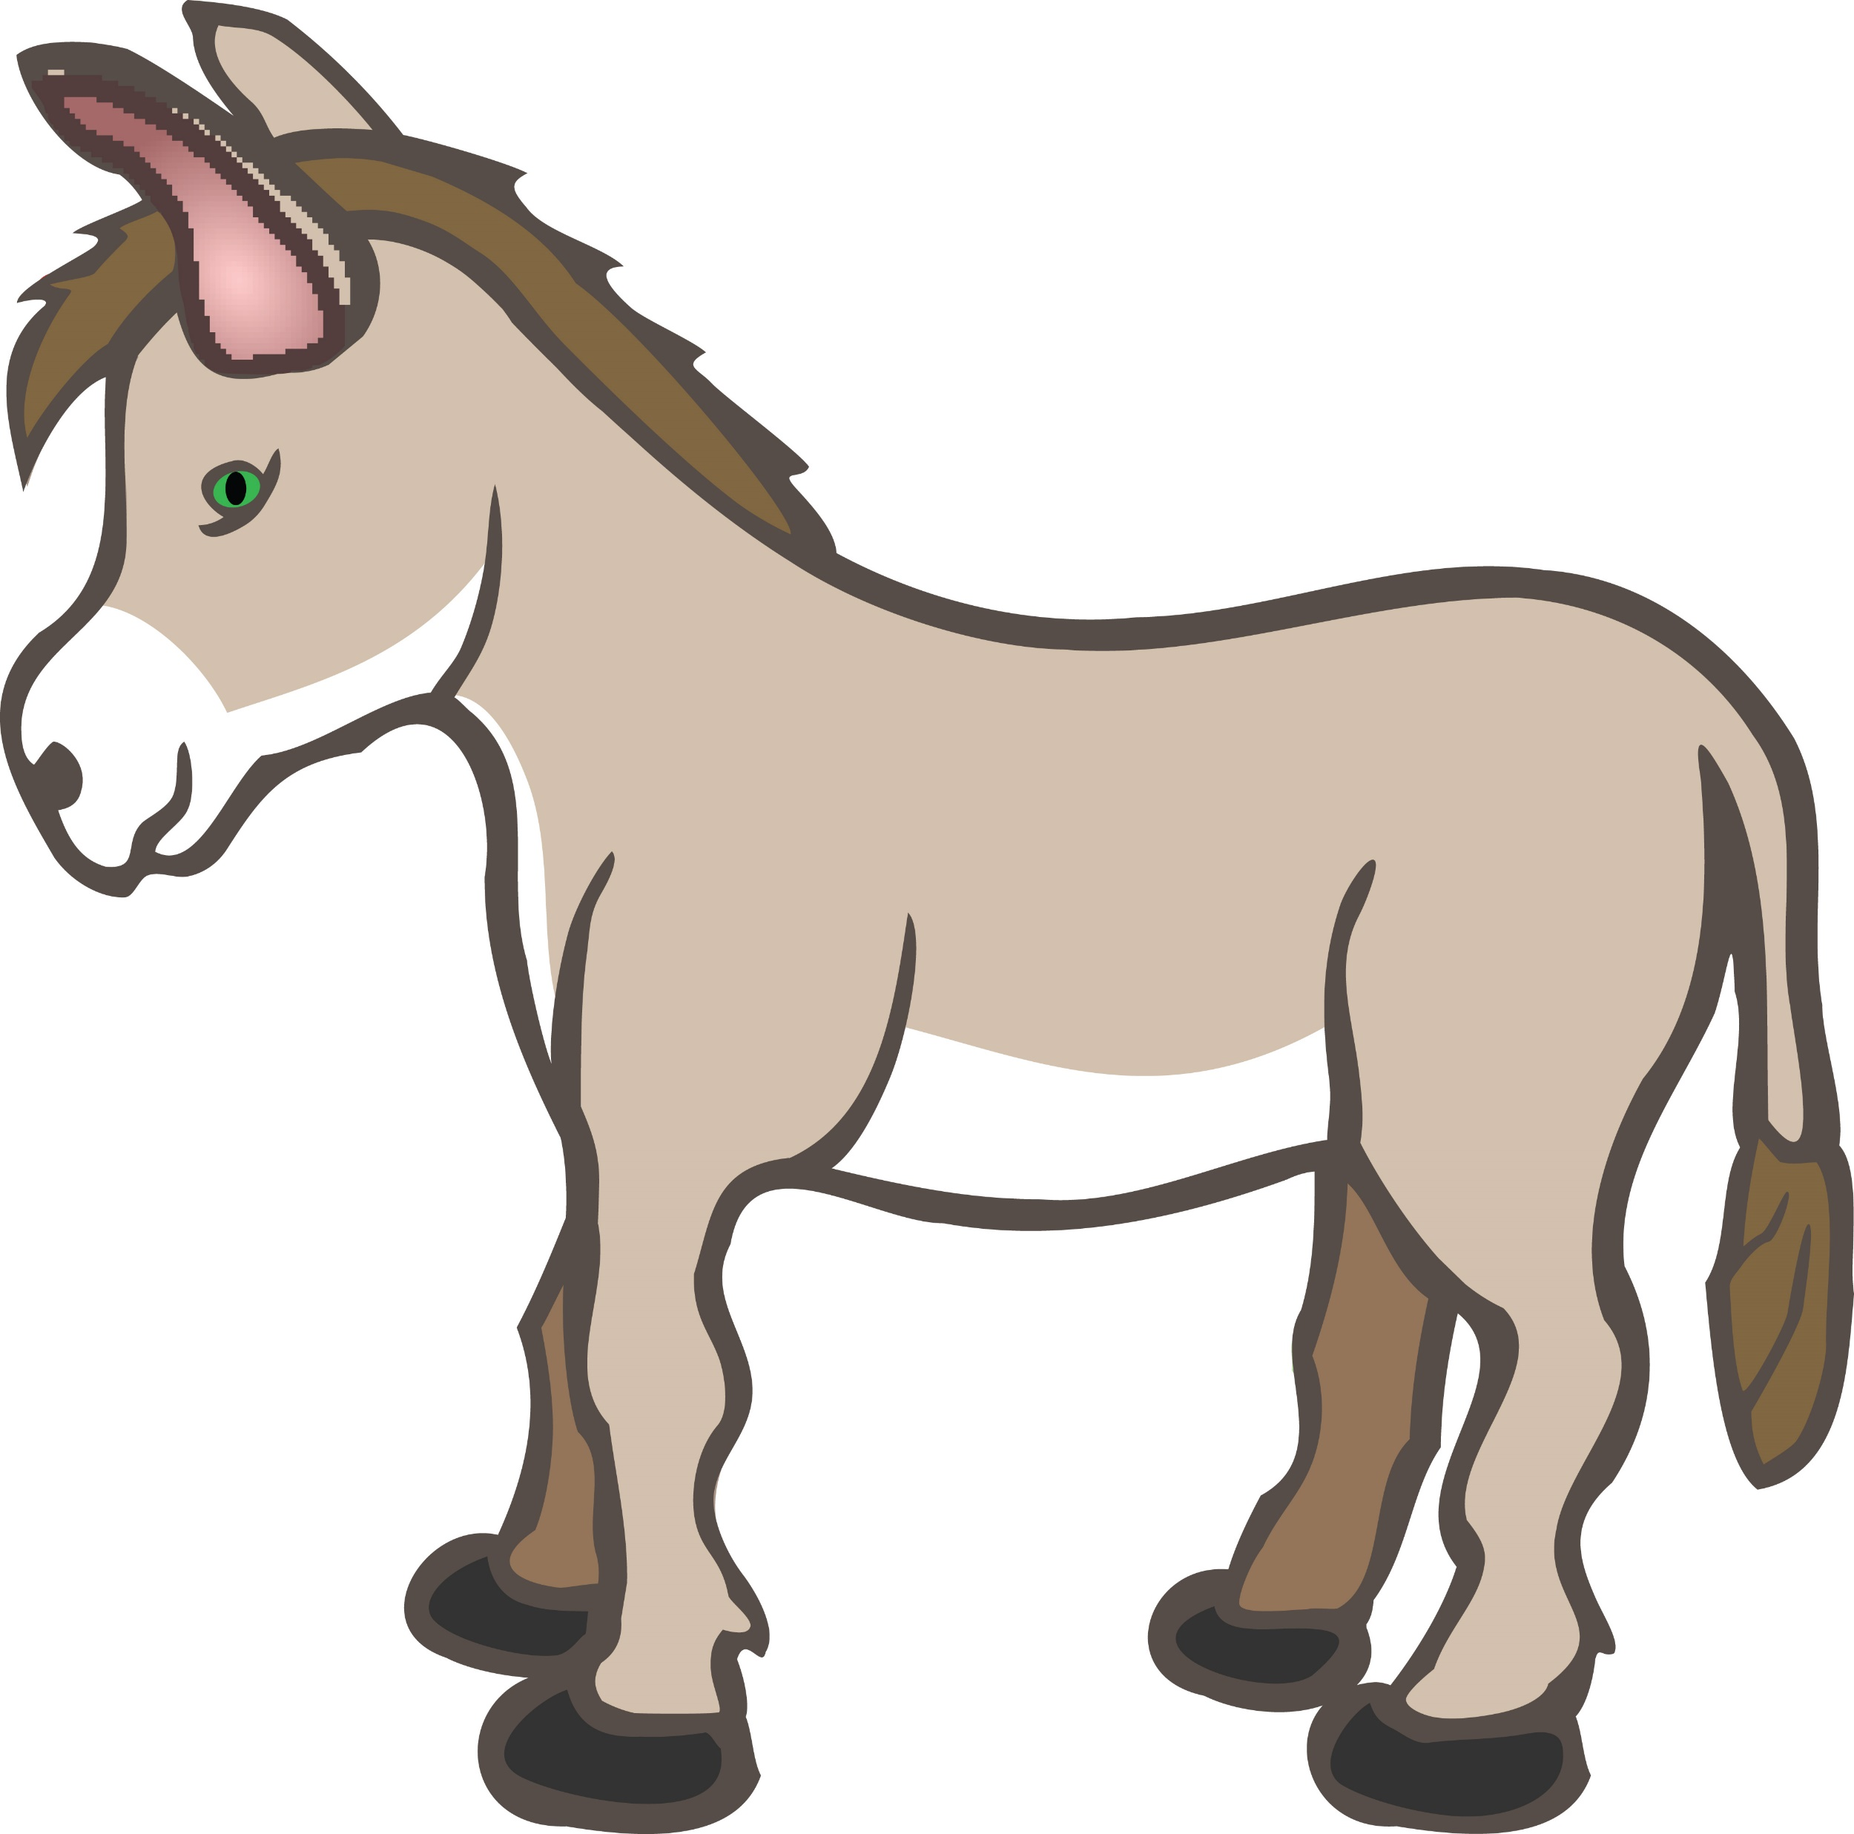
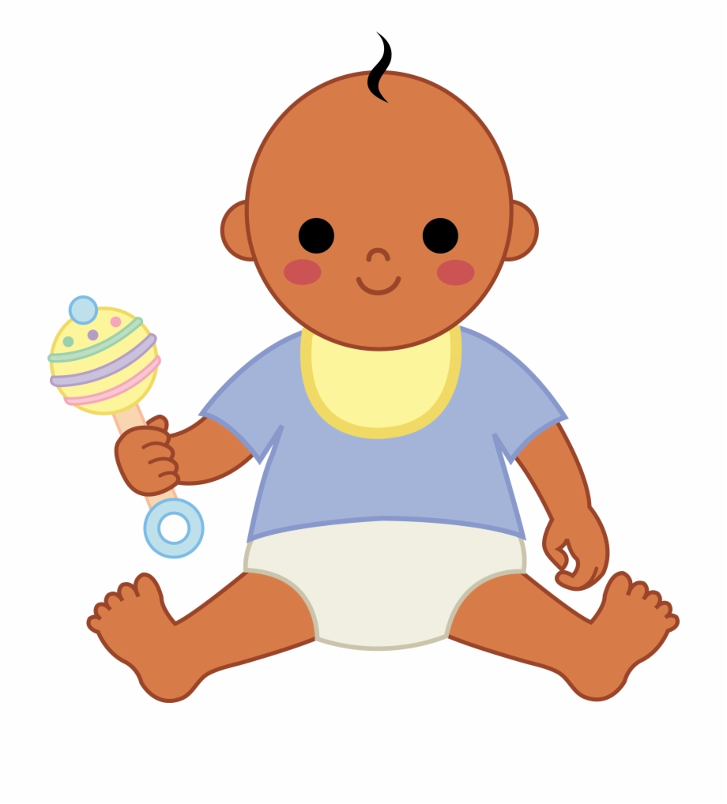
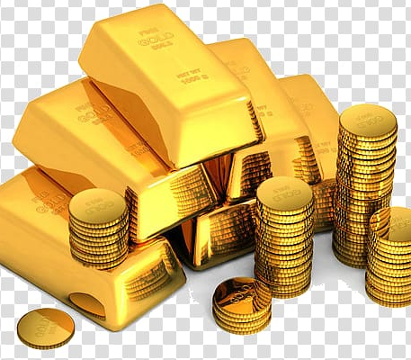
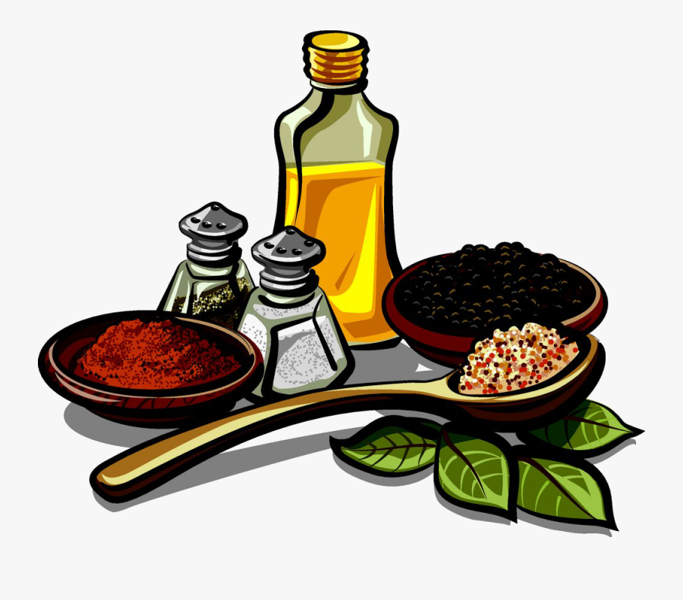





Look around you. Can you find:
Star
Baby
Camel
Mom
Dad
Sheep
Donkey
Gold
Spices
A pyramid
Gift
How many can you find
while the next 3 songs are playing?

Slide 29

Away in the Manger

Slide 30

Go Tell It On The Mountain

Slide 31

Hark the Herald Angels Sing

Slide 32

In Review

Slide 33

O Come, O Come Emmanuel

