Slide 1
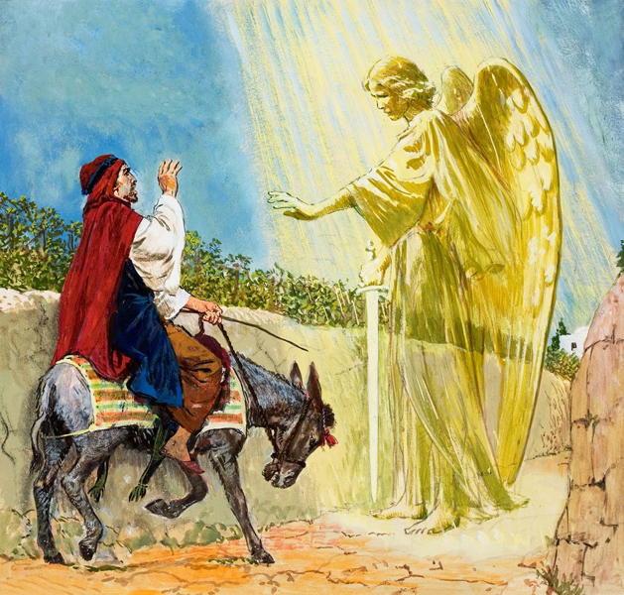
BALAAM AND BALAK
Curses or Blessings for God’s people?

Slide 2
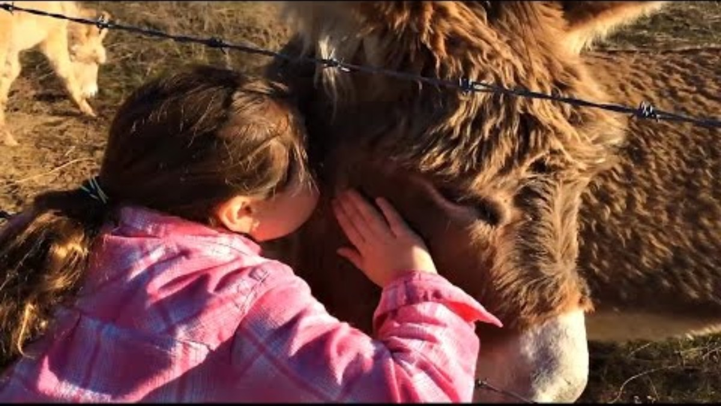
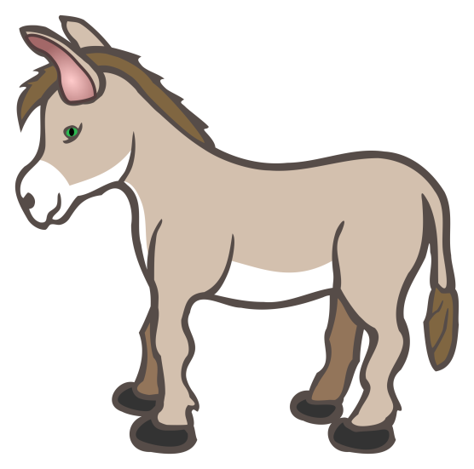
Our Donkey

Slide 3
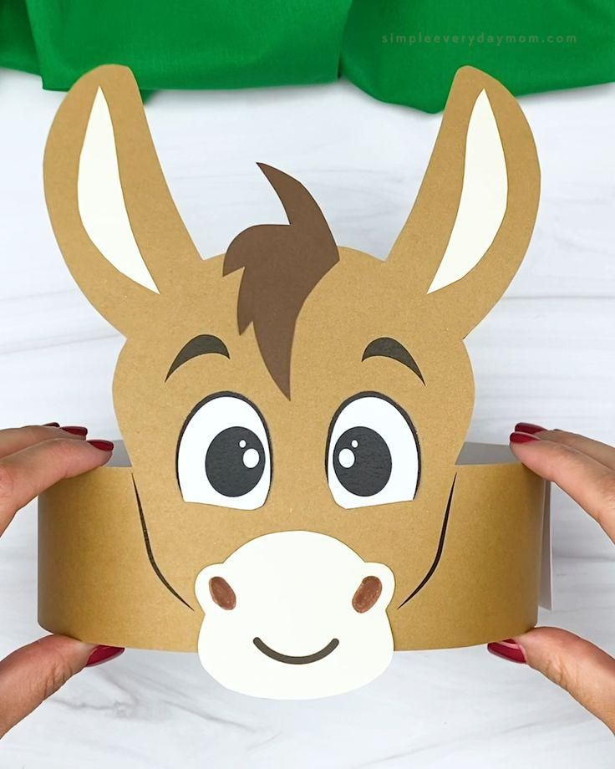

CRAFT TIME
Directions:
https://www.simpleeverydaymom.com/donkey-headband-craft/
Etsy Donkey Crown digital download after small fee

Slide 4
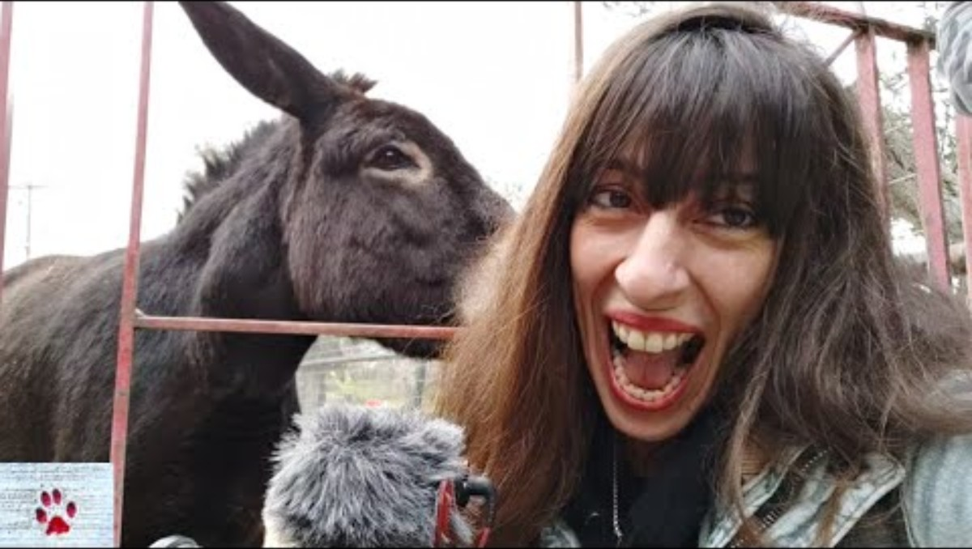
Donkey Facts

Slide 5
Have you ever felt unsafe and lied or were mean?
Today our story is about a king who did that.

Slide 6

1 Thessalonians 5:11
Therefore
encourage one another
and build each other up,
just as in fact you are doing.
Exodus 20:16
1 Thessalonians
5:11
Commandment # 9
Exodus 20:16
“You shall not give false testimony against your neighbor.
Romans 12:14
Bless those
who persecute you;
bless and do not curse

Slide 7
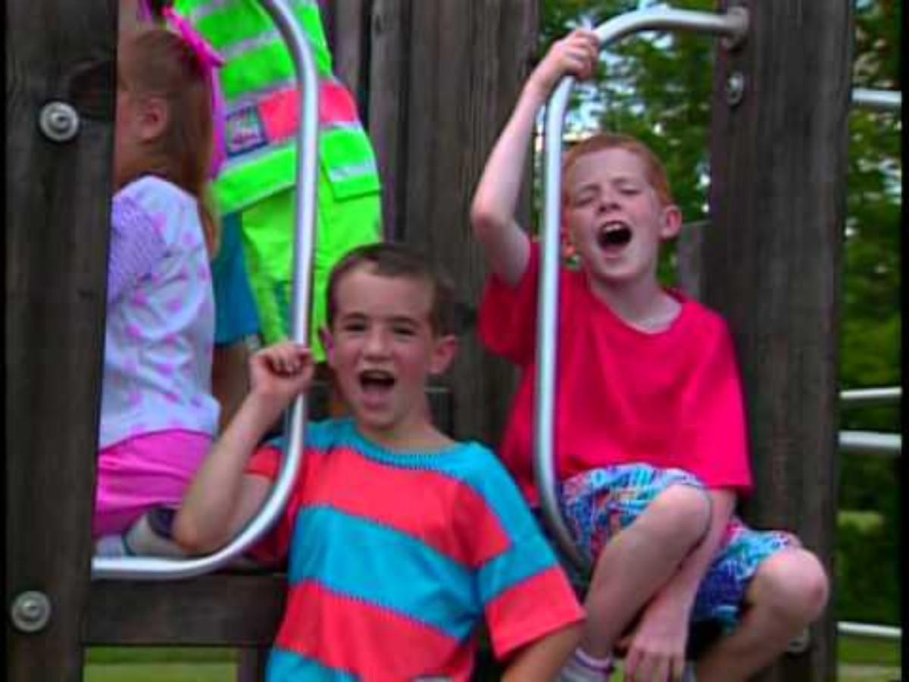
Keep
Your
Tongue
From
Evil
Psalms 34:13
keep your tongue from evil
and your lips from telling lies.

Slide 8
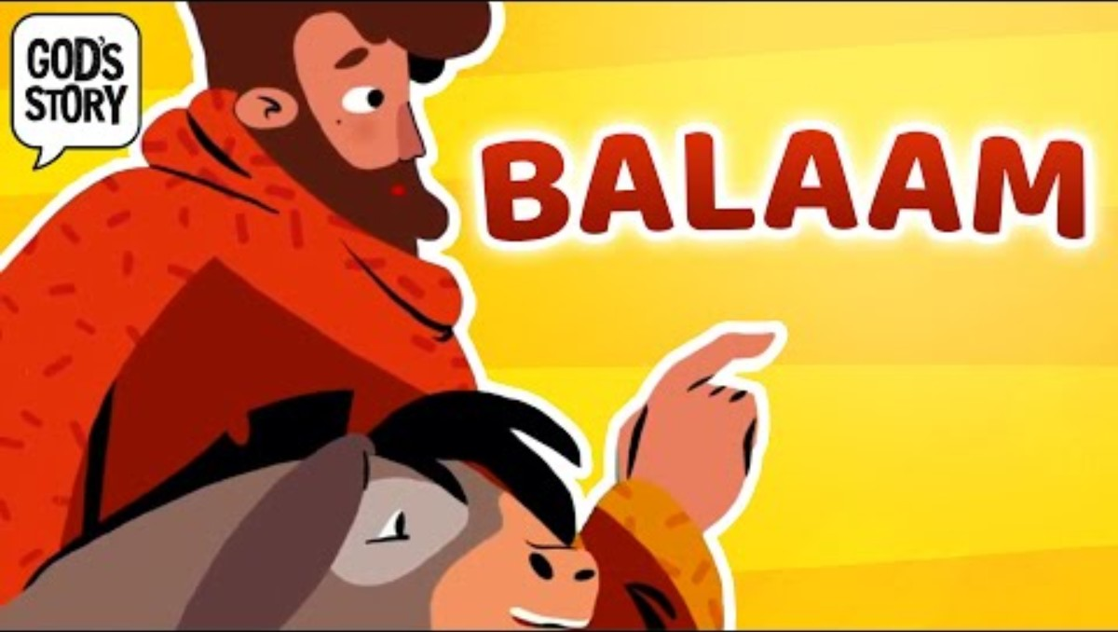

Slide 9
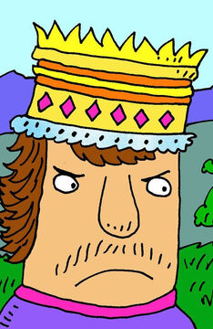
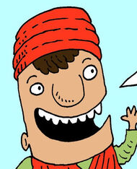
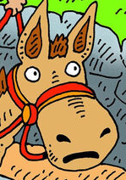
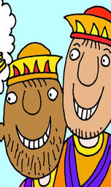
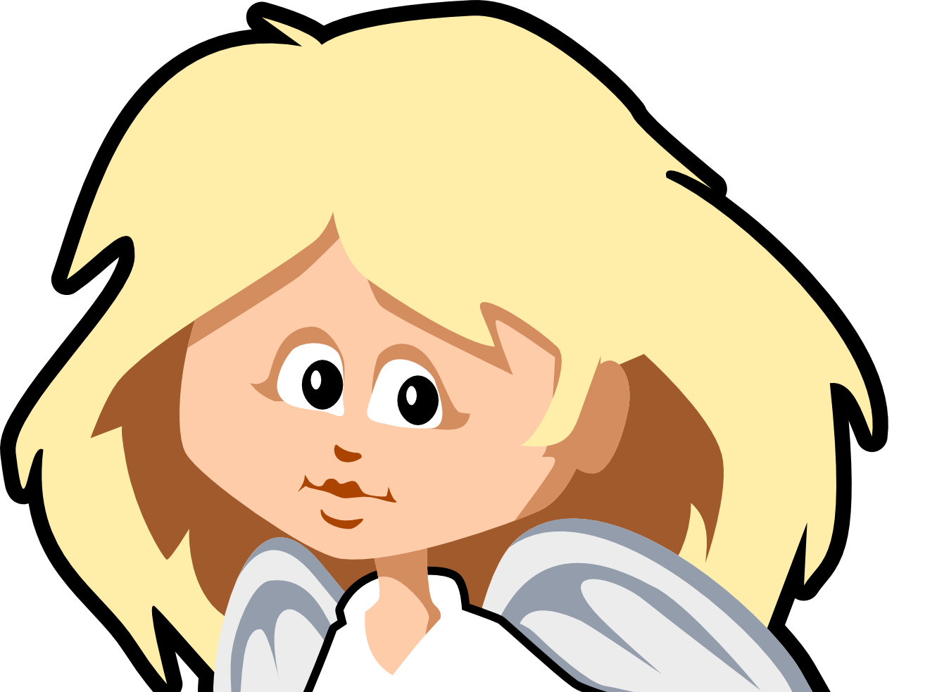
Balak, Balaam and a Donkey
Reading Parts:
Balak, king of Moab
Prophet Balaam
Voice of God
Donkey
Servants
Narrator
Angel (no lines)
Props:
Bag of gold
Flaming torch for angel
Donkey mask (optional) -- child playing donkey crawls

Slide 10
Narrator: The Israelites have defeated 3 strong nations. God has shown that He is very powerful. Many nations were scared, including Balak from Moab.
King Balak: Yikes! Look at all those Israelites! They have overcome my neighbors, now they will fight me! What can I do?
I’ll call Balaam. What he says will happen, always happens … Servants!
Servants: Yes king?

Slide 11

King Balak: Take this gold and go get Balaam. He must come and curse these Israelites. Disease, death, drought, disaster,… any kind of bad thing will help us overcome them.
Servants: Yes king, we will go.

Slide 12

WAIT!
What Balak didn’t know was what God had told Moses.
“The Lord said to me, ‘Don’t bother the Moabites.
Don’t start a war against them. I will not give you any of their land. They are the descendants of Lot, and I gave them the city of Ar.’” Deuteronomy 2:9
Balak didn’t even have to worry!

Slide 13
Servants: Balaam, this gold is for you if you come curse the Isrealites.
Balaam: Come in, let me ask God.
Voice of God: Don’t go! These are my blessed people.
Servants: OK Let’s Go tell the king

Slide 14
Servants: Balaam said, “No”
King Balak: Go back! Offer more gold!

Slide 15
Servants: Balaam, this gold is for you if you come curse the Isrealites.
Balaam: Come in, let me ask God.
Voice of God: Only say what I tell you to say.

Slide 16
Balaam: I will say only what God wants me to say, but I know what the people can do so that the Israelites will be cursed!
Servants: OK! Here is the gold.

Slide 17
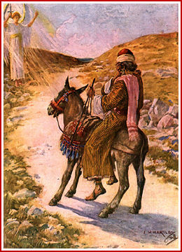
Angel: (stands in way with flaming sword)
Donkey: Hee Haw
Balaam: Bam! Bam!
Get back on the road!
Donkey: Clippety Clop

Slide 18
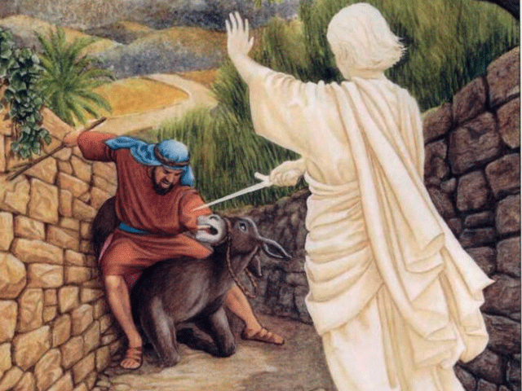
Donkey: Hee Haw! Hee Haw!
Angel: (flashes sword towards donkey)
Balaam: Ouch! You stupid beast! You crushed my leg!
Bam! Bam!
Get going now!
Donkey: Clippety Clop

Slide 19
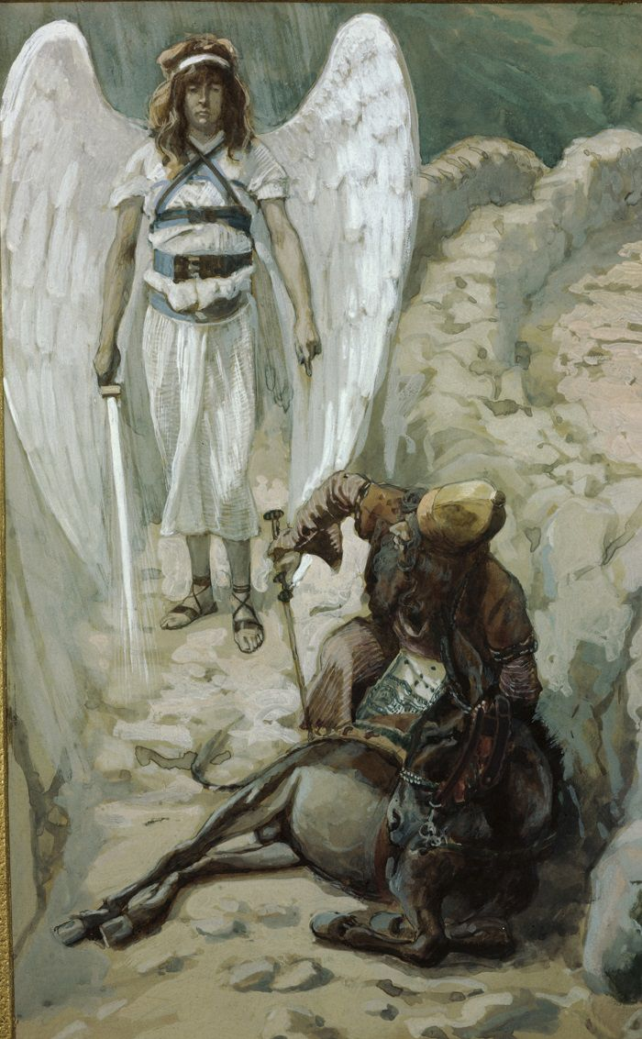
Donkey: Hee Haw! Hee Haw!
Angel: (flashes sword towards donkey)
Balaam: Get up and get going!
Bam! Bam!
Donkey: Clippety Clop

Slide 20
Donkey: What have I done to you
to make you beat me these three
times?
Balaam: You have made a fool of me!
If I had a sword in my hand, I would kill you right now!

Slide 21
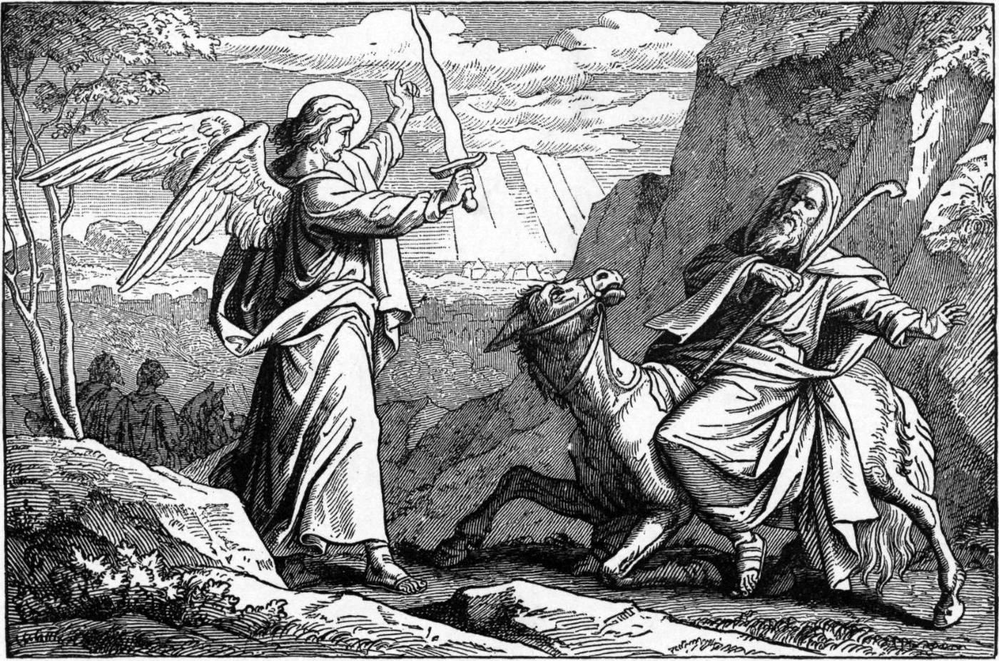
Donkey: Am I not your own donkey, which you have always ridden, to this day? Have I been in the habit of doing this to you?
Balaam: No
Voice of God: See!
Angel: (flashes sword towards Balaam)
Balaam: Oh no! An angel of God!

Slide 22
Voice of God: Why have you beaten your donkey these 3 times. I have come to oppose you because your path is a reckless one before me. If your donkey had not turned away, I would have killed you.
Balaam: I have sinned. I did not realize you were standing in the road to oppose me. Now if you are displeased, I will go back.
Voice of God: You may go with the men, but only say what I tell you to say.

Slide 23
King Balak: Finally, you are here! I have prepared cattle and sheep for a sacrifice. We’ll go to Bamoth Baal. You’ll see the Israelites and curse them.
Balaam: I can only say what God wants me to say.
King Balak: Here we are.
Balaam: Balak has brought me to curse Israel. How can I curse what God has blessed? From these rocky peaks I can see them. No one can number even a fourth of them.

Slide 24
King Balak: That wasn’t a curse!
Balaam: I can only say what God wants me to say.
King Balak: Come we’ll go to the field of Zophim and offer sacrifices and you can curse them.
Balaam: Listen Balak.
God is not a man, that he should lie.
He will not change his mind. He will keep His promises. God brought Israel from Egypt.
He will be strong. Like a lioness, he will devour his prey.

Slide 25
King Balak: That wasn’t a curse! Don’t curse or bless them.
Balaam: I can only say what God wants me to say.
King Balak: Come we’ll go to the top of Peor, overlooking the wasteland. We’ll offer sacrifices again.
Balaam: I see clearly. How beautiful are your tents O Israel! Their kingdom will be exalted. They will be as strong as an ox. They devour hostile nations. May those who bless you be blessed and those who curse you be cursed.

Slide 26
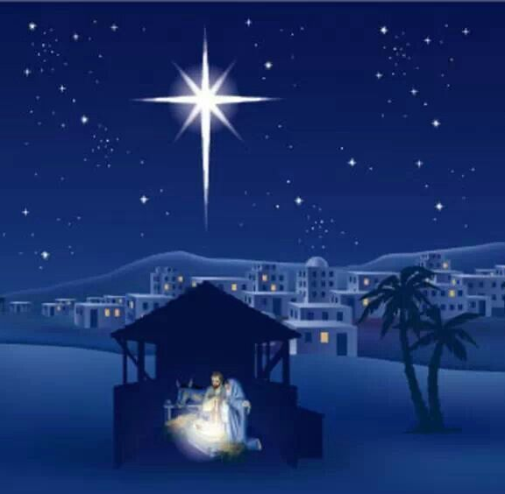
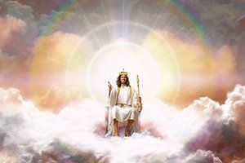
King Balak: You are terrible!
I brought you here to curse my enemies, and you have blessed them! Now leave at once and go home!
Balaam: Did I not say, I can only say what God tells me to say?
I see clearly! a star will come out of Jacob, a scepter will rise out of Israel…
His enemy will be conquered,
but Israel
will grow strong.

Slide 27

WAIT!
I wished the story would
right there!
God gave words of blessing to Balaam to give to his people.
What words of blessing can we give to others?
We’ll talk more about this.

Slide 28
However, the story continues…..
King Balak: Go!
Balaam: One thing you can do to bring curses is to invite your people to a celebration of your gods. Encourage them to worship your idols. Have your women entice their men. This will be a sin against their God. God will judge them.

Slide 29

However, the story continues…..
Narrator:
That is what the Moabites did.
Sad to say, the Israelites fell for the temptation.
They broke God’s commandments.
They joined the Moabites in worshipping their idols, ate the food offered to the idols, and committed adultery.
Narrator:
Because of this a plague broke out in the camp of Israel.
24,000 people died.

Slide 30
God’s Voice: (Numbers 25:16-18)
“Be hostile to the Midianites and attack them; for they have been hostile to you with their tricks, with which they have deceived you …
Narrator:
So, Balaam and King Balak’s plan did not work after all. Their country was destroyed.

Slide 31
1 Thessalonians 5:11
Therefore
encourage one another
and build each other up,
just as in fact you are doing.
Exodus 20:16
1 Thessalonians
5:11
Commandment # 9
Exodus 20:16
“You shall not give false testimony against your neighbor.
Romans 12:14
Bless those
who persecute you;
bless and do not curse

Slide 32



Let’s send a blessing. Make a card
_______, you are a blessing.
________, may the Lord bless you and keep you. (Numbers 6:24)
_________, may the God of hope fill you with all joy and peace. (Romans 15:13)
_________, may the grace of the Lord Jesus Christ and the love of God be with you. (2 Cor. 13:14)
_______, the Lord will watch over your life no matter where you go, now and forever. (Psalm 121:8)

Slide 33
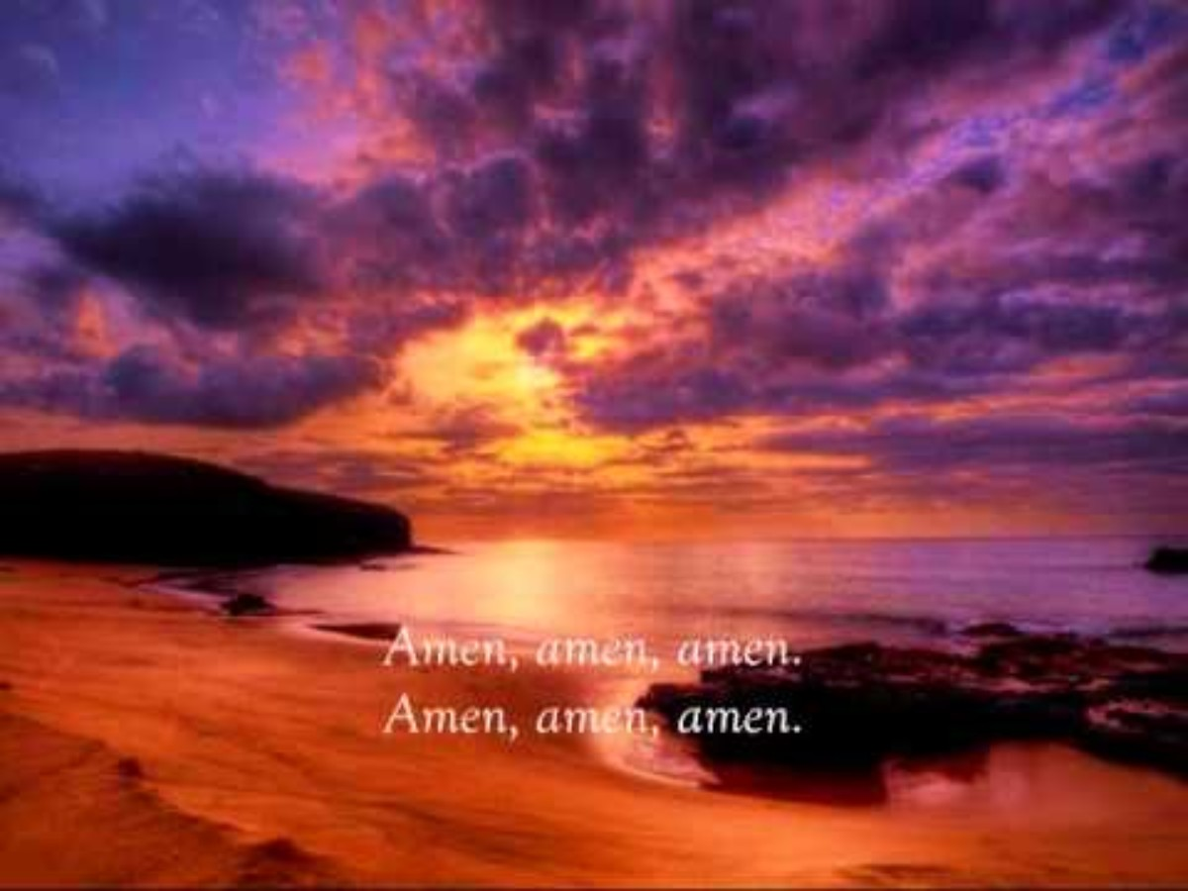
The Lord Bless you and keep you

Slide 34
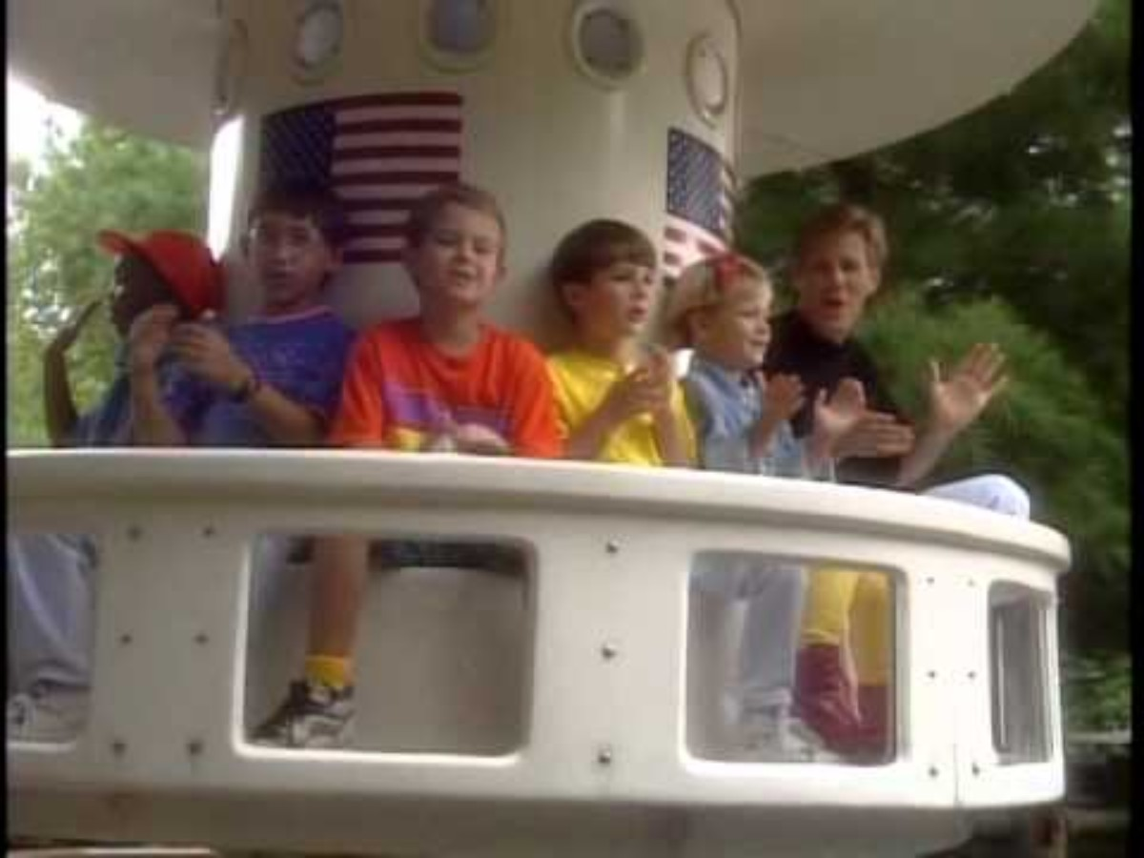
Encourage
One
Another
1 Thessalonians 5:11
Therefore
Encourage
one another
and build each other up,
just as in fact
you are doing.

Slide 35

Extra Slides
You can find more programs like this at: https://activity-array.com/

Slide 36
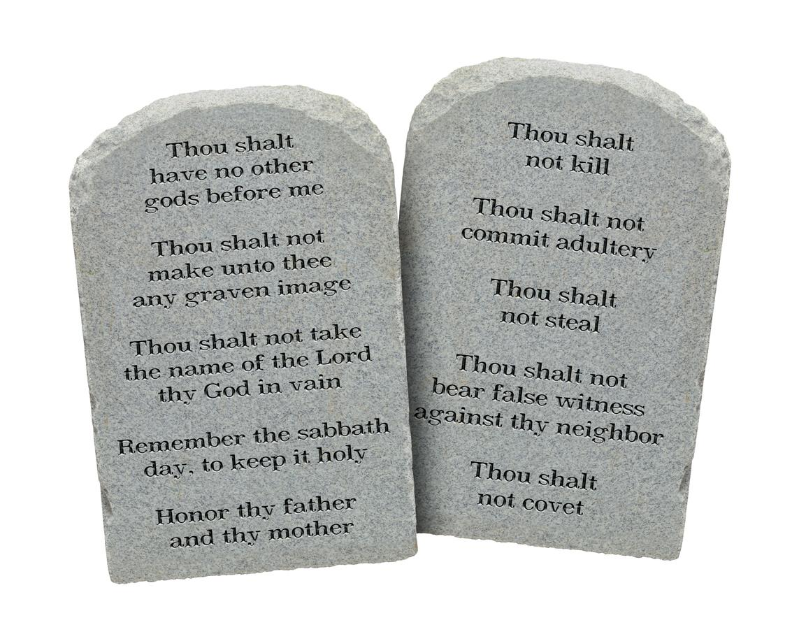

Slide 37
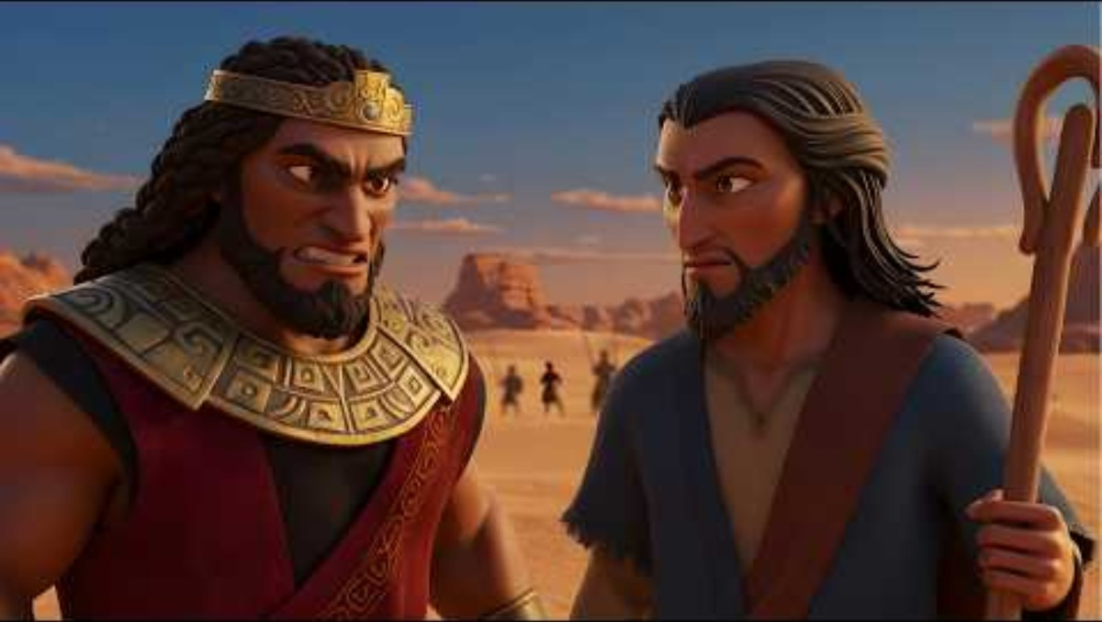

Slide 38
“But I have a few things against you. You have people there who follow the teaching of Balaam. Balaam taught Balak how to make the people of Israel sin. They sinned by eating food offered to idols and by committing sexual sins.
Revelation 2:14

Slide 39
Memory Verse
John 14:23 Easy-to-Read Version (ERV)
²³ Jesus answered, “All who love me will obey my teaching. My Father will love them. My Father and I will come to them and live with them.
John 14:23 New King James Version (NKJV)
²³ Jesus answered and said to him, “If anyone loves Me, he will keep My word; and My Father will love him, and We will come to him and make Our home with him.

