Slide 1
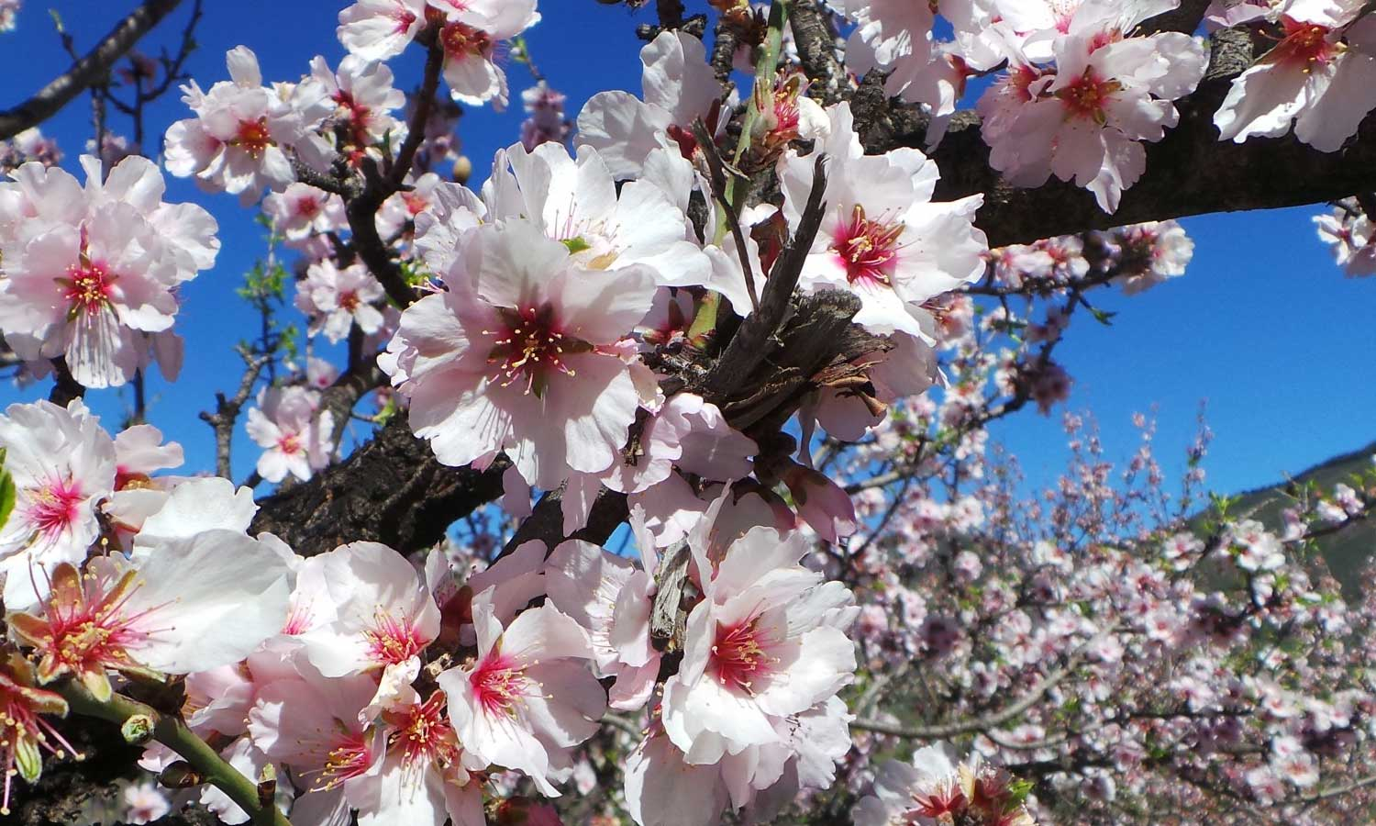
Who is the head priest?
Aaron’s Rod buds
Numbers 17

Slide 2
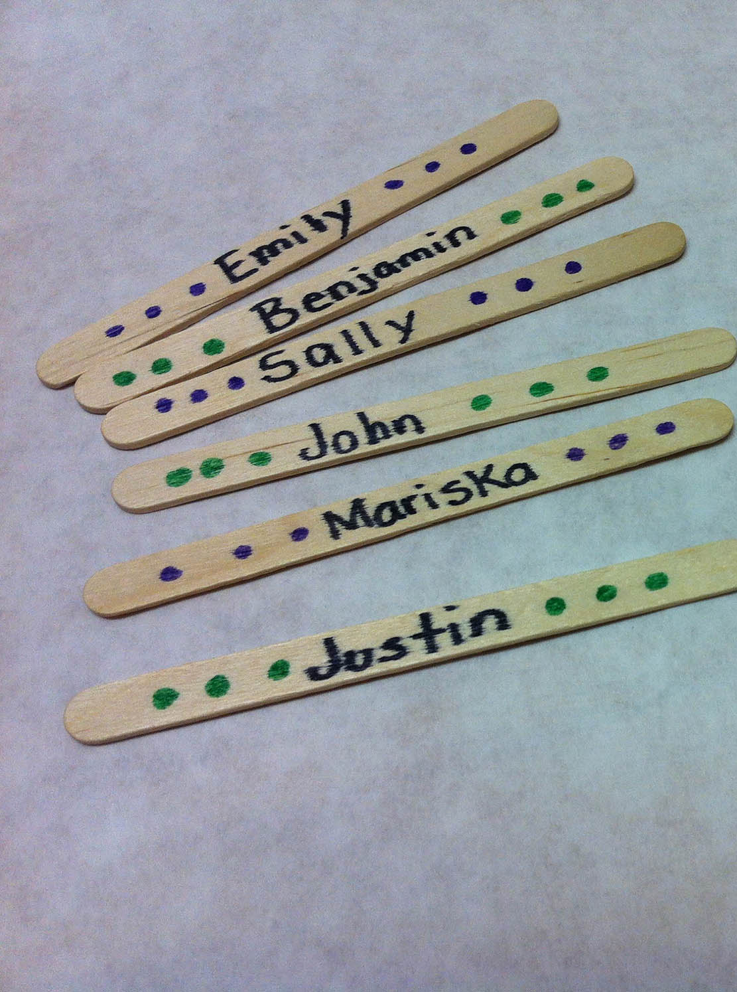
WHO’S THE WINNER
I have a bag of prizes.
Write your name on a stick and put it in this can.
I’ll draw a stick out and see who wins this prize.

Slide 3

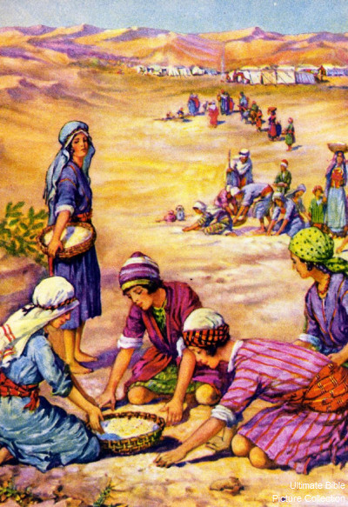
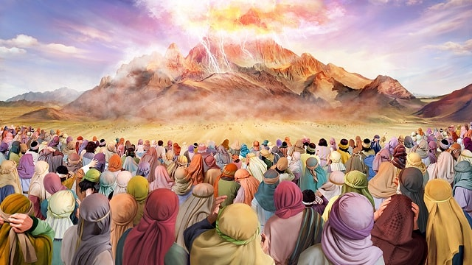
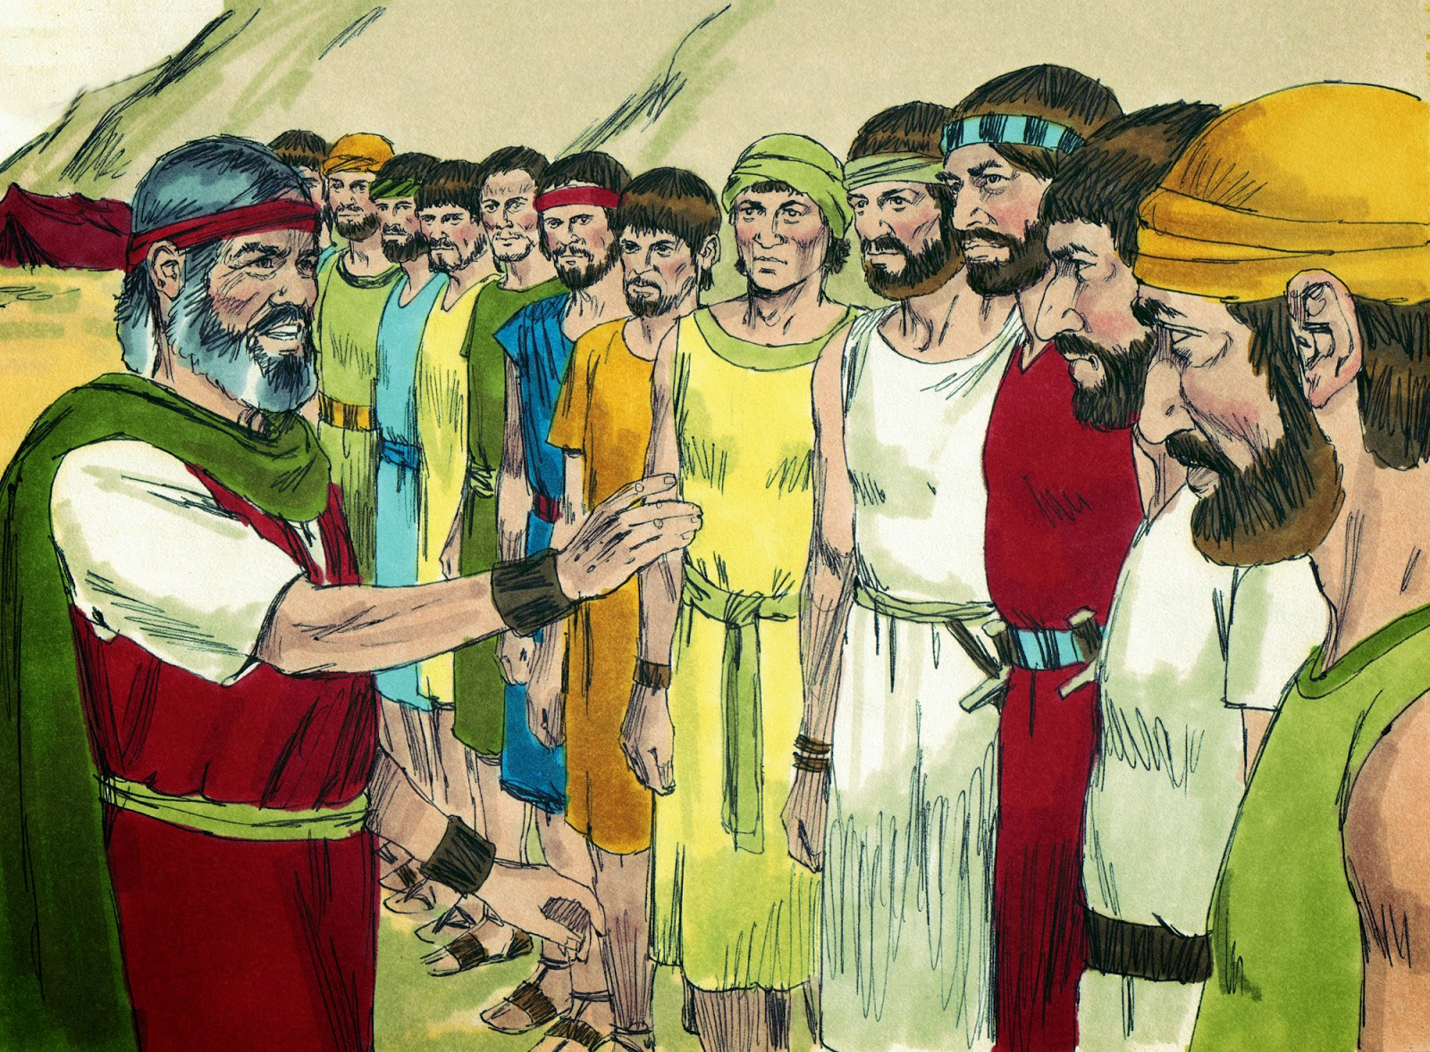
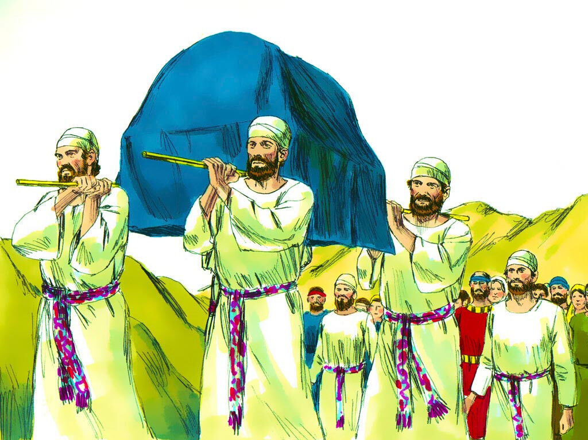
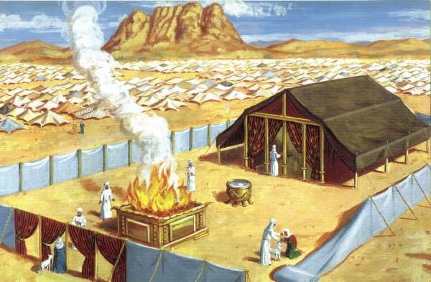
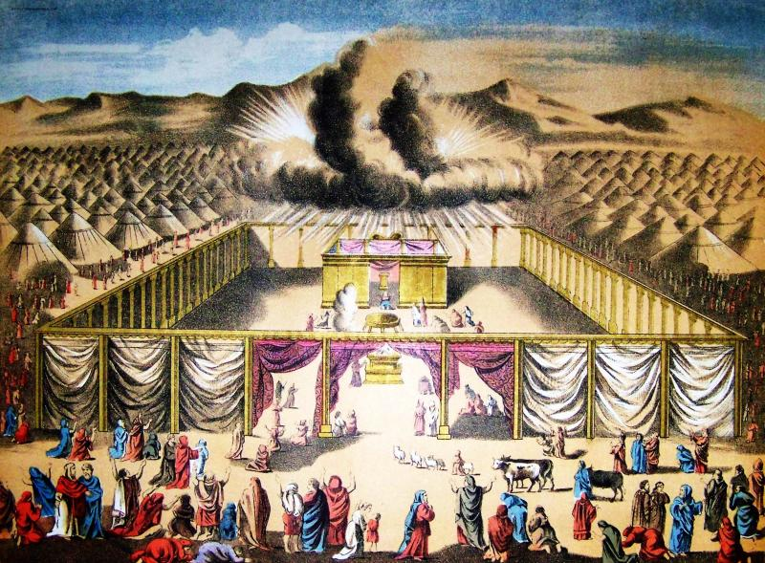
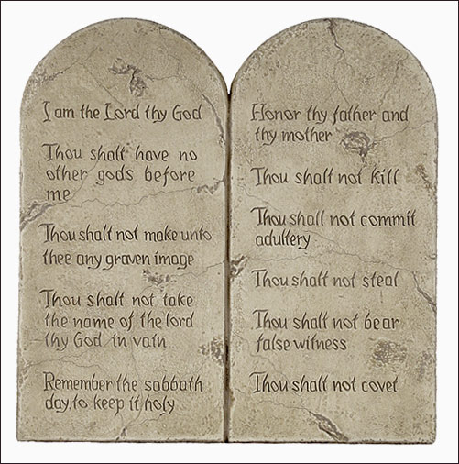
God continued to lead the Israelites
God gave them food
God gave them 10 good laws
He gave them the plans for the tabernacle sanctuary. The Israelites followed God’s instructions and spent almost a year building it. God’s glory came in and over the tabernacle.
God chose a man from each tribe to help Moses by leading their tribe.
God chose the tribe of Levites to take care of the tabernacle and help move it from place to place.
God chose Aaron and his sons to be priests and offer offerings and sacrifices. This way people’s sins were forgiven and they worshipped God.

Slide 4
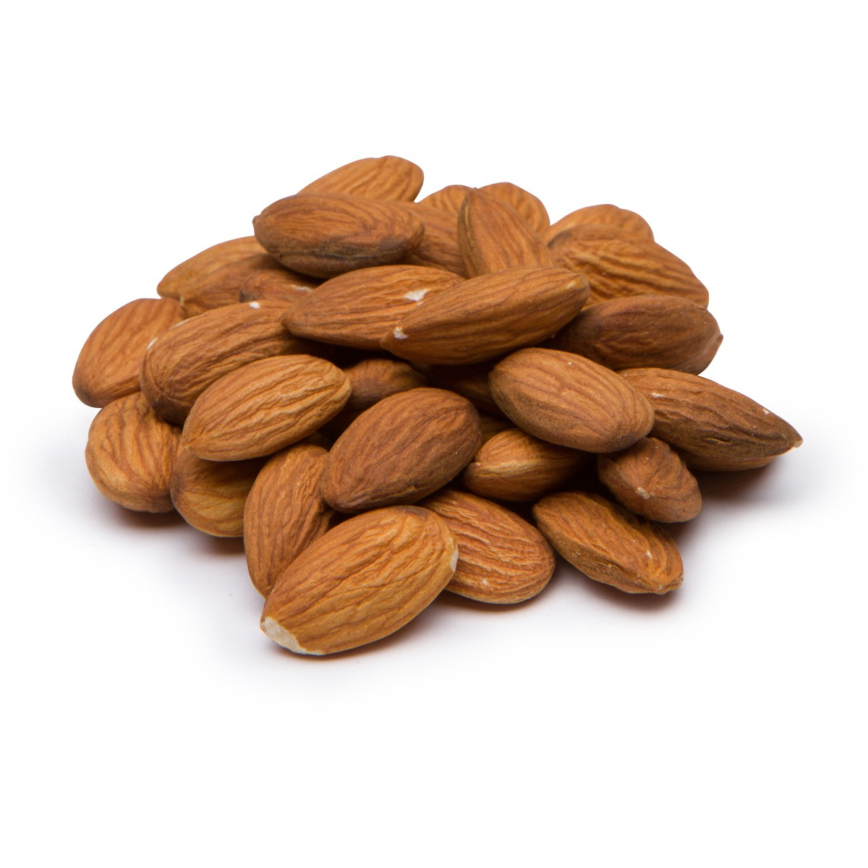

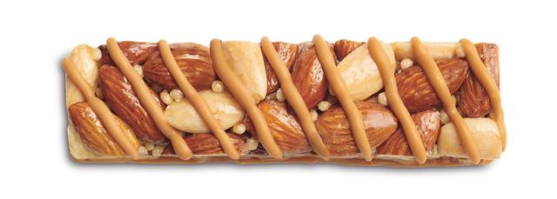
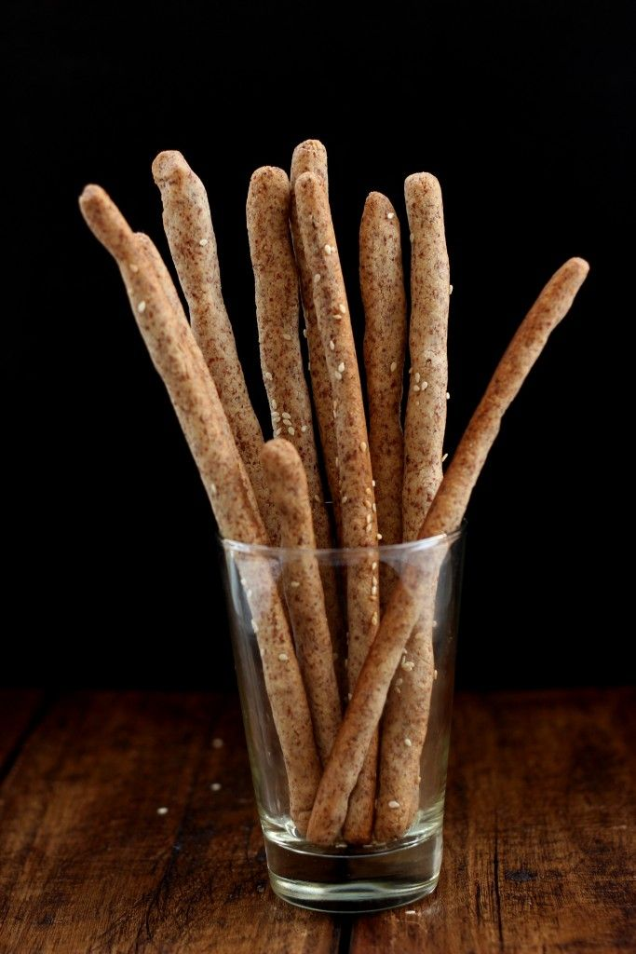
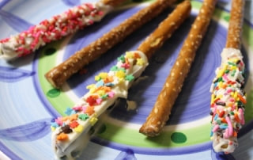
SNACK TIME ideas
Make Almond flour bread sticks
8 spoons white wheat flour
6 spoons almond flour
4 spoons powdered sugar
½ spoon baking powder
A shake of cinnamon
  MIX above together
Add 1 spoon of water
  MIX all together
  Squish and form 2 bread sticks
  BAKE 425º for 10 min.
    or until lightly golden

Slide 5

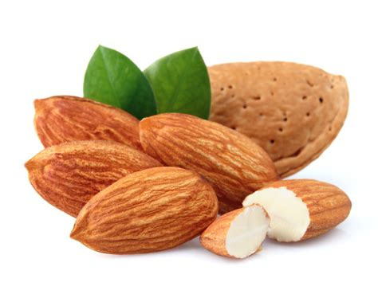
What is AUTHORITY?

Slide 6
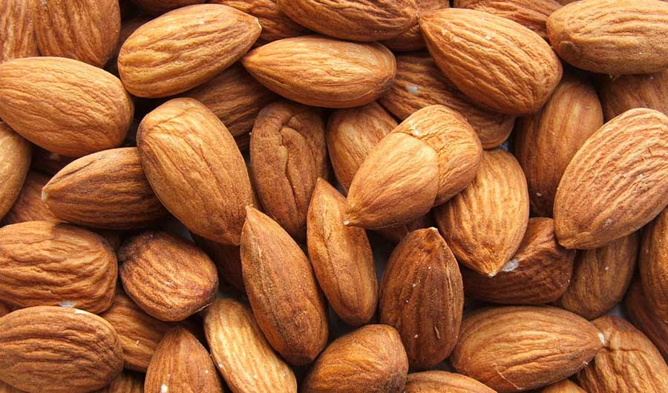
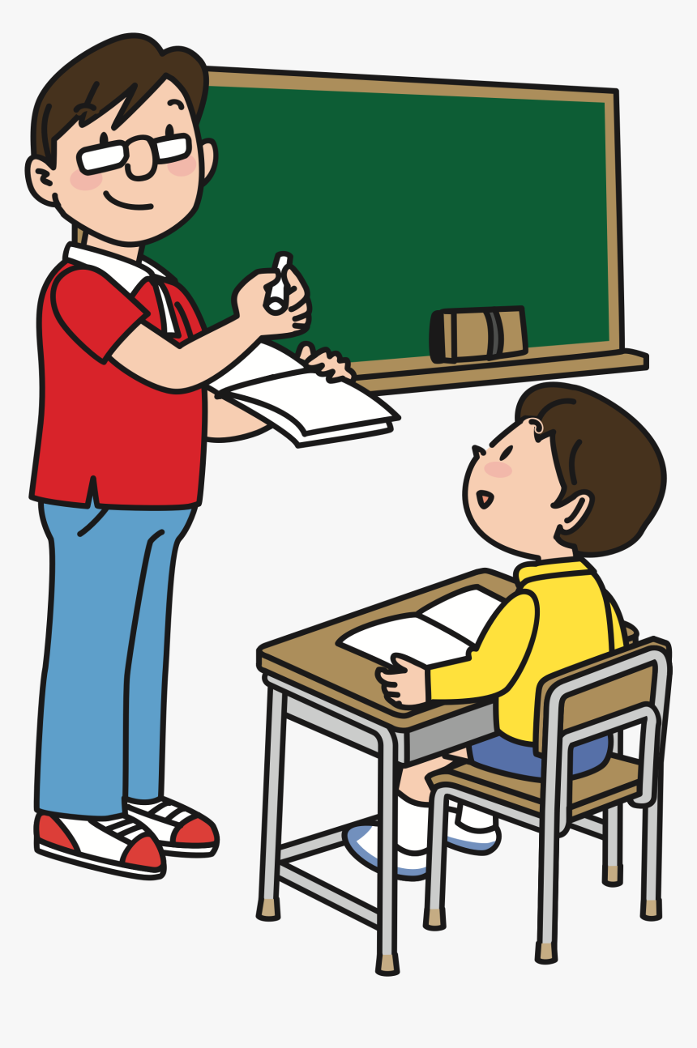
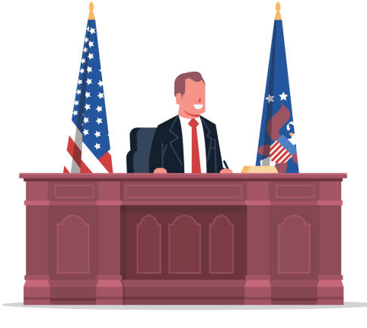
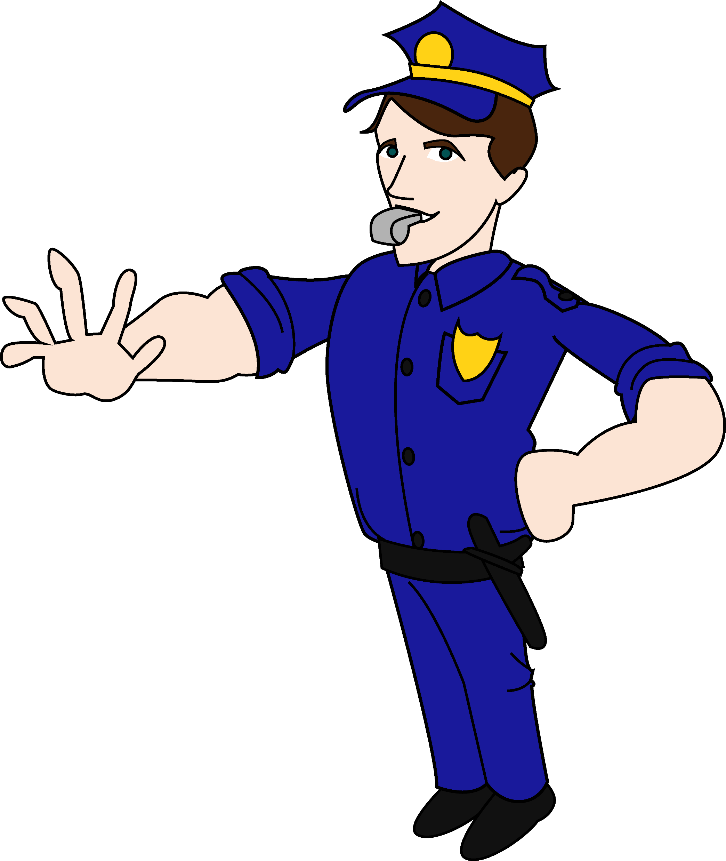

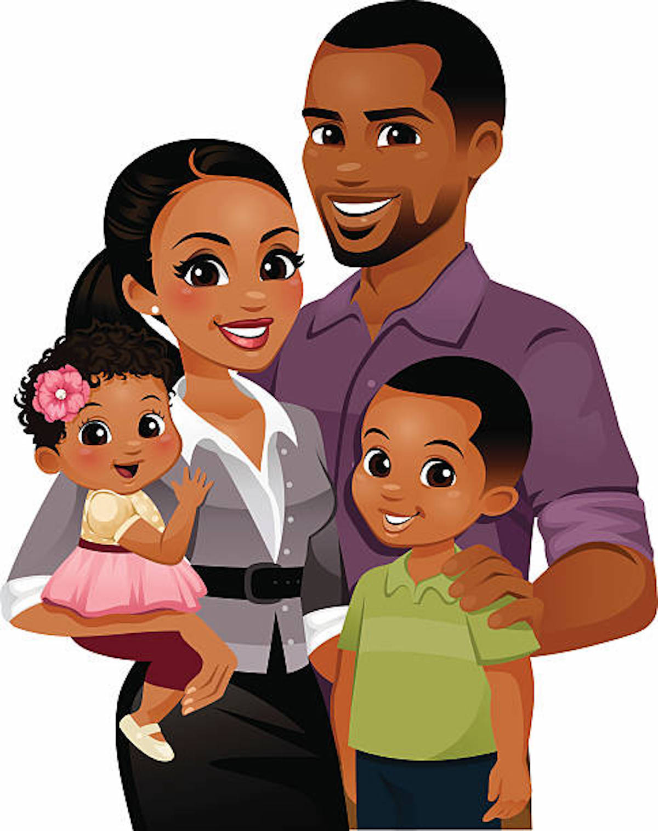
Respect authority – the leaders placed over you.
All of you must obey the government rulers.
Everyone who rules was given the power to rule by God.
And all those who rule now were given that power by God.
Romans 13:1
Let everyone be subject to the governing authorities,
for there is no authority except that which God has established.
The authorities that exist have been established by God.
Romans 13:1

Slide 7


Respect authority – the leaders placed over you.
Choose different kids to be in charge. What if all the boys give a command? Or all the girls are in charge at once?

Slide 8
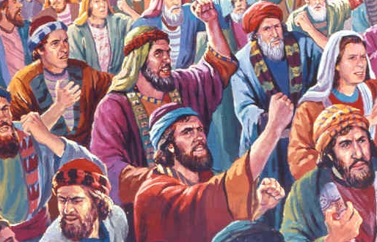
Many grumbled
Numbers 16
“ Korah son of Izhar, the son of Kohath, the son of Levi, and certain Reubenites—Dathan and Abiram, sons of Eliab, and On son of Peleth—became insolent[ ² These four men gathered 250 other men from Israel together and came against Moses. “
_____
These men started a rebellion. They wanted to be special priests and leaders too. But God had not chosen them for that job.
Korah did have a special job though. He and his family were responsible for carrying the Tabernacle furniture when the Israelites moved. But he wasn’t content with his job.

Slide 9
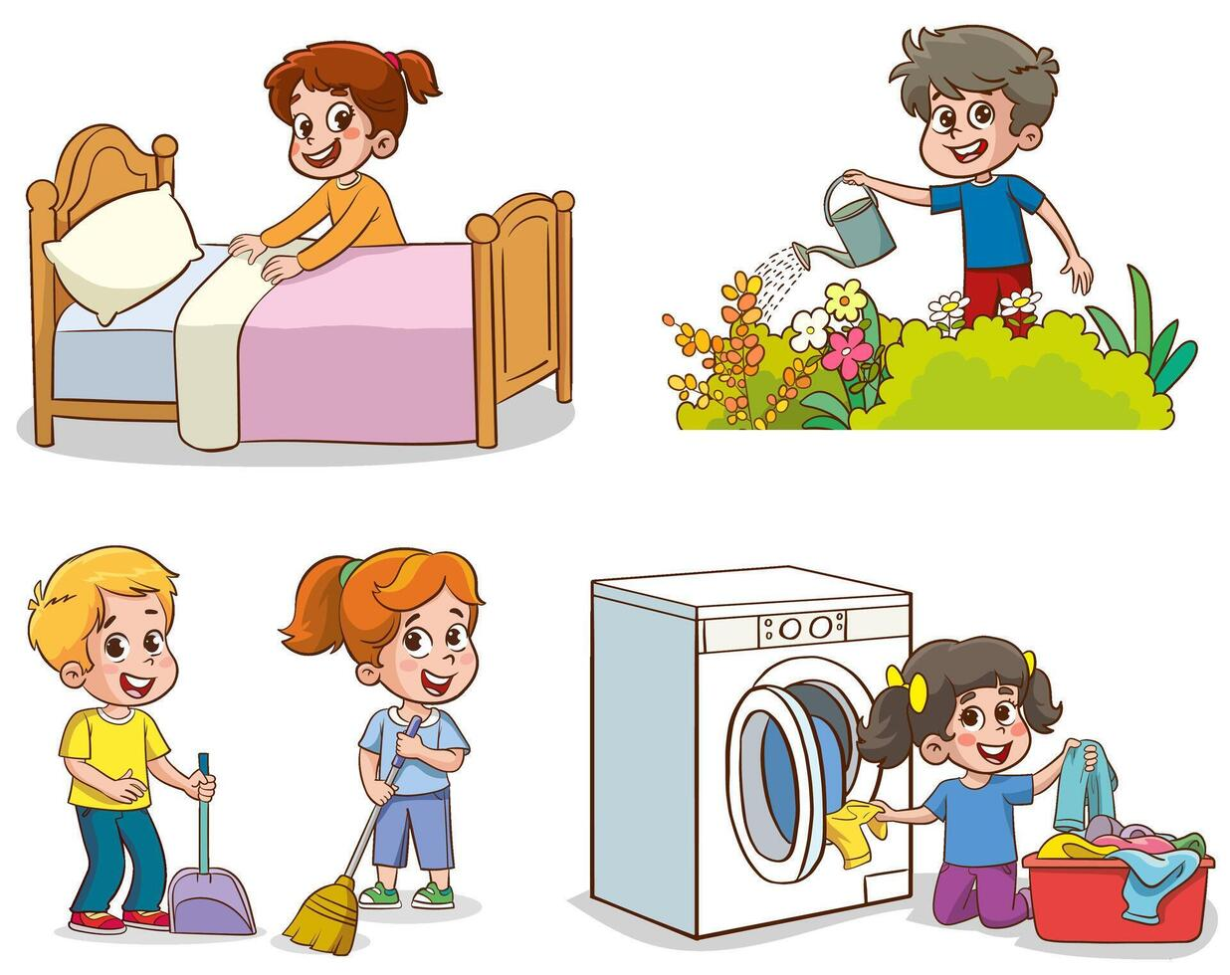

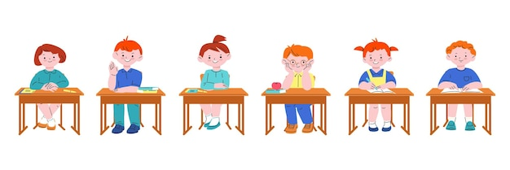
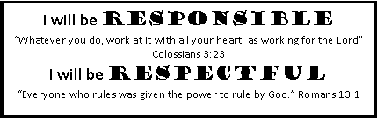
Be Content
Our parents and teachers give us jobs to do.
Be Content. Don’t demand a more important job.
Be Responsible
Be Respectful
The Bible tells us to do our work well..
“Whatever you do, work at it with all your heart like you are working for the LORD.
The job may not seem important or might not be fun, but if we do it well, our parents and leaders will know that we can do even more important jobs.
We need to respect those who are in authority over us like our parents and teachers because God has given them the responsibility to teach us and keep us safe.

Slide 10
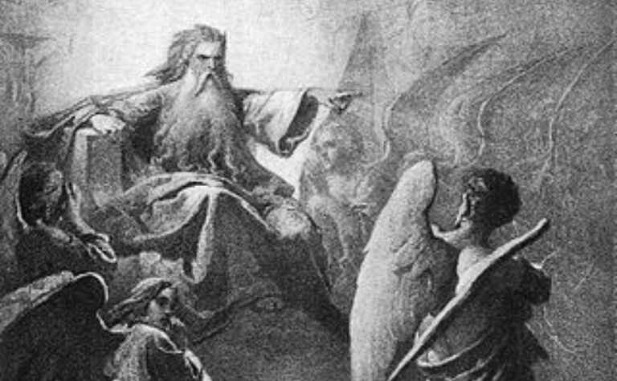
Did you know…?
Did you know that the Devil, who was called Lucifer, was one of the most important Angels in heaven. One of His jobs was to lead the choir.
But He wanted to be even more important.
He didn’t like God’s rules.
He was NOT content. He was NOT respectful. And he still isn’t.
This attitude led to pride and rebellion.
It is sin.
Isaiah 14 says:
¹² “How you are fallen from heaven,
O Day Star, son of Dawn!
How you are cut down to the ground,
you who laid the nations low!
¹³ You said in your heart,
‘I will ascend to heaven;
above the stars of God
I will set my throne on high;
I will sit on the mount of assembly
in the far reaches of the north;^{[c]}
¹⁴ I will ascend above the heights of the clouds;
I will make myself like the Most High.’
¹⁵ But you are brought down to Sheol,
to the far reaches of the pit.

Slide 11
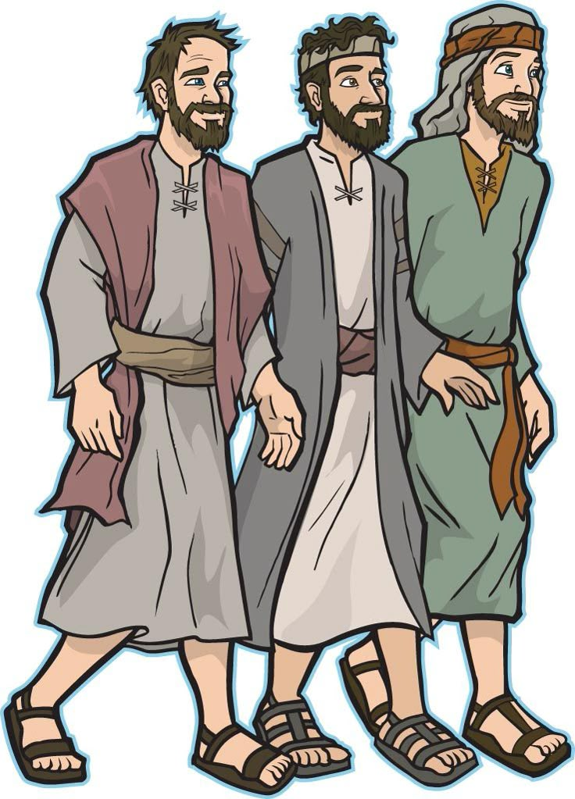
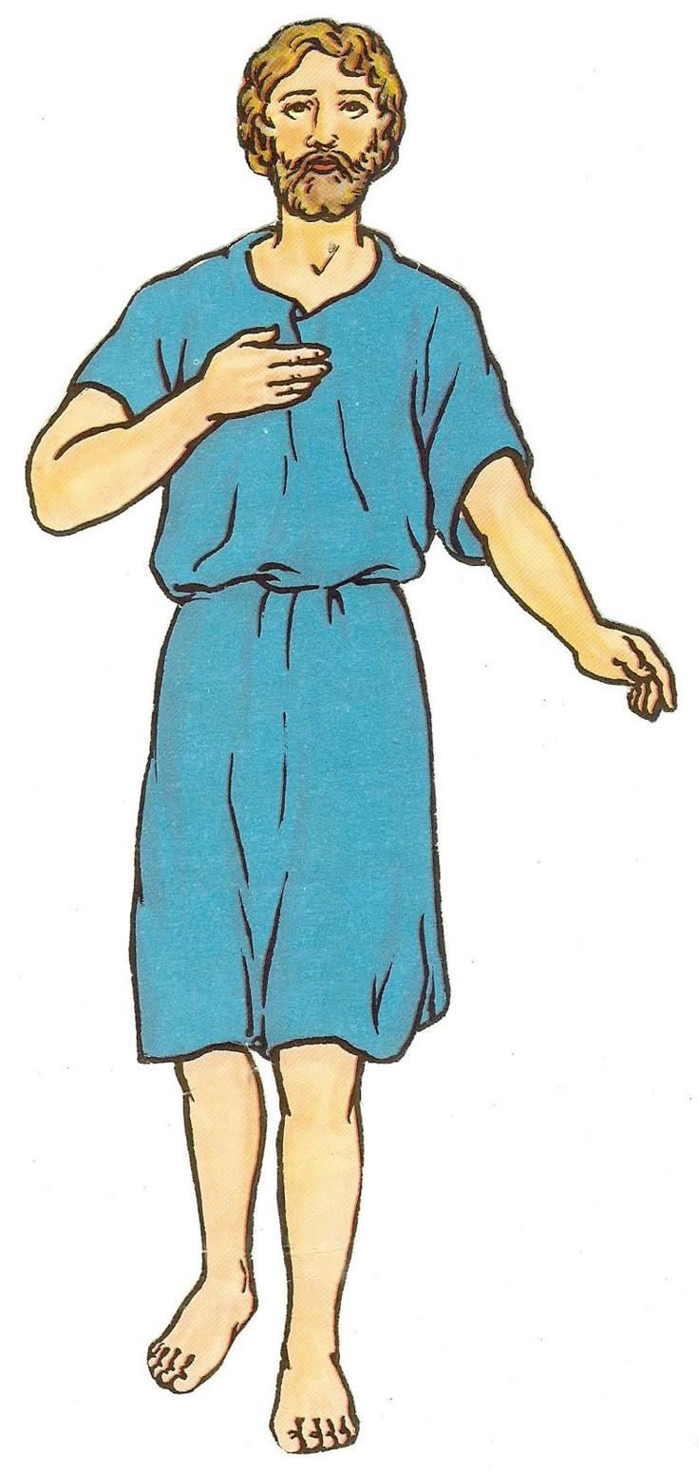
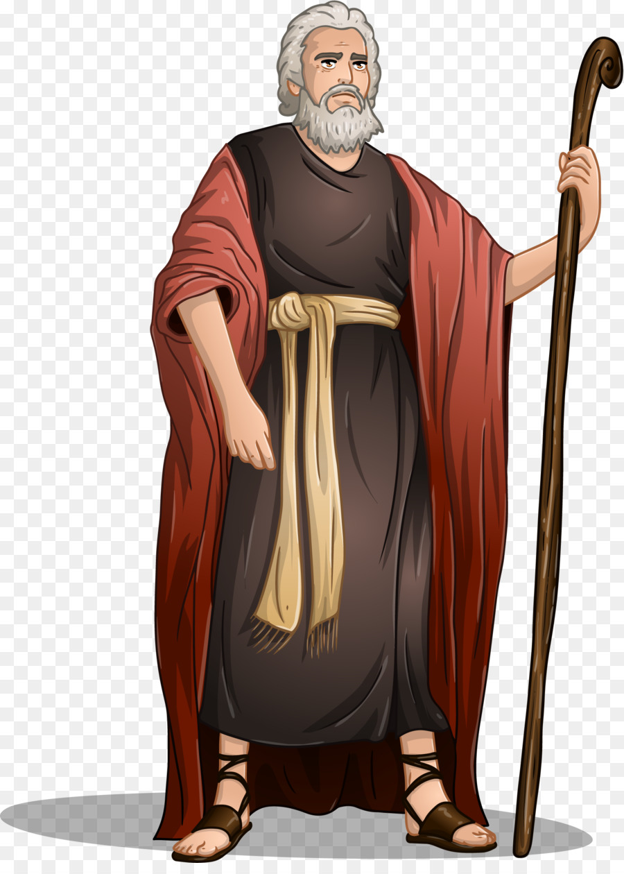
God chose the tribe of Levi to work in the tabernacle.
They served in the sanctuary.
^{Numbers 16:8} Moses also said to Korah, “You Levites, listen to me. ⁹ You should be happy that the God of Israel chose you to be different from the rest of the Israelites. He lets you come near to him to do the special work in the Lord’s Holy Tent to help the Israelites worship him. Isn’t that enough? ¹⁰ He brought you Levites near to him to help the priests, but now you are trying to become priests also. ¹¹ You and your followers have joined together and turned against the Lord! Did Aaron do anything wrong? No, so why are you complaining against Aaron?” ….
We should be leaders like you and Aaron!
It’s not fair!
You Levites listen to me!
You should be happy that God has chosen you to do the Lord’s work in the Tabernacle!
You and your followers have joined together and turned against the LORD!
Isn’t that enough? He brought you Levites close to Him and made you priests.
Did Aaron do anything wrong? NO!
So why are you complaining against Aaron?

Slide 12
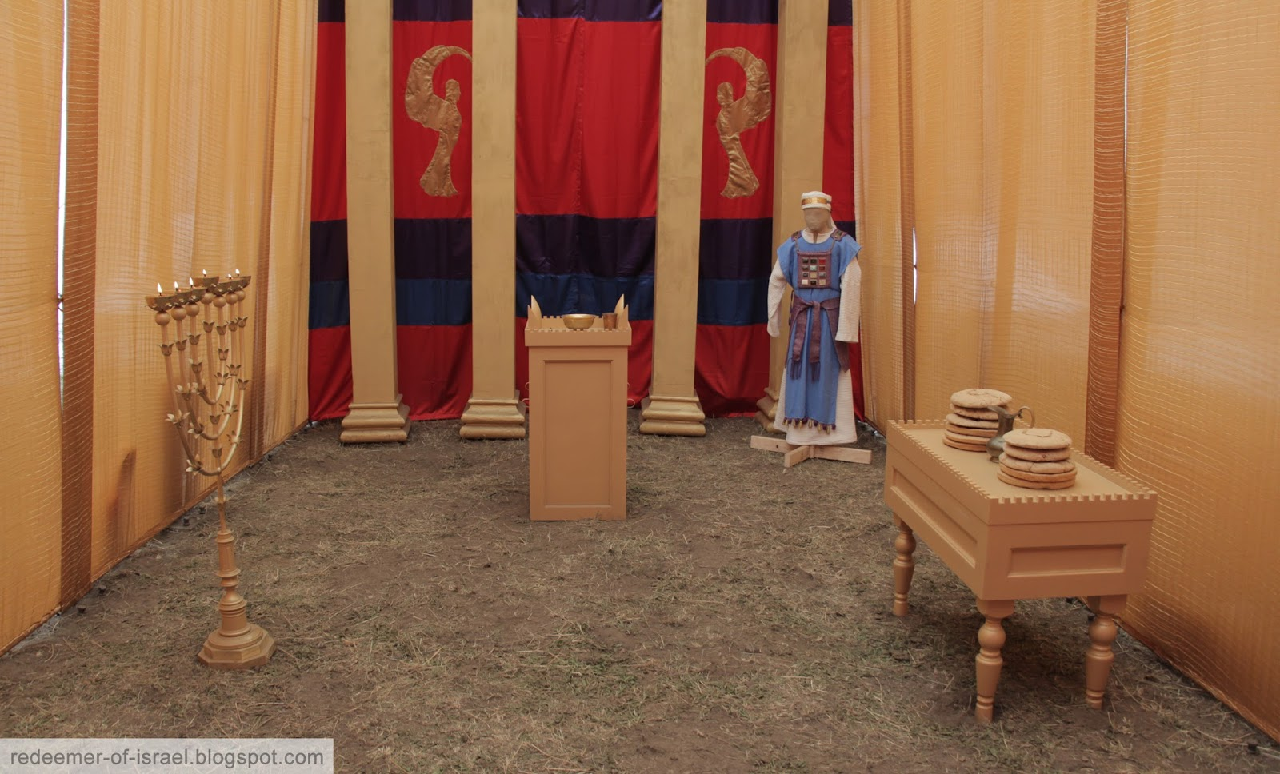
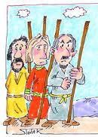
12 leaders put their name on their staffs and placed them before the Lord
I will choose 1 man to be the true priest. You will know who it is because his walking stick will begin to grow new leaves.
Tell the Israelites. Have each tribe’s leader put his name on his staff and bring it to the Tabernacle.
Then everyone will know who I have chosen and stop complaining.
Reuben Elizar
Simeon - Shelumiel
Gad - Eliasaph
Judah - Nahshon
Issachar - Nethanel
Zebulun - Eliab
Ephraim - Elishama
Manasseh - Gamaliel
Benjamin - Abidan
Dan - Ahiezer
Asher - Pagiel
Naphtali - Ahira
Levi - Aaron
17 The Lord said to Moses, ² “Speak to the Israelites. Get twelve wooden walking sticks from them. Get one from the leader of each of the twelve tribes. Write the name of each man on his walking stick. ³ On the stick from Levi, write Aaron’s name. There must be one stick for the head of each of the twelve tribes. ⁴ Put these walking sticks in the Meeting Tent in front of the Box of the Agreement. This is the place where I meet with you. ⁵ I will choose one man to be the true priest. You will know which man I choose because his walking stick will begin to grow new leaves. In this way I will stop the people from always complaining against you and me.”
⁶ So Moses spoke to the Israelites. Each of the leaders gave him a walking stick. There were twelve walking sticks. There was one stick from each leader of each tribe. One of the walking sticks belonged to Aaron. ⁷ Moses put the walking sticks before the Lord in the Tent of the Agreement.

Slide 13
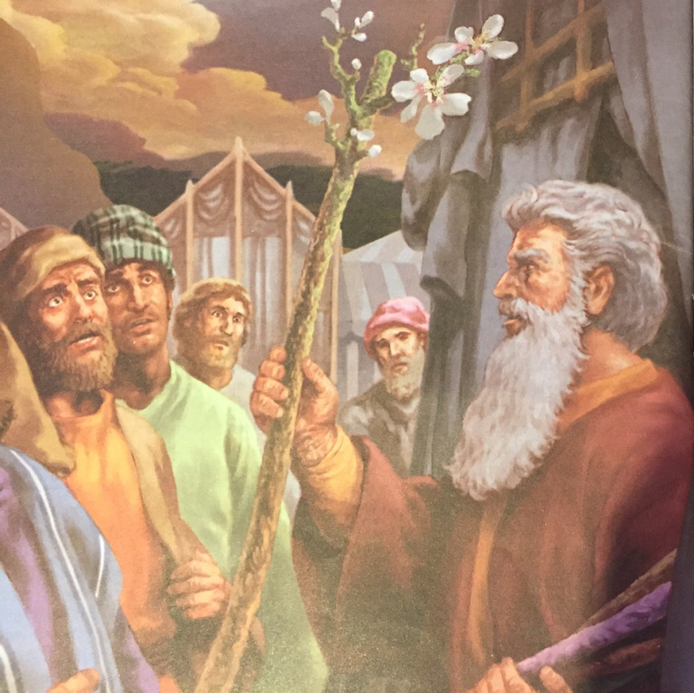

Aaron is the high priest
⁸ The next day Moses entered the Tent. He saw that Aaron’s walking stick, the stick from the family of Levi, was the one that had grown new leaves. That walking stick had even grown branches and made almonds. ⁹ So Moses brought out all the sticks from the Lord’s place. He showed the walking sticks to the Israelites. They all looked at the sticks, and each man took his own stick back.
Rueben
Naphtali
Asher
Issachar
Ephraim
Gad
Benjamin
Zebulun
Dan
Manasseh
Simeon
Judah
Levi - Aaron

Slide 14
Respect God. Respect His choices and commands.
God told Aaron, (Numbers 18:6-7)
“I myself chose the Levites from among all the Israelites. They are as a gift to you. I gave them to you to serve the Lord and work in the Meeting Tent.
⁷ But, Aaron, only you and your sons may serve as priests. You are the only ones who can go near the altar or behind the curtain into the Most Holy Place. I am giving you a gift—your service as a priest. Anyone else who tries to come too close must be killed.”

Slide 15
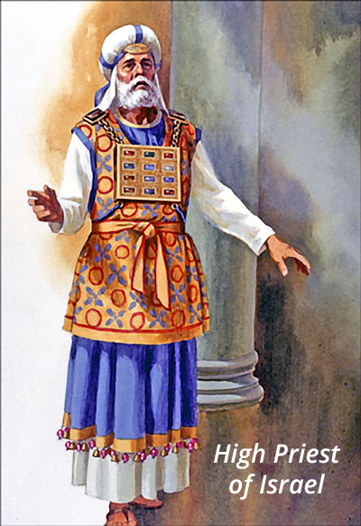
The High Priest
Offer gifts and sacrifices for sins
Teach the Israelites all the commands of God.
Find out God’s will
Offer prayers
Bring the blood of offerings before God to remove all sin.

Slide 16
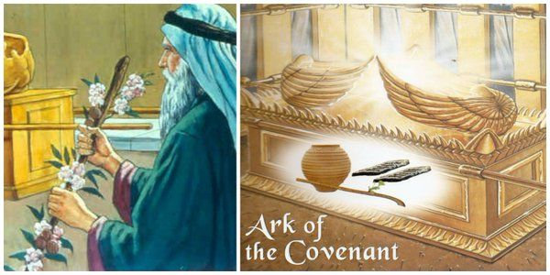
Remember to respect God’s chosen leader
¹⁰ Then the Lord said to Moses, “Put Aaron’s walking stick back in front of the Box that holds the Agreement.^{[a]} This will be a warning for these people who are always turning against me. This will stop their complaining against me so that I will not destroy them.” ¹¹ So Moses did what the Lord commanded him.
Levi - Aaron

Slide 17
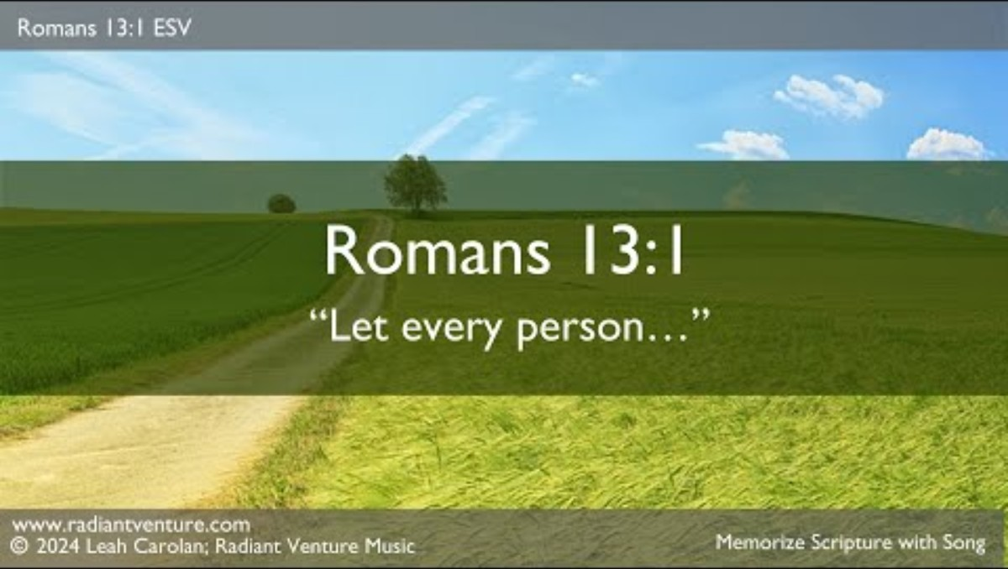

All of you must obey the government rulers. Everyone who rules was given the power to rule by God. And all those who rule now were given that power by God. Romans 13:1

Slide 18
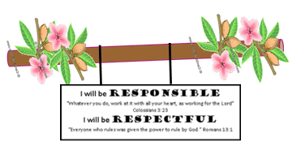
CRAFT TIME
I will respect leaders
Have a stick/dowel/twig
Glue green leaves to the stick
Glue real almonds to the stick
Make tissue paper blossoms by:
  Have a 2 inch square (or circle) of white tissue paper or napkin
  Color a Dark pink center
  Crumple the tissue paper a little
Glue on tissue paper ‘blossoms’

Slide 19

Let’s Sing

Slide 20
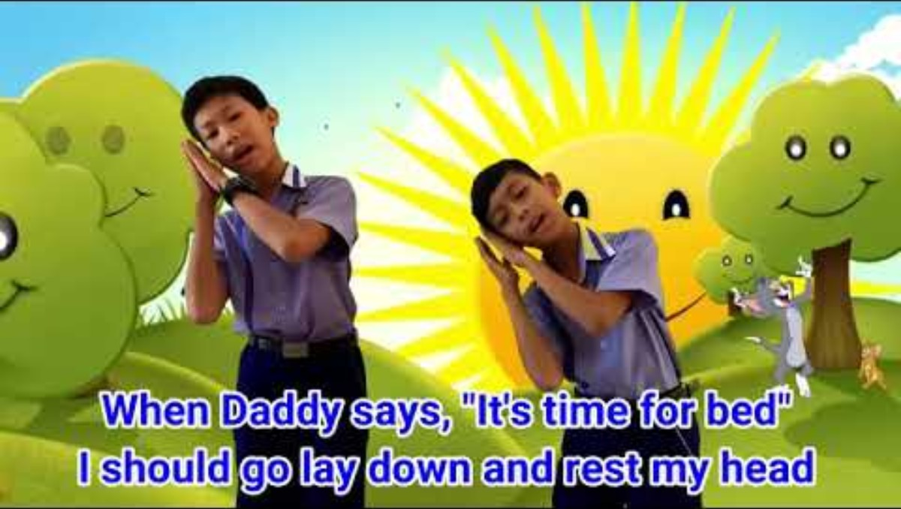
Let’s Sing

Slide 21

Let’s Sing

Slide 22
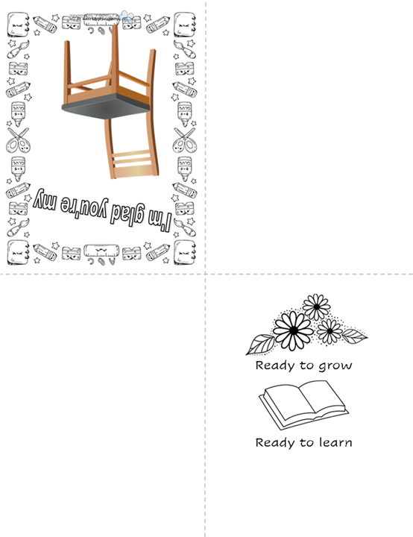
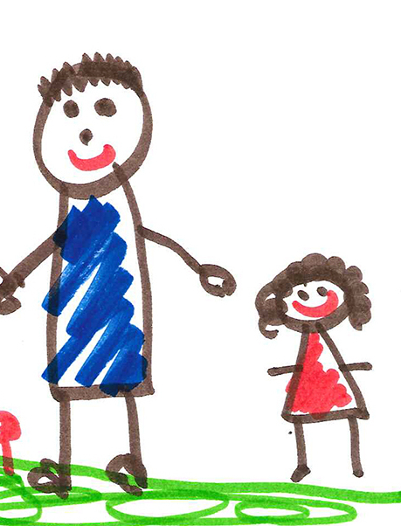

CRAFT TIME
Who is an authority over you? Who would you like to make a card for? Parent? Teacher? Pastor? Other?
Directions:
Fold the paper in half and then in half again on the dotted lines.
Draw a picture of you and the person you chose on the left side of the inside of the card.
Color the graphics and add any other message.
Attach a tea bag on top of the chair. Tea+chair = Teacher

Slide 23
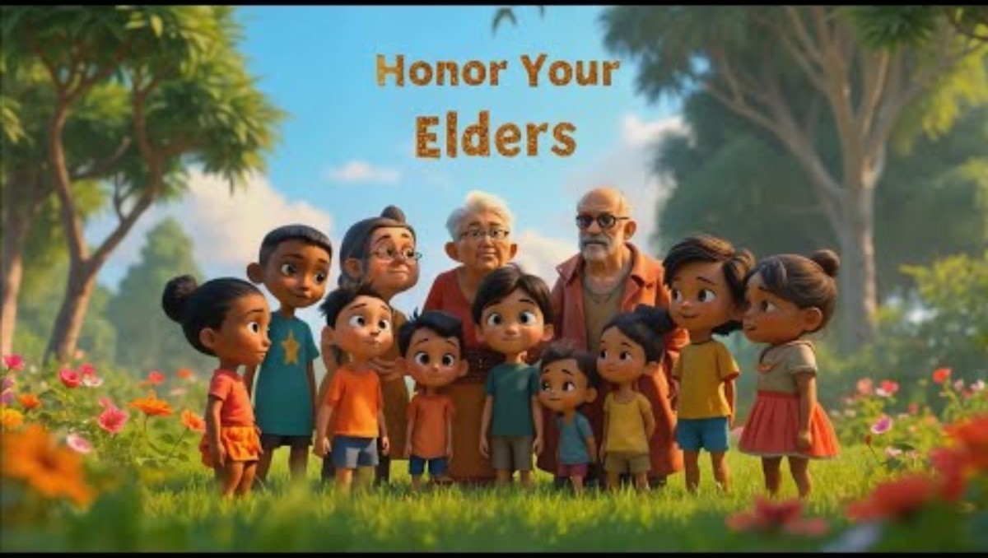
Let’s Sing

Slide 24
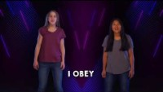
Let’s Sing

Slide 25
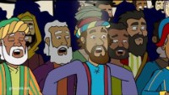
God’s Choice

Slide 26

Let’s Sing

Slide 27

Let’s Sing

Slide 28
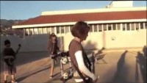
Let’s Sing

Slide 29
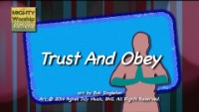
Let’s Sing

Slide 30
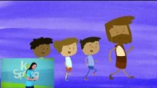
Let’s Sing

Slide 31

https://activity-array.com/

Slide 32
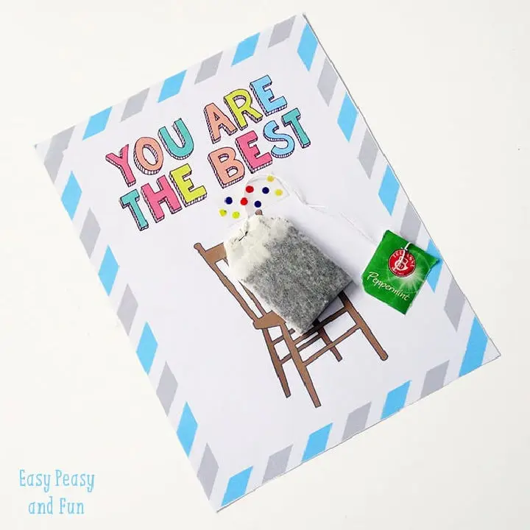


CRAFT TIME
Who is an authority over you? Who would you like to make a card for? Parent? Teacher? Pastor? Other?
https://momenvy.co/free-printable-teacher-appreciation-cards-color/

