Slide 1

Water from a rock
Exodus 17:1-7

Slide 2
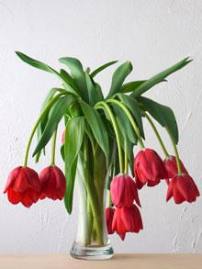
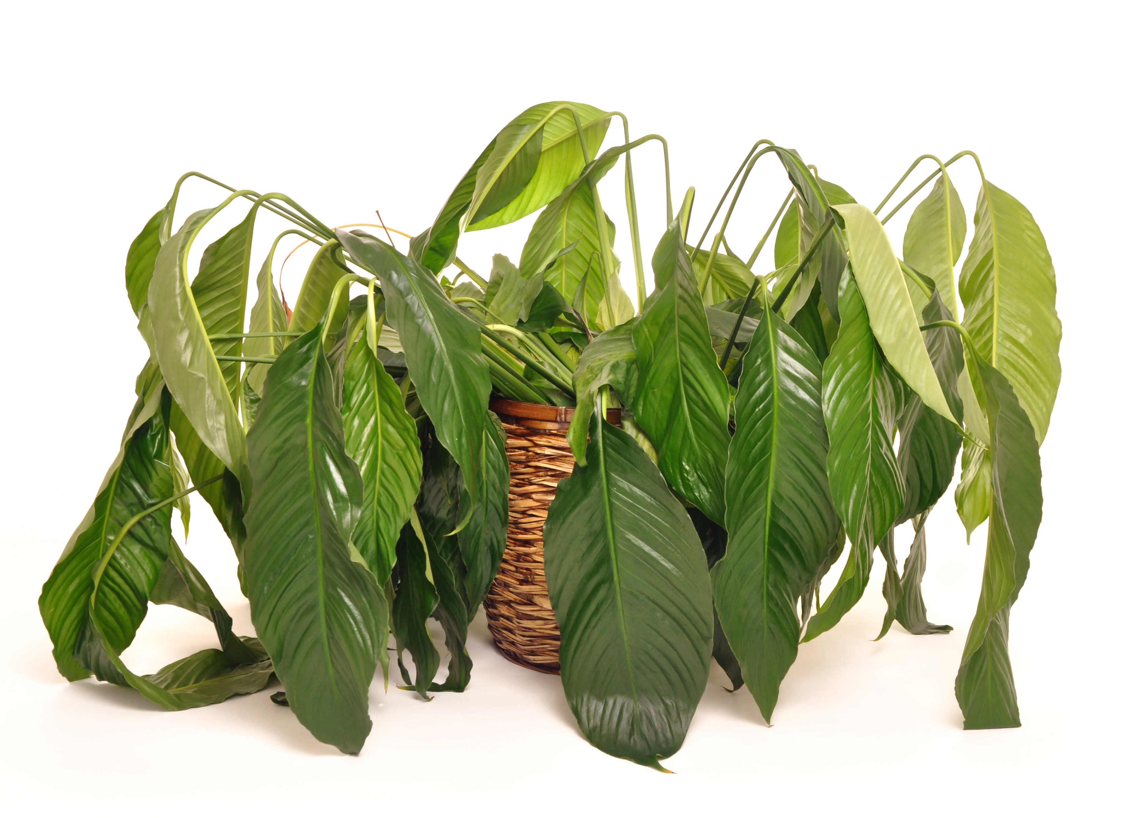
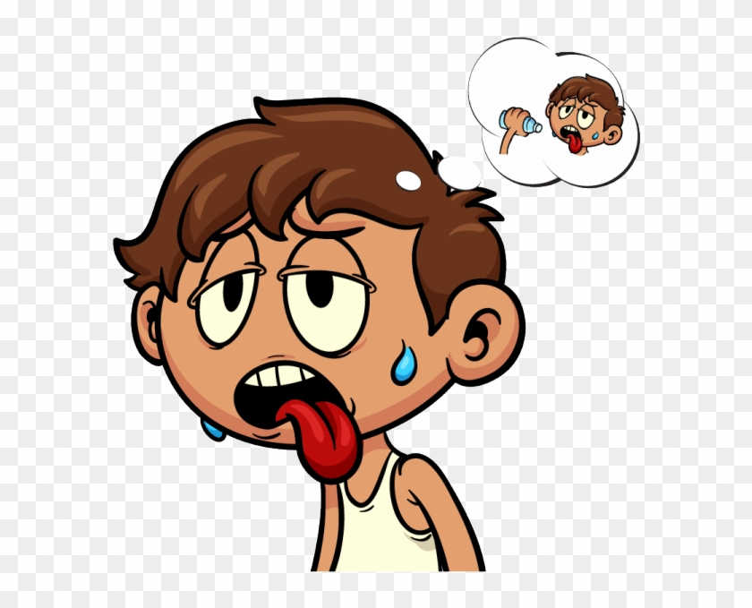
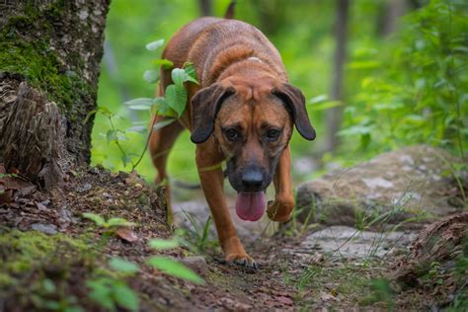
What do these need?
Demo: Trim & put a wilted flower or lettuce leaf in water .

Slide 3
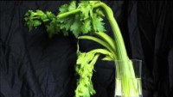
When we are thirsty, water revives us.

Slide 4
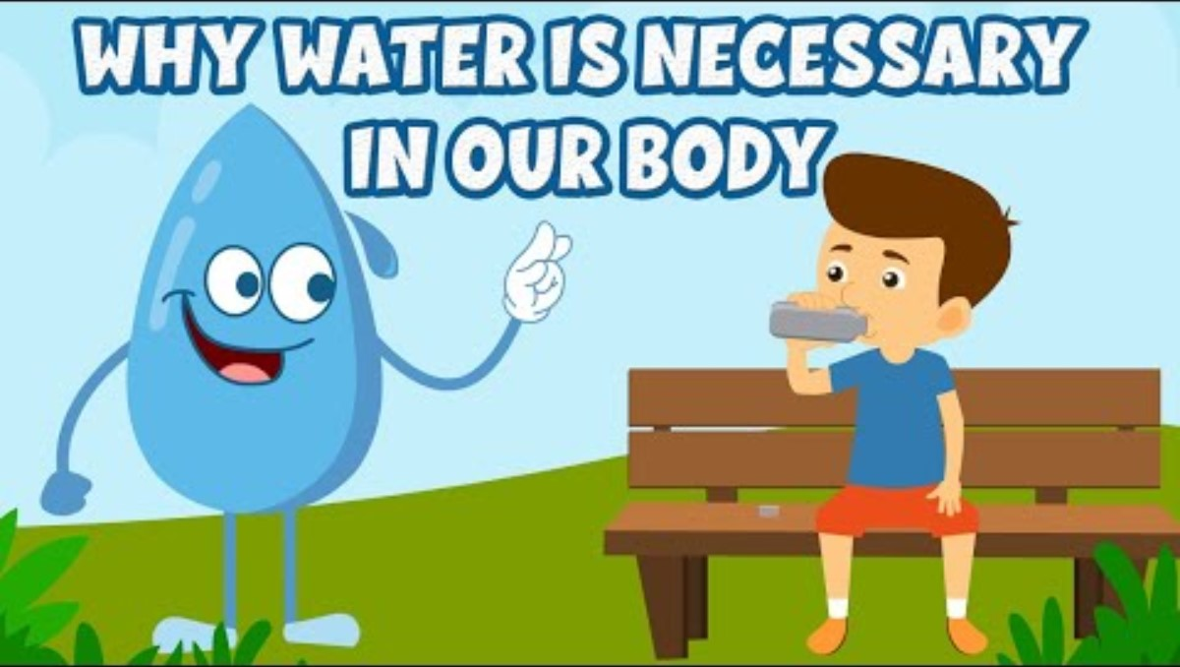

Every part of our body needs water.
We totally need God also. Jesus said, “Come to me all who are thirsty.” and He said, “I will give you Living Water.” The Holy Spirit will fill us and quench our thirst for Truth about God and His Way of living.

Slide 5
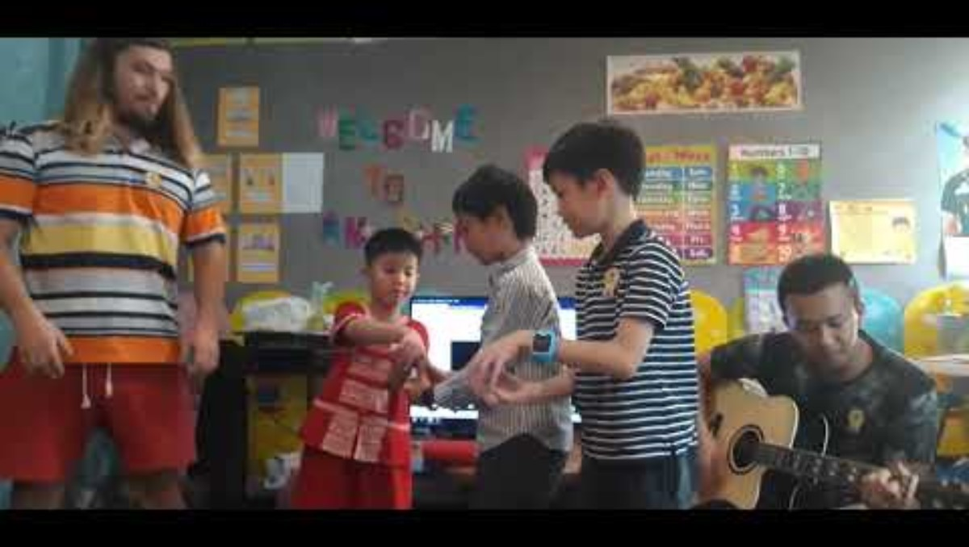
Fill It Up & Let it Overflow

Slide 6
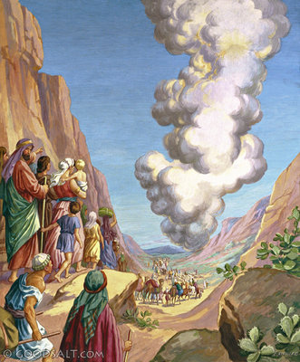
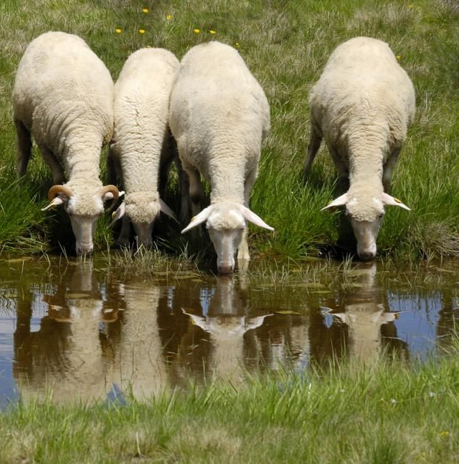
Follow that cloud
Will you follow God?
Will you follow Him when he leads you in pastures green and by streams of clear water?
Will you follow God when life is easy and fun?

Slide 7
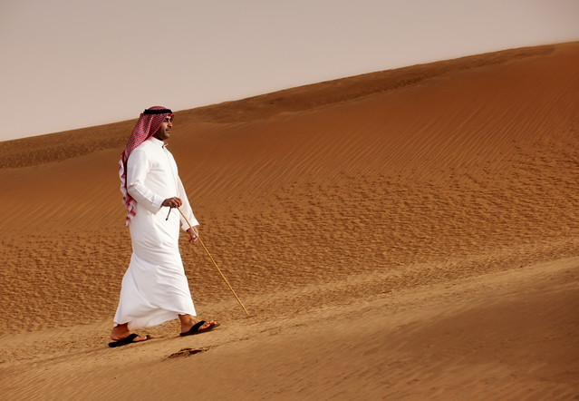
Follow that cloud
Will you follow God?
Will you follow Him when He leads you into the dessert?
Will you follow Him when times are tough!

Slide 8
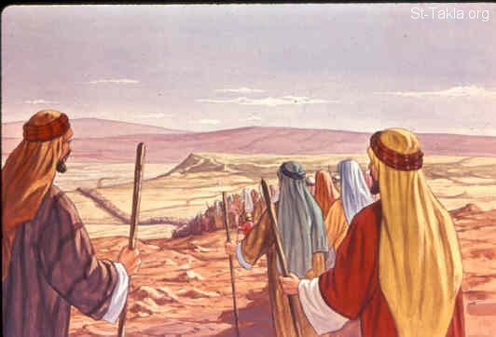
Follow God
The people were traveling each day getting closer to the destination God had for them. Their travel was through the dry, hot desert. They needed to fully depend on God.
^{Exodus 17:1}
The whole Israelite community set out from the Desert of Sin, traveling from place to place as the Lord commanded.

Slide 9
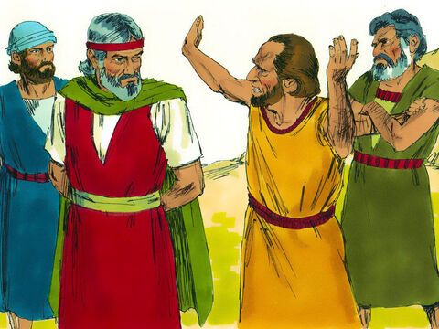
Quarreling& complaining
Give us water to drink!
Why did you bring us out of Egypt to make us die of thirst?
² So they quarreled with Moses and said, “Give us water to drink.”
Moses replied, “Why do you quarrel with me? Why do you put the Lord to the test?”
³ But the people were thirsty for water there, and they grumbled against Moses. They said, “Why did you bring us up out of Egypt to make us and our children and livestock die of thirst?”
Why do you quarrel with me? Why are you putting the LORD to the test?

Slide 10
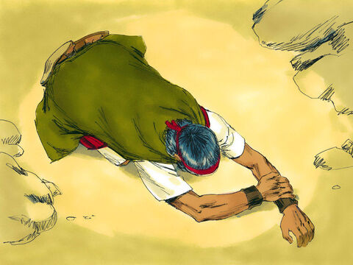
Cry out to the LORD -- pray
² ⁴ Then Moses cried out to the Lord, “What am I to do with these people? They are almost ready to stone me.”
LORD,
What am I to do with these people? They are almost ready to stone me!

Slide 11
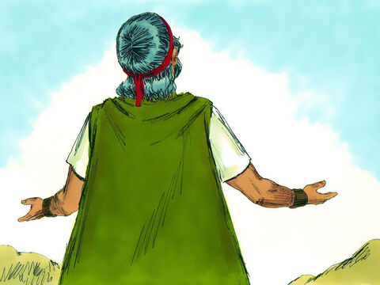
Cry out to the LORD -- pray
⁵ The Lord answered Moses, “Go out in front of the people. Take with you some of the elders of Israel and take in your hand the staff with which you struck the Nile, and go. ⁶ I will stand there before you by the rock at Horeb. Strike the rock, and water will come out of it for the people to drink.”
Take your staff in your hand. In front of everyone, stand in front of the rock at Horeb. Strike the rock. Water will come out of it for everyone to drink.

Slide 12
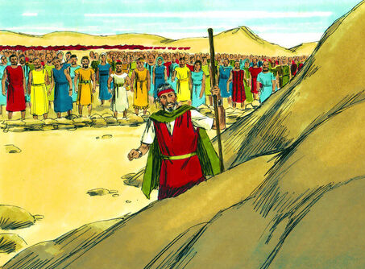
Cry out to the LORD -- pray
What is Moses going to do?
Is he looking for water in a rock? That’s crazy! There’s no water!
So, Moses did this in the sight of the elders of Israel.
All things are possible with God. You do not need to complain and quarrel or put Him to a test. Just trust God.

Slide 13
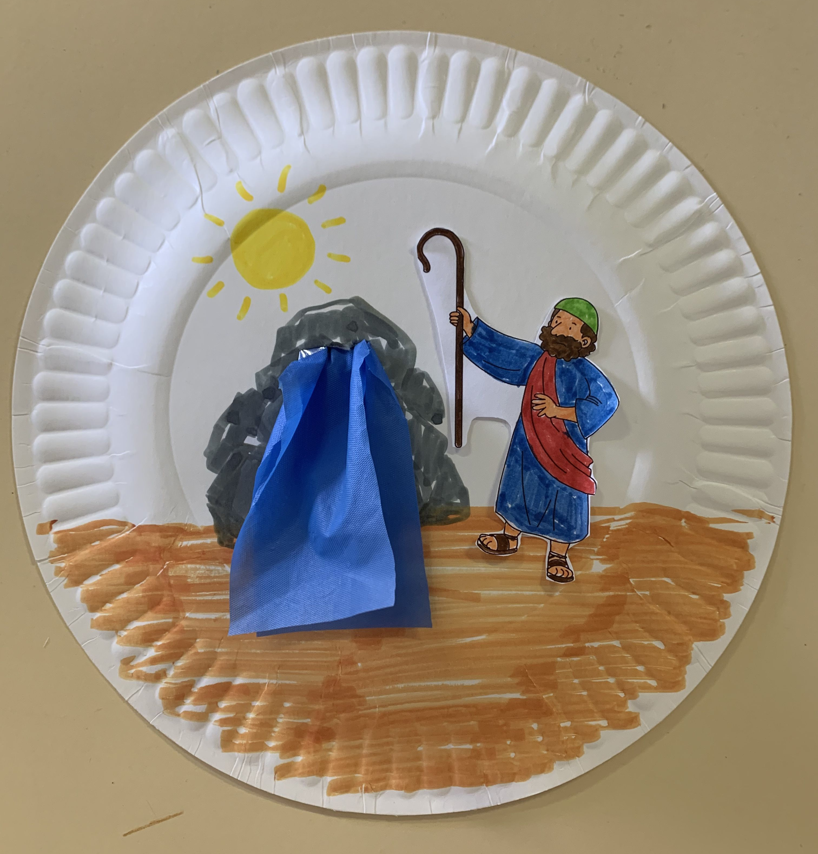
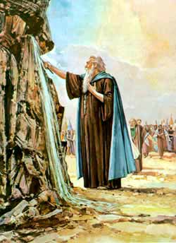

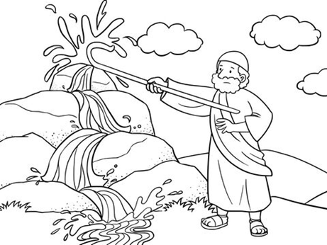
CRAFT TIME
Moses struck the rock and water came out.
Options:
#1 Draw on a paper plate. Add tissue water.
#2 Color the picture

Slide 14
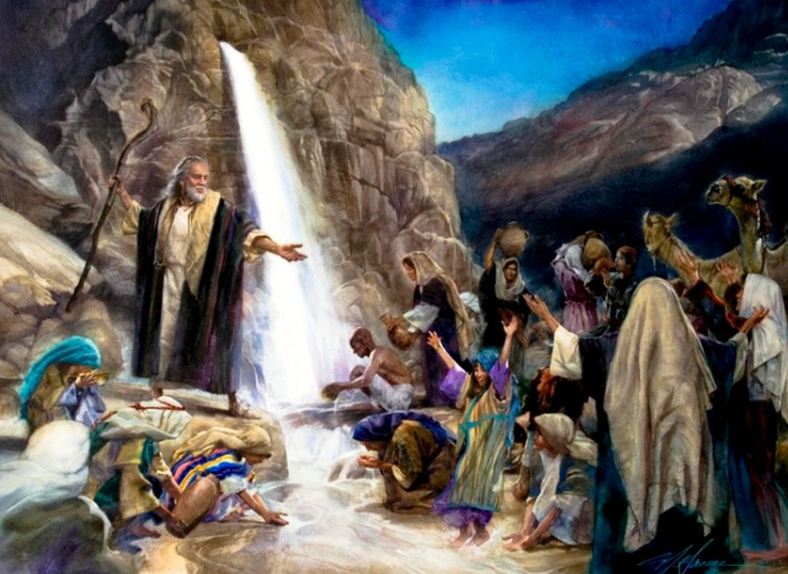
Cry out to the LORD -- pray
God has provided you water to drink.
This place is called Massah because you tested God.
And it is called Meribah because you were quarreling.
⁷ And he called the place Massah and Meribah because the Israelites quarreled and because they tested the Lord saying, “Is the Lord among us or not?”

Slide 15

Peace Like A River
Let’s not grumble or complain. Let’s trust God, pray, and He will care for us.

Slide 16
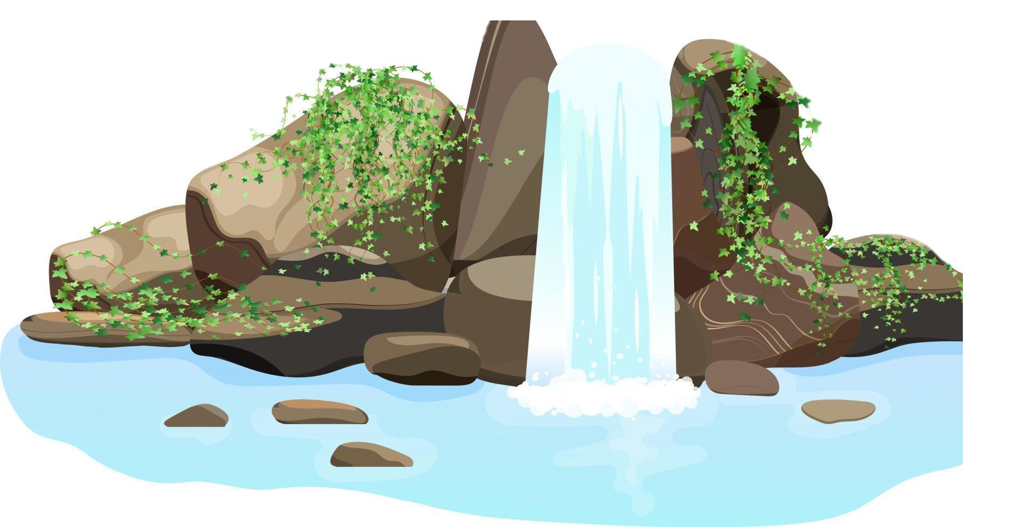
“He satisfies those who are thirsty.
He fills those who are hungry with good things.” Psalms 107:9
The Israelites were thirsty. We, too, get thirsty.
But do you get thirsty for God? Do you really, really want God.
Do you want to get to know God and to be with Him?

Slide 17
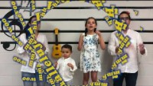
Jesus’ Love is
Bubbling Over

Slide 18
“Blessed are those who hunger and thirst for righteousness, For they shall be filled.” Matthew 5:6
The Israelites were thirsty. We, too, get thirsty.
But do you get thirsty for God? Do you really, really want God.
Do you want to get to know God and to be with Him?

Slide 19


Slide 20




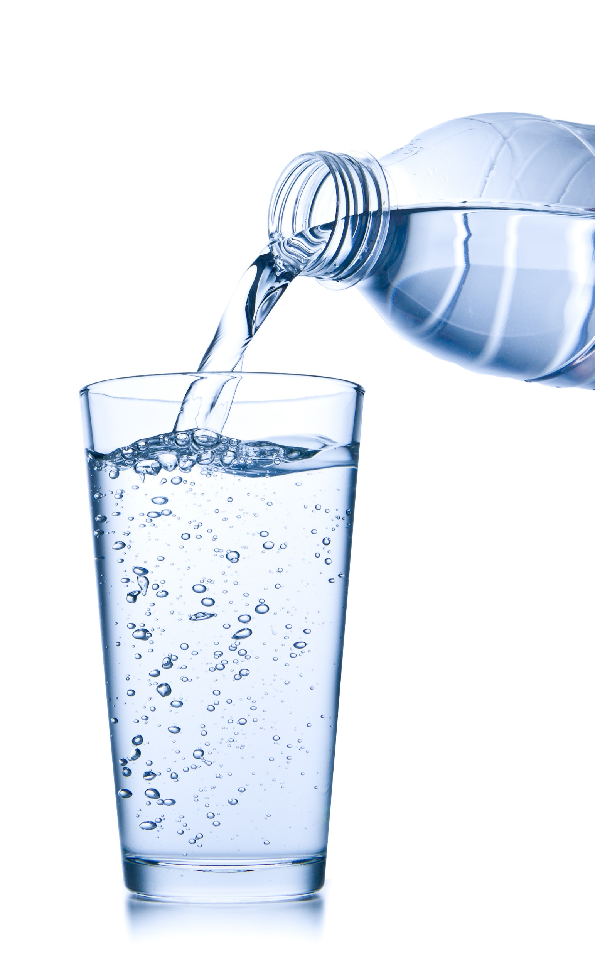
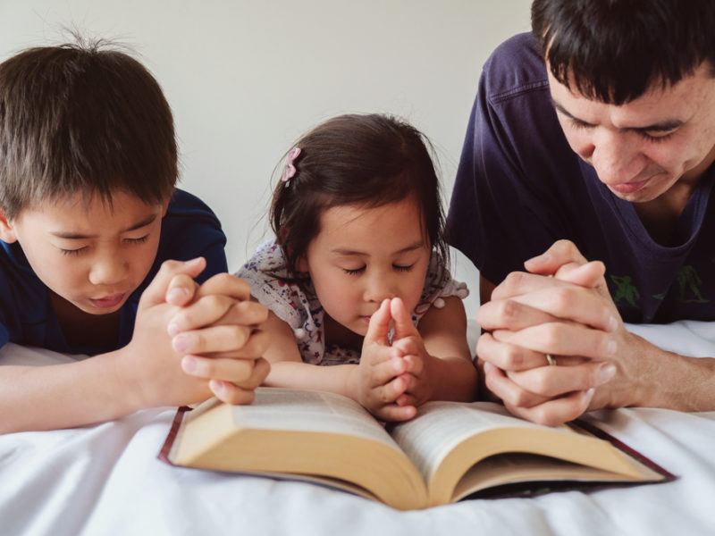
How thirsty are you?
Not really
No, I don’t need it.
If I have to.
Please,
May I?
I will ask, seek & find some!
May I have more please?
Do you really want to spend time with God?

Slide 21
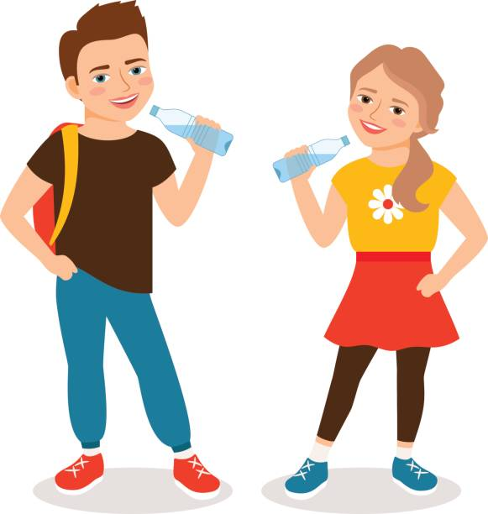
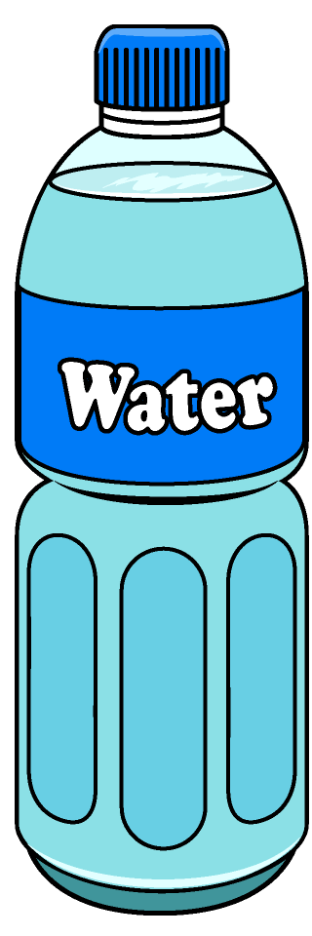
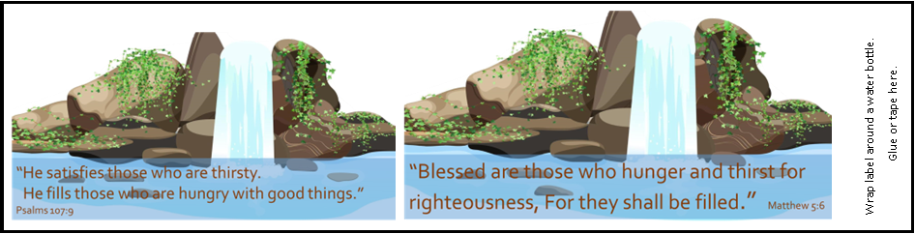
Decorate water bottles to give to others.

Slide 22
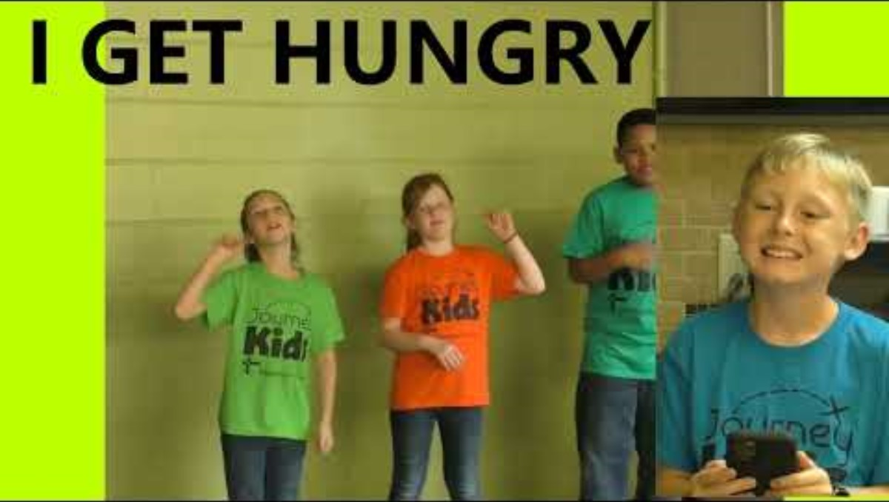
I Get Hungry for God

Slide 23

Holy Spirit Fills Me

Slide 24
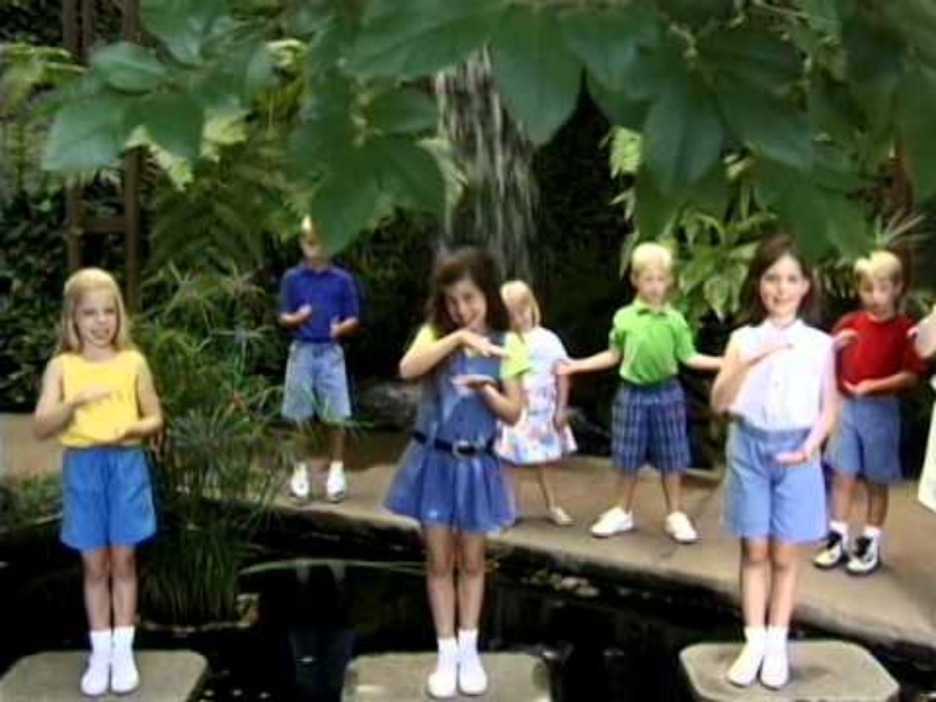
Deep and Wide

Slide 25
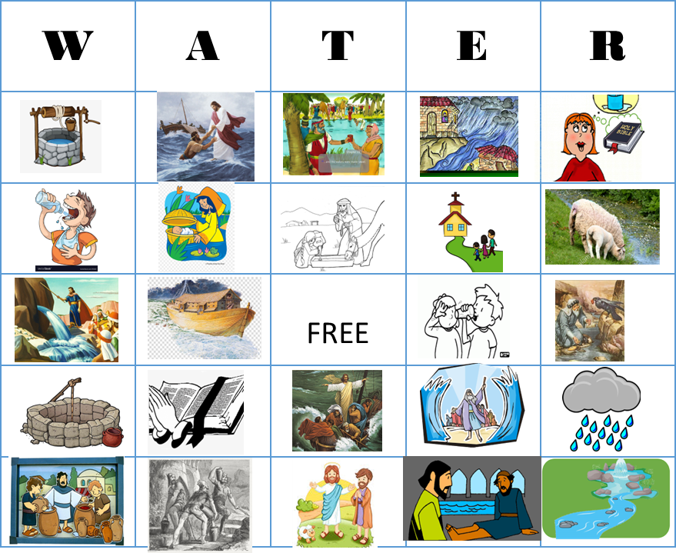
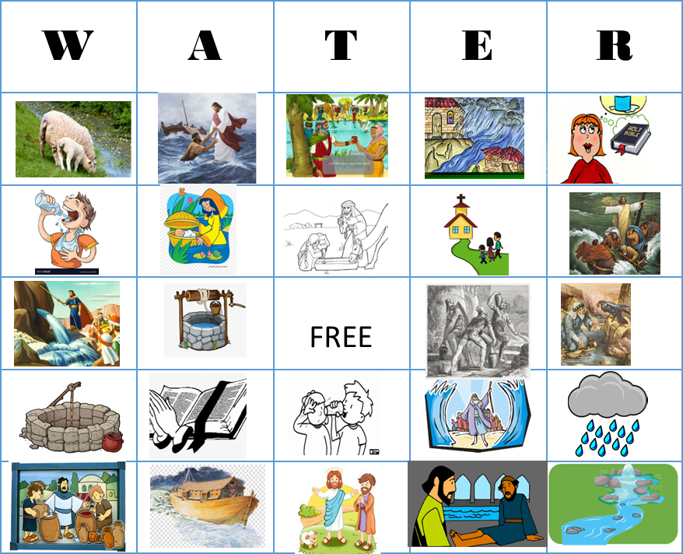
GAME TIME
W A T E R (PLAYED LIKE BINGO)
What happened with the water in the story?
Place a marker on the square that shows the picture.

Slide 26
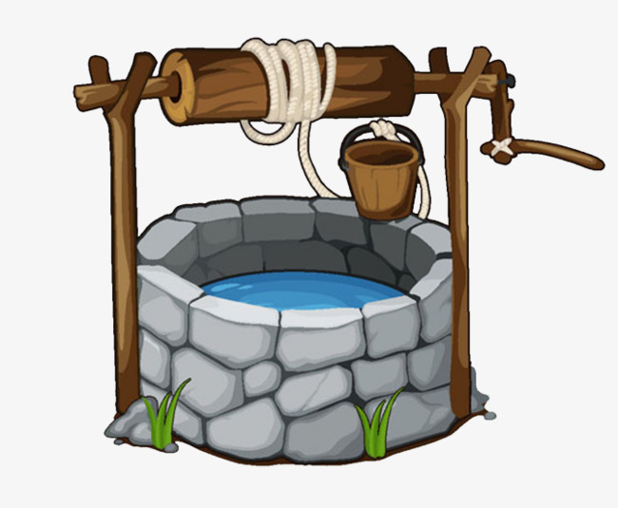
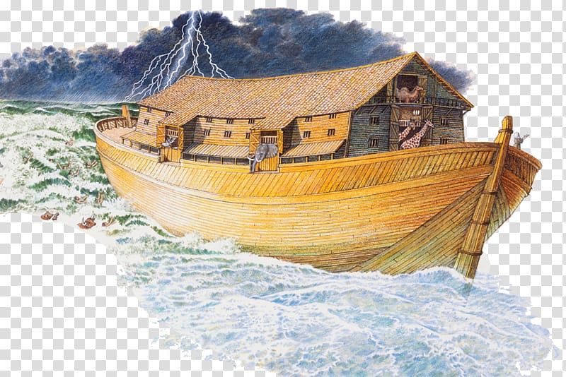
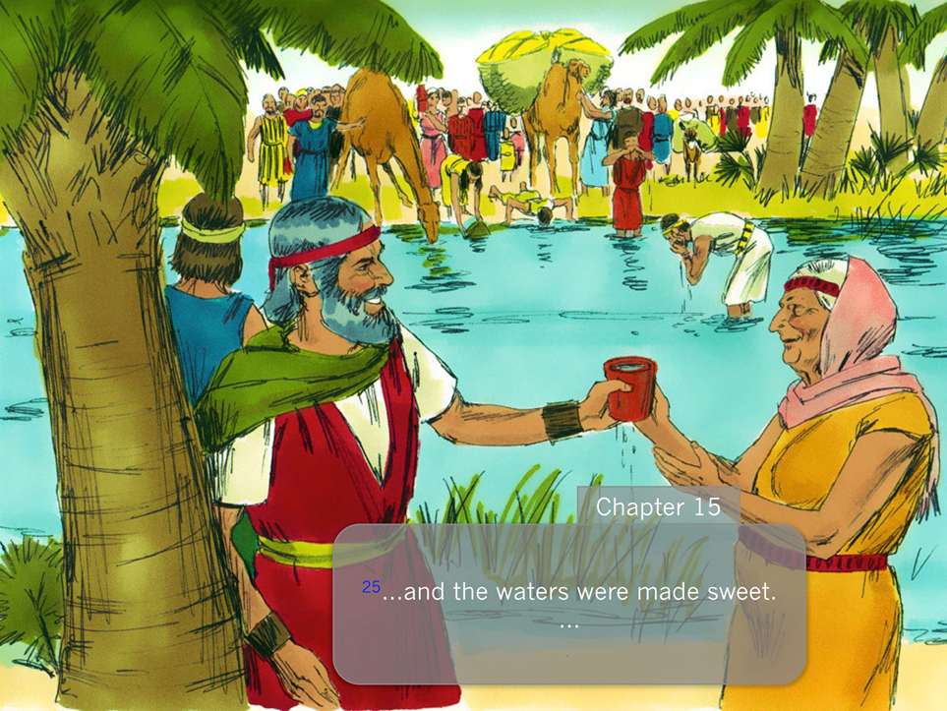
W A T E R
1
Jesus asked a woman
for a drink. She came
to get water from a _ _ _ _.
Jesus promised to satisfy her thirst.
2
God told Noah to build an _ _ _.
It rained and rained for 40 days.
There was a big _ _ _ _ _ over all the earth. God saved Noah and his family because they chose to obey God.
3
The Israelites had traveled for 3 days without _ _ _ _ _. They were very thirsty!
They came to Marah. The water was bitter, but God made it sweet. Then he led them to a place with 12 wells and 70 palm trees.

Slide 27
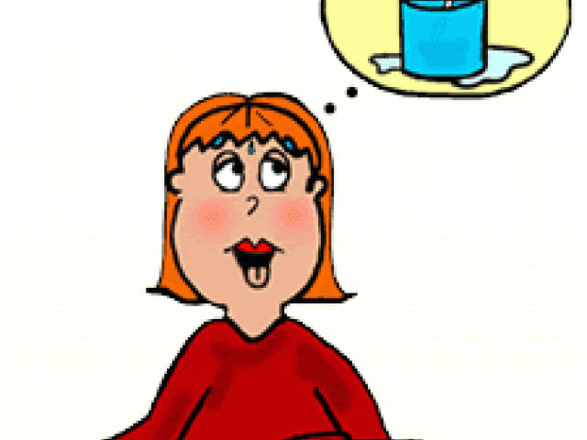

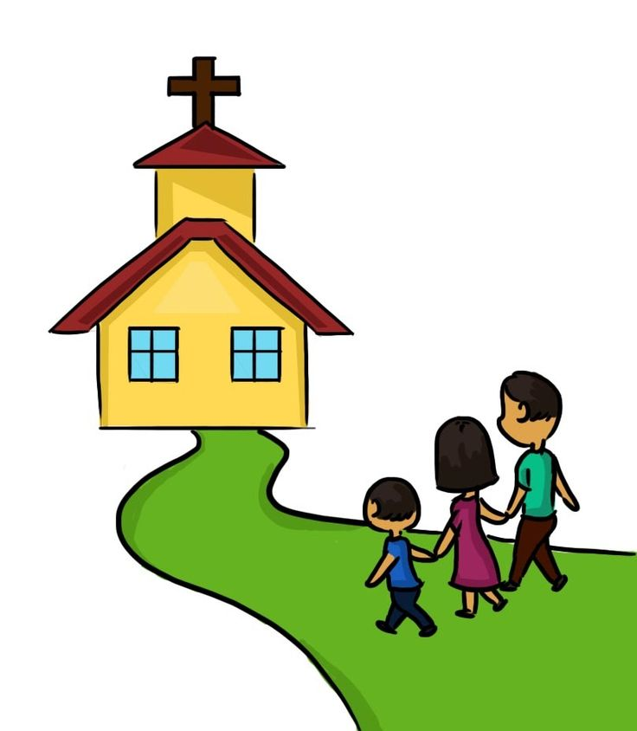

W A T E R
1
“Blessed are those who hunger and thirst for righteousness,
For they shall be filled.” Matthew 5:6
David wrote
“Like a deer drinking from a stream,
I reach out to you, my God.^{[a]}
² My soul thirsts for the living God.
When can I go to meet with him?”
Psalms 42:1-2
3
As the song says,
Read your Bible, pray every day, and you’ll grow, grow, grow.

Slide 28
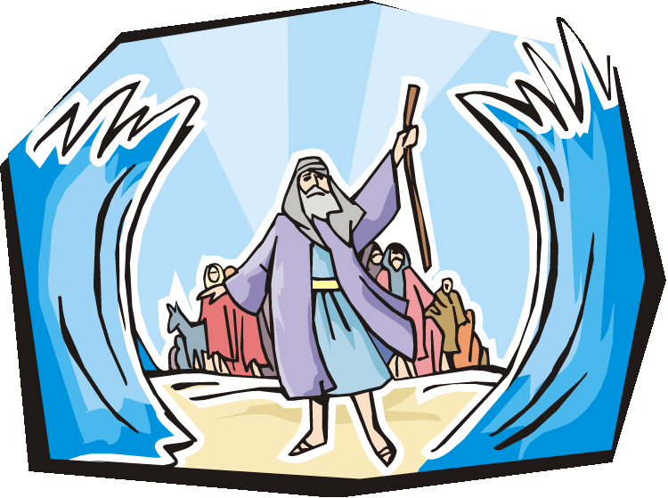
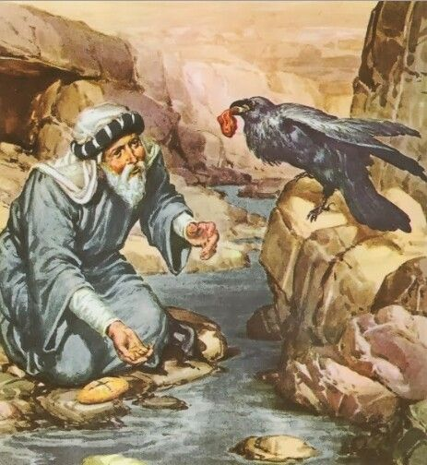
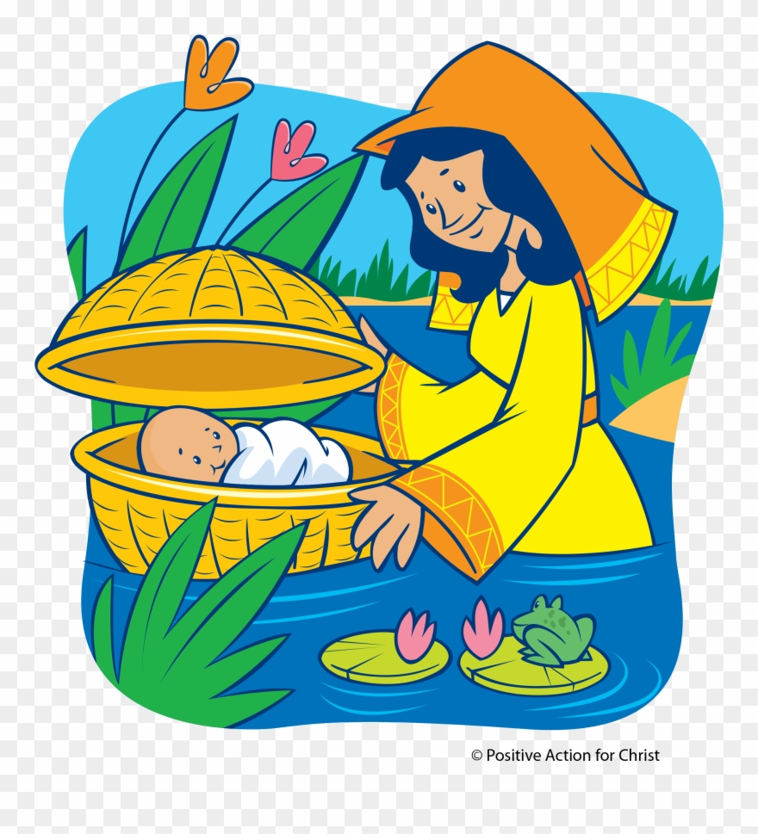
W A T E R
1
God led the Israelites to the Red Sea. It looked like they were trapped, but God opened up the _ _ _. They walked on dry land. The Egyptians died in the _ _ _.
2
King Ahab did not love or obey God.
Elijah gave him God’s message,
“There will not be any _ _ _ _ until I say so.” Elijah hid beside brook Cherith. He had _ _ _ _ _ to drink. Ravens brought him food.
3
Jocabed knew baby Moses was extra special . She wanted to save him from the bad Pharoah.. She hid him in a basket boat and put him in the Nile _ _ _ _ _. Pharoah’s daughter saw him and rescued him. Now he was safe.

Slide 29
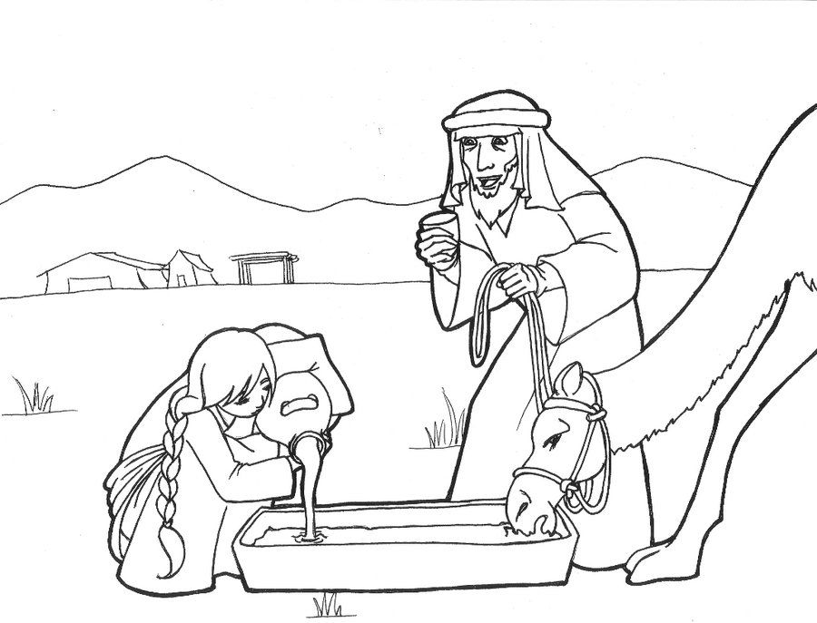
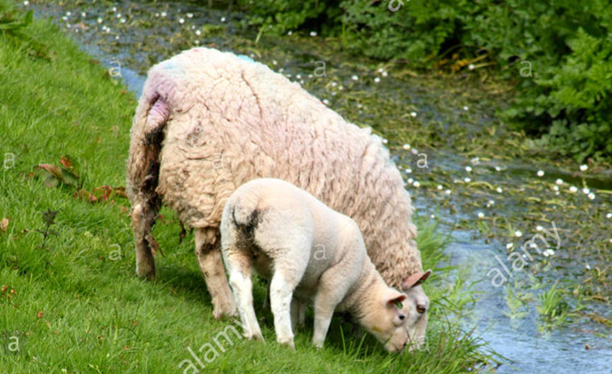
W A T E R
1.
Abraham wanted a wife for Isaac. He sent his servant to find one. The servant prayed that a nice girl would give him a _ _ _ _ and give _ _ _ _ _ to all of his camels. Rebekah did. She became Isaac’s wife.
2
David was a good shepherd.
He made sure that his sheep had good grass to eat and good _ _ _ _ _ to drink. He kept them safe.
3
Jesus told a story. The wiseman built his house on the rock. The foolish man built his house on the sand. It _ _ _ _ _ _ and rained. There was a flood. Which house stood firm?

Slide 30
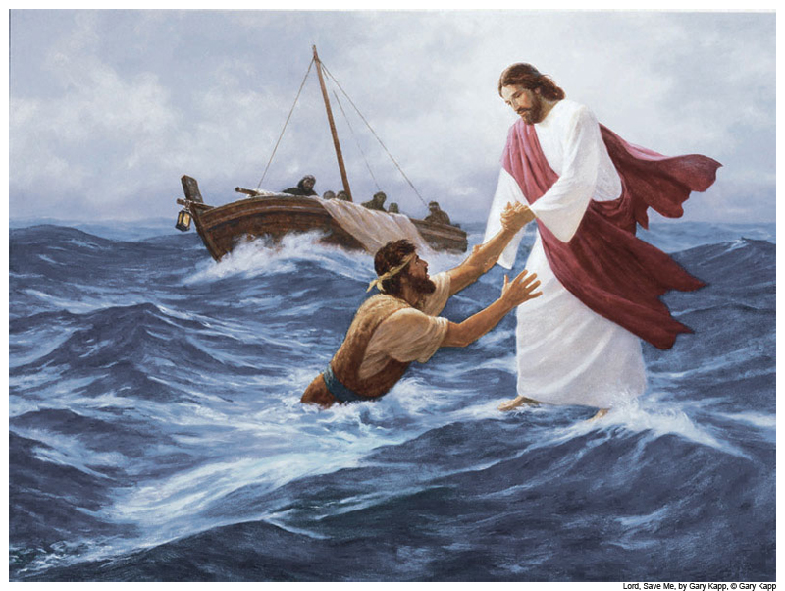
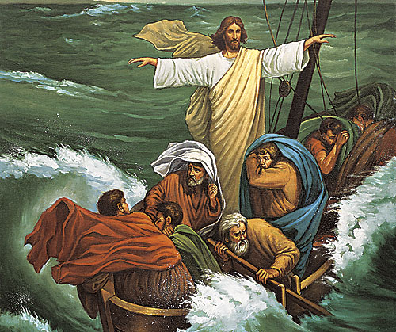
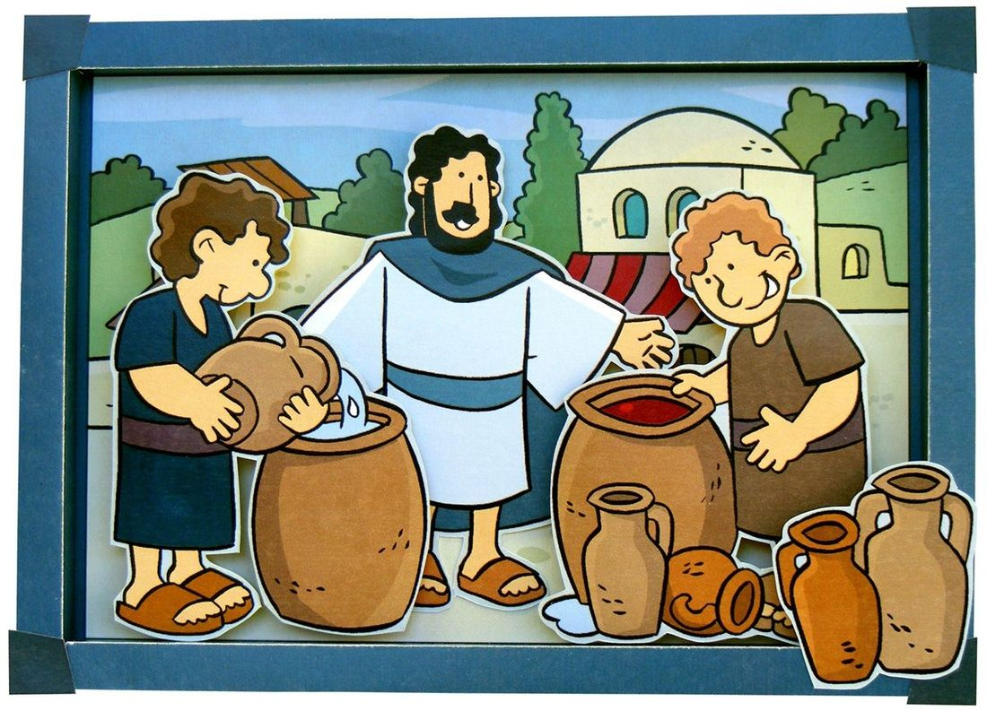
W A T E R
1
Jesus walked on _ _ _ _ _.
Peter said, “call me.”
Peter walked on water too.
2
It was so stormy! There was lightning and thunder and lots of wind! Waves were coming into the boat! The disciples were scared! Jesus said, “Peace be still!” The _ _ _ _ was calm. There was no more storm.
Jesus and his disciples were at a wedding. They ran out of wine. Jesus turned water into wine! Now they had good grape juice to drink.

Slide 31
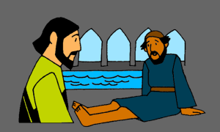
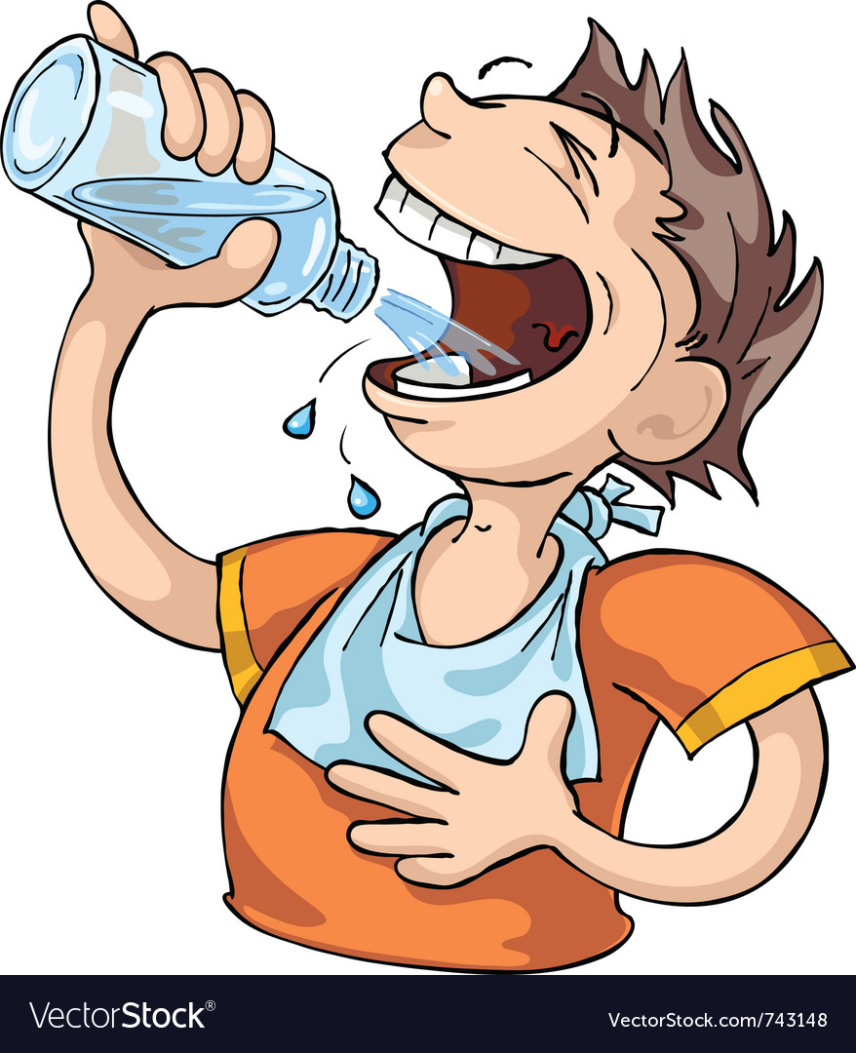

W A T E R
1
A crippled man sat by a pool. He waited for the _ _ _ _ _ to move. Jesus asked, “Do you want to be healed?” He did! Jesus healed him and then he could walk and run! He praised God!
2 “He satisfies those who are thirsty.
He fills those who are hungry with good things.” Psalms 107:9
3
He gives rain for the earth and water for the fields.
Job 5:10

Slide 32
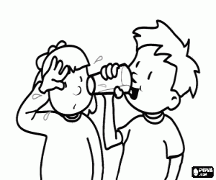
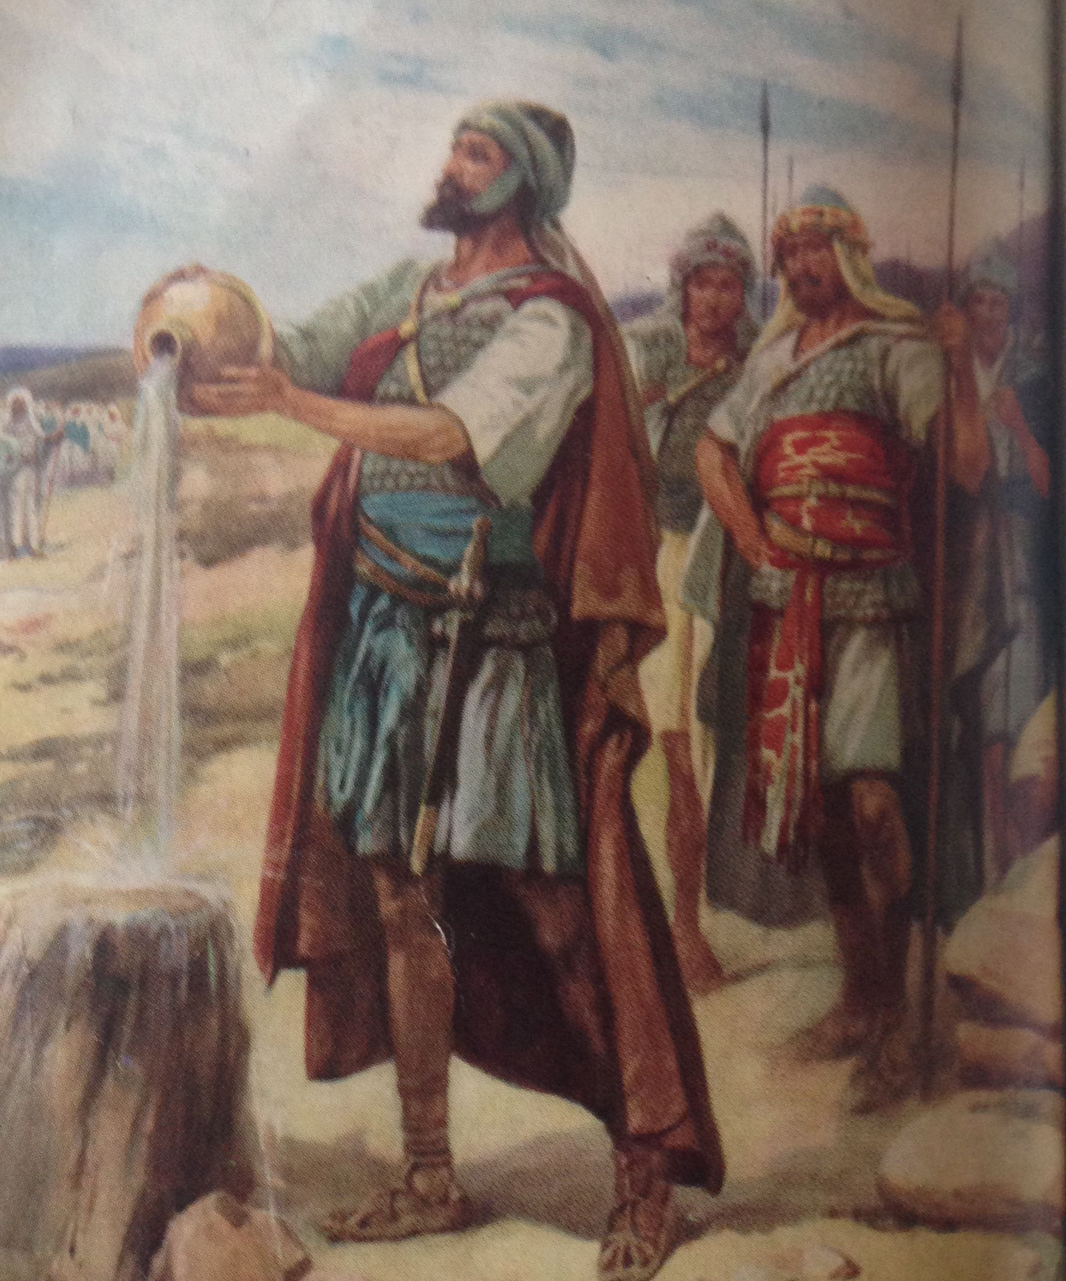
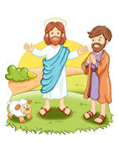
W A T E R
1
Our body needs water to stay clean and healthy, keep cool, think better, digest food, and more.
Drink 8 glasses of water a day.
2
David missed the fresh, clean water from the well at his home in Bethlehem. But it was dangerous for him to go there then. His friends went to get him a drink.
3
The Lord is my shepherd; I shall not want. He makes me lie down in green pastures. He leads me beside still waters. He restores my soul. He leads me in paths of righteousness for his name's sake.
Psalms 23:1-3

Slide 33
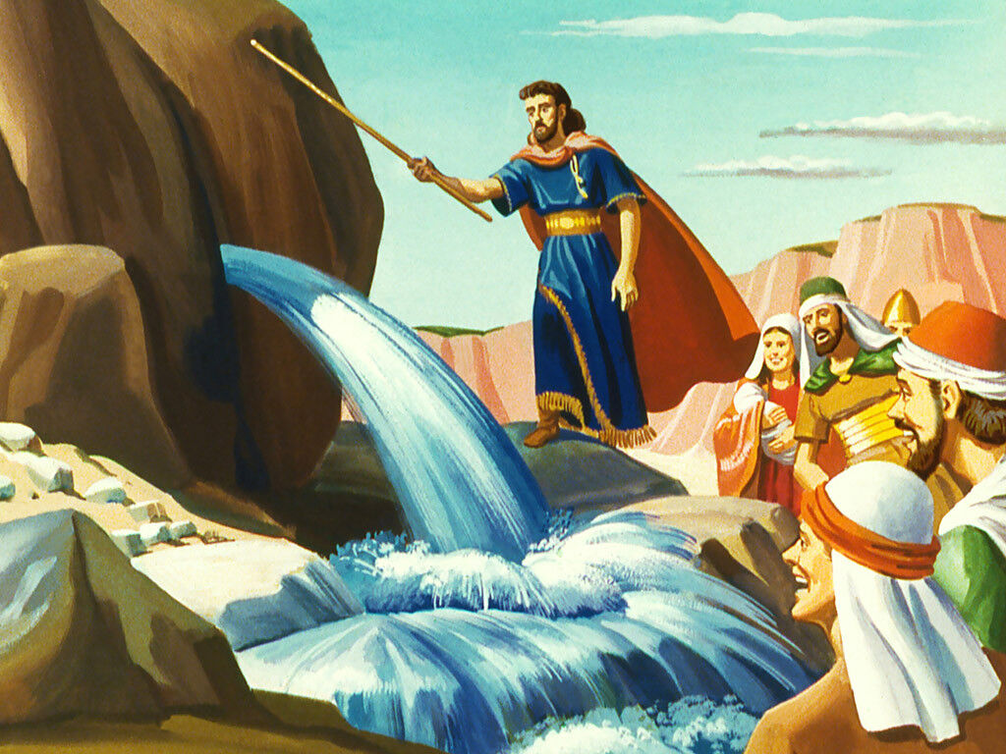
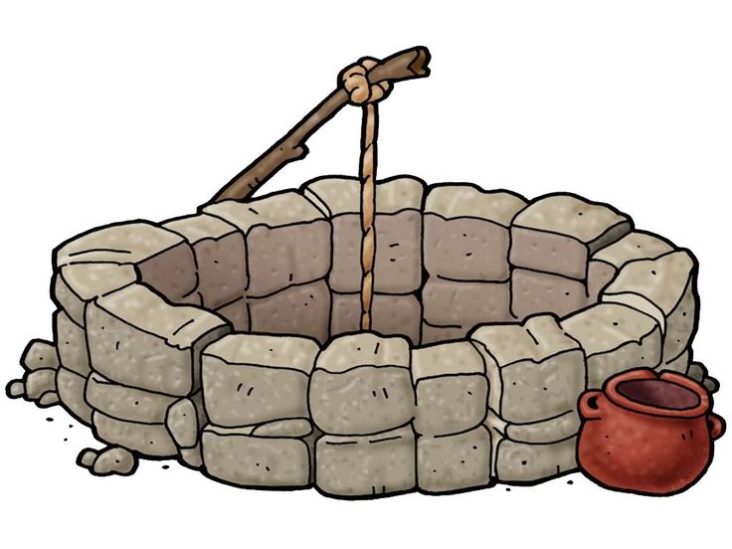


W A T E R
1
Again, the Israelites were thirsty and needed water in the desert. This time Moses struck a rock and God made water come out of the rock.
2
Again, they were thirsty! They complained and complained.
God showed them a well in Beer.
They praised God for the water.
3
He sends forth springs in the valleys;
They flow between the mountains.
Psalms 104:10

Slide 34

The Water Song
-- drink water

Slide 35

Deep Cries Out To Deep

Slide 36

https://activity-array.com/

