Slide 1
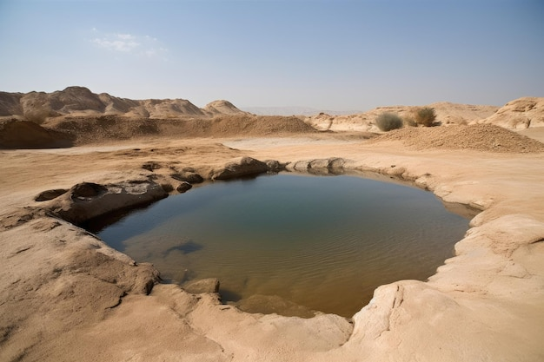
Marah
Bitter Water
Exodus 15:25-27

Slide 2


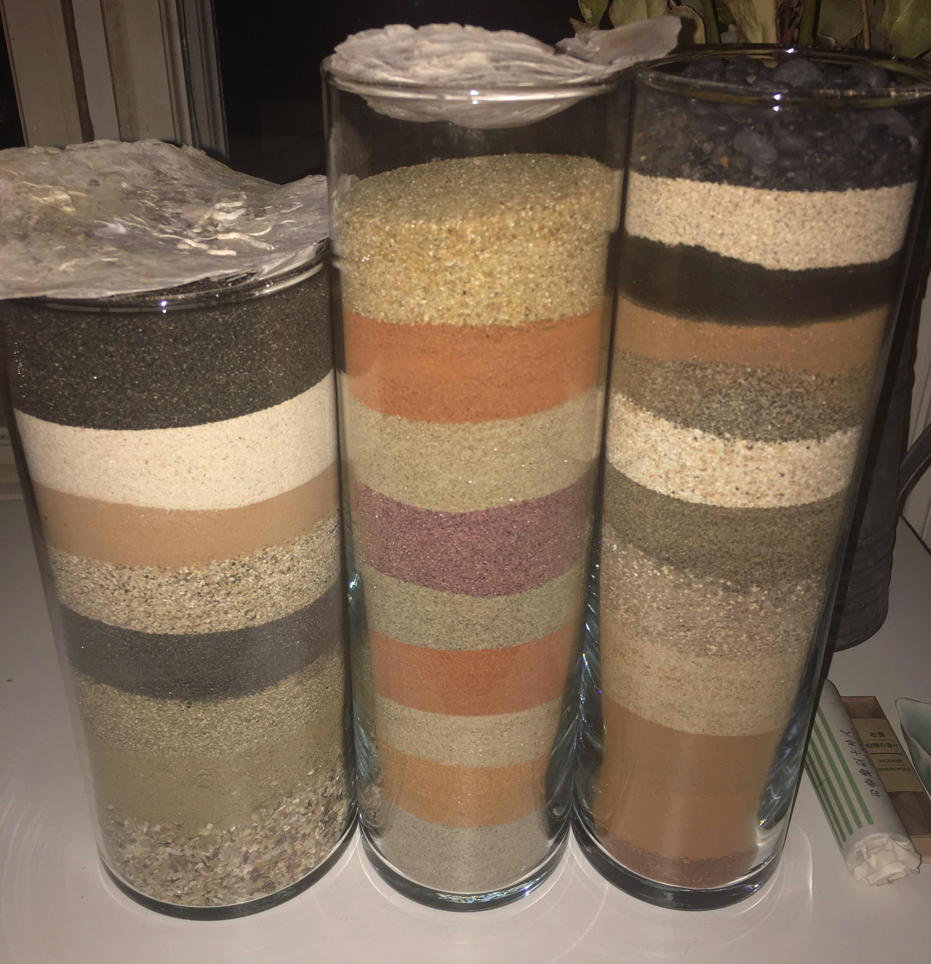
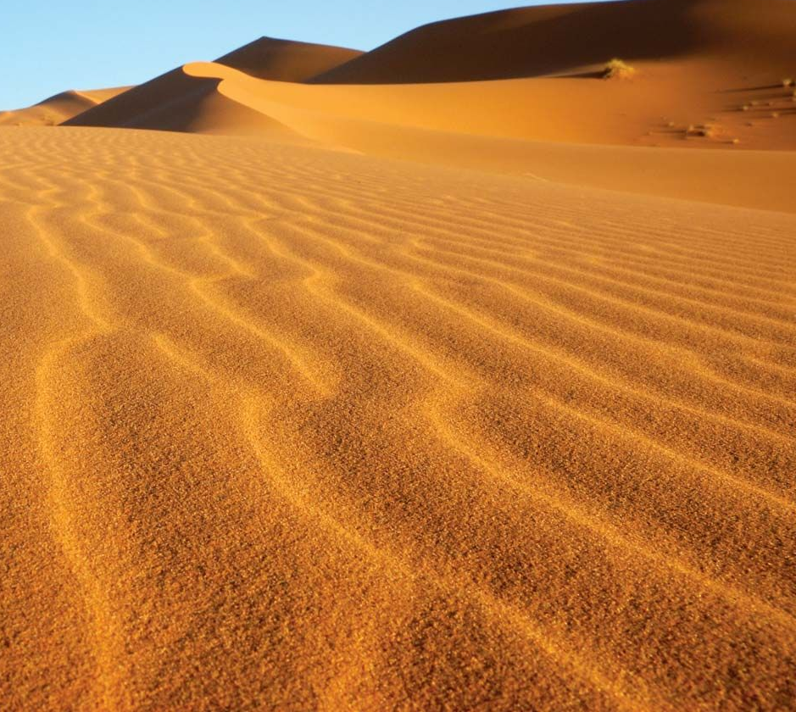
Desert
Have you ever been to the desert?
What kinds of things can you find there?
There’s a lot of sand!
There are many kinds of sand.
We have some for you to look at.

Slide 3
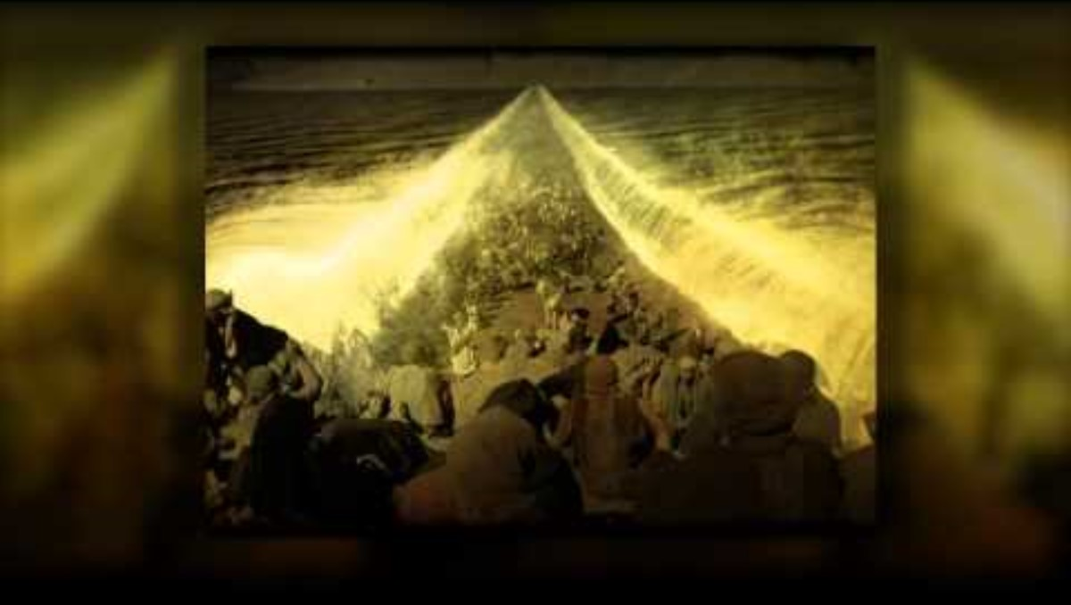
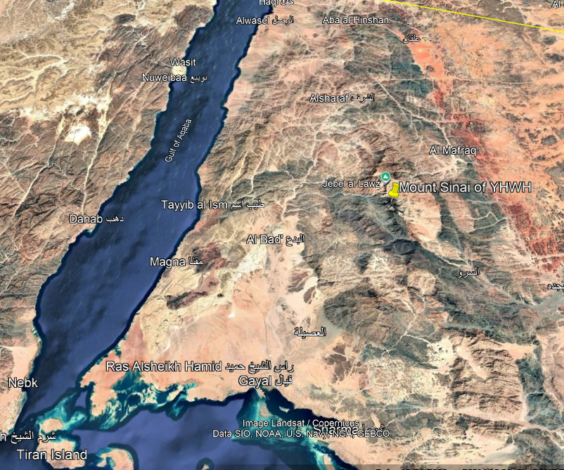
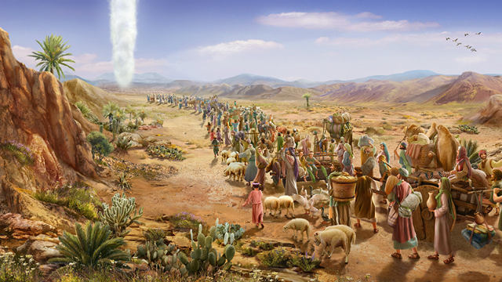
Exodus 15
²² Then Moses led Israel from the Red Sea
and they went into the Desert of Shur.
Our strong God is leading us!
We are free!
No more Egyptians making us work so hard!

Slide 4
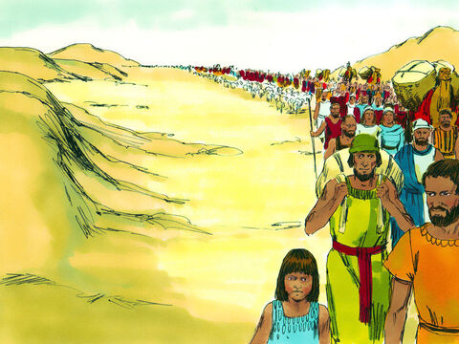
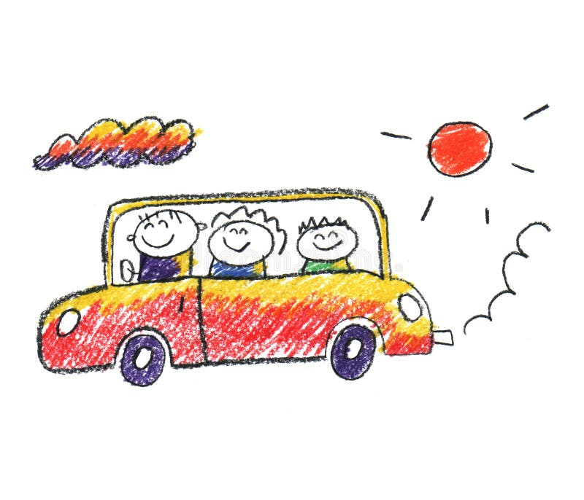
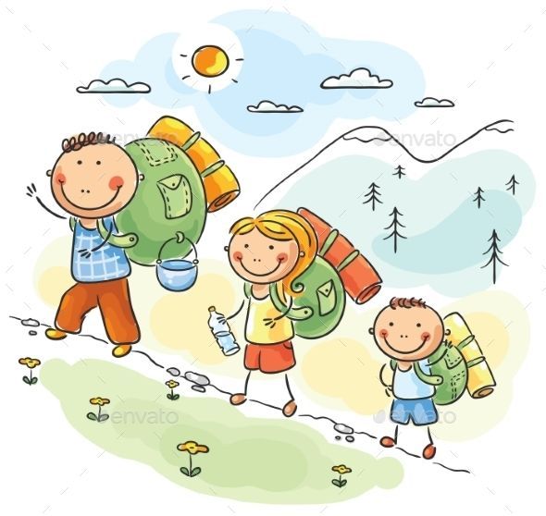
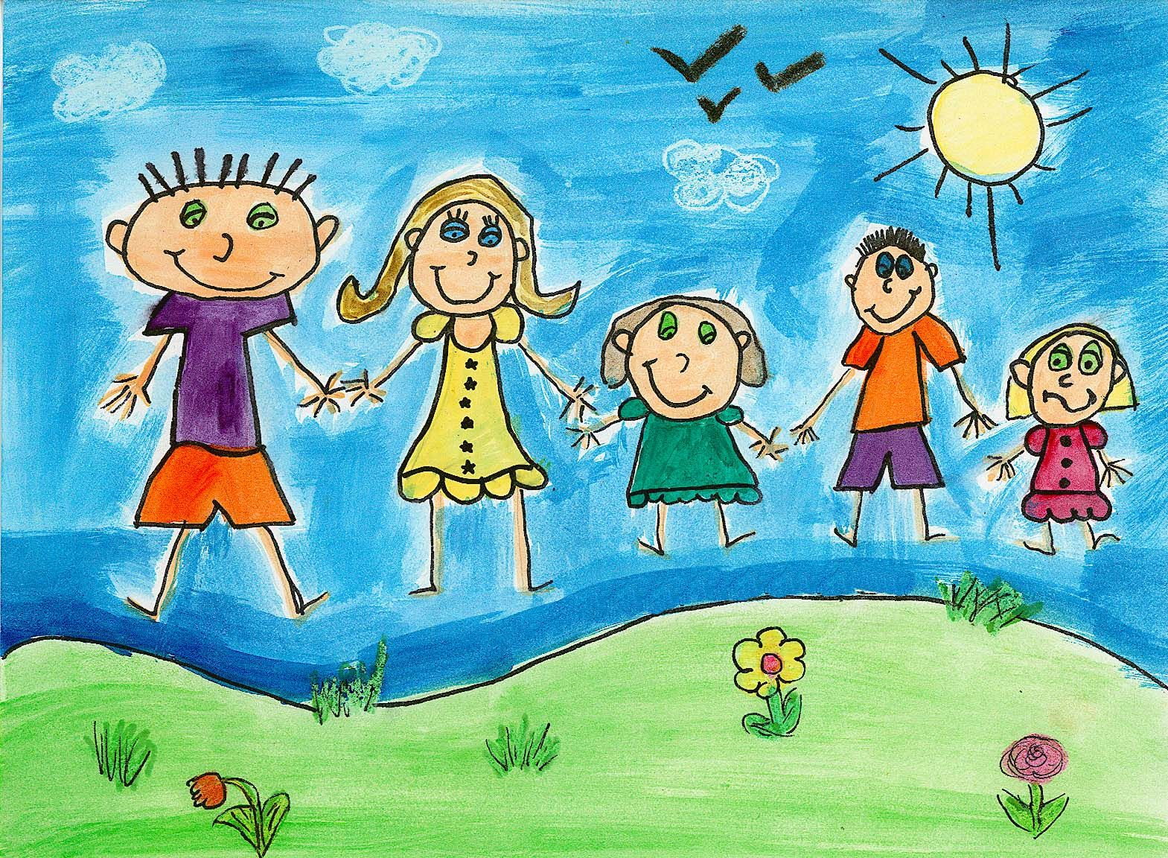
With family
Draw a picture of you and your family traveling or going for a long walk.
What do you do when you travel?

Slide 5
Day 2
²² Then Moses led Israel from the Red Sea
and they went into the Desert of Shur.
I’m glad God’s cloud is giving us some shade! It’s hot!
We’re going to have a festival!
Are we
there yet?
Remember Moses said it would take 3 days

Slide 6

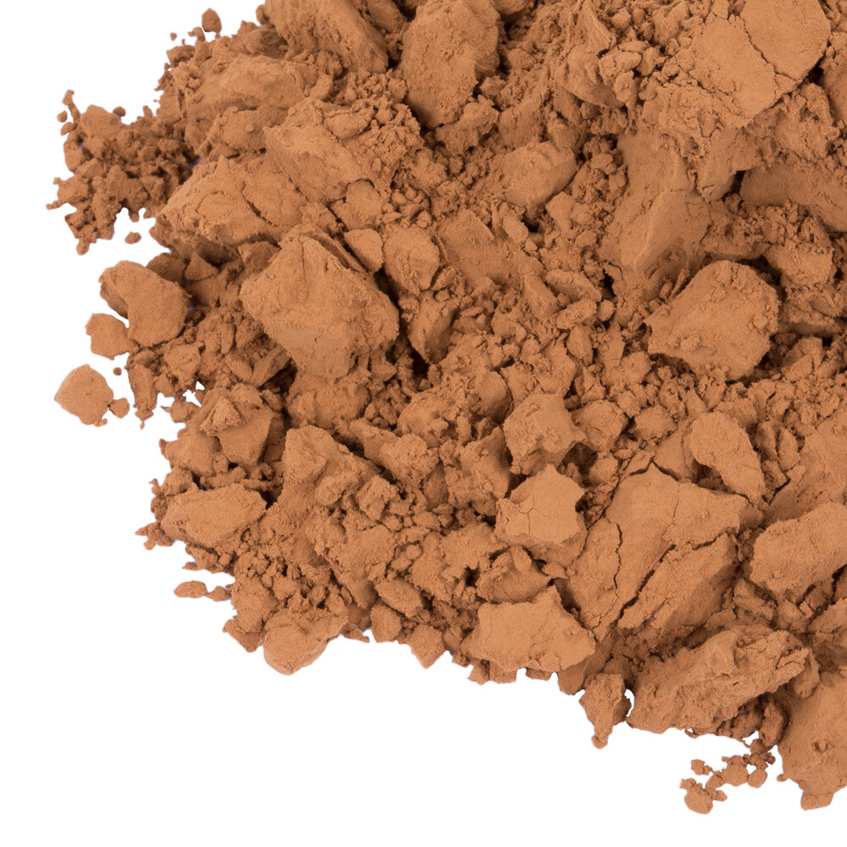
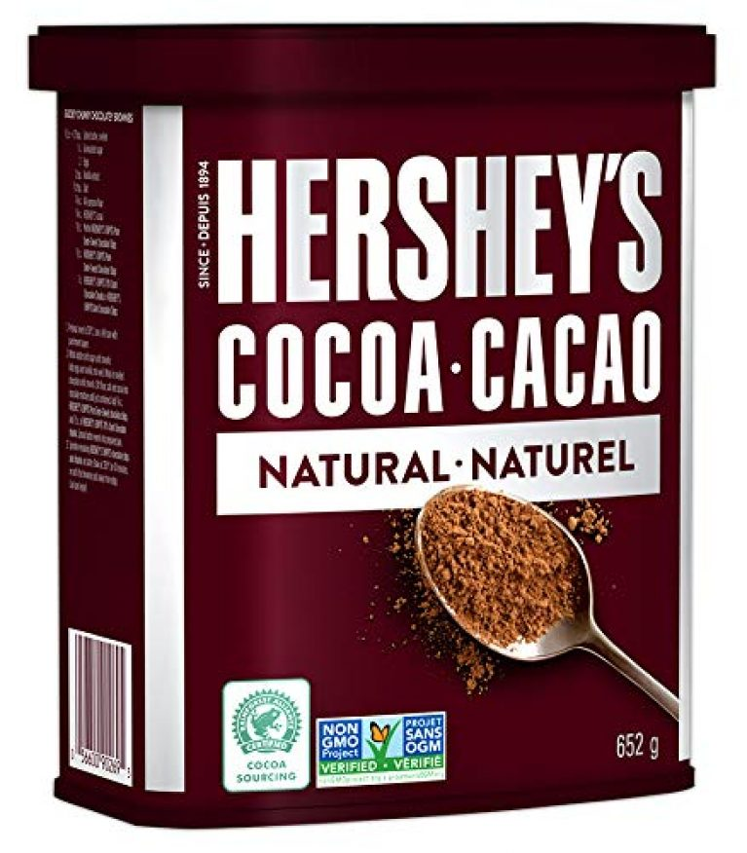
Chocolate
We’re going to make some hot chocolate.
This (baker’s powdered) chocolate looks like sand. I’ll put some in a cup for you.
(2 tsp in mug)
Does that look like hot chocolate?
Does it taste like hot chocolate?
Hmmmmm We’ll fix it later.
See recipe in notes on this slide or at end of presentation.
Notes:
Ingredients
¼ cup unsweetened cocoa powder
½ cup granulated sugar
⅓ cup hot water
⅛ teaspoon salt
4 cups milk, dairy or non-dairy
1 teaspoon vanilla extract
Instructions
In a medium saucepan, combine the cocoa powder, sugar, water, and salt over medium heat.
Cook, stirring constantly, until smooth and bring to a simmer.
Reduce heat, and stir in the milk, do not boil.
Remove from the heat and stir in the vanilla. Pour into mugs and serve immediately.
Notes
For one: in the bottom of a mug, mix 2 teaspoons of cocoa powder and 2 tablespoons of sugar. Heat 1 ¼ cups of milk until hot but not boiling (in the microwave or stovetop). Pour a little bit of the hot milk, just enough to cover the powdered mixture, and with a spoon or small whisk, dissolve the cocoa and sugar. Once you have a chocolatey base, add ¼ teaspoon of vanilla. Pour the rest of the hot milk into the mug and stir to combine.

Slide 7
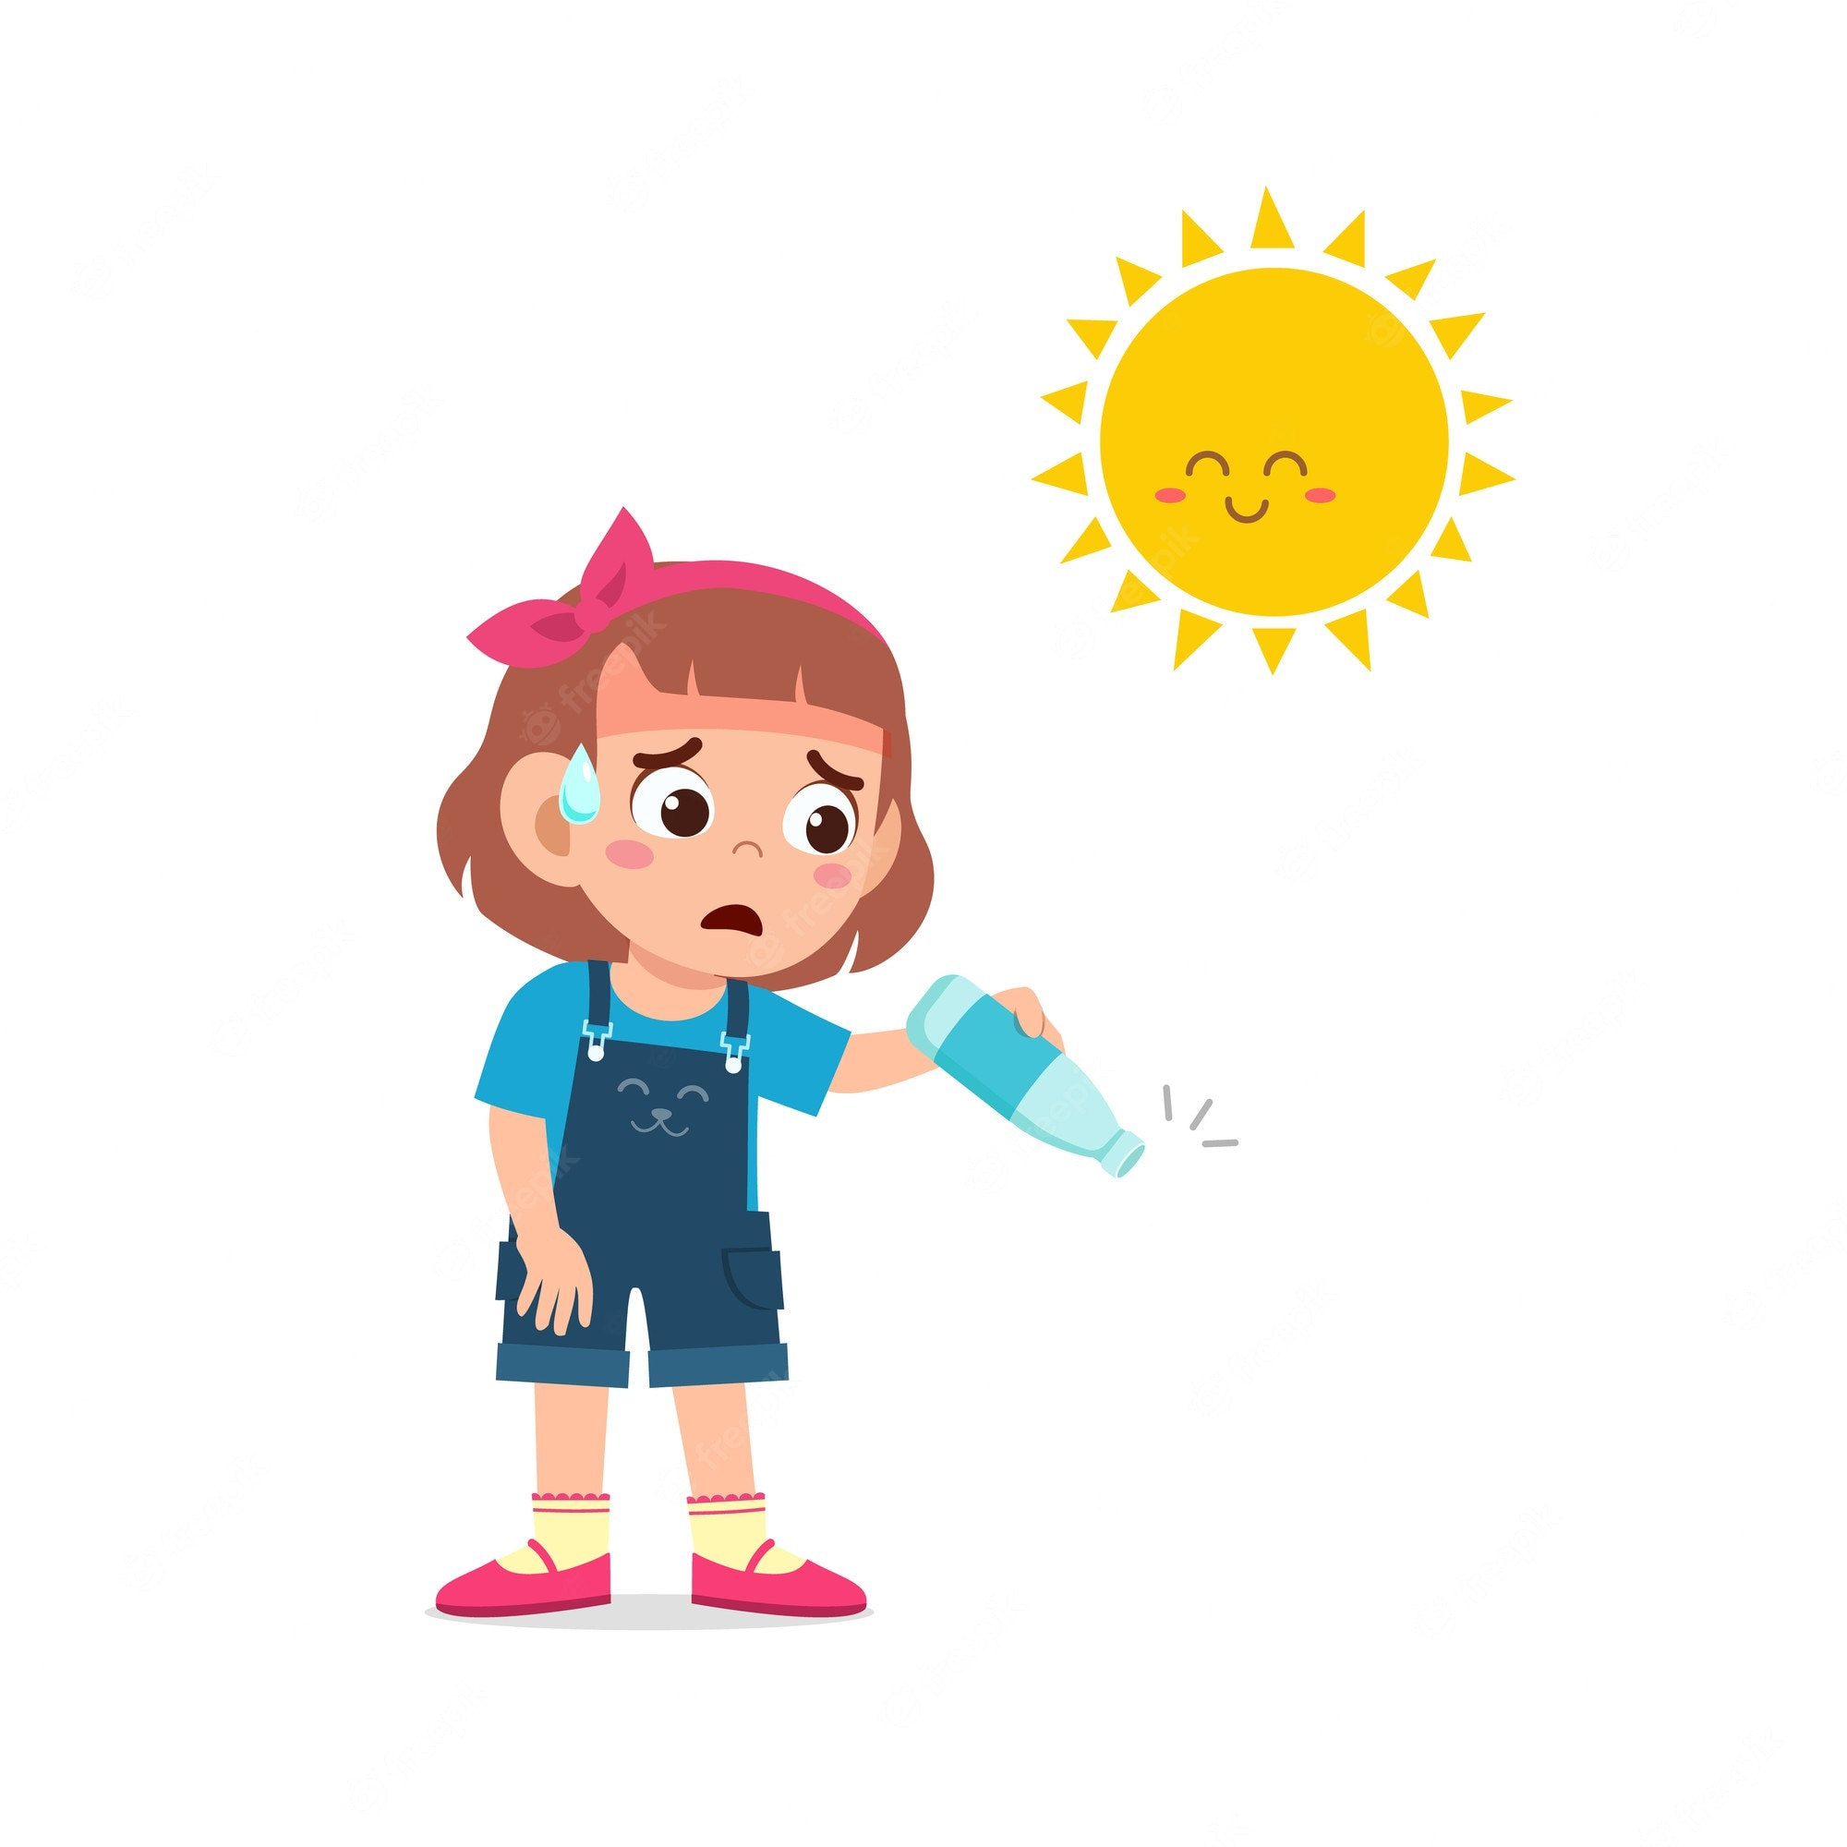
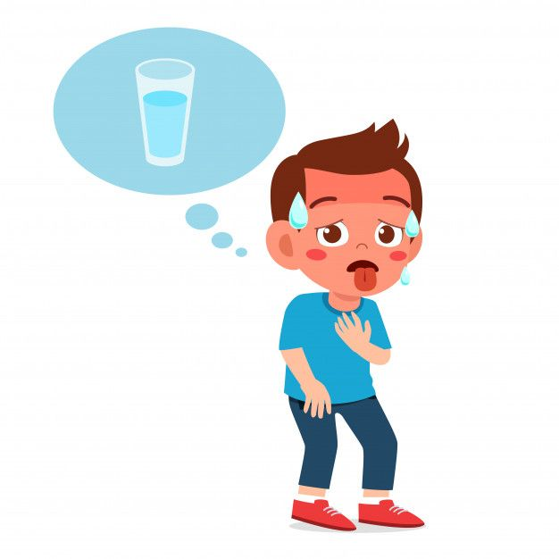
Have you ever been really really thirsty?
Day 2
For three days they traveled in the desert without finding water.
My water is gone!
Mine too!
I’m so thirsty!
Are we there yet?
I’m so hot!!!
We need water! All I see is sand, sand, and more sand!

Slide 8

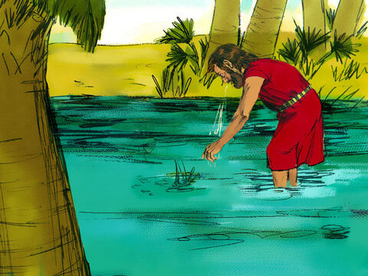
Bitter water
Have you ever tasted something bitter?
Did you taste your chocolate?
Water!
I’m going to get big drink!
Ooooo Yuk! Bla! Plew!
It is bitter! We can’t drink this!
²³ When they came to Marah, they could not drink its water because it was bitter. (That is why the place is called Marah.^{[f]}) ²⁴ So the people grumbled against Moses, saying, “What are we to drink?”

Slide 9
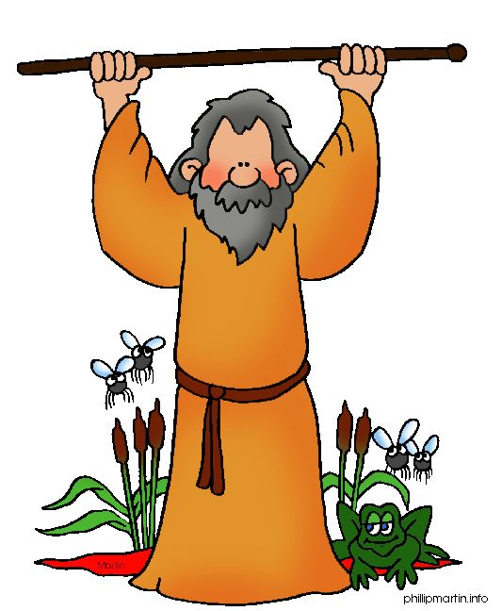
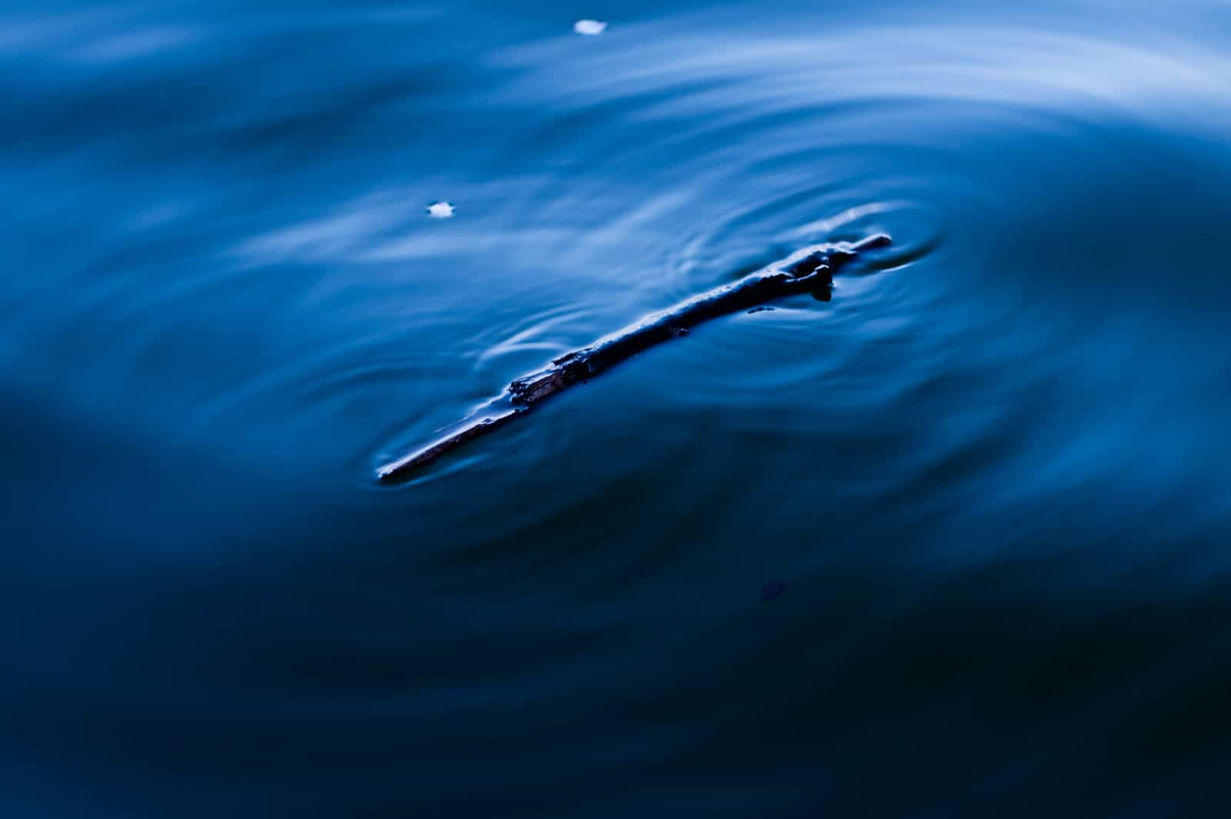
Bitter to Sweet
Throw that stick into the water.
Lord what should I do? We need water to drink!
²⁵ Then Moses cried out to the Lord, and the Lord showed him a piece of wood. He threw it into the water, and the water became fit to drink.

Slide 10
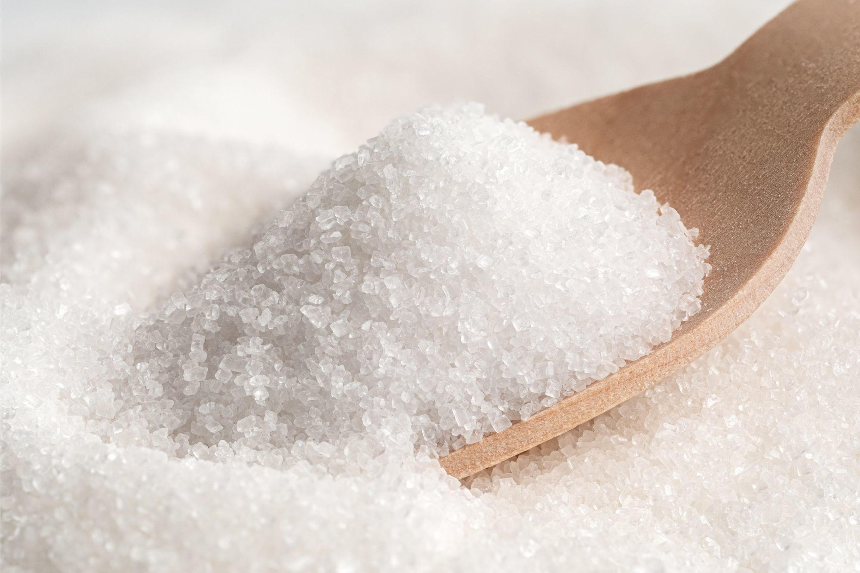
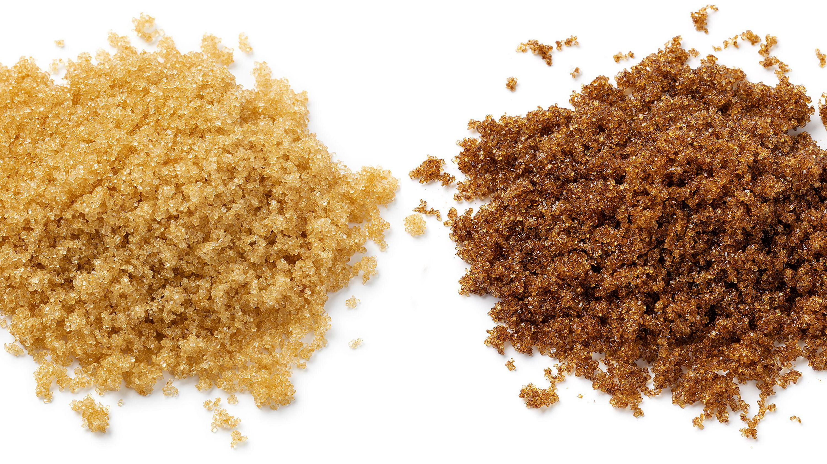
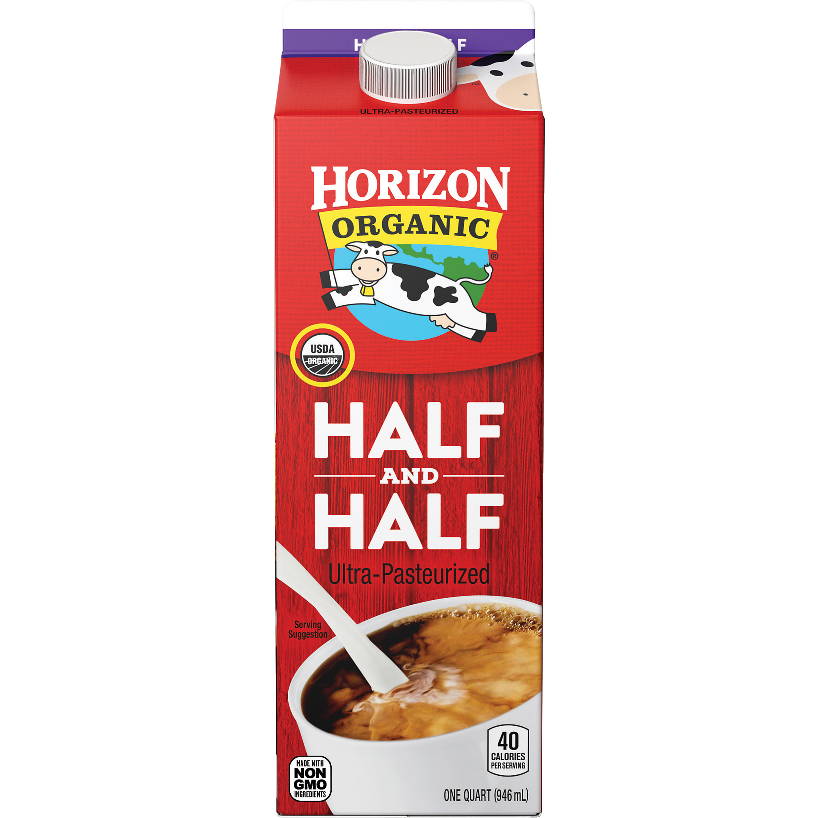
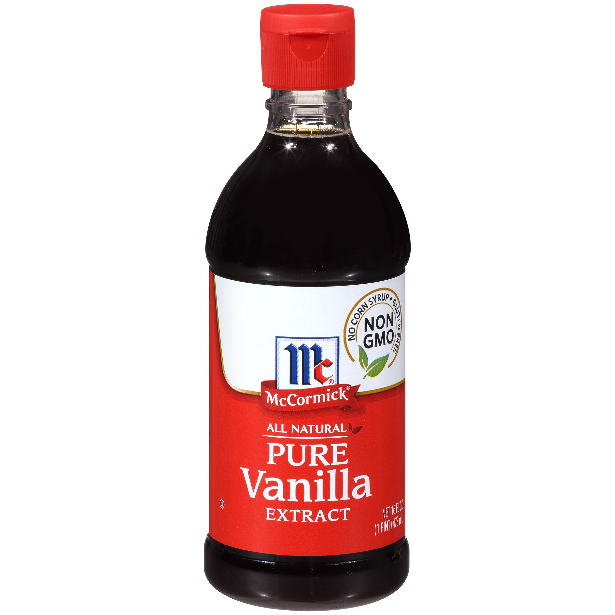
Chocolate
God made the bitter water sweet.
It was a miracle!
What shall we add to sweeten our chocolate?
Sugar? Honey?
Add 2 Tablespoons sugar to mug.
Add ¾ cup very hot water and stir with a small whisk.
Add ¼ tsp vanilla and ½ cup cold half n half or cream.

Slide 11
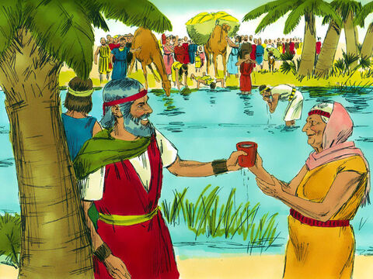
Water to drink
Water!
Oh so cool!
Now we have water!
Praise God!
Thank you!
The people were so happy that they could have good water to drink!
Are you enjoying your drink?
Would you like some water too?
Now the water is good!

Slide 12

God will Take Care of Me

Slide 13
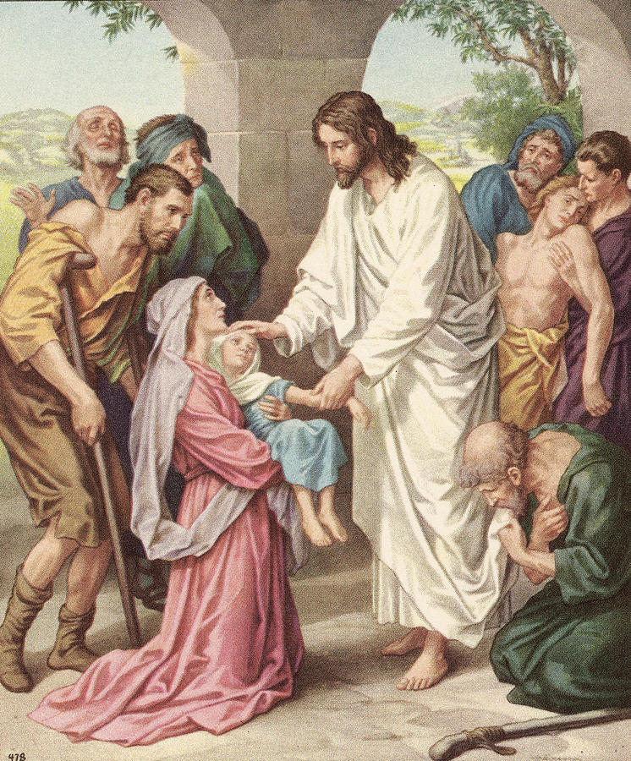
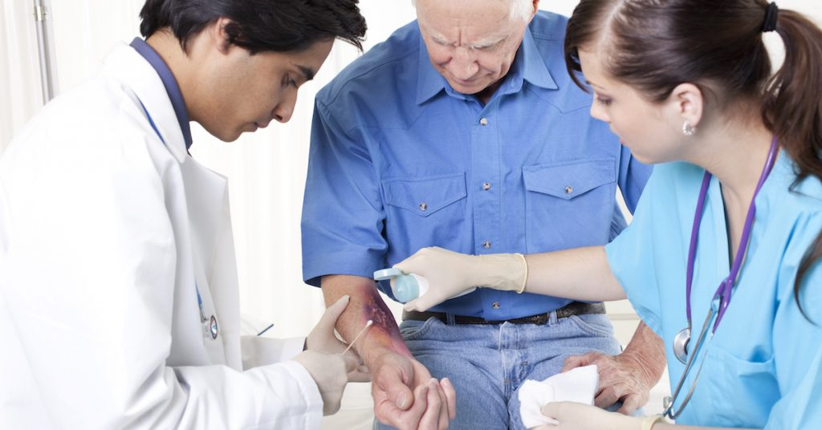
The Lord heals
The Lord healed the water
There the Lord issued a ruling and instruction for them and put them to the test.
²⁶ He said, “If you listen carefully to the Lord your God and do what is right in his eyes, if you pay attention to his commands and keep all his decrees, I will not bring on you any of the diseases I brought on the Egyptians, for I am the Lord, who heals you.”
It is the Lord who heals us too!

Slide 14
Let’s Go
²² Then Moses led Israel from the Red Sea
and they went into the Desert of Shur.
The cloud is moving.
We aren’t staying here.
I wonder where we are going?
At least our water bottles are full.
We can trust God.

Slide 15
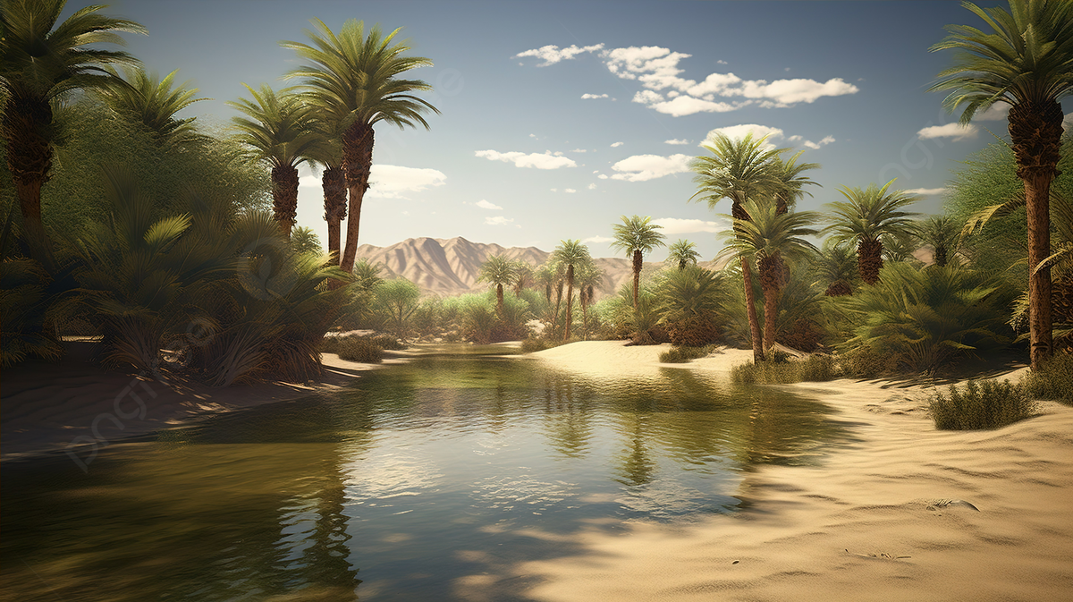
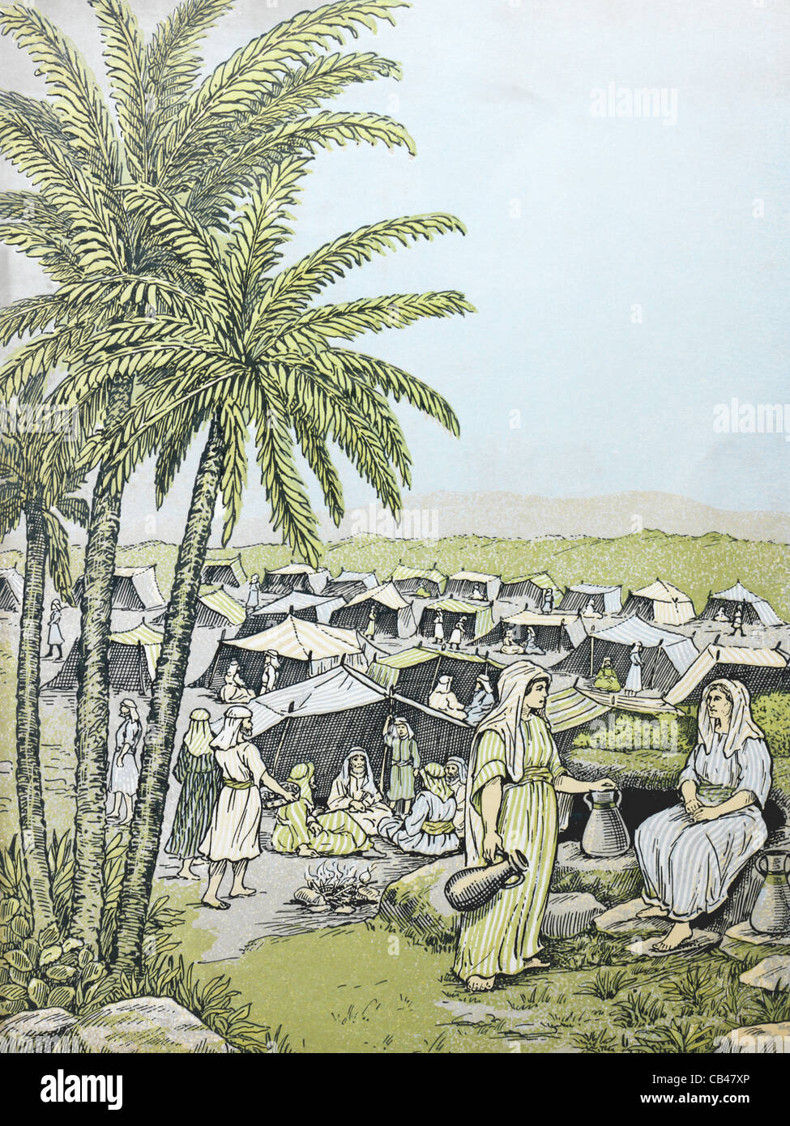
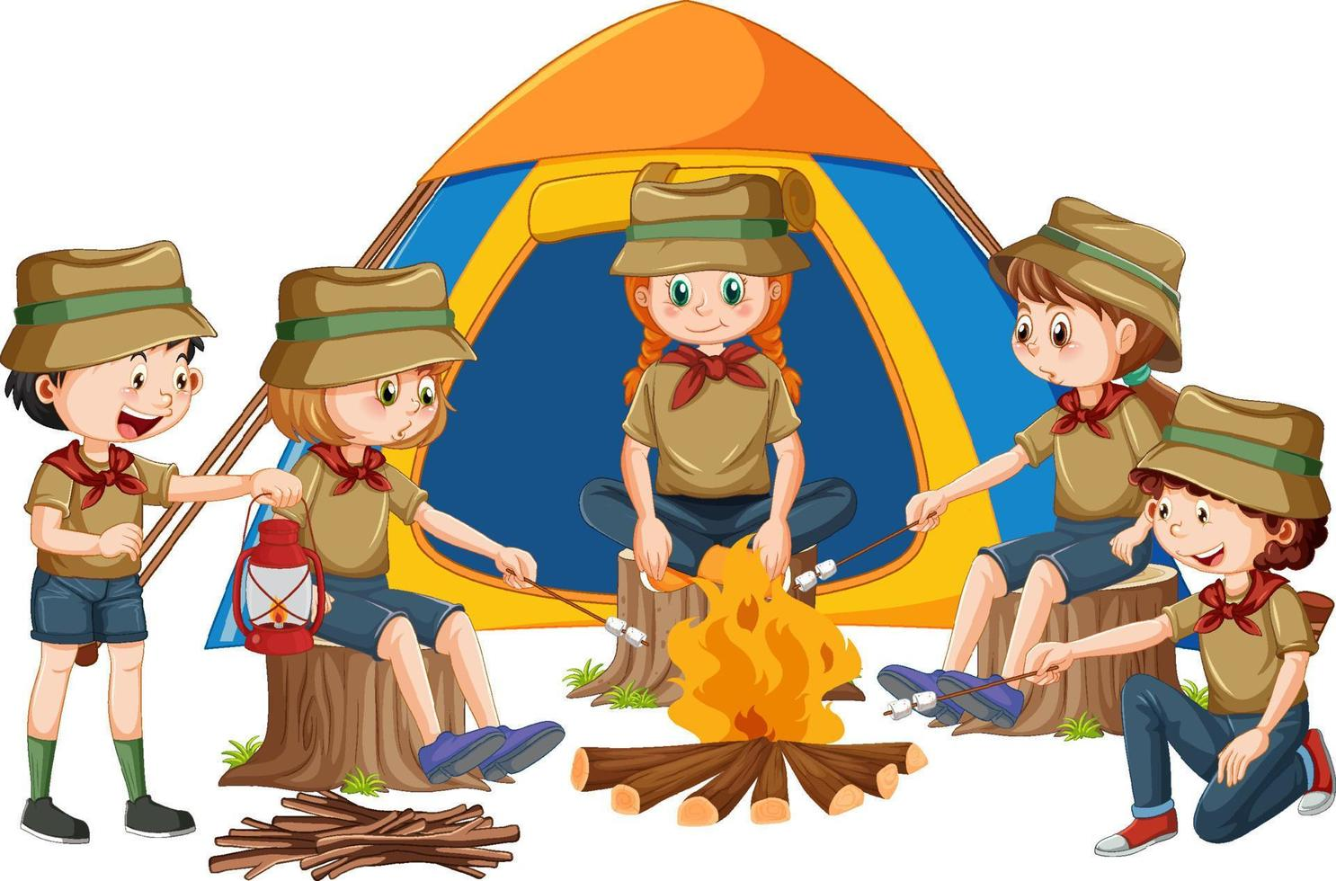
God brings us to a good place!
Have you ever gone camping?
Let’s set up a tent.
²⁷ Then they came to Elim, where there were twelve springs and seventy palm trees, and they camped there near the water.

Slide 16

God brings us to a good place!
Now we are in our tent.
Let’s think about our story and what we have learned.

Slide 17
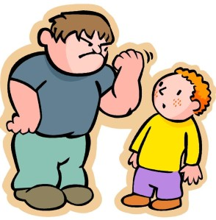


Reflect
Maybe someone was mean to you.
The Israelites came to bitter water.
Have you ever had a bitter experience?
Maybe a friend moved away and you had to say good-bye
Maybe someone you loved died.

Slide 18

God’s promises
Those are really bitter times.
Just like God healed the bitter water, He will heal our hearts and minds. Let’s read some promises from the Bible.
.
Psalms 30:11
Isaiah 61:3
and provide for those who grieve in Zion—
to bestow on them a crown of beauty
instead of ashes,
the oil of joy
instead of mourning,
and a garment of praise
instead of a spirit of despair.
They will be called oaks of righteousness,
a planting of the Lord
for the display of his splendor.
Isaiah 61:3
You turned my wailing into dancing;
you removed
my sackcloth and clothed me with joy,
Psalms 30:11

Slide 19

Reflect
God didn’t just leave the people there at Marah.
He took them to a really great place with lots of water and lots of trees where the people could really rest.
He wants us not only to be good, but to be great!
Not just happy, but to be filled with joy!

Slide 20
Let’s pray
Dear Heavenly Father,
Some of us have come to a bitter time also. For some friends are leaving, there is sickness, there is death, there are big problems only You can fix.
But we remember, just like the Israelites could, that You bring victory. You brought them out of Egypt slavery. You give us freedom also.
You made a way when there seemed to be no way. You brought them through the Red Sea. We know that you are with us too.
When they were thirsty and the water was bad, you made it good. You give us Living Water. You have given Jesus. He is our Savior. He gives us everlasting life and joy. Thank you Heavenly Father! Thank you Jesus!.
We love you. Amen.

Slide 21

I’m So happy

Slide 22
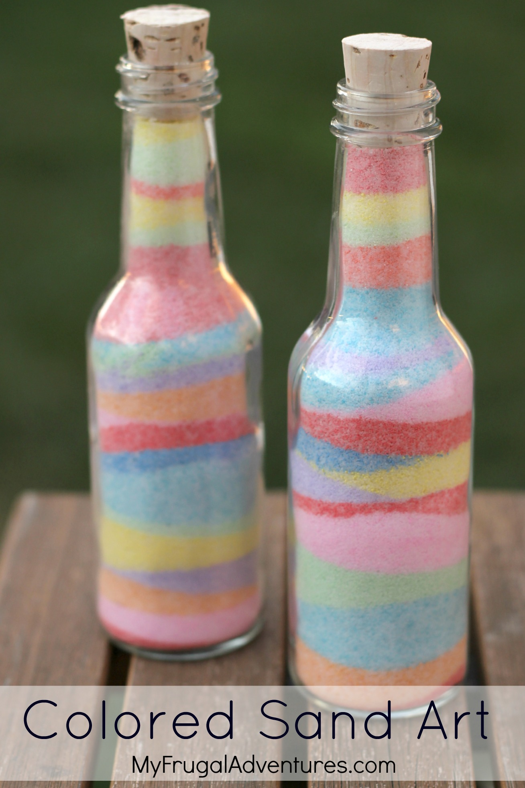
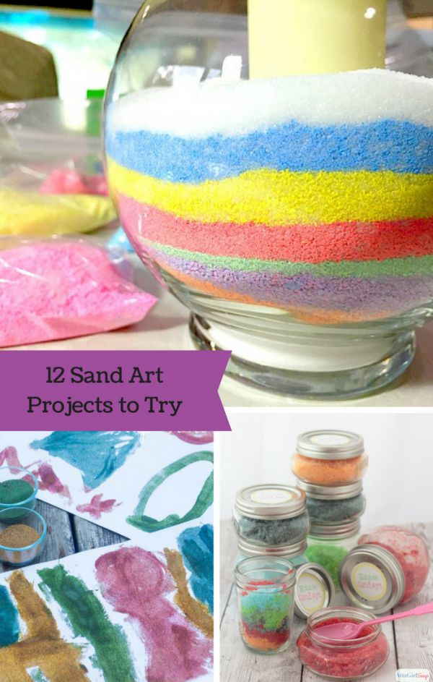
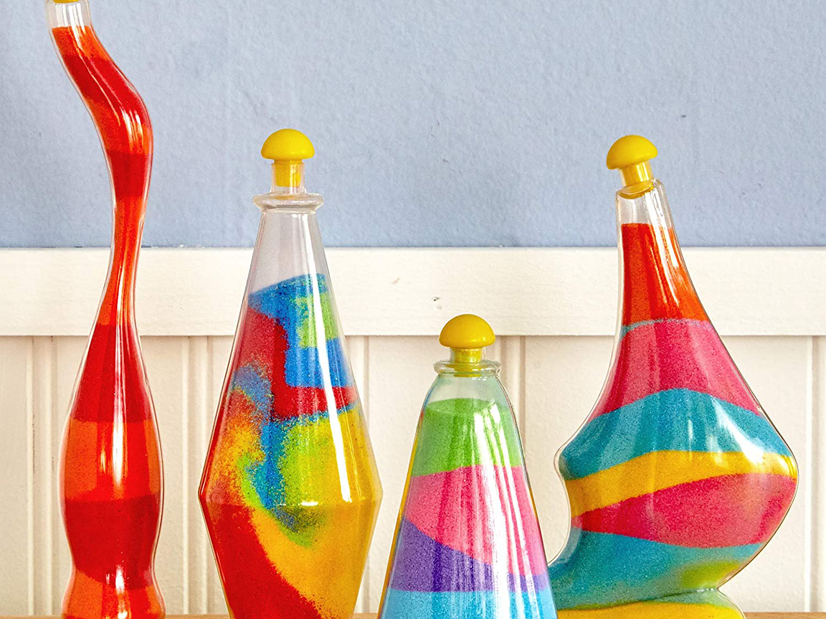
Craft Time
You turned my wailing into dancing;
you removed
my sackcloth and clothed me with joy,
Psalms 30:11
Let’s put colored sand in this container. Make lots of pretty layers.
We’ll put a verse on the container to remind us that God turns bitterness to beauty, despair to delight, sad to glad.
We can trust God. He will fill us with good things.

Slide 23
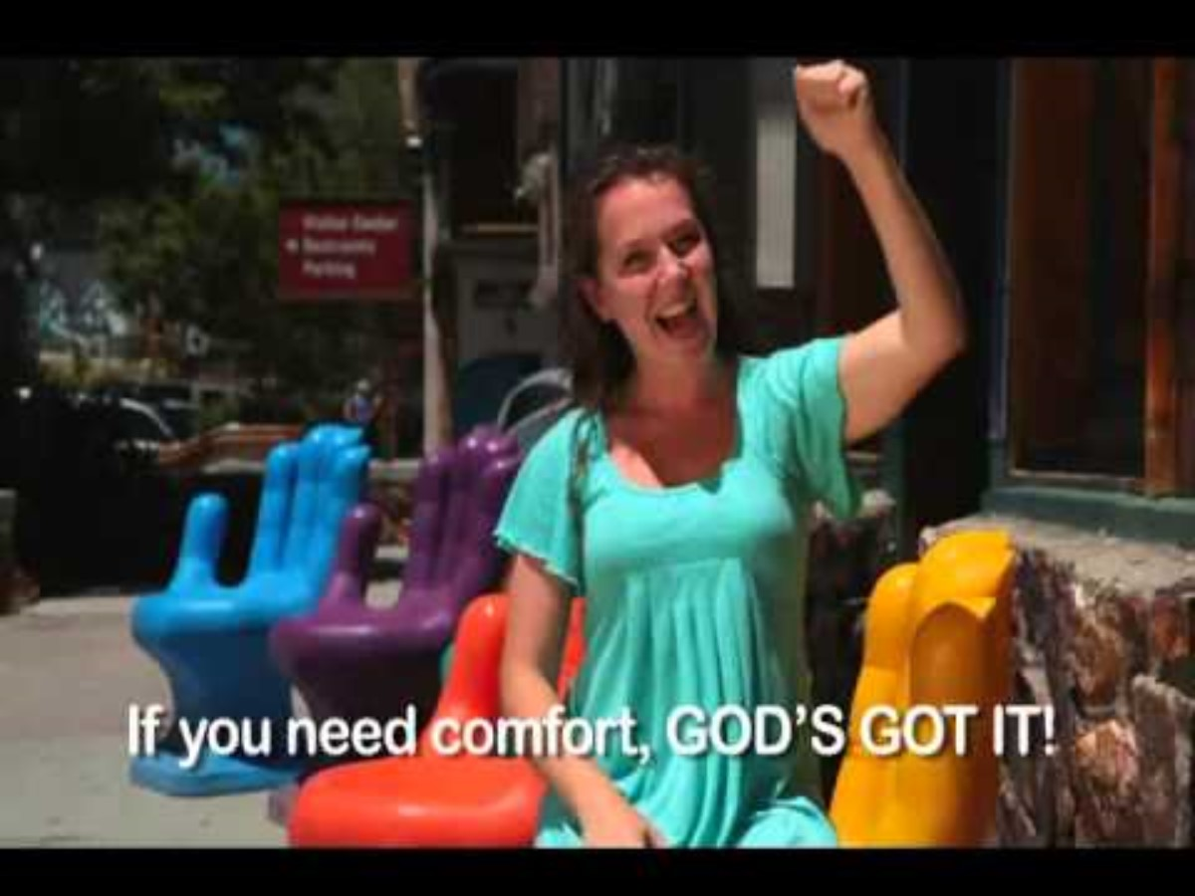
God Provides

Slide 24

God Provides

Slide 25

I Can Trust God

Slide 26
Recipe for teacher
Hot Cocoa Recipe
by Laura Fuentes.
Ingredients
¼ cup unsweetened cocoa powder
½ cup granulated sugar
⅓ cup hot water
⅛ teaspoon salt
4 cups milk, dairy or non-dairy
1 teaspoon vanilla extract
Instructions
In a medium saucepan, combine the cocoa powder, sugar, water, and salt over medium heat.
Cook, stirring constantly, until smooth and bring to a simmer.
Reduce heat, and stir in the milk, do not boil.
Remove from the heat and stir in the vanilla. Pour into mugs and serve immediately.
Notes
For one: in the bottom of a mug, mix 2 teaspoons of cocoa powder and 2 tablespoons of sugar. Heat 1 ¼ cups of milk until hot but not boiling (in the microwave or stovetop). Pour a little bit of the hot milk, just enough to cover the powdered mixture, and with a spoon or small whisk, dissolve the cocoa and sugar. Once you have a chocolatey base, add ¼ teaspoon of vanilla. Pour the rest of the hot milk into the mug and stir to combine.

Slide 27



