Slide 1


Temperance
Requirements apply to Companions & Guides

Slide 2

What does TEMPERANCE mean?
DEFINITION:
noun
Abstinence from or moderation in drinking alcoholic beverages. synonym: abstinence.
Similar: abstinence
Moderation and self-restraint, as in behavior or expression.
Moderation; the observance of moderation; temperateness.
Abstinence = none; not doing it
Moderation = not too little, nor too much
Self restraint = self control = choosing not to do/eat/take it
What would it mean to:
Abstain from desert?
Eat desert moderately?

Slide 3

To have TEMPERANCE, would you abstain or use moderation for:
Should I be careful and have/do only
a little some of the time?
Should I just say NO and abstain?
DESERT – cookies, ice-cream, fudge, pie, …..
SCREEN TIME – gaming, TV, phone chats, videos…..
VEGETABLES – broccoli, peas, carrots, grapes, …..
DRUGS – alcohol, nicotine, meth, pop, cannabis……
EXERCISE – play ball, bike, walk, canoe, swim, climb ….
WORK – school, job, chores, ….
TALK – phone calls, chats, visit, gossip, ….
DRESS UP – cool, fancy, clothes, fancy hair-dos, make-up….
Abstinence = none; not doing it
Moderation = not too little, nor too much
Self restraint = self control = choosing not to do/eat/take it
Should I do this as much as possible?

Slide 4




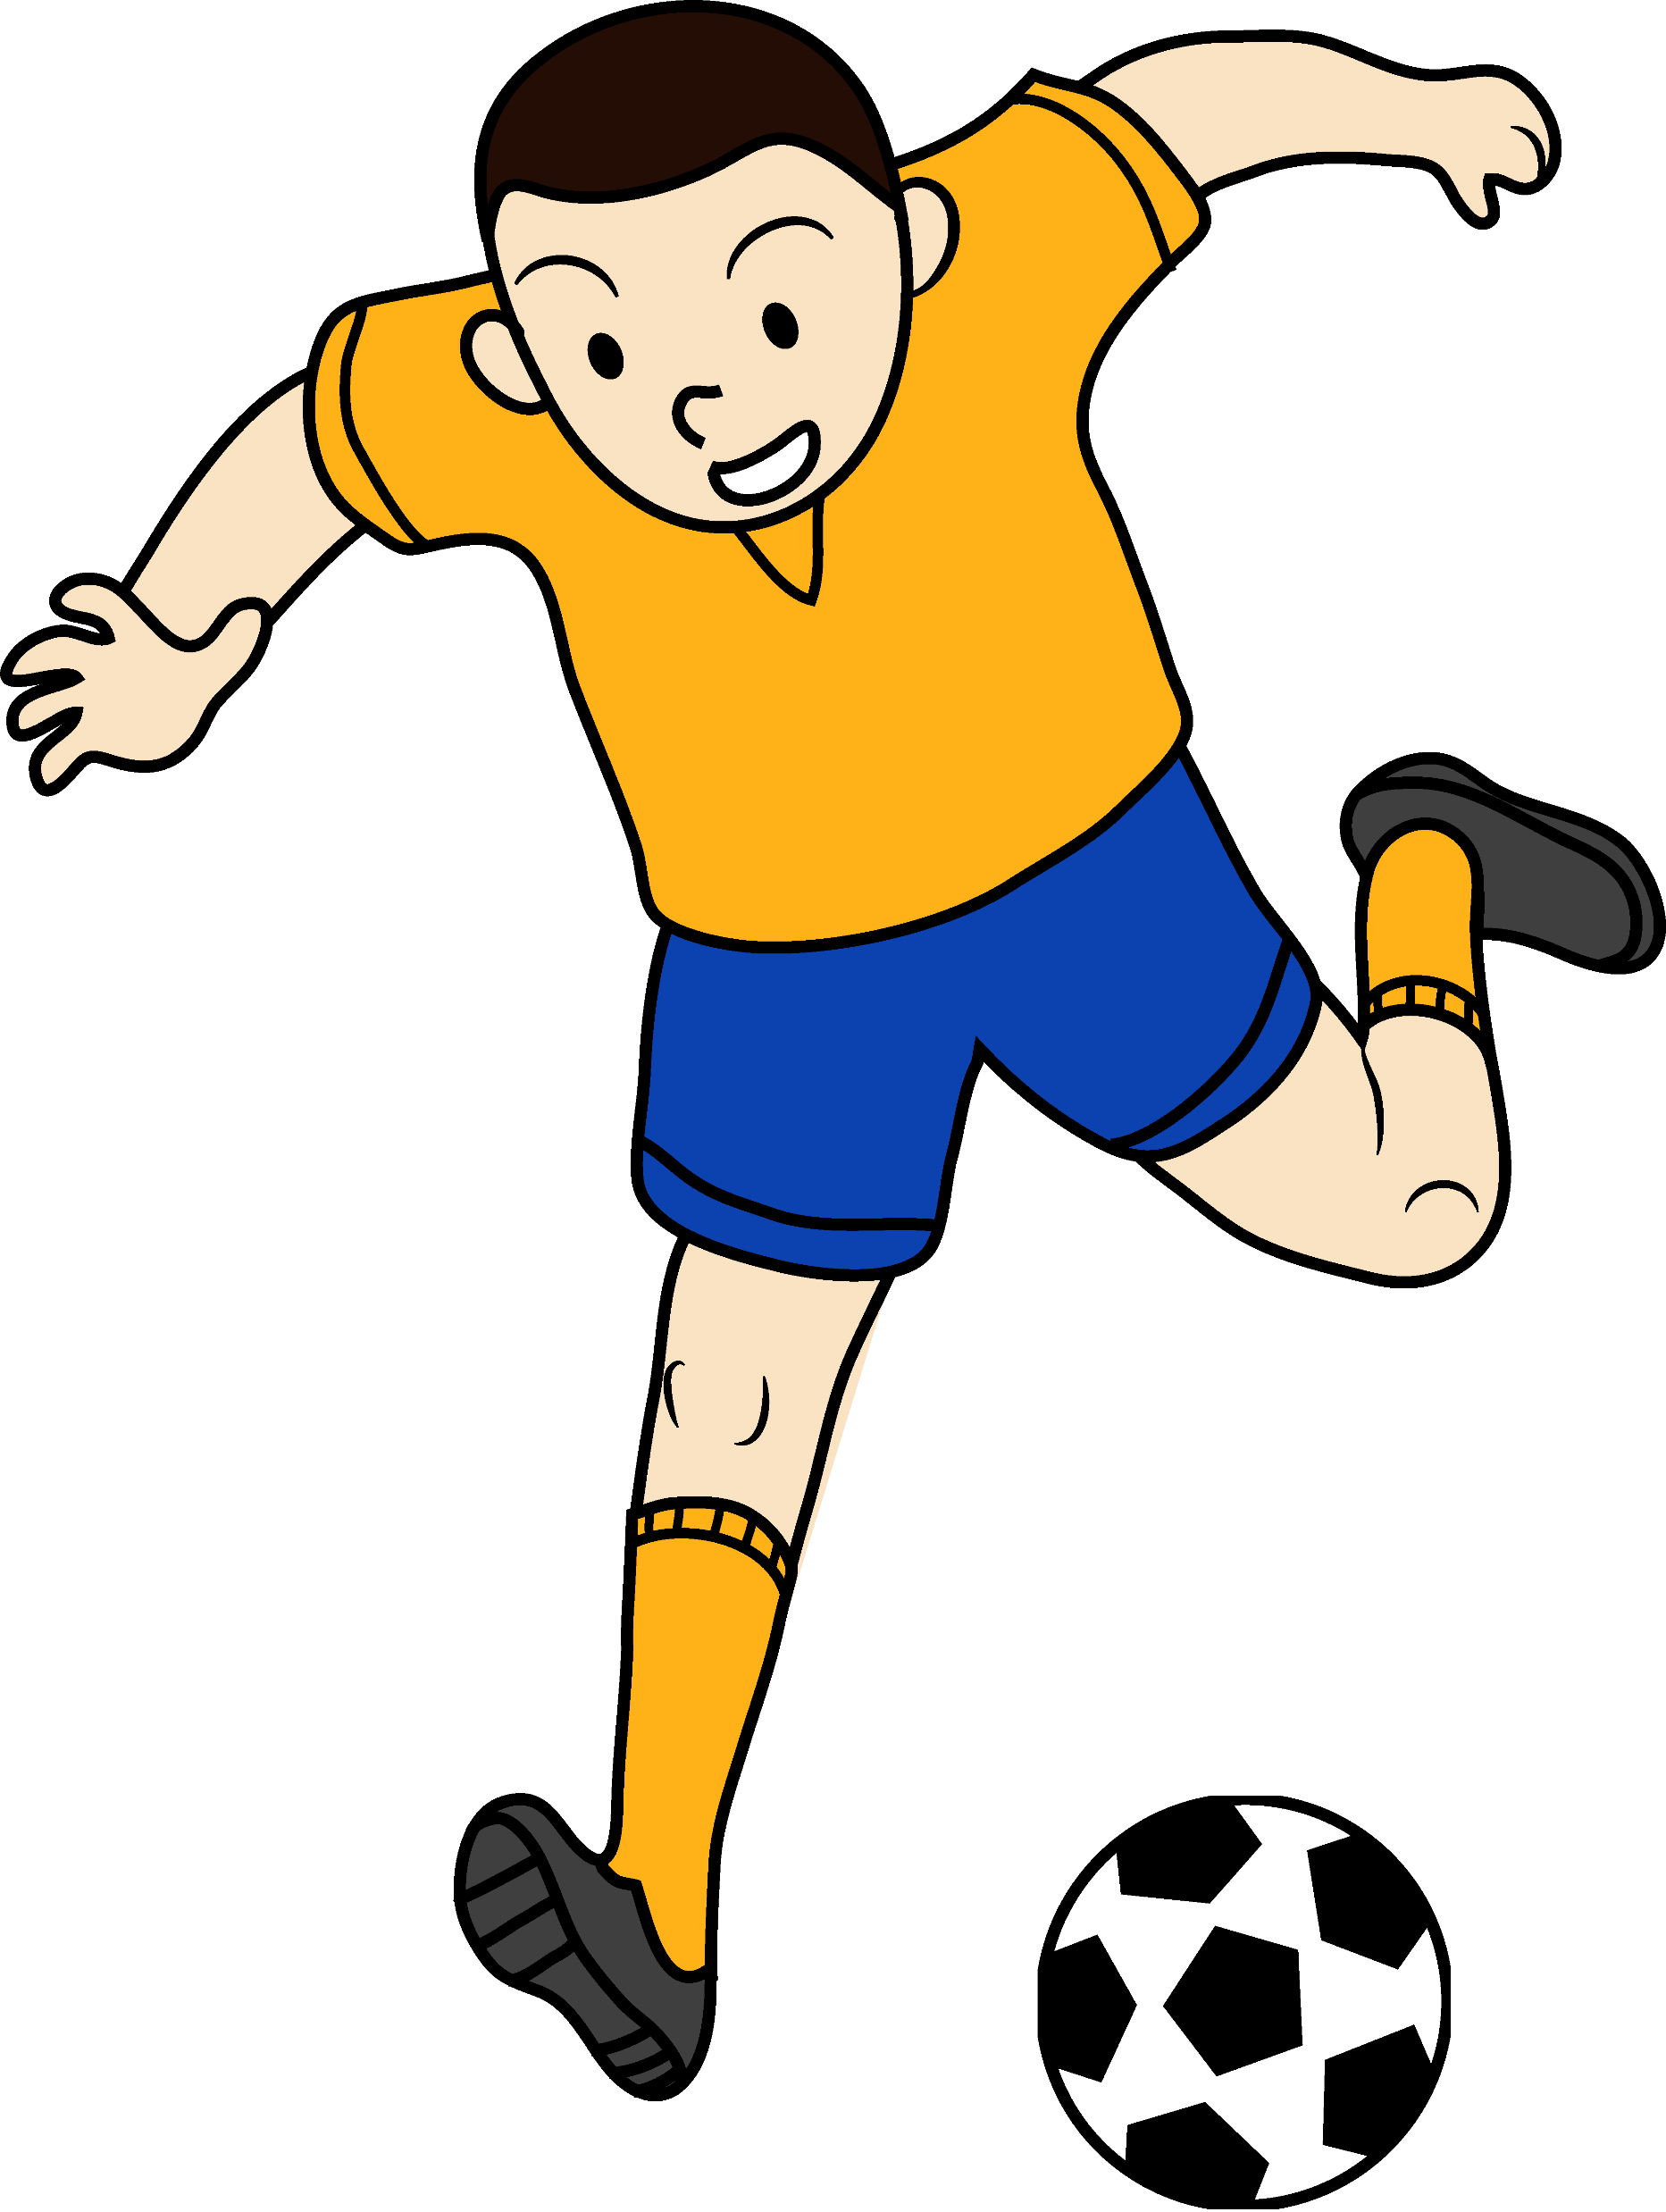




You’ve had a really bad day.
Life has been rough.
You feel terrible.
What will help you feel better?

Slide 5

Life seems boring.
You want to do something exciting!!
You want to feel the exhilaration and challenge.
What could you do?

Slide 6
Companion Requirements
Companions: Do #1, #2, and #7
Guides: Teach #1, #2, #7

Slide 7
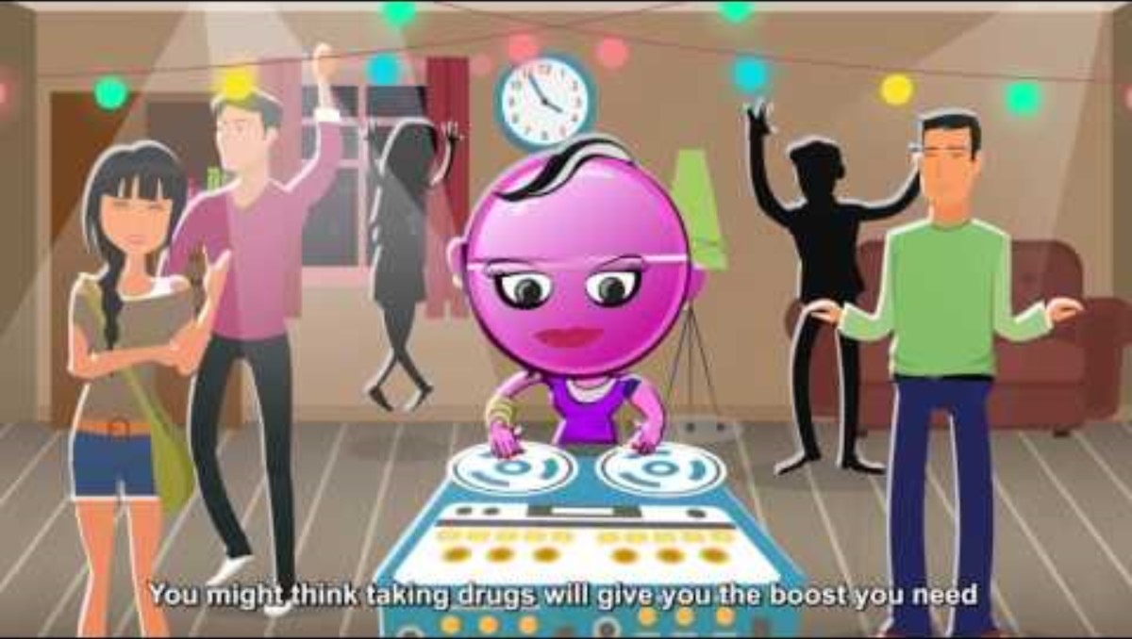
Why is it important to abstain from drugs?

Slide 8
2. Memorize two of the following Bible texts and two of the following quotations from the writings of Ellen G. White:
What does the Bible say?
  a. Bible Texts
    i. Romans 12:1,2
    ii. 1 Corinthians 10:31
    iii. 1 Corinthians 6:19, 20
    iv. Proverbs 20:1
    v. Galatians 5:22, 23
    vi. 3 John 2
Therefore, I urge you, brothers, in view of God's mercy,
to offer your bodies as living sacrifices, holy and pleasing to God
—this is your spiritual act of worship.
Do not conform any longer to the pattern of this world,
but be transformed by the renewing of your mind.
Then you will be able to test and approve what God's will is
—his good, pleasing and perfect will.
— Romans 12:1-2 (NIV)
So, whether you eat or drink
or whatever you do,
do it all for the glory of God.
— 1 Corinthians 10:31 (NIV)
Do you not know that your body is a temple of the Holy Spirit,
who is in you, whom you have received from God?
You are not your own; you were bought at a price.
Therefore honor God with your body.
— 1 Corinthians 6:19,20 (NIV)
Wine is a mocker and beer a brawler;
whoever is led astray by them is not wise.
— Proverbs 20:1 (NIV)
But the fruit of the Spirit is
love, joy, peace, patience, kindness, goodness,
faithfulness, gentleness and self-control.
Against such things there is no law.
— Galatians 5:22,23 (NIV)
Dear friend, I pray that you may enjoy good health
and that all may go well with you,
even as your soul is getting along well.
— 3 John 2 (NIV)

Slide 9
2. Memorize two of the following Bible texts and two of the following quotations from the writings of Ellen G. White:
What did Ellen White say?
  b. Writings of Ellen G. White
    i. Temperance, p. 3
    ii. Counsels on Diet and Foods, p. 428
    iii. Temperance, p. 201
    iv. Temperance, p. 113
    v. Ministry of Healing, p. 327-328
“True temperance teaches us
to abstain entirely from that which is injurious,
and to use judiciously only healthful and nutritious
articles of food.”
Temperance, p. 3.
“The only safe course is to touch not, taste not, handle not,
tea, coffee,
wines, tobacco, opium, and alcoholic drinks.”
Counsels on Diet and Foods, p. 428.
“...temperance alone is the foundation
of all the graces that come from God,
the foundation of all victories to be gained.”
Temperance, p. 201.
“A pure and noble life,
a life of victory over appetite and lust,
is possible to everyone
who will unite his weak, wavering, human will
to the omnipotent, unwavering will of God.”
Temperance, p.113.
“Tobacco is a slow, insidious, but most malignant poison,
in whatever form it is used, it tells upon the constitution;
it is all the more dangerous
because its effects are slow and at first hardly perceptible.”
Ministry of Healing, p. 327-328.

Slide 10


Activities: What drugs can do to you.
Spin around and around 20 times
  Walk in a straight line
Look through wax paper
  Read what is says on the screen
Blow up a balloon, let out the air and repeat 7 times
  Breathe
Smell test – what is it.
  How do you want to smell?

Slide 11


1. Memorize and sign the Temperance Pledge:
“Realizing the importance of healthy body and mind,
I (your name) promise, with the help of God,
to live a Christian life of true temperance in all good things
and total abstinence from the use of tobacco, alcohol, or any other narcotic.”

Slide 12



Slide 13

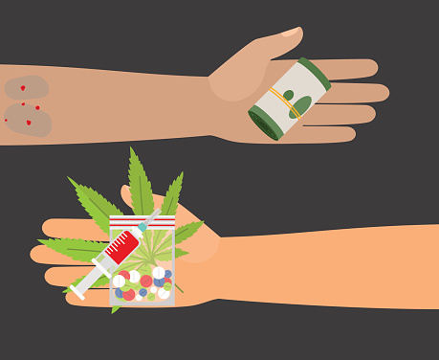
7. Discuss the following situations and role-play what you would do if:
  a. Your best friend asks you to try a cigarette.
  b. A classmate offers you money to sell marijuana.
  c. An older relative offers you a drink of beer.
  d. The smoke from a stranger’s cigarette is bothering you.
  e. A friend asks you to smoke marijuana.
  f. You are at a party with a friend, he gets drunk and insists on driving you home.

Slide 14

Continue to finish the
Temperance Honor
https://wiki.pathfindersonline.org/w/AY_Honors/Temperance/Answer_Key

Slide 15


5. Read the chapter “Stimulants and Narcotics” in Ministry of Healing. Be able to discuss briefly or provide a written summary approximately two or three paragraphs in length.
http://www.whiteestate.org/books/mh/mh26.html.
You can color your poster or other project while we read.

Slide 16
6. After studying the following materials, list three things that contribute to temperance and good health. (Other than abstaining from that which is harmful.)
  a. Temperance page 139 paragraph 1
  b. Counsels on Diet and Foods, page 406 paragraph 1
  c. Temperance page 140 paragraph 2
  d. Temperance page 142 paragraph 3
  e. Counsels on Health, page 127 paragraph 4
  f. Temperance page 147 paragraph 3
Through his devices, Satan, in many respects, has made the domestic life one of care and complicated burdens, in order to meet the demands of fashion. His purpose in doing this is to keep minds occupied so fully with the things of this life that they can give but little attention to their highest interest. Intemperance in eating and in dressing has so engrossed the minds of the Christian world that they do not take time to become intelligent in regard to the laws of their being, that they may obey them. To profess the name of Christ is of but little account if the life does not correspond with the will of God, revealed in His word. . . .
Those who have received instruction regarding the evils of the use of flesh foods, tea and coffee, and rich and unhealthful food preparations, and who are determined to make a covenant with God by sacrifice,
will not continue to indulge their appetite
for food that they know to be unhealthful. God demands that the appetites be cleansed, and that self-denial be practiced in regard to those things which are not good.
This is a work that will have to be done before His people can stand before Him a perfected people.
The drunkard sells himself for a cup of poison. Satan takes control of his reason, his affections, his conscience.
Such a man is destroying the temple of God. Tea drinking helps to do this work.
Yet how many there are who place destroying agencies on their tables.
Intemperance in study is a species of intoxication, and those who indulge in it,
like the drunkard, wander from safe paths,
and stumble and fall in the darkness.
The Lord would have every student
bear in mind that the eye
must be kept single to the glory of God.
He is not to exhaust and waste his physical
and mental powers in seeking to acquire all possible knowledge of the sciences,
but is to preserve the freshness and vigor of all his powers to engage in the work
which the Lord has appointed him in helping souls to find the path of righteousness.
We are health reformers,
seeking to come back, as far as possible,
to the Lord's original plan of temperance. Temperance does not consist merely in abstaining from intoxicating liquors and tobacco; it extends farther than this.
It must regulate what we eat.
We should practice temperance in our labor.
It is not our duty to place ourselves where we shall be overworked.
Some may at times be placed where this is necessary, but it should be the exception, not the rule.
We are to practice temperance in all things.
If we honor the Lord by acting our part, He will on His part preserve our health. We should have a sensible control of all our organs.
By practicing temperance in eating,
in drinking, in dressing, in labor, and in all things, we can do for ourselves what no physician can do for us.
Three things
that contribute to temperance and good health:
Practice a healthy balance of work & play and exercise & rest and all areas of life.
Keep your mind, body, & heart fit and clean so that you can please God in all that you do.
Practice saying NO and self denial to improve your self-control

Slide 17
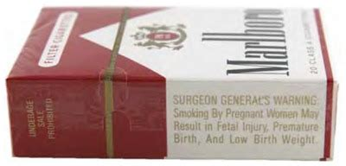

4. Know and explain:
  a. The reason behind the warning on the cigarette packet: “Warning—smoking is a health hazard”
The Public Health Cigarette Smoking Act is a United States federal law passed in 1970 that required a stronger health warning on cigarette packages.
The warning read: "Warning: The Surgeon General Has Determined that Cigarette Smoking Is Dangerous to Your Health."
The act also banned cigarette advertising on radio and television.
Cigarette smoking increases the risk for many types of cancer, including cancers of the lip, oral cavity, and pharynx; esophagus; pancreas; larynx (voice box); lung; breast; uterine cervix; urinary bladder; and kidney.

Slide 18
4. Know and explain:
Nicotine, the stimulant and active ingredient in cigarettes, is highly addictive.
  b. Seven ingredients of tobacco smoke:
    i. Nicotine
    ii. Arsenic
    iii. Formaldehyde
    iv. Cyanide
    v. Carbon monoxide
    vi. Phenolbenzophyrine
    vii. Amonia
This is a notoriously poisonous metalloid. Arsenic is rarely found free in nature, but its compounds are widely distributed in minerals. Arsenic and its compounds are used as pesticides, herbicides, insecticides and various alloys.
At concentrations above 0.1 mg/kg in air, inhaled formaldehyde can irritate the eyes and mucous membranes, resulting in watery eyes, headache, a burning sensation in the throat, and difficulty breathing. More Formaldehyde is converted to formic acid in the body, leading to a rise in blood acidity (acidosis), rapid, shallow breathing, blurred vision or complete blindness, hypothermia, and, in the most severe cases, coma or death.
Cyanide is an irreversible enzyme inhibitor. Tissues that mainly depend on aerobic respiration, such as the central nervous system and the heart, are particularly affected.
Carbon monoxide poisoning occurs after the inhalation of carbon monoxide gas. Carbon monoxide (CO) is a product of combustion of organic matter under conditions of restricted oxygen supply, which prevents complete oxidation to carbon dioxide. Carbon monoxide is colorless, odorless, tasteless, and non-irritating, making it difficult for people to detect.
During the 1960s, Tobacco companies such as Brown & Williamson and Philip Morris began using ammonia in cigarettes. The addition of ammonia serves to enhance the delivery of nicotine into the blood stream. As a result the reinforcement effect of the nicotine was enhanced, increasing its addictive ability without actually increasing the portion of nicotine.
Phenolbenzophyrine is a highly carcinogenic and mutagenic compound which is formed during the incomplete combustion of organic matter. Tobacco manufacturers have experimented with combustionless vaporizer technology to allow cigarettes to be consumed without the formation of carcinogenic benzopyrenes.

Slide 19
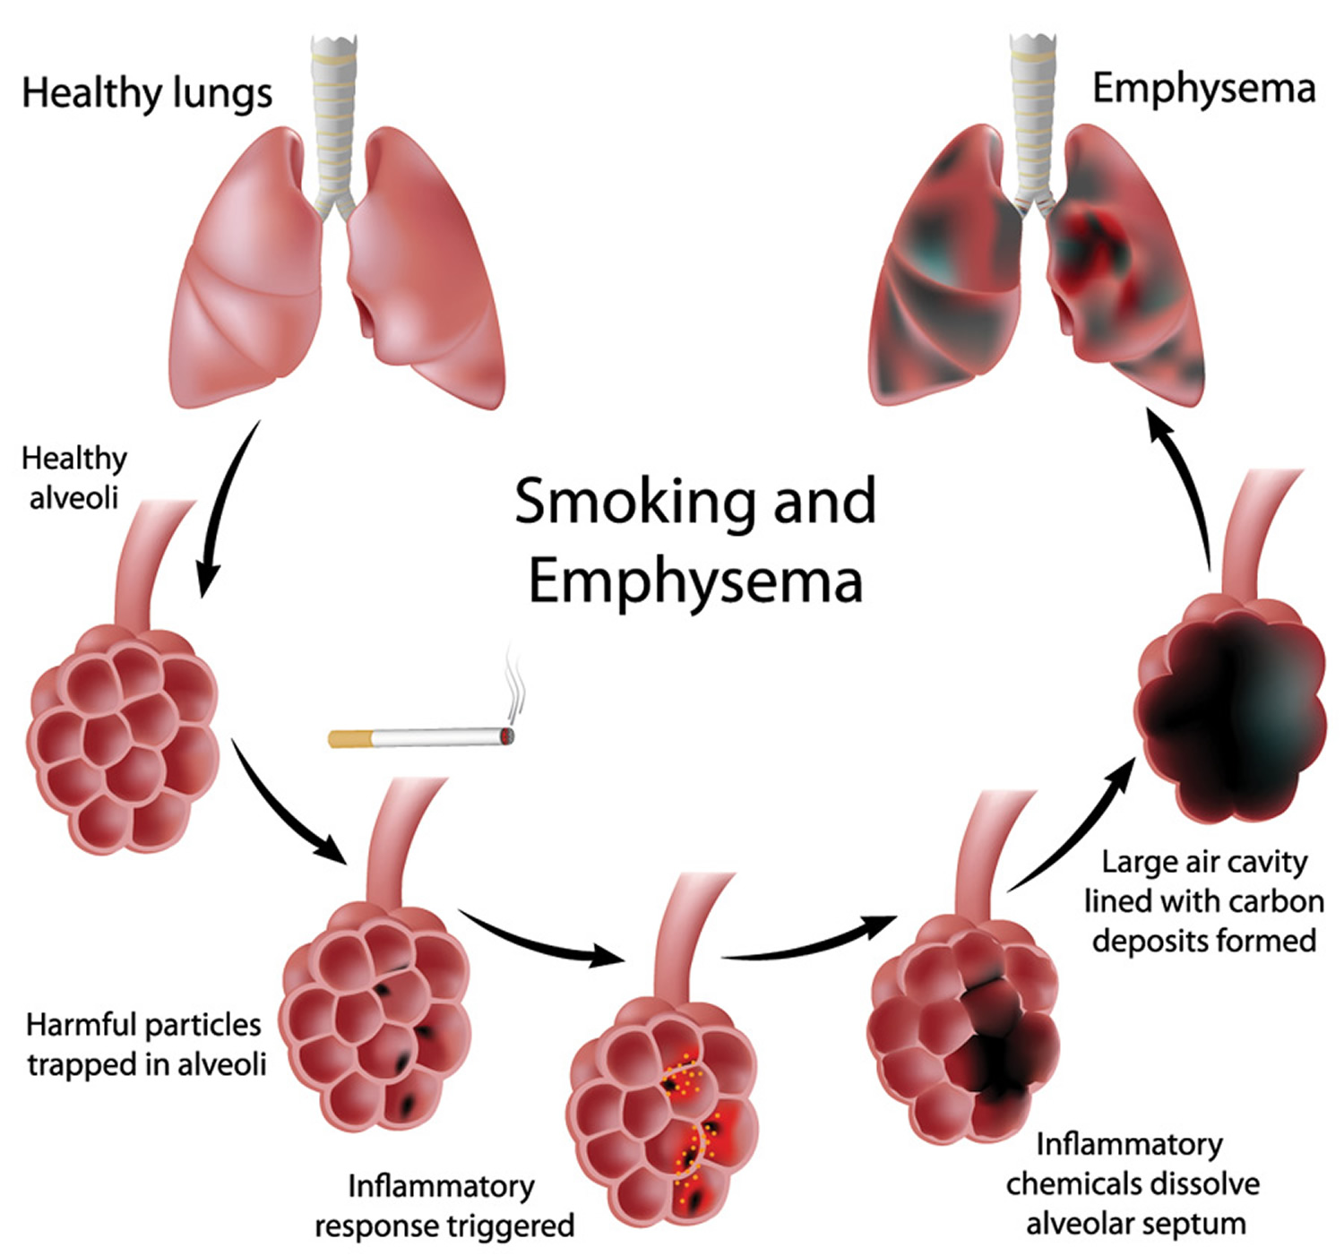
4. Know and explain:
  c. Emphysema, cirrhosis, addiction
Emphysema is a chronic obstructive pulmonary disease. It is often caused by exposure to toxic chemicals or long-term exposure to tobacco smoke.
The lung alveoli are destroyed.
This impedes airflow and traps air in the lungs, as with other obstructive lung diseases. Symptoms include shortness of breath on exertion and later at rest, hyperventilation, and an expanded chest.

Slide 20
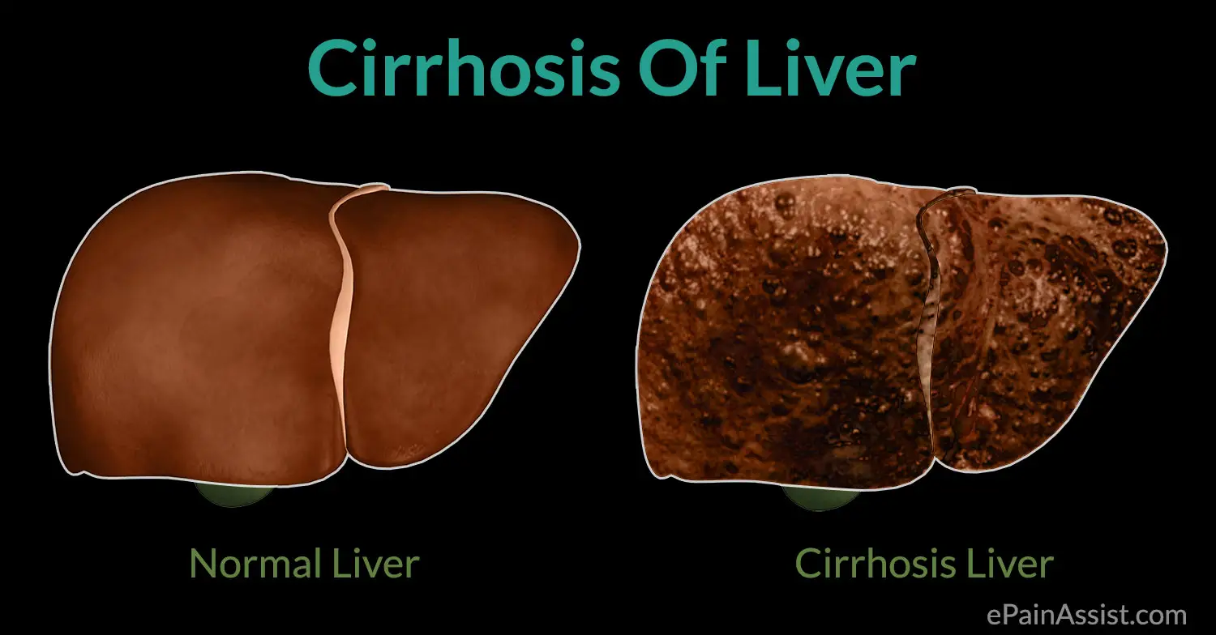
4. Know and explain:
  c. Emphysema, cirrhosis, addiction
Cirrhosis is a consequence of chronic liver disease characterized by replacement of liver tissue by fibrous scar tissue as well as regenerative nodules (lumps that occur as a result of a process in which damaged tissue is regenerated) leading to progressive loss of liver function. Cirrhosis is most commonly caused by alcoholism and hepatitis C, but has many other possible causes.

Slide 21

4. Know and explain:
  d. The effects of tobacco, alcohol, drugs on pregnancy and babies

Slide 22







3. Do four of the following:
  a. Write and deliver a five-to eight-minute speech (oration)
  b. Write an essay on alcohol, tobacco, drugs, or physical fitness of 150 to 200 words and your commitment to a healthy lifestyle
  c. Write a four-line jingle on a Drug Prevention topic.
  d. Draw/make a poster 22 x 28 inches (55.9 x 63.5 cm) that tells about the harmful effects of a drug, tobacco, or alcohol
  e. Make a substance abuse exhibit for a local shopping mall, library, or school
  f. Make a scrapbook of at least 20 pages showing various Drug Prevention advertisements
  g. Share with at least five other persons (excluding your immediate relatives) what you have accomplished from the above list and obtain their signed Temperance Pledges
HUGS
NOT DRUGS

Slide 23
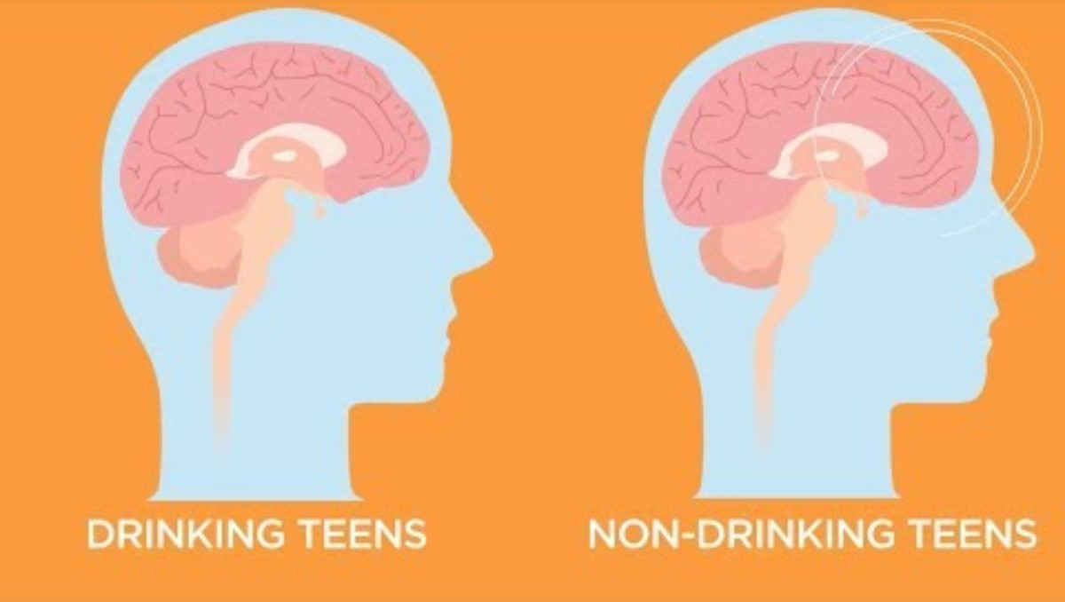
Alcohol

Slide 24


