Slide 1
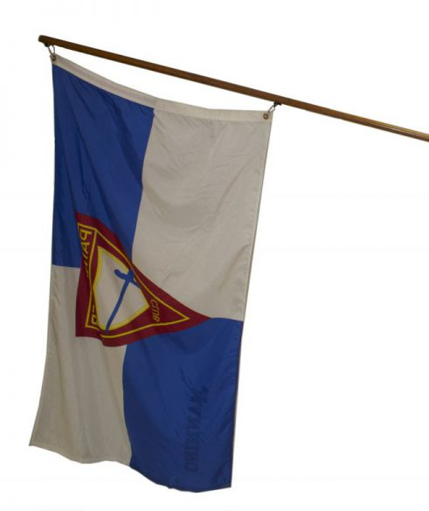
Pathfinder
Pledge and Emblem
Explorer IA

Slide 2

1. Describe the Pathfinder emblem
The middle emblem is _________
  Pathfinder emblem
The shield represents ____
  The protection of God
Red represents Jesus’ _____
  Sacrifice, shed blood
The gold represents
  excellence
The triangle represent __
  Completeness, The Godhead, and the 3 parts of education: mental, physical, and spiritual
The sword represents __
  The Word of God, the Bible
Blue represents ___________
  Loyalty
white represents ___
  Purity
Pathfinder Flag

Slide 3
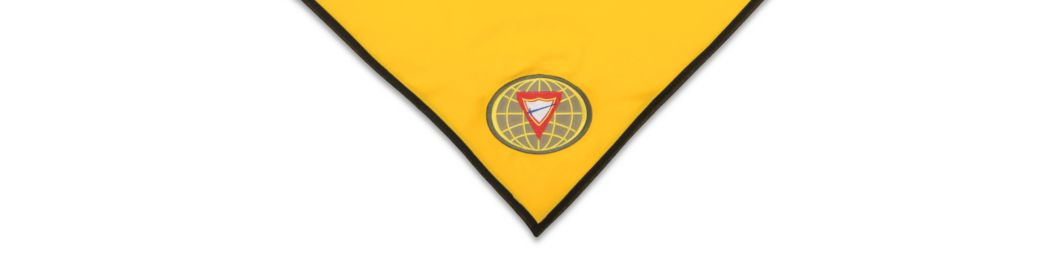
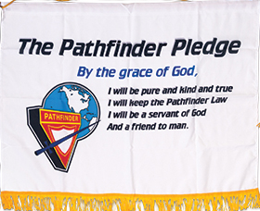

By the grace of God
As Pathfinders,
it is our desire
and pledge:
Meaning that only
as I rely on God to help me, can I do His will.

Slide 4
I will be pure
As Pathfinders,
it is our desire
and pledge:
Meaning
that I will rise above
the wicked world
in which I live
and keep my life clean
with words and actions
that will make others happy.

Slide 5
I will be kind
As Pathfinders,
it is our desire
and pledge:
Meaning
That I will not only
be considerate and kind
to my fellow mankind,
but also, to all of
God’s creation.

Slide 6
I will be true
As Pathfinders,
it is our desire
and pledge:
Meaning
I will be honest and upright
in study, work and play
and can always be counted
upon to do my very best.

Slide 7
I will keep the Pathfinder Law
As Pathfinders,
it is our desire
and pledge:
Meaning I will seek to
understand the meaning
of the Pathfinder Law
and will strive to live up to its spirit,
realizing that obedience to law
is essential in any organization.

Slide 8
I will be a servant of God
As Pathfinders,
it is our desire
and pledge:
Meaning
I will pledge myself to serve God
first, last and best
in everything
I am called upon
to be or do.

Slide 9
I will be a friend to man
As Pathfinders,
it is our desire
and pledge:
Meaning
I will live to bless others and to do unto them
as I would have them
to do me.

Slide 10
Pathfinder
Pledge
Law
By the grace of God,
I will be pure, and kind, and true.
I will keep the Pathfinder Law.
I will be a servant of God
and a friend to man.
Keep the morning watch
Do my honest part
Care for my body,
Keep a level eye
Be courteous and obedient
Walk softly in the sanctuary,
Keep a song in my heart,
Go on God's errand.

