Slide 1
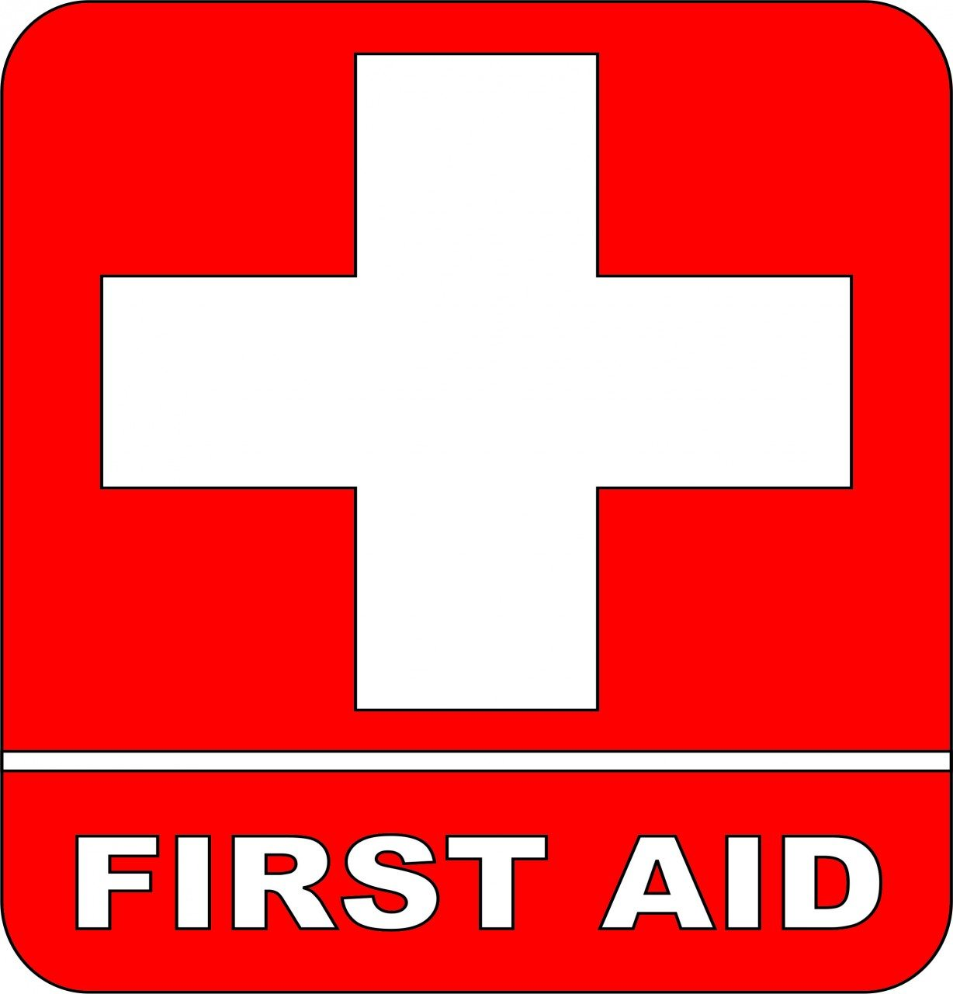
Basic First Aid
Pathfinder Honor

Slide 2
Fire and burns
Part 1

Slide 3

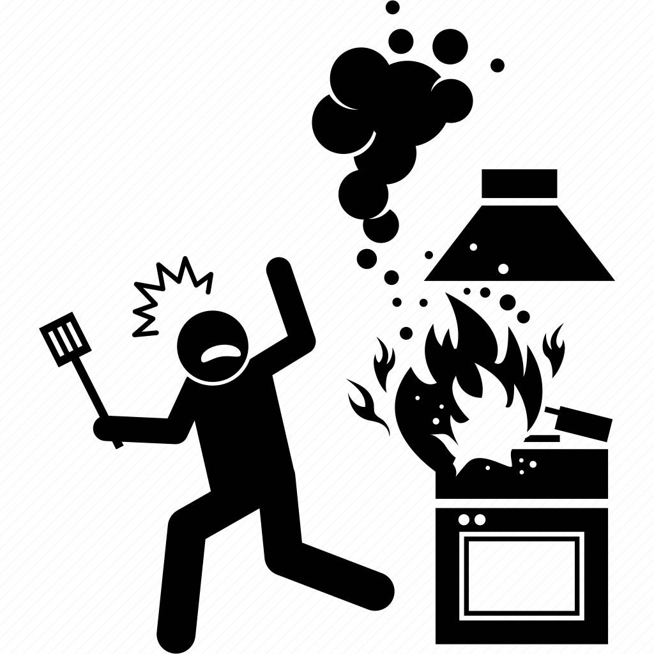
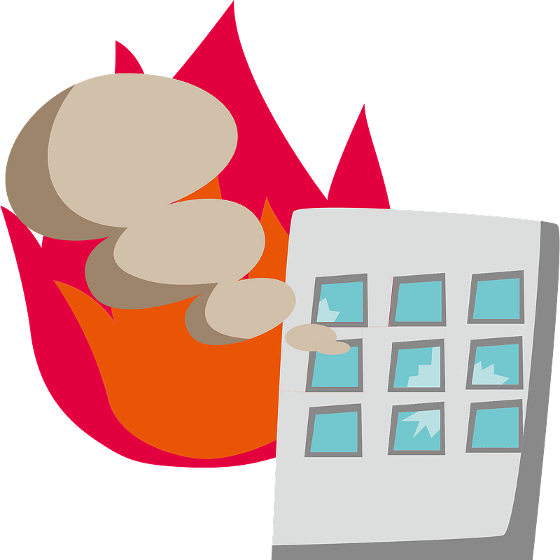
Scenario: FIRE
What
Should
You do?

Slide 4
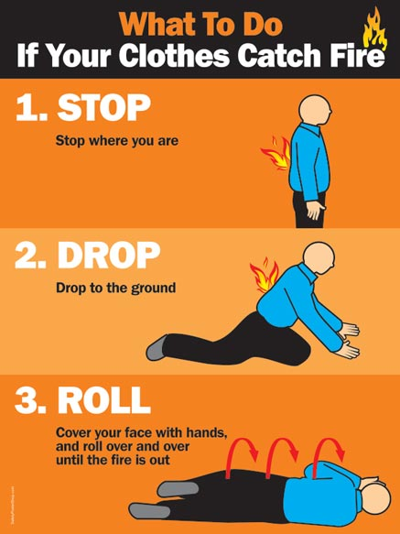
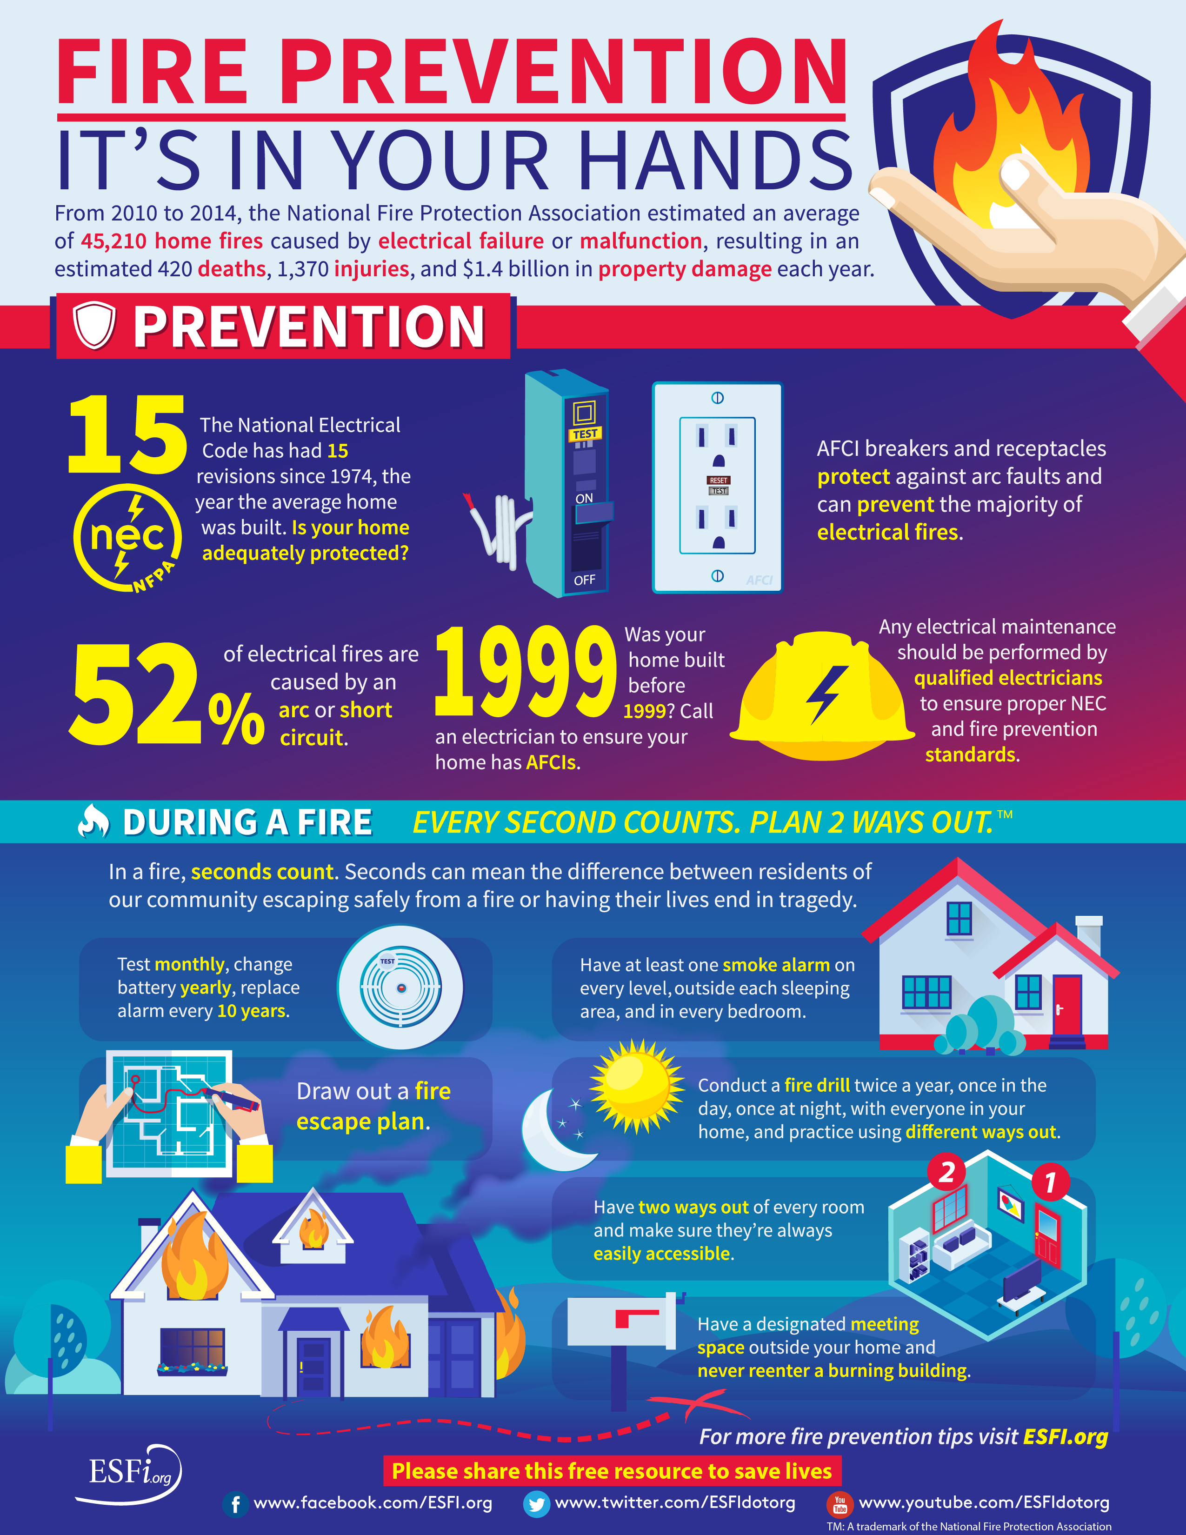

Slide 5
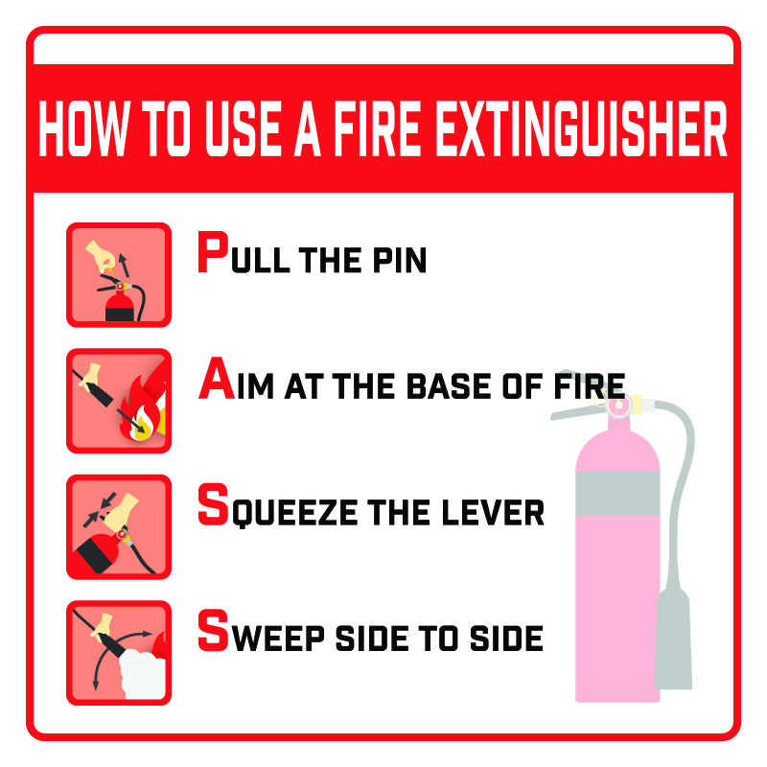
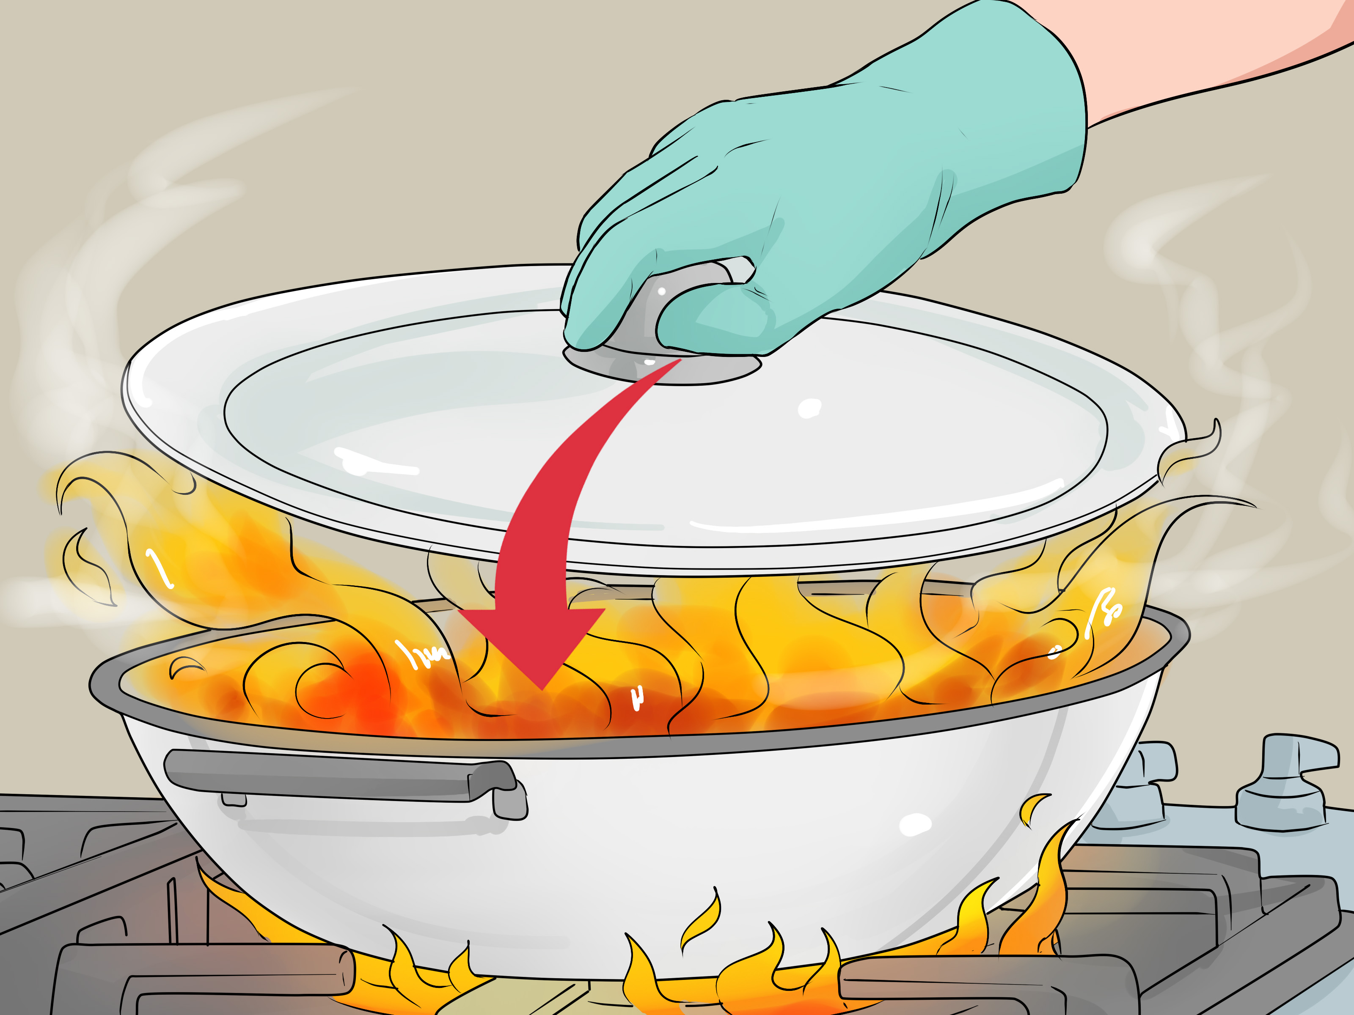
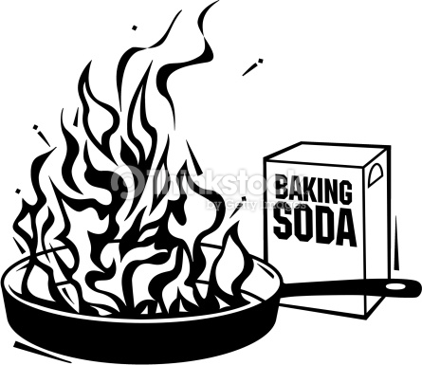
Small fire
Smother it

Slide 6
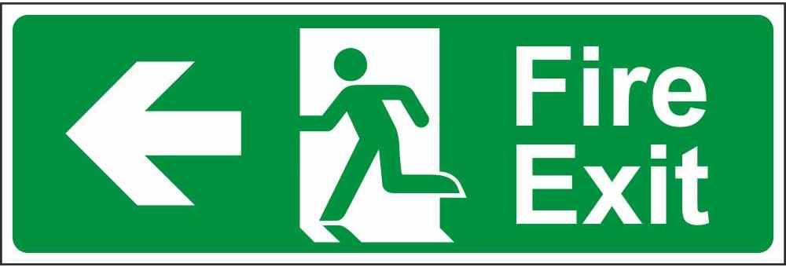
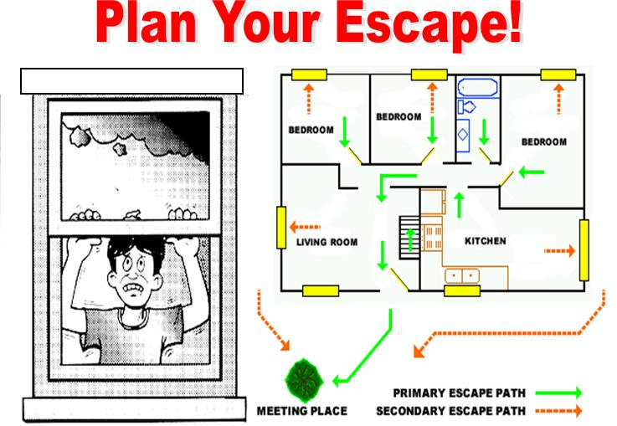
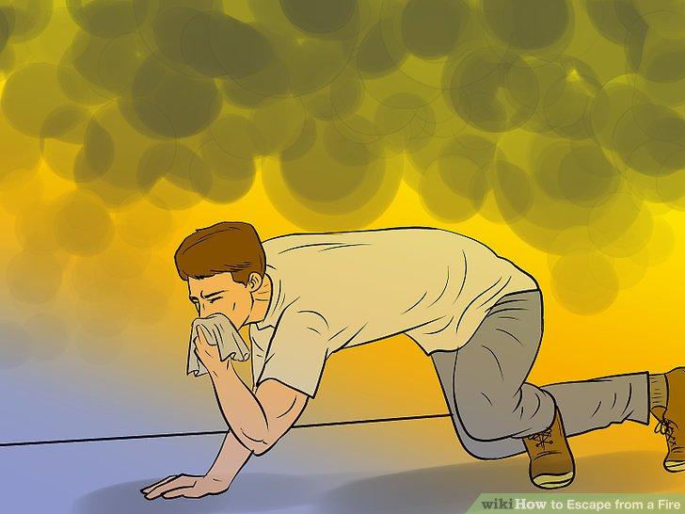
Building FIRE
Check your route:
Is the door hot? Is there smoke?
Get low and get OUT!
Call 9-1-1
What is your fire escape plan?

Slide 7
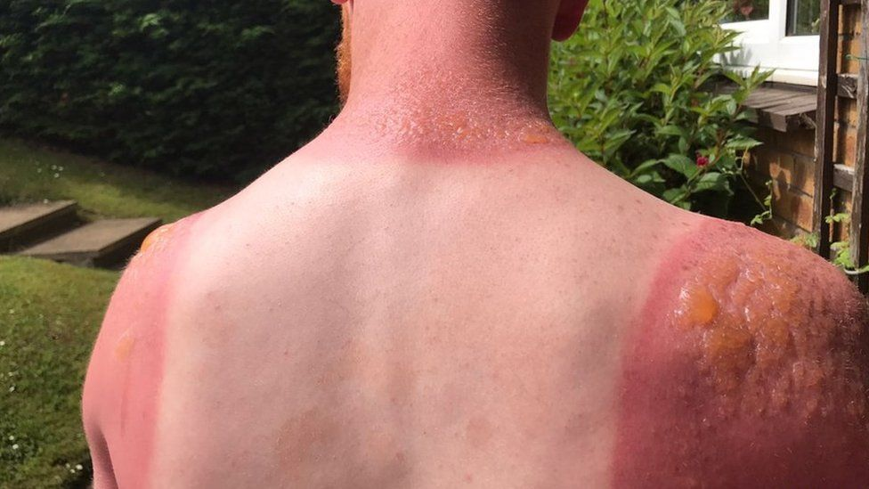
Scenario: BURNT
What
Should
You do?

Slide 8

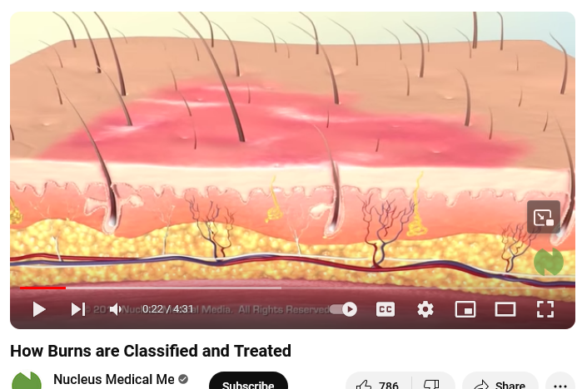
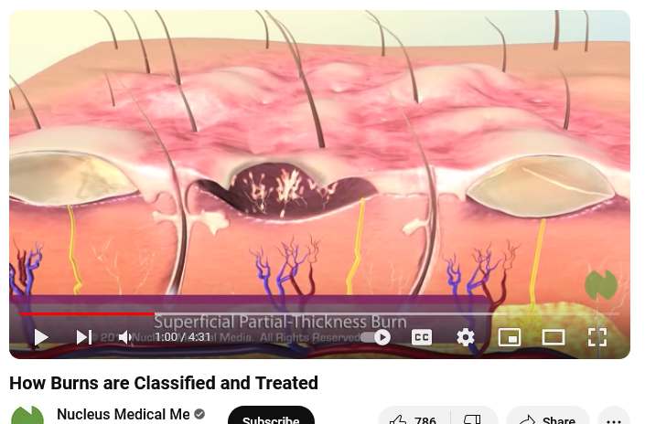
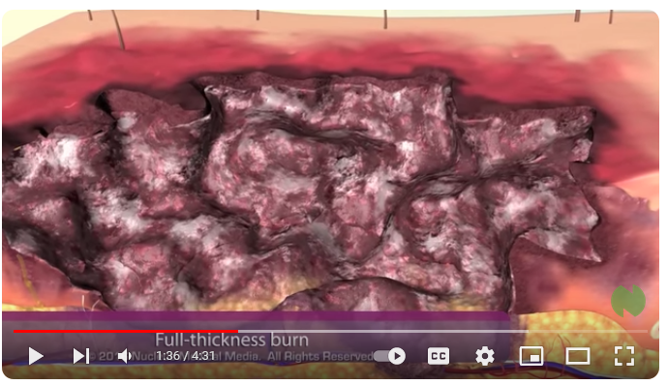
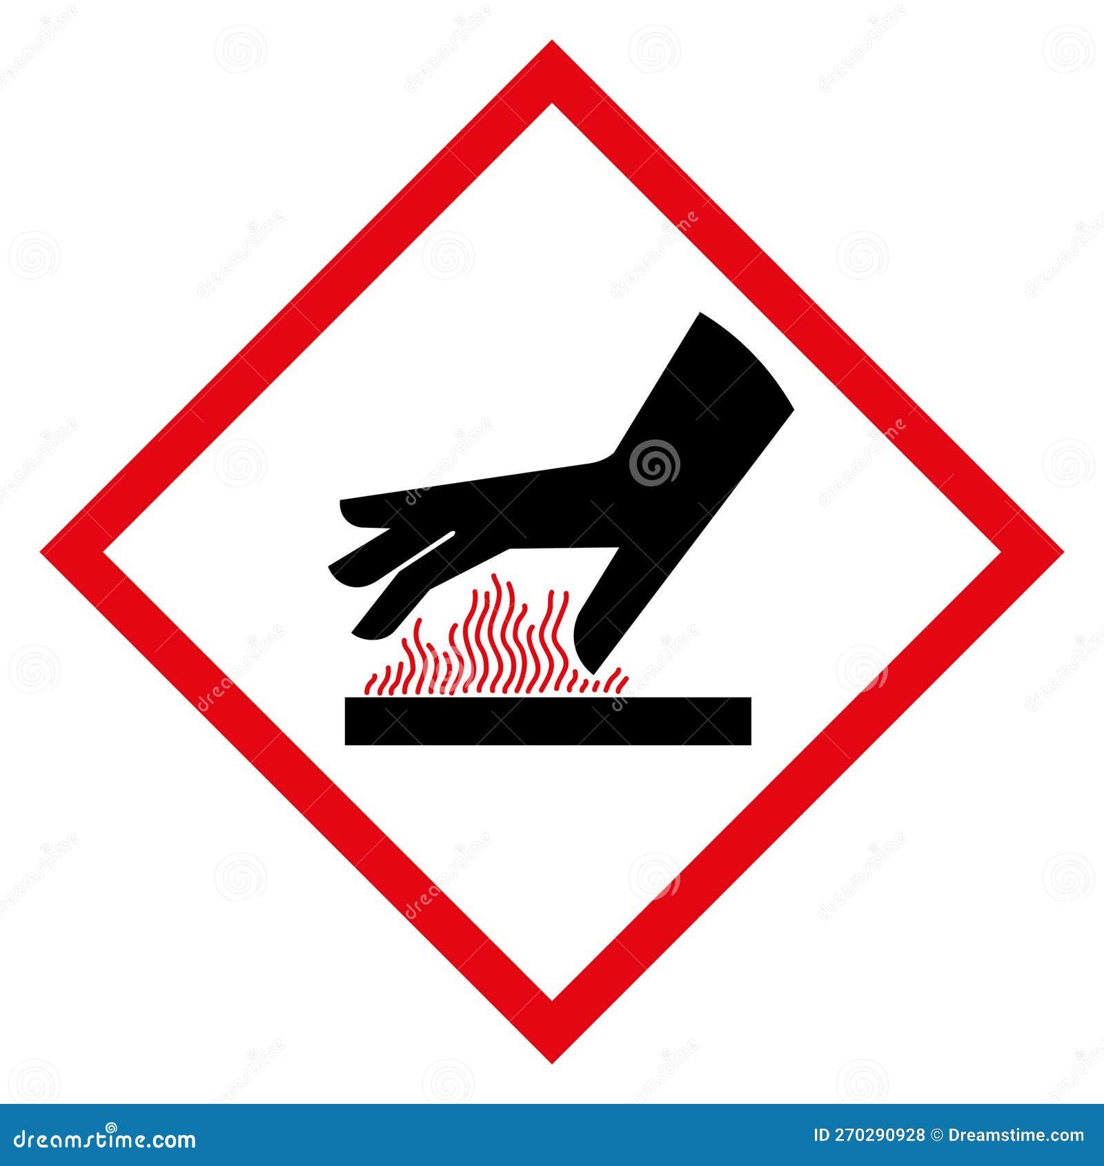

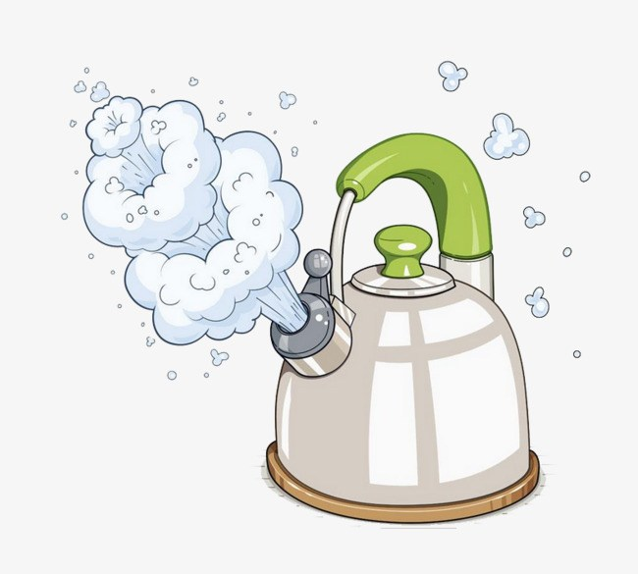
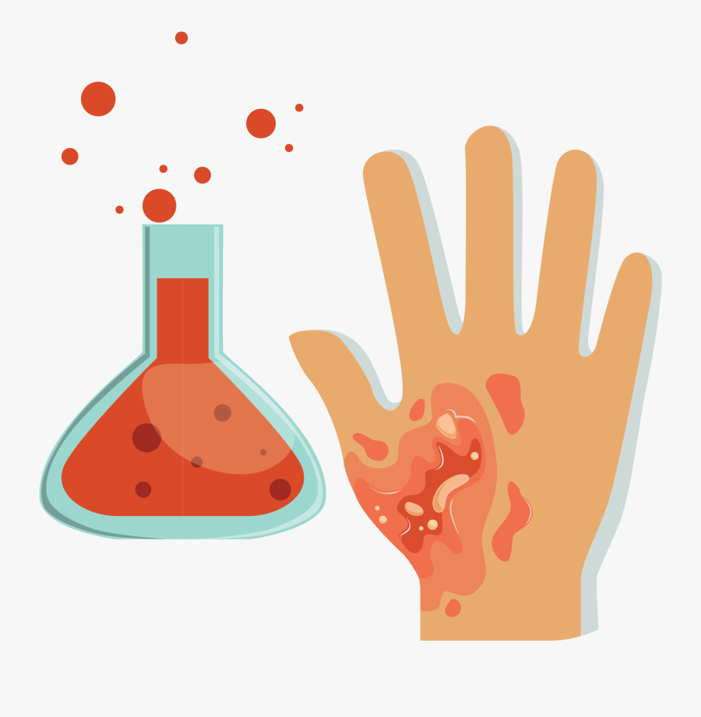


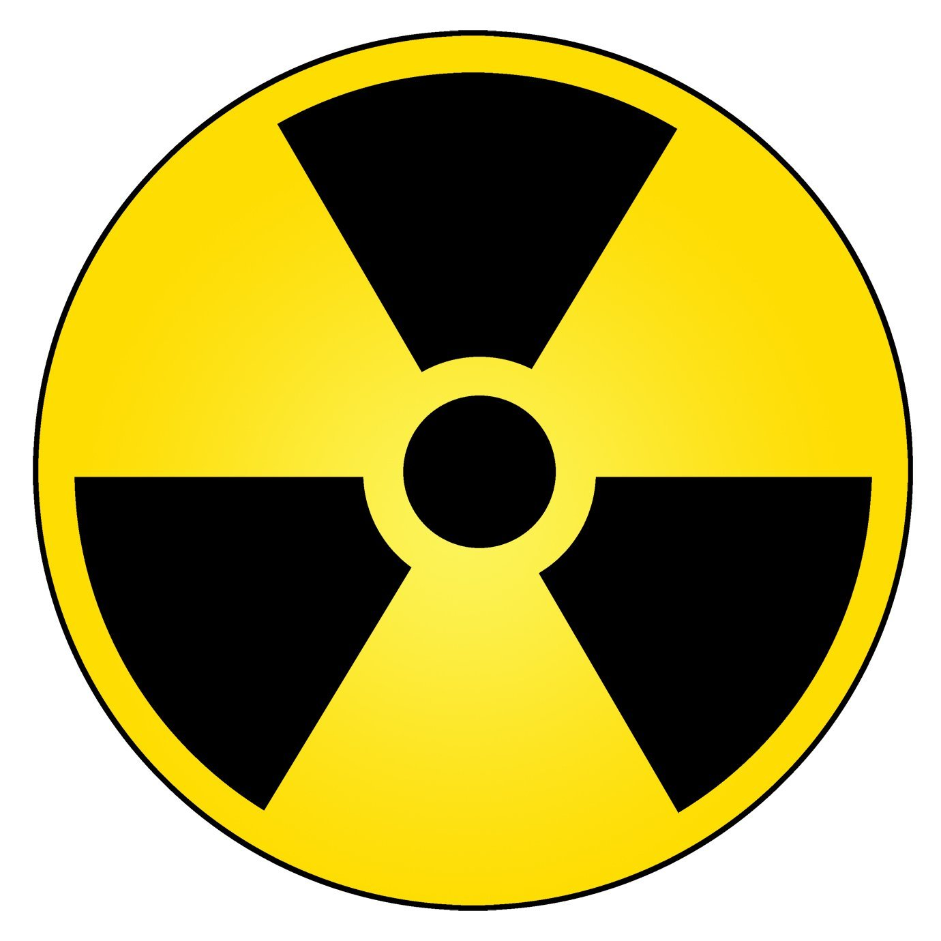

1st Degree Burn
2nd Degree Burn
3rd Degree Burn
The epidermis and full dermis layers of the skin are damaged.
The burned area is white, brown, dry and charred.
This will take a very long time to heal.
Only the skin’s first layer, the epidermis is affected.
It is red and painful.
This will take some time to heal.
Effect the epidermis and papillary dermis.
There are blisters and intense pain.
This will take a long time to heal.
What can cause a burn? How have you been burnt?

Slide 9
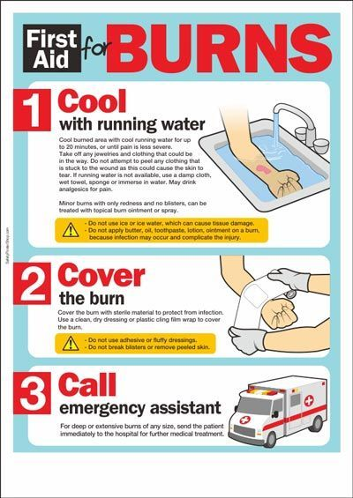
First Aid for burns
DO IT
Get away from what is causing the burn. Remove clothing as necessary and possible. If clothing is stuck, leave it there.
Run cold water on the burned area for 10 minutes or until the pain goes away. Do NOT use ice. (It will freeze the burn and make more damage.)
Cover the burn with antibiotic ointment and dry, breathable, clean gauze. Aloe vera helps too. Never use oil, butter, or other fat!
Seek medical attention.
Put arm under running cold water.
Cover with gauze.
Treat for pain or shock as necessary
Go to doctor

Slide 10
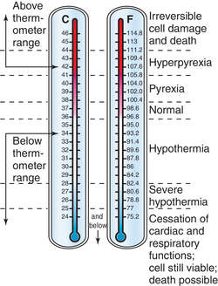
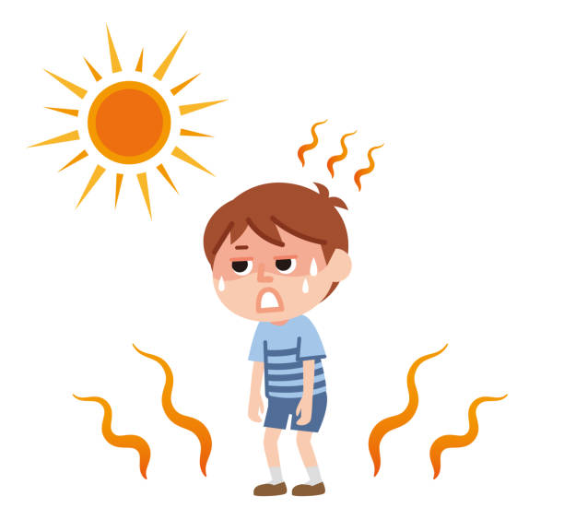
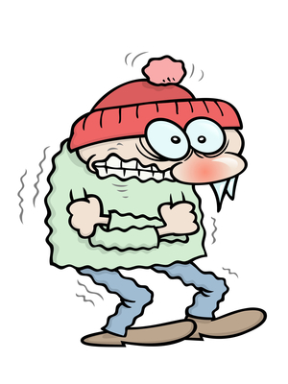
TOO HOT --- TOO COLD
What
Should
You do?

Slide 11
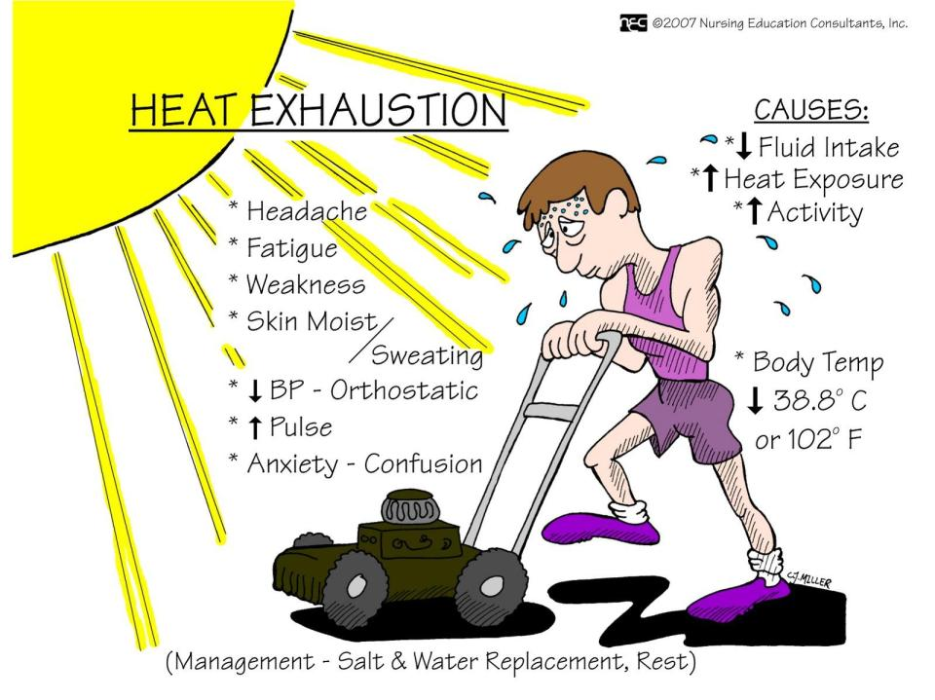
Heat Exhaustion
First Aid Treatment
100°+ Feverish
Drink lots of water and salt electrolytes like Gatorade
Rest in the shade
Cool down with cool cloths or spray, loosen clothing and remove extra covering
103° Hyperpyrexia - Way too hot!
Call 9-1-1
(more info on note page)
Know the proper treatment of the effects of heat (heat exhaustion & heat stroke and the difference) [B18b, S11g]
Notes:
By Mayo Clinic Staff https://www.mayoclinic.org/first-aid/first-aid-heat-exhaustion/basics/art-20056651
Heat exhaustion is one of the heat-related syndromes. These syndromes vary in seriousness, ranging from mild to possibly life-threatening. Other types of heat-related illnesses include heat rash, heat cramps, heat syncope and heatstroke.
Heat exhaustion can happen when the body loses too much water or salt — usually because of heavy sweating or dehydration. It can begin suddenly or happen over time, usually after working, exercising or playing in the heat.
Heat exhaustion symptoms include:
Cool, moist skin with goose bumps when in the heat.
Heavy sweating.
Faintness.
Dizziness.
Fatigue.
Weak, rapid pulse.
Low blood pressure after standing up.
Muscle cramps.
Nausea or vomiting.
Headache.
Extreme thirst.
Mild confusion.
Decreased urine output.
If you suspect heat exhaustion
Untreated, heat exhaustion can lead to heatstroke, which is a life-threatening condition. If you suspect heat exhaustion, take these steps immediately:
Move the person out of the heat and into a shady or air-conditioned place.
Lay the person down and raise the legs and feet slightly.
Remove tight or heavy clothing.
Have the person sip chilled water, a sports drink containing electrolytes or another nonalcoholic beverage without caffeine.
Cool the person by spraying or sponging with cool water and fanning.
Monitor the person carefully.
Contact a healthcare professional if symptoms get worse or if the person doesn't improve after taking first-aid measures.
Call 911 or your local emergency number if the person's condition gets worse, especially if the person:
Faints.
Becomes agitated.
Is confused.
Has a seizure.
Is not able to drink.
Has a core body temperature — measured with a rectal thermometer — of 104 degrees Fahrenheit (40 degrees Celsius), which indicates heatstroke.

Slide 12
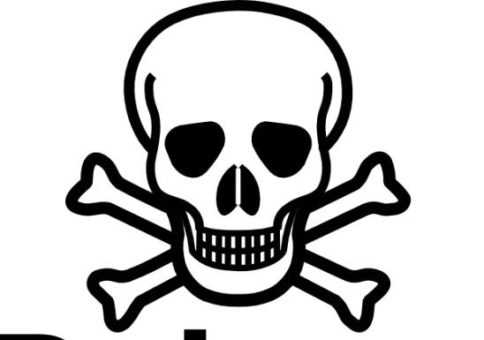
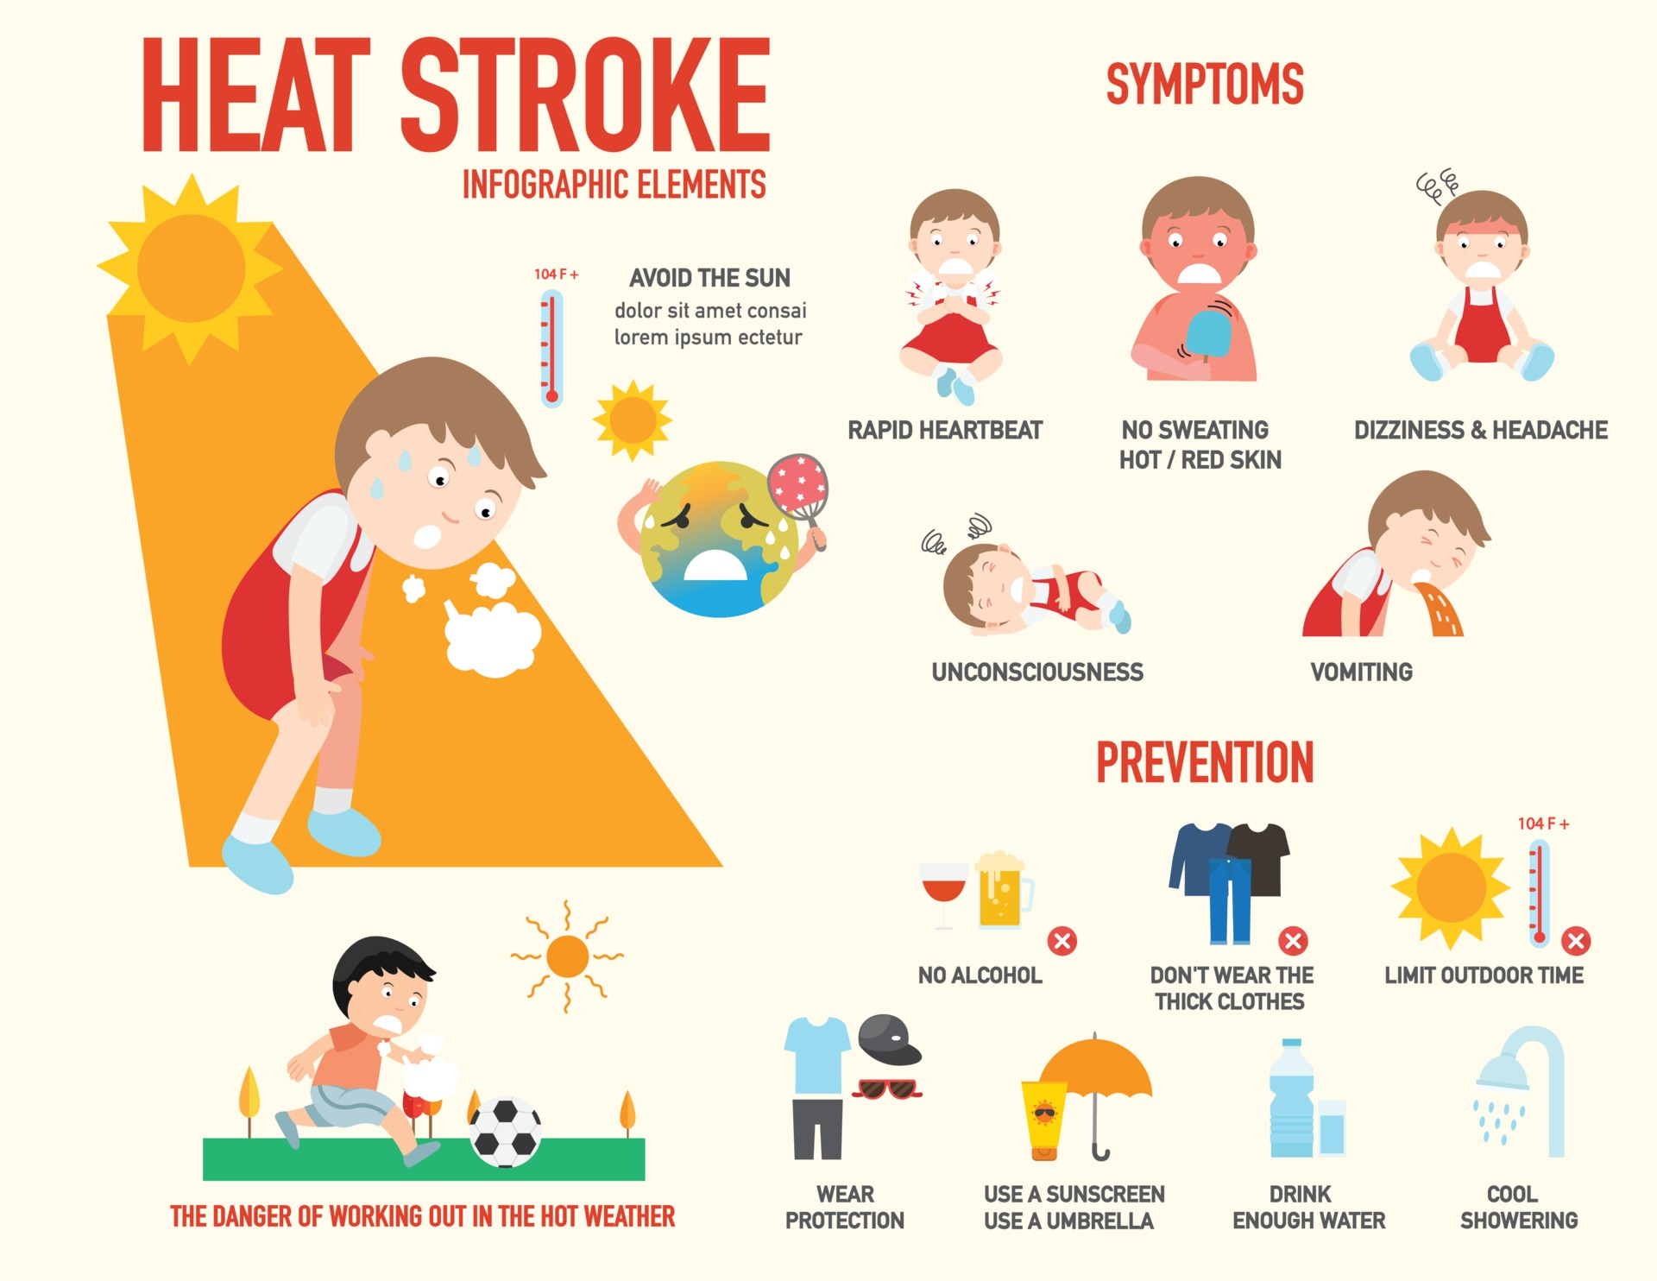
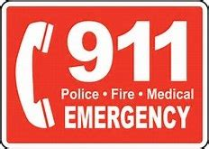
Heat Stroke .
A severe condition caused by impairment of the body's temperature-regulating abilities, resulting from prolonged exposure to excessive heat and characterized by cessation of sweating, severe headache, high fever, hot dry skin, and in serious cases collapse and coma.
CALL
Know the difference between
heat exhaustion & heat stroke
[B18b, S11g]
Notes:
By Mayo Clinic Staff https://www.mayoclinic.org/first-aid/first-aid-heat-exhaustion/basics/art-20056651
Heat exhaustion is one of the heat-related syndromes. These syndromes vary in seriousness, ranging from mild to possibly life-threatening. Other types of heat-related illnesses include heat rash, heat cramps, heat syncope and heatstroke.
Heat exhaustion can happen when the body loses too much water or salt — usually because of heavy sweating or dehydration. It can begin suddenly or happen over time, usually after working, exercising or playing in the heat.
Heat exhaustion symptoms include:
Cool, moist skin with goose bumps when in the heat.
Heavy sweating.
Faintness.
Dizziness.
Fatigue.
Weak, rapid pulse.
Low blood pressure after standing up.
Muscle cramps.
Nausea or vomiting.
Headache.
Extreme thirst.
Mild confusion.
Decreased urine output.
If you suspect heat exhaustion
Untreated, heat exhaustion can lead to heatstroke, which is a life-threatening condition. If you suspect heat exhaustion, take these steps immediately:
Move the person out of the heat and into a shady or air-conditioned place.
Lay the person down and raise the legs and feet slightly.
Remove tight or heavy clothing.
Have the person sip chilled water, a sports drink containing electrolytes or another nonalcoholic beverage without caffeine.
Cool the person by spraying or sponging with cool water and fanning.
Monitor the person carefully.
Contact a healthcare professional if symptoms get worse or if the person doesn't improve after taking first-aid measures.
Call 911 or your local emergency number if the person's condition gets worse, especially if the person:
Faints.
Becomes agitated.
Is confused.
Has a seizure.
Is not able to drink.
Has a core body temperature — measured with a rectal thermometer — of 104 degrees Fahrenheit (40 degrees Celsius), which indicates heatstroke.

Slide 13
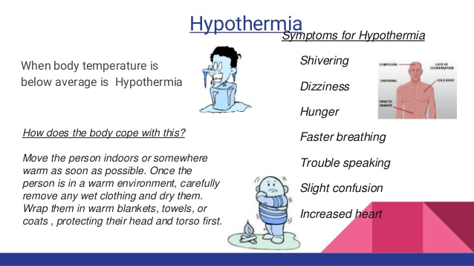
Hypothermia

Slide 14
Poisoning
Part 2

Slide 15
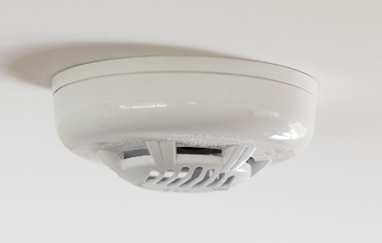
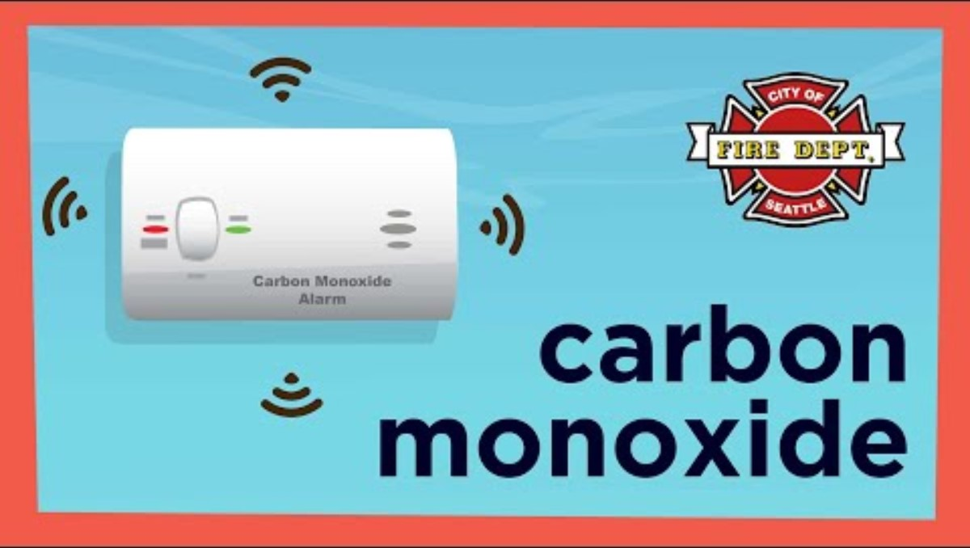
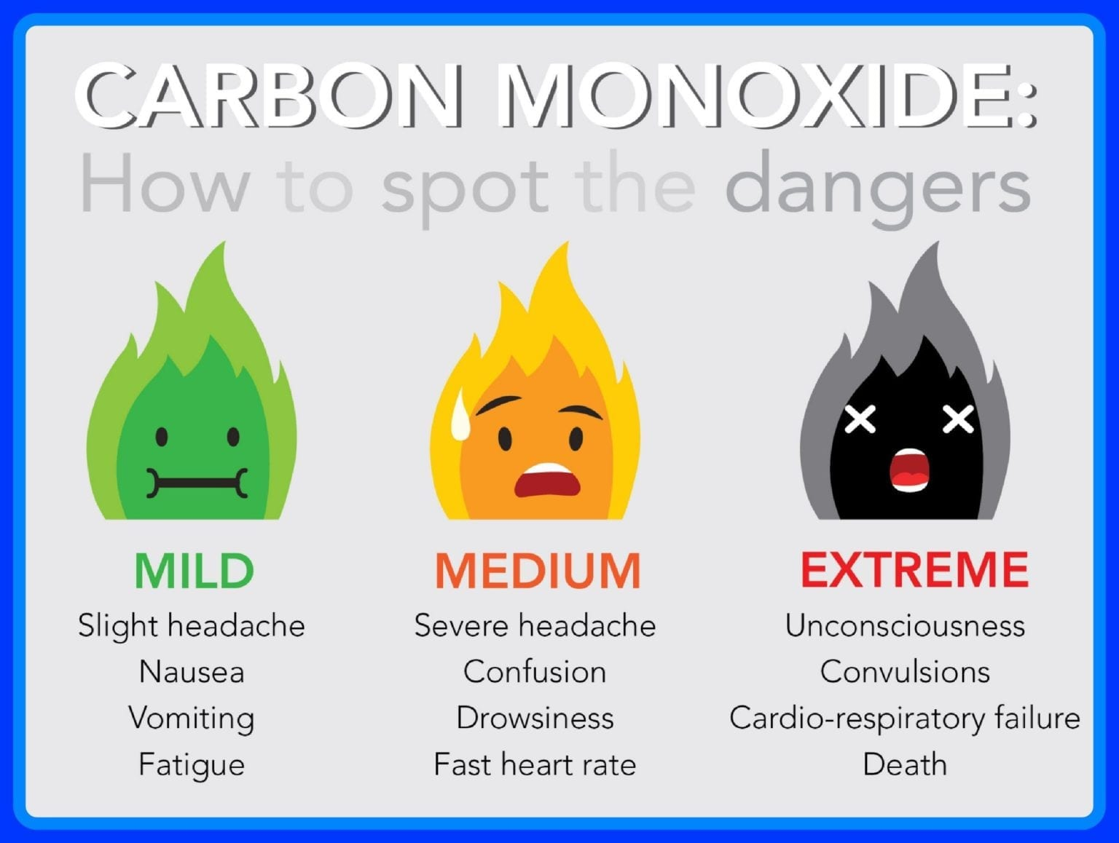
Carbon Monoxide Poisoning
First Aid
Everyone Get OUT to fresh air
Call 9-1-1
Responders should check air
and source of CO₂
Carbon Monoxide detector
Carbon monoxide is a poisonous, flammable gas that is colorless, odorless, tasteless, and slightly less dense than air.
When too much carbon monoxide is in the air, the body replaces the oxygen in the red blood cells with carbon monoxide. This can lead to serious tissue damage, or even death.

Slide 16
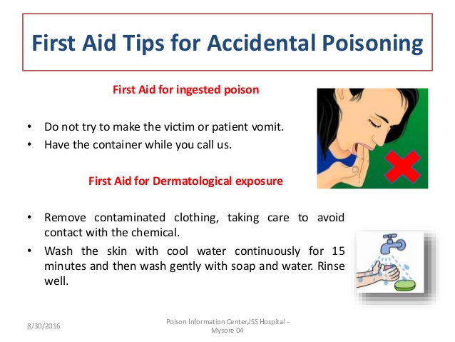
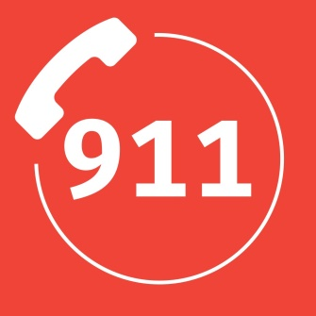

Poison
Call 9-1-1
Look for evidence of the poison so you can tell what it was.
Follow the directions of the emergency operator.
What is the first aid for poisoning?

Slide 17
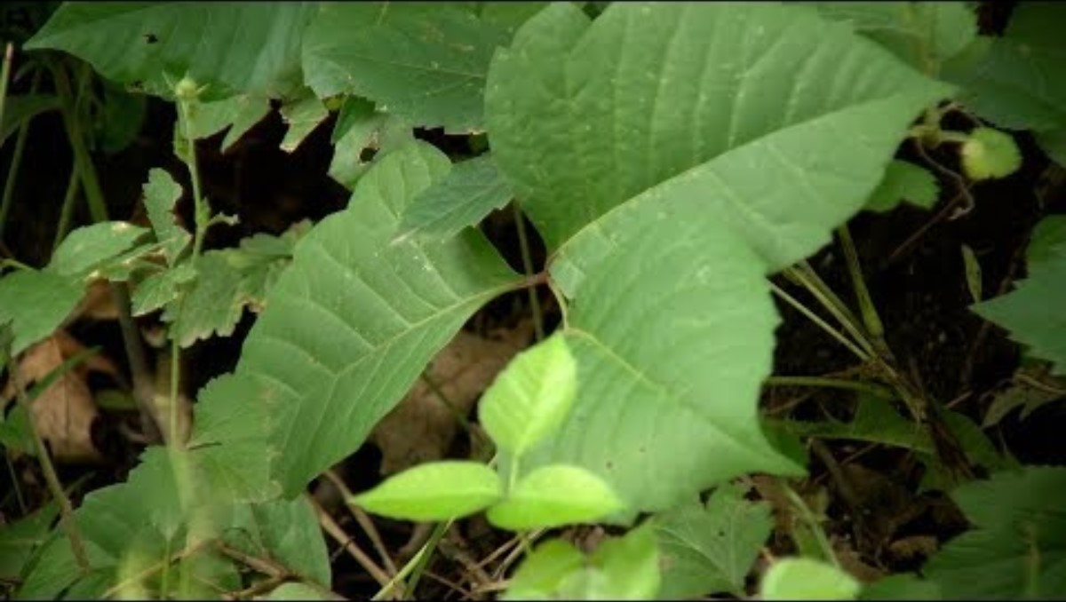
Poisonous Plants: Ivy, Sumac, or Oak
Wash well!
Wash skin & clothes
PREVENTION:
Stay away from it!
Stay on the trail
Wear pants or tall socks and boots in areas with it.

Slide 18
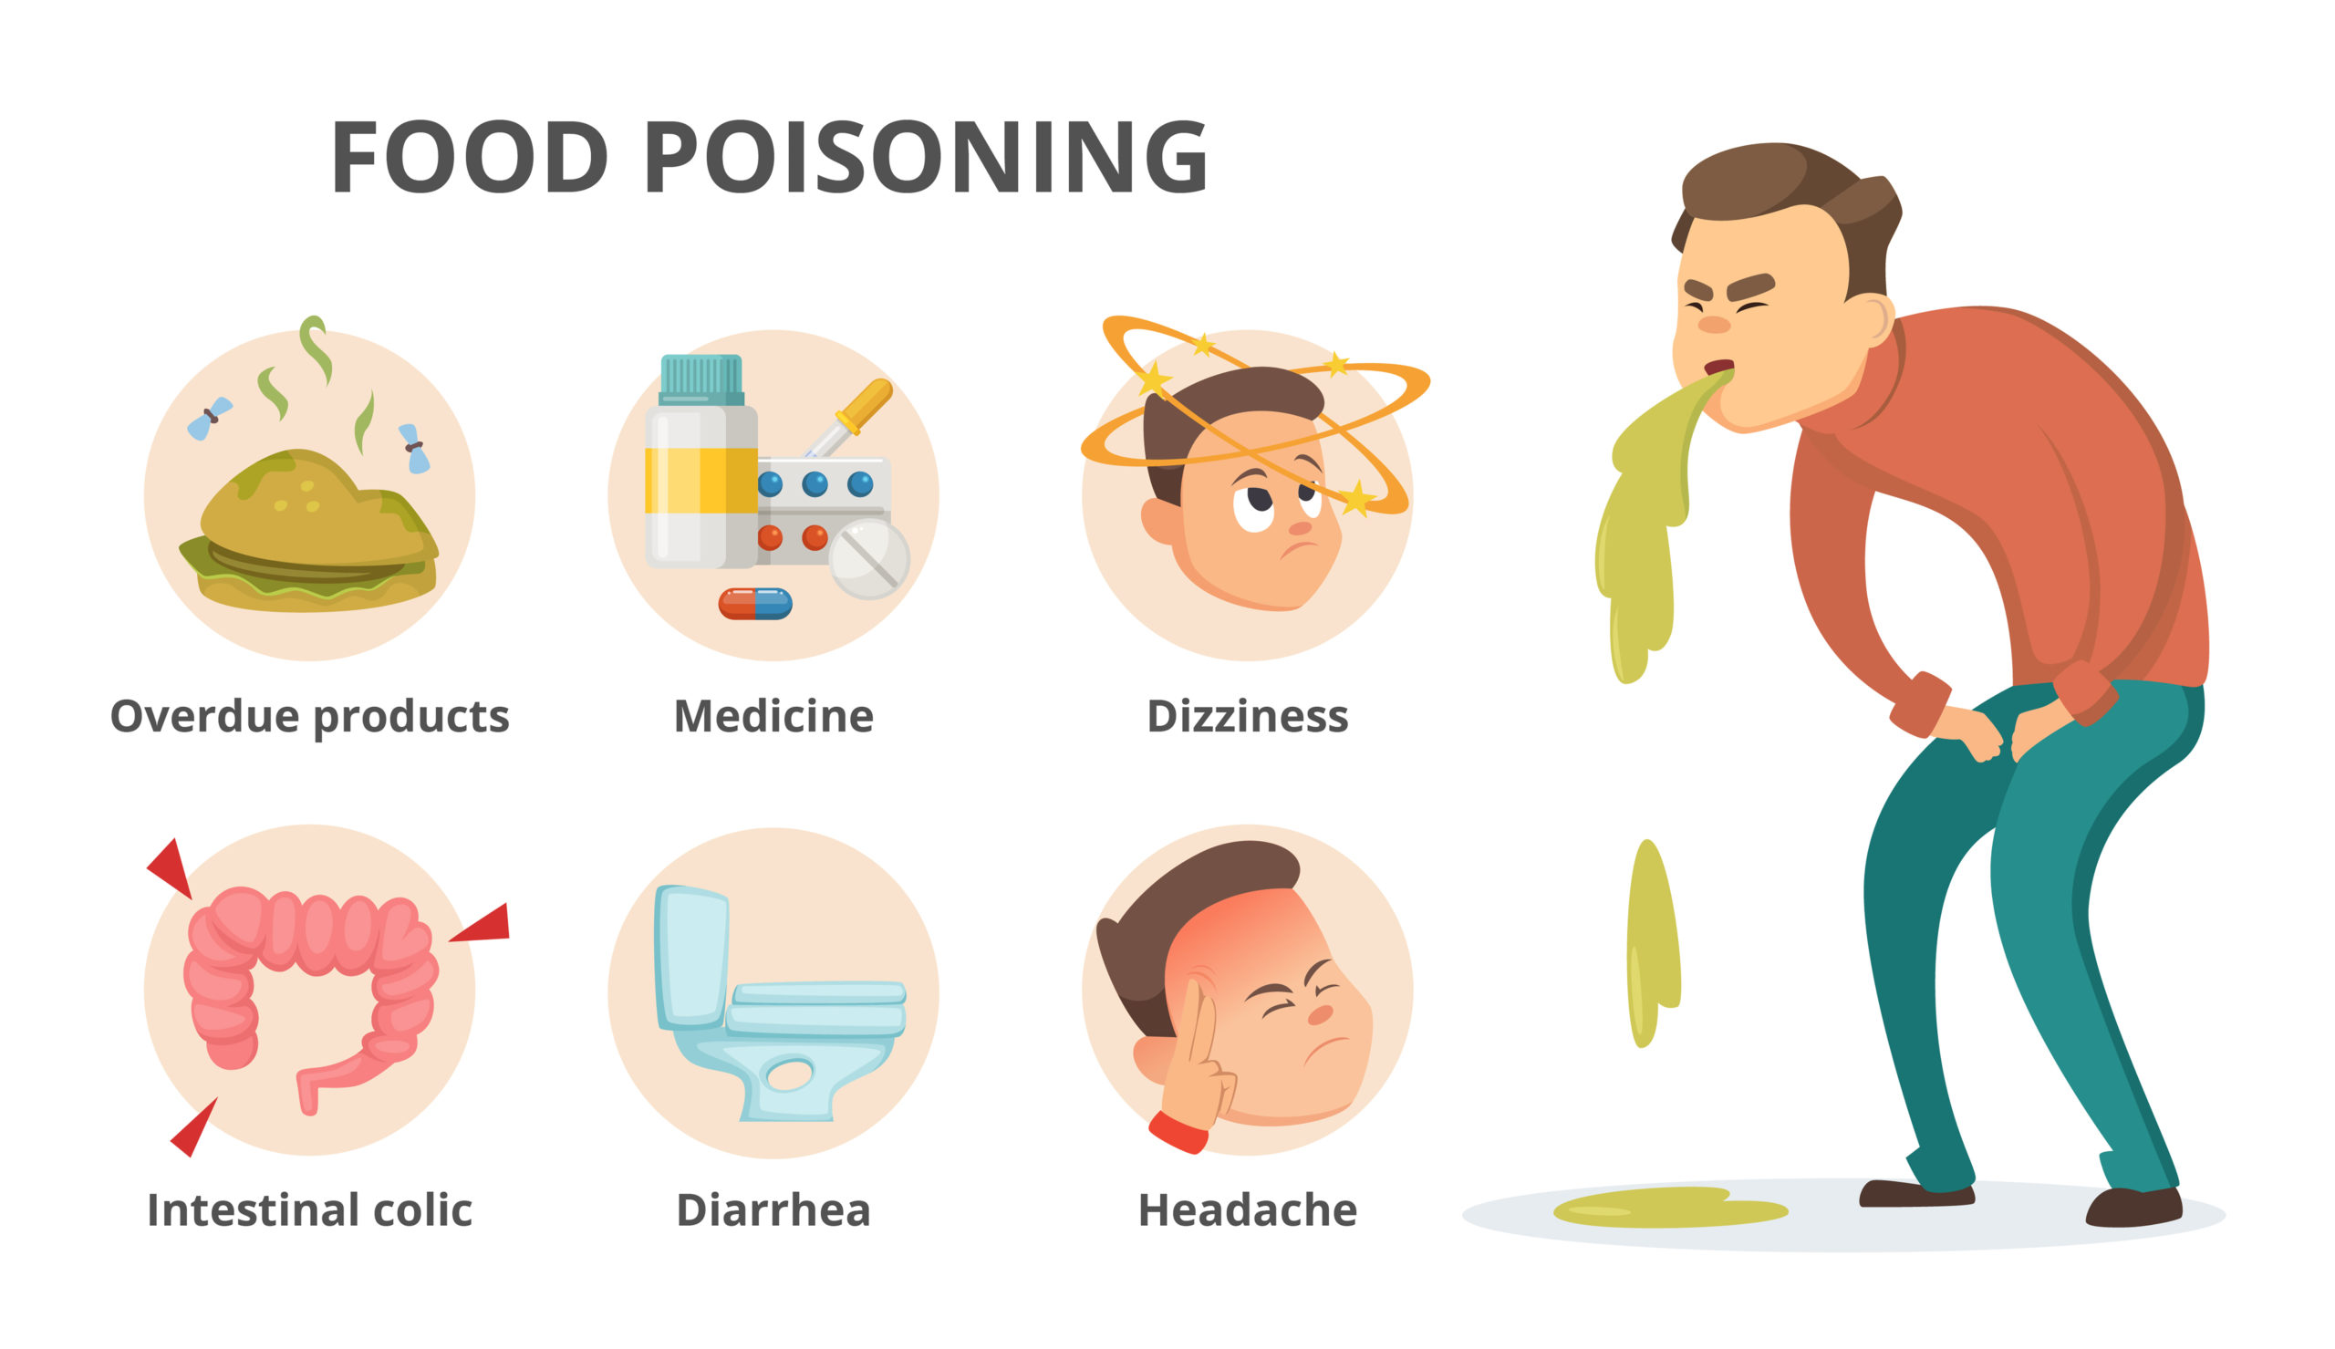
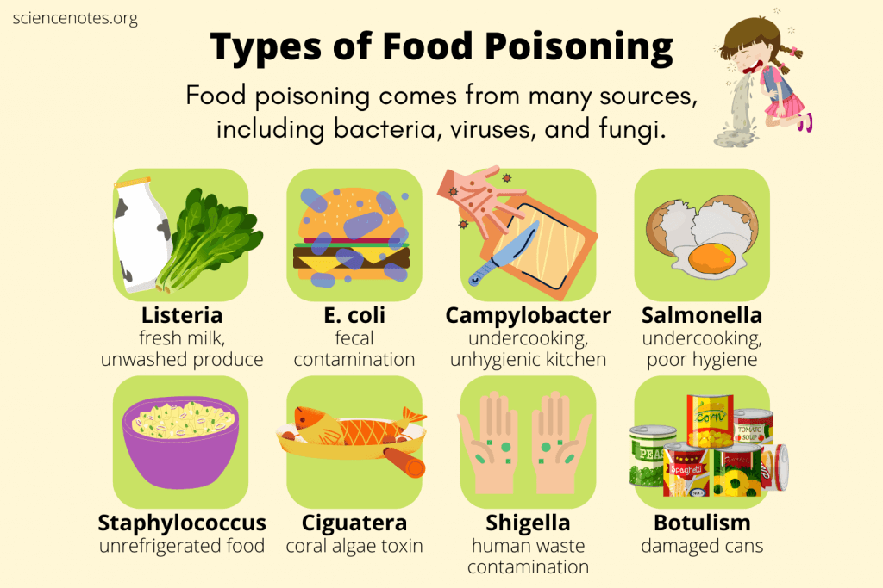
Food Poisoning
Food poisoning, a type of foodborne illness, is a sickness people get from something they ate or drank. The causes are germs or other harmful things in the food or beverage.
Symptoms of food poisoning often include upset stomach, diarrhea and vomiting. Symptoms usually start within hours or several days of eating the food. Most people have mild illness and get better without treatment.
Sometimes food poisoning causes severe illness or complications.
Food can be contaminated at any point from the farm or fishery to the table. The problem can begin during growing, harvesting or catching, processing, storing, shipping, or preparing.
More info from MayoClinic

Slide 19
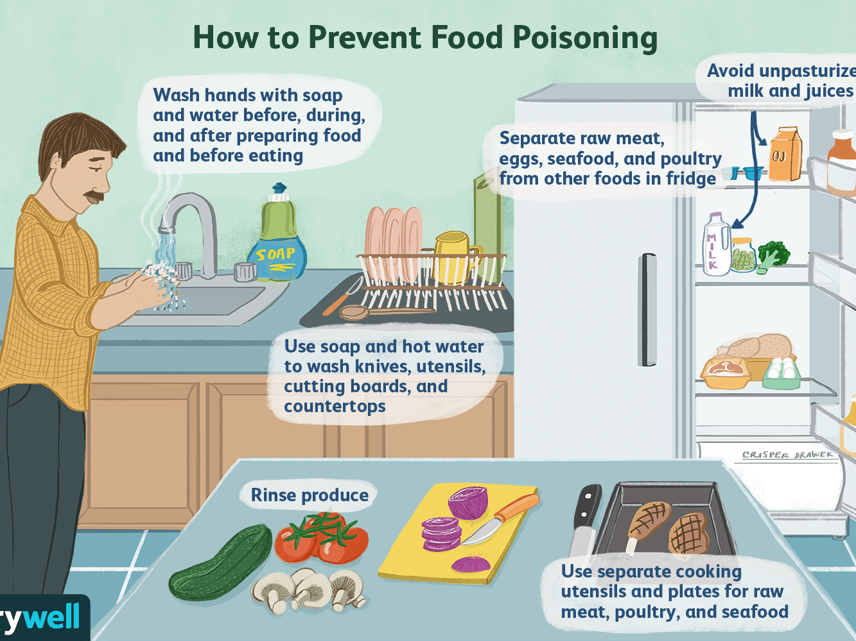
Food Poisoning
PREVENTION
Wash your hands!
Wash fresh food
Store food properly
Cook food properly
If you handle food for others, take a food handler’s course

Slide 20

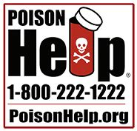
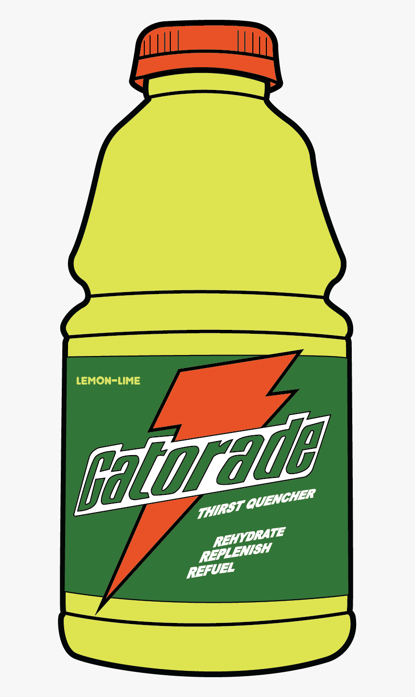
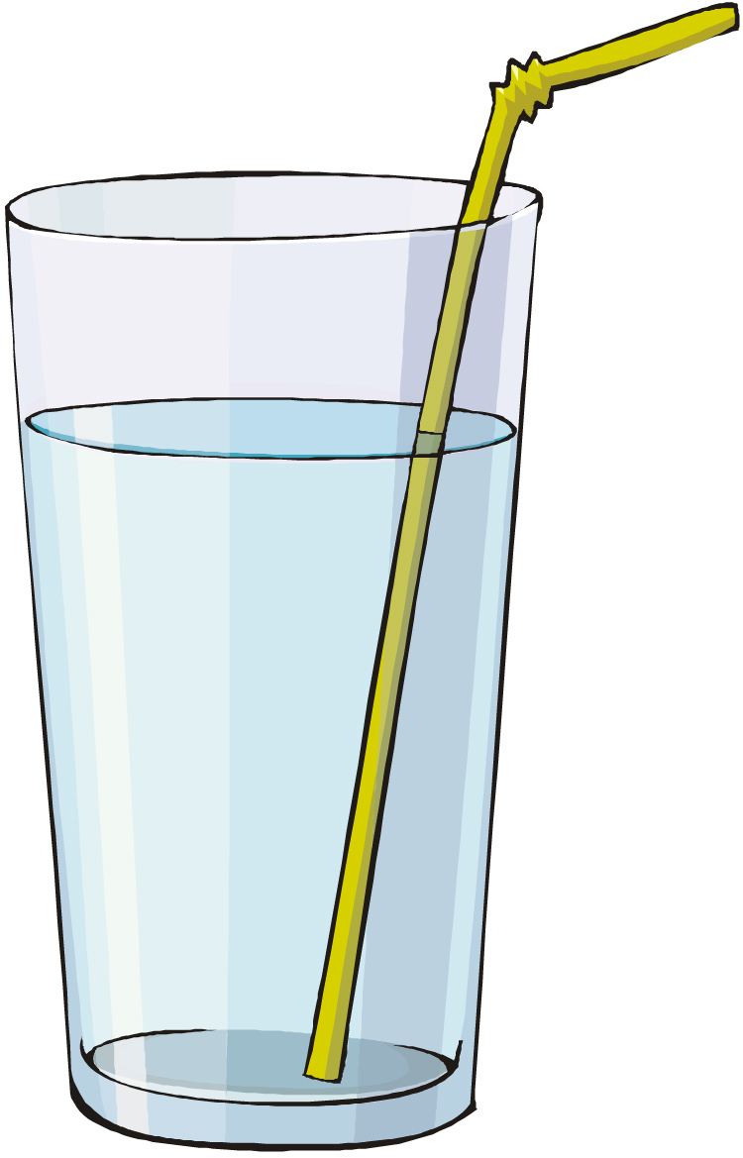
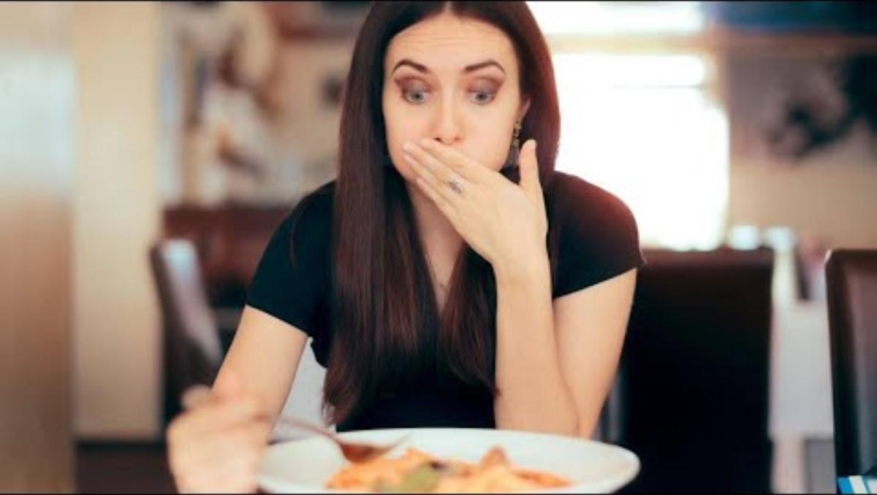
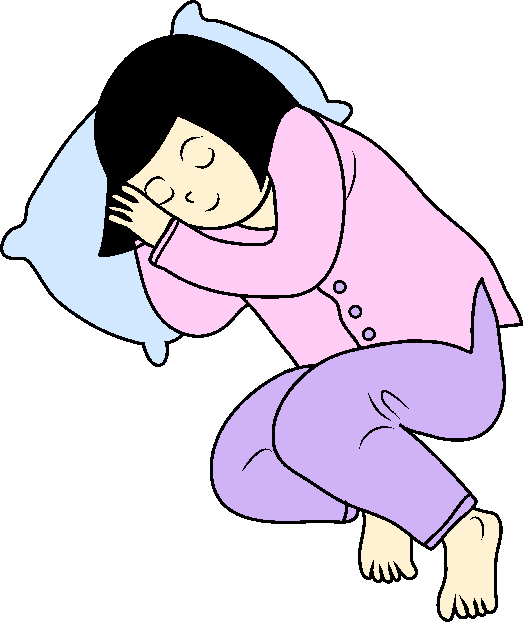
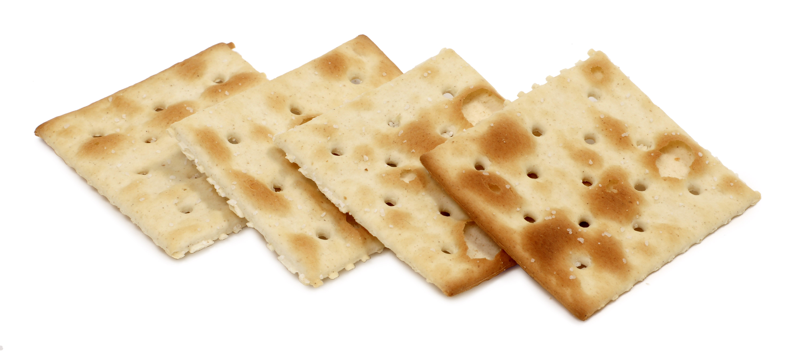
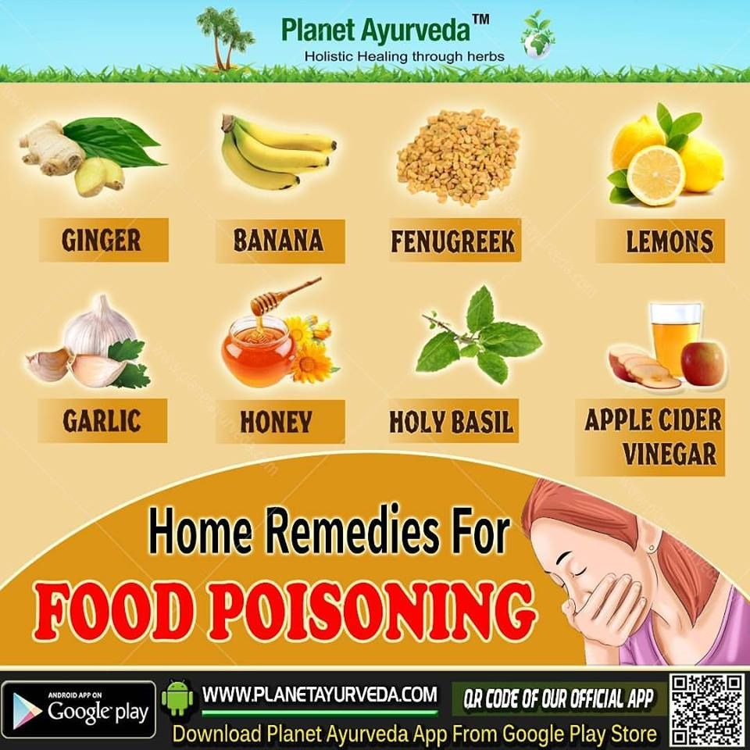
Now what should I do?
Drink lots
of water
or electrolytes
like Gatorade
Rest
Nibble on soda crackers or toast
First call 1800-222-1222 before doing anything else!

Slide 21
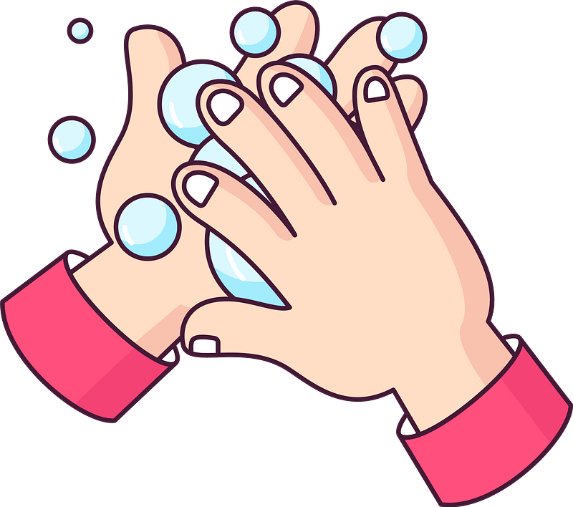
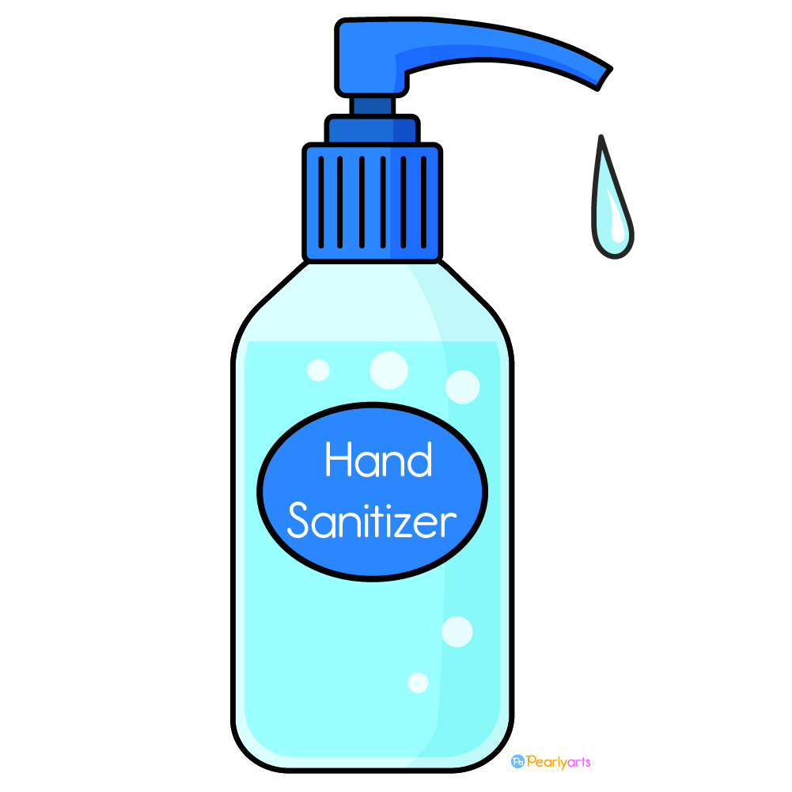
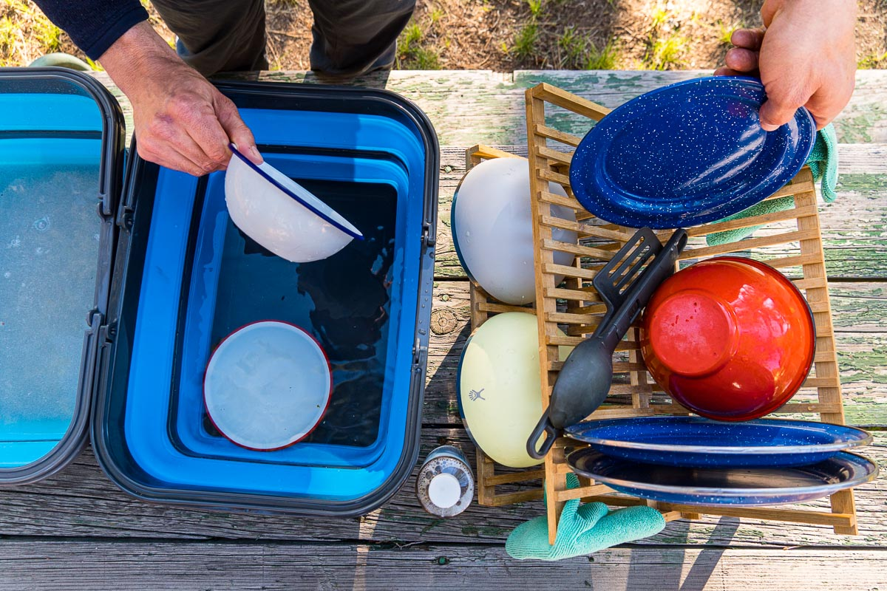
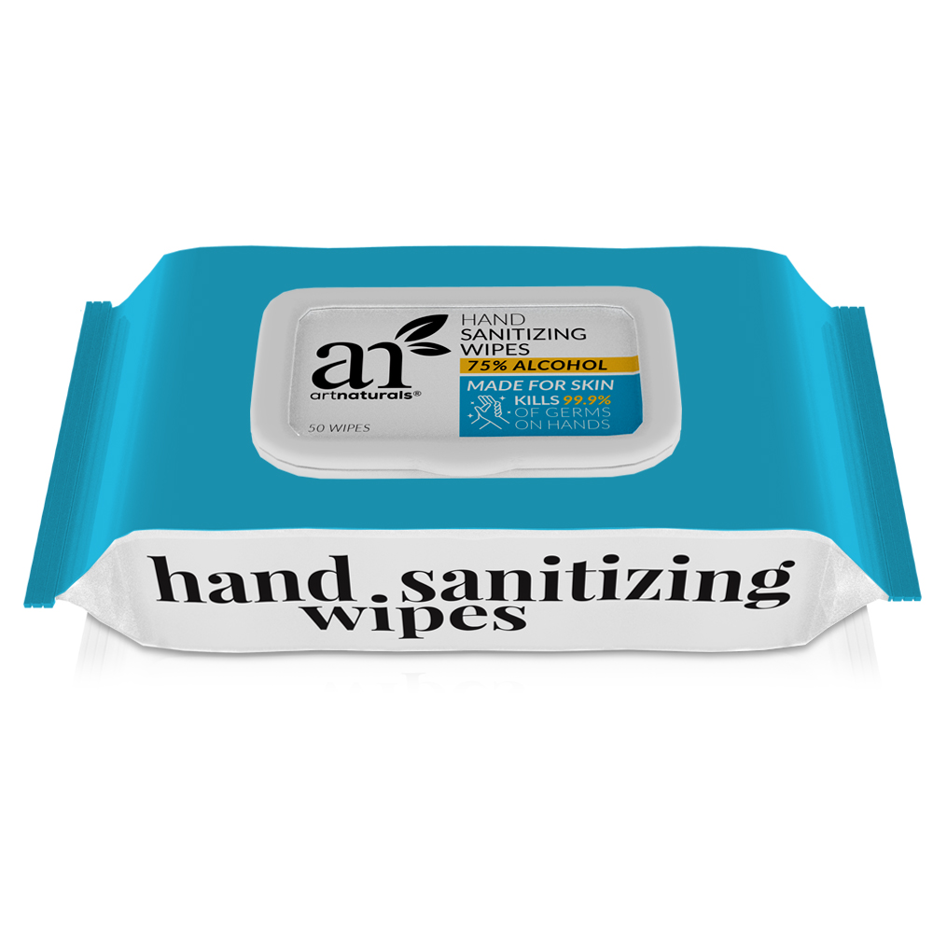
Handle food safely outside at picnics and while camping too!
Camping Skills II
Hygiene
CLEAN HANDS
Wash hands to get the grime off.
If soap is not available, use hand sanitizer.
CLEAN FOOD AREA
After use, rinse all dishes. You can rinse in the stream wipe with paper towels.
Heat water (boil stream water)
Wash dishes in warm, soapy water.
Rinse in hot water.
Dip silverware and cups in water with bleach (1/4 tsp bleach for 2 gallons water)

Slide 22
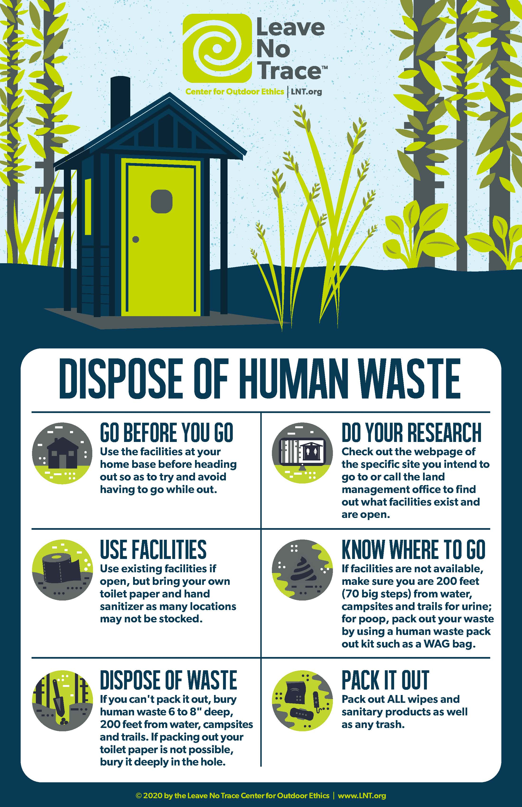
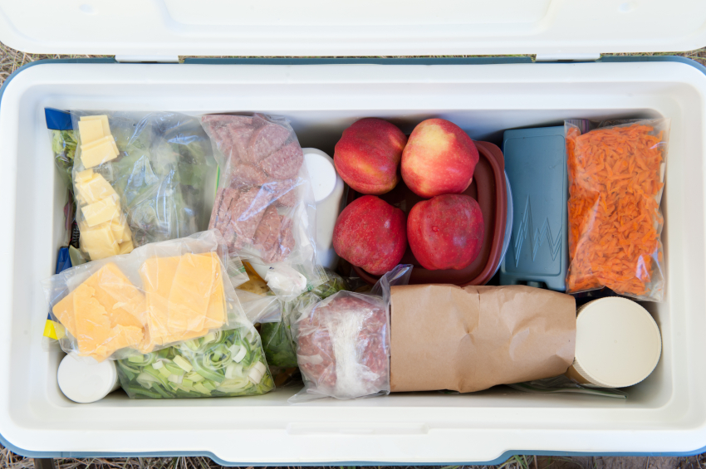


Camping Skills II
Hygiene
DISPOSE WASTE PROPERLY
In most locations, burying human feces in a cat hole in the correct manner is the most effective method and most widely accepted method of waste disposal.
Move at least 200 feet (about 70 steps) away from any water sources, trails, parking areas and campsites. Select an inconspicuous site where other people will be unlikely to walk or camp.
Choose a sunny site with rich soil that’s free from roots and large rocks. Sunlight and soil help your waste decompose faster. If camping in the area for more than one night, or if camping with a large group, cat hole sites should be widely dispersed. Don’t go to the same place twice.
Use a trowel, stick or rock to dig a hole that is 4–6 inches wide and 6–8 inches deep.
After you’ve done your business,
fill in hole with the original dirt
and completely cover it using
natural materials.
Use toilet paper sparingly and use only plain, white, non-perfumed brands. Toilet paper must be disposed of properly! It should either be thoroughly buried in a cat hole or placed in plastic bags and packed out. Natural toilet paper has been used by many campers for years. When done correctly, this method is as sanitary as regular toilet paper, but without the impact problems. Popular types of natural toilet paper include stones, vegetation and snow. Obviously, some experimentation is necessary to make this practice work for you, but it is worth a try!
FOOD STORAGE
Keep meats in a separate cooler with plenty of ice.
Keep dairy products and fresh produce in a cooler with plenty of ice.

Slide 23





Camping Skills II
Hygiene
SAFE WATER
Ways to get safe water:
Water purifier that you can buy
Water purifier tablets
UV lamp
Tiny bit of Bleach and let sit
Boil water
UV exposure – sunlight – wait and wait
Heat rock (danger: explosion) and put it in container of water
Natural materials as shown
Transpiration – water from leaves with a ziplock bag
Soil still – Evaporating water

Slide 24

Strokes, heart attack, shock
Part 3
WHAT DO YOU DO?

Slide 25


choking

Slide 26



Epilepsy

Slide 27





Fainting

Slide 28




Stroke

Slide 29

Heart Attack
CALL
Heart Attack is caused by an arterial blockage which prevents blood from reaching the heart as part of routine circulation. If the blocked artery is not reopened quickly the part of the heart normally nourished by that artery begins to die.
GET HELP -- 9-1-1
Follow their directions
Check for heart beat and breathing
Do CPR if there is none

Slide 30

Cardiac Arrest
CALL
Immediately!
Cardiac Arrest is a condition in which the heart suddenly and unexpectedly stops beating.
The victim quickly loses consciousness as the oxygen supply to the brain and other vital organs is cut off.
FIRST AID
Call 9-1-1
Have someone get an AED
Meanwhile do CPR compressions
Turn AED on and follow the directions
Do CPR

Slide 31


CPR
Hard fast chest compressions are most important. The heel of your hands should be between the ribs on the sternum.
Breathing is not required and could be infectious and dangerous.

Slide 32


