Slide 1

Basic Rescue in an Emergency
Pathfinder Honor and part of the Explorer Classwork

Slide 2
When it’s an emergency
Definitions & Indications

Slide 3
Define “emergency rescue”
A rescue is the act of removing someone from danger.
An Emergency Rescue is a technical term for a rescue taking place under hazardous circumstances and with high risk to the rescue personnel, but must be done immediately to save a person's life.

Slide 4
Know 6 indications for the need of an immediate rescue
Can you name 6?
1. The victim has stopped breathing
2. The victim has severe bleeding
3. The victim is being electrically shocked
4. The victim has a heart attack
5. The victim is on fire
6. The victim is drowning
7. The victim has been poisoned

Slide 5
Rescuing victim from a
Life threatening situation
Without getting hurt yourself

Slide 6

Know 6 procedures to follow before moving a victim from a life-threatening situation.
1. The first task is to assess the whole situation and to plan the rescue.
2. Be sure you can perform the rescue without injuring yourself.
3. Make sure that moving the victim will not cause additional injury.
4. Know where you intend to move the victim before lifting him.
5. If bystanders must be used, it is essential that they be briefed in thorough detail on what you want them to do.
6. Unless the danger is immediate, any first aid should be given before moving the victim.
7. If you suspect a spinal injury, do not move the victim.

Slide 7
Know 5 principles involved in moving a victim from a life-threatening situation.
1. Be sure that it is necessary to move the victim. If it is not necessary, do not move the victim.
2. Know how you will move the victim before trying to move him.
3. Know where you will move the victim before trying to move him.
4. Be sure that you are able to lift the victim before lifting him. If the victim is too heavy, drag him instead.
5. Maintain your balance. Do not start the move from an unbalanced position.
6. Keep your footing throughout the move.

Slide 8
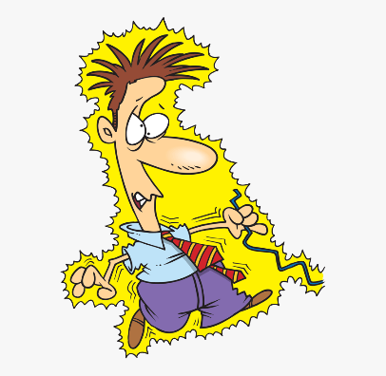

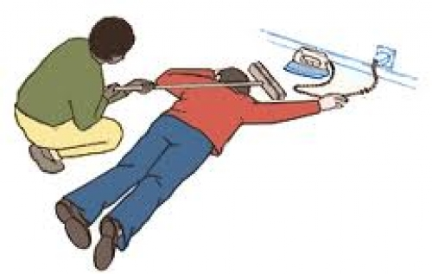

Show how to safely rescue a person from -- being in contact with a live electric wire
1st
turn off the
electricity!
2nd
call 9-1-1
If and when there is no electrical current present, assess person & give first aid as necessary for burns, CPR, and place them in the recovery position.

Slide 9
Role play the rescue
Using a string or rope for the ‘live’ wire, have someone role play touching the wire and others roleplay the rescue.
Do
it

Slide 10


When and how should you be careful with electricity?

Slide 11
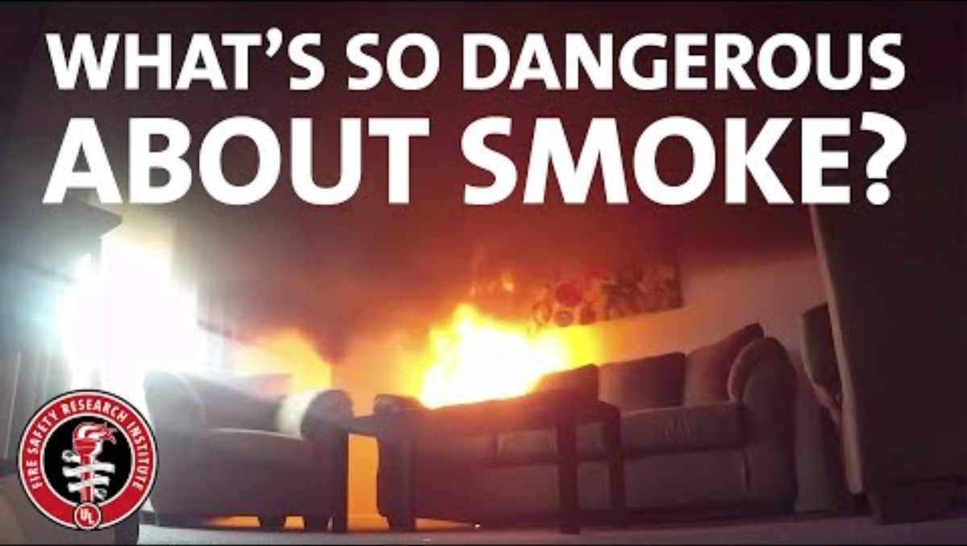
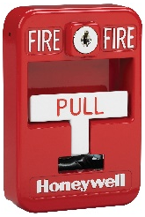
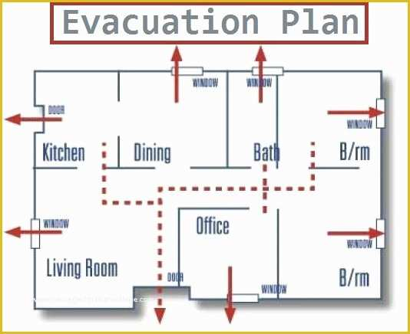
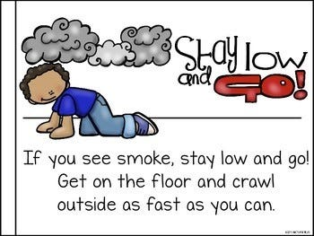
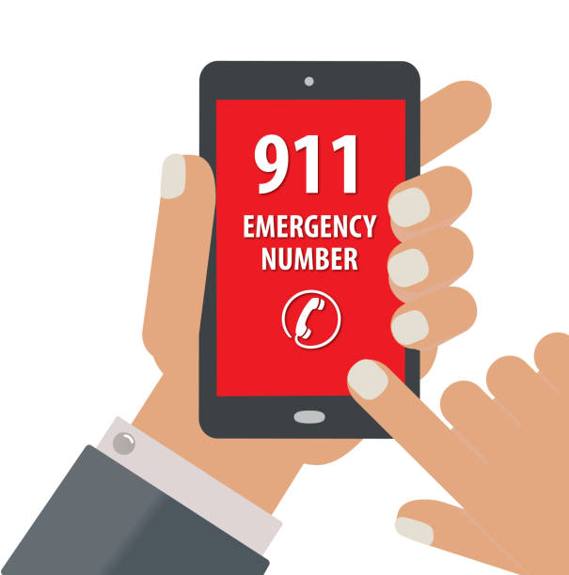
Show how to respond if a room is filled with fumes or smoke
Sound the alarm
FIRE!

Slide 12
Show how to safely rescue a person from -- a room filled with fumes or smoke
If they are on your route out of the house, make sure they come with you. If they aren’t, tell the firefighters as soon as they arrive. They are trained and equipped for saving lives!

Slide 13
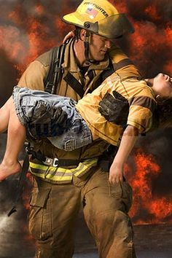
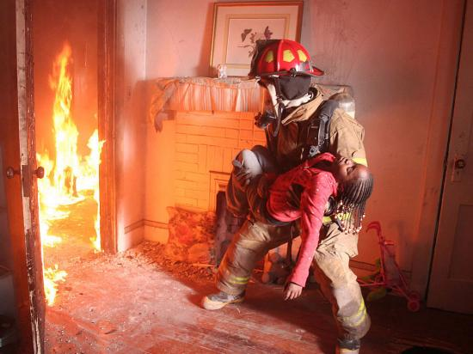
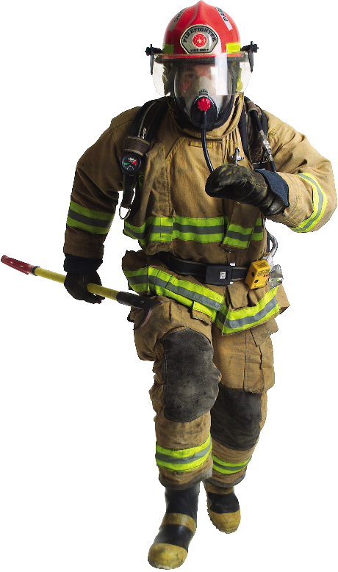
Stay safe –
Let a firefighter rescue them
They train, they are strong, and they are equipped!

Slide 14
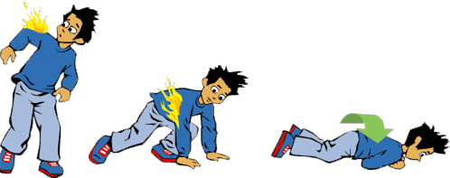
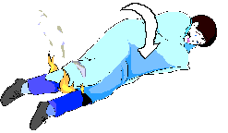
Show how to safely rescue a person or yourself if -- their clothes are on fire
STOP
DROP
ROLL
Do
it

Slide 15
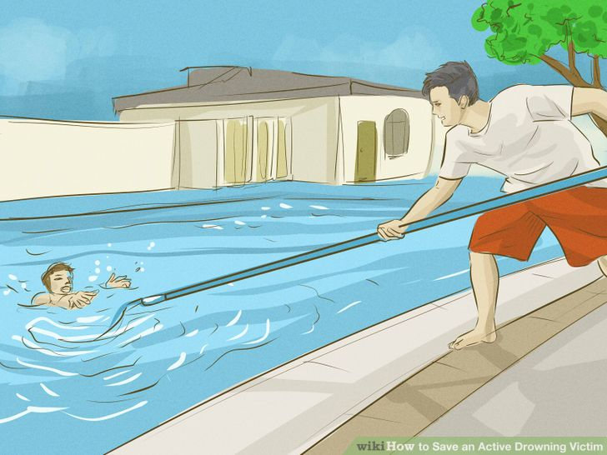
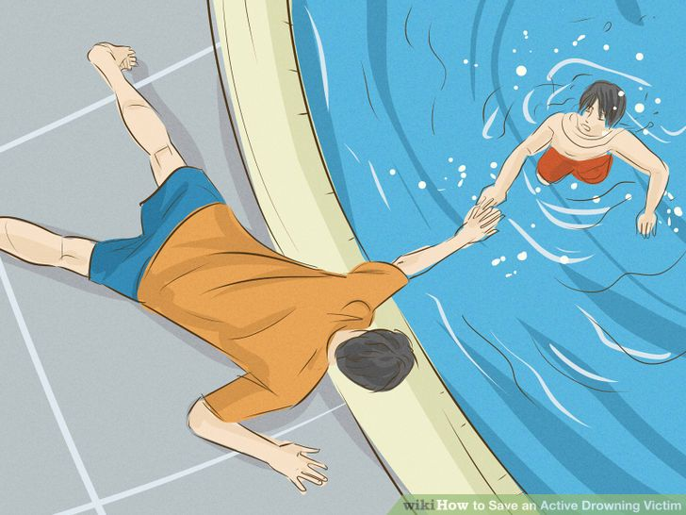
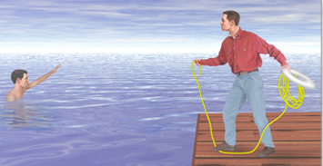
Show how to safely rescue a person from -- drowning using a non-swimming rescue
Reach
Throw
row
don’t go

Slide 16
Show how to safely rescue a person from -- drowning using a non-swimming rescue
video #2
Reach
Throw
row
don’t go

Slide 17
This is how lifeguards would rescue a drowning person
optional video

Slide 18
Role play the rescue
Spread a blanket for the water or indicate an area that is the water.
Role-play the rescue with a rope, pillow, or flotation device.
Remember to stand or lay sideways with your strong foot or arm in front. Lean towards land.
Do
it

Slide 19
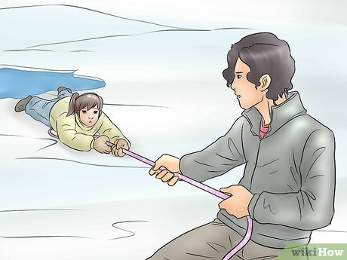
Show how to safely rescue a person from -- an ice accident
call
reach
throw
ROW
Stay BACK
Don’t Go
… unless you are trained and equipped, but even they don’t “go” unless they have to!

Slide 20
Show how to safely rescue a person from -- an ice accident
call
reach
throw
ROW
Stay BACK
Don’t Go

Slide 21
Role play the rescue
Spread a blanket for the water or indicate an area that is the icy water. Role-play the rescue with a rope, pillow, or flotation device.
Do
it

Slide 22
Survive falling thru ice
Show how to safely rescue yourself from --
an ice accident
Another great video is at:
https://www.facebook.com/techinsider/videos/652886031576423/

Slide 23
Role play the rescue
Stand next to a sturdy table or counter top. Pretend you are in icy water and the table/counter-top is the floating ice. Kick and pull and rescue yourself.
Do
it
In real scenario, if you can’t pull yourself out, your clothes will be wet.
Let them freeze to the ice and simply lift your legs like you are laying down.
Call out and wait for rescue.

Slide 24
Signaling & Communicating
Get help on the way

Slide 25

When and how should you contact emergency personnel?
Call 9-1-1
Remember: Nine-one-one is only to be used ONLY in emergency situations. An emergency is any situation that requires immediate assistance from the police/sheriff, the fire department or an ambulance.
If you are ever in doubt of whether a situation is an emergency you should call 9-1-1.
there’s a fire
severe burns
chest pain
choking
difficulty speaking
drowning
numbness
poisoning
suicide threat
crime scene
car crash
other serious medical problems
Stay on the line. Answer the 9-1-1 operators questions. Give your name, where you are at, what happened, and the current condition. Get help knowing what to do.

Slide 26

What steps should be taken before reporting a lost person?
Quickly double check that they ARE missing
  call their cell phone
  look where you saw them last
  If you’re in a store or public place, notify the officials so they can do an announcement (code Adam) or lock-down and help you search
If not immediately found, CALL 911; keep searching & calling key contacts
  call their home; search through the house & yard
  call friends, family, and school or work
IF FOUND, NOTIFY THE OFFICIALS & THOSE CONTACTED
call 9-1-1

Slide 27
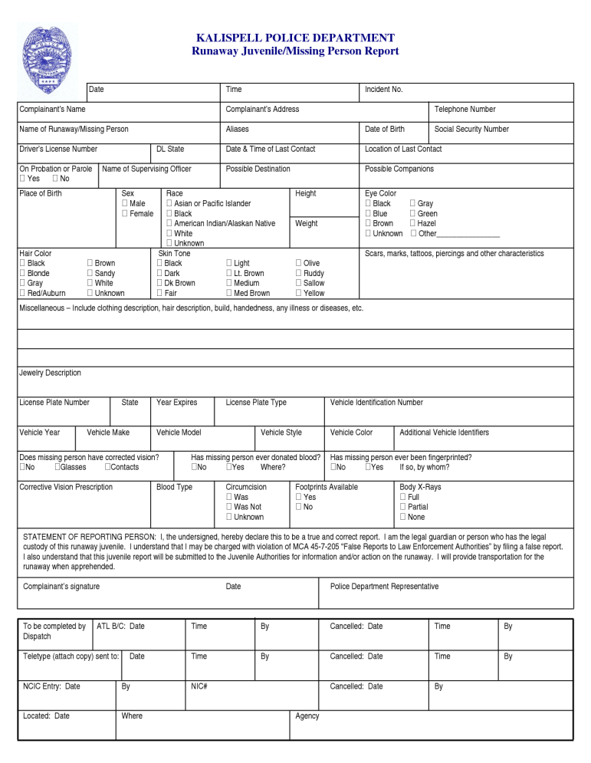
What information will be needed when reporting a lost person?
Call MUPU at 1-800-543-5678
Missing & Unidentified Persons Unit
Picture/description
what they were wearing when last seen
any identifying marks
description of vehicle
their doctor or dentist
where they were supposed to be
When you are going on a trip or an outing let someone know where you will be going. Give them your routes and destinations.
Call them when you get there.

Slide 28
Role play the rescue
Designate the on-the-scene rescuers and emergency dispatch. Role-play what information each will ask for and give.
Do
it

Slide 29
Search & Rescue Discussion
stop, think, plan

Slide 30
How is a search for a lost person conducted in a wilderness area?
In wilderness areas searches are conducted in an ever widening circle normally. All available resources are used including hunting dogs, aircraft, search hikers, and mounted search personnel.
When a person is lost in the wilderness there is rarely any expense spared in the search for the person.
If details are known about intended camping sites and hiking routes then teams will be sent to investigate those locations directly while others are sent into line of site search patterns where from the best known location for the missing person(s) was outward with each searcher being within site of the next. This will also be done in staggered waves so that any evidence overlooked by one searcher might be found by the next.
When the area becomes large enough to make line of site searches impractical the teams will be broken into zones using a search grid. A team of two or more will be assigned some small piece of the map area to search, all areas will be searched repeatedly for missed evidence or people.
All the while roadways and known paths will have searches, or outposts on them in case the victim is still mobile and trying to work his way out of his circumstance.
Aircraft will search in grids as well when weather provides. At night some aircraft may utilize heat sensors to try and identify people in the wilderness, this has proven effective at times and at other times not. When an aircraft identifies a possible victim a search team in the grid will respond to the location, sometimes they find nothing; other times they find animals. If a person is seeking shelter in a very cold area, he may have burrowed deep enough into a location as to defeat the heat sensors on any aircraft as was the case with a child in Arizona who hid among some cactus which cool greatly at night. This particular child had evaded rescuers intentionally for more than a day because he was not supposed to talk to strangers.

Slide 31
Ground Search Team Training
OPTIONAL -- 40 min.

Slide 32
Show 3 ways to attract and communicate with rescue aircraft
Light 3 fires
Write SOS in a clearing using resources you have
Use a signal mirror to flash SOS …---…

Slide 33
Show 3 ways to attract and communicate with rescue aircraft
Light 3 fires
Write SOS in a clearing using resources you have
Use a signal mirror to flash SOS …---…

Slide 34
Role play the SEARCH rescue
Send someone to hide on the premises.
Using the principles of finding a lost person, conduct a rescue.
The ‘lost’ person should stay put, but signal his location using sound or bright objects.
Do
it

Slide 35
Proper ways to move a victim
Without hurting them more nor yourself

Slide 36
How firefighters do it
This is a great 5 minute video just press the YouTube button on the bottom of the video to open it in a separate screen.

Slide 37
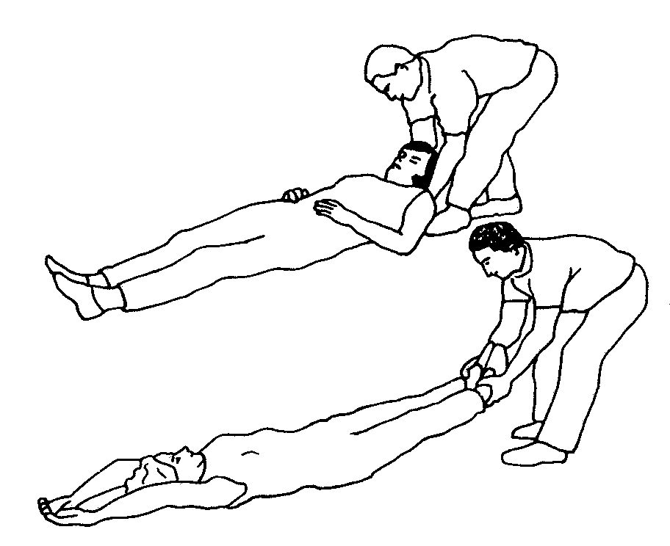
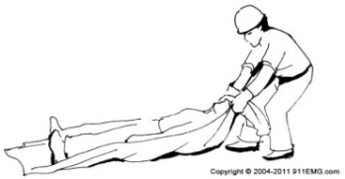
Know the proper ways to help a victim, without assistance by pulling or dragging the victim

Slide 38
Know the proper ways to help a victim, without assistance by lifting the victim

Slide 39
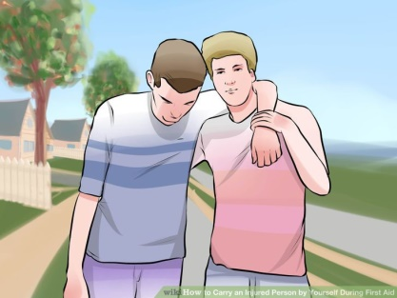
Know the proper ways to help a victim, without assistance by assisting a victim in walking

Slide 40
Role play the rescue
Practice each of the three ways to move a ‘victim’. Drag, lift, and assist them.
Do
it

Slide 41
Role play the rescue
Practice each of the following rescue carries also. They work if you have more people.
Do
it

Slide 42
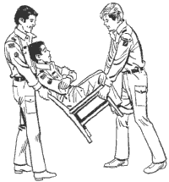
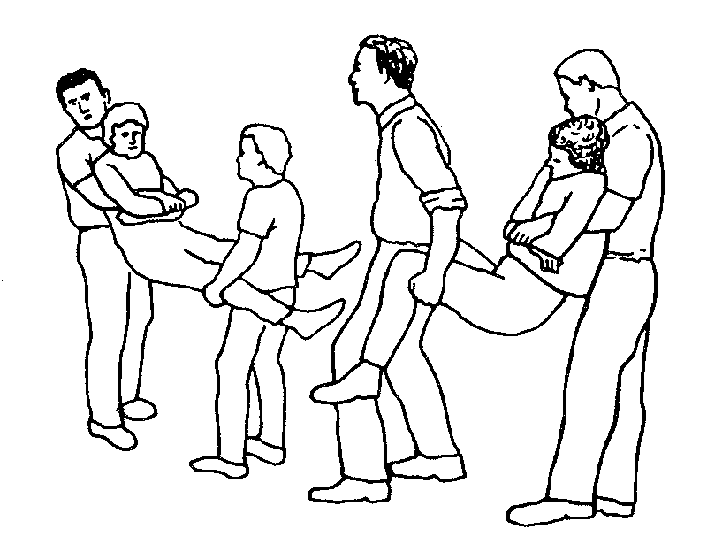
Know the proper way to help a victim, with assistance, with the chair carry

Slide 43
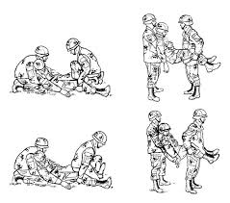
Know the proper way to help a victim, with assistance, with the fore and aft carry

Slide 44
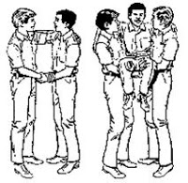
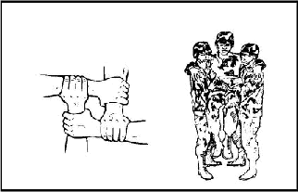
Know the proper way to help a victim, with assistance, with 2 handed and 4 handed seats

Slide 45
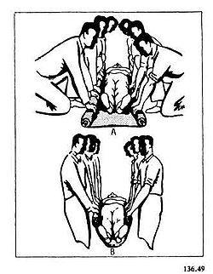
Know the proper way to help a victim, with assistance, with blanket carry

Slide 46

Know the proper way to help a victim, with assistance, with 3 man hammock with victim in supine position

Slide 47
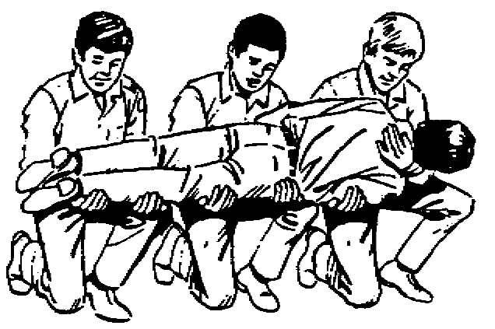
Know the proper way to help a victim, with assistance, with 3 man hammock with victim in prone position

Slide 48

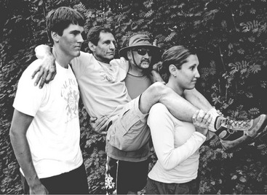
Know the proper way to help a victim, with assistance, with 3 or 4 man lift
wheelbarrow carry – one in front can lean over & take more weight
see: https://www.youtube.com/watch?v=K5EhzPNUpI8

Slide 49

Know the proper way to help a victim, with assistance, with 6 (or 8) man lift and carry

Slide 50
Know how to properly use a stretcher and carry a victim on a stretcher
watch at least the first 4 min. then skip to 19 min. and continue to 27 min.

Slide 51
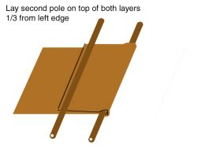
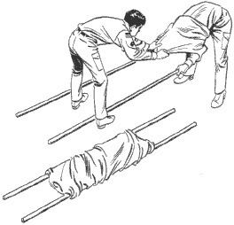
Know how to make an improvised stretcher and carry a victim on the stretcher

Slide 52
Rescue Drill Team

Slide 53

https://activity-array.com/

