Slide 1
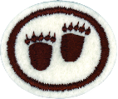
Animal Tracking Honor
Required for Companions

Slide 2
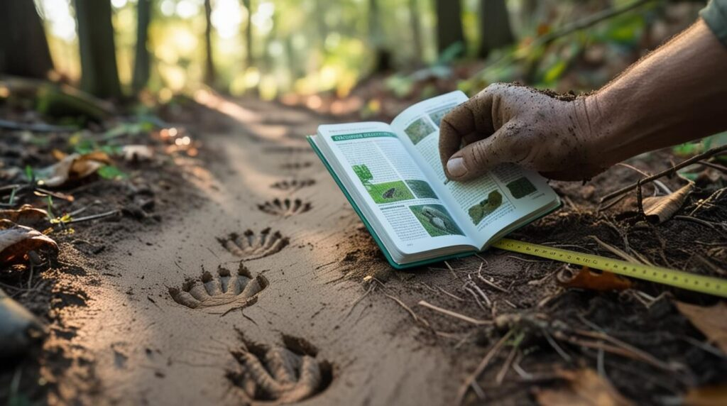
Tracking Station
Make a tracking station
DIRECTIONS:
Select a flat open space in a quiet place where animals like to come (near water or natural food source)
Smooth out the ground. Soft or muddy ground will make better tracks.
Putting food out is not recommended and may be prohibited.
Check for animal tracks later today and for several other days.

Slide 3

What does the Bible say about footprints?
Psalms
119:133 and
37:23
Joshua 1:3
Psalms 119:133 and 37:23-24
Joshua 1:3-6
Who will direct our footprints, if we let Him?
Think about it: Are your tracks going a direction that others should follow?
What do you think it means for God to establish our footsteps?
How did God establish Joshua’s footsteps?

Slide 4
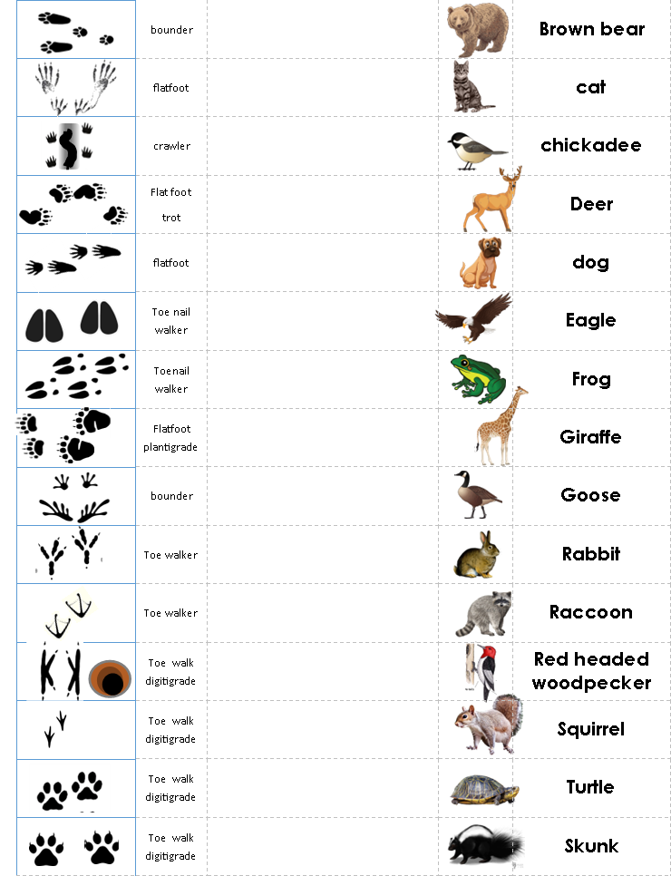
TRACKING ACTIVITY
In the classrooms and hallway, you will find tracks. They will lead to an animal. Look around for the animal.
If you don’t see it right away, look for additional tracks further on.
When you find the animal, on your paper, match the track with the animal.
When you are done, come back to this room.

Slide 5
TRACKING ACTIVITY
rabbit
squirrel
Turtle
skunk
raccoon
giraffe
deer
How did you do?
I hope you did a great job
so that you will do well
at the game we will soon play!
You may reference your paper
Brown bear
frog
eagle
goose
woodpecker
chickadee
cat
dog

Slide 6
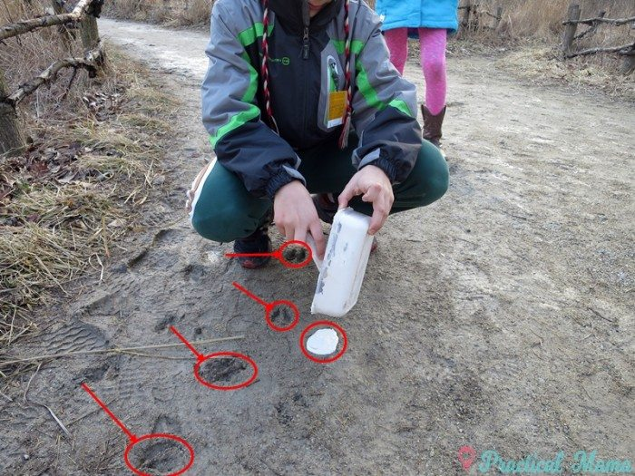
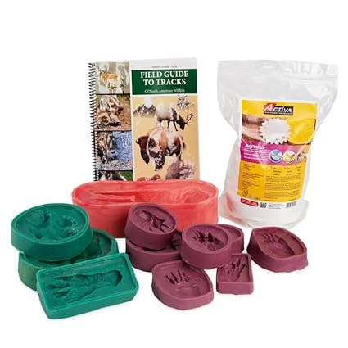
PLASTER CASTING
Make 5 plaster casts, each of a different animal’s track or footprint.
DIRECTIONS:
Find an animal footprint in the dirt or make one by pushing a footprint maker into wet sand.
Take a strip of cardstock and make a circle big enough to go around the track.
Mix your plaster: In a large Styrofoam cup, put in ¼ cup water. Add ½ cup Plaster of Paris and stir into a thick paste.
Quickly pour the plaster into the footprint so that it fills the footprint and goes part way up the cardstock strip border.
Let it dry.
Take out the dried plaster and brush off the sand or dirt.
Other Activity OPTIONS:
Form 5 footprints out of playdough
Form 5 footprints out of bread or biscuit dough, bake and eat.
Press footprints into rollout cookie dough. Melt chocolate and fill the footprints with it.
Nasco Track molds

Slide 7
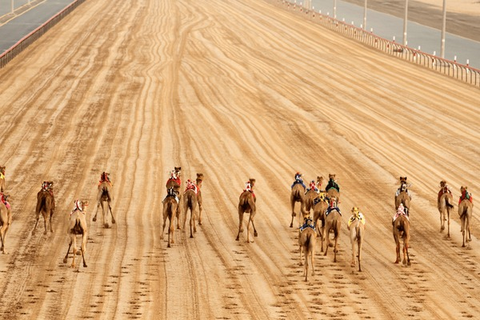
Name that Track
GAME TIME
Choose a game and teams:
Track race – draw 2 lines with 9 dots on each line.
Mark the consecutive dots as the team correctly answers the questions.
You may use your matching sheet to help you.

Slide 8
TEAM 1
Question:
Fur, scat (animal poop), or tracks are signs that
a _ _ _ _ _ s _r_
p_ _ _ _ _ _
Answer:
Animals are present

Slide 9
TEAM 2
Question:
Why do some animals have feet that are shaped like hands?
Answer:
So that they can grasp things and climb trees

Slide 10
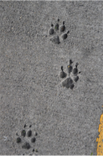
BONUS BLURT
NAME THAT TRACK
Blurt out the answer
First team to say the right answer
gets to move forward 1 bonus space.
A
DOG
MADE THAT TRACK

Slide 11
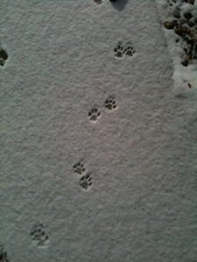
BONUS BLURT
NAME THAT TRACK
Blurt out the answer
First team to say the right answer
gets to move forward 1 bonus space.
A
CAT
MADE THAT TRACK

Slide 12


TEAM 1
Question:
How are cat and dog tracks usually different?
Usually, dogs have nail prints, cats don’t.
A dog’s heel pad is more triangular and points towards the toes.
A cat’s heel pad is more rounded
All the above
Answer:
D: All the above

Slide 13
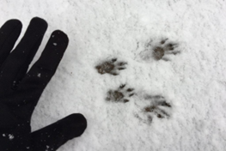
BONUS BLURT
NAME THAT TRACK
Blurt out the answer
First team to say the right answer
gets to move forward 1 bonus space.
A
SQUIRREL
MADE THAT TRACK

Slide 14
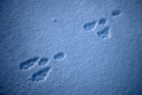
BONUS BLURT
NAME THAT TRACK
Blurt out the answer
First team to say the right answer
gets to move forward 1 bonus space.
A
RABBIT
MADE THAT TRACK

Slide 15
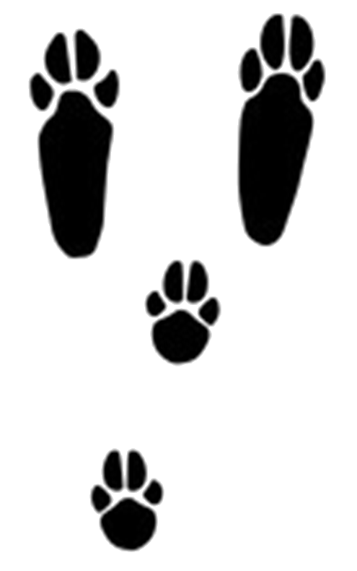

TEAM 2
Question:
What is the difference between rabbit and squirrel tracks?
Rabbit tracks are bigger
Rabbits have the same number of toes on all feet
Squirrels have 4 toes on the front feet and 5 on the back
None of the above
All of the above.
Answer:
E: All of the above

Slide 16

BONUS BLURT
NAME THAT TRACK
Blurt out the answer
First team to say the right answer
gets to move forward 1 bonus space.
A
DEER
MADE THAT TRACK

Slide 17
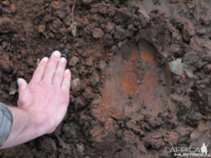
BONUS BLURT
NAME THAT TRACK
Blurt out the answer
First team to say the right answer
gets to move forward 1 bonus space.
A
GIRAFFE
MADE THAT TRACK

Slide 18
TEAM 1
Question:
Why do some animals have feet that are hooves?
Possible Answers (one is sufficient):
Hooves help them dig into the ground
Help them not slip when running fast
Protect the delicate tissues, bones, nerves and blood vessels inside the hoof from rocks, thorns, and rough terrain
Helps support heavy weight
Works like a shock absorber
Helps them spring off the ground

Slide 19
TEAM 2
Question:
Giraffe and Deer, along with horse , cows, & pigs, are examples of what kind of walkers?
Flatfoot – plantigrade
Toe walker – digitigrade
Toe nail walker – unguligrade
Answer:
C: Unguligrade
Toe-nail walkers

Slide 20
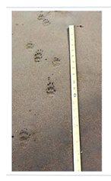
BONUS BLURT
NAME THAT TRACK
Blurt out the answer
First team to say the right answer
gets to move forward 1 bonus space.
A
SKUNK
MADE THAT TRACK

Slide 21
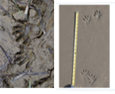
BONUS BLURT
NAME THAT TRACK
Blurt out the answer
First team to say the right answer
gets to move forward 1 bonus space.
A
RACCOON
MADE THAT TRACK

Slide 22
TEAM 1
Question:
Skunk and racoon are examples of what kind of walkers?
Flatfoot – plantigrade
Toe walker – digitigrade
Toe nail walker – unguligrade
Answer:
A: plantigrade
Flat foot walkers

Slide 23
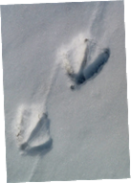
BONUS BLURT
NAME THAT TRACK
Blurt out the answer
First team to say the right answer
gets to move forward 1 bonus space.
A
GOOSE
MADE THAT TRACK

Slide 24
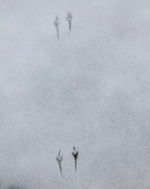
BONUS BLURT
NAME THAT TRACK
Blurt out the answer
First team to say the right answer
gets to move forward 1 bonus space.
A
CHICKADEE
MADE THAT TRACK

Slide 25
TEAM 2
Question:
Why do some animals have webbed feet?
Answers:
The webbed feet help them swim more efficiently

Slide 26
TEAM 1
Question:
You can tell if a bird
or any other animal
is hopping if……
Their footprints alternate
One foot is ahead of the other
Their footprints are side by side
Answer:
C: their footprints are side by side.

Slide 27
TEAM 2
Question:
Goose, chickadee, cats, and dogs, are examples of what kind of walkers?
Flatfoot – plantigrade
Toe walker – digitigrade
Toe nail walker – unguligrade
Answer:
B: Digitigrade
Toe walkers

Slide 28
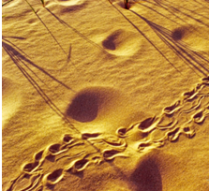
BONUS BLURT
NAME THAT TRACK
Blurt out the answer
First team to say the right answer
gets to move forward 1 bonus space.
A
TURTLE
MADE THAT TRACK

Slide 29
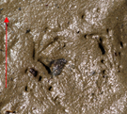
BONUS BLURT
NAME THAT TRACK
Blurt out the answer
First team to say the right answer
gets to move forward 1 bonus space.
A
FROGS
MADE THAT TRACK

Slide 30
TEAM 1
Question:
Name at least three things that tracks tell us.
Color of the animal’s fur, where water is, which way is North
The species, direction of travel, the size of the animal
The animal’s MPH, what time the tracks were made, how high the animal jumped
All the above
Answer:
B: The species, direction of travel, the size of the animal

Slide 31
TEAM 2
Question:
Signs that animals are present include:
Tracks, fur, scat
Tree scratches, holes, antlers
Scent posts, carcasses,
All the above
Answer:
D: All the above

Slide 32
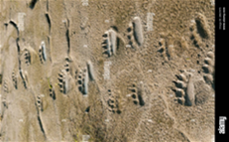
BONUS BLURT
NAME THAT TRACK
Blurt out the answer
First team to say the right answer
gets to move forward 1 bonus space.
A
BEAR
MADE THAT TRACK

Slide 33
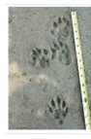
BONUS BLURT
NAME THAT TRACK
Blurt out the answer
First team to say the right answer
gets to move forward 1 bonus space.
A
OTTER
MADE THAT TRACK

Slide 34
TEAM 1
Question:
Name two types of animals that leave tracks or scent trails for another of their kind to follow?
A few
Possible Answers:
Ants
Bear
Beavers
Cats
Deer
Elephants
Moose
Llama
Otters

Slide 35
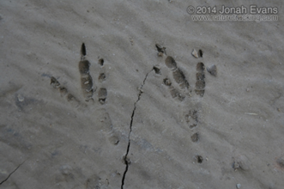
BONUS BLURT
NAME THAT TRACK
Blurt out the answer
First team to say the right answer
gets to move forward 1 bonus space.
A
EAGLE
MADE THAT TRACK

Slide 36
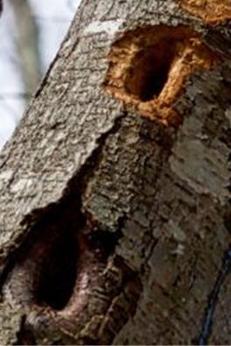

BONUS BLURT
NAME THAT TRACK
Blurt out the answer
First team to say the right answer
gets to move forward 1 bonus space.
A
WOODPECKER
MADE THAT TRACK

Slide 37
TEAM 2
Question:
Besides tracks, give two other signs of the presence of birds.
Possible Answers:
Feathers, eggs, nests, songs, holes

Slide 38
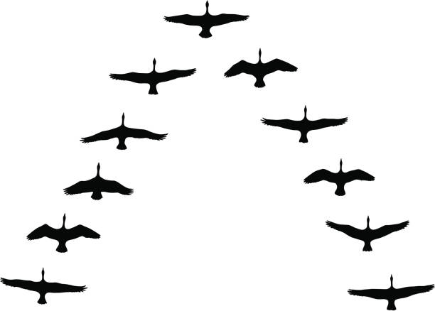
BONUS BLURT
NAME THAT
FLIGHT TRACK
Blurt out the answer
First team to say the right answer
gets to move forward 1 bonus space.
A
Canadian goose
MADE THAT
FLIGHT TRACK

Slide 39
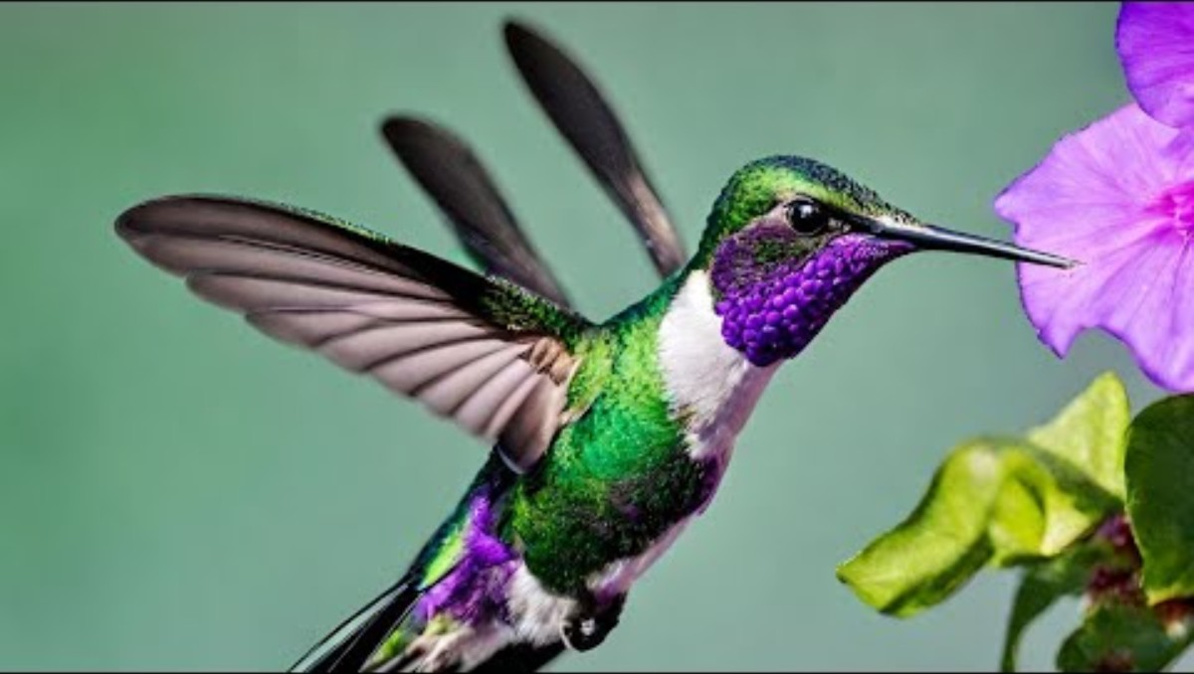
BONUS BLURT
NAME THAT
FLIGHT TRACK
Blurt out the answer
First team to say the right answer
gets to move forward 1 bonus space.
A
Humming
bird
MADE THAT
FLIGHT TRACK

Slide 40
Team 1
Question:
Name two birds you can identify by their flight pattern.
Possible Answers:
humming bird
Canadian geese
More info at bird-life.com

Slide 41
Team 2
Question:
What does digitgrade mean?
Answers:
The animal walks on its toes, which are digits.

Slide 42
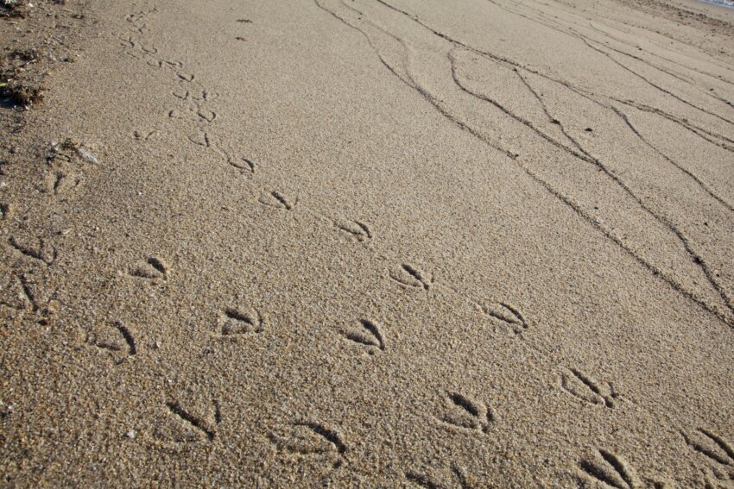
Check your
Tracking Station
Do you see any tracks?
Do you recognize them?
If not, use a tracking guide book or google lens to discover what made the tracks.

Slide 43
PLASTER CASTING
Make 5 plaster casts, each of a different animal’s track or footprint.
DIRECTIONS:
Find an animal footprint in the dirt or make one by pushing a footprint maker into wet sand.
Take a strip of cardstock and make a circle big enough to go around the track.
Mix your plaster: In a large Styrofoam cup, put in ¼ cup water. Add ½ cup Plaster of Paris and stir into a thick paste.
Quickly pour the plaster into the footprint so that it fills the footprint and goes part way up the cardstock strip border.
Let it dry.
Take out the dried plaster and brush off the sand or dirt.
Other Activity OPTIONS:
Form 5 footprints out of playdough
Form 5 footprints out of bread or biscuit dough, bake and eat.
Press footprints into rollout cookie dough. Melt chocolate and fill the footprints with it.
Nasco Track molds

Slide 44
CONGRATULATIONS!
YOU JUST EARNED THE
ANIMAL TRACKING HONOR!
If you finished all the activities
And answered most of the questions correctly.

