Slide 1
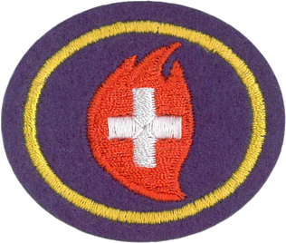
Red Alert
Pathfinder Honor
Level 1; Part of FRIEND requirements
https://wiki.pathfindersonline.org/w/AY_Honors/Red_Alert/Answer_Key

Slide 2
Red Alert Honor – at a glance
1. Tell what you should do to prevent injury and/or possible loss of life in the following situations:
  a. A fire in your house, a neighbor's house, and a public building
  b. If you are stranded in a car in a blizzard or desert
  c. Motor vehicle accident
  d. Earthquake
  e. Flood
  f. Tornado
  g. Hurricane
  h. Thunderstorm
  i. Atomic emergency
  j. Rock or snow avalanche
  k. Your boat or canoe capsizes in open water
2. When telephoning for help in an emergency situation, what essential information should be given and who should hang the telephone up last?
3. Demonstrate what emergency first aid measures you should take in the following situations.
  a. Someone's clothes catch on fire
  b. A severely bleeding wound
  c. Someone is choking
  d. Someone swallows poison
4. Do the following:
  a. Draw an escape route for your family in case of fire in your home when your normal exits are blocked.
  b. Practice with your family a home fire drill.
  c. Discuss with your examiner the procedures for safely getting people out of your church and school in case of a fire. Consideration should be given as to how to prevent panic.
5. What should you and your parents do to prevent abduction of children in your family? What should you do if you are abducted?

Slide 3
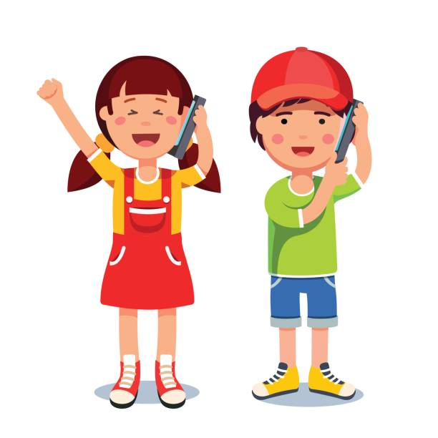
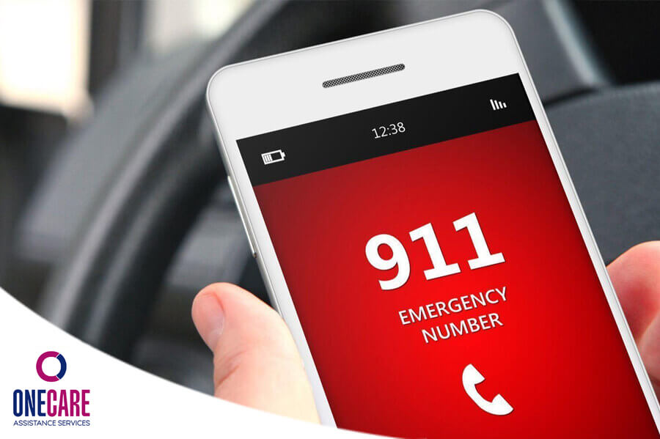
What should you tell 9-1-1 operator?
Give them:
Your name
Location of emergency
What the emergency is
Who is hurt and how they are
They will wait until you hang up the phone.
Now practice
calling
Notes:
2. When telephoning for help in an emergency situation, what essential information should be given and who should hang the telephone up last?
Give your name, phone number, the nature of emergency, the location of the emergency, and whether any personal dangers or injuries are present. To make sure the police correctly attach you (and not someone else with a similar name) to the report you should also provide your birthdate and home address once the more important information is provided.
The person making the call to report an emergency should be the last to hang up the telephone. If you ever call 911 by accident do not hang up. Stay on the line and explain your mistake. Otherwise the police will send out a response you do not need, which could endanger others as emergency vehicles rush to your non-emergency.

Slide 4
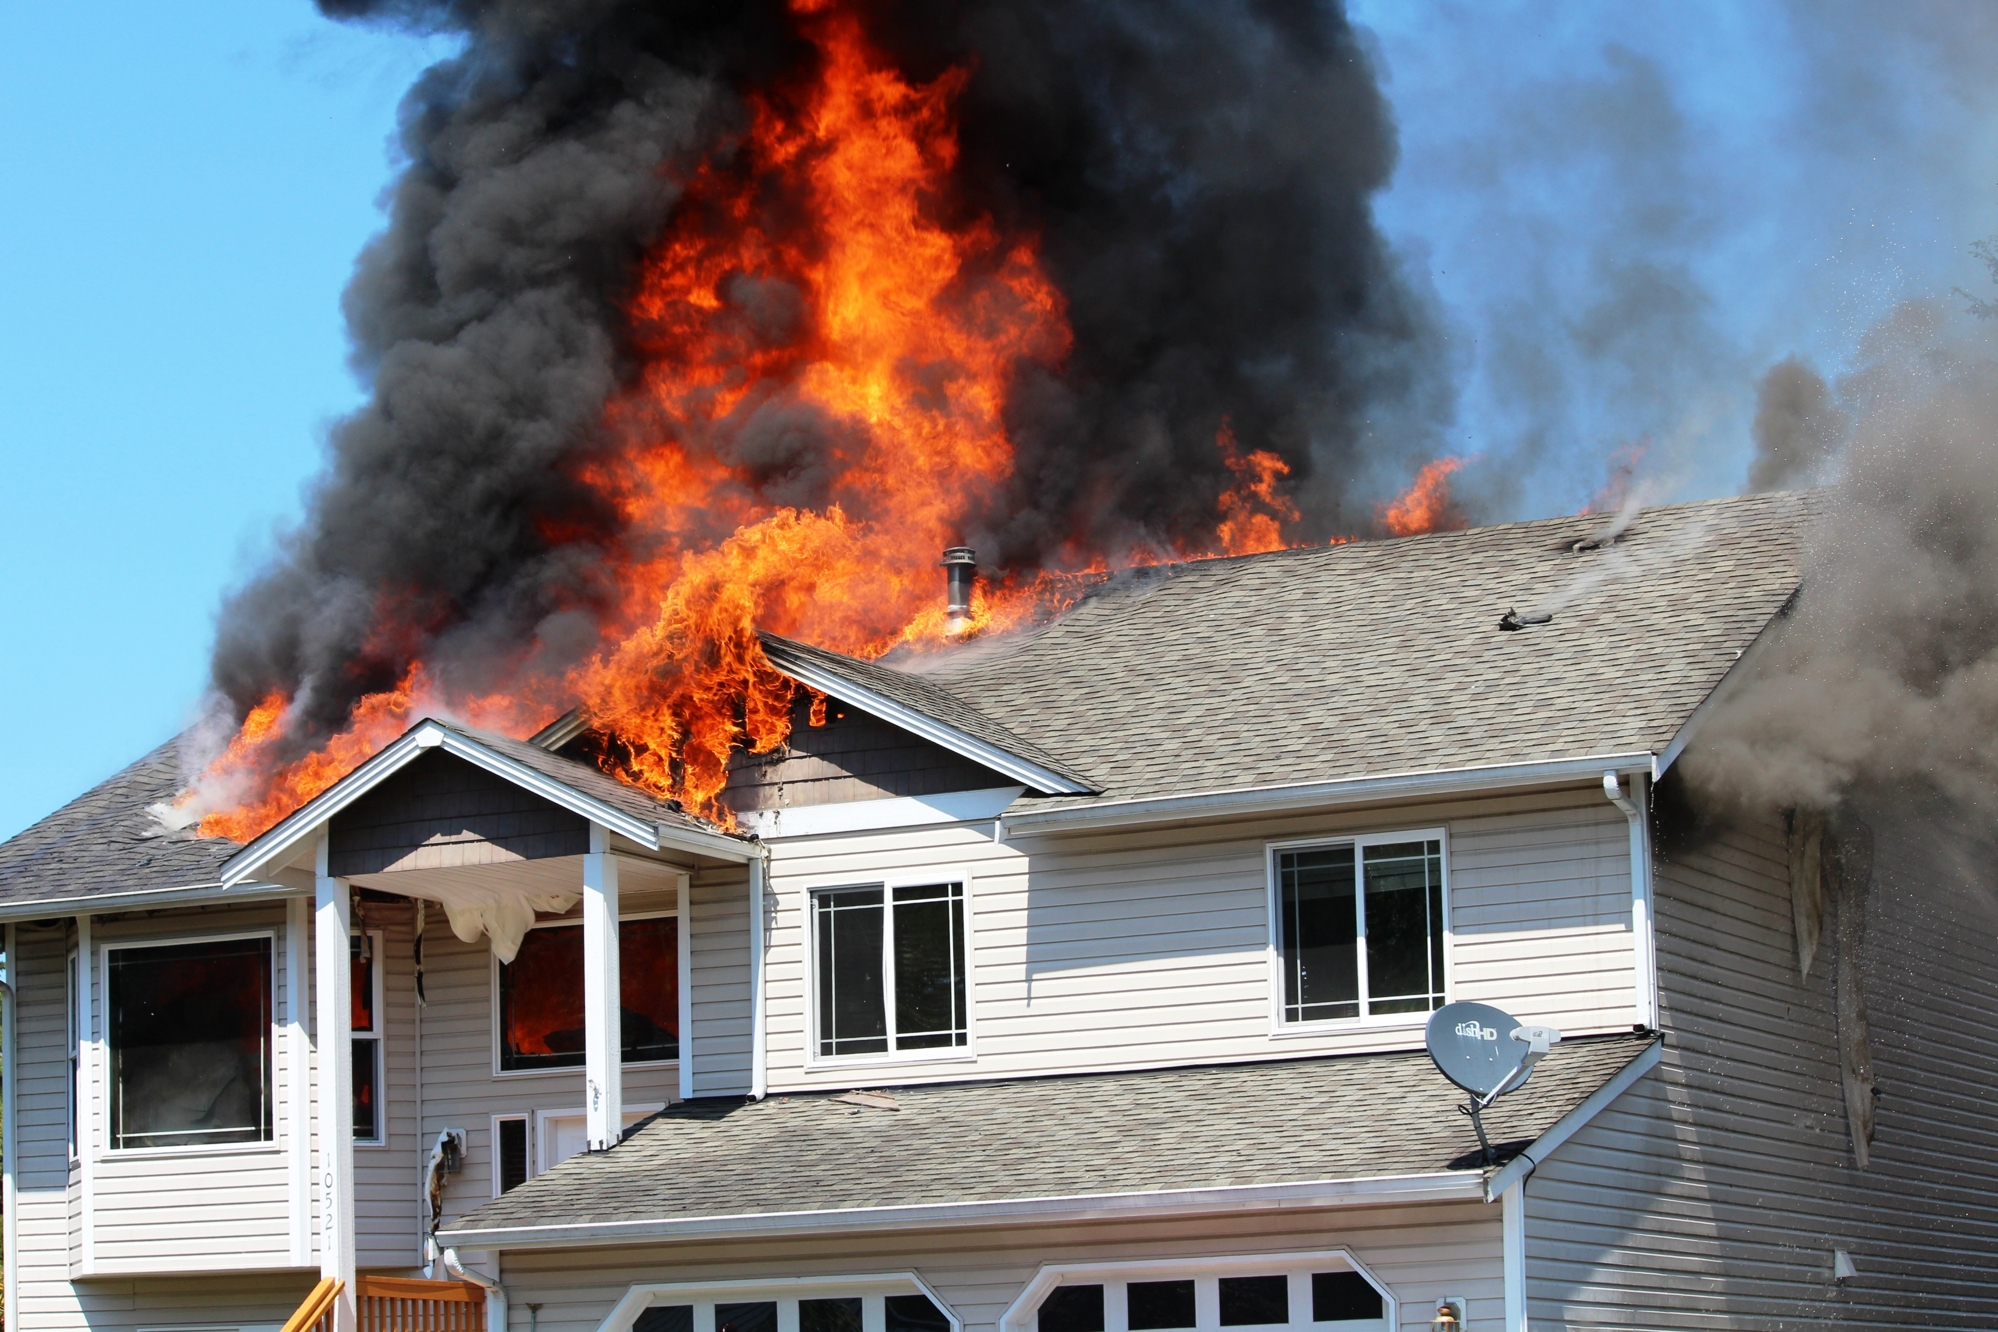
Scenario 1

Slide 5
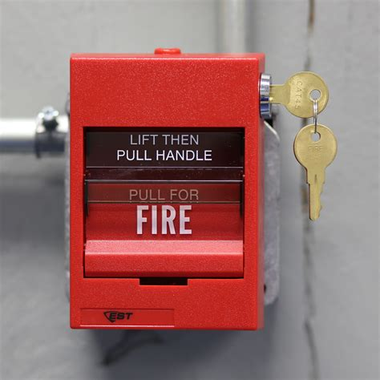
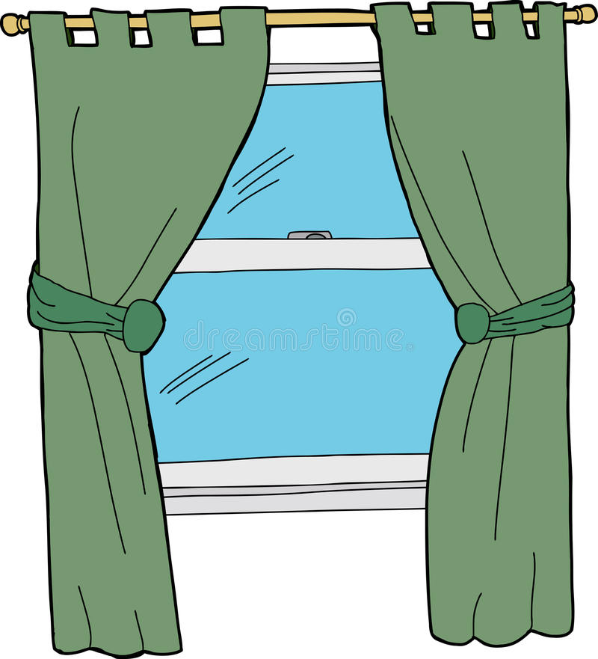

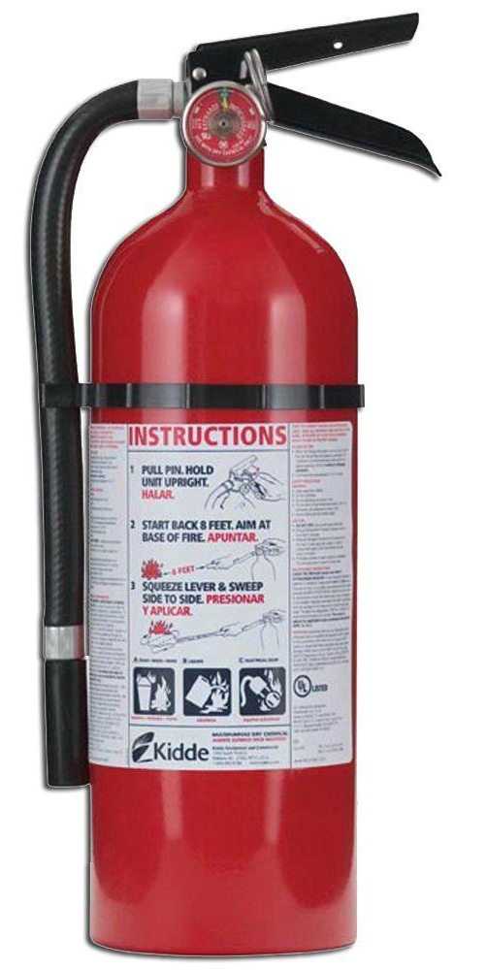

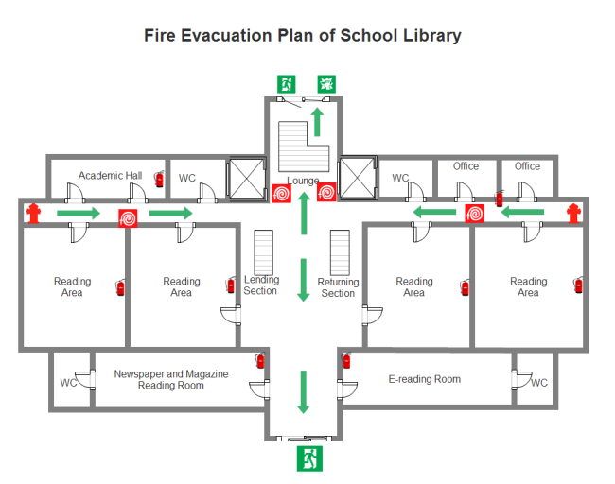
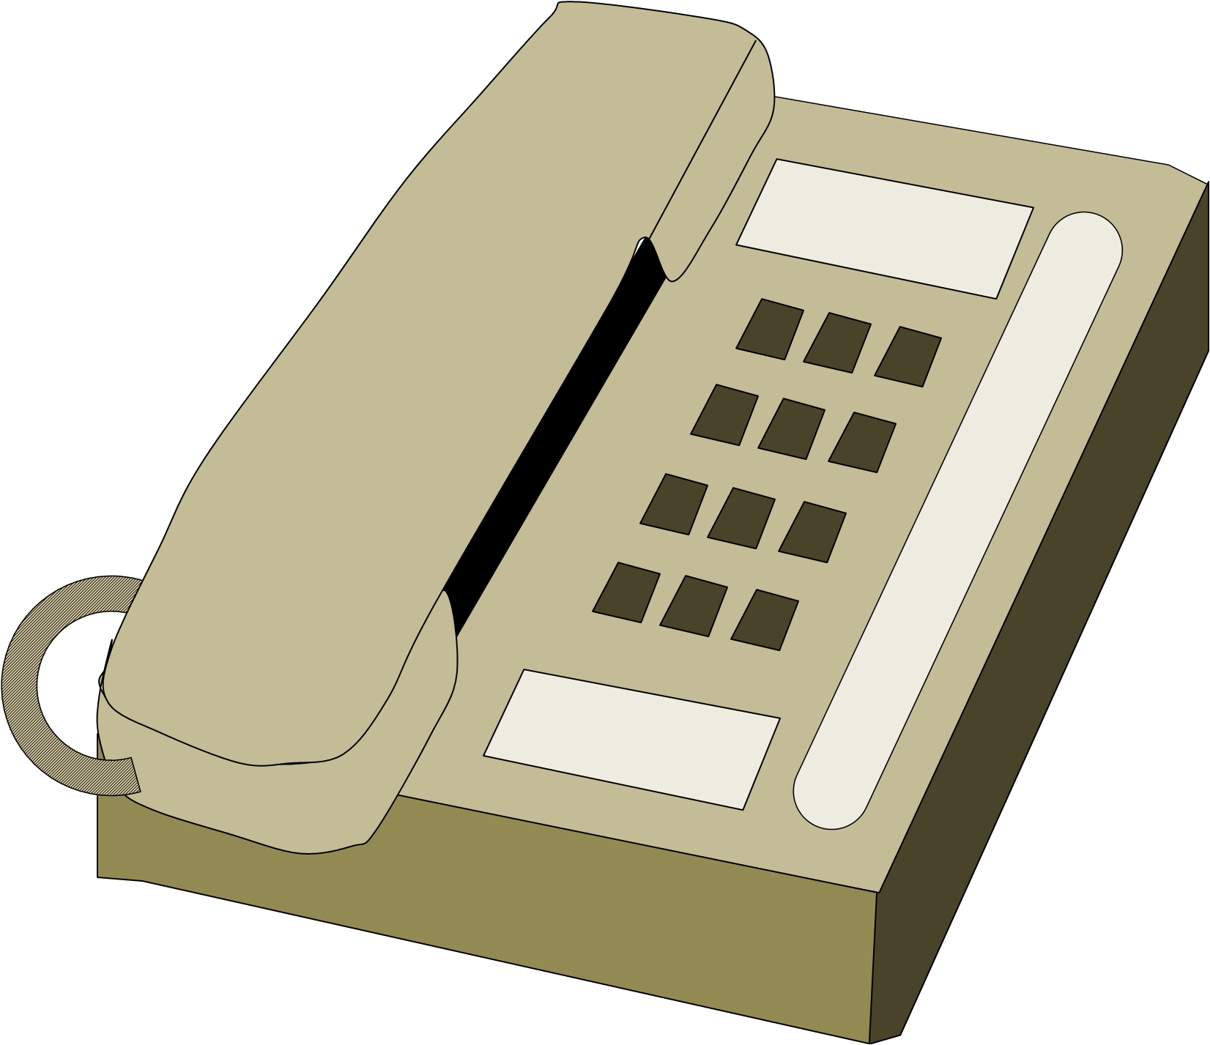
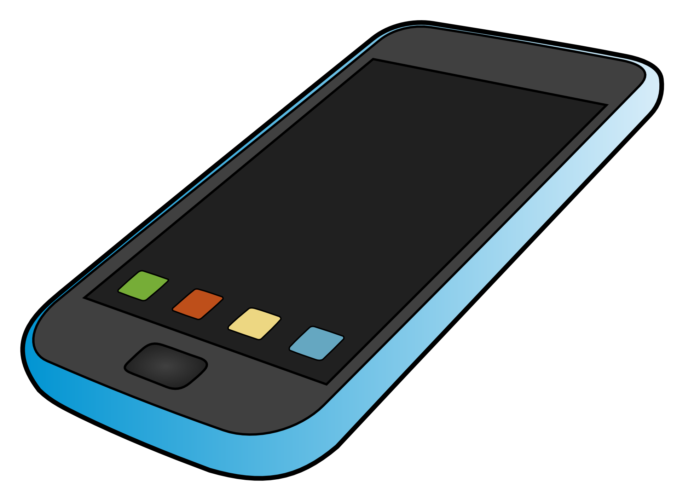
What should you do if your house is on fire?
When and how should you use or do the following:
Tell what you should do to prevent injury and/or possible loss of life in the following situations:
A fire in your house,
a neighbor's house, and
a public building
Presenter: see note pages for more information.
Put out tiny fire
Get out safely
Warn others
Stop drop & roll
Put rug or blanket under door if staying in place
Get out
Call for help
Notes:
If possible, and only if you can do it safely-locate the fire. Remember to stay calm. Alert any other people that are in the building, preferably by pulling the nearest fire alarm (when in a public building).
If the fire is small and a fire extinguisher is handy, an attempt to put the fire out should be made.
If the fire is already large, or you fail to extinguish it, you must evacuate the building as safely and as quickly as possible. Keep in mind that fires can spread very quickly so it is better to err on the side of caution by getting the fire department started before the fire is out of control.
Feel any door before opening it, and if it is hot, do not open it.
Try to exit the building without going through an area that is in flames, then stop, drop, and crawl.
Call the fire department.

Slide 6
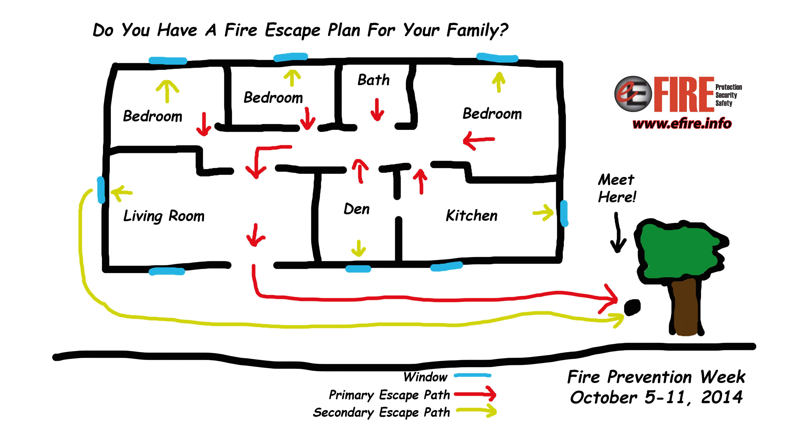
Make a House Fire Escape Route
Do the following:
  a. Draw an escape route for your family in case of fire in your home when your normal exits are blocked.

Slide 7
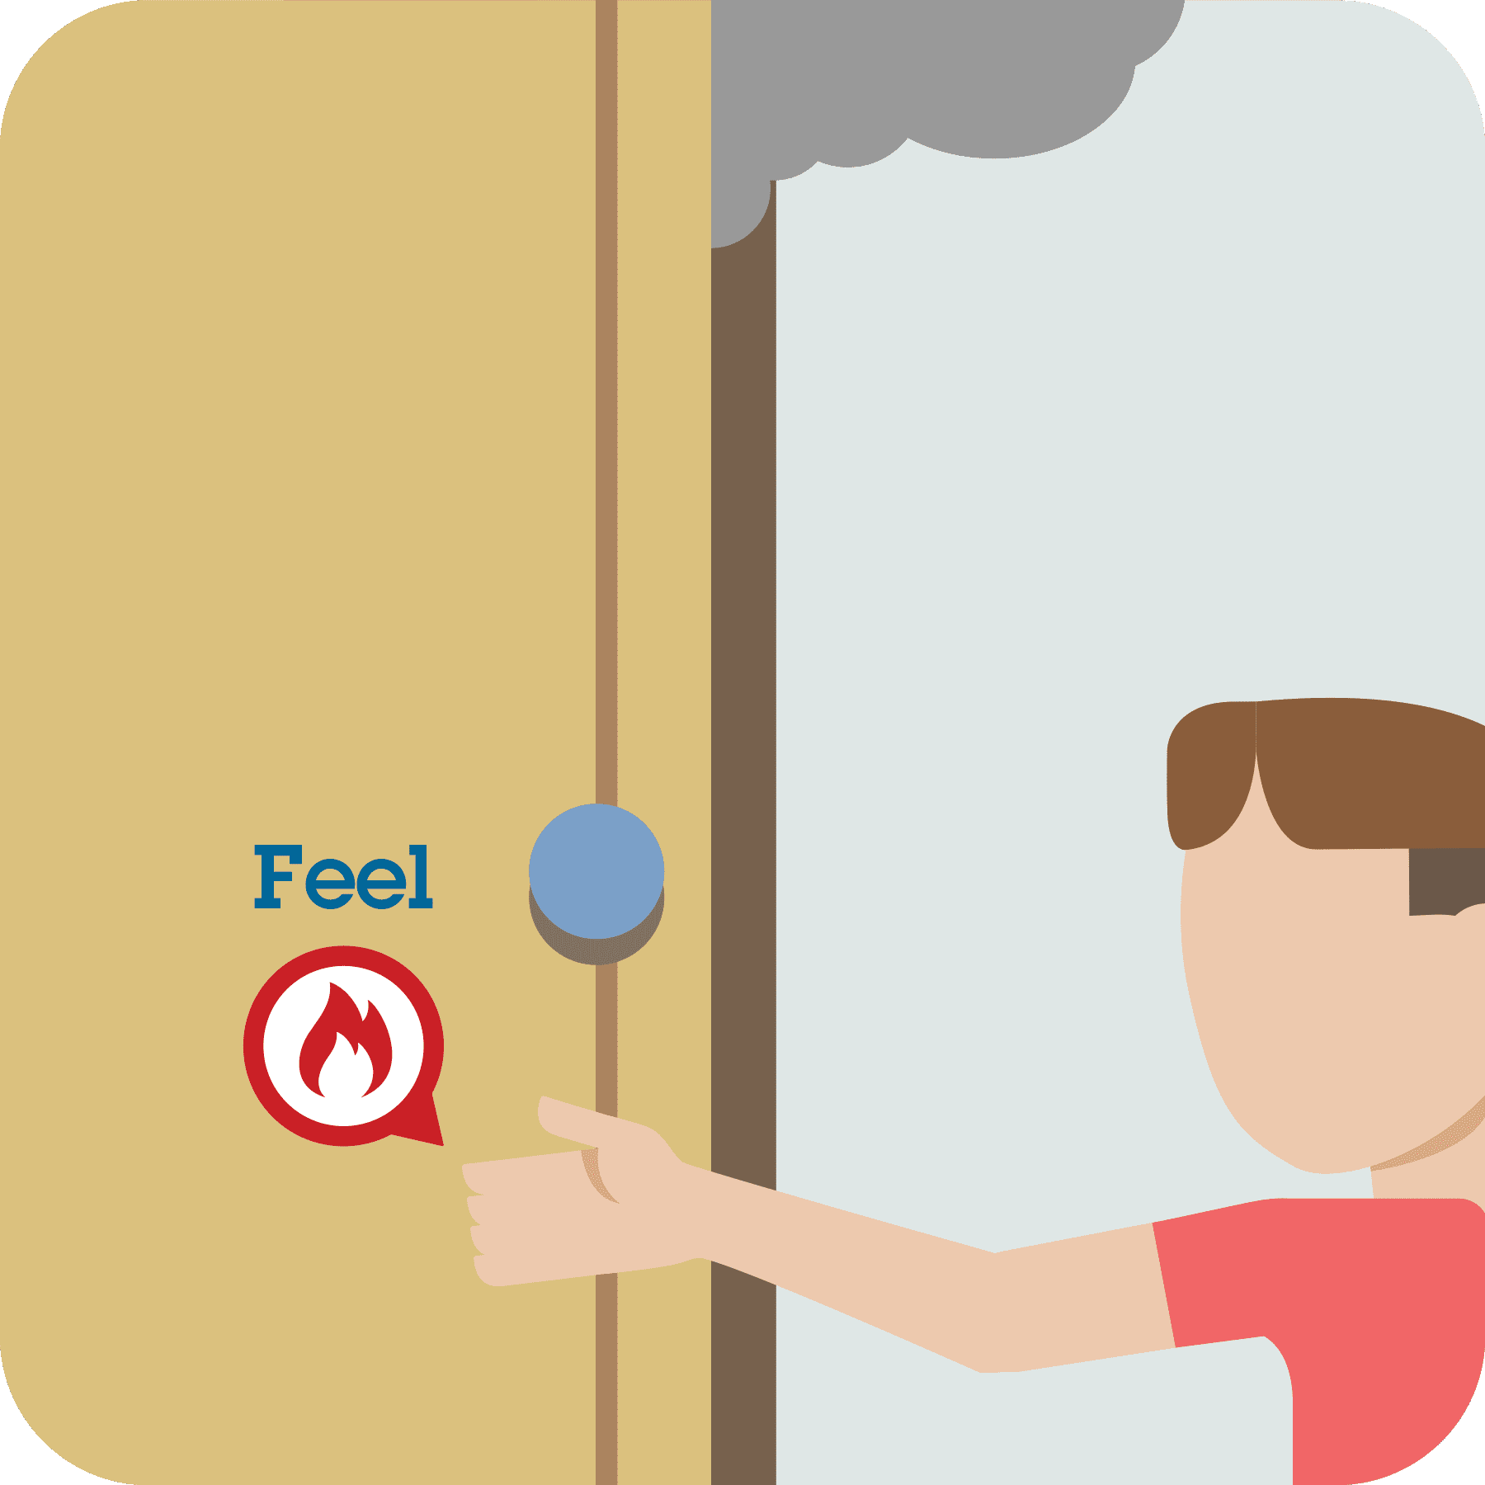
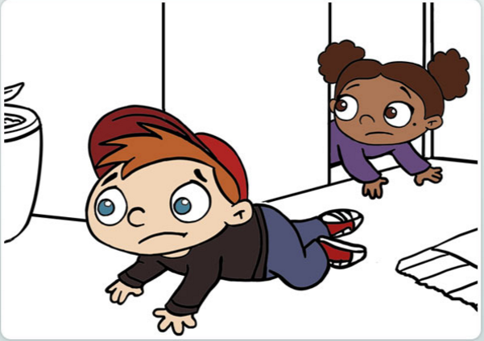
Building Fire Drill
Have courage
Be calm
Stay low
stay together
  b. Practice with your family a home fire drill.
  c. Discuss with your examiner the procedures for safely getting people out of your church and school in case of a fire. Consideration should be given as to how to prevent panic.

Slide 8
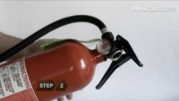
How do you use an extinguisher?
Class A, B, C
Inspect fire extinguisher
Pressure gauge in green
Evacuate if bigger fire
Pull, Aim, Squeeze, Sweep

Slide 9
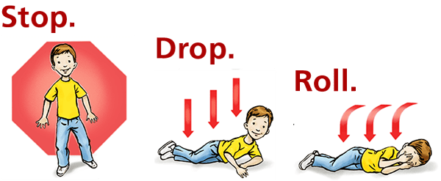
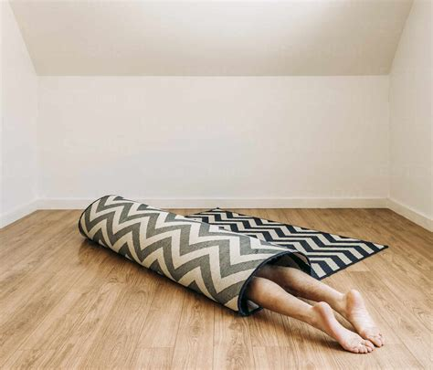
What should you do if your clothes catch on fire?
Someone's clothes catch on fire
Get the person to the ground and roll him over and over on the ground. Another option is to wrap the victim with a blanket, coat, or jacket if one is handy. If your own clothes catch on fire, stop, drop, and roll - do the same thing to yourself as you would to someone else.
Notes:
Someone's clothes catch on fire
Get the person to the ground and roll him over and over on the ground. Another option is to wrap the victim with a blanket, coat, or jacket if one is handy. If your own clothes catch on fire, stop, drop, and roll - do the same thing to yourself as you would to someone else.

Slide 10
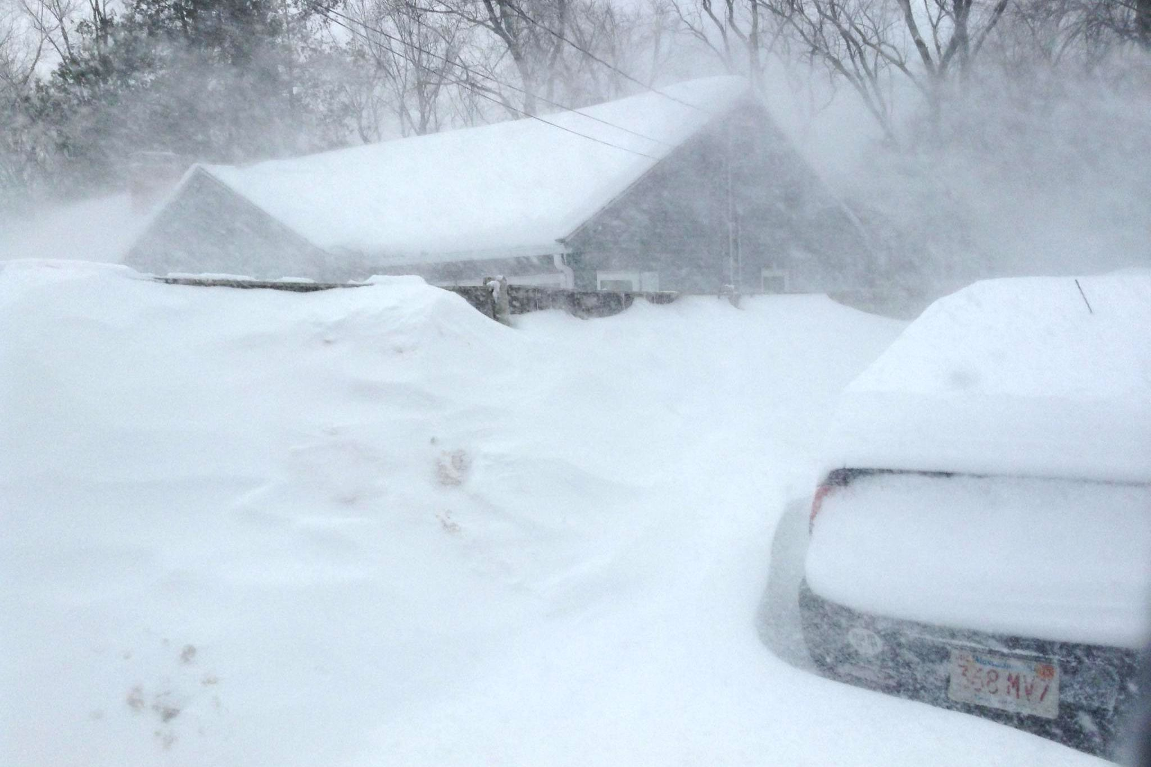

Scenario 2
Notes:
You are stuck in a blizzard

Slide 11
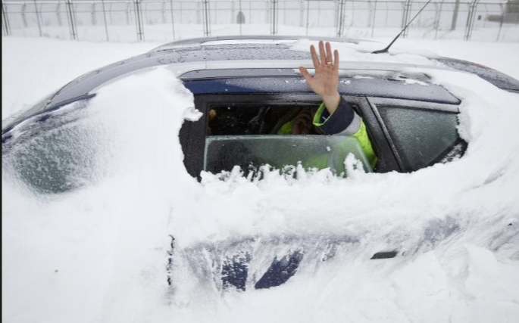
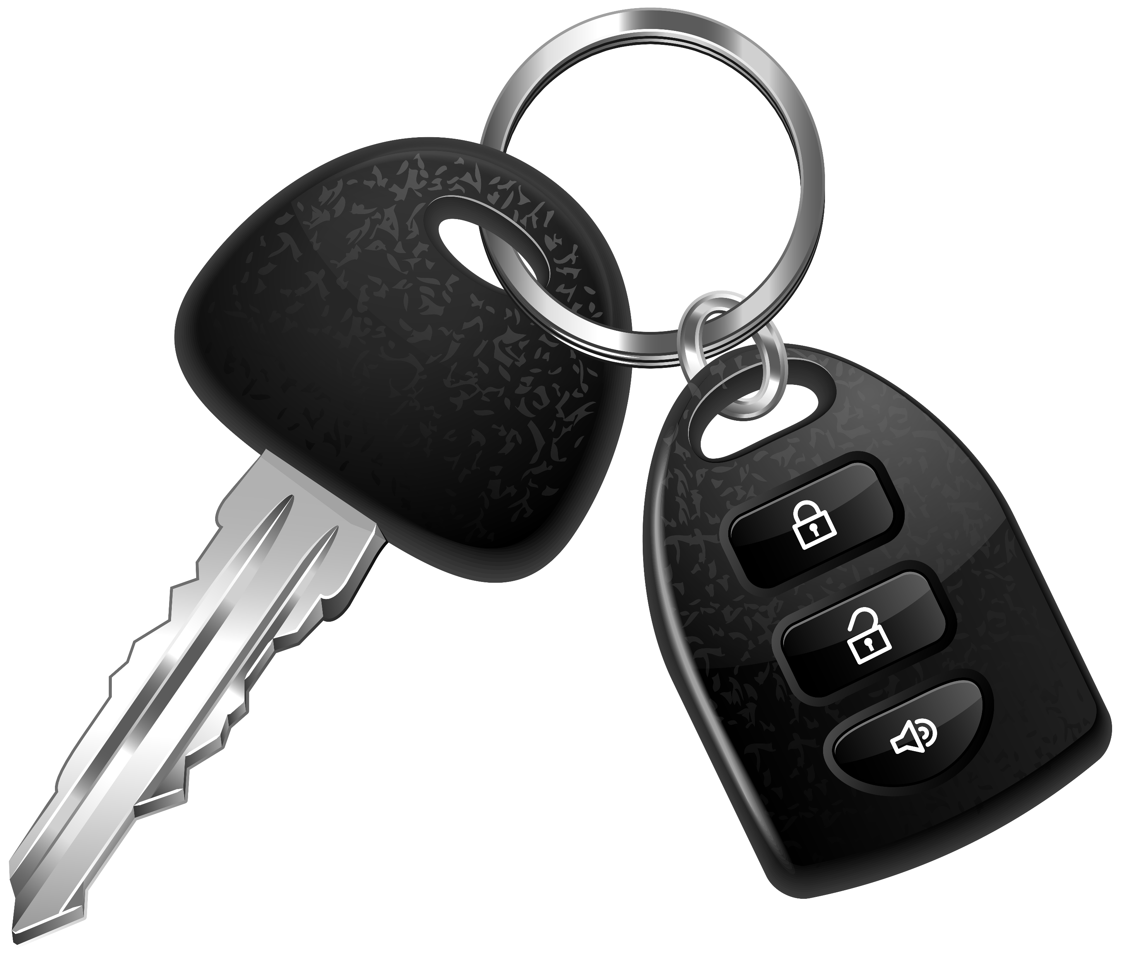
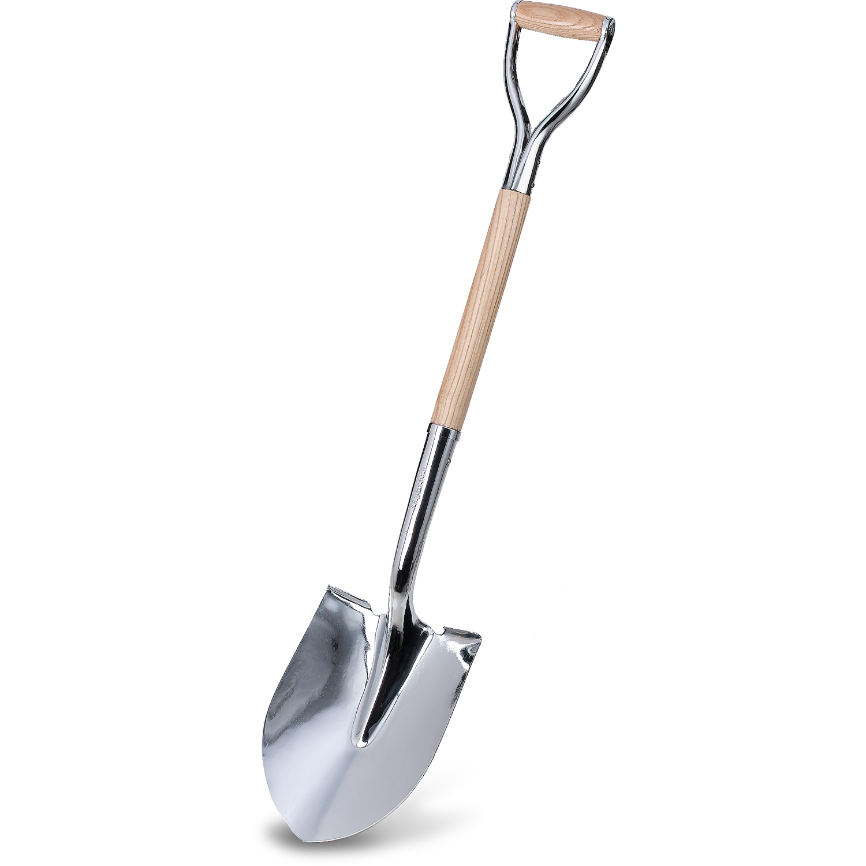
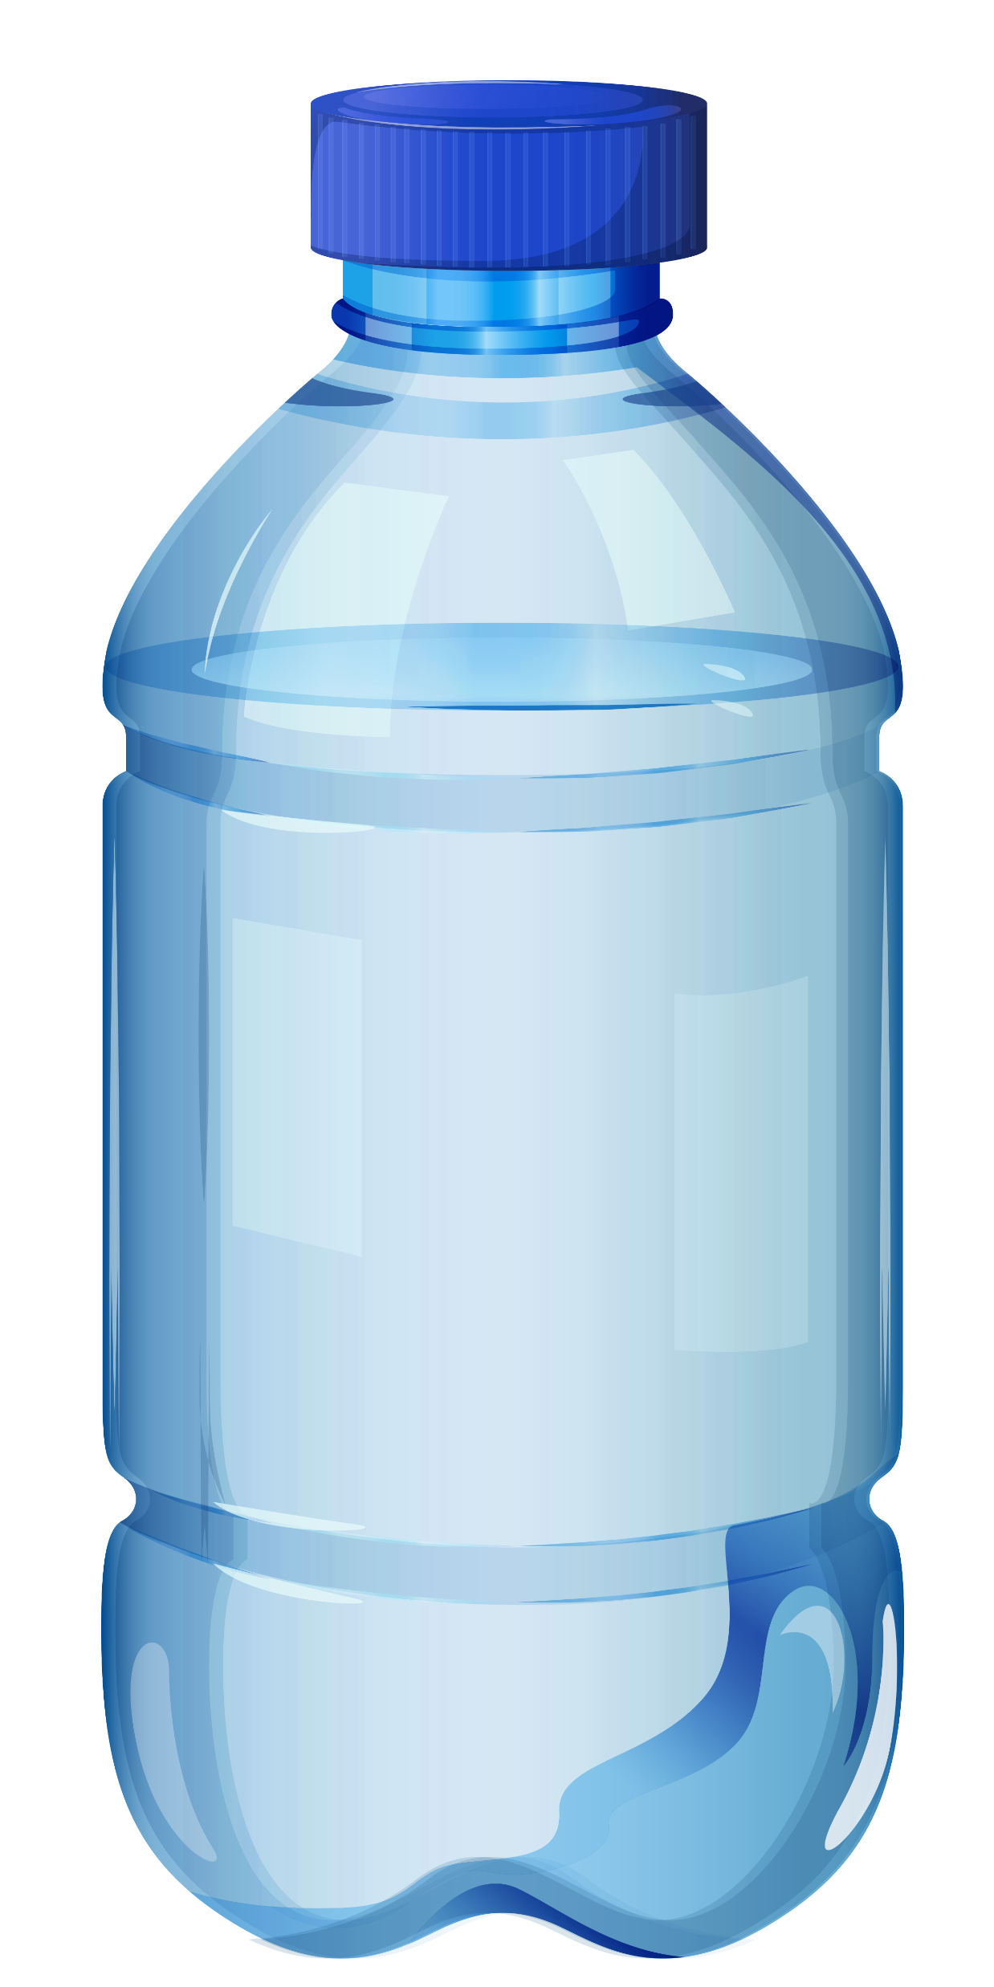
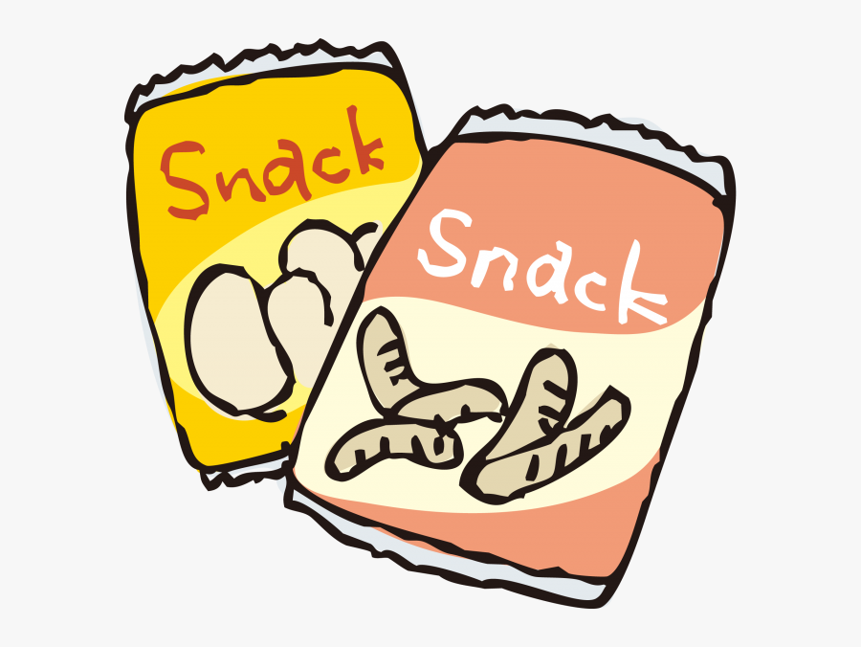
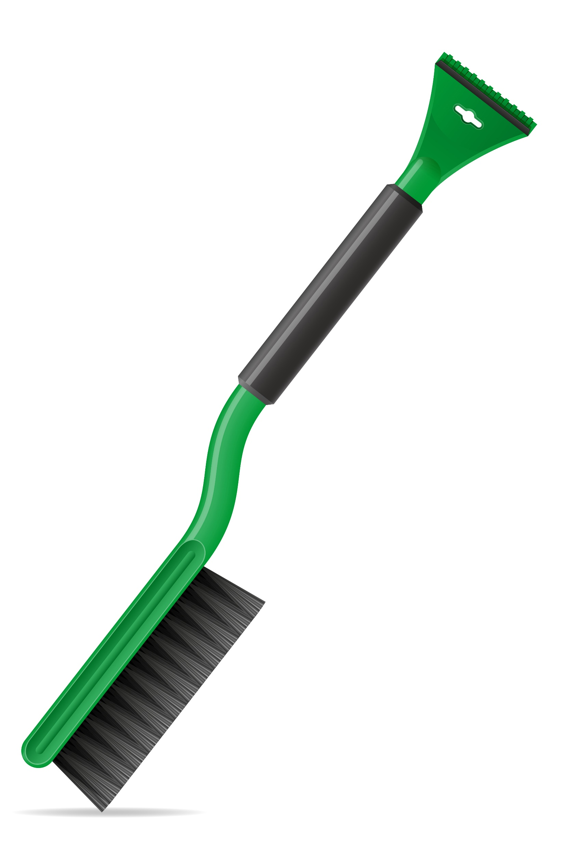
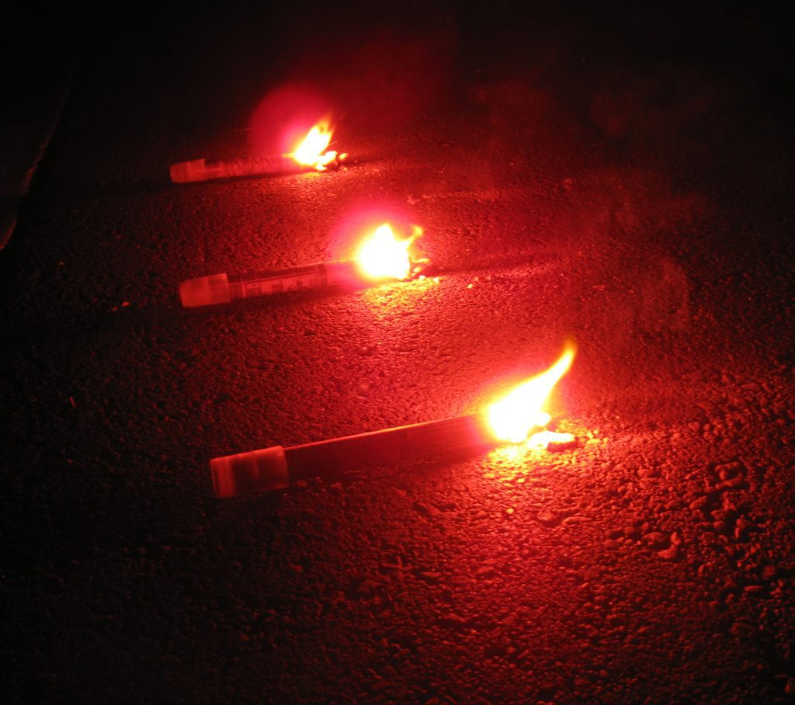
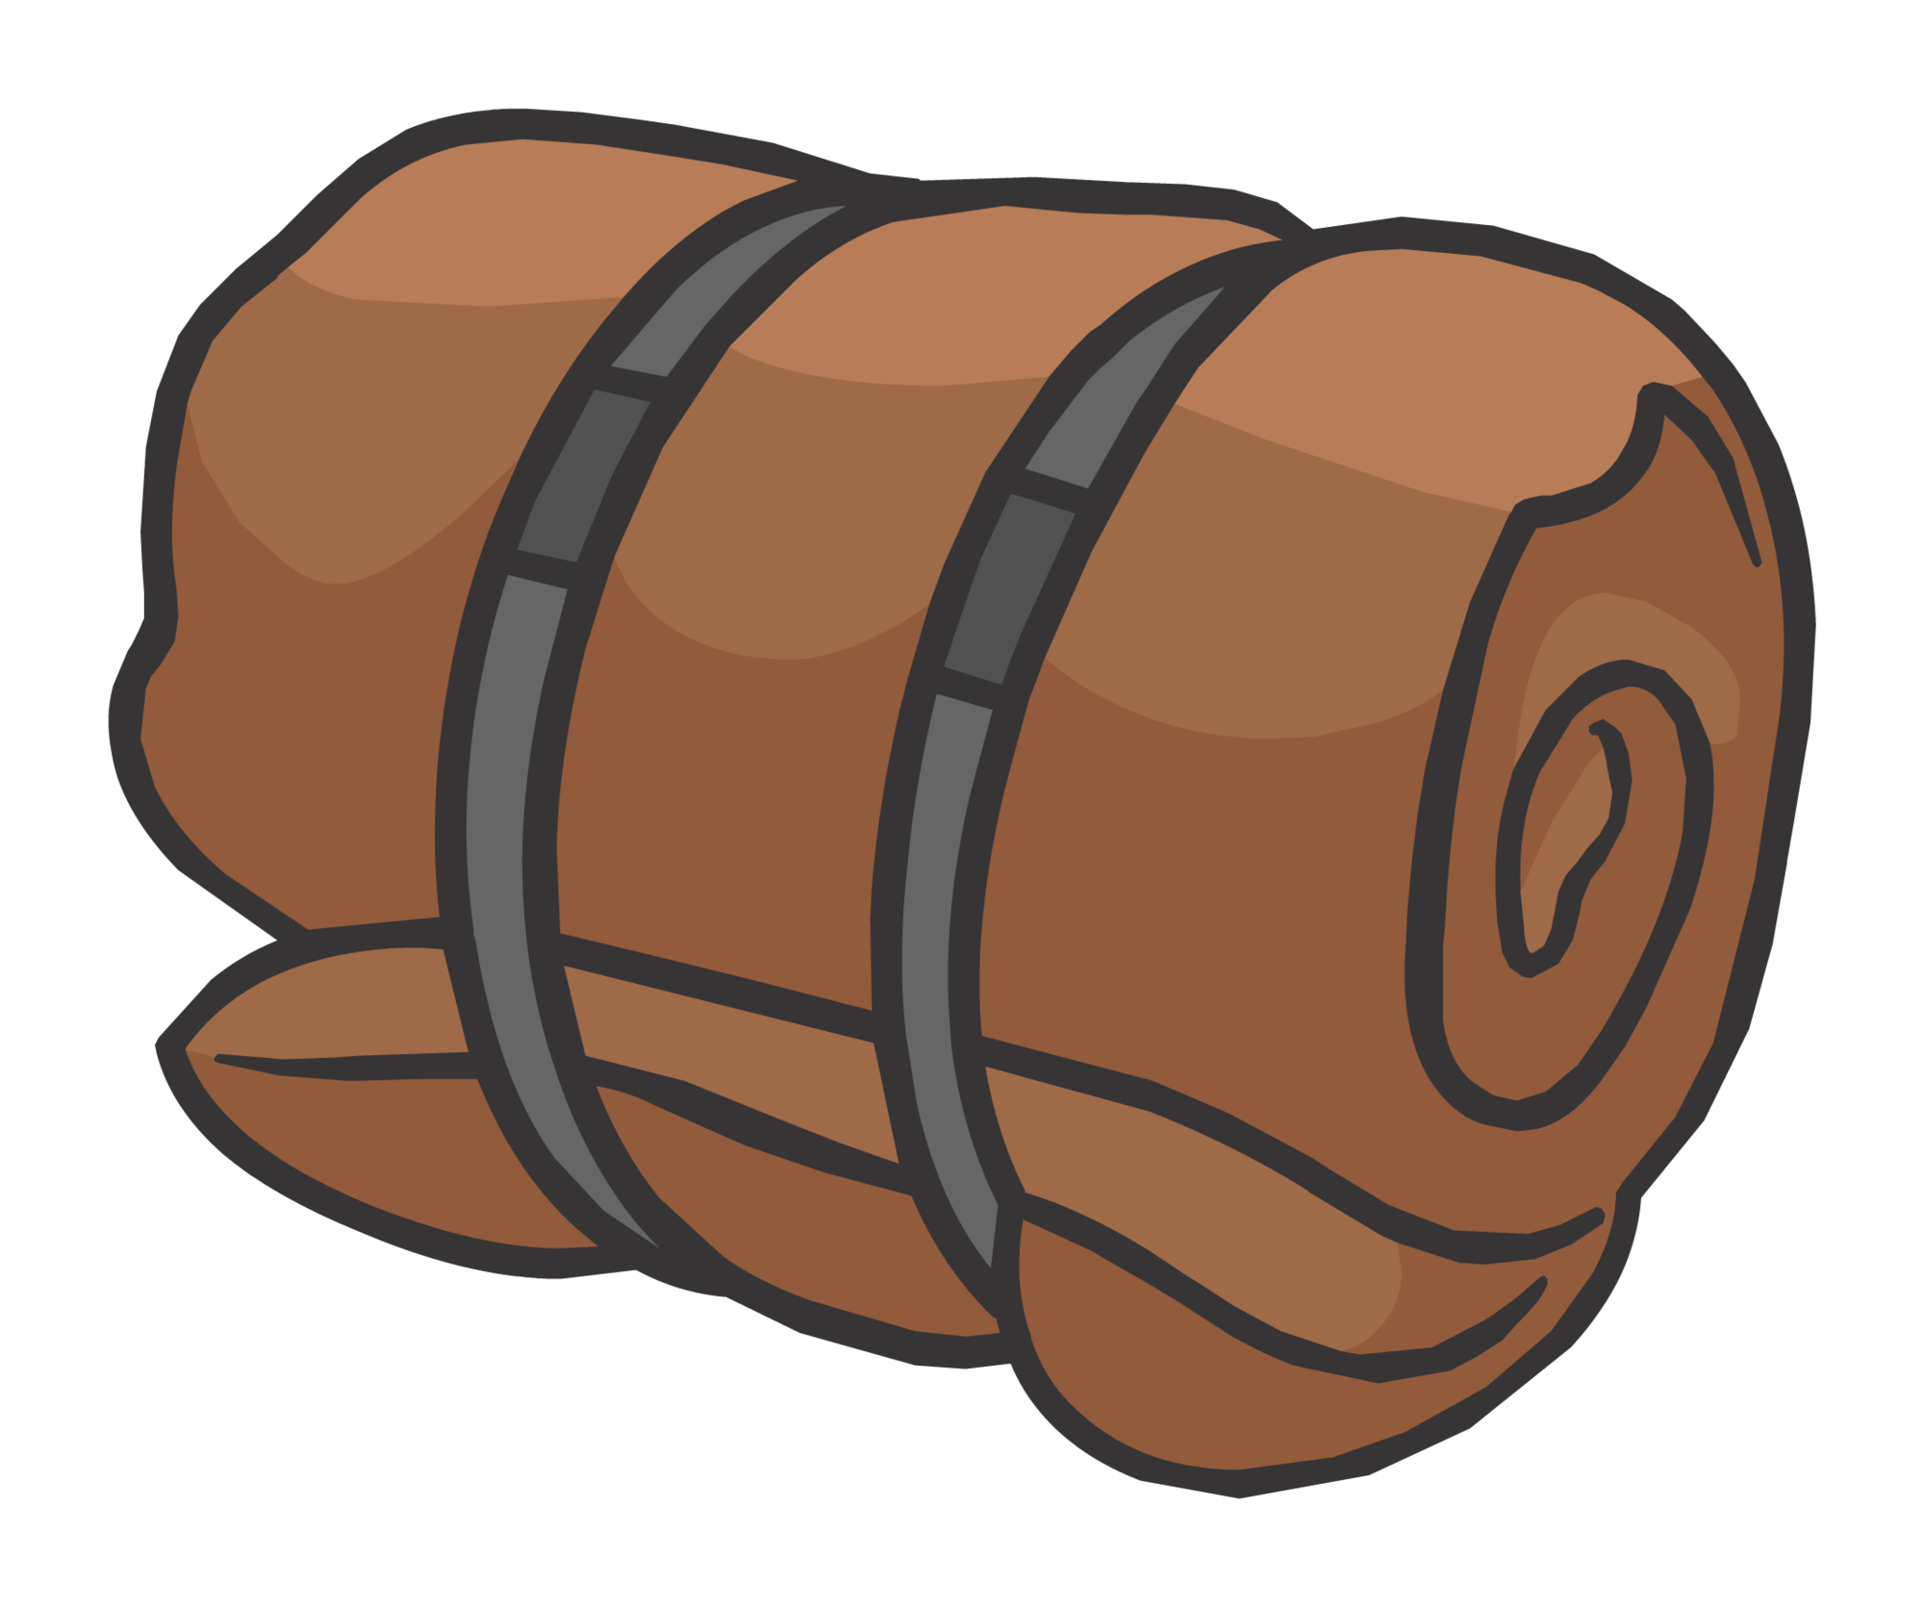
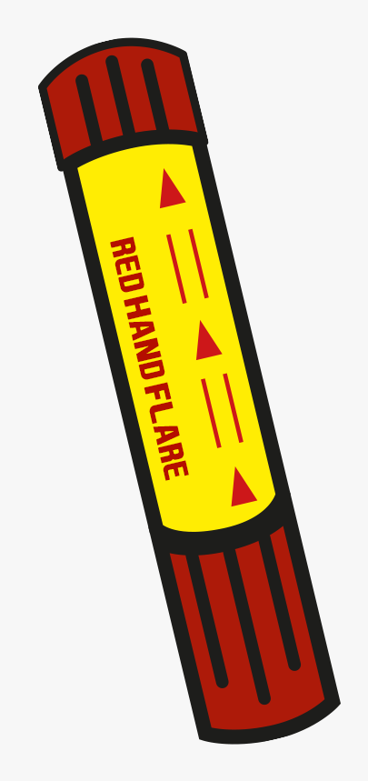


You are stranded in a car in a blizzard.
How and when should you use the following items?
Call for help
Turn off car
Uncover your car
Stay warm
Show where you are
Notes:
If you are stranded in a car in a blizzard or desert
Blizzard
In a blizzard, make sure the doors are closed and all windows are up. Use water a little at a time and shut off the car's engine to prevent carbon monoxide poisoning.
When the snow stops, get out of the car and clear the snow off the roof, hood, trunk, and windows. This will allow others to see the car and will allow sunlight to warm the inside
During storm:
Call for help
Turn off car
Stay warm with blanket or sleeping bag
Eat and drink sparingly
After storm:
Call for help
Shovel snow away from exhaust pipe if you can and maybe start car if it’s clear
Shovel snow away from car so you can be seen
Put out a flare or something bright so you can be seen

Slide 12
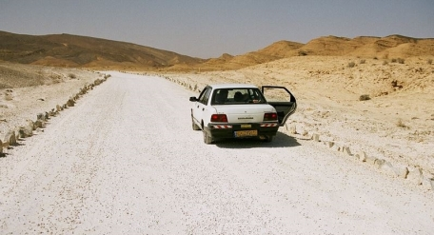
Scenario 3

Slide 13
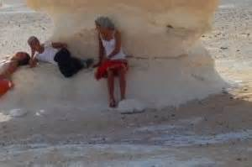

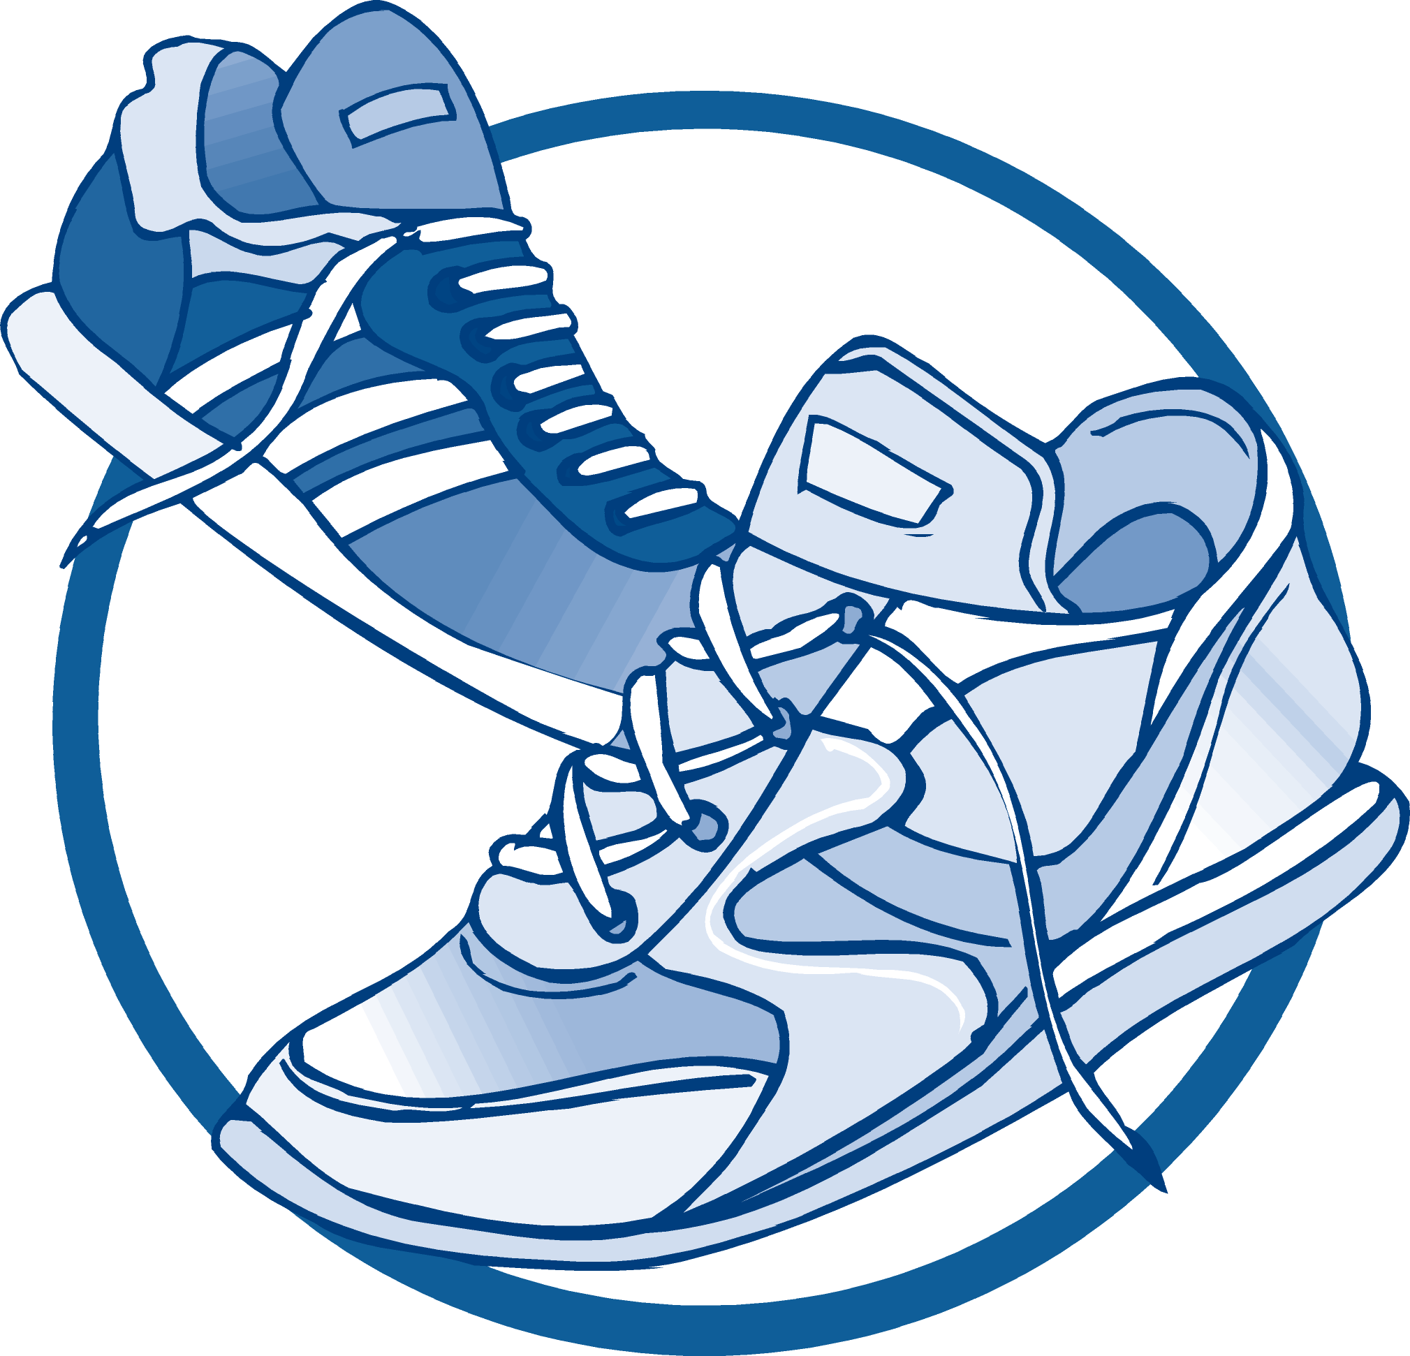
You are stuck in the desert on a very hot day.
How and when should you use the following items?
Find shade nearby
Call for help
Stay hydrated
Notes:
Desert
Get out of the car and find shade. If necessary, take shelter in the shadow of your car. Try to stay hydrated by drinking water. If you run out of water you may be able to collect it off the car in the morning when the dew falls. Rather than rationing your water, drink all you can when you can. Rather than shedding your clothing, put more on to hold in your body's moisture. Stay near the car. Do not try to hike to the gas station you think you passed "two miles ago." It could easily have been 10 miles ago

Slide 14
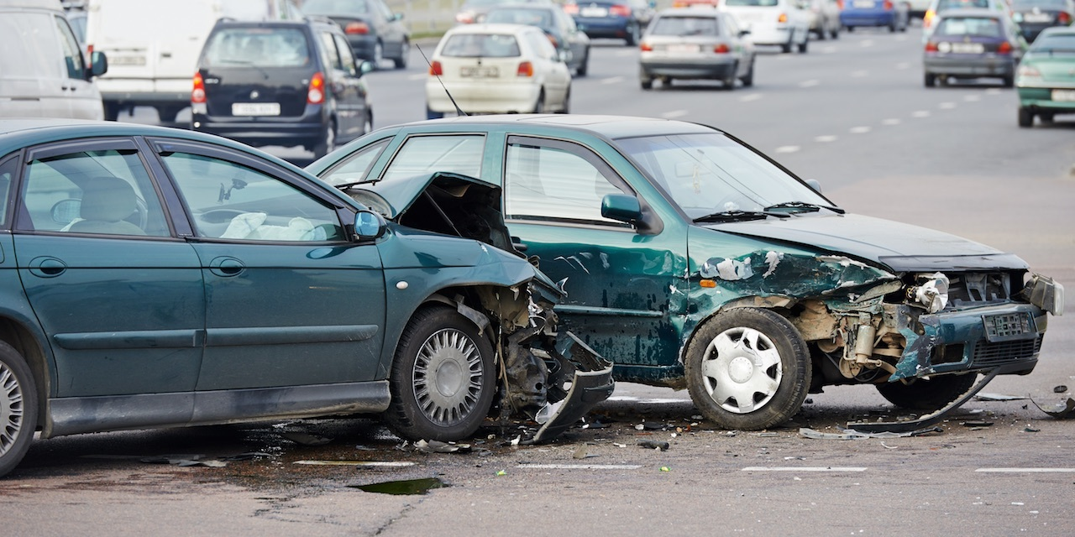
Scenario 4

Slide 15
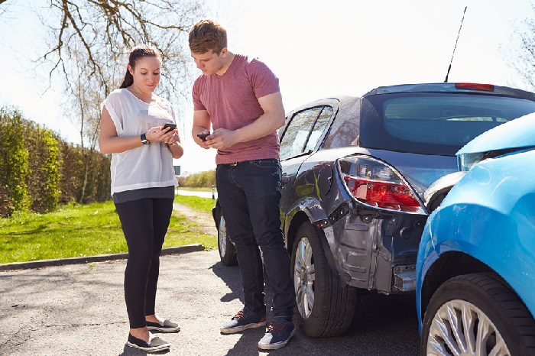
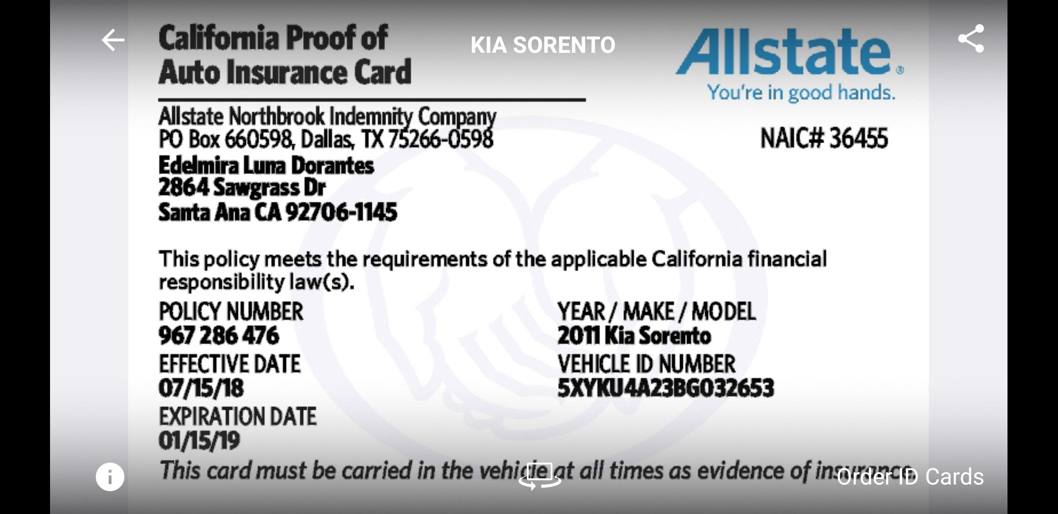
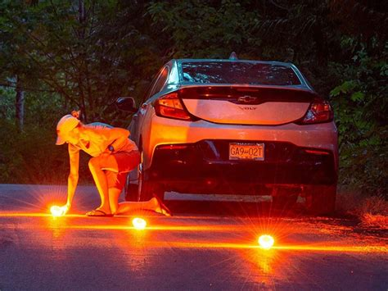
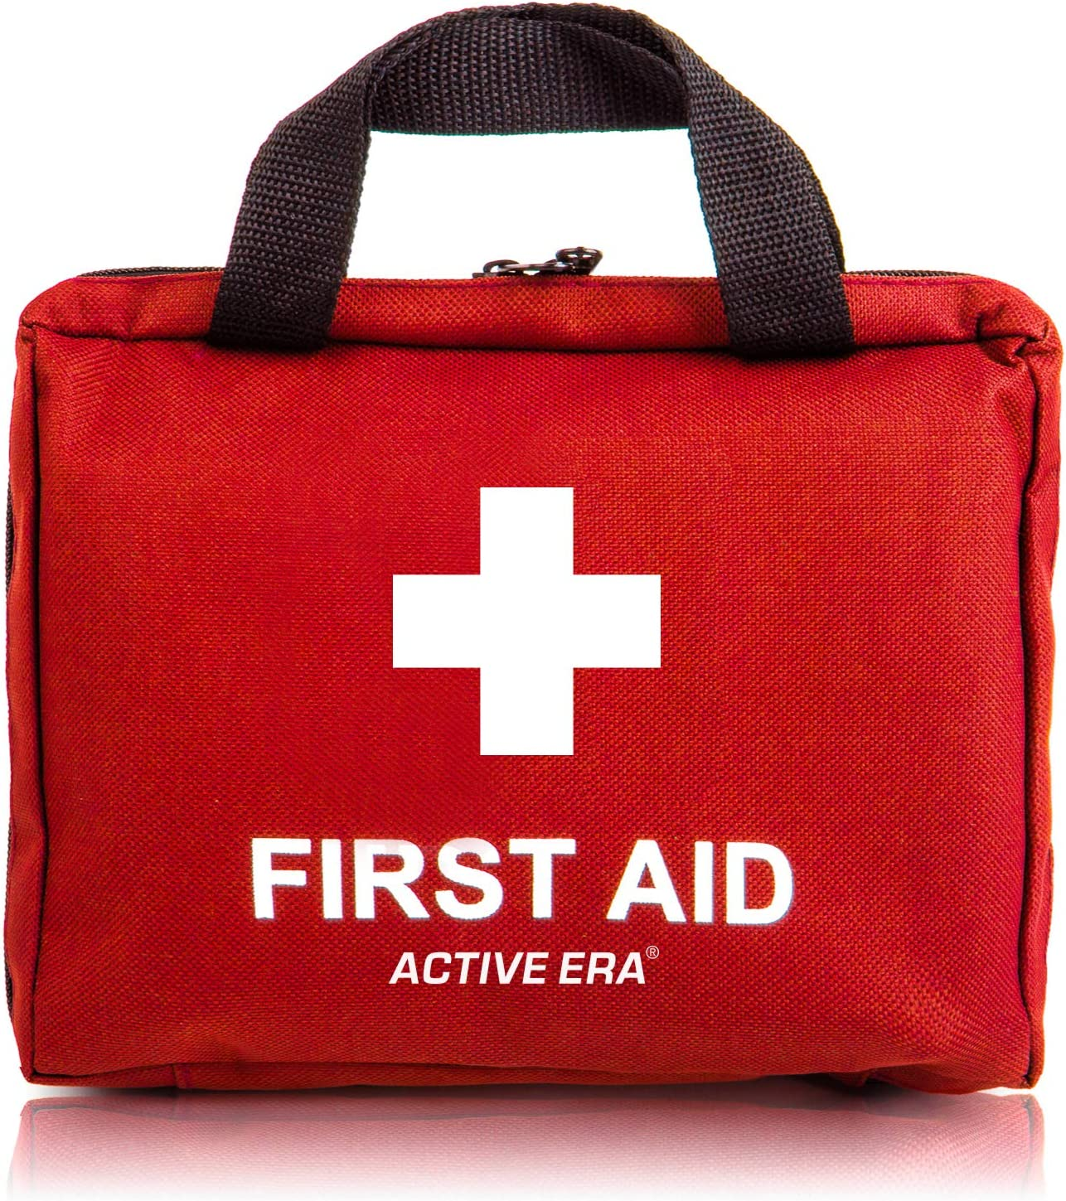
You just had a car accident.
How and when should you use the following items?
Call for help
Exchange information
Turn off car
Get out and to safety
Give first aid
If you are able to do so
Notes:
Contact the police and stay calm.
Stay out of traffic. If your car is in the traffic lanes try to move it or get everyone out of the car and away from traffic to prevent injury if the disabled car is hit again.
If available, light road flares to alert other motorists of the danger ahead.
The drivers of those involved need to share their contact information and insurance name and policy number and car license number.
Administer first aid as needed, as well as you are able.

Slide 16
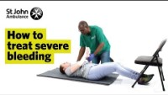
What should you do if someone is bleeding?
Put a clean cloth or bandage on the wound
Press down on wound to stop bleeding
If arm or leg is cut, elevate it.
If it is serious, call 9-1-1
Notes:
If you see a person who is bleeding heavily, you can do the following:
Press hard onto the wound to stop the bleeding.
If an arm or leg is cut, elevate the limb.
Cover with a clean pad and apply a bandage.
Check that the bleeding has stopped. If it has not, add another pad, and bandage, do not remove previous bandage.
If you have bandaged a limb, check frequently that the fingers and toes remain warm. If fingers and toes are getting cold, loosen the bandage to let the blood circulate.
For severe bleeding (5 cups of blood or more), get the person to a hospital for stitches (and possibly immunization against Tetanus) keeping the limb raised.

Slide 17
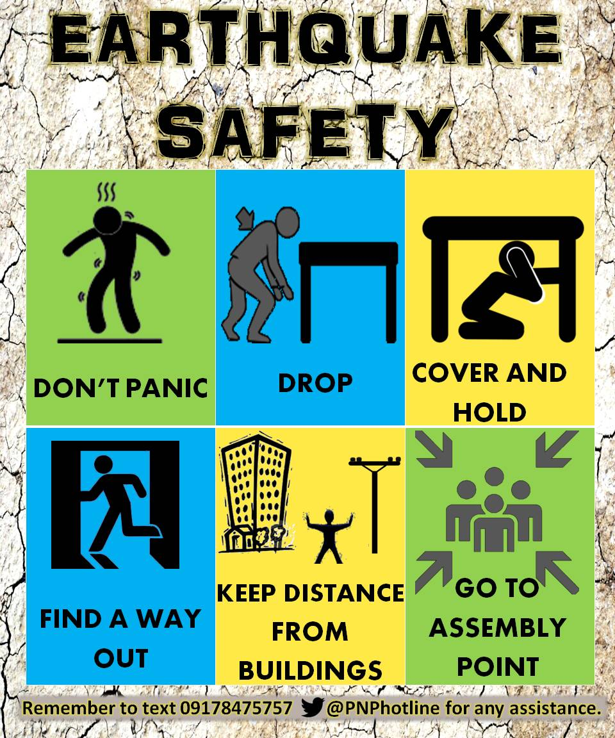
Earthquake safety
Scenario 5
Go somewhere safe such as under a heavy table or desk, beside a bed, and away from windows, breakable and objects.
Stay calm.
If you are outside, stay away from buildings and power lines.
Once the shaking stops, exit the building and stay outside until the building judged safe by a responsible adult (minor earthquake) or building inspector (major damage).
Be aware aftershocks commonly follow earthquakes so don't assume the danger is over just because the shaking stopped.
Notes:
Go somewhere safe such as under a heavy table or desk, beside a bed, and away from windows, breakable and objects.
Stay calm.
If you are outside, stay away from buildings and power lines.
Once the shaking stops, exit the building and stay outside until the building judged safe by a responsible adult (minor earthquake) or building inspector (major damage).
Be aware aftershocks commonly follow earthquakes so don't assume the danger is over just because the shaking stopped.

Slide 18
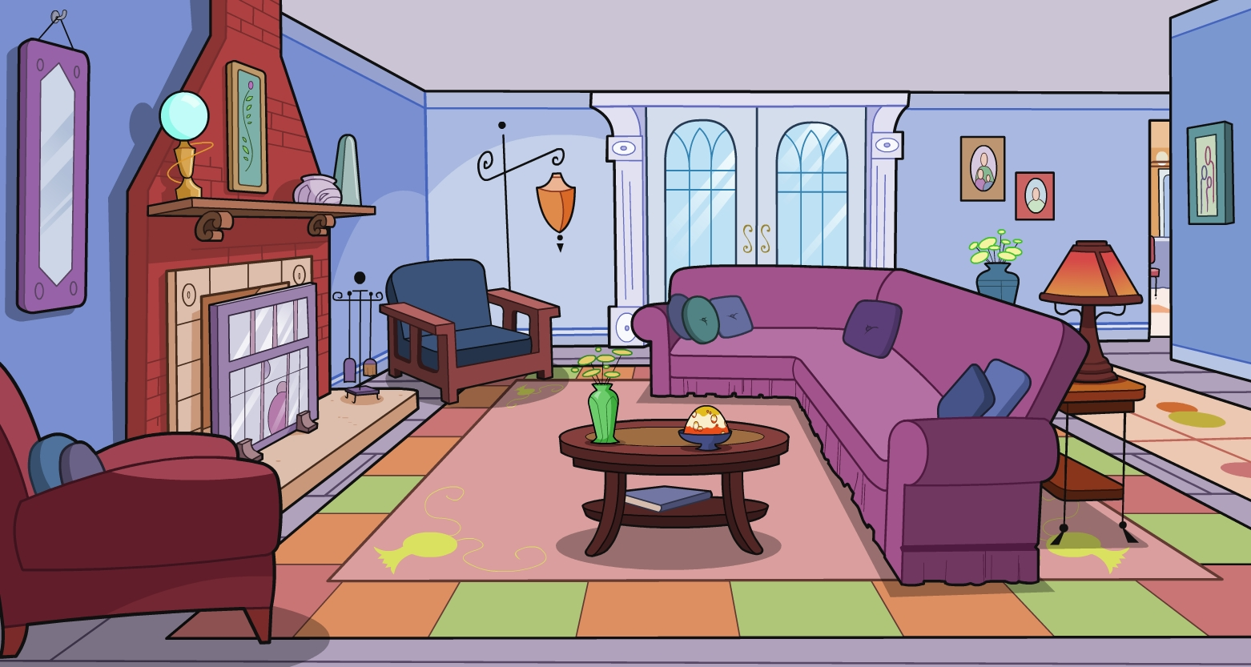
Earthquake
Drill

Slide 19
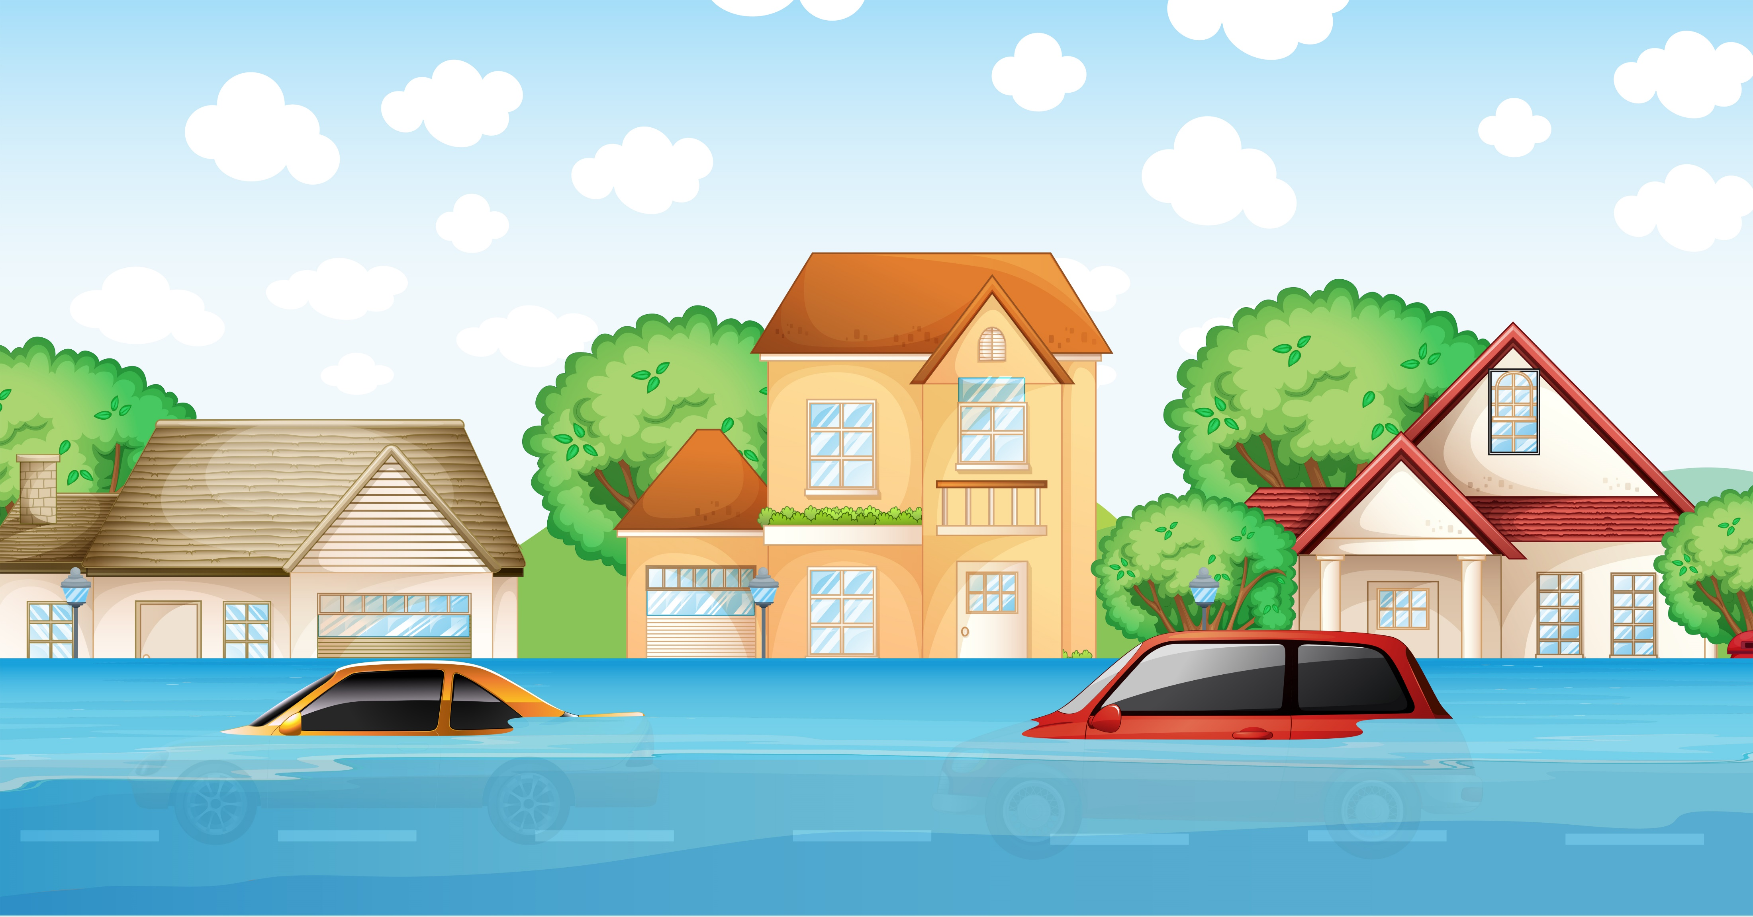
Scenario 6

Slide 20
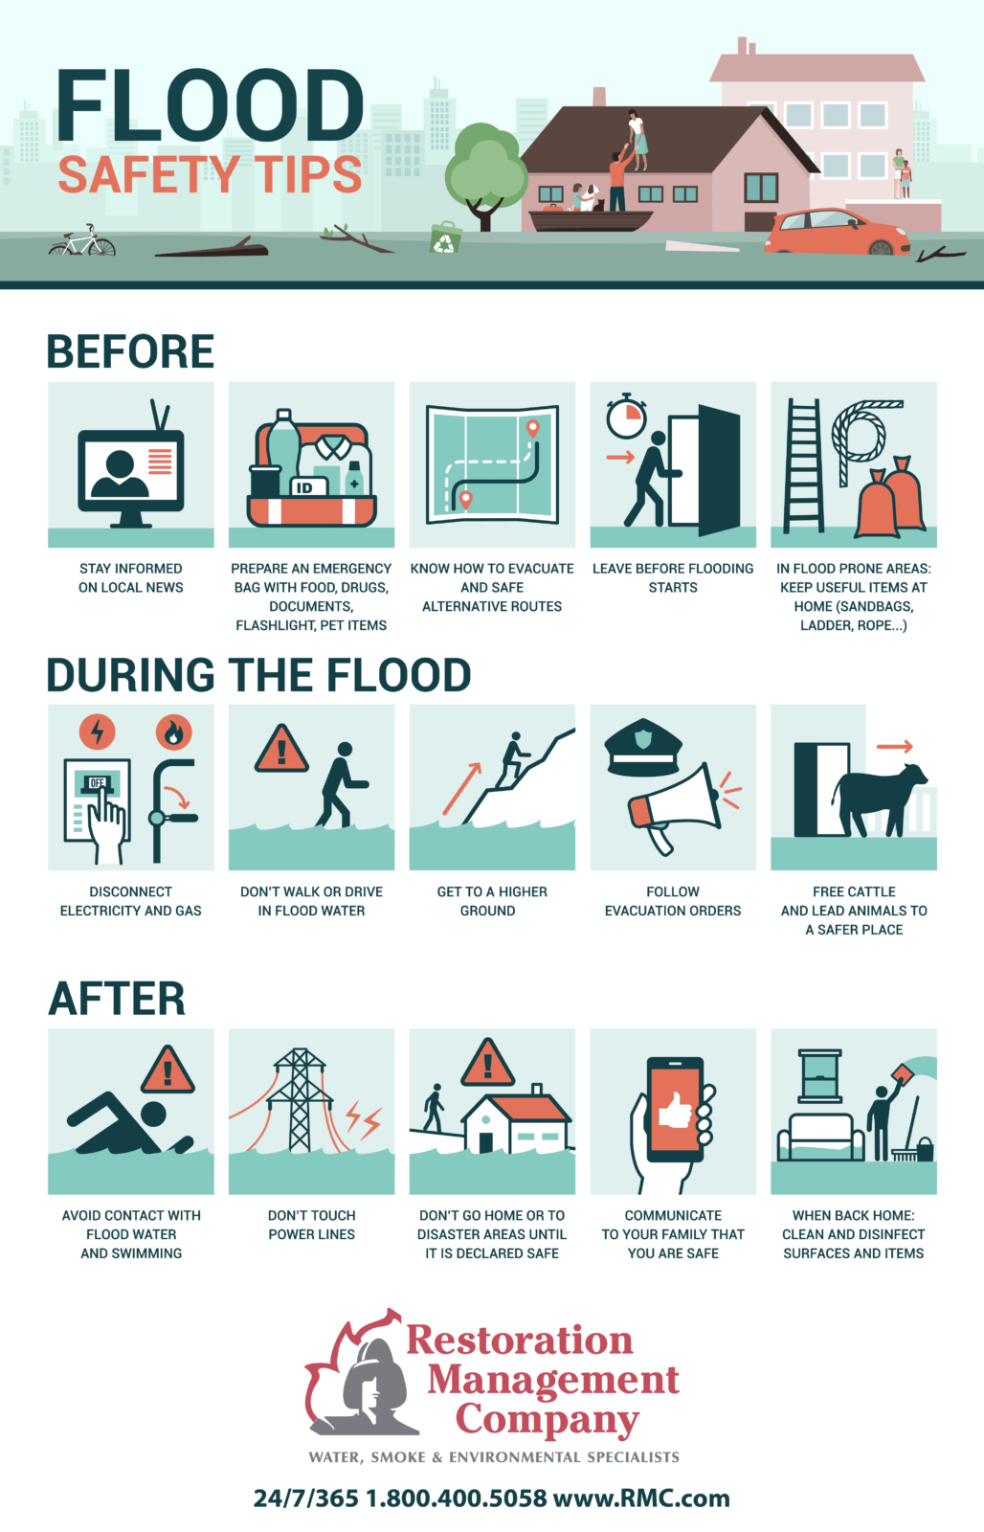
Flood –
Go up to safety
Learn the safest route to travel, staying on higher ground away from low-lying areas.
Disconnect electrical appliances and equipment, or turn off the main breaker.
Know public warning in your area.
Do not attempt to cross a flooded stream, such as one that is over the road. Water is very strong and can sweep even a heavy truck downstream in an instant.
If you find yourself being swept downstream, try to float on your back and get your feet in front of you with your toes out of the water to avoid foot-entrapment. Do not try to stand in swift water, as if you are knocked over and your foot becomes entrapped by something under the water, the water will hold you down and you will not be able to get up.
Use your arms to keep yourself afloat and to guide yourself to the bank.
Notes:
Learn the safest route to travel, staying on higher ground away from low-lying areas.
Disconnect electrical appliances and equipment, or turn off the main breaker.
Know public warning in your area.
Do not attempt to cross a flooded stream, such as one that is over the road. Water is very strong and can sweep even a heavy truck downstream in an instant.
If you find yourself being swept downstream, try to float on your back and get your feet in front of you with your toes out of the water to avoid foot-entrapment. Do not try to stand in swift water, as if you are knocked over and your foot becomes entrapped by something under the water, the water will hold you down and you will not be able to get up.
Use your arms to keep yourself afloat and to guide yourself to the bank.

Slide 21
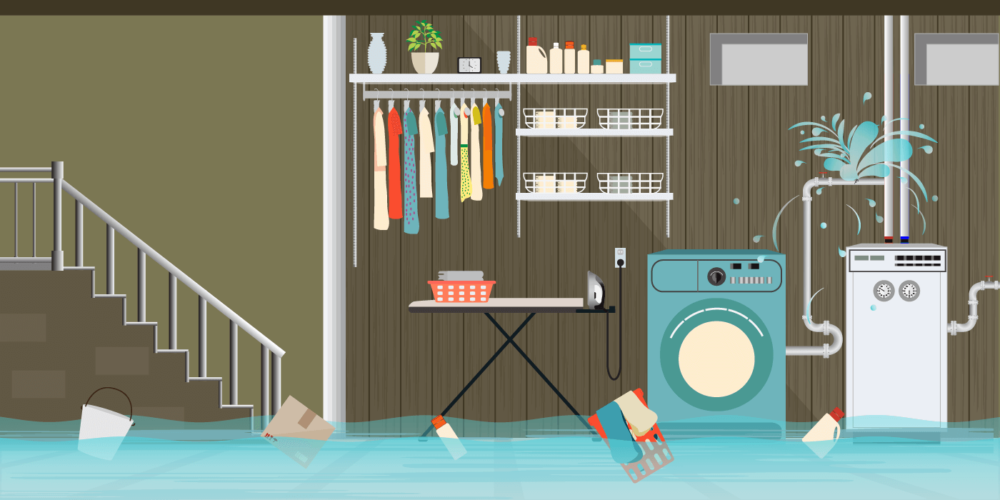
What should you do? Where should you go?
Go up to safety
Turn off water
Turn off electricity
Notes:
Desert
Get out of the car and find shade. If necessary, take shelter in the shadow of your car. Try to stay hydrated by drinking water. If you run out of water you may be able to collect it off the car in the morning when the dew falls. Rather than rationing your water, drink all you can when you can. Rather than shedding your clothing, put more on to hold in your body's moisture. Stay near the car. Do not try to hike to the gas station you think you passed "two miles ago." It could easily have been 10 miles ago

Slide 22
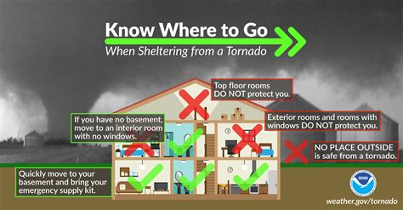
Tornado
Go down to shelter
Scenario 7
Tornado
Go to a basement or storm shelter. Remain alert to weather conditions. Be familiar with the community warning systems.

Slide 23
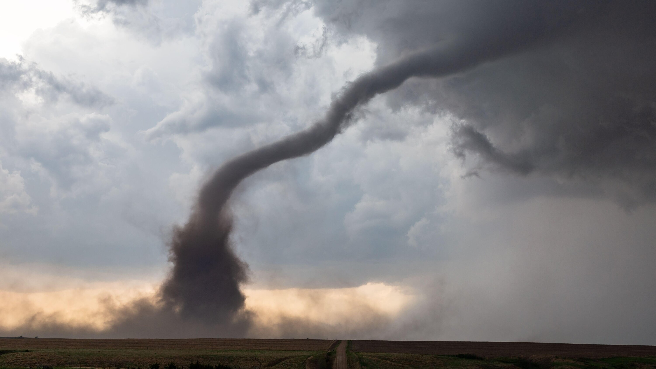
Tornado Drill
Go to basement or inner room
Notes:
Desert
Get out of the car and find shade. If necessary, take shelter in the shadow of your car. Try to stay hydrated by drinking water. If you run out of water you may be able to collect it off the car in the morning when the dew falls. Rather than rationing your water, drink all you can when you can. Rather than shedding your clothing, put more on to hold in your body's moisture. Stay near the car. Do not try to hike to the gas station you think you passed "two miles ago." It could easily have been 10 miles ago

Slide 24
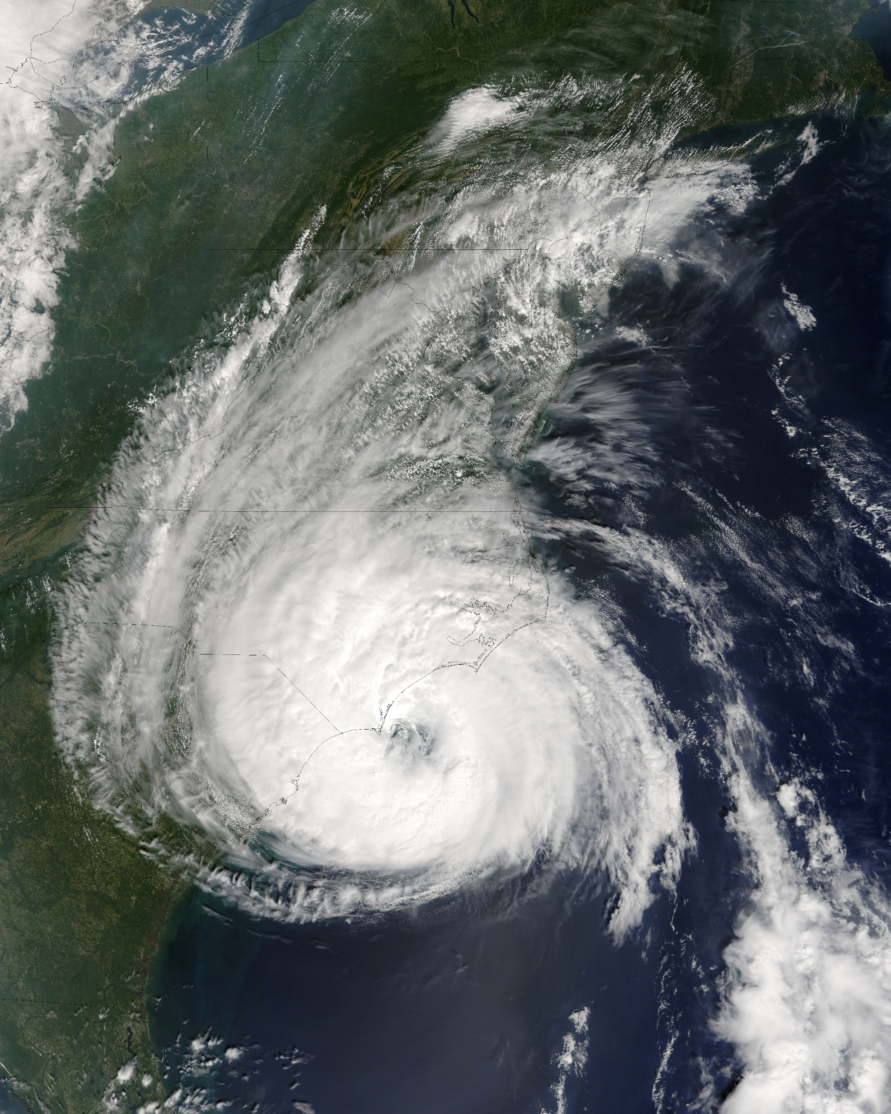

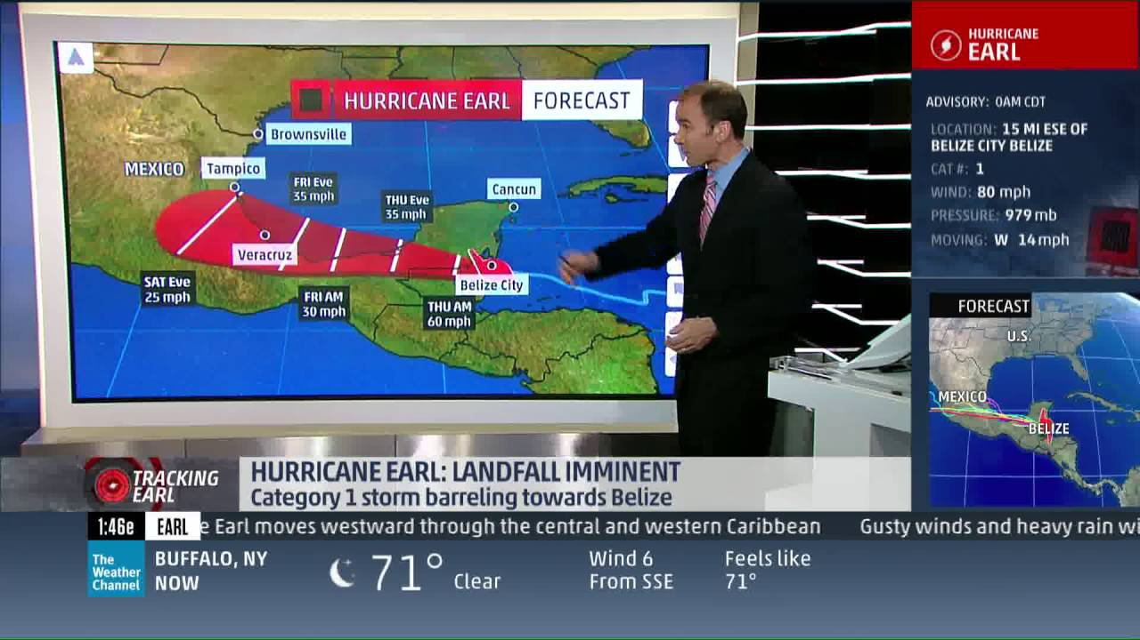
Scenario 7
Hurricane

Slide 25
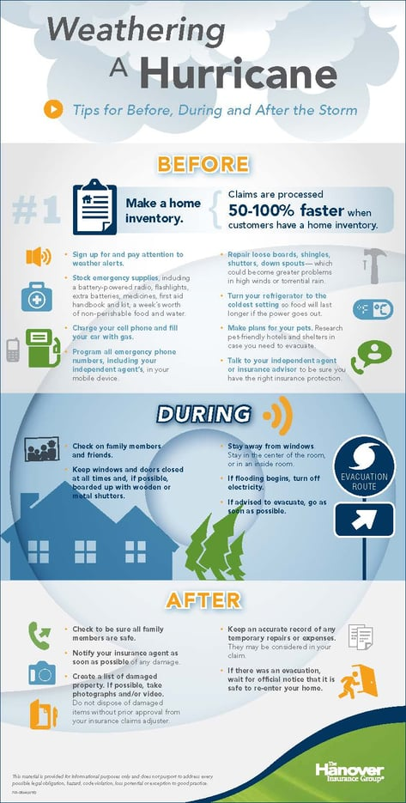
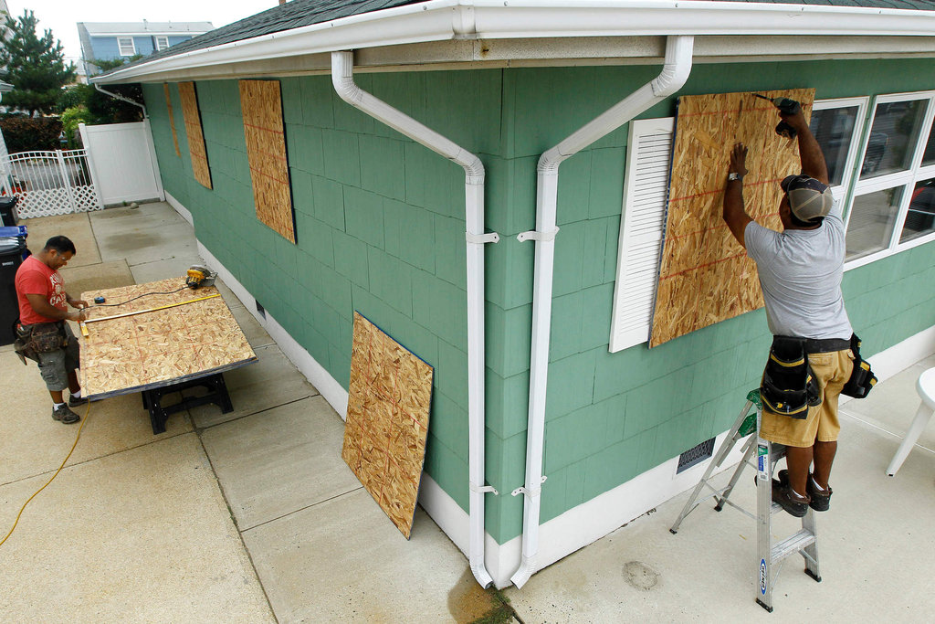
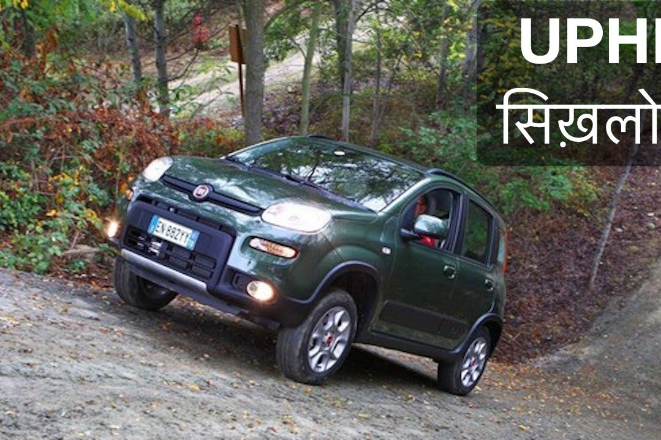
Hurricane Evacuate
Hurricane
When a hurricane is forecast to strike your area, take steps to protect yourself.
Put up shutters to protect your property and
evacuate if advised to do so by local officials.
Have a supply of non-perishable food and water on hand.
Be aware of storm surge, which is caused when a hurricane temporarily raises the level of the ocean, sometimes by dozens of feet.
Take shelter somewhere on high ground during the storm.
Go up
Notes:
Hurricane
When a hurricane is forecast to strike your area, take steps to protect yourself.
Put up shutters to protect your property and
evacuate if advised to do so by local officials.
Have a supply of non-perishable food and water on hand.
Be aware of storm surge, which is caused when a hurricane temporarily raises the level of the ocean, sometimes by dozens of feet.
Take shelter somewhere on high ground during the storm.

Slide 26
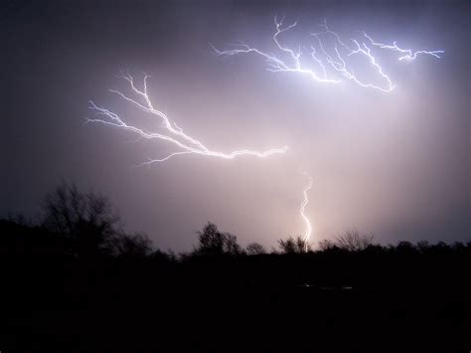
Scenario 8

Slide 27
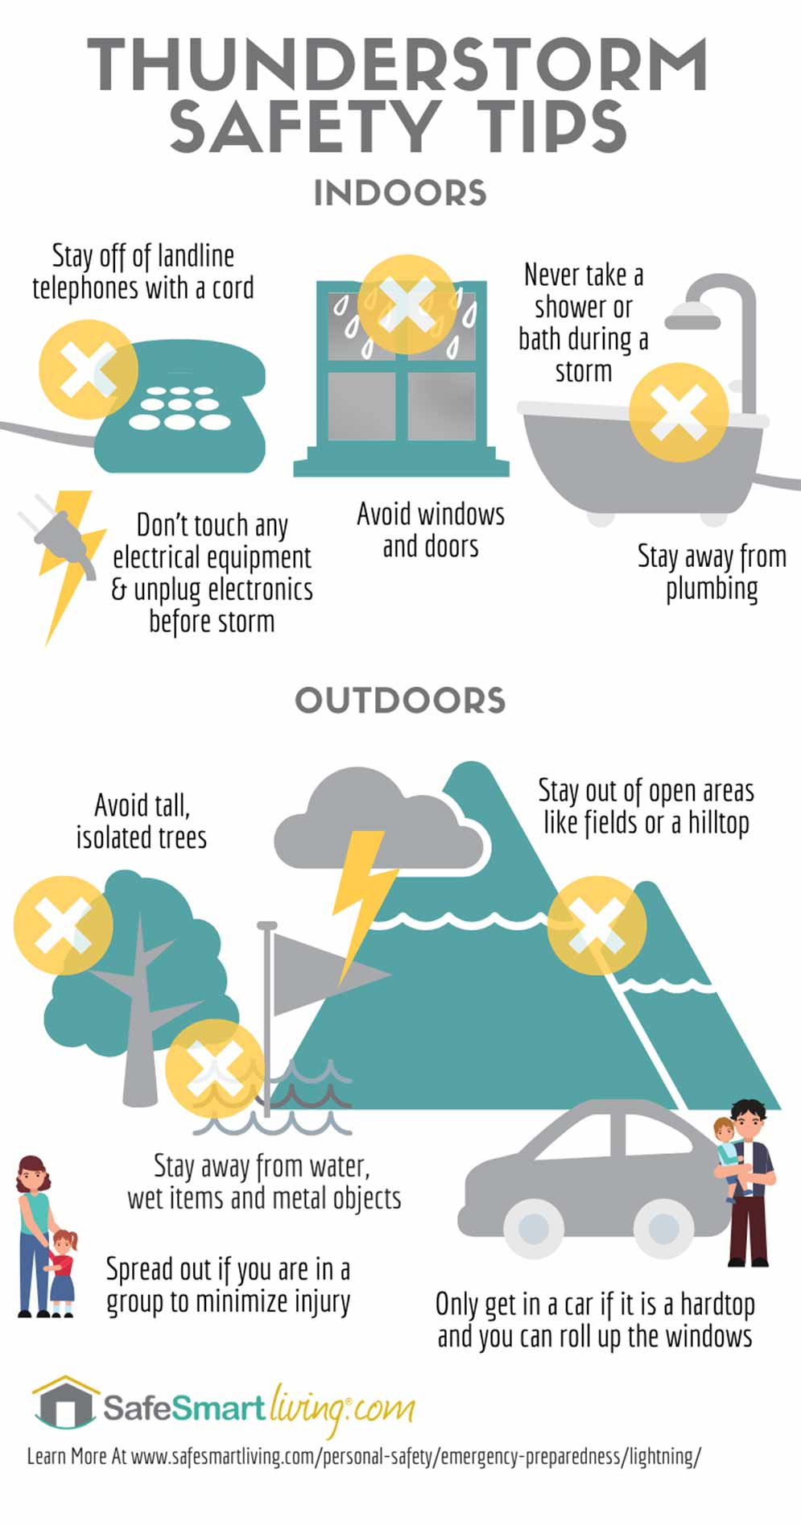
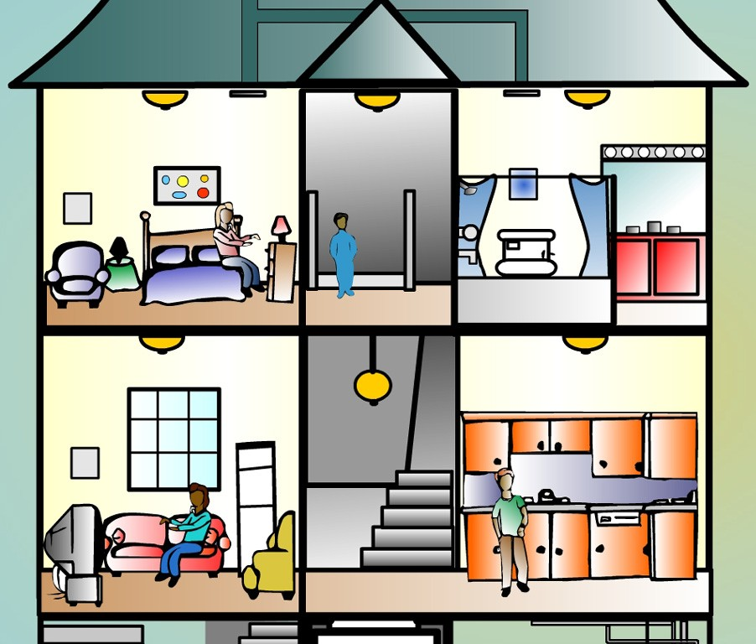

During a close thunderstorm, which should you not use?
Where should you not go?
Stay away from trees, tall objects, water, and objects made of metal (such as railing).
If possible, get inside a building or in a car. If your hair stands on end, drop to your knees and place your hands on your knees. This will make you a smaller target for a lightning strike. Do not lay on the ground, as this will make you a larger target.
Do not use a traditional land-line telephone (cell phones are OK though). Stay away from windows. Do not take a shower or a bath during a thunderstorm.

Slide 28



Scenario 9

Slide 29









Atomic Emergency
Evacuate Immediately OR Shelter in place
What should you have and use?
Atomic emergency
You will first need to decide if you should evacuate or take shelter.
If the emergency is already underway, you will need to take shelter underground.
If the emergency is pending, but likely, you should evacuate to a safe area without delay. Television and radio reports as well as the local law enforcement should be able to help you make this decision.
On an individual scale, one means of preparation for exposure to nuclear fallout is to obtain potassium iodide (KI) tablets as a safety measure to protect the human thyroid gland from the uptake of dangerous radioactive iodine.
Another measure is to cover the nose, mouth and eyes with a piece of cloth and sunglasses to protect against alpha particles.
Cover windows and doors inside
Keep outside air OUT
Recycle air
Plants for oxygen
Call family
Listen to news
Have food
& water
Notes:
Atomic emergency
You will first need to decide if you should evacuate or take shelter.
If the emergency is already underway, you will need to take shelter underground.
If the emergency is pending, but likely, you should evacuate to a safe area without delay. Television and radio reports as well as the local law enforcement should be able to help you make this decision.
On an individual scale, one means of preparation for exposure to nuclear fallout is to obtain potassium iodide (KI) tablets as a safety measure to protect the human thyroid gland from the uptake of dangerous radioactive iodine.
Another measure is to cover the nose, mouth and eyes with a piece of cloth and sunglasses to protect against alpha particles.

Slide 30

Atomic Emergency Shelter

Slide 31


Scenario 10

Slide 32




Snow Avalanche
Stay away
Snow
It is better to not travel in avalanche country, but if travel is necessary, risk can be reduced by observing avalanche safety rules and carrying proper equipment.
This includes a radio beacon on every member of your party, and shovels. Radio beacons made for this purpose transmit constantly, and can be switched to receiver mode after an avalanche. These can help to find buried victims. Finding victims quickly and digging them out greatly increases their chances of survival. Avalanche snow compacts into a very hard mass very quickly after an avalanche, so a shovel is an essential piece of gear. It is next to impossible to dig someone out of an avalanche with bare hands or even with a ski, but if that is all you have available, you should start right away.
Notes:
Snow
It is better to not travel in avalanche country, but if travel is necessary, risk can be reduced by observing avalanche safety rules and carrying proper equipment.
This includes a radio beacon on every member of your party, and shovels. Radio beacons made for this purpose transmit constantly, and can be switched to receiver mode after an avalanche. These can help to find buried victims. Finding victims quickly and digging them out greatly increases their chances of survival. Avalanche snow compacts into a very hard mass very quickly after an avalanche, so a shovel is an essential piece of gear. It is next to impossible to dig someone out of an avalanche with bare hands or even with a ski, but if that is all you have available, you should start right away.

Slide 33

Rock Avalanche
Escape to protected area
Rock Avalanche
Quickly exit the affected area.
If escape is not possible, curl into a tight ball facing downhill (with your back to the oncoming rocks) and cover your head.
When the landslide ends, check for trapped or injured persons without entering the slide area (more debris could follow). Direct rescue personnel to any victims you are able to locate.
Watch for flooding - landslides are usually triggered by water. Watch for broken utility lines (electric, gas, and water) and report them to the authorities.
Notes:
Rock Avalanche
Quickly exit the affected area.
If escape is not possible, curl into a tight ball facing downhill (with your back to the oncoming rocks) and cover your head.
When the landslide ends, check for trapped or injured persons without entering the slide area (more debris could follow). Direct rescue personnel to any victims you are able to locate.
Watch for flooding - landslides are usually triggered by water. Watch for broken utility lines (electric, gas, and water) and report them to the authorities.

Slide 34


Scenario 11
Notes:
Your boat or canoe capsizes in open water
Get as much of your body out of the water as quickly as possible.
Get back to the boat immediately.
If possible, right the boat, climb in, and bail it out.
Otherwise, stay with the boat, as this will make it easier for a rescuer to find you.
Do not attempt to swim to shore, as it is often a lot farther away than it appears.

Slide 35


Boat or Canoe capsizes in open water
Stay with your boat
It will float.
Your boat or canoe capsizes in open water
Get as much of your body out of the water as quickly as possible.
Get back to the boat immediately.
If possible, right the boat, climb in, and bail it out.
Otherwise, stay with the boat, as this will make it easier for a rescuer to find you.
Do not attempt to swim to shore, as it is often a lot farther away than it appears.
Notes:
Your boat or canoe capsizes in open water
Get as much of your body out of the water as quickly as possible.
Get back to the boat immediately.
If possible, right the boat, climb in, and bail it out.
Otherwise, stay with the boat, as this will make it easier for a rescuer to find you.
Do not attempt to swim to shore, as it is often a lot farther away than it appears.

Slide 36


Boat Safety

Slide 37


I need your help.
I’ll give you a treat.
Scenario 12
Notes:
What should you and your parents do to prevent abduction of children in your family? What should you do if you are abducted?
Know where your children are all the time. Never leave children alone in cars. Establish a family code word. Tell the children never to go with anyone who does not know the code word. Have fingerprints taken of your children. Keep current photos and records (dental/medical). Make mental note of what your child wears every day. Make sure your children know their address and telephone number, and how to use the telephone. Teach them how to dial 9-1-1.
What to do if abducted: Yell - This person is not my father/mother. Kick the kidnapper's foot or knee. Scream "Fire!" as this is more likely to attract attention than screaming "Help!"

Slide 38

What should you do?
I need your help.
I’ll give you a treat.
Help!
Stranger Danger!
NO!
Notes:
What should you and your parents do to prevent abduction of children in your family? What should you do if you are abducted?
Know where your children are all the time. Never leave children alone in cars. Establish a family code word. Tell the children never to go with anyone who does not know the code word. Have fingerprints taken of your children. Keep current photos and records (dental/medical). Make mental note of what your child wears every day. Make sure your children know their address and telephone number, and how to use the telephone. Teach them how to dial 9-1-1.
What to do if abducted: Yell - This person is not my father/mother. Kick the kidnapper's foot or knee. Scream "Fire!" as this is more likely to attract attention than screaming "Help!"

Slide 39

Scenario 13
Notes:
What should you and your parents do to prevent abduction of children in your family? What should you do if you are abducted?
Know where your children are all the time. Never leave children alone in cars. Establish a family code word. Tell the children never to go with anyone who does not know the code word. Have fingerprints taken of your children. Keep current photos and records (dental/medical). Make mental note of what your child wears every day. Make sure your children know their address and telephone number, and how to use the telephone. Teach them how to dial 9-1-1.
What to do if abducted: Yell - This person is not my father/mother. Kick the kidnapper's foot or knee. Scream "Fire!" as this is more likely to attract attention than screaming "Help!"

Slide 40

What should you do if someone is choking?
Notes:
Someone is choking
A diagram of the Heimlich Maneuver
Coughing is the body's natural defense against choking, and it is generally very effective. If the victim is coughing, do not interfere. If the victim stops coughing (or was never coughing in the first place), ask her "are you choking?" If the victim indicates that she is choking, tell her you are going to help her. To do this, you will need to perform the Heimlich Maneuver.
Briefly, a person performing the Heimlich Maneuver uses their hands to exert pressure on the bottom of the diaphragm. This compresses the lungs and exerts pressure on any object lodged in the trachea, hopefully expelling it. This amounts to an artificial cough. (The victim of an obstructed airway, having lost the ability to draw air into the lungs, has lost the ability to cough on their own.)
Even when performed correctly, the Heimlich Maneuver can injure the person it is performed on. The Heimlich Maneuver should never be performed on someone who can still cough, breathe, or speak. It should not be demonstrated or practiced on a healthy, non-choking person.

Slide 41


What should you do if someone ate something poisonous?
Notes:
With poison container in hand, call the local poison control center and do NOT try to make the patient vomit. Only induce vomiting if a poison center worker or a doctor advises you to do so. If the poison is on the skin or clothes, remove the clothing and wash with a large amount of water. If poison gets in the eyes, flush the eyes with clean water for 10 minutes.
Get the victim to a hospital as soon as possible, and if possible, bring the poison container with you.

Slide 42

https://activity-array.com/

