Slide 1

FRIENDS
Pathfinder Song
Pathfinder Pledge and Law
New Testament Books
Qualities of a Good Friend

Slide 2

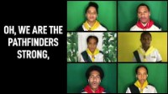
Pathfinder Song

Slide 3
Pathfinder
Pledge
Law
By the grace of God,
I will be pure, and kind, and true.
I will keep the Pathfinder Law.
I will be a servant of God
and a friend to man.
Keep the morning watch
Do my honest part
Care for my body,
Keep a level eye
Be courteous and obedient
Walk softly in the sanctuary,
Keep a song in my heart,
Go on God's errand.

Slide 4
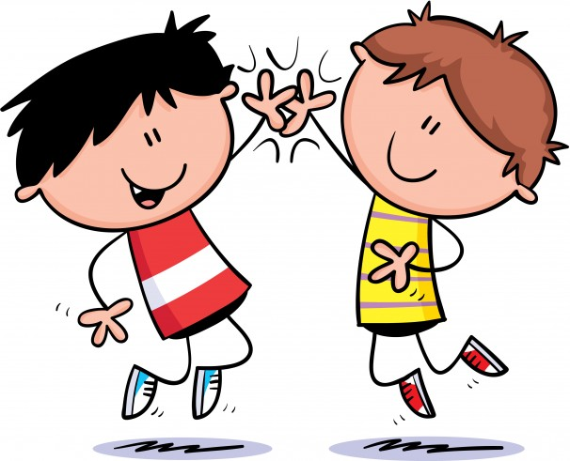
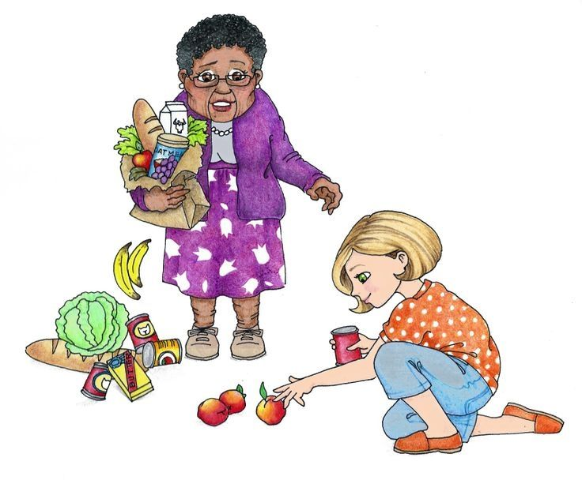
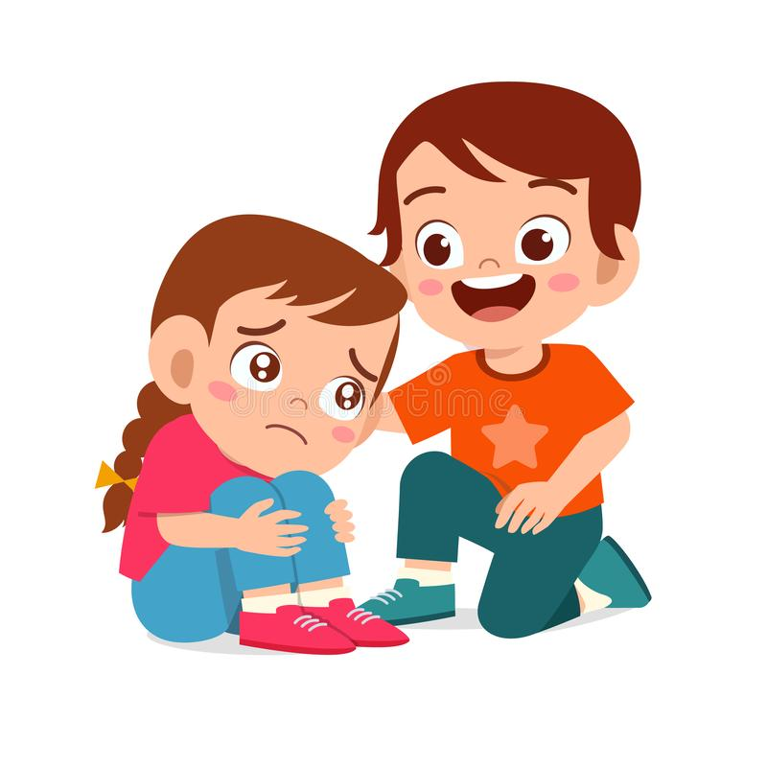
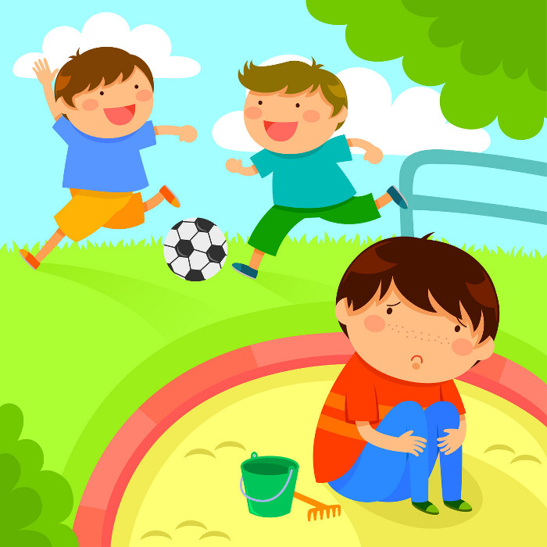
Pathfinder
Pledge
By the grace of God,
I will be pure, and kind, and true.
I will keep the Pathfinder Law.
I will be a servant of God
and a friend to man.
What would be the friendly, kind thing to do?

Slide 5


Pathfinder
Law
Read the Bible & pray
Keep the morning watch
Do my honest part
Care for my body,
Keep a level eye
Be courteous and obedient
Walk softly in the sanctuary,
Keep a song in my heart,
Go on God's errand.
Work together

Slide 6
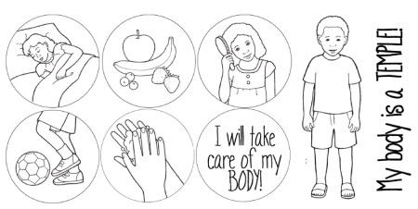

Pathfinder Law
Keep the morning watch
Do my honest part
Care for my body,
Keep a level eye
Be courteous and obedient
Walk softly in the sanctuary,
Keep a song in my heart,
Go on God's errand.
Keep healthy
Rejoice in the Lord always

Slide 7

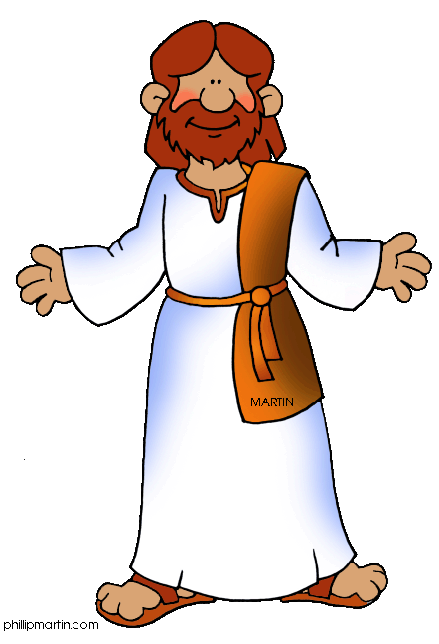





Pathfinder Law
I will not lie, cheat or deceive and will despise dirty talk and evil thinking
I will not lie, cheat or deceive and will despise dirty talk and evil thinking
Keep the morning watch
Do my honest part
Care for my body,
Keep a level eye
Be courteous and obedient
Walk softly in the sanctuary,
Keep a song in my heart,
Go on God's errand.
Make good choices
Be respectful

Slide 8

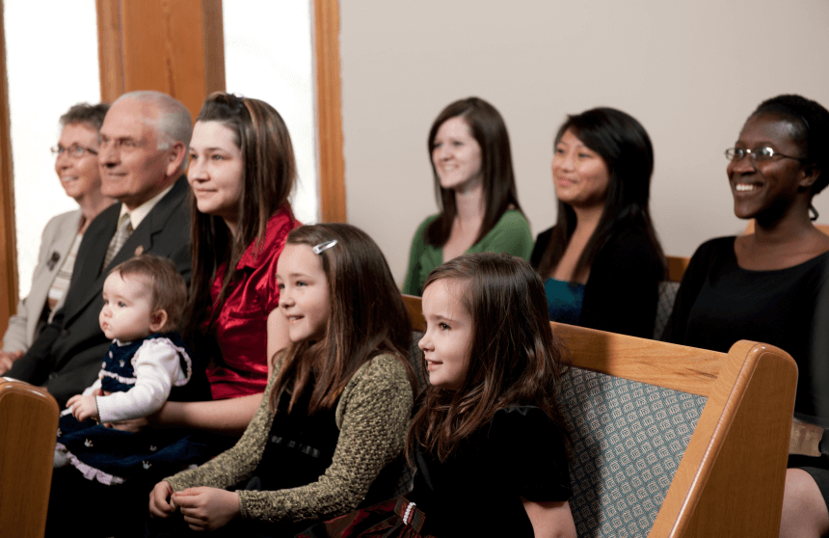

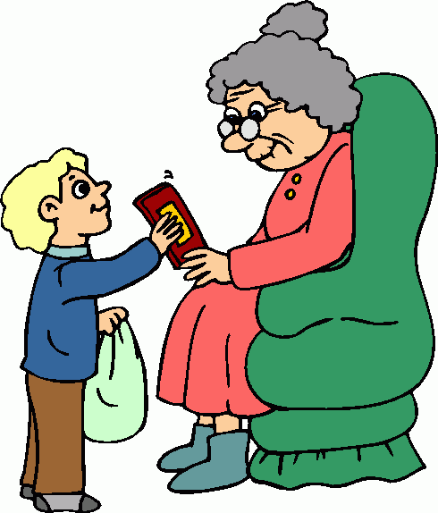
Pathfinder Law
Keep the morning watch
Do my honest part
Care for my body,
Keep a level eye
Be courteous and obedient
Walk softly in the sanctuary,
Keep a song in my heart,
Go on God's errand.
Be quiet and respectful in church
Care for one another
Share God’s Love

Slide 9
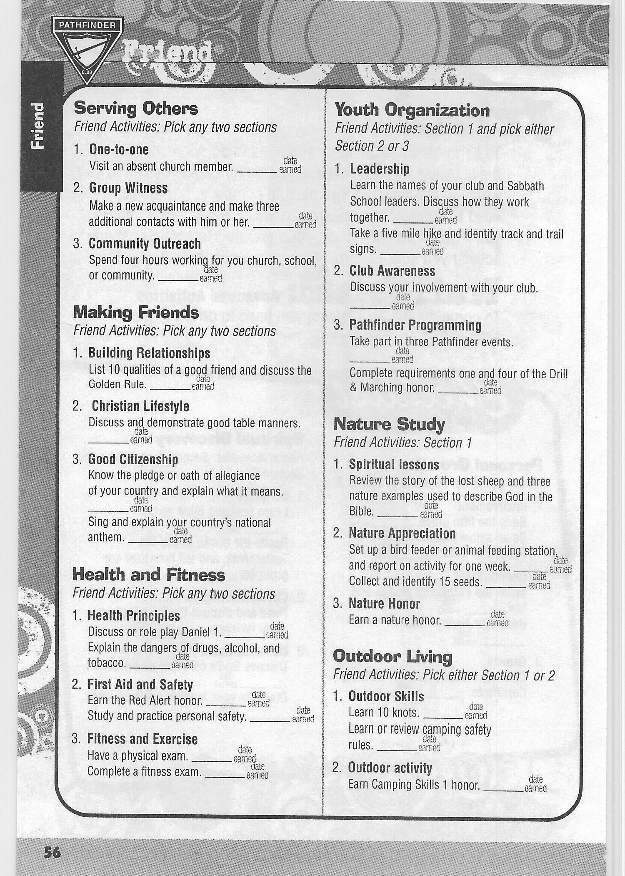

Qualities of a good friend:
• Genuine
• Giving
• Considerate
• Approachable
• Friendly
• Accepting
• Respectful
• Dependable
• Loyal
• Flexible
• Supportive
• Truthful
• Encouraging
• Positive
• Appreciative
• An active listener
• Understanding
• Enriching
• Honest
• Understanding of one’s
personal space
Discuss the questions on the next few slides.
Orchards Pathfinder Journal 2023
9

Slide 10
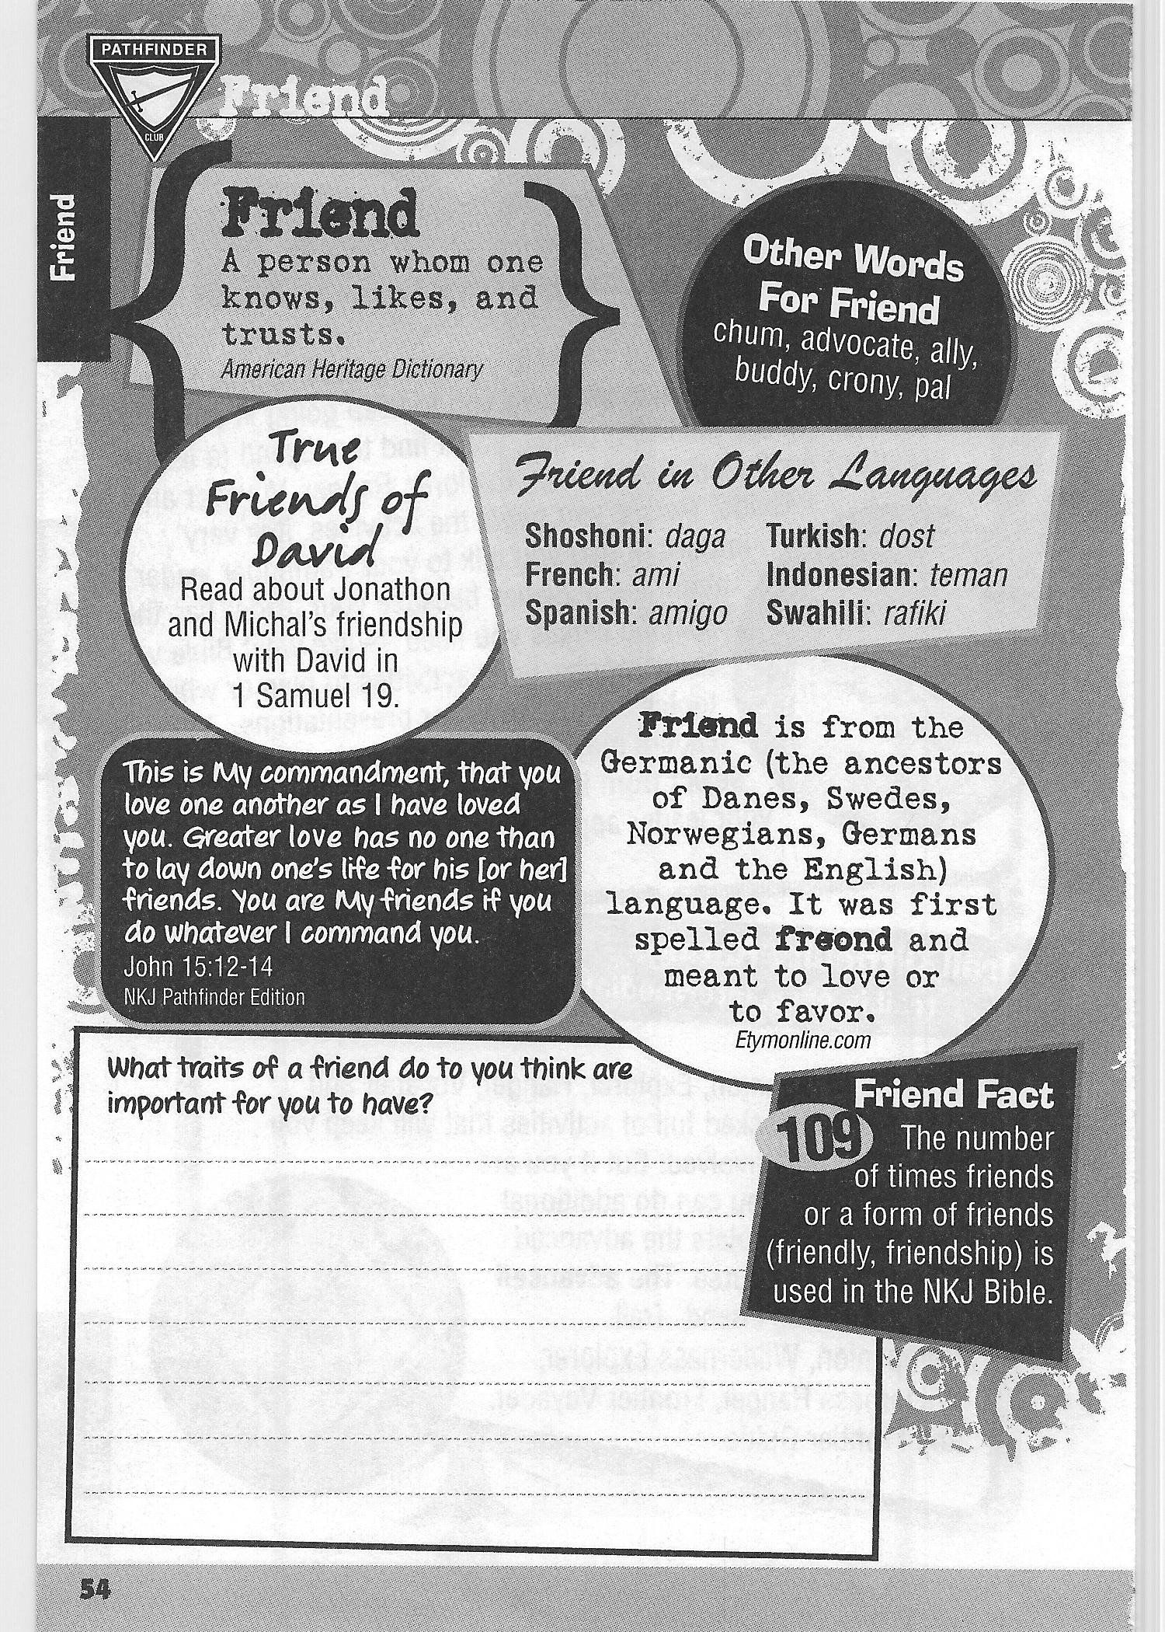



Orchards Pathfinder Journal 2023
10

Slide 11
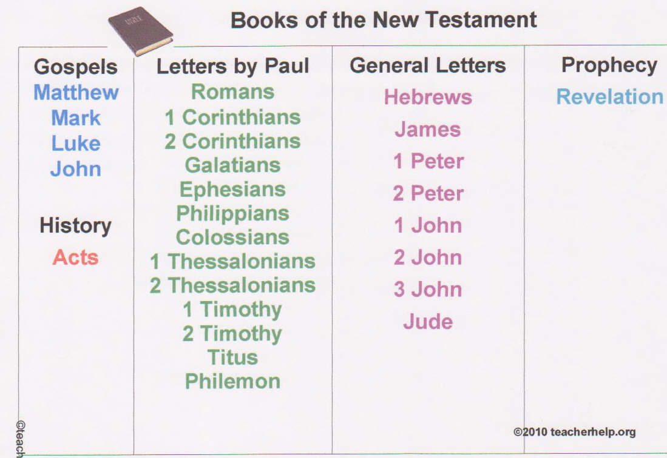

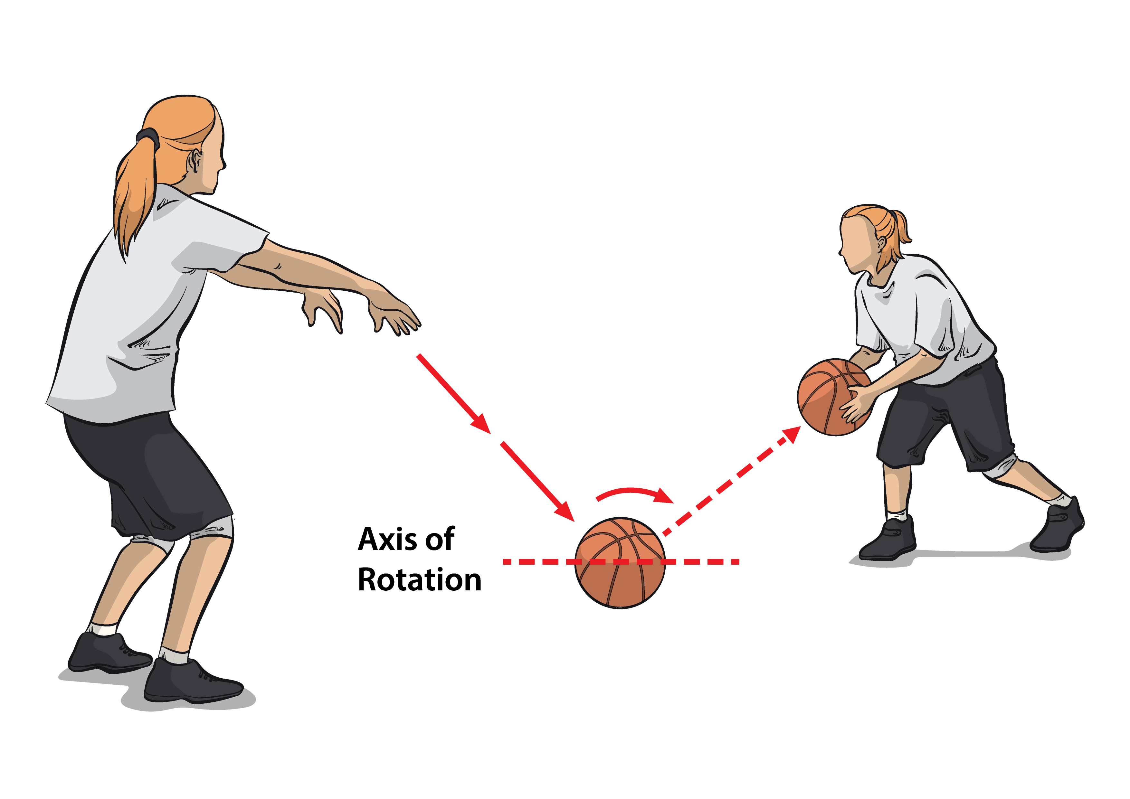
Learn the books of the New Testament
Now take turns saying the books
while you bounce a ball to a friend.

Slide 12
Optional Friendship Quality Activity:
Friendship Escape room

Slide 13
Another option for Pledge and Law slides:

Slide 14
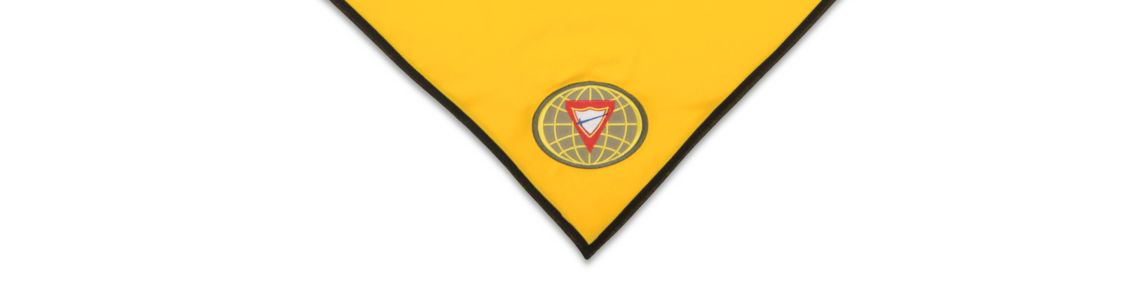
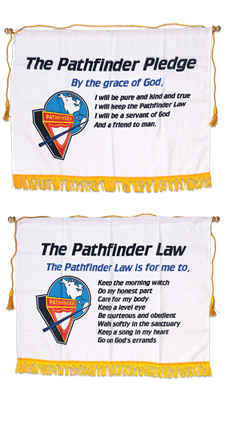

By the grace of God
As Pathfinders,
it is our desire
and pledge:
Meaning that only
as I rely on God to help me, can I do His will.

Slide 15
I will be pure
As Pathfinders,
it is our desire
and pledge:
Meaning
that I will rise above
the wicked world
in which I live
and keep my life clean
with words and actions
that will make others happy.

Slide 16
I will be kind
As Pathfinders,
it is our desire
and pledge:
Meaning
That I will not only
be considerate and kind
to my fellow mankind,
but also, to all of
God’s creation.

Slide 17
I will be true
As Pathfinders,
it is our desire
and pledge:
Meaning
I will be honest and upright
in study, work and play
and can always be counted
upon to do my very best.

Slide 18
I will keep the Pathfinder Law
As Pathfinders,
it is our desire
and pledge:
Meaning I will seek to
understand the meaning
of the Pathfinder Law
and will strive to live up to its spirit,
realizing that obedience to law
is essential in any organization.

Slide 19
I will be a servant of God
As Pathfinders,
it is our desire
and pledge:
Meaning
I will pledge myself to serve God
first, last and best
in everything
I am called upon
to be or do.

Slide 20
I will be a friend to man
As Pathfinders,
it is our desire
and pledge:
Meaning
I will live to bless others and to do unto them
as I would have them
to do me.

Slide 21
Keep the morning watch
As Pathfinders,
We will strive to keep the law, by God grace:
Because God wants me to know Him,
I will have prayer and personal Bible study each day.

Slide 22
Do my honest part
As Pathfinders,
We will strive to keep the law, by God grace:
Because God is faithful,
by the power of God,
I will help others,
and do my duty
and my honest share
wherever I may be.

Slide 23
Care for my body
As Pathfinders,
We will strive to keep the law, by God grace:
Because my Creator places His Holy Spirit within me,
I will be temperate
in all things
and strive to reach a high
standard of physical fitness.

Slide 24
Keep a level eye
As Pathfinders,
We will strive to keep the law, by God grace:
Because God is the
LORD of Truth,
I will not lie, cheat,
or deceive,
and will despise dirty talk
or evil thinking.

Slide 25
Be courteous and obedient
As Pathfinders,
We will strive to keep the law, by God grace:
Because God loves me,
I will be kind and
thoughtful of others,
reflecting the love of Jesus
in all my association
with others.

Slide 26
Walk softly in the sanctuary
As Pathfinders,
We will strive to keep the law, by God grace:
Because God Almighty is majestic and Holy,
In any devotional exercise I will be quiet, respectful, and reverent.

Slide 27
Keep a song in my heart
As Pathfinders,
We will strive to keep the law, by God grace:
Because God is with me
and fills me with joy,
I will be cheerful and happy
and let the influence of my life
be as sunshine to others.

Slide 28
Go on God’s errands
As Pathfinders,
We will strive to keep the law, by God grace:
Because God seeks to save the lost and bring light to darkness,
I will always be ready to
share my faith
and go about doing good
as Jesus did.

