Slide 1
Complete
Friend
IA requirements
Christian Citizenship

Slide 2

Citizenship Honor #1-3
For Friend Pin

Slide 3

1. Describe this flag.
50 stars represent _________
  50 states
The stars have ____ points
  5 points
The stars are on a _____ field
  Blue
Blue represents ___________
  Vigilance, perseverance, & justice
13 stripes represent _________
  13 original colonies
The color red stripes represent __
  Bravery
The color white stripes represent ___
  Purity and innocence
USA National Flag

Slide 4

1. Describe this flag.
Blue represents ___________
  Loyalty
white represents ___
  Purity
The middle emblem is _________
  Pathfinder emblem
The shield represents ____
  The protection of God
Red represents Jesus’ _____
  Sacrifice, shed blood
The gold represents
  excellence
The triangle represent __
  Completeness, The Godhead, and the 3 parts of education: mental, physical, and spiritual
The sword represents __
  The Word of God, the Bible
Pathfinder Flag

Slide 5

1. Describe this flag.
Blue represents ___________
  Loyalty
white stripes represents ___
  Purity
Red cross represents Jesus’ _____
  Sacrifice, shed blood
Christian Flag

Slide 6

1. Describe this flag.
white stripes represents ___
  Purity
Red represents Jesus’ _____
  Sacrifice, shed blood
The middle emblem is _________
  AY emblem
AY stands for
  Adventist Youth
The yellow 3 angels represents ____
  The 3 angels messages found in Revelation 14:6-12
  Worship God
  Fallen, Babylon (evil) is fallen
  Get away and stay away from evil! Be faithful and follow God’s commandments
AY Flag

Slide 7

1. Describe this flag.
The green background represents ___
  Washington is the Evergreen State
President ____ is pictured on the seal
  George Washington, the state namesake
Washington State entered the Union in the year ______
  1889
It is the only state flag with a green background
It is the only state flag with a president on it.
Washington State Flag

Slide 8
GAME TIME Play 20 Questions or I SPY
Choose a flag, give clues, others guess which flag was your choice.

Slide 9
Say the Pathfinder
Pledge and Law
Pathfinder Pledge and Law:
By the grace of God,
I will be pure, and kind, and true.
I will keep the Pathfinder Law.
I will be a servant of God and a friend to man.
The Law is for me to:
Keep the morning watch
Do my honest part
Care for my body,
Keep a level eye
Be courteous and obedient
Walk softly in the sanctuary,
Keep a song in my heart,
Go on God's errand.
Notes:
Pathfinder Pledge Explanation
By the grace of God Only as we rely on God to help us can we do His will.
I will be pure
I will fill my mind with everything that is right and true and spend my time in activities that will build a strong, clean character.
I will be kind
I will be considerate and kind, not only to my fellow man, but also to all of God's creation.
I will be true.
I will be honest and upright in study, work and play and can always be counted upon to do my very best.
I will keep the Pathfinder Law.
I will seek to understand the meaning of the Law and will strive to live up to it's spirit, realizing that obedience to law is essential in any organization
I will be a servant to God
I will pledge myself to serve God first, last, and best in everything I am called upon to be or do.
I will be a friend to man.
I will live to bless others and do unto them as I would have them do unto me.
Pathfinder Law Explanation
Keep the Morning Watch.
I will have prayer and personal bible study each day.
Do my honest part.
By the power of God I will help others, and do my duty and my honest share, wherever I may be.
Care for my body
I will be temperate in all things and strive to reach a higher standard of physical fitness.
Keep a level eye.
I will not lie, cheat or deceive, and will despise dirty talk or evil thinking.
Be courteous and obedient.
I will be kind and thoughtful of others, reflecting the love of Jesus in all my association with others.
Walk softly in the sanctuary.
In any devotional exercise I will be quiet, careful and reverent.
Keep a song in my heart
I will be cheerful and happy and let the influence of my life be as sunshine to others.
Go on God's errands.
I will always be ready to share my faith and go about doing good as Jesus did.

Slide 10

Learn the Pathfinder Song

Slide 11
2. Know how to display the national flag with two other flags under the following situations:
  a. Camp out/camporee
  b. Fair
  c. Pathfinder Day program
  d. Parade
Principles of displaying the USA flag:
The USA flag is the dominate flag and should always be higher and center
The USA flag should be at the right of who it serves.
  If it is on a stage, it serves the speaker and should be on his/her right.
  If it is on the floor level, it serves the congregation and should be on their right.
  If it is in a parade of a row of flags, it should be on their right.
  However, if it is in a procession of many rows, it should be front and center.
  The blue portion should be at the top of the flag. If the flag not flying on a pole, then the blue should be on the top left.

Slide 12
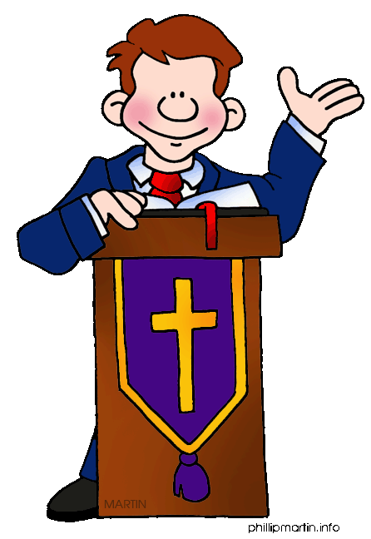

Where would you place the flags?

Slide 13
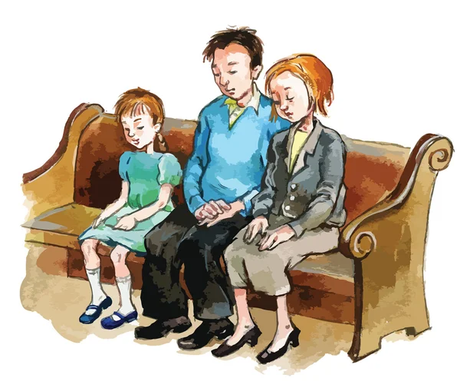
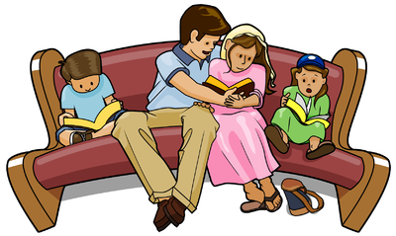
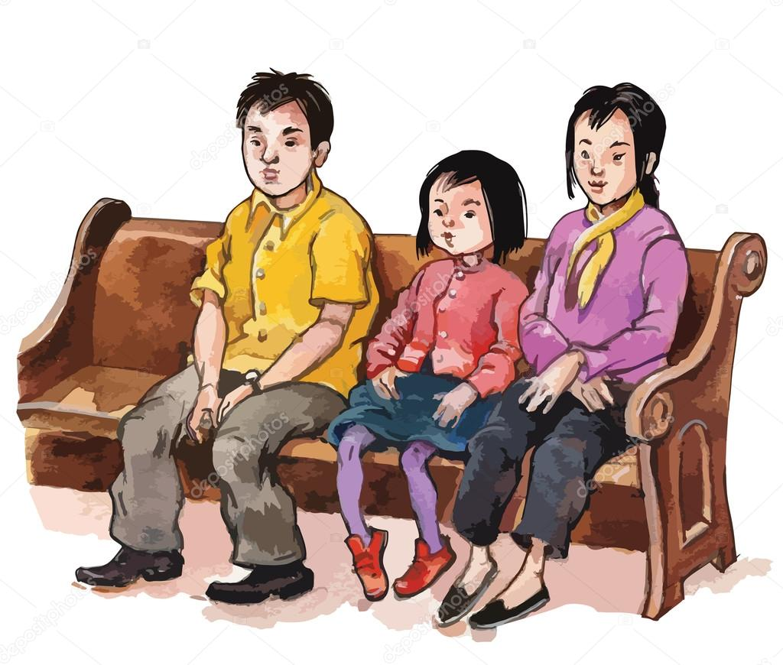

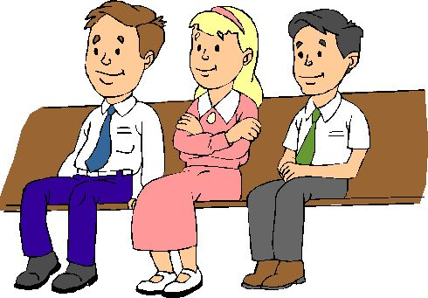

Where would you place the flags?

Slide 14

Where would you place the flags?

Slide 15
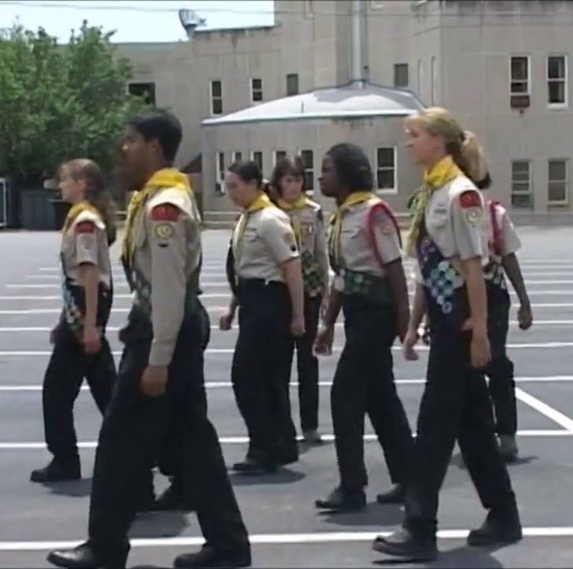
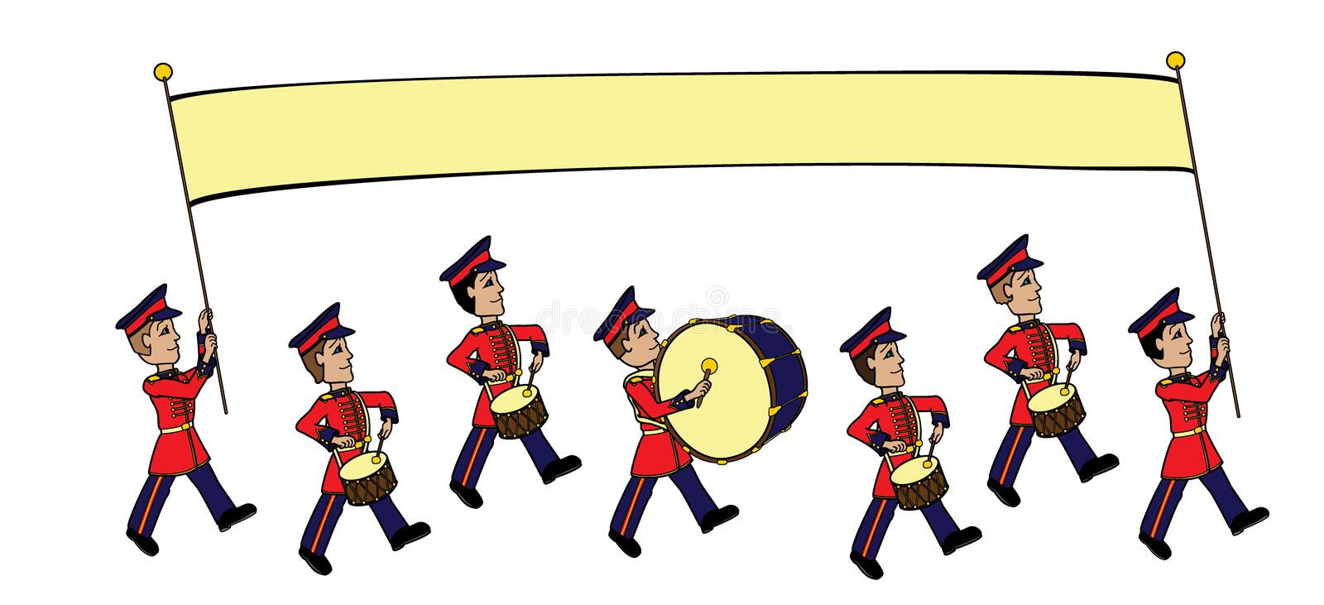
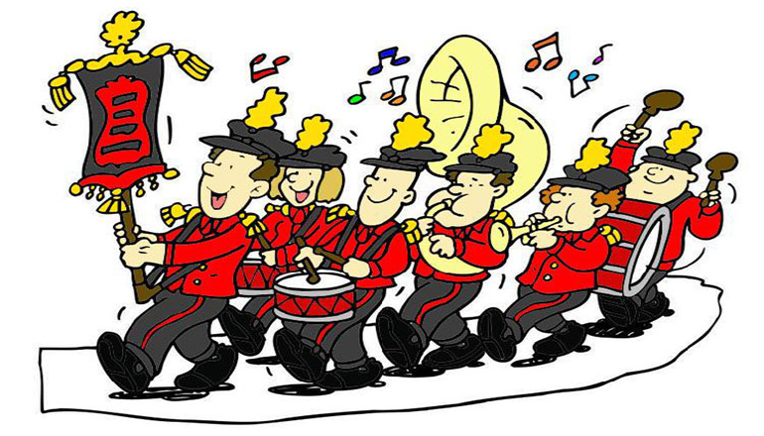
Where would you place the flags?

Slide 16
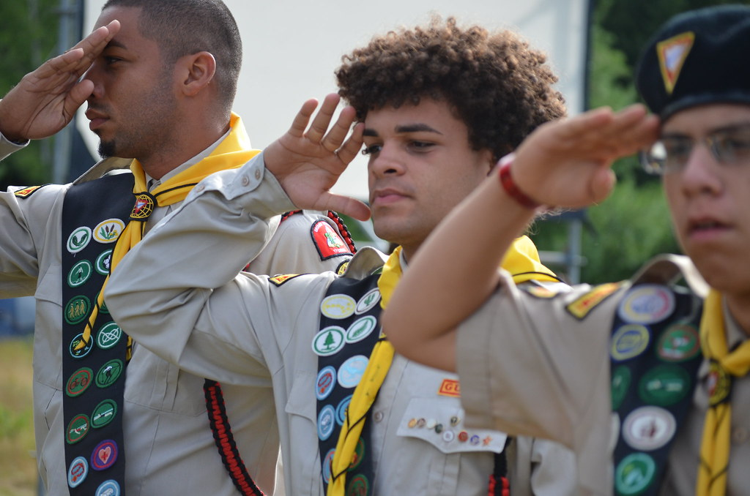
3. Demonstrate how to salute your national flag.
Mention when and how it should be displayed.
Who is saluting correctly?
Say the pledge of
allegiance

Slide 17
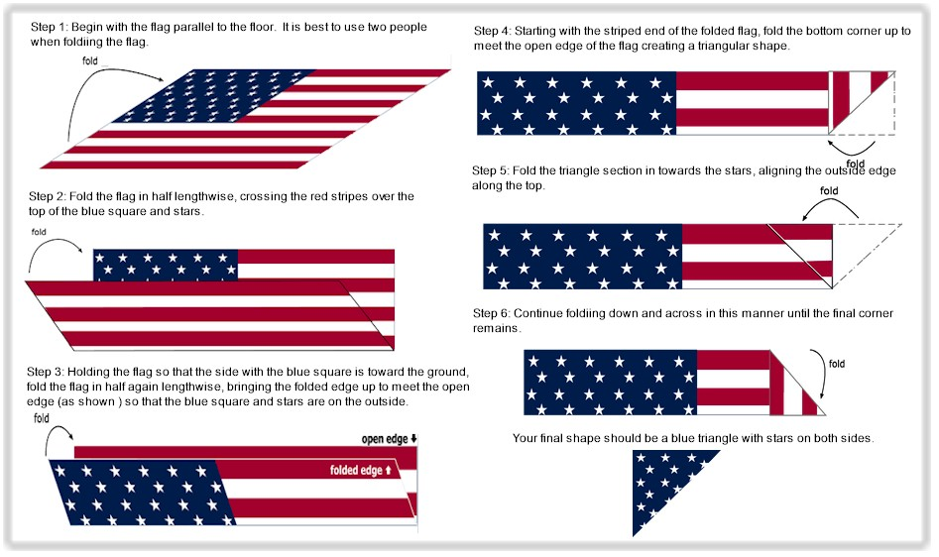
3. Demonstrate how to fold your national flag.

Slide 18

What are the rights and responsibilities of American Citizens?
5.5 min.

Slide 19
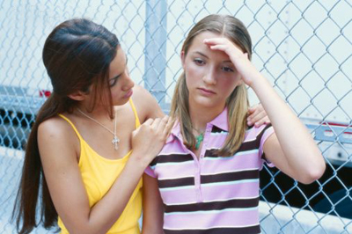
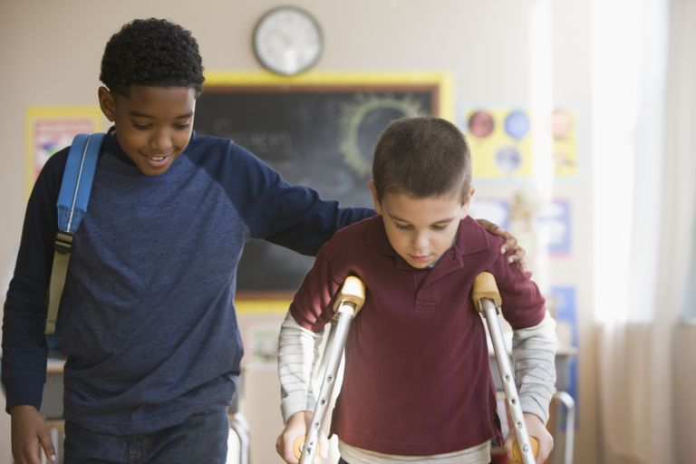
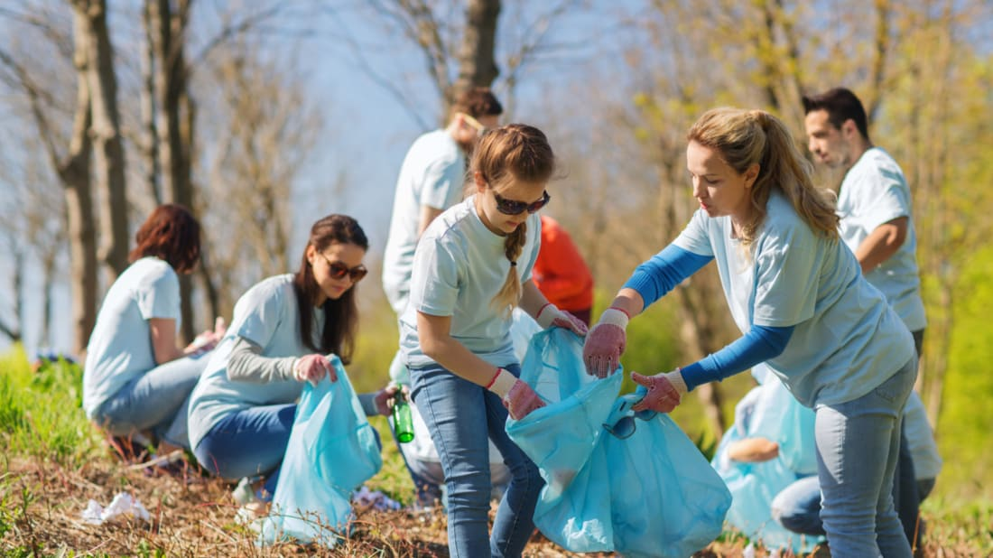

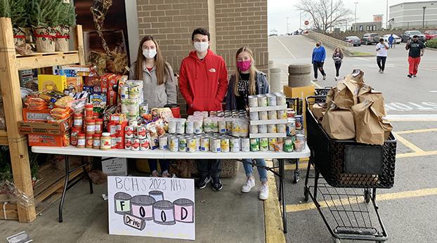
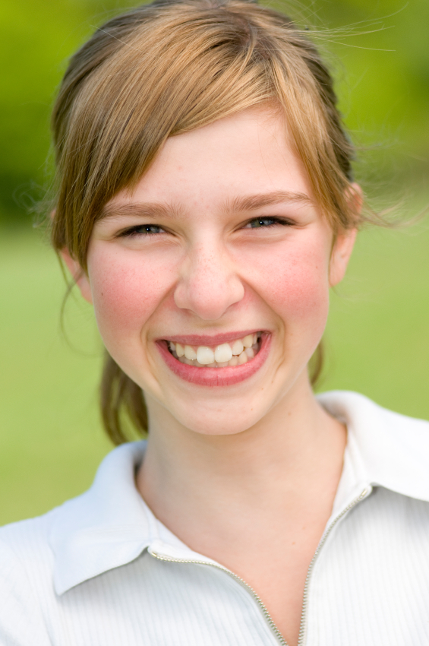

Be a Good Citizen
How can we be a good citizen of our government and of God’s kingdom?
What principles are in the Bible?
Matthew 22:21
Romans 13:1-7
  1 Timothy 2:1-3
  Titus 3:1
  1 Peter 2:13-14

Slide 20
Be a Good Citizen of Christ’s Kingdom
Matthew 9:35-38
Have you been friendly to someone who needed a friend? Tell me about it.
Who do you know that needs some help or encouragement? What can we do?

Slide 21
Be a Good Neighbor in a community
Voyagers
There are many communities:
The neighborhood of your church, school, or home
Your home
Your school
Your church
Your Pathfinder group
Your friends
Choose a community
Where is the community – describe or show on a map
Who lives there?
How healthy is the community and those in that community?
What needs does the community have and those in it?
  Health needs
  Economic needs $
  Housing needs
  Emotional needs
  Spiritual needs
  Transportation needs
  Other needs
Make a list of 3 projects that would benefit the community

Slide 22

What does a mayor do?

Slide 23
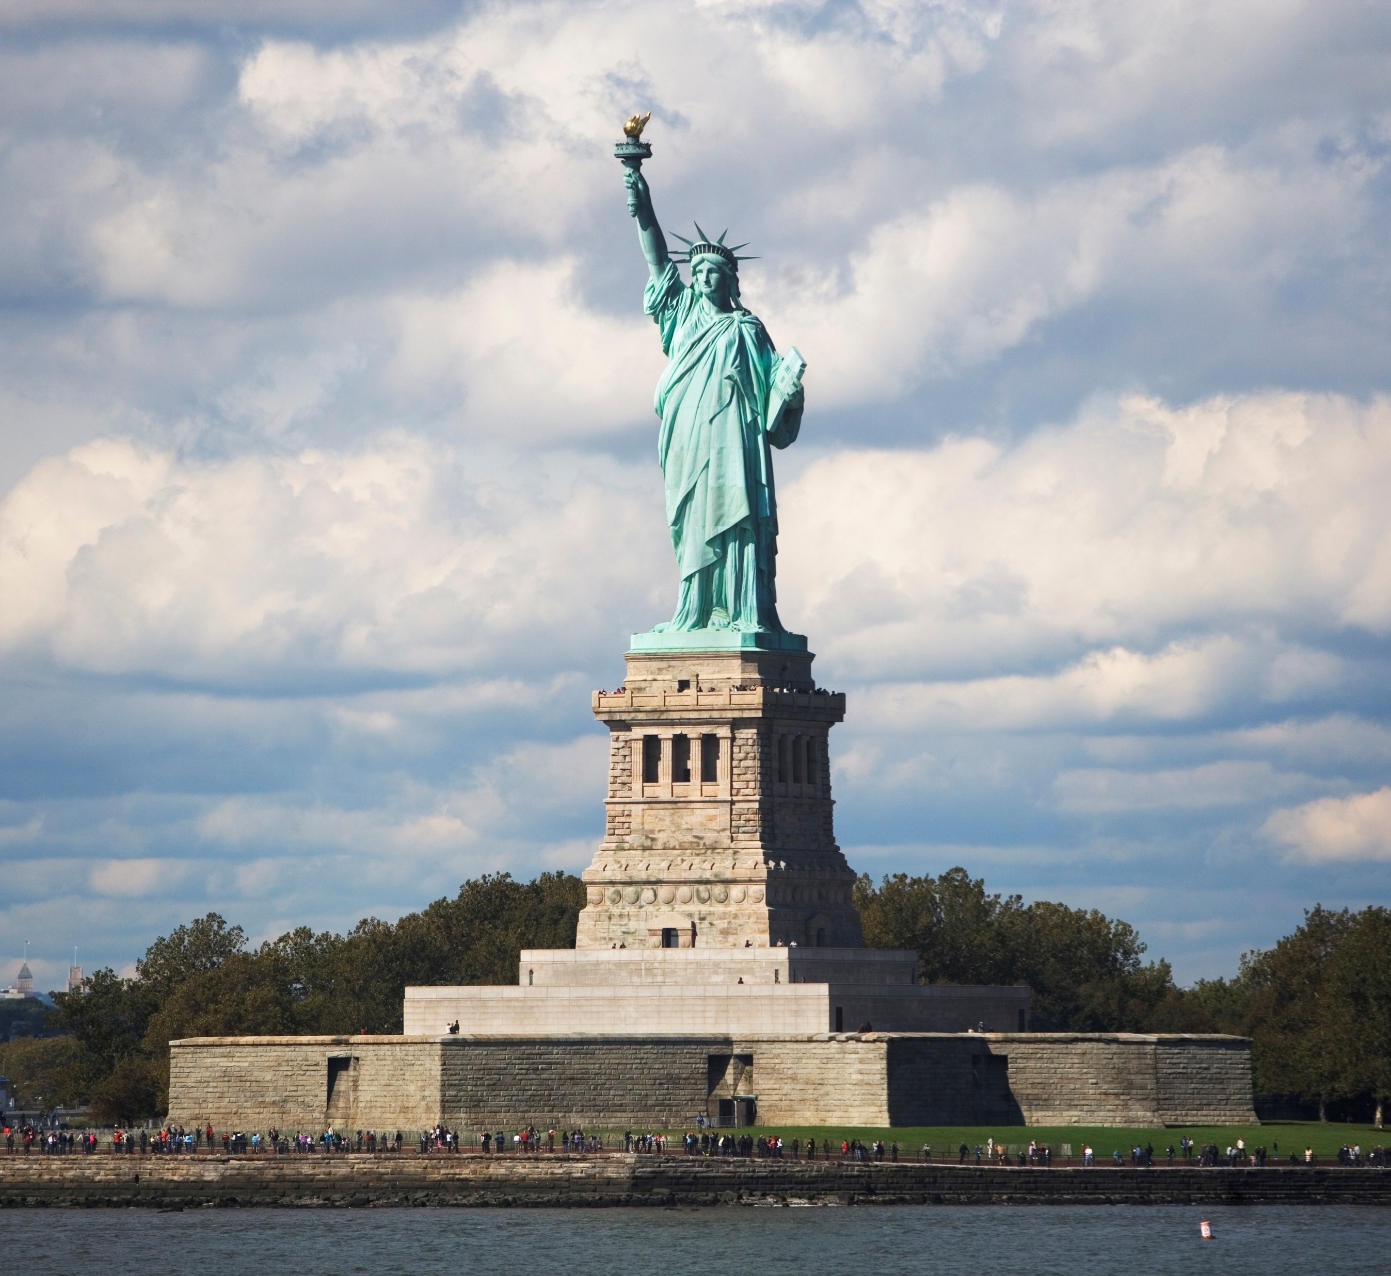
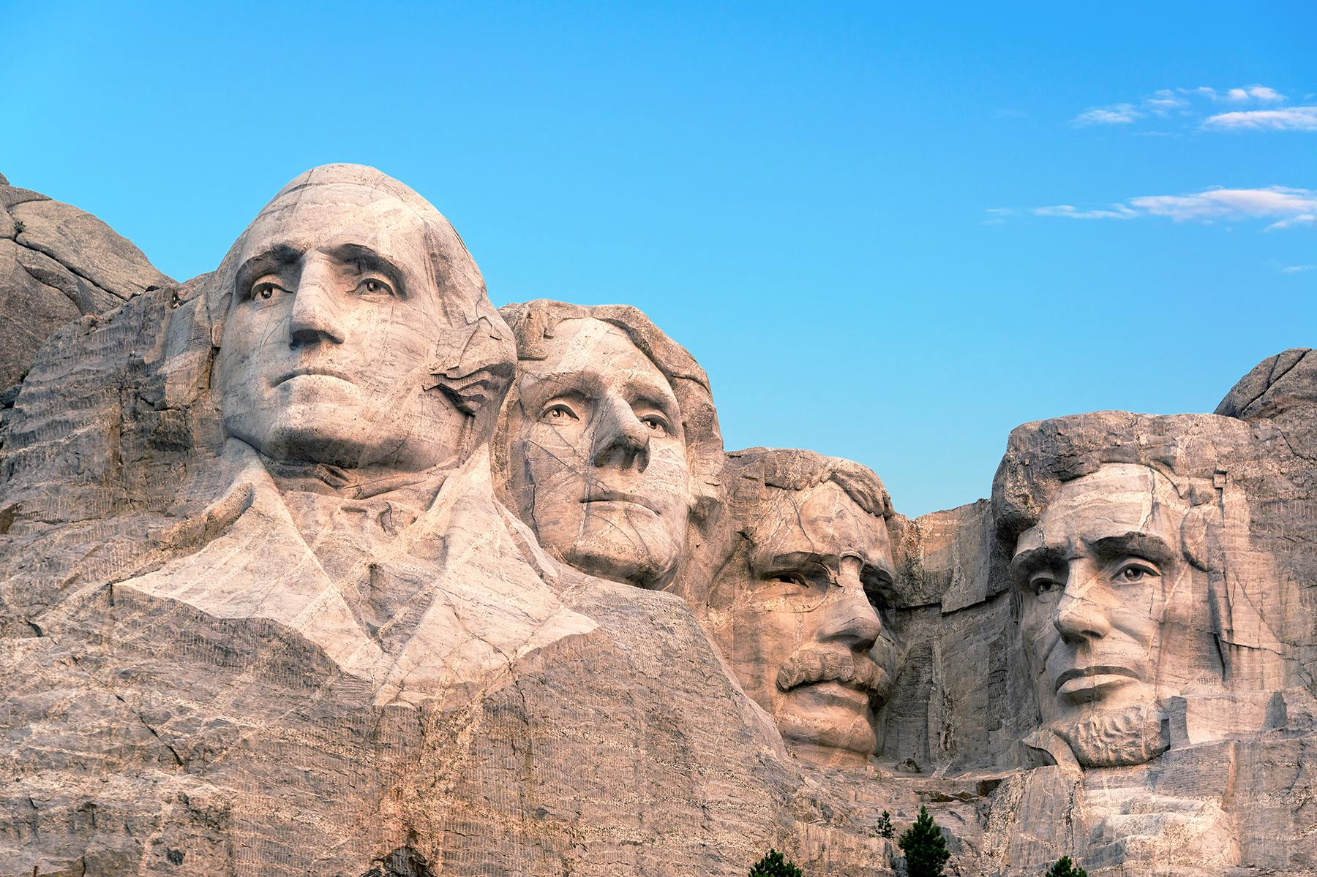
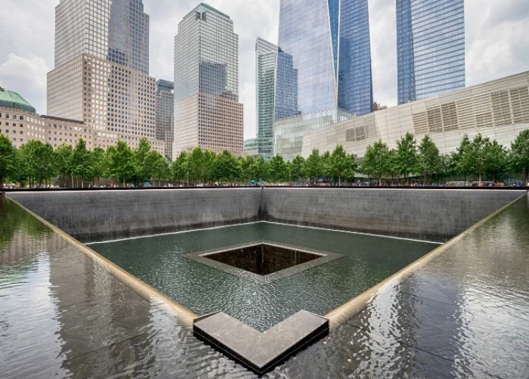
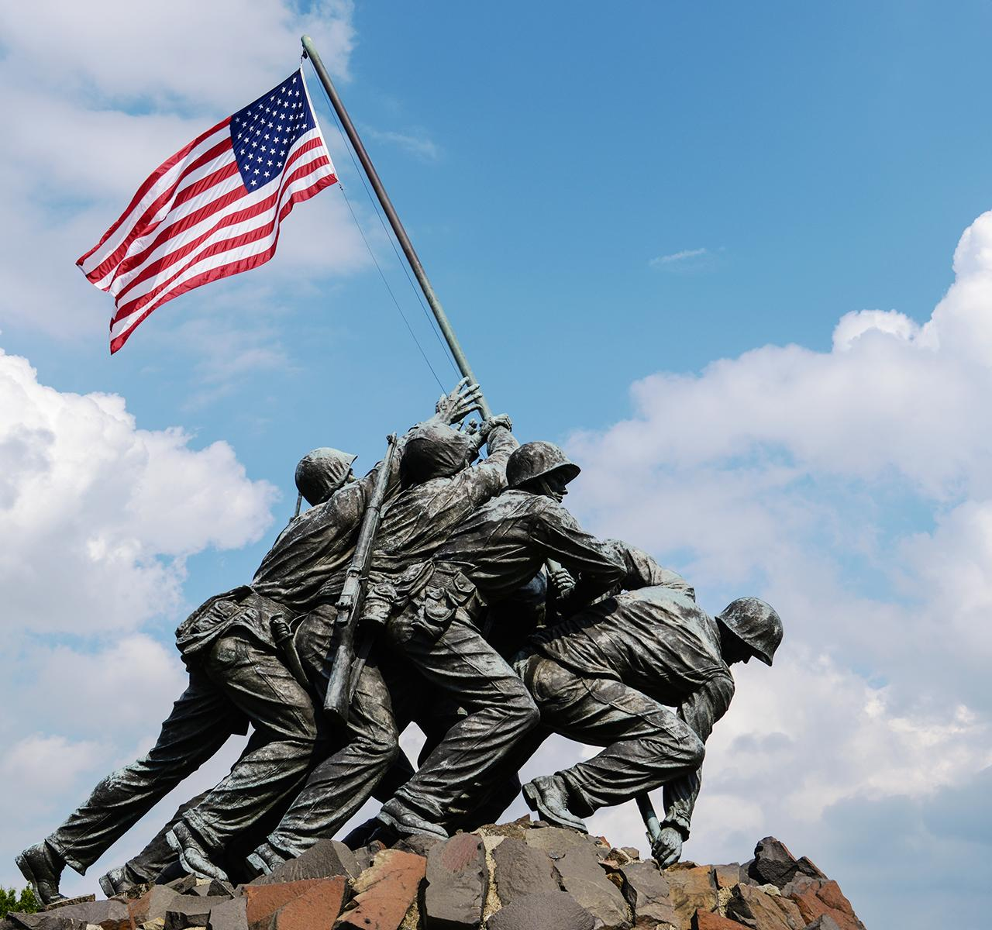
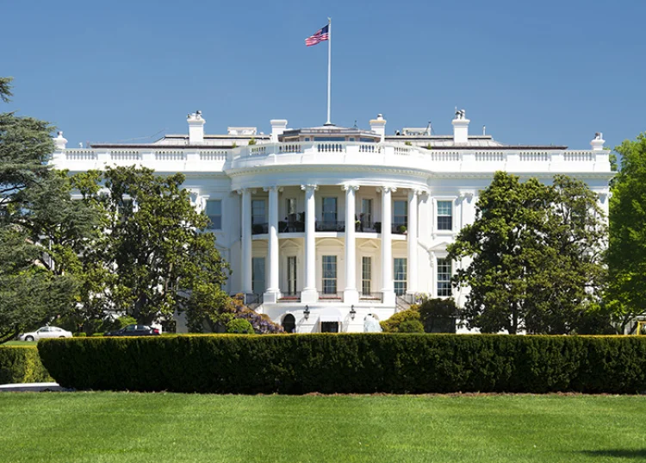
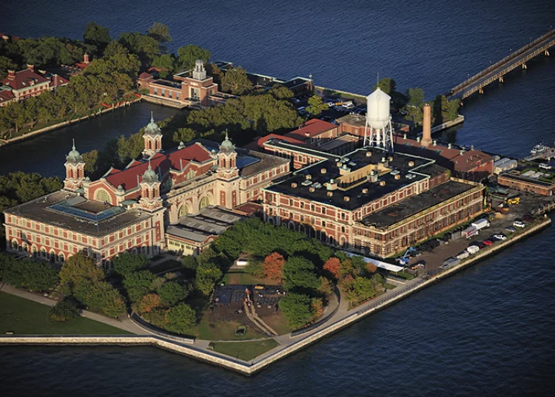
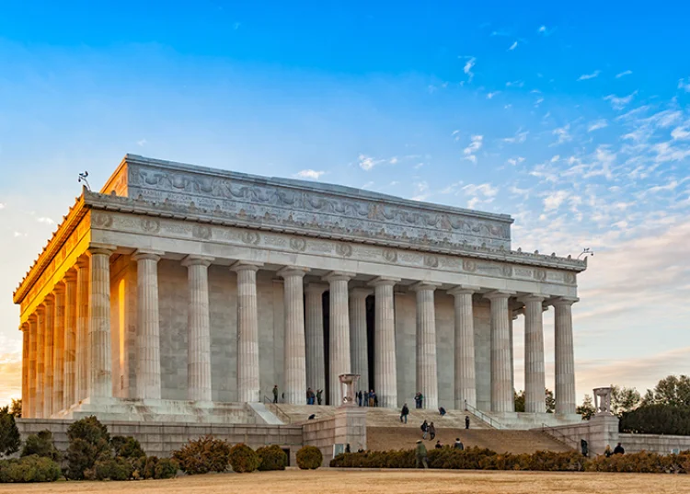
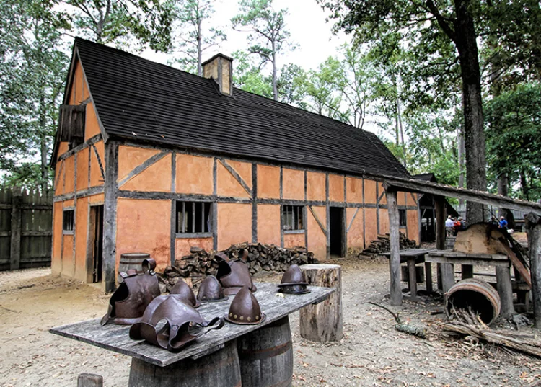
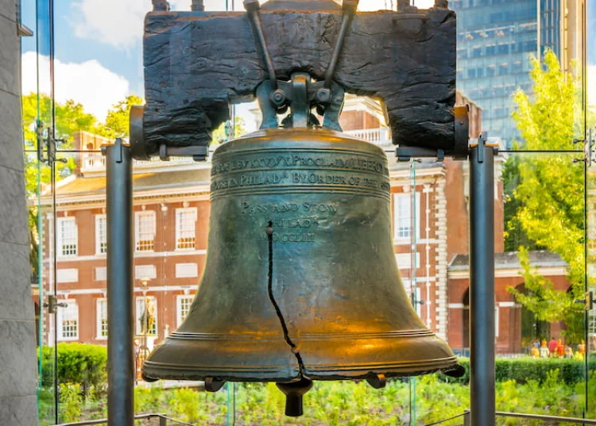
Make a list of 10
Choose the title of your 10 and then make a list of 10:
10 famous quotes
10 historic places
10 historic events
10 famous landmarks
https://www.historyhit.com/guides/historic-sites-in-the-united-states/

Slide 24
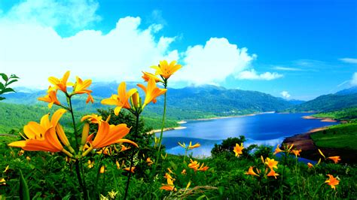
How does nature reveal the character of God?
Look up and read
Romans 1:19-20
Can you find some more verses? Look in:
Job 12
Psalms 19
Psalms 8
Matthew 6

Slide 25
Besides government, city, or church leaders,
Who is our overall CHIEF LEADER?
Also required for Friend IA….
God the Father and Jesus Christ

Slide 26
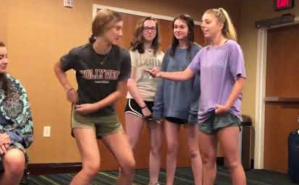
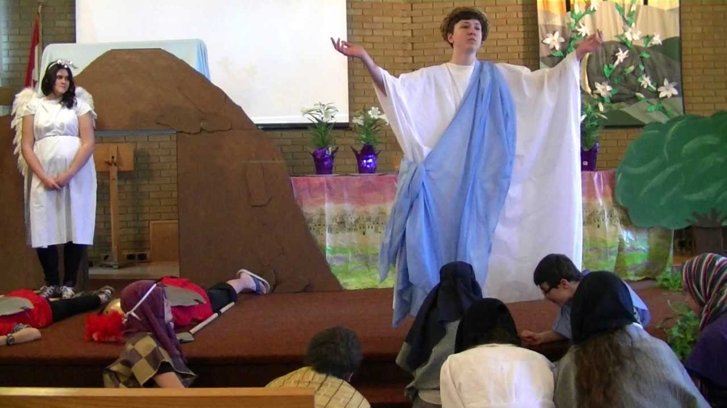
Let’s do a skit about the life of Jesus
Choose a Story:
Healing at the Pool John 5
Jesus feeds 5000 John 6
Jesus heals blind man John 9
Jesus’ resurrection John 20
Breakfast on the beach John 21
Read the story from the Bible
Choose which character you want to be.
Props and costumes are optional or should be simple
Do an impromptu skit
  Have someone read the text
  Others act out the story
  Speaking parts are optional and can be simplified and said in own words
Whom shall we
do the skit for?

Slide 27

https://activity-array.com/

