Slide 1
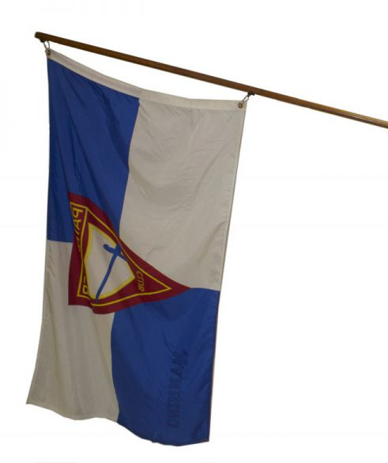
Pathfinder Induction
Ceremony

Slide 2
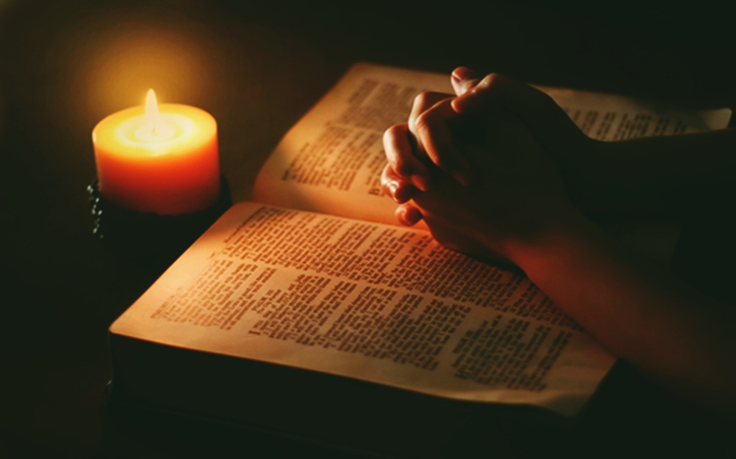
Invocation

Slide 3

Pledge of Allegiance All

Slide 4
Pathfinder Song
Oh, we are the Pathfinders strong,
The servants of God are we.
Faithful as we march along,
In kindness, truth, and purity
A Message to tell to the world,
A truth that will set us free!
King Jesus the Savior's coming back
For you, and me!

Slide 5
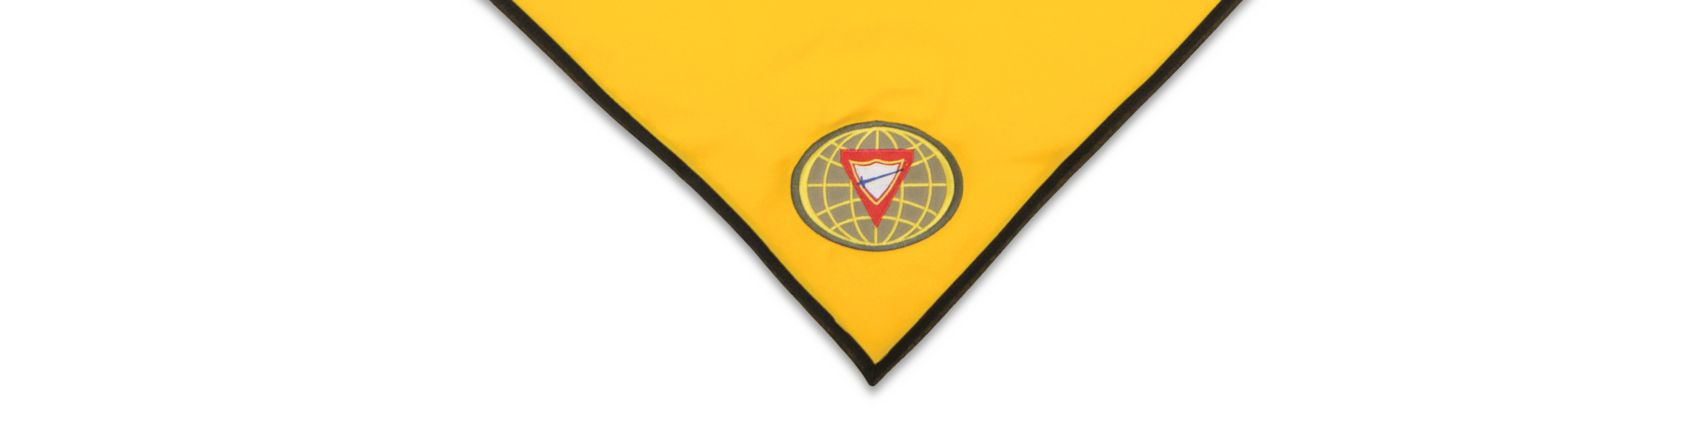

It is the spirit of adventure, fun, learning, camaraderie, awareness, and awakening and above all, a spirit of reverence and a spirit of service to God and man.
The candle
we light first
is the
SPIRIT OF PATHFINDERING

Slide 6


is a course of study in learning, skills, and physical fitness that will help one to be a better neighbor now and a friend of God throughout eternity.
The FRIEND
Investiture Achievement

Slide 7

is a course of study in learning, skills, and physical fitness that will give more meaning to life and a companionship with Jesus Christ every hour of the day.
The COMPANION
Investiture Achievement

Slide 8

is a course of study that will help one find new adventure in exploring God’s world to secure true and genuine happiness.
The EXPLORER
Investiture Achievement

Slide 9

is a course of study that will open up new areas of discovery in the natural and spiritual world to secure true and genuine happiness.
The RANGER
Investiture Achievement

Slide 10


is a course of study in physical, mental, cultural, and spiritual development that challenges the teen to develop a wholesome self-concept and Christian life-style.
The VOYAGER
Investiture Achievement

Slide 11

is a course of study that emphasizes personal growth and spiritual discoveries and prepares the Pathfinder for development of new skills in leadership and survival techniques.
The GUIDE
Investiture Achievement

Slide 12
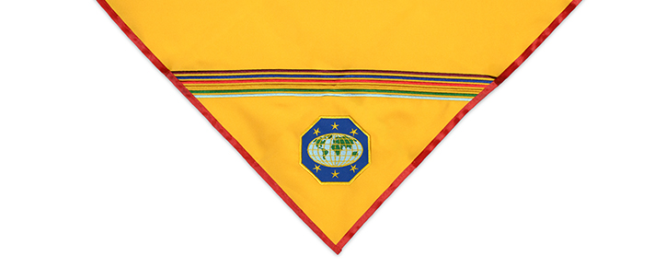












The Pathfinder program promotes physical, mental, emotional, and spiritual growth in all ages of pathfinders from pre-teens to staff.
Our pledge and law reflect these goals.

Slide 13
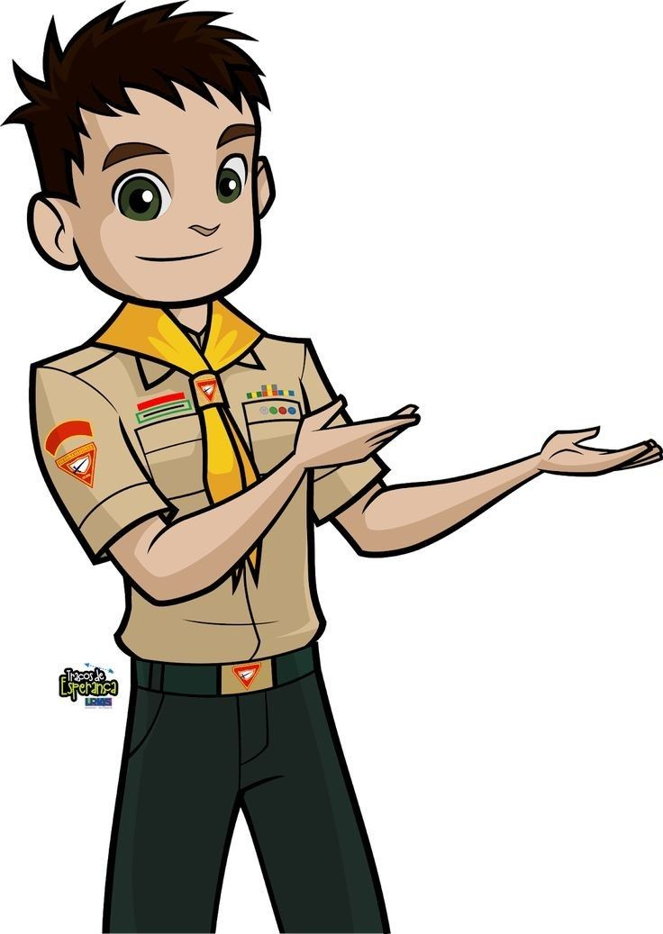

Introducing our new Pathfinders:

Slide 14
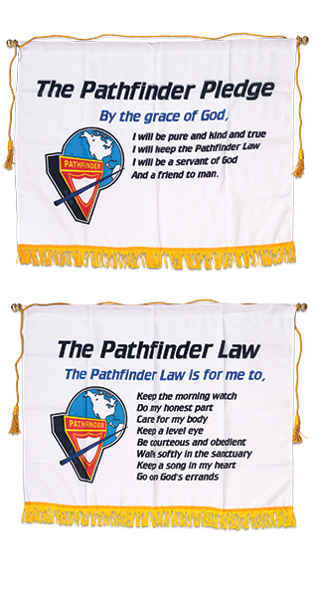
By the grace of God
As Pathfinders,
it is our desire
and pledge:
Meaning that only
as I rely on God to help me, can I do His will.

Slide 15
I will be pure
As Pathfinders,
it is our desire
and pledge:
Meaning
that I will rise above
the wicked world
in which I live
and keep my life clean
with words and actions
that will make others happy.

Slide 16
I will be kind
As Pathfinders,
it is our desire
and pledge:
Meaning
That I will not only
be considerate and kind
to my fellow mankind,
but also, to all of
God’s creation.

Slide 17
I will be true
As Pathfinders,
it is our desire
and pledge:
Meaning
I will be honest and upright
in study, work and play
and can always be counted
upon to do my very best.

Slide 18
I will keep the Pathfinder Law
As Pathfinders,
it is our desire
and pledge:
Meaning I will seek to
understand the meaning
of the Pathfinder Law
and will strive to live up to its spirit,
realizing that obedience to law
is essential in any organization.

Slide 19
I will be a servant of God
As Pathfinders,
it is our desire
and pledge:
Meaning
I will pledge myself to serve God
first, last and best
in everything
I am called upon
to be or do.

Slide 20
I will be a friend to man
As Pathfinders,
it is our desire
and pledge:
Meaning
I will live to bless others and to do unto them
as I would have them
to do me.

Slide 21

Pathfinders, please come up to help us light the candles
representing the Pathfinder law.
Pathfinders will say the law phrase.
One Pathfinder will receive a candle and place it on the table.
Each of you will take turns putting a candle on the table to represent the section of the law as the rest of us tell what that law means.

Slide 22
Keep the morning watch
As Pathfinders,
We will strive to keep the law, by God grace:
Because God wants me to know Him,
I will have prayer and personal Bible study each day.

Slide 23
Do my honest part
As Pathfinders,
We will strive to keep the law, by God grace:
Because God is faithful,
by the power of God,
I will help others,
and do my duty
and my honest share
wherever I may be.

Slide 24
Care for my body
As Pathfinders,
We will strive to keep the law, by God grace:
Because my Creator places His Holy Spirit within me,
I will be temperate
in all things
and strive to reach a high
standard of physical fitness.

Slide 25
Keep a level eye
As Pathfinders,
We will strive to keep the law, by God grace:
Because God is the
LORD of Truth,
I will not lie, cheat,
or deceive,
and will despise dirty talk
or evil thinking.

Slide 26
Be courteous and obedient
As Pathfinders,
We will strive to keep the law, by God grace:
Because God loves me,
I will be kind and
thoughtful of others,
reflecting the love of Jesus
in all my association
with others.

Slide 27
Walk softly in the sanctuary
As Pathfinders,
We will strive to keep the law, by God grace:
Because God Almighty is majestic and Holy,
In any devotional exercise I will be quiet, respectful, and reverent.

Slide 28
Keep a song in my heart
As Pathfinders,
We will strive to keep the law, by God grace:
Because God is with me
and fills me with joy,
I will be cheerful and happy
and let the influence of my life
be as sunshine to others.

Slide 29
Go on God’s errands
As Pathfinders,
We will strive to keep the law, by God grace:
Because God seeks to save the lost and bring light to darkness,
I will always be ready to
share my faith
and go about doing good
as Jesus did.

Slide 30

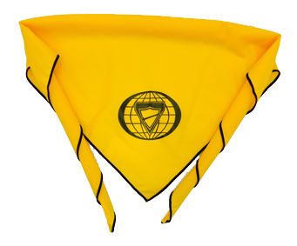
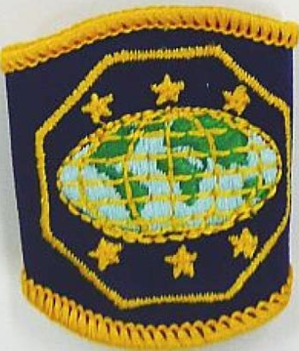
We now welcome to our Orchards Pathfinder club:
Pathfinder
Name
Come and receive your scarf, slide, and Bible.

Slide 31
We now welcome to our Orchards Pathfinder club:
Pathfinder
Name
Come and receive your scarf, slide, and Bible.

Slide 32


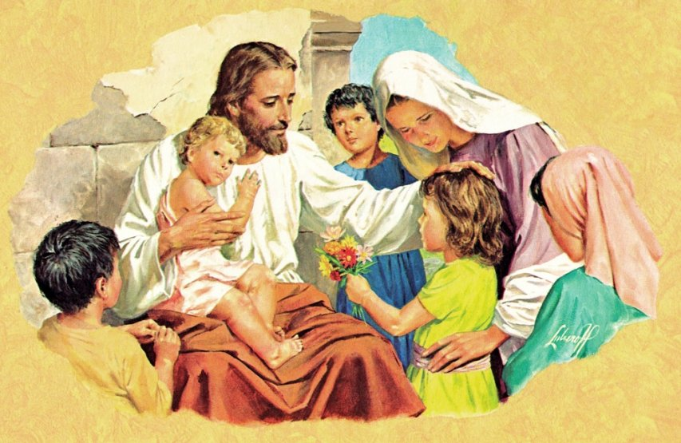

Prayer of Dedication
Pathfinder, Adventurers and families please come up front
for a prayer of dedication.

Slide 33
Pathfinder Song
Oh, we are the Pathfinders strong,
The servants of God are we.
Faithful as we march along,
In kindness, truth, and purity
A Message to tell to the world,
A truth that will set us free!
King Jesus the Savior's coming back
For you, and me!

Slide 34


Slide 35
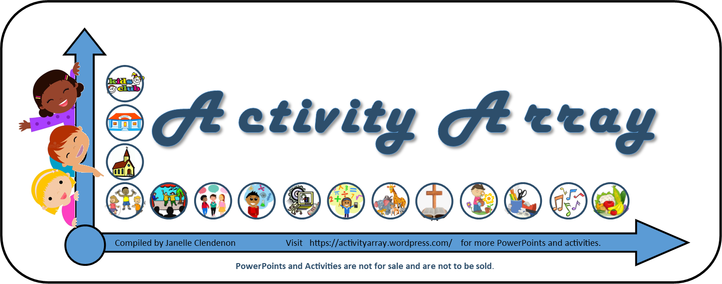
https://activityarray.wordpress.com/

Slide 36
Extra Slides – Adventurer Induction

Slide 37







Adventurers has six investiture achievement classes:
Little Lamb
Eager Beaver
Busy Bee
Sunbeam
Builder
Helping Hand
This year, our adventurers are working on
Eager Beaver and Busy Bees.

Slide 38
The Eager Beaver Class
is a journey through discovery, play, and learning that will introduce them to the example of Jesus in eagerly sharing His love.

Slide 39
The Busy Bee Class
is a voyage through adventure, activity and learning that will help the Adventurer to understand the value of working together for Jesus.

Slide 40
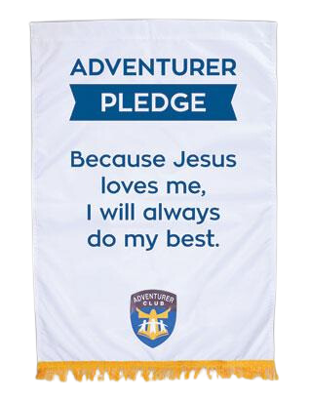

Adventurer
Pledge
Because Jesus
loves me,
I will always
do my best.

Slide 41

Adventurers, and parents of younger adventurers, please come up to help us light the candles​
representing the Adventurer law.​
​
We will say the law phrase all together.​
One Adventurer will receive a candle and place it on the table.​
​
Each of you will take turns putting a candle on the table to represent the section of the law as I read what that law means.

Slide 42
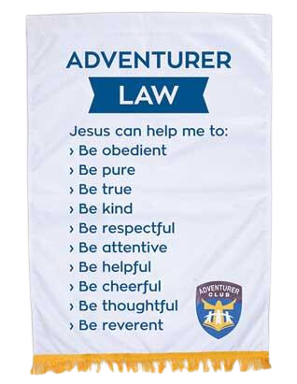
Be Obedient
I will obey God’s laws and cheerfully do what my parents and teachers ask me to do. I will obey the laws of my country.

Slide 43
Be Pure
My body is the temple of God, so I want to keep it clean.

Slide 44
Be True
I will always tell the truth and never try to deceive - even if I may get in trouble for it.

Slide 45
Be Kind
I will look for ways to make other people happy. I will never hurt a person or animal intentionally. I will share my toys.

Slide 46
Be Respectful
I will be courteous to those whom God put in authority over me (like parents and teachers) and to those who are younger and weaker than me (like little brothers and sisters). I will take good care of other people’s property, even something as small as a borrowed pencil.

Slide 47
Be Attentive
I will listen when someone is talking to me at home,
at school, and at church.
I will especially listen for God to tell me what to do with my life.

Slide 48
Be Helpful
I will look for ways to help and not wait to be asked.
I can help family at home, teachers and friends at school, and others in my community.
I can even help God.

Slide 49
Be Cheerful
I will not grumble or complain when I don’t get my way or when I have work to do. I will remember that God made me; knowing that makes me happy.

Slide 50
Be Thoughtful
I will make courtesy a habit, both in words and actions. I will look for ways to be nice to people.
I will not be rude or irritating.

Slide 51
Be Reverent
I will listen carefully to God, His word, and His messengers. I will take good care of my Bible and church property. I will never make fun of holy things.

Slide 52
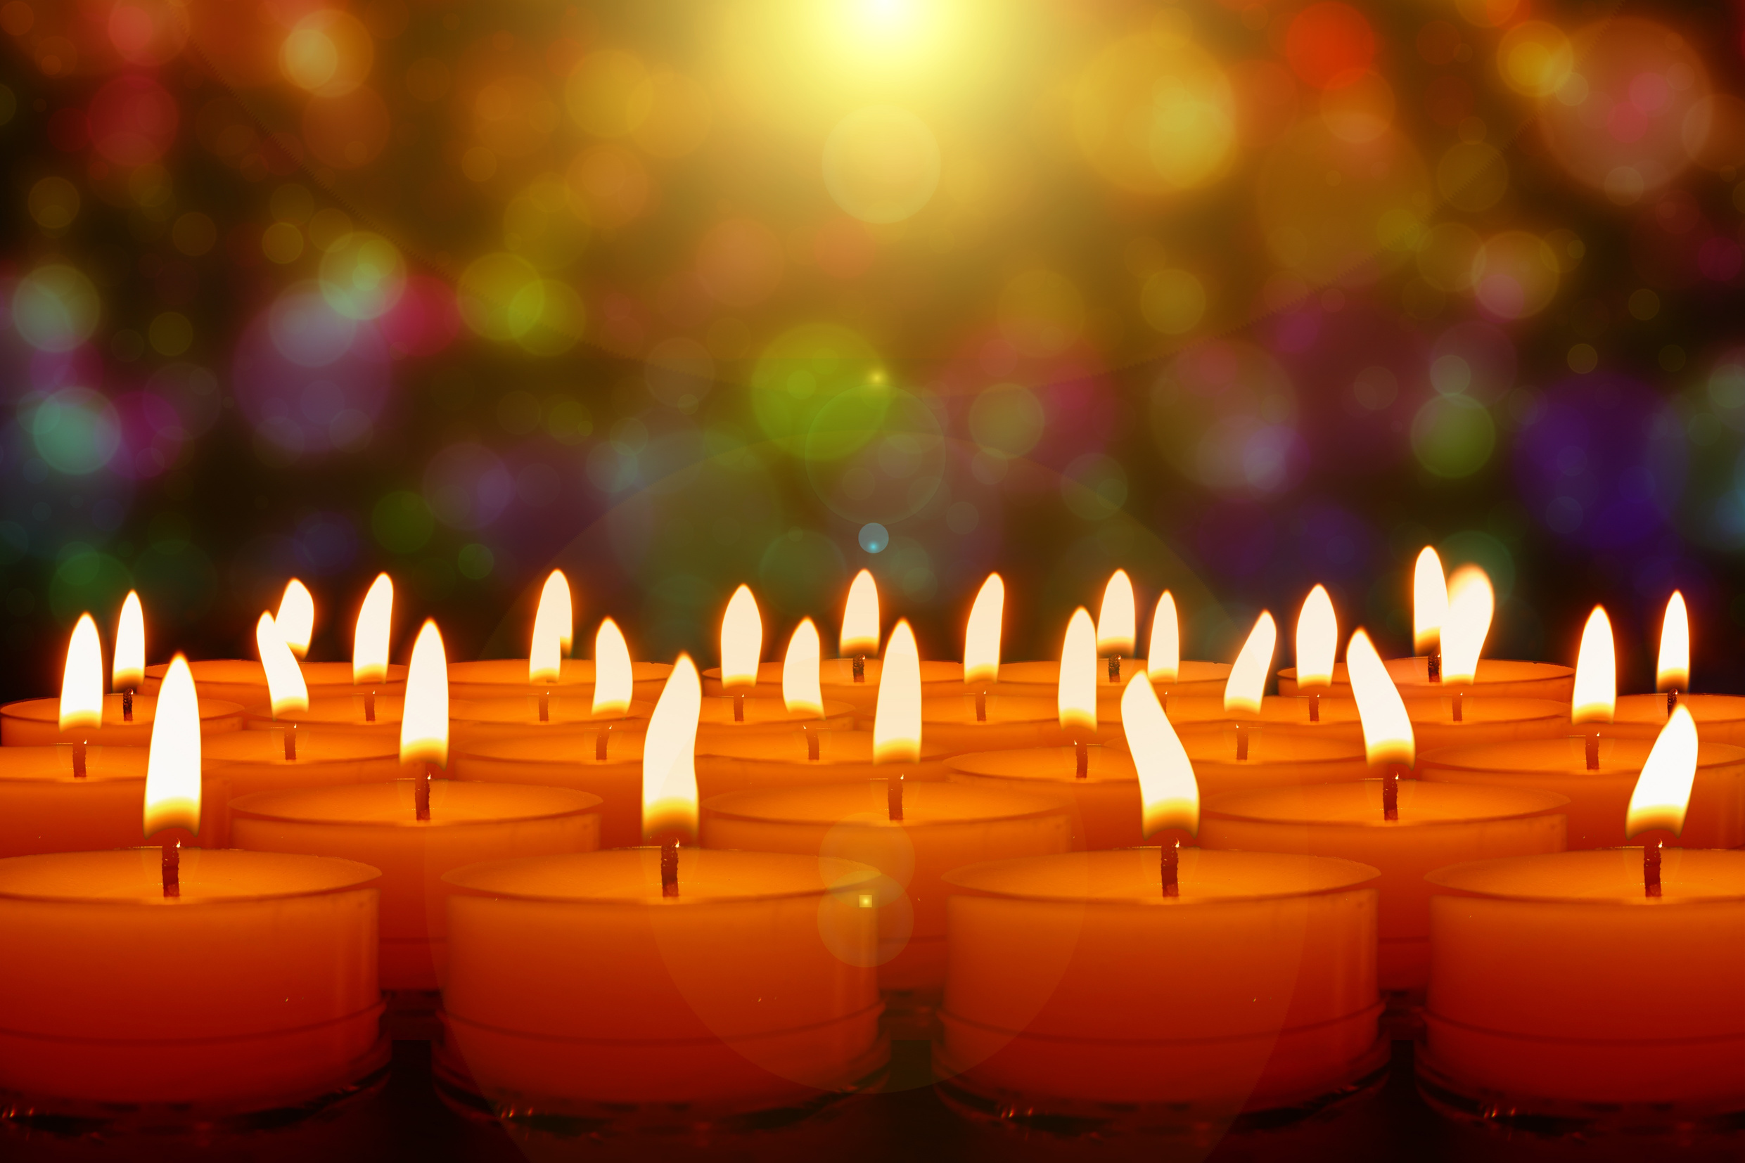
Jesus said, “I am the light of the world.
Anyone who follows me will never walk in darkness. They will have that light.
They will have life.”
John 8:12
Notes:
The candles you have lit this afternoon symbolize the light of Jesus shining through you and through our clubs into our community.

Slide 53
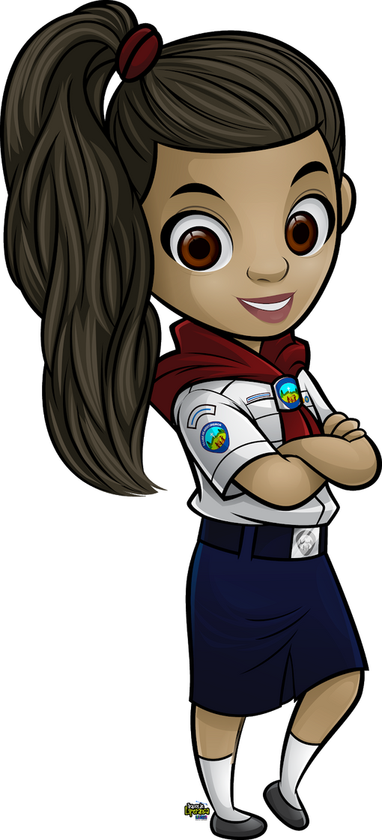
Club Name Adventurers
Staff Induction
Name
Notes:
Because volunteers are so essential to club ministries, it is exciting each time a person steps forward and volunteers to become staff.
I met Monica last fall when she and her daughter Aria joined Adventurers. I have enjoyed getting to know them. It's scary when you first start teaching an Adventurer class - especially a class with both young children and their parents! Monica enthusiastically jumped in last spring when I asked the parents to fill in for the Little Lambs teacher for a few meetings. I am thrilled that she has chosen to become an official staff member in our club. This year Monica is teaching our Eager Beavers.
Her mom tells me three words that describe Monica are loving, supportive, and genuine.
Welcome to the team, Monica.

Slide 54
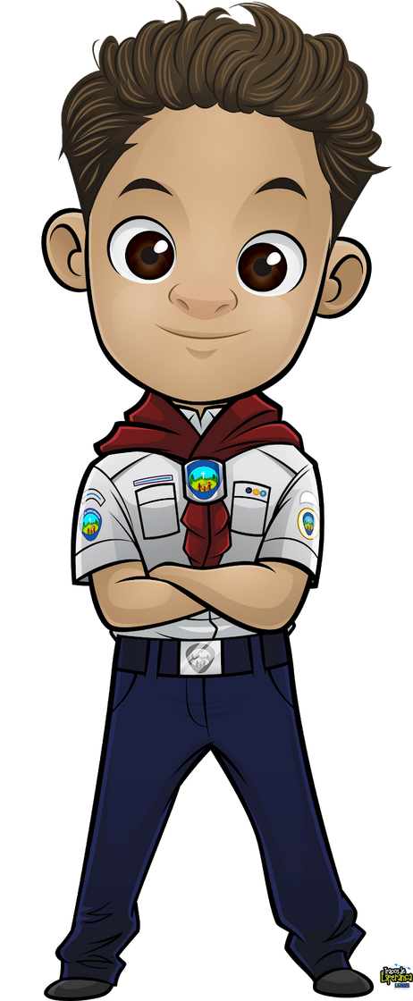
Club Name Adventurers
Induction
Children’s
Names
Notes:
At this time, we will induct our new Adventurers. When I call your name, please come up and bring your adults with you.
Daniel Serna: Daniel is in third grade and attends Emerald Elementary School. Three words that describe Daniel are bright, emphatic, and brave.
Daniel Spitsyn: Daniel is in third grade and attends Maple Grove Elementary School. Three words that describe Daniel are curious, crafty, and adventurous.
Maline Touray: Maline is in third grade and attends Emerald Elementary School. Three words that describe Maline are adventurous, energetic, and playful.
Matthew Reuk: Matthew is four years old. Three words that describe Matthew are funny, cheerful, and curious.

Slide 55
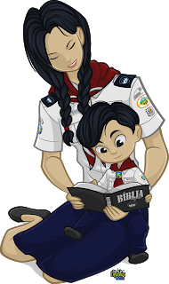
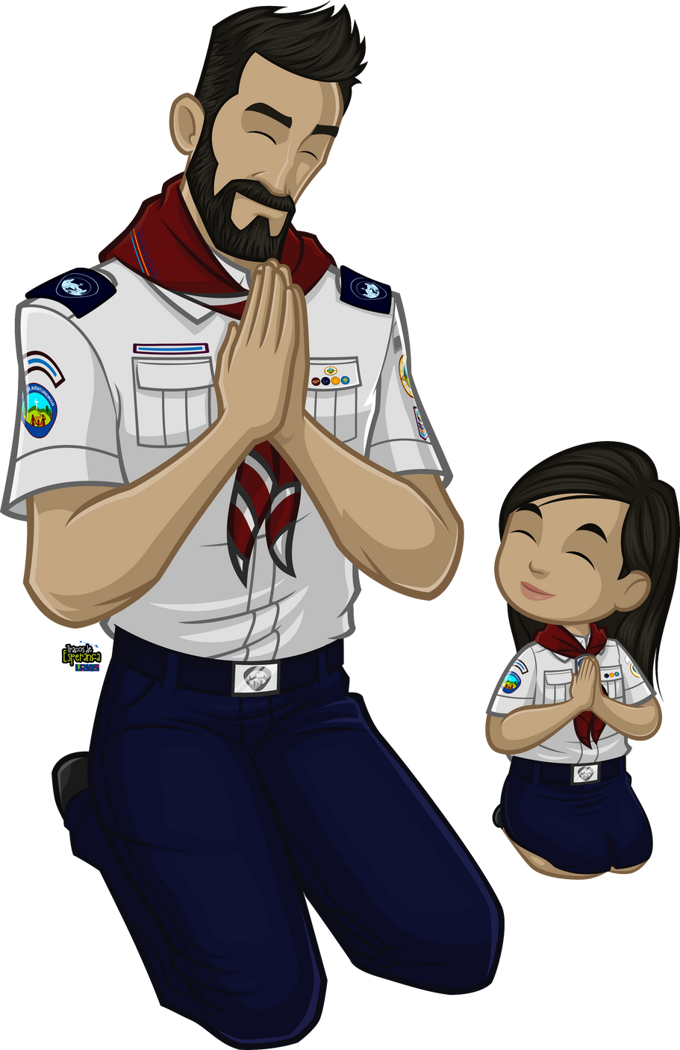
The child that stands before you needs the warmth, security, and love of their parent(s). The Adventurer Club is to encourage you in your care of this child but not to take your place.
Do you pledge your participation in fulfilling your child’s pledge of commitment to the Adventurer Club?
Notes:
We hereby declare these candidate to be accepted into the Orchards Adventurer Club.

